Slide 1
Section 3.4
Introduction to Functions and Function Notation

Slide 2
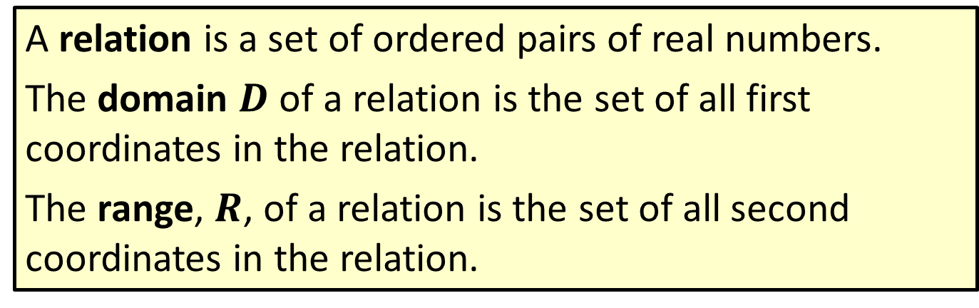
Definition: Relation, Domain, and Range
A relation is a set of ordered pairs of real numbers.
The domain $D$ of a relation is the set of all first coordinates in the relation.
The range, $R$, of a relation is the set of all second coordinates in the relation.

Slide 3
Note
The ordered pairs discussed in this text are ordered pairs of real numbers. However, more generally, ordered pairs might be other types of pairs such as (child, mother), (city, state), or (name, batting average).

Slide 4

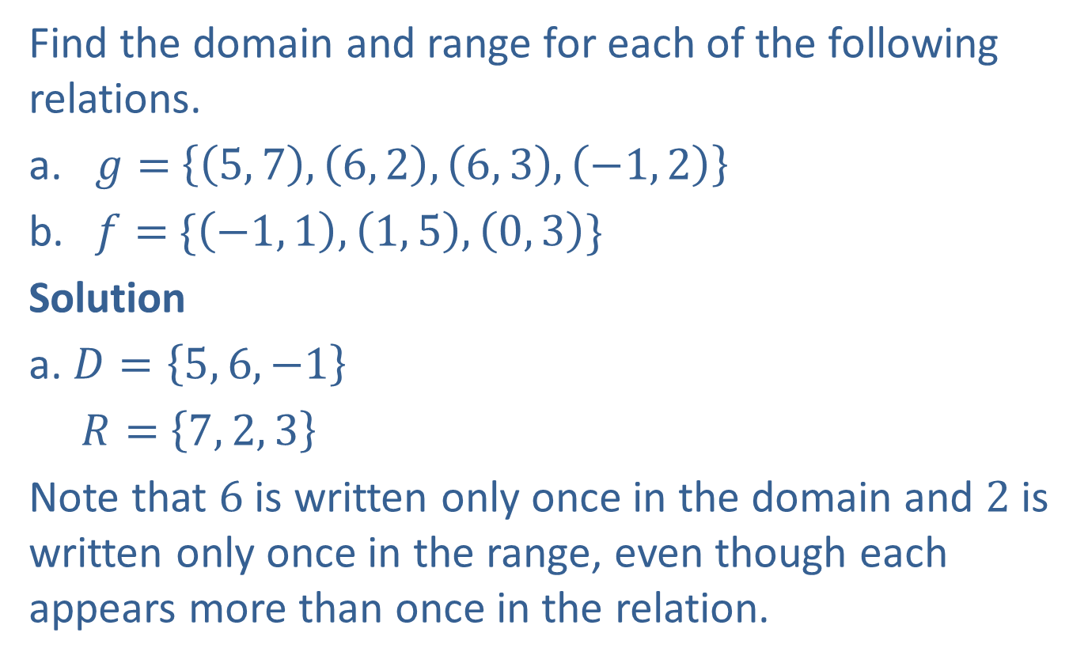

Example 1: Finding the Domain and Range
Find the domain and range for each of the following relations.
​$g=$ $\left\{\left(5, 7\right), \left(6, 2\right), \left(6, 3\right), \left(−1, 2\right)\right\}$
​$f=$ $\{\left(−1, 1\right), \left(1, 5\right),\left(0, 3\right)\}$
Solution
a. $D=\left\{5, 6, −1\right\}$
$R=$ $\left\{7, 2, 3\right\}$
Note that $6$ is written only once in the domain and $2$ is written only once in the range, even though each appears more than once in the relation.
The set of all the first coordinates in $g$
The set of all the second coordinates in $g$

Slide 5



Example 1: Finding the Domain and Range (cont.)
​$D=$ $\{−1, 1, 0\}$
$R=$ $\left\{1, 5, 3\right\}$
The set of all the first coordinates in $f$
The set of all the second coordinates in $f$

Slide 6
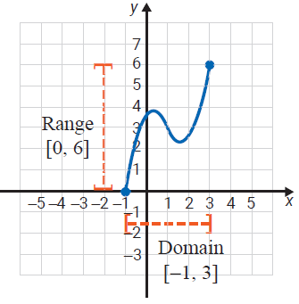
Example 2: Reading Domain and Range from the Graph of a Relation
Identify the domain and range from the graph of each relation.
a.

Slide 7

Example 2: Reading Domain and Range from the Graph of a Relation (cont.)
The domain consists of the set of $x$-values for all points on the graph. In this case, the domain is the interval [$−1, 3$]. The range consists of the set of $y$-values for all points on the graph. In this case, the range is the interval [$0, 6$].

Slide 8
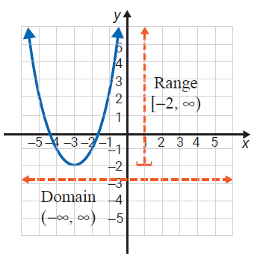
Example 2: Reading Domain and Range from the Graph of a Relation (cont.)
b.

Slide 9
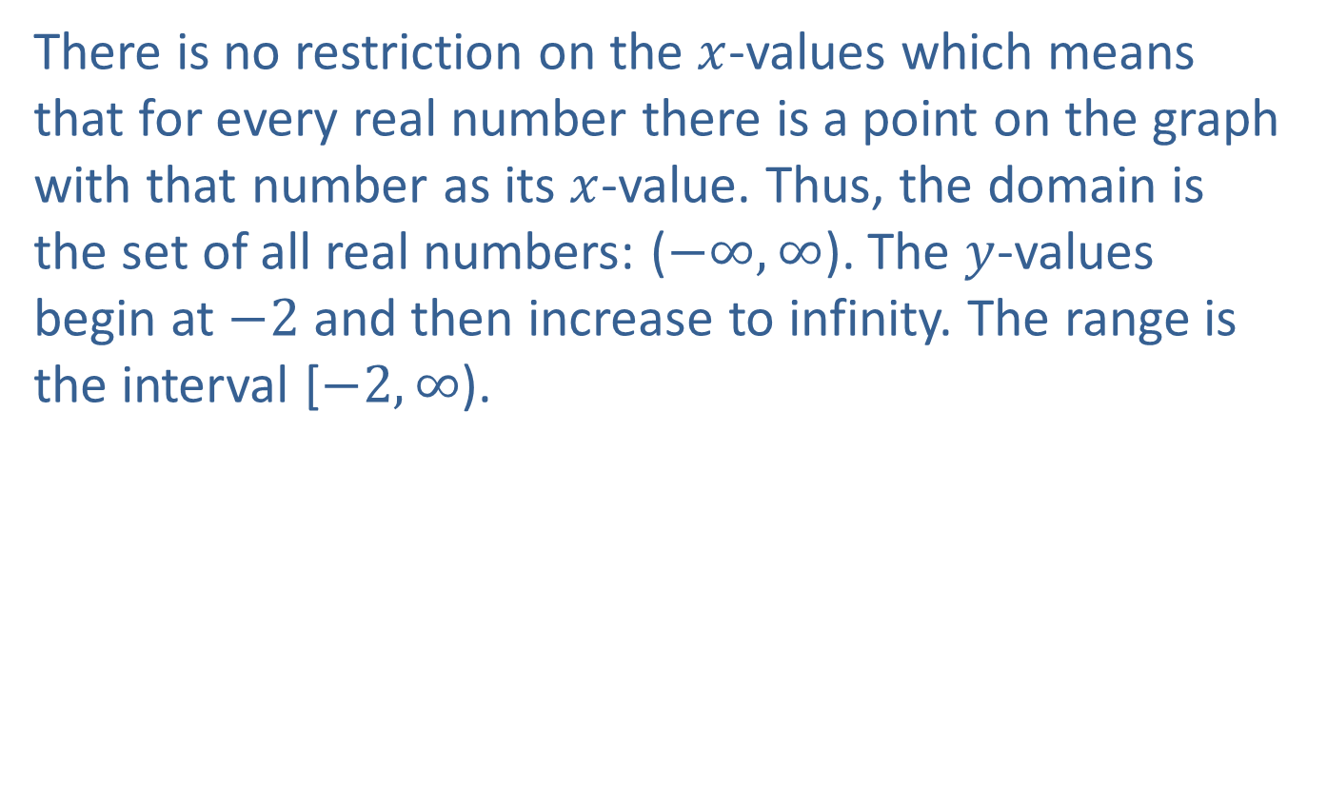
Example 2: Reading Domain and Range from the Graph of a Relation (cont.)
There is no restriction on the $x$-values which means that for every real number there is a point on the graph with that number as its $x$-value. Thus, the domain is the set of all real numbers: ($−∞, ∞$). The $y$-values begin at $−2$ and then increase to infinity. The range is the interval [$−2, ∞$).

Slide 10
Definition: Functions
A function is a relation in which each domain element has exactly one corresponding range element.

Slide 11

Example 3: Determining If a Relation Is a Function
Determine whether each of the following relations is a function.
​$s=\{\left(2, 3\right), \left(1, 6\right), \left(2, \sqrt{5}\right), \left(0,−1\right)\}$
$t=\{\left(1, 5\right), \left(3, 5\right), \left(\sqrt{2}, 5\right), \left(−1, 5\right), (−4, 5)\}$

Slide 12
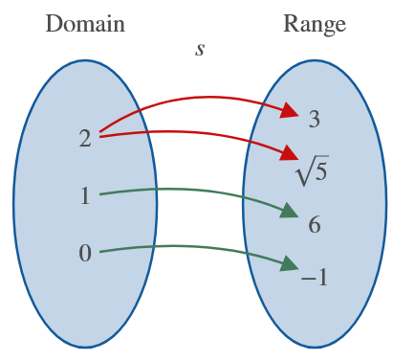

Example 3: Determining if a Relation is a Function (cont.)
Solution
a. $s$ is not a function. The number $2$ appears as a first coordinate more than once.

Slide 13
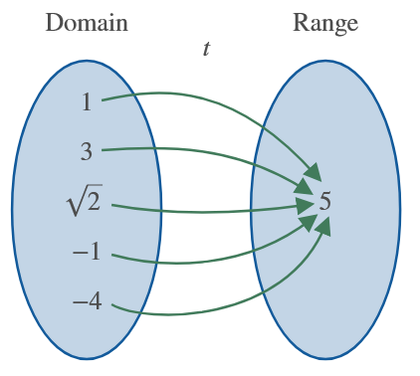

Example 3: Determining if a Relation is a Function (cont.)
b. $t$ is a function. Each first coordinate appears only once. The fact that the second coordinates are all the same has no effect on the concept of a function.

Slide 14
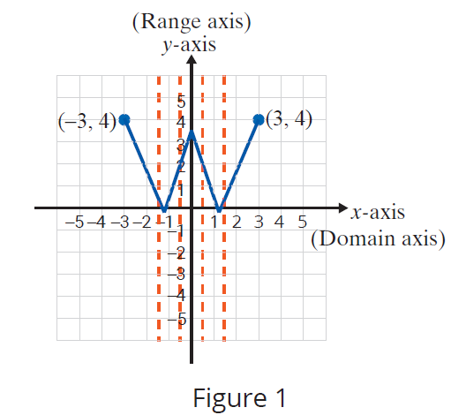
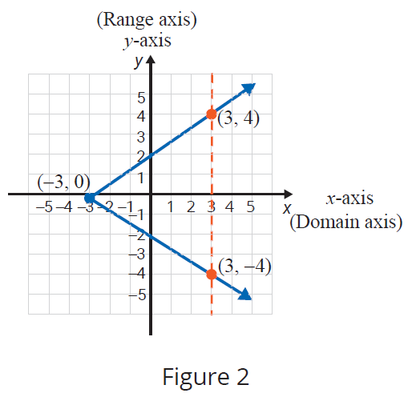
Procedure: Vertical Line Test
If any vertical line intersects the graph of a relation at more than one point, then the relation is not a function.

Slide 15
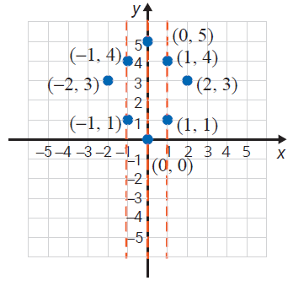
Example 4: Using the Vertical Line Test
Use the vertical line test to determine whether each graph represents a function. Then list the domain and range of each graph.
a.

Slide 16
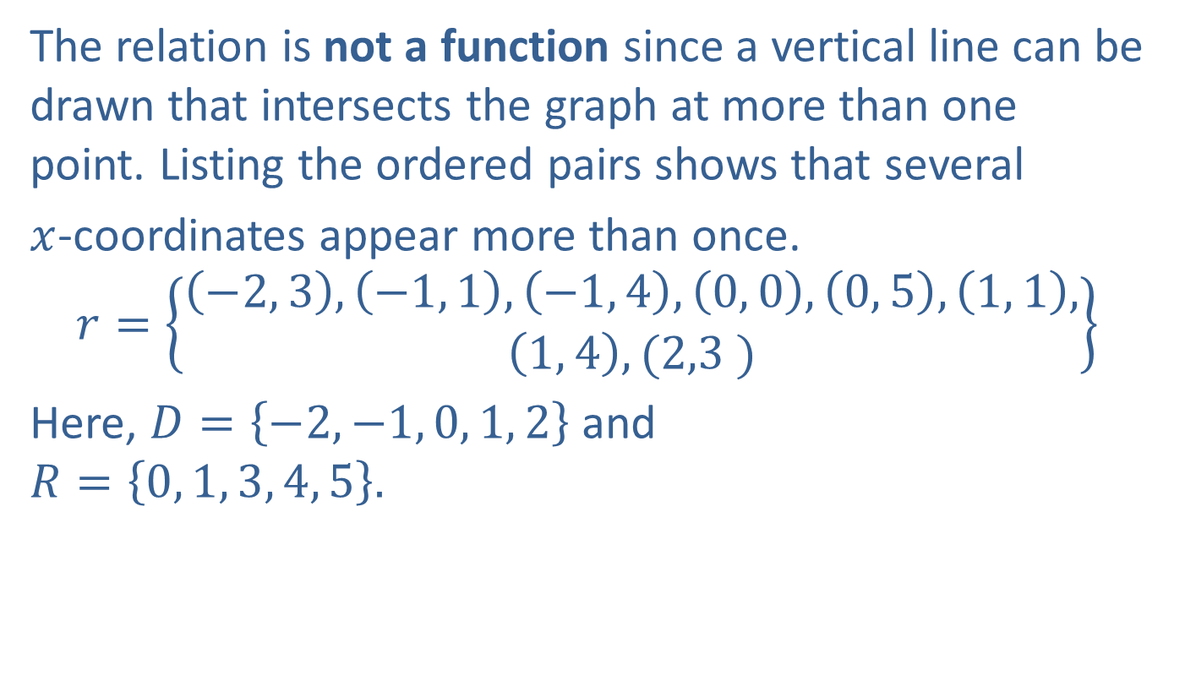
Example 4: Using the Vertical Line Test (cont.)
The relation is not a function since a vertical line can be drawn that intersects the graph at more than one point. Listing the ordered pairs shows that several
$x$-coordinates appear more than once.
$$r=\left\{\begin{aligned}\left(−2, 3\right), \left(−1, 1\right), \left(−1, 4\right), \left(0, 0\right), \left(0, 5\right), \left(1, 1\right), \\ \left(1, 4\right), (2,3 )\end{aligned}\right\}$$
Here, $D=\left\{−2, −1, 0, 1, 2\right\}$ and
$$R=\left\{0, 1, 3, 4, 5\right\}.$$

Slide 17
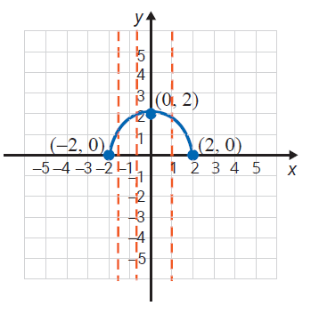
Example 4: Using the Vertical Line Test (cont.)
b.

Slide 18

Example 4: Using the Vertical Line Test (cont.)
The relation is a function. No vertical line will intersect the graph at more than one point. Several vertical lines are drawn to illustrate this.
For this function, we see from the graph that
$D=\left[−2, 2\right]$ and $R=\left[0, 2\right].$

Slide 19
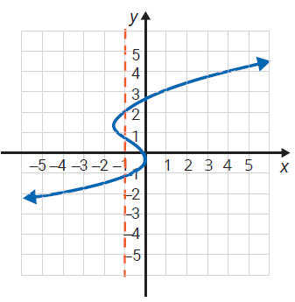
Example 4: Using the Vertical Line Test (cont.)
c.

Slide 20

Example 4: Using the Vertical Line Test (cont.)
The relation is not a function. At least one vertical line (drawn) intersects the graph at more than one point. Here, $D=\left(−∞,∞\right)$ and $R=\left(−∞,∞\right)$.

Slide 21
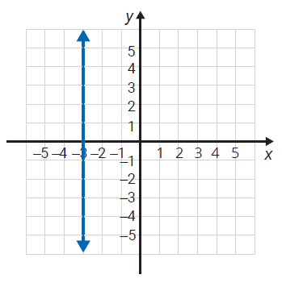
Example 4: Using the Vertical Line Test (cont.)
d.

Slide 22

Example 4: Using the Vertical Line Test (cont.)
The relation is not a function. Every point has the same $x$-value: $x=−3.$ In fact, no vertical line is a function since every point will have the same $x$-value.
Here, $D=\left\{3\right\}$ and $R=\left(−∞,∞\right)$.

Slide 23
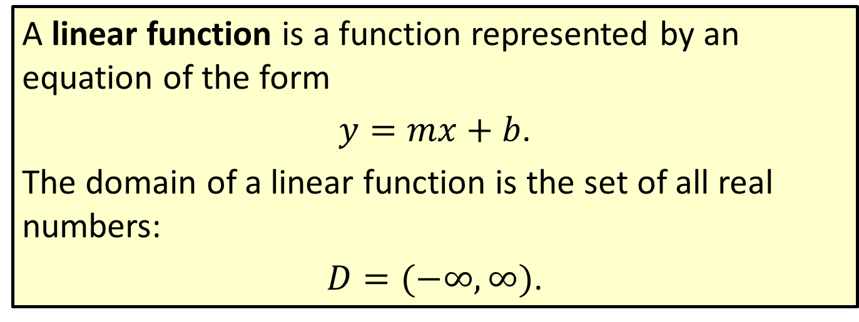
Definition: Linear Function
A linear function is a function represented by an equation of the form
$y=mx+b$.
The domain of a linear function is the set of all real numbers:
$D=(−∞, ∞)$.

Slide 24
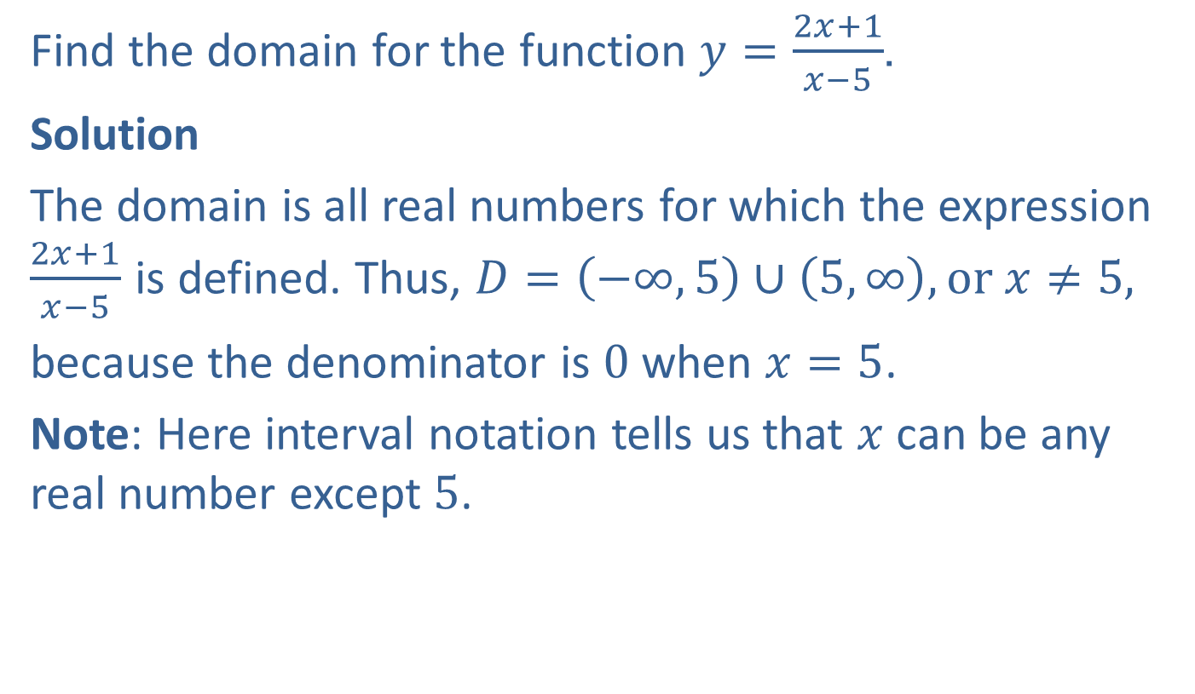
Example 5: Finding the Domain of a Function
Find the domain for the function $y=\frac{2x+1}{x−5}$.
Solution
The domain is all real numbers for which the expression $\frac{2x+1}{x−5}$ is defined. Thus, $D=\left(−∞,5\right)∪\left(5, ∞\right), or x≠5,$
because the denominator is $0$ when $x=5$.
Note: Here interval notation tells us that $x$ can be any real number except $5$.

Slide 25
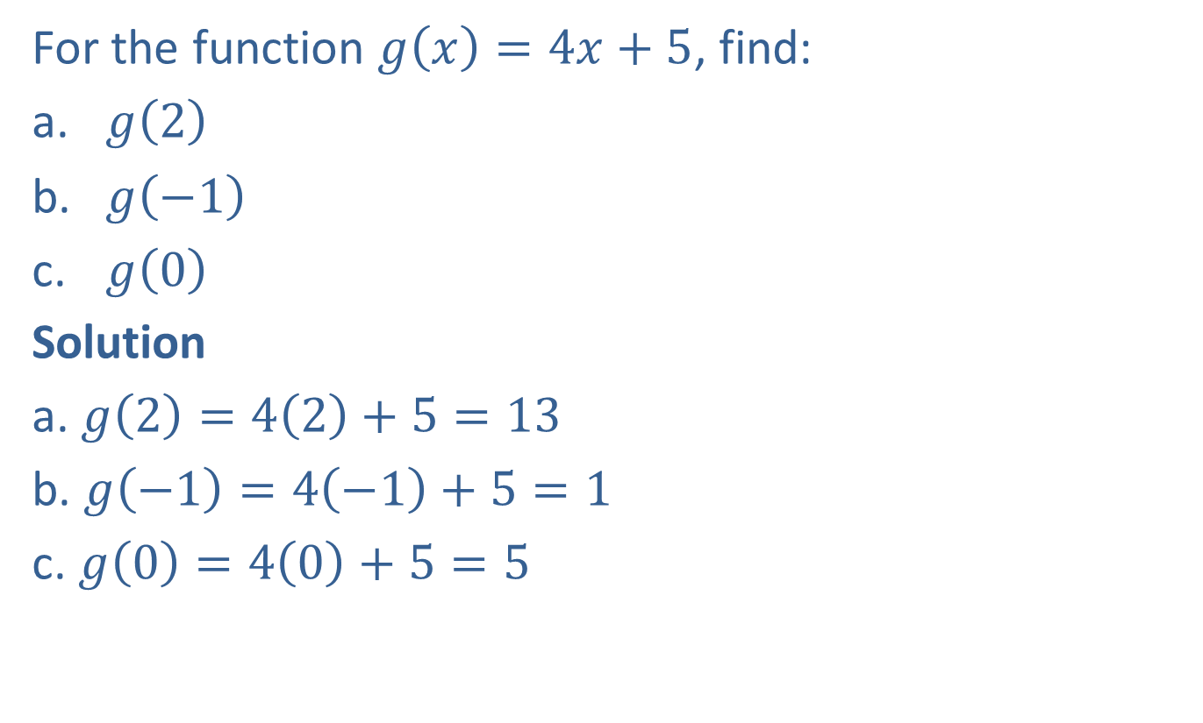
Example 6: Evaluating Functions
For the function $g\left(x\right)=4x+5$, find:
​$g⁡\left(2\right)$
​$g⁡\left(−1\right)$
​$g⁡\left(0\right)$
Solution
a. $g\left(2\right)=4\left(2\right)+5=13$
b. $g\left(−1\right)=4\left(−1\right)+5=1$
c. $g\left(0\right)=4\left(0\right)+5=5$

Slide 26
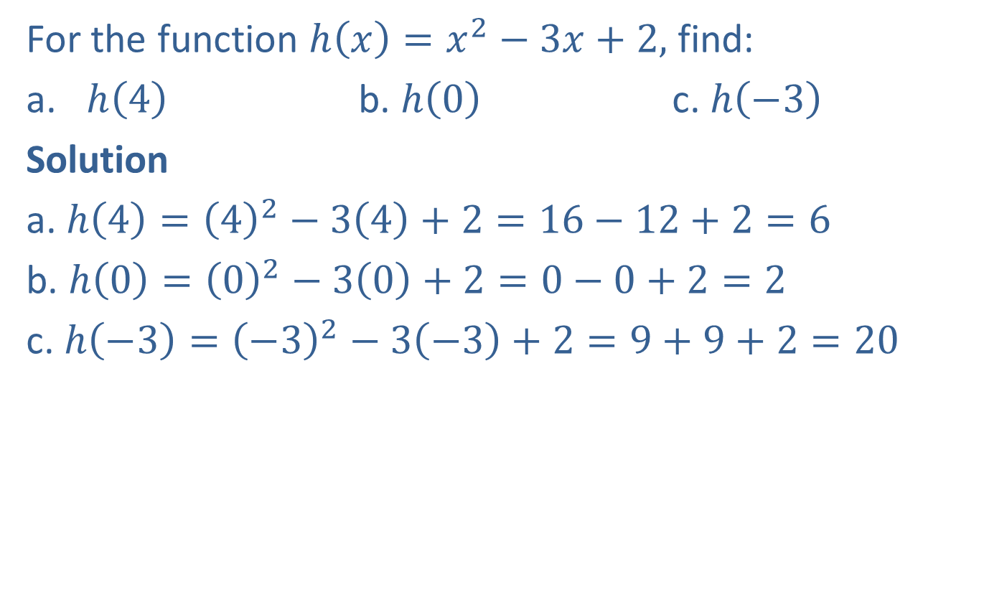
Example 7: Evaluating Nonlinear Functions
For the function $h\left(x\right)=x^{2}−3x+2,$ find:
​$h⁡\left(4\right)$ b. ​$h⁡\left(0\right)$ c. ​$h⁡\left(−3\right)$
Solution
a. $h\left(4\right)={\left(4\right)}^{2}−3\left(4\right)+2=16−12+2=6$
b. $h\left(0\right)={\left(0\right)}^{2}−3\left(0\right)+2=0−0+2=2$
c. $h\left(−3\right)={\left(−3\right)}^{2}−3\left(−3\right)+2=9+9+2=20$

Slide 27
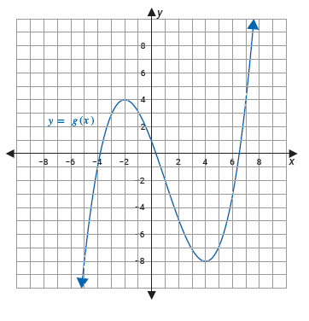

Example 8: Evaluating Functions From a Graph
Using the graph of $g⁡\left(x\right)$, find each of the following values.
​$g⁡\left(−2\right)$ b. ​$g⁡\left(1\right)$ c. ​$g⁡\left(4\right)$

Slide 28
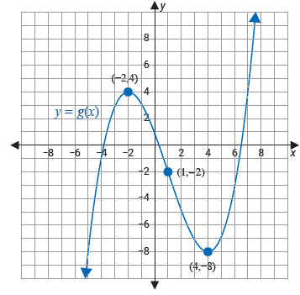

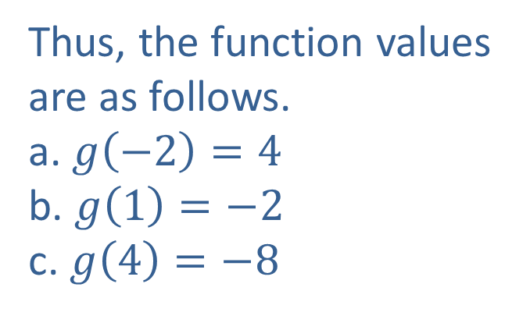
Example 8: Evaluating Functions From a Graph (cont.)
Solution
Using the graph, we need to find the $y$-value that corresponds to each $x$-value.
Thus, the function values are as follows.
a. $g\left(−2\right)=4$
b. $g\left(1\right)=−2$
c. $g\left(4\right)=−8$

Slide 29
Note
Vertical lines are not functions and cannot be graphed by the calculator in function mode.

Slide 30
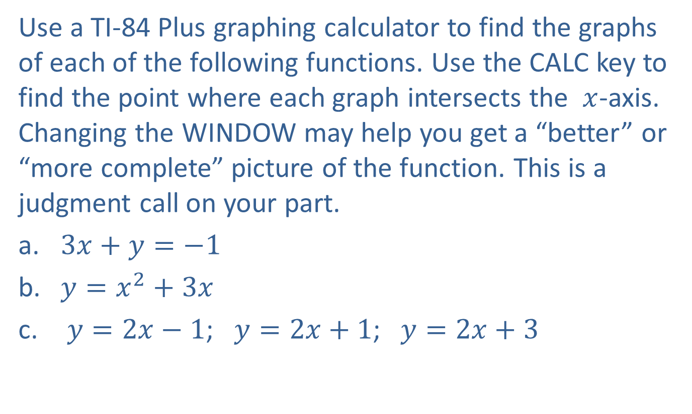
Example 9: Graphing Functions with a TI-84 Plus
Use a TI-84 Plus graphing calculator to find the graphs of each of the following functions. Use the CALC key to find the point where each graph intersects the $x$-axis. Changing the WINDOW may help you get a “better” or “more complete” picture of the function. This is a judgment call on your part.
​$3x+y=−1$
​​​$y=x^{2}+3x$
$y=2x−1$; $y=2x+1$;​ $y=2x+3$

Slide 31
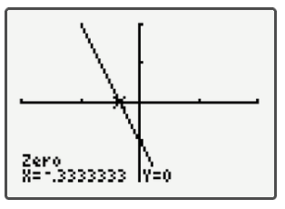
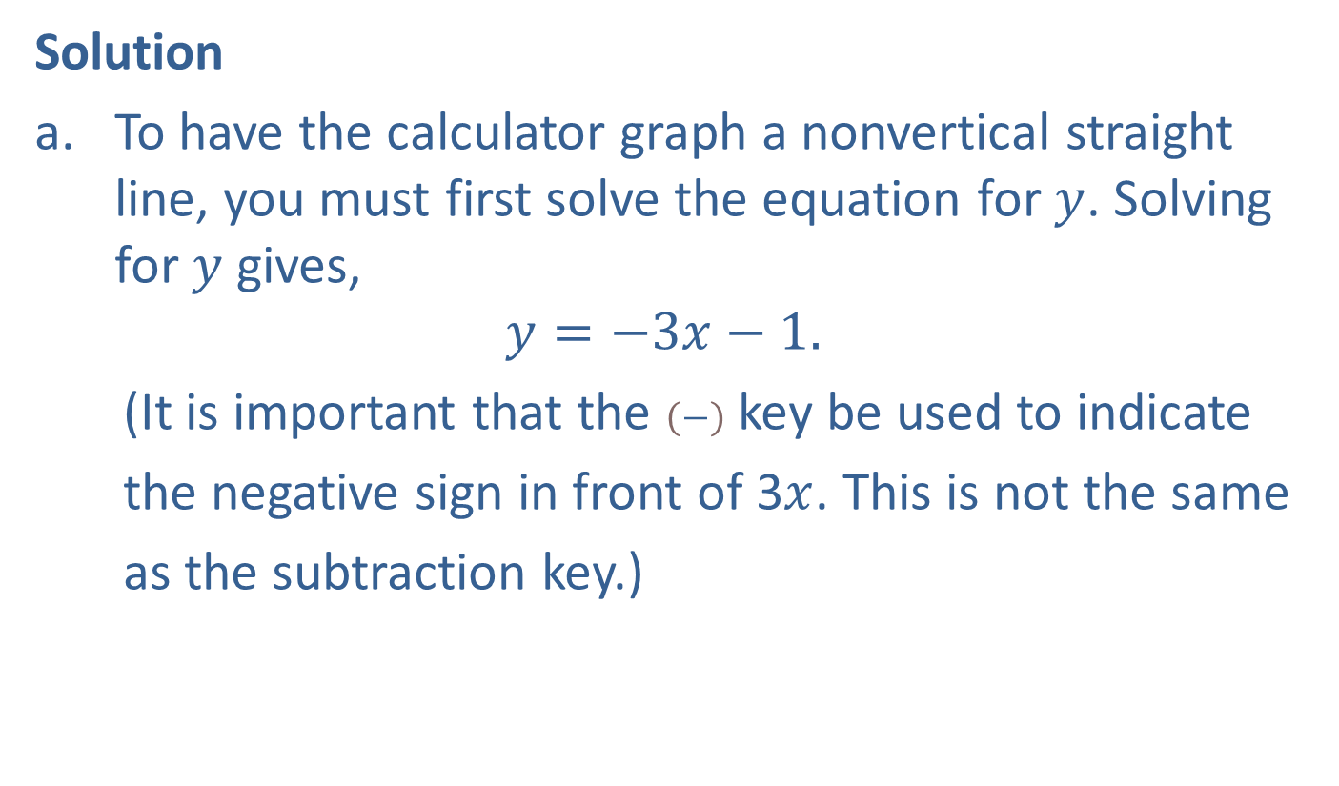
Example 9: Graphing Functions with a TI-84 Plus (cont.)
Solution
To have the calculator graph a nonvertical straight line, you must first solve the equation for $y$. Solving for $y$ gives,
$$y=−3x−1.$$
(It is important that the $\left(−\right)$ key be used to indicate
the negative sign in front of 3$x$. This is not the same
as the subtraction key.)

Slide 32
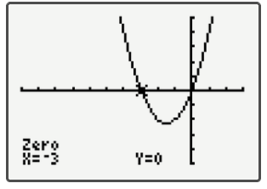
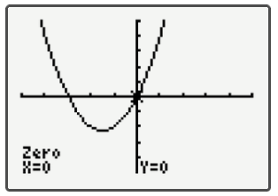

Example 9: Graphing Functions with a TI-84 Plus (cont.)
Since the graph of this function has two $x$-intercepts, we have shown the graph twice. Each graph shows the coordinates of a distinct $x$-intercept.

Slide 33
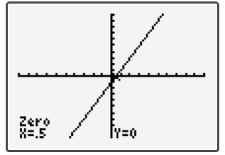
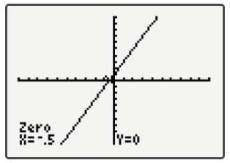
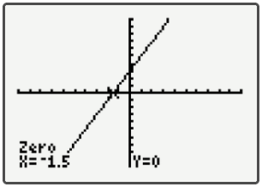

Example 9: Graphing Functions with a TI-84 Plus (cont.)
$y=2x−1$ $y=2x+1$ $y=2x+3$

Slide 34
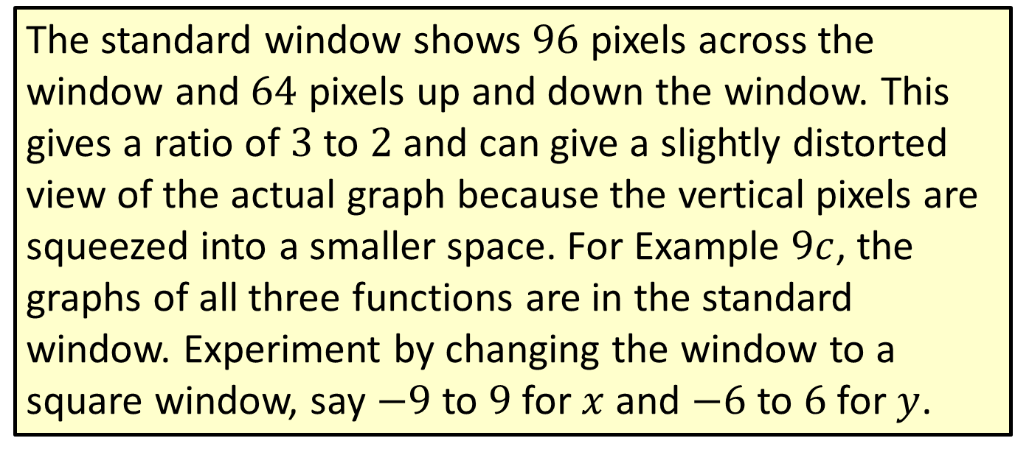
Note
The standard window shows $96$ pixels across the window and $64$ pixels up and down the window. This gives a ratio of $3$ to $2$ and can give a slightly distorted view of the actual graph because the vertical pixels are squeezed into a smaller space. For Example $9c$, the graphs of all three functions are in the standard window. Experiment by changing the window to a square window, say $−9$ to $9$ for $x$ and $−6$ to $6$ for $y$.

Slide 35
Note (cont.)
Then graph the functions and notice the slight differences (and better representation) in the appearances on the display.

