Slide 1
Section 3.5
Linear Correlation and Regression

Slide 2
Definition: Correlation
When a data set is presented in a scatter plot and there appears to be linear pattern to the data, we say that the variables represented by the data are correlated. An upward trend in the data indicates a positive correlation. A downward trend in the data indicates a negative correlation.

Slide 3
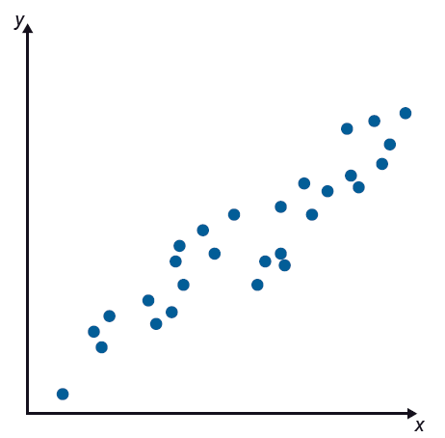
Example 1: Identifying Correlations
Determine if the data set appears to have a positive correlation, a negative correlation, or no correlation.

Slide 4

Example 1: Identifying Correlations (cont.)
Solution
As the value along the $x$-axis increases, the value along the $y$-value also increases, so this data set has a positive correlation.

Slide 5
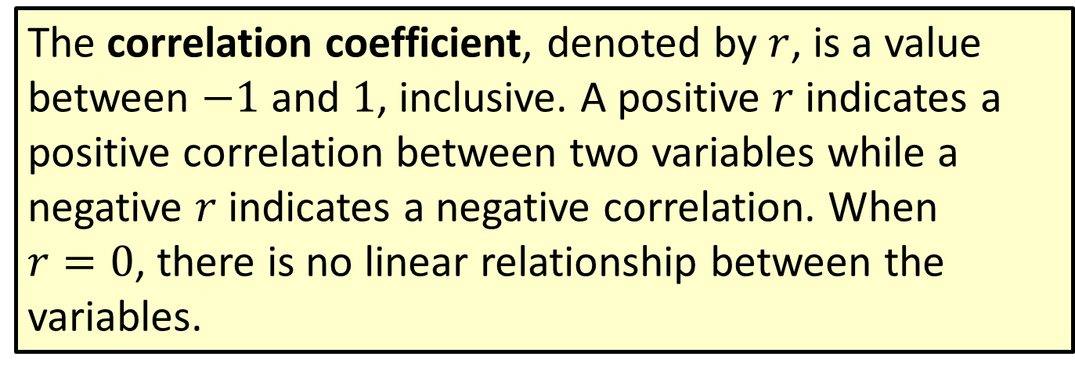
Definition: Correlation Coefficient
The correlation coefficient, denoted by $r$, is a value between $−1$ and 1, inclusive. A positive $r$ indicates a positive correlation between two variables while a negative $r$ indicates a negative correlation. When $r=0$, there is no linear relationship between the variables.

Slide 6
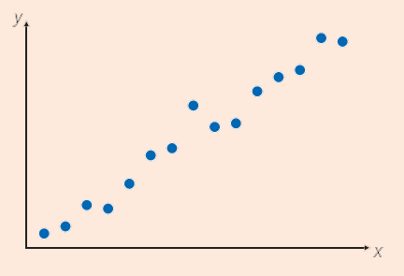
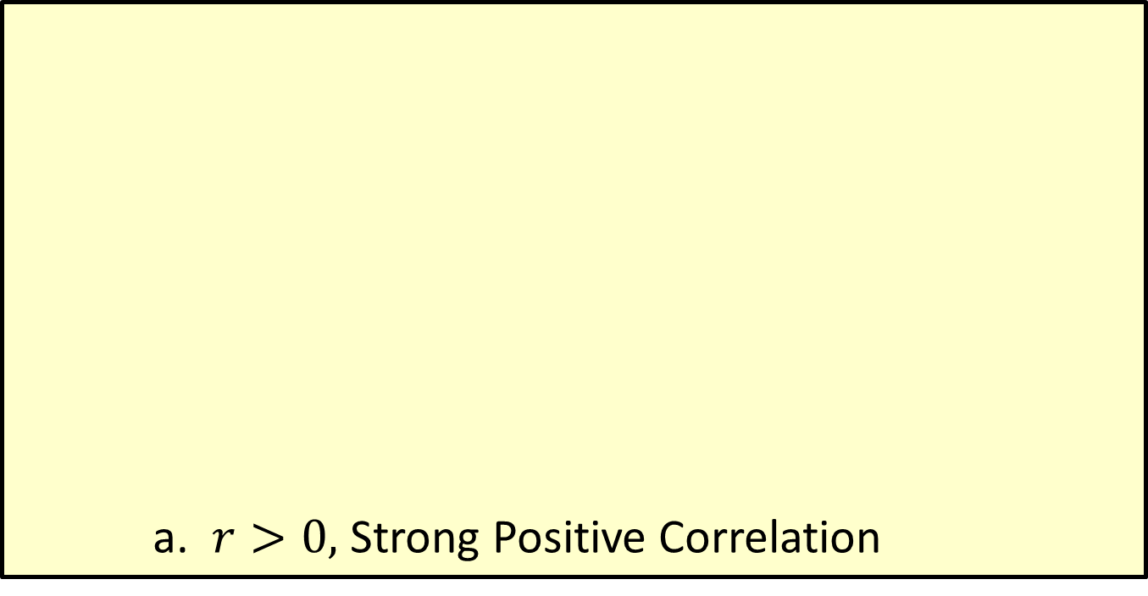
Definition: Correlation Coefficient (cont.)
a. $r>0,$ Strong Positive Correlation

Slide 7
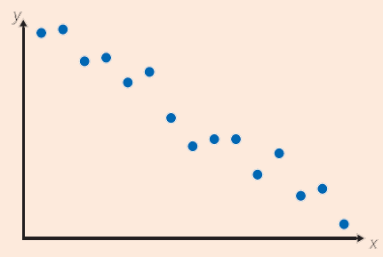
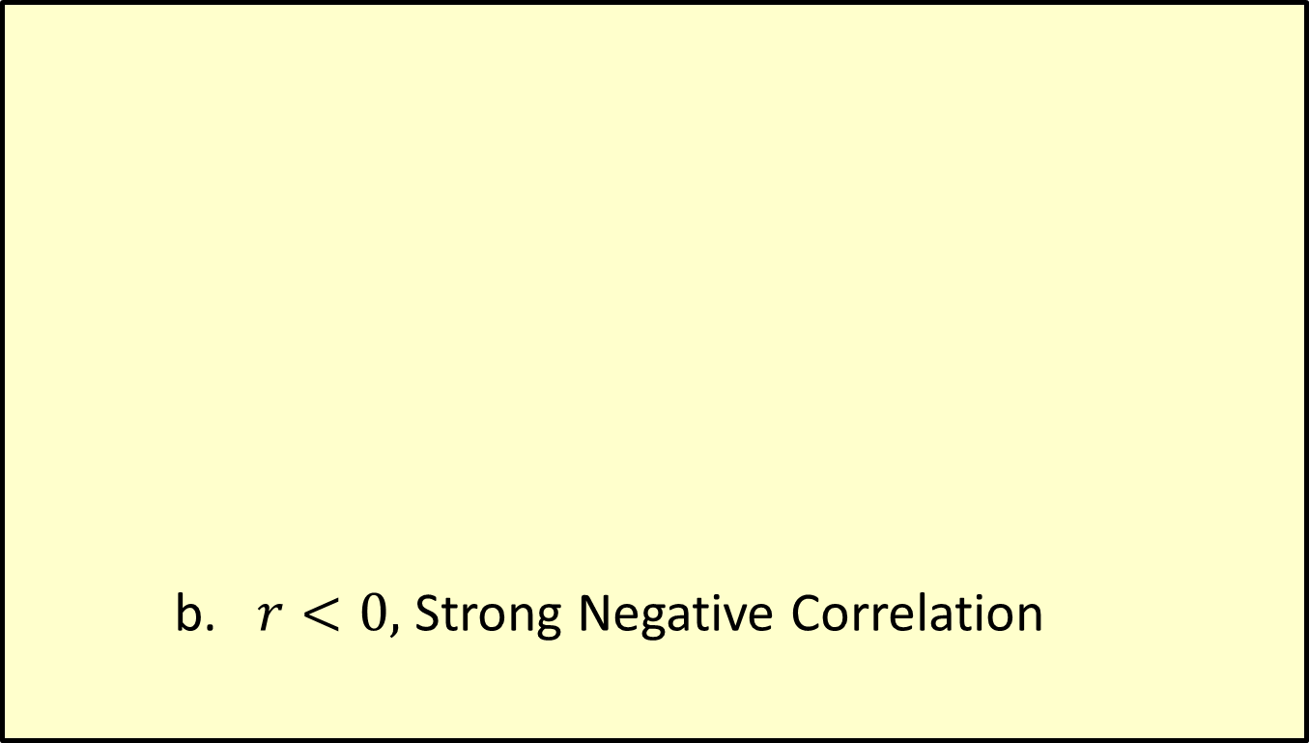
Definition: Correlation Coefficient (cont.)
b. $r<0,$ Strong Negative Correlation

Slide 8
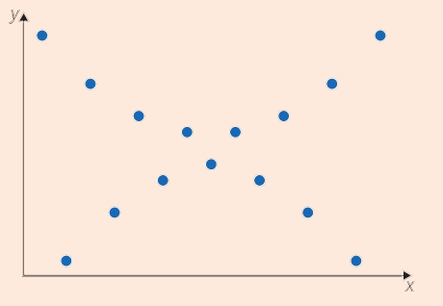
Definition: Correlation Coefficient (cont.)
c. No Correlation

Slide 9
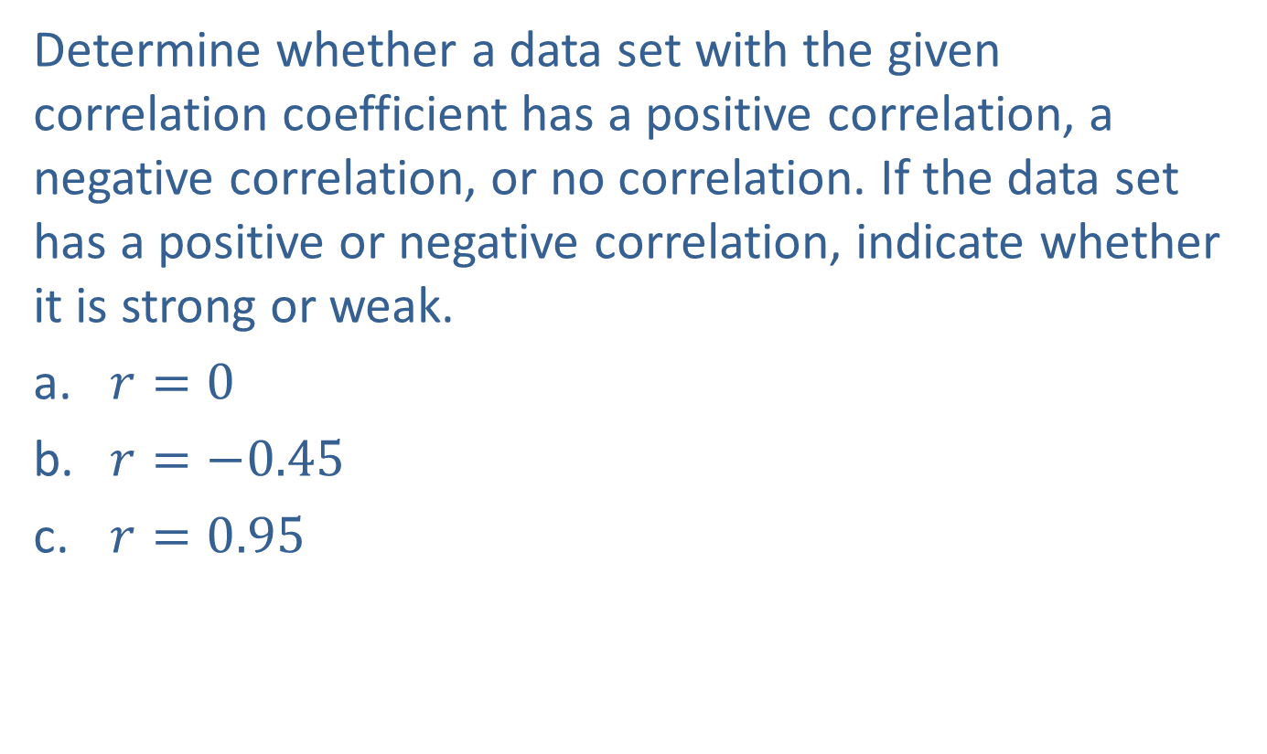
Example 2: Correlation Coefficients
Determine whether a data set with the given correlation coefficient has a positive correlation, a negative correlation, or no correlation. If the data set has a positive or negative correlation, indicate whether it is strong or weak.
​$r=0$
​$r=−0.45$
​$r=0.95$

Slide 10
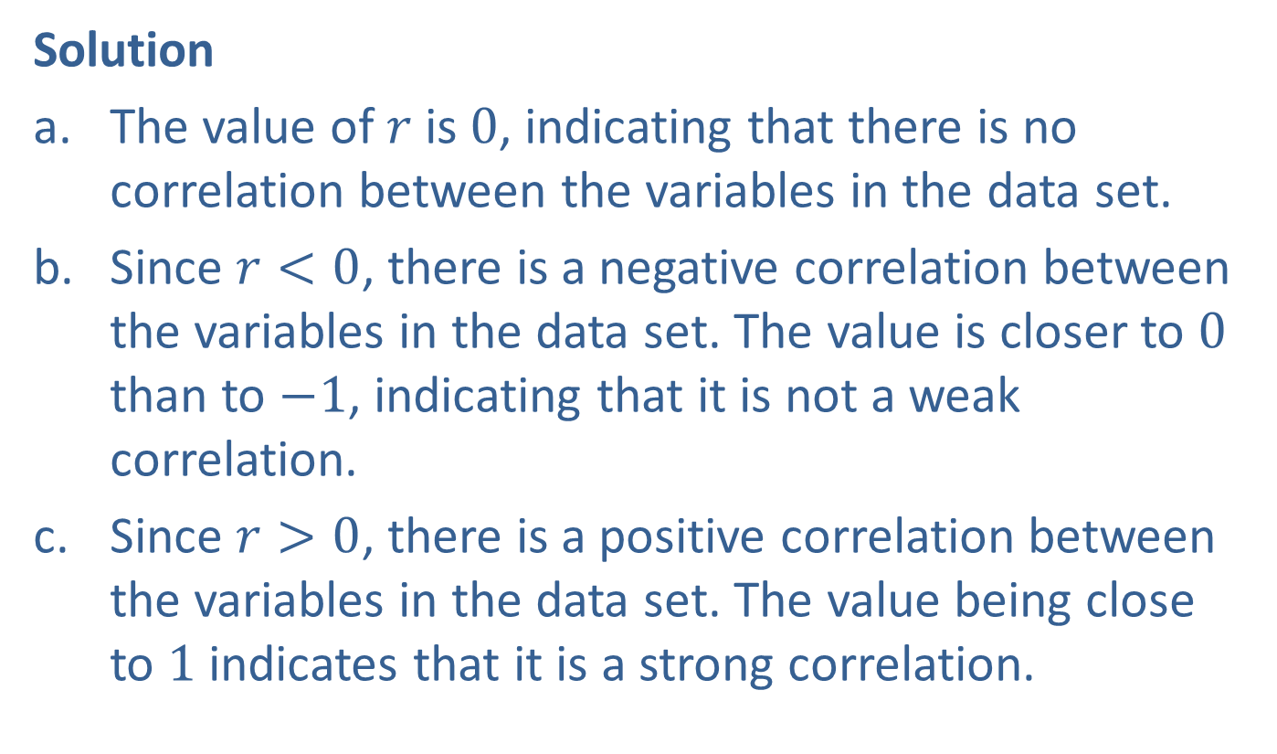
Example 2: Correlation Coefficients (cont.)
Solution
The value of $r$ is $0$, indicating that there is no correlation between the variables in the data set.
Since $r<0$, there is a negative correlation between the variables in the data set. The value is closer to $0$ than to $−1$, indicating that it is not a weak correlation.
Since $r>0$, there is a positive correlation between the variables in the data set. The value being close to $1$ indicates that it is a strong correlation.

Slide 11
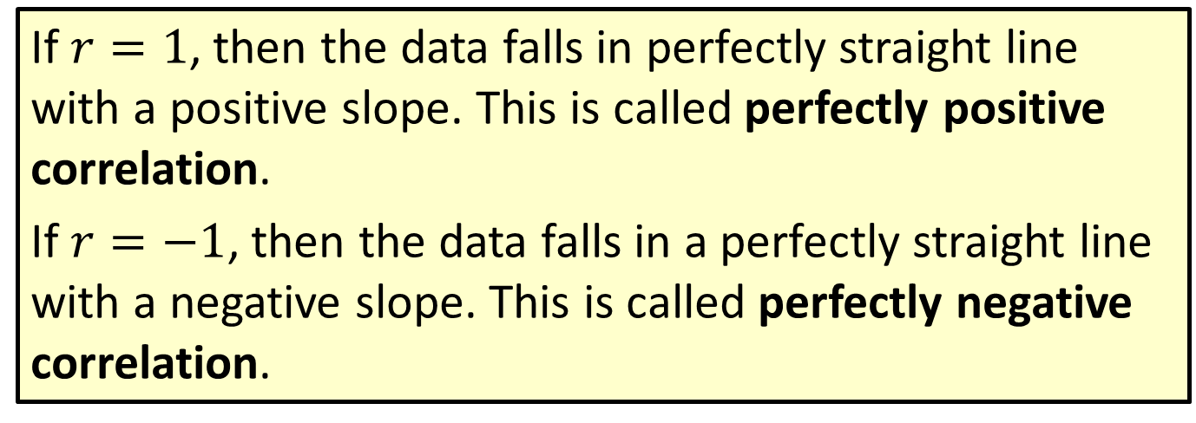
Definition: Perfectly Positive and Perfectly Negative Correlation
If $r=1$, then the data falls in perfectly straight line with a positive slope. This is called perfectly positive correlation.
If $r=−1$, then the data falls in a perfectly straight line with a negative slope. This is called perfectly negative correlation.

Slide 12
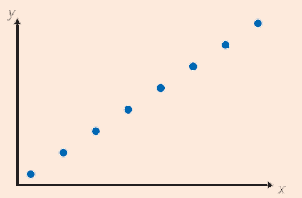
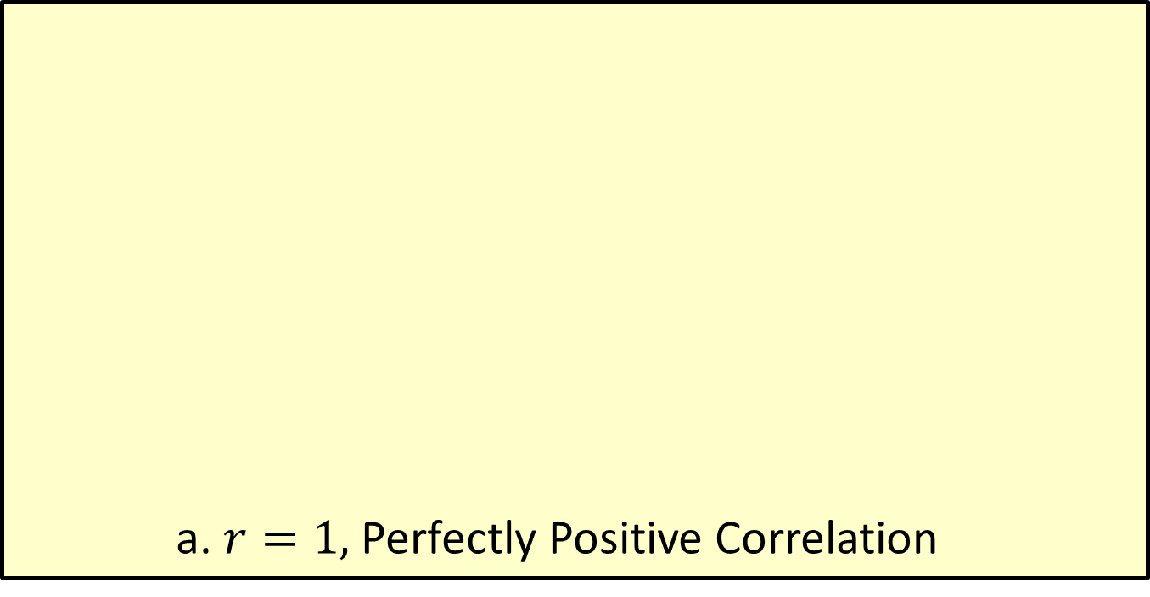
Definition: Perfectly Positive and Perfectly Negative Correlation (cont.)
a. $r=1,$ Perfectly Positive Correlation

Slide 13
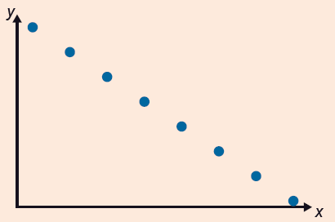
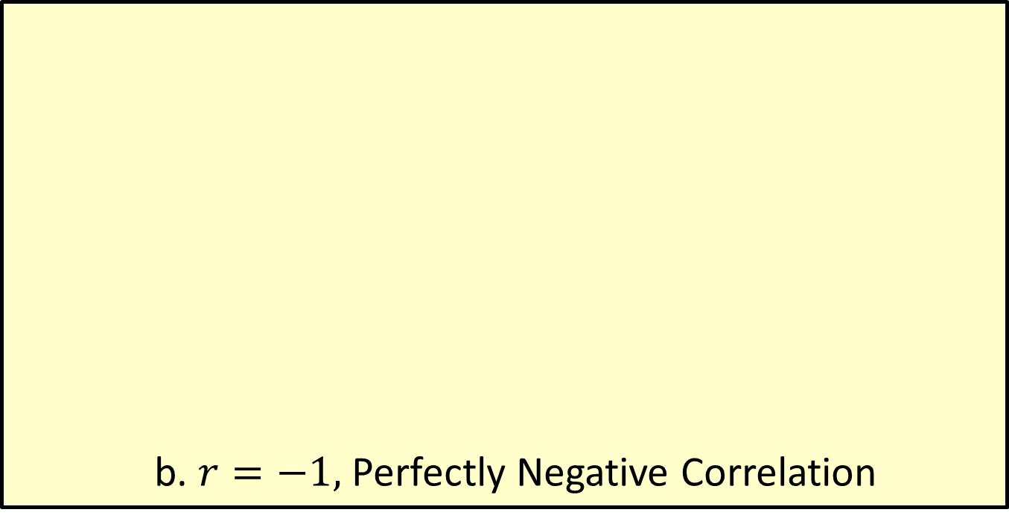
Definition: Perfectly Positive and Perfectly Negative Correlation (cont.)
b. $r=−1,$ Perfectly Negative Correlation

Slide 14
Definition: Linear Regression
Linear regression is the process of modeling the linear relationship between two variables.

Slide 15
Example 3: Using Linear Regression to Model a Data Set
Use the given points to determine the point-slope form of the equation that represents the data set for time spent studying versus grade earned. Graph the line on the scatter plot of the data set.
Time Spent Studying vs. Grade Earned
Time Spent Studying (in Minutes) | Grade on Exam (out of 100)
70 | 90
40 | 70
80 | 92
120 | 100
60 | 70

Slide 16
Example 3: Using Linear Regression to Model a Data Set (cont.)
Time Spent Studying vs. Grade Earned (cont.)
Time Spent Studying (in Minutes) | Grade on Exam (out of 100)
30 | 55
80 | 95
100 | 90
90 | 80
40 | 70
60 | 60
90 | 85
110 | 94
70 | 75
80 | 90

Slide 17
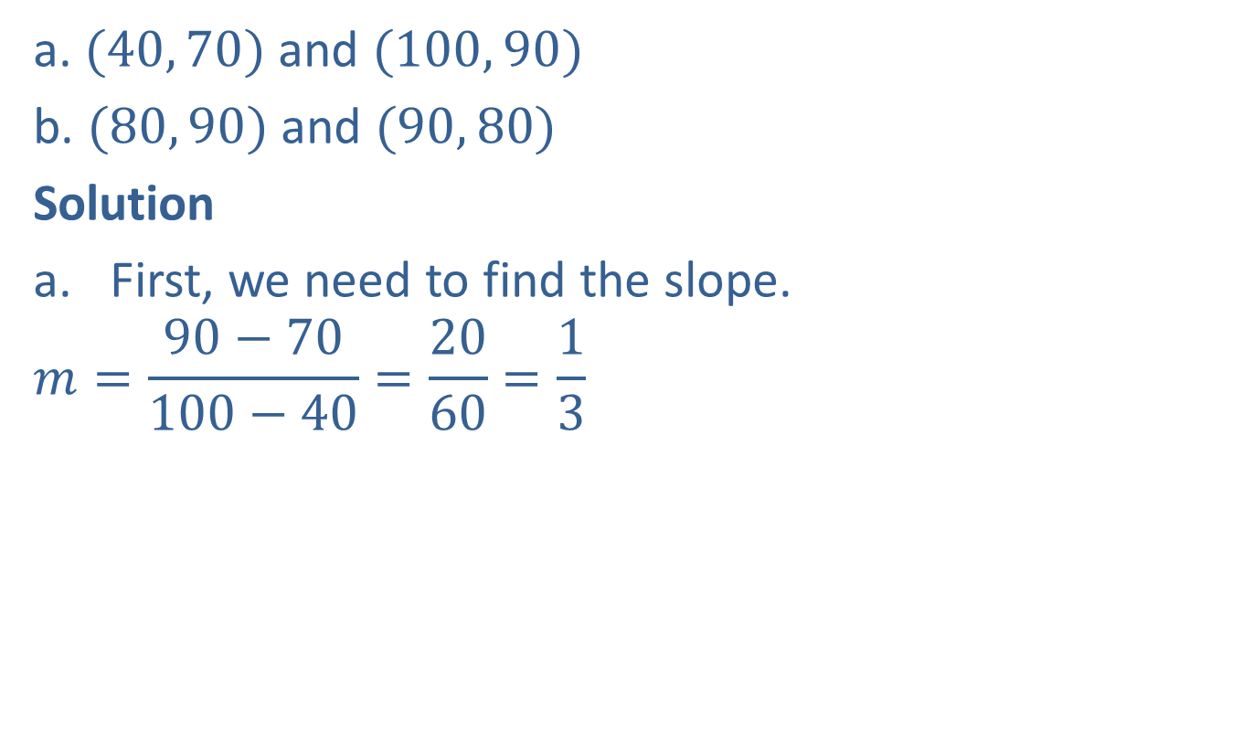
Example 3: Using Linear Regression to Model a Data Set (cont.)
a. $(40, 70)$ and $(100, 90)$
b. $(80, 90)$ and $(90, 80)$
Solution
First, we need to find the slope.
$$m=\frac{90−70}{100−40}=\frac{20}{60}=\frac{1}{3}$$

Slide 18

Example 3: Using Linear Regression to Model a Data Set (cont.)
Now, use the point-slope form of the line to find the equation.
$$y−\left(70\right)=\frac{1}{3}(x−40)$$
$$y−70=\frac{1}{3}x−\frac{40}{3}$$
$$y=\frac{1}{3}x+56\frac{2}{3}$$

Slide 19
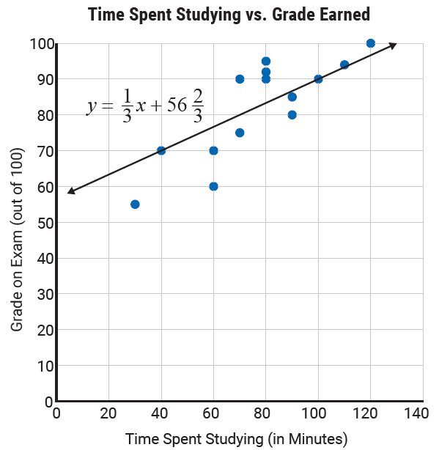
Example 3: Using Linear Regression to Model a Data Set (cont.)
Notice that this equation seems to fit the data pretty well.

Slide 20
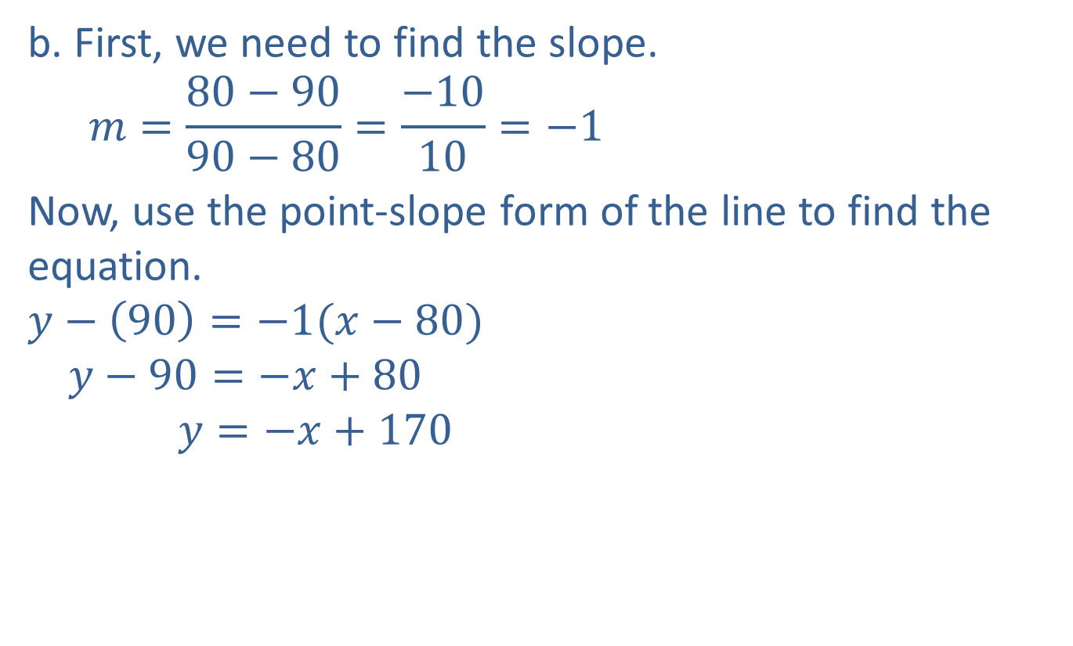
Example 3: Using Linear Regression to Model a Data Set (cont.)
b. First, we need to find the slope.
$$m=\frac{80−90}{90−80}=\frac{−10}{10}=−1$$
Now, use the point-slope form of the line to find the equation.
$$y−\left(90\right)=−1(x−80)$$
$$y−90=−x+80$$
$$y=−x+170$$

Slide 21
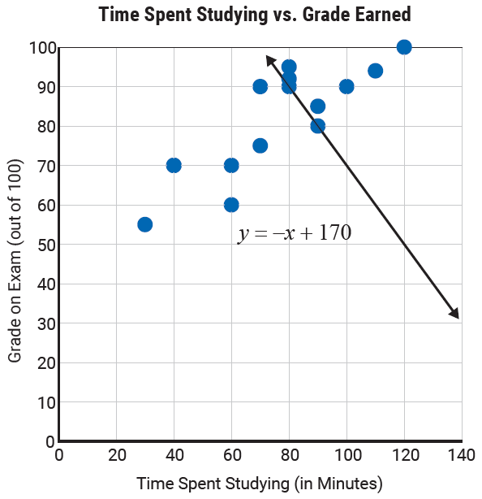
Example 3: Using Linear Regression to Model a Data Set (cont.)
Notice that this line doesn’t fit the data at all.

Slide 22
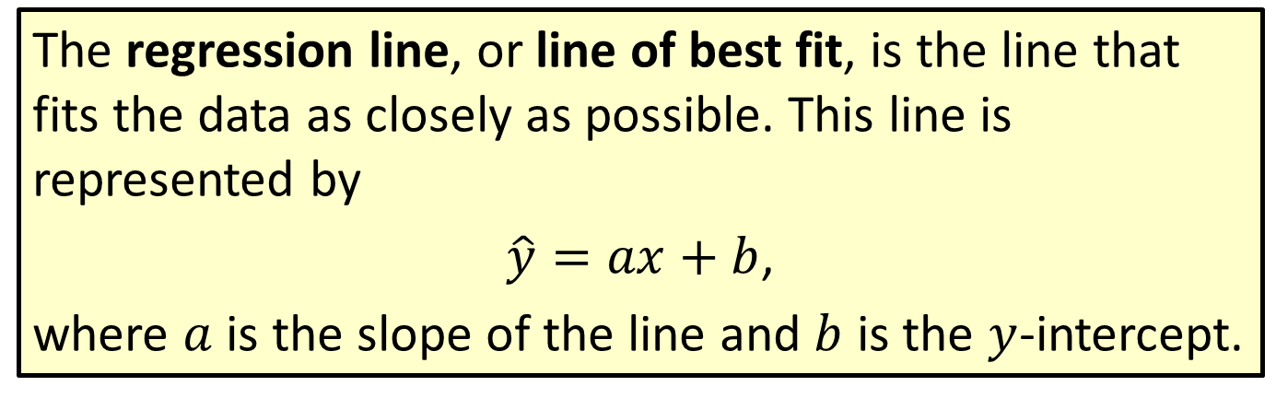
Definition: Regression Line
The regression line, or line of best fit, is the line that fits the data as closely as possible. This line is represented by
$\hat{y}=ax+b$,
where $a$ is the slope of the line and $b$ is the $y$-intercept.

Slide 23
Example 4: Finding a Linear Regression Line Using a Graphing Calculator
The following data set from the introduction represents the time that students spent studying for an exam versus the grade they earned on the exam.
Time Spent Studying vs. Grade Earned
Time Spent Studying (in Minutes) | Grade on Exam (out of 100)
70 | 90
40 | 70
80 | 92
120 | 100
60 | 70
30 | 55
80 | 95

Slide 24
Example 4: Finding a Linear Regression Line Using a Graphing Calculator (cont.)
Time Spent Studying vs. Grade Earned (cont.)
Time Spent Studying (in Minutes) | Grade on Exam (out of 100)
100 | 90
90 | 80
40 | 70
60 | 60
90 | 85
110 | 94
70 | 75
80 | 90

Slide 25
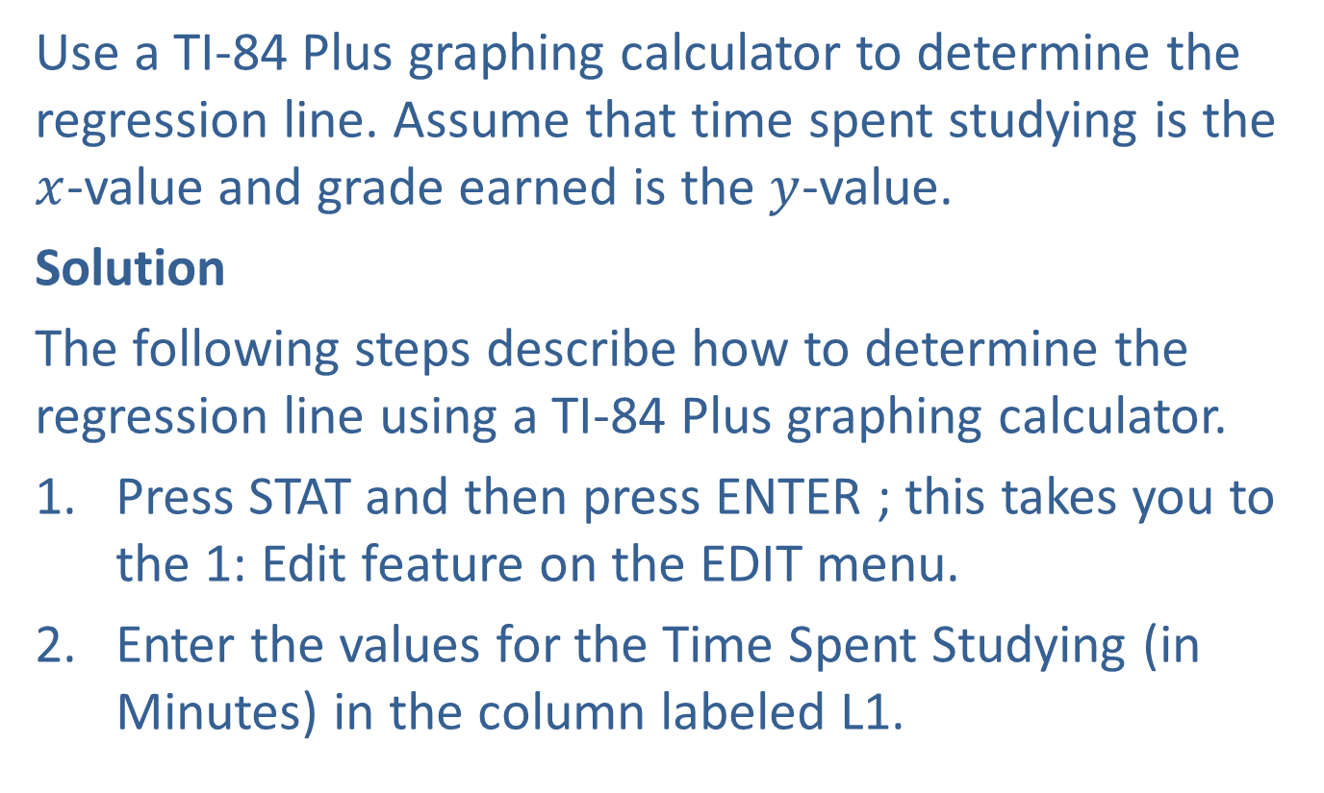
Example 4: Finding a Linear Regression Line Using a Graphing Calculator (cont.)
Use a TI-84 Plus graphing calculator to determine the regression line. Assume that time spent studying is the $x$-value and grade earned is the $y$-value.
Solution
The following steps describe how to determine the regression line using a TI-84 Plus graphing calculator.
Press STAT and then press ENTER ; this takes you to the 1: Edit feature on the EDIT menu.
Enter the values for the Time Spent Studying (in Minutes) in the column labeled L1.

Slide 26
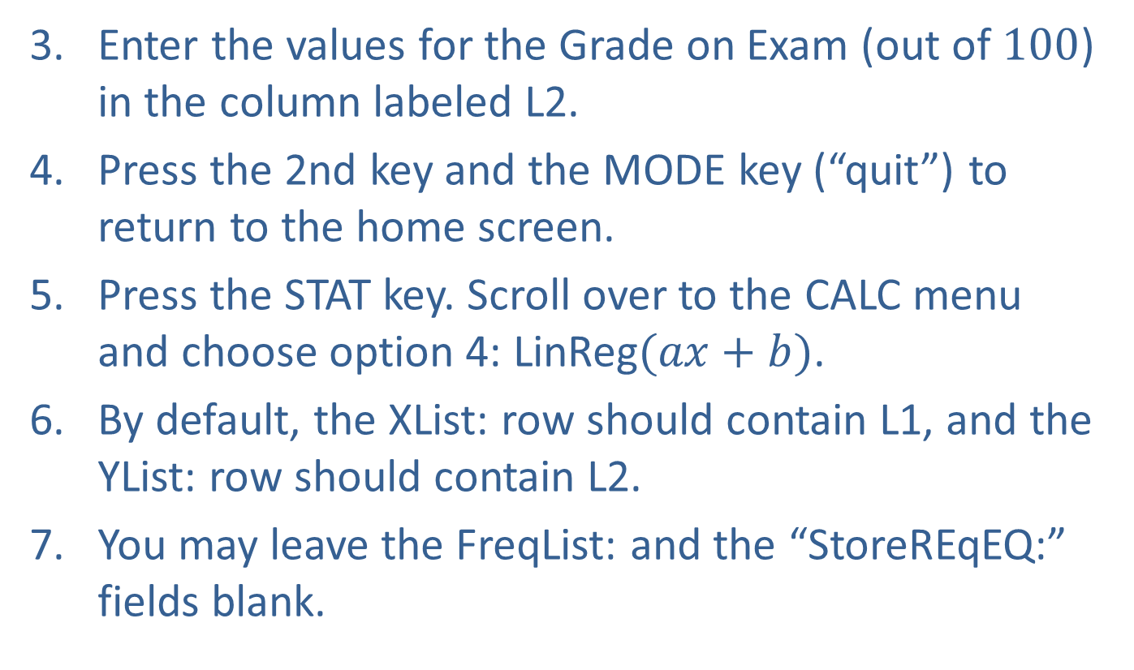
Example 4: Finding a Linear Regression Line Using a Graphing Calculator (cont.)
Enter the values for the Grade on Exam (out of $100$) in the column labeled L2.
Press the 2nd key and the MODE key (“quit”) to return to the home screen.
Press the STAT key. Scroll over to the CALC menu and choose option 4: LinReg$(ax+b)$.
By default, the XList: row should contain L1, and the YList: row should contain L2.
You may leave the FreqList: and the “StoreREqEQ:” fields blank.

Slide 27
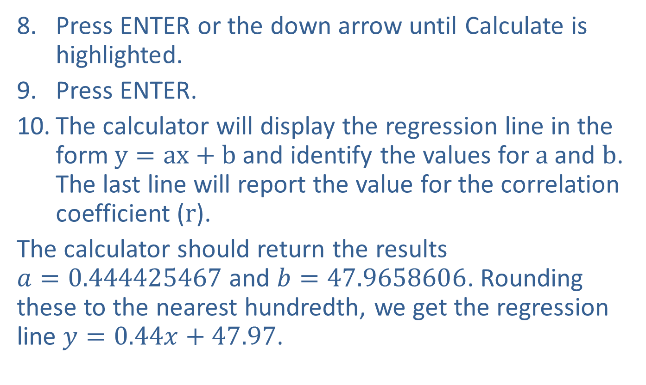
Example 4: Finding a Linear Regression Line Using a Graphing Calculator (cont.)
Press ENTER or the down arrow until Calculate is highlighted.
Press ENTER.
The calculator will display the regression line in the form $y=ax+b$and identify the values for $a$ and $b$. The last line will report the value for the correlation coefficient ($r$).
The calculator should return the results $a=0.444425467$ and $b=47.9658606$. Rounding these to the nearest hundredth, we get the regression line $y=0.44x+47.97$.

Slide 28
Example 5: Predicting Values Using a Regression Line
The following data set from the introduction represents the time that students spent studying for an example versus the grade they earned on the exam.
Time Spent Studying vs. Grade Earned
Time Spent Studying (in Minutes) | Grade on Exam (out of 100)
70 | 90
40 | 70
80 | 92
120 | 100
60 | 70
30 | 55
80 | 95

Slide 29
Example 5: Predicting Values Using a Regression Line (cont.)
Time Spent Studying vs. Grade Earned (cont.)
Time Spent Studying (in Minutes) | Grade on Exam (out of 100)
100 | 90
90 | 80
40 | 70
60 | 60
90 | 84
110 | 94
70 | 75
80 | 90

Slide 30
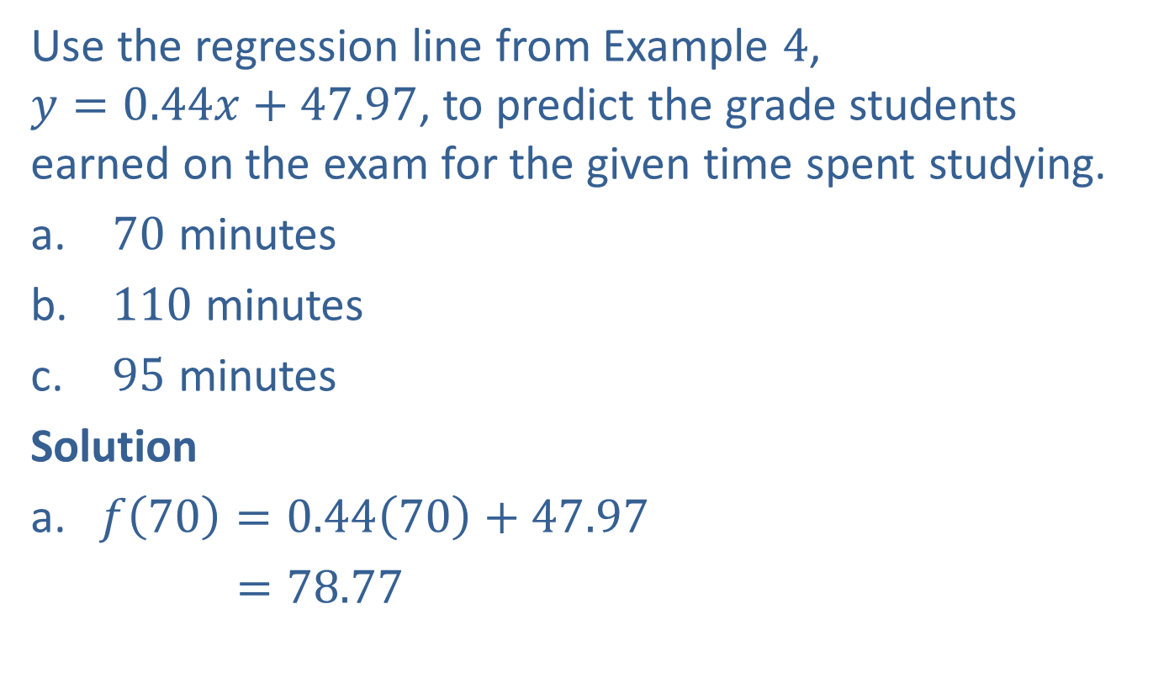
Example 5: Predicting Values Using a Regression Line (cont.)
Use the regression line from Example $4$, $y=0.44x+47.97$, to predict the grade students earned on the exam for the given time spent studying.
$70$ minutes
$110$ minutes
$95$ minutes
Solution
a. $f\left(70\right)=0.44\left(70\right)+47.97$
$=78.77$

Slide 31
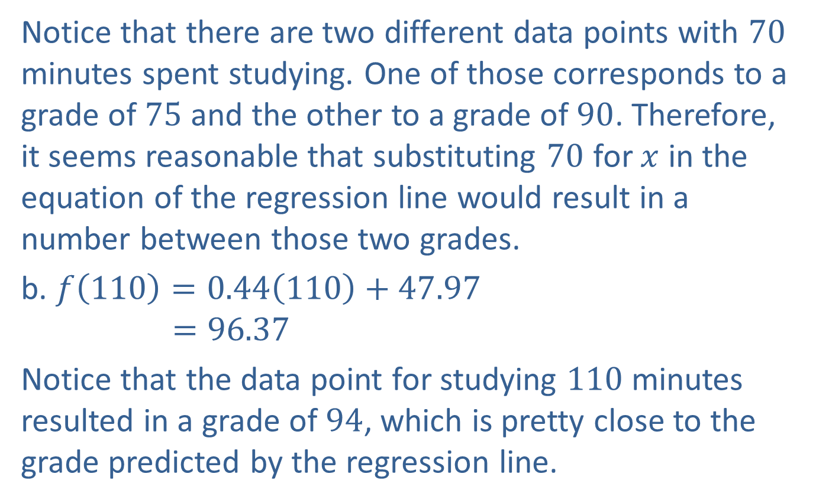
Example 5: Predicting Values Using a Regression Line (cont.)
Notice that there are two different data points with $70$ minutes spent studying. One of those corresponds to a grade of $75$ and the other to a grade of $90$. Therefore, it seems reasonable that substituting $70$ for $x$ in the equation of the regression line would result in a number between those two grades.
b. $f\left(110\right)=0.44\left(110\right)+47.97$
$$=96.37$$
Notice that the data point for studying $110$ minutes resulted in a grade of $94$, which is pretty close to the grade predicted by the regression line.

Slide 32
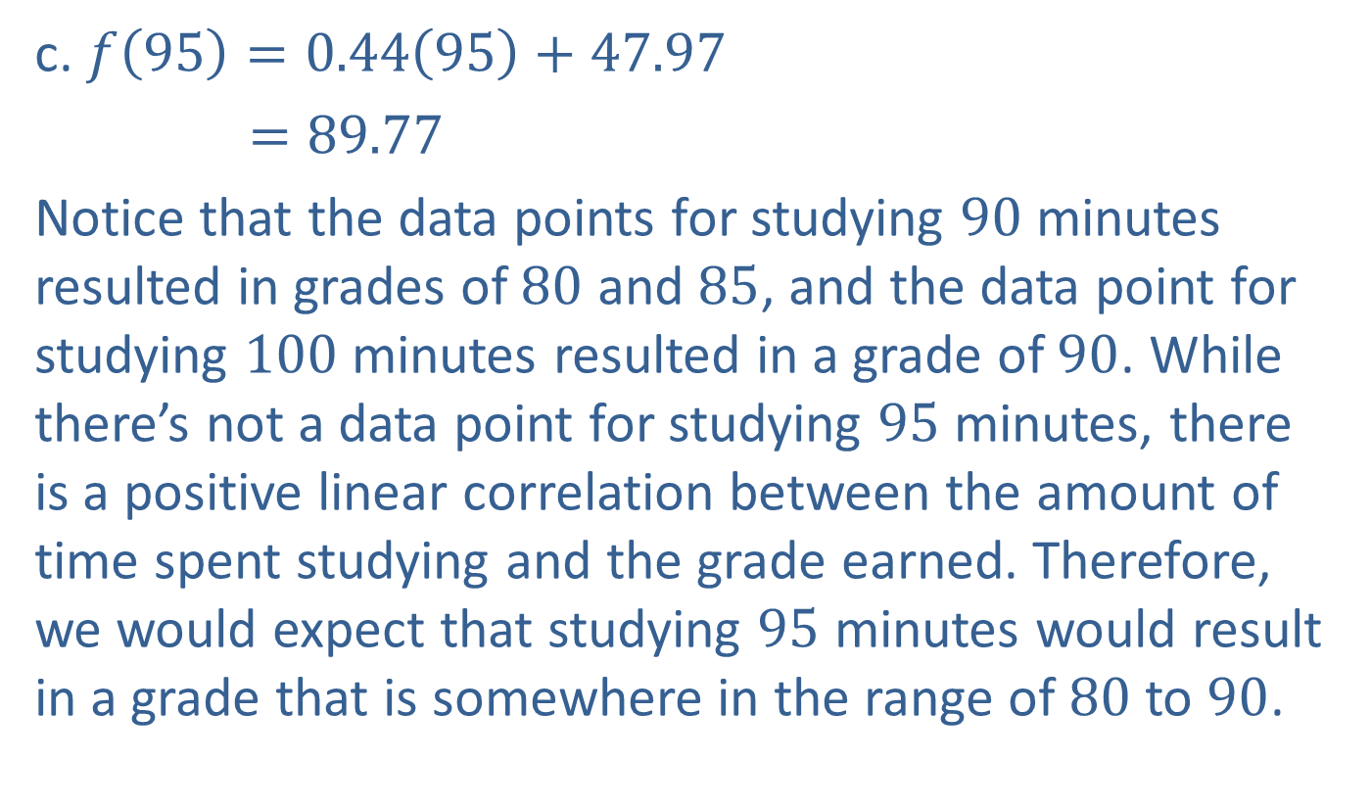
Example 5: Predicting Values Using a Regression Line (cont.)
c. $f\left(95\right)=0.44\left(95\right)+47.97$
$=89.77$
Notice that the data points for studying $90$ minutes resulted in grades of $80$ and $85$, and the data point for studying $100$ minutes resulted in a grade of $90$. While there’s not a data point for studying $95$ minutes, there is a positive linear correlation between the amount of time spent studying and the grade earned. Therefore, we would expect that studying $95$ minutes would result in a grade that is somewhere in the range of $80$ to $90$.

