Slide 1
Section 3.6
Systems of Linear Equations in Two Variables

Slide 2
Definition: Consistent and Inconsistent Systems of Linear Equations
​A system is consistent if it has one or more solutions.
​A system is inconsistent if it has no solutions.

Slide 3
Definition: Dependent and Independent Systems of Linear Equations
If the graphs of two linear equations are
​the same line, then the equations are dependent.
​different lines, then the equations are independent.

Slide 4
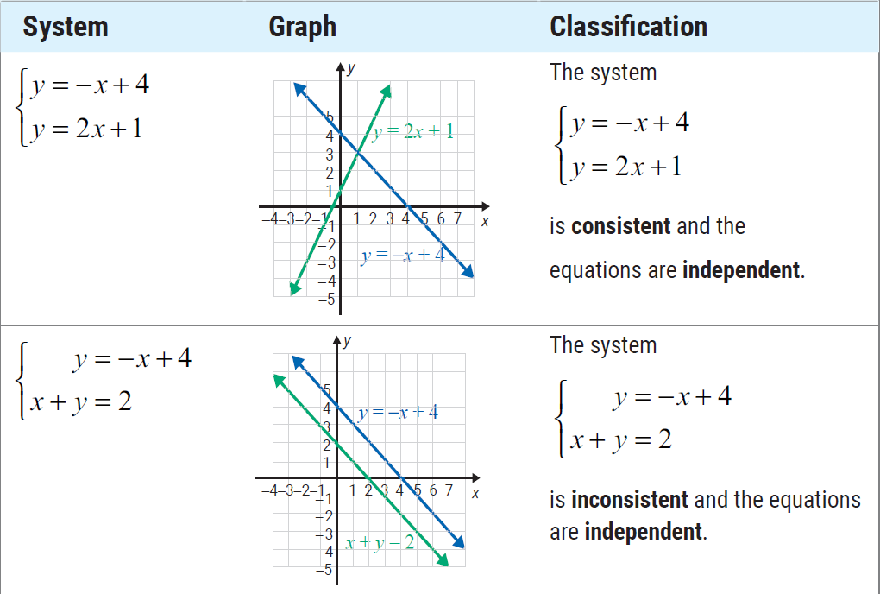
Table 1

Slide 5
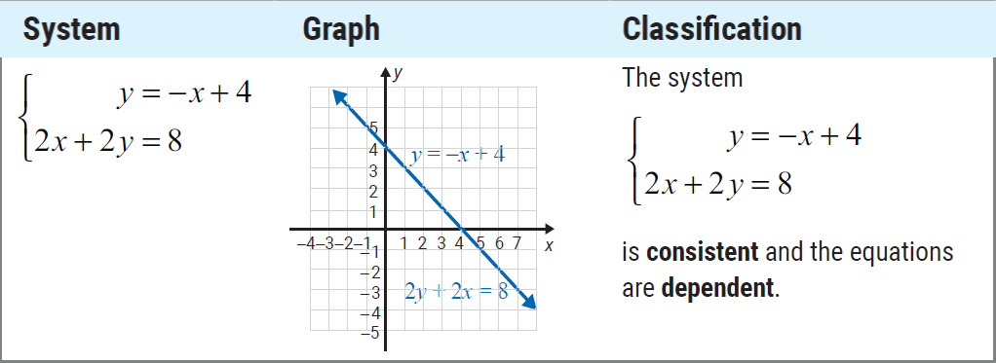
Table 1 (cont.)

Slide 6
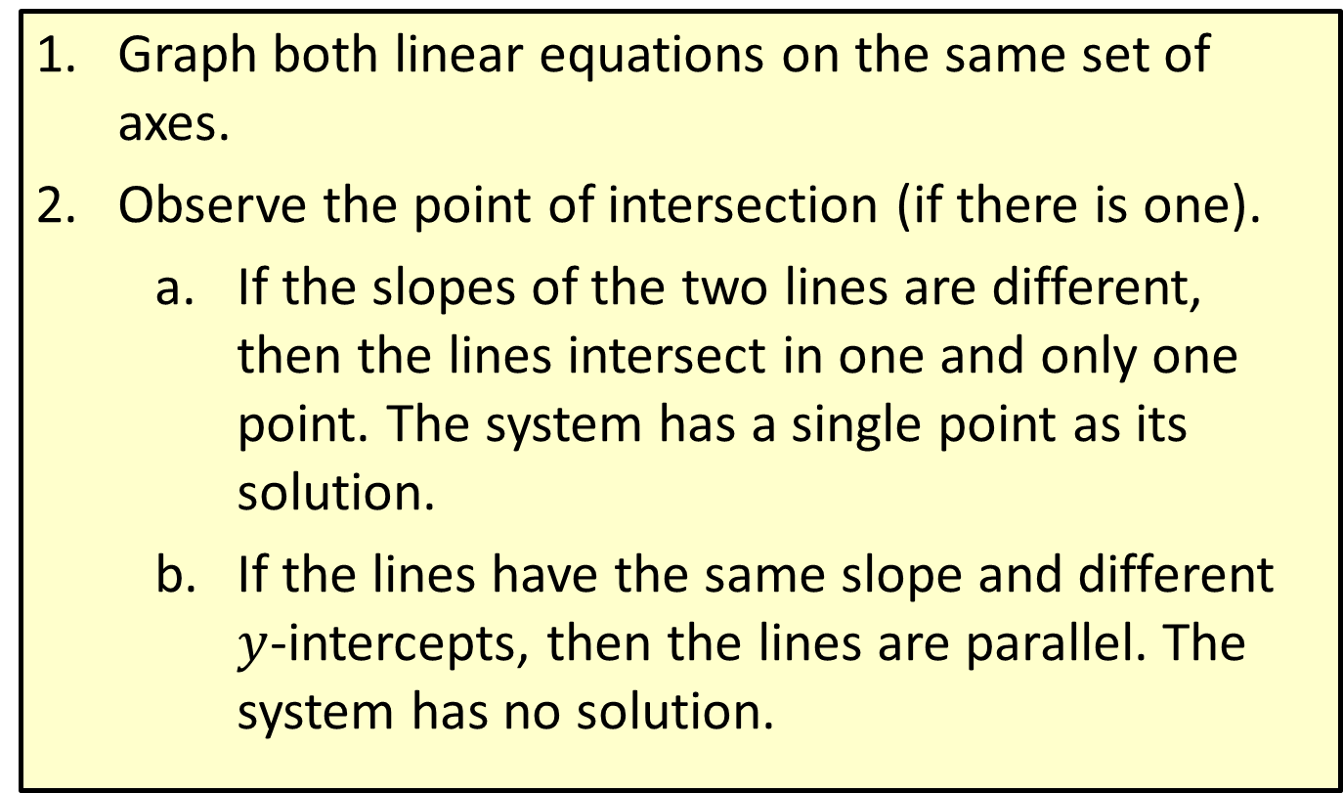
Procedure: To Solve a System of Linear Equations by Graphing
​Graph both linear equations on the same set of axes.
​Observe the point of intersection (if there is one).
​If the slopes of the two lines are different, then the lines intersect in one and only one point. The system has a single point as its solution.
​If the lines have the same slope and different $y$-intercepts, then the lines are parallel. The system has no solution.

Slide 7
Procedure: To Solve a System of Linear Equations by Graphing (cont.)
​​If the lines are the same line, then all the points on the line constitute the solution. There is an infinite number of solutions.
​Check the solution (if there is one) in both of the original equations.

Slide 8
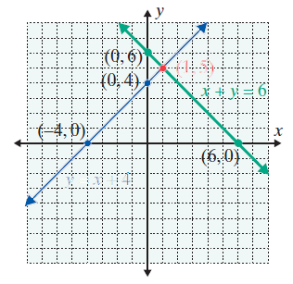

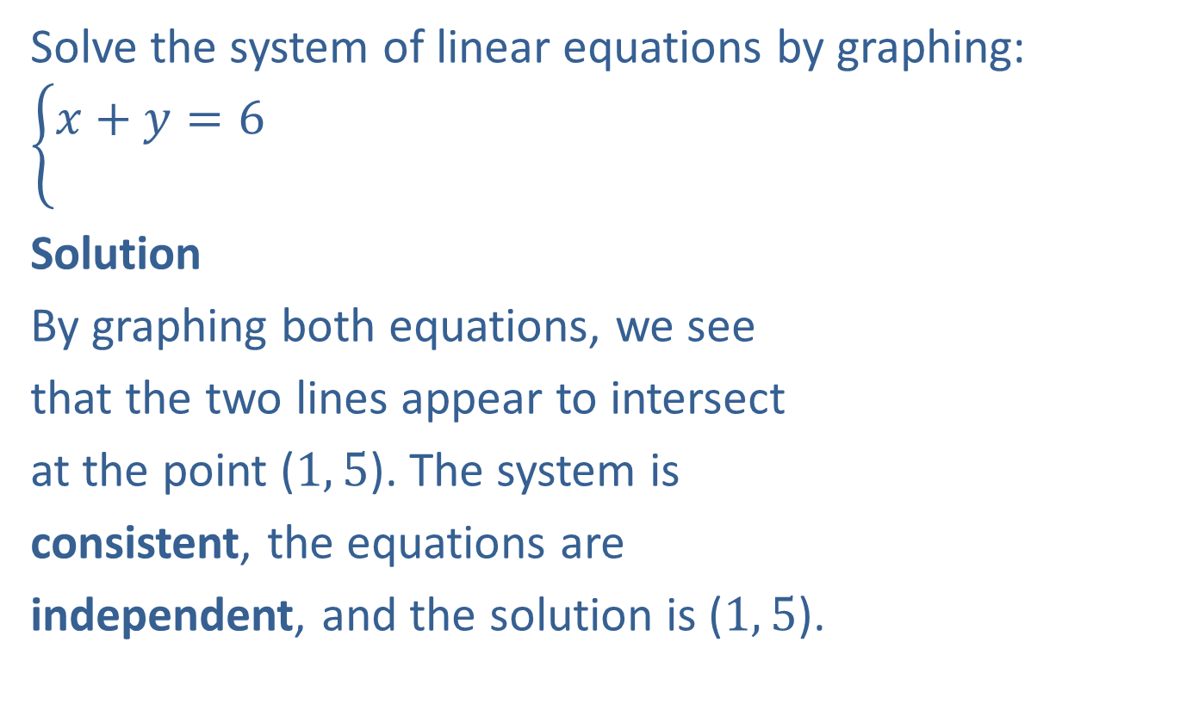
Example 1: Solving a Consistent System by Graphing
Solve the system of linear equations by graphing: $\left\{\begin{aligned}x+y=6 \\ \end{aligned}\right.$
Solution
By graphing both equations, we see
that the two lines appear to intersect
at the point ($1, 5$). The system is
consistent, the equations are
independent, and the solution is ($1, 5$).
$$y=x+4$$

Slide 9
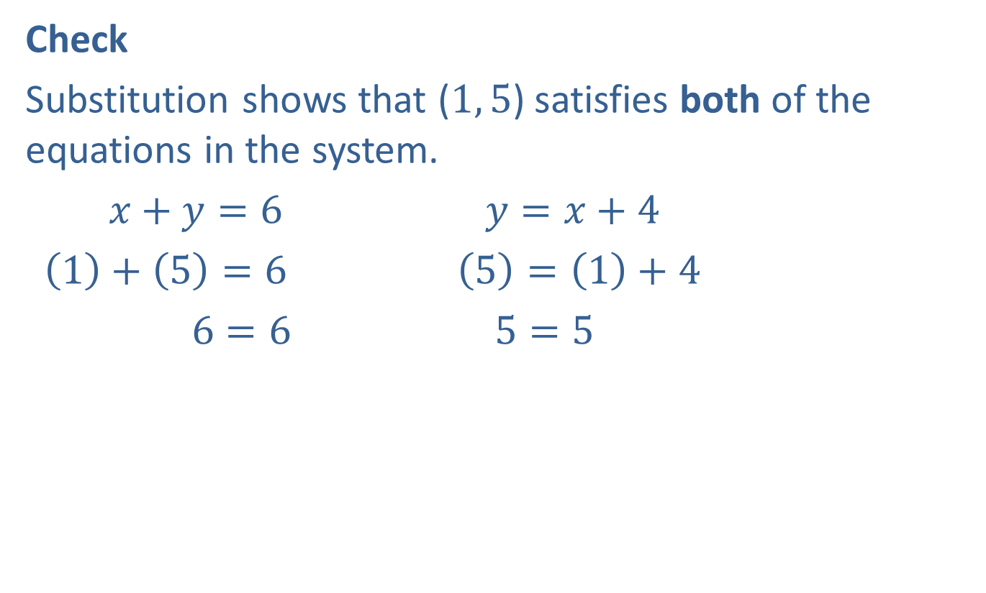
Example 1: Solving a Consistent System by Graphing (cont.)
Check
Substitution shows that ($1, 5$) satisfies both of the equations in the system.
$x+y=6$ $y=x+4$
$\left(1\right)+\left(5\right)=6$ $\left(5\right)=\left(1\right)+4$
$6=6$ $5=5$
?
?

Slide 10
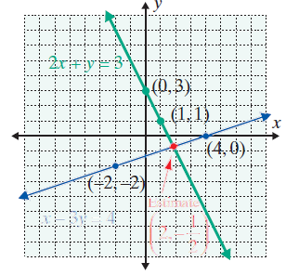
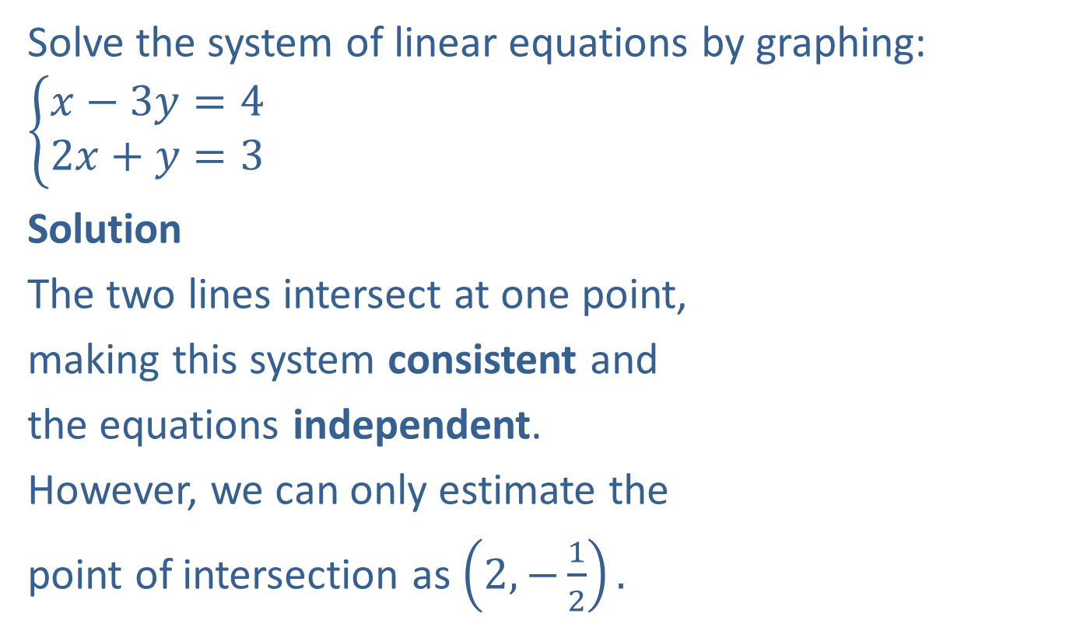
Example 2: Solving a Consistent System by Graphing
Solve the system of linear equations by graphing: $\left\{\begin{aligned}x−3y=4 \\ 2x+y=3\end{aligned}\right.$
Solution
The two lines intersect at one point,
making this system consistent and
the equations independent.
However, we can only estimate the
point of intersection as $\left(2,−\frac{1}{2}\right).$

Slide 11
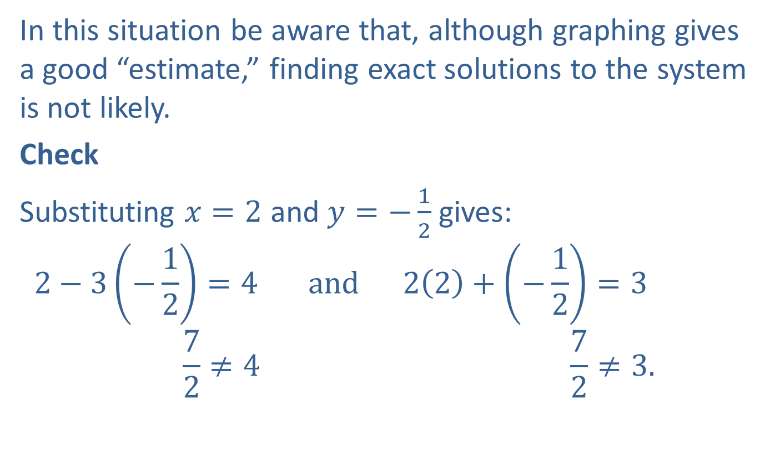
Example 2: Solving a Consistent System by Graphing (cont.)
In this situation be aware that, although graphing gives a good “estimate,” finding exact solutions to the system is not likely.
Check
Substituting $x=2$ and $y=−\frac{1}{2}$ gives:
$$2−3\left(−\frac{1}{2}\right)=4 and 2\left(2\right)+\left(−\frac{1}{2}\right)=3$$
$$\frac{7}{2}≠4 \frac{7}{2}≠3.$$
?
?

Slide 12
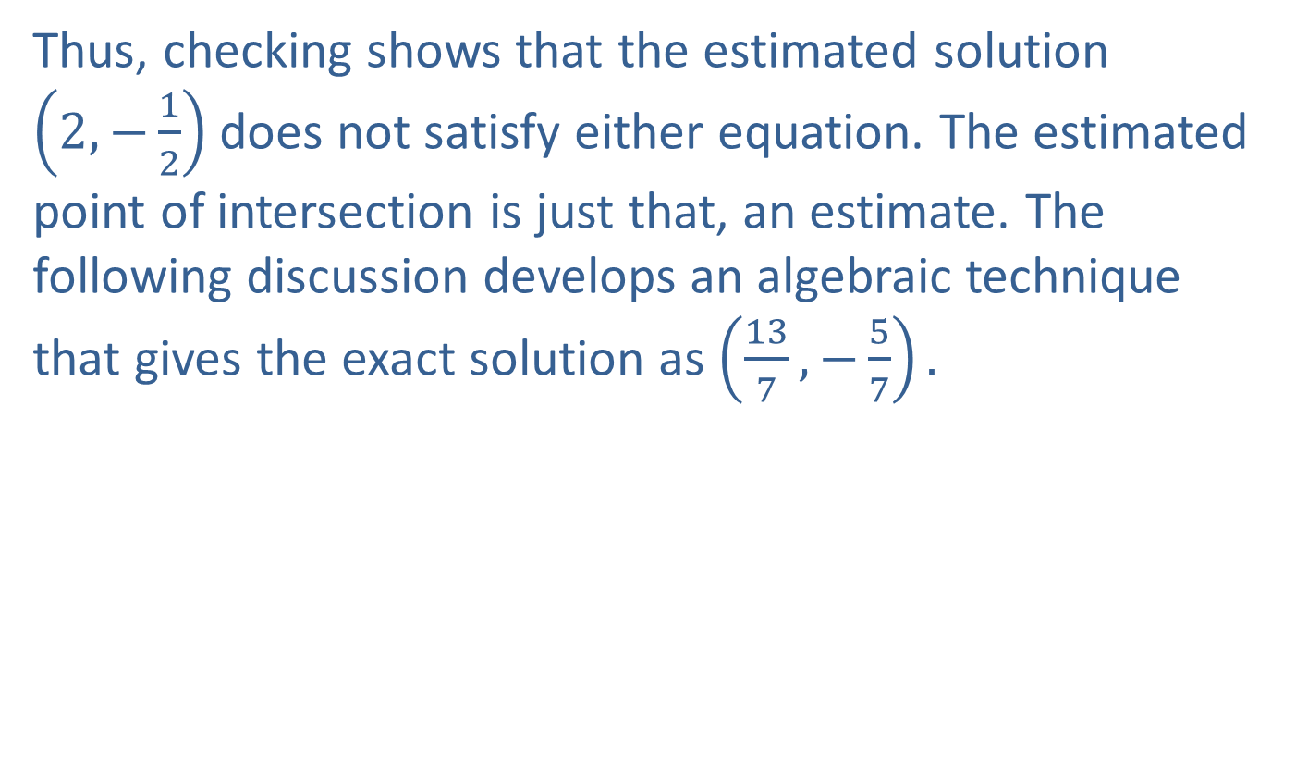
Example 2: Solving a Consistent System by Graphing (cont.)
Thus, checking shows that the estimated solution $\left(2,−\frac{1}{2}\right)$ does not satisfy either equation. The estimated point of intersection is just that, an estimate. The following discussion develops an algebraic technique that gives the exact solution as $\left(\frac{13}{7},−\frac{5}{7}\right).$

Slide 13
Procedure: To Solve a System of Linear Equations by Substitution
​Solve one of the equations for one of the variables.
​Substitute the resulting expression into the other equation.
​Solve this new equation, if possible, and then substitute back into one of the original equations to find the value of the other variable. (This is known as back substitution.)
​Check the solution in both of the original equations.

Slide 14
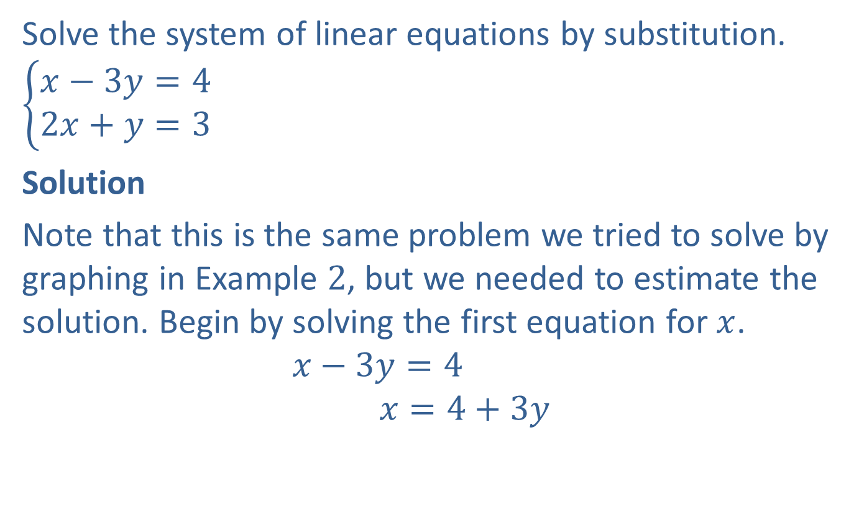
Example 3: Solving a Consistent System by Substitution
Solve the system of linear equations by substitution.
$$\left\{\begin{aligned}x−3y=4 \\ 2x+y=3\end{aligned}\right.$$
Solution
Note that this is the same problem we tried to solve by graphing in Example $2$, but we needed to estimate the solution. Begin by solving the first equation for $x$.
$$x−3y=4$$
$$x=4+3y$$

Slide 15


Example 3: Solving a Consistent System by Substitution (cont.)
Now substitute $4+3y$ for $x$ in the second equation.
$$2x+y=3$$
$$2\left(4+3y\right)+y=3$$
$$8+6y+y=3$$
$$7y=−5$$
$$y=−\frac{5}{7}$$
Solve the new equation for $y.$

Slide 16
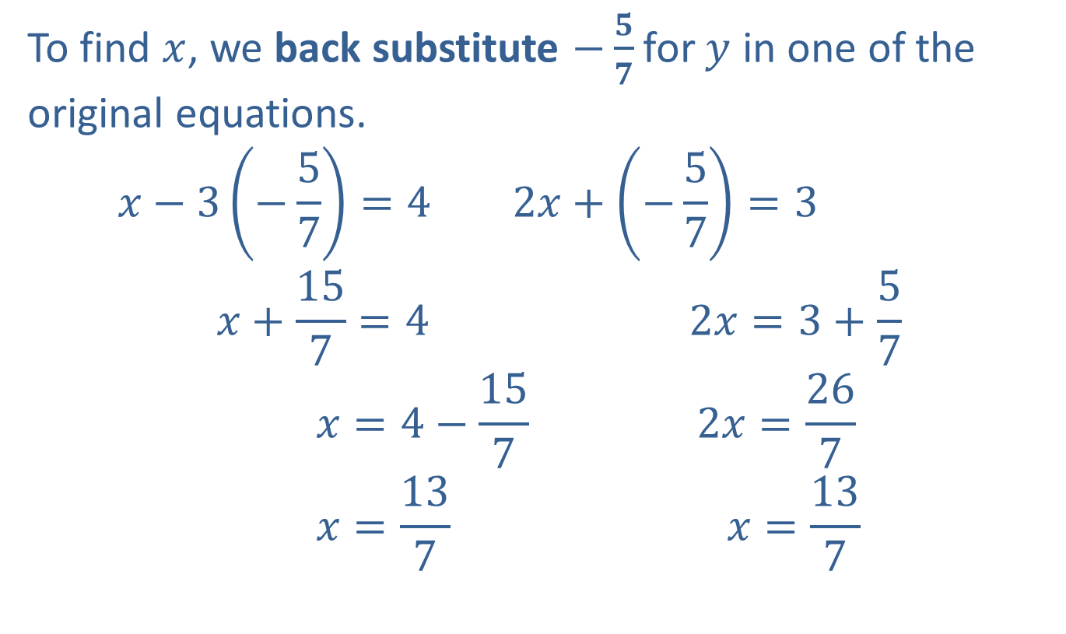
Example 3: Solving a Consistent System by Substitution (cont.)
To find $x$, we back substitute $−\frac{5}{7}$for $y$ in one of the original equations.
$$x−3\left(−\frac{5}{7}\right)=4 2x+\left(−\frac{5}{7}\right)=3$$
$$x+\frac{15}{7}=4 2x=3+\frac{5}{7}$$
$$x=4−\frac{15}{7} 2x=\frac{26}{7}$$
$$x=\frac{13}{7} x=\frac{13}{7}$$
OR

Slide 17
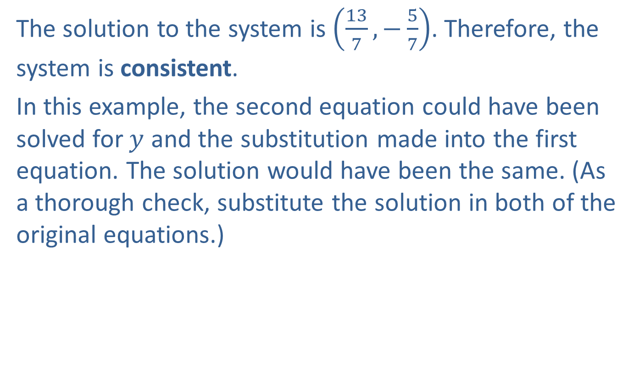
Example 3: Solving a Consistent System by Substitution (cont.)
The solution to the system is $\left(\frac{13}{7},−\frac{5}{7}\right)$. Therefore, the system is consistent.
In this example, the second equation could have been solved for $y$ and the substitution made into the first equation. The solution would have been the same. (As a thorough check, substitute the solution in both of the original equations.)

Slide 18
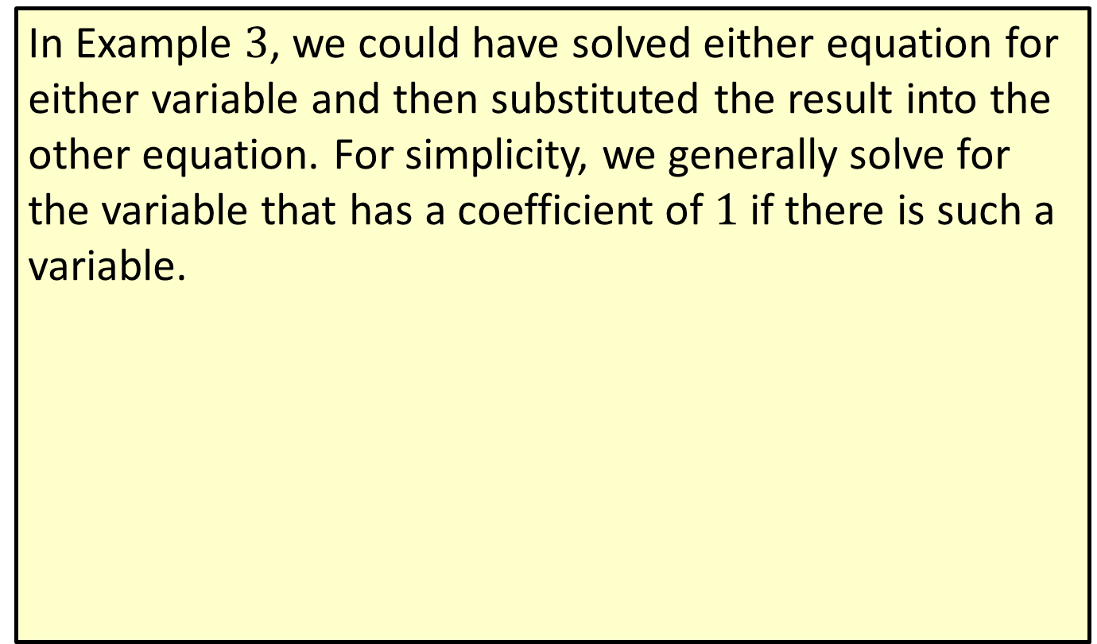
Note
In Example $3$, we could have solved either equation for either variable and then substituted the result into the other equation. For simplicity, we generally solve for the variable that has a coefficient of $1$ if there is such a variable.

Slide 19
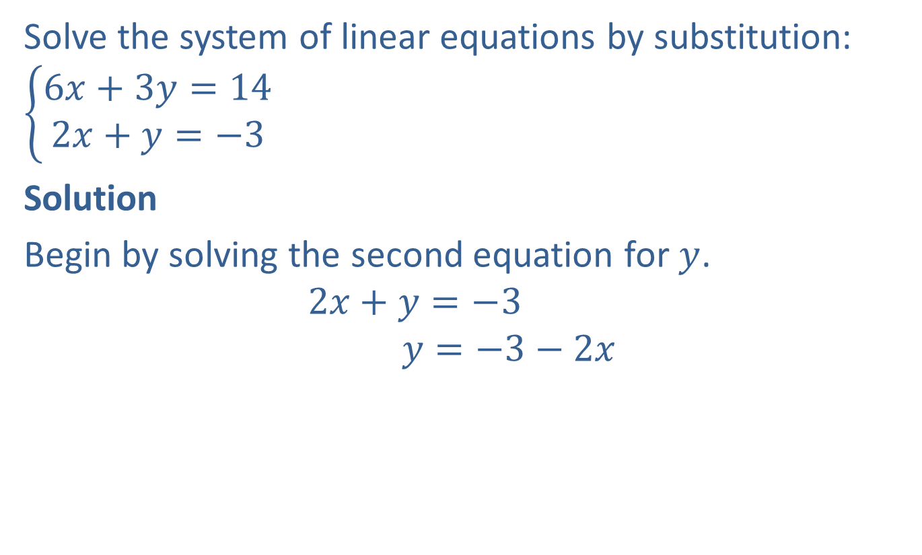
Example 4: Solving an Inconsistent System by Substitution
Solve the system of linear equations by substitution:
$$\left\{\begin{aligned}6x+3y=14 \\ 2x+y=−3\end{aligned}\right.$$
Solution
Begin by solving the second equation for $y$.
$$2x+y=−3$$
$$y=−3−2x$$

Slide 20
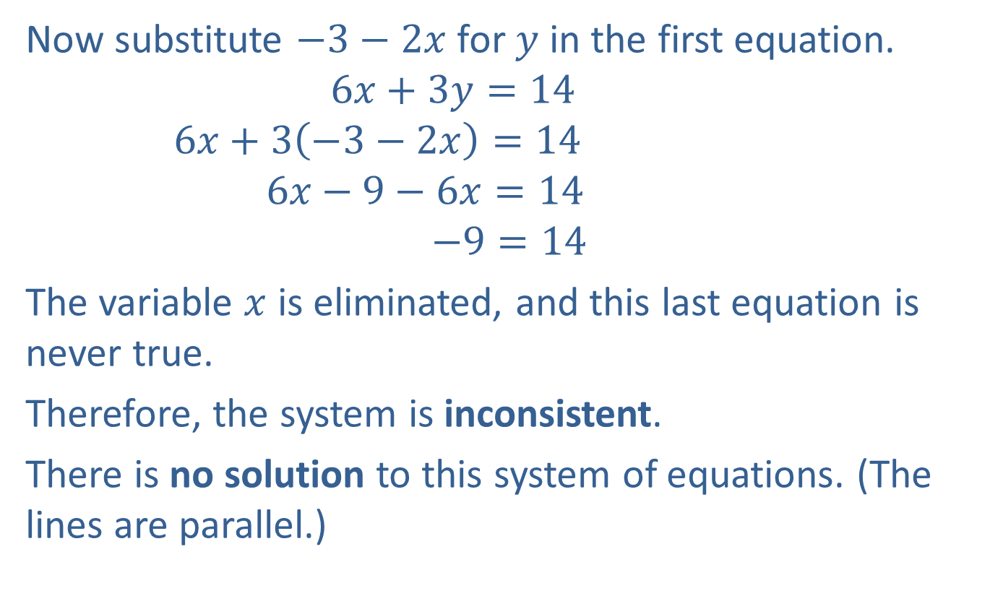
Example 4: Solving an Inconsistent System by Substitution (cont.)
Now substitute $−3−2x$for $y$ in the first equation.
$$6x+3y=14$$
$$6x+3\left(−3−2x\right)=14$$
$$6x−9−6x=14$$
$$−9=14$$
The variable $x$ is eliminated, and this last equation is never true.
Therefore, the system is inconsistent.
There is no solution to this system of equations. (The lines are parallel.)
Simplify.
False statement

Slide 21
Procedure: To Solve a System of Linear Equations by Addition
​Write the equations in standard form, one under the other, so that like terms are aligned.
​Multiply all terms of one equation by a constant (and possibly all terms of the other equation by another constant) so that two like terms have opposite coefficients.
​Add the two equations by combining like terms and solve the resulting equation, if possible.
​Back substitute into one of the original equations to find the value of the other variable.
​Check the solution in both of the original equations.

Slide 22
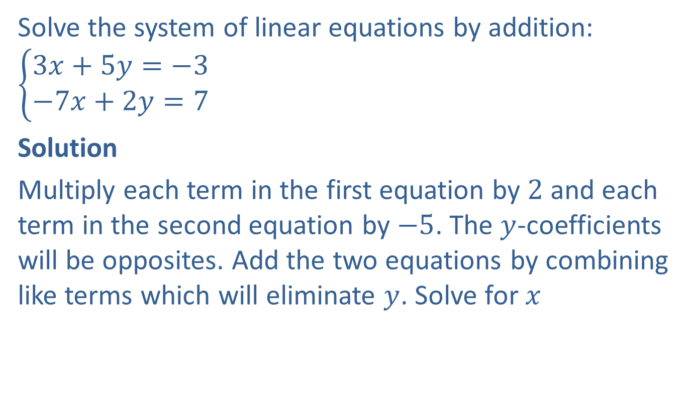
Example 5: Solving a Consistent System by Addition
Solve the system of linear equations by addition: $\left\{\begin{aligned}3x+5y=−3 \\ −7x+2y=7\end{aligned}\right.$
Solution
Multiply each term in the first equation by $2$ and each term in the second equation by $−5$. The $y$-coefficients will be opposites. Add the two equations by combining like terms which will eliminate $y$. Solve for $x$

Slide 23

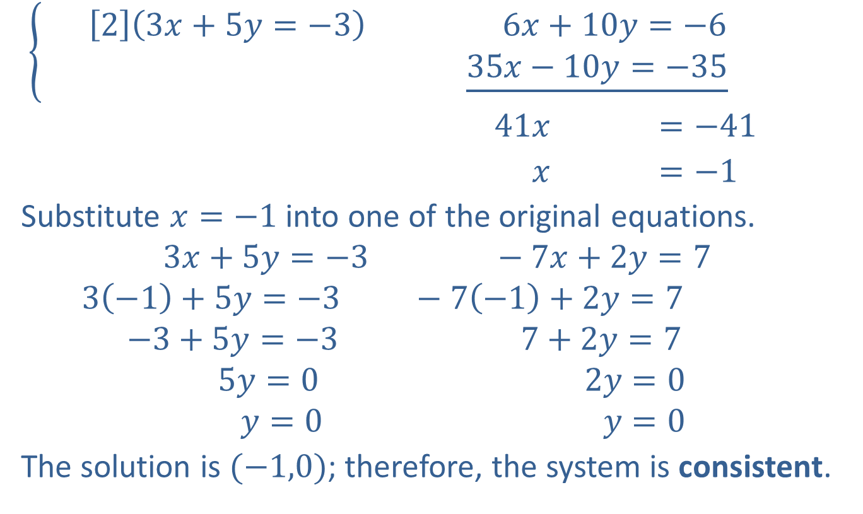
Example 5: Solving a Consistent System by Addition (cont.)
$\left\{\begin{aligned}\left[2\right]\left(3x+5y=−3\right) 6x+10y=−6 \\ \underline{35x−10y=−35} \end{aligned}\right.$
$41x =−41$
$x =−1$
Substitute $x=−1$ into one of the original equations.
$$3x+5y=−3 −7x+2y=7$$
$$3\left(−1\right)+5y=−3 −7\left(−1\right)+2y=7$$
$$−3+5y=−3 7+2y=7$$
$$5y=0 2y=0$$
$$y=0 y=0$$
The solution is $(−1,0)$; therefore, the system is consistent.
$$\left[−5\right](−7x+2y=7)$$
OR

Slide 24
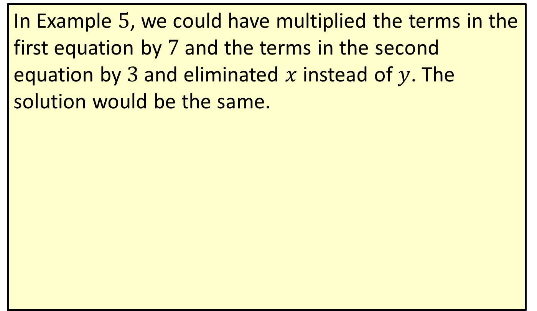
Note
In Example $5$, we could have multiplied the terms in the first equation by $7$ and the terms in the second equation by $3$and eliminated $x$instead of $y$. The solution would be the same.

Slide 25
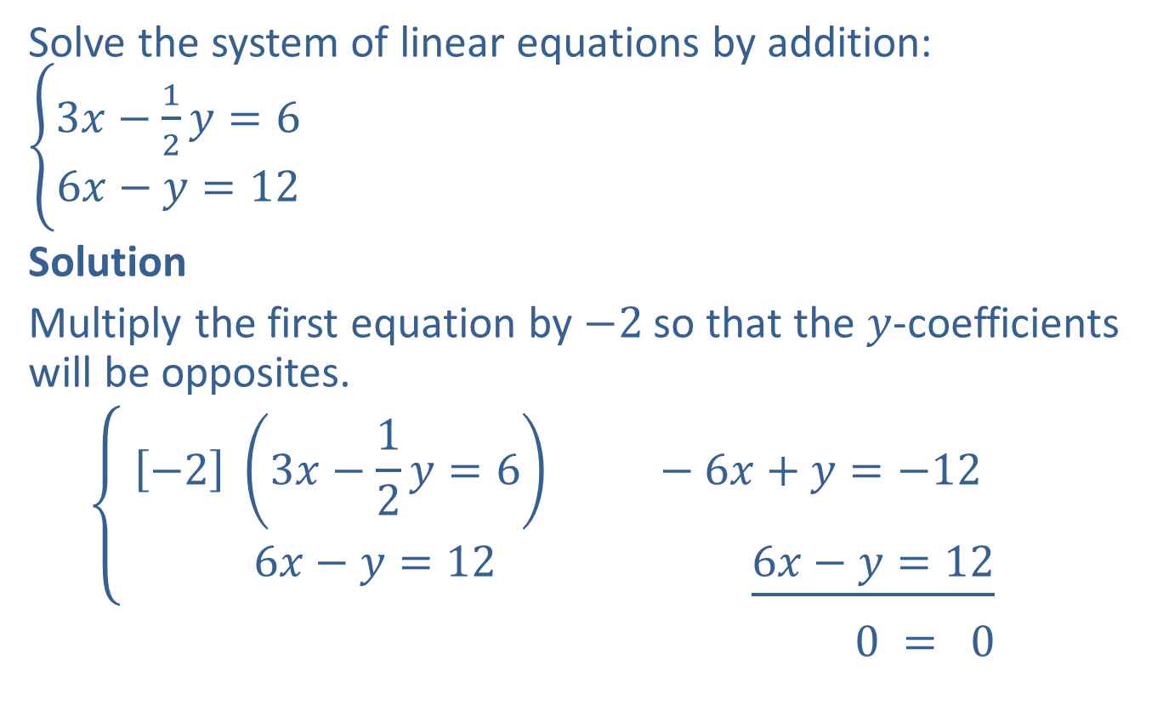
Example 6: Solving a Consistent System by Addition
Solve the system of linear equations by addition: $\left\{\begin{aligned}3x−\frac{1}{2}y=6 \\ 6x−y=12\end{aligned}\right.$
Solution
Multiply the first equation by $−2$ so that the $y$-coefficients will be opposites.
$$\left\{\begin{aligned}\left[−2\right] \left(3x−\frac{1}{2}y=6\right) −6x+y=−12 \\ 6x−y=12 \underline{6x−y=12}\end{aligned}\right.$$
$0 = 0$

Slide 26
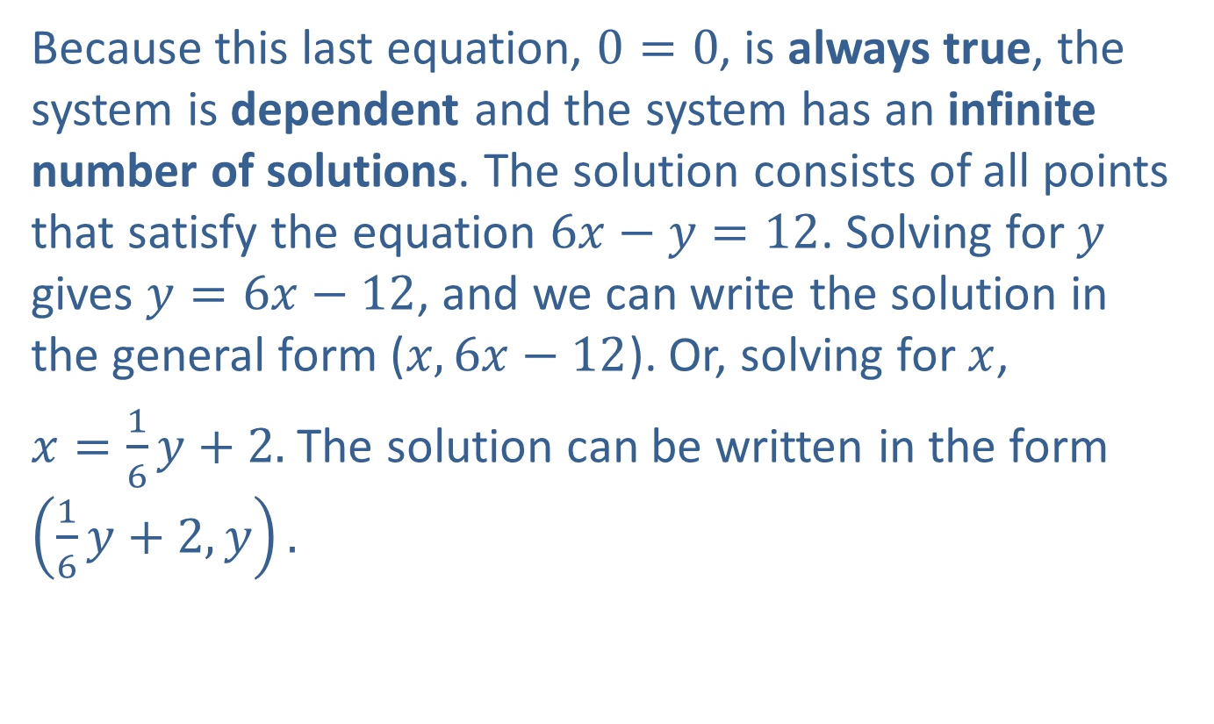
Example 6: Solving a Consistent System by Addition (cont.)
Because this last equation, $0=0$, is always true, the system is dependent and the system has an infinite number of solutions. The solution consists of all points that satisfy the equation $6x−y=12$. Solving for $y$ gives $y=6x−12$, and we can write the solution in the general form ($x,6x−12$). Or, solving for $x$,
$x=\frac{1}{6}y+2.$ The solution can be written in the form $\left(\frac{1}{6}y+2,y\right).$

Slide 27
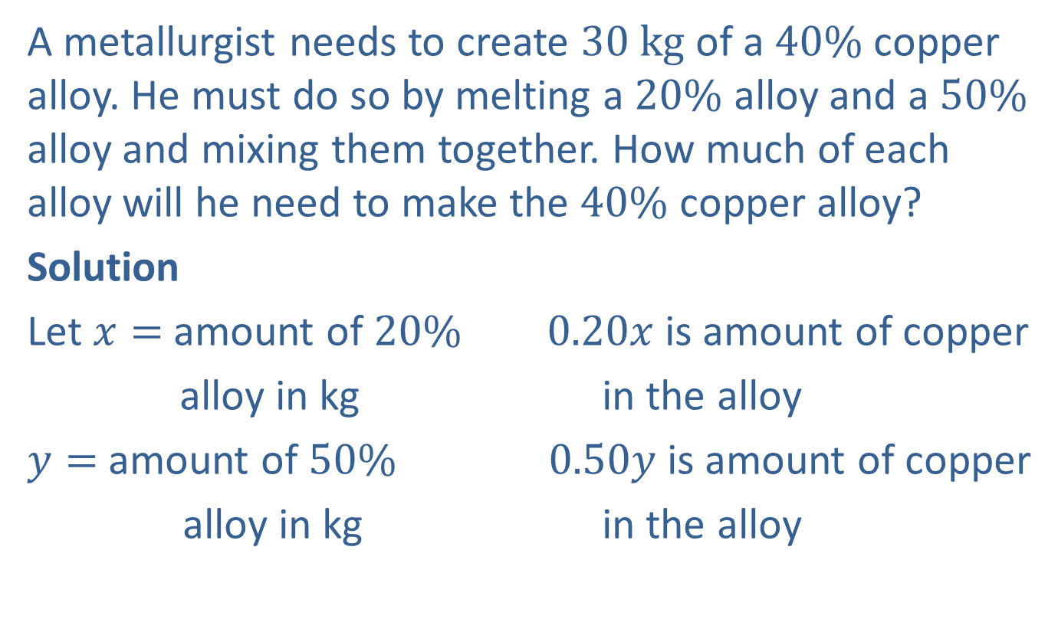
Example 7: Application: Mixture
A metallurgist needs to create $30 kg$ of a $40\%$ copper alloy. He must do so by melting a $20\%$ alloy and a $50\%$ alloy and mixing them together. How much of each alloy will he need to make the $40\%$ copper alloy?
Solution
Let $x=$ amount of $20\%$ $0.20x$ is amount of copper
alloy in kg in the alloy
$y=$ amount of $50\%$ $0.50y$ is amount of copper
alloy in kg in the alloy

Slide 28
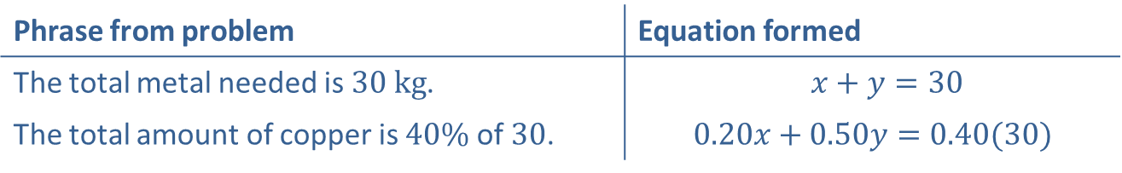
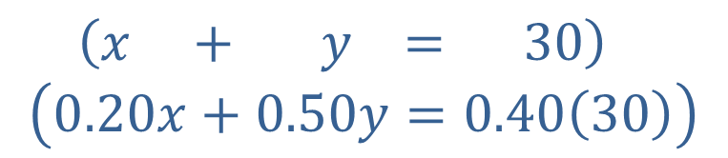

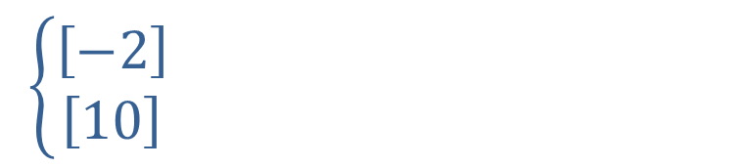
Example 7: Application: Mixture (cont.)
Form two equations based on the information given.
Now solve the system. We will use the addition method.
Phrase from problem | Equation formed
The total metal needed is $30 kg$. | $$x+y=30$$
The total amount of copper is $40\%$ of $30$. | $$0.20x+0.50y=0.40(30)$$
$$\left\{\begin{aligned}\left[−2\right] \\ \left[10\right] \end{aligned}\right.$$
$−2x−2y=−60$
$$\underline{2x+5y=120}$$
$$3y=60$$
$$y=20$$
$\left(x + y = 30\right)$
$$\left(0.20x+0.50y=0.40\left(30\right)\right)$$

Slide 29
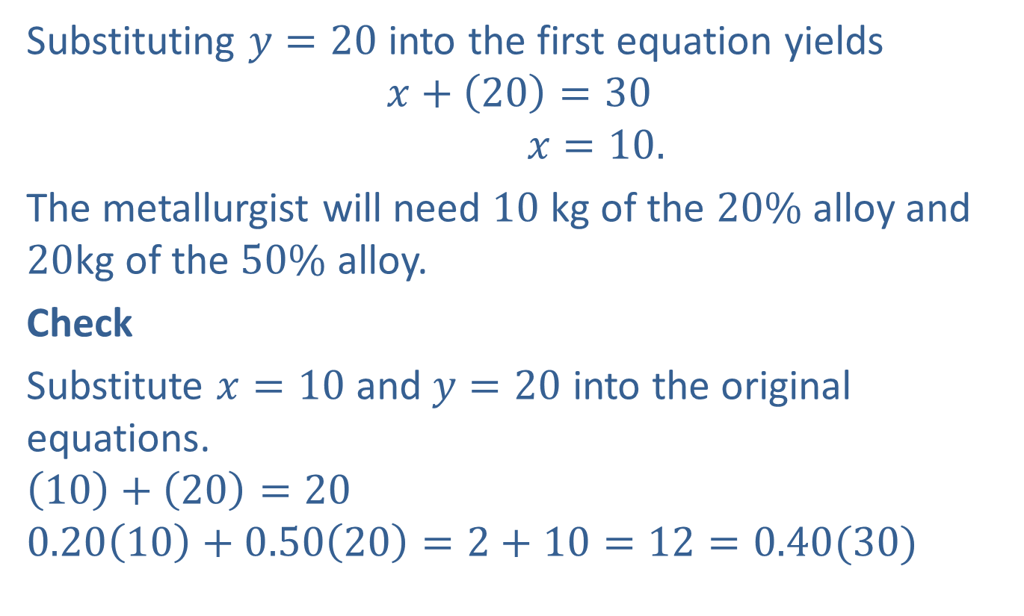
Example 7: Application: Mixture (cont.)
Substituting $y=20$into the first equation yields
$$x+\left(20\right)=30$$
$$x=10.$$
The metallurgist will need $10$ kg of the $20\%$ alloy and $20$kg of the $50\%$ alloy.
Check
Substitute $x=10$ and $y=20$ into the original equations.
$$\left(10\right)+\left(20\right)=20$$
$$0.20\left(10\right)+0.50\left(20\right)=2+10=12=0.40(30)$$

Slide 30
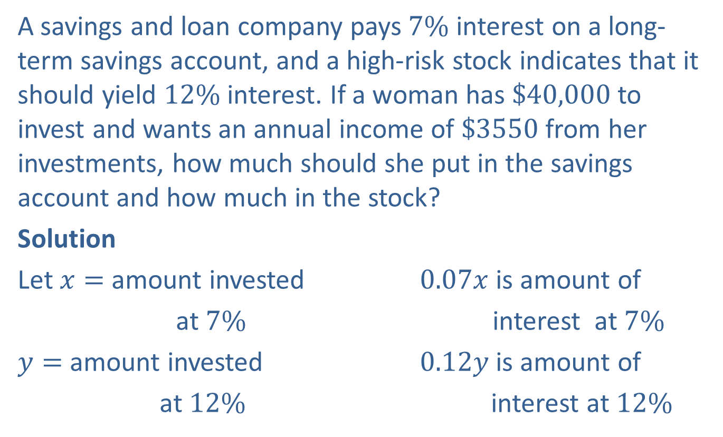
Example 8: Application: Interest
A savings and loan company pays $7\%$ interest on a long-term savings account, and a high-risk stock indicates that it should yield $12\%$ interest. If a woman has $\$40,000$ to invest and wants an annual income of $\$3550$ from her investments, how much should she put in the savings account and how much in the stock?
Solution
Let $x=$ amount invested $0.07x$ is amount of
at $7\%$ interest at $7\%$
$y=$ amount invested $0.12y$ is amount of
at $12\%$ interest at $12\%$

Slide 31
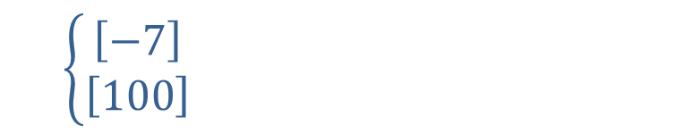
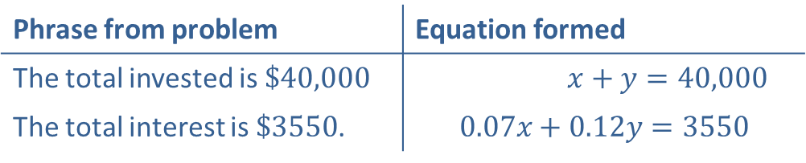
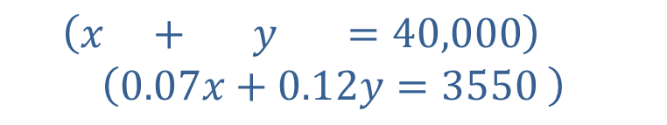

Example 8: Application: Interest (cont.)
Phrase from problem | Equation formed
The total invested is $\$40,000$ | $x+y=40,000$
The total interest is $\$3550$. | $$0.07x+0.12y=3550$$
$$\left\{\begin{aligned}\left[−7\right] \\ \left[100\right] \end{aligned}\right.$$
$−7x−7y=−280,000$
$$\underline{ 7x+12y = 355,000}$$
$$5y=75,000$$
$$y=15,000$$
$\left(x + y =40,000\right)$
$$\left(0.07x+0.12y=3550 \right)$$

Slide 32

Example 8: Application: Interest (cont.)
Back substituting $y=15,000$ gives
$x+\left(15,000\right)=40,000$
$x=25,000.$
She should put $\$25,000$in the savings account at $7\%$ and $\$15,000$in the stock at $12\%$.

Slide 33
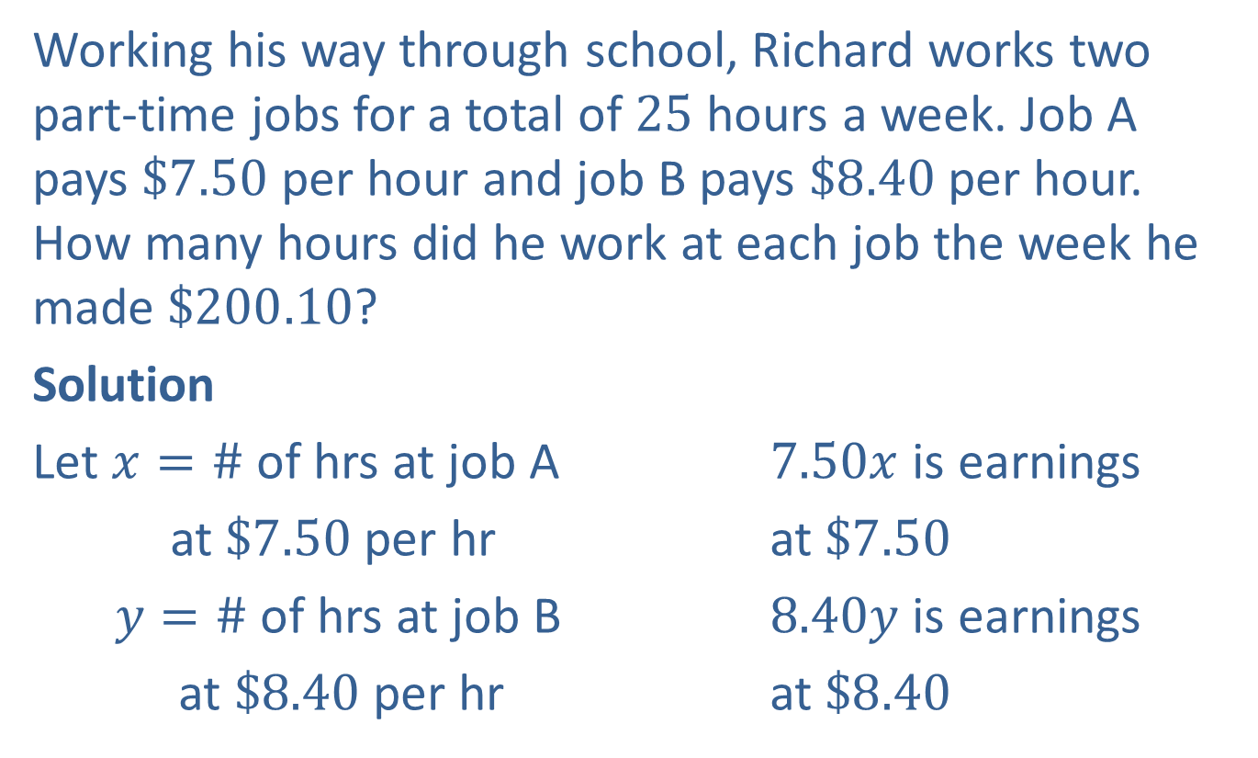
Example 9: Application: Work
Working his way through school, Richard works two part-time jobs for a total of 25 hours a week. Job A pays $\$7.50$ per hour and job B pays $\$8.40$ per hour. How many hours did he work at each job the week he made $\$200.10$?
Solution
Let $x=\#$ of hrs at job A $7.50x$ is earnings
at $\$7.50$ per hr at $\$7.50$
$y=\#$ of hrs at job B $8.40y$ is earnings
at $\$8.40$ per hr at $\$8.40$

Slide 34


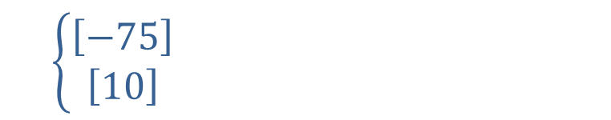
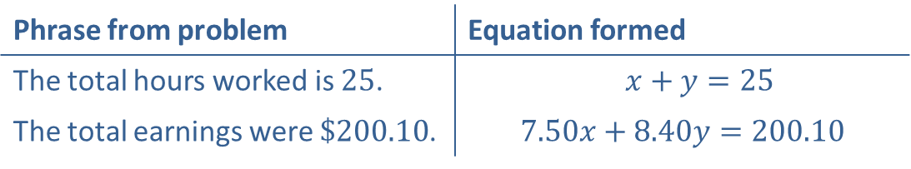
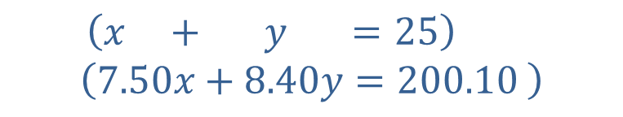
Example 9: Application: Work (cont.)
Back substitute $y=14$ to obtain
$$x+\left(14\right)=25$$
$$x=11.$$
Richard worked $11$ hours at job A and $14$ hours at job B.
Phrase from problem | Equation formed
The total hours worked is $25$. | $x+y=25$
The total earnings were $\$200.10$. | $$7.50x+8.40y=200.10$$
$$\left\{\begin{aligned}\left[−75\right] \\ \left[10\right] \end{aligned}\right.$$
$\left(x + y =25\right)$
$$\left(7.50x+8.40y=200.10 \right)$$
$−75x−75y=−1875$
$$\underline{ 75x+84y=2001 }$$
$$9y=126$$
$$y=14$$

