Slide 1
Section 3.7
Graphing Linear Inequalities in Two Variables

Slide 2
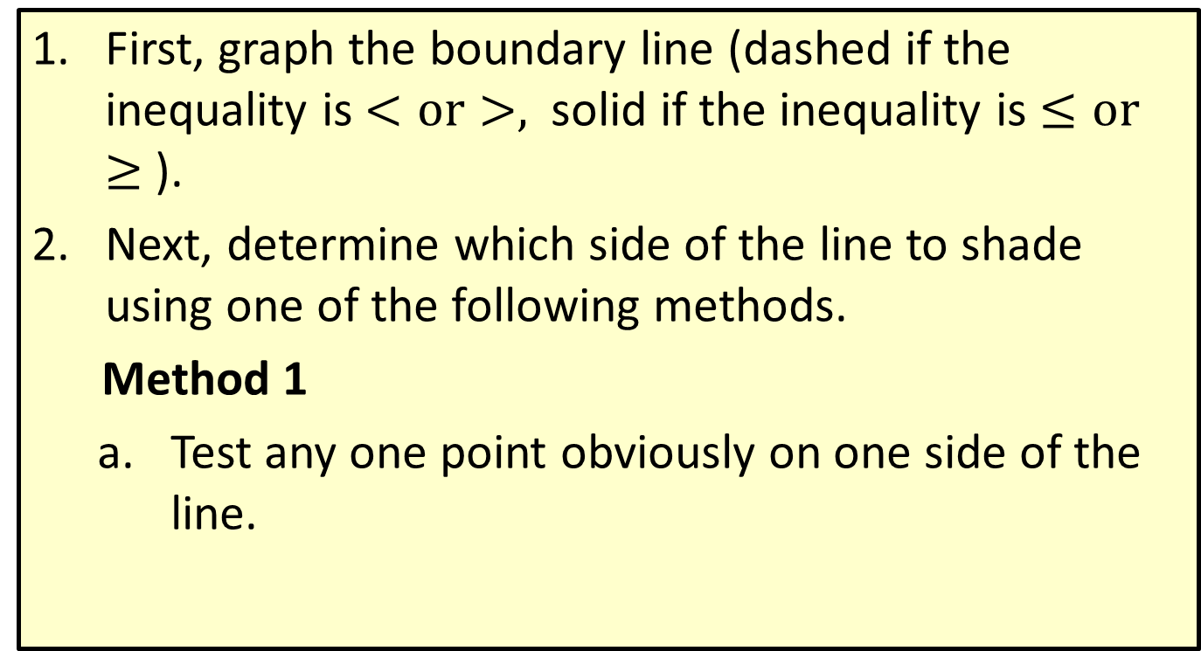
Procedure: Graphing Linear Inequalities
First, graph the boundary line (dashed if the inequality is $<or>,$solid if the inequality is $≤or≥$ ).
Next, determine which side of the line to shade using one of the following methods.
Method 1
  Test any one point obviously on one side of the line.

Slide 3
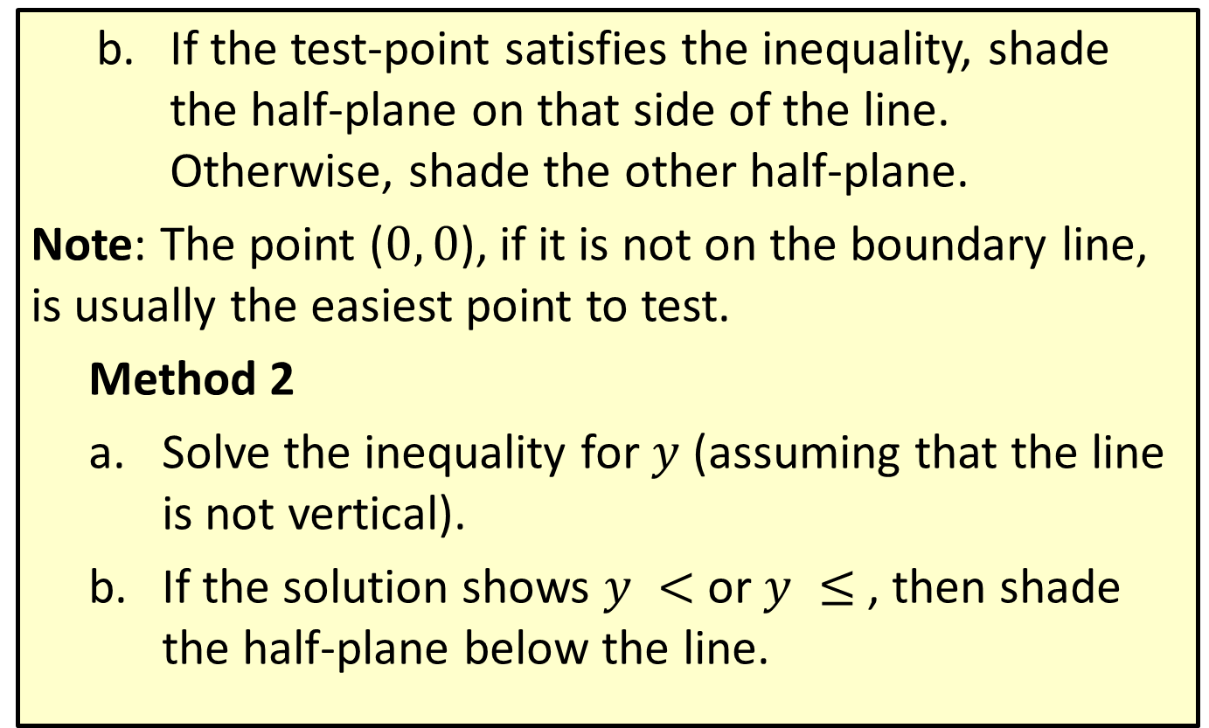
Procedure: Graphing Linear Inequalities (cont.)
  If the test-point satisfies the inequality, shade the half-plane on that side of the line. Otherwise, shade the other half-plane.
  Note: The point ($0, 0$), if it is not on the boundary line, is usually the easiest point to test.
    Method 2
    Solve the inequality for $y$ (assuming that the line is not vertical).
    If the solution shows $y <$or $y ≤$ , then shade the half-plane below the line.

Slide 4
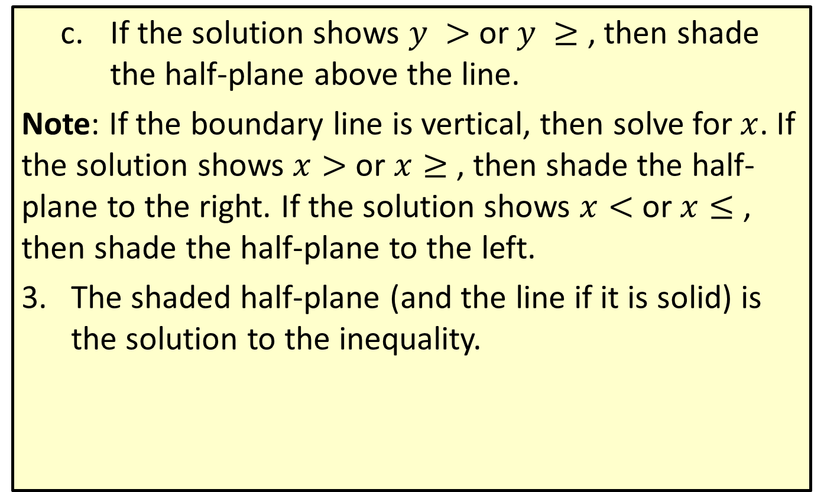
Procedure: Graphing Linear Inequalities (cont.)
    If the solution shows $y >$ or $y ≥$ , then shade the half-plane above the line.
    Note: If the boundary line is vertical, then solve for $x$. If the solution shows $x>$ or $x≥$ , then shade the half-plane to the right. If the solution shows $x<$ or $x≤$ , then shade the half-plane to the left.
    The shaded half-plane (and the line if it is solid) is the solution to the inequality.

Slide 5
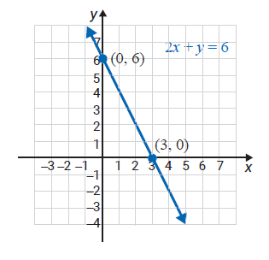
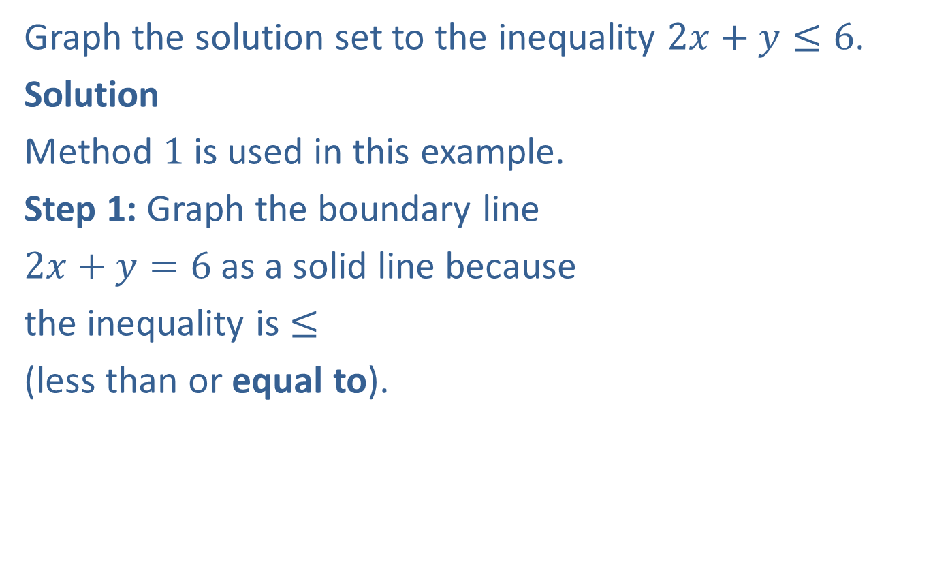
Example 1: Graphing Linear Inequalities
Graph the solution set to the inequality $2x+y≤6$.
Solution
Method $1$ is used in this example.
Step 1: Graph the boundary line
$2x+y=6$ as a solid line because
the inequality is $≤$
(less than or equal to).

Slide 6
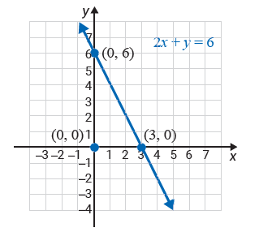

Example 1: Graphing Linear Inequalities (cont.)
Step 2: Test any point on one side of the line.
In this example, we have chosen $(0, 0)$.
$$2\left(0\right)+(0)≤6$$
$$0≤6$$
This is a true statement.

Slide 7
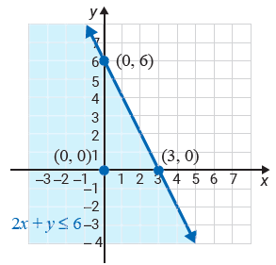

Example 1: Graphing Linear Inequalities (cont.)
Step 3: Shade the half-plane on the same
side of the line as the point ($0, 0$). (The shaded half-plane and the boundary line is the solution set to
the inequality.)

Slide 8
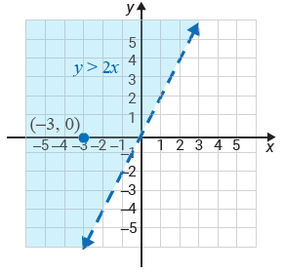
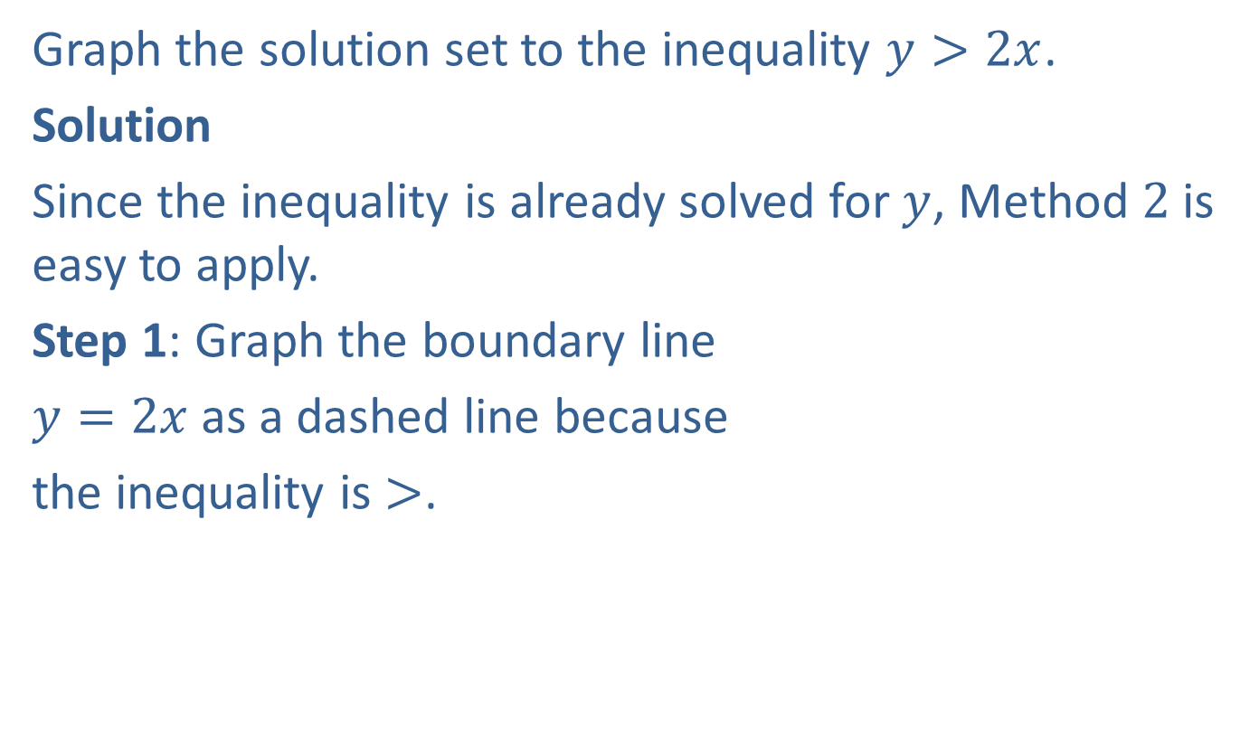
Example 2: Graphing Linear Inequalities
Graph the solution set to the inequality $y>2x$.
Solution
Since the inequality is already solved for $y$, Method $2$ is easy to apply.
Step 1: Graph the boundary line
$y=2x$as a dashed line because
the inequality is $>$.

Slide 9
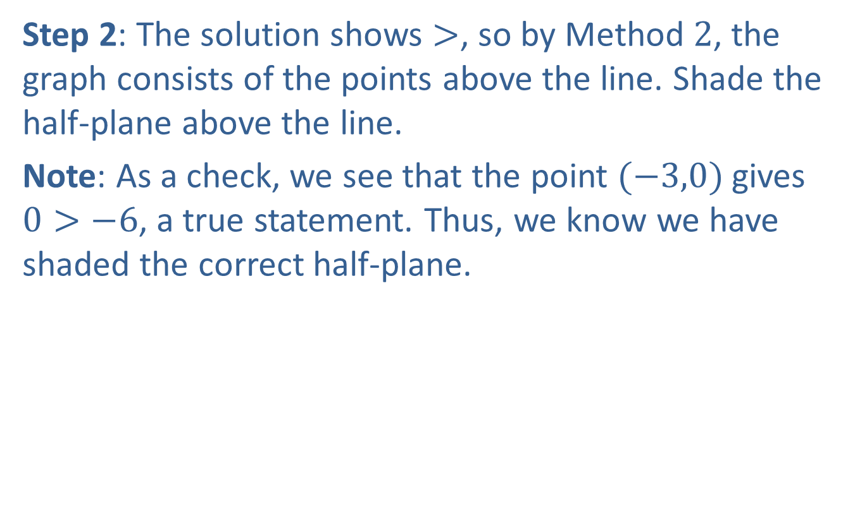
Example 2: Graphing Linear Inequalities (cont.)
Step 2: The solution shows $>$, so by Method $2$, the graph consists of the points above the line. Shade the half-plane above the line.
Note: As a check, we see that the point $(−3,0)$gives $0>−6$, a true statement. Thus, we know we have shaded the correct half-plane.

Slide 10
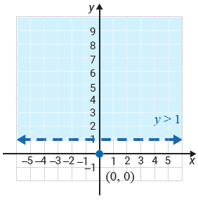
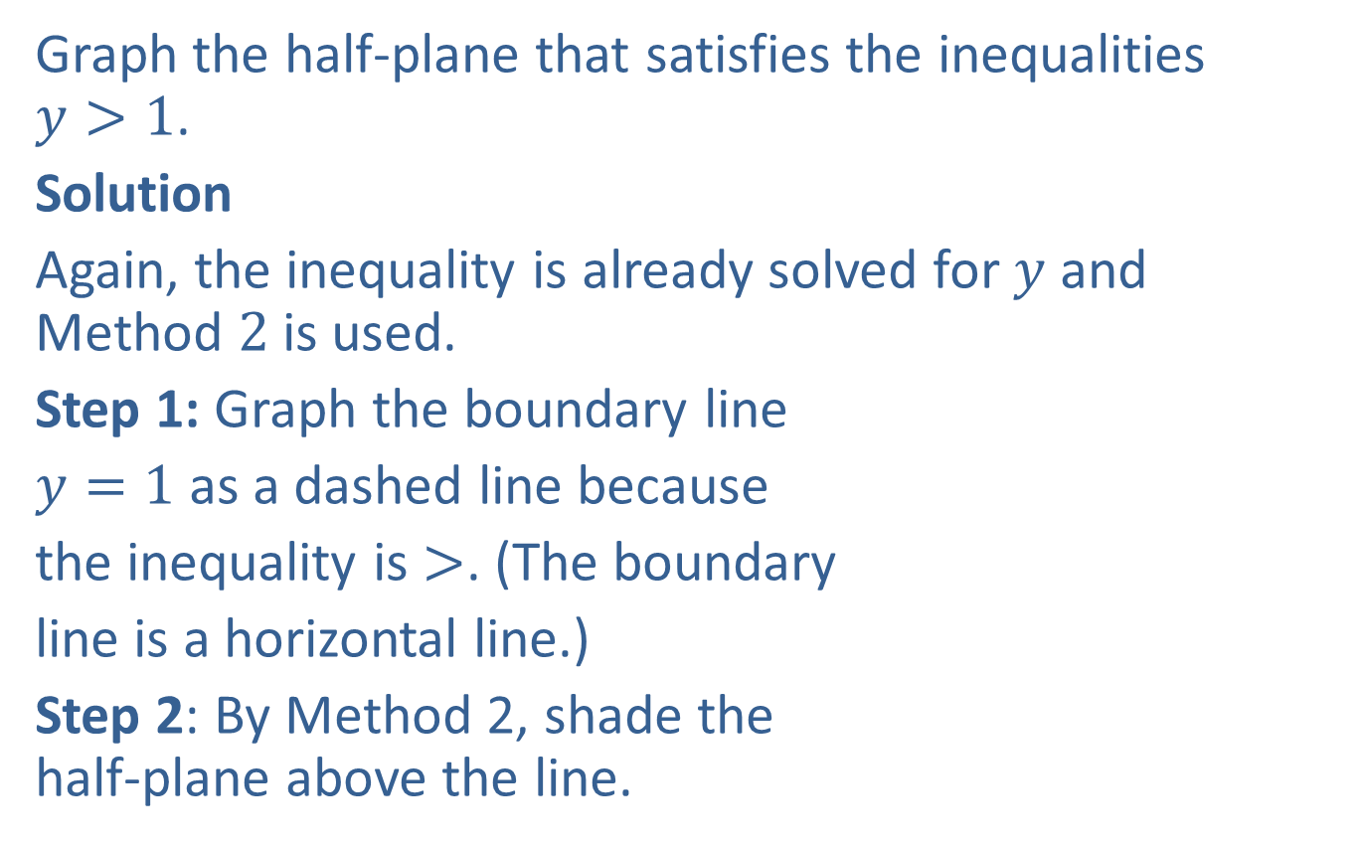
Example 3: Graphing Linear Inequalities
Graph the half-plane that satisfies the inequalities $y>1$.
Solution
Again, the inequality is already solved for $y$ and Method $2$ is used.
Step 1: Graph the boundary line
$y=1$ as a dashed line because
the inequality is $>$. (The boundary
line is a horizontal line.)
Step 2: By Method 2, shade the half-plane above the line.

Slide 11
Procedure: To Solve a System of Two Linear Inequalities
​For each inequality, graph the boundary line and shade the appropriate half-plane.
​Determine the region of the graph that is common to both half-planes (the region where the shading overlaps).
(This region is called the intersection of the two
half-planes and is the solution set of the system.)
​To check, pick one test-point in the intersection and verify that it satisfies both inequalities.
Note: If there is no intersection, then the system has no solution.

Slide 12
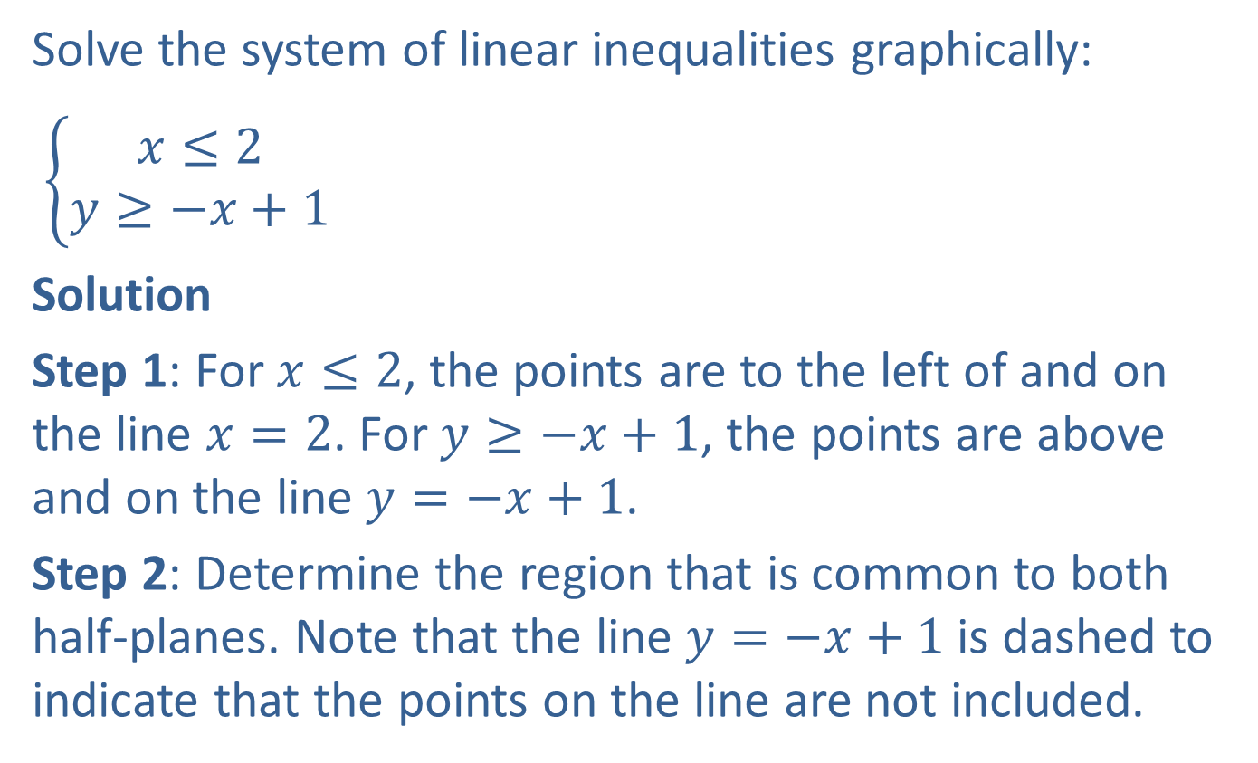
Example 4: Solving Systems of Linear Inequalities
Solve the system of linear inequalities graphically:
$\left\{\begin{aligned}x≤2 \\ y≥−x+1\end{aligned}\right.$
Solution
Step 1: For $x≤2$, the points are to the left of and on the line $x=2$. For $y≥−x+1$, the points are above and on the line $y=−x+1$.
Step 2: Determine the region that is common to both half-planes. Note that the line $y=−x+1$ is dashed to indicate that the points on the line are not included.

Slide 13
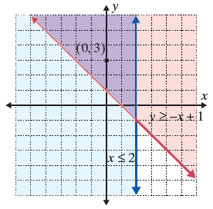
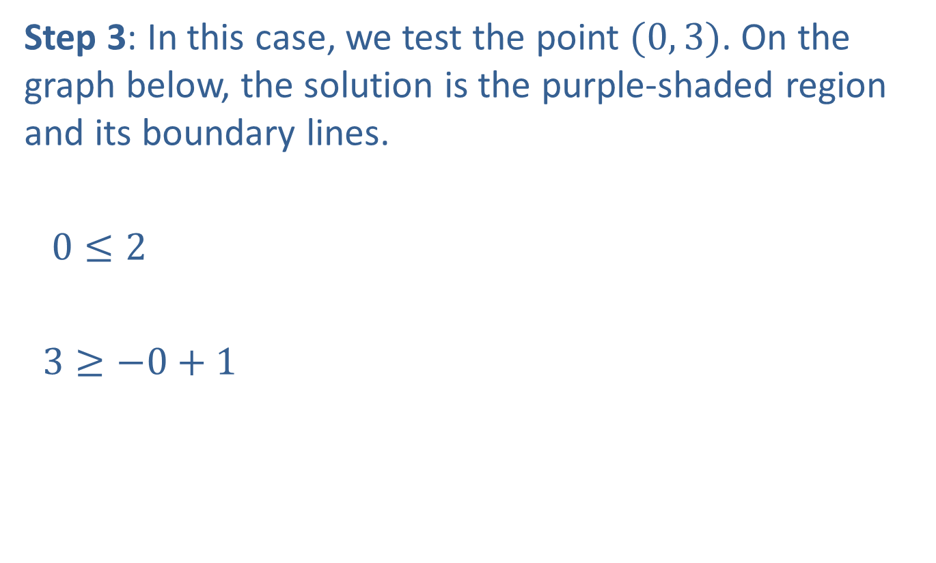
Example 4: Solving Systems of Linear Inequalities (cont.)
Step 3: In this case, we test the point $(0, 3)$. On the graph below, the solution is the purple-shaded region and its boundary lines.
$0≤2$
$3≥−0+1$
A true statement
A true statement

Slide 14
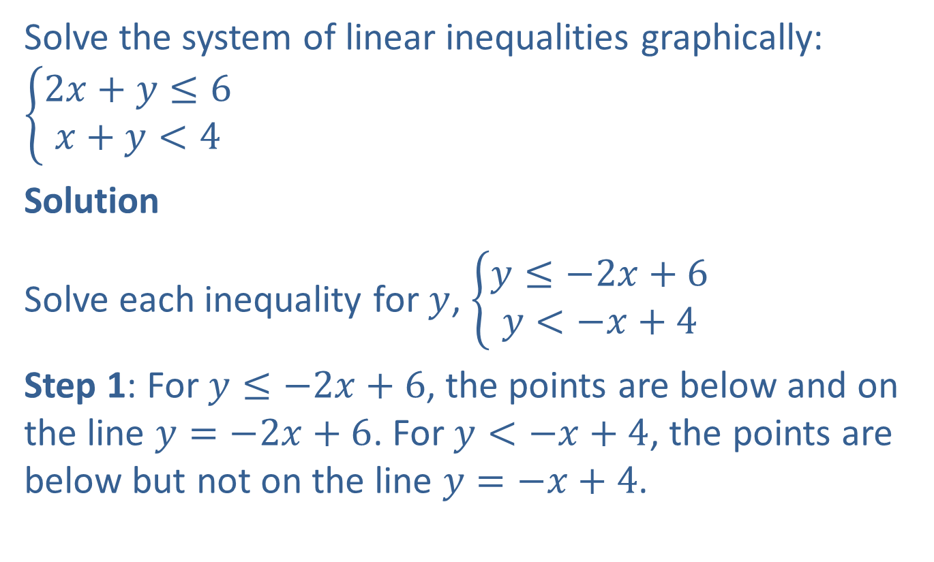
Example 5: Solving Systems of Linear Inequalities
Solve the system of linear inequalities graphically:
$$\left\{\begin{aligned}2x+y≤6 \\ x+y<4\end{aligned}\right.$$
Solution
Solve each inequality for $y$, $\left\{\begin{aligned}y≤−2x+6 \\ y<−x+4\end{aligned}\right.$
Step 1: For $y≤−2x+6$, the points are below and on the line $y=−2x+6$. For $y<−x+4$, the points are below but not on the line $y=−x+4$.

Slide 15
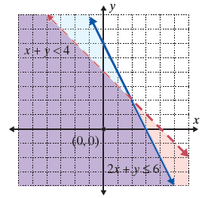
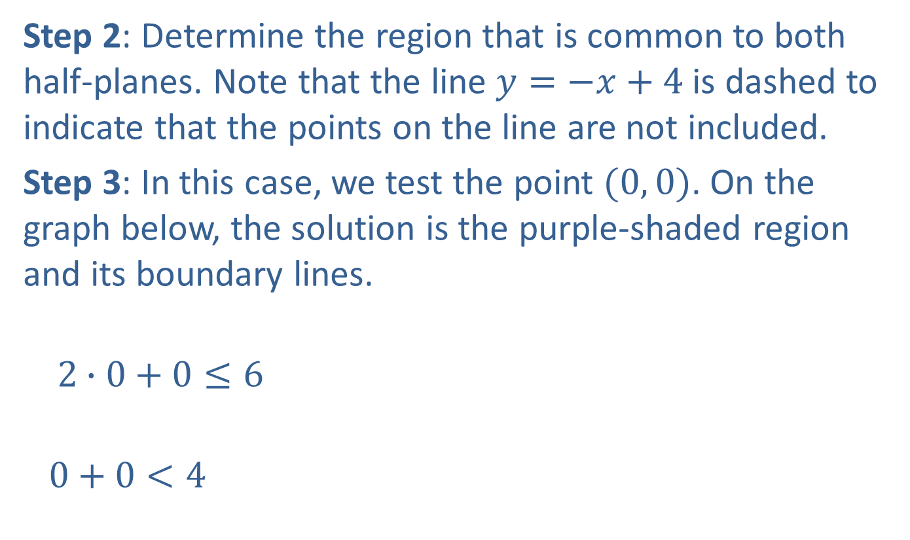
Example 5: Solving Systems of Linear Inequalities (cont.)
Step 2: Determine the region that is common to both half-planes. Note that the line $y=−x+4$ is dashed to indicate that the points on the line are not included.
Step 3: In this case, we test the point $(0, 0)$. On the graph below, the solution is the purple-shaded region and its boundary lines.
$$2∙0+0≤6$$
$$0+0<4$$
A true statement
A true statement

Slide 16
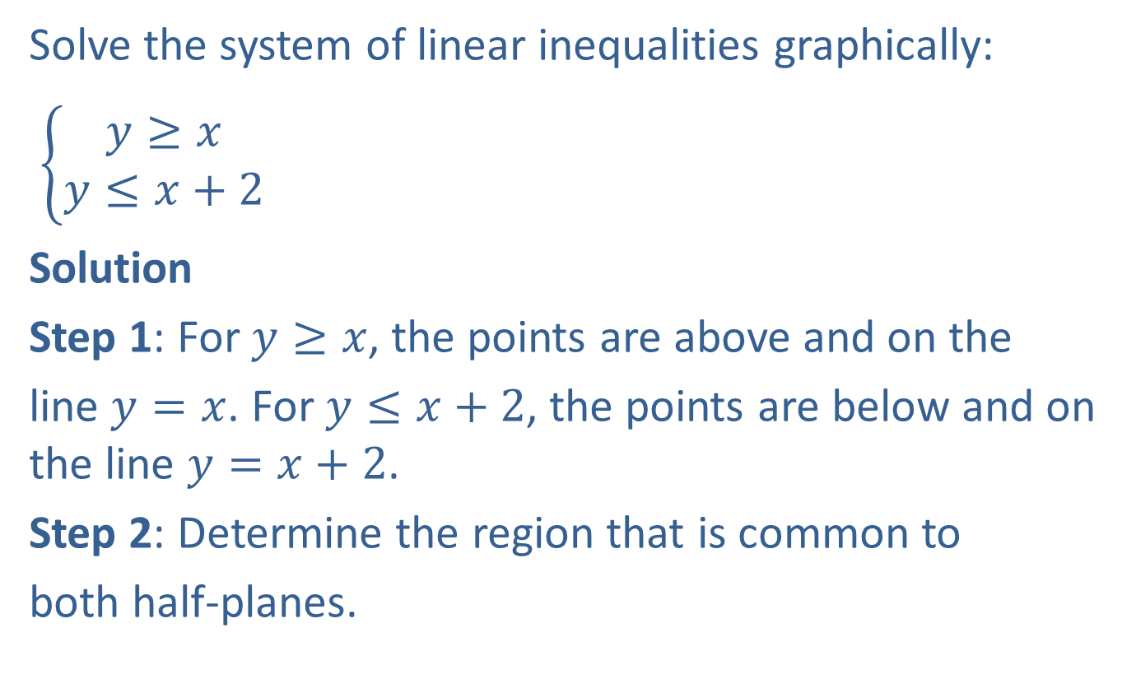
Example 6: Solving Systems of Linear Inequalities
Solve the system of linear inequalities graphically:
$\left\{\begin{aligned}y≥x \\ y≤x+2\end{aligned}\right.$
Solution
Step 1: For $y≥x$, the points are above and on the
line $y=x$. For $y≤x+2$, the points are below and on the line $y=x+2$.
Step 2: Determine the region that is common to
both half-planes.

Slide 17
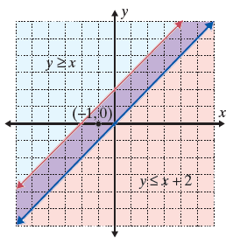

Example 6: Solving Systems of Linear Inequalities (cont.)
Step 3: We test the point ($−1, 0$). The solution set consists of the boundary lines and the region between them.

Slide 18
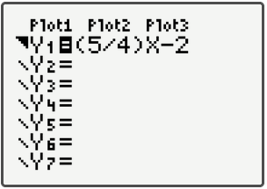
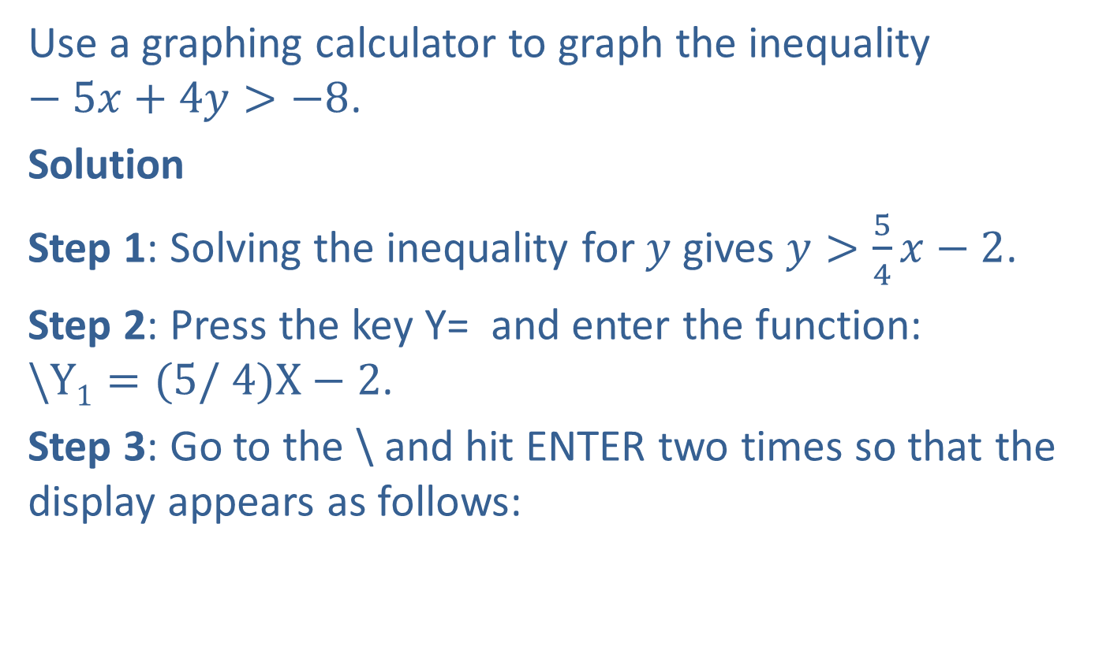
Example 7: Graphing Linear Inequalities Using a Calculator
Use a graphing calculator to graph the inequality $−5x+4y>−8$.
Solution
Step 1: Solving the inequality for $y$ gives $y>\frac{5}{4}x−2$.
Step 2: Press the key Y= and enter the function: $\backslash Y1=(5/ 4)X−2$.
Step 3: Go to the \ and hit ENTER two times so that the display appears as follows:

Slide 19
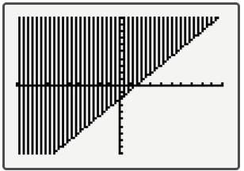
Example 7: Graphing Linear Inequalities Using a Calculator (cont.)
Step 4: Press GRAPH and (using the standard WINDOW settings) the following graph should appear on the display. (Note: The boundary line should actually be dotted.)

Slide 20
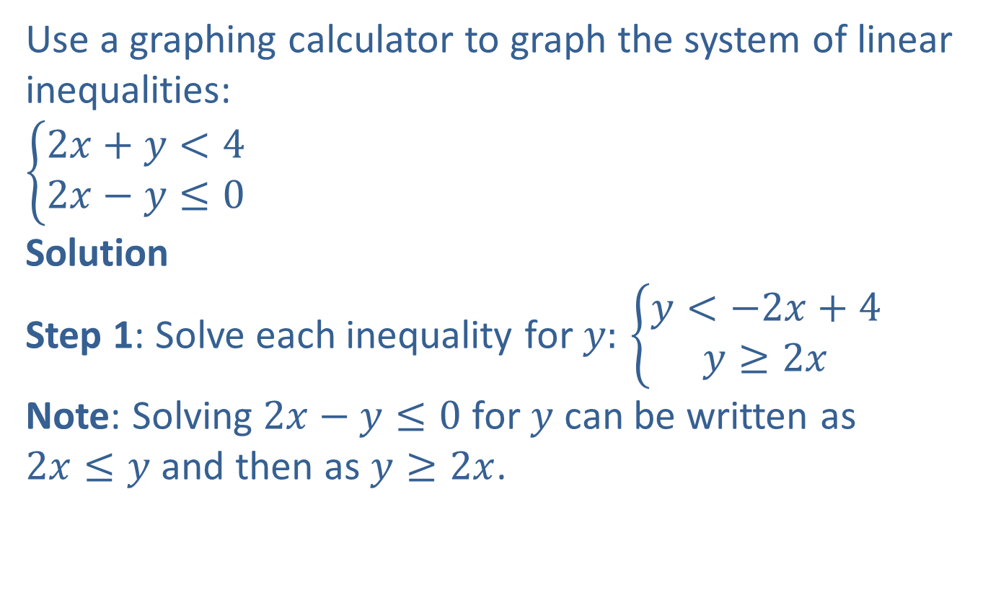
Example 8: Graphing Systems of Linear Inequalities
Use a graphing calculator to graph the system of linear inequalities:
$$\left\{\begin{aligned}2x+y<4 \\ 2x−y≤0\end{aligned}\right.$$
Solution
Step 1: Solve each inequality for $y:$ $\left\{\begin{aligned}y<−2x+4 \\ y≥2x\end{aligned}\right.$
Note: Solving $2x−y≤0$ for $y$ can be written as $2x≤y$ and then as $y≥2x$.

Slide 21
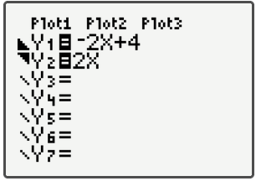
Example 8: Graphing Systems of Linear Inequalities (cont.)
Step 2 and 3: Press the Y= key and enter both functions and the corresponding symbols as they appear here.

Slide 22
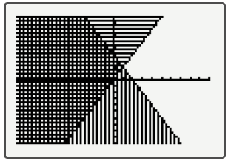
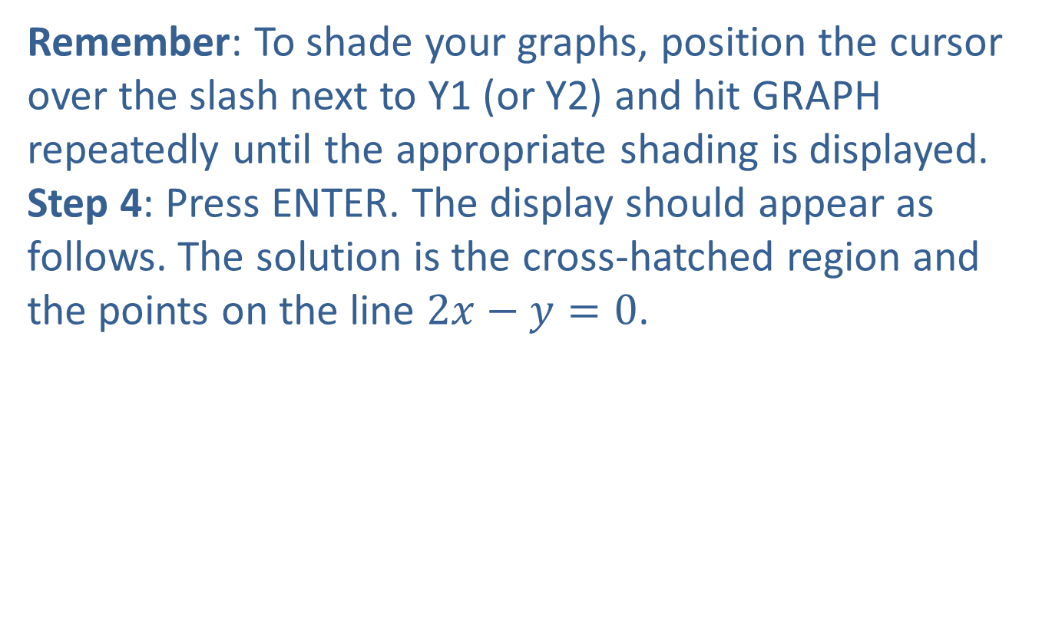
Example 8: Graphing Systems of Linear Inequalities (cont.)
Remember: To shade your graphs, position the cursor over the slash next to Y1 (or Y2) and hit GRAPH repeatedly until the appropriate shading is displayed.
Step 4: Press ENTER. The display should appear as follows. The solution is the cross-hatched region and the points on the line $2x−y=0$.

