Slide 1
Section 4.1
Exponents

Slide 2
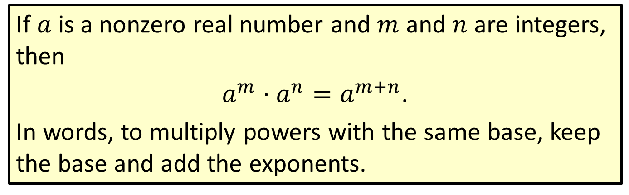
Definition: Product Rule for Exponents
If $a$ is a nonzero real number and $m$ and $n$ are integers, then
$a^{m}⋅a^{n}=a^{m+n}$.
In words, to multiply powers with the same base, keep the base and add the exponents.

Slide 3

Example 1: Using the Product Rule for Exponents
Use the product rule for exponents to simplify each expression.
​$3^{2}⋅3^{3}$
​$6^{2}⋅6$
​$\left(7y^{2}\right)\left(−3y^{5}\right)$
​$3x^{2}y^{3}⋅2x^{3}y^{5}$

Slide 4

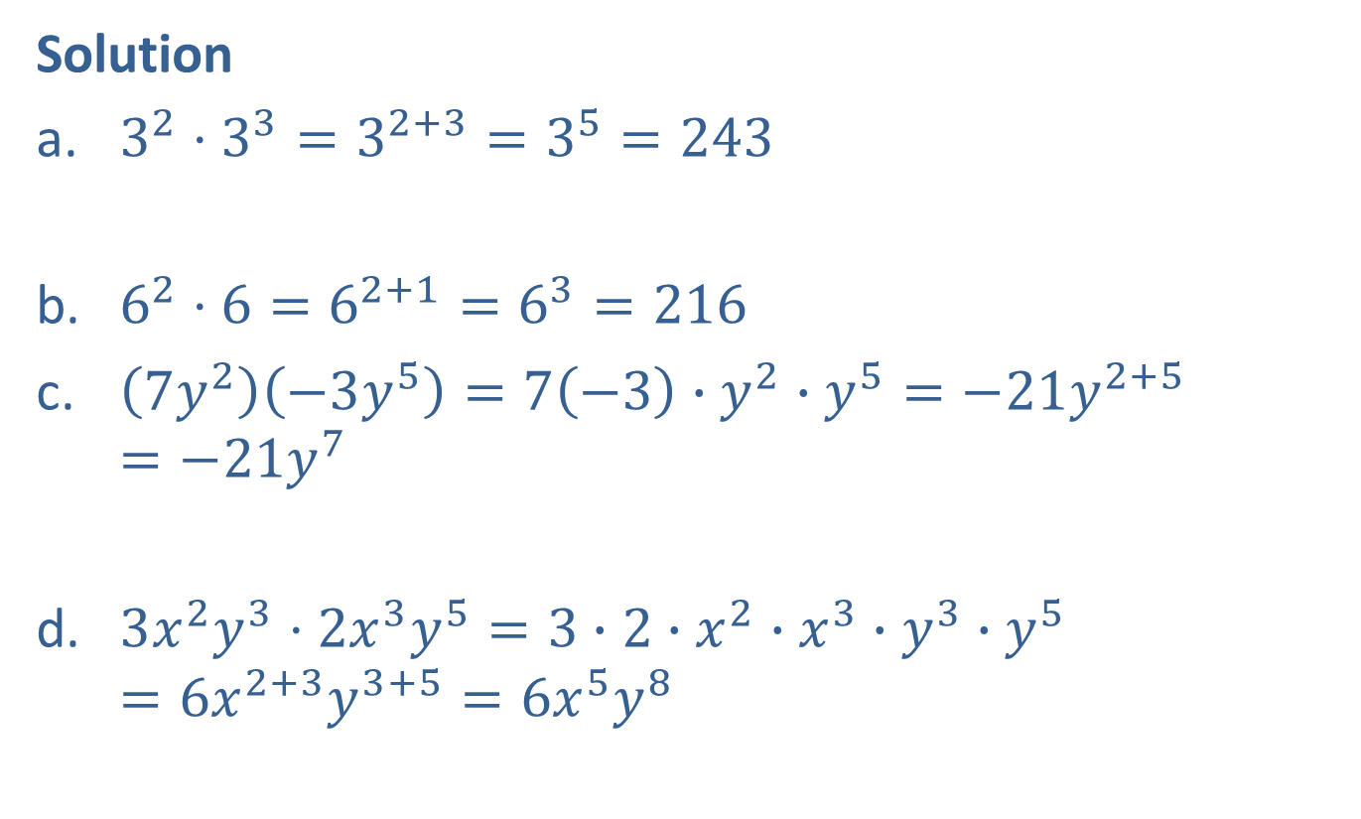
Example 1: Using the Product Rule for Exponents (cont.)
Solution
​$3^{2}⋅3^{3}=3^{2+3}=3^{5}=243$
​$6^{2}⋅6=6^{2+1}=6^{3}=216$
​$\left(7y^{2}\right)\left(−3y^{5}\right)=7\left(−3\right)∙y^{2}∙y^{5}=−21y^{2+5}=−21y^{7}$
​$3x^{2}y^{3}⋅2x^{3}y^{5}=3∙2∙x^{2}∙x^{3}∙y^{3}∙y^{5}=6x^{2+3}y^{3+5}=6x^{5}y^{8}$
Note that the bases are not multiplied. The base 3 stays the same.
Remember $6=61.$
In c. and d., the commutative and associative properties of multiplication have been used.

Slide 5
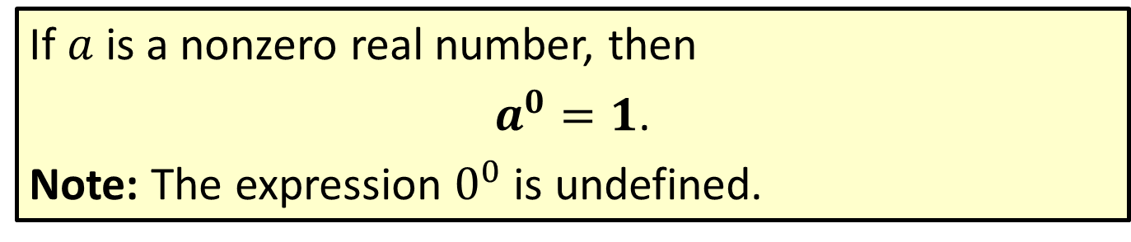

Definition: The Exponent $0$
If $a$ is a nonzero real number, then
$a^{0}=1$.
Note: The expression $0^{0}$ is undefined.

Slide 6
Note
Throughout this text, unless specifically stated otherwise, we will assume that the bases of exponents are nonzero.

Slide 7
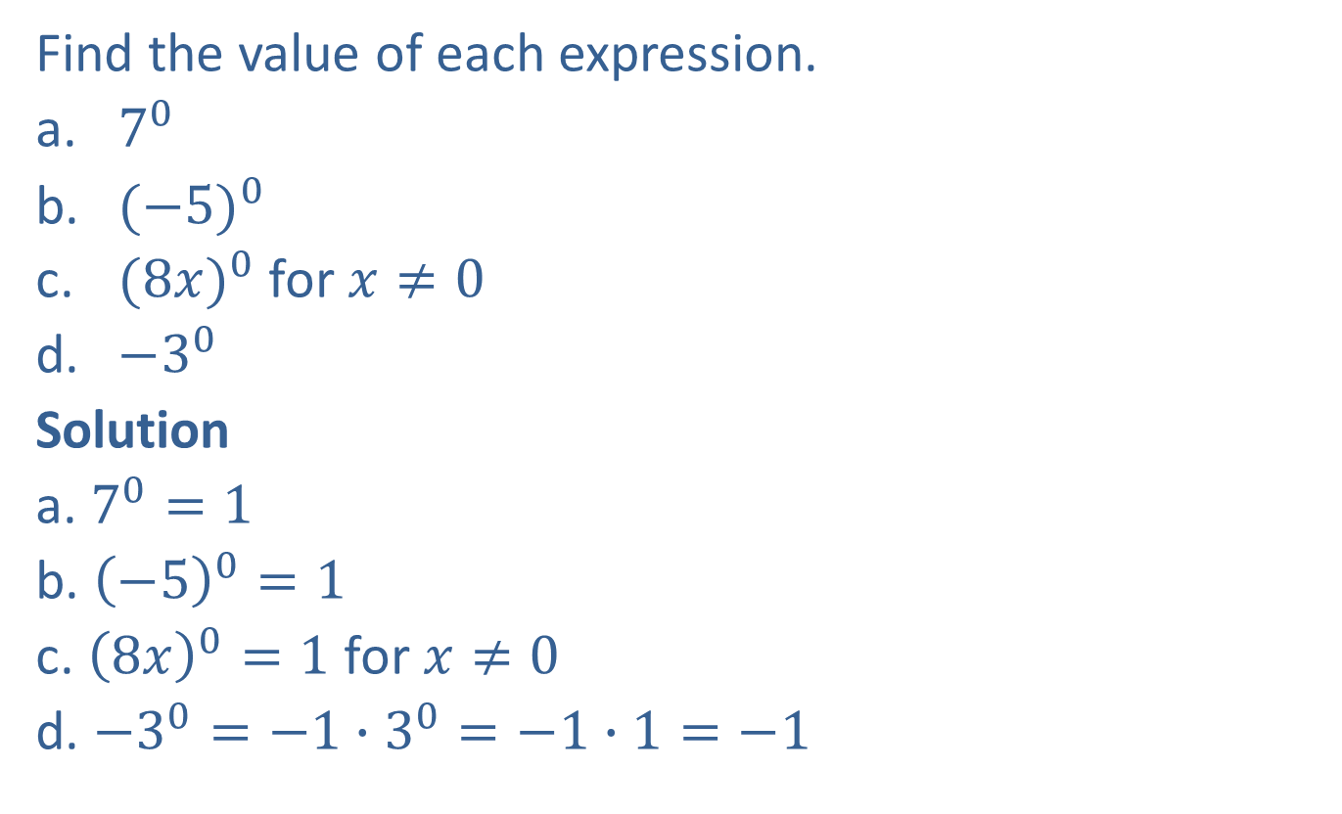
Example 2: Evaluating the Exponent 0
Find the value of each expression.
​$7^{0}$
​${(−5)}^{0}$
​${(8x)}^{0}$ for $x≠0$
​${−3}^{0}$
Solution
a. $7^{0}=1$
b. ${\left(−5\right)}^{0}=1$
c. ${\left(8x\right)}^{0}=1$ for $x≠0$
d. $−3^{0}=−1∙3^{0}=−1∙1=−1$

Slide 8
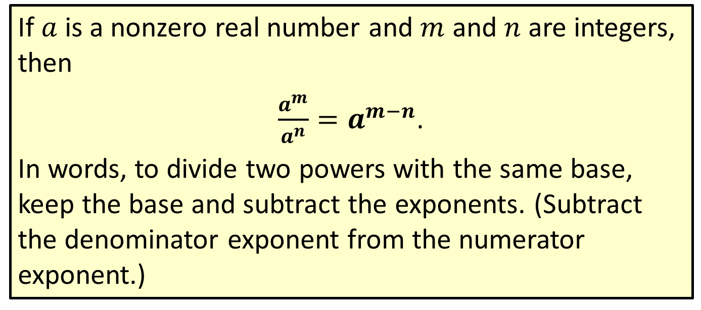
Definition: Quotient Rule for Exponents
If $a$ is a nonzero real number and $m$ and $n$ are integers, then
$\frac{a^{m}}{a^{n}}=a^{m−n}$.
In words, to divide two powers with the same base, keep the base and subtract the exponents. (Subtract the denominator exponent from the numerator exponent.)

Slide 9
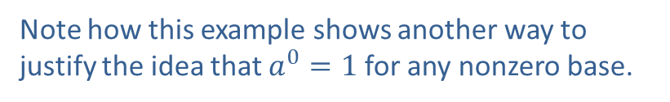
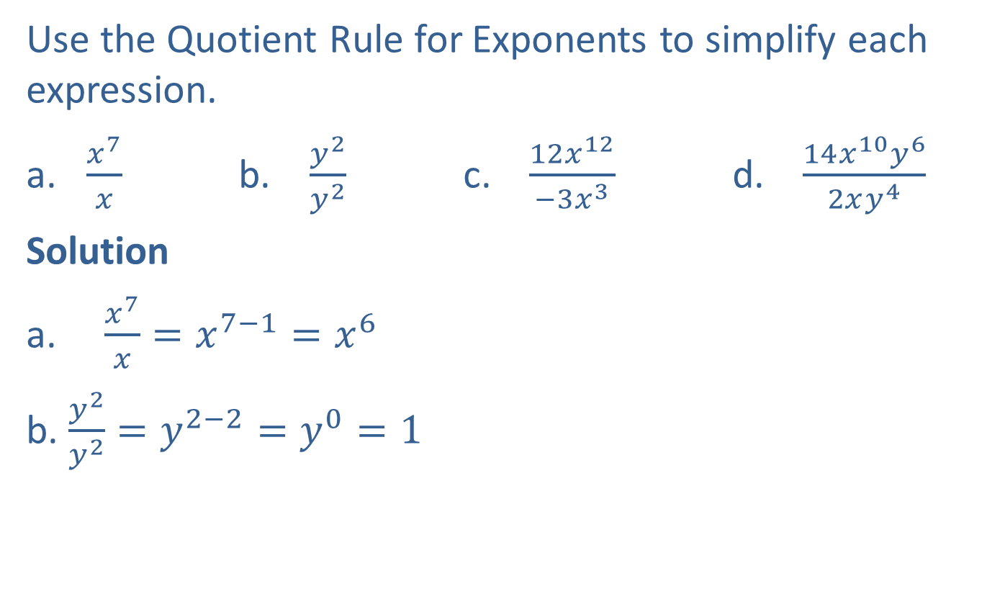
Example 3: Using the Quotient Rule for Exponents
Use the Quotient Rule for Exponents to simplify each expression.
​$\frac{x^{7}}{x}$ b. ​$\frac{y^{2}}{y^{2}}$ c. $\frac{12x^{12}}{−3x^{3}}$ d. $\frac{14x^{10}y^{6}}{2xy^{4}}$
Solution
a. $\frac{x^{7}}{x}=x^{7−1}=x^{6}$
b. $\frac{y^{2}}{y^{2}}=y^{2−2}=y^{0}=1$
Note how this example shows another way to justify the idea that $a^{0}=1$ for any nonzero base.

Slide 10

Example 3: Using the Quotient Rule for Exponents (cont.)
c. $\frac{12x^{12}}{−3x^{3}}=\frac{12}{−3}∙x^{12−3}=−4x^{9}$
d. $\frac{14x^{10}y^{6}}{2xy^{4}}=\frac{14}{2}∙x^{10−1}∙y^{6−4}=7x^{9}y^{2}$
Note that the coefficients are divided and the exponents are subtracted.

Slide 11
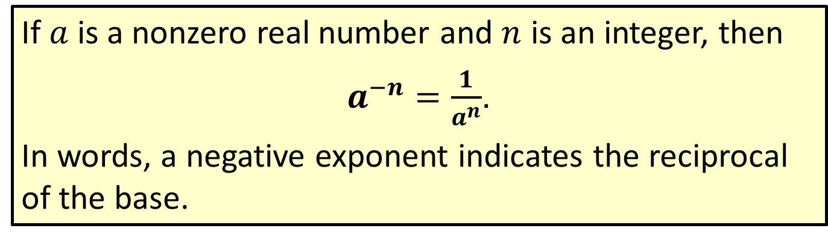
Definition: Rule for Negative Exponents
If $a$ is a nonzero real number and $n$ is an integer, then
$a^{−n}=\frac{1}{a^{n}}$.
In words, a negative exponent indicates the reciprocal of the base.

Slide 12
Note
There is nothing wrong with negative exponents. In fact, negative exponents are preferred in some courses in mathematics and science. However, so that all answers are the same, in this course we will consider expressions to be simplified if
1. all exponents are positive and
2. each base appears only once

Slide 13
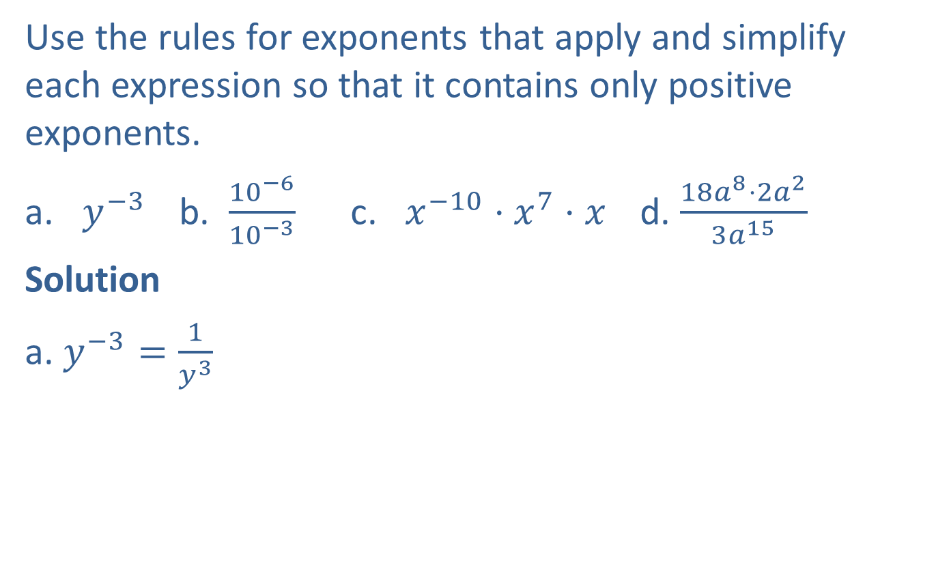
Example 4: Simplifying Expressions with Negative Exponents
Use the rules for exponents that apply and simplify each expression so that it contains only positive exponents.
​$y^{−3}$ b. ​$\frac{{10}^{−6}}{{10}^{−3}}$ c. ​$x^{−10}⋅x^{7}⋅x$ d. ​$\frac{18a^{8}⋅2a^{2}}{3a^{15}}$
Solution
a. $y^{−3}=\frac{1}{y^{3}}$
Use the rule for negative exponents.

Slide 14

Example 4: Simplifying Expressions with Negative Exponents (cont.)
b. $\frac{{10}^{−6}}{{10}^{−3}}={10}^{−6−(−3)}$
$$={10}^{−6+3}$$
$$={10}^{−3}$$
$$=\frac{1}{{10}^{3}} or \frac{1}{1000}$$
c. $x^{−10}∙x^{7}∙x=x^{−10+7+1}=x^{−2}=\frac{1}{x^{2}}$
Use the quotient rule.
Simplify.
Use the rule for negative exponents.
Use the product rule and the rule for negative exponents.

Slide 15

Example 4: Simplifying Expressions with Negative Exponents (cont.)
d. $\frac{{18a^{8}∙2a^{2}}^{ }}{{3a}^{15}}={\frac{36a^{8+2}}{3a^{15}}}^{ }$
$$={12a^{10−15}}^{ }$$
$$={12a^{−5}}^{ }$$
$$=\frac{12}{a^{5}}$$
Use the product rule.
Use the quotient rule.
Use the rule for negative exponents.

Slide 16
Note
Special Note about Using the Quotient Rule
Regardless of the size of the exponents or whether they are positive or negative, the following single subtraction policy can be used with the Quotient Rule.
(numerator exponent) − (denominator exponent)
This subtraction will always lead to the correct answer.

Slide 17
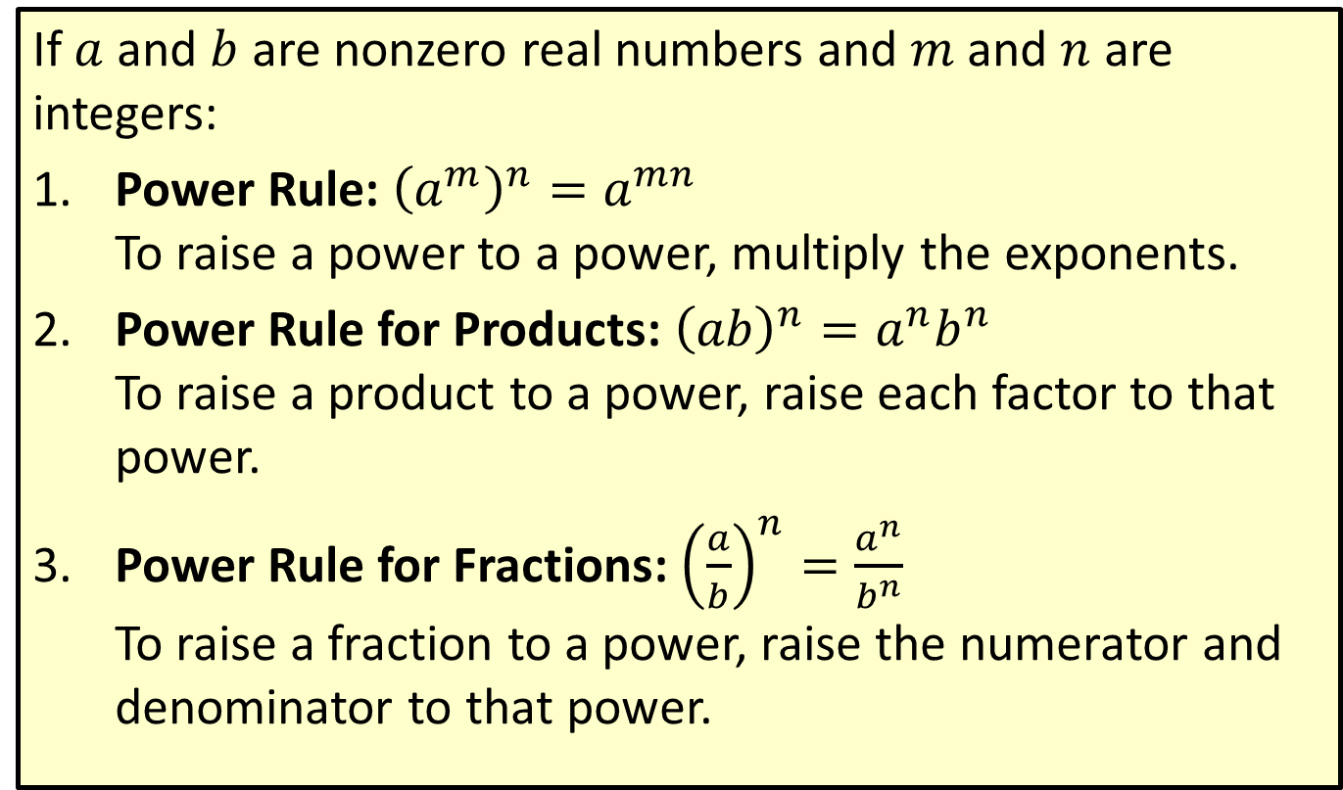
Definition: Power Rules for Exponents
If $a$ and $b$ are nonzero real numbers and $m$ and $n$ are integers:
​Power Rule: ${\left(a^{m}\right)}^{n}=a^{mn}$​ To raise a power to a power, multiply the exponents.
​Power Rule for Products: ${\left(ab\right)}^{n}=a^{n}b^{n}$​ To raise a product to a power, raise each factor to that power.
​Power Rule for Fractions: ${\left(\frac{a}{b}\right)}^{n}=\frac{a^{n}}{b^{n}}$ To raise a fraction to a power, raise the numerator and denominator to that power.

Slide 18
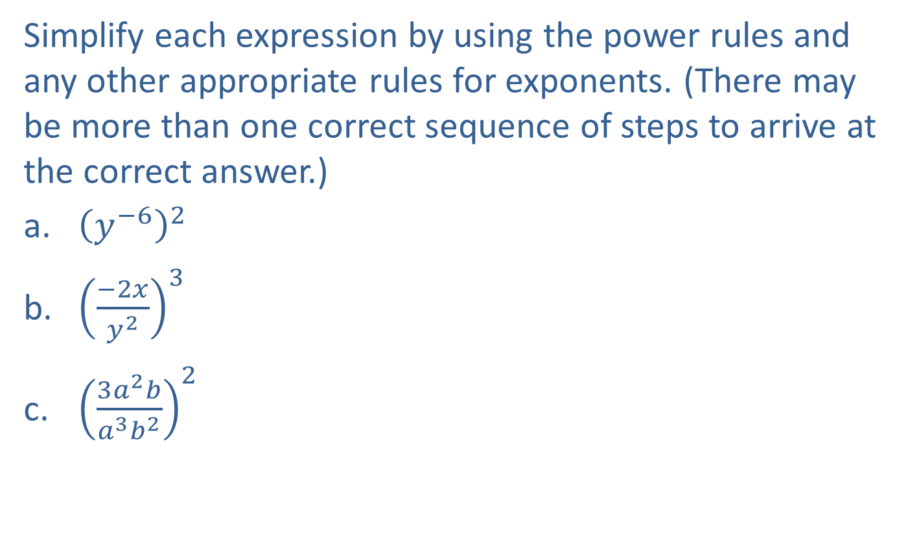
Example 5: Using Combinations of the Rules for Exponents
Simplify each expression by using the power rules and any other appropriate rules for exponents. (There may be more than one correct sequence of steps to arrive at the correct answer.)
​${\left(y^{−6}\right)}^{2}$
​${\left(\frac{−2x}{y^{2}}\right)}^{3}$
​${\left(\frac{3a^{2}b}{a^{3}b^{2}}\right)}^{2}$

Slide 19
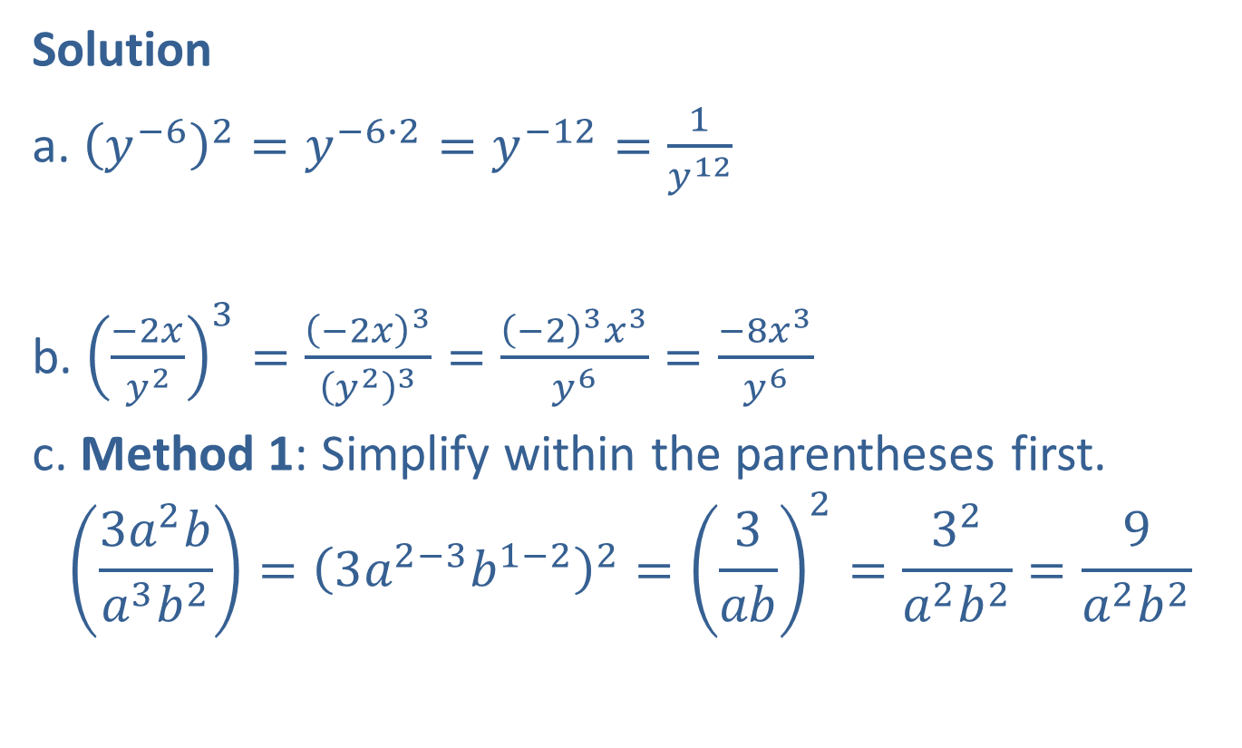
Example 5: Using Combinations of the Rules for Exponents (cont.)
Solution
a. ${\left(y^{−6}\right)}^{2}=y^{−6∙2}=y^{−12}=\frac{1}{y^{12}}$
b. ${\left(\frac{−2x}{y^{2}}\right)}^{3}=\frac{{\left(−2x\right)}^{3}}{{\left(y^{2}\right)}^{3}}=\frac{{\left(−2\right)}^{3}x^{3}}{y^{6}}=\frac{−8x^{3}}{y^{6}}$
c. Method 1: Simplify within the parentheses first.
$$\left(\frac{3a^{2}b}{a^{3}b^{2}}\right)={\left(3a^{2−3}b^{1−2}\right)}^{2}={\left(\frac{3}{ab}\right)}^{2}=\frac{3^{2}}{a^{2}b^{2}}=\frac{9}{a^{2}b^{2}}$$
Use the power rule and the rule for negative exponents.

Slide 20
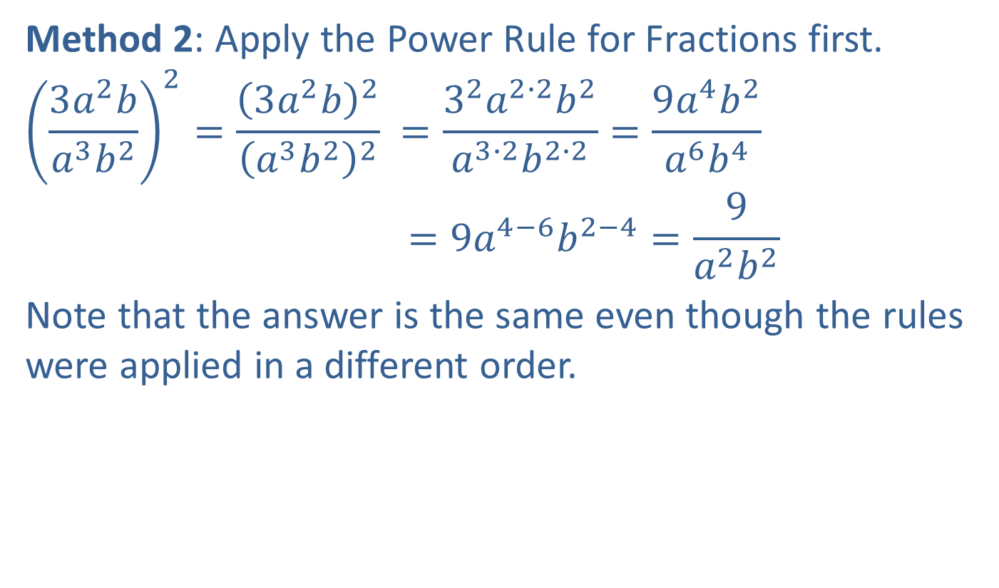
Example 5: Using Combinations of the Rules for Exponents (cont.)
Method 2: Apply the Power Rule for Fractions first.
$${\left(\frac{3a^{2}b}{a^{3}b^{2}}\right)}^{2}={\frac{{\left(3a^{2}b\right)}^{2}}{{\left(a^{3}b^{2}\right)}^{2}}}^{ }=\frac{3^{2}a^{2∙2}b^{2}}{a^{3∙2}b^{2∙2}}=\frac{9a^{4}b^{2}}{a^{6}b^{4}}$$
$$=9a^{4−6}b^{2−4}=\frac{9}{a^{2}b^{2}}$$
Note that the answer is the same even though the rules were applied in a different order.

Slide 21
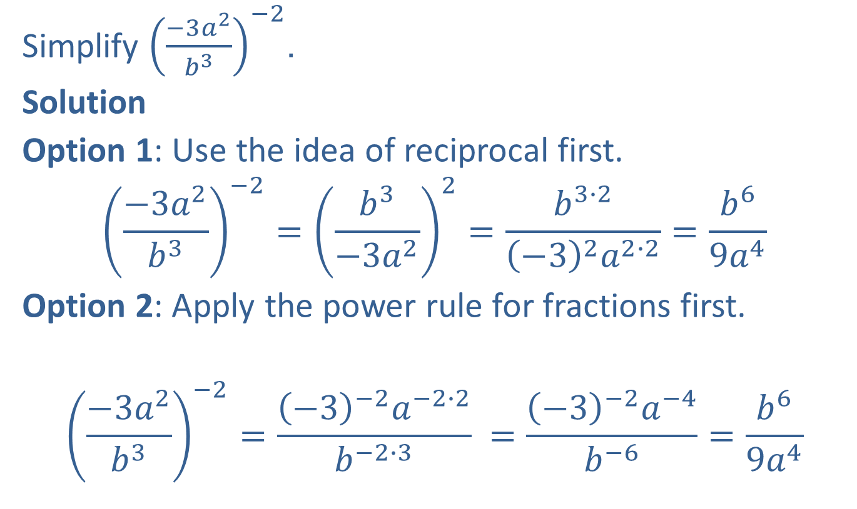
Example 6: Using Two Approaches with Fractional Expressions and Negative Exponents
Simplify ${\left(\frac{−3a^{2}}{b^{3}}\right)}^{−2}$.
Solution
Option 1: Use the idea of reciprocal first.
$${\left(\frac{−3a^{2}}{b^{3}}\right)}^{−2}={\left(\frac{b^{3}}{−3a^{2}}\right)}^{2}=\frac{b^{3∙2}}{{\left(−3\right)}^{2}a^{2∙2}}=\frac{b^{6}}{9a^{4}}$$
Option 2: Apply the power rule for fractions first.
$${\left(\frac{−3a^{2}}{b^{3}}\right)}^{−2}={\frac{{\left(−3\right)}^{−2}a^{−2∙2}}{b^{−2∙3}}}^{ }=\frac{{\left(−3\right)}^{−2}a^{−4}}{b^{−6}}=\frac{b^{6}}{9a^{4}}$$

Slide 22
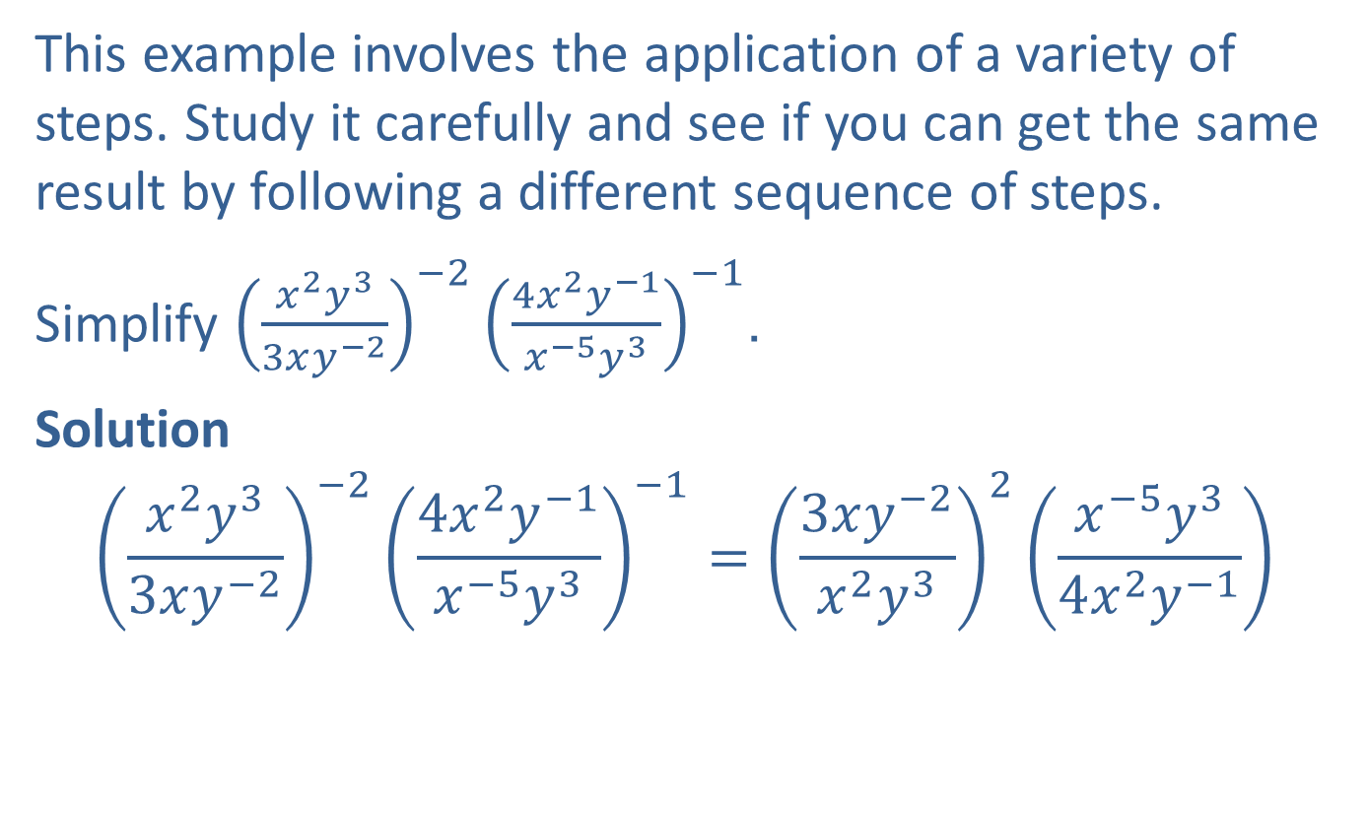
Example 7: Simplifying a More Complex Example
This example involves the application of a variety of steps. Study it carefully and see if you can get the same result by following a different sequence of steps.
Simplify ${\left(\frac{x^{2}y^{3}}{3xy^{−2}}\right)}^{−2}{\left(\frac{4x^{2}y^{−1}}{x^{−5}y^{3}}\right)}^{−1}$.
Solution
$${\left(\frac{x^{2}y^{3}}{3xy^{−2}}\right)}^{−2}{\left(\frac{4x^{2}y^{−1}}{x^{−5}y^{3}}\right)}^{−1}={\left(\frac{3xy^{−2}}{x^{2}y^{3}}\right)}^{2}\left(\frac{x^{−5}y^{3}}{4x^{2}y^{−1}}\right)$$
Use the rule for
negative exponents.

Slide 23

Example 7: Simplifying a More Complex Example (cont.)
$$={{\left(3x^{1−2}y^{−2−3}\right)}^{2}\left(\frac{x^{−5−2}y^{3−(−1)}}{4}\right)}^{ }$$
$$={\left(3x^{−1}y^{−5}\right)}^{2}\left(\frac{x^{−7}y^{4}}{4}\right)$$
$$=\left(3^{2}x^{−1∙2}y^{−5∙2}\right)\left(\frac{x^{−7}y^{4}}{4}\right)$$
$$=3^{2}x^{−2}y^{−10}∙\frac{x^{−7}y^{4}}{4}$$
Use the quotient rule.
Use the power rule and the
power rule for products.

Slide 24

Example 7: Simplifying a More Complex Example (cont.)
$$=\frac{9x^{−2+(−7)}y^{−10+4}}{4}$$
$$=\frac{9x^{−9}y^{−6}}{4}=\frac{9}{4x^{9}y^{6}}$$
Use the product rule.
Use the rule for negative
exponents.

Slide 25
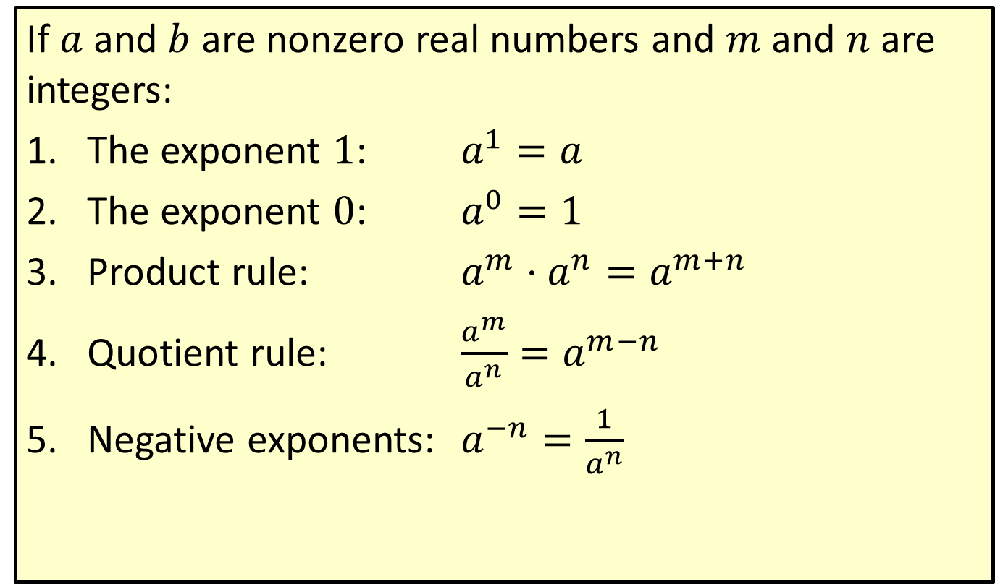
Definition: Summary of Properties and Rules for Exponents
If $a$ and $b$ are nonzero real numbers and $m$ and $n$ are integers:
​The exponent 1: $a^{1}=a$
​The exponent 0: $a^{0}=1$
​Product rule: $a^{m}⋅a^{n}=a^{m+n}$
​Quotient rule: $\frac{a^{m}}{a^{n}}=a^{m−n}$
​Negative exponents: $a^{−n}=\frac{1}{a^{n}}$

Slide 26
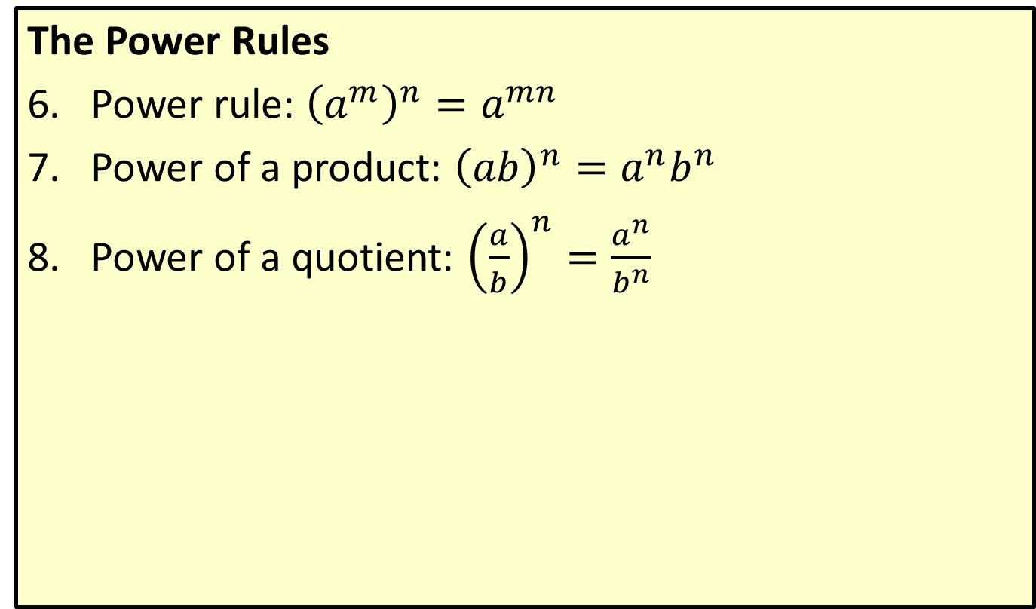
Definition: Summary of Properties and Rules for Exponents (cont.)
The Power Rules
​Power rule: ${\left(a^{m}\right)}^{n}=a^{mn}$
​Power of a product: ${\left(ab\right)}^{n}=a^{n}b^{n}$
​Power of a quotient: ${\left(\frac{a}{b}\right)}^{n}=\frac{a^{n}}{b^{n}}$

