Slide 1
Section 4.2
Scientific Notation

Slide 2
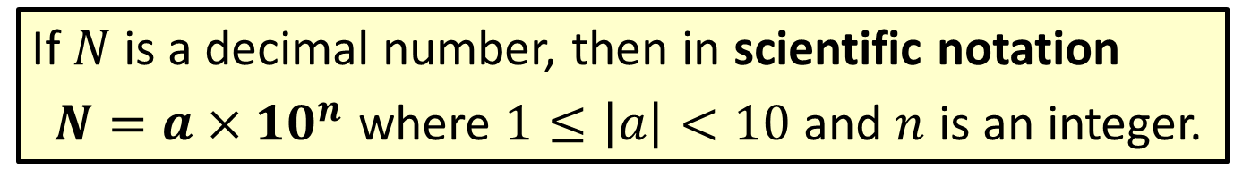
Definition: Scientific Notation
If $N$ is a decimal number, then in scientific notation
$N=a×{10}^{n}$ where $1≤\left|a\right|<10$ and $n$ is an integer.

Slide 3

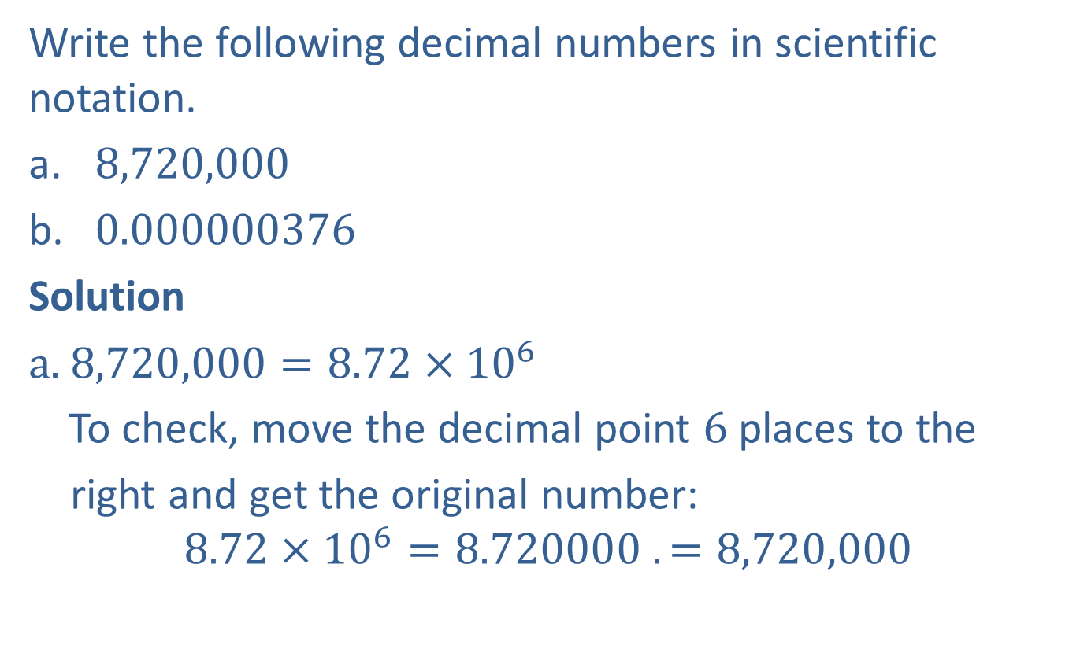

Example 1: Writing Decimals in Scientific Notation
Write the following decimal numbers in scientific notation.
​8,720,000
​0.000000376
Solution
a. $8,720,000=8.72×{10}^{6}$
To check, move the decimal point $6$ places to the
right and get the original number:
$$8.72×{10}^{6}=8.720000 .=8,720,000$$
$8.72$ is between $1$ and $10$.

Slide 4



Example 1: Writing Decimals in Scientific Notation (cont.)
b. $0.000000376=3.76×{10}^{−7}$
To check, move the decimal point $7$ places to the
left and get the original number:
$$3.76×{10}^{−7}=0.0000003. 76=0.000000376$$
$3.76$ is between $1$ and $10$.

Slide 5
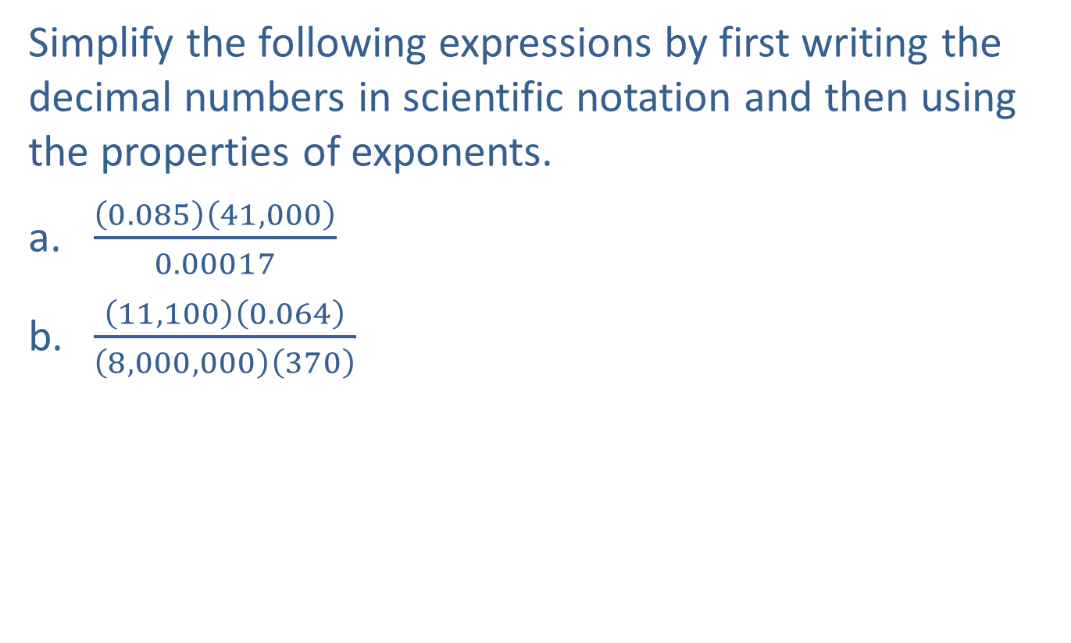
Example 2: Using Scientific Notation while Simplifying
Simplify the following expressions by first writing the decimal numbers in scientific notation and then using the properties of exponents.
​$\frac{\left(0.085\right)\left(41,000\right)}{0.00017}$
​$\frac{\left(11,100\right)\left(0.064\right)}{\left(8,000,000\right)\left(370\right)}$

Slide 6
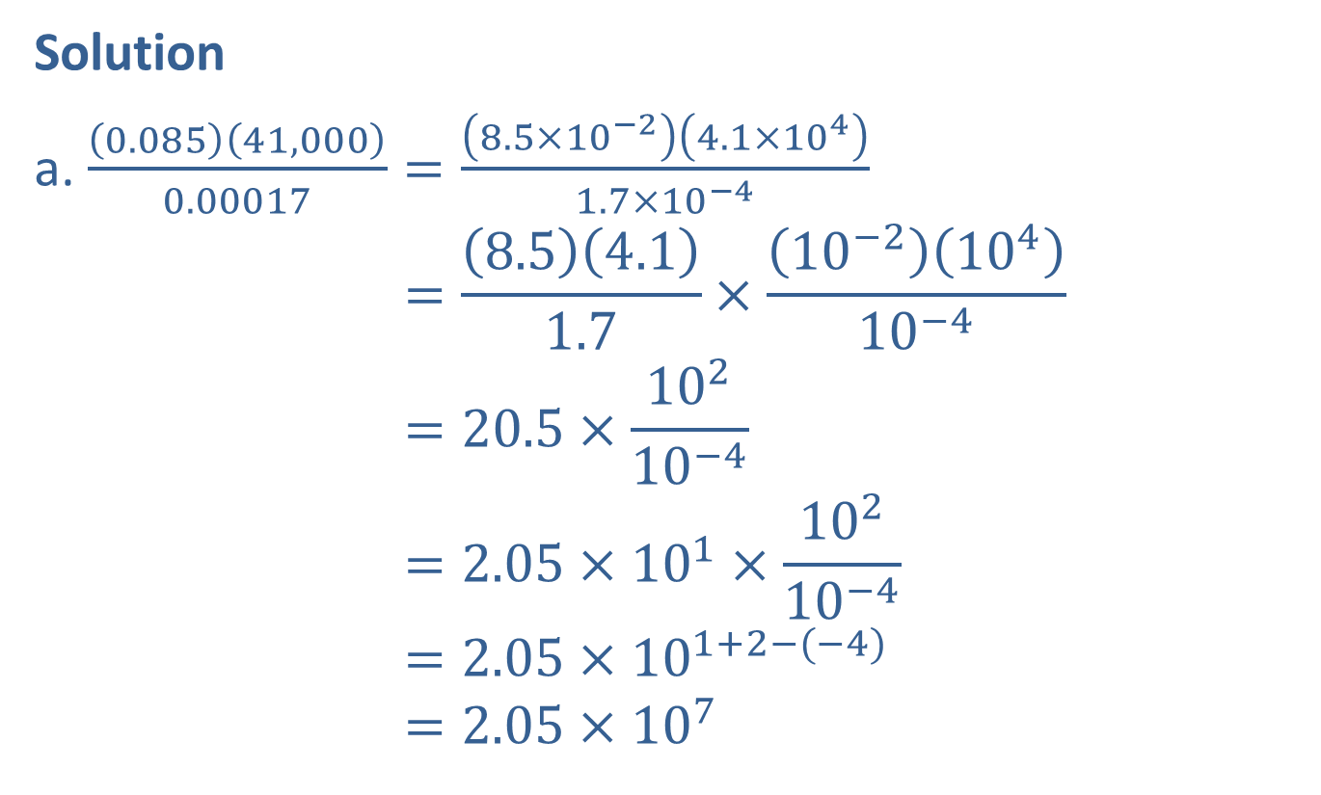
Example 2: Using Scientific Notation while Simplifying (cont.)
Solution
a. $\frac{\left(0.085\right)\left(41,000\right)}{0.00017}=\frac{\left(8.5×{10}^{−2}\right)\left(4.1×{10}^{4}\right)}{1.7×{10}^{−4}}$
$$=\frac{\left(8.5\right)\left(4.1\right)}{1.7}×\frac{\left({10}^{−2}\right)\left({10}^{4}\right)}{{10}^{−4}}$$
$$=20.5×\frac{{10}^{2}}{{10}^{−4}}$$
$$=2.05×{10}^{1}×\frac{{10}^{2}}{{10}^{−4}}$$
$$=2.05×{10}^{1+2−(−4)}$$
$$=2.05×{10}^{7}$$
Write each number in scientific notation.
5
Reduce and simplify by using the appropriate rules for exponents.

Slide 7
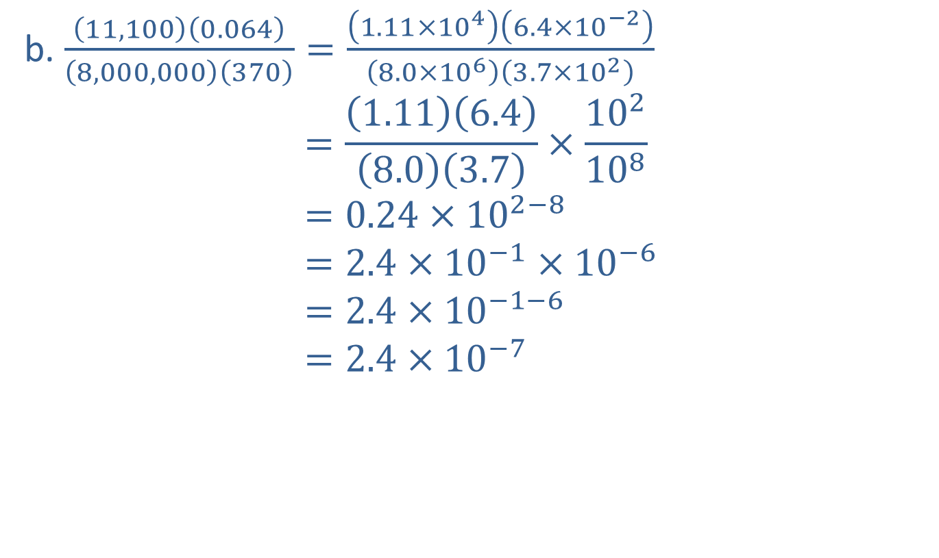
Example 2: Using Scientific Notation while Simplifying (cont.)
b. $\frac{\left(11,100\right)\left(0.064\right)}{\left(8,000,000\right)\left(370\right)}=\frac{\left(1.11×{10}^{4}\right)\left(6.4×{10}^{−2}\right)}{\left(8.0×{10}^{6}\right)\left(3.7×{10}^{2}\right)}$
$$=\frac{\left(1.11\right)\left(6.4\right)}{\left(8.0\right)\left(3.7\right)}×\frac{{10}^{2}}{{10}^{8}}$$
$$=0.24×{10}^{2−8}$$
$$=2.4×{10}^{−1}×{10}^{−6}$$
$$=2.4×{10}^{−1−6}$$
$$=2.4×{10}^{−7}$$
Write each number in scientific notation.
0.3
0.8
Reduce and simplify by using the appropriate rules for exponents.

Slide 8
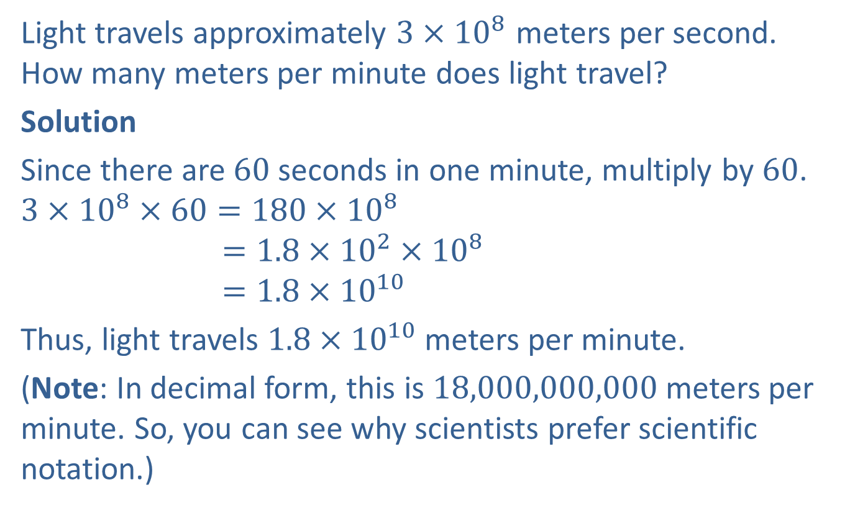
Example 3: Application: Scientific Notation
Light travels approximately $3×{10}^{8}$ meters per second. How many meters per minute does light travel?
Solution
Since there are $60$ seconds in one minute, multiply by $60$.
$$3×{10}^{8}×60=180×{10}^{8}$$
$$=1.8×{10}^{2}×{10}^{8}$$
$$=1.8×{10}^{10}$$
Thus, light travels $1.8×{10}^{10}$ meters per minute.
(Note: In decimal form, this is $18,000,000,000$ meters per minute. So, you can see why scientists prefer scientific notation.)

Slide 9
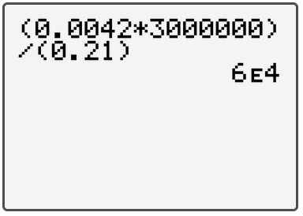
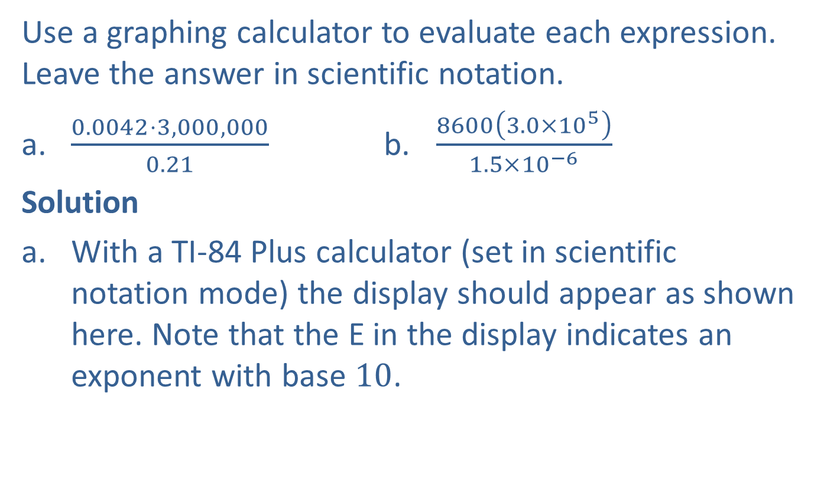
Example 4: Scientific Notation and Calculators
Use a graphing calculator to evaluate each expression. Leave the answer in scientific notation.
​$\frac{0.0042⋅3,000,000}{0.21}$ b. $\frac{8600\left(3.0×{10}^{5}\right)}{1.5×{10}^{−6}}$
Solution
With a TI-84 Plus calculator (set in scientific notation mode) the display should appear as shown here. Note that the E in the display indicates an exponent with base $10$.

Slide 10
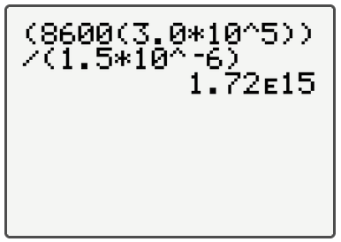

Example 4: Scientific Notation and Calculators (cont.)
With a graphing calculator (set in scientific notation mode) the display should appear as shown here. Note: Remember, the caret key $^$ is used to indicate an exponent and that the numerator and denominator must be set in parentheses.

Slide 11
Note
You can press the key and select SCI on the first line to have all decimal calculations in scientific notation.
MODE

Slide 12
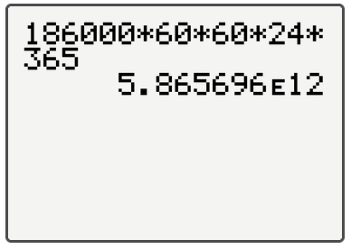
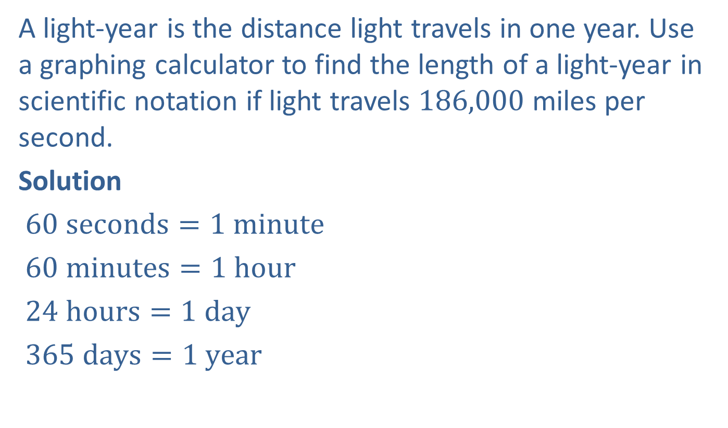
Example 5: Application: Scientific Notation and Calculators (cont.)
A light-year is the distance light travels in one year. Use a graphing calculator to find the length of a light-year in scientific notation if light travels 186,000 miles per second.
Solution
$60 seconds=1 minute$
$60 minutes=1 hour$
$24 hours=1 day$
$365 days=1 year$
Multiplication gives the following display on your calculator.

Slide 13

Example 5: Application: Scientific Notation and Calculators
Thus, a light-year is $5.865696×{10}^{12}$, or $5,865,696,000,000$ miles ($5$ trillion, $865$ billion, $696$ million miles).

