Slide 1
Section 4.3
Modeling with Exponential Functions

Slide 2
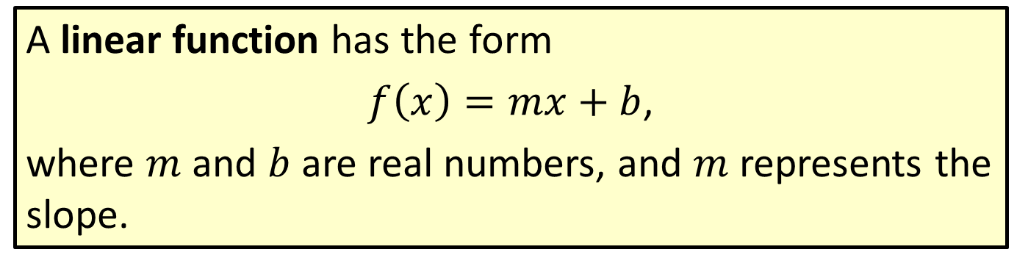
Definition: Linear Functions
A linear function has the form
$f\left(x\right)=mx+b$,
where $m$ and $b$ are real numbers, and $m$ represents the slope.

Slide 3
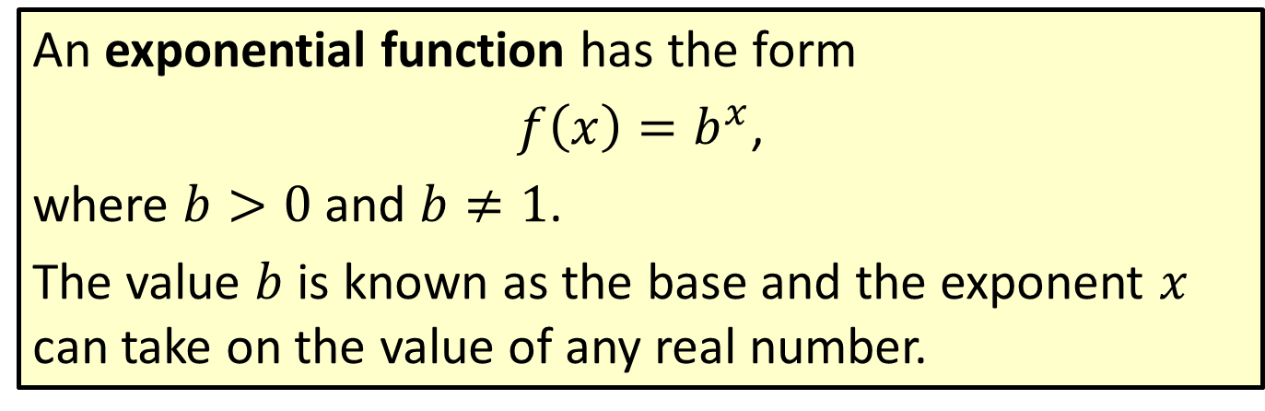
Definition: Exponential Functions
An exponential function has the form
$f\left(x\right)=b^{x}$,
where $b>0$ and $b≠1$.
The value $b$ is known as the base and the exponent $x$ can take on the value of any real number.

Slide 4
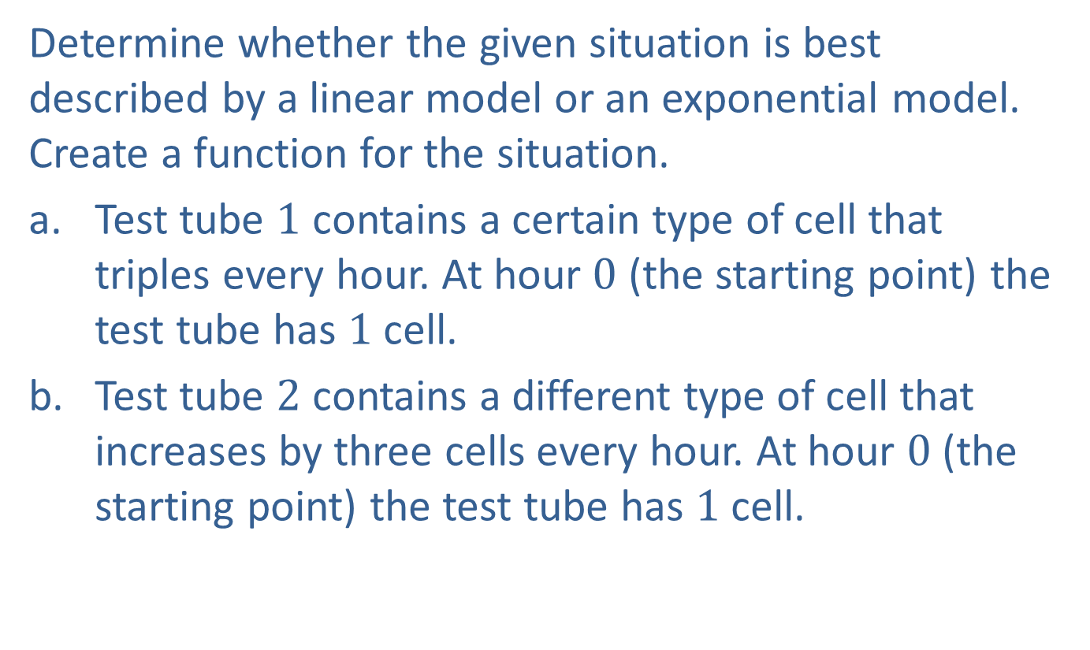
Example 1: Application: Linear Models versus Exponential Models
Determine whether the given situation is best described by a linear model or an exponential model. Create a function for the situation.
​Test tube $1$ contains a certain type of cell that triples every hour. At hour $0$ (the starting point) the test tube has $1$ cell.
​Test tube $2$ contains a different type of cell that increases by three cells every hour. At hour $0$ (the starting point) the test tube has $1$ cell.

Slide 5
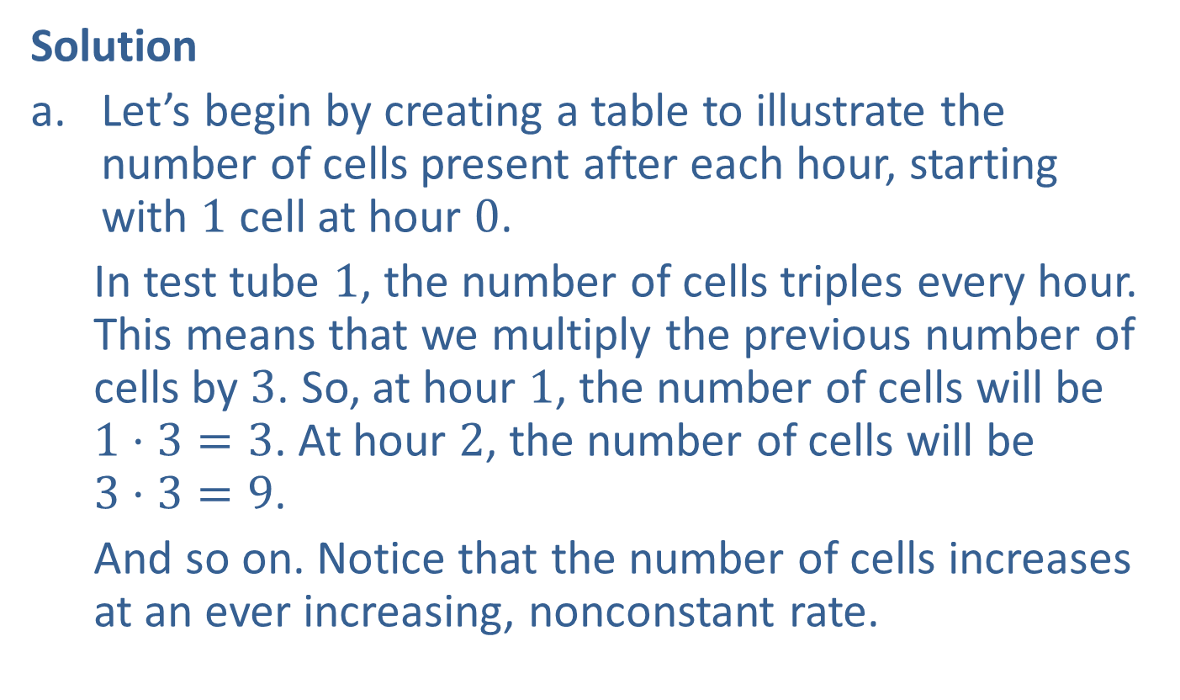
Example 1: Application: Linear Models versus Exponential Models (cont.)
Solution
​Let’s begin by creating a table to illustrate the number of cells present after each hour, starting with $1$ cell at hour $0$.
​In test tube $1$, the number of cells triples every hour. This means that we multiply the previous number of cells by $3$. So, at hour $1$, the number of cells will be $1⋅3=3$. At hour $2$, the number of cells will be $3⋅3=9$.
And so on. Notice that the number of cells increases at an ever increasing, nonconstant rate.

Slide 6
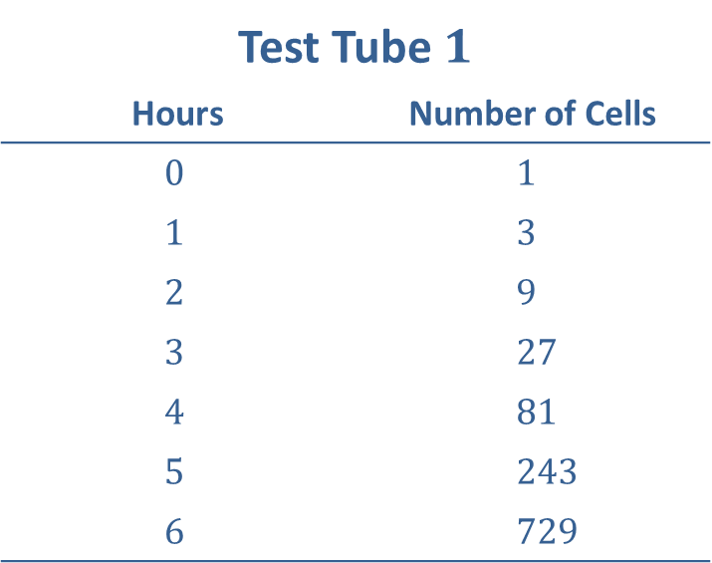
Example 1: Application: Linear Models versus Exponential Models (cont.)
​
Test Tube $1$
Hours | Number of Cells
$$0$$ | $$1$$
$$1$$ | $$3$$
$$2$$ | $$9$$
$$3$$ | $$27$$
$$4$$ | $$81$$
$$5$$ | $$243$$
$$6$$ | $$729$$

Slide 7
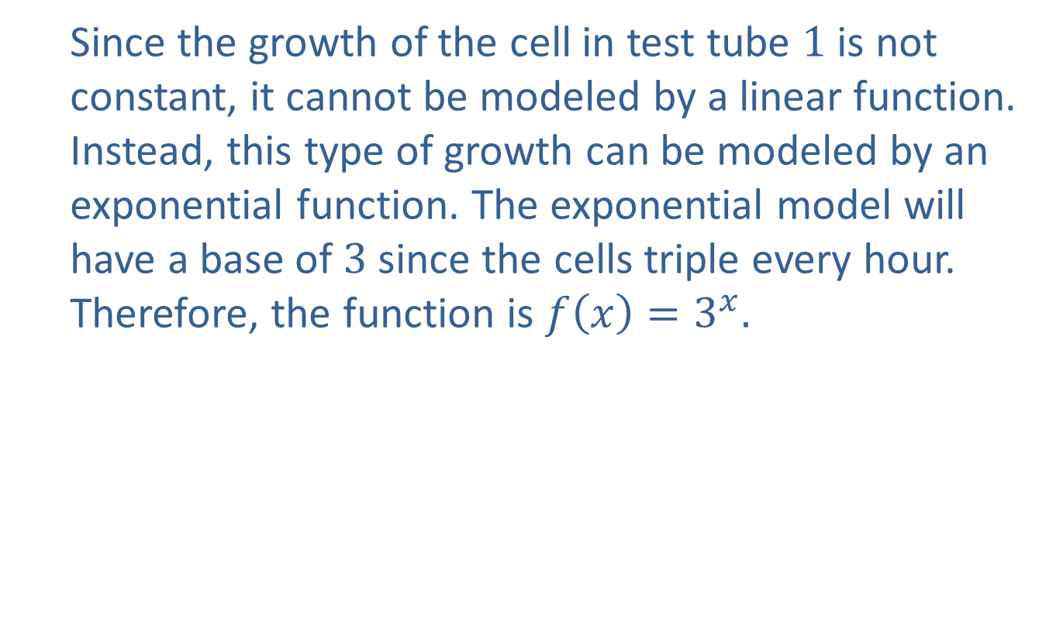
Example 1: Application: Linear Models versus Exponential Models (cont.)
Since the growth of the cell in test tube $1$ is not constant, it cannot be modeled by a linear function. Instead, this type of growth can be modeled by an exponential function. The exponential model will have a base of $3$ since the cells triple every hour. Therefore, the function is $f\left(x\right)=3^{x}.$

Slide 8
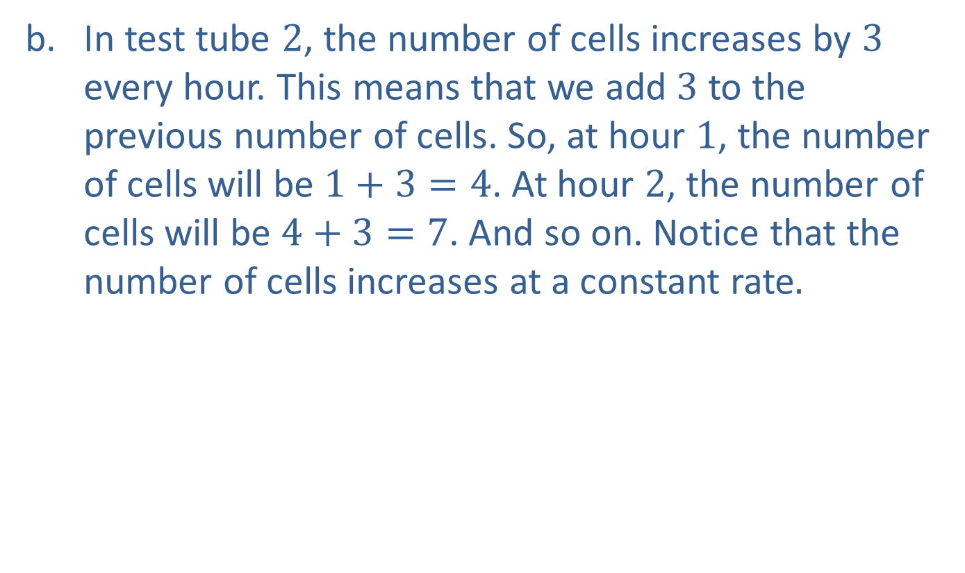
Example 1: Application: Linear Models versus Exponential Models (cont.)
In test tube $2$, the number of cells increases by $3$ every hour. This means that we add $3$ to the previous number of cells. So, at hour $1$, the number of cells will be $1+3=4$. At hour $2$, the number of cells will be $4+3=7$. And so on. Notice that the number of cells increases at a constant rate$.$

Slide 9
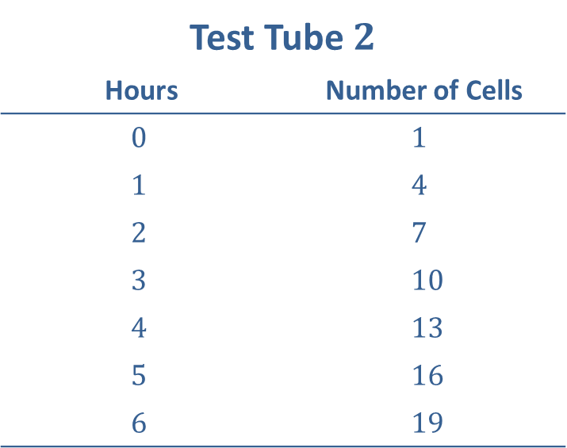
Example 1: Application: Linear Models versus Exponential Models (cont.)
​
Test Tube $2$
Hours | Number of Cells
$$0$$ | $$1$$
$$1$$ | $$4$$
$$2$$ | $$7$$
$$3$$ | $$10$$
$$4$$ | $$13$$
$$5$$ | $$16$$
$$6$$ | $$19$$

Slide 10
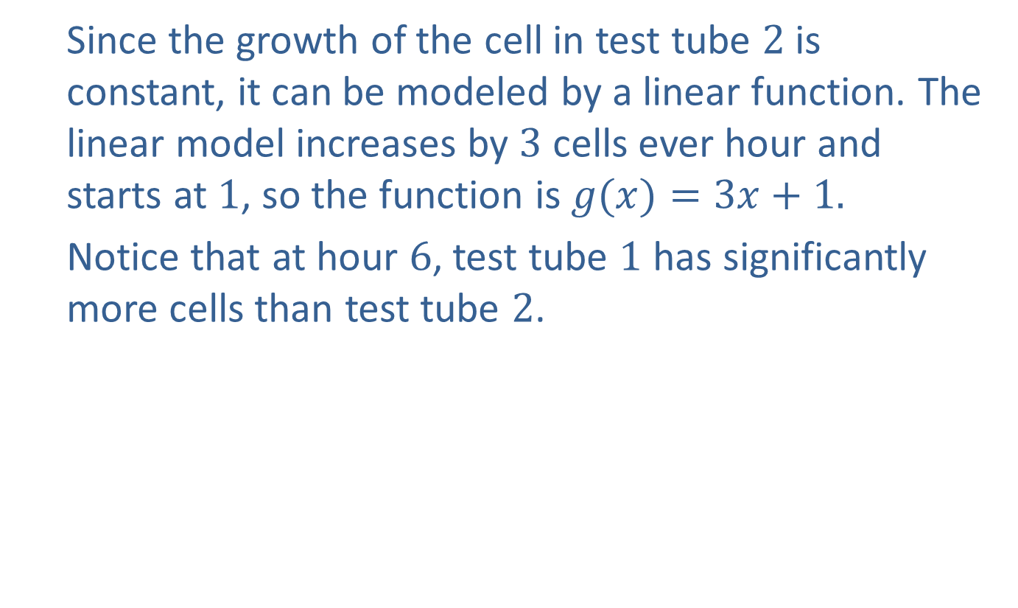
Example 1: Application: Linear Models versus Exponential Models (cont.)
Since the growth of the cell in test tube $2$ is constant, it can be modeled by a linear function. The linear model increases by $3$ cells ever hour and starts at $1$, so the function is $g(x)=3x+1.$
Notice that at hour $6$, test tube $1$ has significantly more cells than test tube $2$.

Slide 11
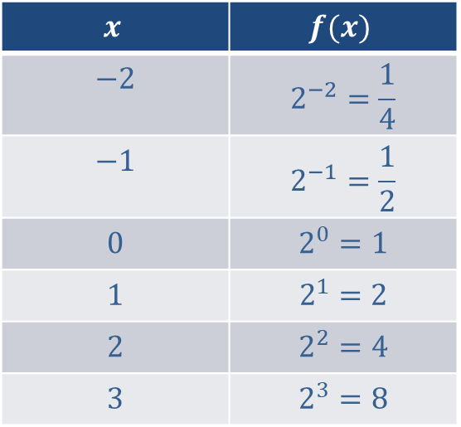

Example 2: Graphing Exponential Functions
Graph the function $f⁡\left(x\right)=2^{x}$
Solution
Start by creating a table of values.
$$x$$ | $$f(x)$$
$$−2$$ | $$2^{−2}=\frac{1}{4}$$
$$−1$$ | $$2^{−1}=\frac{1}{2}$$
$$0$$ | $$2^{0}=1$$
$$1$$ | $$2^{1}=2$$
$$2$$ | $$2^{2}=4$$
$$3$$ | $$2^{3}=8$$

Slide 12
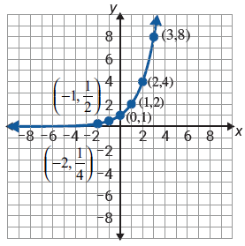
Example 2: Graphing Exponential Functions (cont.)
Now plot the points on a coordinate plane and draw a curve through the points. Be sure to extend the curve to the ends of the plane.

Slide 13
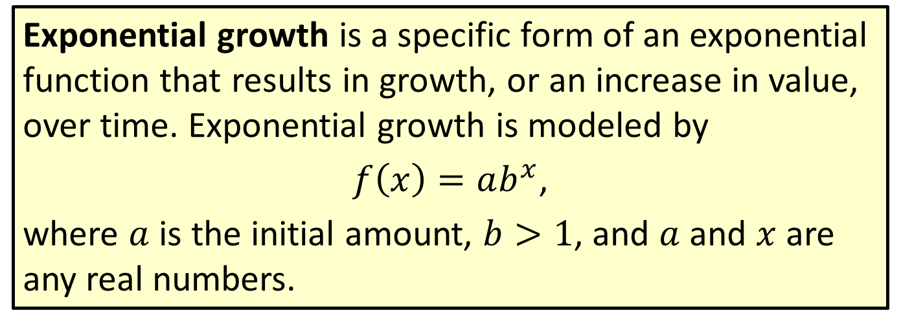
Definition: Exponential Growth
Exponential growth is a specific form of an exponential function that results in growth, or an increase in value, over time. Exponential growth is modeled by
$f\left(x\right)=ab^{x}$,
where $a$ is the initial amount, $b>1$, and $a$ and $x$ are any real numbers.

Slide 14
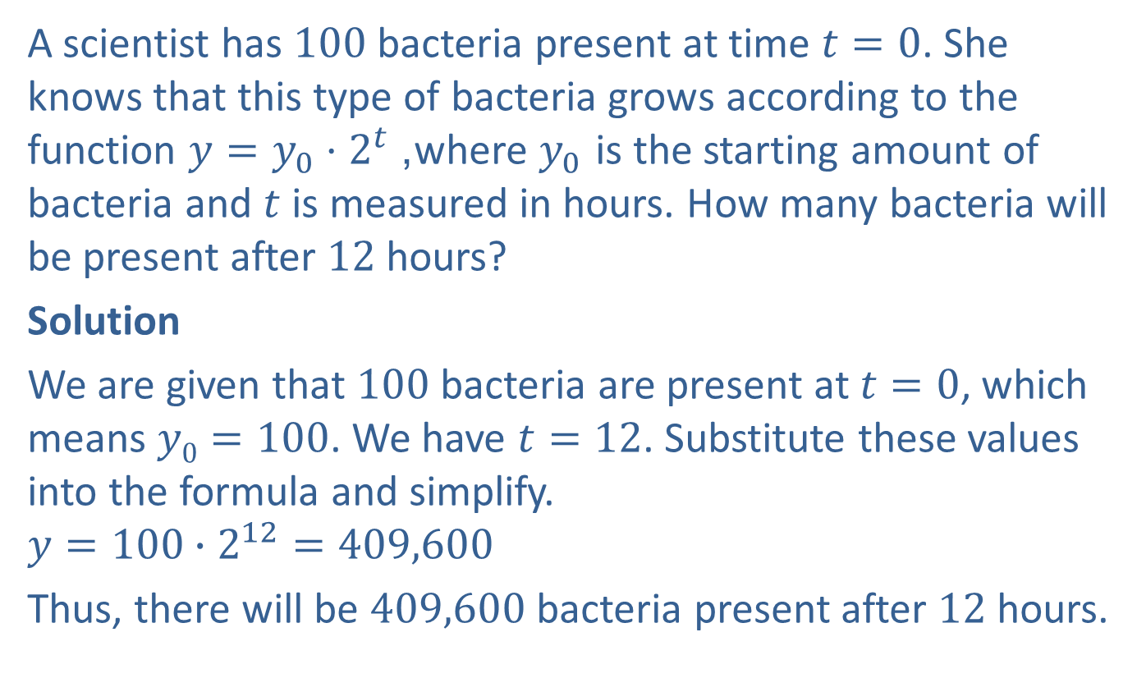
Example 3: Application: Exponential Growth
A scientist has 100 bacteria present at time $t=0$. She knows that this type of bacteria grows according to the function $y=y_{0}⋅2^{t}$, where $y_{0}$ is the starting amount of bacteria and $t$ is measured in hours. How many bacteria will be present after 12 hours?
Solution
We are given that $100$ bacteria are present at $t=0$, which means $y0=100$. We have $t=12$. Substitute these values into the formula and simplify.
$$y=100∙2^{12}=409,600$$
Thus, there will be $409,600$ bacteria present after $12$ hours.

Slide 15
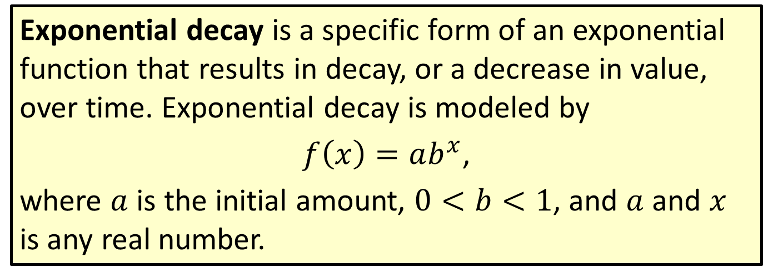
Definition: Exponential Decay
Exponential decay is a specific form of an exponential function that results in decay, or a decrease in value, over time. Exponential decay is modeled by
$f\left(x\right)=ab^{x}$,
where $a$ is the initial amount, $0<b<1$, and $a$ and $x$ is any real number.

Slide 16
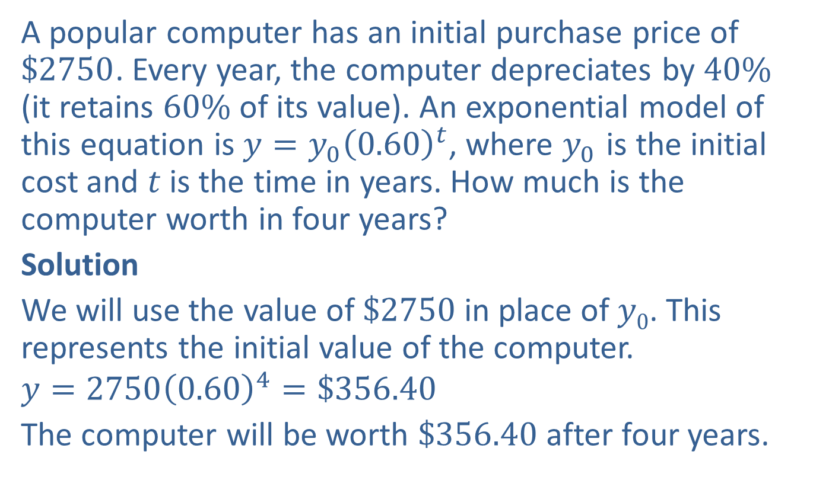
Example 4: Application: Exponential Decay
A popular computer has an initial purchase price of $\$2750$. Every year, the computer depreciates by $40\%$ (it retains $60\%$ of its value). An exponential model of this equation is $y=y_{0}{\left(0.60\right)}^{t}$, where $y_{0}$ is the initial cost and $t$ is the time in years. How much is the computer worth in four years?
Solution
We will use the value of $\$2750$in place of $y0$. This represents the initial value of the computer.
$$y=2750{\left(0.60\right)}^{4}=\$356.40$$
The computer will be worth $\$356.40$after four years.

Slide 17
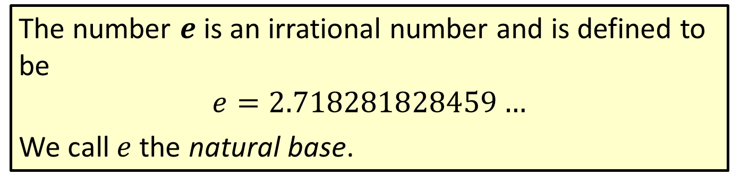

Definition: The Number $e$
The number $e$ is an irrational number and is defined to be
$$e=2.718281828459…$$
We call $e$ the natural base.

Slide 18
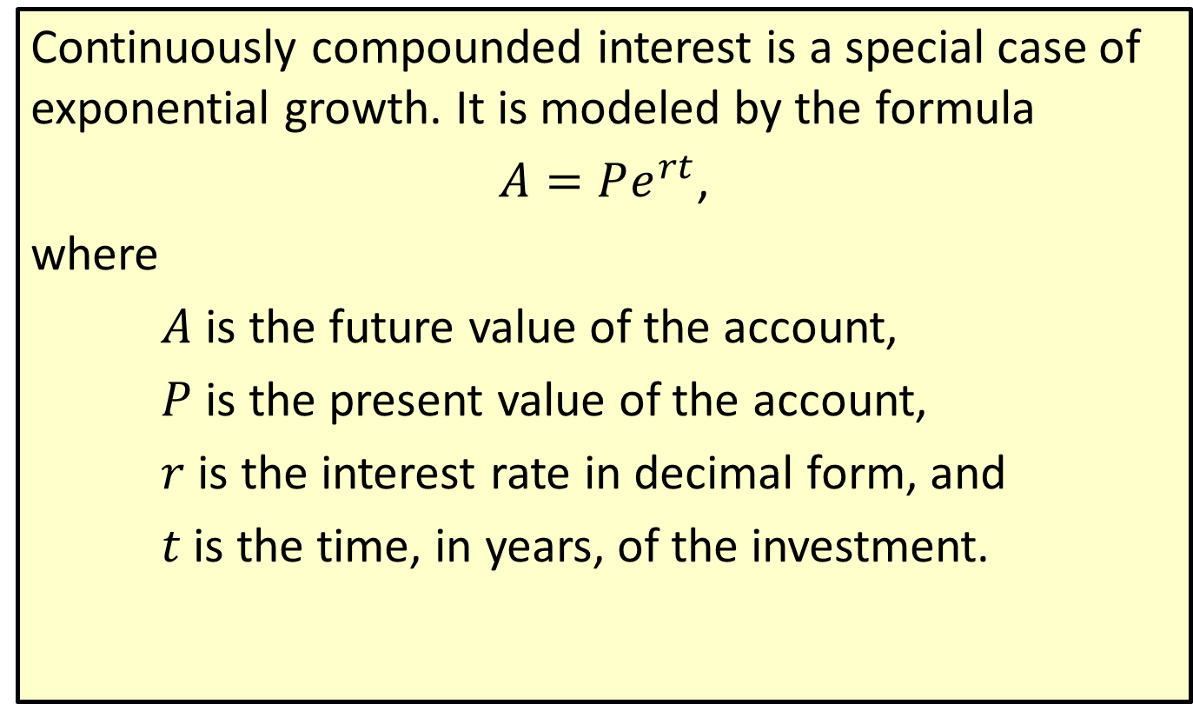
Definition: Continually Compounded Interest
Continuously compounded interest is a special case of exponential growth. It is modeled by the formula
$A=Pe^{rt}$,
where
$A$ is the future value of the account,
$P$ is the present value of the account,
$r$ is the interest rate in decimal form, and
$t$ is the time, in years, of the investment.

Slide 19
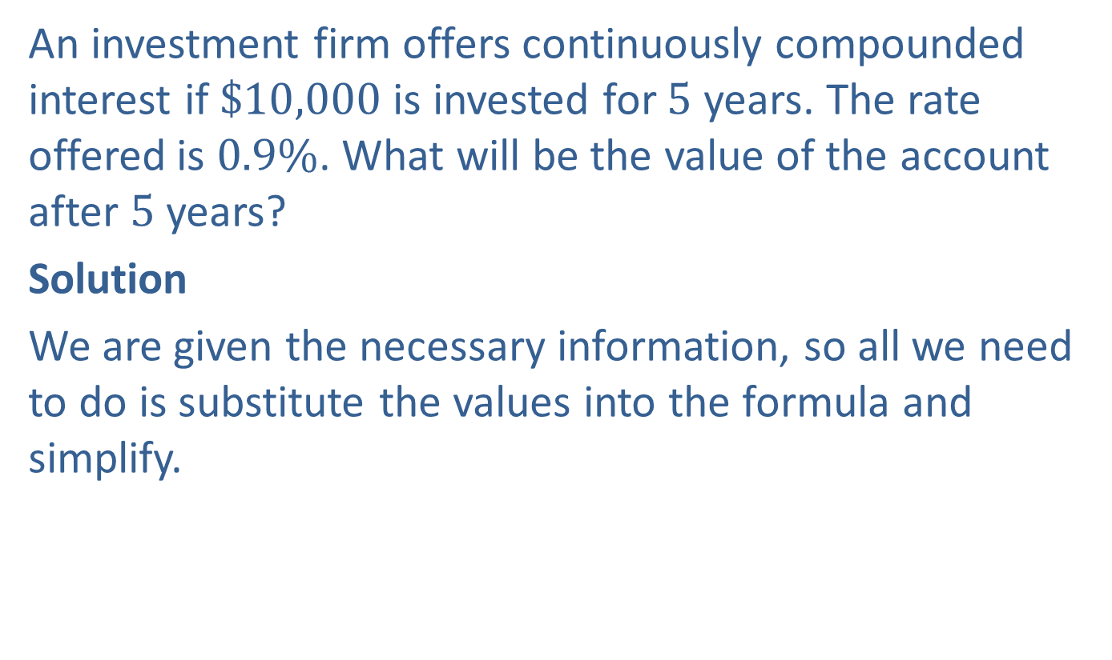
Example 5: Application: Continuously Compounded Interest
An investment firm offers continuously compounded interest if $\$10,000$ is invested for 5 years. The rate offered is $0.9\%$. What will be the value of the account after 5 years?
Solution
We are given the necessary information, so all we need to do is substitute the values into the formula and simplify.

Slide 20
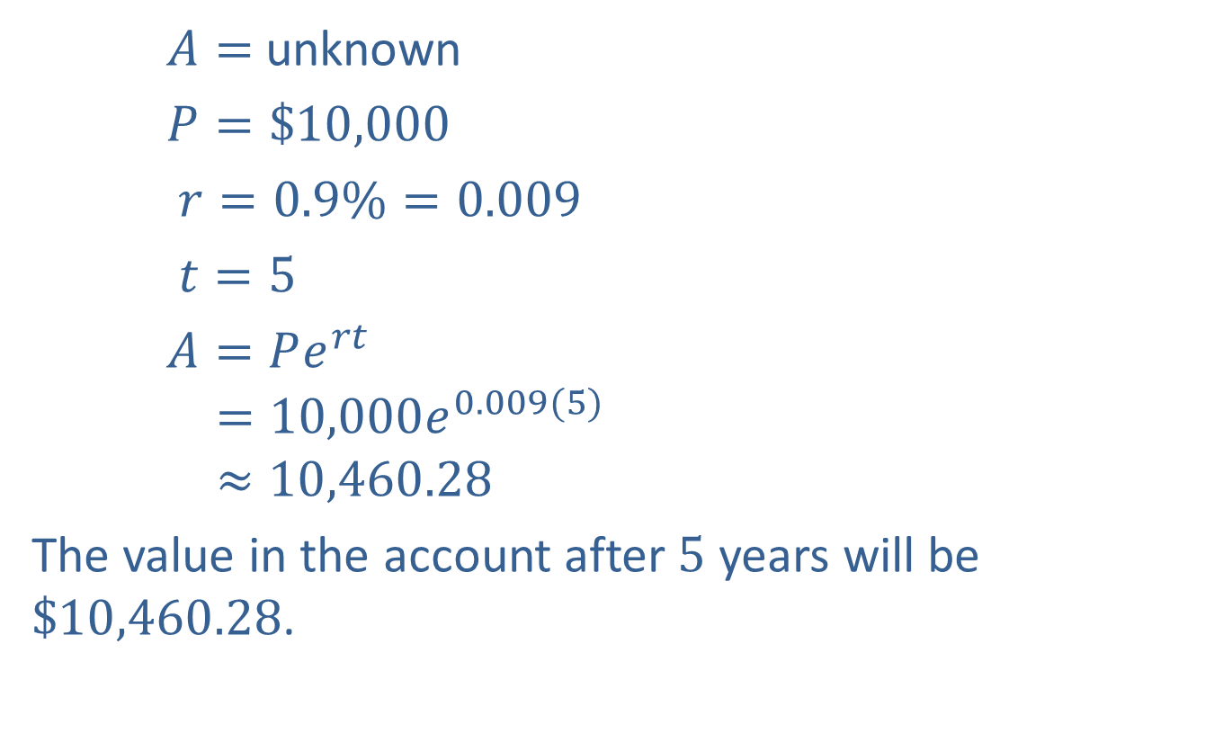
Example 5: Application: Continuously Compounded Interest (cont.)
$A=$ unknown
$P=\$10,000$
$r=0.9\%=0.009$
$t=5$
$A=Pe^{rt}$
$$=10,000e^{0.009(5)}$$
$$≈10,460.28$$
The value in the account after $5$ years will be $\$10,460.28$.

Slide 21
Example 6: Application: Exponential Regression with a Graphing Calculator
A professor at a local university created a free phone app to help his students learn algebra. The table provides the number of times the app was downloaded during the first six weeks after its release.
Weeks after Release | Number of Downloads
1 | 5
2 | 6
3 | 8
4 | 10
5 | 12
6 | 15

Slide 22
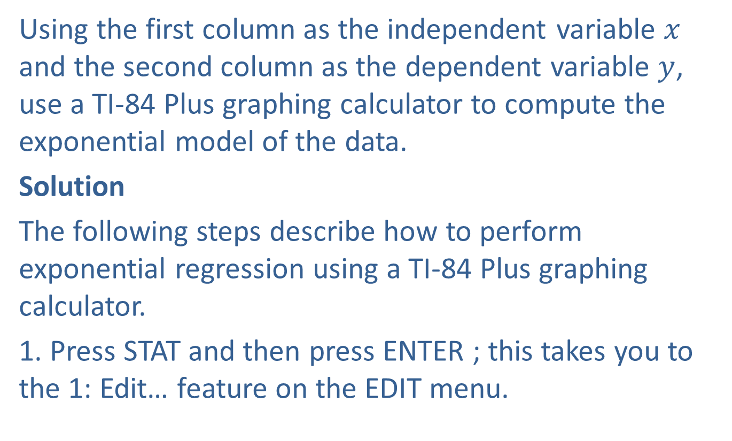
Example 6: Application: Exponential Regression with a Graphing Calculator (cont.)
Using the first column as the independent variable $x$ and the second column as the dependent variable $y$, use a TI-84 Plus graphing calculator to compute the exponential model of the data.
Solution
The following steps describe how to perform exponential regression using a TI-84 Plus graphing calculator.
1. Press STAT and then press ENTER ; this takes you to the 1: Edit… feature on the EDIT menu.

Slide 23
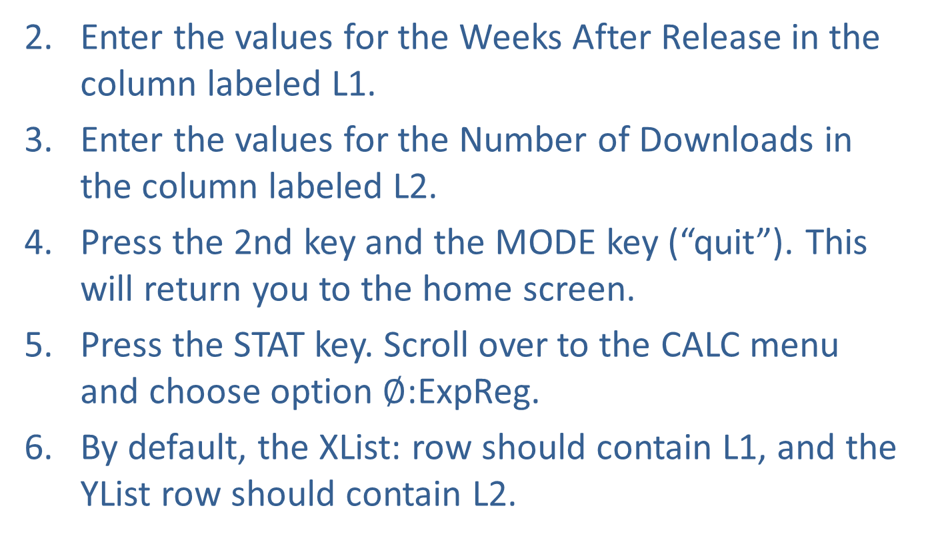
Example 6: Application: Exponential Regression with a Graphing Calculator (cont.)
Enter the values for the Weeks After Release in the column labeled L1.
Enter the values for the Number of Downloads in the column labeled L2.
Press the 2nd key and the MODE key (“quit”). This will return you to the home screen.
Press the STAT key. Scroll over to the CALC menu and choose option $∅$:ExpReg.
By default, the XList: row should contain L1, and the YList row should contain L2.

Slide 24
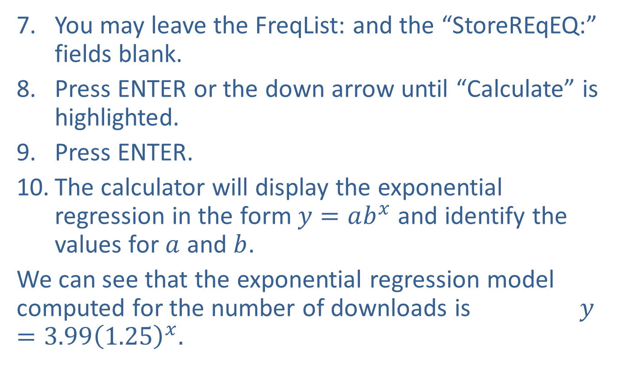
Example 6: Application: Exponential Regression with a Graphing Calculator (cont.)
You may leave the FreqList: and the “StoreREqEQ:” fields blank.
Press ENTER or the down arrow until “Calculate” is highlighted.
Press ENTER.
The calculator will display the exponential regression in the form $y=ab^{x}$and identify the values for $a$ and $b$.
We can see that the exponential regression model computed for the number of downloads is $y=3.99{\left(1.25\right)}^{x}.$

