Slide 1
Section 4.4
Addition and Subtraction with Polynomials

Slide 2
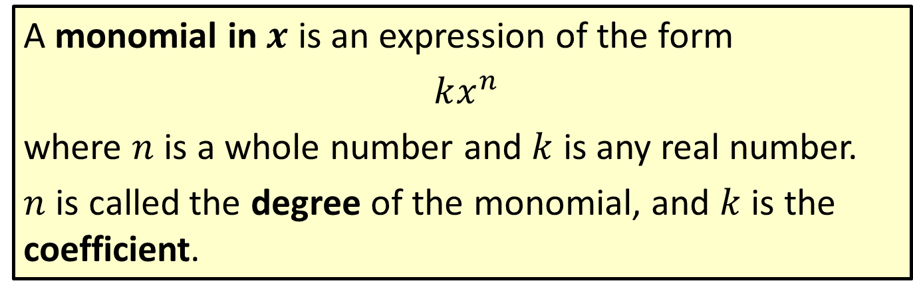
Definition: Monomial
A monomial in $x$ is an expression of the form
$kx^{n}$
where $n$ is a whole number and $k$ is any real number.
$n$ is called the degree of the monomial, and $k$ is the coefficient.

Slide 3
Note
Point out that in some applications, the order of writing the terms is very helpful. For example, to have the most “important” term (the one of highest degree) first and foremost helps one identify the nature of the two extremities of the graph of a polynomial. Also, writing in standard form (descending order) helps with the “inventory” of combining like terms.

Slide 4
Definition: Polynomial
A polynomial is a monomial or the algebraic sum or difference of monomials.
The degree of a polynomial is the largest of the degrees of its terms after like terms have been combined.
The coefficient of the term of largest degree is called the leading coefficient.

Slide 5
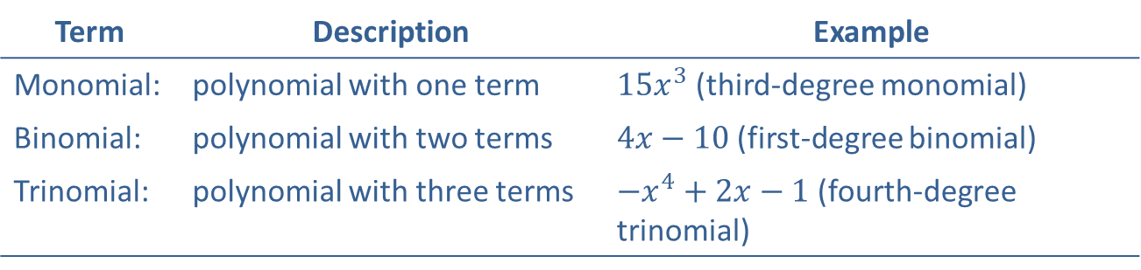
Definition: Classification of Polynomials
Term | Description | Example
Monomial: | polynomial with one term | $15x^{3}$ (third-degree monomial)
Binomial: | polynomial with two terms | $4x−10$ (first-degree binomial)
Trinomial: | polynomial with three terms | $−x^{4}+2x−1$ (fourth-degree trinomial)

Slide 6
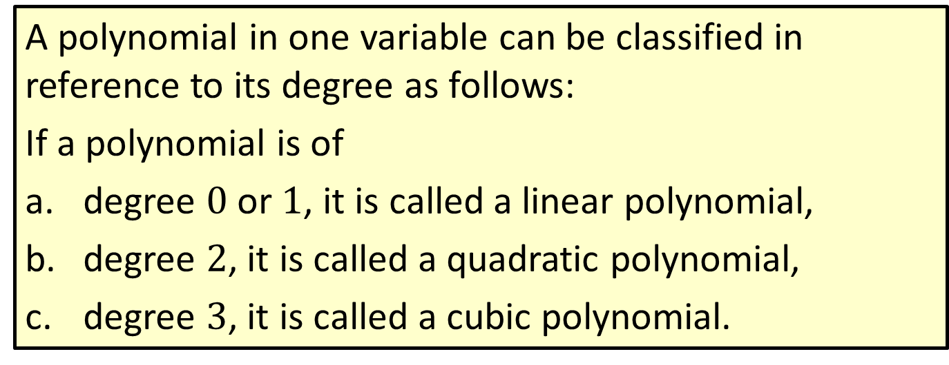
Definition: Classifying a Polynomial by Its Degree
A polynomial in one variable can be classified in reference to its degree as follows:
If a polynomial is of
degree $0$ or $1$, it is called a linear polynomial,
degree $2$, it is called a quadratic polynomial,
degree $3$, it is called a cubic polynomial.

Slide 7
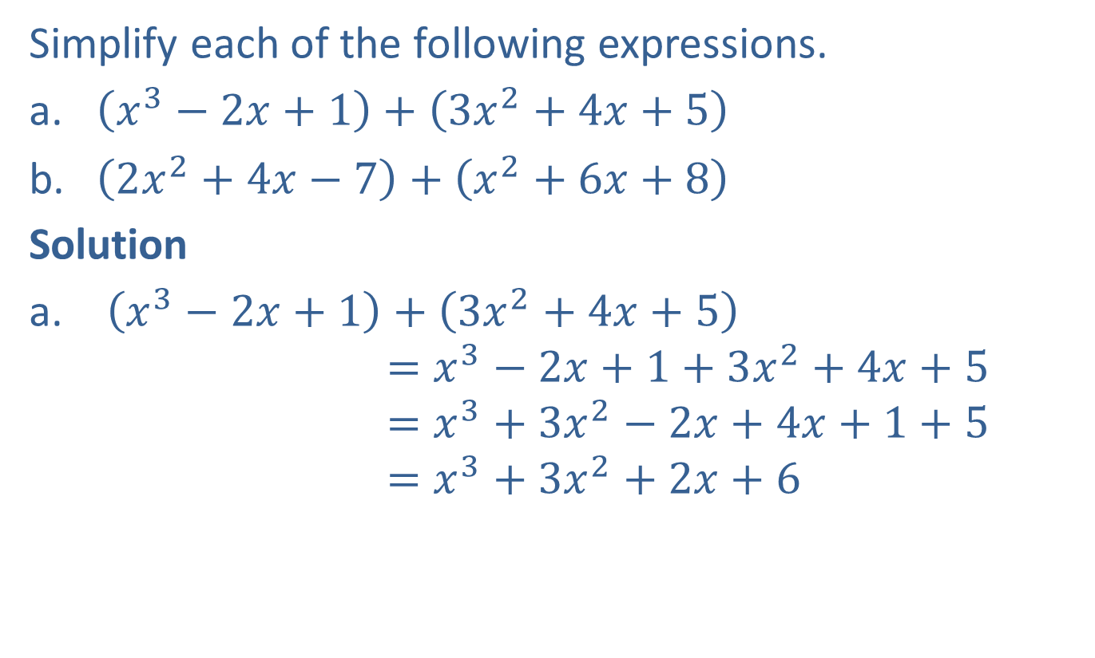
Example 1: Adding Polynomials
Simplify each of the following expressions.
​$\left(x^{3}−2x+1\right)+\left(3x^{2}+4x+5\right)$
​$\left(2x^{2}+4x−7\right)+\left(x^{2}+6x+8\right)$
Solution
$\left(x^{3}−2x+1\right)+\left(3x^{2}+4x+5\right)$
$$=x^{3}−2x+1+3x^{2}+4x+5$$
$$=x^{3}+3x^{2}−2x+4x+1+5$$
$$=x^{3}+3x^{2}+2x+6$$

Slide 8

Example 1: Adding Polynomials (cont.)
$\left(2x^{2}+4x−7\right)+\left(x^{2}+6x+8\right)$
$$=2x^{2}+4x−7+x^{2}+6x+8$$
$$=2x^{2}+x^{2}+4x+6x−7+8$$
$=3x^{2}+10x+1$

Slide 9

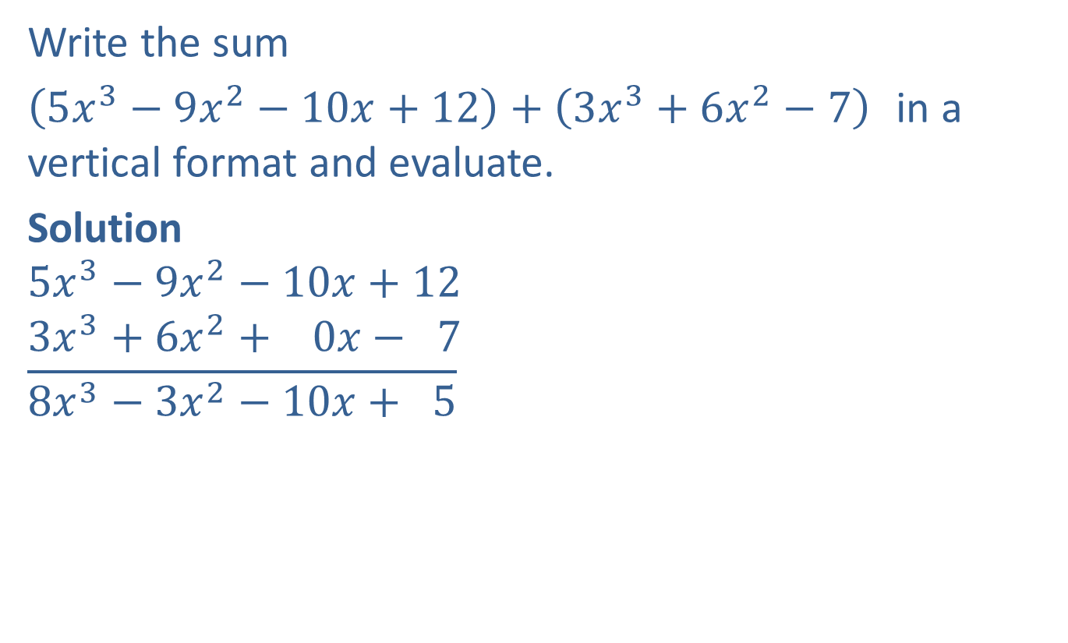
Example 2: Adding Polynomials in a Vertical Format
Write the sum
$\left(5x^{3}−9x^{2}−10x+12\right)+\left(3x^{3}+6x^{2}−7\right)$ in a vertical format and evaluate.
Solution
$$5x^{3}−9x^{2}−10x+12$$
$$3x^{3}+6x^{2}+ 0x− 7$$
$$\overline{8x^{3}−3x^{2}−10x+ 5}$$
Note that $0x$ is written as a placeholder.

Slide 10
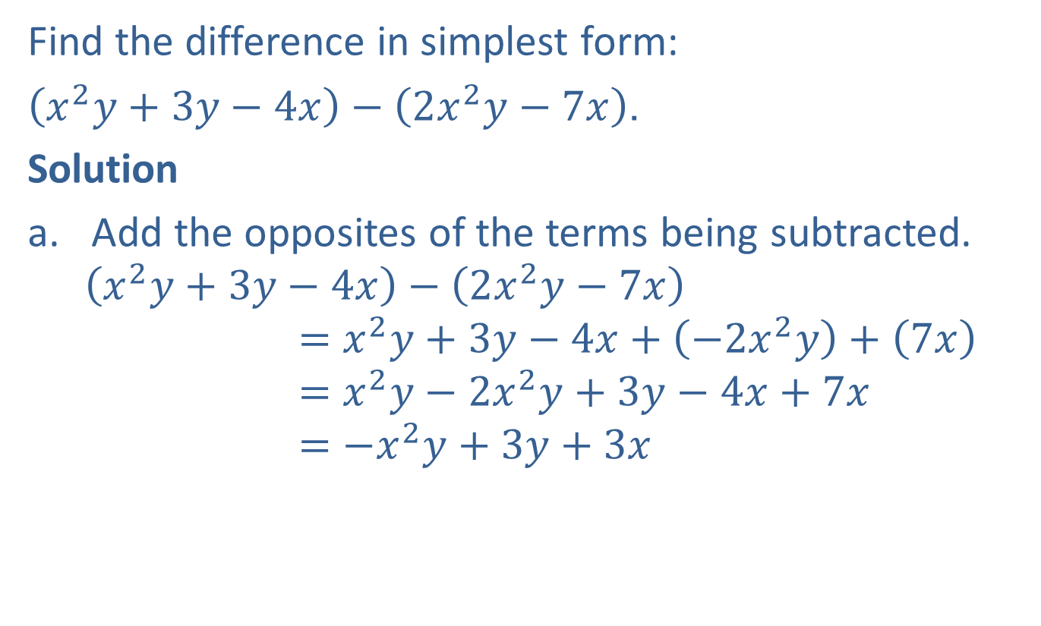
Example 3: Subtracting Polynomials
Find the difference in simplest form:
$\left(x^{2}y+3y−4x\right)−\left(2x^{2}y−7x\right)$.
Solution
Add the opposites of the terms being subtracted.
  $$\left(x^{2}y+3y−4x\right)−\left(2x^{2}y−7x\right)$$
  $$=x^{2}y+3y−4x+\left(−2x^{2}y\right)+\left(7x\right)$$
  $$=x^{2}y−2x^{2}y+3y−4x+7x$$
  $$=−x^{2}y+3y+3x$$

Slide 11
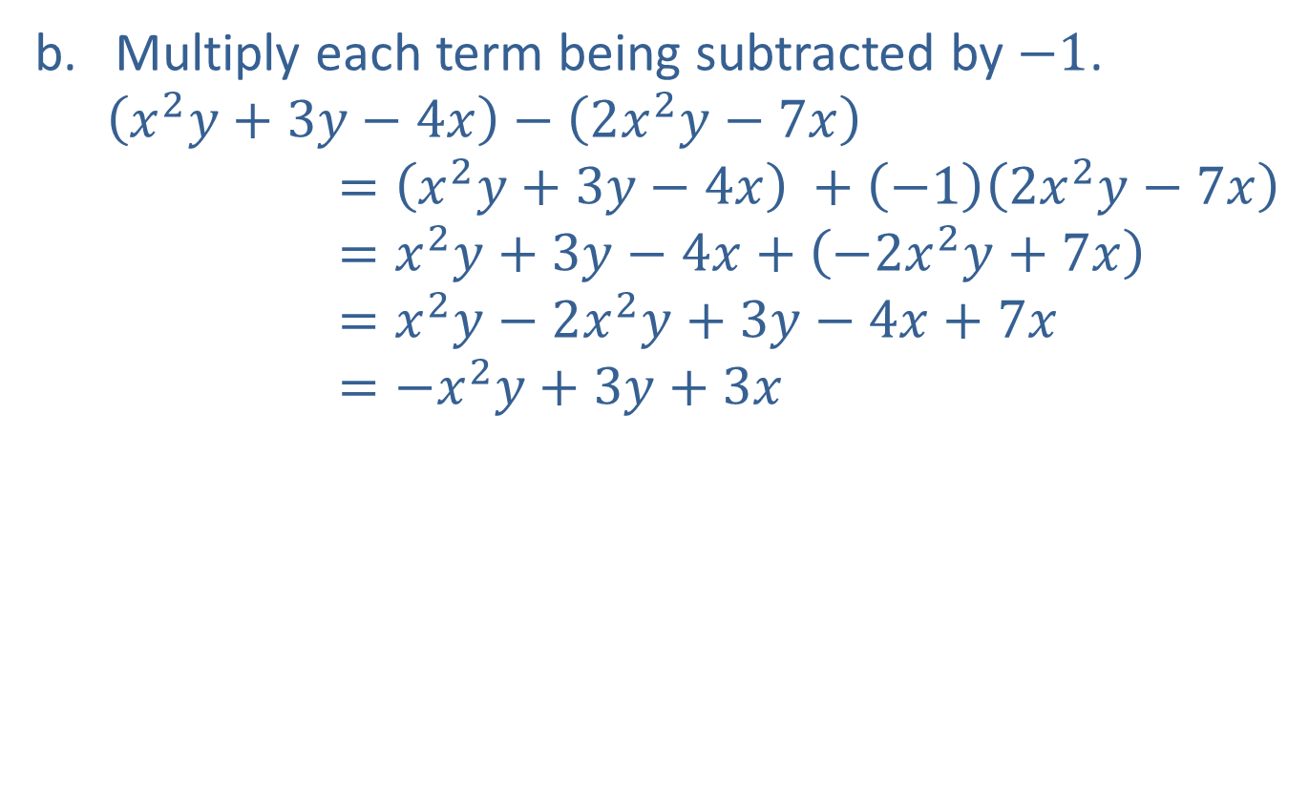
Example 3: Subtracting Polynomials (cont.)
Multiply each term being subtracted by $−1$.
  $$\left(x^{2}y+3y−4x\right)−\left(2x^{2}y−7x\right)$$
  $$={\left(x^{2}y+3y−4x\right)}^{ }+\left(−1\right)\left(2x^{2}y−7x\right)$$
  $$=x^{2}y+3y−4x+\left(−2x^{2}y+7x\right)$$
  $$=x^{2}y−2x^{2}y+3y−4x+7x$$
  $$=−x^{2}y+3y+3x$$

Slide 12
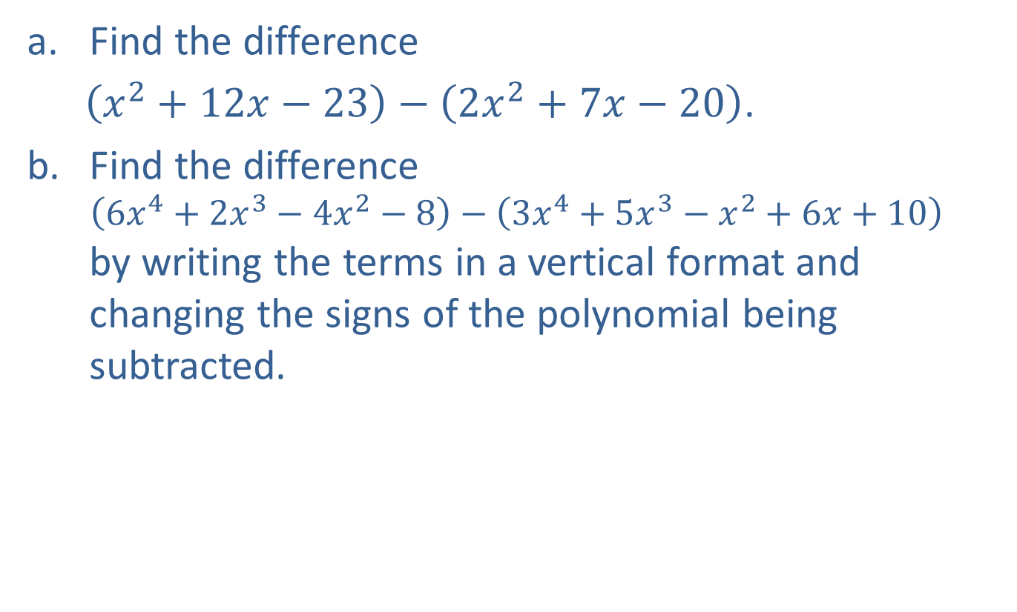
Example 4: Subtracting Polynomials
​Find the difference
$\left(x^{2}+12x−23\right)−\left(2x^{2}+7x−20\right)$.
Find the difference
$\left(6x^{4}+2x^{3}−4x^{2}−8\right)−\left(3x^{4}+5x^{3}−x^{2}+6x+10\right)$
by writing the terms in a vertical format and changing the signs of the polynomial being subtracted.

Slide 13
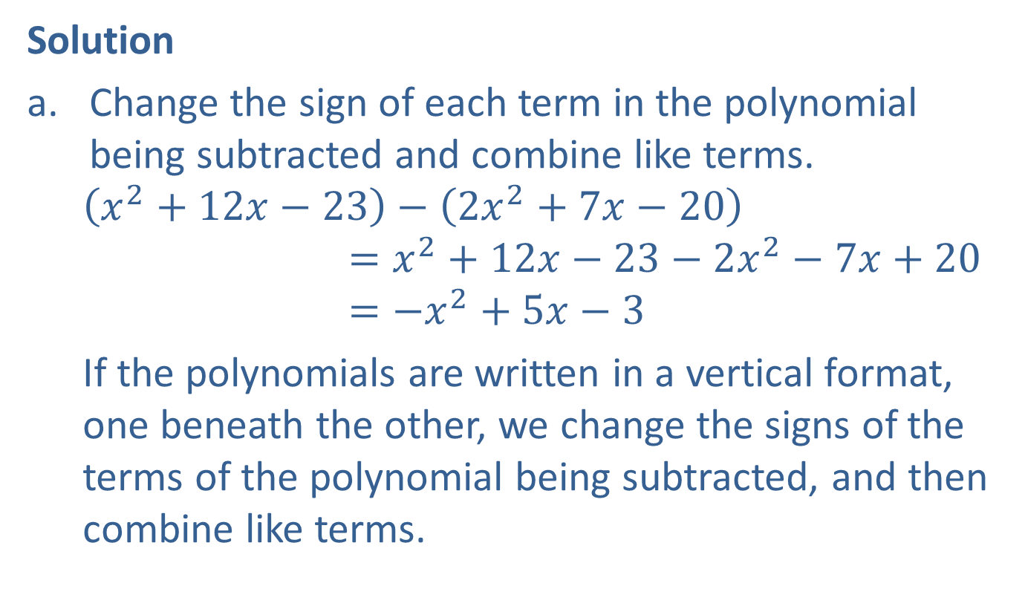
Example 4: Subtracting Polynomials (cont.)
Solution
Change the sign of each term in the polynomial being subtracted and combine like terms.
  $$\left(x^{2}+12x−23\right)−\left(2x^{2}+7x−20\right)$$
  $$=x^{2}+12x−23−2x^{2}−7x+20$$
  $$=−x^{2}+5x−3$$
  If the polynomials are written in a vertical format, one beneath the other, we change the signs of the terms of the polynomial being subtracted, and then combine like terms.

Slide 14

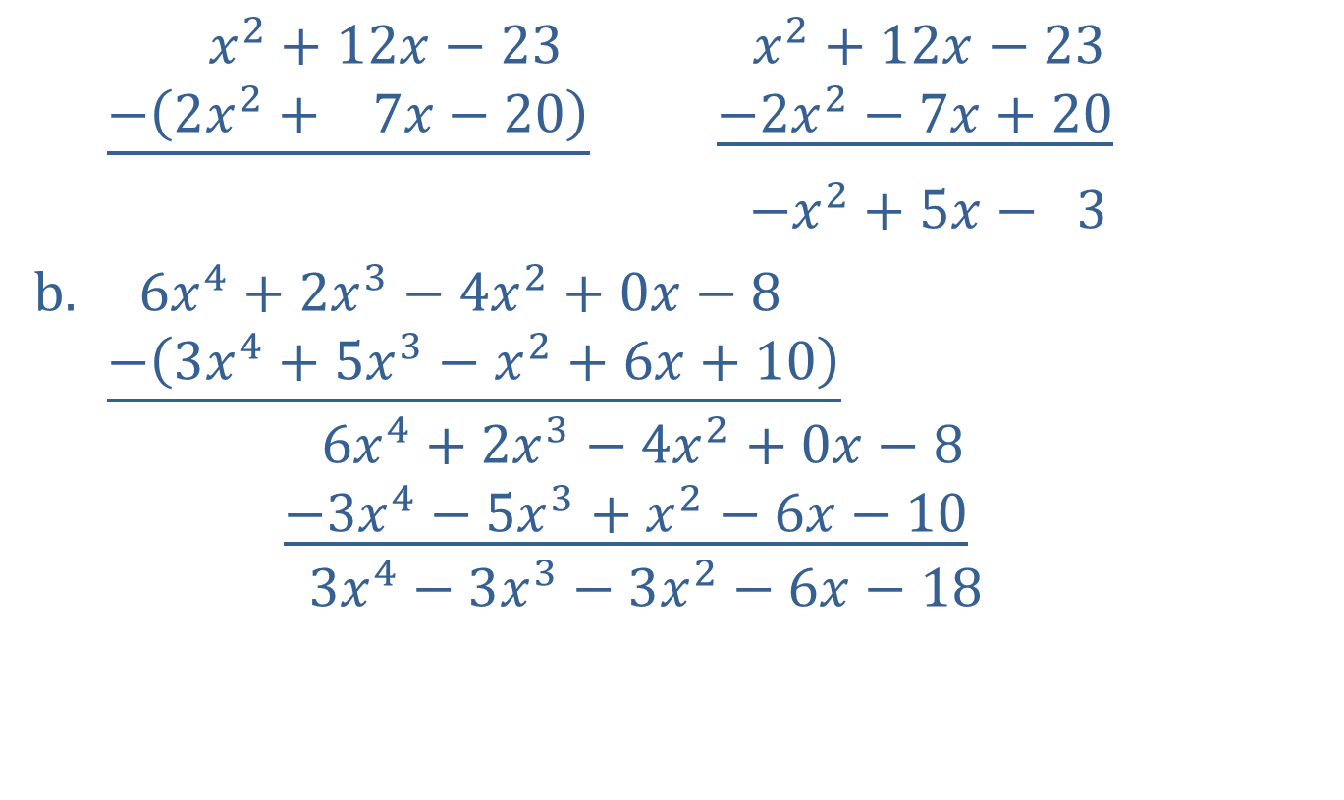
Example 4: Subtracting Polynomials (cont.)
  $$x^{2}+12x−23 x^{2}+12x−23$$
  $$\underline{−\left(2x^{2}+ 7x−20\right)} \underline{−2x^{2}−7x+20}$$
  $−x^{2}+5x− 3$
$6x^{4}+2x^{3}−4x^{2}+0x−8$
  $$\underline{−\left(3x^{4}+5x^{3}−x^{2}+6x+10\right)}$$
  $$6x^{4}+2x^{3}−4x^{2}+0x−8$$
  $$\underline{−3x^{4}−5x^{3}+x^{2}−6x−10}$$
  $$3x^{4}−3x^{3}−3x^{2}−6x−18$$
Note that $0x$ is written as a placeholder.

Slide 15
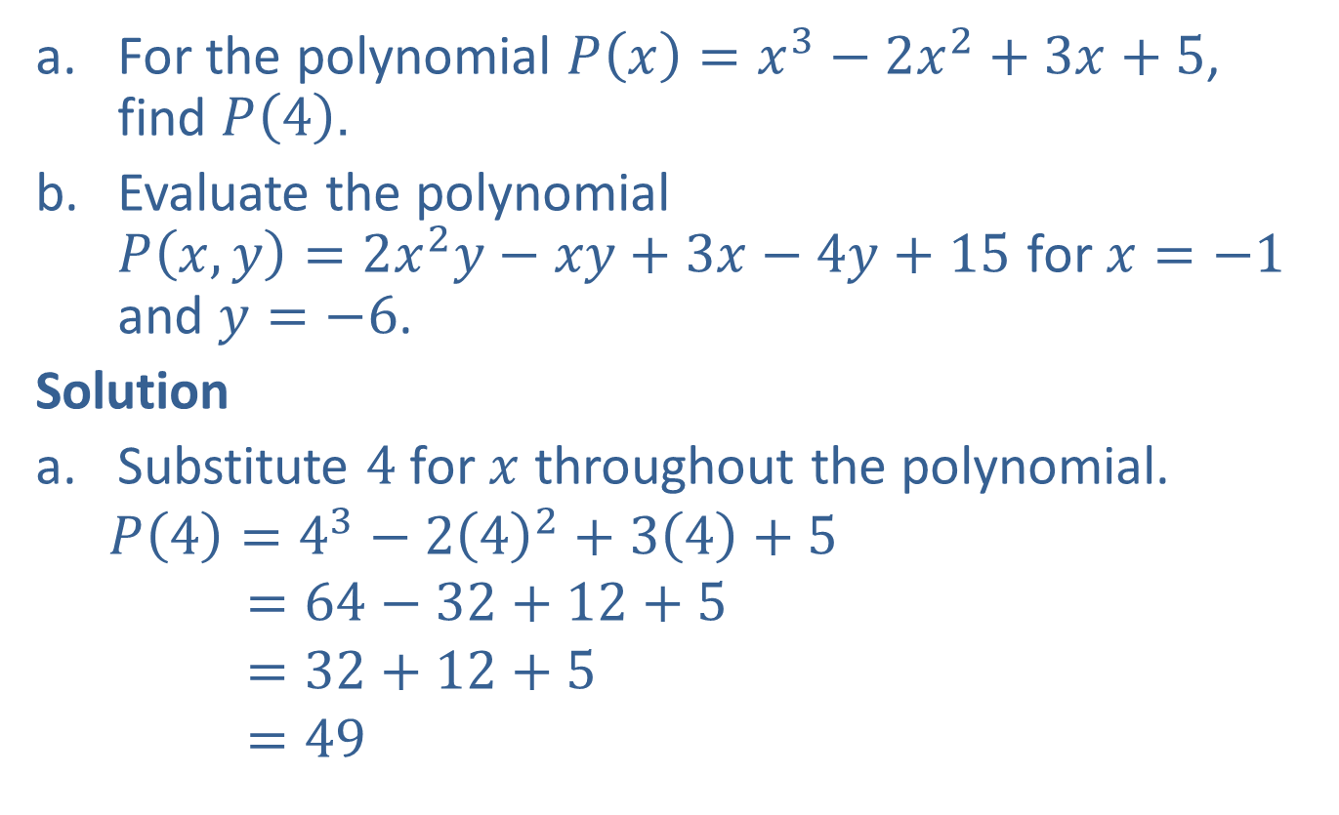
Example 5: Evaluating Polynomials
​For the polynomial $P\left(x\right)=x^{3}−2x^{2}+3x+5$,
find $P⁡\left(4\right)$.
​Evaluate the polynomial
$P\left(x,y\right)=2x^{2}y−xy+3x−4y+15$ for $x=−1$ and $y=−6$.
Solution
Substitute $4$for $x$ throughout the polynomial.
  $$P\left(4\right)=4^{3}−2{\left(4\right)}^{2}+3\left(4\right)+5$$
  $$=64−32+12+5$$
  $$=32+12+5$$
  $$=49$$

Slide 16
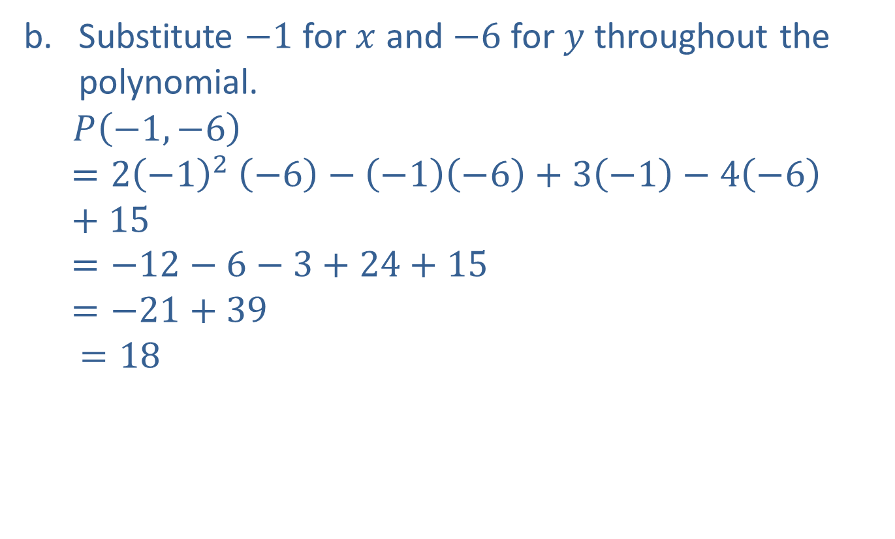
Example 5: Evaluating Polynomials (cont.)
Substitute $−1$for $x$ and $−6$ for $y$ throughout the polynomial.
  $$P\left(−1,−6\right)$$
  $$={2{\left(−1\right)}^{2}}^{ }\left(−6\right)−\left(−1\right)\left(−6\right)+3\left(−1\right)−4\left(−6\right)+15$$
  $$=−12−6−3+24+15$$
  $$=−21+39$$
  $$=18$$

