Slide 1
Section 4.5
Multiplication with Polynomials

Slide 2

Example 1: Multiplying Polynomials
Multiply: $−6x\left(2x^{2}+3x−11\right)$
Solution
$$−6x\left(2x^{2}+3x−11\right)$$
$$=−6x∙2x^{2}−6x∙3x−6x\left(−11\right)$$
$$=−12x^{3}−18x^{2}+66x$$

Slide 3

Example 2: Multiplying Polynomials
Multiply: $\left(2x+1\right)\left(x−5\right)$
Solution
$$\left(2x+1\right)\left(x−5\right)=2x\left(x−5\right)+1\left(x−5\right)$$
$$=2x∙x+2x\left(−5\right)+1x+1\left(−5\right)$$
$$=2x^{2}−10x+x−5$$
$$=2x^{2}−9x−5$$

Slide 4
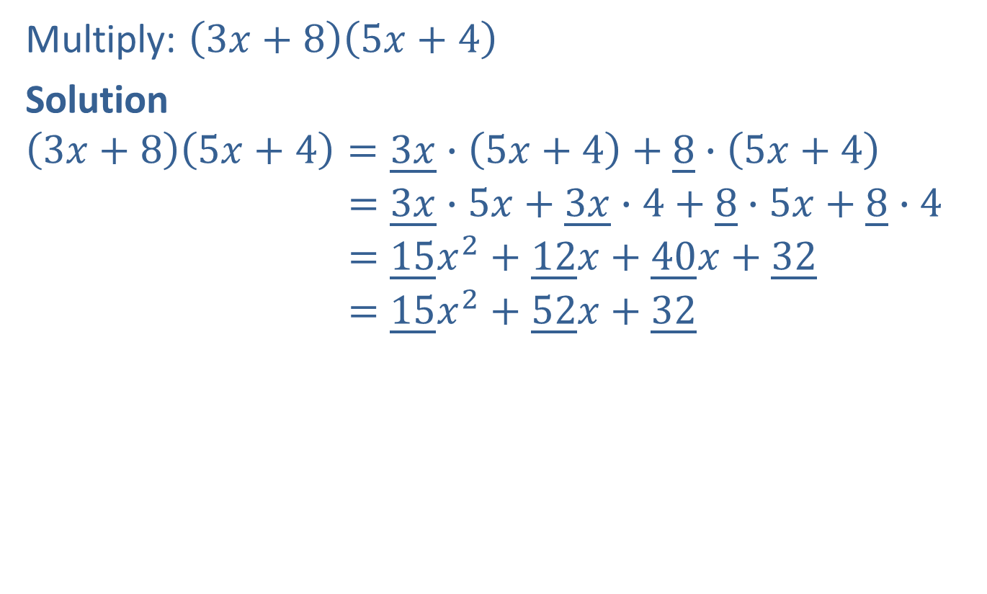
Completion Example 3: Multiplying Polynomials
Multiply: $\left(3x+8\right)\left(5x+4\right)$
Solution
$$\left(3x+8\right)\left(5x+4\right)=\underline{3x}∙\left(5x+4\right)+\underline{8}∙\left(5x+4\right)$$
$$=\underline{3x}∙5x+\underline{3x}∙4+\underline{8}∙5x+\underline{8}∙4$$
$$=\underline{15}x^{2}+\underline{12}x+\underline{40}x+\underline{32}$$
$$=\underline{15}x^{2}+\underline{52}x+\underline{32}$$

Slide 5

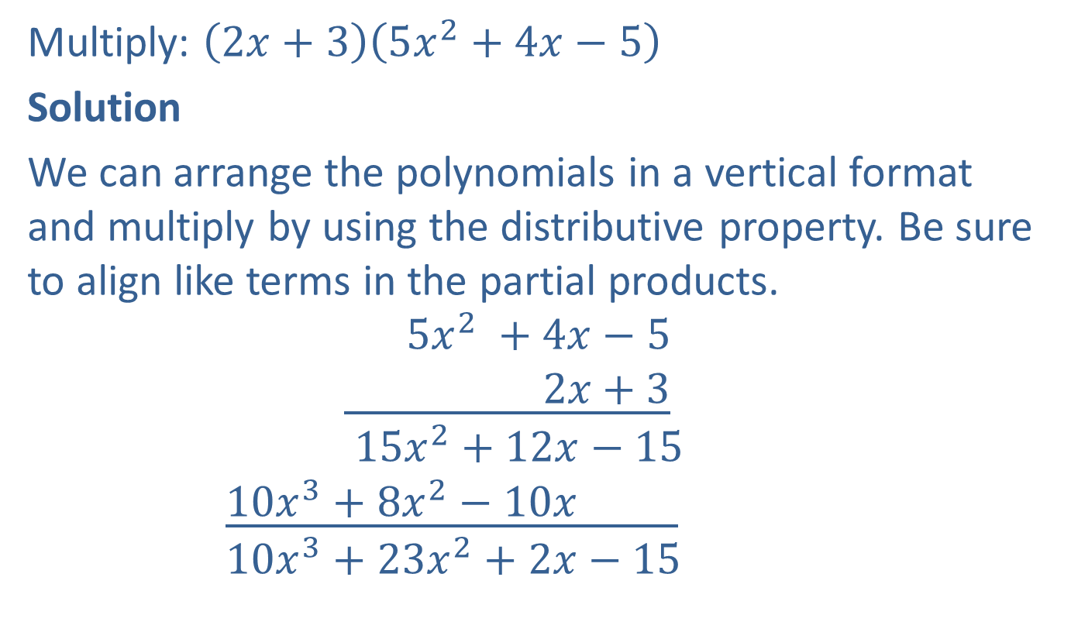

Example 4: Multiplying Polynomials
Multiply: $\left(2x+3\right)\left(5x^{2}+4x−5\right)$
Solution
We can arrange the polynomials in a vertical format and multiply by using the distributive property. Be sure to align like terms in the partial products.
$$5x^{2} +4x−5$$
$$\underline{ 2x+3}$$
$$15x^{2}+12x−15$$
$$\underline{10x^{3}+8x^{2}−10x }$$
$$10x^{3}+23x^{2}+2x−15$$
Multiply by $3$.
Multiply by $2x$.
Combine like terms.

Slide 6




Example 5: Multiplying Polynomials
Multiply: $x^{2}+2x+3$
$$\underline{x^{2}−2x+3}$$
Solution
$$x^{2}+2x+3$$
$$\underline{ x^{2}−2x+3}$$
$$3x^{2}+6x+9$$
$$−2x^{3}−4x^{2}−6x$$
$$\underline{x^{4}+2x^{3}+3x^{2} }$$
$$x^{4} +2x^{2} +9$$
Multiply by $3$.
Multiply by $−2x$.
Multiply by $x^{2}$.
Combine like terms.

Slide 7





Example 6: Using the FOIL Method to Multiply Binomials
Multiply: $\left(x+3\right)\left(2x+8\right)$
Solution
$$\left(x+3\right)\left(2x+8\right)=2x^{2}+8x+6x+24$$
$$=2x^{2}+14x+24$$
$$2x^{2}$$
$$24$$
F O I L
$$6x$$
$$8x$$

Slide 8





Example 7: Using the FOIL Method to Multiply Binomials
Multiply: $\left(2x−3\right)\left(3x−5\right)$
Solution
$$\left(2x−3\right)\left(3x−5\right)=6x^{2}−10x−9x+15$$
$$=6x^{2}−19x+15$$
$$6x^{2}$$
$$15$$
F O I L
$$−9x$$
$$−10x$$

Slide 9
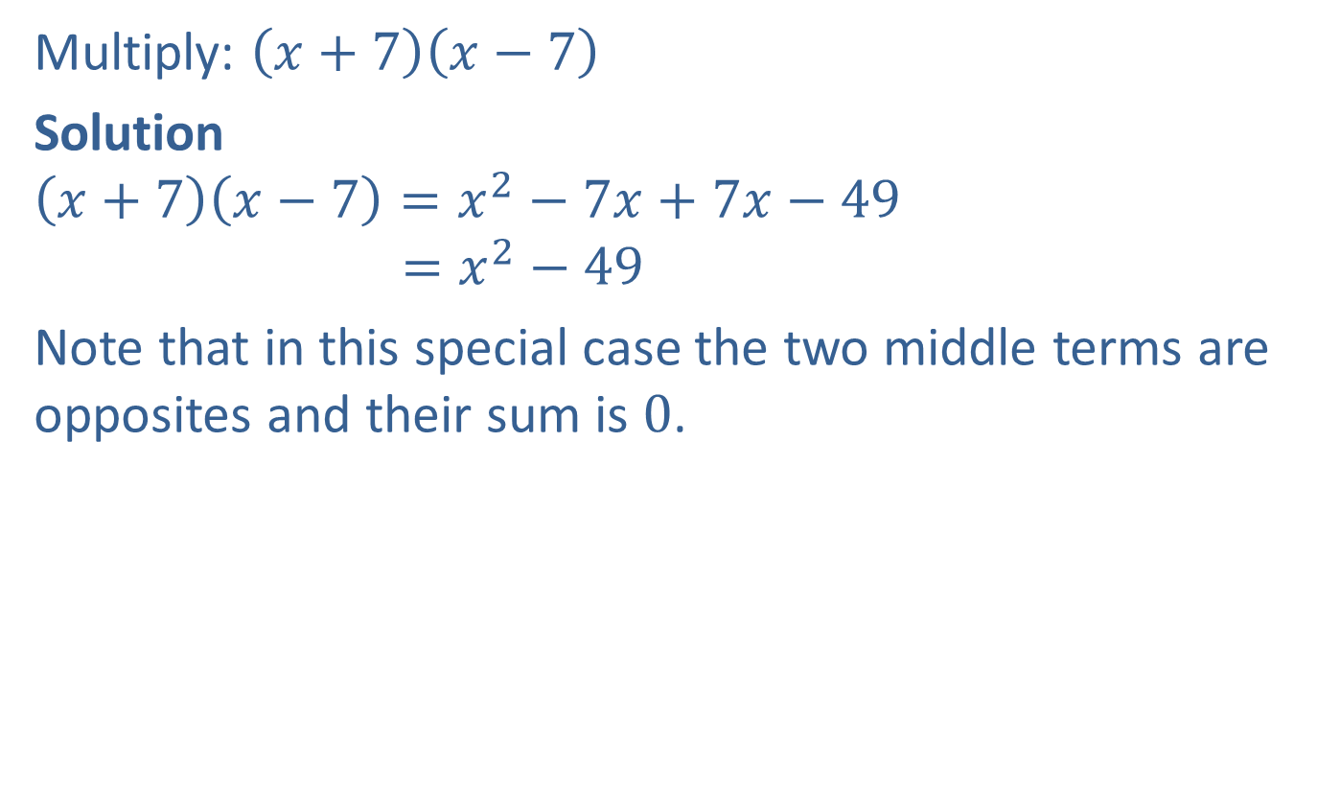
Example 8: Using the FOIL Method to Multiply Binomials
Multiply: $\left(x+7\right)\left(x−7\right)$
Solution
$$\left(x+7\right)\left(x−7\right)=x^{2}−7x+7x−49$$
$$=x^{2}−49$$
Note that in this special case the two middle terms are opposites and their sum is $0$.
Apply the FOIL
method mentally.

Slide 10

Completion Example 9: Using the FOIL Method to Multiply Binomials
Multiply: $\left(x+11\right)\left(3x−2\right)$
Solution
$$\left(x+11\right)\left(3x−2\right)$$
$$={x∙\underline{ 3x}+x∙\left(\underline{−2}\right)+11∙\underline{3x}+11∙\left(\underline{−2}\right)}^{ }$$
$$={\underline{3}x}^{2}+\underline{31}x−\underline{22}$$

Slide 11

Definition: Difference of Two Squares
$$\left(a+b\right)\left(a−b\right)=a^{2}−b^{2}$$

Slide 12
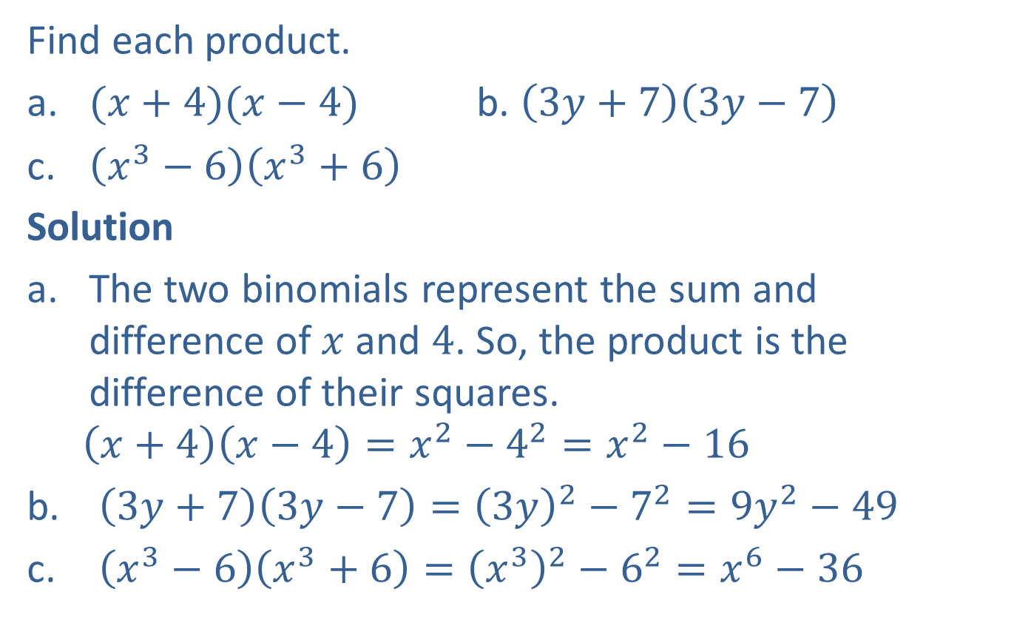
Example 10: Difference of Two Squares
Find each product.
​${(x+4)(x−4)}^{ }$ b. ​$\left(3y+7\right)\left(3y−7\right)$
​$\left(x^{3}−6\right)\left(x^{3}+6\right)$
Solution
The two binomials represent the sum and difference of $x$ and $4$. So, the product is the difference of their squares.
  $$\left(x+4\right)\left(x−4\right)=x^{2}−4^{2}=x^{2}−16$$
$\left(3y+7\right)\left(3y−7\right)={\left(3y\right)}^{2}−7^{2}=9y^{2}−49$
$\left(x^{3}−6\right)\left(x^{3}+6\right)={\left(x^{3}\right)}^{2}−6^{2}=x^{6}−36$

Slide 13
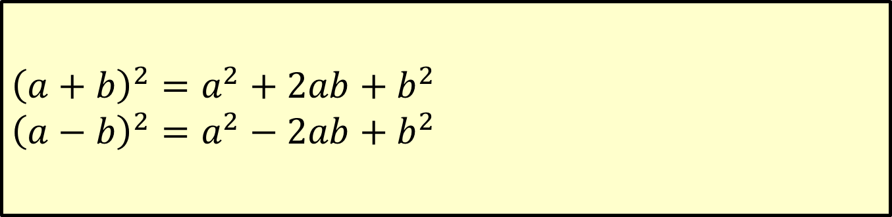
Definition: Squares of Binomials (Perfect Square Trinomials)
${\left(a+b\right)}^{2}=a^{2}+2ab+b^{2}$
$${\left(a−b\right)}^{2}=a^{2}−2ab+b^{2}$$
Square of a binomial sum
Square of a binomial difference

Slide 14
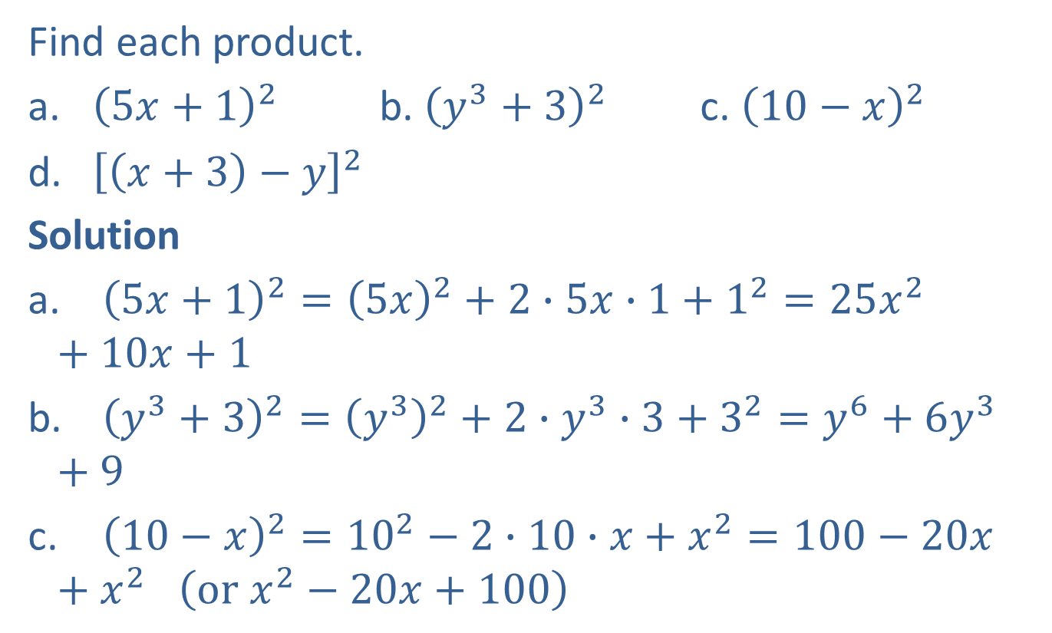
Example 11: Squares of Binomials (Perfect Square Trinomials)
Find each product.
​${{\left(5x+1\right)}^{2}}^{ }$ b. ​${\left(y^{3}+3\right)}^{2}$ c. ${\left(10−x\right)}^{2}$
​${\left[\left(x+3\right)−y\right]}^{2}$
Solution
${\left(5x+1\right)}^{2}={\left(5x\right)}^{2}+2∙5x∙1+1^{2}=25x^{2}+10x+1$
${\left(y^{3}+3\right)}^{2}={\left(y^{3}\right)}^{2}+2∙y^{3}∙3+3^{2}=y^{6}+6y^{3}+9$
${\left(10−x\right)}^{2}={10}^{2}−2∙10∙x+x^{2}=100−20x+x^{2}$ $\left(or x^{2}−20x+100\right)$

Slide 15

Example 11: Squares of Binomials (Perfect Square Trinomials) (cont.)
d. ${\left[\left(x+3\right)−y\right]}^{2}={\left(x+3\right)}^{2}−2∙\left(x+3\right)∙y+y^{2}$
$$=x^{2}+2∙x∙3+3^{2}−2xy−6y+y^{2}$$
$$=x^{2}+6x+9−2xy−6y+y^{2}$$

Slide 16
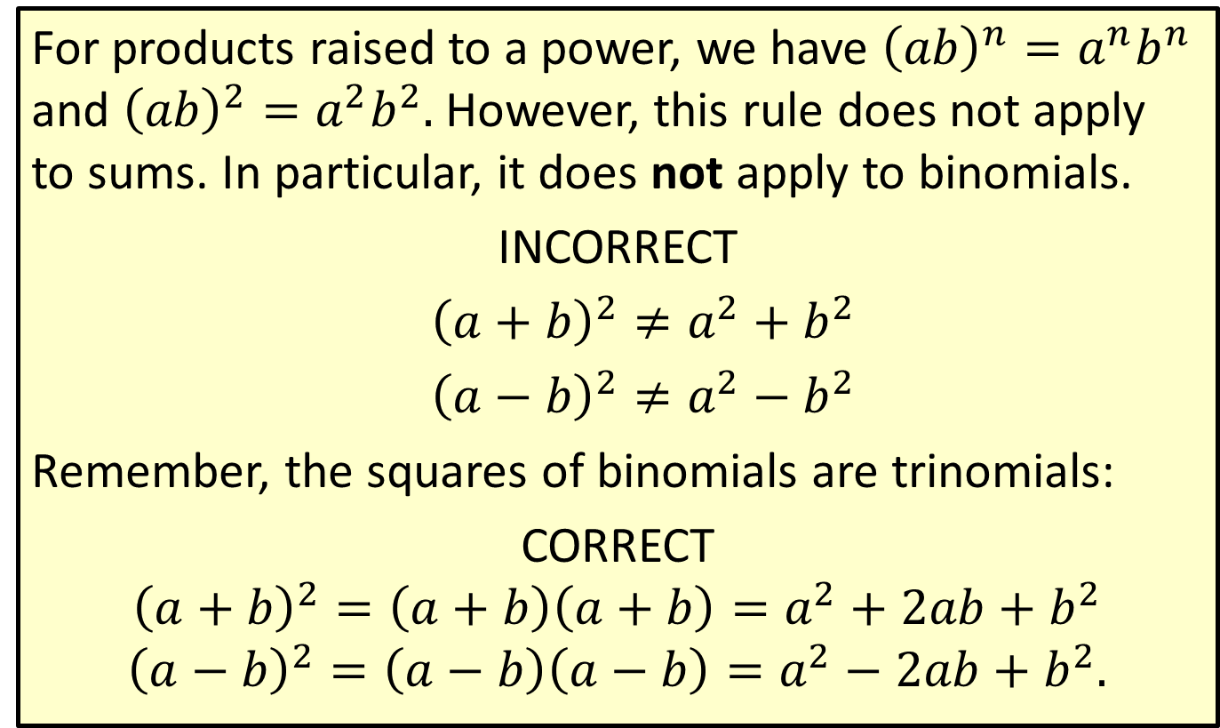
Caution: Common Error
For products raised to a power, we have ${\left(ab\right)}^{n}=a^{n}b^{n}$ and ${\left(ab\right)}^{2}=a^{2}b^{2}.$ However, this rule does not apply to sums. In particular, it does not apply to binomials.
INCORRECT
${\left(a+b\right)}^{2}≠a^{2}+b^{2}$
${\left(a−b\right)}^{2}≠a^{2}−b^{2}$
Remember, the squares of binomials are trinomials:
CORRECT
$${\left(a+b\right)}^{2}=\left(a+b\right)\left(a+b\right)=a^{2}+2ab+b^{2}$$
$${\left(a−b\right)}^{2}=\left(a−b\right)\left(a−b\right)=a^{2}−2ab+b^{2}.$$

