Slide 1
Section 5.1
GCF and an Introduction to Factoring Polynomials

Slide 2
Procedure: Procedure for Finding the GCF of a Set of Terms
​Find the prime factorization of all integers and integer coefficients.
​List all the factors that are common to all terms, including variables.
​Raise each common factor to the smallest exponent on that factor in the list.
​Multiply these powers to find the GCF.
Note: If there is no common prime factor or variable, then the GCF is 1.

Slide 3
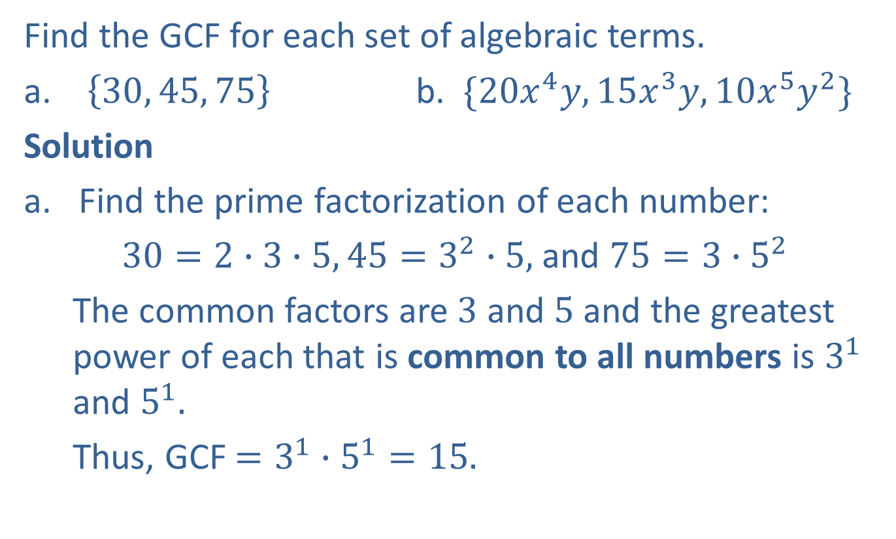
Example 1: Finding the GCF
Find the GCF for each set of algebraic terms.
​ $\left\{30, 45, 75\right\}$ b. $\{20x^{4}y, 15x^{3}y, 10x^{5}y^{2}\}$
Solution
Find the prime factorization of each number:
$30=2∙3∙5, 45=3^{2}∙5,$ and $75=3∙5^{2}$
The common factors are $3$ and $5$ and the greatest power of each that is common to all numbers is $3^{1}$ and $5^{1}.$
Thus, GCF $=3^{1}∙5^{1}=15.$

Slide 4
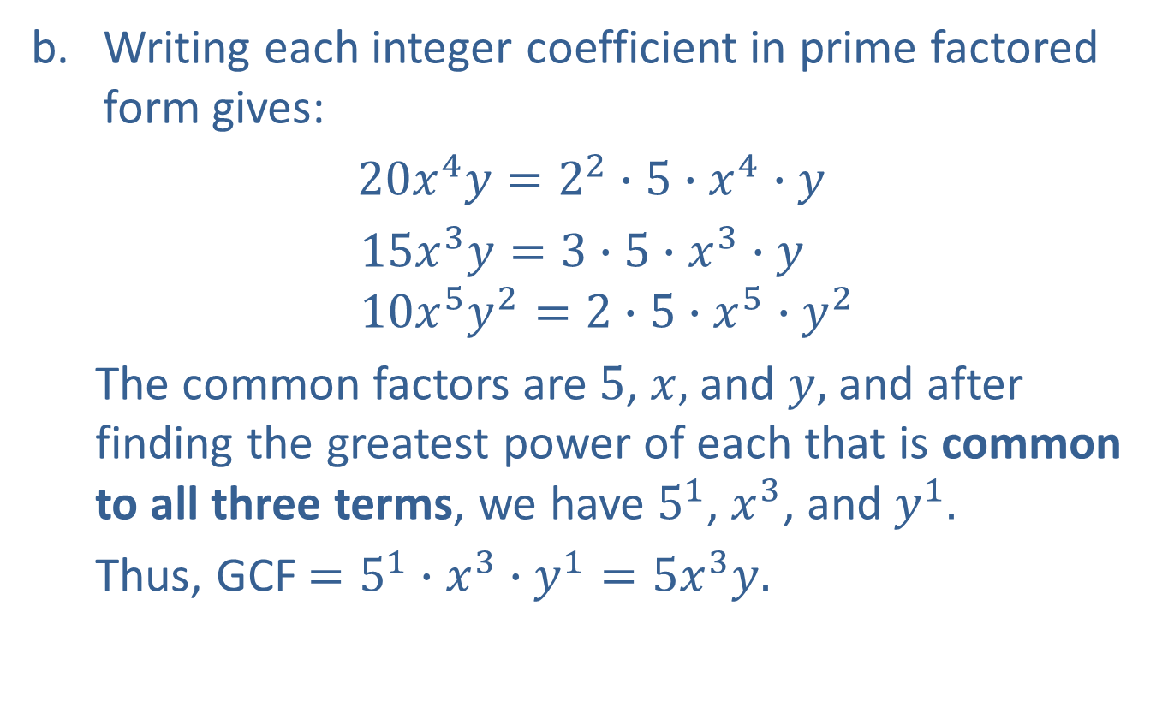
Example 1: Finding the GCF (cont.)
Writing each integer coefficient in prime factored form gives:
$20x^{4}y=2^{2}∙5∙x^{4}∙y$
$15x^{3}y=3$ $∙5∙x^{3}∙y$
$$10x^{5}y^{2}=2∙5∙x^{5}∙y^{2}$$
The common factors are $5$, $x,$and $y,$ and after finding the greatest power of each that is common to all three terms, we have $5^{1}$, $x^{3}$, and $y^{1}.$
Thus, GCF $=5^{1}∙x^{3}∙y^{1}=5x^{3}y.$

Slide 5
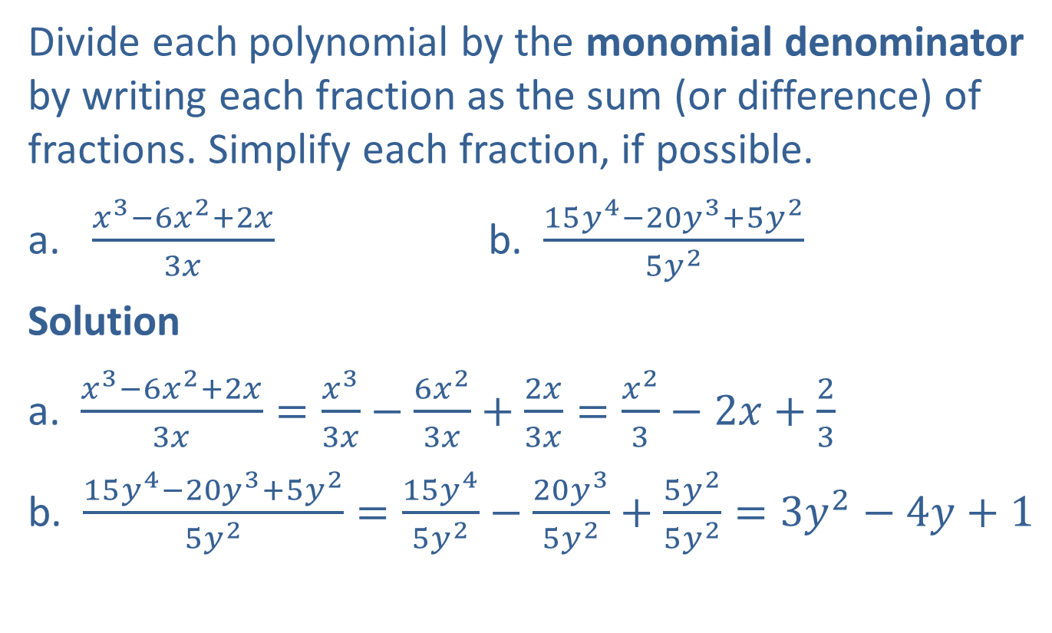
Example 2: Dividing by a Monomial
Divide each polynomial by the monomial denominator by writing each fraction as the sum (or difference) of fractions. Simplify each fraction, if possible.
​$\frac{x^{3}−6x^{2}+2x}{3x}$ b. ​$\frac{15y^{4}−20y^{3}+5y^{2}}{5y^{2}}$
Solution
a. $\frac{x^{3}−6x^{2}+2x}{3x}=\frac{x^{3}}{3x}−\frac{6x^{2}}{3x}+\frac{2x}{3x}=\frac{x^{2}}{3}−2x+\frac{2}{3}$
b. $\frac{15y^{4}−20y^{3}+5y^{2}}{5y^{2}}=\frac{15y^{4}}{5y^{2}}−\frac{20y^{3}}{5y^{2}}+\frac{5y^{2}}{5y^{2}}=3y^{2}−4y+1$

Slide 6
Procedure: Factoring Out the GCF
​Find the GCF of the terms in the polynomial.
​Divide this monomial factor into each term of the polynomial, resulting in another polynomial factor.
The product of the GCF and this new polynomial factor is a factored form of the original polynomial.

Slide 7
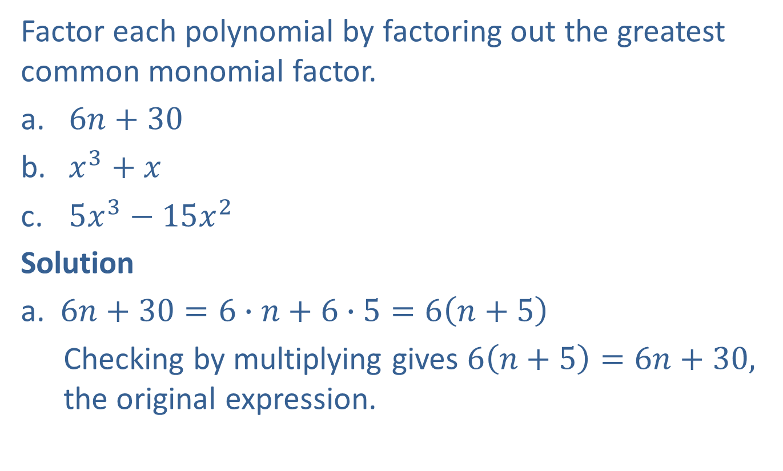
Example 3: Factoring Out the GCF of a Polynomial
Factor each polynomial by factoring out the greatest common monomial factor.
​$6n+30$
​$x^{3}+x$
​$5x^{3}−15x^{2}$
Solution
a. $6n+30=6∙n+6∙5=6\left(n+5\right)$
Checking by multiplying gives $6\left(n+5\right)=6n+30,$ the original expression.

Slide 8

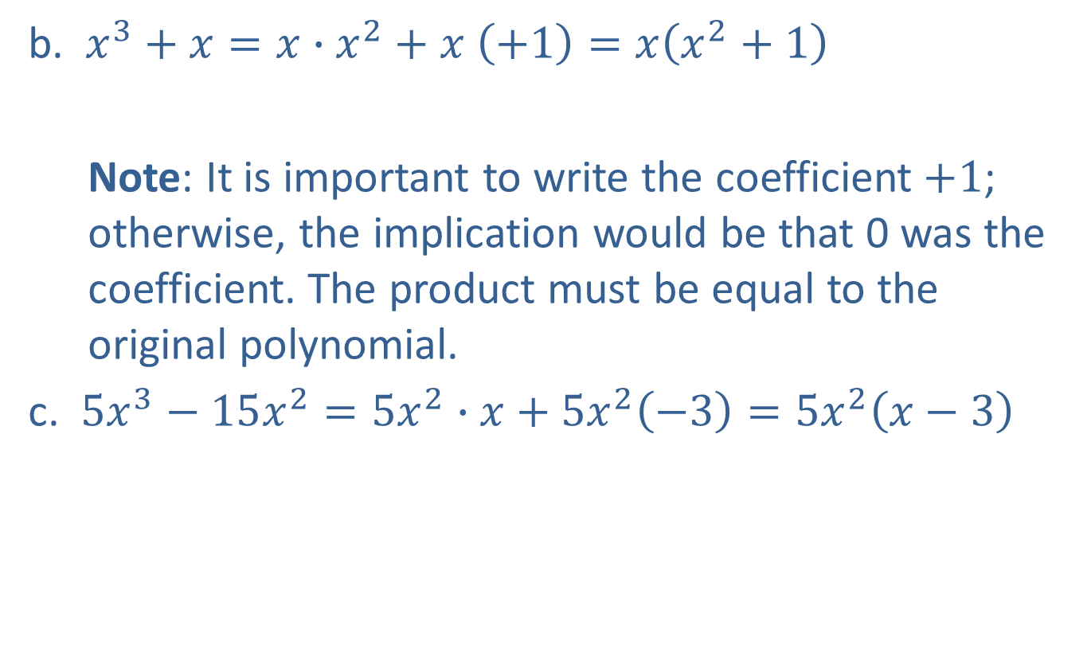
Example 3: Factoring Out the GCF of a Polynomial (cont.)
b. $x^{3}+x=x∙x^{2}+x \left(+1\right)=x\left(x^{2}+1\right)$
Note: It is important to write the coefficient $+1$; otherwise, the implication would be that 0 was the coefficient. The product must be equal to the original polynomial.
c. $5x^{3}−15x^{2}=5x^{2}∙x+5x^{2}\left(−3\right)=5x^{2}\left(x−3\right)$
$+1$ is the coefficient of $x$.

Slide 9

Example 4: Factoring Out the GCF of a Polynomial
Factor $2x^{4}−3x^{2}+2$ by factoring out the GCF.
Solution
$$2x^{4}−3x^{2}+2$$
This polynomial has no common monomial factor other than $1$. In fact, this polynomial is not factorable.

Slide 10
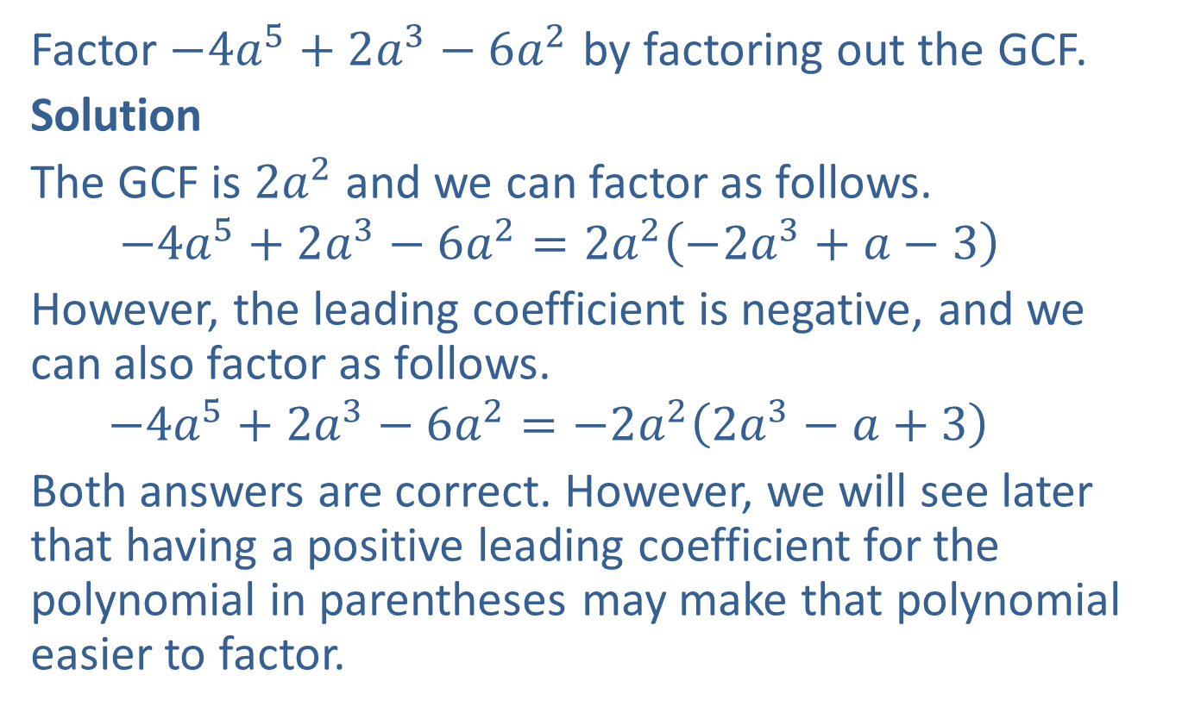
Example 5: Factoring Out the GCF of a Polynomial
Factor $−4a^{5}+2a^{3}−6a^{2}$ by factoring out the GCF.
Solution
The GCF is $2a^{2}$ and we can factor as follows.
$$−4a^{5}+2a^{3}−6a^{2}=2a^{2}\left(−2a^{3}+a−3\right)$$
However, the leading coefficient is negative, and we can also factor as follows.
$$−4a^{5}+2a^{3}−6a^{2}=−2a^{2}\left(2a^{3}−a+3\right)$$
Both answers are correct. However, we will see later that having a positive leading coefficient for the polynomial in parentheses may make that polynomial easier to factor.

Slide 11

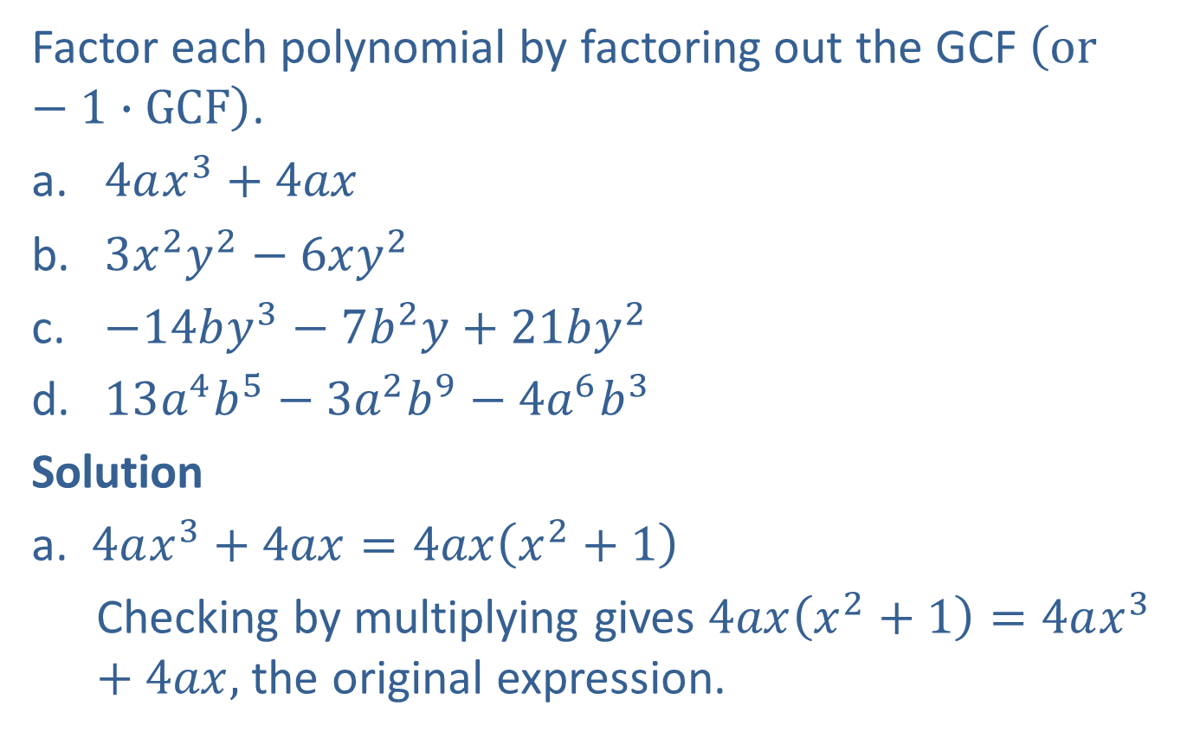
Example 6: Factoring Out the GCF of a Multi-Variable Polynomial
Factor each polynomial by factoring out the GCF $\left(or−1∙GCF\right)$.
​$4ax^{3}+4ax$
​$3x^{2}y^{2}−6xy^{2}$
​$−14by^{3}−7b^{2}y+21by^{2}$
​$13a^{4}b^{5}−3a^{2}b^{9}−4a^{6}b^{3}$
Solution
a. $4ax^{3}+4ax=4ax\left(x^{2}+1\right)$
Checking by multiplying gives $4ax\left(x^{2}+1\right)=4ax^{3}+4ax,$ the original expression.
Note that $4ax=1∙4ax.$

Slide 12
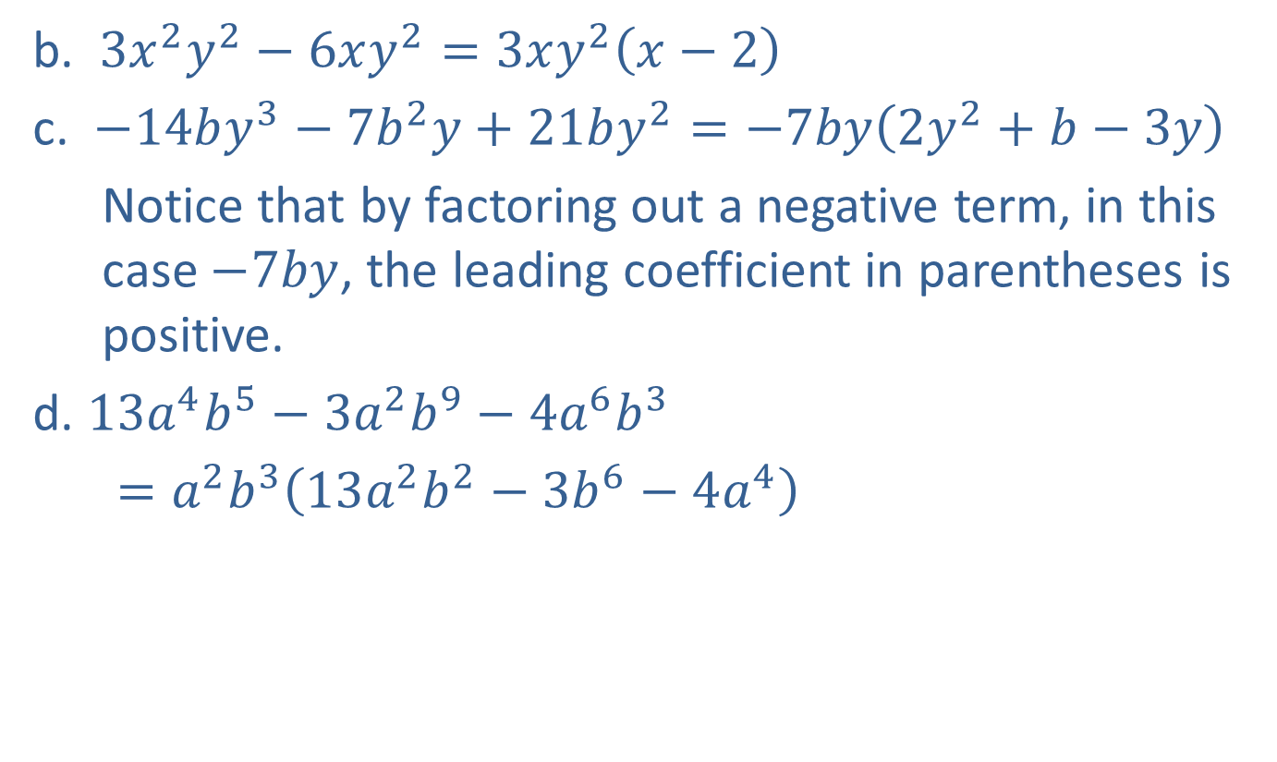
Example 6: Factoring Out the GCF of a Multi-Variable Polynomial (cont.)
b. $3x^{2}y^{2}−6xy^{2}=3xy^{2}\left(x−2\right)$
c. $−14by^{3}−7b^{2}y+21by^{2}=−7by\left(2y^{2}+b−3y\right)$
Notice that by factoring out a negative term, in this case $−7by$, the leading coefficient in parentheses is positive.
d. $13a^{4}b^{5}−3a^{2}b^{9}−4a^{6}b^{3}$
$=a^{2}b^{3}\left(13a^{2}b^{2}−3b^{6}−4a^{4}\right)$

Slide 13

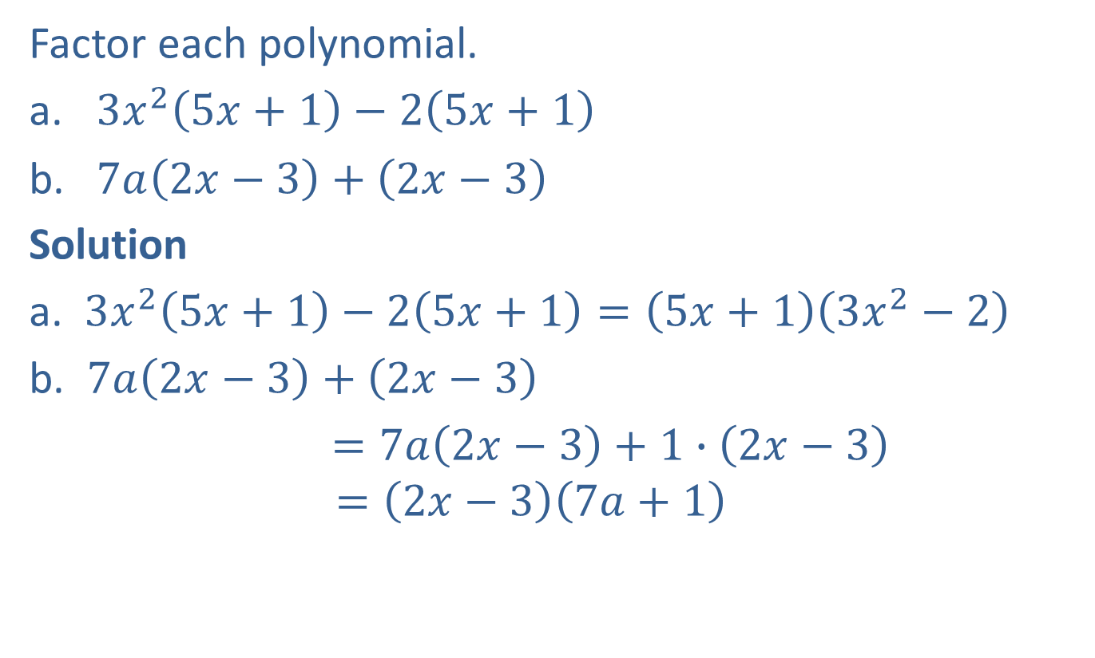
Example 7: Factoring Out a Common Binomial Factor
Factor each polynomial.
​$3x^{2}\left(5x+1\right)−2\left(5x+1\right)$
​$7a\left(2x−3\right)+\left(2x−3\right)$
Solution
a. $3x^{2}\left(5x+1\right)−2\left(5x+1\right)=\left(5x+1\right)\left(3x^{2}−2\right)$
b. $7a\left(2x−3\right)+\left(2x−3\right)$
$=7a\left(2x−3\right)+1∙\left(2x−3\right)$
$$=\left(2x−3\right)\left(7a+1\right)$$
$1$is the understood coefficient of $\left(2x−3\right).$

Slide 14

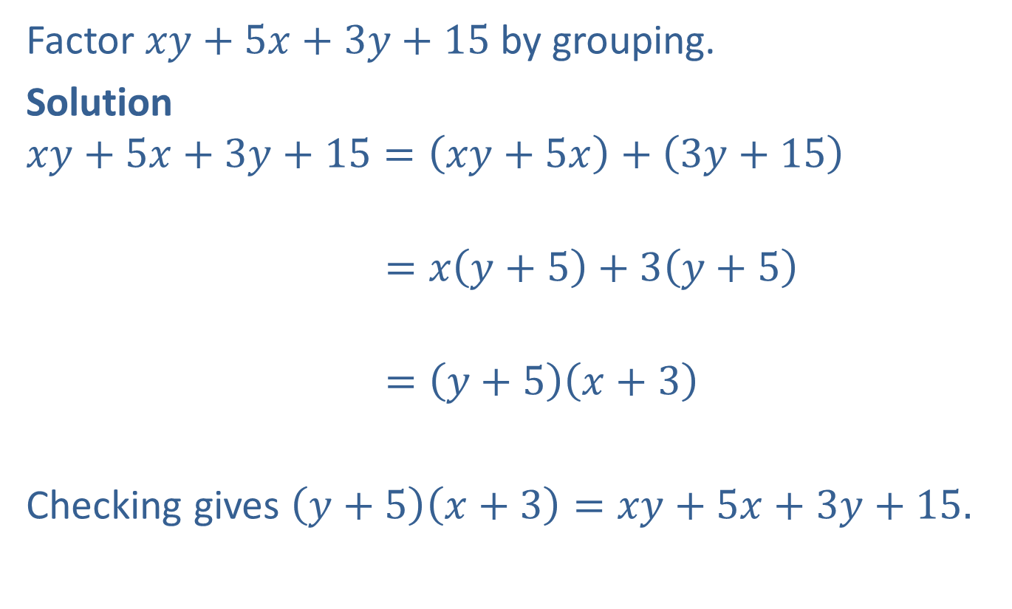
Example 8: Factoring Polynomials by Grouping
Factor $xy+5x+3y+15$ by grouping.
Solution
$$xy+5x+3y+15=\left(xy+5x\right)+\left(3y+15\right)$$
$$=x\left(y+5\right)+3\left(y+5\right)$$
$$=\left(y+5\right)\left(x+3\right)$$
Checking gives $\left(y+5\right)\left(x+3\right)=xy+5x+3y+15.$
Group terms that have a common monomial factor.
Use the distributive property.
$\left(y+5\right)$ is a common factor.

Slide 15
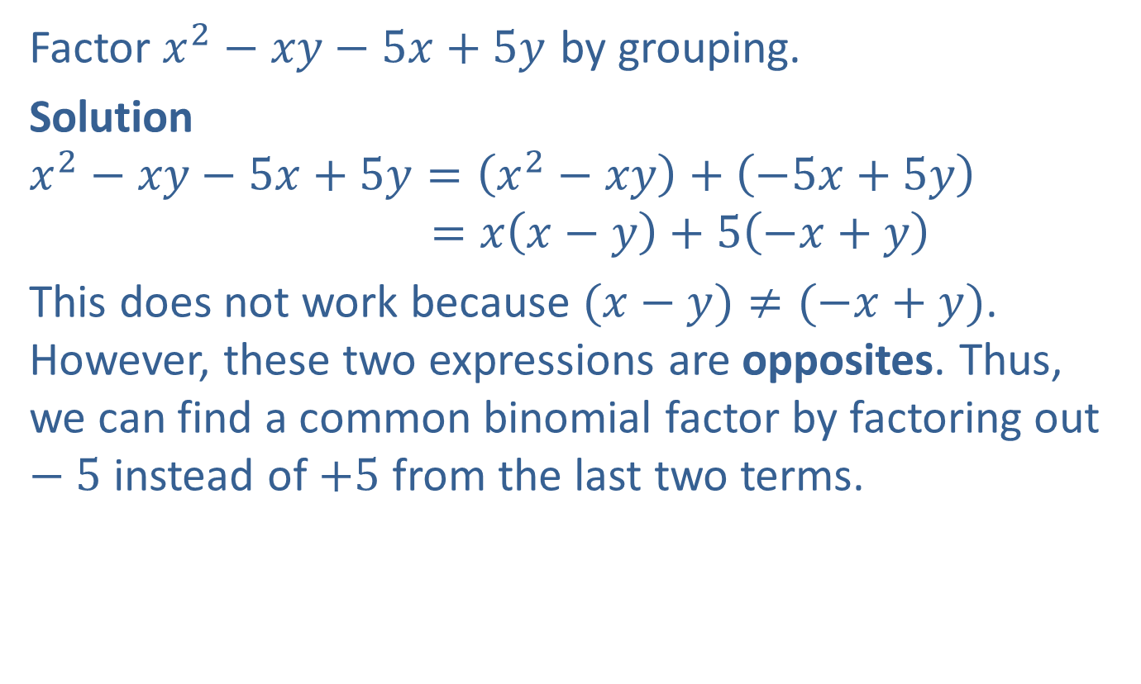
Example 9: Factoring Polynomials by Grouping
Factor $x^{2}−xy−5x+5y$ by grouping.
Solution
$$x^{2}−xy−5x+5y=\left(x^{2}−xy\right)+\left(−5x+5y\right)$$
$$=x\left(x−y\right)+5\left(−x+y\right)$$
This does not work because $(x−y)≠(−x+y)$. However, these two expressions are opposites. Thus, we can find a common binomial factor by factoring out $−5$ instead of $+5$ from the last two terms.

Slide 16

Example 9: Factoring Polynomials by Grouping (cont.)
$$x^{2}−xy−5x+5y=\left(x^{2}−xy\right)+\left(−5x+5y\right)$$
$$=x\left(x−y\right)−5\left(x−y\right)$$
$$=\left(x−y\right)\left(x−5\right)$$
Success!

Slide 17
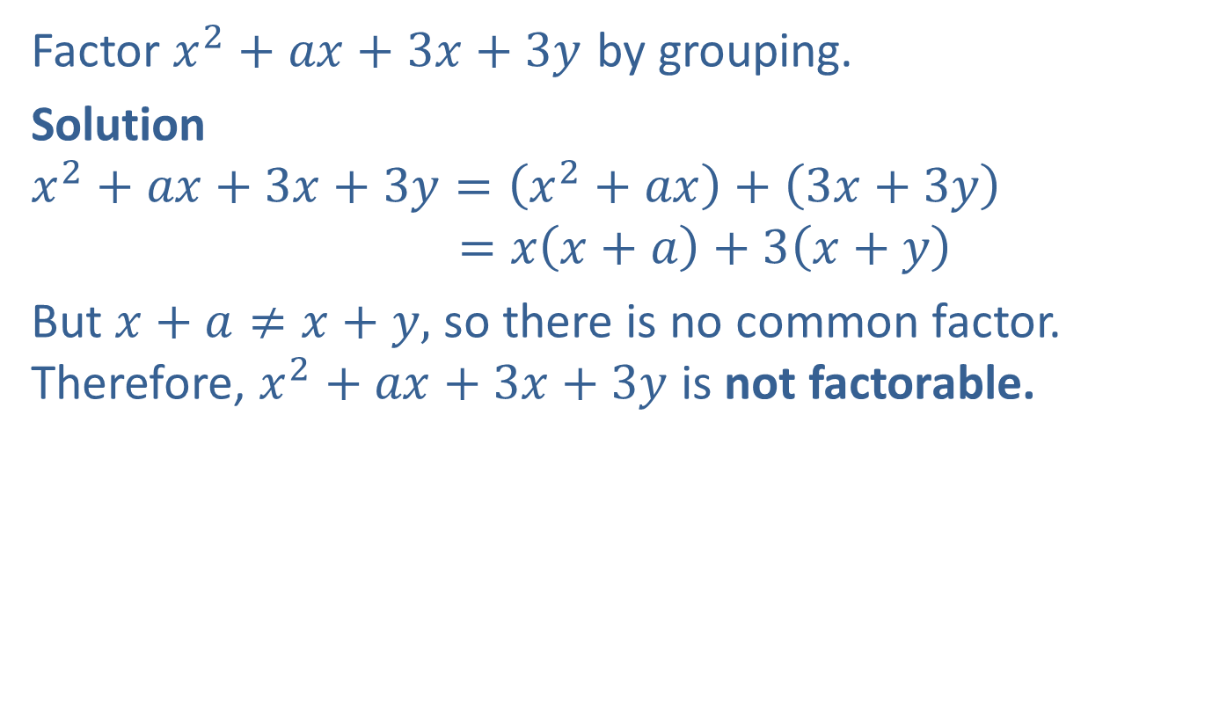
Example 10: Factoring Polynomials by Grouping
Factor $x^{2}+ax+3x+3y$ by grouping.
Solution
$$x^{2}+ax+3x+3y=\left(x^{2}+ax\right)+\left(3x+3y\right)$$
$$=x\left(x+a\right)+3\left(x+y\right)$$
But $x+a≠x+y,$ so there is no common factor. Therefore, $x^{2}+ax+3x+3y$ is not factorable.

Slide 18
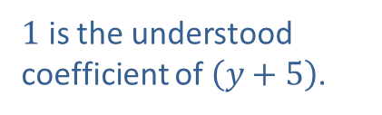

Example 11: Factoring Polynomials by Grouping
Factor $xy+5x+y+5$ by grouping.
Solution
$$xy+5x+y+5=\left(xy+5x\right)+\left(y+5\right)$$
$$=x\left(y+5\right)+1∙\left(y+5\right)$$
$$=\left(y+5\right)\left(x+1\right)$$
$1$ is the understood coefficient of $\left(y+5\right)$.

Slide 19
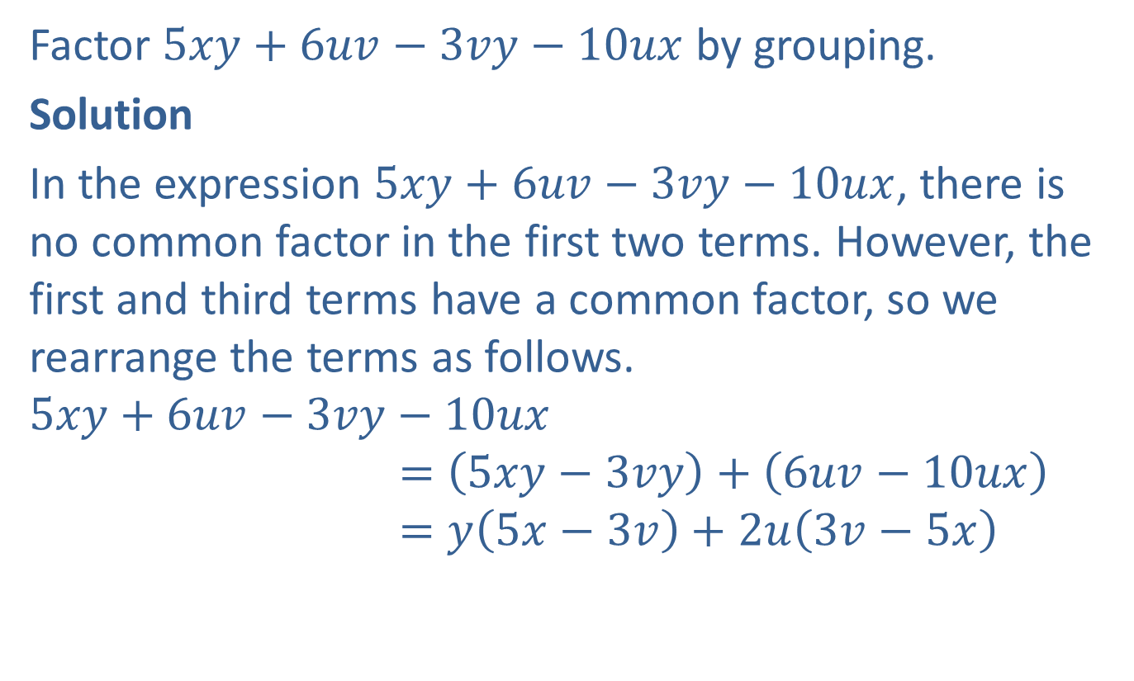
Example 12: Factoring Polynomials by Grouping
Factor $5xy+6uv−3vy−10ux$ by grouping.
Solution
In the expression $5xy+6uv−3vy−10ux$, there is no common factor in the first two terms. However, the first and third terms have a common factor, so we rearrange the terms as follows.
$$5xy+6uv−3vy−10ux$$
$$=\left(5xy−3vy\right)+\left(6uv−10ux\right)$$
$$=y\left(5x−3v\right)+2u\left(3v−5x\right)$$

Slide 20

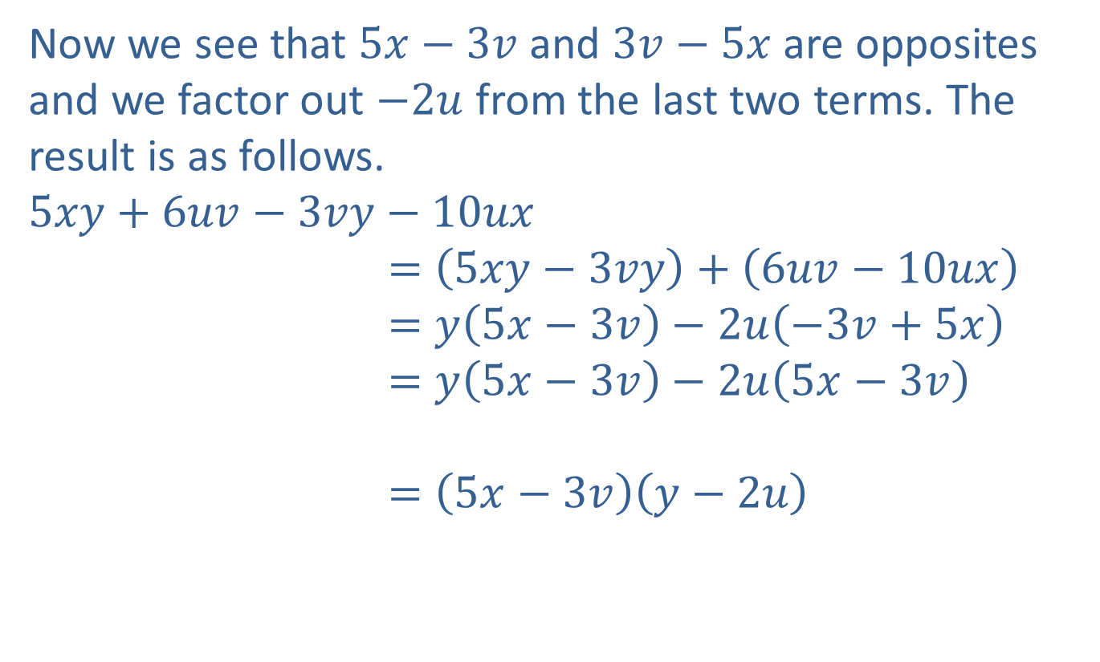
Example 12: Factoring Polynomials by Grouping (cont.)
Now we see that $5x−3v$ and $3v−5x$ are opposites and we factor out $−2u$from the last two terms. The result is as follows.
$$5xy+6uv−3vy−10ux$$
$$=\left(5xy−3vy\right)+\left(6uv−10ux\right)$$
$$=y\left(5x−3v\right)−2u\left(−3v+5x\right)$$
$$=y\left(5x−3v\right)−2u\left(5x−3v\right)$$
$$=\left(5x−3v\right)\left(y−2u\right)$$
Note: $5x−3v=−3v+5x$

