Slide 1
Section 5.2
Factoring Trinomials

Slide 2
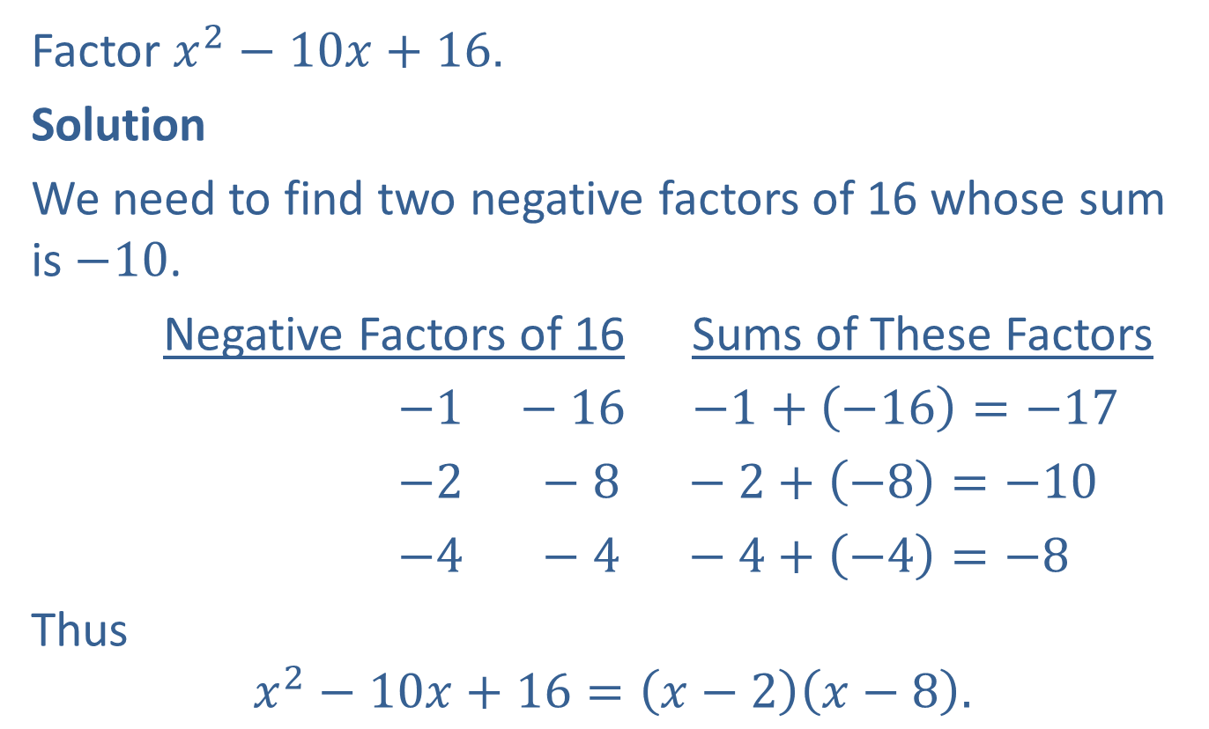
Example 1: Factoring Trinomials with Leading Coefficient 1
Factor $x^{2}−10x+16$.
Solution
We need to find two negative factors of 16 whose sum is $−10$.
Negative Factors of 16 Sums of These Factors
$−1 −16$ $−1+\left(−16\right)=−17$
$−2 −8 −2+\left(−8\right)=−10$
$−4 −4 −4+\left(−4\right)=−8$
Thus
$$x^{2}−10x+16=\left(x−2\right)\left(x−8\right).$$

Slide 3

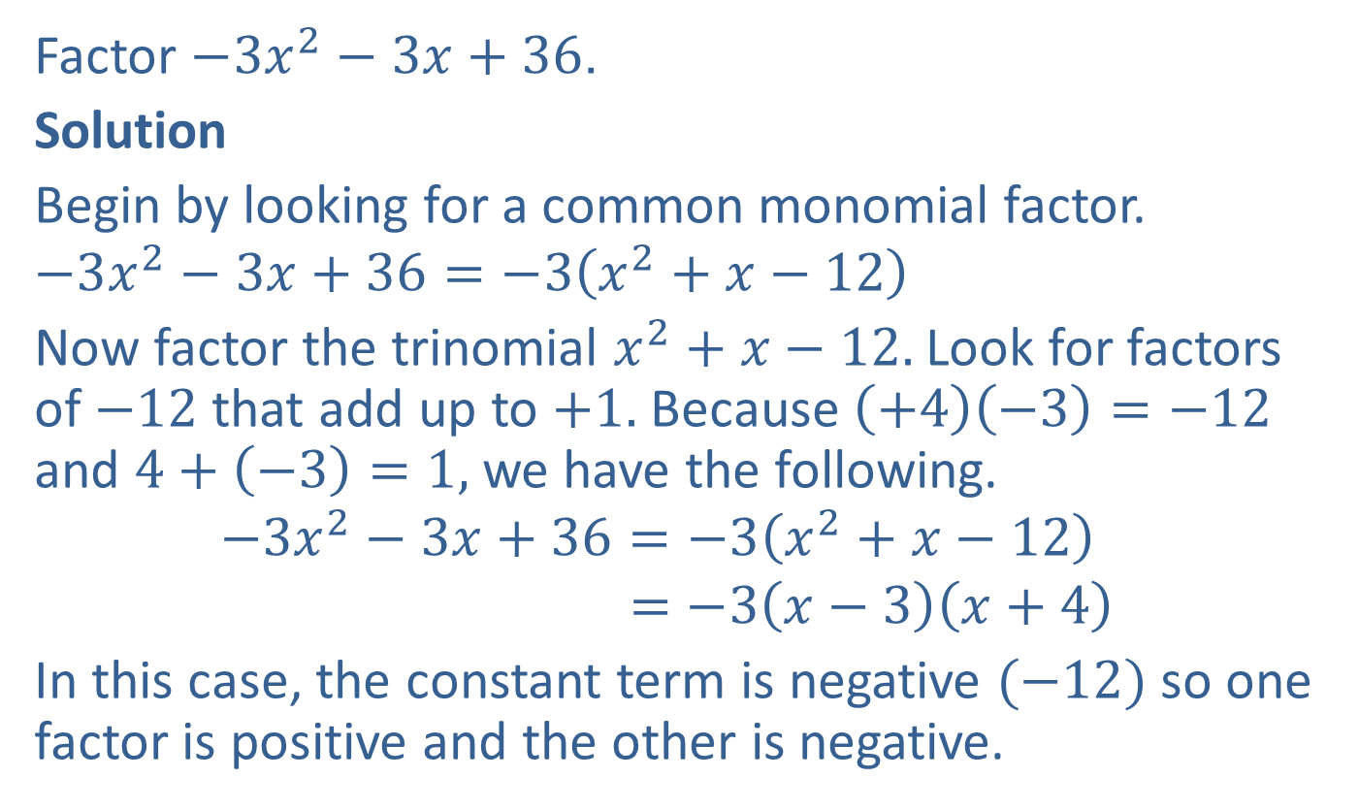
Example 2: Finding a Common Monomial Factor
Factor $−3x^{2}−3x+36$.
Solution
Begin by looking for a common monomial factor.
$$−3x^{2}−3x+36=−3\left(x^{2}+x−12\right)$$
Now factor the trinomial $x^{2}+x−12.$ Look for factors of $−12$ that add up to $+1.$ Because $\left(+4\right)\left(−3\right)=−12$ and $4+\left(−3\right)=1,$ we have the following.
$$−3x^{2}−3x+36=−3\left(x^{2}+x−12\right)$$
$$=−3\left(x−3\right)\left(x+4\right)$$
In this case, the constant term is negative $(−12)$so one factor is positive and the other is negative.
$−3$ is a common factor.

Slide 4
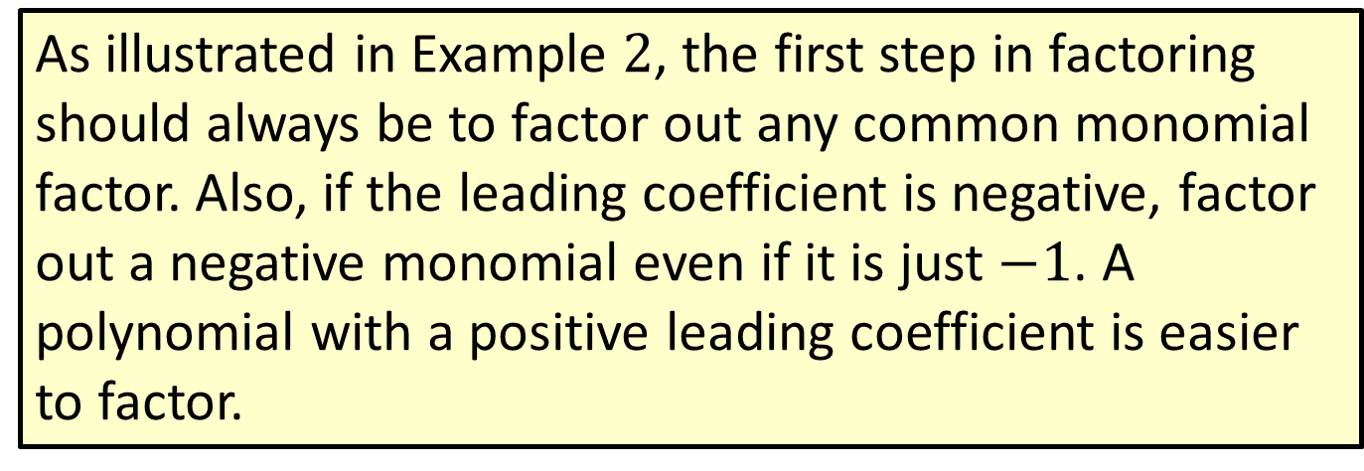
Note
As illustrated in Example $2$, the first step in factoring should always be to factor out any common monomial factor. Also, if the leading coefficient is negative, factor out a negative monomial even if it is just $−1$. A polynomial with a positive leading coefficient is easier to factor.

Slide 5
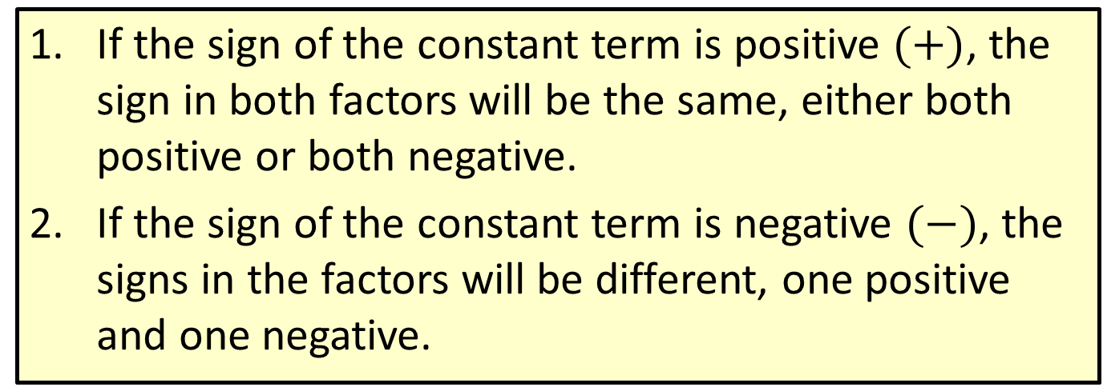
Procedure: Guidelines for the Trial-and-Error Method
If the sign of the constant term is positive $(+)$, the sign in both factors will be the same, either both positive or both negative.
If the sign of the constant term is negative $(−)$, the signs in the factors will be different, one positive and one negative.

Slide 6

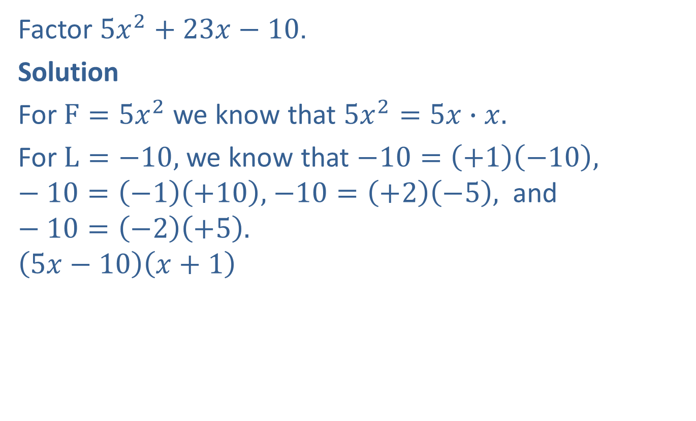
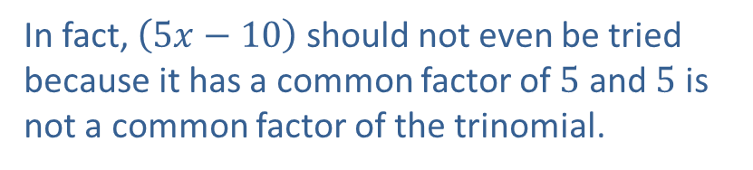


Example 3: Using the Trial and Error Method
Factor $5x^{2}+23x−10$.
Solution
For $F=5x^{2}$ we know that $5x^{2}=5x∙x.$
For $L=−10,$ we know that $−10=\left(+1\right)\left(−10\right),$ $−10=\left(−1\right)\left(+10\right),$ $−10=\left(+2\right)\left(−5\right),$ and $−10=\left(−2\right)\left(+5\right).$
$$\left(5x−10\right)\left(x+1\right)$$
$5x−10x=−5x$ is the wrong middle term.
In fact, $\left(5x−10\right)$ should not even be tried
because it has a common factor of $5$ and $5$ is
not a common factor of the trinomial.
$$−10x$$
$$5x$$

Slide 7




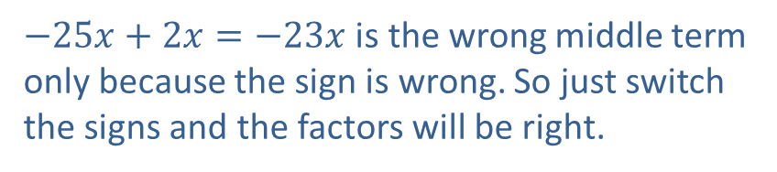





Example 3: Using the Trial and Error Method (cont.)
$$\left(5x−1\right)\left(x+10\right)$$
$$\left(5x+2\right)\left(x−5\right)$$
$$\left(5x−2\right)\left(x+5\right)$$
Therefore, $5x^{2}+23x−10=\left(5x−2\right)\left(x+5\right).$
$50x−x=49x$ is the wrong middle term.
$$−x$$
$$50x$$
$−25x+2x=−23x$ is the wrong middle term only because the sign is wrong. So just switch the signs and the factors will be right.
$$2x$$
$$−25x$$
$25x−2x=23x$ is the right middle term.
$$−2x$$
$$25x$$

Slide 8
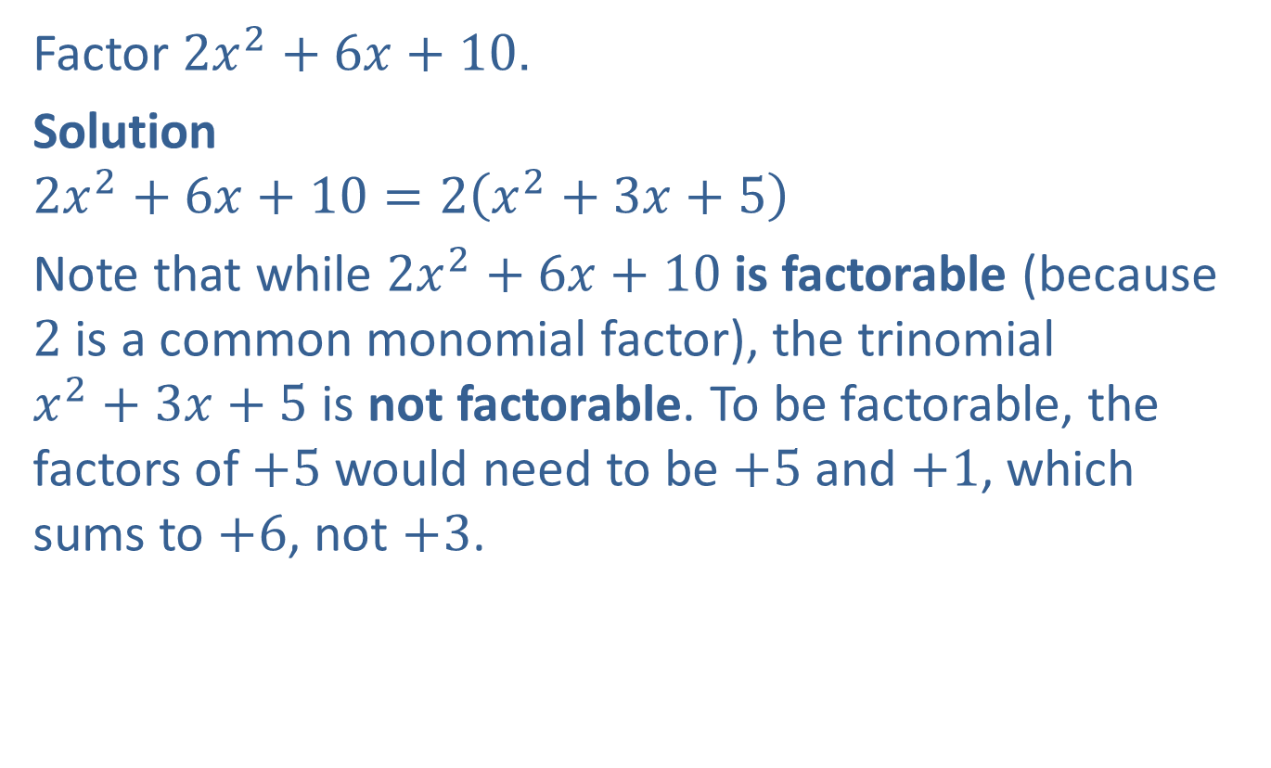
Example 4: Using the Trial and Error Method
Factor $2x^{2}+6x+10$.
Solution
$$2x^{2}+6x+10=2\left(x^{2}+3x+5\right)$$
Note that while $2x^{2}+6x+10$is factorable (because $2$ is a common monomial factor), the trinomial $x^{2}+3x+5$ is not factorable. To be factorable, the factors of $+5$ would need to be $+5$ and $+1$, which sums to $+6$, not $+3$.

Slide 9
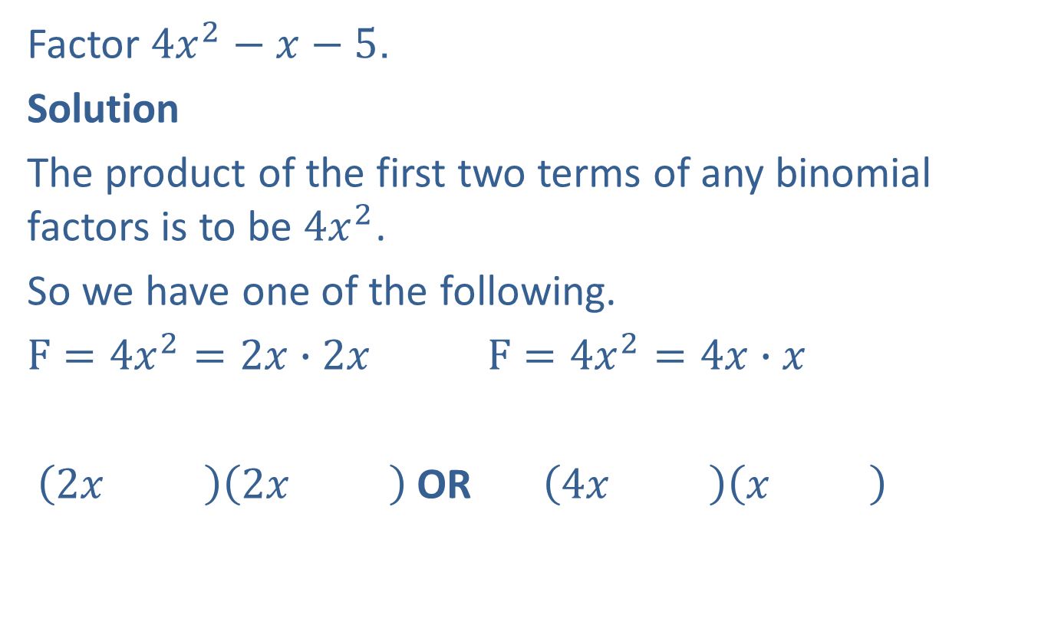
Example 5: Using the Trial and Error Method
Factor $4x^{2}−x−5$.
Solution
The product of the first two terms of any binomial factors is to be $4x^{2}$.
So we have one of the following.
$F=4x^{2}=2x∙2x$ $F=4x^{2}=4x∙x$
$\left(2x \right)\left(2x \right)$ OR $\left(4x \right)\left(x \right)$

Slide 10
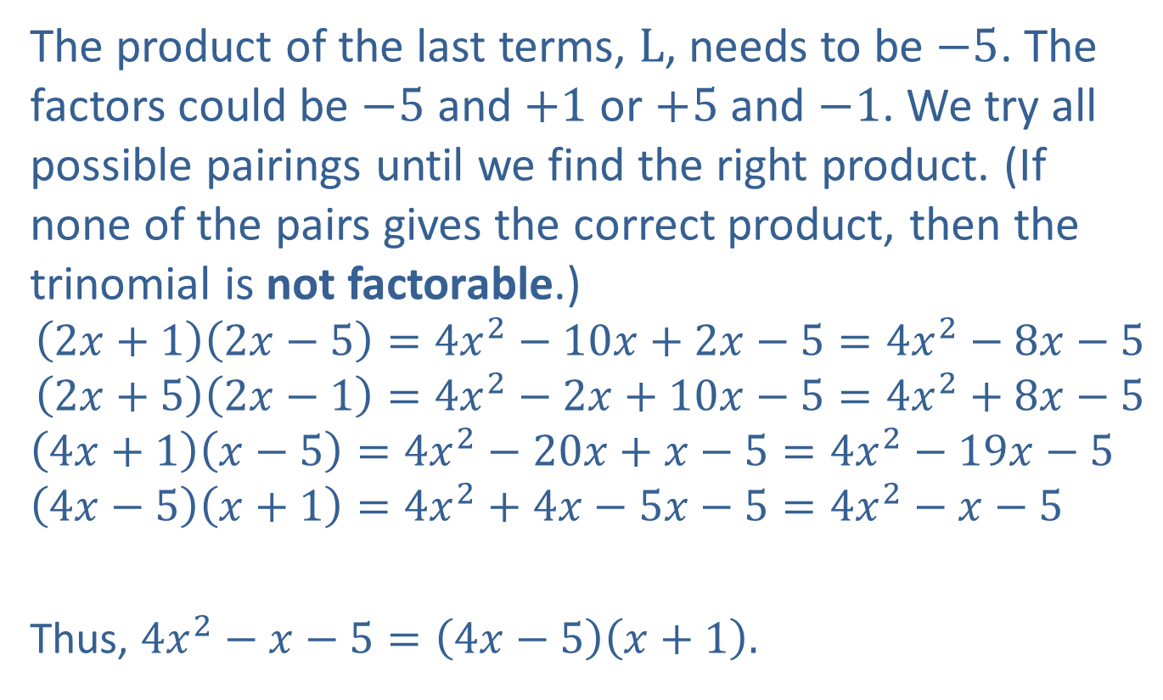
Example 5: Using the Trial and Error Method (cont.)
The product of the last terms, $L$, needs to be $−5$. The factors could be $−5$ and $+1$ or $+5$ and $−1$. We try all possible pairings until we find the right product. (If none of the pairs gives the correct product, then the trinomial is not factorable.)
$$\left(2x+1\right)\left(2x−5\right)=4x^{2}−10x+2x−5=4x^{2}−8x−5$$
$$\left(2x+5\right)\left(2x−1\right)=4x^{2}−2x+10x−5=4x^{2}+8x−5$$
$$\left(4x+1\right)\left(x−5\right)=4x^{2}−20x+x−5=4x^{2}−19x−5$$
$$\left(4x−5\right)\left(x+1\right)=4x^{2}+4x−5x−5=4x^{2}−x−5$$
Thus, $4x^{2}−x−5=\left(4x−5\right)\left(x+1\right).$
The desired product.

Slide 11
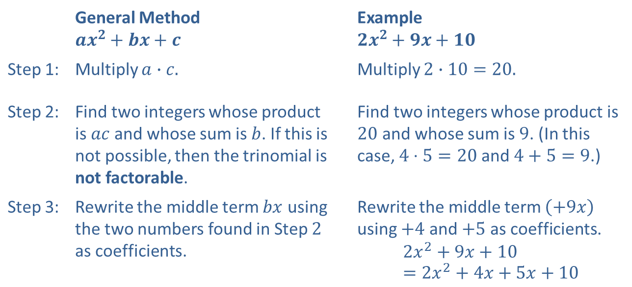

Procedure: Analysis of Factoring by the
$ac$-Method
 | General Method $$ax^{2}+bx+c$$ | Example $$2x^{2}+9x+10$$
Step 1: | Multiply $a∙c.$ | Multiply $2∙10=20.$
Step 2: | Find two integers whose product is $ac$and whose sum is $b$. If this is not possible, then the trinomial is not factorable. | Find two integers whose product is $20$ and whose sum is $9$. (In this case, $4⋅5=20$and $4+5=9$.)
Step 3: | Rewrite the middle term $bx$ using the two numbers found in Step $2$ as coefficients. | Rewrite the middle term $\left(+9x\right)$ using $+4$ and $+5$ as coefficients. $$2x^{2}+9x+10=2x^{2}+4x+5x+10$$

Slide 12
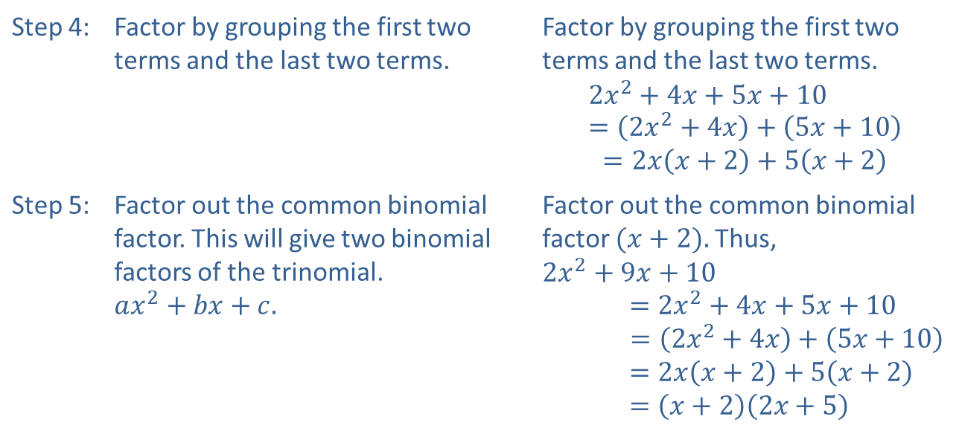

Procedure: Analysis of Factoring by the
$ac$-Method (cont.)
Step 4: | Factor by grouping the first two terms and the last two terms. | Factor by grouping the first two terms and the last two terms. $$2x^{2}+4x+5x+10=\left(2x^{2}+4x\right)+\left(5x+10\right)$$ $$=2x\left(x+2\right)+5\left(x+2\right)$$
Step 5: | Factor out the common binomial factor. This will give two binomial factors of the trinomial. $$ax^{2}+bx+c.$$ | Factor out the common binomial factor $(x+2).$Thus, $$2x^{2}+9x+10$$ $$=2x^{2}+4x+5x+10$$ $=\left(2x^{2}+4x\right)+\left(5x+10\right)$ $$=2x\left(x+2\right)+5\left(x+2\right)$$ $$=\left(x+2\right)\left(2x+5\right)$$

Slide 13
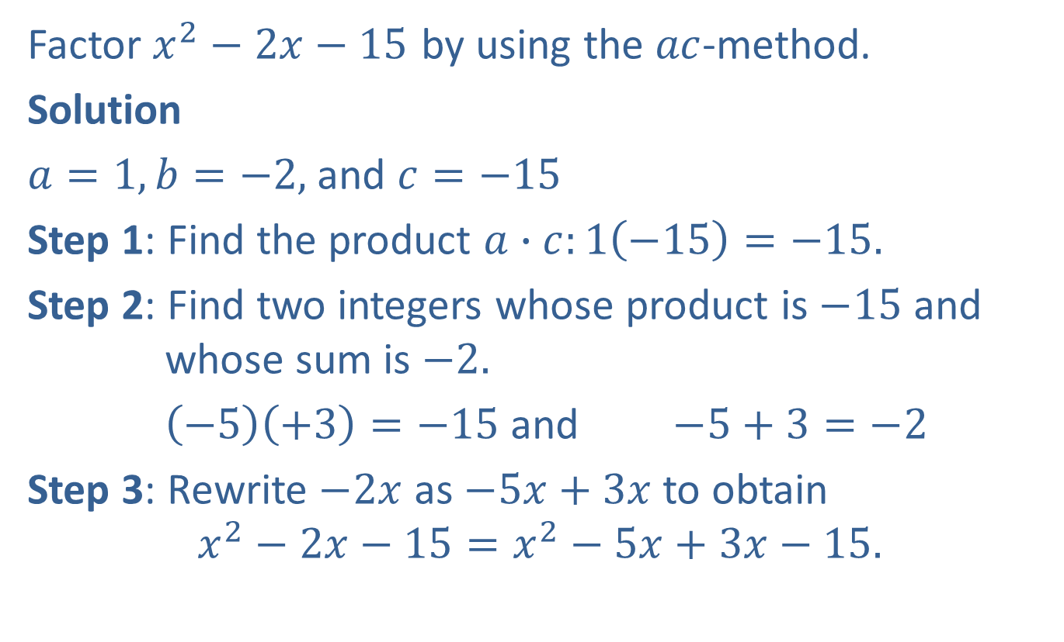
Example 6: Using the 𝑎𝑐-Method
Factor $x^{2}−2x−15$ by using the $ac$-method.
Solution
$a=1, b=−2,$ and $c=−15$
Step 1: Find the product $a∙c:1\left(−15\right)=−15.$
Step 2: Find two integers whose product is $−15$ and whose sum is $−2.$
$\left(−5\right)\left(+3\right)=−15$ and $−5+3=−2$
Step 3: Rewrite $−2x$ as $−5x+3x$ to obtain
$$x^{2}−2x−15=x^{2}−5x+3x−15.$$

Slide 14
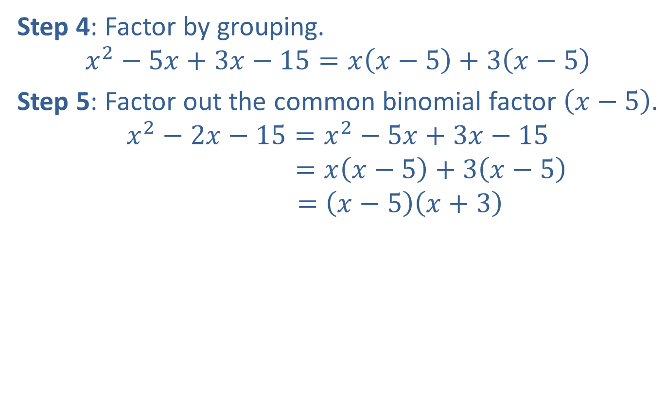
Example 6: Using the 𝑎𝑐-Method (cont.)
Step 4: Factor by grouping.
$$x^{2}−5x+3x−15=x\left(x−5\right)+3\left(x−5\right)$$
Step 5: Factor out the common binomial factor $\left(x−5\right).$
$$x^{2}−2x−15=x^{2}−5x+3x−15$$
$$=x\left(x−5\right)+3\left(x−5\right)$$
$$=\left(x−5\right)\left(x+3\right)$$

Slide 15
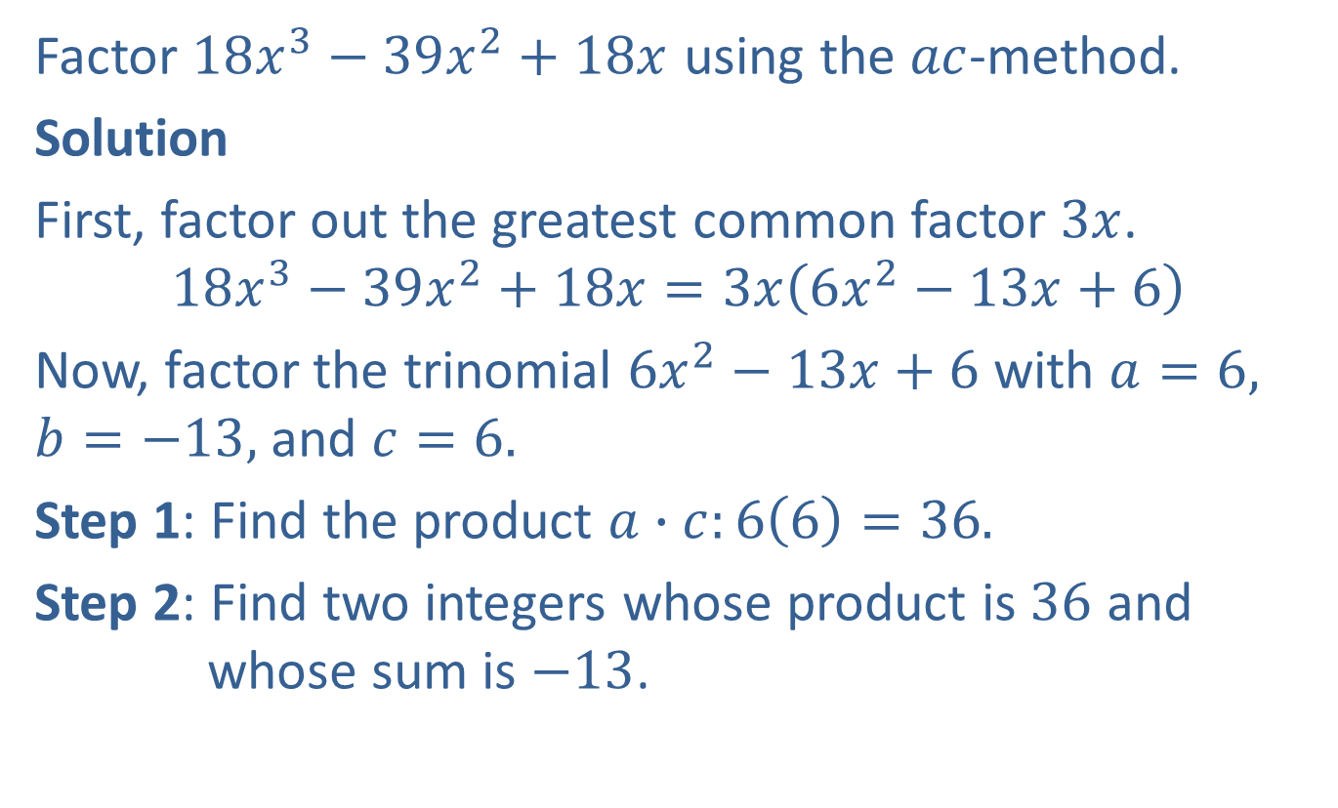
Example 7: Using the 𝑎𝑐-Method
Factor $18x^{3}−39x^{2}+18x$ using the $ac$-method.
Solution
First, factor out the greatest common factor $3x$.
$$18x^{3}−39x^{2}+18x=3x\left(6x^{2}−13x+6\right)$$
Now, factor the trinomial $6x^{2}−13x+6$ with $a=6,$ $b=−13,$ and $c=6.$
Step 1: Find the product $a∙c:6\left(6\right)=36.$
Step 2: Find two integers whose product is $36$ and whose sum is $−13$.

Slide 16
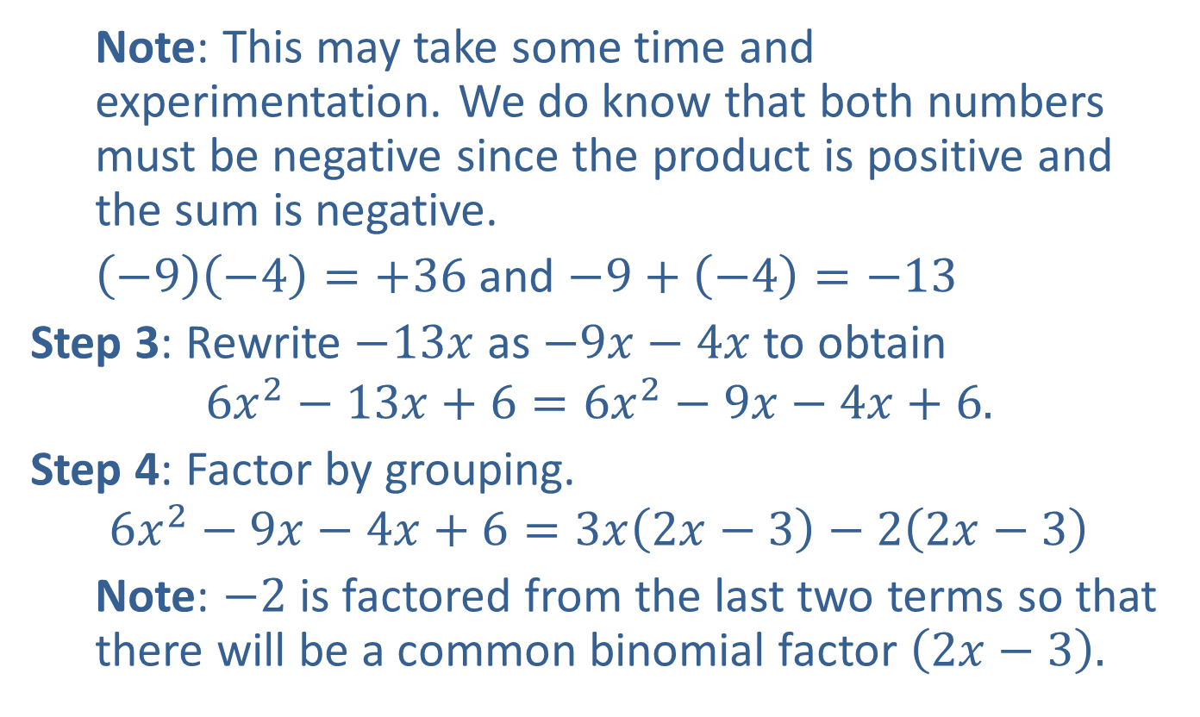
Example 7: Using the 𝑎𝑐-Method (cont.)
  Note: This may take some time and experimentation. We do know that both numbers must be negative since the product is positive and the sum is negative.
  $\left(−9\right)\left(−4\right)=+36$ and $−9+\left(−4\right)=−13$
Step 3: Rewrite $−13x$ as $−9x−4x$ to obtain
$$6x^{2}−13x+6=6x^{2}−9x−4x+6.$$
Step 4: Factor by grouping.
$$6x^{2}−9x−4x+6=3x\left(2x−3\right)−2\left(2x−3\right)$$
  Note: $−2$ is factored from the last two terms so that there will be a common binomial factor $\left(2x−3\right).$

Slide 17
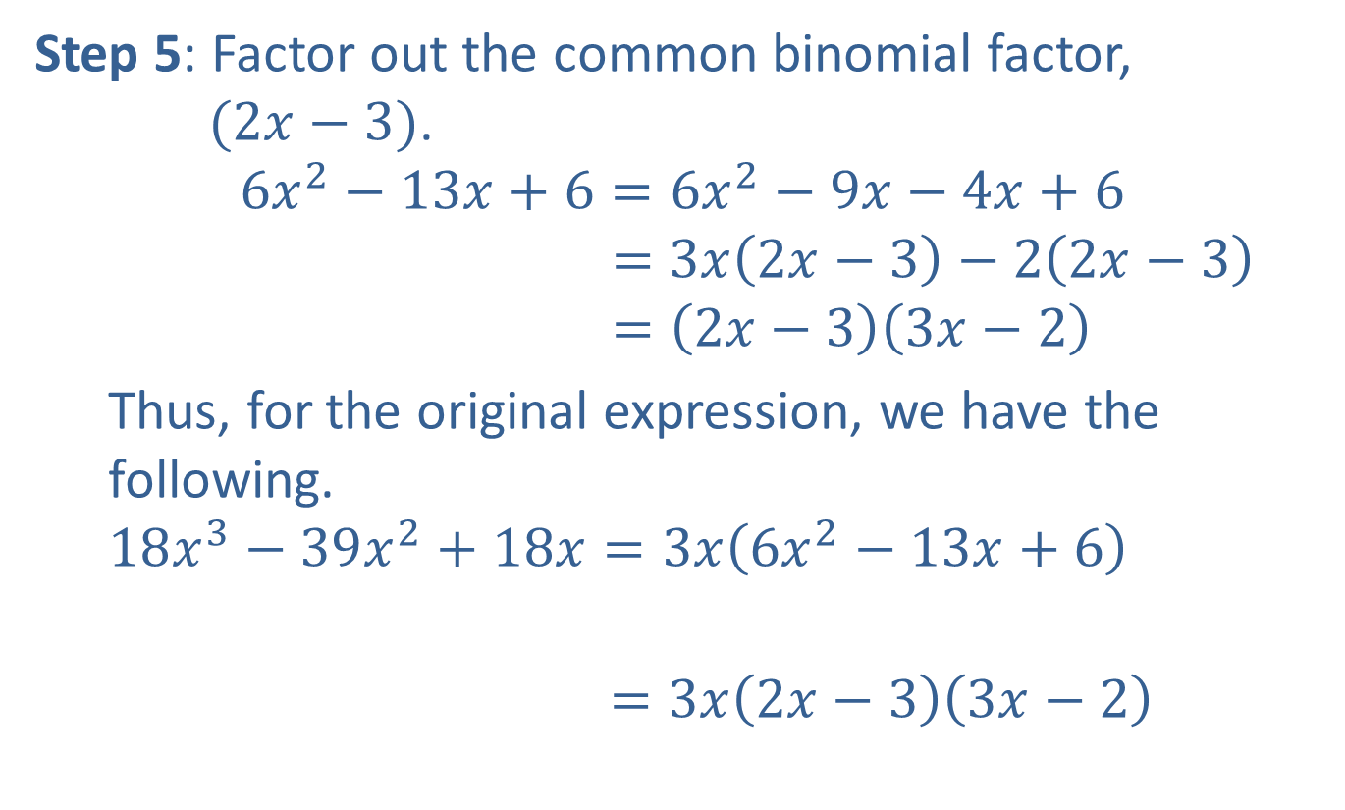
Example 7: Using the 𝑎𝑐-Method (cont.)
Step 5: Factor out the common binomial factor, $(2x−3)$.
$$6x^{2}−13x+6=6x^{2}−9x−4x+6$$
$$=3x\left(2x−3\right)−2\left(2x−3\right)$$
$$=\left(2x−3\right)\left(3x−2\right)$$
  Thus, for the original expression, we have the following.
  $$18x^{3}−39x^{2}+18x=3x\left(6x^{2}−13x+6\right)$$
  $$=3x\left(2x−3\right)\left(3x−2\right)$$
Remember to include the original GCF in the final product

Slide 18
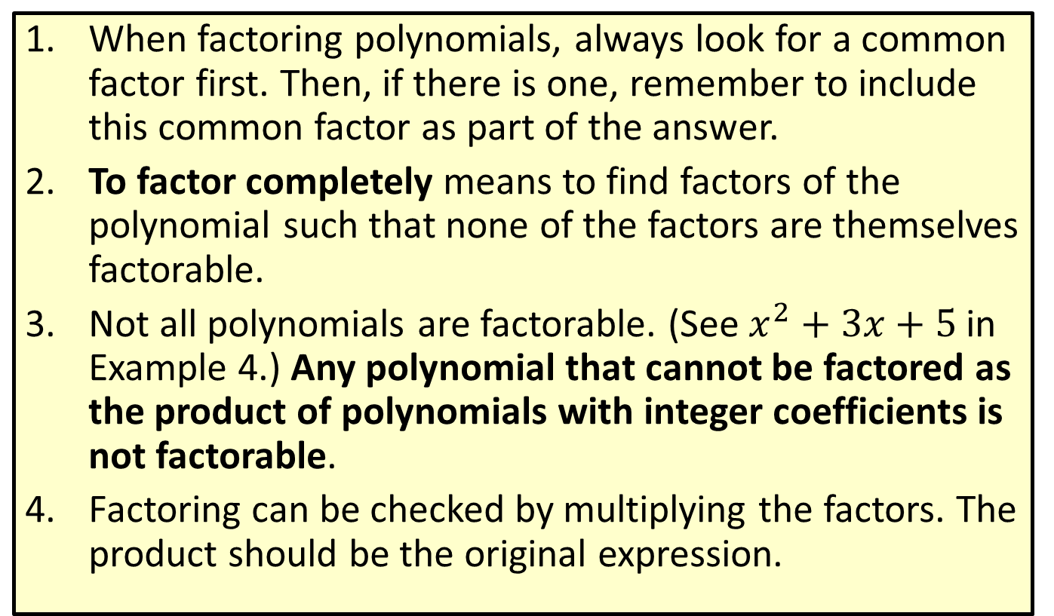
Procedure: Tips to Keep in Mind while Factoring
​When factoring polynomials, always look for a common factor first. Then, if there is one, remember to include this common factor as part of the answer.
​To factor completely means to find factors of the polynomial such that none of the factors are themselves factorable.
​Not all polynomials are factorable. (See $x^{2}+3x+5$ in Example 4.) Any polynomial that cannot be factored as the product of polynomials with integer coefficients is not factorable.
​Factoring can be checked by multiplying the factors. The product should be the original expression.

