Slide 1
Section 5.3
Special Factoring Techniques and General Guidelines for Factoring

Slide 2
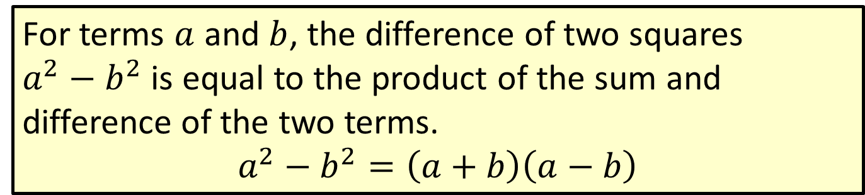
Definition: Difference of Two Squares
For terms $a$ and $b$, the difference of two squares $a^{2}−b^{2}$ is equal to the product of the sum and difference of the two terms.
$$a^{2}−b^{2}=\left(a+b\right)\left(a−b\right)$$

Slide 3

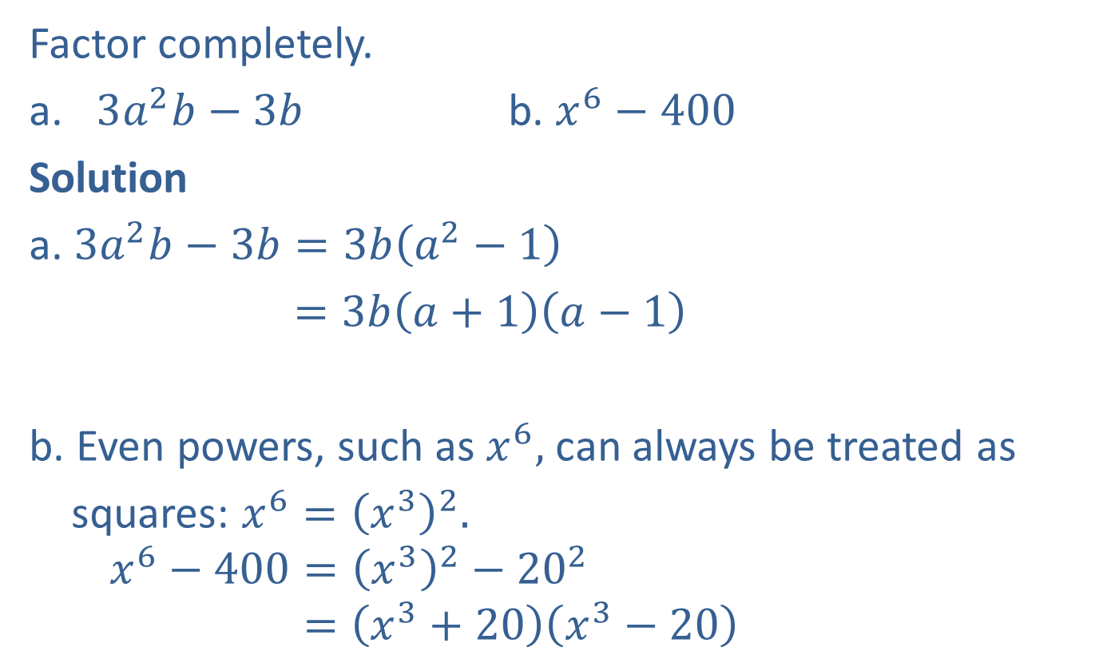

Example 1: Factoring the Difference of Two Squares
Factor completely.
​$3a^{2}b−3b$ b. ​$x^{6}−400$
Solution
a. $3a^{2}b−3b=3b\left(a^{2}−1\right)$
$=3b\left(a+1\right)\left(a−1\right)$
b. Even powers, such as $x^{6},$ can always be treated as
squares: $x^{6}={\left(x^{3}\right)}^{2}.$
$$x^{6}−400={\left(x^{3}\right)}^{2}−{20}^{2}$$
$$=\left(x^{3}+20\right)\left(x^{3}−20\right)$$
Factor out the GCF, $3b.$
Difference of two squares Don’t forget that $3b$ is a factor.
Difference of two squares

Slide 4
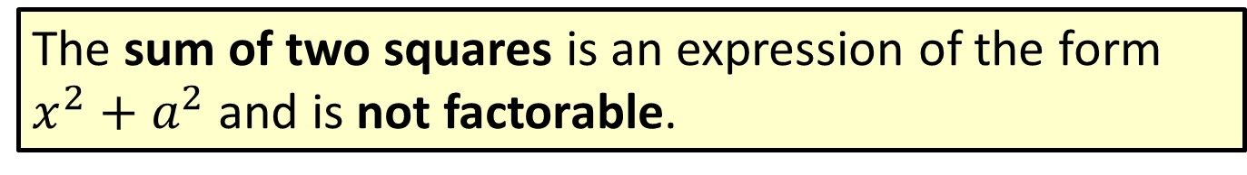
Definition: Sum of Two Squares
The sum of two squares is an expression of the form $x^{2}+a^{2}$ and is not factorable.

Slide 5
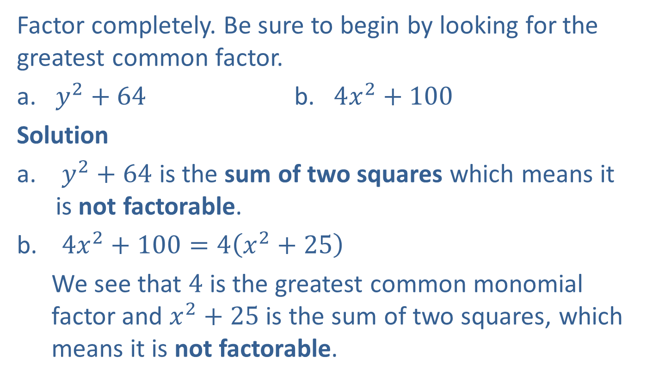
Example 2: Factoring the Sum of Two Squares (Not Factorable)
Factor completely. Be sure to begin by looking for the greatest common factor.
​$y^{2}+64$ b. ​$4x^{2}+100$
Solution
$y^{2}+64$ is the sum of two squares which means it is not factorable.
$4x^{2}+100=4\left(x^{2}+25\right)$
We see that $4$ is the greatest common monomial factor and $x^{2}+25$ is the sum of two squares, which means it is not factorable.
Factored completely

Slide 6
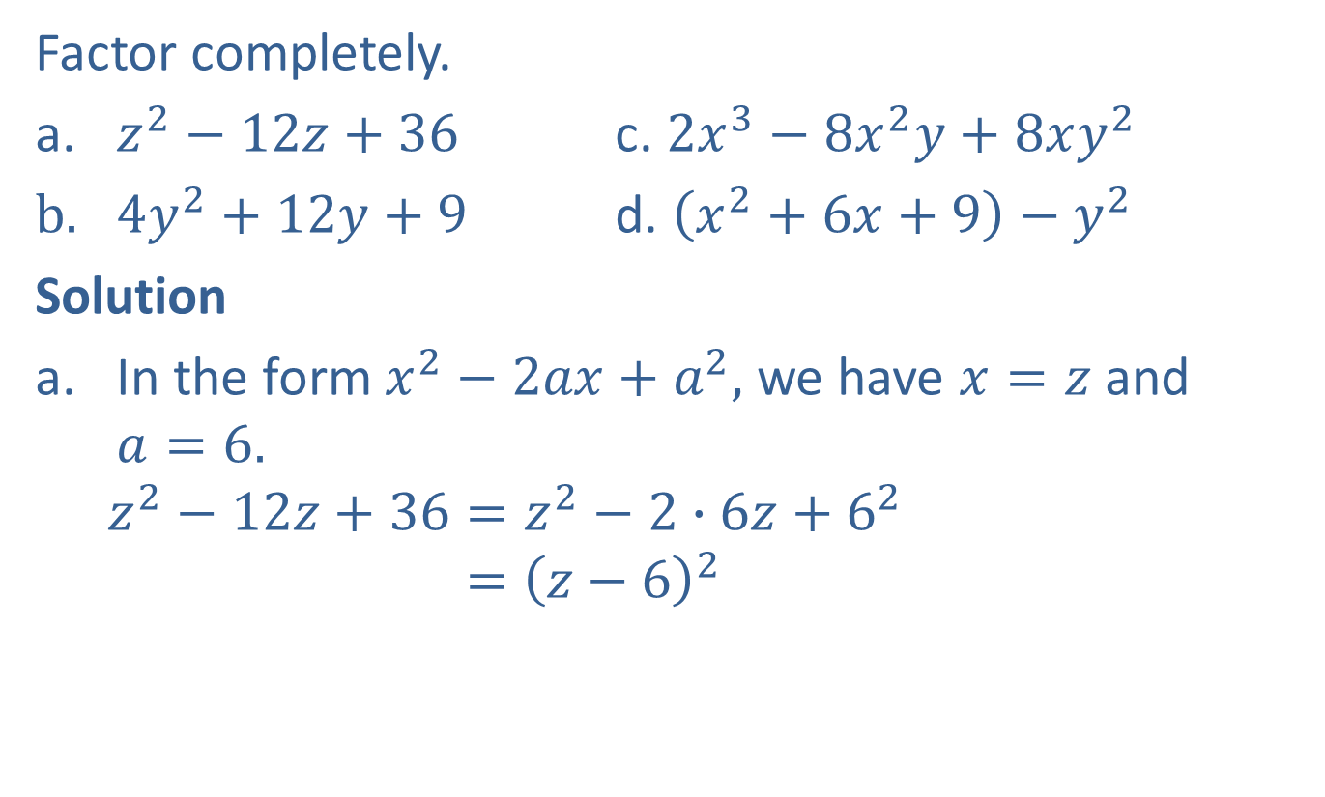
Example 3: Factoring Perfect Square Trinomials
Factor completely.
​$z^{2}−12z+36$ c. ​$2x^{3}−8x^{2}y+8xy^{2}$
$4y^{2}+12y+9$ ​ d. ​$\left(x^{2}+6x+9\right)−y^{2}$
Solution
In the form $x^{2}−2ax+a^{2},$ we have $x=z$ and $a=6.$
$$z^{2}−12z+36=z^{2}−2∙6z+6^{2}$$
$$={\left(z−6\right)}^{2}$$

Slide 7
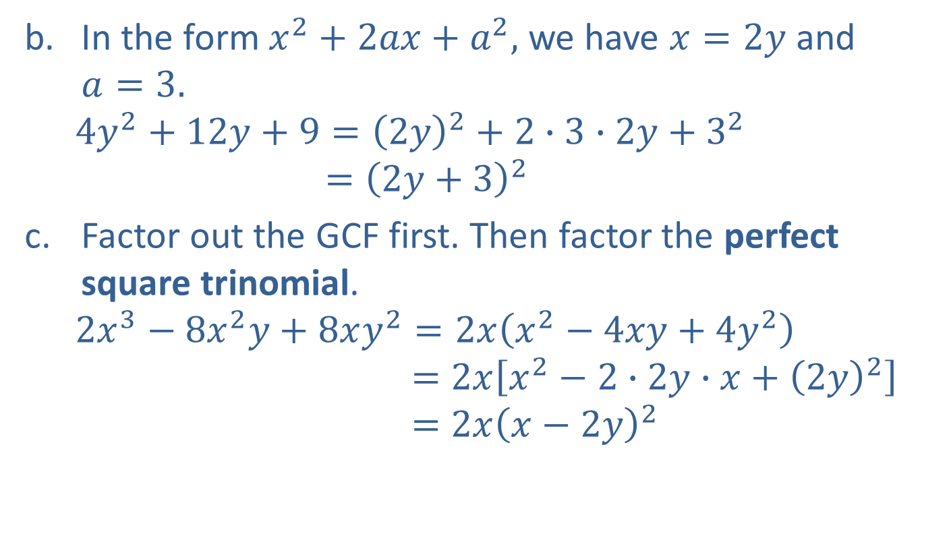
Example 3: Factoring Perfect Square Trinomials (cont.)
In the form $x^{2}+2ax+a^{2},$ we have $x=2y$ and $a=3.$
$${4y}^{2}+12y+9={\left(2y\right)}^{2}+2∙3∙2y+3^{2}$$
$$={\left(2y+3\right)}^{2}$$
Factor out the GCF first. Then factor the perfect square trinomial.
$$2x^{3}−8x^{2}y+8xy^{2}=2x\left(x^{2}−4xy+4y^{2}\right)$$
$$={2x\left[x^{2}−2∙2y∙x+{\left(2y\right)}^{2}\right]}^{ }$$
$$=2x{\left(x−2y\right)}^{2}$$

Slide 8

Example 3: Factoring Perfect Square Trinomials (cont.)
Treat $x^{2}+6x+9$ as a perfect square trinomial, then factor the difference of two squares.
$$\left(x^{2}+6x+9\right)−y^{2}={\left(x+3\right)}^{2}−y^{2}$$
$$={{\left(x+3+y\right)\left(x+3−y\right)}^{ }}^{ }$$

Slide 9
Note
Tips for Working with Sums and Differences of Two Cubes
In each case, after multiplying the factors, the middle terms cancel and only two terms are left.
The trinomials in parentheses are not perfect square trinomials. These trinomials are not factorable.
The sign in the binomial factor agrees with the sign between the two cubes.

Slide 10
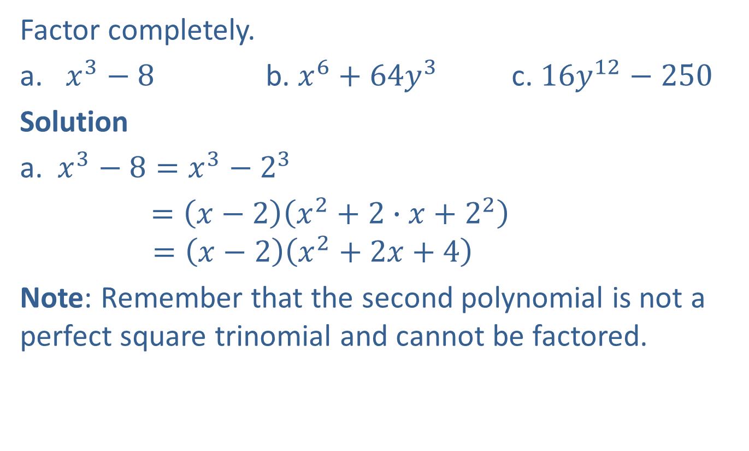
Example 4: Factoring Sums and Differences of Two Cubes
Factor completely.
​$x^{3}−8$ b. ​$x^{6}+64y^{3}$ c. ​$16y^{12}−250$
Solution
a. $x^{3}−8=x^{3}−2^{3}$
$=\left(x−2\right)\left(x^{2}+2∙x+2^{2}\right)$
$$=\left(x−2\right)\left(x^{2}+2x+4\right)$$
Note: Remember that the second polynomial is not a perfect square trinomial and cannot be factored.

Slide 11
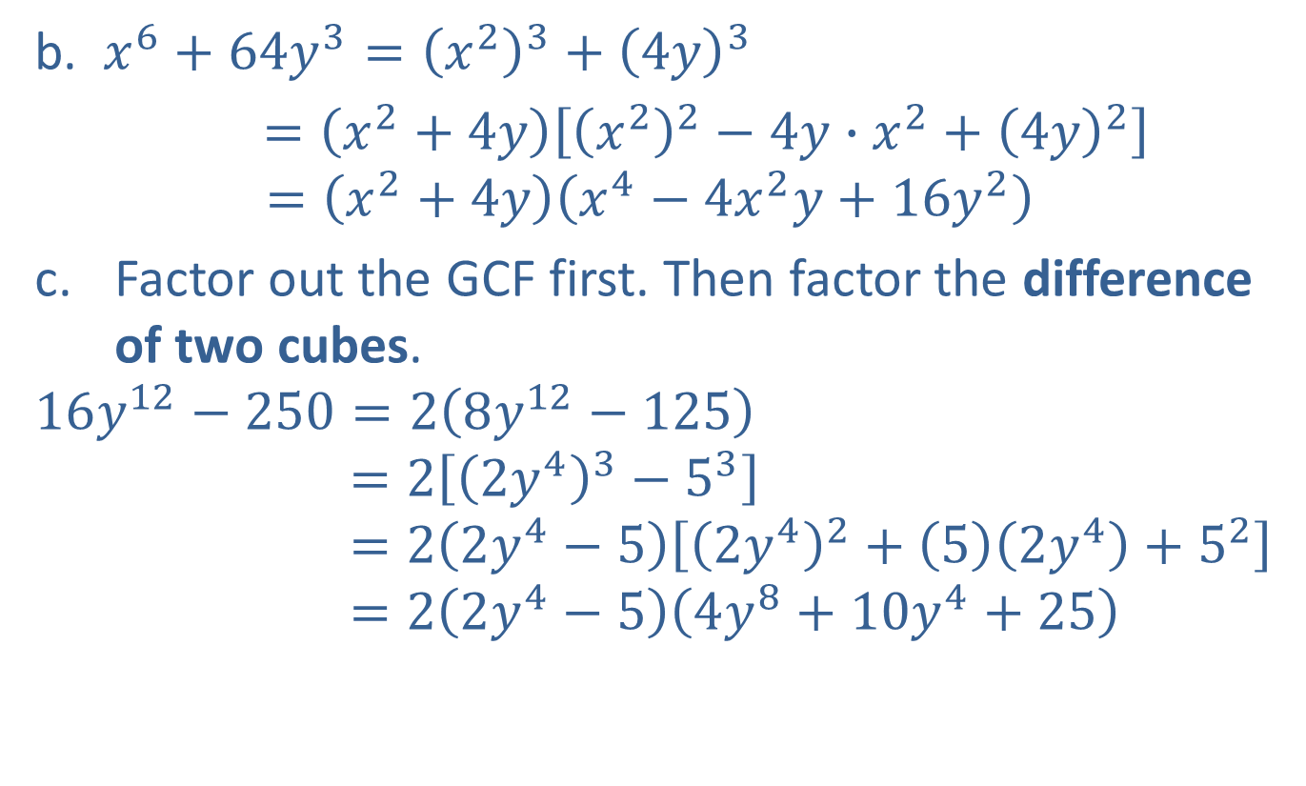
Example 4: Factoring Sums and Differences of Two Cubes (cont.)
b. $x^{6}+64y^{3}={\left(x^{2}\right)}^{3}+{\left(4y\right)}^{3}$
$=\left(x^{2}+4y\right)\left[{\left(x^{2}\right)}^{2}−4y∙x^{2}+{\left(4y\right)}^{2}\right]$
$$=\left(x^{2}+4y\right)\left(x^{4}−4x^{2}y+16y^{2}\right)$$
Factor out the GCF first. Then factor the difference of two cubes.
$$16y^{12}−250=2\left(8y^{12}−125\right)$$
$$=2\left[{\left(2y^{4}\right)}^{3}−5^{3}\right]$$
$$=2\left(2y^{4}−5\right)\left[{\left(2y^{4}\right)}^{2}+\left(5\right)\left(2y^{4}\right)+5^{2}\right]$$
$$=2\left(2y^{4}−5\right)\left(4y^{8}+10y^{4}+25\right)$$

Slide 12
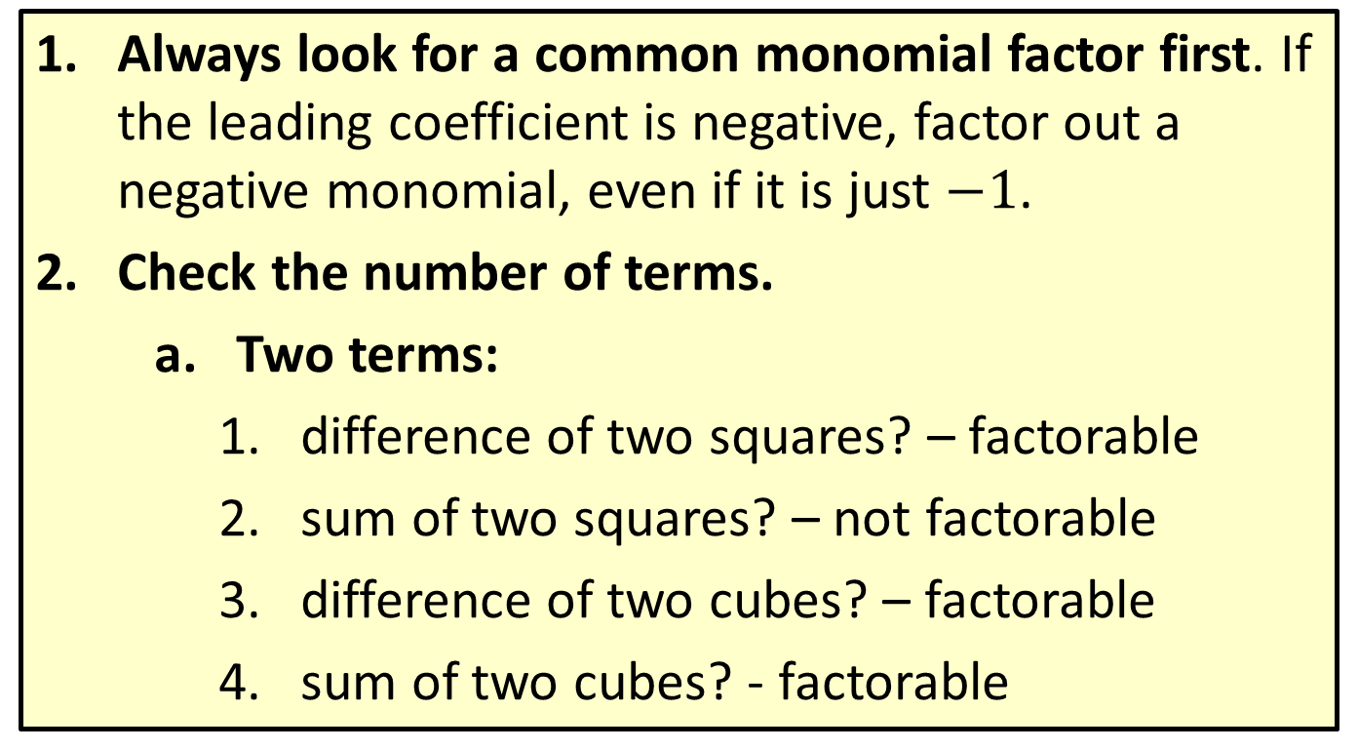
Procedure: General Guidelines for Factoring Polynomials
Always look for a common monomial factor first. If the leading coefficient is negative, factor out a negative monomial, even if it is just $−1$.
Check the number of terms.
Two terms:
difference of two squares? – factorable
sum of two squares? – not factorable
difference of two cubes? – factorable
sum of two cubes? - factorable

Slide 13
Procedure: General Guidelines for Factoring Polynomials (cont.)
Three terms:
perfect square trinomial? − factorable
use trial-and-error method?
Guidelines for the trial-and-error method
If the sign of the constant term is positive, the signs in both factors will be the same, either both positive or both negative.
If the sign of the constant term is negative, the signs in the factors will be different, one positive and one negative.

Slide 14
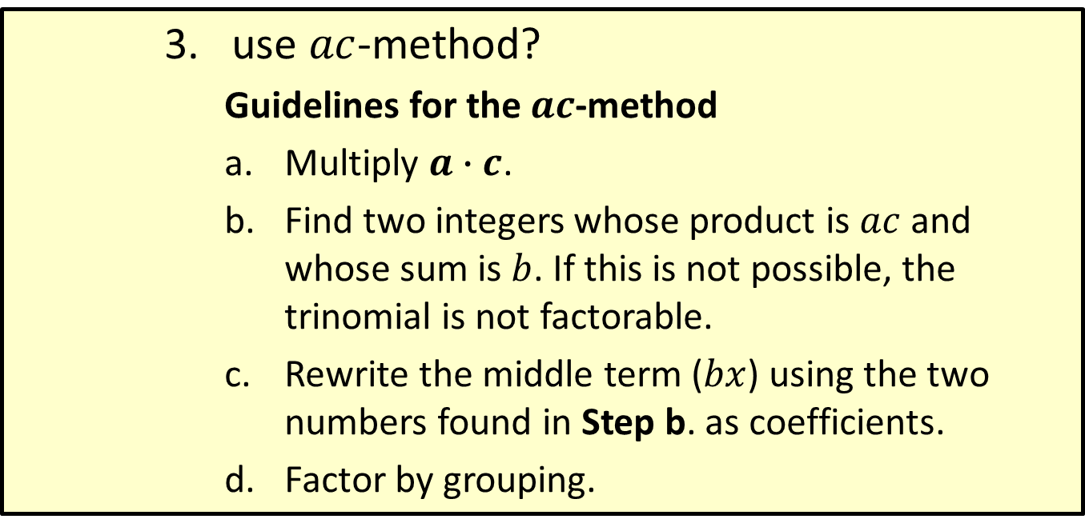
Procedure: General Guidelines for Factoring Polynomials (cont.)
use $ac$-method?
Guidelines for the $ac$-method
Multiply $a∙c$.
Find two integers whose product is $ac$ and whose sum is $b$. If this is not possible, the trinomial is not factorable.
Rewrite the middle term ($bx$) using the two numbers found in Step b. as coefficients.
Factor by grouping.

Slide 15
Procedure: General Guidelines for Factoring Polynomials (cont.)
Four terms:
Group terms with a common factor and factor out any common binomial factor.
Check the possibility of factoring any of the factors.
Checking: Factoring can be checked by multiplying the factors. The product should be the original expression.

