Slide 1
Section 5.4
Solving Quadratic Equations by Factoring

Slide 2
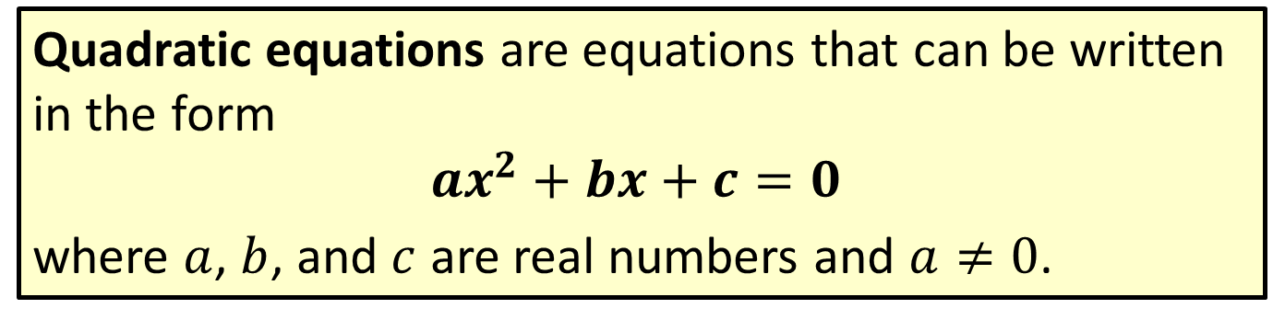
Definition: Quadratic Equations
Quadratic equations are equations that can be written in the form
$$ax^{2}+bx+c=0$$
where $a$, $b$, and $c$ are real numbers and $a≠0$.

Slide 3
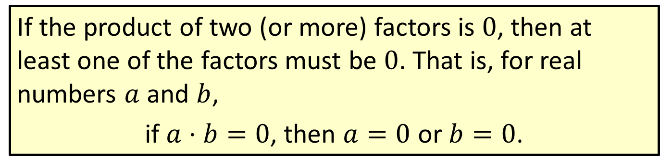
Definition: Zero-Factor Law
If the product of two (or more) factors is 0, then at least one of the factors must be 0. That is, for real numbers $a$ and $b$,
if $a⋅b=0$, then $a=0$ or $b=0$.

Slide 4
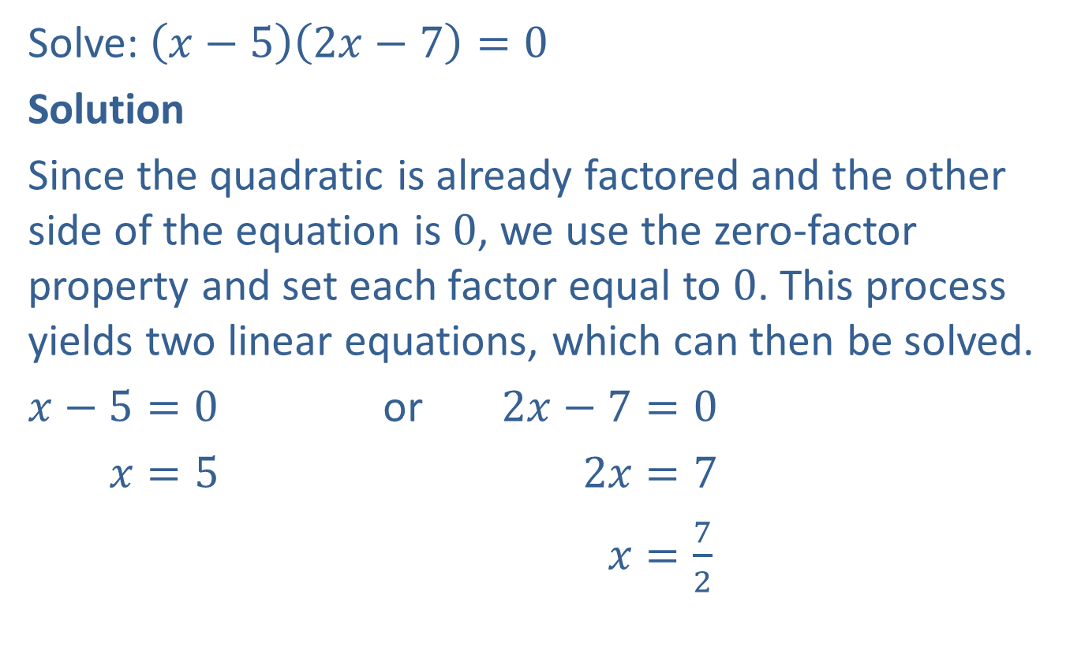
Example 1: Solving Factored Quadratic Equations
Solve: $\left(x−5\right)\left(2x−7\right)=0$
Solution
Since the quadratic is already factored and the other side of the equation is $0$, we use the zero‑factor property and set each factor equal to $0$. This process yields two linear equations, which can then be solved.
$x−5=0$ or $2x−7=0$
$x=5$ $2x=7$
$x=\frac{7}{2}$

Slide 5
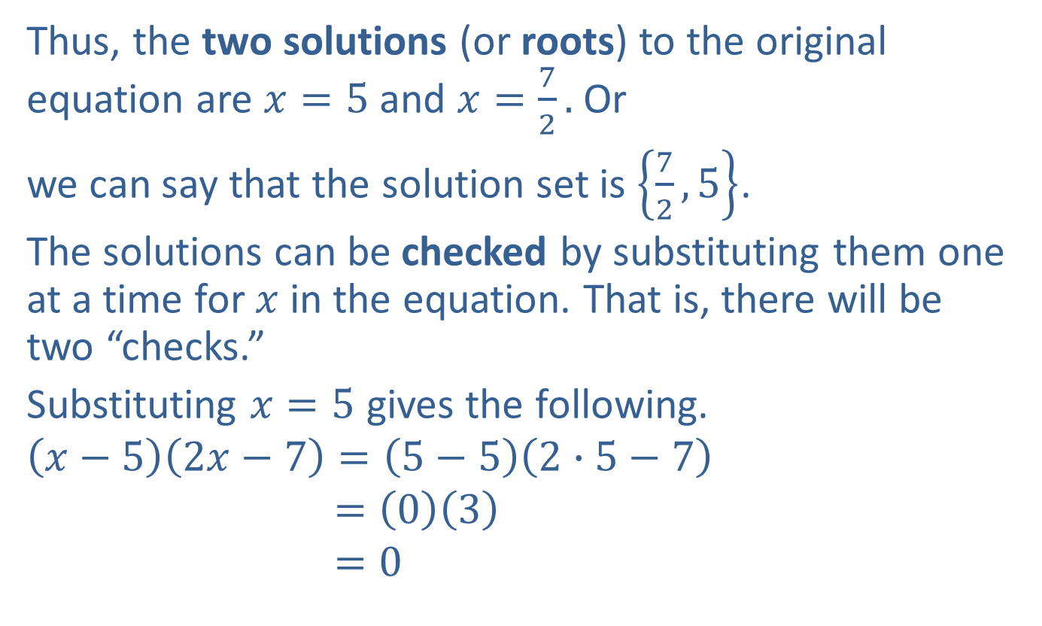
Example 1: Solving Factored Quadratic Equations (cont.)
Thus, the two solutions (or roots) to the original equation are $x=5$ and $x=\frac{7}{2}.$ Or
we can say that the solution set is $\left\{\frac{7}{2},5\right\}$.
The solutions can be checked by substituting them one at a time for $x$ in the equation. That is, there will be two “checks.”
Substituting $x=5$ gives the following.
$$\left(x−5\right)\left(2x−7\right)=\left(5−5\right)\left(2∙5−7\right)$$
$$=\left(0\right)\left(3\right)$$
$$=0$$

Slide 6
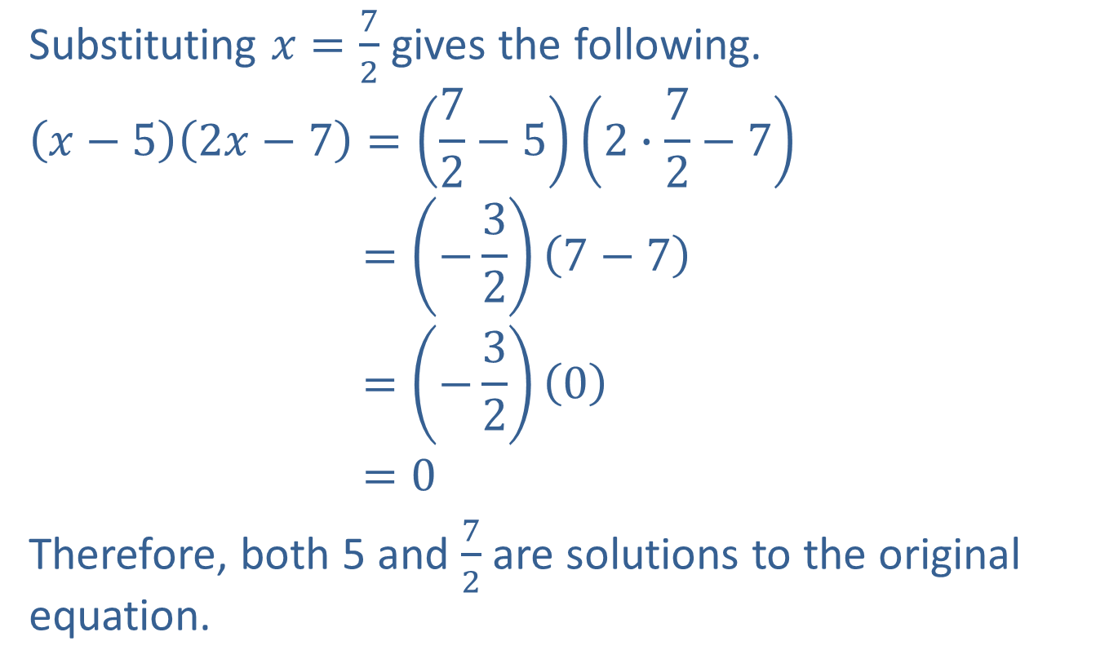
Example 1: Solving Factored Quadratic Equations (cont.)
Substituting $x=\frac{7}{2}$ gives the following.
$$\left(x−5\right)\left(2x−7\right)=\left(\frac{7}{2}−5\right)\left(2∙\frac{7}{2}−7\right)$$
$$=\left(−\frac{3}{2}\right)\left(7−7\right)$$
$$=\left(−\frac{3}{2}\right)\left(0\right)$$
$$=0$$
Therefore, both 5 and $\frac{7}{2}$ are solutions to the original equation.

Slide 7
Note
To make factoring easier, the terms should be arranged so that the leading coefficient is a positive number.

Slide 8
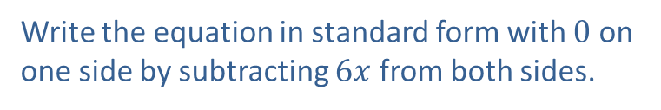



Example 2: Solving Quadratic Equations by Factoring
Solve by factoring: $3x^{2}=6x$
Solution
$$3x^{2}=6x$$
$$3x^{2}−6x=0$$
$$3x\left(x−2\right)=0$$
$3x=0$ or $x−2=0$
$x=0$ $x=2$
The solutions are $0$ and $2.$
Write the equation in standard form with $0$ on one side by subtracting $6x$ from both sides.
Factor out the common monomial, $3x.$
Set each factor equal to $0.$
Solve each linear equation.

Slide 9
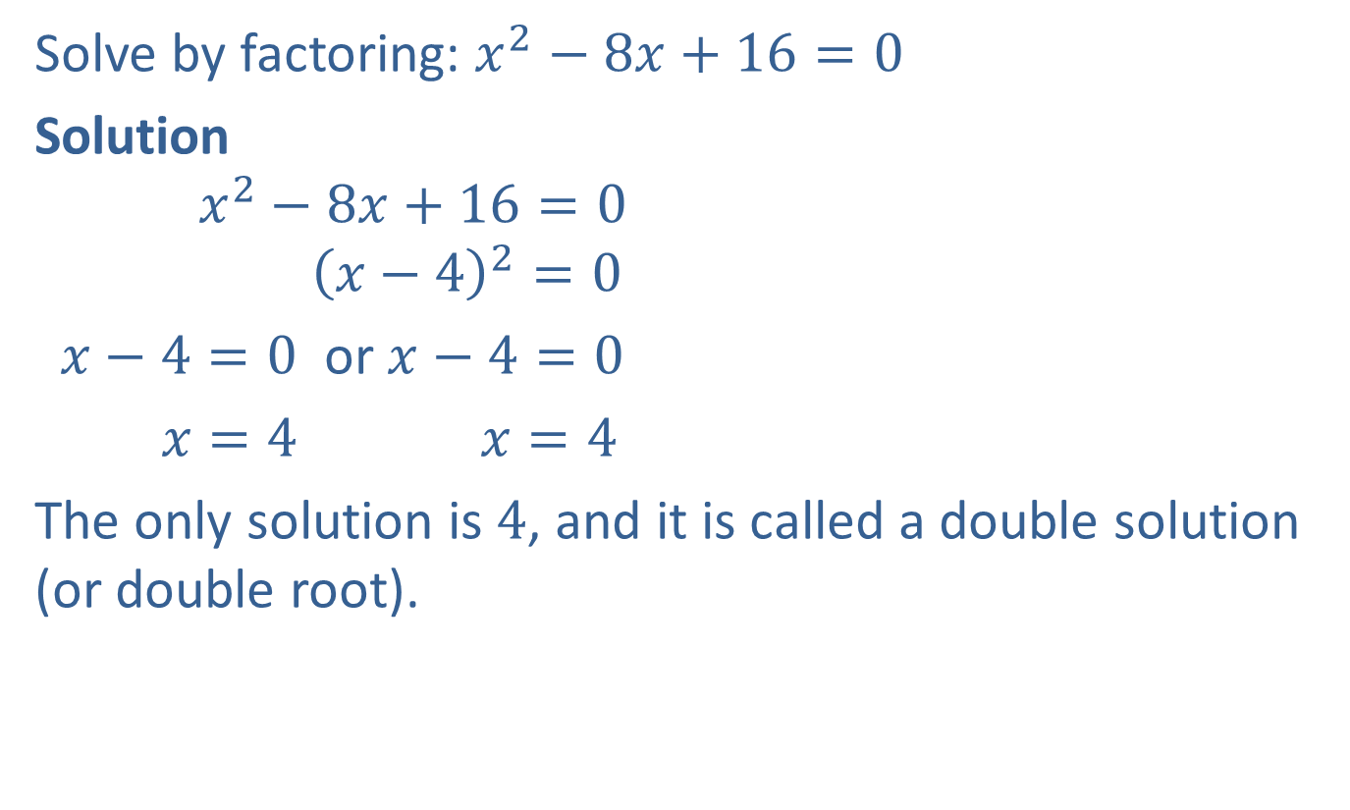
Example 3: Solving Quadratic Equations by Factoring
Solve by factoring: $x^{2}−8x+16=0$
Solution
$$x^{2}−8x+16=0$$
$${\left(x−4\right)}^{2}=0$$
$x−4=0$ or $x−4=0$
$x=4$ $x=4$
The only solution is $4$, and it is called a double solution (or double root).
The trinomial is a perfect square.
Both factors are the same, so there is only one distinct solution.

Slide 10

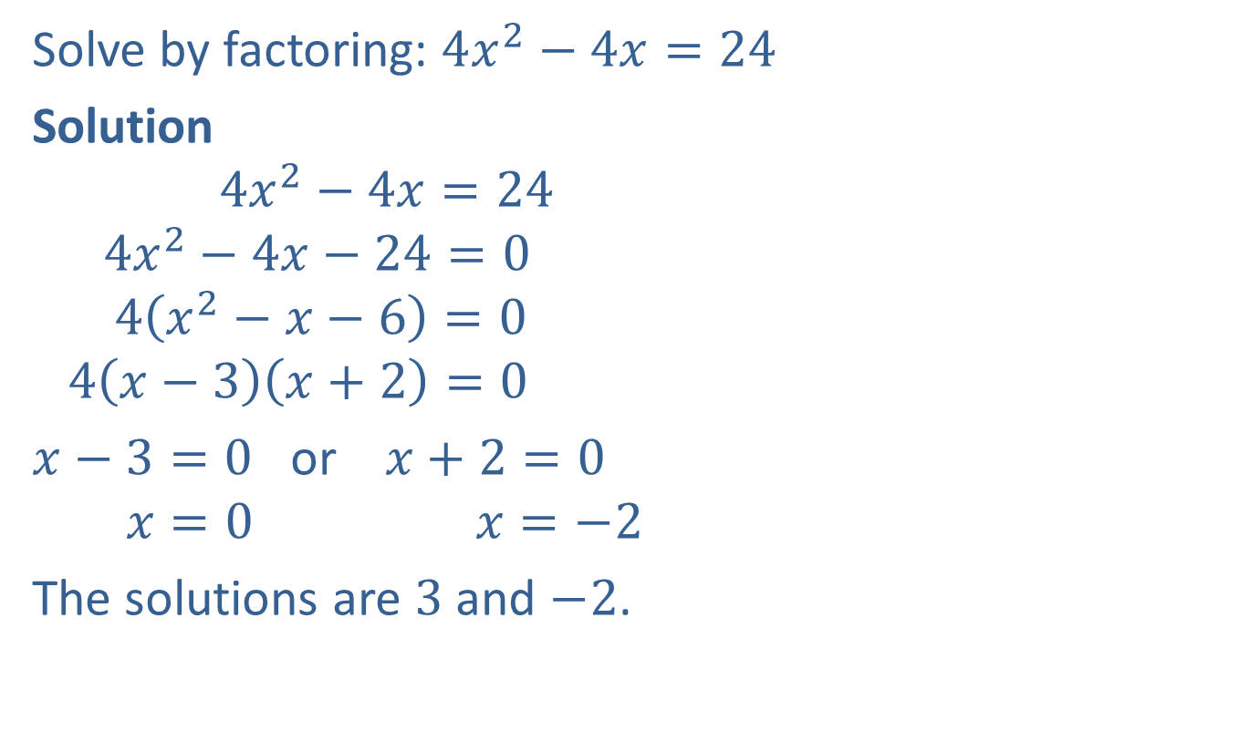

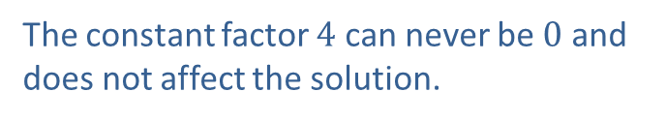
Example 4: Solving Quadratic Equations by Factoring
Solve by factoring: $4x^{2}−4x=24$
Solution
$$4x^{2}−4x=24$$
$$4x^{2}−4x−24=0$$
$$4\left(x^{2}−x−6\right)=0$$
$$4\left(x−3\right)\left(x+2\right)=0$$
$x−3=0$ or $x+2=0$
$$x=0 x=−2$$
The solutions are $3$ and $−2$.
Add $−24$to both sides so that one side is 0.
Factor out the common monomial, $4.$
The constant factor $4$ can never be $0$ and does not affect the solution.

Slide 11

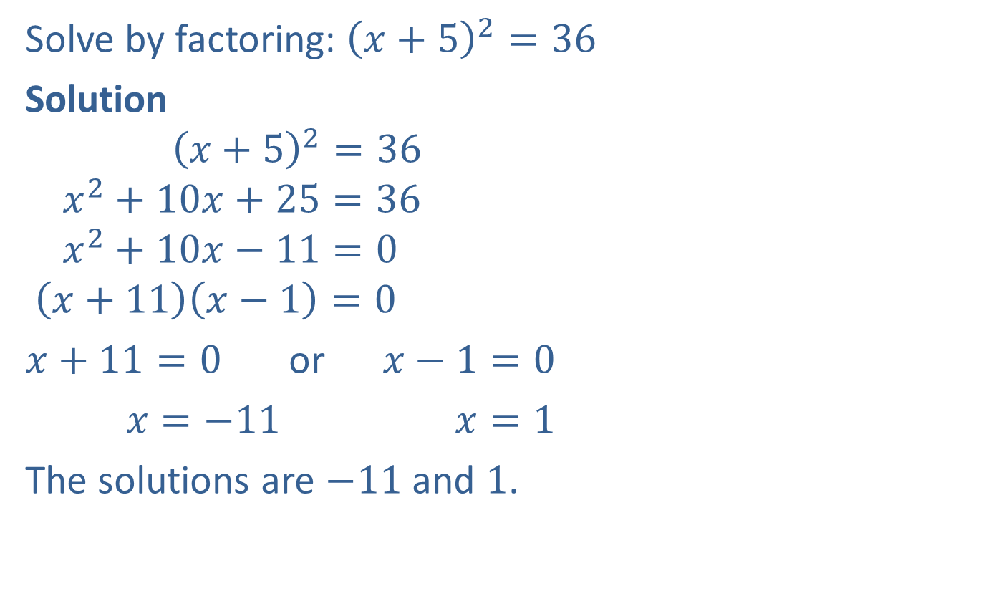

Example 5: Solving Quadratic Equations by Factoring
Solve by factoring: ${\left(x+5\right)}^{2}=36$
Solution
$${\left(x+5\right)}^{2}=36$$
$$x^{2}+10x+25=36$$
$$x^{2}+10x−11=0$$
$$\left(x+11\right)\left(x−1\right)=0$$
$x+11=0$ or $x−1=0$
$x=−11$ $x=1$
The solutions are $−11$ and $1$.
Multiply ${\left(x+5\right)}^{2}.$
Add $−36$ to both sides so that one side is $0$.
Factor.

Slide 12

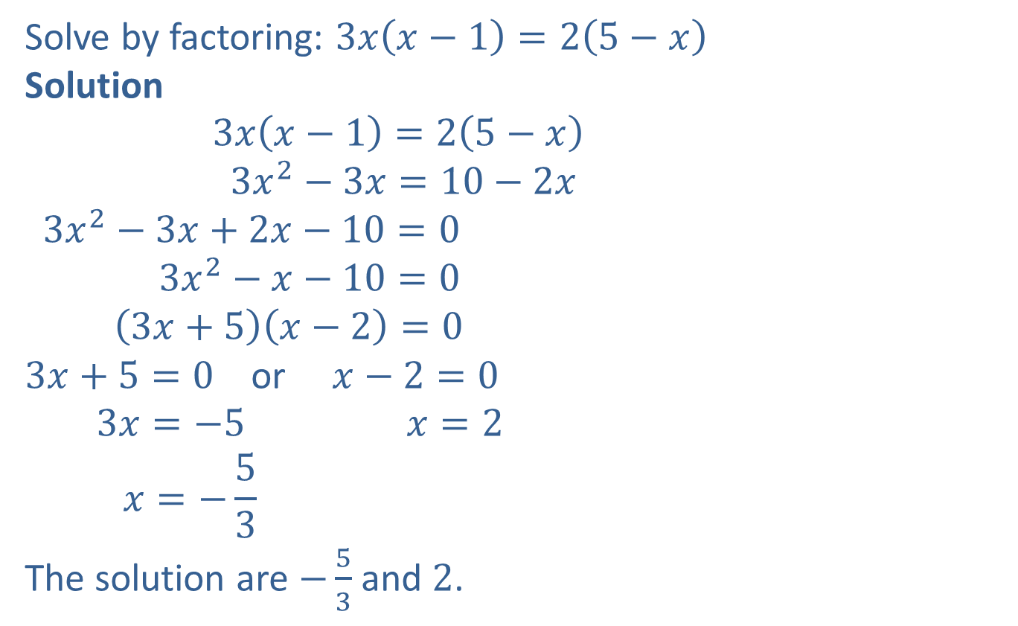
Example 6: Solving Quadratic Equations by Factoring
Solve by factoring: $3x\left(x−1\right)=2\left(5−x\right)$
Solution
$$3x\left(x−1\right)=2\left(5−x\right)$$
$$3x^{2}−3x=10−2x$$
$$3x^{2}−3x+2x−10=0$$
$$3x^{2}−x−10=0$$
$$\left(3x+5\right)\left(x−2\right)=0$$
$3x+5=0$ or $x−2=0$
$$3x=−5 x=2$$
$$x=−\frac{5}{3}$$
The solution are $−\frac{5}{3}$ and $2$.
Use the distributive property twice.
Arrange terms so that $0$ is on one side.
Simplify.
Factor.

Slide 13

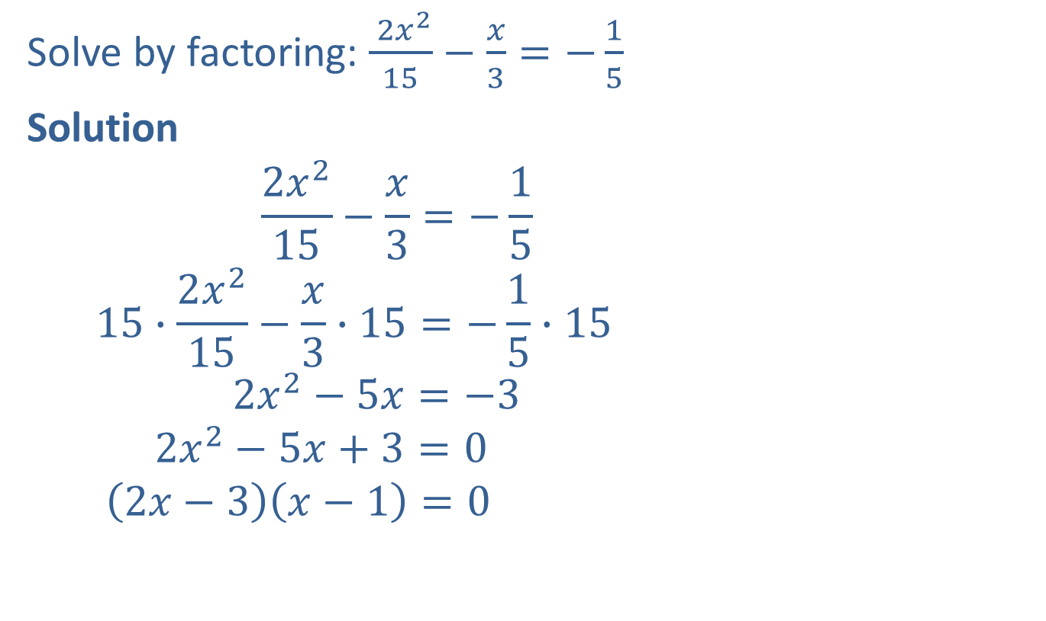
Example 7: Solving Quadratic Equations by Factoring
Solve by factoring: $\frac{ 2x^{2}}{15}−\frac{x}{3}=−\frac{1}{5}$
Solution
$$\frac{2x^{2}}{15}−\frac{x}{3}=−\frac{1}{5}$$
$$15∙\frac{2x^{2}}{15}−\frac{x}{3}∙15=−\frac{1}{5}∙15$$
$$2x^{2}−5x=−3$$
$$2x^{2}−5x+3=0$$
$$\left(2x−3\right)\left(x−1\right)=0$$
Multiply each term by 15, the LCM of the denominators, to get integer coefficients.
Simplify.
Add $3$ to both sides so that one side is $0$.
Factor.

Slide 14

Example 7: Solving Quadratic Equations by Factoring (cont.)
$2x−3=0$ or $x−1=0$
$2x=3$ $x=1$
$$x=\frac{3}{2}$$
The solutions are $\frac{3}{2}$ and $1$.

Slide 15
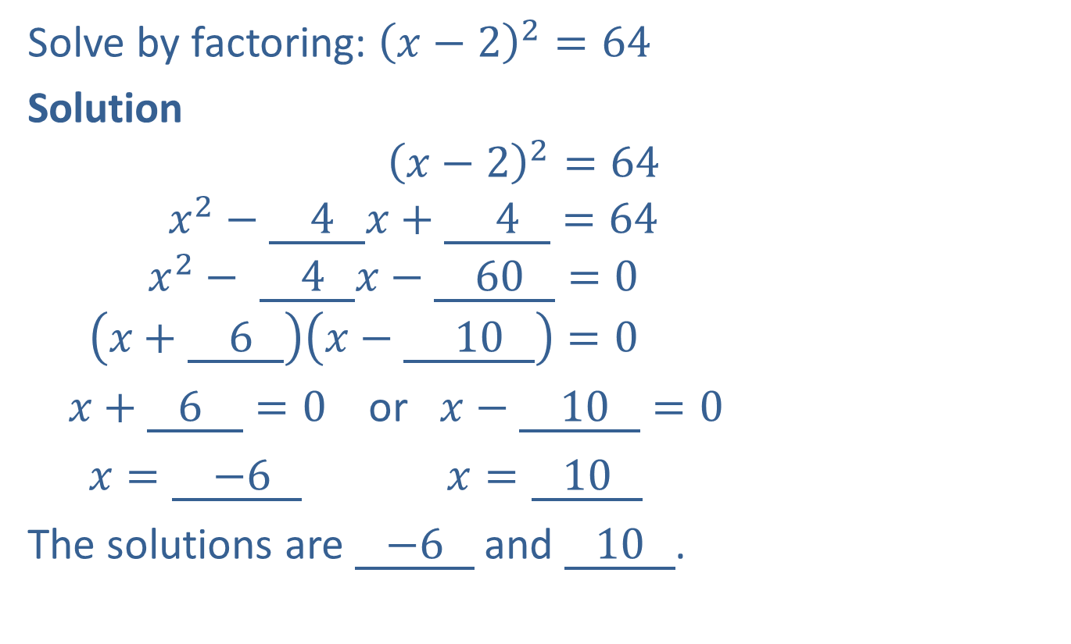
Completion Example 8: Solving Quadratic Equations by Factoring
Solve by factoring: ${\left(x−2\right)}^{2}=64$
Solution
$${\left(x−2\right)}^{2}=64$$
$$x^{2}−\underline{ 4 }x+\underline{ 4 }=64$$
$$x^{2}− \underline{ 4 }x−\underline{ 60 }=0$$
$$\left(x+\underline{ 6 }\right)\left(x−\underline{ 10 }\right)=0$$
$x+\underline{ 6 }=0$ or $x−\underline{ 10 }=0$
$x=\underline{ −6 }$ $x=\underline{ 10 }$
The solutions are $\underline{ −6 }$ and $\underline{ 10 }$.

Slide 16

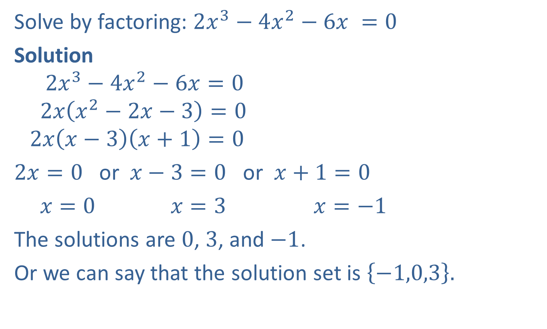
Example 9: Solving Higher Degree Equations
Solve by factoring: ${2x^{3}−4x^{2}−6x}^{ }=0$
Solution
$$2x^{3}−4x^{2}−6x=0$$
$$2x\left(x^{2}−2x−3\right)=0$$
$$2x\left(x−3\right)\left(x+1\right)=0$$
$2x=0$ or $x−3=0$ or $x+1=0$
$x=0$ $x=3$ $x=−1$
The solutions are $0$, $3$, and $−1$.
Or we can say that the solution set is $\left\{−1,0,3\right\}.$
Factor out the common monomial, $2x.$
Factor the trinomial.
Set each factor equal
to 0 and solve.

Slide 17
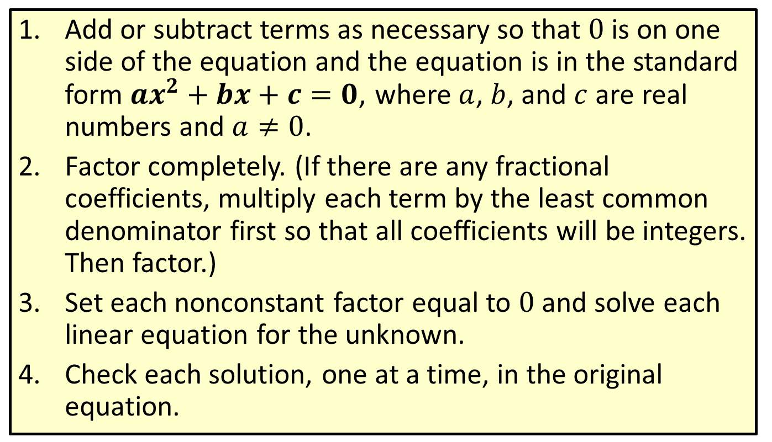
Procedure: To Solve a Quadratic Equation by Factoring
​Add or subtract terms as necessary so that 0 is on one side of the equation and the equation is in the standard form $ax^{2}+bx+c=0$, where $a$, $b$, and $c$ are real numbers and $a≠0$.
​Factor completely. (If there are any fractional coefficients, multiply each term by the least common denominator first so that all coefficients will be integers. Then factor.)
​Set each nonconstant factor equal to 0 and solve each linear equation for the unknown.
​Check each solution, one at a time, in the original equation.

Slide 18
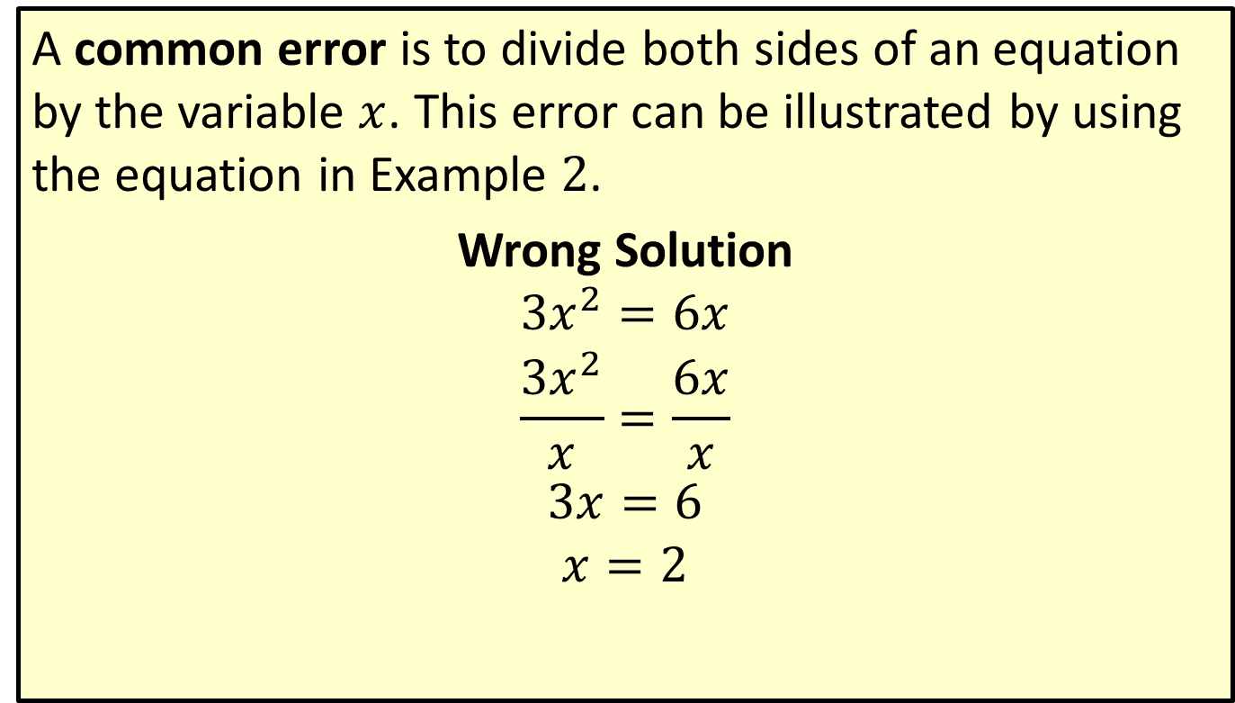
Caution: Common Error
A common error is to divide both sides of an equation by the variable $x$. This error can be illustrated by using the equation in Example $2$.
Wrong Solution
$$3x^{2}=6x$$
$$\frac{3x^{2}}{x}=\frac{6x}{x}$$
$$3x=6$$
$$x=2$$

Slide 19
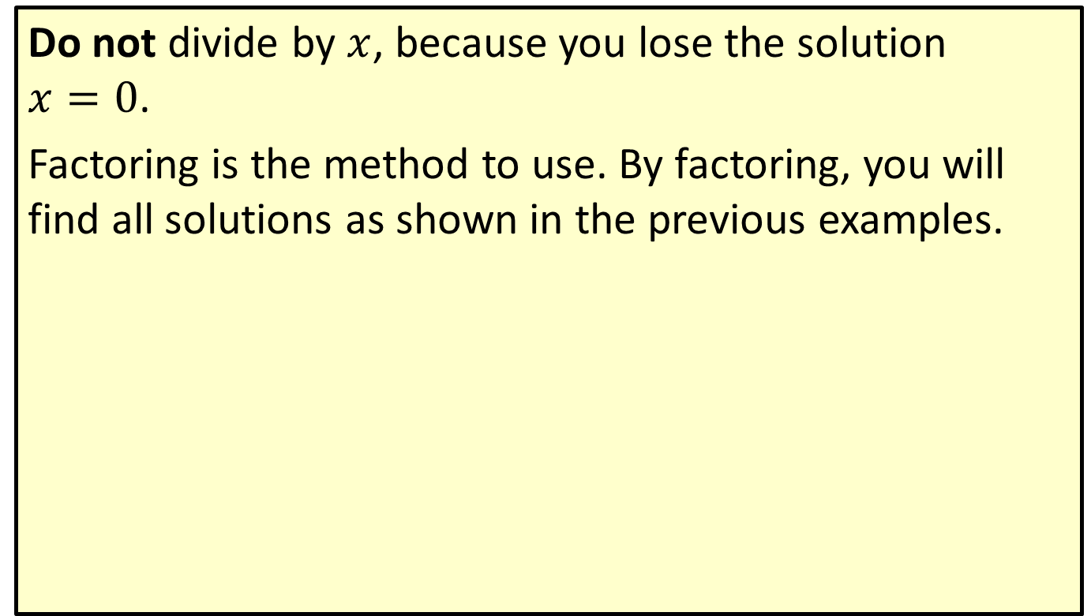
Caution: Common Error (cont.)
Do not divide by $x$, because you lose the solution $x=0$.
Factoring is the method to use. By factoring, you will find all solutions as shown in the previous examples.

