Slide 1
Section 5.5
Operations with Radicals

Slide 2
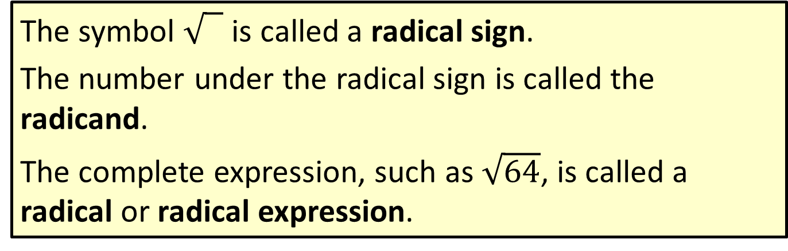
Definition: Radical Terminology
The symbol 0 is called a radical sign.
The number under the radical sign is called the radicand.
The complete expression, such as $\sqrt{64}$, is called a radical or radical expression.

Slide 3
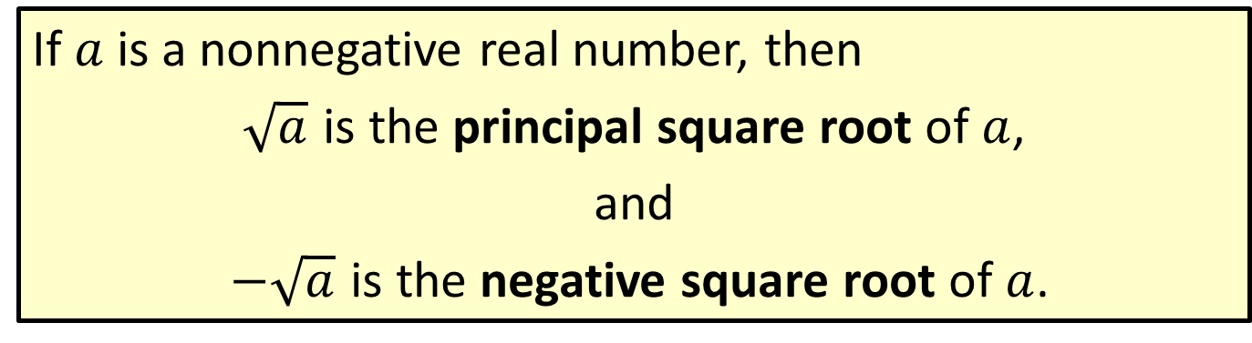
Definition: Square Root
If $a$ is a nonnegative real number, then
$\sqrt{a}$ is the principal square root of $a$,
and
$−\sqrt{a}$ is the negative square root of $a$.

Slide 4

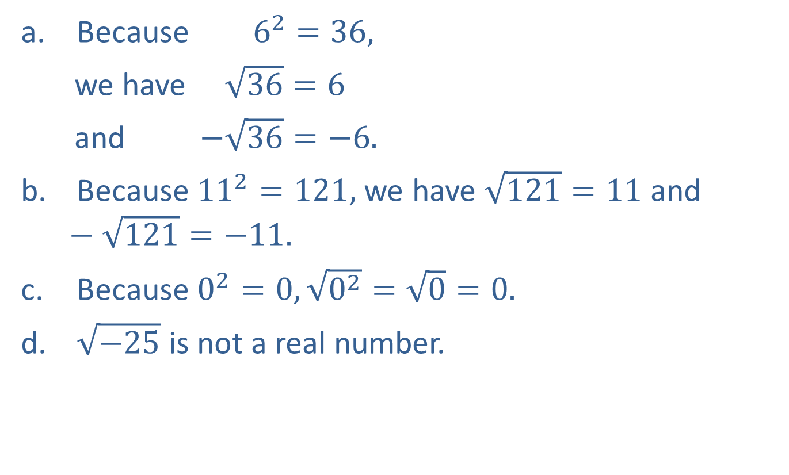

Example 1: Evaluating Square Roots
Because $6^{2}=36,$
we have $\sqrt{36}=6$
and $−\sqrt{36}=−6.$ ​
Because ${11}^{2}=121,$ we have $\sqrt{121}=11$ and $−\sqrt{121}=−11.$
​ Because $0^{2}=0, \sqrt{0^{2}}=\sqrt{0}=0.$
​ $\sqrt{−25}$ is not a real number.
The principal square root of $36$
The negative square root of $36$

Slide 5

Example 2: Evaluating Square Roots
Because ​${\left(\frac{4}{5}\right)}^{2}=\frac{16}{25},$we know that $\sqrt{\frac{16}{25}}=\frac{4}{5}$​.
$−\sqrt{0.0009}=−0.03$ because ${\left(0.03\right)}^{2}=0.0009.$

Slide 6
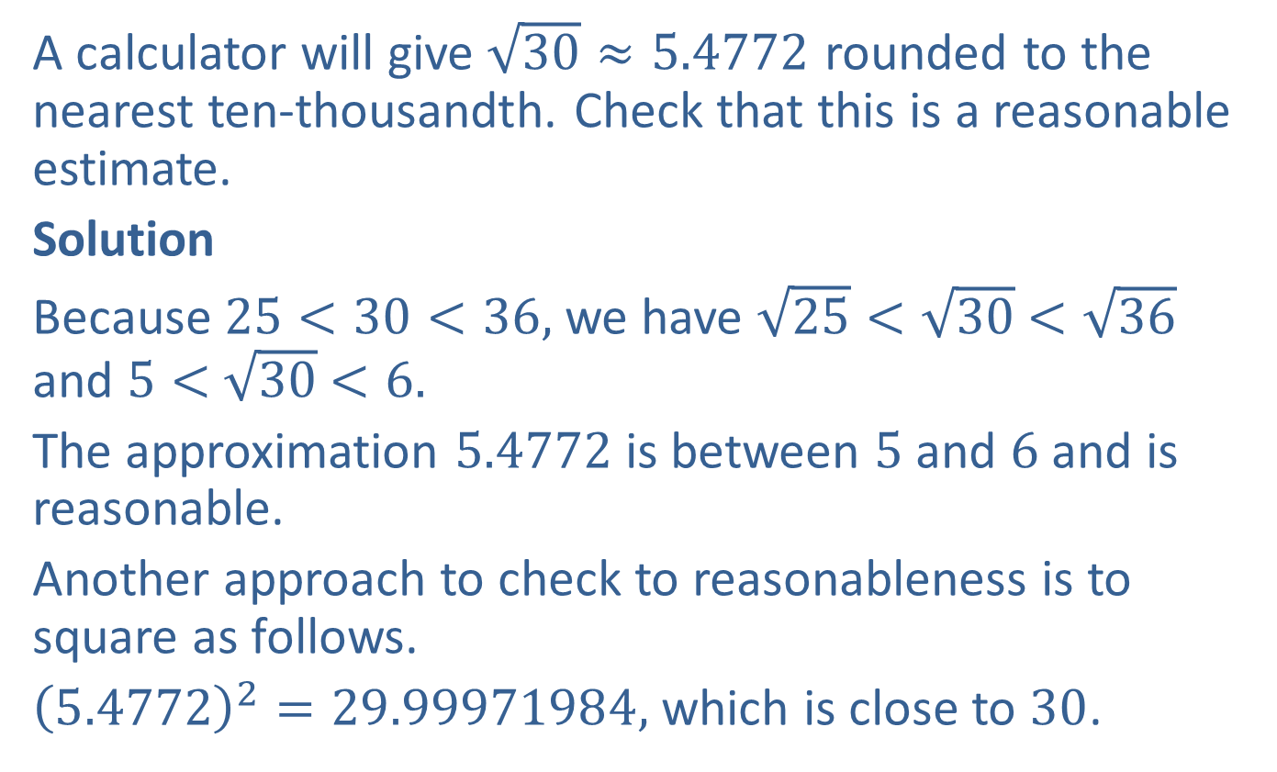
Example 3: Estimating Square Roots
A calculator will give $\sqrt{30}≈5.4772$ rounded to the nearest ten-thousandth. Check that this is a reasonable estimate.
Solution
Because $25<30<36,$ we have $\sqrt{25}<\sqrt{30}$ $<\sqrt{36}$ and $5<$ $\sqrt{30}$ $<6.$
The approximation $5.4772$ is between $5$ and $6$ and is reasonable.
Another approach to check to reasonableness is to square as follows.
${\left(5.4772\right)}^{2}=29.99971984,$ which is close to $30$.

Slide 7
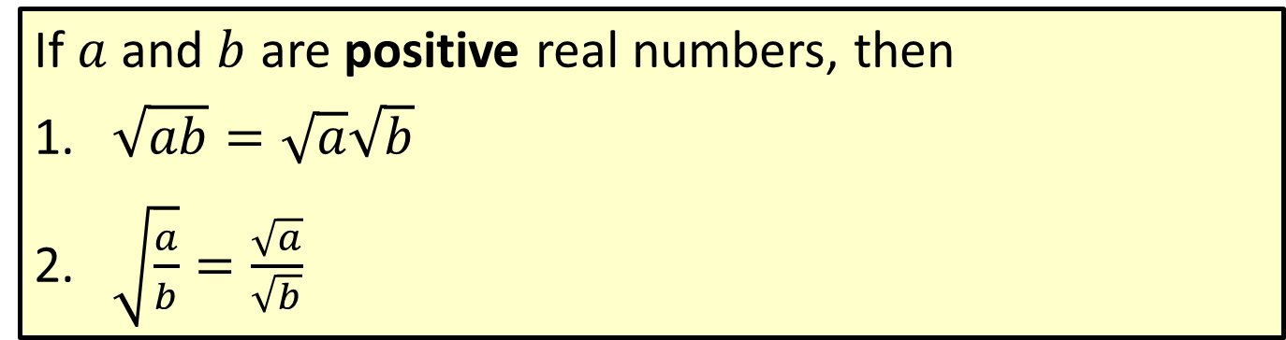
Properties: Properties of Square Roots
If $a$ and $b$ are positive real numbers, then
​$\sqrt{ab}=\sqrt{a}\sqrt{b}$
​$\sqrt{\frac{a}{b}}=\frac{\sqrt{a}}{\sqrt{b}}$

Slide 8
Definition: Simplest Form for Square Roots
A square root is considered to be in simplest form when the radicand has no perfect square as a factor.

Slide 9
Note
Of these three approaches, the second appears to be the easiest because it has the fewest steps. However, “seeing” the largest perfect square factor may be difficult. If you do not immediately see a perfect square factor, proceed by finding other factors or prime factors as illustrated.

Slide 10
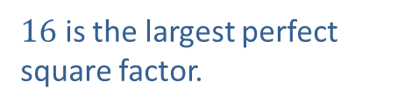
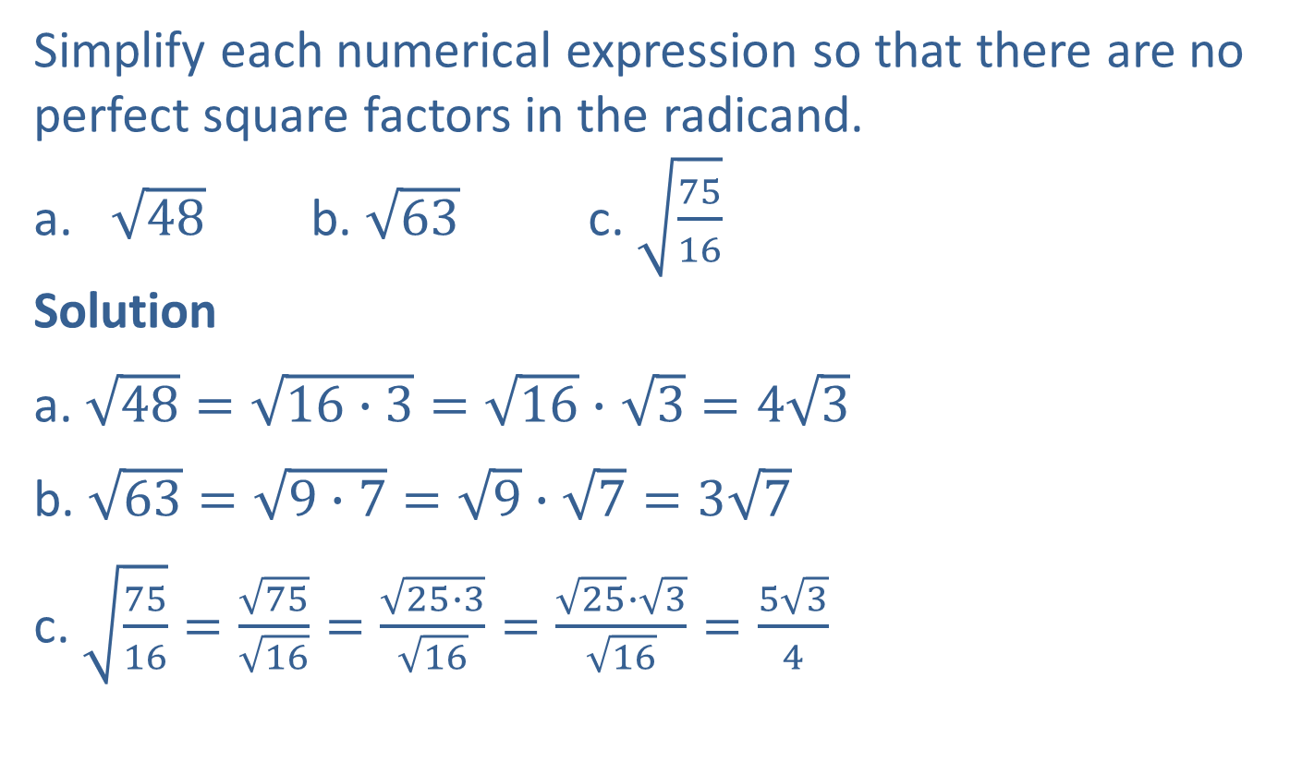
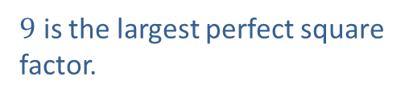
Example 4: Simplifying Radical Expressions with Square Roots
Simplify each numerical expression so that there are no perfect square factors in the radicand.
​$\sqrt{48}$ b. ​$\sqrt{63}$ c. ​$\sqrt{\frac{75}{16}}$
Solution
a. $\sqrt{48}=\sqrt{16∙3}=$ $\sqrt{16}∙$ $\sqrt{3}=4\sqrt{3}$
b. $\sqrt{63}=\sqrt{9∙7}=\sqrt{9}∙\sqrt{7}=3\sqrt{7}$
c. $\sqrt{\frac{75}{16}}=\frac{\sqrt{75}}{\sqrt{16}}=\frac{\sqrt{25∙3}}{\sqrt{16}}=\frac{\sqrt{25}∙\sqrt{3}}{\sqrt{16}}=\frac{5\sqrt{3}}{4}$
$16$ is the largest perfect square factor.
$9$ is the largest perfect square factor.

Slide 11
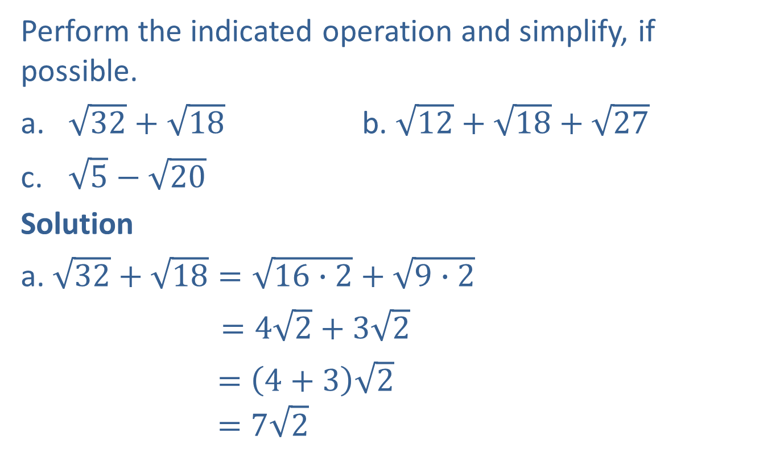
Example 5: Adding and Subtracting with Radicals
Perform the indicated operation and simplify, if possible.
​$\sqrt{32}+\sqrt{18}$ b. ​$\sqrt{12}+\sqrt{18}+\sqrt{27}$
​$\sqrt{5}−\sqrt{20}$
Solution
a. $\sqrt{32}+\sqrt{18}=\sqrt{16∙2}+\sqrt{9∙2}$
$=4\sqrt{2}+3\sqrt{2}$
$=\left(4+3\right)\sqrt{2}$
$$=7\sqrt{2}$$

Slide 12
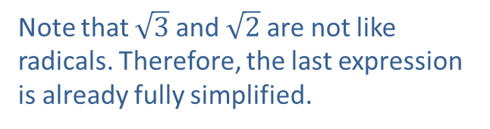
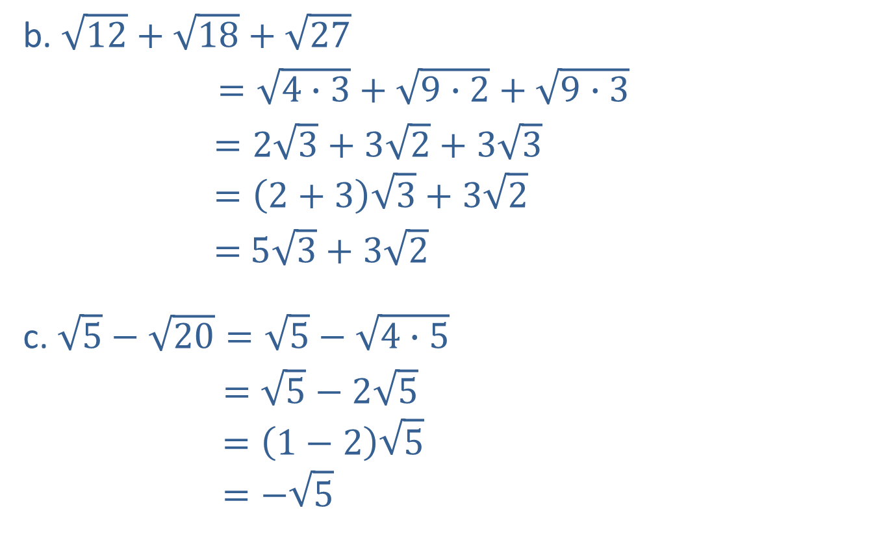
Example 5: Adding and Subtracting with Radicals (cont.)
b. $\sqrt{12}+\sqrt{18}+\sqrt{27}$
$=\sqrt{4∙3}+\sqrt{9∙2}+\sqrt{9∙3}$
$=2\sqrt{3}+3\sqrt{2}+3\sqrt{3}$
$$=\left(2+3\right)\sqrt{3}+3\sqrt{2}$$
$=$ $5\sqrt{3}+3\sqrt{2}$
c. $\sqrt{5}−\sqrt{20}=\sqrt{5}−\sqrt{4∙5}$
$=\sqrt{5}−2\sqrt{5}$
$$=\left(1−2\right)\sqrt{5}$$
$$=−\sqrt{5}$$
Note that $\sqrt{3}$ and $\sqrt{2}$ are not like radicals. Therefore, the last expression is already fully simplified.

Slide 13
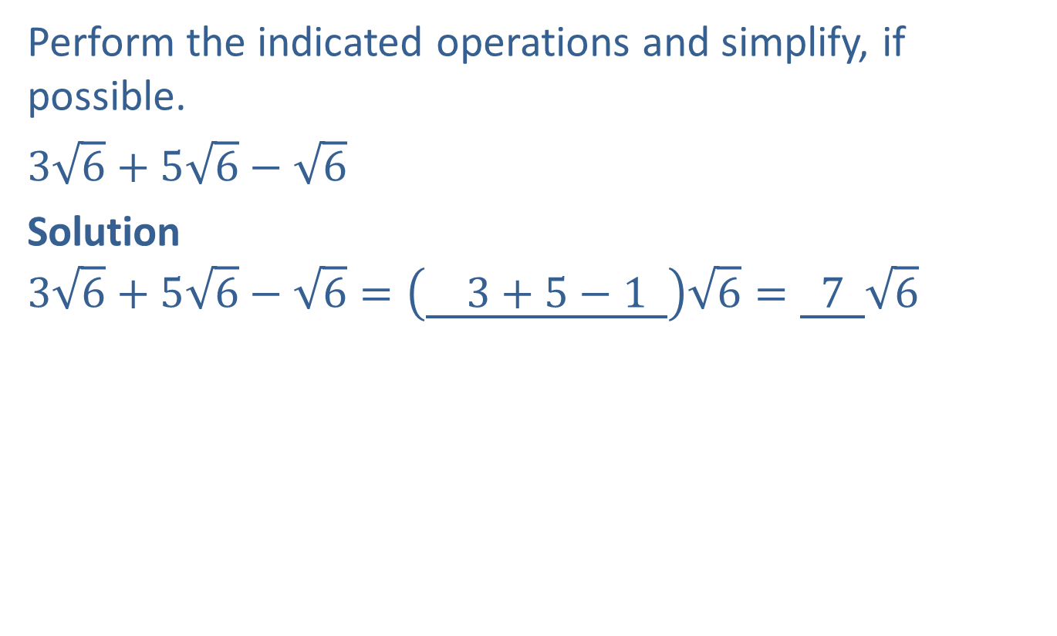
Completion Example 6: Adding and Subtracting with Radicals
Perform the indicated operations and simplify, if possible.
​$3\sqrt{6}+5\sqrt{6}−\sqrt{6}$
Solution
$$3\sqrt{6}+5\sqrt{6}−\sqrt{6}=\left(\underline{ 3+5−1 }\right)\sqrt{6}=\underline{ 7 }\sqrt{6}$$

Slide 14
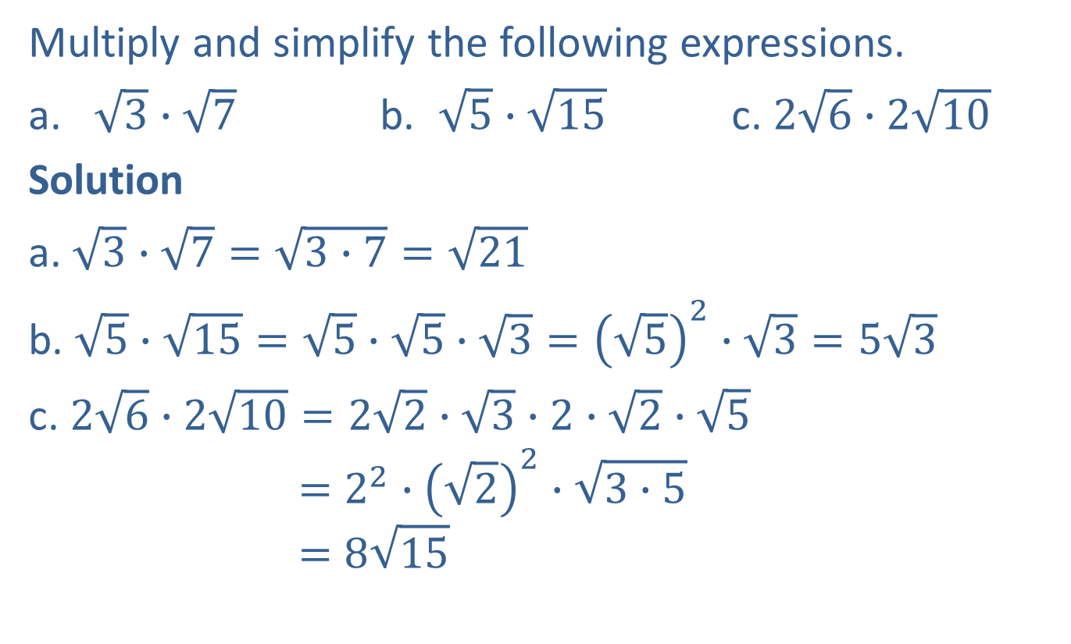
Example 7: Multiplying with Radicals
Multiply and simplify the following expressions.
​$\sqrt{3}∙\sqrt{7}$ b. ​ $\sqrt{5}∙\sqrt{15}$ c. $2\sqrt{6}∙2\sqrt{10}$
Solution
a. $\sqrt{3}∙\sqrt{7}=\sqrt{3∙7}=\sqrt{21}$
b. $\sqrt{5}∙\sqrt{15}=\sqrt{5}∙\sqrt{5}∙\sqrt{3}={\left(\sqrt{5}\right)}^{2}∙\sqrt{3}=5\sqrt{3}$
c. $2\sqrt{6}∙2\sqrt{10}=2\sqrt{2}∙\sqrt{3}∙2∙\sqrt{2}∙\sqrt{5}$
$$=2^{2}∙{\left(\sqrt{2}\right)}^{2}∙\sqrt{3∙5}$$
$$=8\sqrt{15}$$

Slide 15
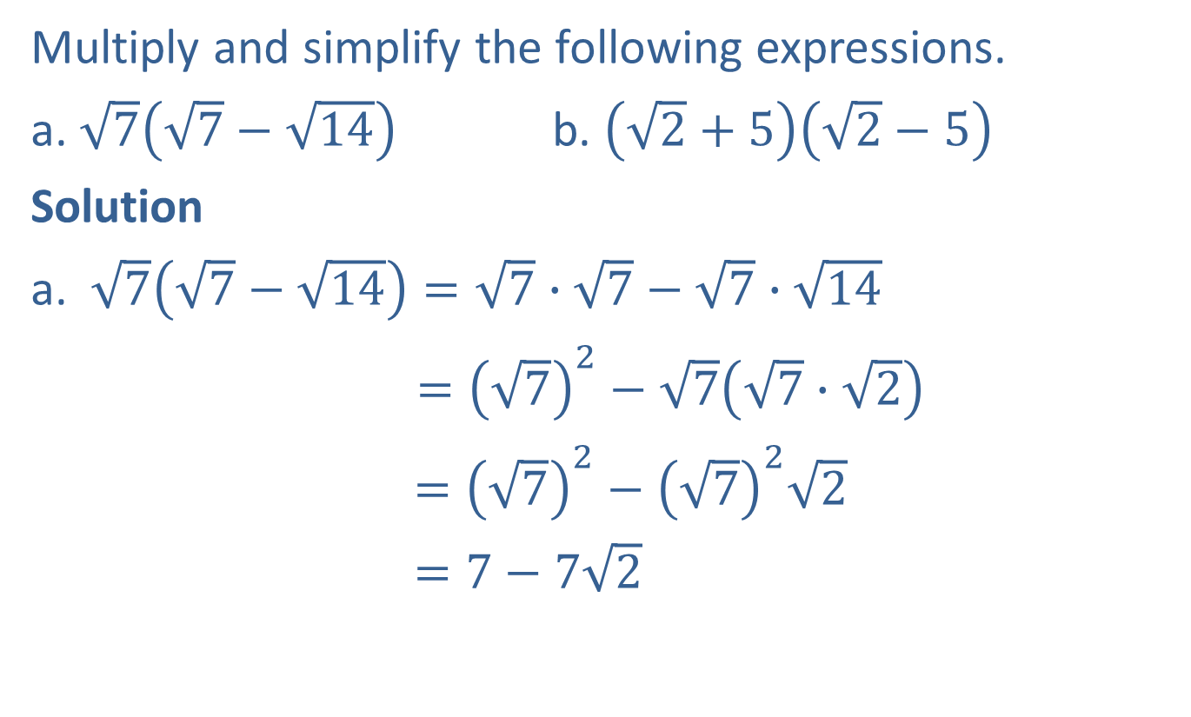
Example 8: Multiplying Radicals
Multiply and simplify the following expressions.
a. $\sqrt{7}\left(\sqrt{7}−\sqrt{14}\right)$ b. $\left(\sqrt{2}+5\right)\left(\sqrt{2}−5\right)$
Solution
a. $\sqrt{7}\left(\sqrt{7}−\sqrt{14}\right)=\sqrt{7}∙\sqrt{7}−\sqrt{7}∙\sqrt{14}$
$={\left(\sqrt{7}\right)}^{2}−\sqrt{7}\left(\sqrt{7}∙\sqrt{2}\right)$
$={\left(\sqrt{7}\right)}^{2}−{\left(\sqrt{7}\right)}^{2}\sqrt{2}$
$=7−7\sqrt{2}$

Slide 16


Example 8: Multiplying Radicals (cont.)
b.$\left(\sqrt{2}+5\right)\left(\sqrt{2}−5\right)={\left(\sqrt{2}\right)}^{2}−{\left(5\right)}^{2}$
$=2−25$
$=−23$
$$\left(a+b\right)\left(a−b\right)=a^{2}−b^{2}$$

Slide 17
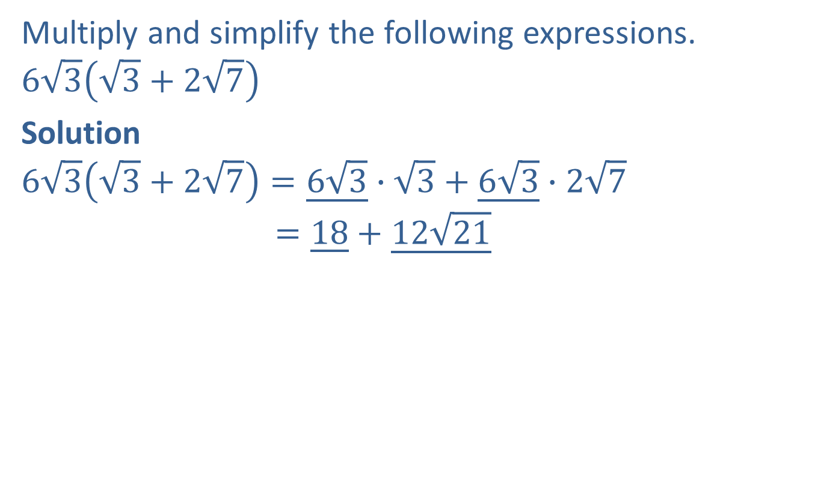
Completion Example 9: Multiplying with Radicals
Multiply and simplify the following expressions.
$$6\sqrt{3}\left(\sqrt{3}+2\sqrt{7}\right)$$
Solution
$$6\sqrt{3}\left(\sqrt{3}+2\sqrt{7}\right)=\underline{6\sqrt{3}}∙\sqrt{3}+\underline{6\sqrt{3}}∙2\sqrt{7}$$
$$=\underline{18}+\underline{12\sqrt{21}}$$

Slide 18
Procedure: Rationalizing a Denominator
Containing a Square Root
If the denominator contains a square root, multiply both the numerator and denominator by an expression that will give a denominator with no square roots.

Slide 19
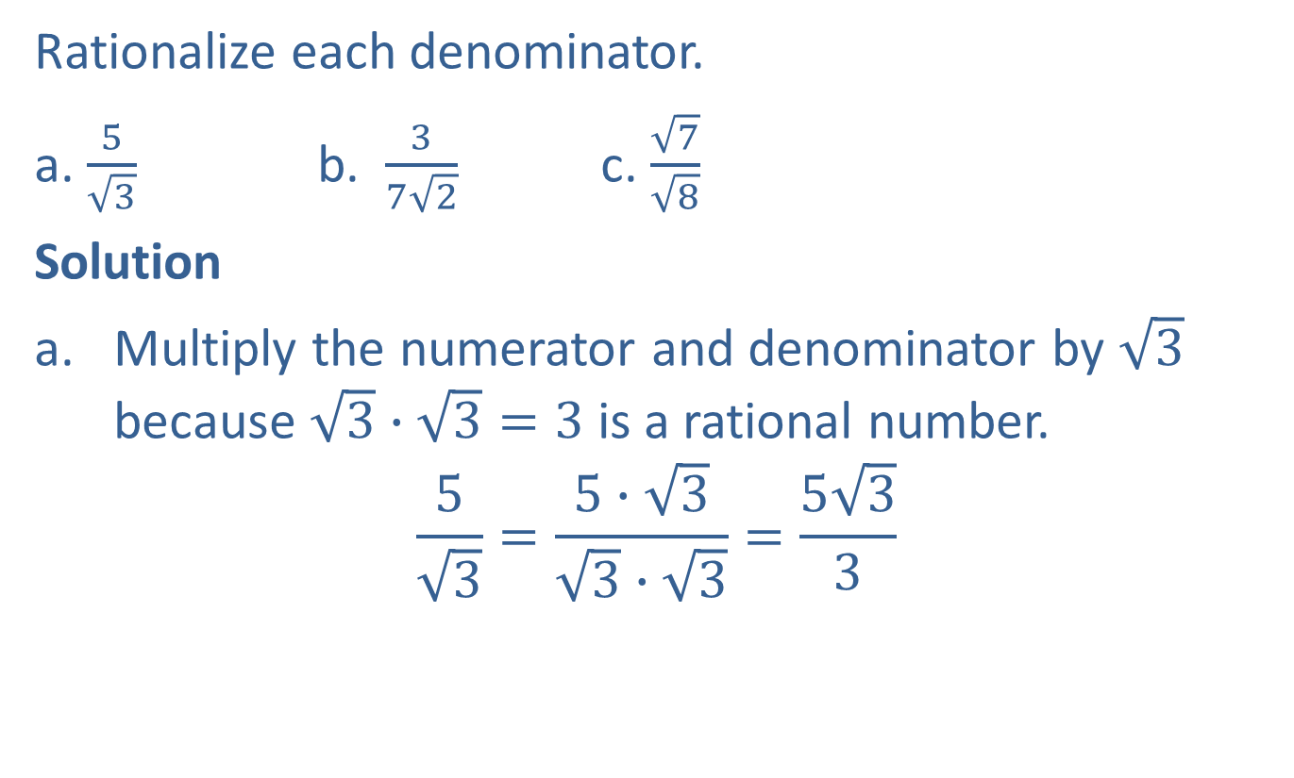
Example 10: Rationalizing Denominators Containing Square Roots
Rationalize each denominator.
a. $\frac{5}{\sqrt{3}}$ b. $\frac{3}{7\sqrt{2}}$ c. $\frac{\sqrt{7}}{\sqrt{8}}$
Solution
Multiply the numerator and denominator by $\sqrt{3}$ because $\sqrt{3}∙\sqrt{3}=3$ is a rational number.
$$\frac{5}{\sqrt{3}}=\frac{5∙\sqrt{3}}{\sqrt{3}∙\sqrt{3}}=\frac{5\sqrt{3}}{3}$$

Slide 20
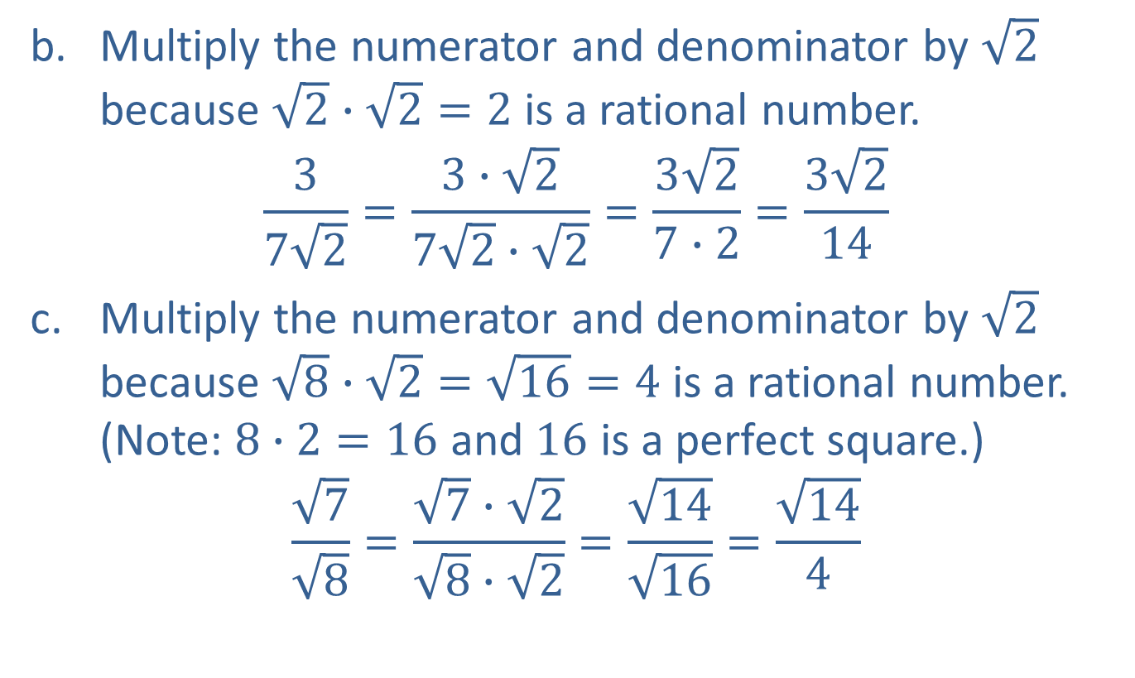
Example 10: Rationalizing Denominators Containing Square Roots (cont.)
Multiply the numerator and denominator by $\sqrt{2}$ because $\sqrt{2}∙\sqrt{2}=2$ is a rational number.
$$\frac{3}{7\sqrt{2}}=\frac{3∙\sqrt{2}}{7\sqrt{2}∙\sqrt{2}}=\frac{3\sqrt{2}}{7∙2}=\frac{3\sqrt{2}}{14}$$
Multiply the numerator and denominator by $\sqrt{2}$ because $\sqrt{8}∙\sqrt{2}=\sqrt{16}=4$ is a rational number. (Note: $8$ $∙$ $2=16$ and $16$ is a perfect square.)
$$\frac{\sqrt{7}}{\sqrt{8}}=\frac{\sqrt{7}∙\sqrt{2}}{\sqrt{8}∙\sqrt{2}}=\frac{\sqrt{14}}{\sqrt{16}}=\frac{\sqrt{14}}{4}$$

Slide 21
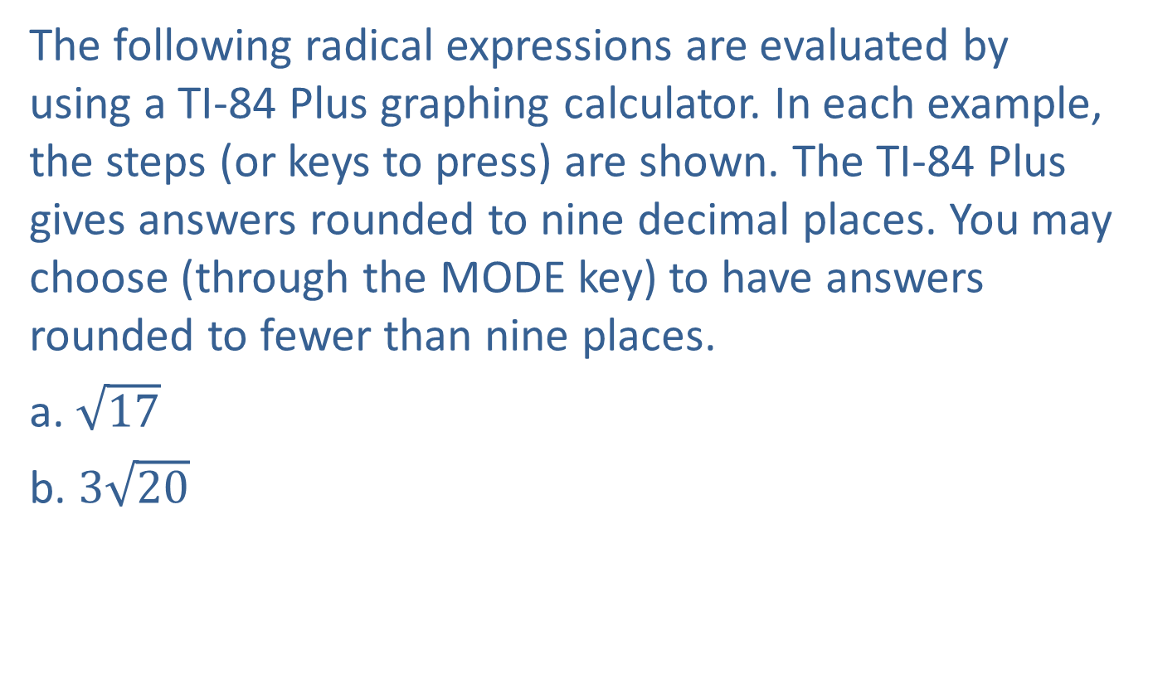
Example 11: Evaluating Radical Expressions with a Calculator
The following radical expressions are evaluated by using a TI-84 Plus graphing calculator. In each example, the steps (or keys to press) are shown. The TI-84 Plus gives answers rounded to nine decimal places. You may choose (through the MODE key) to have answers rounded to fewer than nine places.
a. $\sqrt{17}$
b. $3\sqrt{20}$

Slide 22
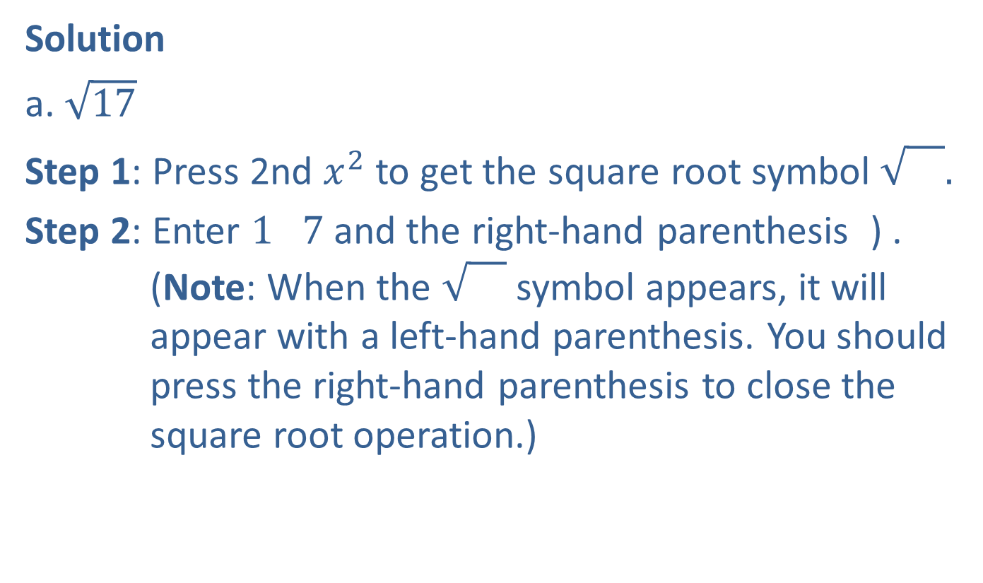
Example 11: Evaluating Radical Expressions with a Calculator (cont.)
Solution
a. $\sqrt{17}$
Step 1: Press 2nd $x^{2}$ to get the square root symbol $\sqrt{}.$
Step 2: Enter $1$ $7$ and the right-hand parenthesis ) . (Note: When the symbol appears, it will appear with a left-hand parenthesis. You should press the right-hand parenthesis to close the square root operation.)

Slide 23
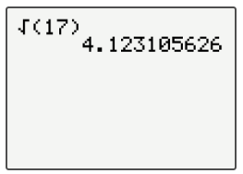
Example 11: Evaluating Radical Expressions with a Calculator (cont.)
Step 3: Press ENTER .
The display will appear as follows.

Slide 24
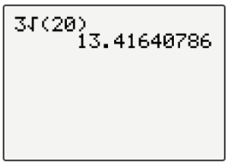
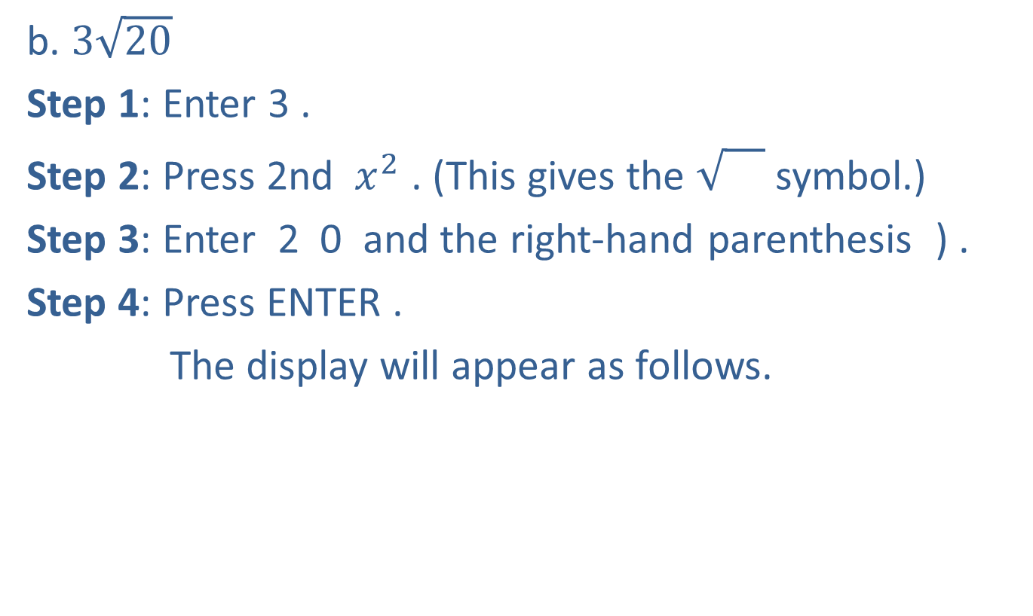
Example 11: Evaluating Radical Expressions with a Calculator (cont.)
b. $3\sqrt{20}$
Step 1: Enter 3 .
Step 2: Press 2nd $x^{2}$ . (This gives the symbol.)
Step 3: Enter 2 0 and the right-hand parenthesis ) .
Step 4: Press ENTER .
The display will appear as follows.
Note: This expression represents $3$ times $\sqrt{20}.$
Note: The calculator is programmed to follow the rules for order of operations.

