Slide 1
Section 5.6
Solving Quadratic Equations by the Square Root Property and the Quadratic Formula

Slide 2
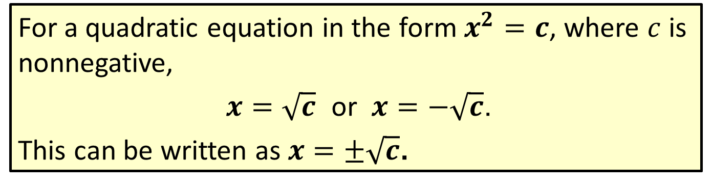
Procedure: Square Root Property
For a quadratic equation in the form $x^{2}=c$, where $c$ is nonnegative,
$x=\sqrt{c}$ or $x=−\sqrt{c}$.
This can be written as $x=±\sqrt{c}$.

Slide 3
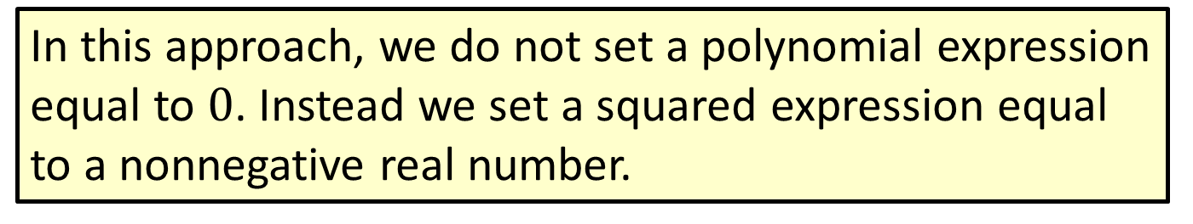
Note
In this approach, we do not set a polynomial expression equal to $0$. Instead we set a squared expression equal to a nonnegative real number.

Slide 4
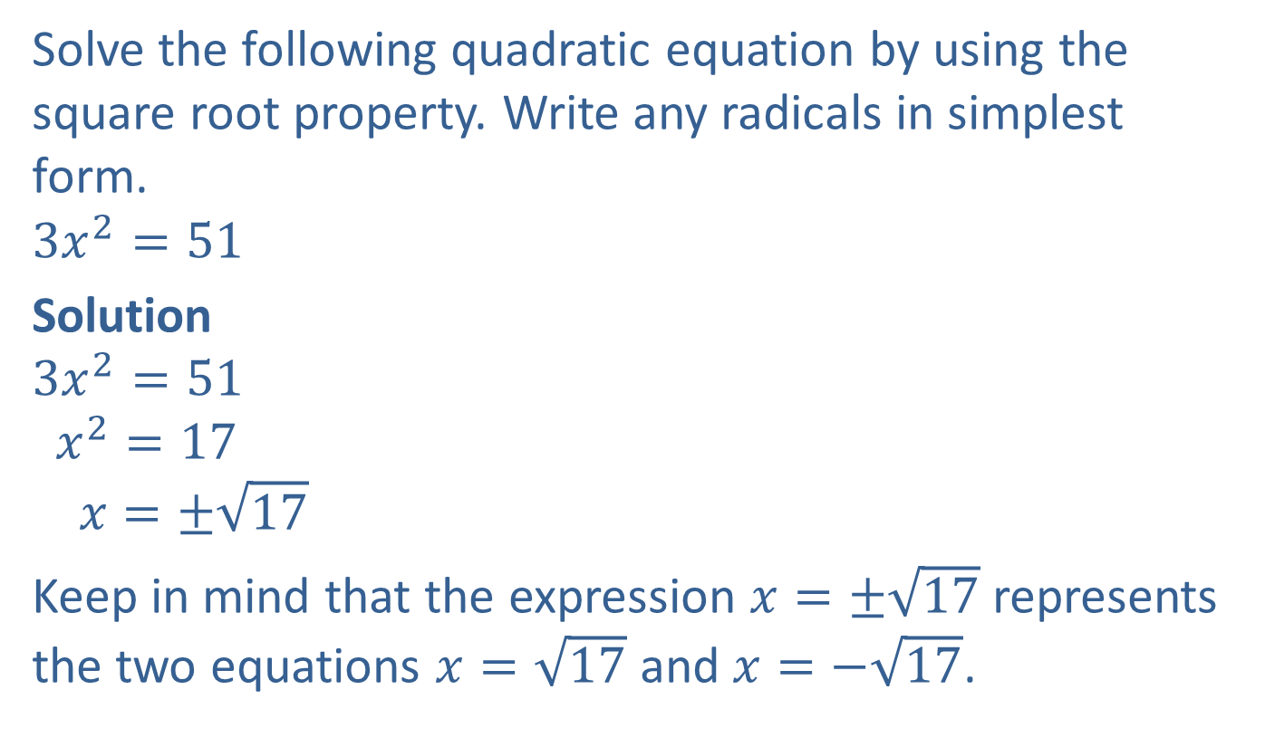
Example 1: Using the Square Root Property
Solve the following quadratic equation by using the square root property. Write any radicals in simplest form.
$$3x^{2}=51$$
Solution
$$3x^{2}=51$$
$$x^{2}=17$$
$$x=±\sqrt{17}$$
Keep in mind that the expression $x=±\sqrt{17}$ represents the two equations $x=\sqrt{17}$ and $x=−\sqrt{17}$.
Divide both sides by $3$ so that the coefficient of $x^{2}$ is 1.

Slide 5
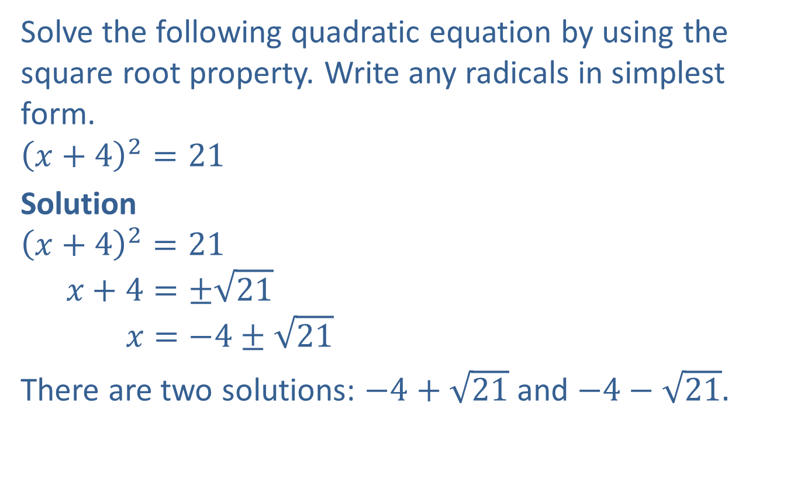
Example 2: Using the Square Root Property
Solve the following quadratic equation by using the square root property. Write any radicals in simplest form.
$${\left(x+4\right)}^{2}=21$$
Solution
$${\left(x+4\right)}^{2}=21$$
$$x+4=±\sqrt{21}$$
$$x=−4±\sqrt{21}$$
There are two solutions: $−4+\sqrt{21}$ and $−4−\sqrt{21}.$

Slide 6

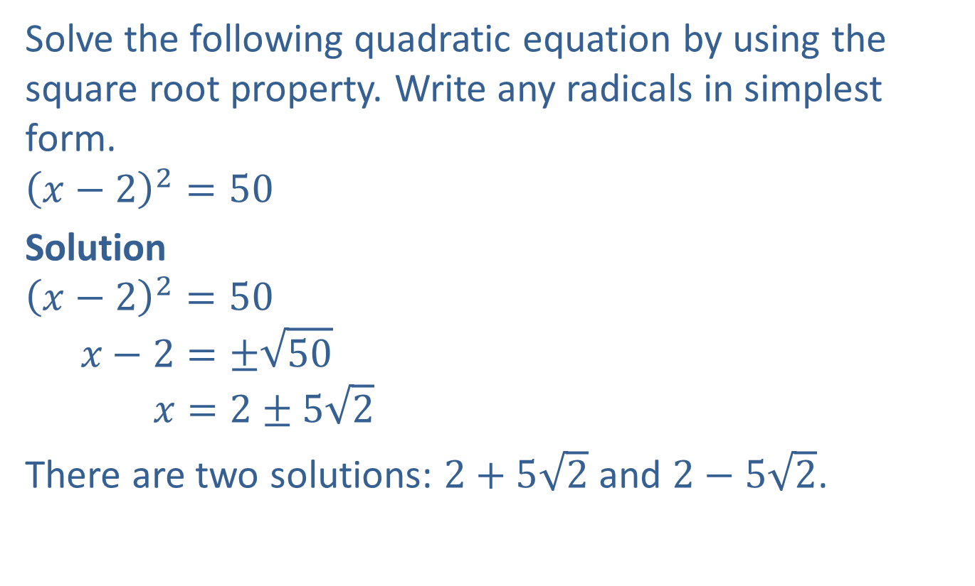
Example 3: Using the Square Root Property
Solve the following quadratic equation by using the square root property. Write any radicals in simplest form.
$${\left(x−2\right)}^{2}=50$$
Solution
$${\left(x−2\right)}^{2}=50$$
$$x−2=±\sqrt{50}$$
$$x=2±5\sqrt{2}$$
There are two solutions: $2+5\sqrt{2}$ and $2−5\sqrt{2}$.
Simplify the radical $\left(\sqrt{50}=\sqrt{25}\sqrt{2}=5\sqrt{2}\right).$

Slide 7

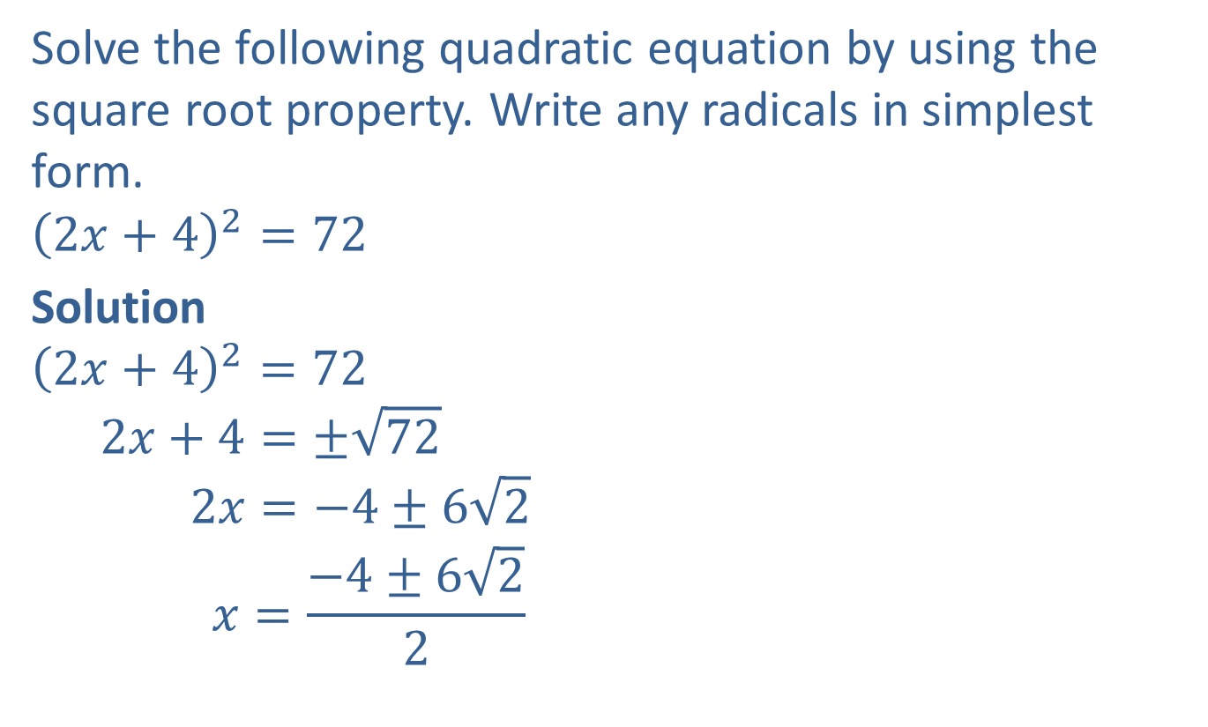
Example 4: Using the Square Root Property
Solve the following quadratic equation by using the square root property. Write any radicals in simplest form.
$${\left(2x+4\right)}^{2}=72$$
Solution
$${\left(2x+4\right)}^{2}=72$$
$$2x+4=±\sqrt{72}$$
$$2x=−4±6\sqrt{2}$$
$$x=\frac{−4±6\sqrt{2}}{2}$$
Simplify the radical $\left(\sqrt{72}=\sqrt{36}\sqrt{2}=6\sqrt{2}\right).$

Slide 8

Example 4: Using the Square Root Property (cont.)
$$x=\frac{2\left(−2±3\sqrt{2}\right)}{2}$$
$$x=−2±3\sqrt{2}$$
There are two solutions: $−2+3\sqrt{2}$ and $−2−3\sqrt{2}$.
Factor and simplify.

Slide 9
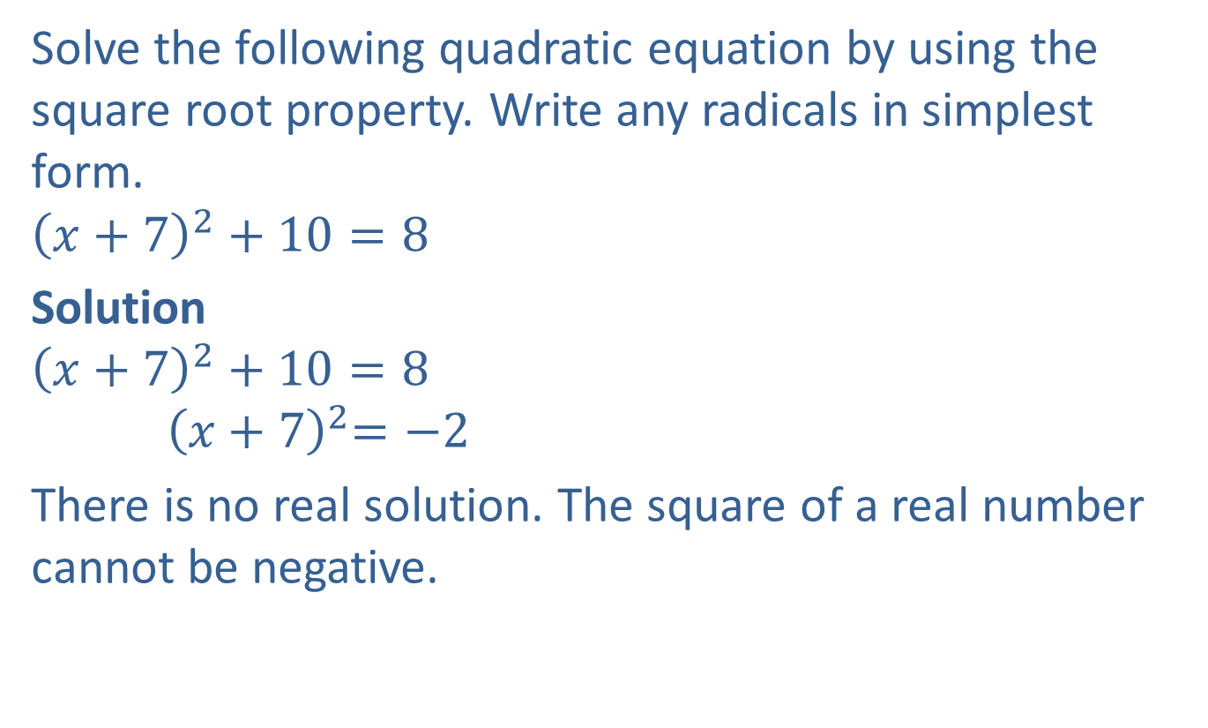
Example 5: Using the Square Root Property
Solve the following quadratic equation by using the square root property. Write any radicals in simplest form.
$${\left(x+7\right)}^{2}+10=8$$
Solution
$${\left(x+7\right)}^{2}+10=8$$
$${ \left(x+7\right)}^{2}=−2$$
There is no real solution. The square of a real number cannot be negative.

Slide 10
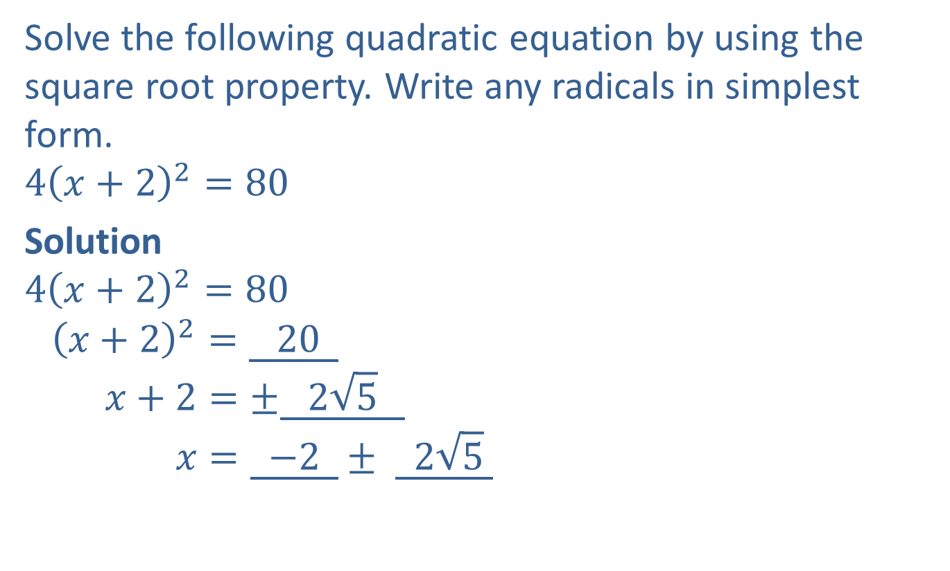
Completion Example 6: Using the Square Root Property
Solve the following quadratic equation by using the square root property. Write any radicals in simplest form.
$$4{\left(x+2\right)}^{2}=80$$
Solution
$$4{\left(x+2\right)}^{2}=80$$
$${\left(x+2\right)}^{2}=\underline{ 20 }$$
$$x+2=±\underline{ 2\sqrt{5} }$$
$$x=\underline{ −2 }± \underline{ 2\sqrt{5} }$$

Slide 11
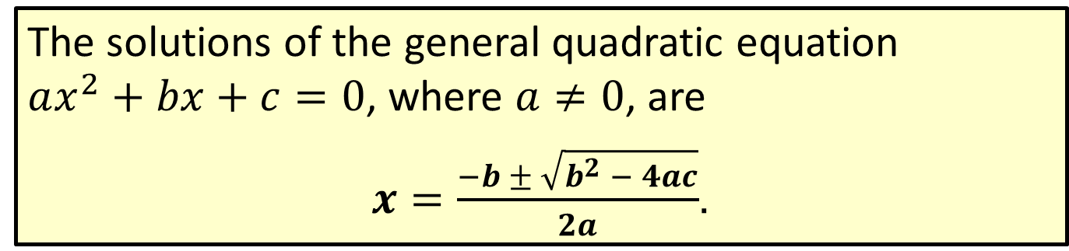
Formula: The Quadratic Formula
The solutions of the general quadratic equation
$ax^{2}+bx+c=0$, where $a≠0$, are
$x=\frac{−b ± \sqrt{b^{2} − 4ac}}{2a}$.

Slide 12
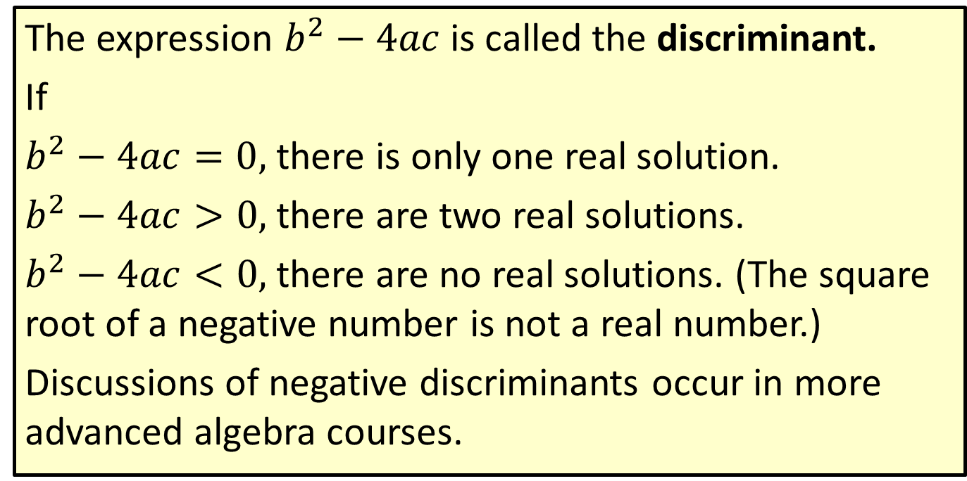
Note
The expression $b^{2}−4ac$is called the discriminant.
If
$b^{2}−4ac=0,$ there is only one real solution.
$b^{2}−4ac>0,$ there are two real solutions.
$b^{2}−4ac<0,$ there are no real solutions. (The square root of a negative number is not a real number.)
Discussions of negative discriminants occur in more advanced algebra courses.

Slide 13
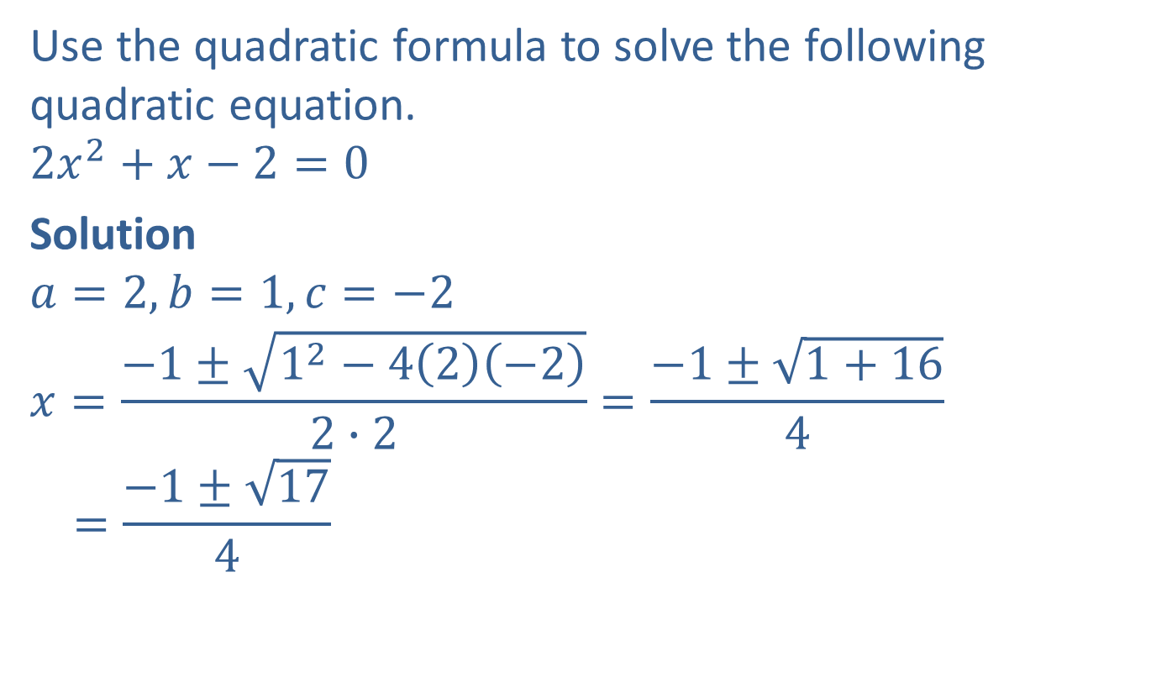
Example 7: The Quadratic Formula
Use the quadratic formula to solve the following quadratic equation.
$$2x^{2}+x−2=0$$
Solution
$$a=2, b=1, c=−2$$
$$x=\frac{−1±\sqrt{1^{2}−4\left(2\right)\left(−2\right)}}{2∙2}=\frac{−1±\sqrt{1+16}}{4}$$
$$=\frac{−1±\sqrt{17}}{4}$$

Slide 14
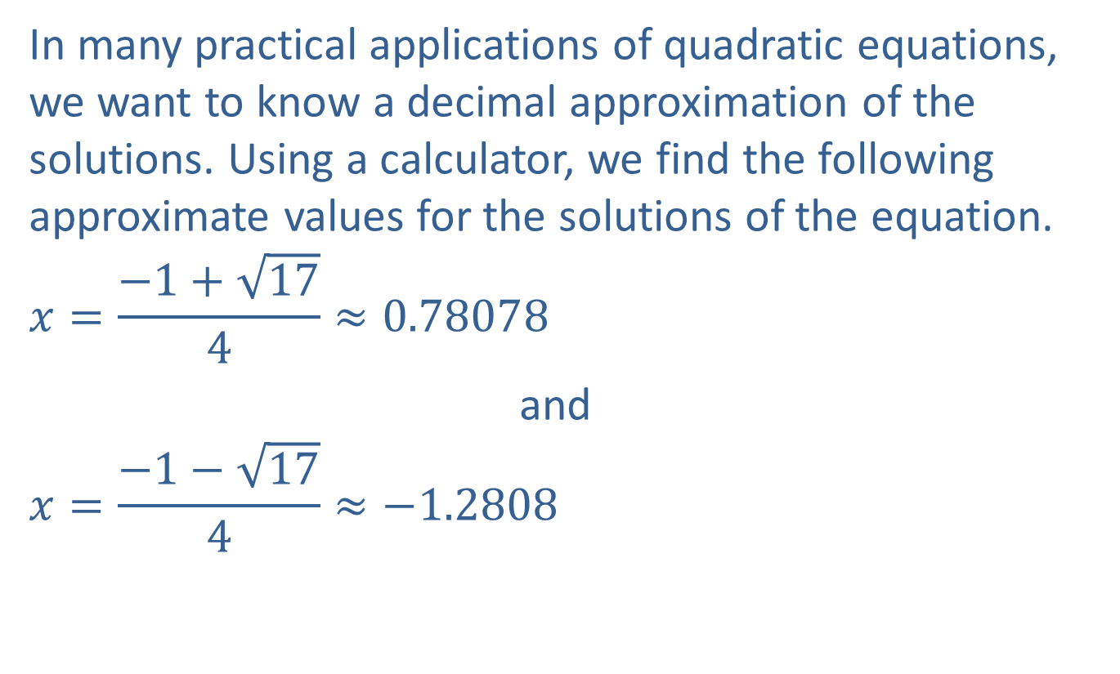
Example 7: The Quadratic Formula (cont.)
In many practical applications of quadratic equations, we want to know a decimal approximation of the solutions. Using a calculator, we find the following approximate values for the solutions of the equation.
$$x=\frac{−1+\sqrt{17}}{4}≈0.78078$$
and
$$x=\frac{−1−\sqrt{17}}{4}≈−1.2808$$

Slide 15

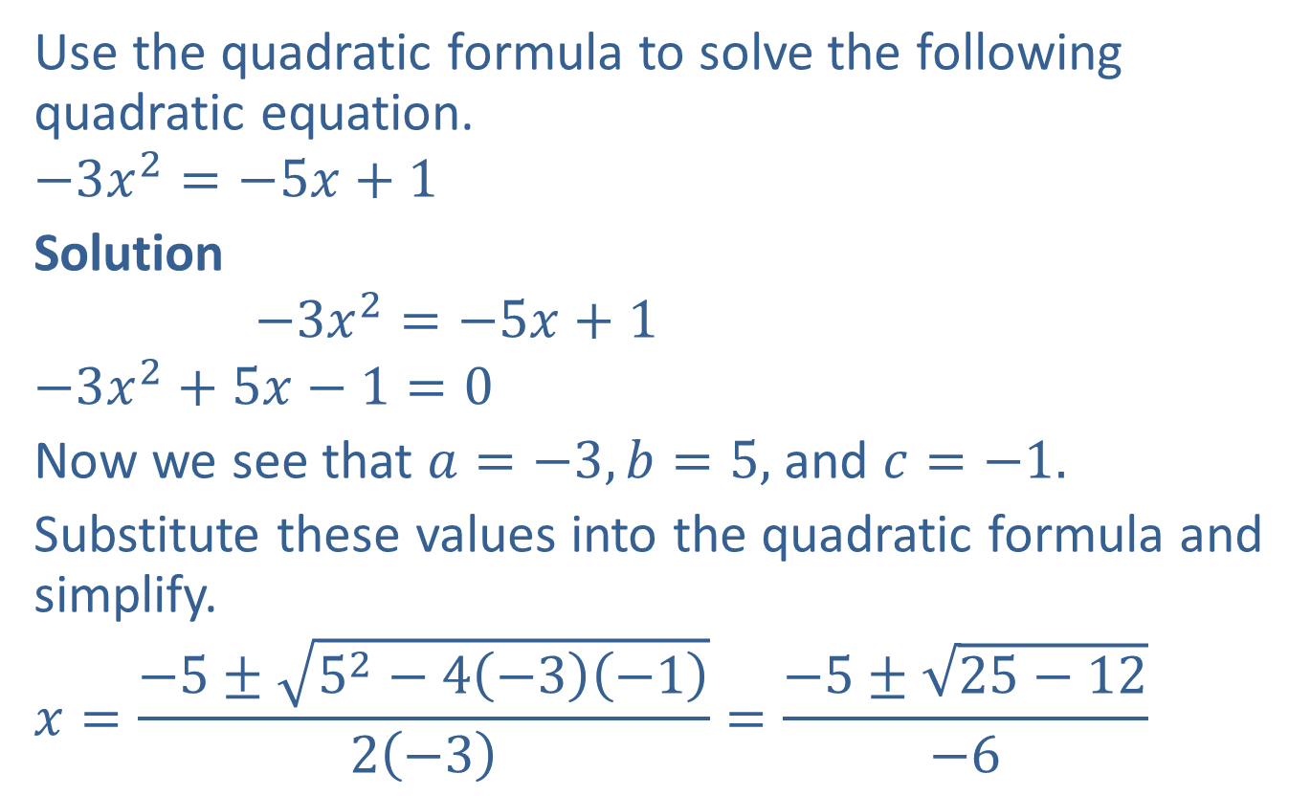
Example 8: The Quadratic Formula
Use the quadratic formula to solve the following quadratic equation.
$$−3x^{2}=−5x+1$$
Solution
$$−3x^{2}=−5x+1$$
$$−3x^{2}+5x−1=0$$
Now we see that $a=−3, b=5,$ and $c=−1.$
Substitute these values into the quadratic formula and simplify.
$$x=\frac{−5±\sqrt{5^{2}−4\left(−3\right)\left(−1\right)}}{2\left(−3\right)}=\frac{−5±\sqrt{25−12}}{−6}$$
First, rewrite the equation so that one side is $0.$

Slide 16

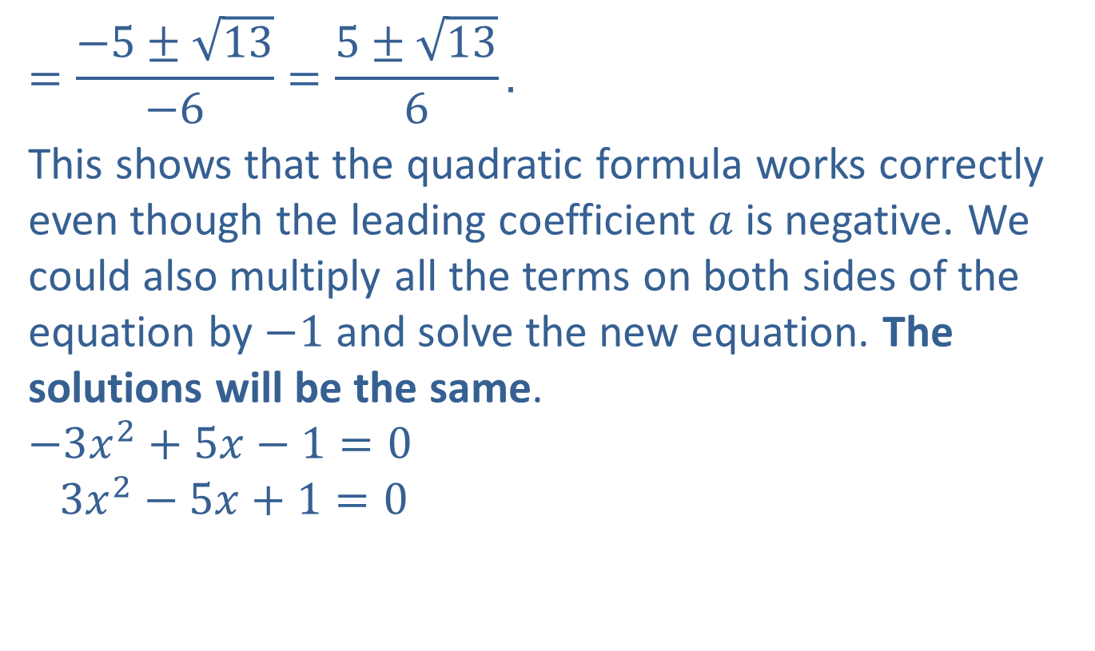
Example 8: The Quadratic Formula (cont.)
$$=\frac{−5±\sqrt{13}}{−6}=\frac{5±\sqrt{13}}{6}.$$
This shows that the quadratic formula works correctly even though the leading coefficient $a$ is negative. We could also multiply all the terms on both sides of the equation by $−1$ and solve the new equation. The solutions will be the same.
$$−3x^{2}+5x−1=0$$
$$3x^{2}−5x+1=0$$
Multiply every term by $−1.$

Slide 17
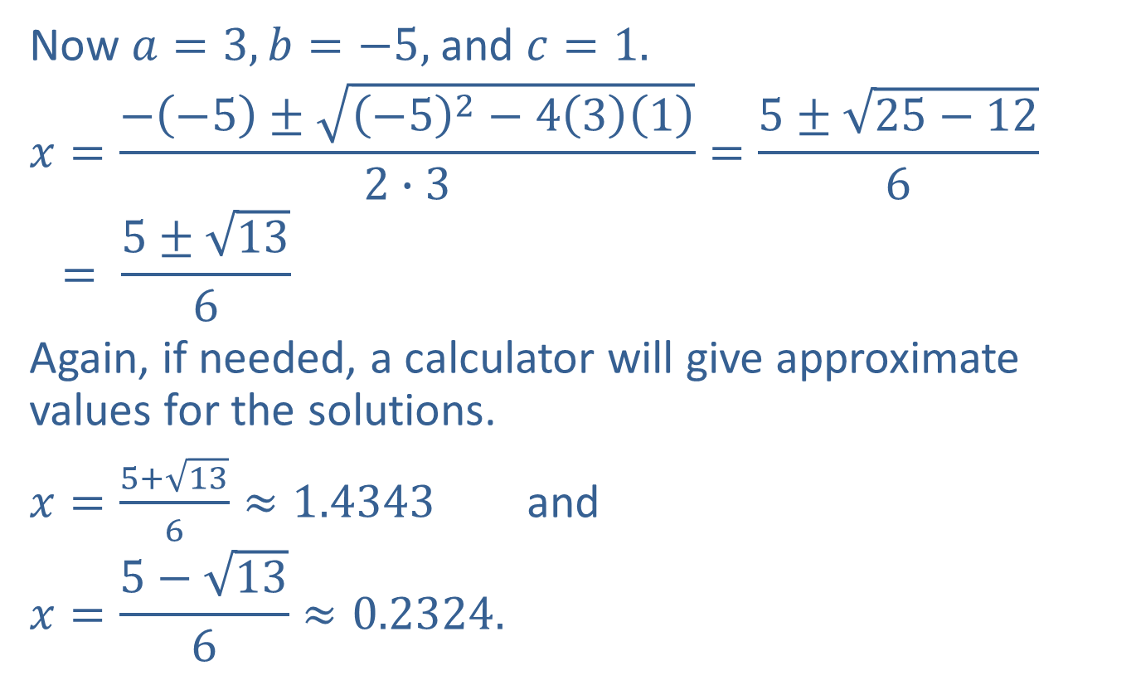
Example 8: The Quadratic Formula (cont.)
Now $a=3, b=−5,$ and $c=1.$
$$x=\frac{−\left(−5\right)±\sqrt{{\left(−5\right)}^{2}−4\left(3\right)\left(1\right)}}{2∙3}=\frac{5±\sqrt{25−12}}{6}$$
$$= \frac{5±\sqrt{13}}{6}$$
Again, if needed, a calculator will give approximate values for the solutions.
$x=\frac{5+\sqrt{13}}{6}≈1.4343$ and
$$x=\frac{5−\sqrt{13}}{6}≈0.2324.$$

Slide 18
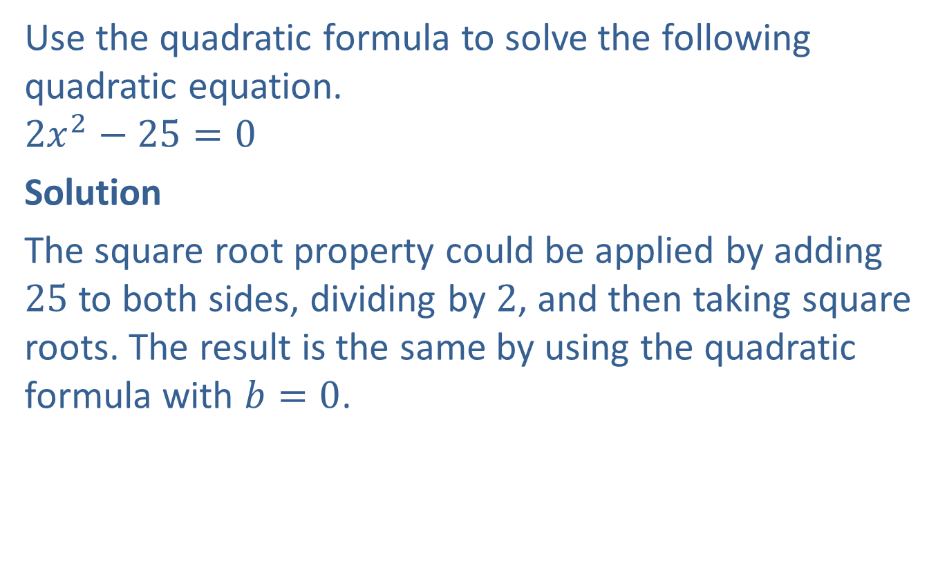
Example 9: The Quadratic Formula
Use the quadratic formula to solve the following quadratic equation.
$$2x^{2}−25=0$$
Solution
The square root property could be applied by adding $25$ to both sides, dividing by $2$, and then taking square roots. The result is the same by using the quadratic formula with $b=0$.

Slide 19
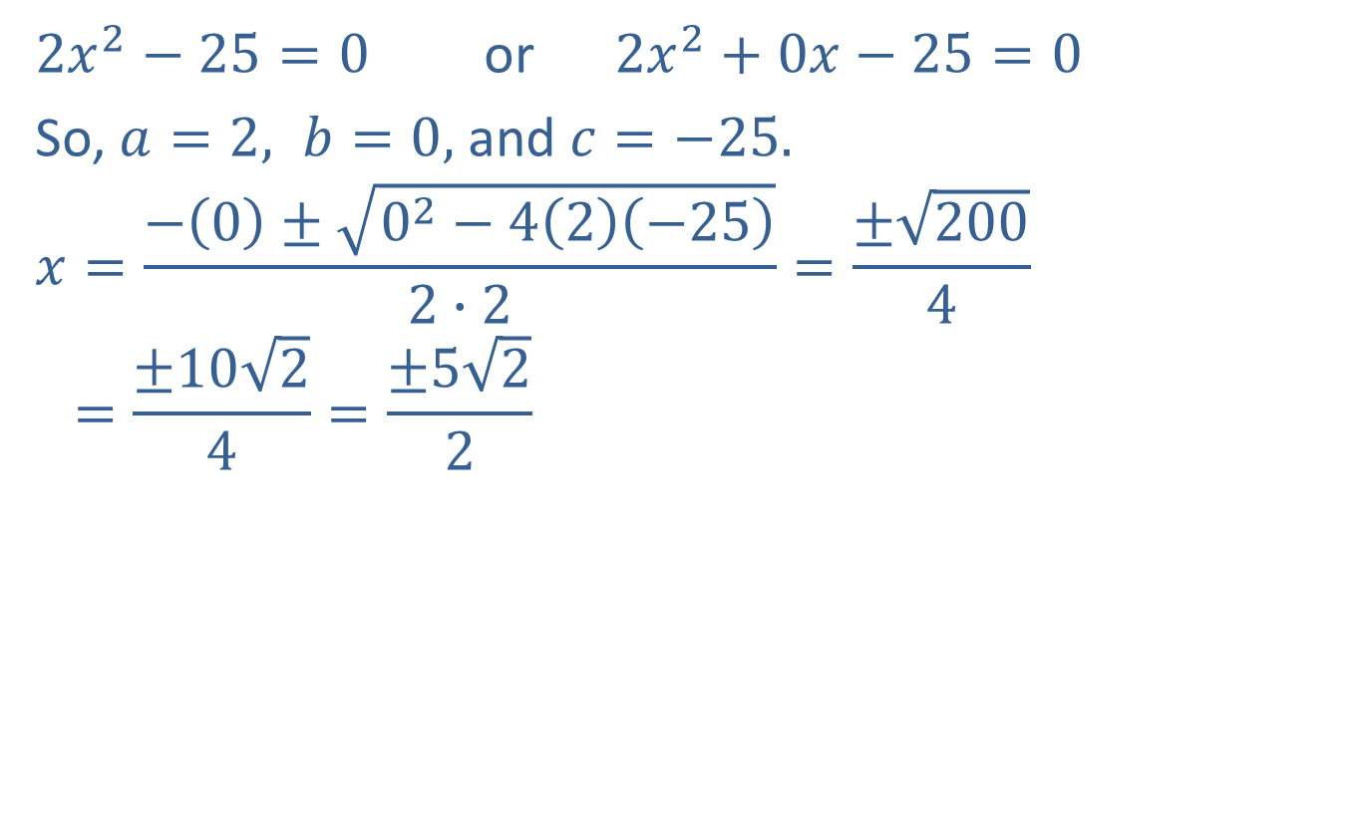
Example 9: The Quadratic Formula (cont.)
$2x^{2}−25=0$ or $2x^{2}+0x−25=0$
So, $a=2, b=0,$ and $c=−25.$
$$x=\frac{−\left(0\right)±\sqrt{0^{2}−4\left(2\right)\left(−25\right)}}{2∙2}=\frac{±\sqrt{200}}{4}$$
$$=\frac{±10\sqrt{2}}{4}=\frac{±5\sqrt{2}}{2}$$

Slide 20
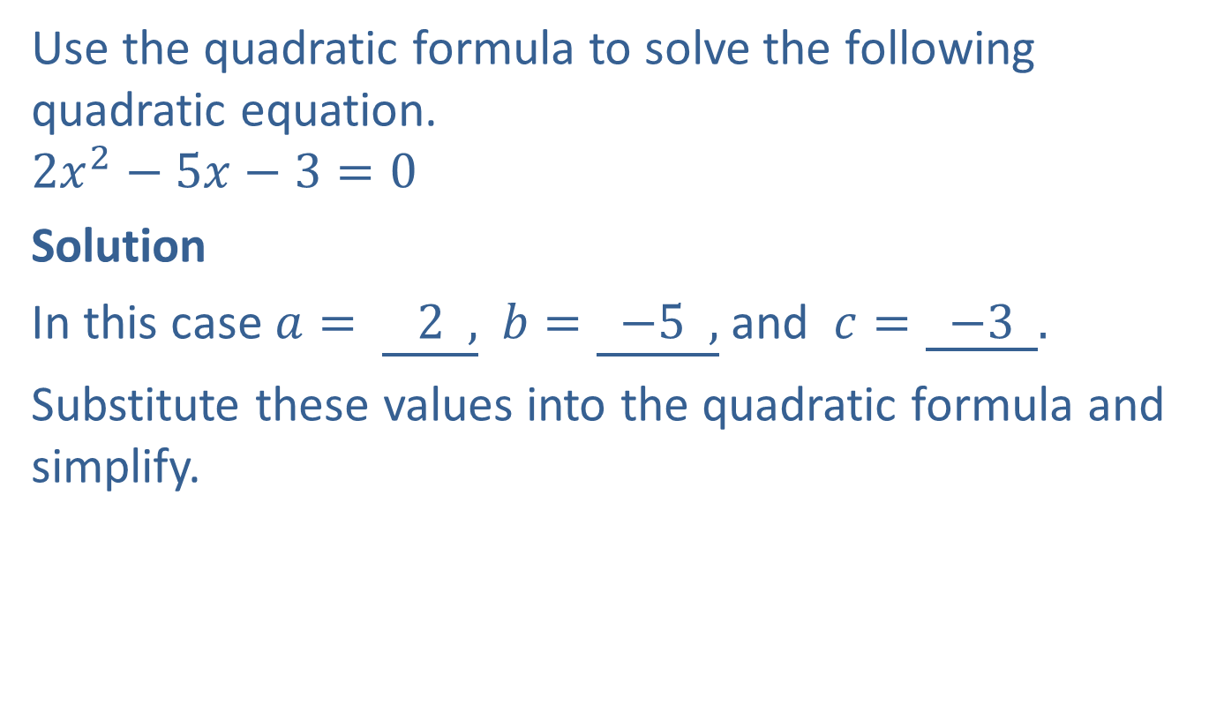
Completion Example 10: The Quadratic Formula
Use the quadratic formula to solve the following quadratic equation.
$$2x^{2}−5x−3=0$$
Solution
In this case $a= \underline{ 2 ,}$ $b=\underline{ −5 ,}$ and $c=\underline{ −3 }.$
Substitute these values into the quadratic formula and simplify.

Slide 21

Completion Example 10: The Quadratic Formula (cont.)
$$x=\frac{−\left(\underline{−5}\right)±\sqrt{{\left(−5\right)}^{2}−4\left(2\right)\left(−3\right)}}{2∙ \underline{ 2 }}=\frac{\underline{ 5 }± \underline{ 7 }}{\underline{ 4 }}$$
$x=\underline{ 3 }$ and $x= \underline{ − \frac{1}{2} }$

Slide 22

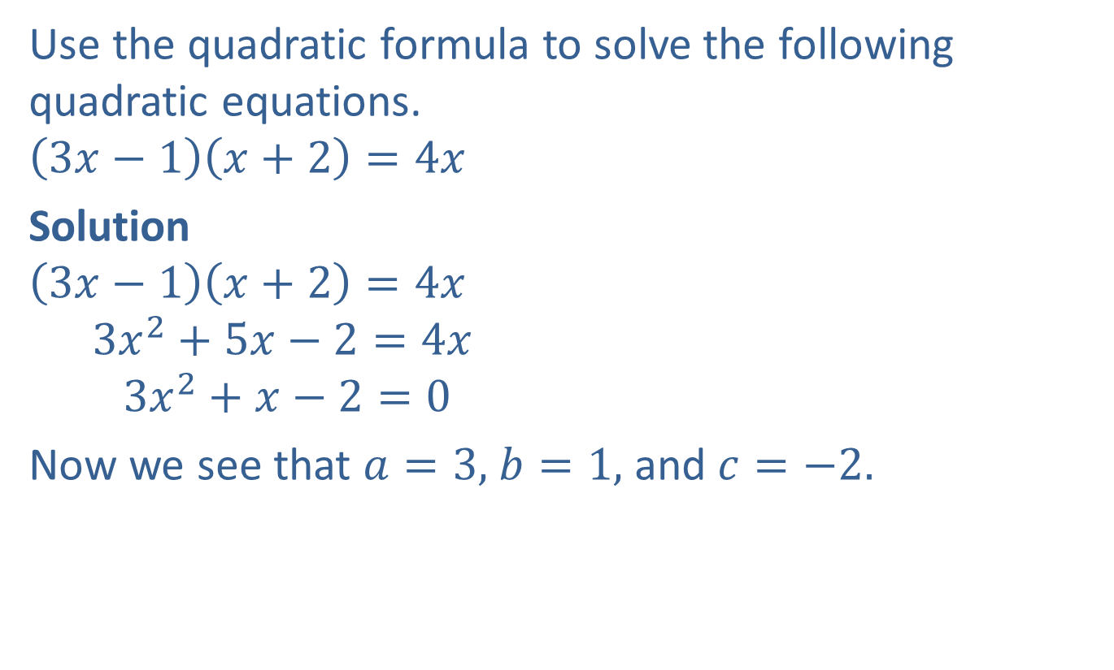
Example 11: The Quadratic Formula
Use the quadratic formula to solve the following quadratic equations.
$$\left(3x−1\right)\left(x+2\right)=4x$$
Solution
$$\left(3x−1\right)\left(x+2\right)=4x$$
$$3x^{2}+5x−2=4x$$
$$3x^{2}+x−2=0$$
Now we see that $a=3,$ $b=1,$ and $c=−2.$
Multiply on the left-hand side.
Subtract $4x$ from both sides so that one side is $0.$

Slide 23
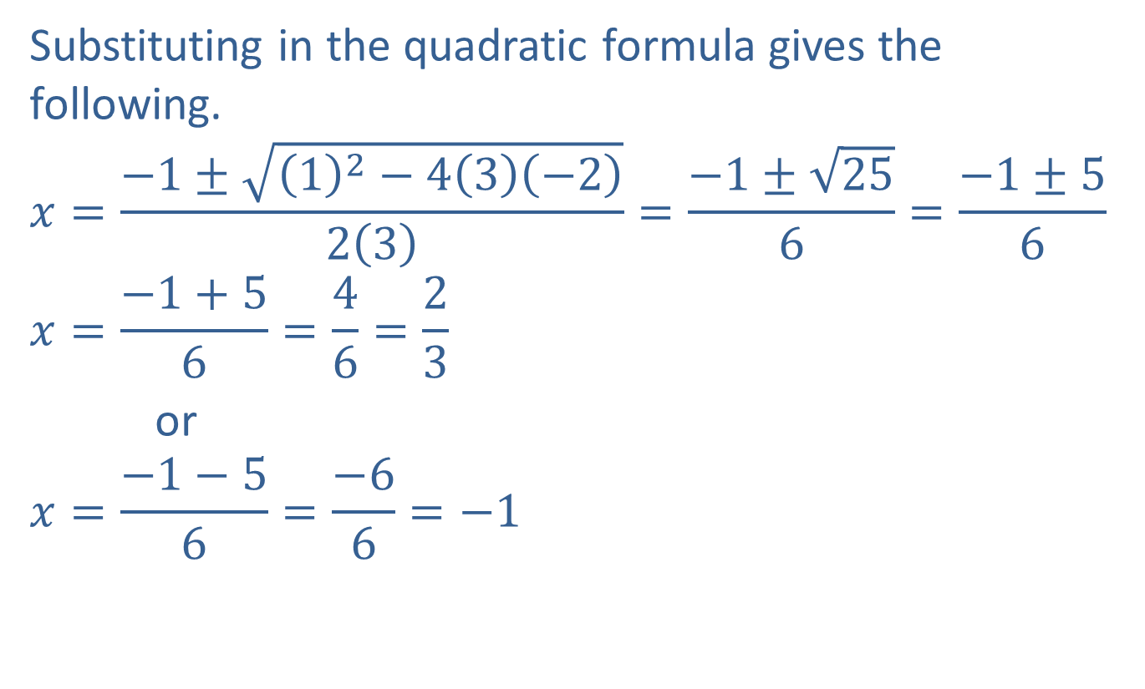
Example 11: The Quadratic Formula (cont.)
Substituting in the quadratic formula gives the following.
$$x=\frac{−1±\sqrt{{\left(1\right)}^{2}−4\left(3\right)\left(−2\right)}}{2\left(3\right)}=\frac{−1±\sqrt{25}}{6}=\frac{−1±5}{6}$$
$$x=\frac{−1+5}{6}=\frac{4}{6}=\frac{2}{3}$$
or
$$x=\frac{−1−5}{6}=\frac{−6}{6}=−1$$

Slide 24
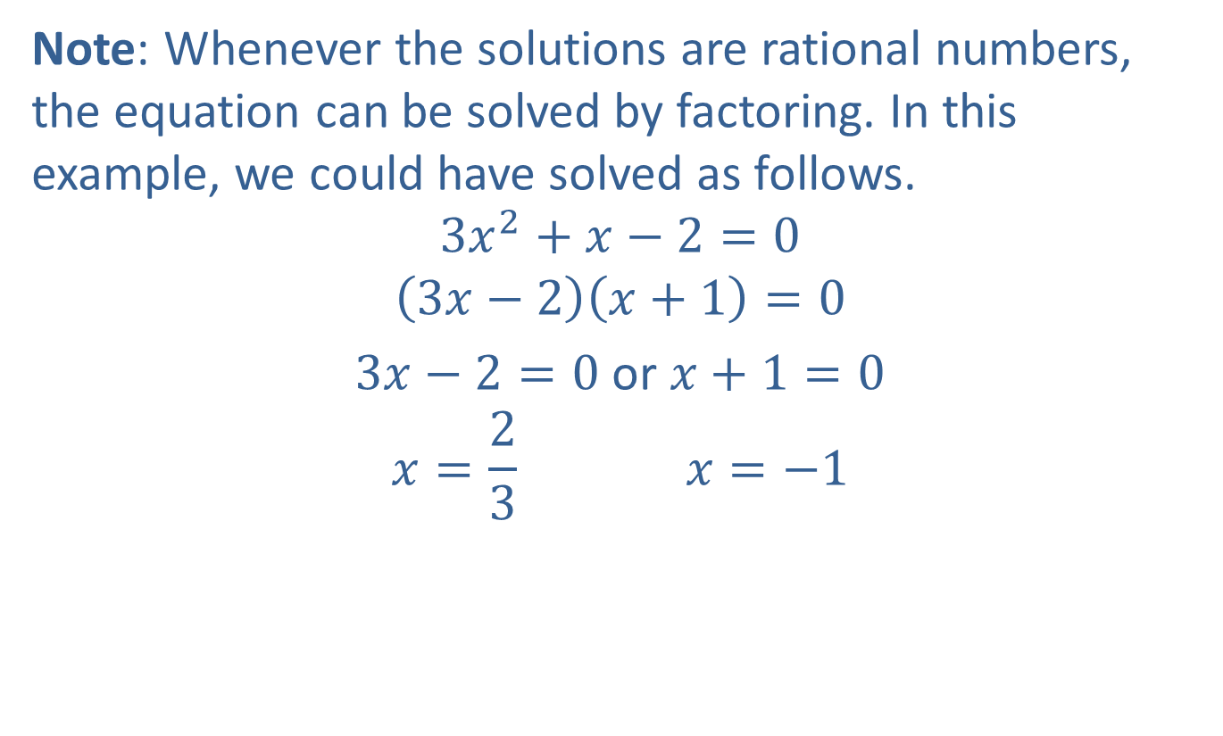
Example 11: The Quadratic Formula (cont.)
Note: Whenever the solutions are rational numbers, the equation can be solved by factoring. In this example, we could have solved as follows.
$$3x^{2}+x−2=0$$
$$\left(3x−2\right)\left(x+1\right)=0$$
$3x−2=0$ or $x+1=0$
$$x=\frac{2}{3} x=−1$$

Slide 25
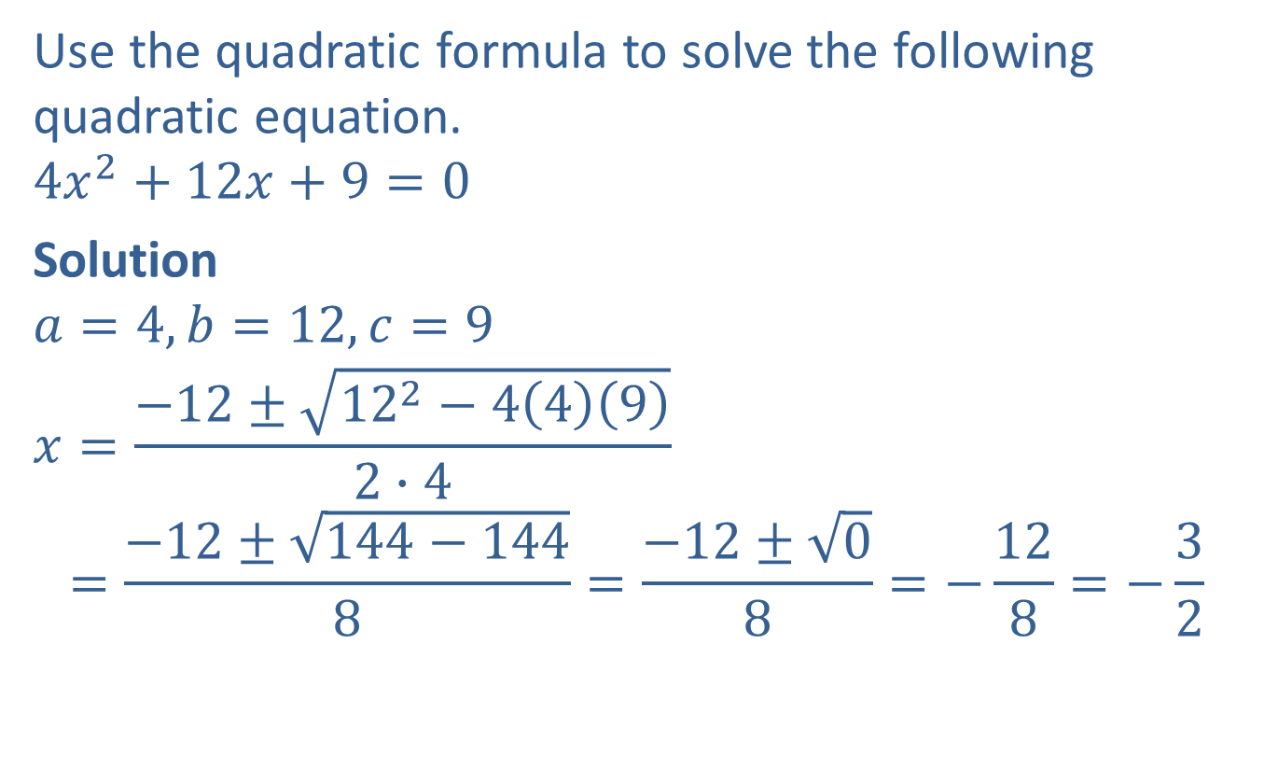
Example 12: The Quadratic Formula and a Double Solution
Use the quadratic formula to solve the following quadratic equation.
$$4x^{2}+12x+9=0$$
Solution
$$a=4, b=12, c=9$$
$$x=\frac{−12±\sqrt{{12}^{2}−4\left(4\right)\left(9\right)}}{2∙4}$$
$$=\frac{−12±\sqrt{144−144}}{8}=\frac{−12±\sqrt{0}}{8}=−\frac{12}{8}=−\frac{3}{2}$$

Slide 26

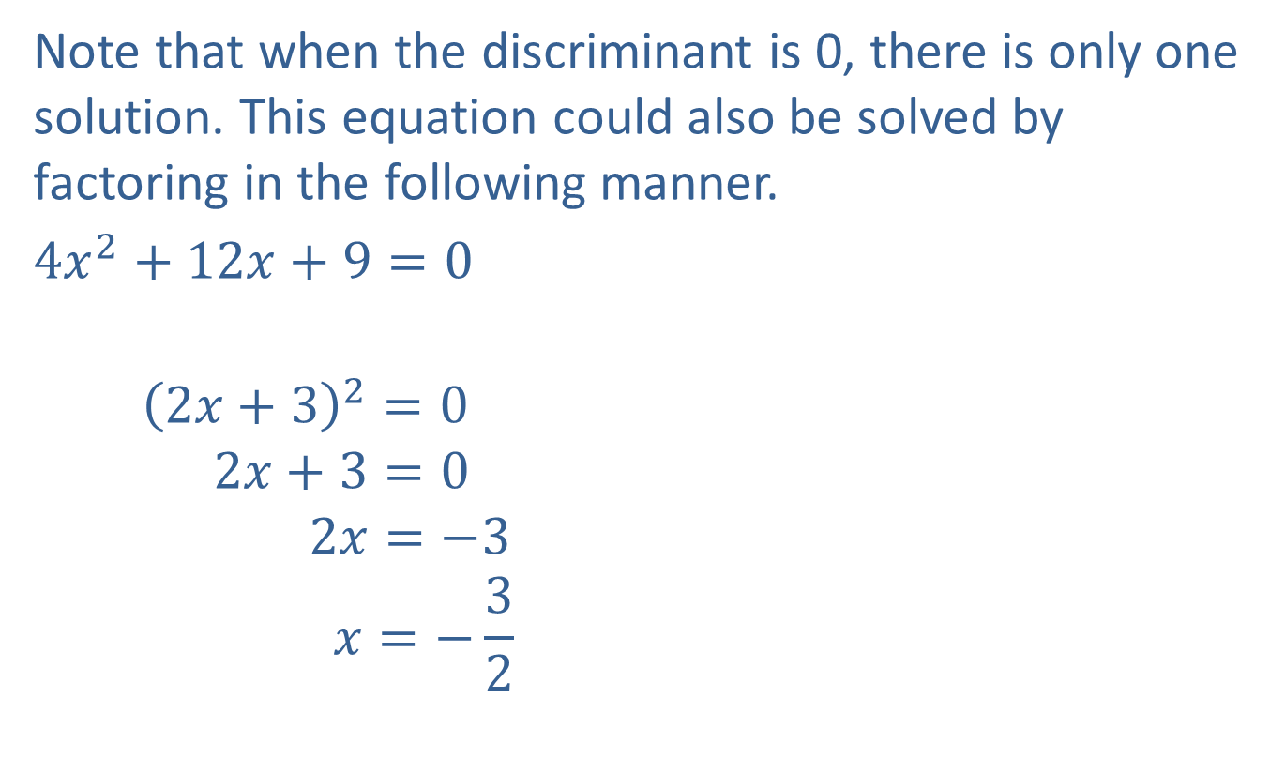

Example 12: The Quadratic Formula and a Double Solution (cont.)
Note that when the discriminant is 0, there is only one solution. This equation could also be solved by factoring in the following manner.
$4x^{2}+12x+9=0$
$${\left(2x+3\right)}^{2}=0$$
$$2x+3=0$$
$$2x=−3$$
$$x=−\frac{3}{2}$$
The quadratic expression is a perfect square trinomial.
The factor $2x+3$ is repeated.
$−\frac{3}{2}$ is called a double solution or a double root.

Slide 27
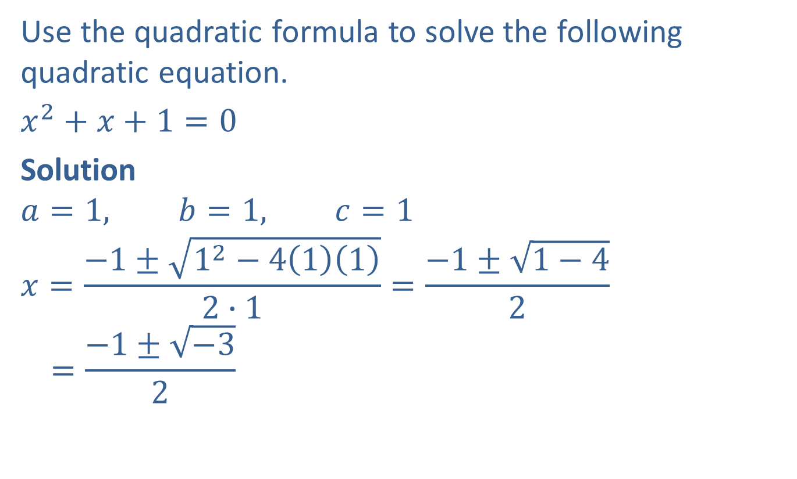
Example 13: The Quadratic Formula and Nonreal Solutions
Use the quadratic formula to solve the following quadratic equation.
$x^{2}+x+1=0$
Solution
$$a=1, b=1, c=1$$
$$x=\frac{−1±\sqrt{1^{2}−4\left(1\right)\left(1\right)}}{2∙1}=\frac{−1±\sqrt{1−4}}{2}$$
$$=\frac{−1±\sqrt{−3}}{2}$$

Slide 28
Example 13: The Quadratic Formula and Nonreal Solutions (cont.)
There is no real solution. This example illustrates the fact that not every equation has real solutions. Such solutions are called nonreal complex numbers and are discussed in more depth in higher-level math courses.

