Slide 1
Section 5.7
Applications of Quadratic Equations

Slide 2
Procedure: Attack Plan for Application Problems
​Read the problem carefully, at least twice.
​Decide what is asked for and assign a variable or variable expression to the unknown quantities. It may help to organize a chart, table, or diagram relating all the information provided.
​Write and then solve an equation that relates the information provided. (A formula of some type may be necessary.)
​Check your solution with the wording of the problem to be sure it makes sense.

Slide 3
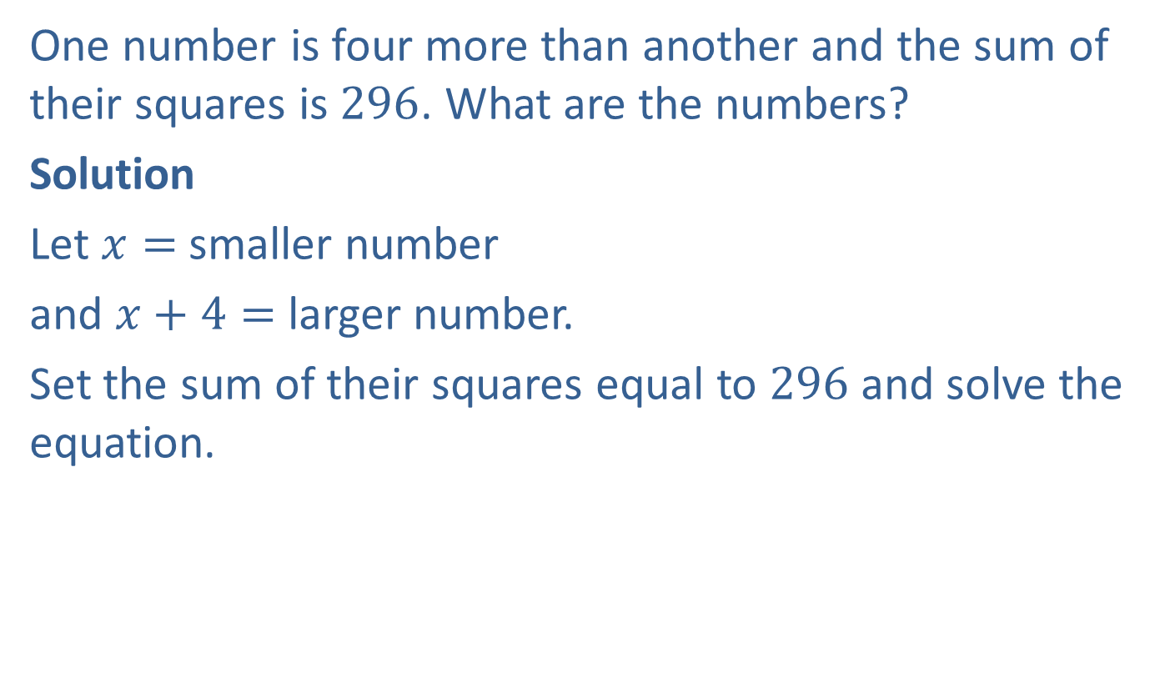
Example 1: Solving Quadratic Number Problems
One number is four more than another and the sum of their squares is $296$. What are the numbers?
Solution
Let $x=$ smaller number
and $x+4=$ larger number.
Set the sum of their squares equal to $296$ and solve the equation.

Slide 4

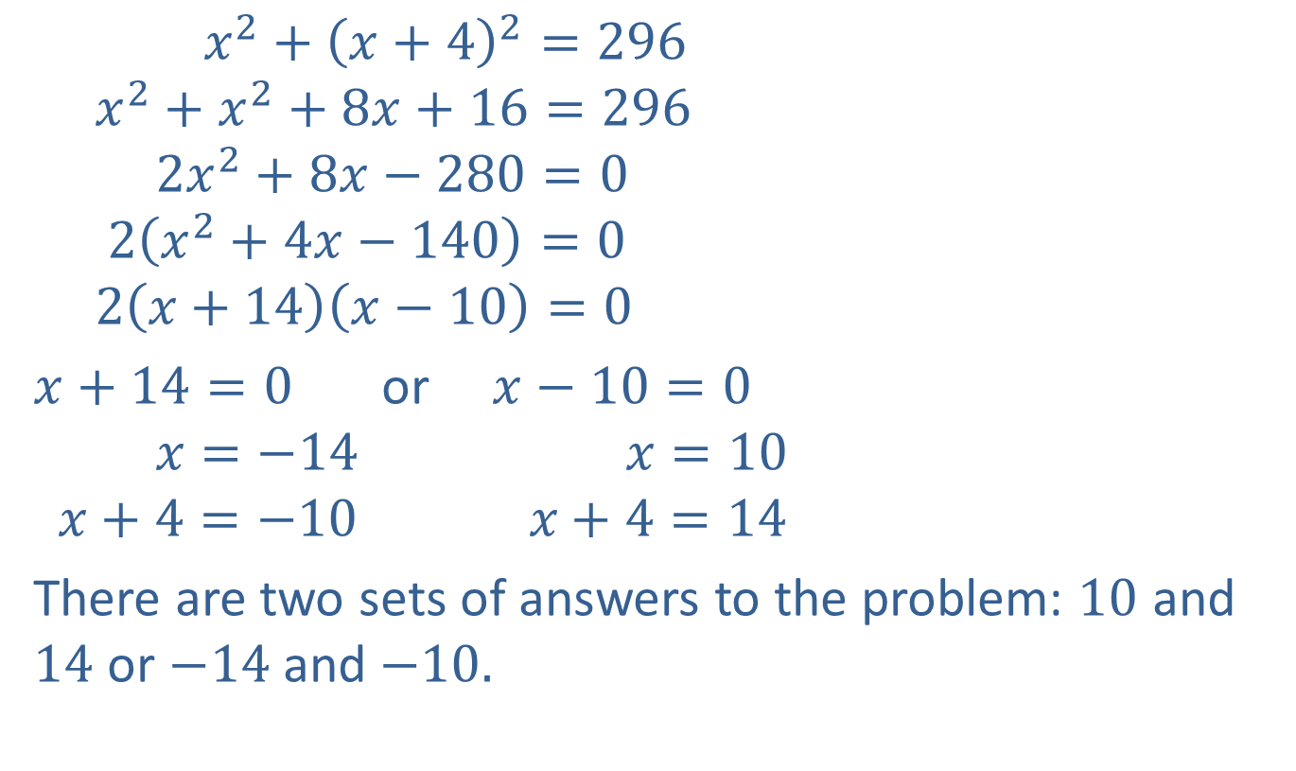
Example 1: Solving Quadratic Number Problems (cont.)
$$x^{2}+{\left(x+4\right)}^{2}=296$$
$$x^{2}+x^{2}+8x+16=296$$
$$2x^{2}+8x−280=0$$
$$2\left(x^{2}+4x−140\right)=0$$
$$2\left(x+14\right)\left(x−10\right)=0$$
$x+14=0$ or $x−10=0$
$$x=−14 x=10$$
$$x+4=−10 x+4=14$$
There are two sets of answers to the problem: $10$ and $14$ or $−14$and $−10.$
Add the squares.
Expand ${\left(x+4\right)}^{2}.$
Write the equation in standard form.
Factor out the GCF.
Factor the trinomial.

Slide 5

Example 1: Solving Quadratic Number Problems (cont.)
Check
$${10}^{2}+{14}^{2}=100+196=296$$
and ${\left(−14\right)}^{2}+{\left(−10\right)}^{2}=196+100=296$

Slide 6
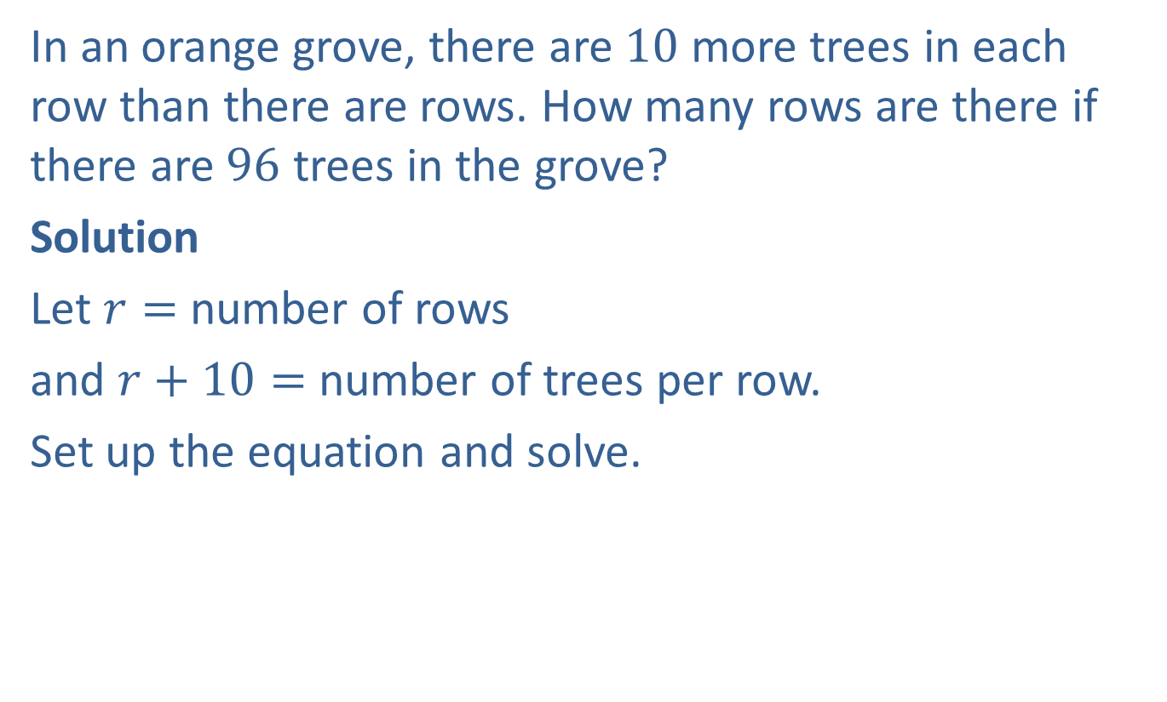
Example 2: Application: Solving Quadratic Equations
In an orange grove, there are $10$ more trees in each row than there are rows. How many rows are there if there are $96$ trees in the grove?
Solution
Let $r=$ number of rows
and $r+10=$ number of trees per row.
Set up the equation and solve.

Slide 7
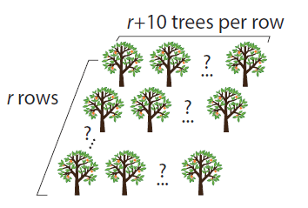
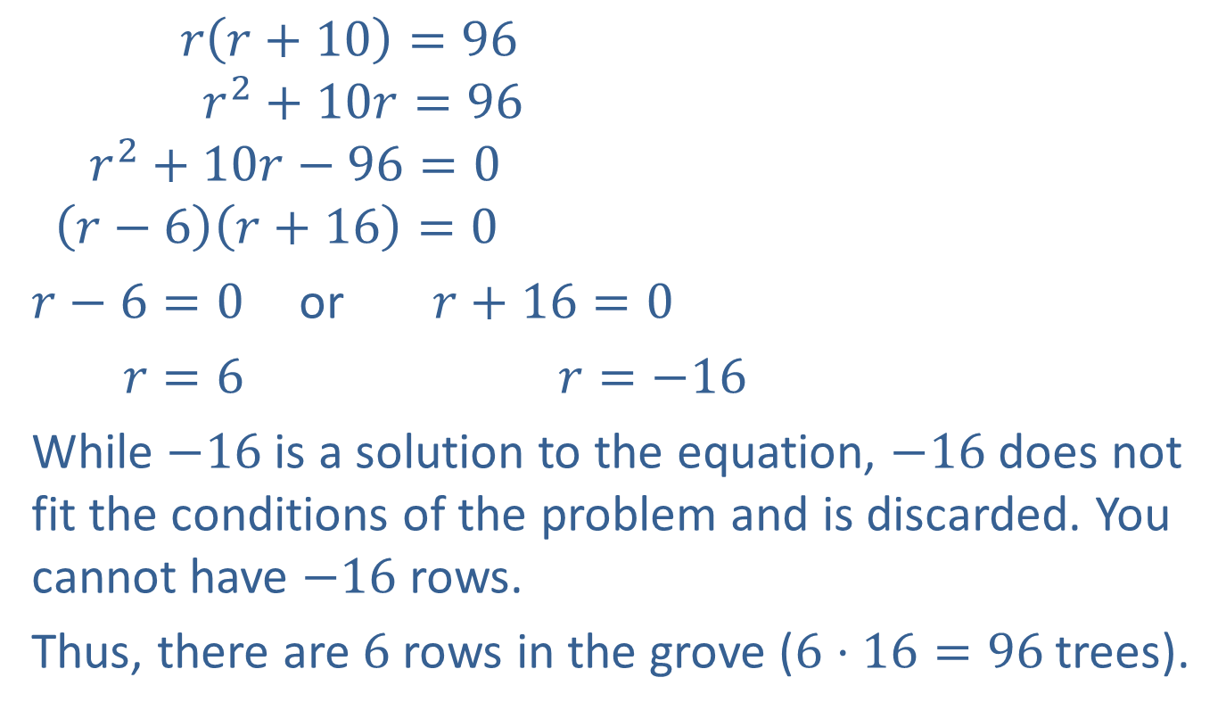
Example 2: Application: Solving Quadratic Equations (cont.)
$$r\left(r+10\right)=96$$
$$r^{2}+10r=96$$
$$r^{2}+10r−96=0$$
$$\left(r−6\right)\left(r+16\right)=0$$
$r−6=0$ or $r+16=0$
$r=6$ $r=−16$
While $−16$is a solution to the equation, $−16$does not fit the conditions of the problem and is discarded. You cannot have $−16$rows.
Thus, there are $6$ rows in the grove ($6⋅16=96$trees).

Slide 8
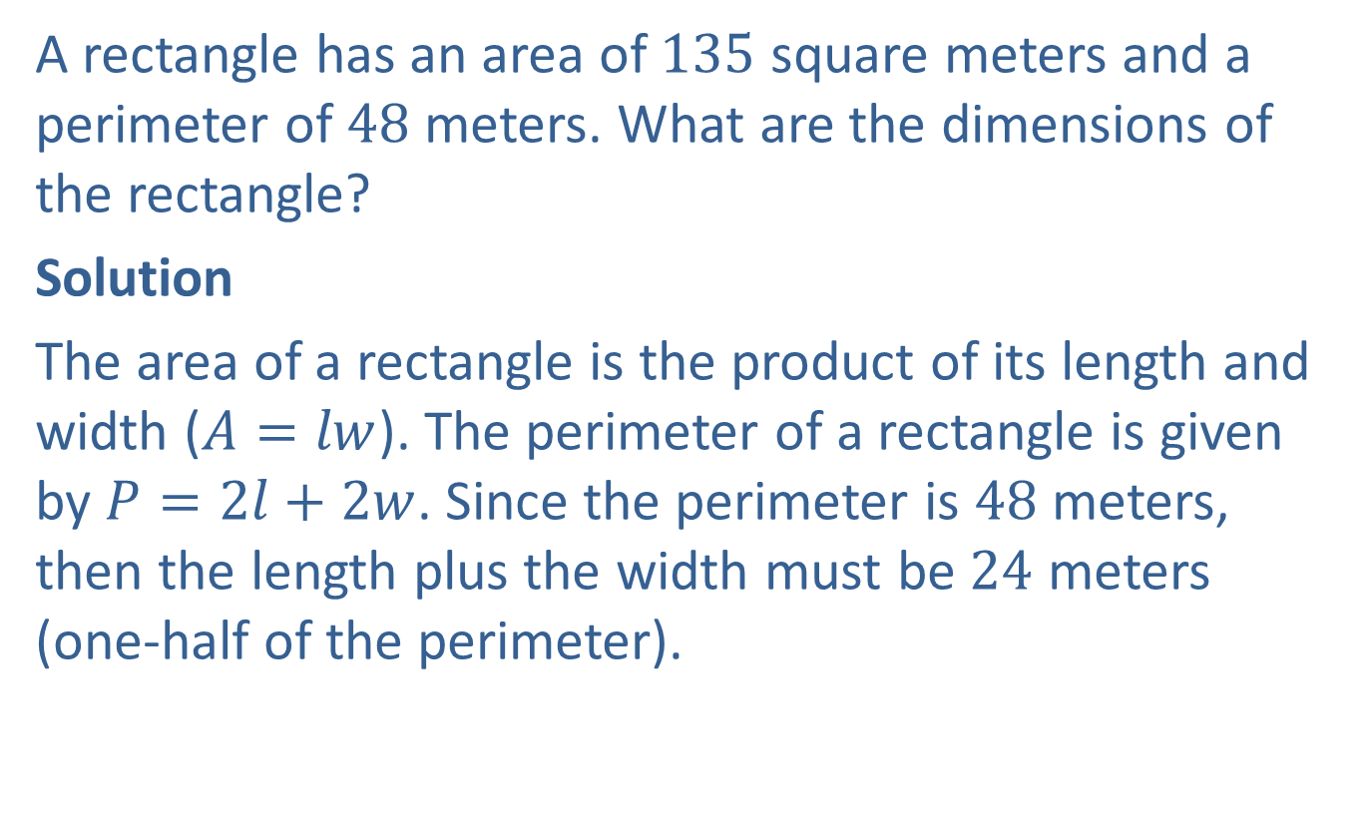
Example 3: Application: Finding the Dimensions of a Rectangle
A rectangle has an area of $135$ square meters and a perimeter of $48$ meters. What are the dimensions of the rectangle?
Solution
The area of a rectangle is the product of its length and width ($A=lw$). The perimeter of a rectangle is given by $P=2l+2w$. Since the perimeter is $48$ meters, then the length plus the width must be $24$ meters (one‑half of the perimeter).

Slide 9
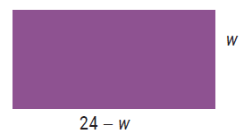
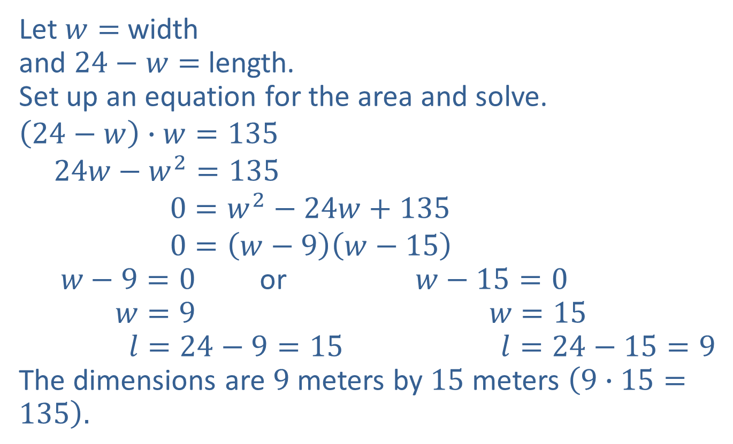
Example 3: Application: Finding the Dimensions of a Rectangle (cont.)
Let $w=$ width
and $24−w=$ length.
Set up an equation for the area and solve.
$$\left(24−w\right)∙w=135$$
$$24w−w^{2}=135$$
$$0=w^{2}−24w+135$$
$$0=\left(w−9\right)\left(w−15\right)$$
$w−9=0$ or $w−15=0$
$w=9$ $w=15$
$l=24−9=15$ $l=24−15=9$
The dimensions are $9$ meters by $15$ meters $\left(9∙15=135\right).$

Slide 10
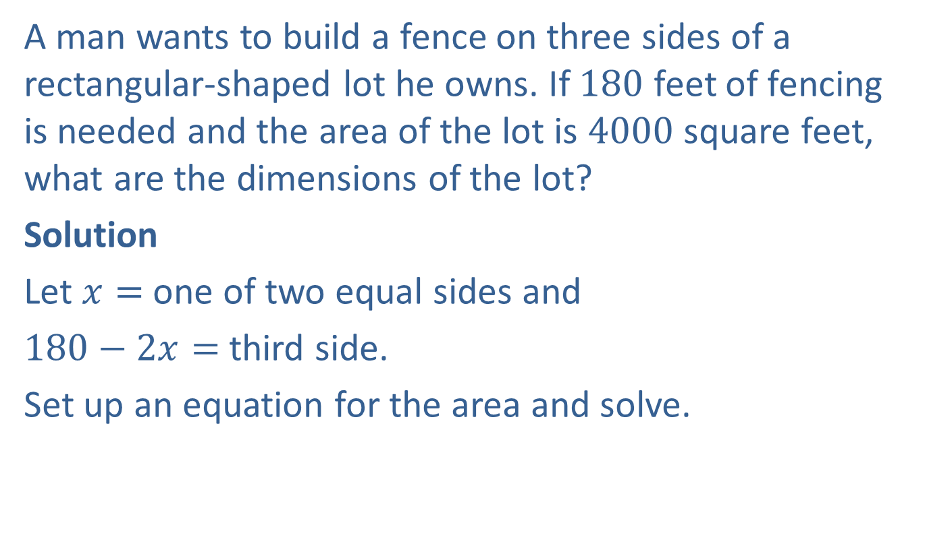
Example 4: Application: Finding the Dimensions of a Rectangle
A man wants to build a fence on three sides of a rectangular‑shaped lot he owns. If $180$ feet of fencing is needed and the area of the lot is $4000$ square feet, what are the dimensions of the lot?
Solution
Let $x=$ one of two equal sides and
$180−2x=$ third side.
Set up an equation for the area and solve.

Slide 11
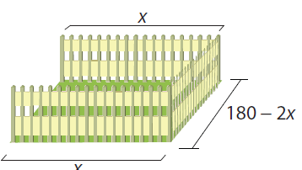
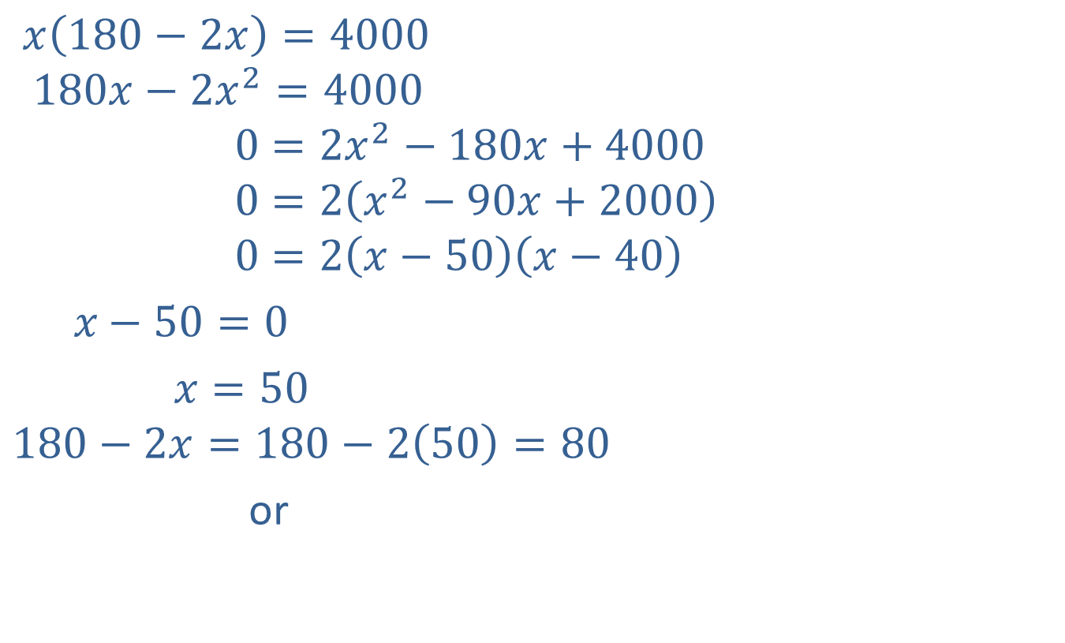
Example 4: Application: Finding the Dimensions of a Rectangle (cont.)
$x\left(180−2x\right)=4000$
$$180x−2x^{2}=4000$$
$$0=2x^{2}−180x+4000$$
$$0=2\left(x^{2}−90x+2000\right)$$
$$0=2\left(x−50\right)\left(x−40\right)$$
$x−50=0$
$x=50$
$$180−2x=180−2\left(50\right)=80$$
or
Third side

Slide 12

Example 4: Application: Finding the Dimensions of a Rectangle (cont.)
$x−40=0$
$x=40$
$$180−2x=180−2\left(40\right)=100$$
Thus, there are two possible answers: the lot is $50$ feet by $80$ feet or the lot is $40$ feet by $100$ feet.
Third side

Slide 13
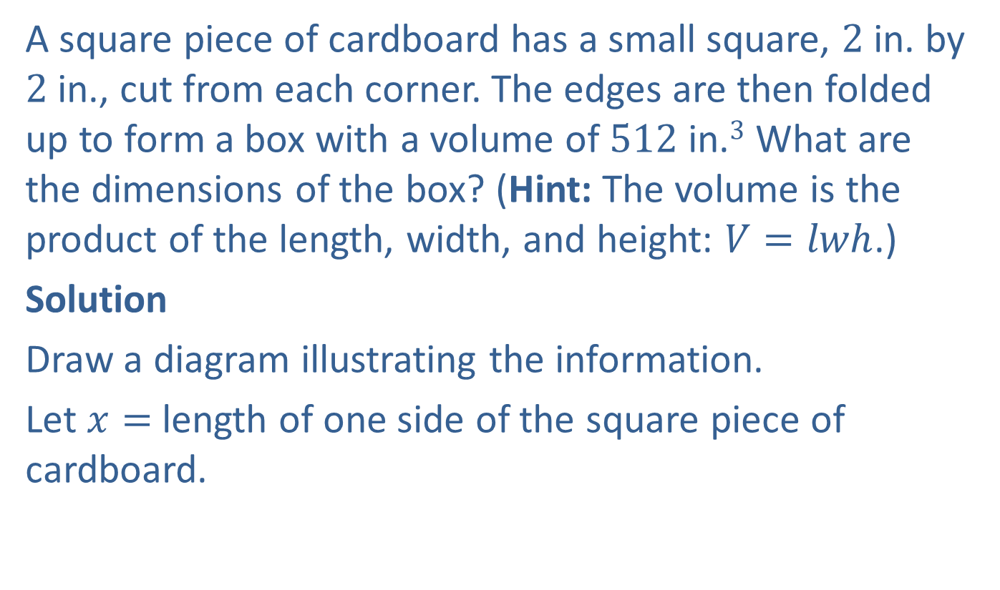
Example 5: Application: Finding the Dimensions of a Box
A square piece of cardboard has a small square, $2$ in. by $2$ in., cut from each corner. The edges are then folded up to form a box with a volume of $512$ in.$3$ What are the dimensions of the box? (Hint: The volume is the product of the length, width, and height: $V=lwh$.)
Solution
Draw a diagram illustrating the information.
Let $x=$ length of one side of the square piece of cardboard.

Slide 14
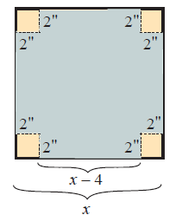
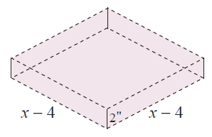

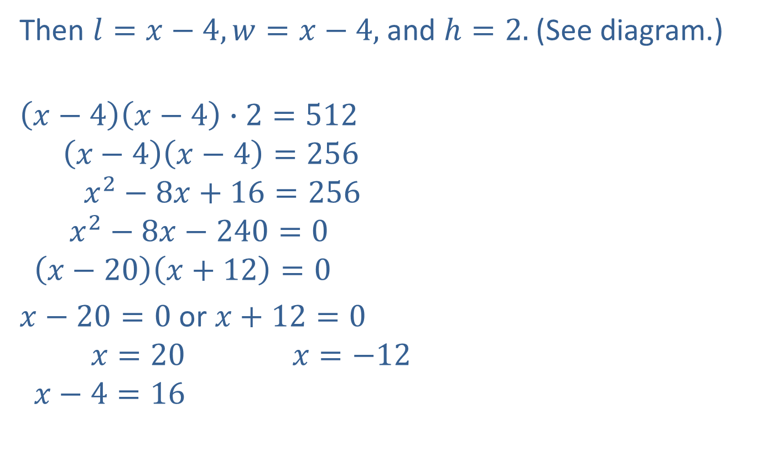


Example 5: Application: Finding the Dimensions of a Box (cont.)
Then $l=x−4, w=x−4,$ and $h=2.$ (See diagram.)
$$\left(x−4\right)\left(x−4\right)∙2=512$$
$$\left(x−4\right)\left(x−4\right)=256$$
$$x^{2}−8x+16=256$$
$$x^{2}−8x−240=0$$
$$\left(x−20\right)\left(x+12\right)=0$$
$x−20=0$ or $x+12=0$
$$x=20 x=−12$$
$$x−4=16$$
length $∙$
width $∙$
height $=$ volume

Slide 15

Example 5: Application: Finding the Dimensions of a Box (cont.)
The dimensions of the box are $16$ in. by $16$ in. by $2$ in.
A negative number does not fit the conditions of the problem.

Slide 16
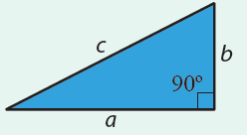
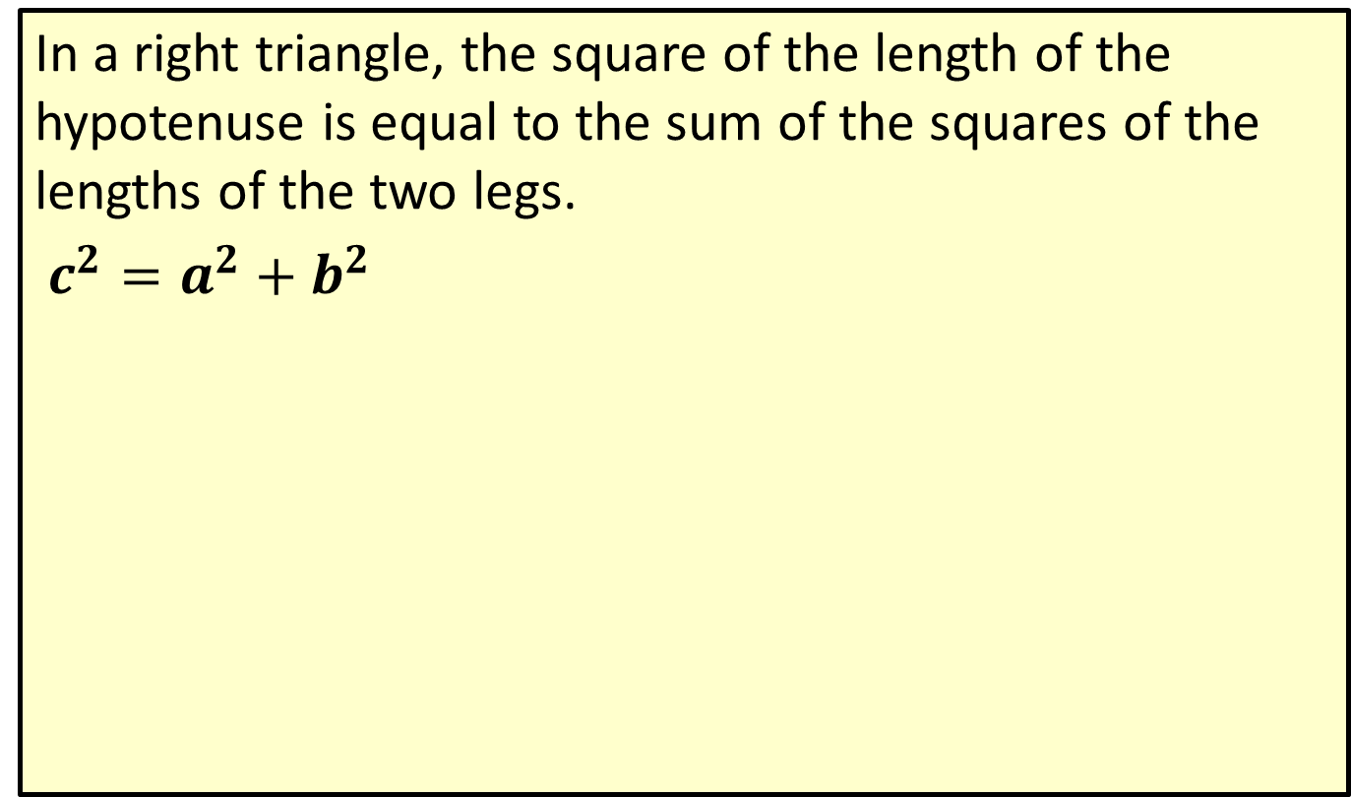
Theorem: The Pythagorean Theorem
In a right triangle, the square of the length of the hypotenuse is equal to the sum of the squares of the lengths of the two legs.
$c^{2}=a^{2}+b^{2}$

Slide 17
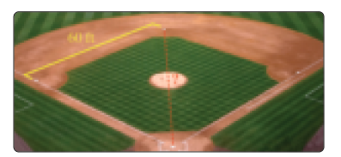

Example 6: Application: The Pythagorean Theorem
A little league baseball field is in the shape of a square with sides of $60$ feet. What is the distance (to the nearest tenth of a foot) the catcher must throw from home plate to second base?

Slide 18
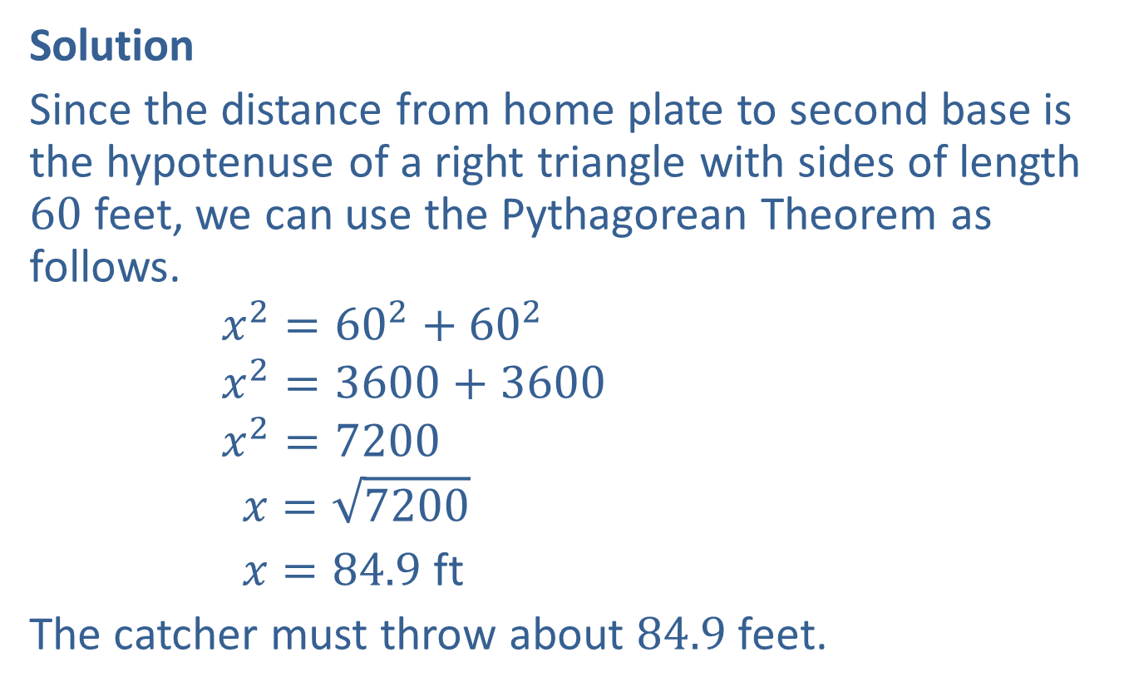
Example 6: Application: The Pythagorean Theorem (cont.)
Solution
Since the distance from home plate to second base is the hypotenuse of a right triangle with sides of length $60$ feet, we can use the Pythagorean Theorem as follows.
$$x^{2}={60}^{2}+{60}^{2}$$
$$x^{2}=3600+3600$$
$$x^{2}=7200$$
$$x=\sqrt{7200}$$
$x=84.9$ ft
The catcher must throw about $84.9$ feet.
We want only the positive square root.
Rounded to the nearest tenth of a foot

Slide 19
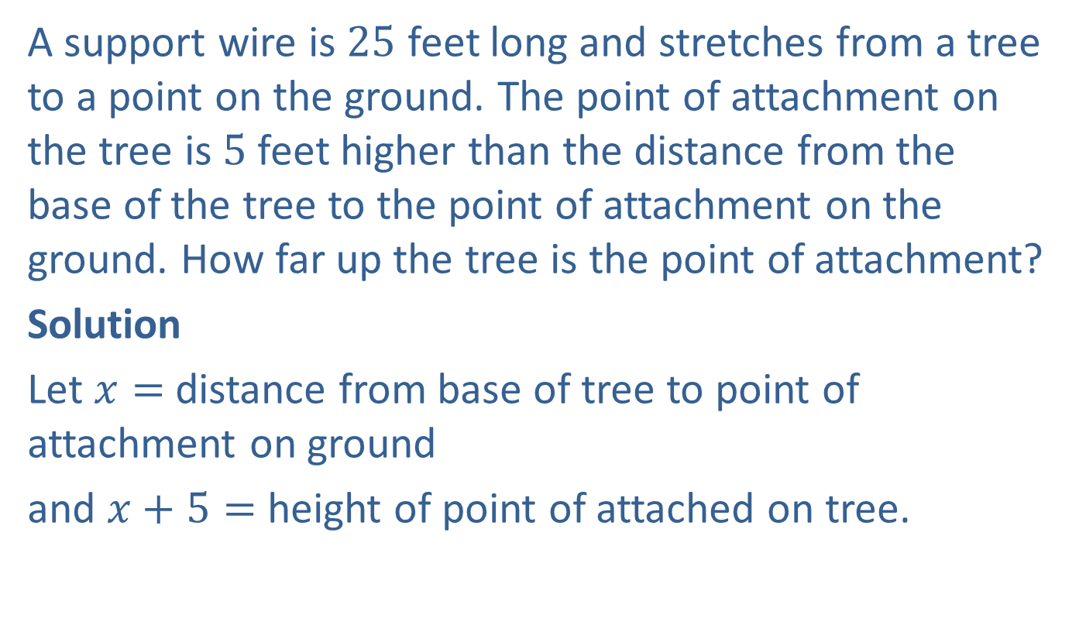
Example 7: Application: The Pythagorean Theorem
A support wire is $25$ feet long and stretches from a tree to a point on the ground. The point of attachment on the tree is $5$ feet higher than the distance from the base of the tree to the point of attachment on the ground. How far up the tree is the point of attachment?
Solution
Let $x=$ distance from base of tree to point of attachment on ground
and $x+5=$ height of point of attached on tree.

Slide 20
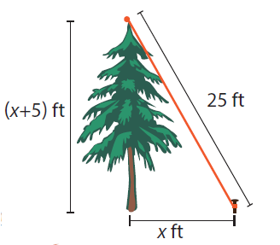
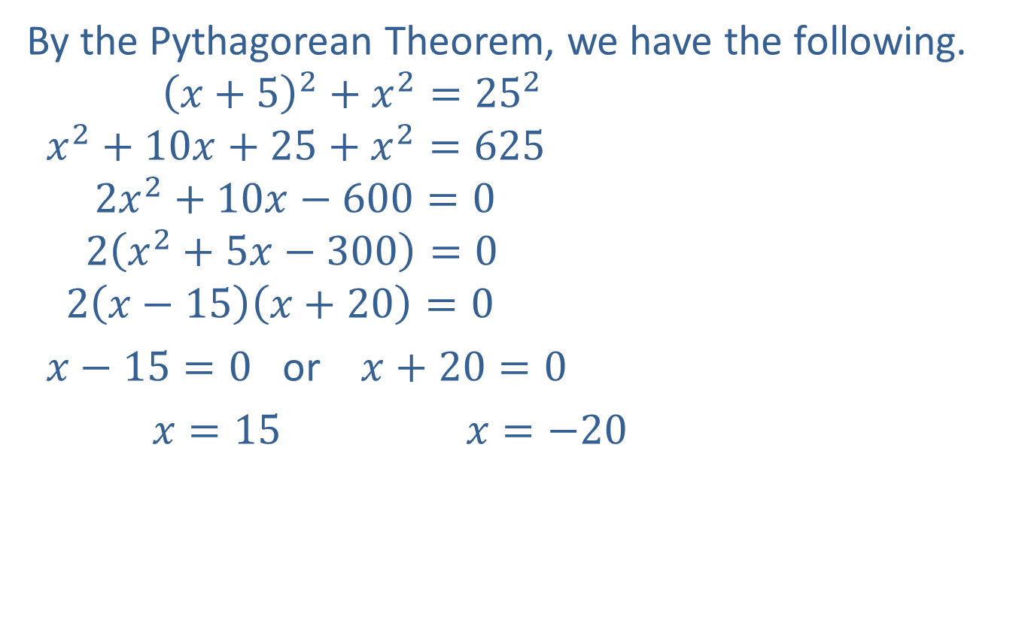
Example 7: Application: The Pythagorean Theorem (cont.)
By the Pythagorean Theorem, we have the following.
$${\left(x+5\right)}^{2}+x^{2}={25}^{2}$$
$$x^{2}+10x+25+x^{2}=625$$
$$2x^{2}+10x−600=0$$
$$2\left(x^{2}+5x−300\right)=0$$
$$2\left(x−15\right)\left(x+20\right)=0$$
$x−15=0$ or $x+20=0$
$x=15$ $x=−20$

Slide 21
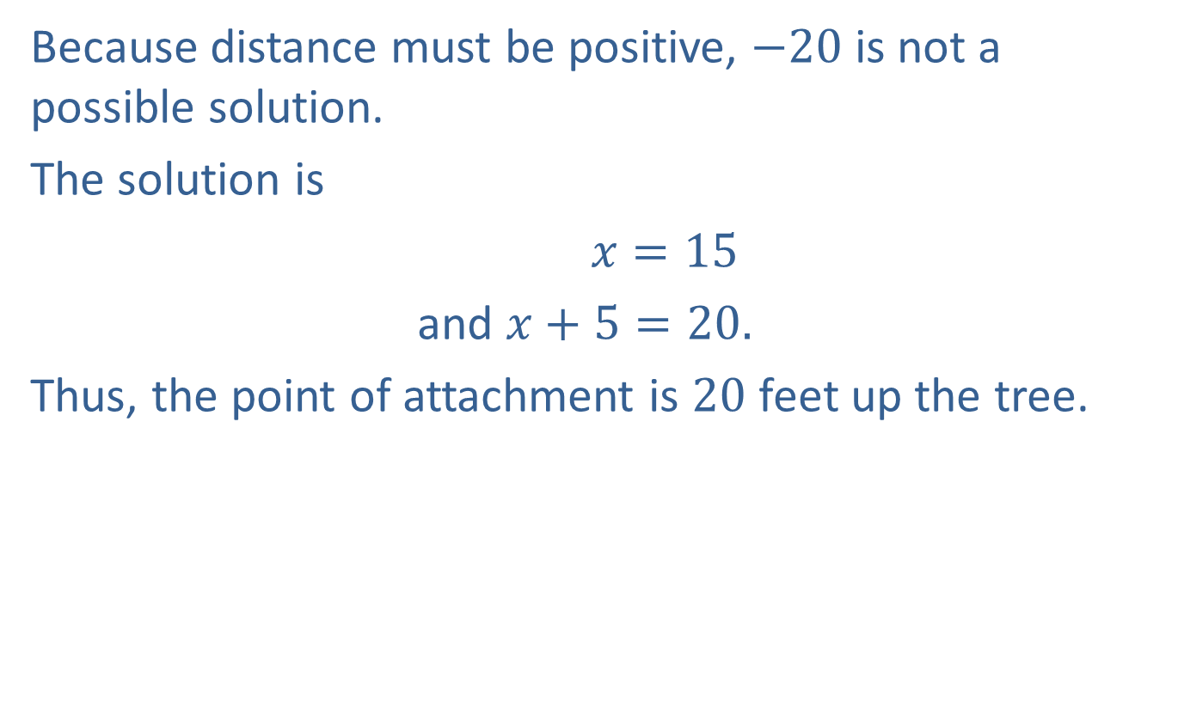
Example 7: Application: The Pythagorean Theorem (cont.)
Because distance must be positive, $−20$is not a possible solution.
The solution is
$x=15$
and $x+5=20.$
Thus, the point of attachment is $20$ feet up the tree.

Slide 22
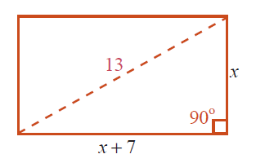
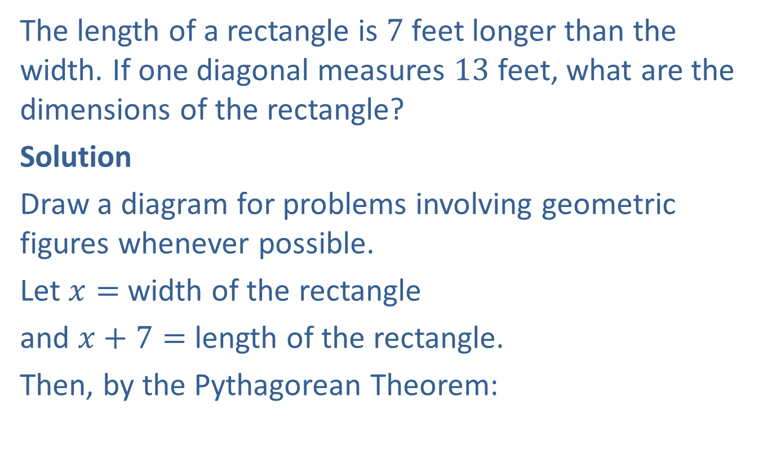
Example 8: Using The Pythagorean Theorem
The length of a rectangle is $7$ feet longer than the width. If one diagonal measures $13$ feet, what are the dimensions of the rectangle?
Solution
Draw a diagram for problems involving geometric figures whenever possible.
Let $x=$ width of the rectangle
and $x+7=$ length of the rectangle.
Then, by the Pythagorean Theorem:

Slide 23
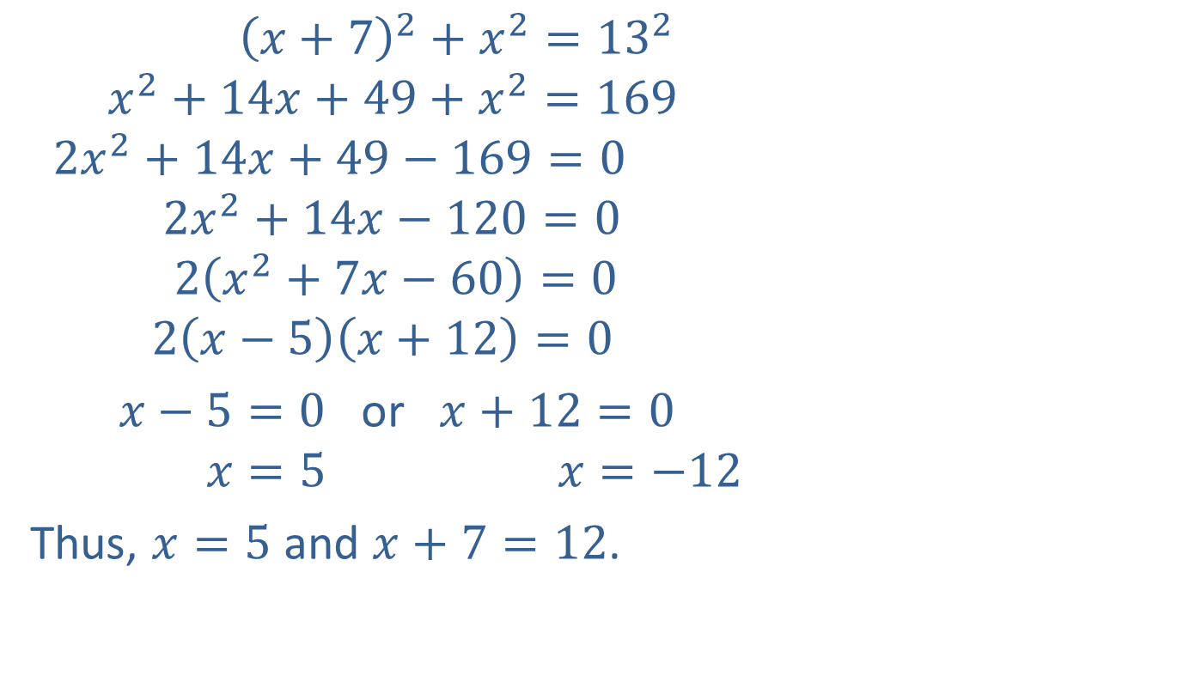
Example 8: Using The Pythagorean Theorem (cont.)
$${\left(x+7\right)}^{2}+x^{2}={13}^{2}$$
$$x^{2}+14x+49+x^{2}=169$$
$$2x^{2}+14x+49−169=0$$
$$2x^{2}+14x−120=0$$
$$2\left(x^{2}+7x−60\right)=0$$
$$2\left(x−5\right)\left(x+12\right)=0$$
$x−5=0$ or $x+12=0$
$$x=5 x=−12$$
Thus, $x=5$ and $x+7=12$.
A negative number does not fit the conditions of the problem.

Slide 24

Example 8: Using The Pythagorean Theorem (cont.)
Check
$$5^{2}+{12}^{2}={13}^{2}$$
$$25+144=169$$
$$169=169$$
The width is $5$ feet and the length is $12$ feet.
?
?
True statement

