Slide 1
Section 5.8
Graphing Quadratic Functions

Slide 2
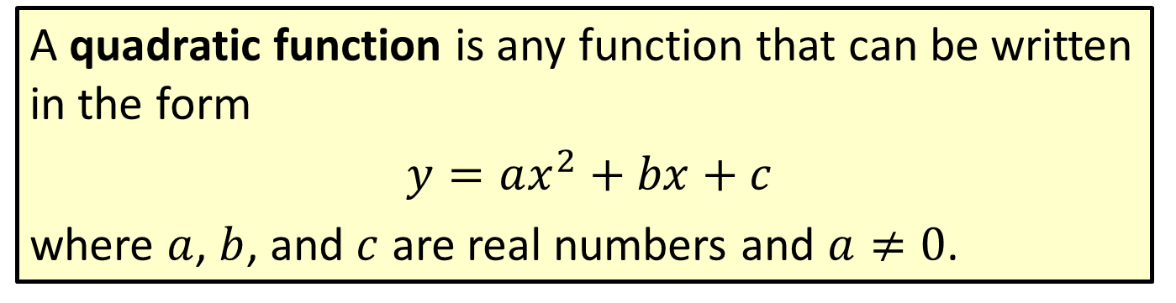
Definition: Quadratic Function
A quadratic function is any function that can be written in the form
$y=ax^{2}+bx+c$
where $a$, $b$, and $c$ are real numbers and $a≠0$.

Slide 3
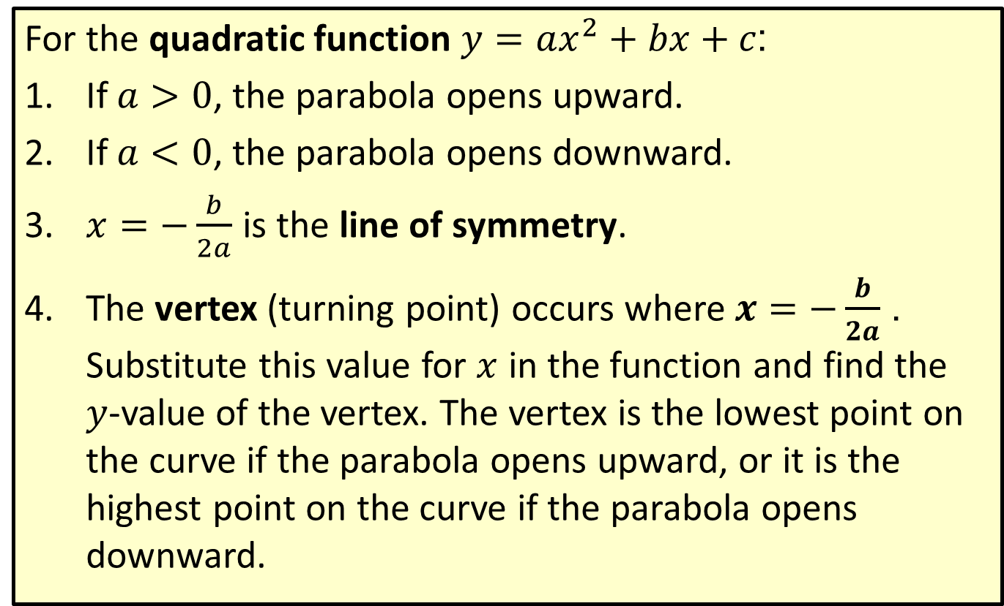
Definition: General Information on Quadratic Functions
For the quadratic function $y=ax^{2}+bx+c$:
​If $a>0$, the parabola opens upward.
​If $a<0$, the parabola opens downward.
​$x=−\frac{b}{2a}$ is the line of symmetry.
​The vertex (turning point) occurs where $x=−\frac{b}{2a}$. Substitute this value for $x$ in the function and find the $y$-value of the vertex. The vertex is the lowest point on the curve if the parabola opens upward, or it is the highest point on the curve if the parabola opens downward.

Slide 4
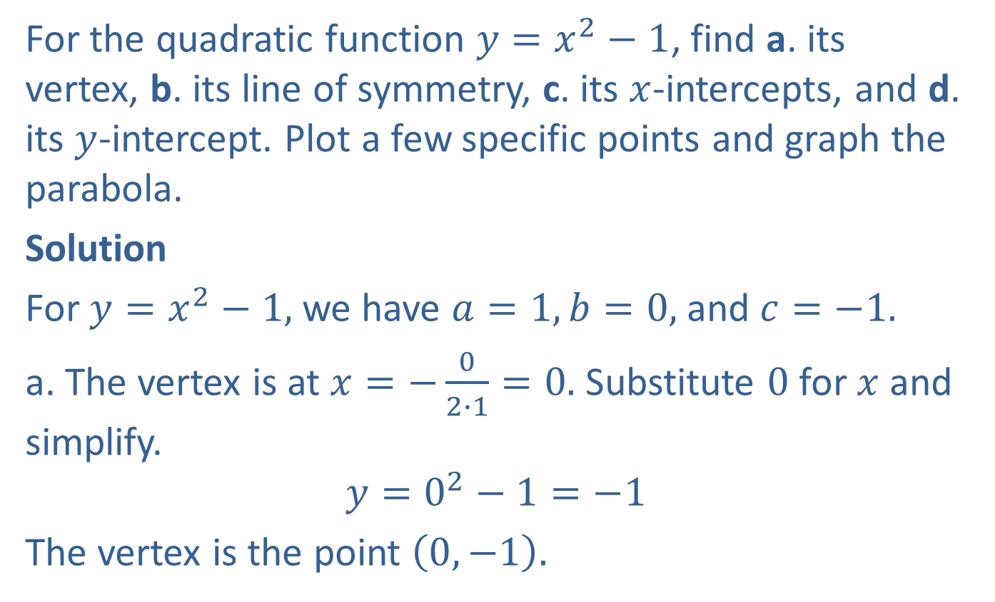
Example 1: Graphing a Quadratic Function (𝑏 = 0)
For the quadratic function $y=x^{2}−1$, find a. its vertex, b. its line of symmetry, c. its $x$-intercepts, and d. its $y$-intercept. Plot a few specific points and graph the parabola.
Solution
For $y=x^{2}−1,$ we have $a=1, b=0,$ and $c=−1.$
a. The vertex is at $x=−\frac{0}{2∙1}=0.$ Substitute $0$ for $x$ and simplify.
$$y=0^{2}−1=−1$$
The vertex is the point $\left(0,−1\right).$

Slide 5
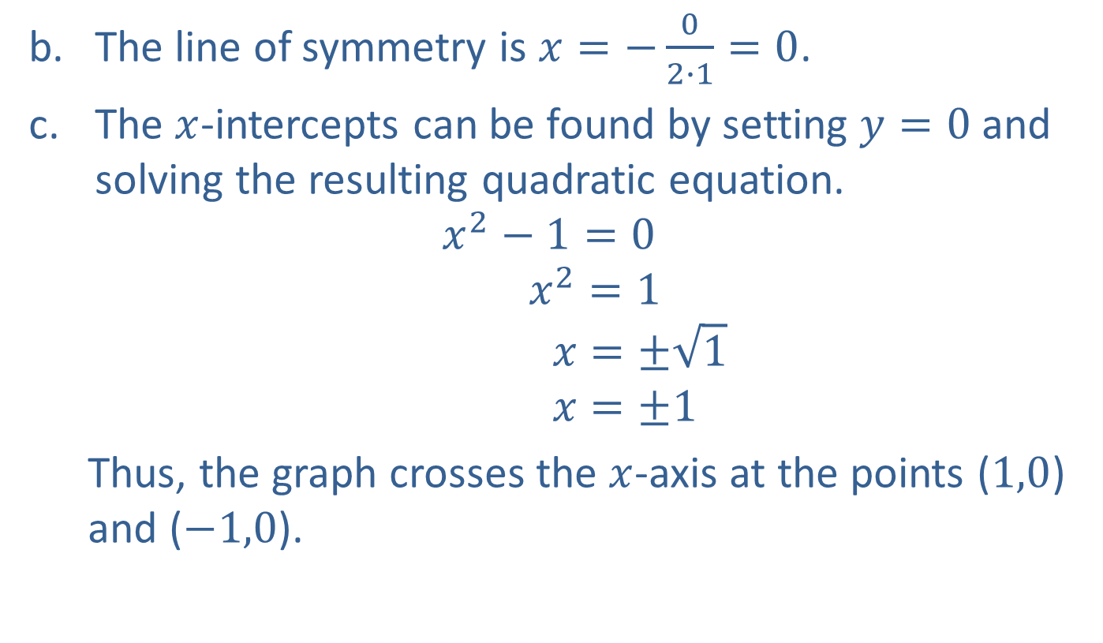
Example 1: Graphing a Quadratic Function (𝑏 = 0) (cont.)
The line of symmetry is $x=−\frac{0}{2∙1}=0$.
The $x$-intercepts can be found by setting $y=0$ and solving the resulting quadratic equation.
$$x^{2}−1=0$$
$$x^{2}=1$$
$$x=±\sqrt{1}$$
$$x=±1$$
Thus, the graph crosses the $x$-axis at the points ($1,0$) and ($−1,0$).

Slide 6
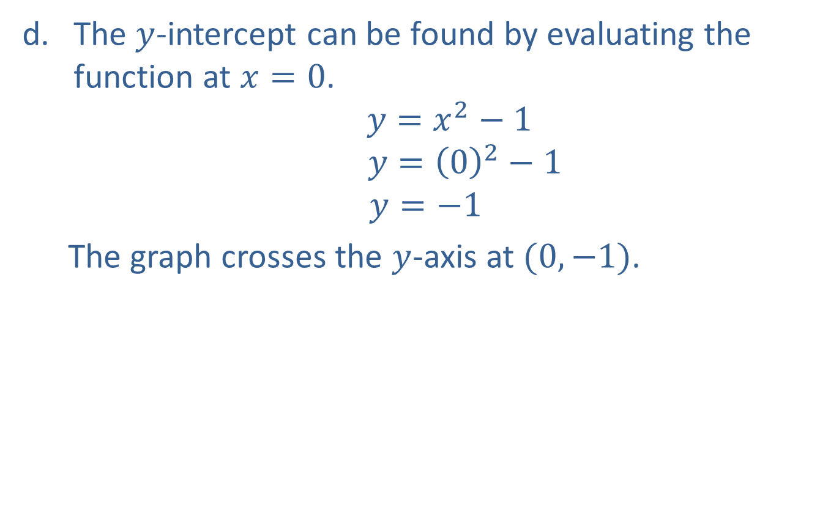
Example 1: Graphing a Quadratic Function (𝑏 = 0) (cont.)
The $y$-intercept can be found by evaluating the function at $x=0$.
$$y=x^{2}−1$$
$$y={\left(0\right)}^{2}−1$$
$$y=−1$$
The graph crosses the $y$-axis at $(0,−1)$.

Slide 7
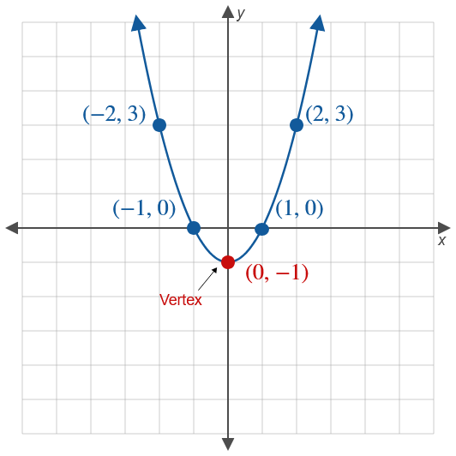


Example 1: Graphing a Quadratic Function (𝑏 = 0) (cont.)
These points and others can be found as shown in the table.
$−1$ is called the minimum value of the quadratic function.
$$x$$ | $$x^{2}−1=y$$
$$−2$$ | $${\left(−2\right)}^{2}−1=3$$
$$−1$$ | $${\left(−1\right)}^{2}−1=0$$
$$0$$ | $${\left(0\right)}^{2}−1=−1$$
$$1$$ | $${\left(1\right)}^{2}−1=0$$
$$2$$ | $${\left(2\right)}^{2}−1=3$$

Slide 8
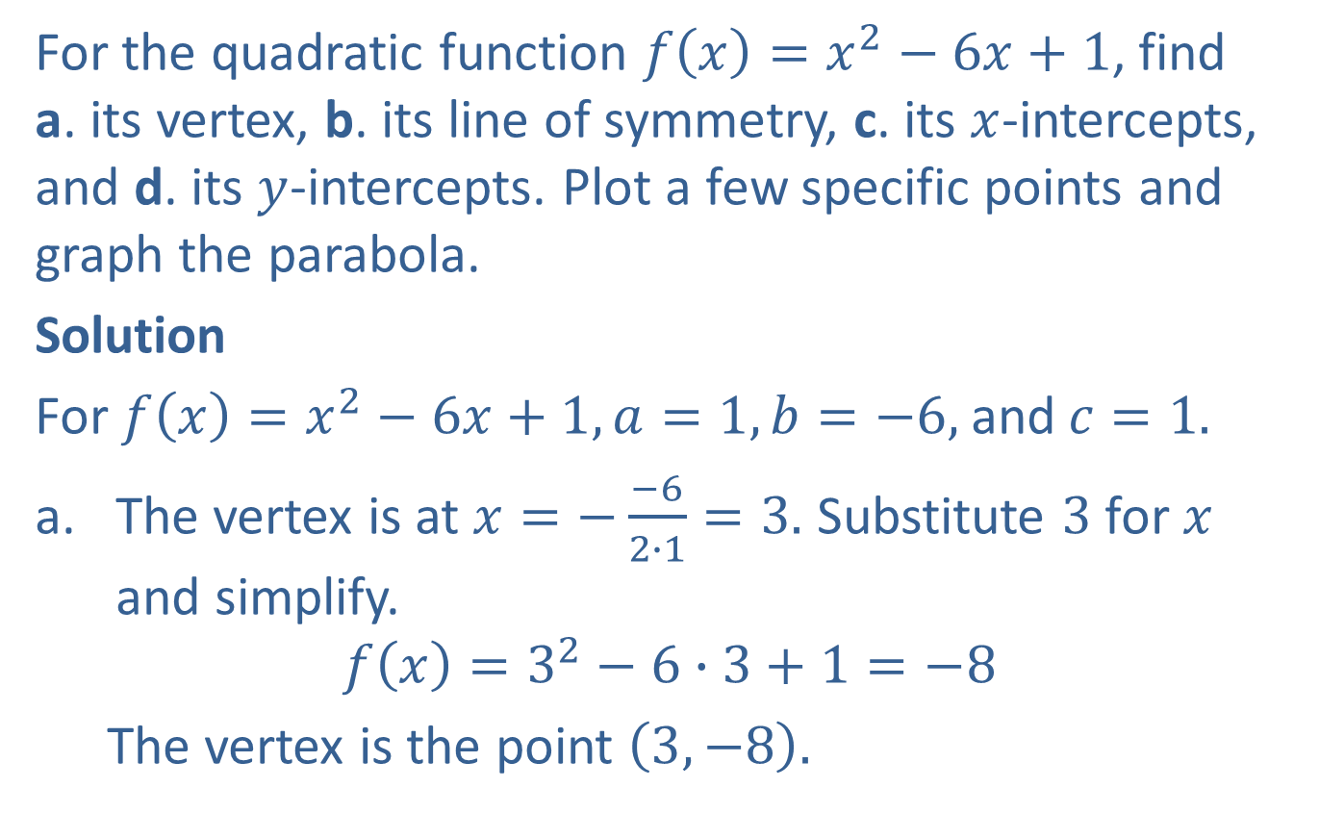
Example 2: Graphing a Quadratic Function
For the quadratic function $f\left(x\right)=x^{2}−6x+1$, find a. its vertex, b. its line of symmetry, c. its $x$-intercepts, and d. its $y$-intercepts. Plot a few specific points and graph the parabola.
Solution
For $f\left(x\right)=x^{2}−6x+1, a=1, b=−6,$and$c=1.$
The vertex is at $x=−\frac{−6}{2∙1}=3.$ Substitute $3$ for $x$ and simplify.
$$f\left(x\right)=3^{2}−6∙3+1=−8$$
The vertex is the point $\left(3,−8\right).$

Slide 9
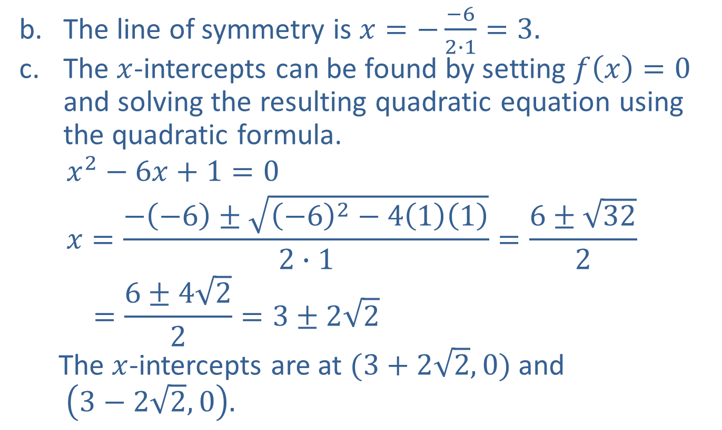
Example 2: Graphing a Quadratic Function (cont.)
The line of symmetry is $x=−\frac{−6}{2∙1}=3.$
The $x$-intercepts can be found by setting $f\left(x\right)=0$ and solving the resulting quadratic equation using the quadratic formula.
$$x^{2}−6x+1=0$$
$$x=\frac{−\left(−6\right)±\sqrt{{\left(−6\right)}^{2}−4\left(1\right)\left(1\right)}}{2∙1}=\frac{6±\sqrt{32}}{2}$$
$$=\frac{6±4\sqrt{2}}{2}=3±2\sqrt{2}$$
The $x$-intercepts are at $(3+2\sqrt{2},0)$and
$\left(3−2\sqrt{2},0\right).$

Slide 10
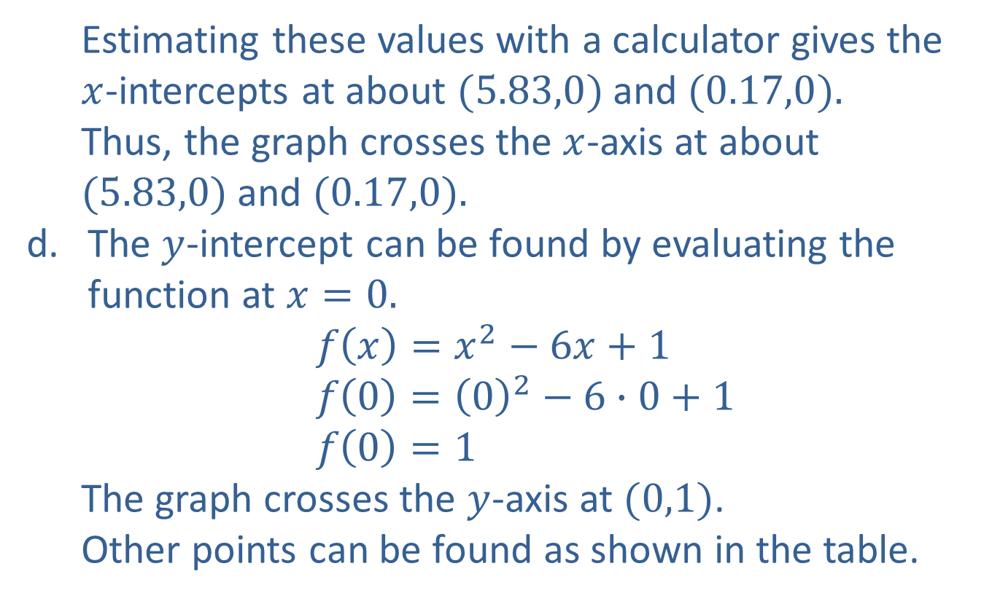
Example 2: Graphing a Quadratic Function (cont.)
Estimating these values with a calculator gives the $x$-intercepts at about $(5.83,0)$and $(0.17,0).$
Thus, the graph crosses the $x$-axis at about $(5.83,0)$and $(0.17,0).$
The $y$-intercept can be found by evaluating the function at $x=0.$
$$f\left(x\right)=x^{2}−6x+1$$
$$f\left(0\right)={\left(0\right)}^{2}−6∙0+1$$
$$f\left(0\right)=1$$
The graph crosses the $y$-axis at $(0,1)$.
Other points can be found as shown in the table.

Slide 11
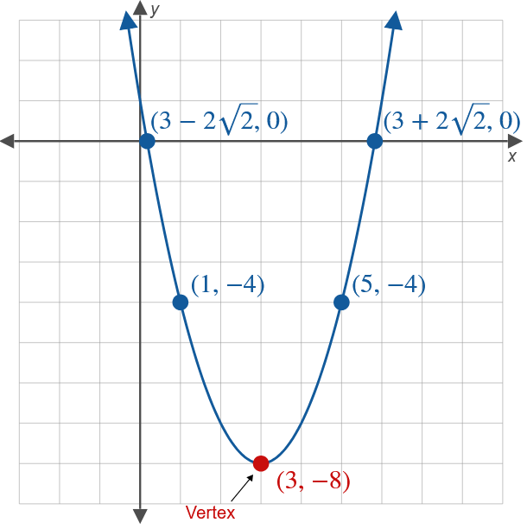
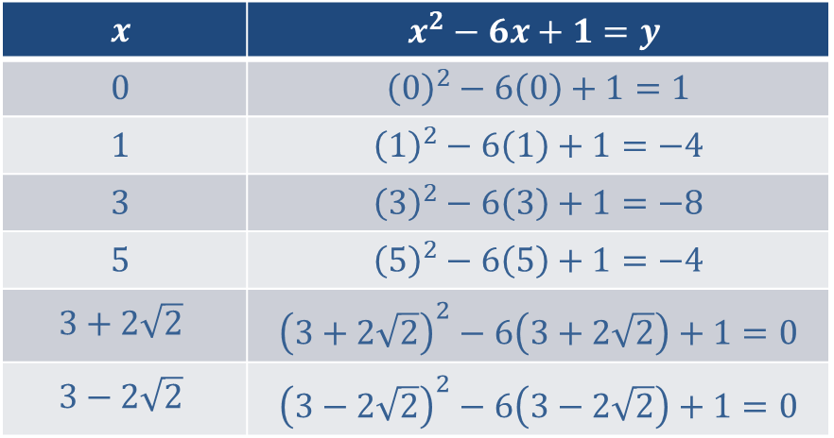

Example 2: Graphing a Quadratic Function (cont.)
$−8$ is the minimum value of the quadratic function.
$$x$$ | $$x^{2}−6x+1=y$$
$$0$$ | $${\left(0\right)}^{2}−6\left(0\right)+1=1$$
$$1$$ | $${\left(1\right)}^{2}−6\left(1\right)+1=−4$$
$$3$$ | $${\left(3\right)}^{2}−6\left(3\right)+1=−8$$
$$5$$ | $${\left(5\right)}^{2}−6\left(5\right)+1=−4$$
$$3+2\sqrt{2}$$ | $${\left(3+2\sqrt{2}\right)}^{2}−6\left(3+2\sqrt{2}\right)+1=0$$
$$3−2\sqrt{2}$$ | $${\left(3−2\sqrt{2}\right)}^{2}−6\left(3−2\sqrt{2}\right)+1=0$$

Slide 12
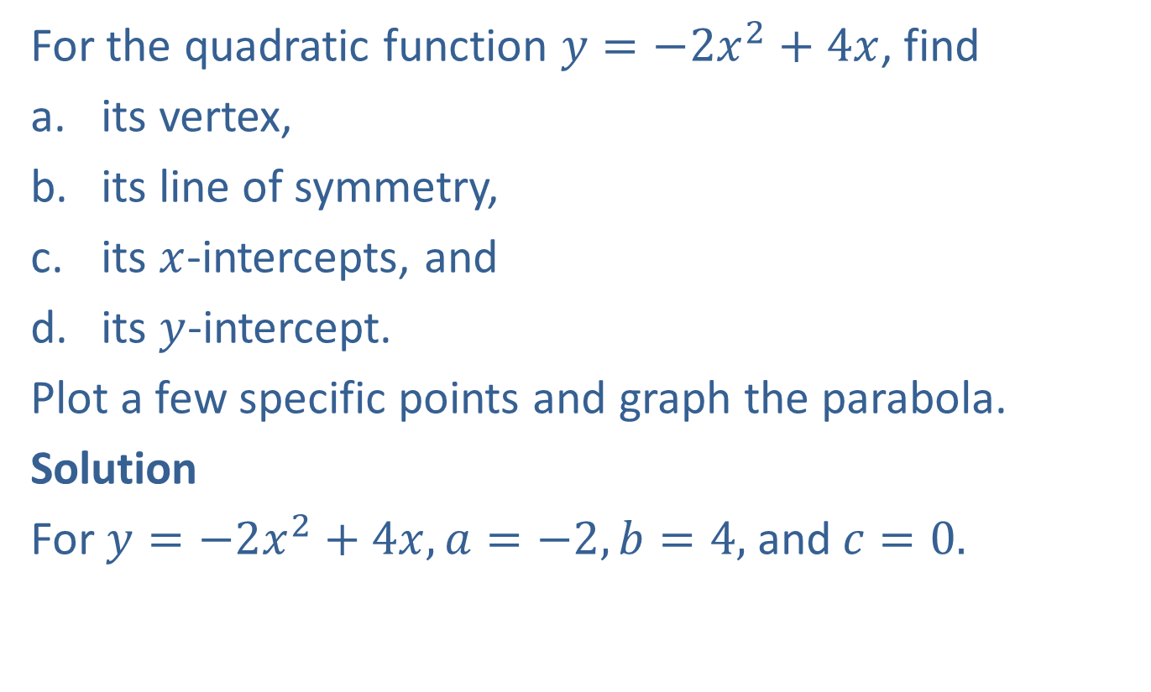
Example 3: Graphing a Quadratic Function (𝑐 = 0)
For the quadratic function $y=−2x^{2}+4x$, find
​its vertex,
​its line of symmetry,
​its $x$-intercepts, and
​its $y$-intercept.
Plot a few specific points and graph the parabola.
Solution
For $y=−2x^{2}+4x, a=−2, b=4,$and$c=0.$

Slide 13
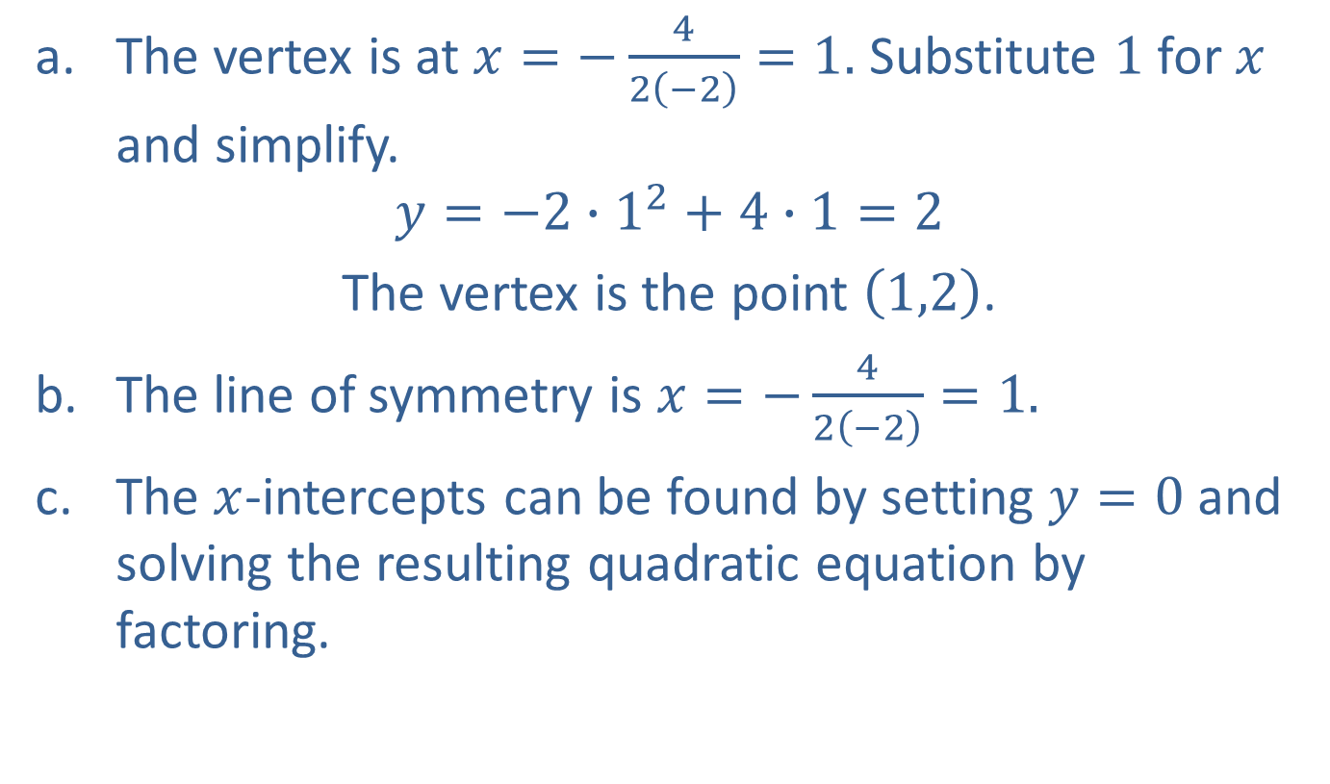
Example 3: Graphing a Quadratic Function (𝑐 = 0) (cont.)
The vertex is at $x=−\frac{4}{2\left(−2\right)}=1.$ Substitute $1$ for $x$ and simplify.
$$y=−2∙1^{2}+4∙1=2$$
The vertex is the point $\left(1,2\right)$.
The line of symmetry is $x=−\frac{4}{2\left(−2\right)}=1.$
The $x$-intercepts can be found by setting $y=0$ and solving the resulting quadratic equation by factoring.

Slide 14
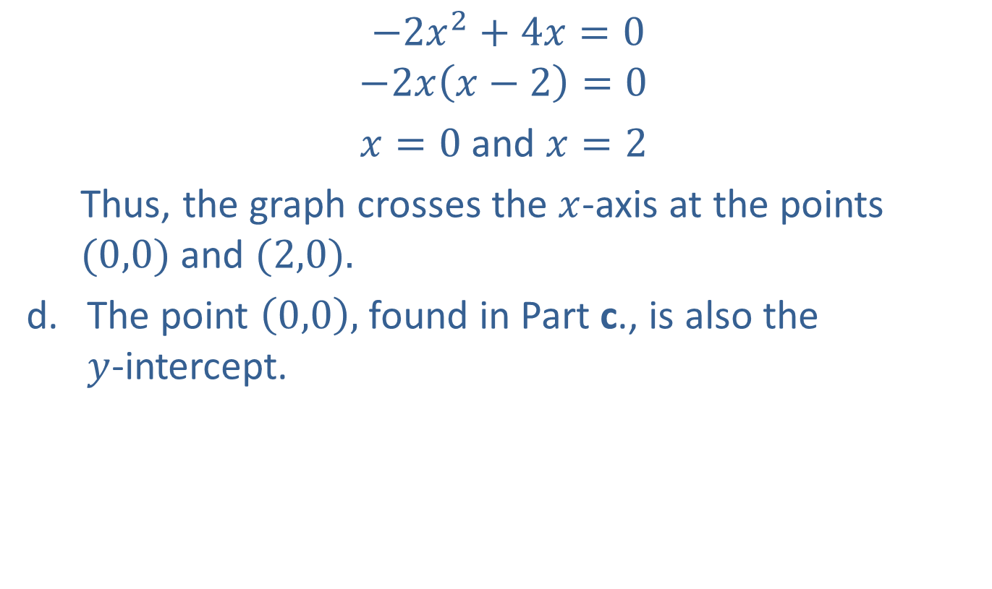
Example 3: Graphing a Quadratic Function (𝑐 = 0) (cont.)
$$−2x^{2}+4x=0$$
$$−2x\left(x−2\right)=0$$
$x=0$and $x=2$
Thus, the graph crosses the $x$-axis at the points $(0,0)$and $(2,0).$
The point $\left(0,0\right),$ found in Part c., is also the $y$-intercept.

Slide 15
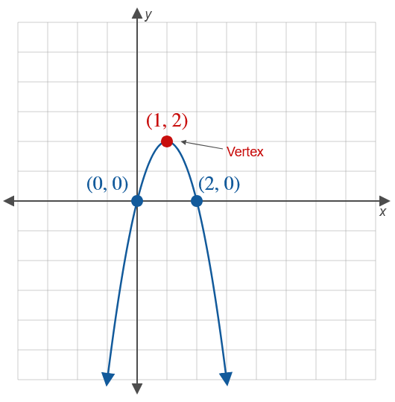

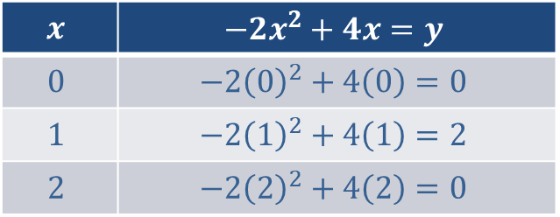
Example 3: Graphing a Quadratic Function (𝑐 = 0) (cont.)
These points are shown in the table.
$2$ is called the maximum value of the quadratic function.
$$x$$ | $$−2x^{2}+4x=y$$
$$0$$ | $$−2{\left(0\right)}^{2}+4\left(0\right)=0$$
$$1$$ | $$−2{\left(1\right)}^{2}+4\left(1\right)=2$$
$$2$$ | $$−2{\left(2\right)}^{2}+4\left(2\right)=0$$

Slide 16
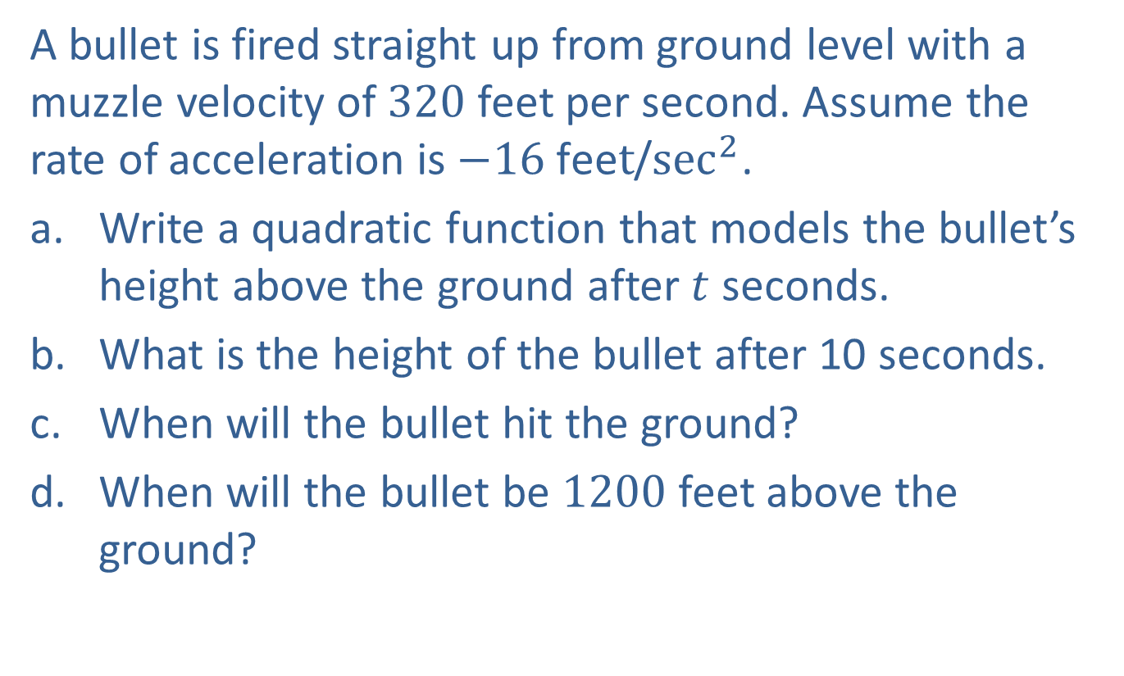
Example 4: Application: Modeling the Path of a Projectile
A bullet is fired straight up from ground level with a muzzle velocity of 320 feet per second. Assume the rate of acceleration is $−16 \text{fee}t$/$\sec^{2}$.
​Write a quadratic function that models the bullet’s height above the ground after $t$ seconds.
What is the height of the bullet after 10 seconds.
​When will the bullet hit the ground?
​When will the bullet be 1200 feet above the ground?

Slide 17
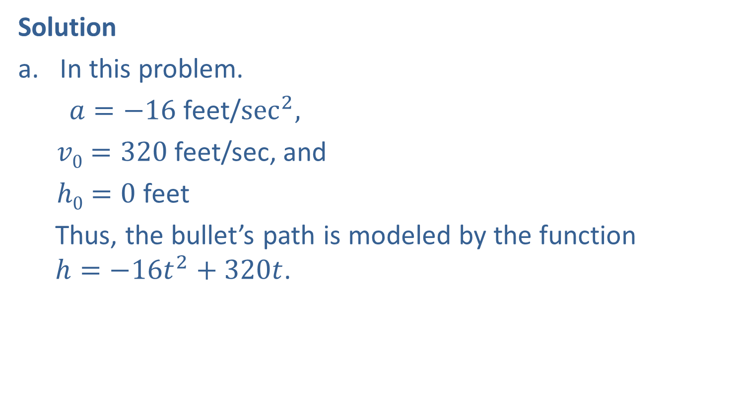
Example 4: Application: Modeling the Path of a Projectile (cont.)
Solution
In this problem.
$a=−16$ feet/$\sec^{2}{,}$
$v0=320$feet/sec, and
$h0=0$ feet
Thus, the bullet’s path is modeled by the function $h=−16t^{2}+320t$.

Slide 18
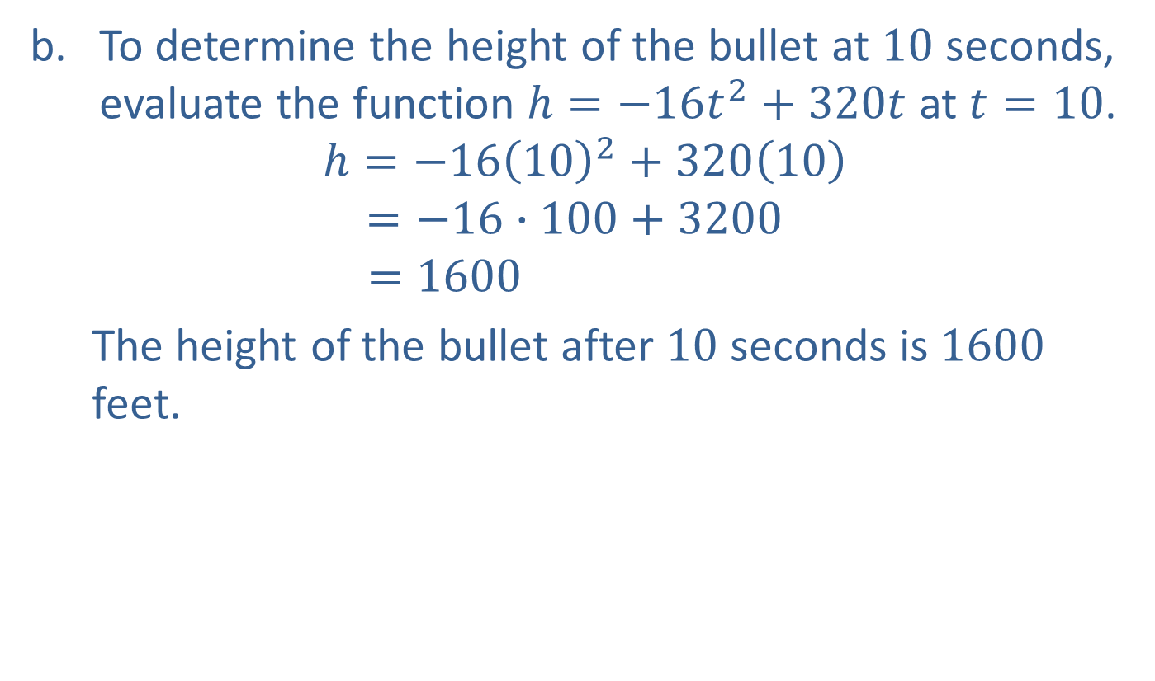
Example 4: Application: Modeling the Path of a Projectile (cont.)
To determine the height of the bullet at $10$ seconds, evaluate the function $h=−16t^{2}+320t$ at $t=10$.
$$h=−16{\left(10\right)}^{2}+320\left(10\right)$$
$$=−16∙100+3200$$
$$=1600$$
The height of the bullet after $10$ seconds is $1600$ feet.

Slide 19

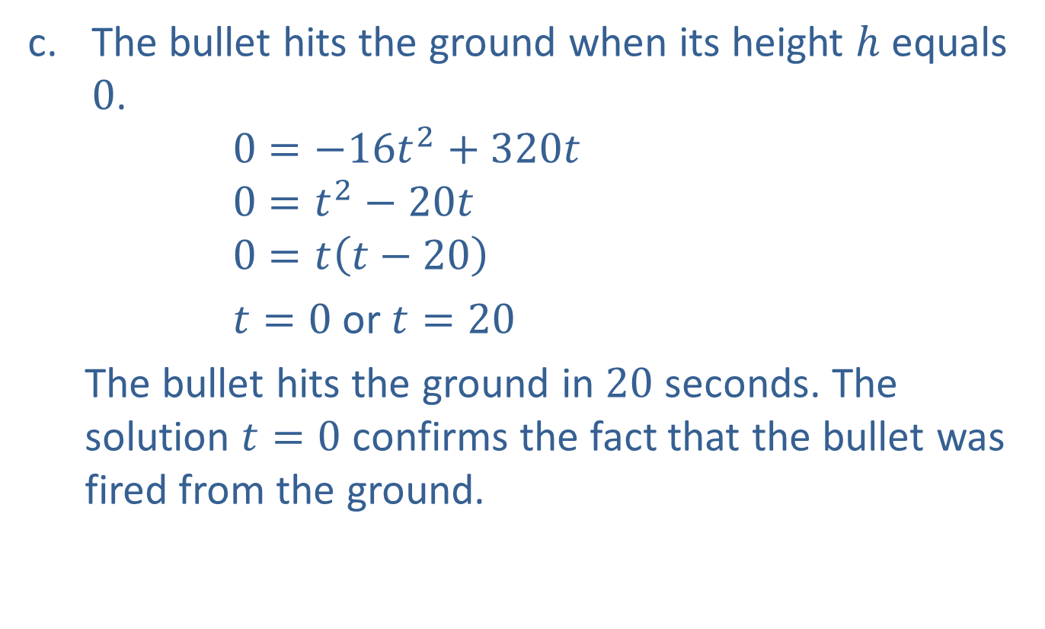
Example 4: Application: Modeling the Path of a Projectile (cont.)
The bullet hits the ground when its height $h$ equals $0$.
$$0=−16t^{2}+320t$$
$$0=t^{2}−20t$$
$$0=t\left(t−20\right)$$
$t=0$or$t=20$
The bullet hits the ground in $20$ seconds. The solution $t=0$ confirms the fact that the bullet was fired from the ground.
Divide both sides by $−16.$
Factor.

Slide 20

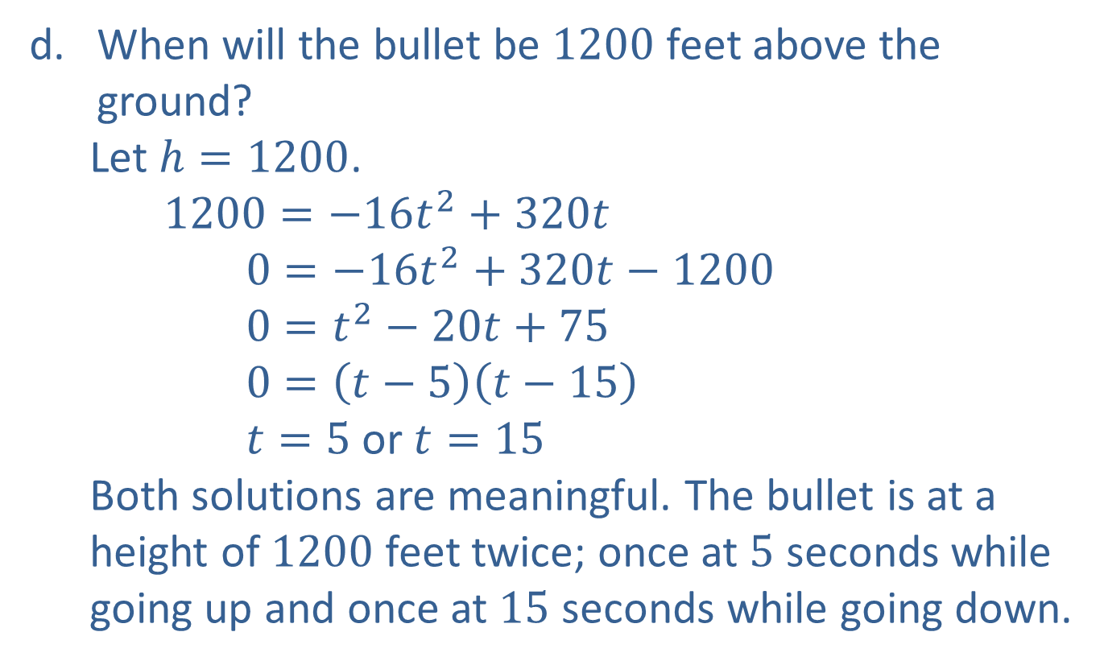
Example 4: Application: Modeling the Path of a Projectile (cont.)
When will the bullet be $1200$ feet above the ground?
Let $h=1200$.
$$1200=−16t^{2}+320t$$
$$0=−16t^{2}+320t−1200$$
$$0=t^{2}−20t+75$$
$$0=\left(t−5\right)\left(t−15\right)$$
$t=5$or$t=15$
Both solutions are meaningful. The bullet is at a height of $1200$ feet twice; once at $5$ seconds while going up and once at $15$ seconds while going down.
Divide both sides by $−16.$
Factor.

Slide 21
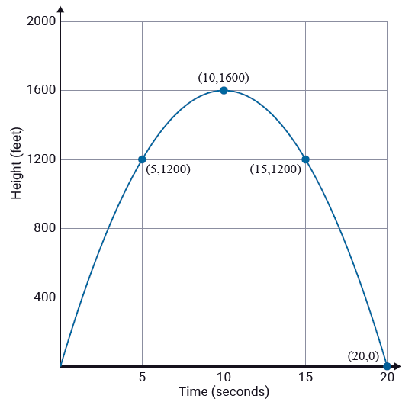
Example 4: Application: Modeling the Path of a Projectile (cont.)

Slide 22
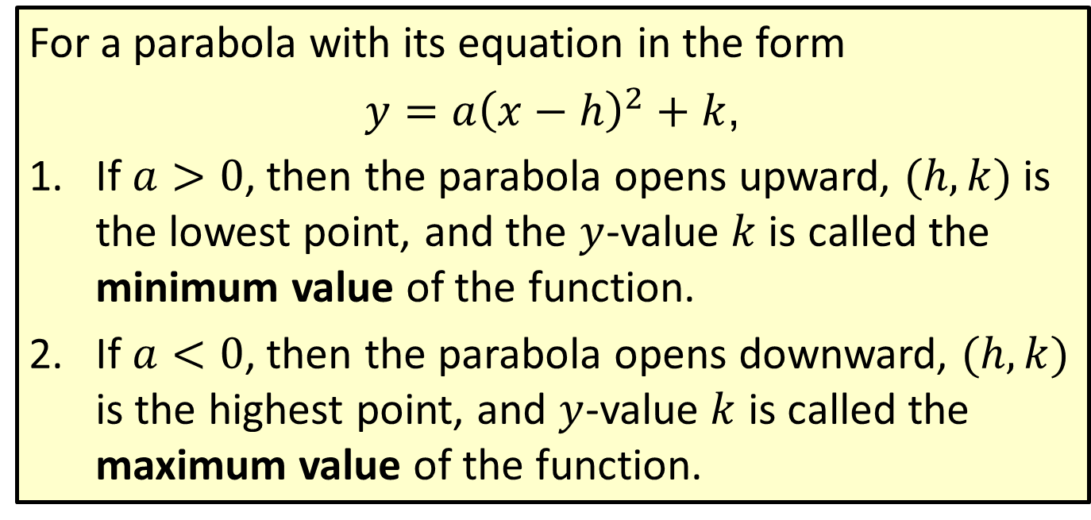
Definition: Minimum and Maximum Values
For a parabola with its equation in the form
$y=a{\left(x−h\right)}^{2}+k$,
​If $a>0$, then the parabola opens upward, $(h, k)$ is the lowest point, and the $y$-value $k$ is called the minimum value of the function.
​If $a<0$, then the parabola opens downward, $(h, k)$ is the highest point, and $y$-value $k$ is called the maximum value of the function.

Slide 23
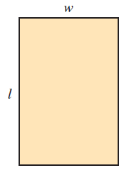
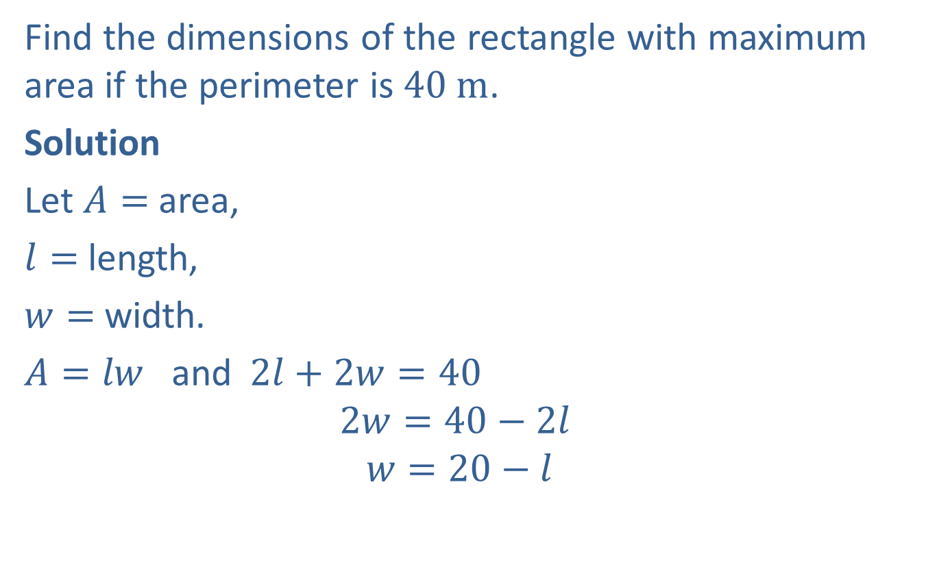
Example 5: Minimum and Maximum Values
Find the dimensions of the rectangle with maximum area if the perimeter is $40 m$.
Solution
Let $A=$ area,
$l=$ length,
$w=$ width.
$A=lw$and$2l+2w=40$
$$2w=40−2l$$
$$w=20−l$$

Slide 24
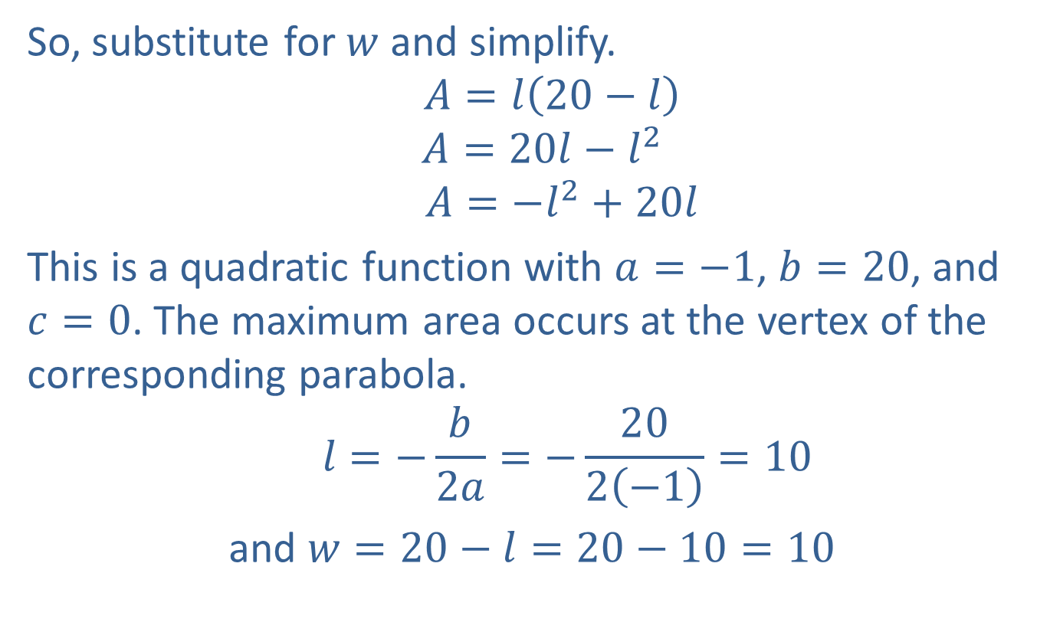
Example 5: Minimum and Maximum Values (cont.)
So, substitute for $w$ and simplify.
$$A=l\left(20−l\right)$$
$$A=20l−l^{2}$$
$$A=−l^{2}+20l$$
This is a quadratic function with $a=−1$, $b=20$, and $c=0$. The maximum area occurs at the vertex of the corresponding parabola.
$$l=−\frac{b}{2a}=−\frac{20}{2\left(−1\right)}=10$$
and $w=20−l=20−10=10$

Slide 25

Example 5: Minimum and Maximum Values (cont.)
Thus, the maximum area occurs when $l=10 m$and $w=10 m$. (The rectangle is, in fact, a square and the area $=100 m^{2}$.)

Slide 26
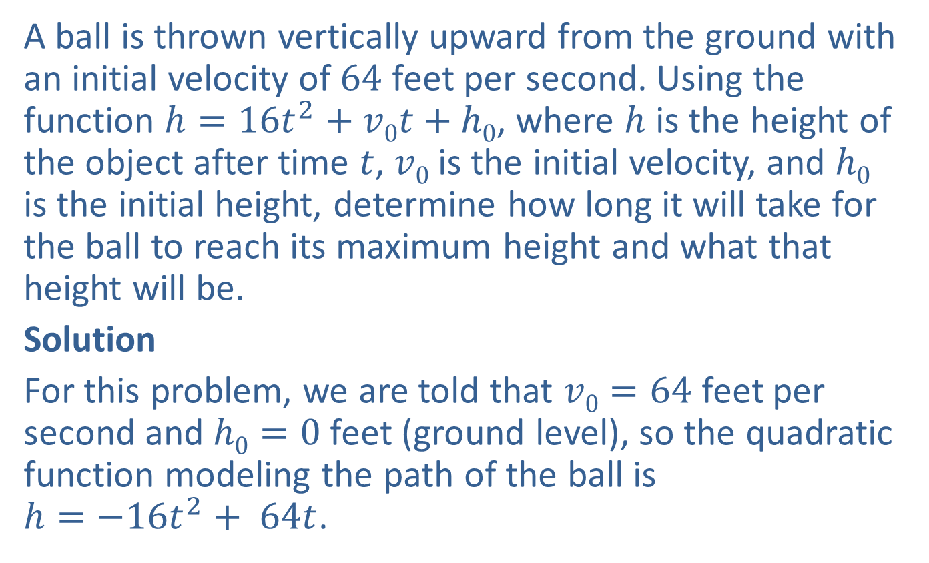
Example 6: Application: Minimum and Maximum Values
A ball is thrown vertically upward from the ground with an initial velocity of $64$ feet per second. Using the function $h=16t^{2}+v0t+h0$, where $h$ is the height of the object after time $t$, $v0$ is the initial velocity, and $h0$ is the initial height, determine how long it will take for the ball to reach its maximum height and what that height will be.
Solution
For this problem, we are told that $v0=64$ feet per second and $h0=0$ feet (ground level), so the quadratic function modeling the path of the ball is $h=−16t^{2}+ 64t$.

Slide 27
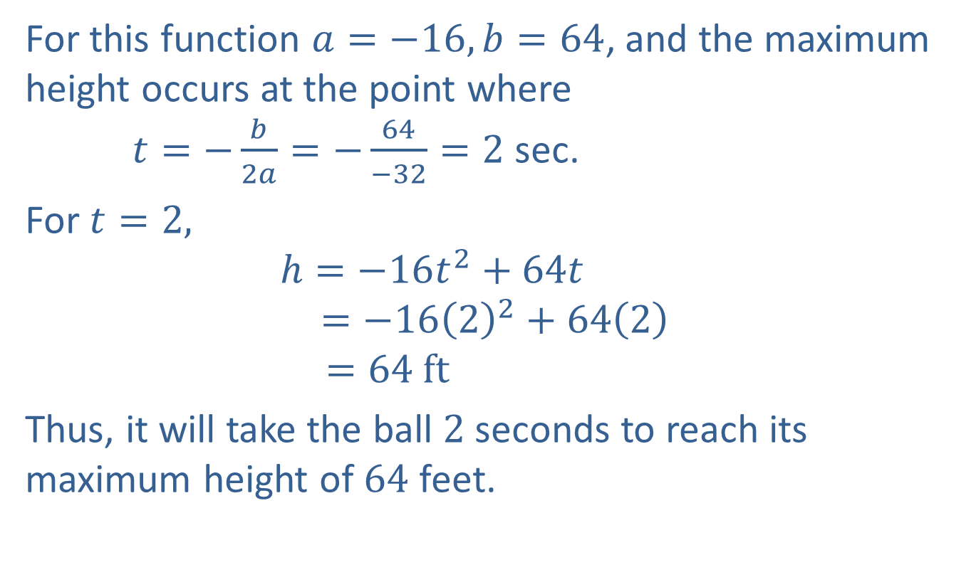
Example 6: Application: Minimum and Maximum Values (cont.)
For this function $a=−16, b=64$, and the maximum height occurs at the point where $t=−\frac{b}{2a}=−\frac{64}{−32}=2$ sec.
For $t=2,$
$$h=−16t^{2}+64t$$
$$=−16{\left(2\right)}^{2}+64\left(2\right)$$
$$=64 ft$$
Thus, it will take the ball $2$ seconds to reach its maximum height of $64$ feet.

Slide 28
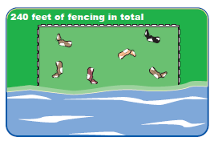

Example 7: Application: Minimum and Maximum Values
A rancher is going to build three sides of a rectangular corral next to a river. He has $240$ feet of fencing and wants to enclose the maximum area possible inside the corral. What are the dimensions of the corral with the maximum area and what is this area?

Slide 29
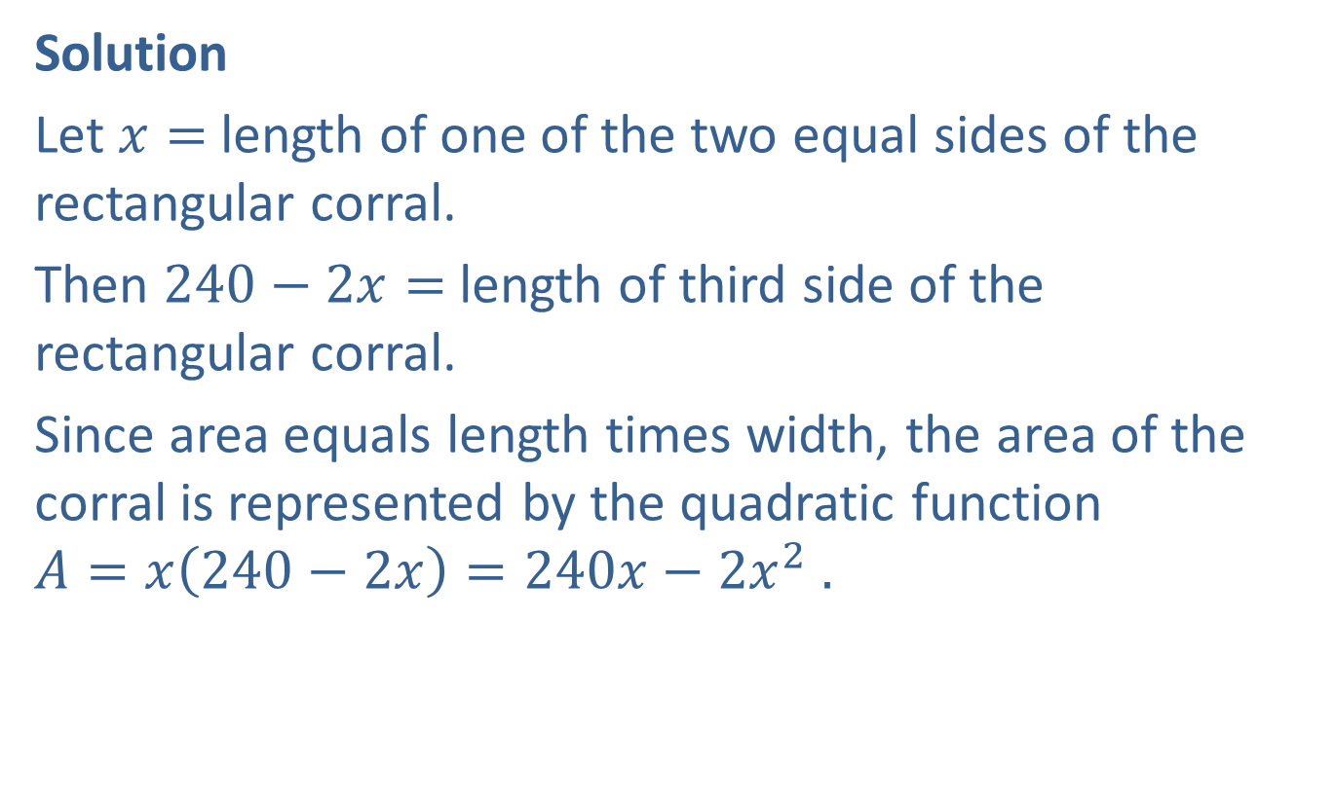
Example 7: Application: Minimum and Maximum Values (cont.)
Solution
Let $x=$length of one of the two equal sides of the rectangular corral.
Then $240−2x=$ length of third side of the rectangular corral.
Since area equals length times width, the area of the corral is represented by the quadratic function $A=x\left(240−2x\right)=240x−2x^{2} .$

Slide 30
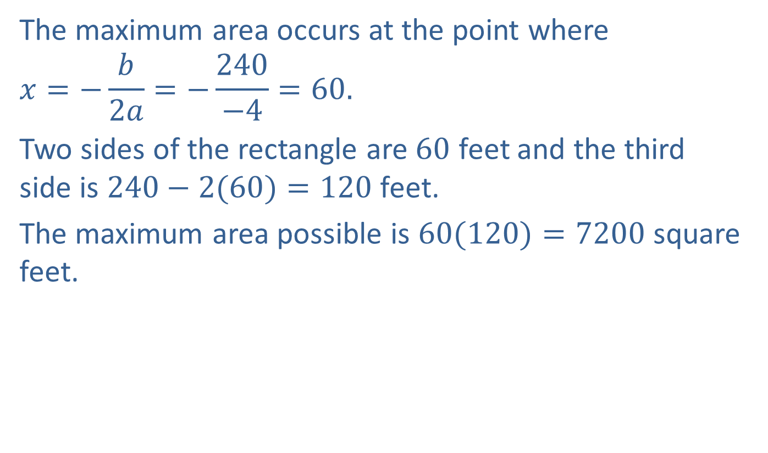
Example 7: Application: Minimum and Maximum Values (cont.)
The maximum area occurs at the point where
$$x=−\frac{b}{2a}=−\frac{240}{−4}=60.$$
Two sides of the rectangle are $60$ feet and the third side is $240−2(60)=120$feet.
The maximum area possible is $60(120)=7200$square feet.

Slide 31
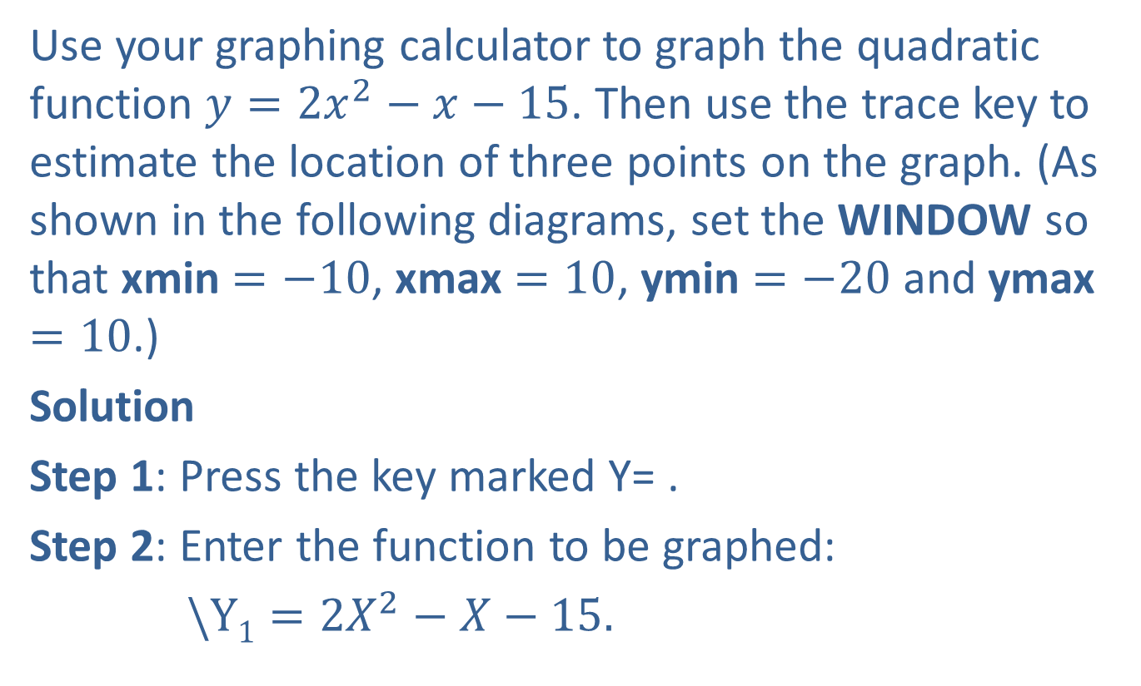
Example 8: Graphing with a Calculator
Use your graphing calculator to graph the quadratic function $y=2x^{2}−x−15$. Then use the trace key to estimate the location of three points on the graph. (As shown in the following diagrams, set the WINDOW so that xmin $=−10$, xmax $=10$, ymin $=−20$and ymax $=10$.)
Solution
Step 1: Press the key marked Y= .
Step 2: Enter the function to be graphed:
$\backslash Y1=2X^{2}−X−15.$

Slide 32
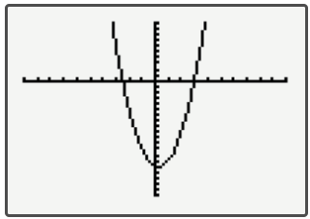
Example 8: Graphing with a Calculator (cont.)
Step 3: Press GRAPH in the upper right hand corner of
the keyboard.
The graph of the parabola should appear on the
display as shown here.

Slide 33
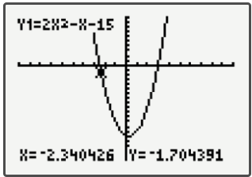
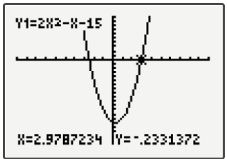
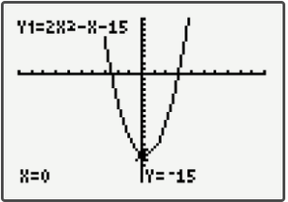
Example 8: Graphing with a Calculator (cont.)
Now, press the TRACE key and move the cursor around to estimate the location of points. Three such locations are shown here.

