Slide 1
Section 6.1
US Measurements

Slide 2
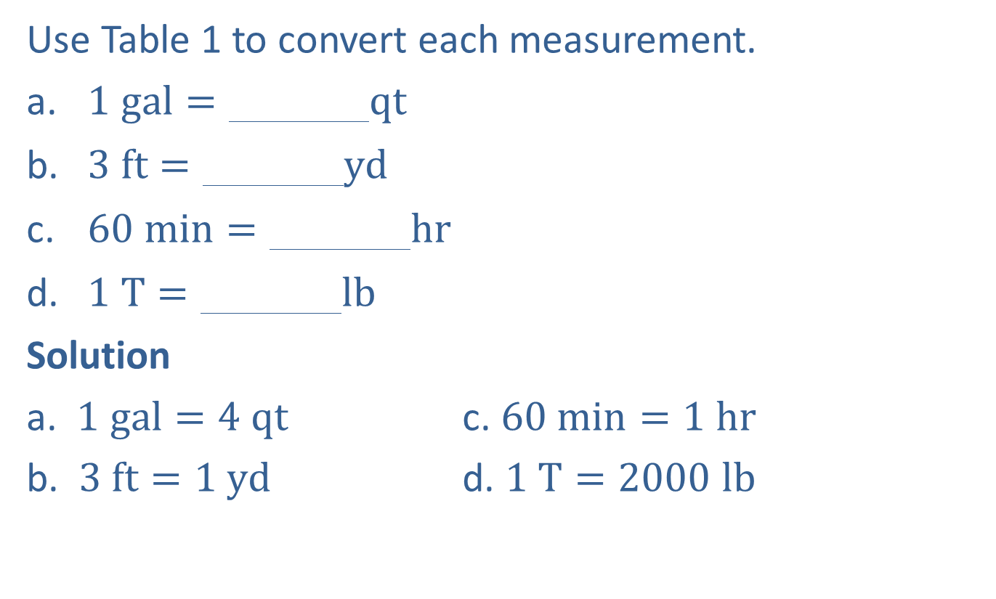
Example 1: Basic Conversions in the US Customary System
Use Table 1 to convert each measurement.
​1 gal=000000qt
​3 ft=000000yd
​60 min=000000hr
​1 T=000000lb
Solution
a. $1 gal=4 qt$ c. $60 min=1 hr$
b. $3 ft=1 yd$ d. $1 T=2000 lb$

Slide 3
Procedure: Using Multiplication and Division to Convert Measurements
​Multiply to convert to smaller units. (There will be more smaller units.)
​Divide to convert to larger units. (There will be fewer larger units.)

Slide 4
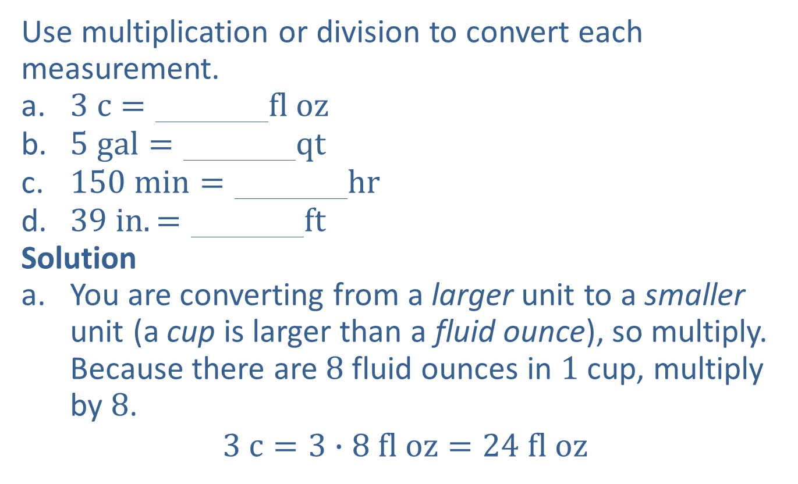
Example 2: Converting US Units of Measure Using Multiplication/Division
Use multiplication or division to convert each measurement.
​3 c=000000fl oz
​5 gal=000000qt
​150 min=000000hr
​39 in.=000000ft
Solution
You are converting from a larger unit to a smaller unit (a cup is larger than a fluid ounce), so multiply. Because there are $8$ fluid ounces in $1$ cup, multiply by $8$.
$$3 c=3∙8 fl oz=24 fl oz$$

Slide 5
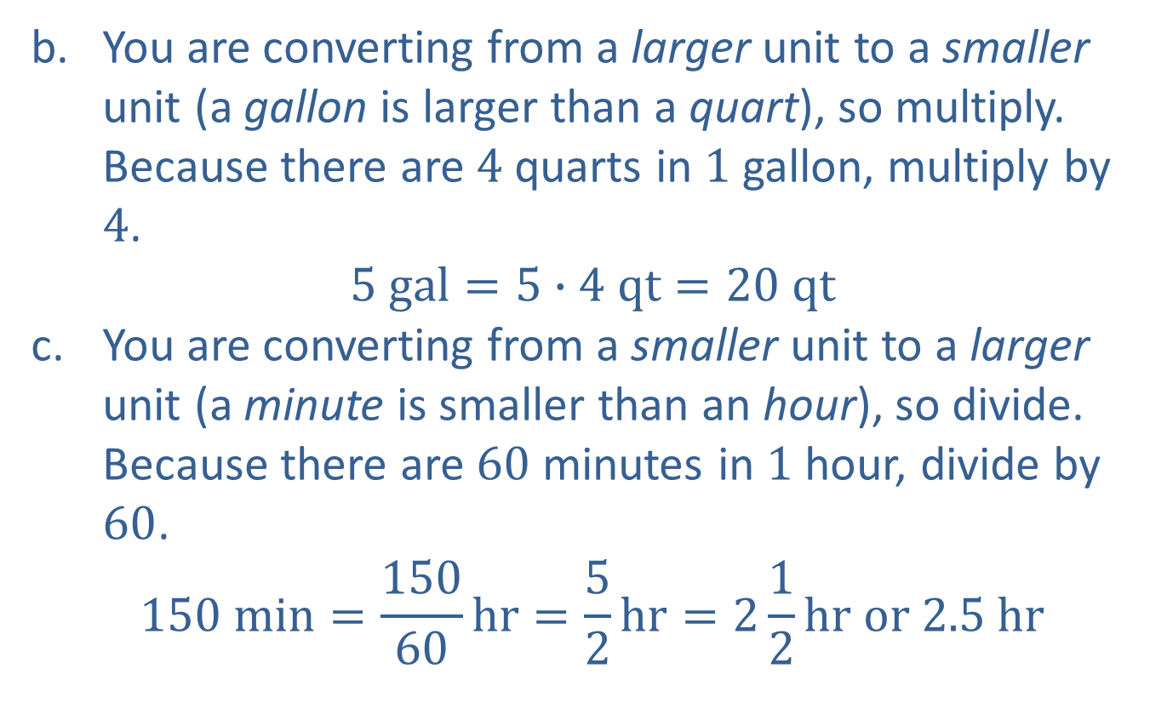
Example 2: Converting US Units of Measure Using Multiplication/Division (cont.)
You are converting from a larger unit to a smaller unit (a gallon is larger than a quart), so multiply. Because there are $4$ quarts in $1$ gallon, multiply by $4$.
$$5 gal=5∙4 qt=20 qt$$
You are converting from a smaller unit to a larger unit (a minute is smaller than an hour), so divide. Because there are $60$ minutes in $1$ hour, divide by $60$.
$$150 min=\frac{150}{60}hr=\frac{5}{2}hr=2\frac{1}{2}hr or 2.5 hr$$

Slide 6

Example 2: Converting US Units of Measure Using Multiplication/Division (cont.)
You are converting from a smaller unit to a larger unit (an inch is smaller than a foot), so divide. Because there are $12$ inches in $1$ foot, divide by $12$.
$$39 in.=\frac{39}{12}ft=\frac{13}{4}ft=3\frac{1}{4}ft or 3.25 ft$$

Slide 7
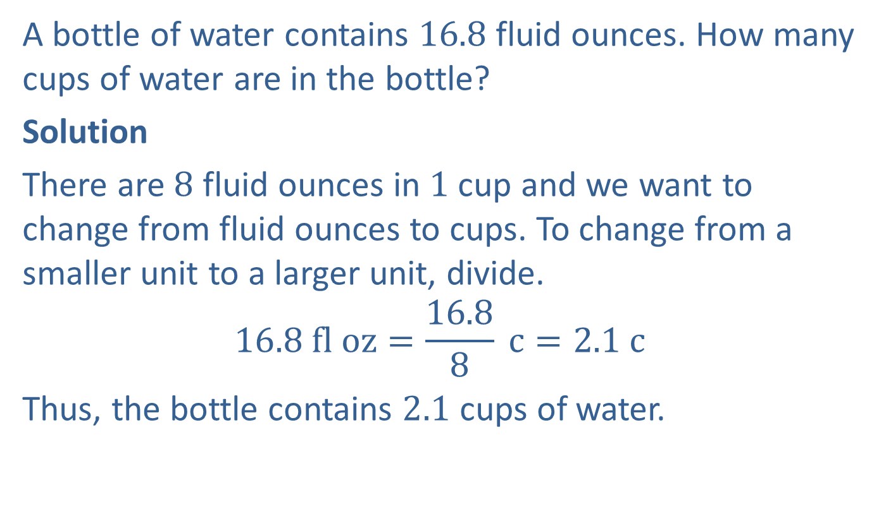
Example 3: Application: Converting US Units of Measure
A bottle of water contains $16.8$ fluid ounces. How many cups of water are in the bottle?
Solution
There are $8$ fluid ounces in $1$ cup and we want to change from fluid ounces to cups. To change from a smaller unit to a larger unit, divide.
$$16.8 fl oz=\frac{16.8}{8} c=2.1 c$$
Thus, the bottle contains $2.1$ cups of water.

Slide 8
Procedure: Using Unit Fractions to Convert Measurements
​The numerator should be in the units of measure of the desired result.
​The denominator should be in the original units of measure.

Slide 9
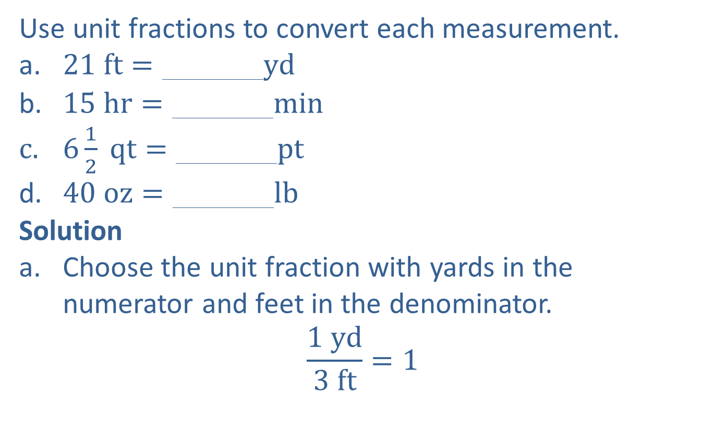
Example 4: Using Unit Fractions to Convert US Units of Measure
Use unit fractions to convert each measurement.
​21 ft=000000yd
​15 hr=000000min
612 qt=000000pt
​40 oz=000000lb
Solution
Choose the unit fraction with yards in the numerator and feet in the denominator.
$$\frac{1 yd}{3 ft}=1$$

Slide 10
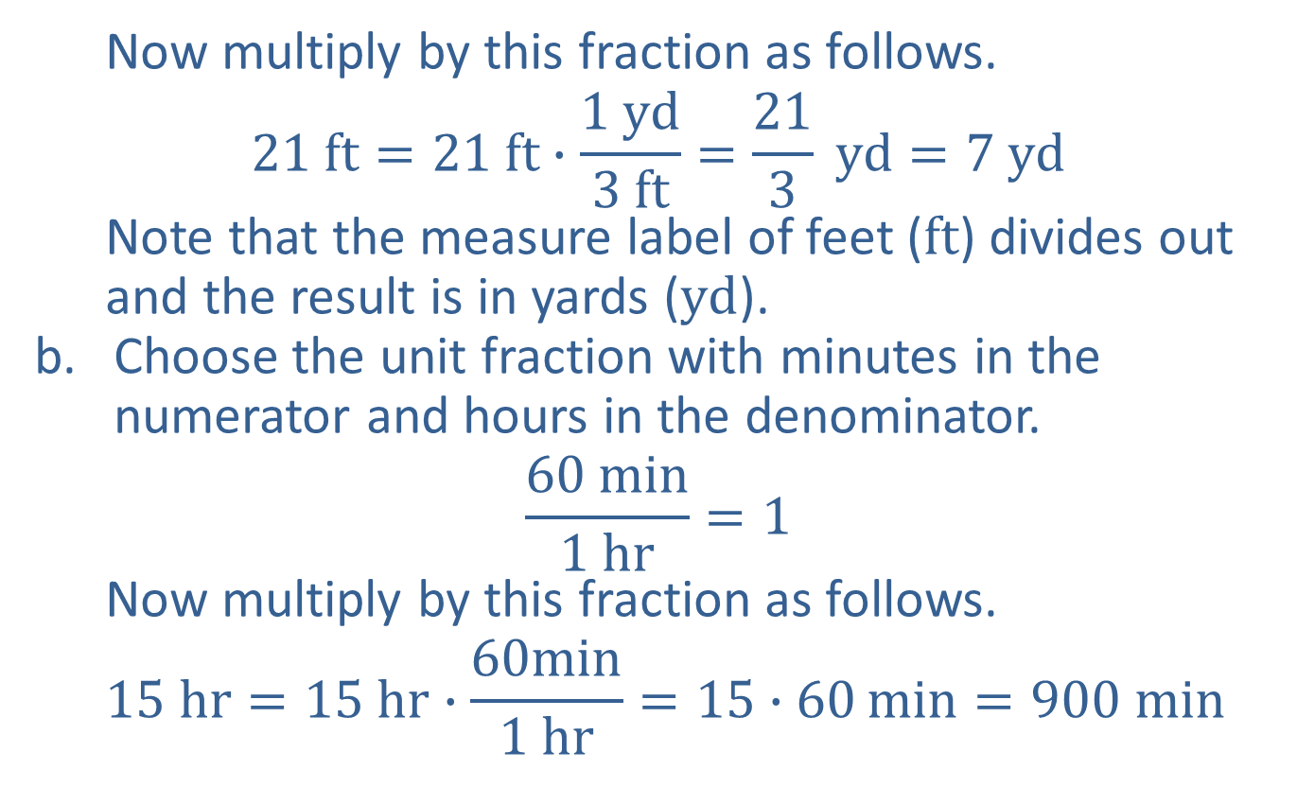
Example 4: Using Unit Fractions to Convert US Units of Measure (cont.)
  Now multiply by this fraction as follows.
$$21 ft=21 ft∙\frac{1 yd}{3 ft}=\frac{21}{3} yd=7 yd$$
  Note that the measure label of feet ($ft$) divides out and the result is in yards ($yd$).
Choose the unit fraction with minutes in the numerator and hours in the denominator.
$$\frac{60 min}{1 hr}=1$$
  Now multiply by this fraction as follows.
  $$15 hr=15 hr∙\frac{60min}{1 hr}=15∙60\min{=900 min}$$

Slide 11
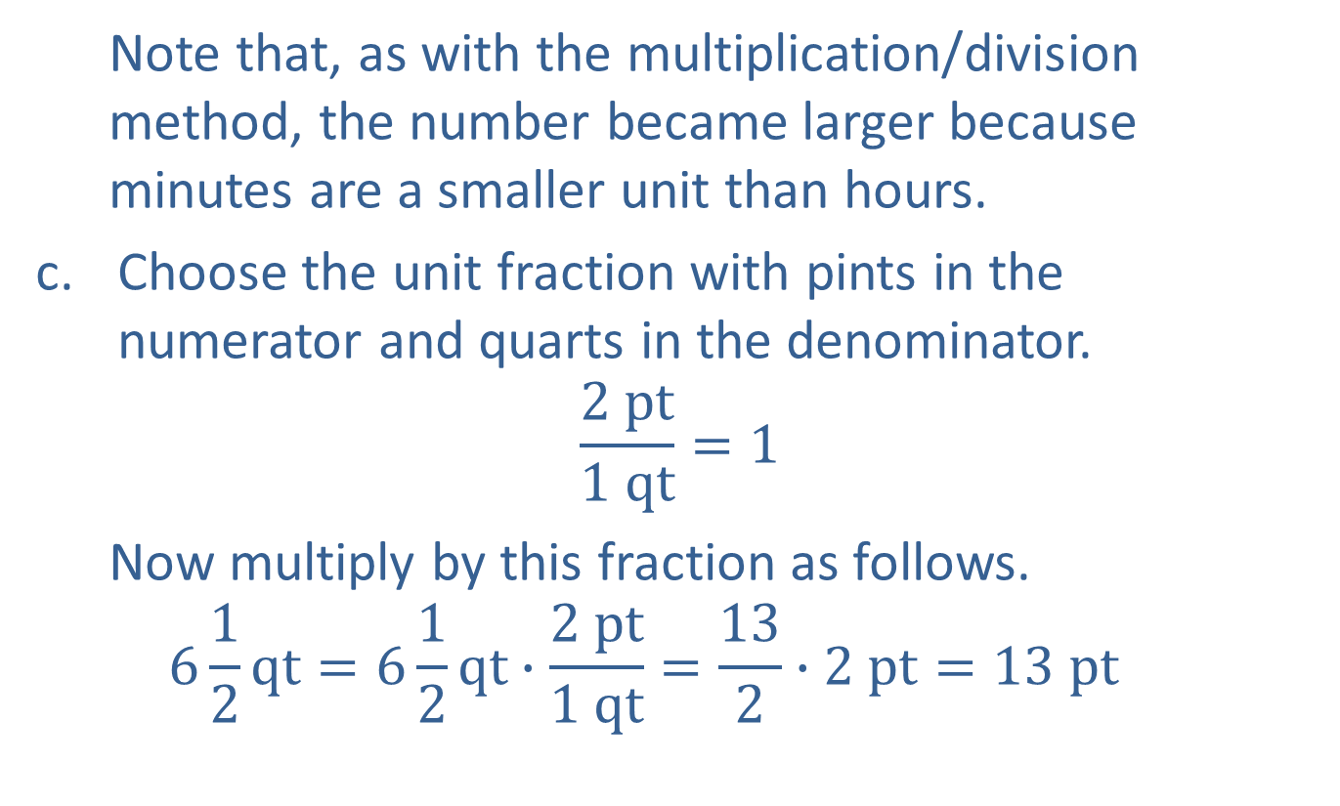
Example 4: Using Unit Fractions to Convert US Units of Measure (cont.)
  Note that, as with the multiplication/division method, the number became larger because minutes are a smaller unit than hours.
Choose the unit fraction with pints in the numerator and quarts in the denominator.
$$\frac{2 pt}{1 qt}=1$$
  Now multiply by this fraction as follows.
  $$6\frac{1}{2}qt=6\frac{1}{2}qt∙\frac{2 pt}{1 qt}=\frac{13}{2}∙2 pt=13 pt$$

Slide 12
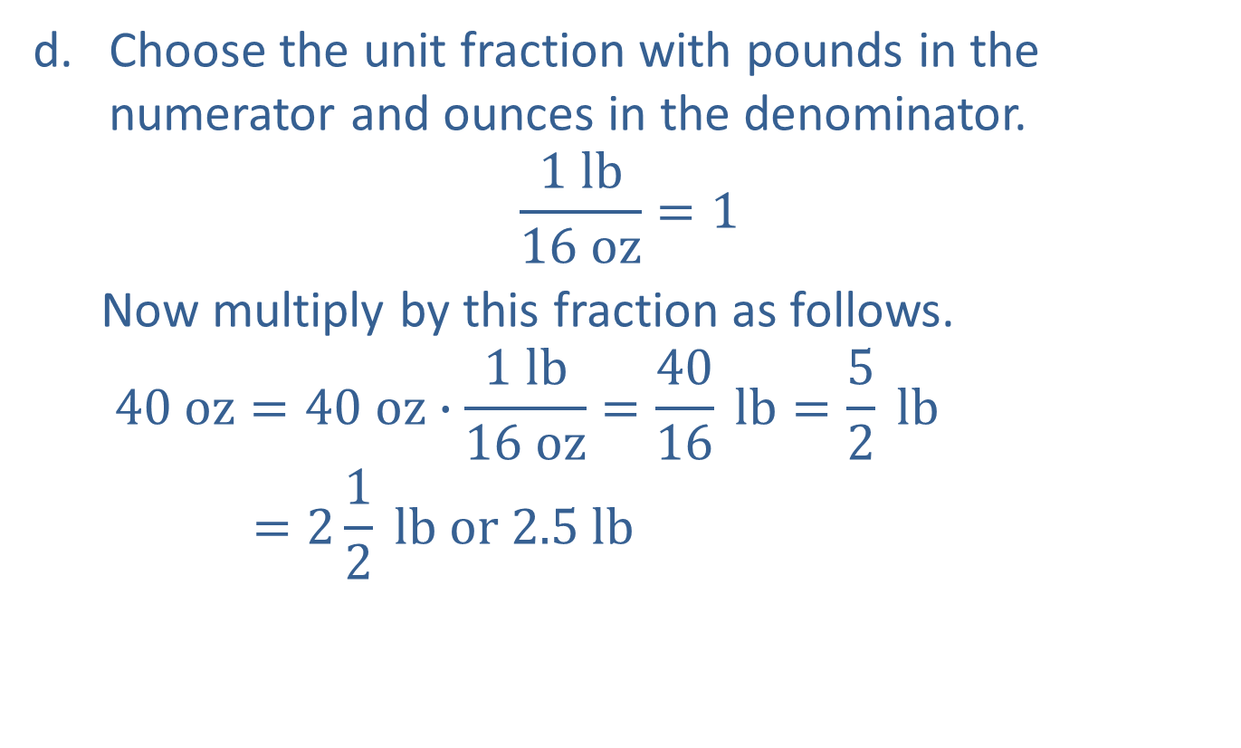
Example 4: Using Unit Fractions to Convert US Units of Measure (cont.)
Choose the unit fraction with pounds in the numerator and ounces in the denominator.
$$\frac{1 lb}{16 oz}=1$$
  Now multiply by this fraction as follows.
  $$40 oz=40 oz∙\frac{1 lb}{16 oz}=\frac{40}{16} lb=\frac{5}{2} lb$$
  $$=2\frac{1}{2} lb or 2.5 lb$$

Slide 13
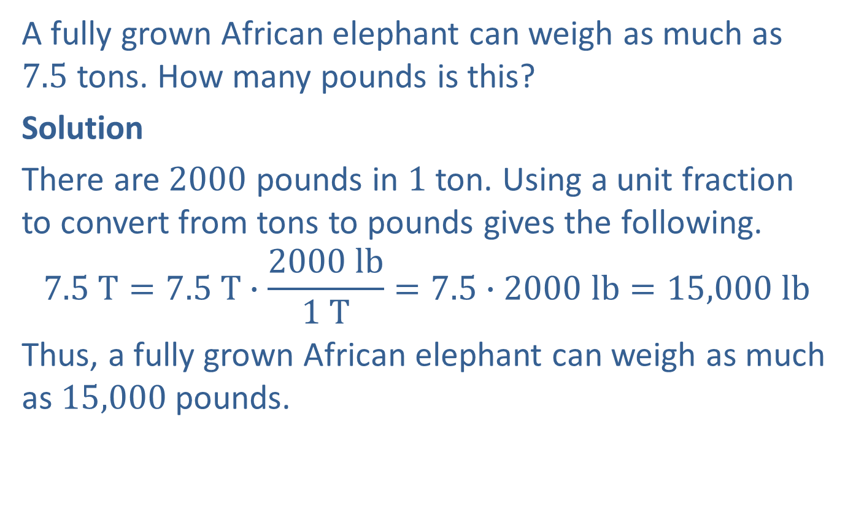
Example 5: Application: Converting US Units of Measure
A fully grown African elephant can weigh as much as 7.5 tons. How many pounds is this?
Solution
There are $2000$ pounds in $1$ ton. Using a unit fraction to convert from tons to pounds gives the following.
$$7.5 T=7.5 T∙\frac{2000 lb}{1 T}=7.5∙2000 lb=15,000 lb$$
Thus, a fully grown African elephant can weigh as much as $15,000$pounds.

Slide 14
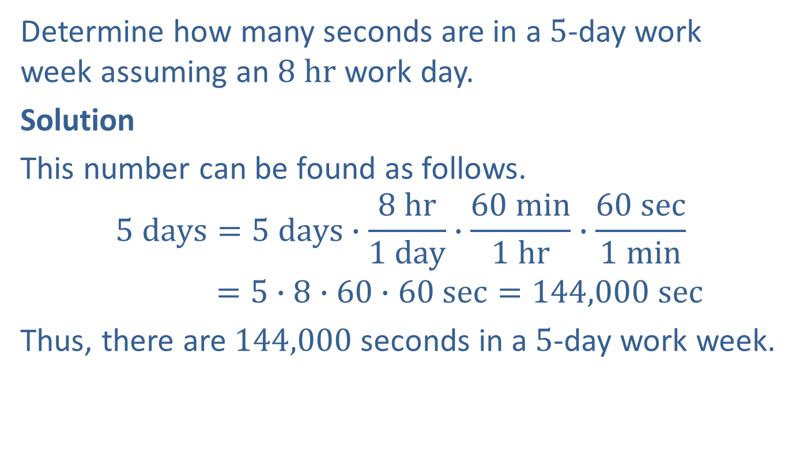
Example 6: Application: Converting US Units of Measure
Determine how many seconds are in a $5$-day work week assuming an $8 hr$ work day.
Solution
This number can be found as follows.
$$5 days=5 days∙\frac{8 hr}{1 day}∙\frac{60 min}{1 hr}∙\frac{60 sec}{1 min}$$
$$=5∙8∙60∙60 sec=144,000 sec$$
Thus, there are $144,000$ seconds in a $5$-day work week.

