Slide 1
Section 6.2
The Metric System: Length and Area

Slide 2
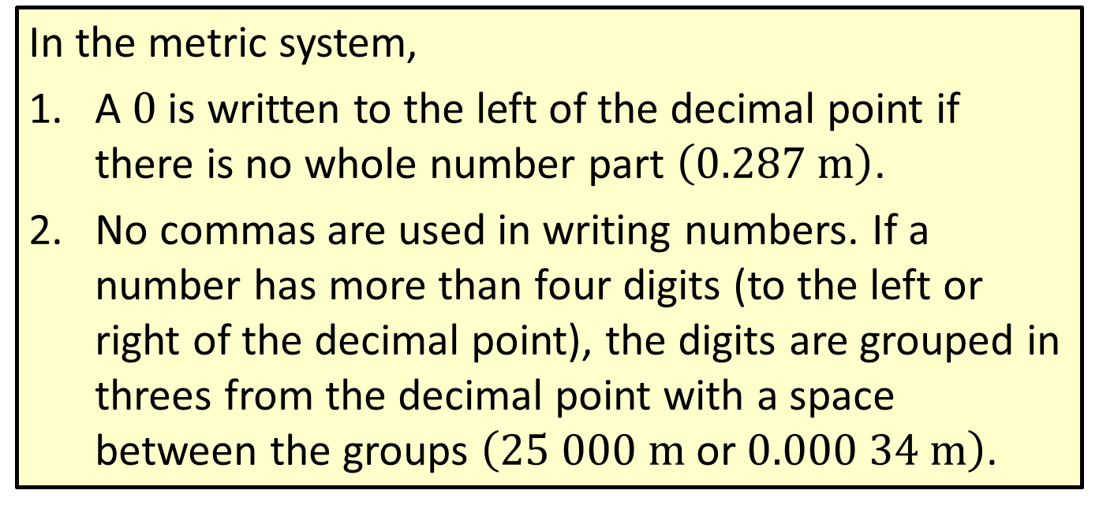
Procedure: Writing Metric Units of Measure
In the metric system,
​A $0$ is written to the left of the decimal point if there is no whole number part $\left(0.287 m\right)$.
​No commas are used in writing numbers. If a number has more than four digits (to the left or right of the decimal point), the digits are grouped in threes from the decimal point with a space between the groups $\left(25 000 m \text{or} 0.000 34 m\right)$.

Slide 3
Procedure: Using Unit Fractions to Convert Measures
​The numerator should be in the units of measure of the desired result.
​The denominator should be in the original units of measure.

Slide 4
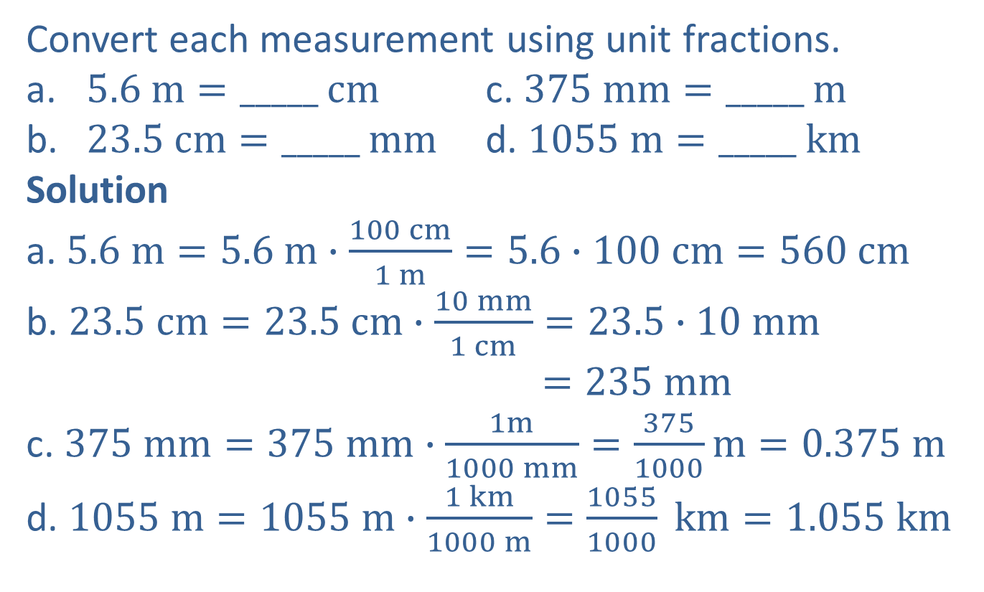
Example 1: Converting Metric Units of Length
Convert each measurement using unit fractions.
​$5.6 m=_____$ $cm$ c. $375 mm=_____$ $m$
​$23.5 cm=_____$ $mm$ d. $1055 m=_____$ $km$​​
Solution
a. $5.6 m=5.6 m∙\frac{100 cm}{1 m}=5.6∙100 cm=560 cm$
b. $23.5 cm=23.5 cm∙\frac{10 mm}{1 cm}=23.5∙10 mm$
$$=235 mm$$
c. $375 mm=375 mm∙\frac{1m}{1000 mm}=\frac{375}{1000}m=0.375 m$
d. $1055 m=1055 m∙\frac{1 km}{1000 m}=\frac{1055}{1000} km=1.055 km$

Slide 5
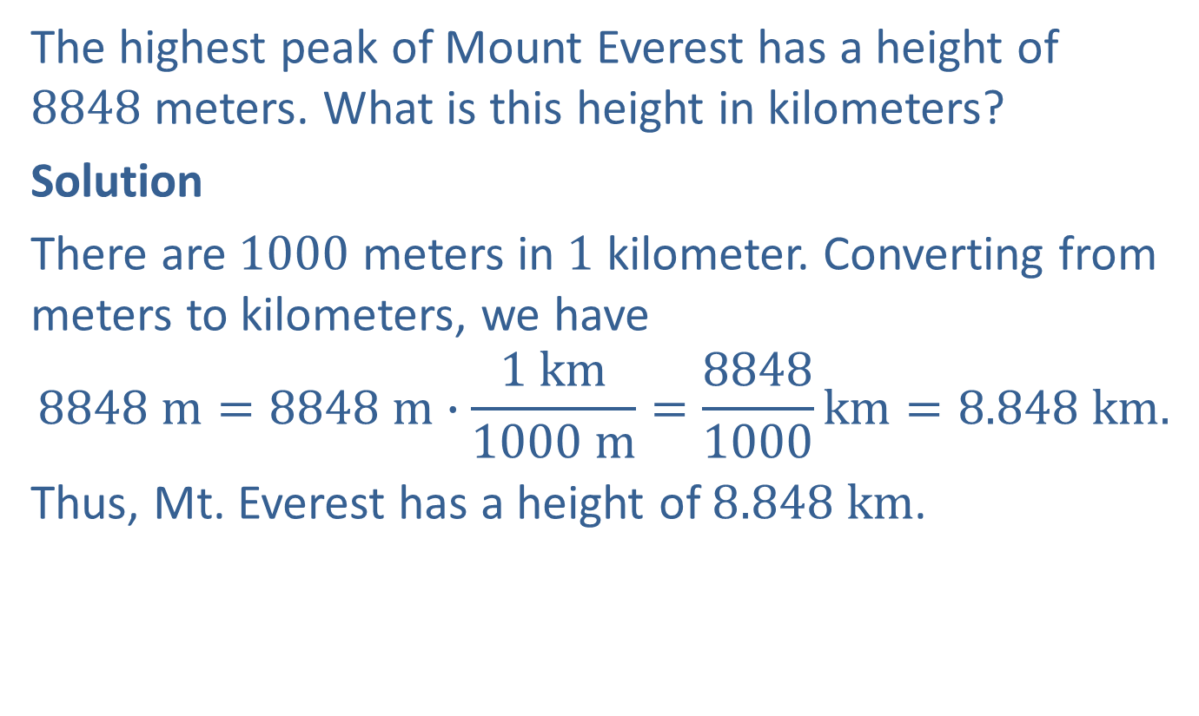
Example 2: Application: Converting Metric Units of Length
The highest peak of Mount Everest has a height of $8848$ meters. What is this height in kilometers?
Solution
There are $1000$ meters in $1$ kilometer. Converting from meters to kilometers, we have
$$8848 m=8848 m∙\frac{1 km}{1000 m}=\frac{8848}{1000}km=8.848 km.$$
Thus, Mt. Everest has a height of $8.848 km$.

Slide 6
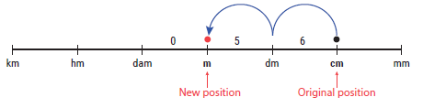
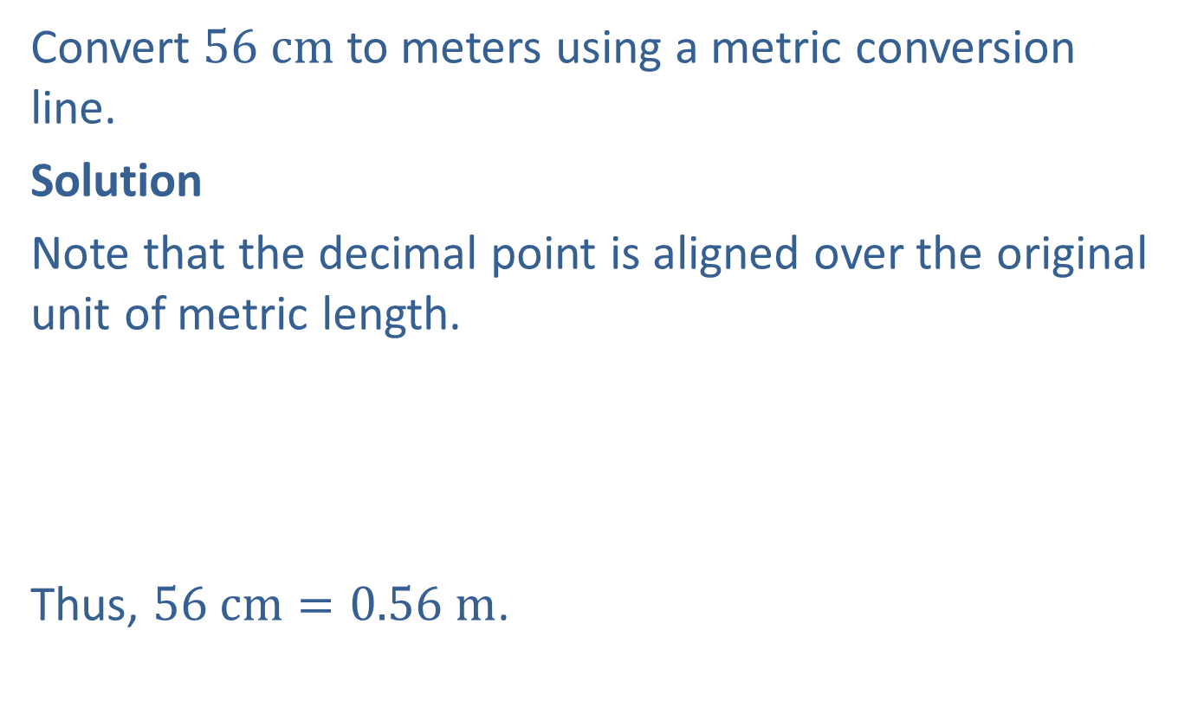
Example 3: Converting Metric Units of Length
Convert $56 cm$ to meters using a metric conversion line.
Solution
Note that the decimal point is aligned over the original unit of metric length.
Thus, $56 cm=0.56 m$.
2 units to the left

Slide 7
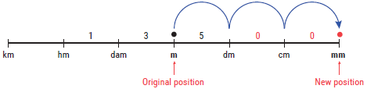

Example 4: Converting Metric Units of Length
Convert $13.5 m$ to millimeters using a metric conversion line.
Solution
Thus, $13.5 m=13 500 mm.$
3 units to the right

Slide 8
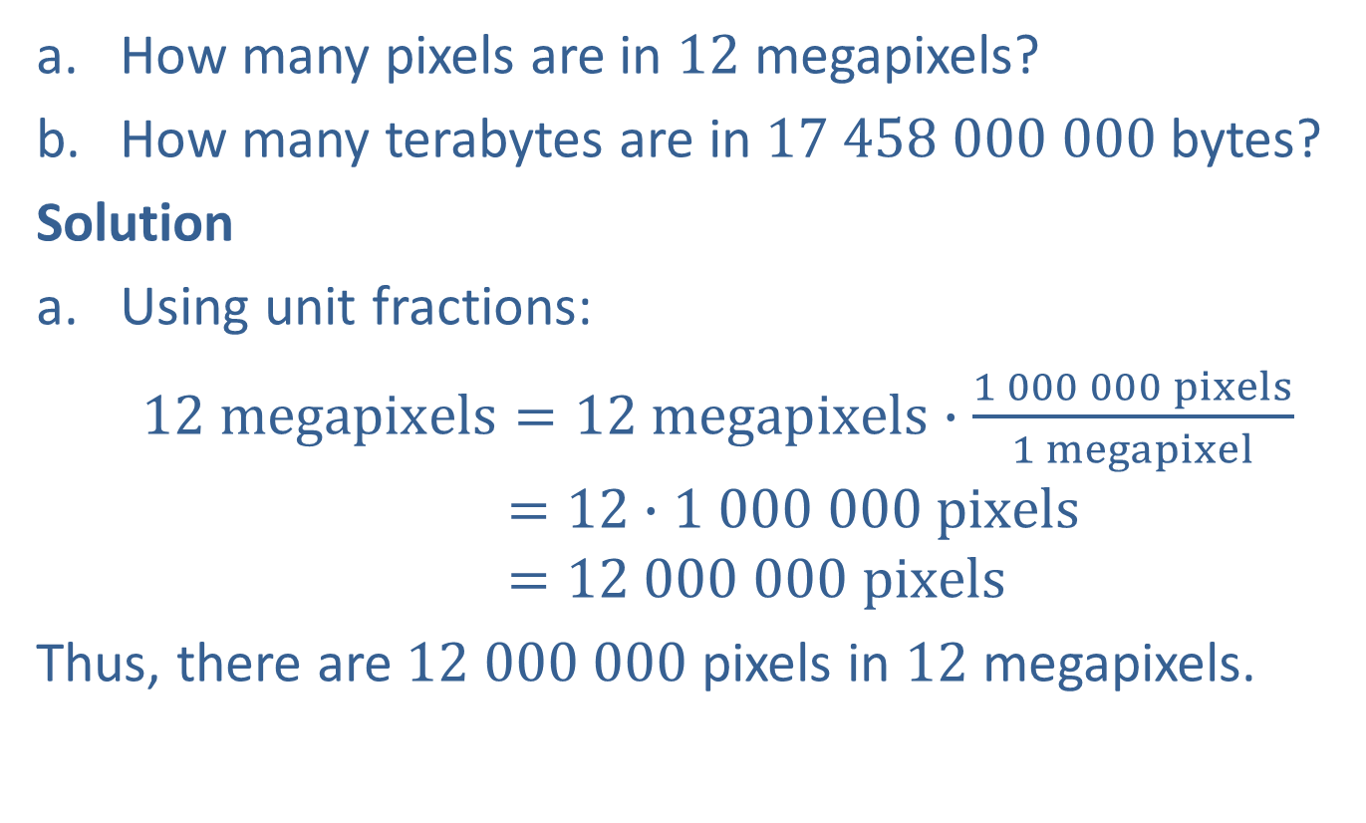
Example 5: The Prefixes Mega-, Giga-, and Tera-
​How many pixels are in $12$ megapixels?
​How many terabytes are in $17 458 000 000$bytes?
Solution
Using unit fractions:
$12 megapixels=12 megapixels∙\frac{1 000 000 pixels}{1 megapixel}$
$$=12∙1 000 000 pixels$$
$$=12 000 000 pixels$$
Thus, there are $12 000 000$pixels in $12$ megapixels.

Slide 9
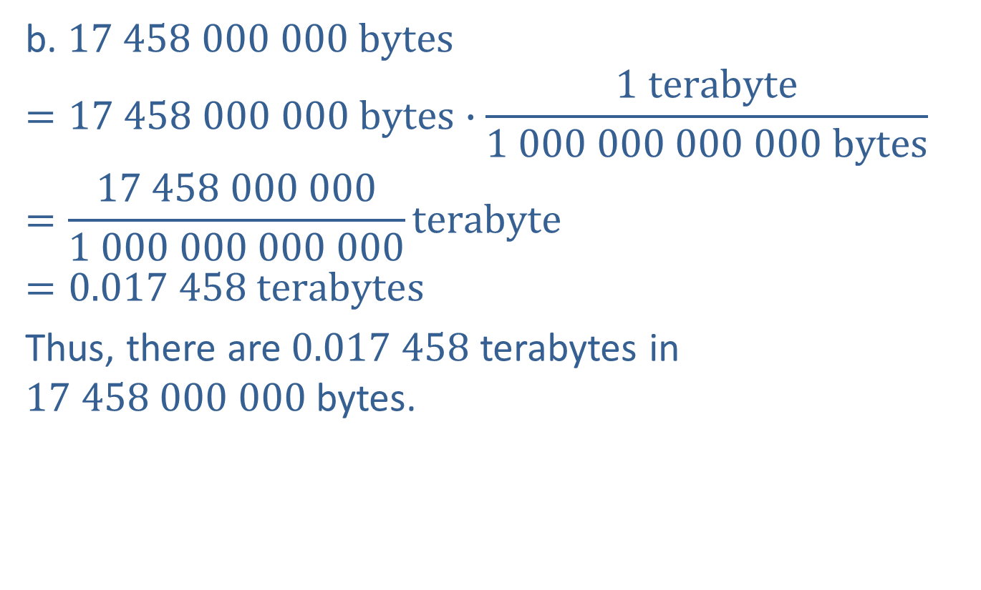
Example 5: The Prefixes Mega-, Giga-, and Tera- (cont.)
b. $17 458 000 000 bytes$
$$=17 458 000 000 bytes∙\frac{1 terabyte}{1 000 000 000 000 bytes}$$
$$=\frac{17 458 000 000}{1 000 000 000 000}terabyte$$
$$=0.017 458 terabytes$$
Thus, there are $0.017 458$terabytes in $17 458 000 000$bytes.

Slide 10
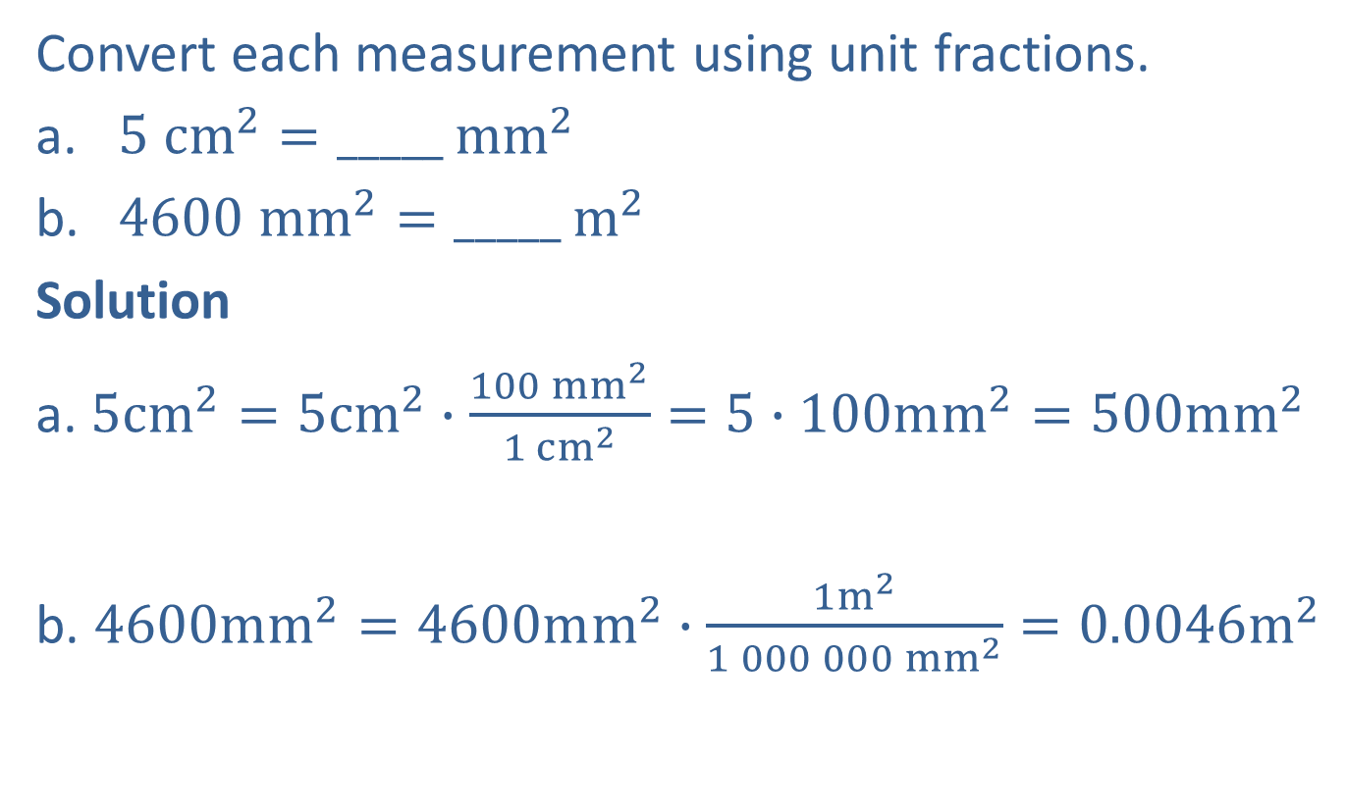
Example 6: Converting Metric Units of Area
Convert each measurement using unit fractions.
​$5 {cm}^{2}=_____$ ${mm}^{2}$
​$4600 {mm}^{2}=_____$ $m^{2}$
Solution
a. $5cm^{2}=5cm^{2}∙\frac{100 mm^{2}}{1 cm^{2}}=5∙100mm^{2}=500mm^{2}$
b. $4600mm^{2}=4600mm^{2}∙\frac{1m^{2}}{1 000 000 mm^{2}}=0.0046m^{2}$
Note that the decimal point is moved 2 places to the right.
Note that the decimal point is moved 6 places to the left.

Slide 11
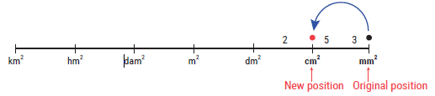
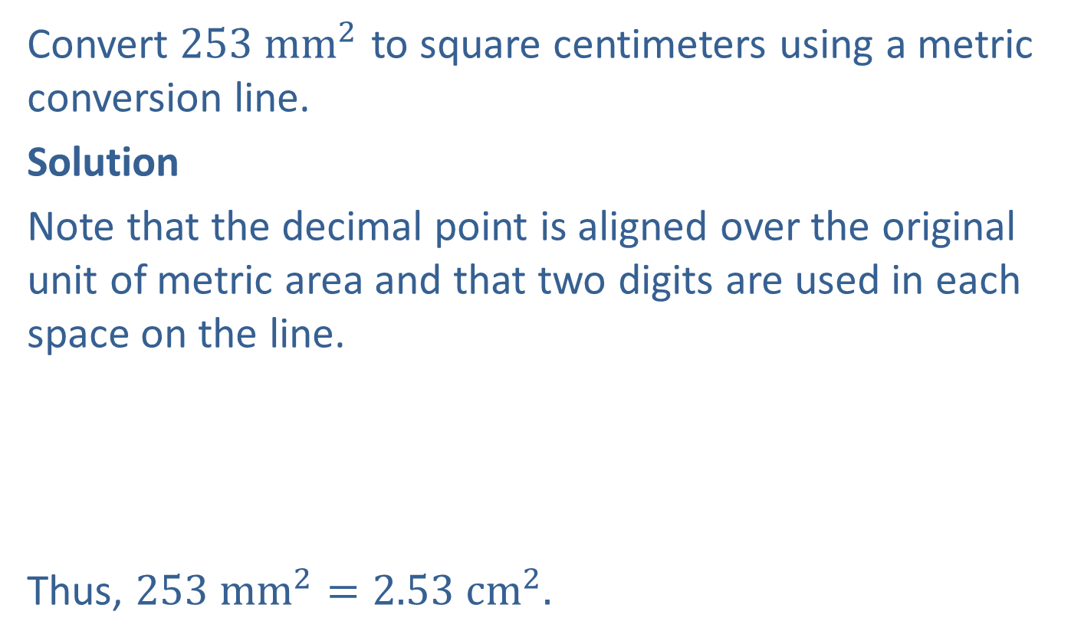
Example 7: Converting Metric Units of Area
Convert ${253 mm}^{2}$ to square centimeters using a metric conversion line.
Solution
Note that the decimal point is aligned over the original unit of metric area and that two digits are used in each space on the line.
Thus, $253 mm^{2}=2.53 cm^{2}.$
1 unit to the left

Slide 12
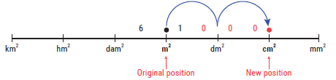

Example 8: Converting Metric Units of Area
Convert ${6.1 m}^{2}$ to square centimeters using a metric conversion line.
Solution
Thus, $6.1 m^{2}=61 000 cm^{2}.$
2 units to the right

Slide 13

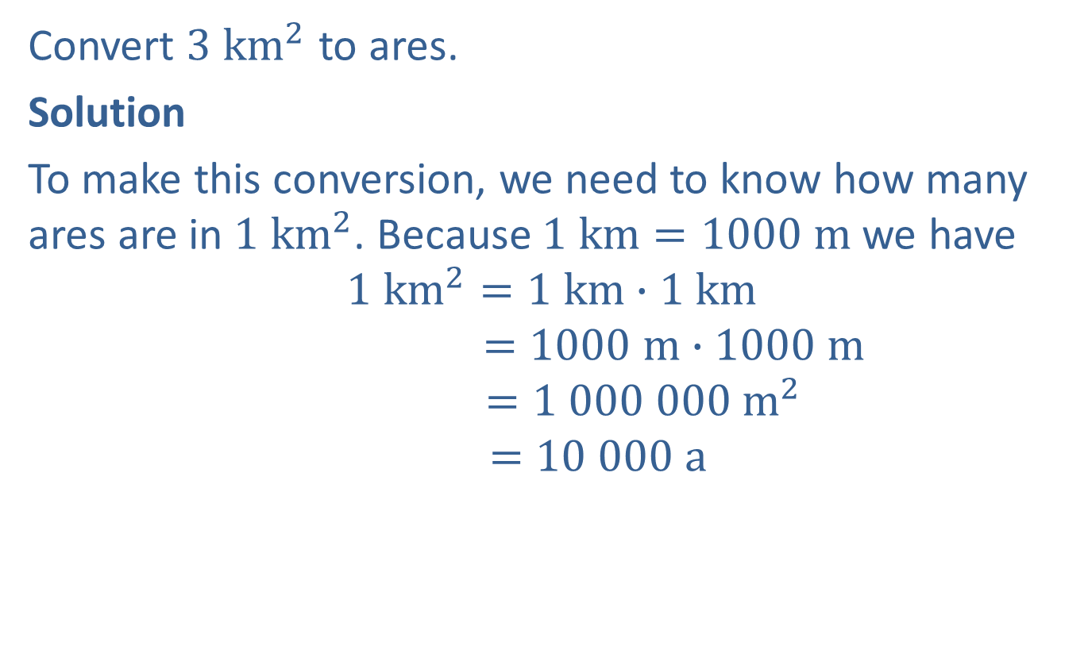
Example 9: Converting Metric Units of Land Area
Convert ${3 km}^{2}$ to ares.
Solution
To make this conversion, we need to know how many ares are in $1 km^{2}$. Because $1 km=1000 m$ we have
$$1 km^{2}=1 km∙1 km$$
$$=1000 m∙1000 m$$
$$=1 000 000 m^{2}$$
$$=10 000 a$$
Divide $m^{2}$ by $100$ to get ares.

Slide 14

Example 9: Converting Metric Units of Land Area (cont.)
Using a unit fraction, we have
$$3 km^{2}=3 {km}^{2}∙\frac{10 000 a}{1 km^{2}}=3∙10 000 a=30 000 a$$
Thus, $3 km^{2}=30 000 a.$

