Slide 1
Section 6.3
The Metric System: Capacity and Weight

Slide 2
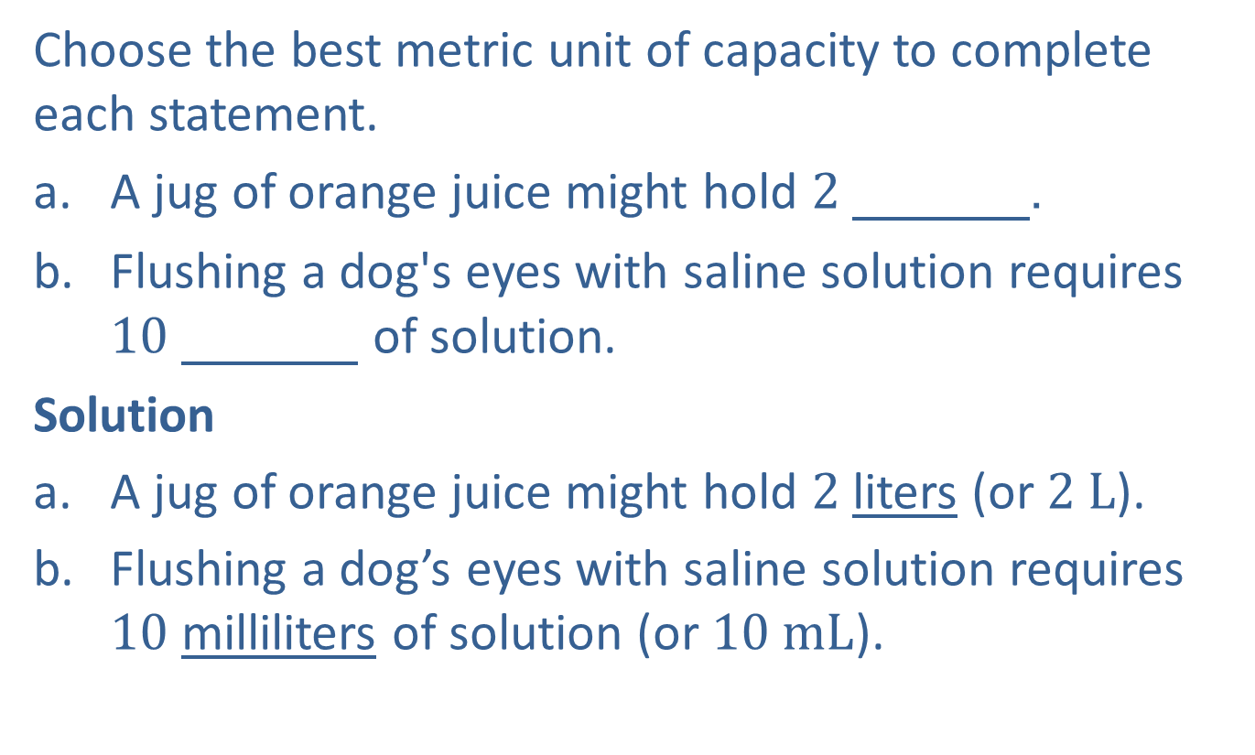
Example 1: Common Metric Units of Capacity
Choose the best metric unit of capacity to complete each statement.
​A jug of orange juice might hold 2 000000.
​Flushing a dog's eyes with saline solution requires 10 000000 of solution.
Solution
A jug of orange juice might hold $2$liters (or $2 L$).
Flushing a dog’s eyes with saline solution requires $10$ milliliters of solution (or $10 mL$).

Slide 3

Example 2: Converting Metric Units of Capacity
Convert $1.4 L$ to milliliters using a unit fraction.
Solution
$$1.4 L=1.4 L∙\frac{1000 mL}{1 L}=1.4∙1000 mL=1400 mL$$

Slide 4
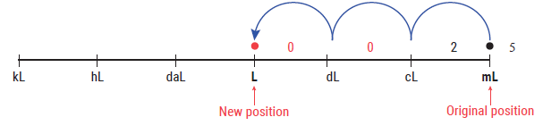

Example 3: Converting Metric Units of Capacity
Convert $2.5 mL$to liters using a metric conversion line.
Solution
Thus, $2.5 mL=0.0025 L.$
3 units to the left

Slide 5
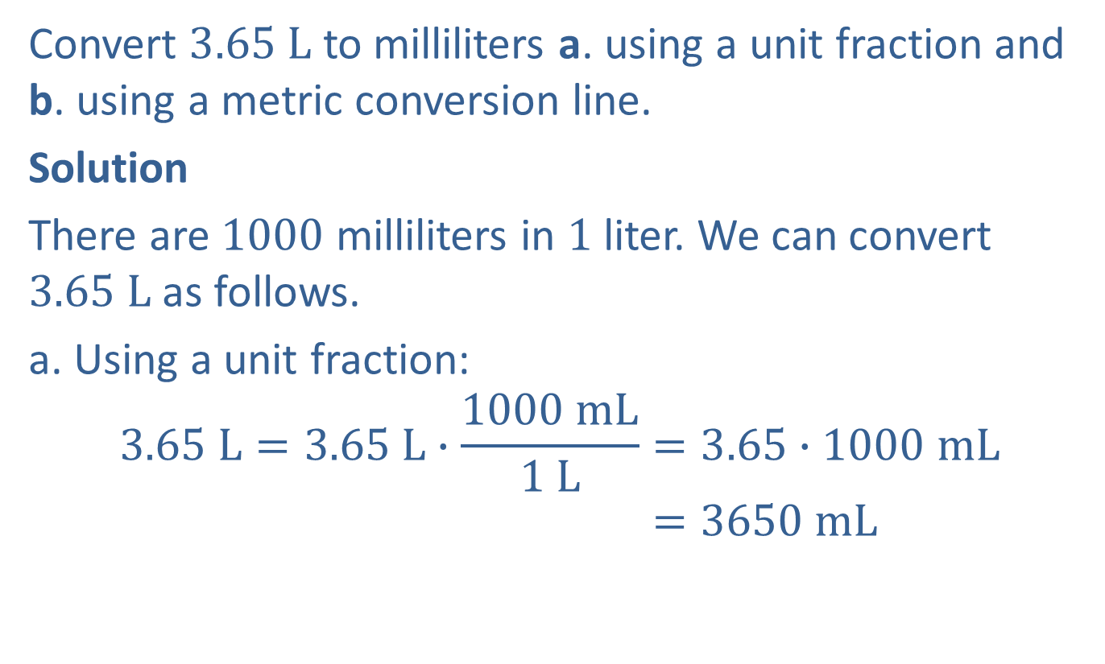
Example 4: Converting Metric Units of Capacity
Convert $3.65 L$ to milliliters a. using a unit fraction and b. using a metric conversion line.
Solution
There are $1000$ milliliters in $1$liter. We can convert $3.65$ $L$as follows.
a. Using a unit fraction:
$$3.65 L=3.65 L∙\frac{1000 mL}{1 L}=3.65∙1000 mL$$
$$=3650 mL$$

Slide 6
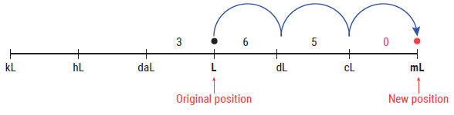

Example 4: Converting Metric Units of Capacity (cont.)
Using a metric conversion line:
Thus, with either method, we have $3.65 L=3650 mL$.
3 units to the right

Slide 7
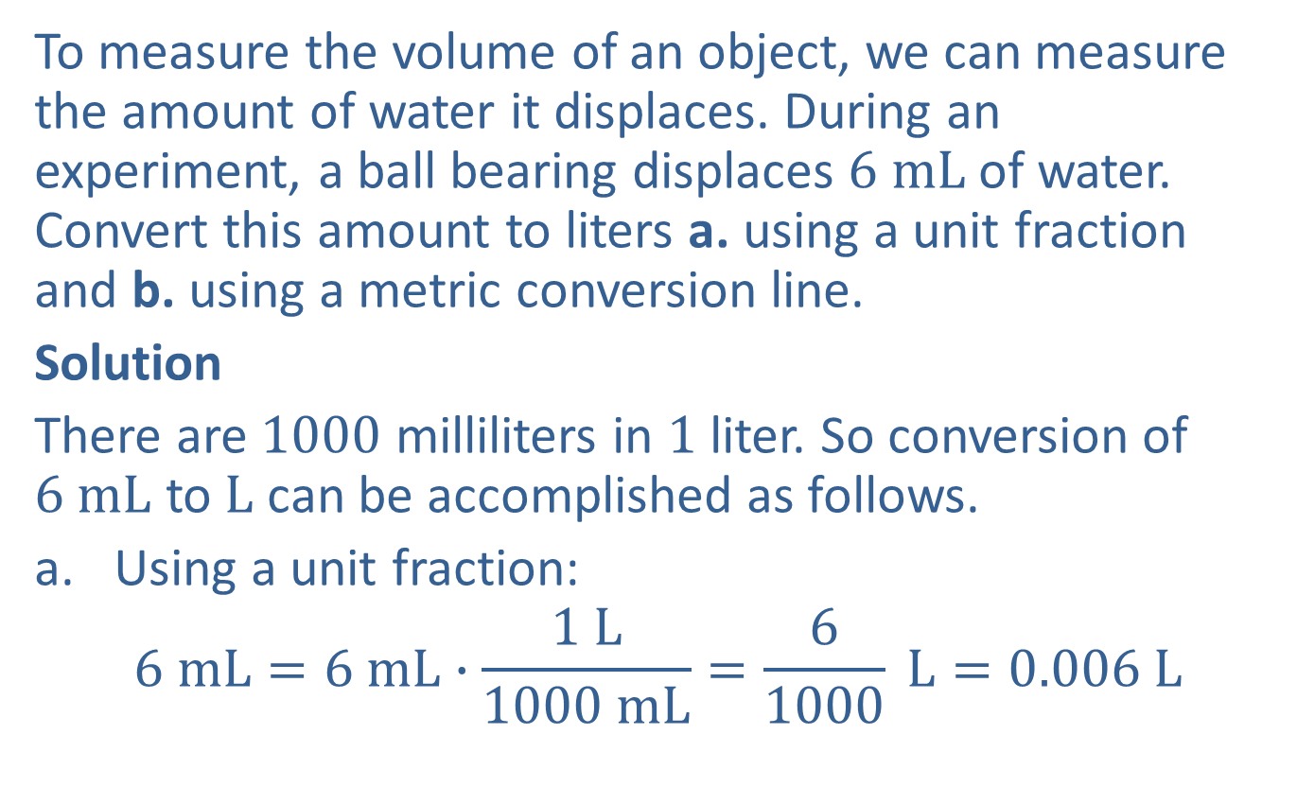
Example 5: Application: Converting Metric Units of Capacity
To measure the volume of an object, we can measure the amount of water it displaces. During an experiment, a ball bearing displaces $6 mL$of water. Convert this amount to liters a. using a unit fraction and b. using a metric conversion line.
Solution
There are $1000$ milliliters in $1$ liter. So conversion of $6$ $mL$ to$L$ can be accomplished as follows.
Using a unit fraction:
$$6 mL=6 mL∙\frac{1 L}{1000 mL}=\frac{6}{1000} L=0.006 L$$

Slide 8
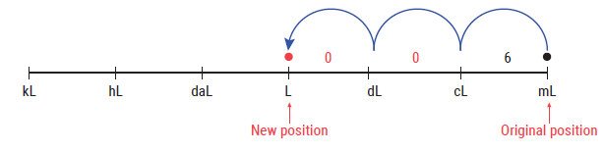

Example 5: Application: Converting Metric Units of Capacity (cont.)
Using a metric conversion line:
With either method, we see that $6 mL$of water is equivalent to $0.006 L$ of water.
3 units to the left

Slide 9
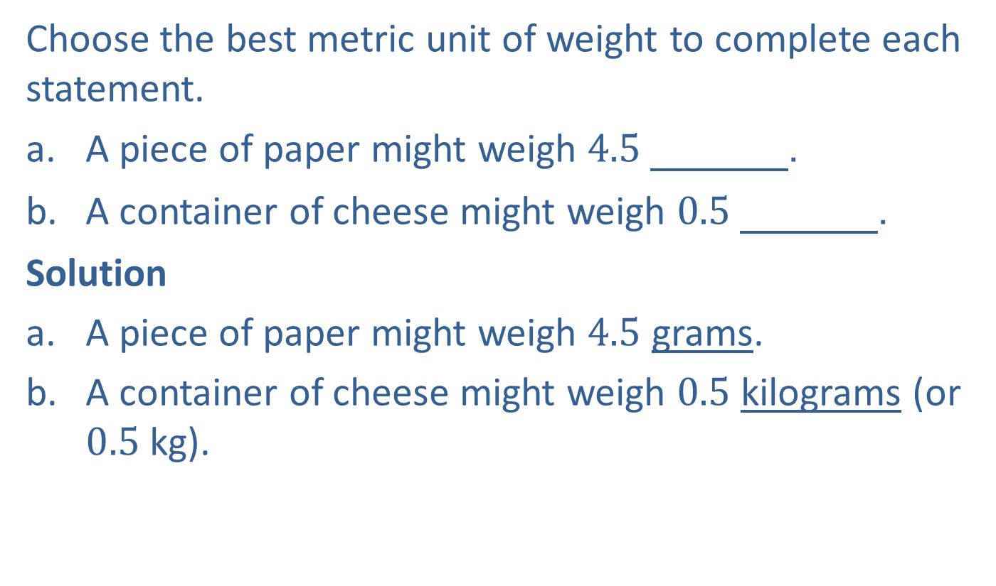
Example 6: Common Metric Units of Weight
Choose the best metric unit of weight to complete each statement.
​A piece of paper might weigh 4.5 000000.
​A container of cheese might weigh 0.5 000000.
Solution
A piece of paper might weigh $4.5$ grams.
A container of cheese might weigh $0.5$ kilograms (or $0.5$ kg).

Slide 10
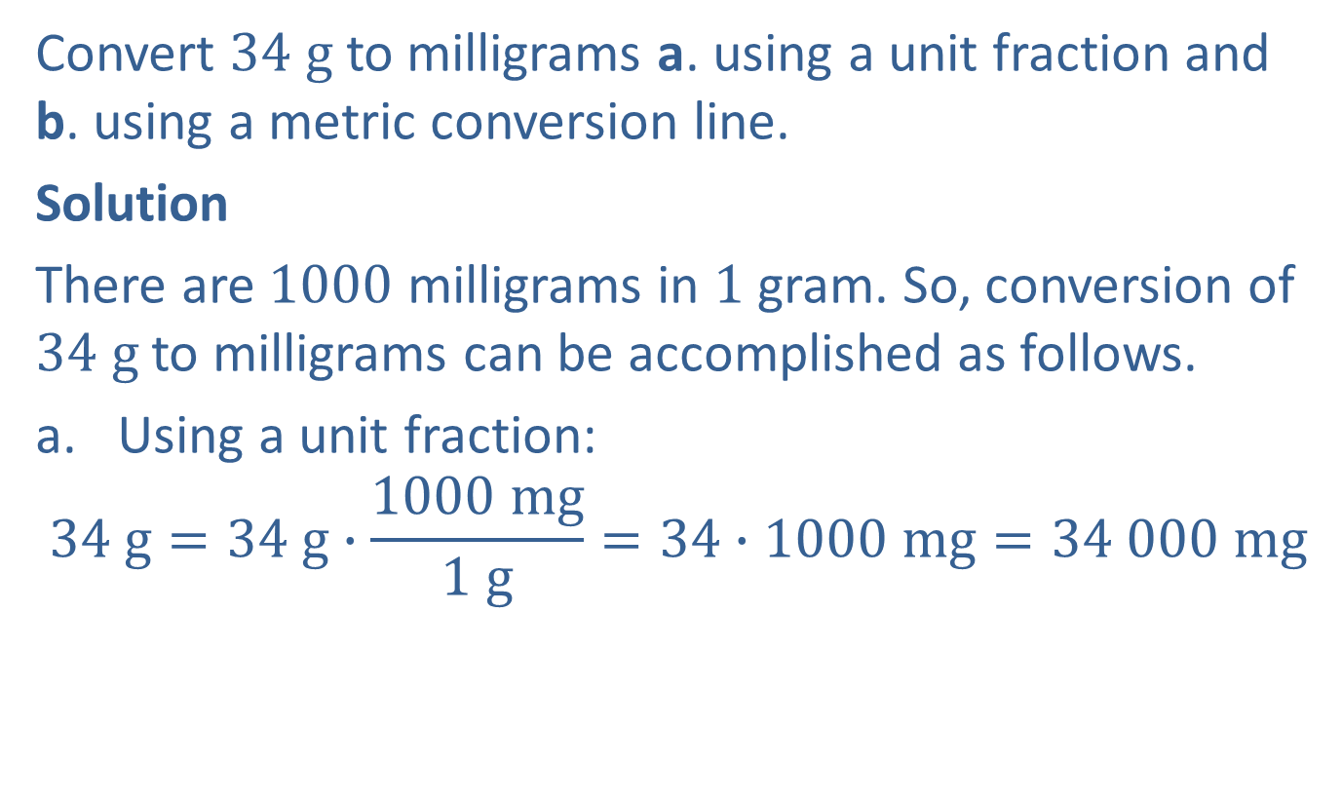
Example 7: Converting Metric Units of Weight
Convert $34 g$ to milligrams a. using a unit fraction and b. using a metric conversion line.
Solution
There are $1000$ milligrams in $1$ gram. So, conversion of $34 g$ to milligrams can be accomplished as follows.
Using a unit fraction:
$$34 g=34 g∙\frac{1000 mg}{1 g}=34∙1000 mg=34 000 mg$$

Slide 11
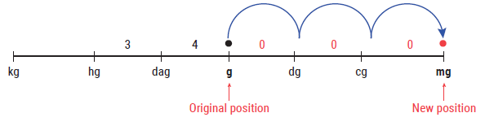

Example 7: Converting Metric Units of Weight (cont.)
Using a metric conversion line:
Thus, with either method, we have $34 g = 34 000 mg.$
3 units to the right

Slide 12
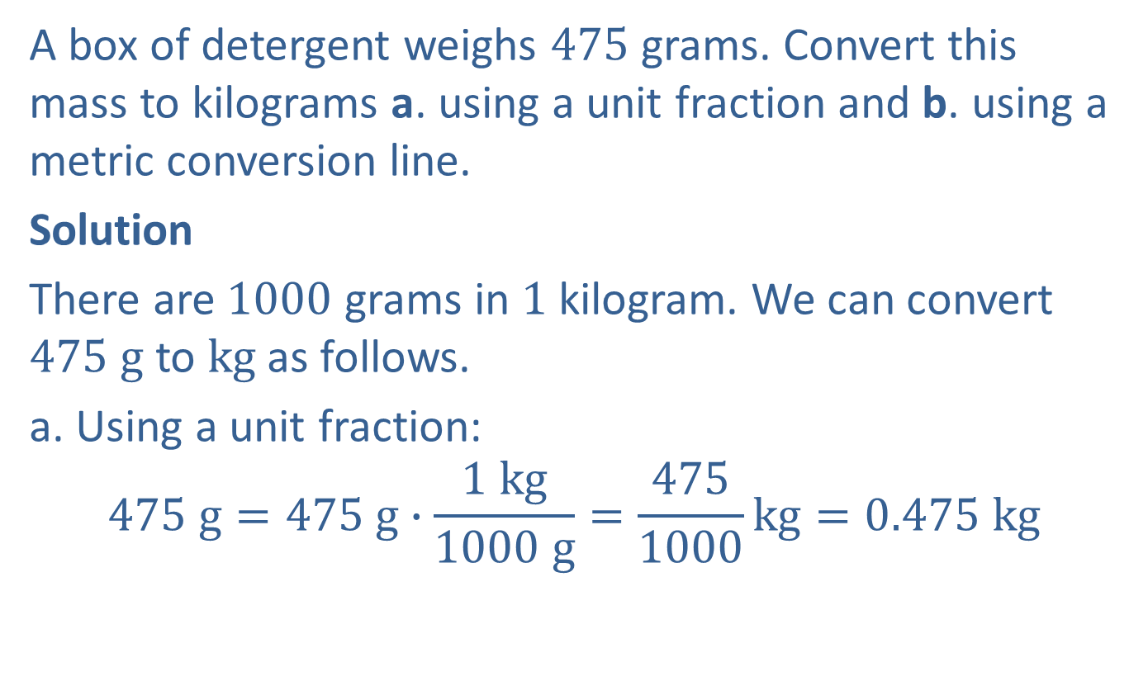
Example 8: Application: Converting Metric Units of Weight
A box of detergent weighs $475$ grams. Convert this mass to kilograms a. using a unit fraction and b. using a metric conversion line.
Solution
There are $1000$ grams in $1$ kilogram. We can convert $475$ $g$ to $kg$as follows.
a. Using a unit fraction:
$$475 g=475 g∙\frac{1 kg}{1000 g}=\frac{475}{1000}kg=0.475 kg$$

Slide 13
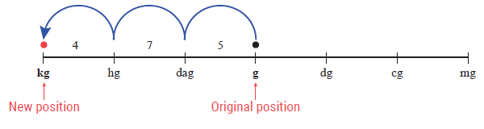

Example 8: Application: Converting Metric Units of Weight (cont.)
b. Using a metric conversion line:
Each method shows that $475 g$ of detergent is equivalent to $0.475 kg$of detergent.
3 units to the left

