Slide 1
Section 6.4
US and Metric Equivalents

Slide 2
Definition: Temperature
US customary measure is in degrees Fahrenheit (℉).
Metric measure is in degrees Celsius (℃).

Slide 3
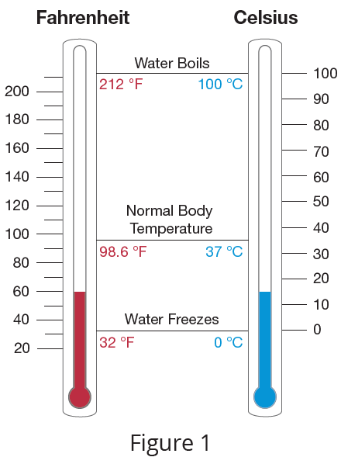
Example 1: Equivalent Measures of Temperature
Hold a straight edge horizontally across the thermometers in Figure 1 and compare equivalent measures of Fahrenheit and Celsius.

Slide 4

Example 1: Equivalent Measures of Temperature (cont.)
$$100 ℃=212 ℉$$
$$40 ℃=104 ℉$$
$$20 ℃=68 ℉$$
Water boils at sea level.
Hot day in the desert
Comfortable room temperature

Slide 5
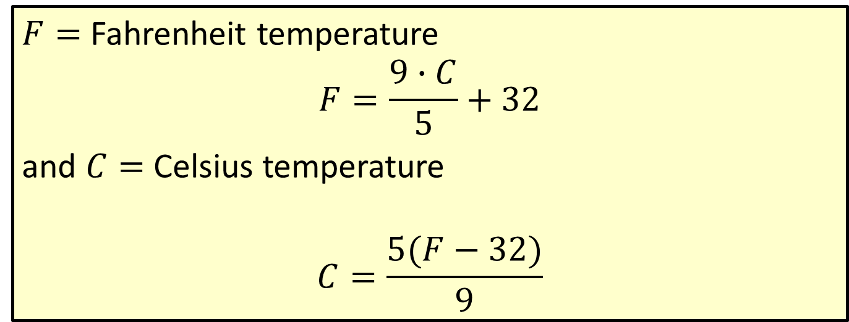
Formula: Temperature Formulas
$F=$ Fahrenheit temperature
$$F=\frac{9∙C}{5}+32$$
and $C=$ Celsius temperature
$$C=\frac{5(F−32)}{9}$$

Slide 6
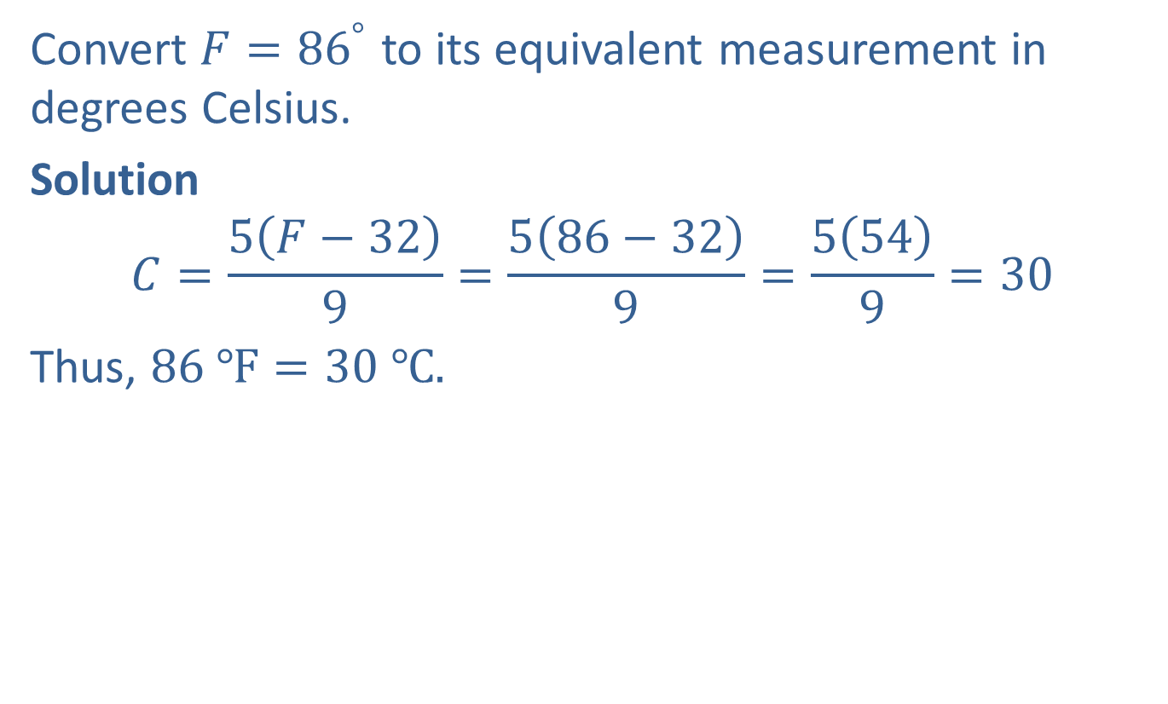
Example 2: Converting Units of Temperature
Convert $F={86}^{°}$ to its equivalent measurement in degrees Celsius.
Solution
$$C=\frac{5\left(F−32\right)}{9}=\frac{5\left(86−32\right)}{9}=\frac{5\left(54\right)}{9}=30$$
Thus, $86 ℉=30 ℃.$

Slide 7
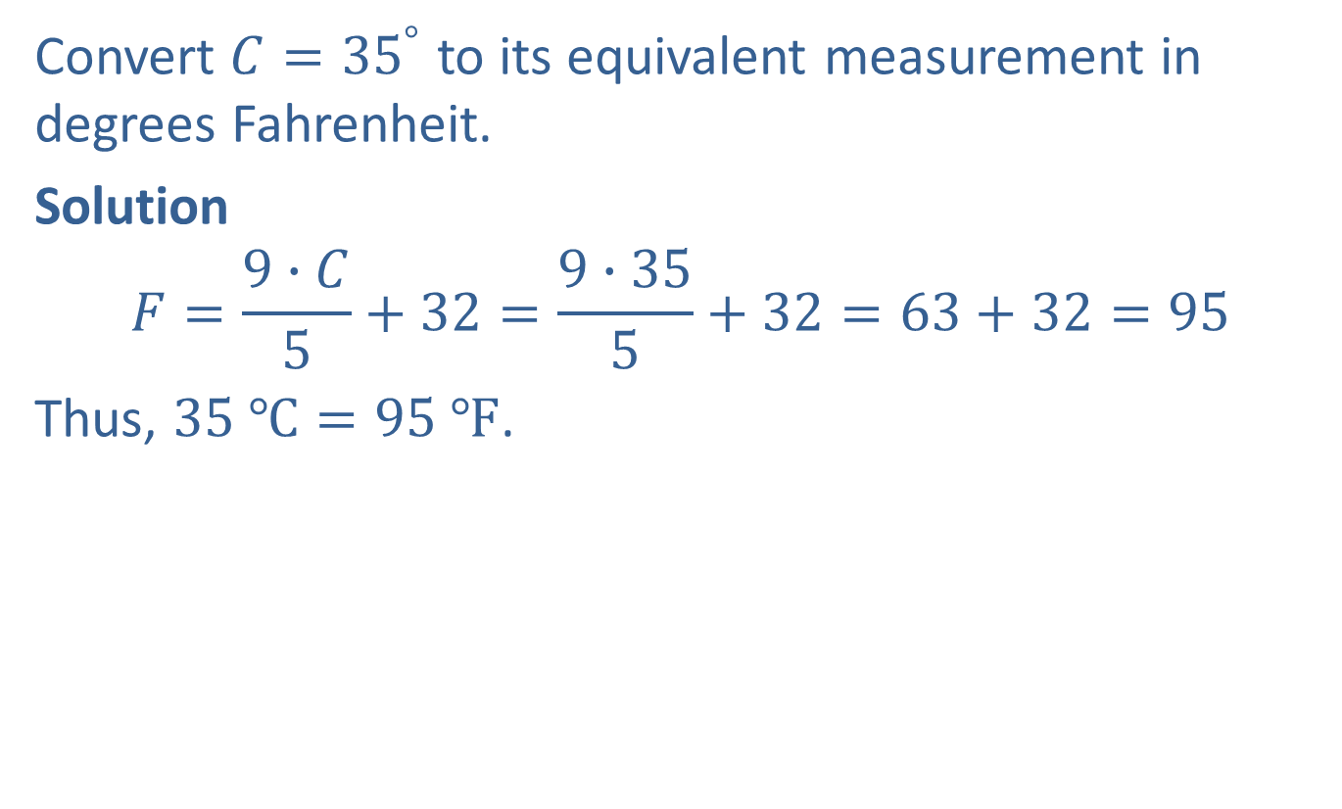
Example 3: Converting Units of Temperature
Convert $C={35}^{°}$ to its equivalent measurement in degrees Fahrenheit.
Solution
$$F=\frac{9∙C}{5}+32=\frac{9∙35}{5}+32=63+32=95$$
Thus, $35 ℃=95 ℉$.

Slide 8
Note
Most of the conversion units are not exact and slightly different answers are possible, depending on the conversion units used. Generally, we will round conversions to the nearest hundredth.

Slide 9
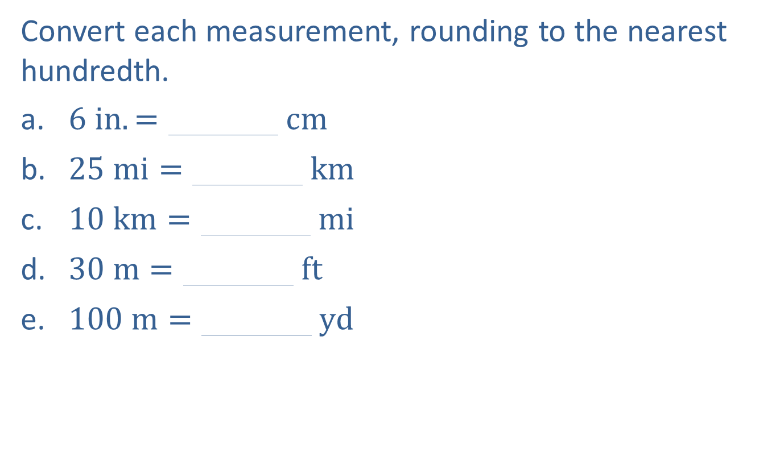
Example 4: Converting Units of Length
Convert each measurement, rounding to the nearest hundredth.
​6 in.=000000 cm
​25 mi=000000 km
​10 km=000000 mi
​30 m=000000 ft
​100 m=000000 yd

Slide 10
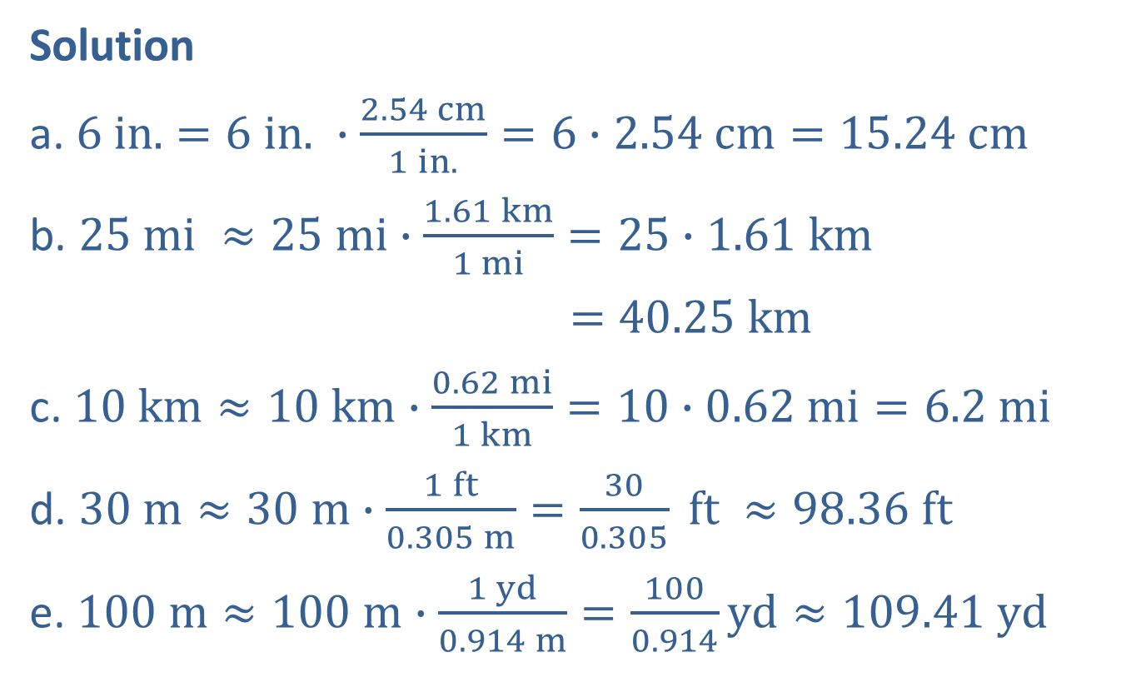
Example 4: Converting Units of Length (cont.)
Solution
a. $6$ $in.$ $=6$ $in.$ $∙\frac{2.54 cm}{1 in.}=6∙2.54 cm=15.24 cm$
b. $25 mi ≈25 mi∙\frac{1.61 km}{1 mi}=25∙1.61 km$
$=40.25 km$
c. $10 km≈10 km∙\frac{0.62 mi}{1 km}=10∙0.62 mi=6.2 mi$
d. $30 m≈30 m∙\frac{1 ft}{0.305 m}=\frac{30}{0.305} ft ≈98.36 ft$
e. $100 m≈100 m∙\frac{1 yd}{0.914 m}=\frac{100}{0.914}yd≈109.41 yd$

Slide 11

Example 4: Converting Units of Length (cont.)
With this information, do you think that a $100 m$ dash is longer (or shorter) than a $100 yd$dash?

Slide 12
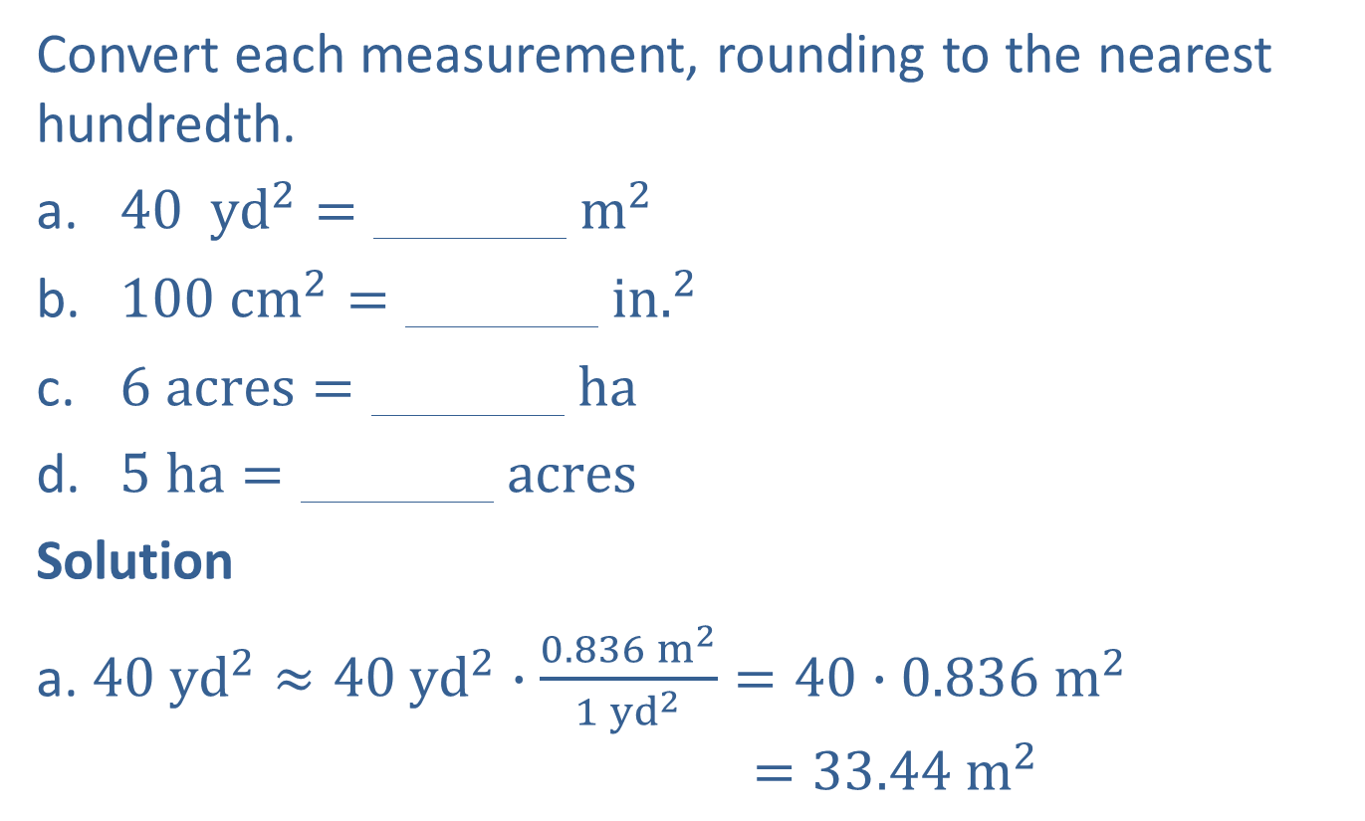
Example 5: Converting Units of Area
Convert each measurement, rounding to the nearest hundredth.
​40 yd2=000000 m2
​100 cm2=000000 in.2
​6 acres=000000 ha
​5 ha=000000 acres
Solution
a. $40 yd^{2}≈40 yd^{2}∙\frac{0.836 m^{2}}{1 yd^{2}}=40∙0.836 m^{2}$
$$=33.44{ m}^{2}$$

Slide 13
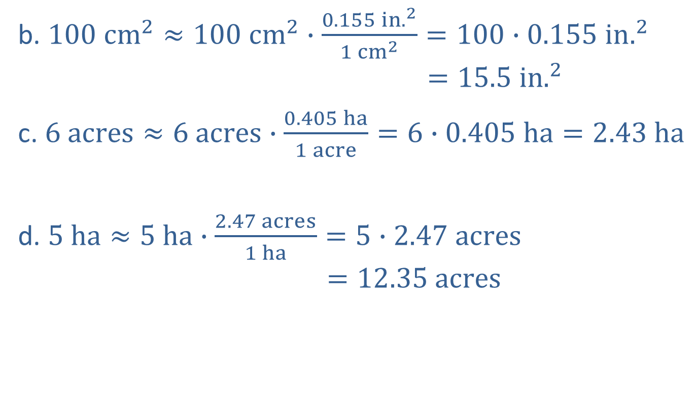
Example 5: Converting Units of Area (cont.)
b. $100 cm^{2}≈100 cm^{2}∙\frac{0.155 {in.}^{2}}{1 {cm}^{2}}=100∙0.155 in.^{2}$
$$=15.5 in.^{2}$$
c. $6 acres≈6 acres∙\frac{0.405 ha}{1 acre}=6∙0.405 ha=2.43 ha$
d. $5 ha≈5 ha∙\frac{2.47 acres}{1 ha}=5∙2.47 acres$
$$=12.35 acres$$

Slide 14
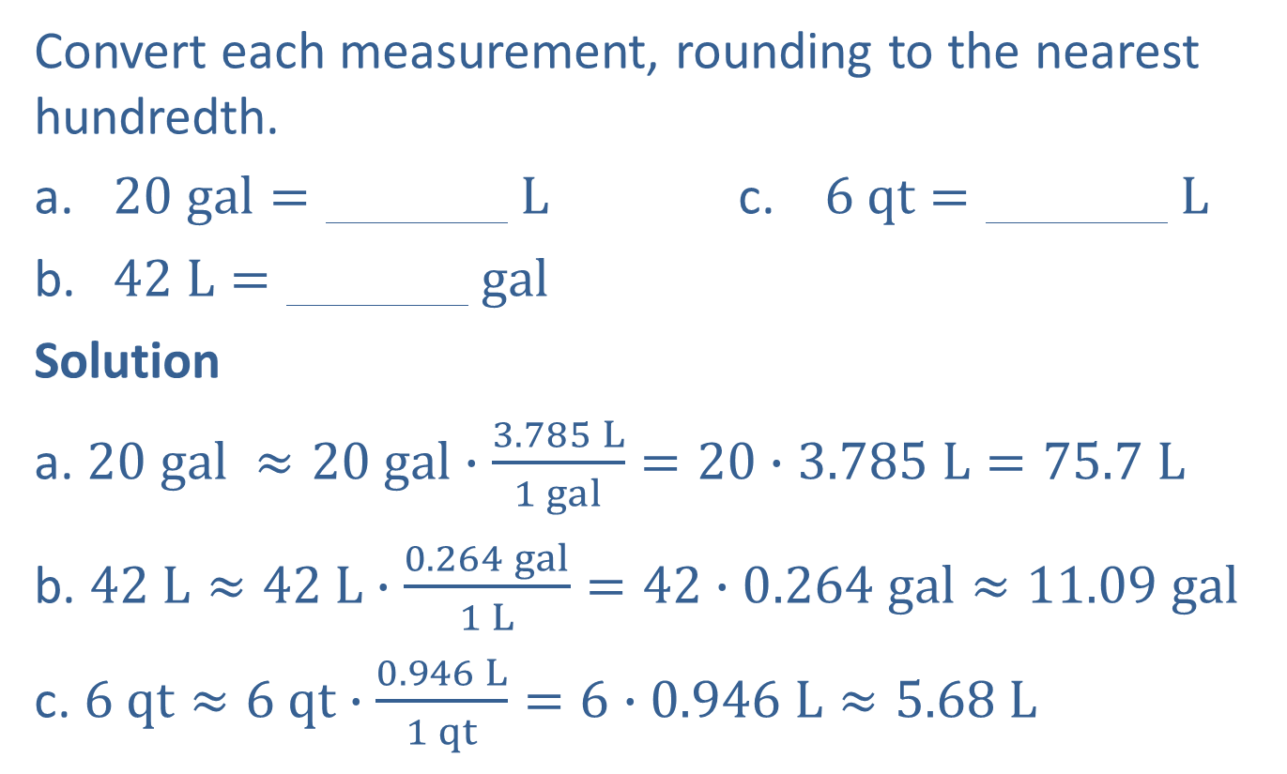
Example 6: Converting Units of Capacity (Liquid Volume)
Convert each measurement, rounding to the nearest hundredth.
​20 gal=000000 L c. 6 qt=000000 L
​42 L=000000 gal
​Solution
a. $20 gal ≈20 gal∙\frac{3.785 L}{1 gal}=20∙3.785 L=75.7 L$
b. $42 L≈42 L∙\frac{0.264 gal}{1 L}=42∙0.264 gal≈11.09 gal$
c. $6 qt≈6 qt∙\frac{0.946 L}{1 qt}=6∙0.946 L≈5.68 L$

Slide 15
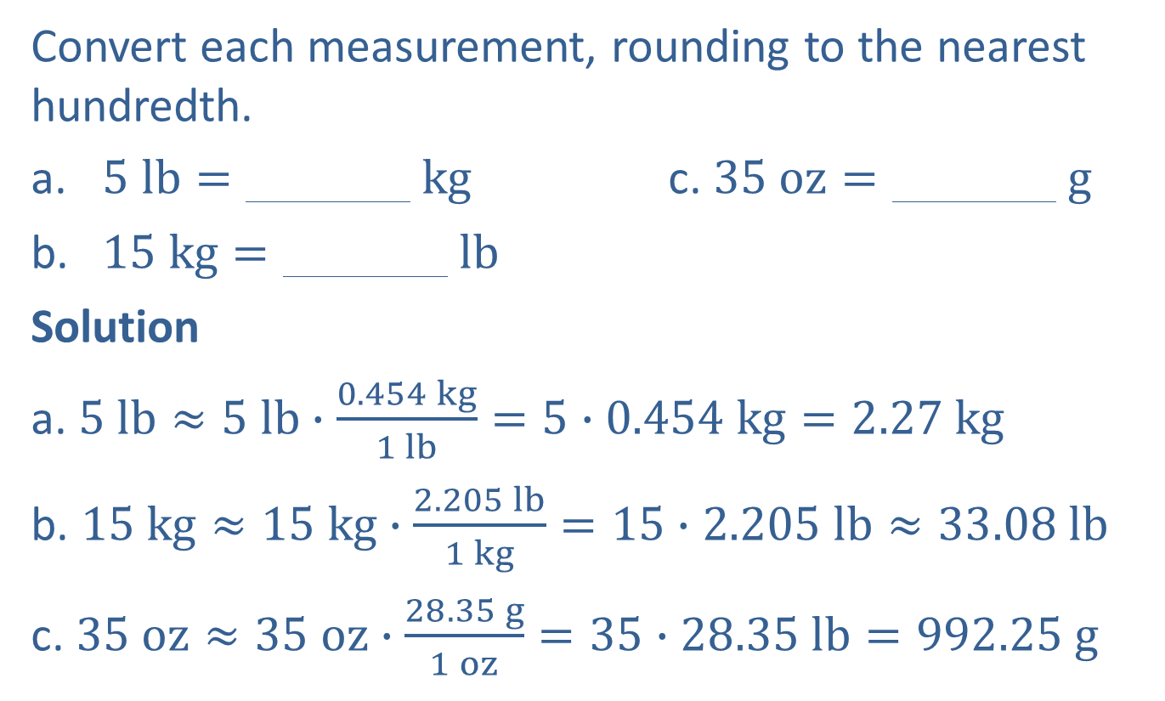
Example 7: Converting Units of Weight (Mass)
Convert each measurement, rounding to the nearest hundredth.
​5 lb=000000 kg c. ​35 oz=000000 g
​15 kg=000000 lb
Solution
a. $5 lb≈5 lb∙\frac{0.454 kg}{1 lb}=5∙0.454 kg=2.27 kg$
b. $15 kg≈15 kg∙\frac{2.205 lb}{1 kg}=15∙2.205 lb≈33.08 lb$
c. $35 oz≈35 oz∙\frac{28.35 g}{1 oz}=35∙28.35 lb=992.25 g$

