Slide 1
Section 6.5
Angles

Slide 2

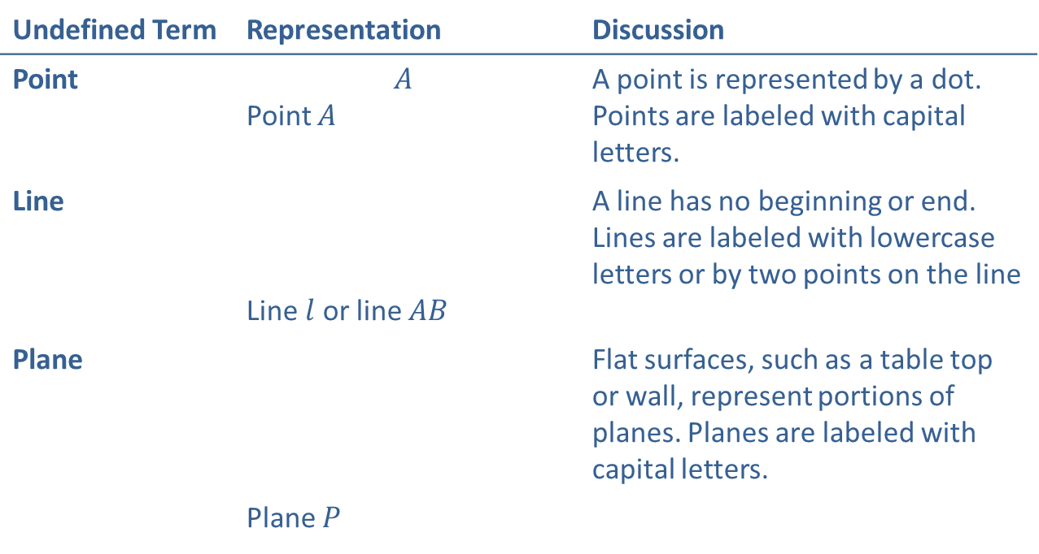


Definition: Point, Line, Plane
Undefined Term | Representation | Discussion
Point | $$A$$ Point $A$ | A point is represented by a dot. Points are labeled with capital letters.
Line | Line $l$ or line $AB$ | A line has no beginning or end. Lines are labeled with lowercase letters or by two points on the line
Plane |  | Flat surfaces, such as a table top or wall, represent portions of planes. Planes are labeled with capital letters.
 | Plane $P$
$$l$$
A
$$B$$
$$P$$

Slide 3

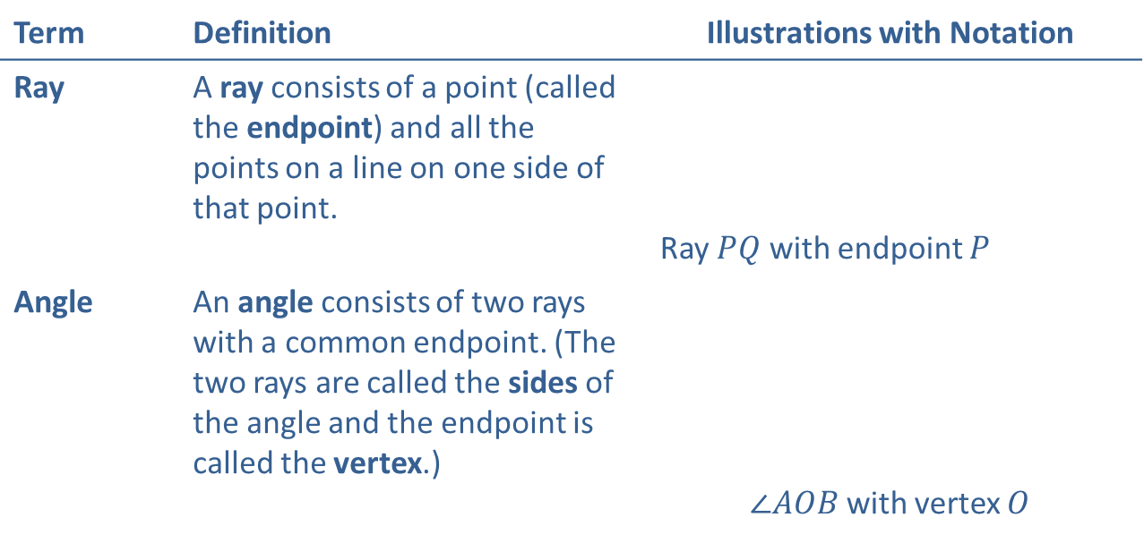



Definition: Ray and Angle
Term | Definition | Illustrations with Notation
Ray | A ray consists of a point (called the endpoint) and all the points on a line on one side of that point. | Ray $PQ$ with endpoint $P$
Angle | An angle consists of two rays with a common endpoint. (The two rays are called the sides of the angle and the endpoint is called the vertex.) | $∠AOB$ with vertex $O$
$$Q$$
P
$$A$$
$$O$$
$$B$$

Slide 4


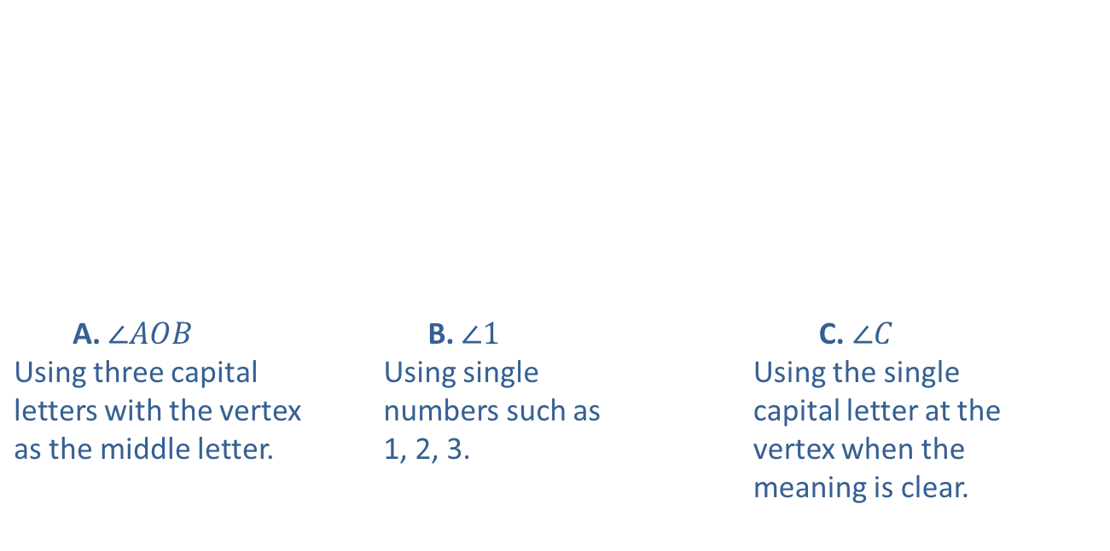



Procedure: Labeling Angles
There are three common ways of labeling angles:
$$A$$
A. $∠AOB$ Using three capital letters with the vertex as the middle letter. | B. $∠1$ Using single numbers such as 1, 2, 3. | C. $∠C$ Using the single capital letter at the vertex when the meaning is clear.
$$1$$
$$B$$
$$O$$
$$C$$

Slide 5

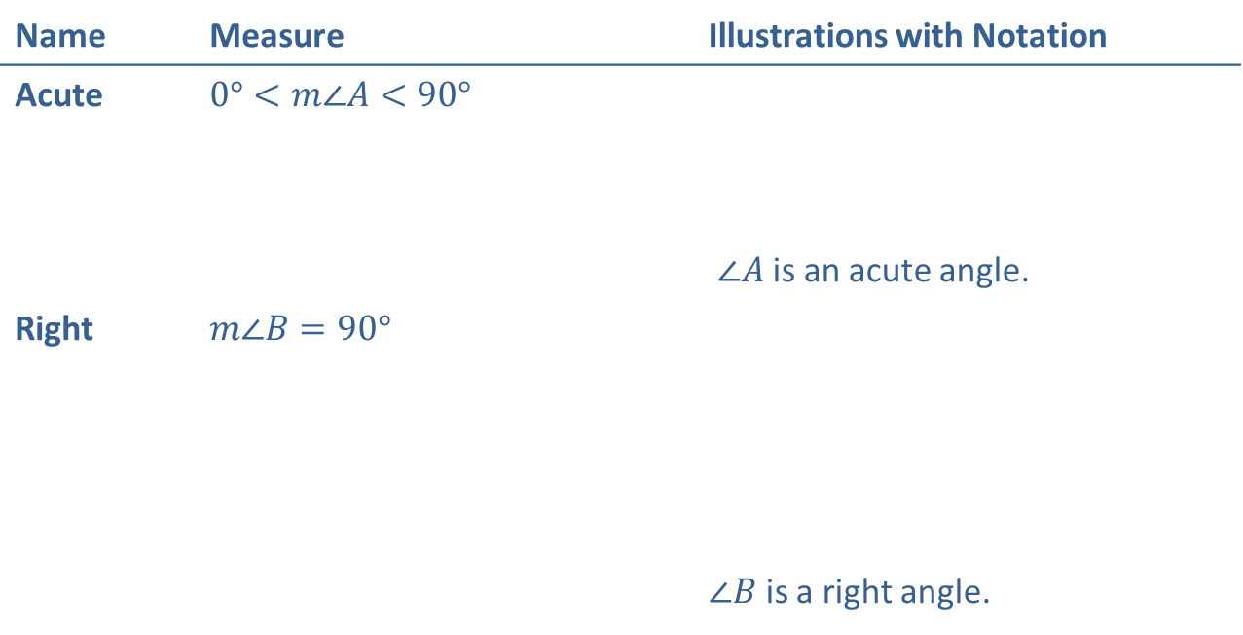

Definition: Angles Classified by Measure
Name | Measure | Illustrations with Notation
Acute | $$0°<m∠A<90°$$ | $∠A$ is an acute angle.
Right | $$m∠B=90°$$ | $∠B$ is a right angle.
$$A$$
$$B$$

Slide 6

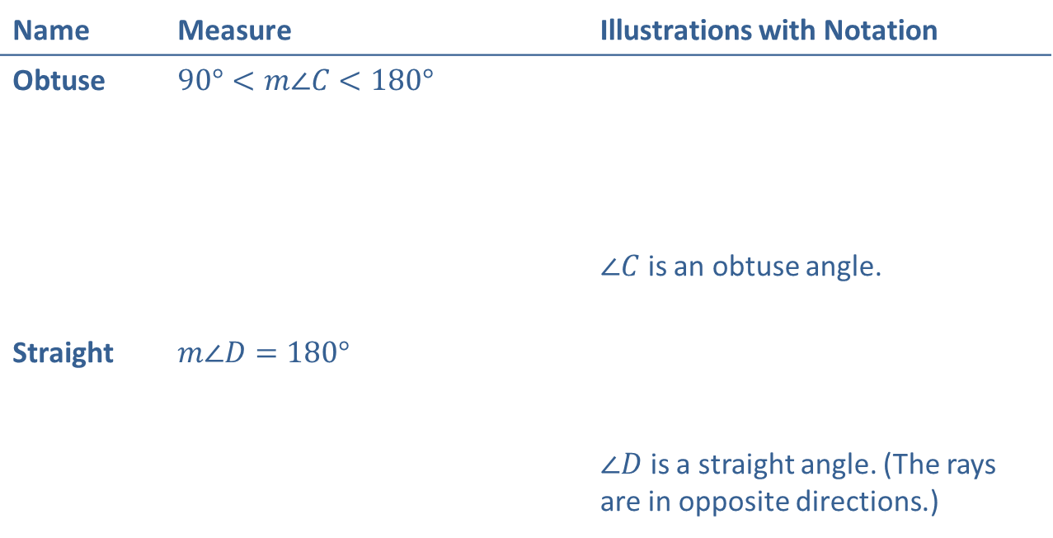

Definition: Angles Classified by Measure (cont.)
Name | Measure | Illustrations with Notation
Obtuse | $$90°<m∠C<180°$$ | $∠C$ is an obtuse angle.
Straight | $$m∠D=180°$$ | $∠D$ is a straight angle. (The rays are in opposite directions.)
$$C$$
$$D$$

Slide 7
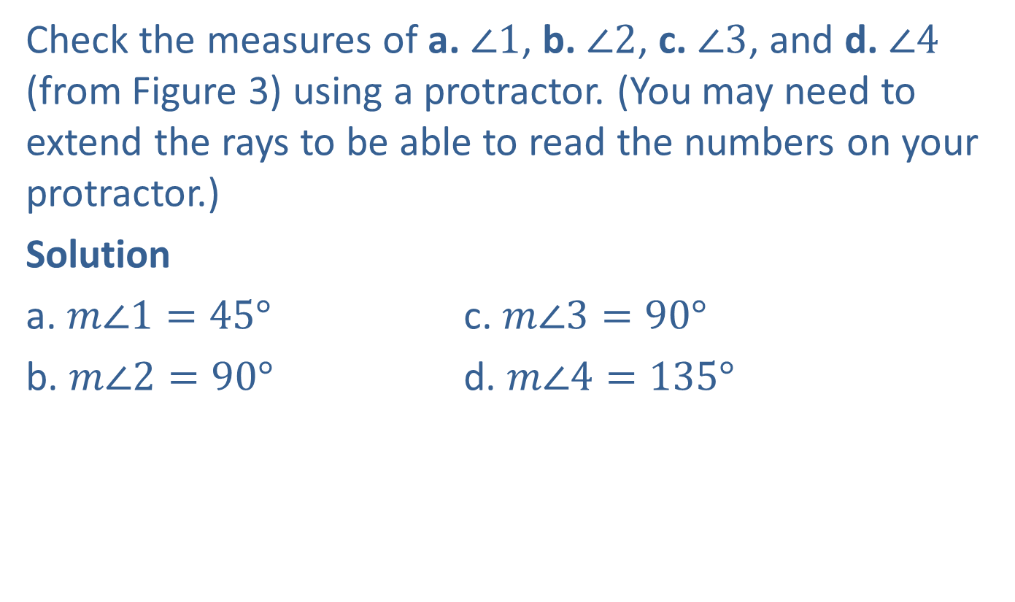
Example 1: Measuring Angles
Check the measures of a. $∠1$, b. $∠2$, c. $∠3$, and d. $∠4$ (from Figure 3) using a protractor. (You may need to extend the rays to be able to read the numbers on your protractor.)
Solution
a. $m∠1=45°$ c. $m∠3=90°$
b. $m∠2=90°$ d. $m∠4=135°$

Slide 8
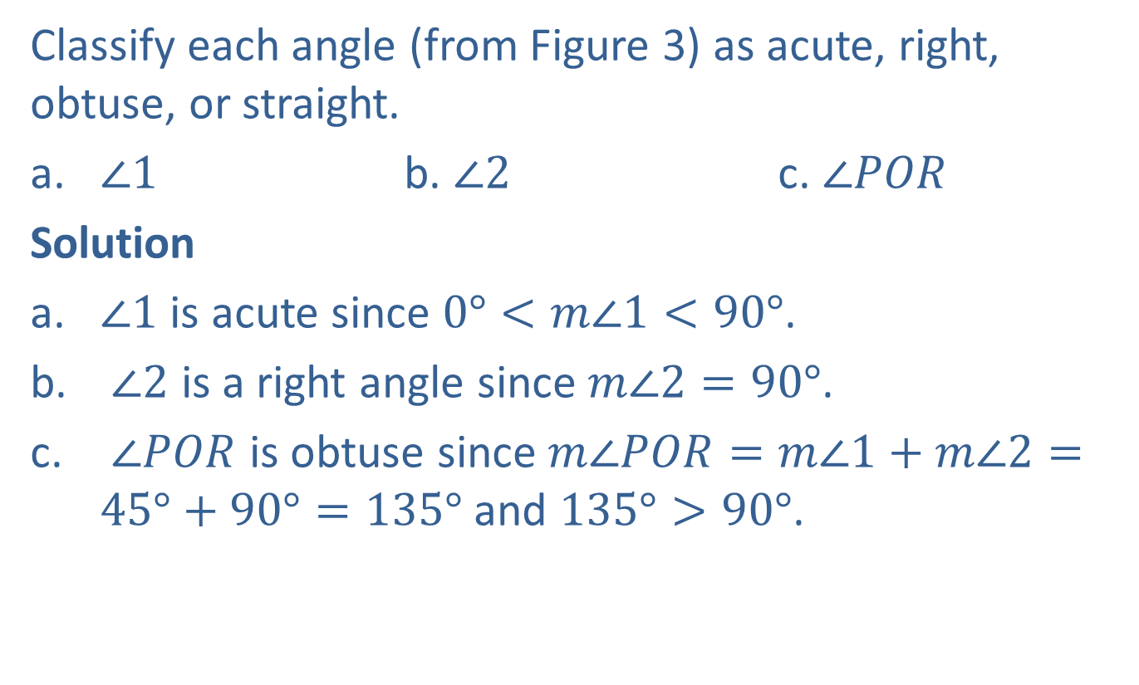
Example 2: Classifying Angles by Their Measure
Classify each angle (from Figure 3) as acute, right, obtuse, or straight.
​$∠1$ b. ​$∠2$ c. ​$∠POR$
Solution
​$∠1$ is acute since $0°<m∠1<90°$.
$∠2$ is a right angle since $m∠2=90°$.
$∠POR$ is obtuse since $m∠POR=m∠1+m∠2=45°+90°=135°$ and $135°>90°$.

Slide 9
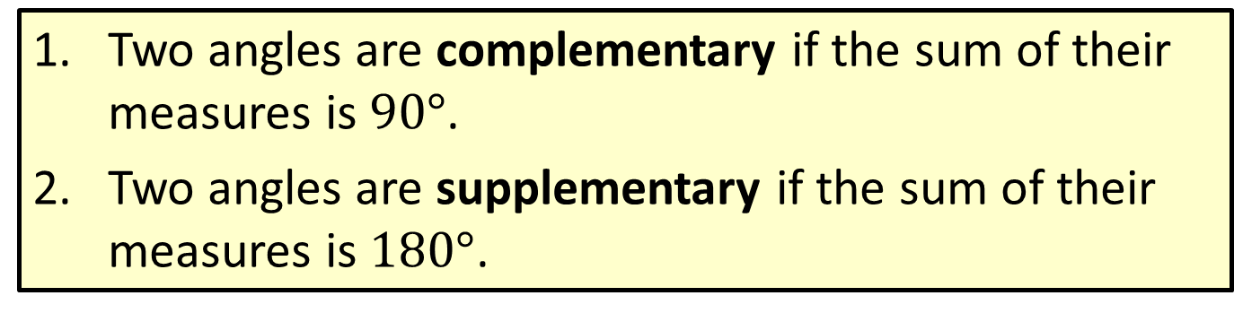
Definition: Complementary and Supplementary Angles
​Two angles are complementary if the sum of their measures is $90°$.
​Two angles are supplementary if the sum of their measures is $180°$.

Slide 10
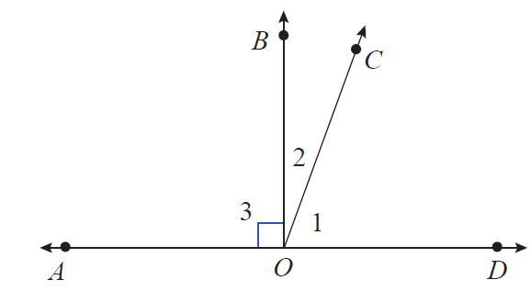


Example 3: Identifying Complementary and Supplementary Angles
In the figure shown, $\overset{↔}{AD}$ is a straight line. Identify all pairs of complementary, supplementary, and straight angles.
$$m∠1=70°$$
$$m∠2=20°$$
$$m∠3=90°$$

Slide 11
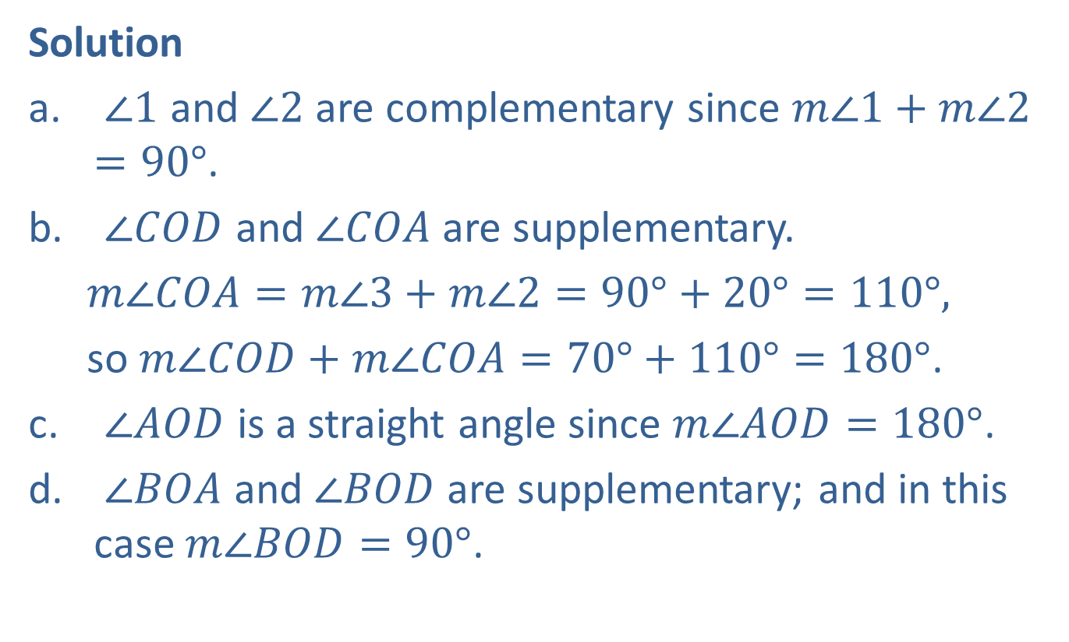
Example 3: Identifying Complementary and Supplementary Angles (cont.)
Solution
$∠1$ and $∠2$ are complementary since $m∠1+m∠2=90°$.
$∠COD$ and $∠COA$ are supplementary.
  $m∠COA=m∠3+m∠2=90°+20°=110°,$
  so $m∠COD+m∠COA=70°+110°=180°$.
$∠AOD$ is a straight angle since $m∠AOD=180°$.
$∠BOA$ and $∠BOD$ are supplementary; and in this case $m∠BOD=90°$.

Slide 12
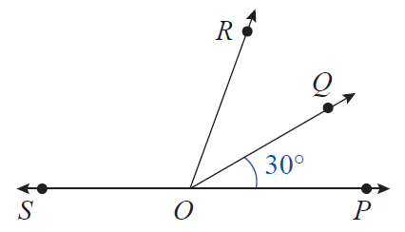
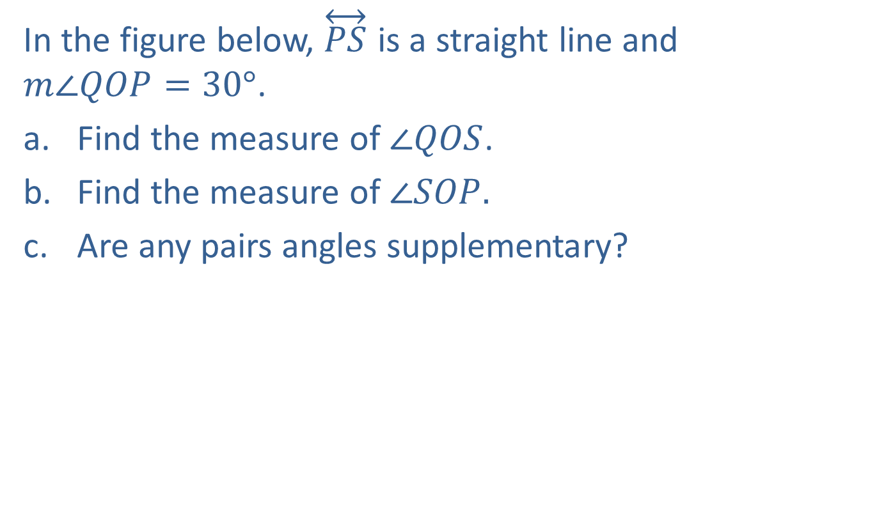
Example 4: Calculating Measures of Angles
In the figure below, $\overset{↔}{PS}$ is a straight line and
$m∠QOP=30°$.
Find the measure of ​$∠QOS$.
​Find the measure of $∠SOP.$
​Are any pairs angles supplementary?

Slide 13

Example 4: Calculating Measures of Angles (cont.)
Solution
$m∠QOS=180°−30°=150°$
$m∠SOP=180°$
Yes, $∠QOP$ and $∠QOS$ are supplementary and $∠ROP$ and $∠ROS$ are supplementary.

Slide 14
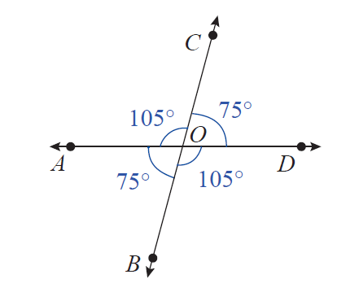

Example 5: Identifying Congruent Angles
Identify the congruent angles in the figure.
Solution
$∠AOB≅∠COD$ and $∠COA≅∠DOB$

Slide 15
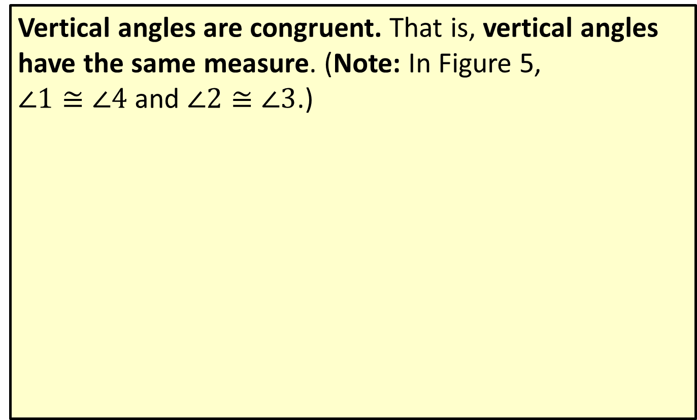
Definition: Vertical Angles
Vertical angles are congruent. That is, vertical angles have the same measure. (Note: In Figure 5,
$∠1≅∠4$ and $∠2≅∠3$.)

Slide 16
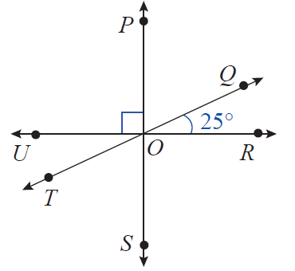
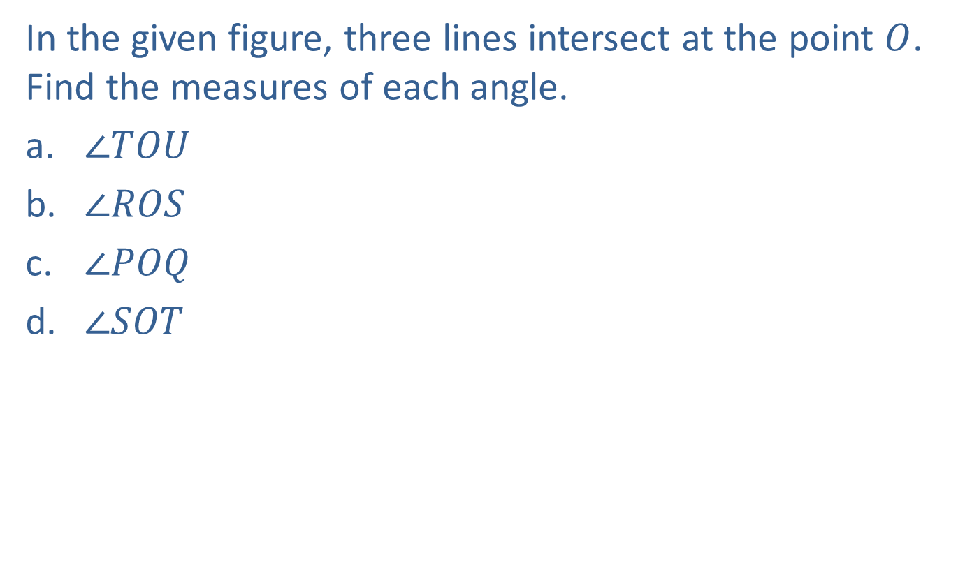
Example 6: Calculating Measures of Angles
In the given figure, three lines intersect at the point $O$. Find the measures of each angle.
​$∠TOU$
​$∠ROS$
​$∠POQ$
​$∠SOT$

Slide 17
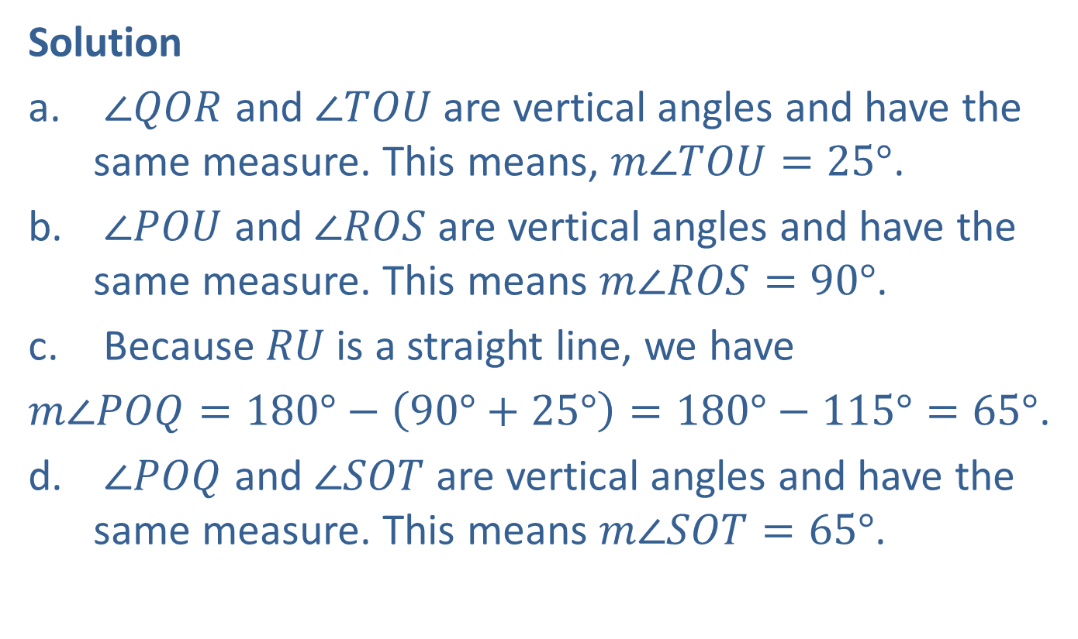
Example 6: Calculating Measures of Angles (cont.)
Solution
$∠QOR$ and $∠TOU$ are vertical angles and have the same measure. This means, $m∠TOU=25°$.
$∠POU$ and $∠ROS$ are vertical angles and have the same measure. This means $m∠ROS=90°$.
Because $RU$ is a straight line, we have
$m∠POQ=180°−\left(90°+25°\right)=180°−115°=65°$.
$∠POQ$ and $∠SOT$ are vertical angles and have the same measure. This means $m∠SOT=65°$.

Slide 18
Definition: Adjacent Angles
Two angles are adjacent if they have a common side.

Slide 19
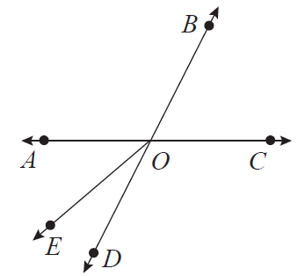
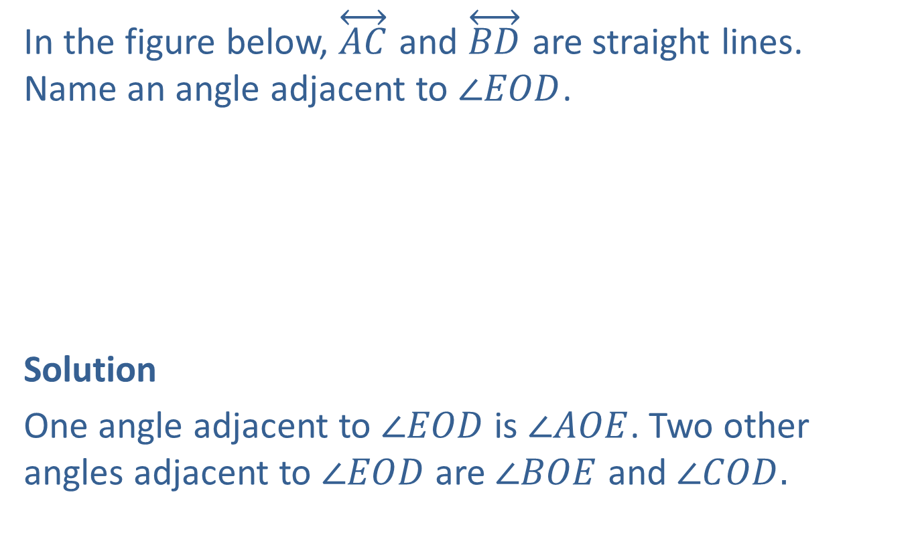
Example 7: Finding Adjacent Angles
In the figure below, $\overset{↔}{AC}$ and $\overset{↔}{BD}$ are straight lines. Name an angle adjacent to $∠EOD$.
Solution
One angle adjacent to $∠EOD$ is $∠AOE$. Two other angles adjacent to $∠EOD$ are $∠BOE$ and $∠COD.$

Slide 20



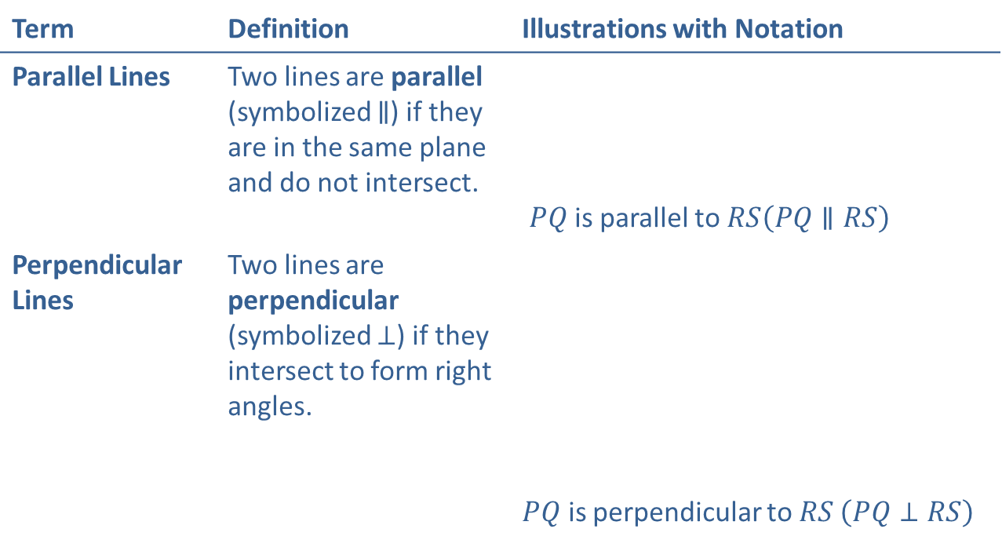



Definition: Parallel Lines and Perpendicular Lines
Term | Definition | Illustrations with Notation
Parallel Lines | Two lines are parallel (symbolized $∥$) if they are in the same plane and do not intersect. | $PQ$ is parallel to $RS\left(PQ∥RS\right)$
Perpendicular Lines | Two lines are perpendicular (symbolized $⊥$) if they intersect to form right angles. | $PQ$ is perpendicular to $RS \left(PQ⊥RS\right)$
$$Q$$
P
$$S$$
R
$$R$$
$$P$$
$$Q$$
$$S$$

Slide 21
Procedure: Parallel Lines and a Transversal
If two parallel lines are cut by a transversal, then the following two statements are true.
​Corresponding angles are congruent.
​Alternate interior angles are congruent.

Slide 22
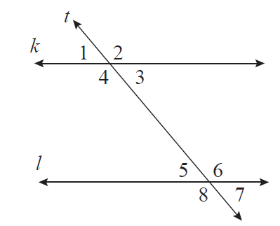


Example 8: Calculating Measures of Angles
In the figure below, lines $k$ and $l$ are parallel, $t$ is a transversal, and $m∠1=50°$. Find the measures of the other 7 angles.
$$m∠1=50°$$

Slide 23
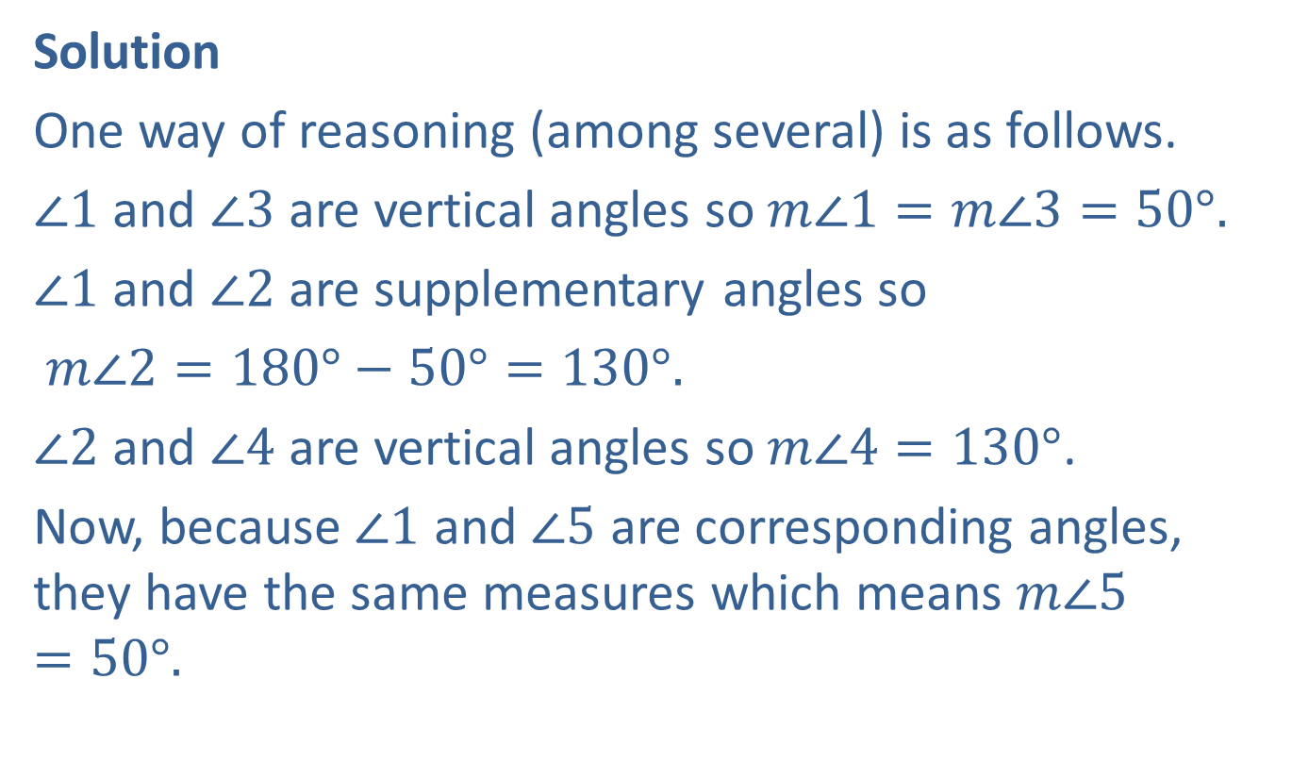
Example 8: Calculating Measures of Angles (cont.)
Solution
One way of reasoning (among several) is as follows.
$∠1$ and $∠3$ are vertical angles so $m∠1=m∠3=50°.$
$∠1$ and $∠2$ are supplementary angles so
$m∠2=180°−50°=130°.$
$∠2$ and $∠4$ are vertical angles so $m∠4=130°$.
Now, because $∠1$ and $∠5$ are corresponding angles, they have the same measures which means $m∠5=50°.$

Slide 24

Example 8: Calculating Measures of Angles (cont.)
Because $∠4$ and $∠6$are alternate interior angles, they have the same measures which means $m∠6=130°.$
Again, using vertical angles, $m∠5=m∠7=50°$and $m∠6=m∠8=130°.$

