Slide 1
Section 6.6
Triangles

Slide 2
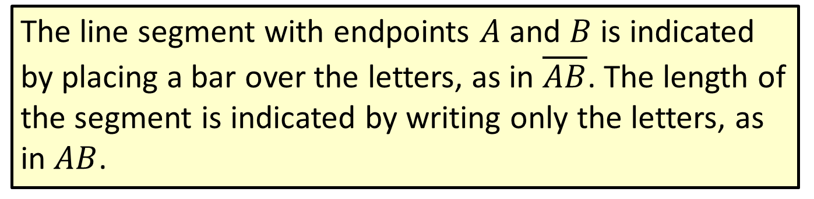
Note
The line segment with endpoints $A$ and $B$ is indicated by placing a bar over the letters, as in $\overline{AB}$. The length of the segment is indicated by writing only the letters, as in $AB$.

Slide 3



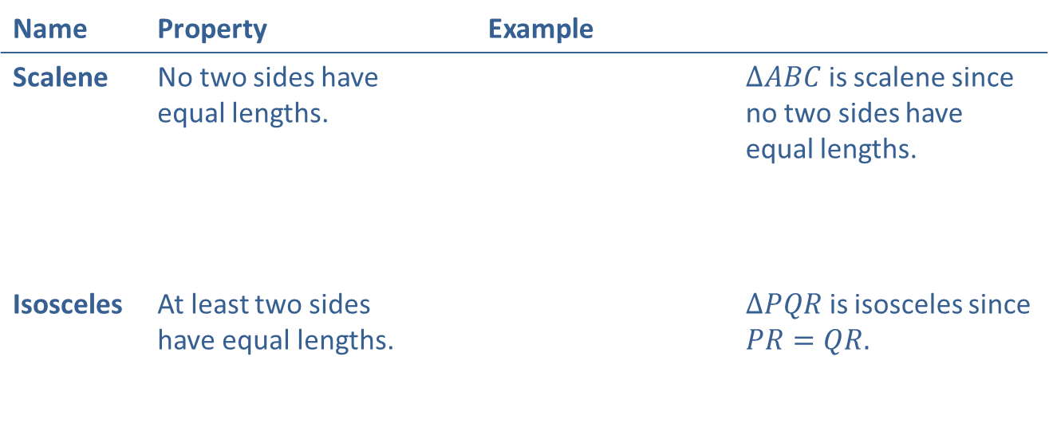



Definition: Triangles Classified by Sides
(Note: In the figures, sides with equal length are indicated by the same number of tic marks.)
Name | Property | Example
Scalene | No two sides have equal lengths. |  | $∆ABC$ is scalene since no two sides have equal lengths.
Isosceles | At least two sides have equal lengths. |  | $∆PQR$ is isosceles since $PR=QR.$
$$A$$
$$C$$
$$B$$
$$R$$
$$P$$
$$Q$$

Slide 4

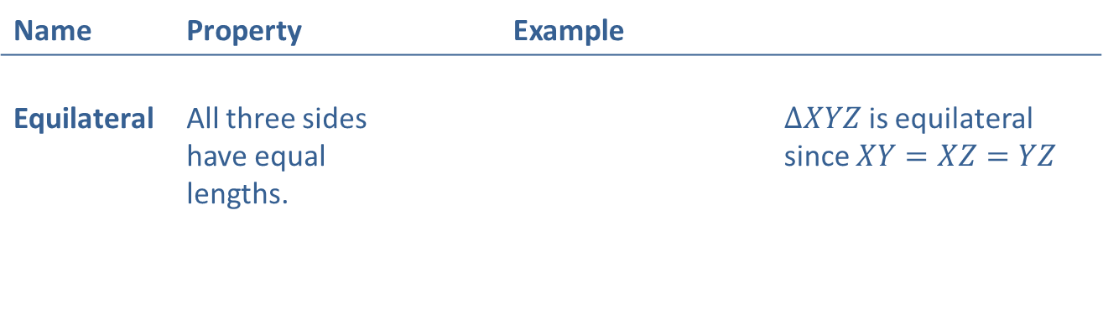


Definition: Triangles Classified by Sides (cont.)
Name | Property | Example
Equilateral | All three sides have equal lengths. |  | $∆XYZ$ is equilateral since $XY=XZ=YZ$
$$Z$$
$$X$$
$$Y$$

Slide 5



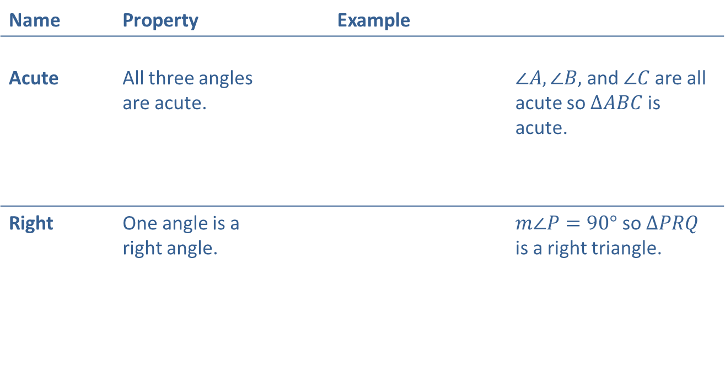



Definition: Triangles Classified by Angles
Name | Property | Example
Acute | All three angles are acute. |  | $∠A, ∠B,$and$∠C$ are all acute so $∆ABC$ is acute.
Right | One angle is a right angle. |  | $m∠P=90°$ so $∆PRQ$ is a right triangle.
$$C$$
$$A$$
$$B$$
$$R$$
$$P$$
$$Q$$

Slide 6

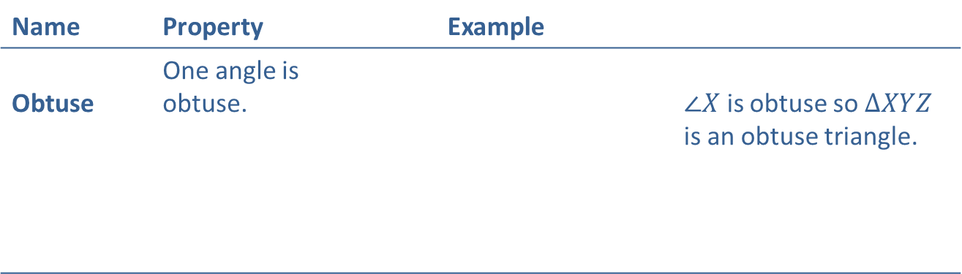


Definition: Triangles Classified by Angles (cont.)
Name | Property | Example
Obtuse | One angle is obtuse. |  | $∠X$ is obtuse so $∆XYZ$ is an obtuse triangle.
$$Z$$
$$X$$
$$Y$$

Slide 7
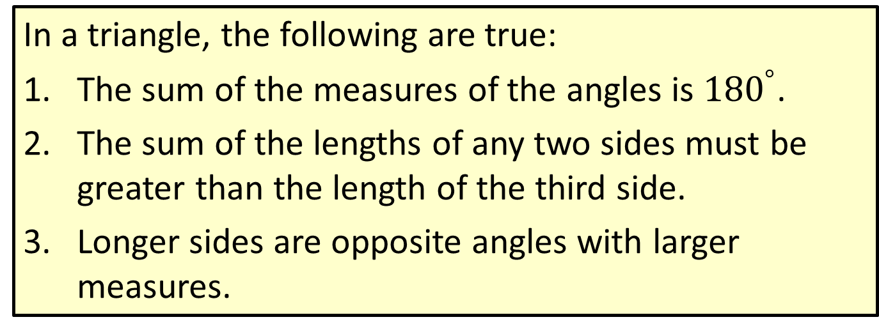
Properties: Three Properties of Triangles
In a triangle, the following are true:
​The sum of the measures of the angles is ${180}^{°}$.
​The sum of the lengths of any two sides must be greater than the length of the third side.
​Longer sides are opposite angles with larger measures.

Slide 8
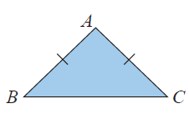
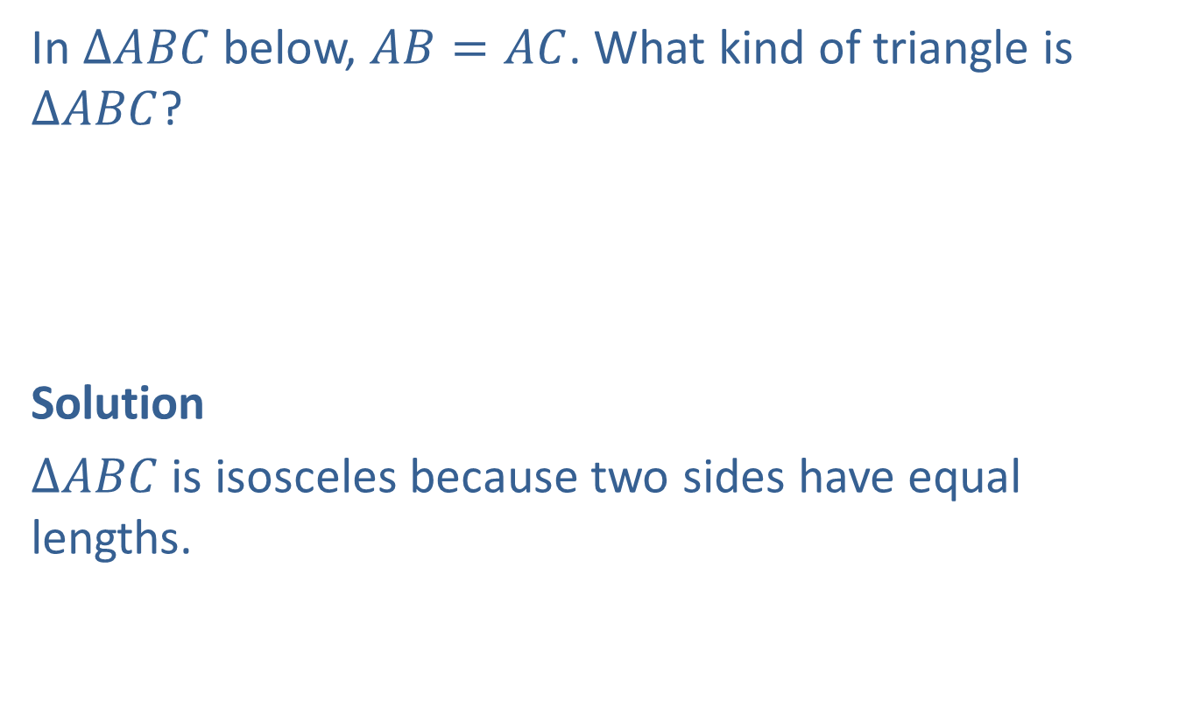
Example 1: Classifying a Triangle by Its Sides
In $∆ABC$ below, $AB=AC$. What kind of triangle is
$∆ABC$?
Solution
$∆ABC$ is isosceles because two sides have equal lengths.

Slide 9
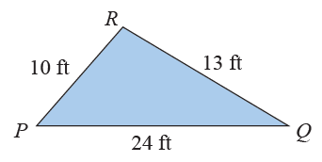
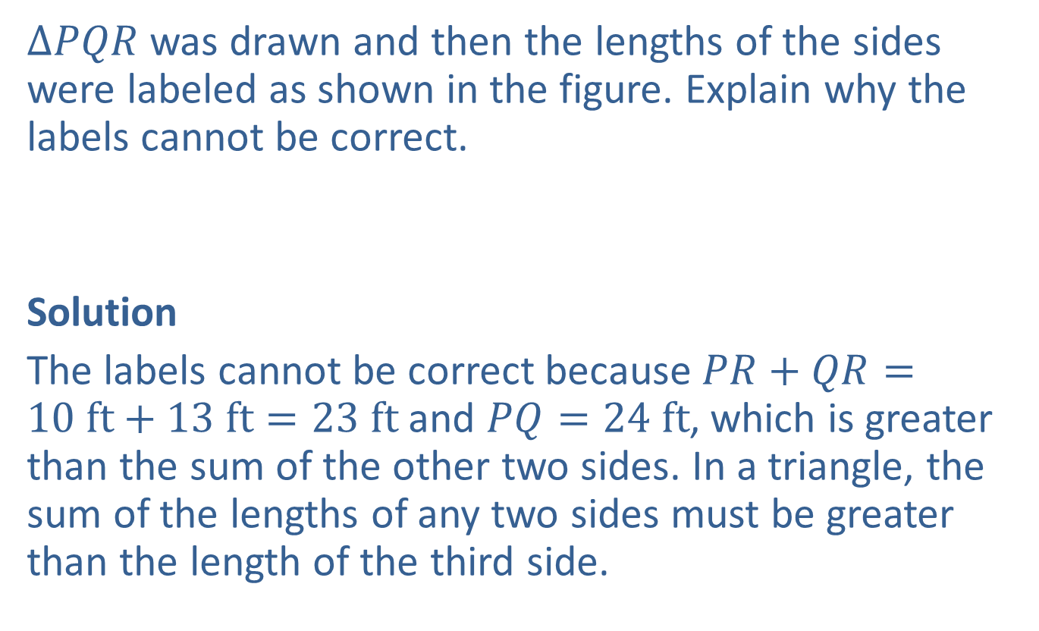
Example 2: Determining Whether a Triangle Exists
$∆PQR$ was drawn and then the lengths of the sides were labeled as shown in the figure. Explain why the labels cannot be correct.
Solution
The labels cannot be correct because $PR+QR=10 ft+13 ft=23 ft$and $PQ=24 ft$, which is greater than the sum of the other two sides. In a triangle, the sum of the lengths of any two sides must be greater than the length of the third side.

Slide 10
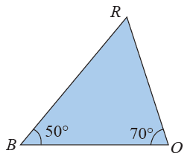
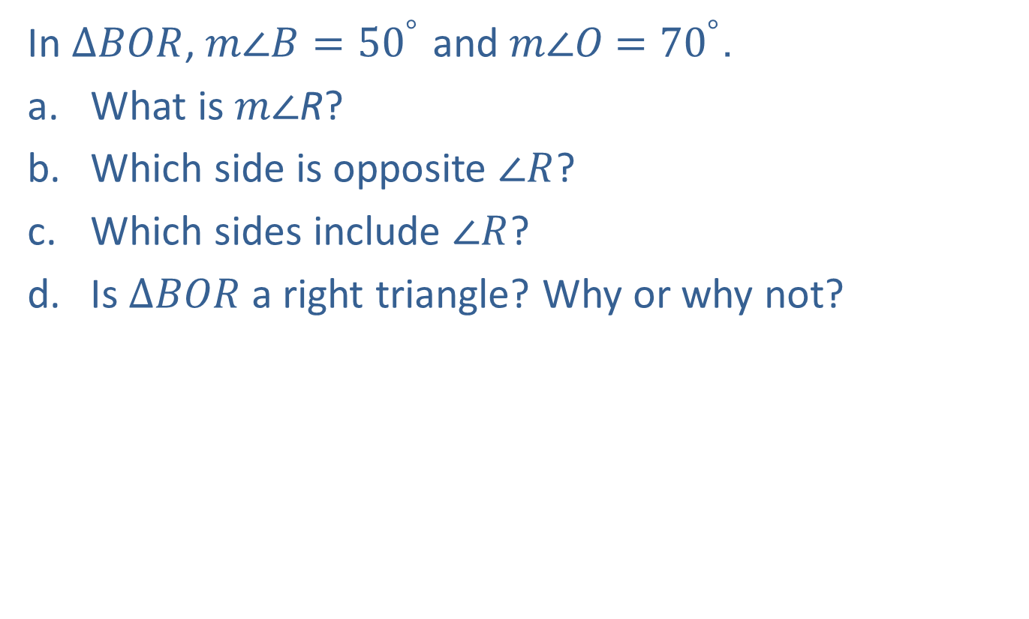
Example 3: Analyzing Triangles
In $∆BOR$, $m∠B={50}^{°}$ and $m∠O$ $={70}^{°}$.
​What is $m∠$R?
​Which side is opposite $∠R$?
​Which sides include $∠R$?
​Is $∆BOR$ a right triangle? Why or why not?

Slide 11
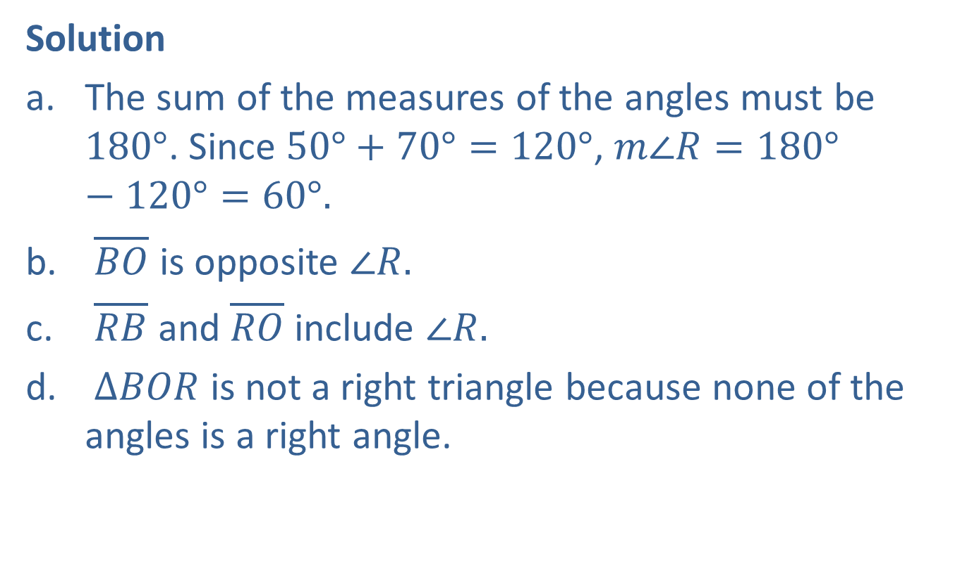
Example 3: Analyzing Triangles (cont.)
Solution
The sum of the measures of the angles must be $180°$. Since $50°+70°=120°$, $m∠R=180°−120°=60°.$
$\overline{BO}$ is opposite $∠R.$
$\overline{RB}$ and $\overline{RO}$ include $∠R.$
$∆BOR$ is not a right triangle because none of the angles is a right angle.

Slide 12
Definition: Similar Triangles
​In similar triangles, the corresponding angles have the same measure. (We say that the corresponding angles are congruent.)
​In similar triangles, the lengths of the corresponding sides are proportional.

Slide 13
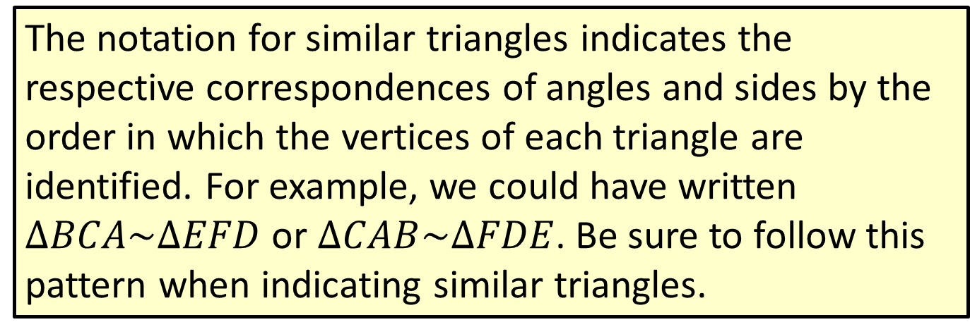
Note
The notation for similar triangles indicates the respective correspondences of angles and sides by the order in which the vertices of each triangle are identified. For example, we could have written $∆BCA\sim ∆EFD$ or $∆CAB\sim ∆FDE$. Be sure to follow this pattern when indicating similar triangles.

Slide 14
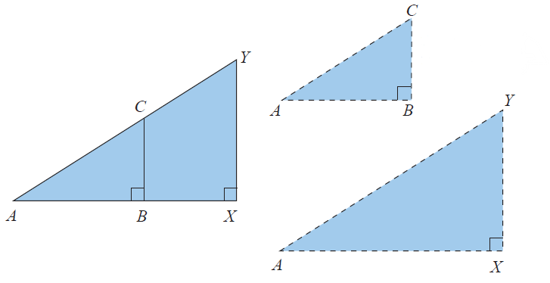

Example 4: Determining Whether Triangles are Similar
Given the two triangles $∆ABC$ and $∆AXY$ with
$m∠\text{ABC}\text{ = }m∠\text{AXY}\text{ =} {90}^{°}$ (as shown in the figure)
determine whether or not $∆ABC∼∆AXY$.
Separate the two triangles mentally.

Slide 15
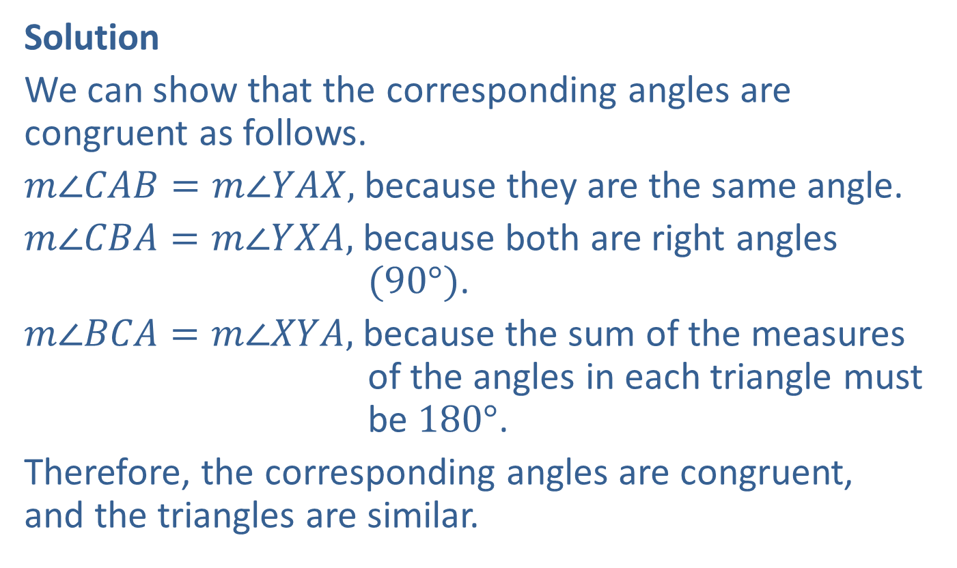
Example 4: Determining Whether Triangles are Similar (cont.)
Solution
We can show that the corresponding angles are congruent as follows.
$m∠CAB=m∠YAX,$ because they are the same angle.
$m∠CBA=m∠YXA,$ because both are right angles $(90°)$.
$m∠BCA=m∠XYA,$ because the sum of the measures of the angles in each triangle must be $180°$.
Therefore, the corresponding angles are congruent, and the triangles are similar.

Slide 16
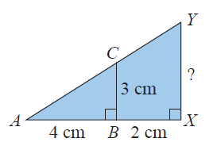
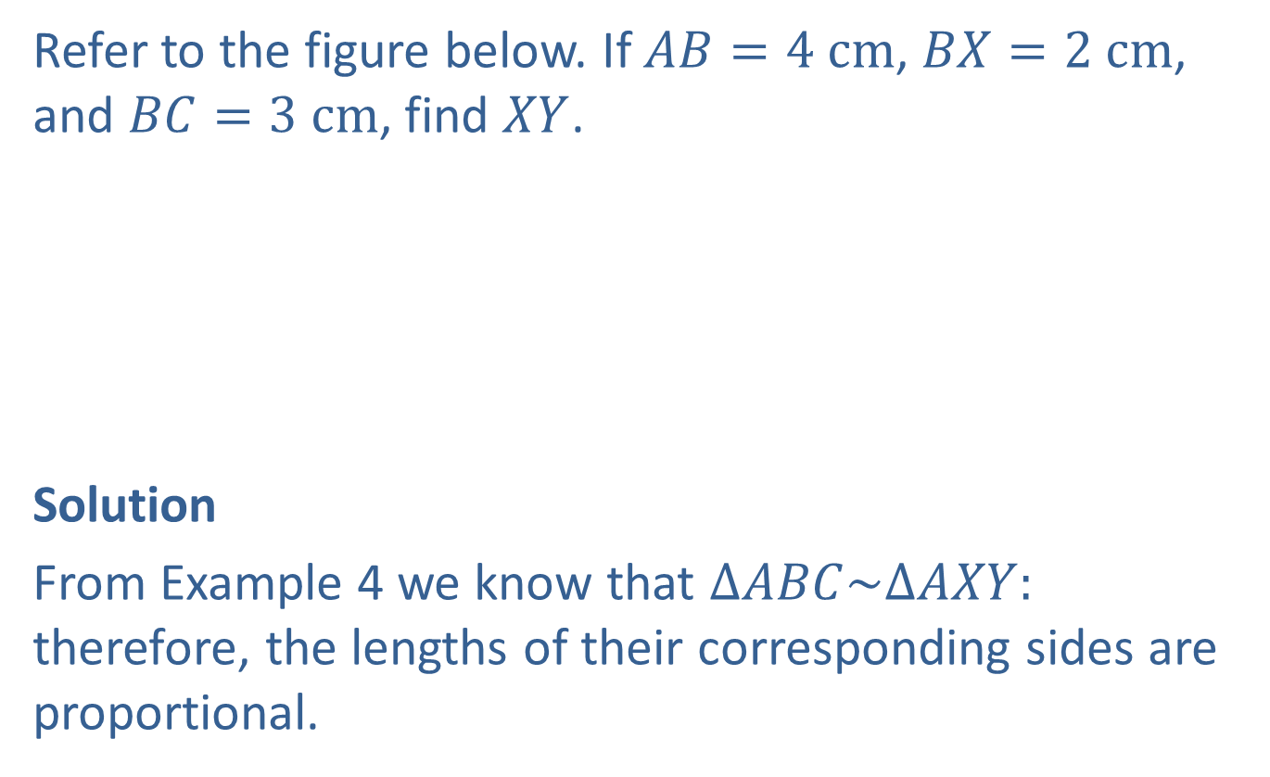
Example 5: Finding Unknown Values Using Similar Triangles
Refer to the figure below. If $AB=4 cm$, $BX=2 cm$, and $BC=3 cm$, find $XY$.
Solution
From Example 4 we know that $∆ABC\sim ∆AXY:$ therefore, the lengths of their corresponding sides are proportional.

Slide 17
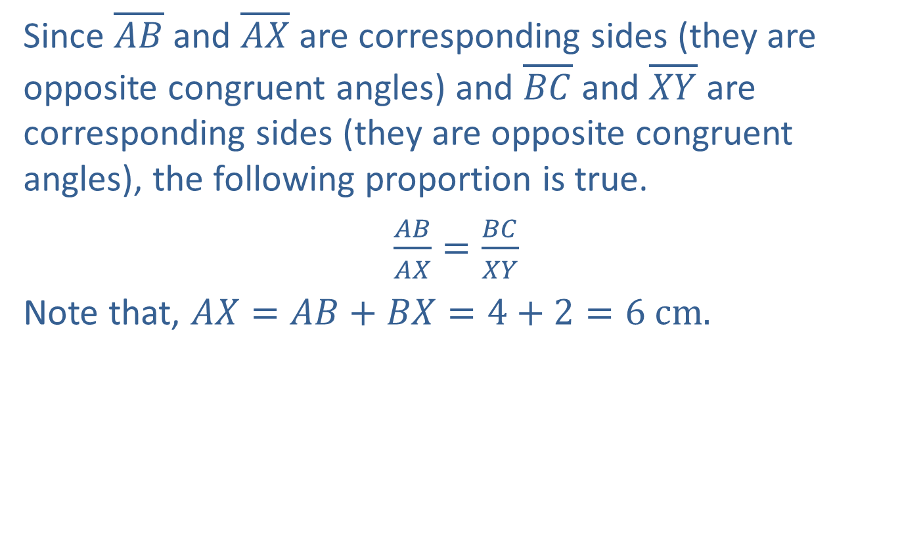
Example 5: Finding Unknown Values Using Similar Triangles (cont.)
Since $\overline{AB}$ and $\overline{AX}$ are corresponding sides (they are opposite congruent angles) and $\overline{BC}$ and $\overline{XY}$ are corresponding sides (they are opposite congruent angles), the following proportion is true.
$\frac{AB}{AX}=\frac{BC}{XY}$
Note that, $AX=AB+BX=4+2=6 cm.$

Slide 18

Example 5: Finding Unknown Values Using Similar Triangles (cont.)
Thus,
$$\frac{4 cm}{6 cm}=\frac{3 cm}{XY}$$
$$4∙XY=3∙6$$
$$\frac{4∙XY}{4}=\frac{18}{4}$$
$$XY=4.5 cm.$$

Slide 19
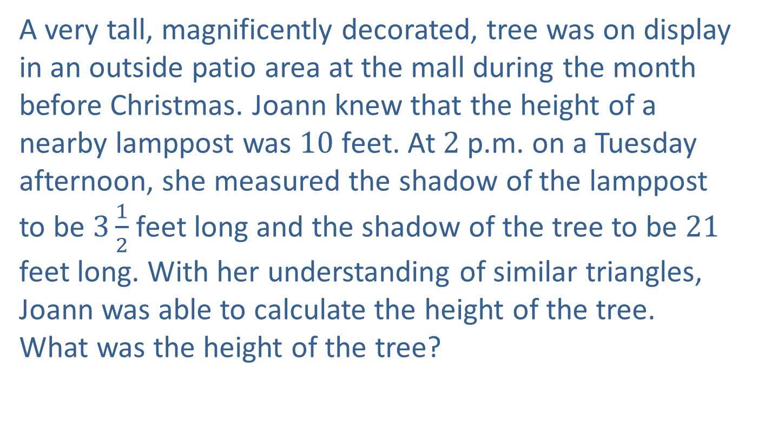
Example 6: Application: Finding Unknown Values Using Similar Triangles
A very tall, magnificently decorated, tree was on display in an outside patio area at the mall during the month before Christmas. Joann knew that the height of a nearby lamppost was $10$ feet. At $2$ p.m. on a Tuesday afternoon, she measured the shadow of the lamppost to be $3\frac{1}{2}$ feet long and the shadow of the tree to be $21$ feet long. With her understanding of similar triangles, Joann was able to calculate the height of the tree. What was the height of the tree?

Slide 20
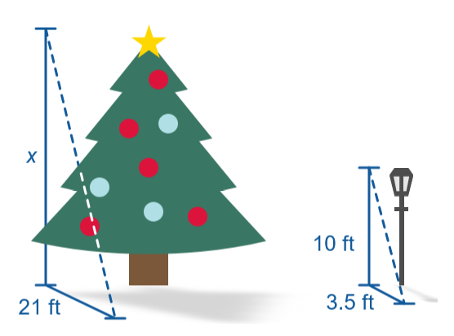

Example 6: Application: Finding Unknown Values Using Similar Triangles (cont.)
Solution
By letting $x$ represent the height of the tree, Joann set up and solved the following proportion.

Slide 21

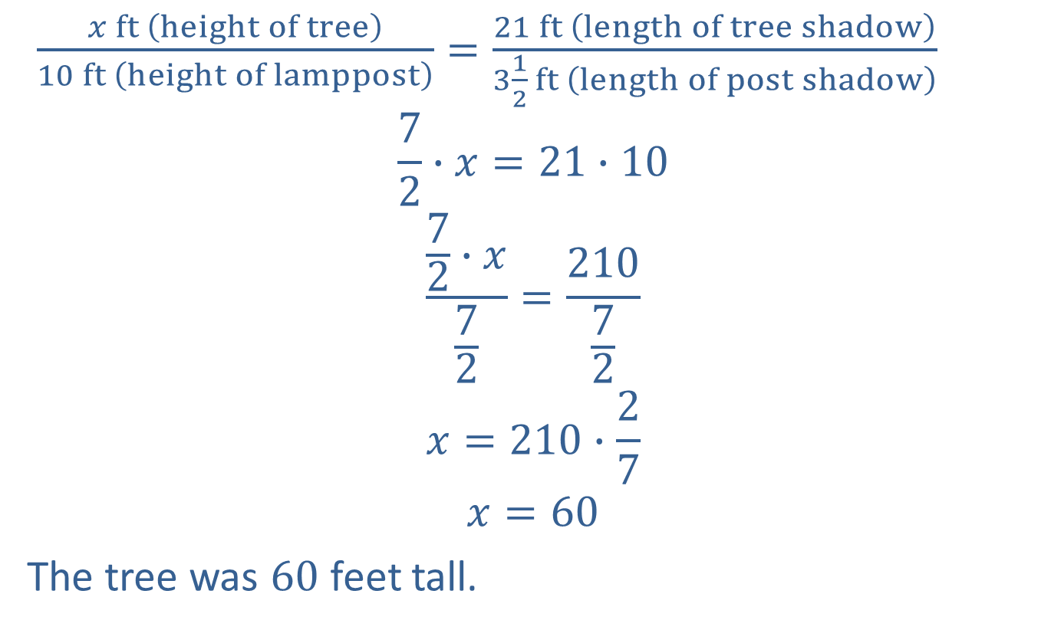
Example 6: Application: Finding Unknown Values Using Similar Triangles (cont.)
$\frac{x ft \left(height of tree\right)}{10 ft \left(height of lamppost\right)}=\frac{21 ft \left(length of tree shadow\right)}{3\frac{1}{2} ft \left(length of post shadow\right)}$
$$\frac{7}{2}∙x=21∙10$$
$$\frac{\frac{7}{2}∙x}{\frac{7}{2}}=\frac{210}{\frac{7}{2}}$$
$$x=210∙\frac{2}{7}$$
$$x=60$$
The tree was $60$ feet tall.
$$30$$

Slide 22
Properties: Properties of Congruent Triangles
Two triangles are congruent if:
​The corresponding angles have the same measure.
​The lengths of corresponding sides are equal.

Slide 23
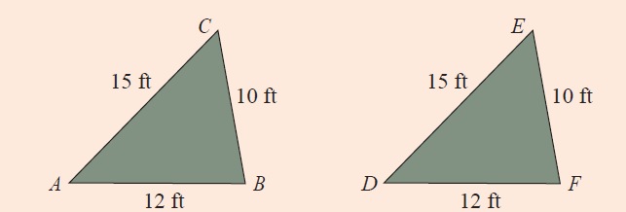
Definition: Determining Congruent Triangles
Side-Side-Side (SSS)
If two triangles are such that the lengths of the three sides of one triangle are equal to the lengths of corresponding sides of the other triangle, then the two triangles are congruent.
Triangle ABC is congruent to triangle DFE by SSS.
Figure 5

Slide 24
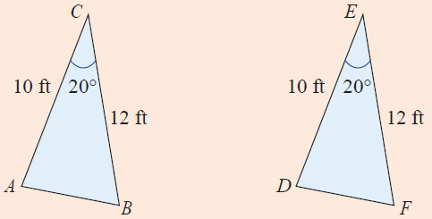
Definition: Determining Congruent Triangles (cont.)
Side-Angle-Side (SAS)
If two triangles are such that the lengths of two sides of one triangle equal the lengths of corresponding sides of the other triangle and the angles included between the sides are congruent, then the two triangles are congruent.
Triangle ABC is congruent to triangle DFE by SAS.
Figure 6

Slide 25
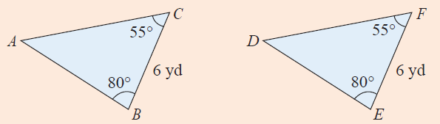
Definition: Determining Congruent Triangles (cont.)
Angle-Side-Angle (ASA)
If two triangles are such that two angles in one triangle are congruent to two angles in the other triangle and the lengths of the sides included between the angles are equal, then the two triangles are congruent.
Triangle ABC is congruent to triangle DEF by ASA.
Figure 7

Slide 26
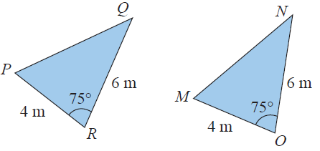
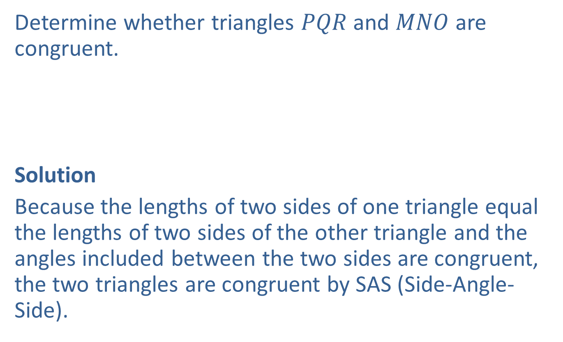
Example 7: Determining Whether Triangles are Congruent
Determine whether triangles $PQR$ and $MNO$ are congruent.
Solution
Because the lengths of two sides of one triangle equal the lengths of two sides of the other triangle and the angles included between the two sides are congruent, the two triangles are congruent by SAS (Side-Angle-Side).

Slide 27

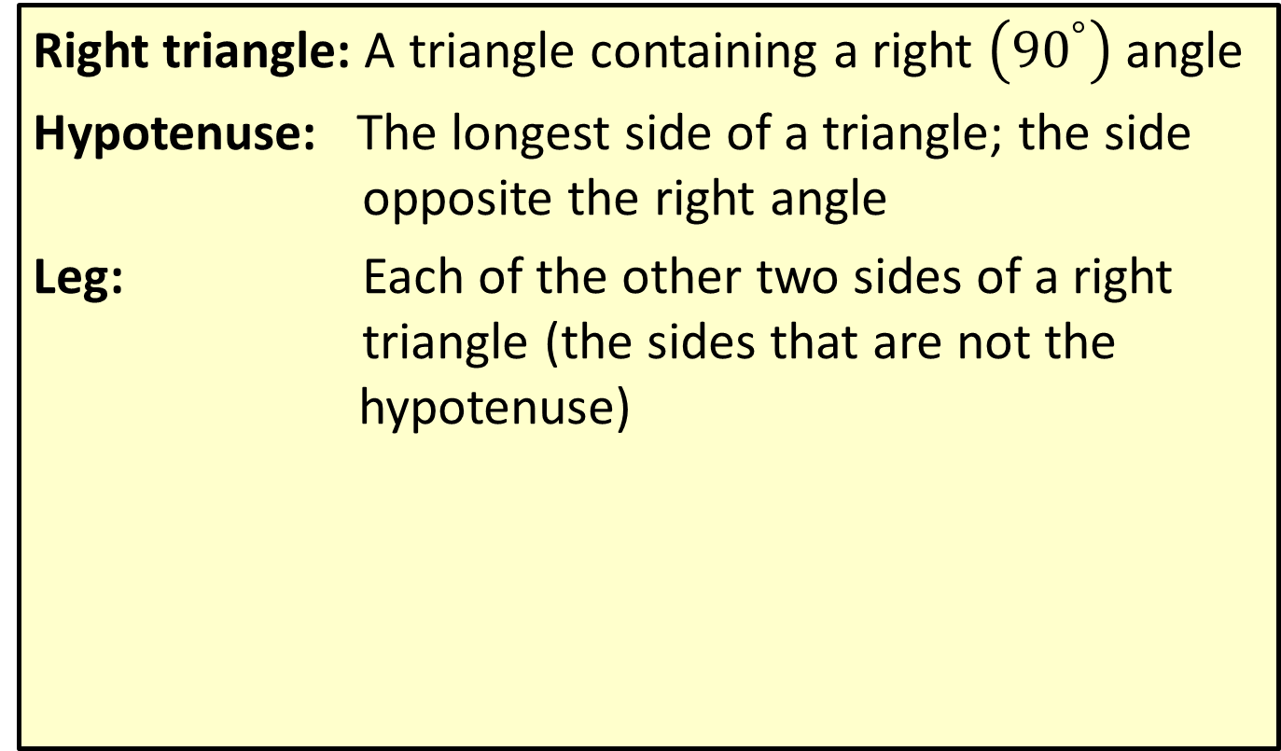
Definition: Terms Related to Right Triangles
Right triangle: A triangle containing a right $\left({90}^{°}\right)$ angle
Hypotenuse: The longest side of a triangle; the side opposite the right angle
Leg: Each of the other two sides of a right triangle (the sides that are not the hypotenuse)
Leg
Hypotenuse
$$90°$$
Leg

Slide 28

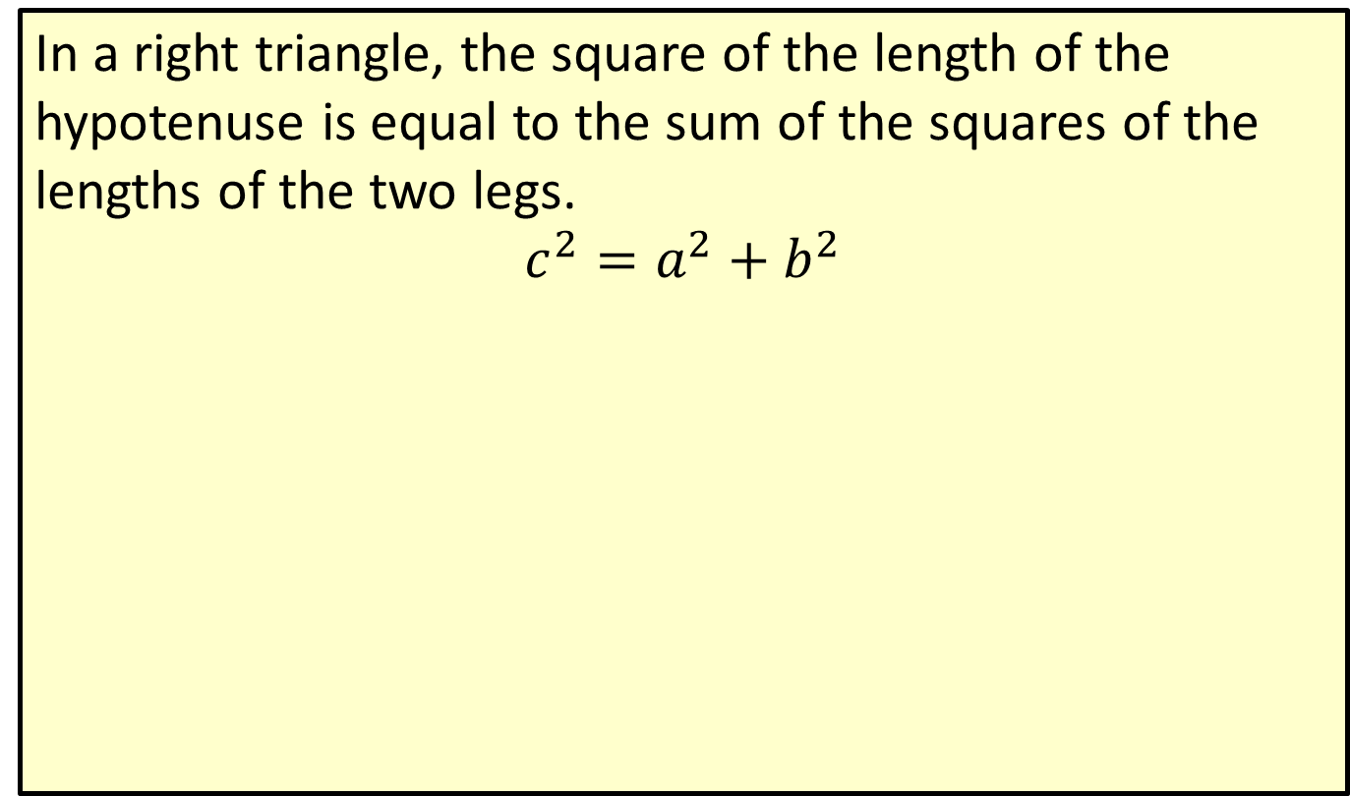



Theorem: The Pythagorean Theorem
In a right triangle, the square of the length of the hypotenuse is equal to the sum of the squares of the lengths of the two legs.
$$c^{2}=a^{2}+b^{2}$$
$$c$$
$$b$$
$$90°$$
$$a$$

Slide 29




Example 8: Verifying Right Triangles
Show that a triangle with sides of lengths 3 inches, 4 inches, and 5 inches must be a right triangle.
Solution
$$5 in.$$
$$4 in.$$
$$90°$$
$$3 in.$$

Slide 30

Example 8: Verifying Right Triangles (cont.)
If the triangle is a right triangle, then its three sides must satisfy the property stated in the Pythagorean Theorem: $c^{2}=a^{2}+b^{2}.$ Or, in this case, $5^{2}=3^{2}+4^{2}.$ Since $25=9+16$ is a true statement, the triangle is a right triangle.

Slide 31

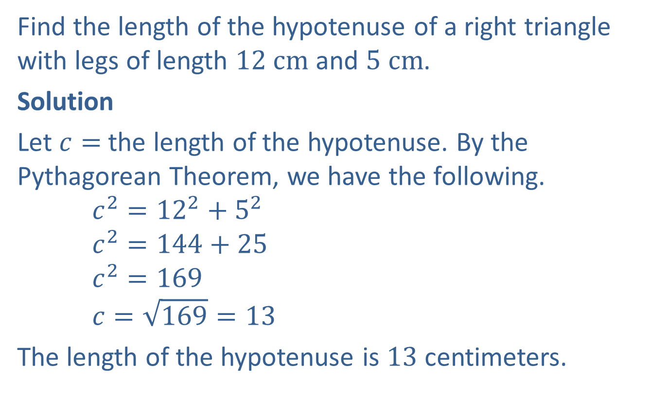


Example 9: Finding the Length of the Hypotenuse
Find the length of the hypotenuse of a right triangle with legs of length $12 cm$ and $5 cm$.
Solution
Let $c=$ the length of the hypotenuse. By the Pythagorean Theorem, we have the following.
$$c^{2}={12}^{2}+5^{2}$$
$$c^{2}=144+25$$
$$c^{2}=169$$
$$c=\sqrt{169}=13$$
The length of the hypotenuse is $13$ centimeters.
$$c$$
$$5 cm$$
$$12 cm$$

Slide 32
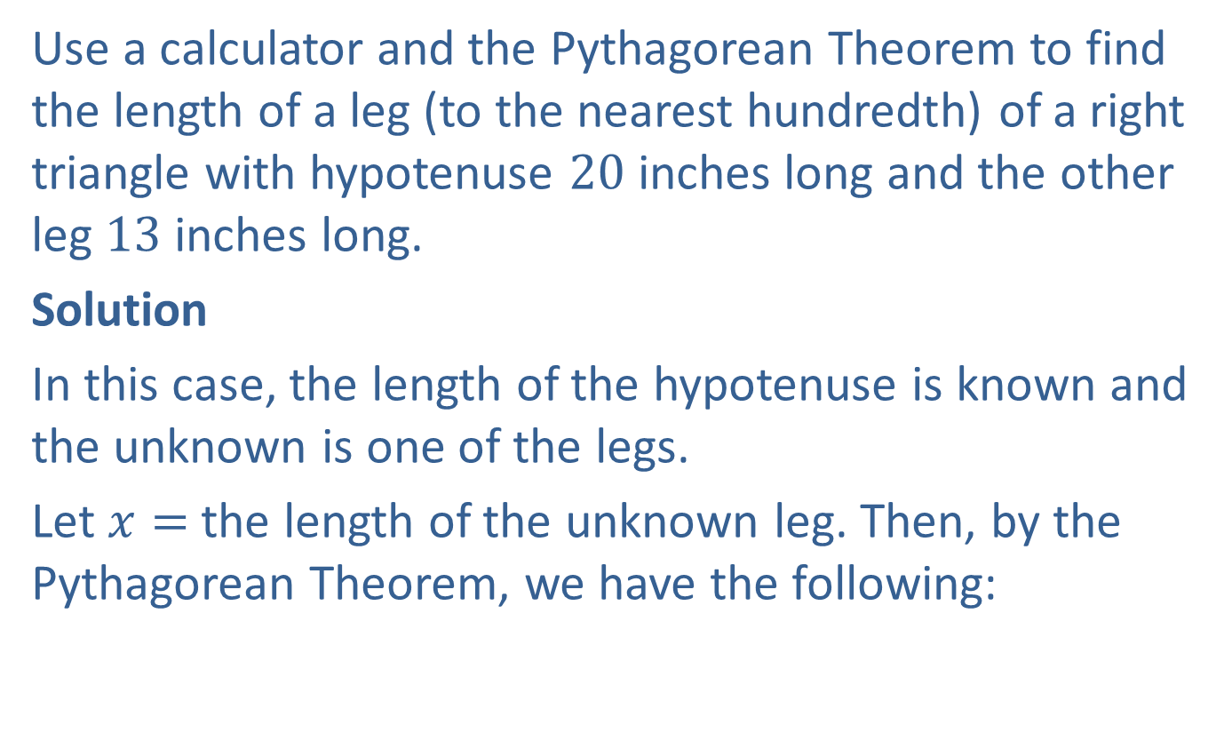
Example 10: Finding the Length of a Leg
Use a calculator and the Pythagorean Theorem to find the length of a leg (to the nearest hundredth) of a right triangle with hypotenuse 20 inches long and the other leg $13$ inches long.
Solution
In this case, the length of the hypotenuse is known and the unknown is one of the legs.
Let $x=$ the length of the unknown leg. Then, by the Pythagorean Theorem, we have the following:

Slide 33

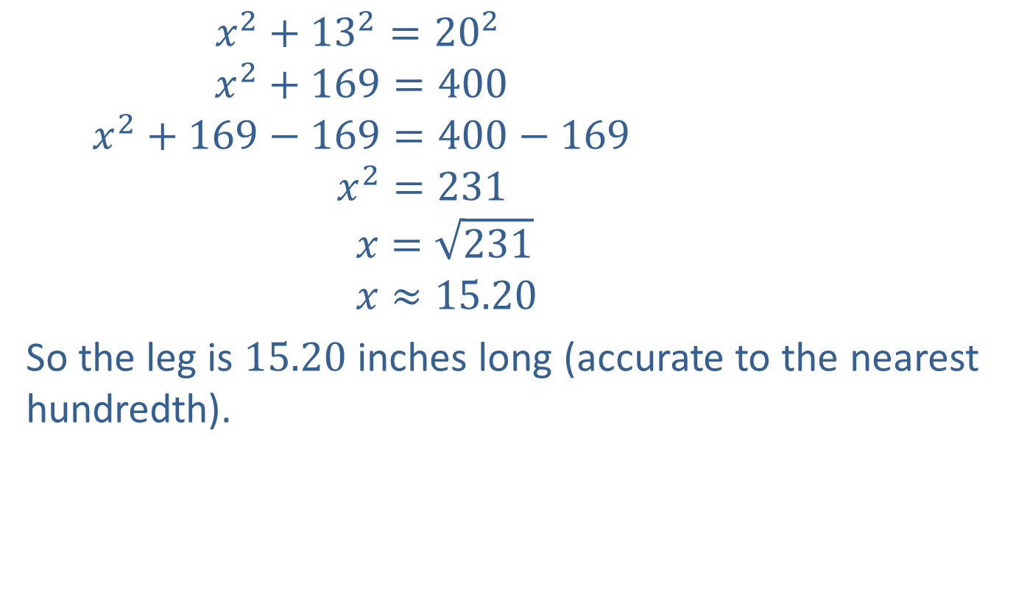


Example 10: Finding the Length of a Leg (cont.)
$x^{2}+{13}^{2}={20}^{2}$
$$x^{2}+169=400$$
$$x^{2}+169−169=400−169$$
$$x^{2}=231$$
$$x=\sqrt{231}$$
$$x≈15.20$$
So the leg is $15.20$ inches long (accurate to the nearest hundredth).
$20 in$.
$13 in$.
$$x$$

Slide 34
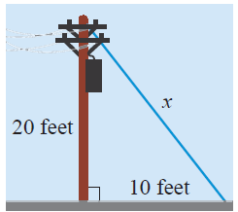

Example 11 Application: Finding the Length of the Hypotenuse
A guy wire is attached to the top of a telephone pole and anchored to the ground $10$ feet from the base of the pole. If the pole is $20$ feet high, what is the length of the guy wire?

Slide 35
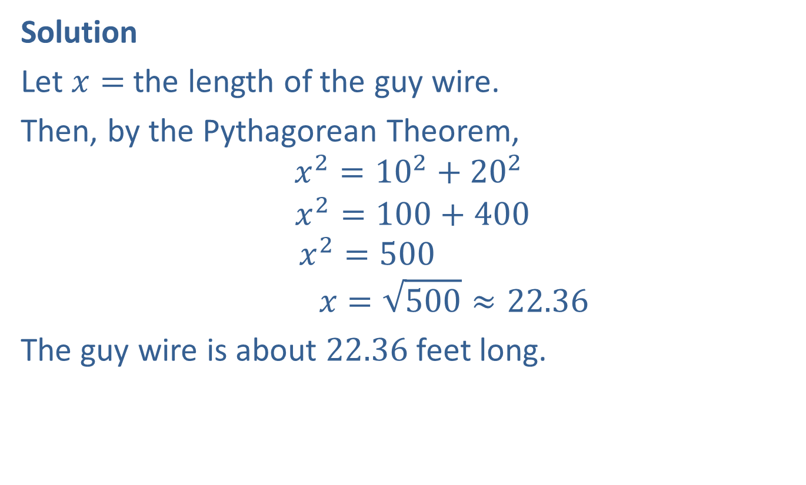
Example 11 Application: Finding the Length of the Hypotenuse (cont.)
Solution
Let $x=$ the length of the guy wire.
Then, by the Pythagorean Theorem,
$$x^{2}={10}^{2}+{20}^{2}$$
$$x^{2}=100+400$$
$$x^{2}=500$$
$$x=\sqrt{500}≈22.36$$
The guy wire is about $22.36$ feet long.

