Slide 1
Section 6.7
Perimeter and Area

Slide 2
Definition: Polygon
A polygon is a closed plane figure, with three or more sides, in which each side is a line segment.
Each point where two sides meet is called a vertex.
Note: A closed figure begins and ends at the same point.

Slide 3
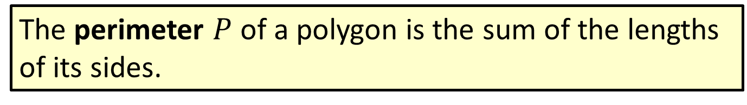
Definition: Perimeter
The perimeter $P$ of a polygon is the sum of the lengths of its sides.

Slide 4
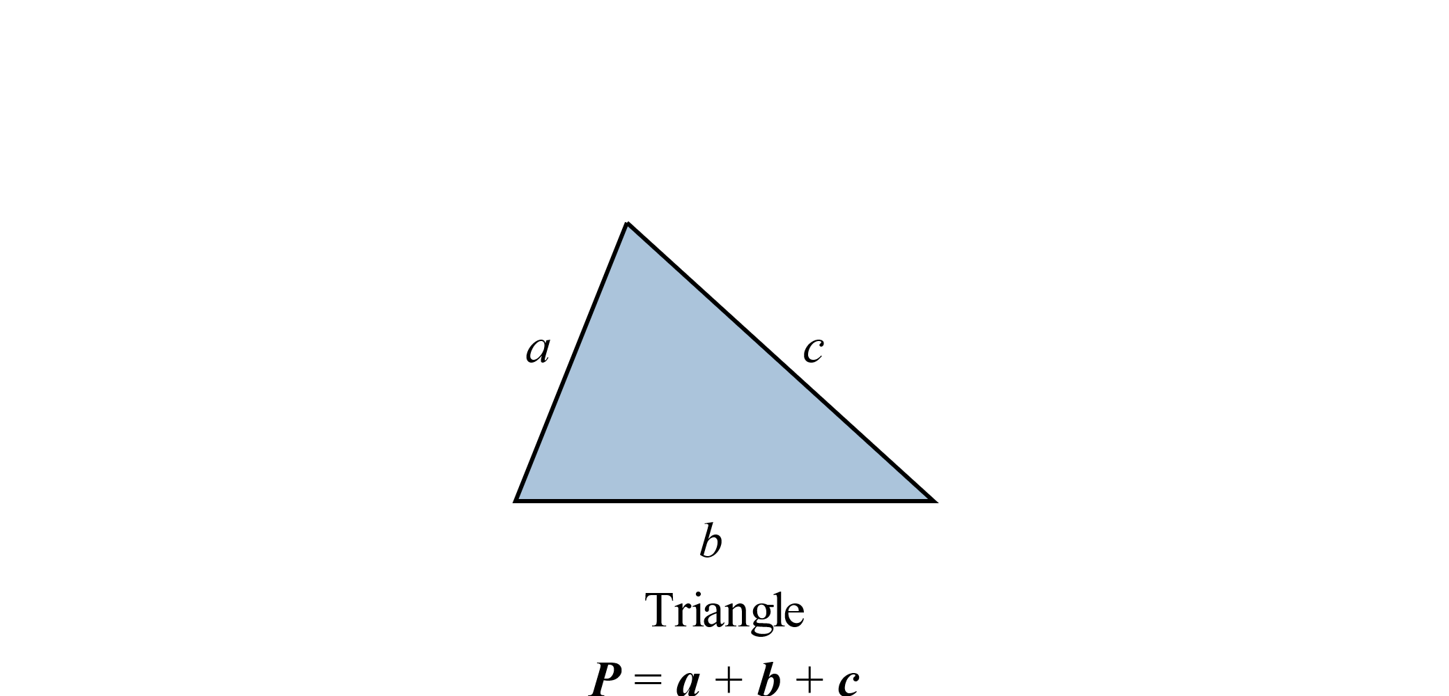
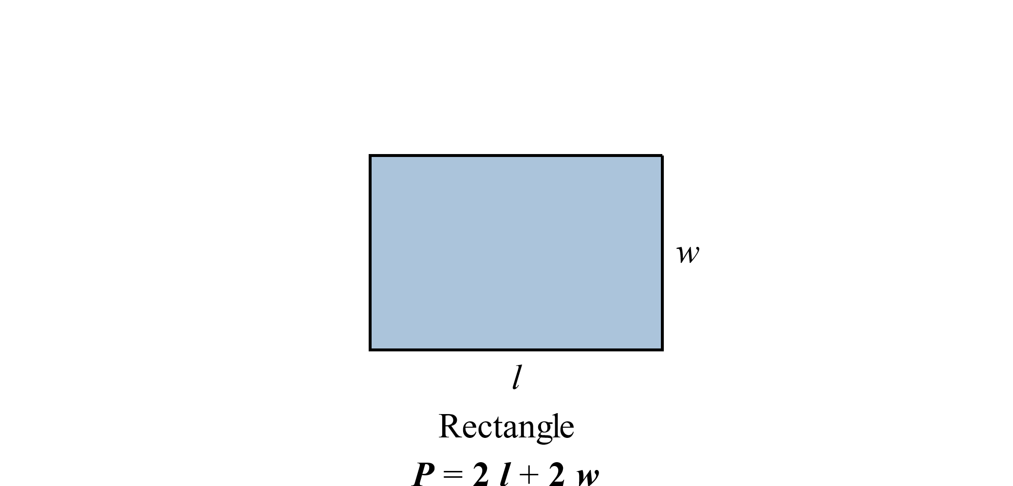
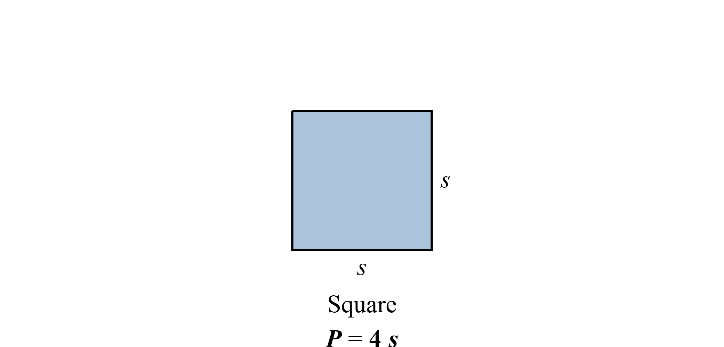
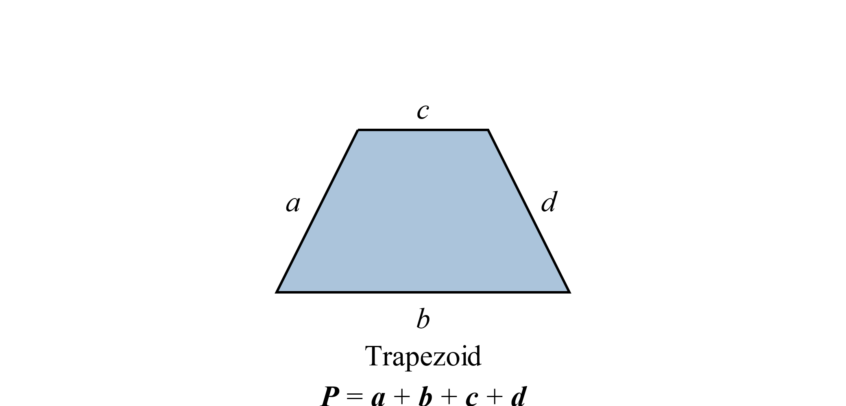
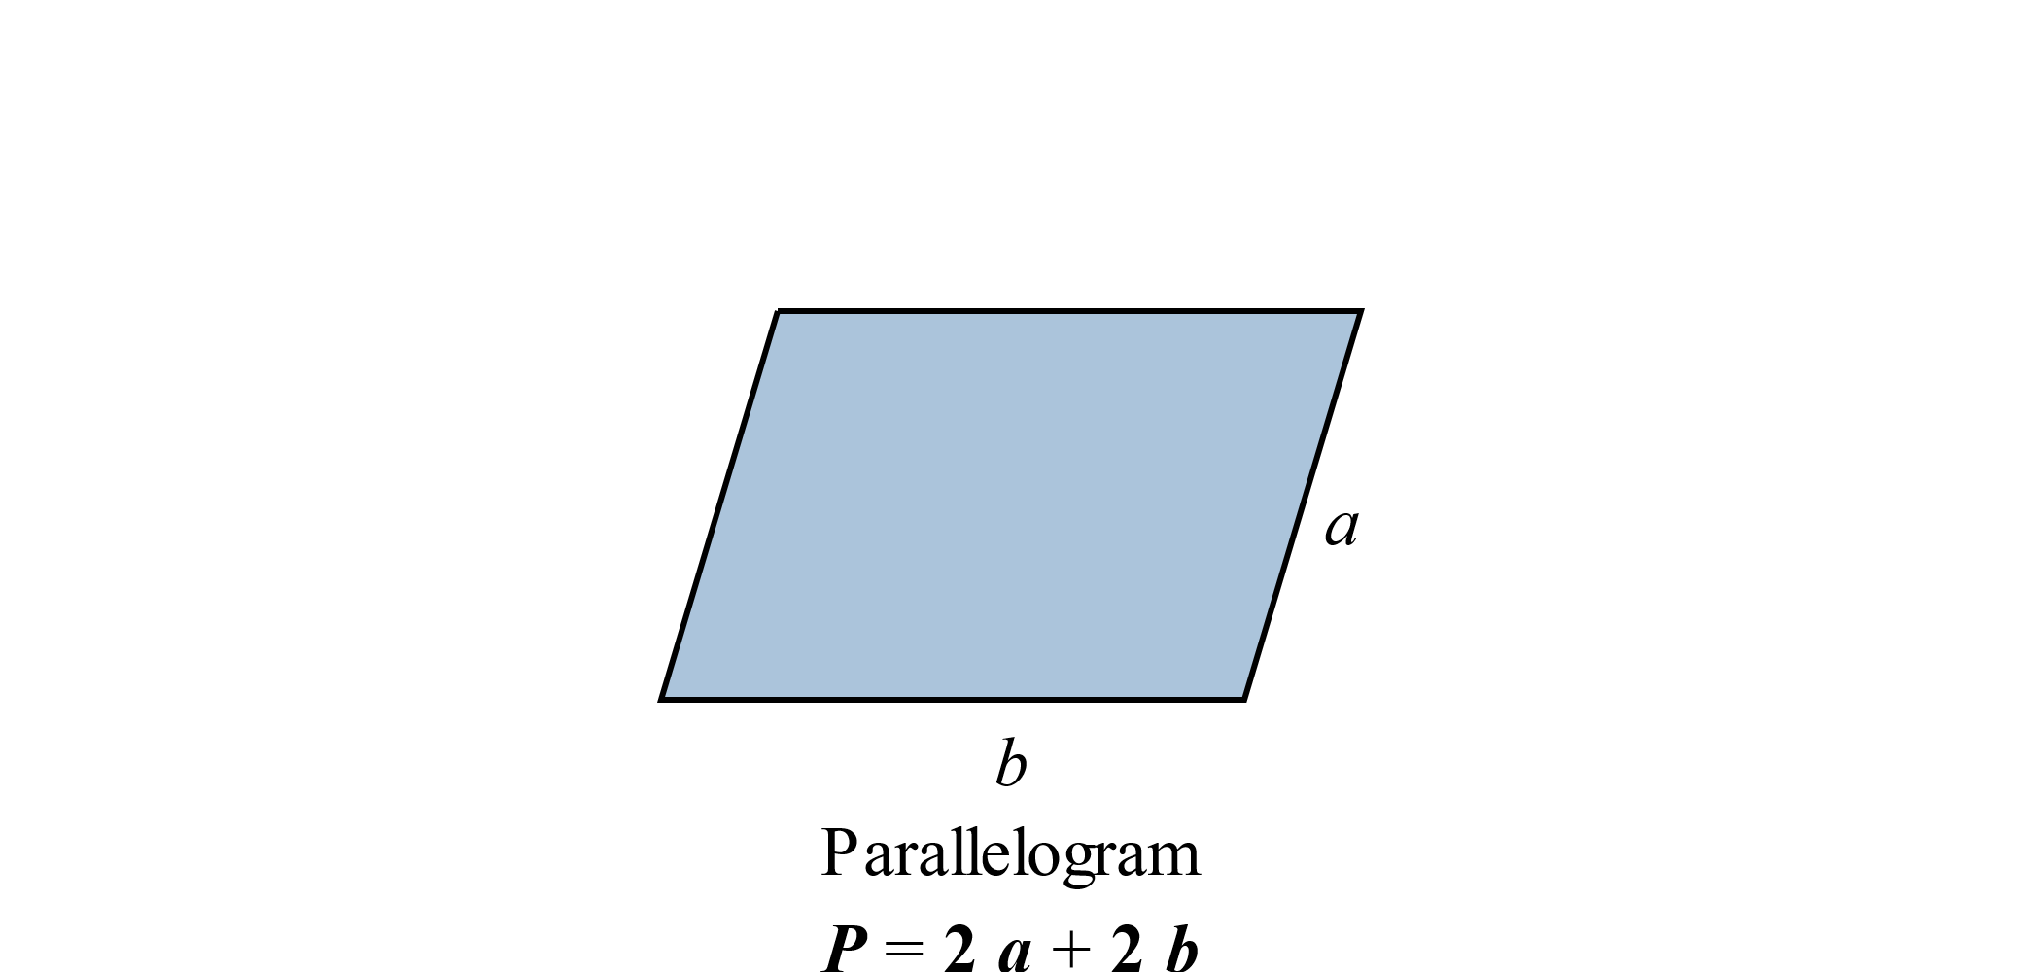
Formula: Perimeter Formulas for Five Polygons
Note that each formula represents the sum of the lengths of the sides.

Slide 5

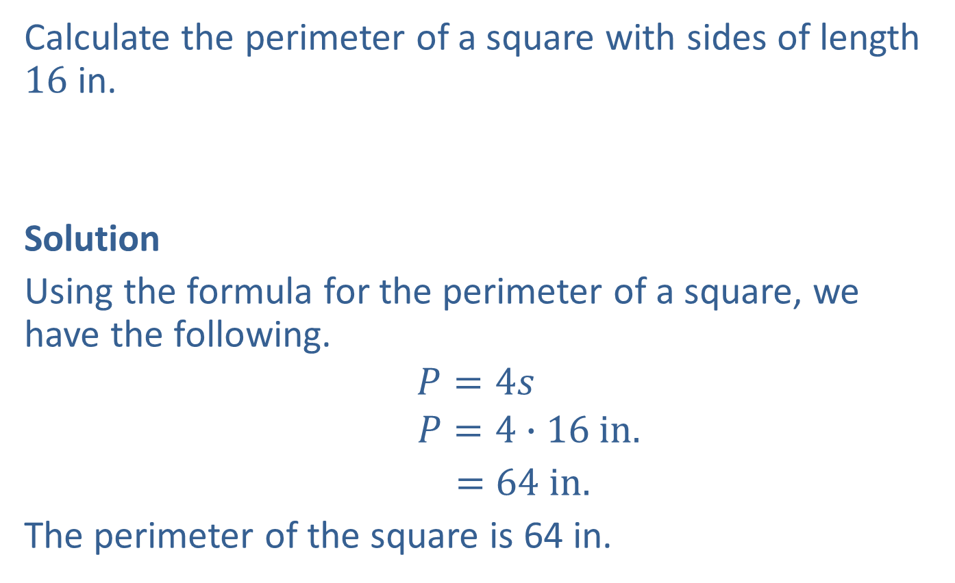
Example 1: Calculating the Perimeter of a Square
Calculate the perimeter of a square with sides of length $16$ in.
Solution
Using the formula for the perimeter of a square, we have the following.
$$P=4s$$
$$P=4∙16 in.$$
$=64$ $in.$
The perimeter of the square is 64 in.
$16$ in.

Slide 6
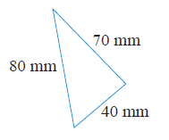

Example 2: Calculating the Perimeter of a Triangle
Calculate the perimeter of a triangle with sides of length $40 mm$, $70 mm$, and $80 mm$.
Solution
First draw a figure and label the lengths of the sides.

Slide 7
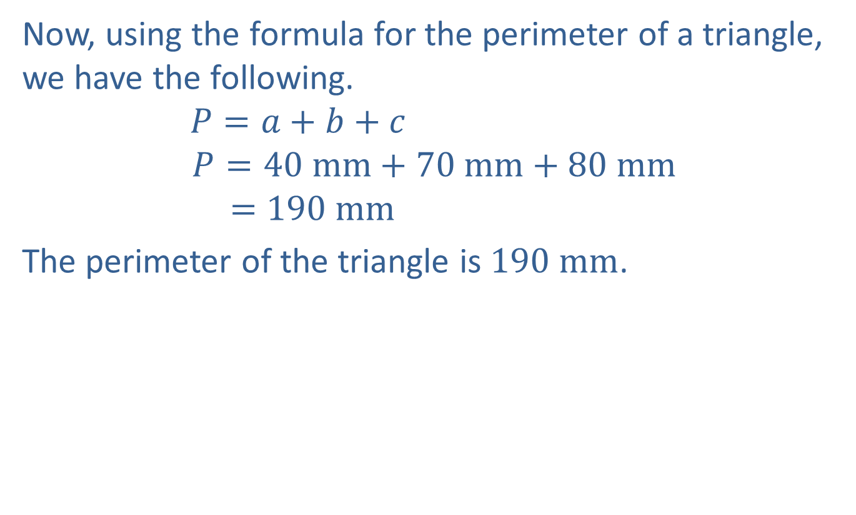
Example 2: Calculating the Perimeter of a Triangle (cont.)
Now, using the formula for the perimeter of a triangle, we have the following.
$$P=a+b+c$$
$$P=40 mm+70 mm+80 mm$$
$$=190 mm$$
The perimeter of the triangle is $190 mm$.

Slide 8
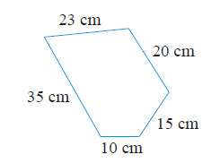

Example 3: Calculating the Perimeter of a Polygon
Calculate the perimeter of the polygon.
(Note: A $5$-sided polygon is called a pentagon.)

Slide 9
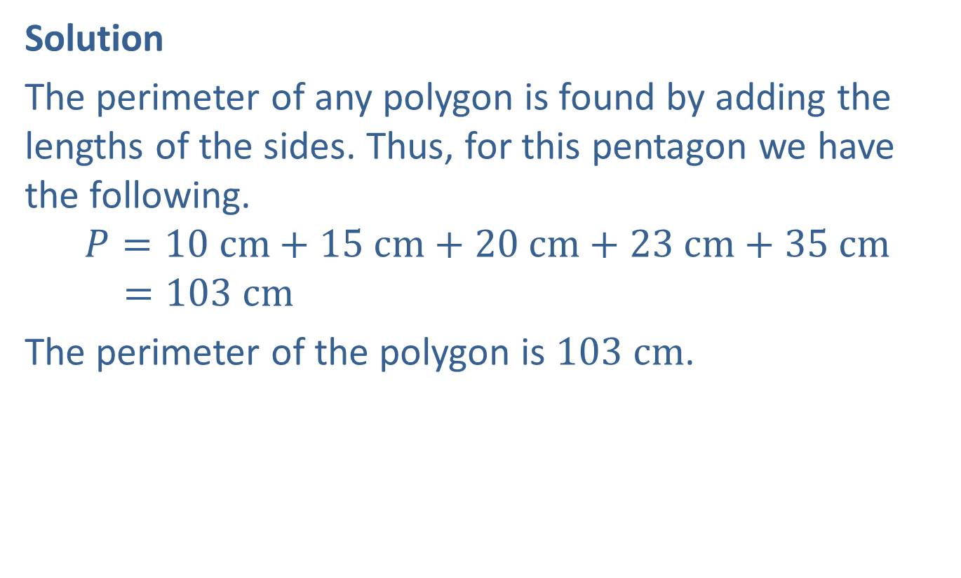
Example 3: Calculating the Perimeter of a Polygon (cont.)
Solution
The perimeter of any polygon is found by adding the lengths of the sides. Thus, for this pentagon we have the following.
$$P=10 cm+15 cm+20 cm+23 cm+35 cm$$
$$=103 cm$$
The perimeter of the polygon is $103 cm$.

Slide 10
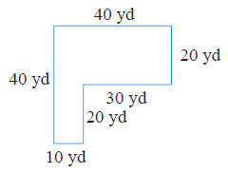
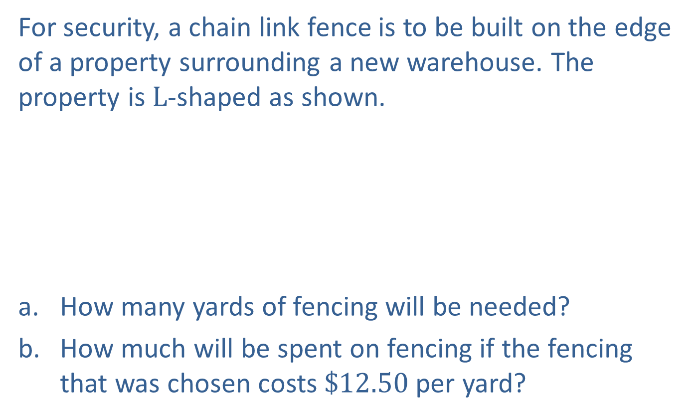
Example 4: Application: Calculating the Perimeter of a Polygon
For security, a chain link fence is to be built on the edge of a property surrounding a new warehouse. The property is $L$-shaped as shown.
How many yards of fencing will be needed?
How much will be spent on fencing if the fencing that was chosen costs $\$12.50$per yard?

Slide 11
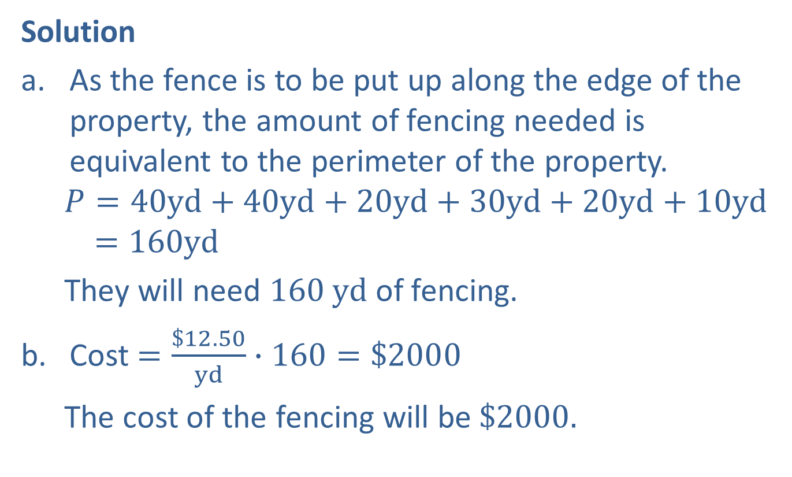
Example 4: Application: Calculating the Perimeter of a Polygon (cont.)
Solution
As the fence is to be put up along the edge of the property, the amount of fencing needed is equivalent to the perimeter of the property.
$$P=40yd+40yd+20yd+30yd+20yd+10yd$$
$$=160yd$$
They will need $160 yd$of fencing.
Cost $=\frac{\$12.50}{yd}∙160=\$2000$
The cost of the fencing will be $\$2000.$

Slide 12
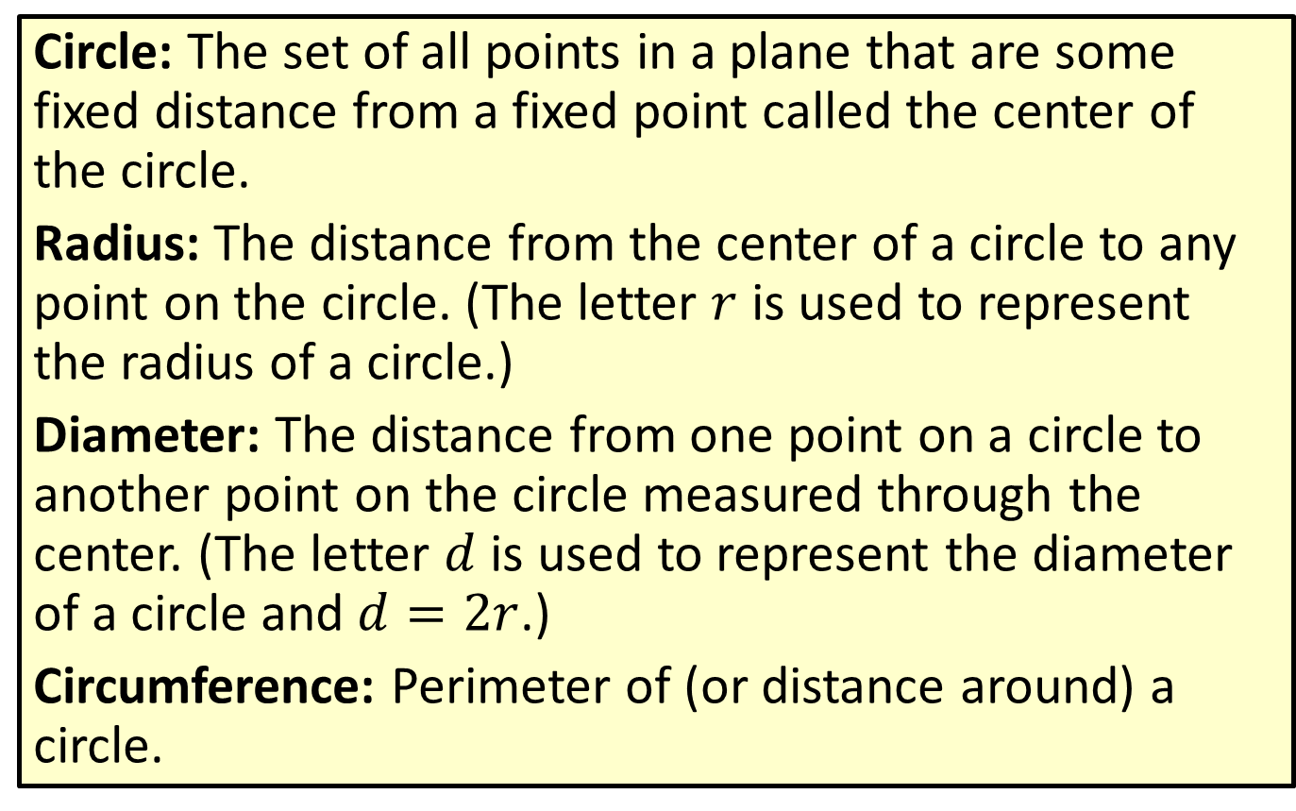
Definition: Circles
Circle: The set of all points in a plane that are some fixed distance from a fixed point called the center of the circle.
Radius: The distance from the center of a circle to any point on the circle. (The letter $r$ is used to represent the radius of a circle.)
Diameter: The distance from one point on a circle to another point on the circle measured through the center. (The letter $d$ is used to represent the diameter of a circle and $d=2r$.)
Circumference: Perimeter of (or distance around) a circle.

Slide 13


Definition: Circles (cont.)
Center
Diameter $d$
Radius $r$

Slide 14
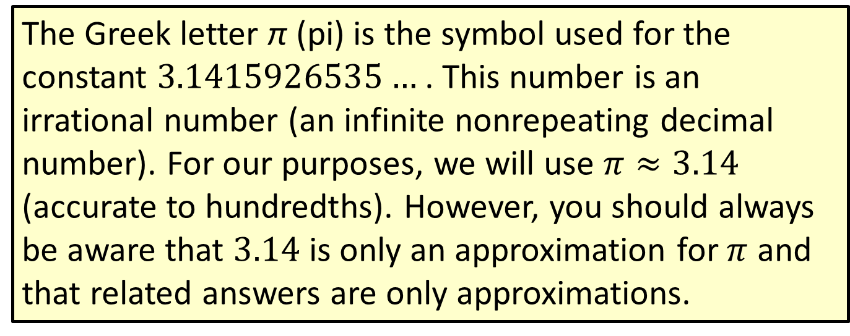
Note
The Greek letter π (pi) is the symbol used for the constant $3.1415926535…$. This number is an irrational number (an infinite nonrepeating decimal number). For our purposes, we will use $π≈3.14$ (accurate to hundredths). However, you should always be aware that $3.14$ is only an approximation for $π$ and that related answers are only approximations.

Slide 15
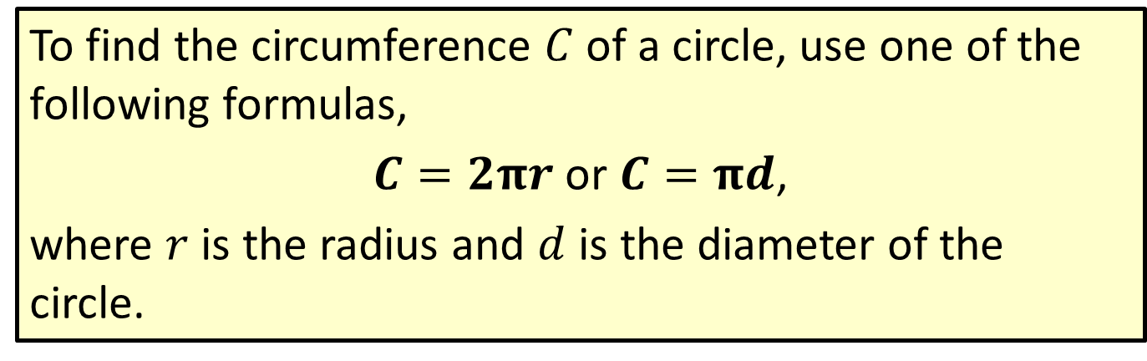
Formula: The Circumference of a Circle
To find the circumference $C$ of a circle, use one of the following formulas,
$C=2πr$ or $C=πd$,
where $r$ is the radius and $d$ is the diameter of the circle.

Slide 16
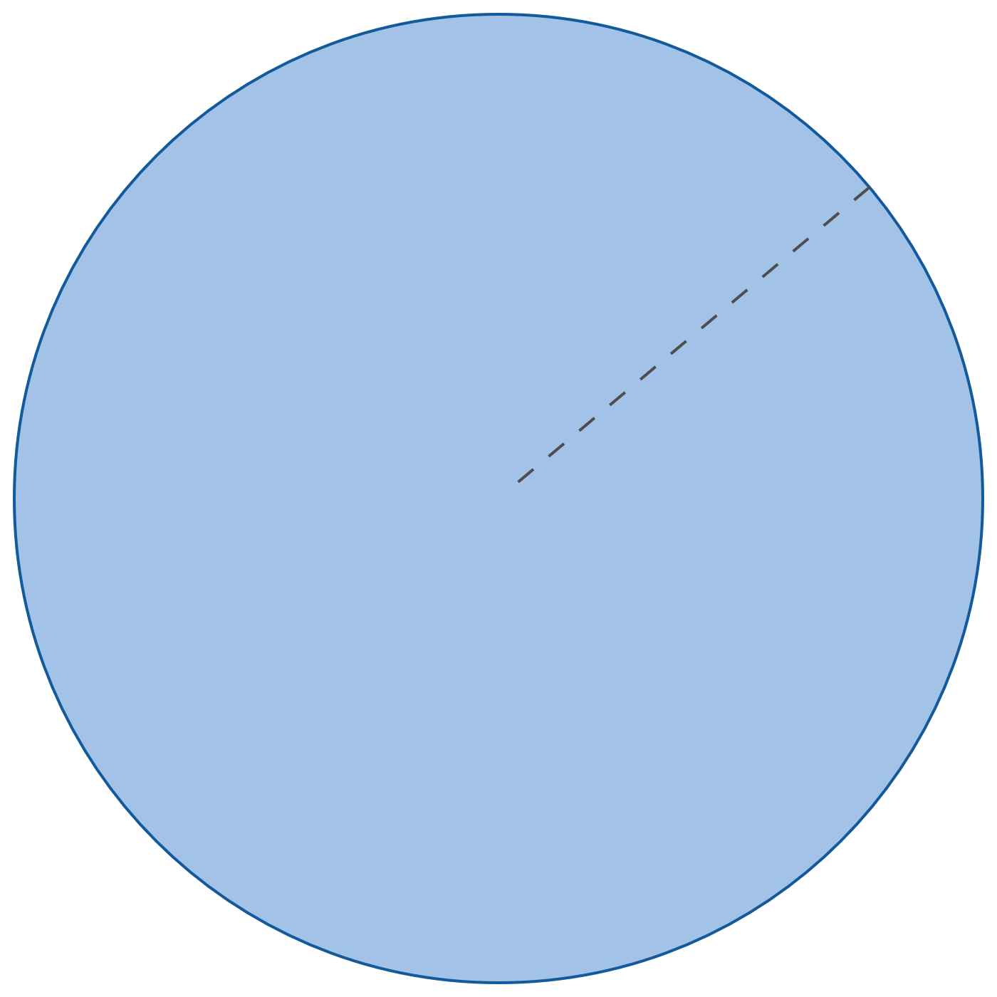
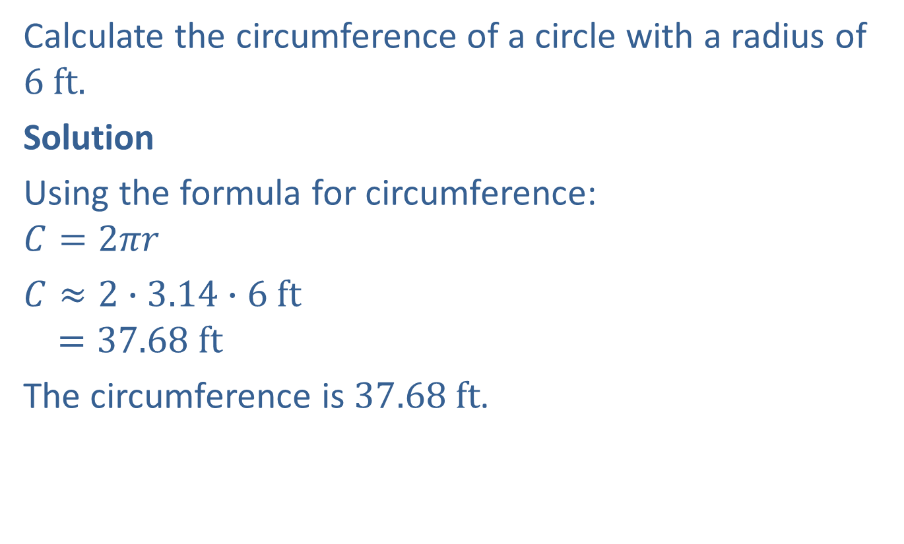

Example 5: Calculating the Circumference of a Circle
Calculate the circumference of a circle with a radius of $6 ft.$
Solution
Using the formula for circumference:
$$C=2πr$$
$C≈2∙3.14∙6$ $ft$
$$=37.68 ft$$
The circumference is $37.68 ft$.
$$r=6 ft$$

Slide 17


Example 6: Calculating the Perimeter
Calculate the perimeter of the figure shown: a semicircle (half of a circle) and a diameter. The diameter is $20 cm$ long.
$$d=20 cm$$

Slide 18
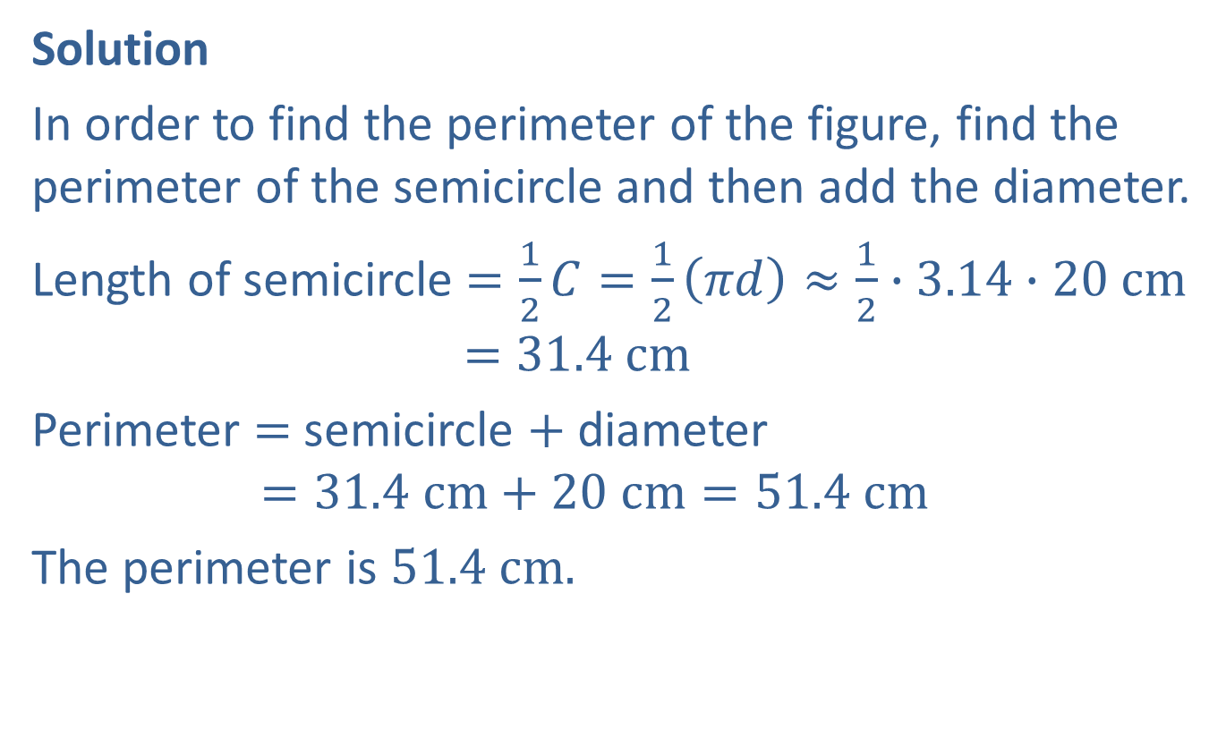
Example 6: Calculating the Perimeter (cont.)
Solution
In order to find the perimeter of the figure, find the perimeter of the semicircle and then add the diameter.
Length of semicircle $=\frac{1}{2}C=\frac{1}{2}\left(πd\right)≈\frac{1}{2}∙3.14∙20 cm$
$$=31.4 cm$$
Perimeter $=$ semicircle $+$ diameter
$$=31.4 cm+20 cm=51.4 cm$$
The perimeter is $51.4 cm.$

Slide 19



Example 7: Calculating Perimeter
Calculate the perimeter of the figure shown here with a rectangular base and a semicircle attached to the top. The rectangle has a length of $16 m$ and a width of $6 m.$
$$6 m$$
$$16 m$$

Slide 20
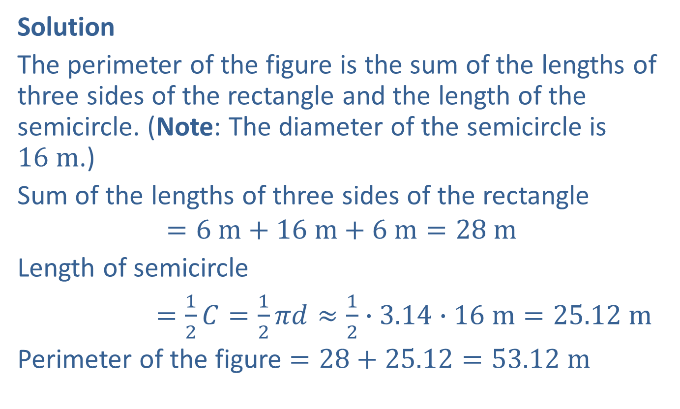
Example 7: Calculating Perimeter (cont.)
Solution
The perimeter of the figure is the sum of the lengths of three sides of the rectangle and the length of the semicircle. (Note: The diameter of the semicircle is $16 m$.)
Sum of the lengths of three sides of the rectangle
$$=6 m+16 m+6 m=28 m$$
Length of semicircle
$=\frac{1}{2}C=\frac{1}{2}πd≈\frac{1}{2}∙3.14∙16 m=25.12 m$
Perimeter of the figure $=28+25.12=53.12 m$

Slide 21
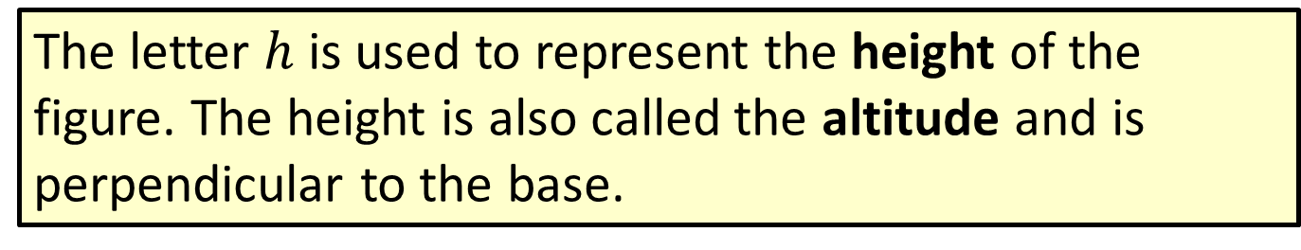
Note
The letter $h$ is used to represent the height of the figure. The height is also called the altitude and is perpendicular to the base.

Slide 22
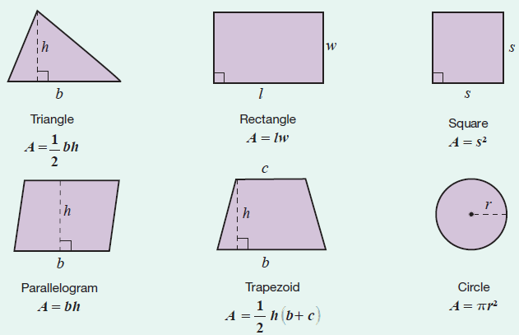
Formula: Area Formulas for Six Geometric Figures

Slide 23
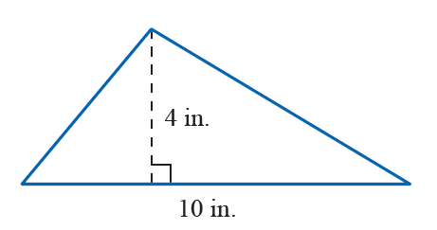

Example 8: Calculating the Area of a Triangle Using a Formula
Calculate the area of a triangle with height $4$ in. and base $10$ in. (Be sure to label the answer in square inches.)

Slide 24
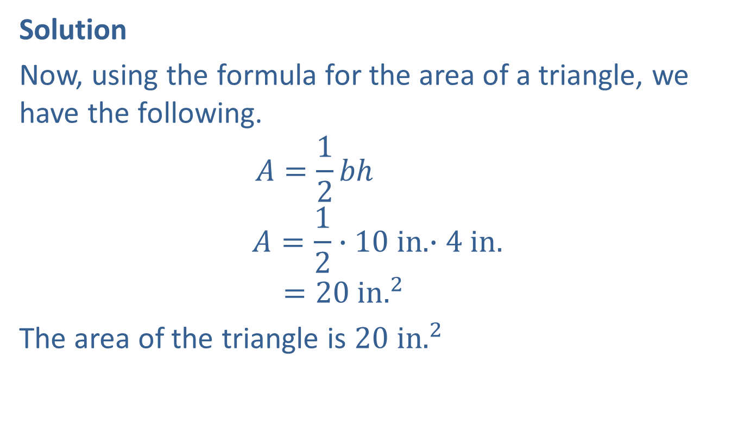
Example 8: Calculating the Area of a Triangle Using a Formula (cont.)
Solution
Now, using the formula for the area of a triangle, we have the following.
$$A=\frac{1}{2}bh$$
$$A=\frac{1}{2}∙10 in. ∙4 in.$$
$$=20 in.^{2}$$
The area of the triangle is $20 in.^{2}$

Slide 25
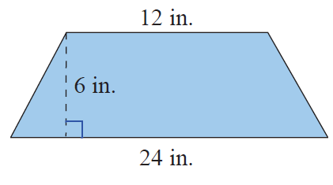

Example 9: Calculating the Area of a Trapezoid Using a Formula
Calculate the area of a trapezoid with altitude $6 in$. and parallel sides of length $12 in$. and $24 in$.
Solution
First draw a figure and label the lengths of the known parts.

Slide 26
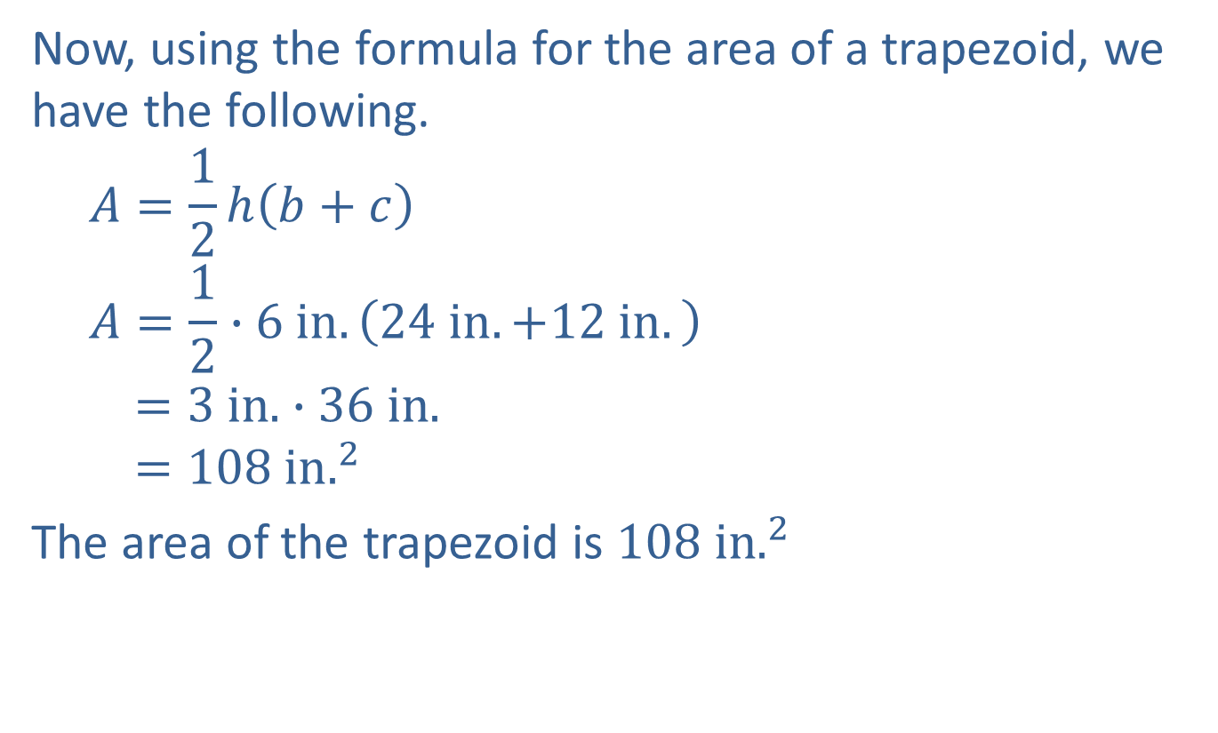
Example 9: Calculating the Area of a Trapezoid Using a Formula (cont.)
Now, using the formula for the area of a trapezoid, we have the following.
$$A=\frac{1}{2}h\left(b+c\right)$$
$$A=\frac{1}{2}∙6 in.\left(24 in.+12 in.\right)$$
$$=3 in. ∙36 in.$$
$$=108 in.^{2}$$
The area of the trapezoid is $108 in.^{2}$

Slide 27
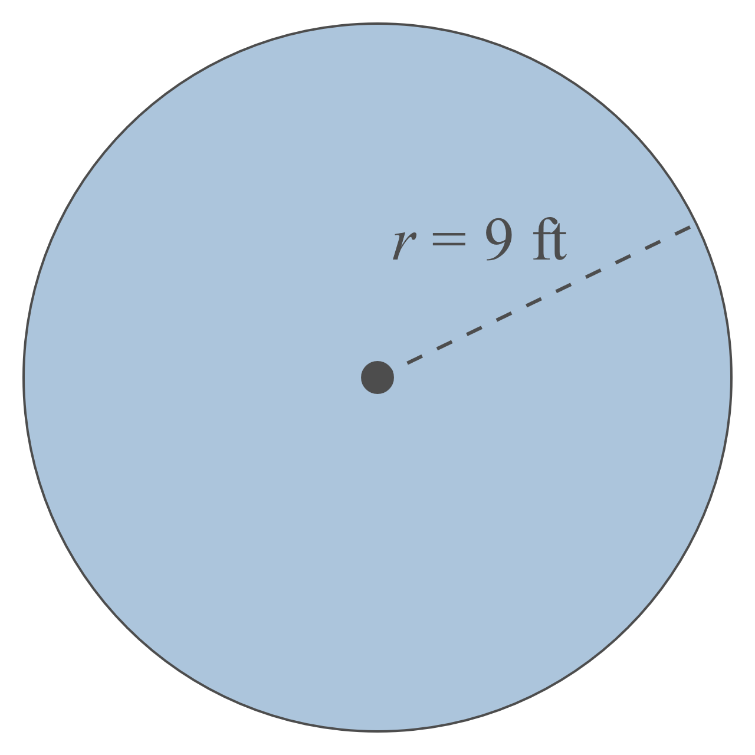
Example 10: Calculating the Area of a Circle
Calculate the area of a circle with a radius of 9 ft.

Slide 28

Example 10: Calculating the Area of a Circle (cont.)
Solution
Using the formula for area:
$$A=πr^{2}$$
$$A≈3.14{\left(9 ft\right)}^{2}$$
$$=3.14∙81 ft^{2}$$
$$=254.34 ft^{2}$$
The area is $254.34 ft^{2}$.

Slide 29
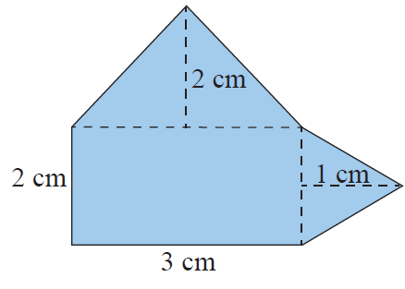
Example 11: Calculating the Area of a Composite Figure
Calculate the area of the composite figure made up of a rectangle and two triangles.
Solution
To find the area of this figure, calculate the area of each part and then add the three areas. The figure is made up of two triangles and one rectangle.

Slide 30
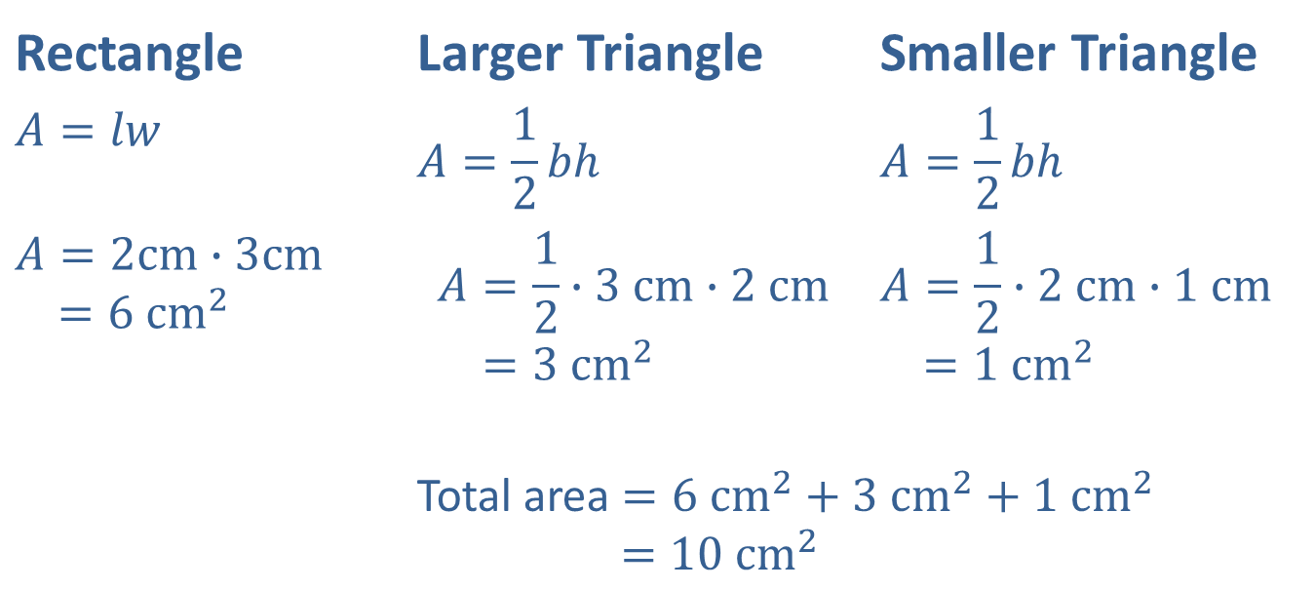

Example 11: Calculating the Area of a Composite Figure (cont.)
The area of the composite figure is $10 cm^{2}.$
Rectangle | Larger Triangle | Smaller Triangle
$$A=lw$$ | $$A=\frac{1}{2}bh$$ | $$A=\frac{1}{2}bh$$
$$A=2cm∙3cm$$ $=6 cm^{2}$ | $$A=\frac{1}{2}∙3 cm∙2 cm$$ $=3 cm^{2}$ | $$A=\frac{1}{2}∙2 cm∙1 cm$$ $$=1 cm^{2}$$
 | Total area $=6 cm^{2}+3 cm^{2}+1 cm^{2}$ $$=10 cm^{2}$$

Slide 31
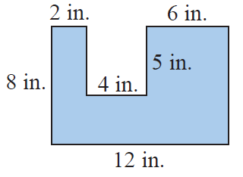
Example 12: Calculating Area
The polygon shown here is a rectangle with a rectangular piece missing. Calculate the area of the polygon.

Slide 32
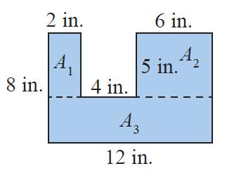
Example 12: Calculating Area (cont.)
Solution
There are several ways to find the area of this figure. One way is to calculate the area of each of the three parts as illustrated here and then add the three areas.
Notice that the height of the bottom rectangle is 8 ─ 5 = 3.

Slide 33
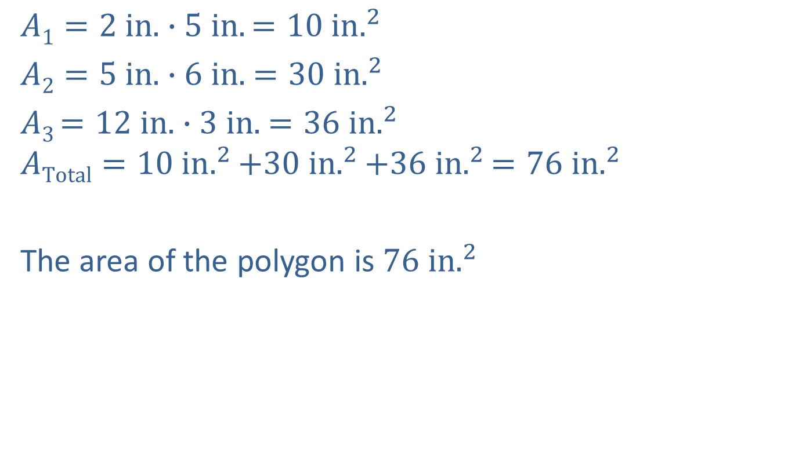
Example 12: Calculating Area (cont.)
$$A1=2 in. ∙5 in.=10 in.^{2}$$
$A2=5 in. ∙6 in.$ $=30 in.^{2}$
$A3$ $=12 in. ∙3 in.$ $=36 in.^{2}$
$$ATotal=10 in.^{2}+30 in.^{2}+36 in.^{2}=76 in.^{2}$$
The area of the polygon is $76 in.^{2}$
Note: $A1$ is read “$A$sub $1$”, $A2$ is read “$A$ sub $2$”, and so on.

Slide 34
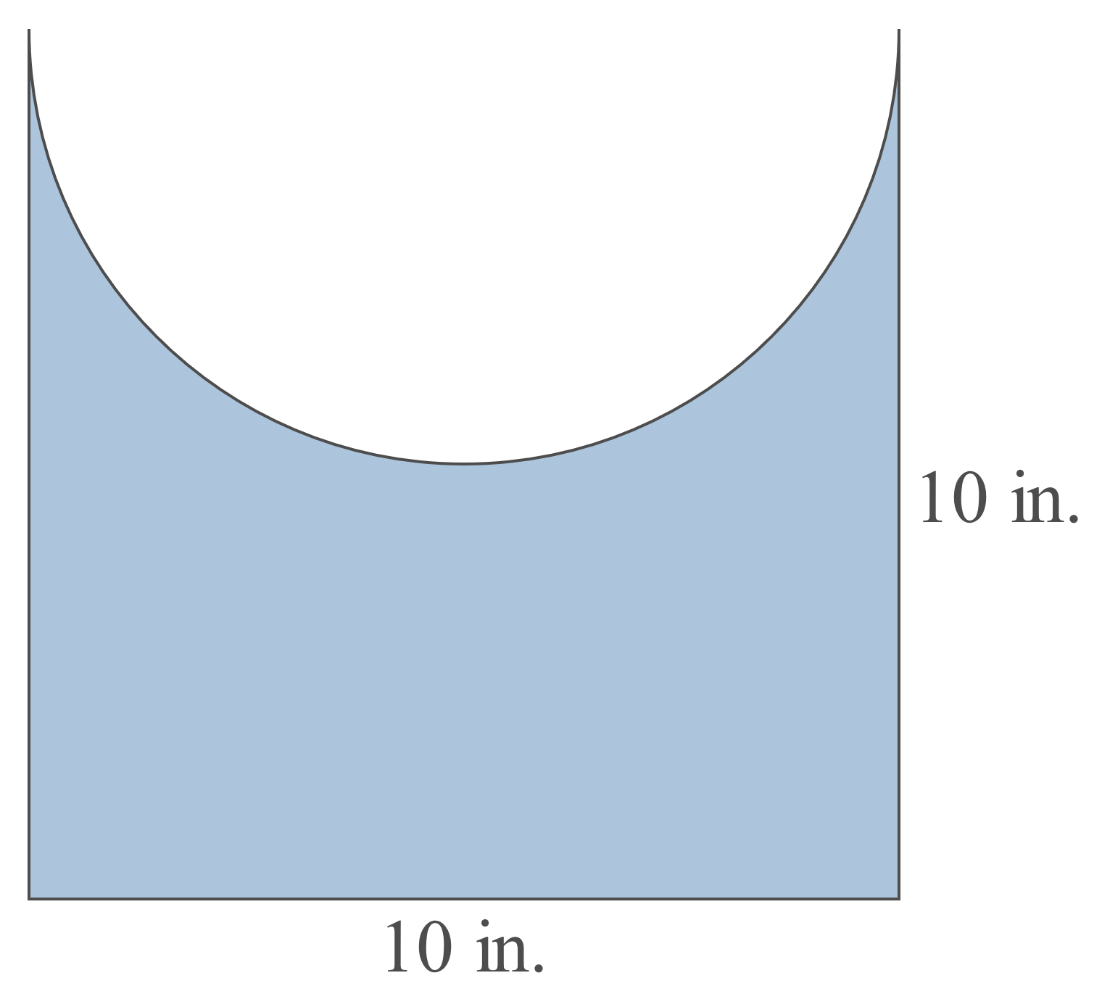

Example 13: Calculating Area
Calculate the area of the figure shown here with a square base and a semicircle cut out of one side. One side of the square is $10 in$. long.

Slide 35

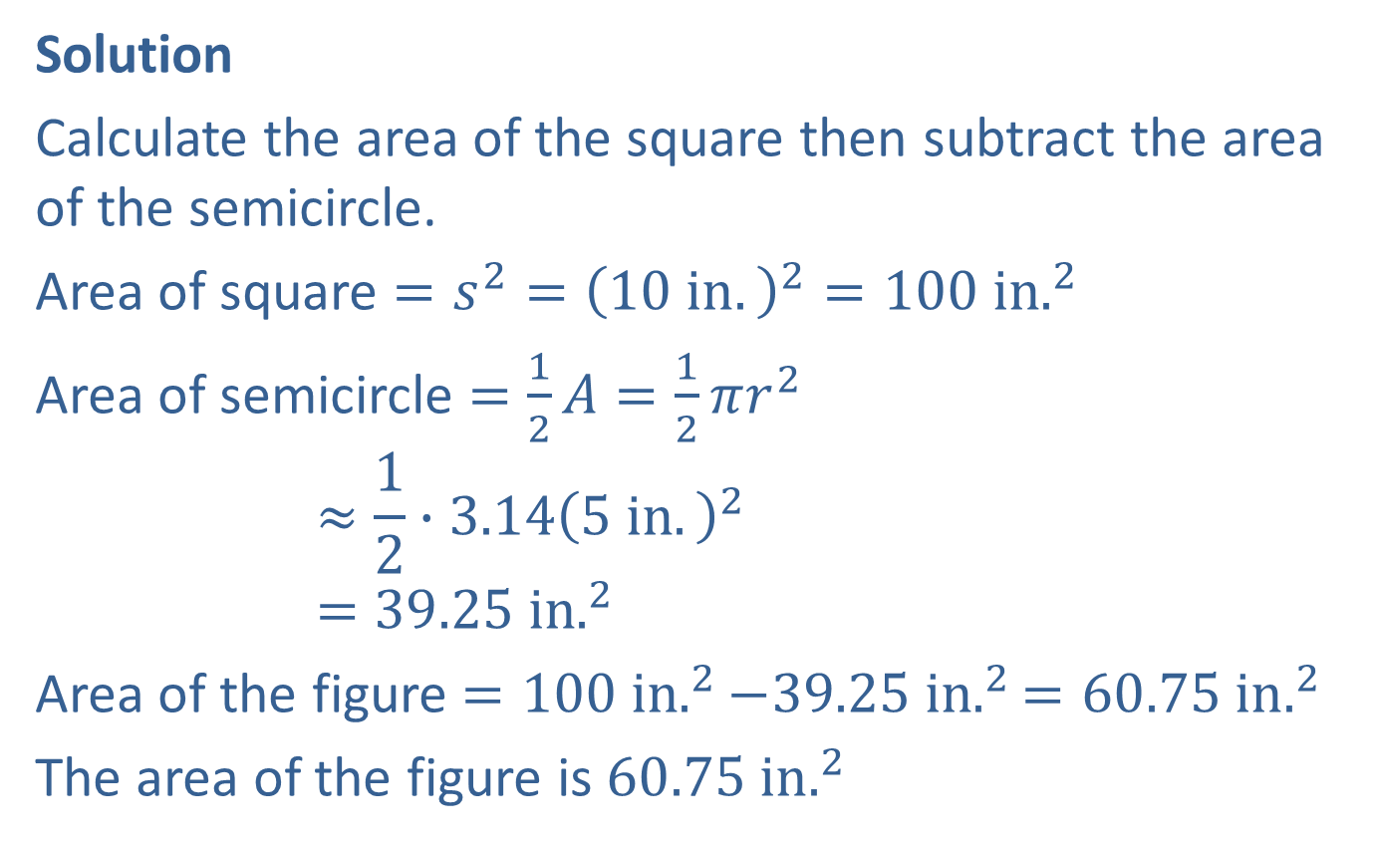
Example 13: Calculating Area (cont.)
Solution
Calculate the area of the square then subtract the area of the semicircle.
Area of square $=s^{2}={\left(10 in.\right)}^{2}=100 in.^{2}$
Area of semicircle $=\frac{1}{2}A=\frac{1}{2}πr^{2}$
$$≈\frac{1}{2}∙3.14{\left(5 in.\right)}^{2}$$
$$=39.25 in.^{2}$$
Area of the figure $=100 in.^{2}−39.25 in.^{2}=60.75 in.^{2}$
The area of the figure is $60.75 in.^{2}$
In this case, $r=\frac{1}{2}d=\frac{1}{2}×10in.=5in.$

