Slide 1
Section 6.8
Volume and Surface Area

Slide 2
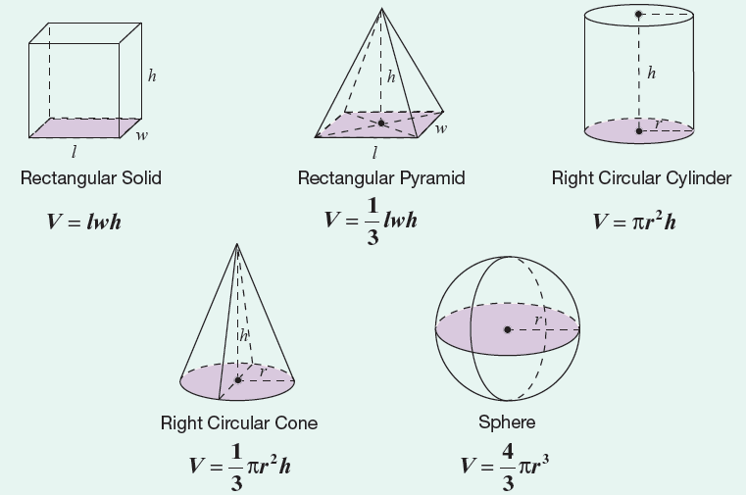
Formula: Volume Formulas for Five Geometric Solids

Slide 3
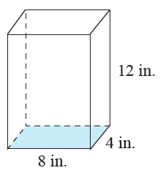

Example 1: Calculating the Volume of a Rectangular Solid
Calculate the volume of the rectangular solid with length $8 in.$, width $4 in.$, and height $12 in$.

Slide 4
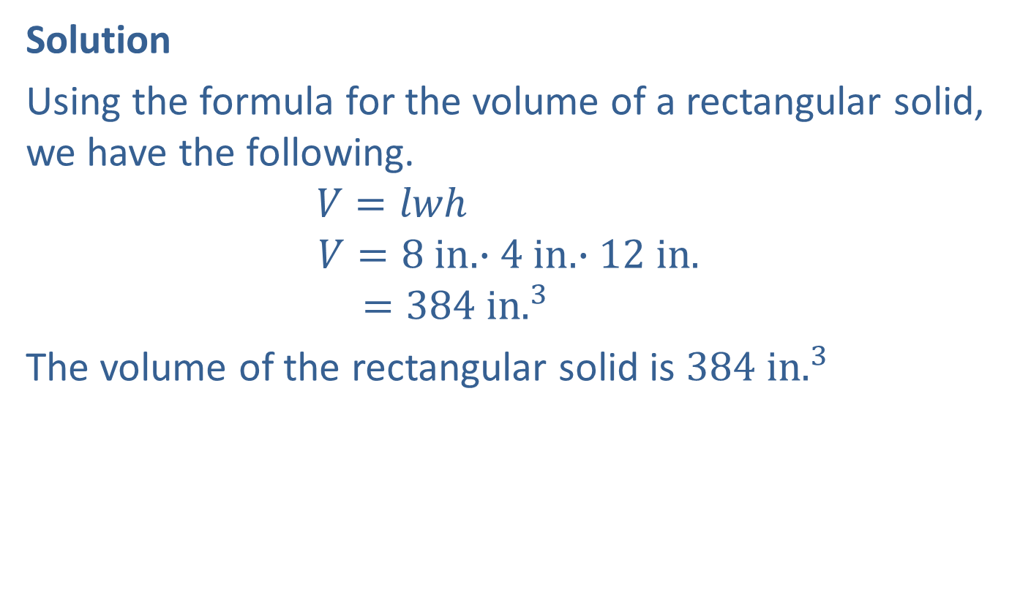
Example 1: Calculating the Volume of a Rectangular Solid (cont.)
Solution
Using the formula for the volume of a rectangular solid, we have the following.
$$V=lwh$$
$$V=8 in.∙4 in.∙12 in.$$
$$=384 in.^{3}$$
The volume of the rectangular solid is $384 in.^{3}$

Slide 5
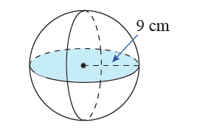

Example 2: Calculating the Volume of a Sphere
Calculate the volume of a sphere with radius $9 cm$.
(Use $π=3.14$.)

Slide 6
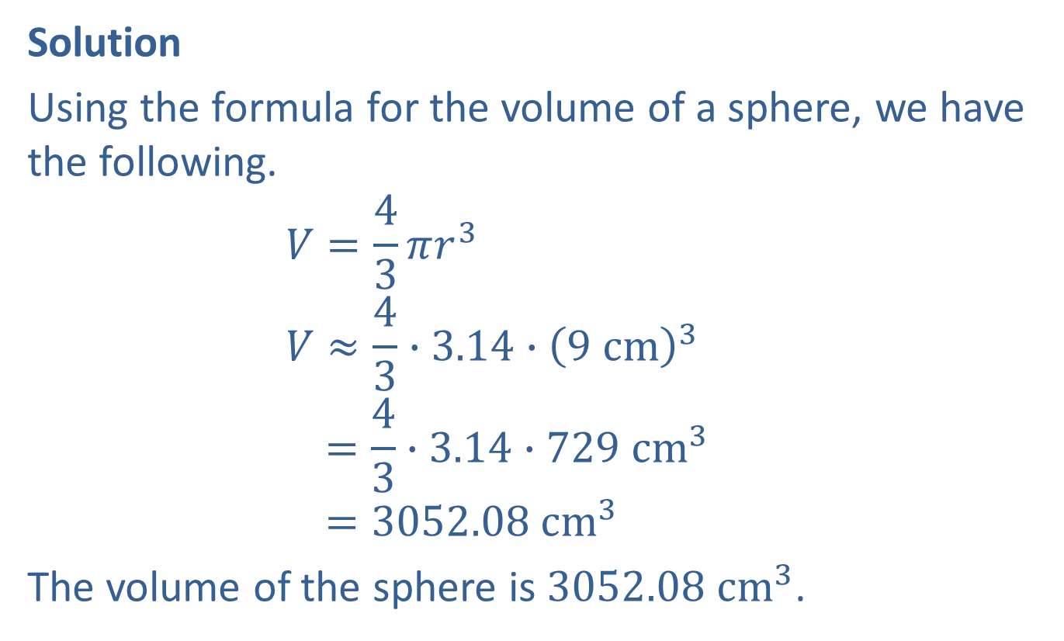
Example 2: Calculating the Volume of a Sphere (cont.)
Solution
Using the formula for the volume of a sphere, we have the following.
$$V=\frac{4}{3}πr^{3}$$
$$V≈\frac{4}{3}∙3.14∙{\left(9 cm\right)}^{3}$$
$$=\frac{4}{3}∙3.14∙729 cm^{3}$$
$$=3052.08 cm^{3}$$
The volume of the sphere is $3052.08 cm^{3}$.

Slide 7
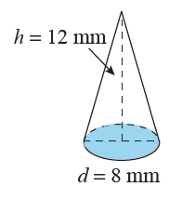

Example 3: Calculating the Volume of a Cone
What is the volume of a cone with a height of $12 mm$ and a circular base with a diameter of $8 mm$? (Use $π=3.14$.)

Slide 8
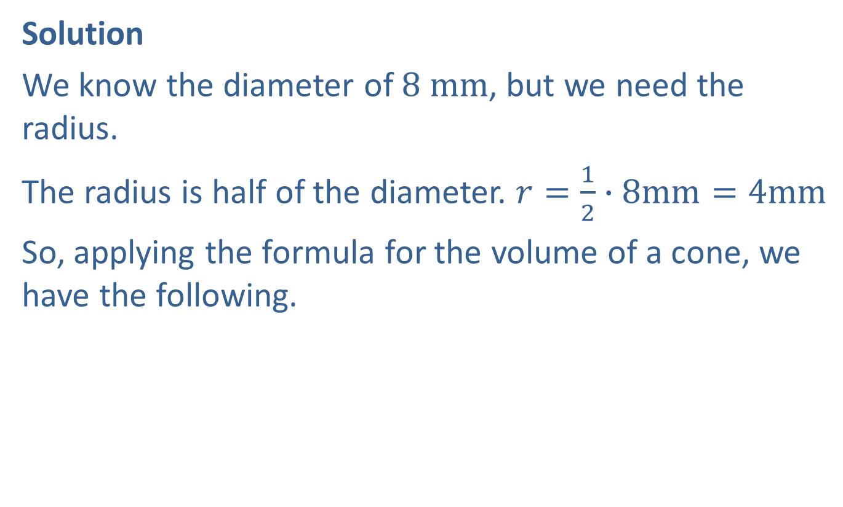
Example 3: Calculating the Volume of a Cone (cont.)
Solution
We know the diameter of $8 mm$, but we need the radius.
The radius is half of the diameter. $r=\frac{1}{2}∙8mm=4mm$
So, applying the formula for the volume of a cone, we have the following.

Slide 9

Example 3: Calculating the Volume of a Cone (cont.)
$$V=\frac{1}{3}πr^{2}h$$
$$V≈\frac{1}{3}∙3.14∙{\left(4 mm\right)}^{2}∙12 mm$$
$$=\frac{1}{3}∙3.14∙192 mm^{3}$$
$$=200.96 mm^{3}$$
The volume of the cone is $200.96 mm^{3}$.

Slide 10
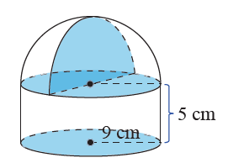
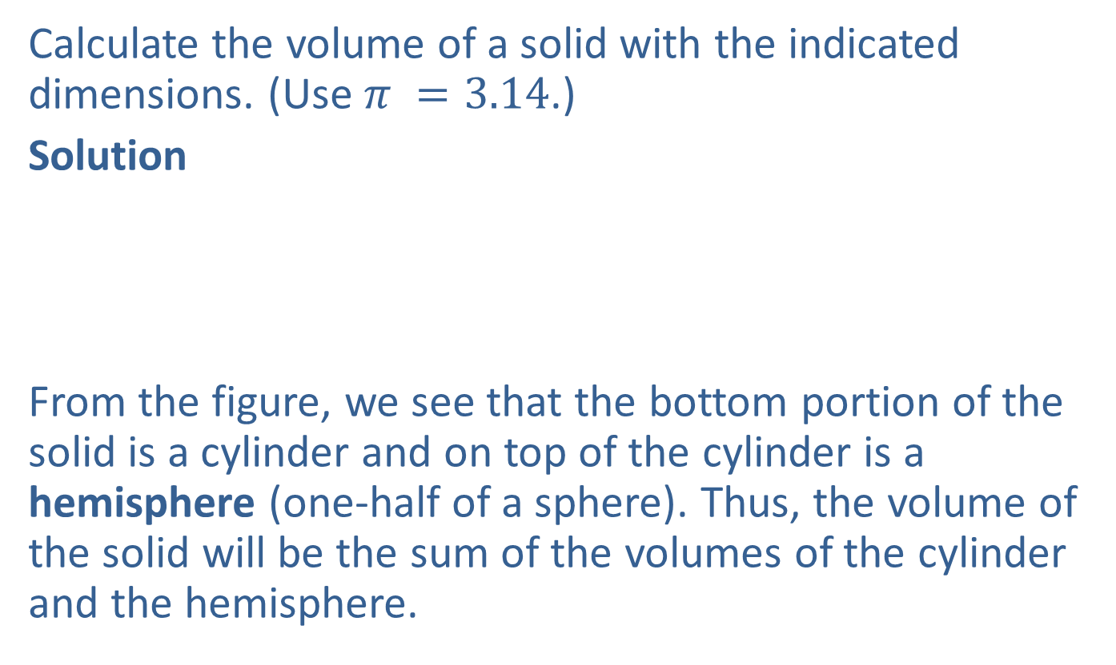
Example 4: Calculating the Volume of a Solid
Calculate the volume of a solid with the indicated dimensions. (Use $π =3.14$.)
Solution
From the figure, we see that the bottom portion of the solid is a cylinder and on top of the cylinder is a hemisphere (one-half of a sphere). Thus, the volume of the solid will be the sum of the volumes of the cylinder and the hemisphere.

Slide 11
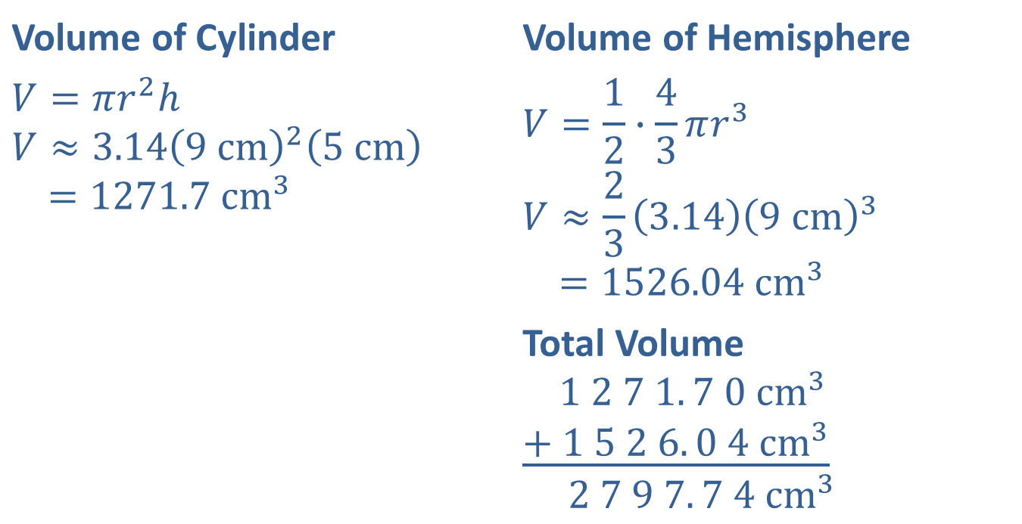

Example 4: Calculating the Volume of a Solid (cont.)
The volume of the solid is $2797.74 cm^{3}.$
Volume of Cylinder | Volume of Hemisphere
$$V=πr^{2}h$$ $$V≈3.14{\left(9 cm\right)}^{2}\left(5 cm\right)$$ $$=1271.7 cm^{3}$$ | $$V=\frac{1}{2}∙\frac{4}{3}πr^{3}$$ $$V≈\frac{2}{3}\left(3.14\right){\left(9 cm\right)}^{3}$$ $$=1526.04 cm^{3}$$
 | Total Volume $$1 2 7 1. 7 0 cm^{3}$$ $$\underline{+ 1 5 2 6. 0 4 cm^{3}}$$ $$2 7 9 7. 7 4 cm^{3}$$
Half the volume of a sphere

Slide 12
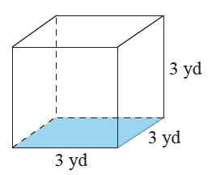

Example 5: Calculating the Volume of a Cube
Calculate the volume of the cube in both cubic yards and cubic feet. $\left(Remember, 1 yd=3 ft.\right)$
Solution

Slide 13
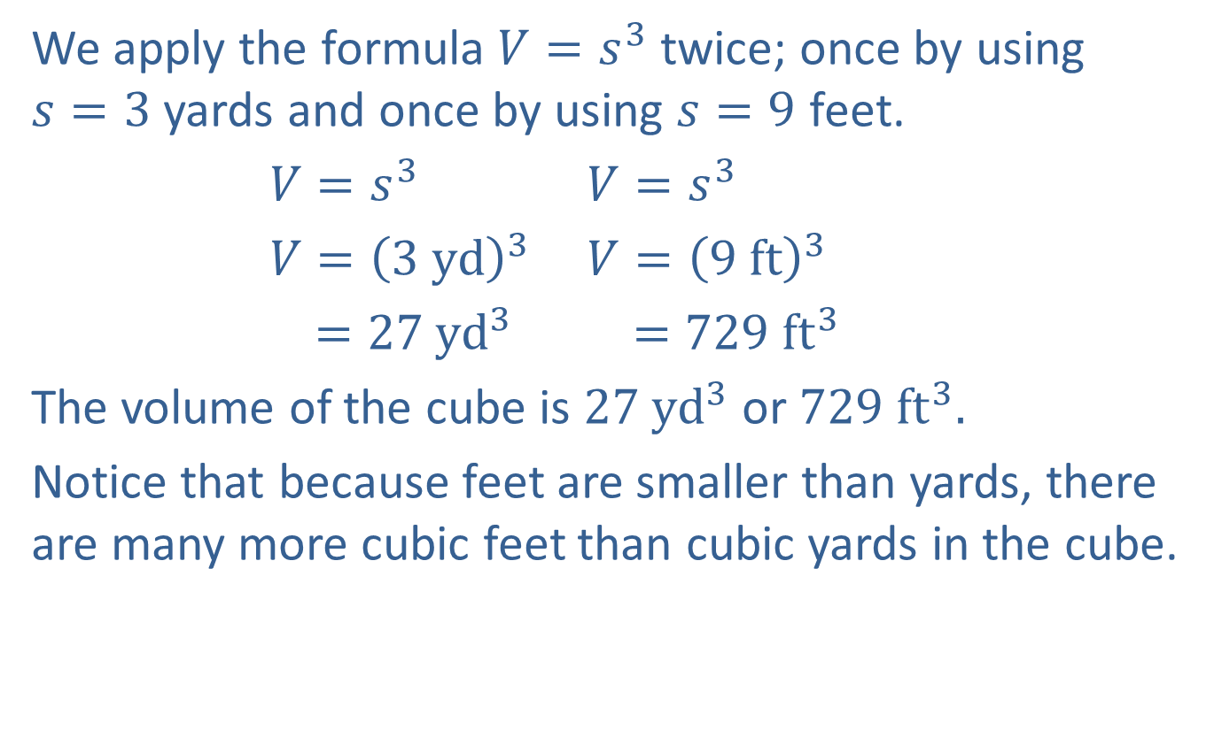
Example 5: Calculating the Volume of a Cube (cont.)
We apply the formula $V=s^{3}$ twice; once by using $s=3$ yards and once by using $s=9$ feet.
$V=s^{3}$ $V=s^{3}$
$V={\left(3 yd\right)}^{3}$ $V={\left(9 ft\right)}^{3}$
$=27 yd^{3}$ $=729 ft^{3}$
The volume of the cube is $27 yd^{3}$ or $729 ft^{3}.$
Notice that because feet are smaller than yards, there are many more cubic feet than cubic yards in the cube.

Slide 14
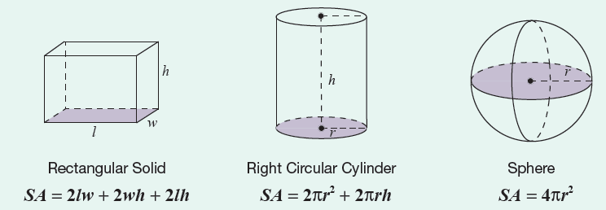
Formula: Surface Area Formulas for Three Geometric Solids

Slide 15
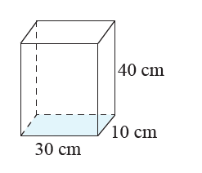

Example 6: Calculating the Surface Area of a Rectangular Solid
Calculate the surface area of a rectangular solid with length $30 cm$, width $10 cm$, and height $40 cm$.

Slide 16
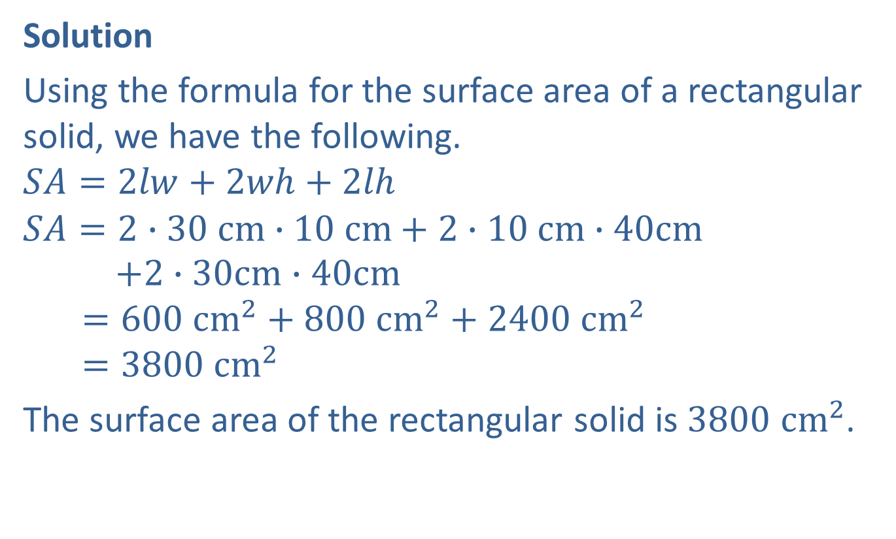
Example 6: Calculating the Surface Area of a Rectangular Solid (cont.)
Solution
Using the formula for the surface area of a rectangular solid, we have the following.
$$SA=2lw+2wh+2lh$$
$$SA=2∙30 cm∙10 cm+2∙10 cm∙40cm$$
$$+2∙30cm∙40cm$$
$$=600 cm^{2}+800 cm^{2}+2400 cm^{2}$$
$$=3800 cm^{2}$$
The surface area of the rectangular solid is $3800 cm^{2}$.

Slide 17
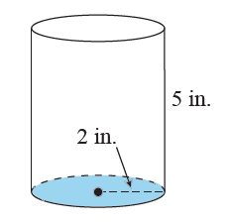

Example 7: Calculating the Surface Area of a Cylinder
Calculate the surface area of a coffee can in the shape of a cylinder with a height of $5$ in. and a circular base with a radius of $2$ in. $(Use π= 3.14.)$

Slide 18
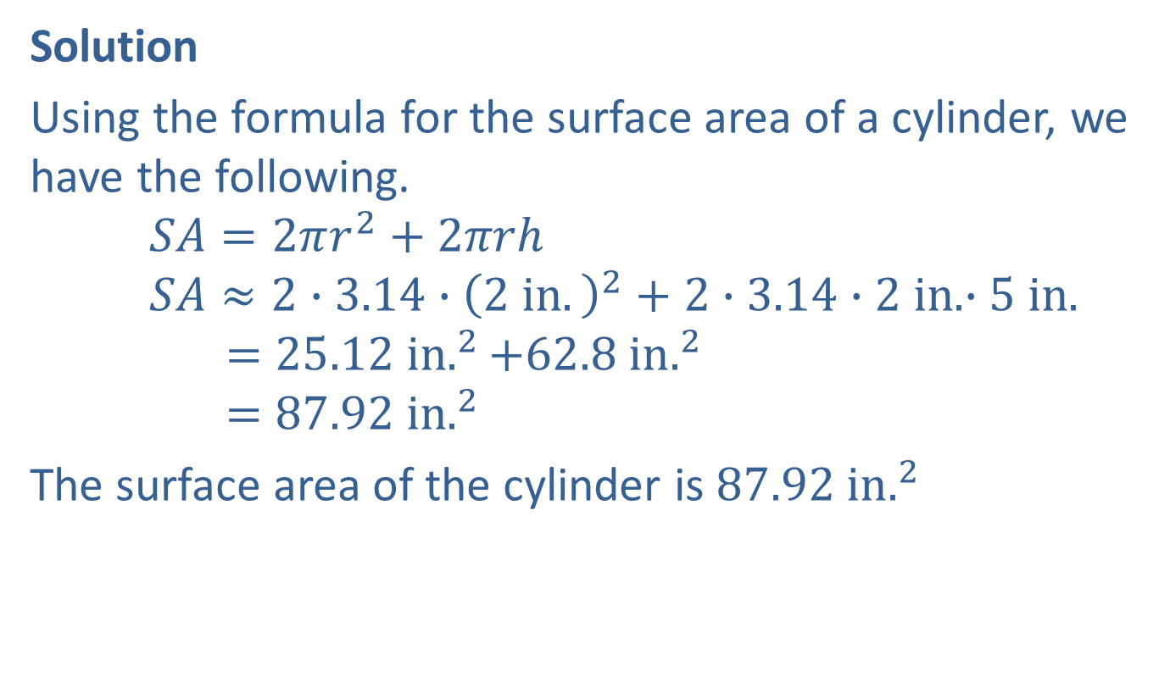
Example 7: Calculating the Surface Area of a Cylinder (cont.)
Solution
Using the formula for the surface area of a cylinder, we have the following.
$$SA=2πr^{2}+2πrh$$
$$SA≈2∙3.14∙{\left(2 in.\right)}^{2}+2∙3.14∙2 in.∙5 in.$$
$$=25.12 in.^{2}+62.8 i{n.}^{2}$$
$$=87.92 in.^{2}$$
The surface area of the cylinder is $87.92 in.^{2}$

