Slide 1
Section 6.9
Right Triangle Trigonometry

Slide 2
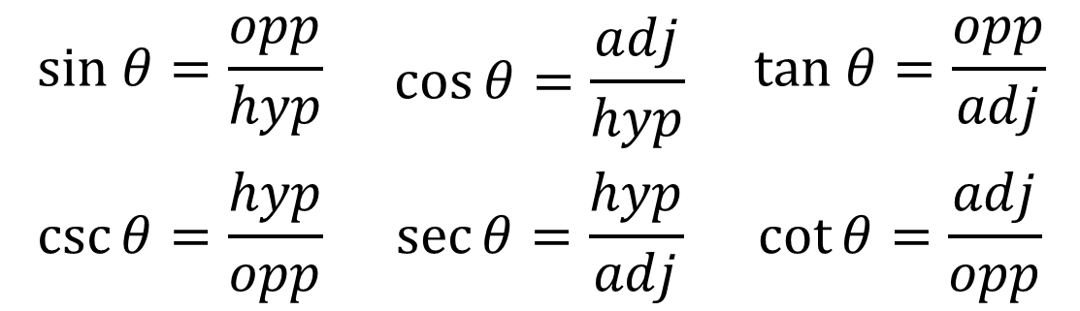
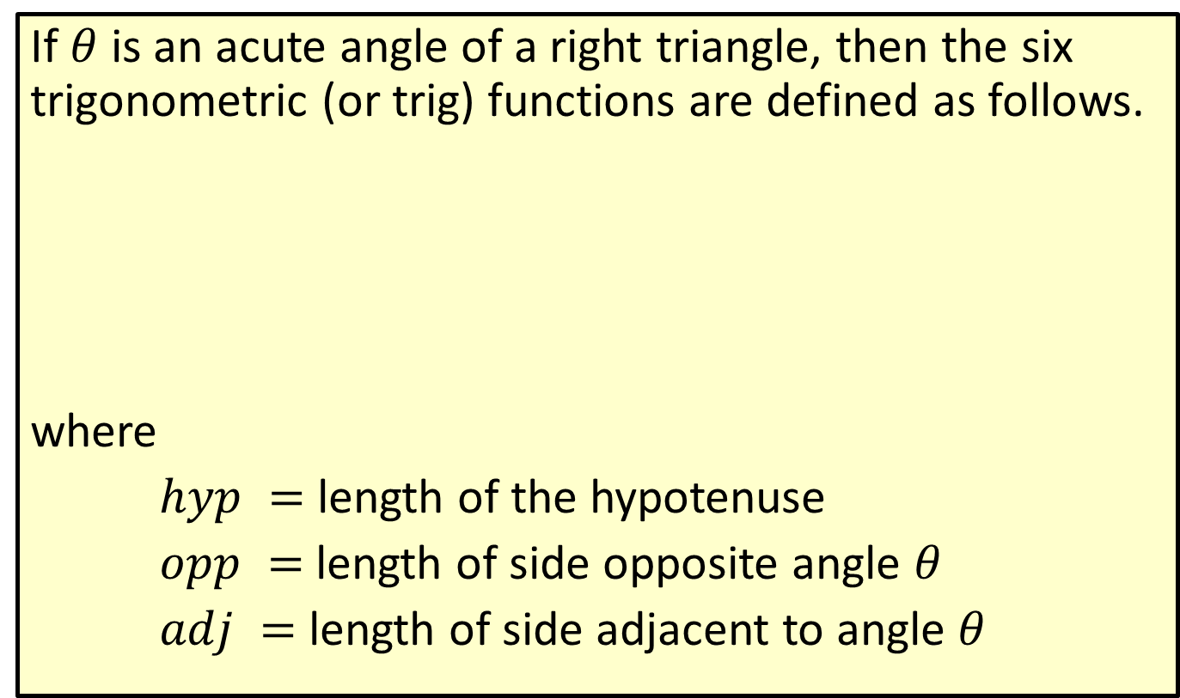
Definition: Trigonometric Functions
If $θ$ is an acute angle of a right triangle, then the six trigonometric (or trig) functions are defined as follows.
where
$hyp =$ length of the hypotenuse
$opp =$ length of side opposite angle $θ$
$adj =$length of side adjacent to angle $θ$
$$sin θ=\frac{opp}{hyp}$$ | $$\cos{θ=\frac{adj}{hyp}}$$ | $$tan θ=\frac{opp}{adj}$$
$$\csc{θ}=\frac{hyp}{opp}$$ | $$\sec{θ}=\frac{hyp}{adj}$$ | $$\cot{θ=\frac{adj}{opp}}$$

Slide 3
Note
In this text only the first three functions (sin, cos, and tan) will be used in the examples and exercises. These are the functions used most frequently in applications. The second three functions (csc, sec, and cot) are the reciprocals of the respective first three functions, respectively.

Slide 4
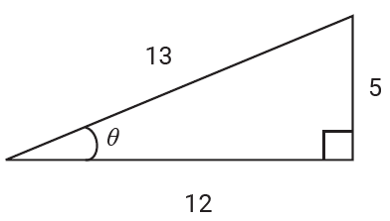
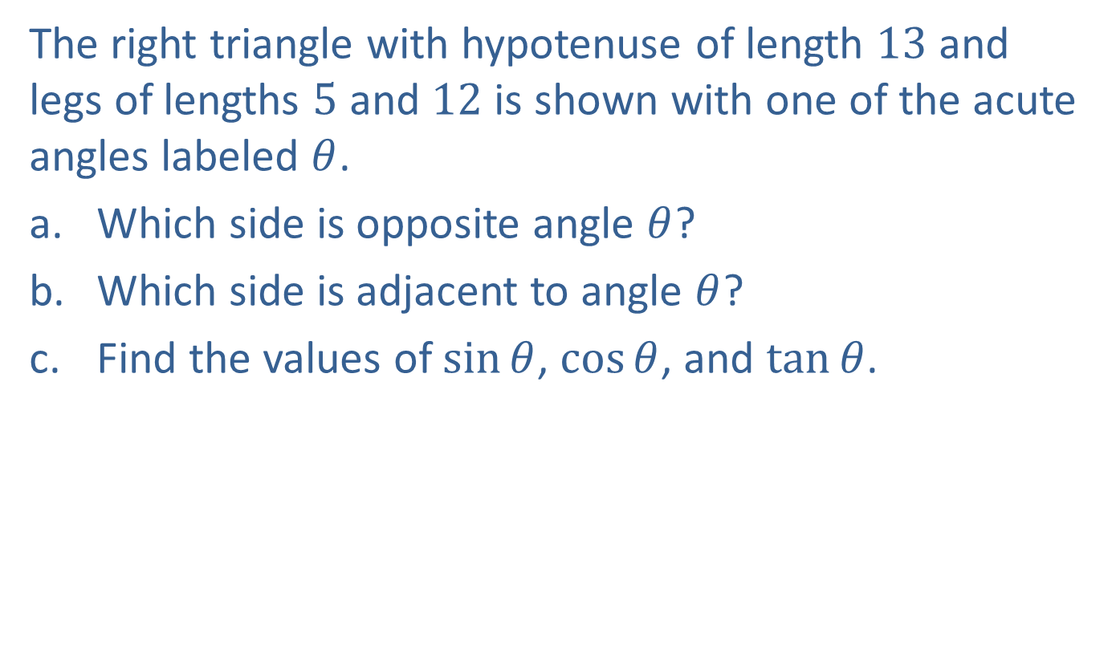
Example 1: Finding Values of Trig Functions
The right triangle with hypotenuse of length $13$ and legs of lengths $5$ and $12$ is shown with one of the acute angles labeled $θ$.
​Which side is opposite angle $θ$?
​Which side is adjacent to angle $θ$?
​Find the values of $sin⁡θ$, $cos⁡θ$, and $tan⁡θ$.

Slide 5
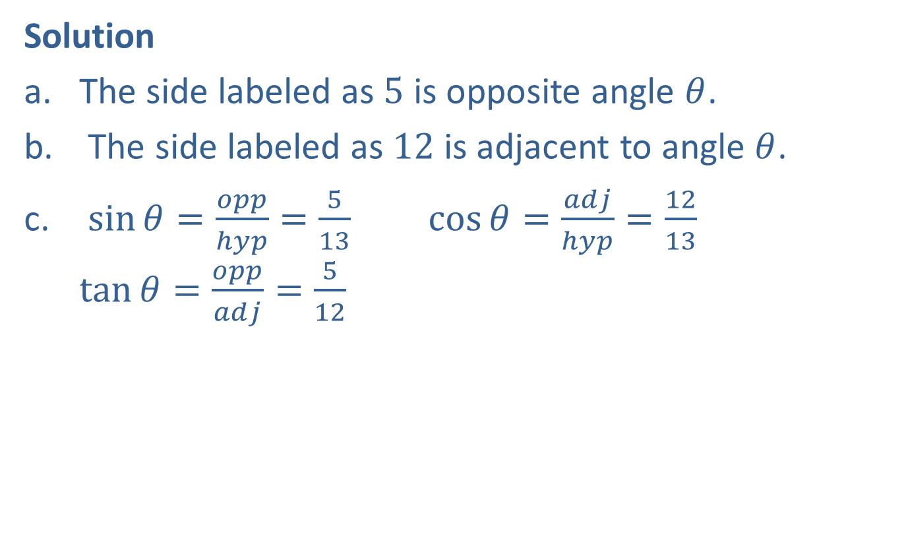
Example 1: Finding Values of Trig Functions (cont.)
Solution
The side labeled as $5$ is opposite angle $θ$.
The side labeled as $12$ is adjacent to angle $θ$.
$\sin{θ}=\frac{opp}{hyp}=\frac{5}{13}$ $\cos{θ=\frac{adj}{hyp}=\frac{12}{13}}$ $\tan{θ=\frac{opp}{adj}=\frac{5}{12}}$

Slide 6
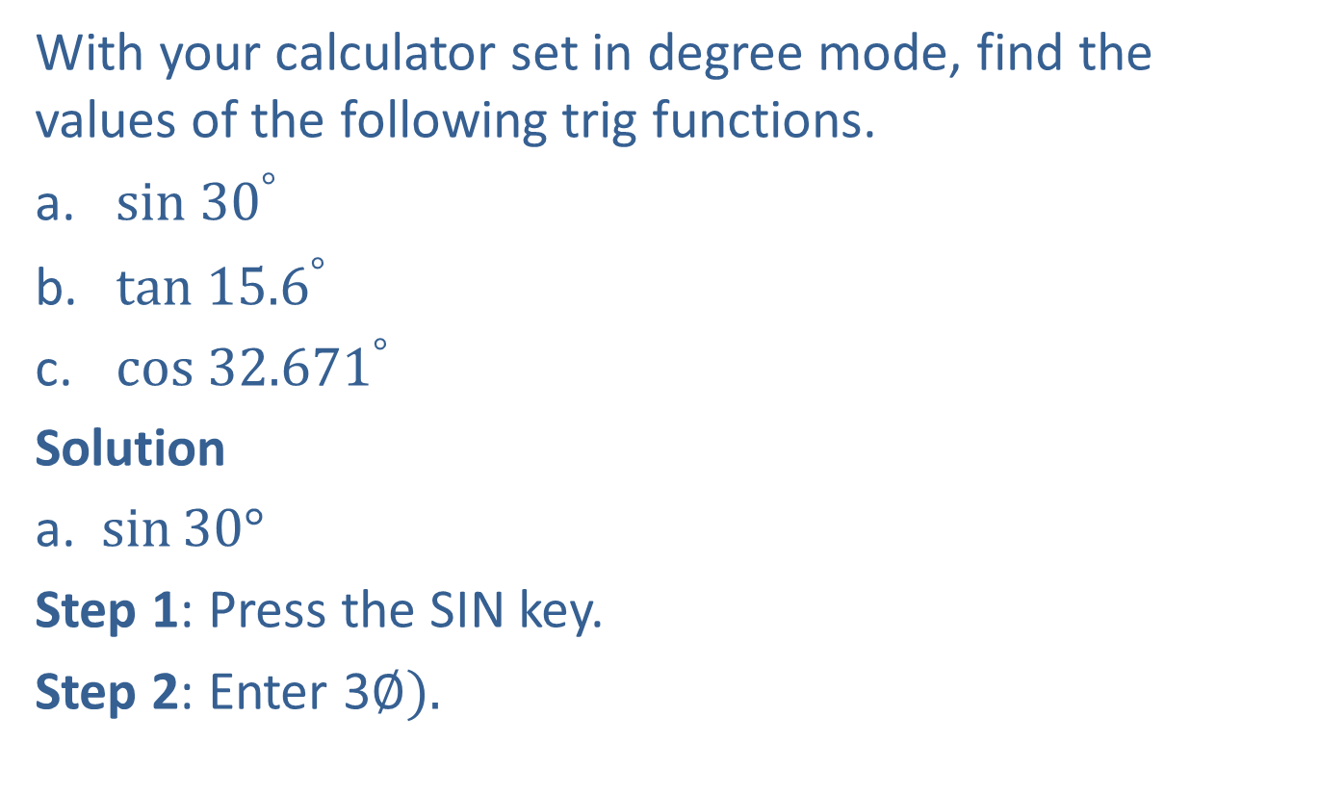
Example 2: Using a Calculator to Find Values of Trig Functions
With your calculator set in degree mode, find the values of the following trig functions.
​$sin {30}^{°}⁡$
​$tan {15.6}^{°}⁡$
​$cos{ 32.671}^{°}⁡$
Solution
a. $\sin{30°}$
Step 1: Press the SIN key.
Step 2: Enter 3$∅).$​

Slide 7
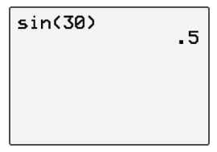
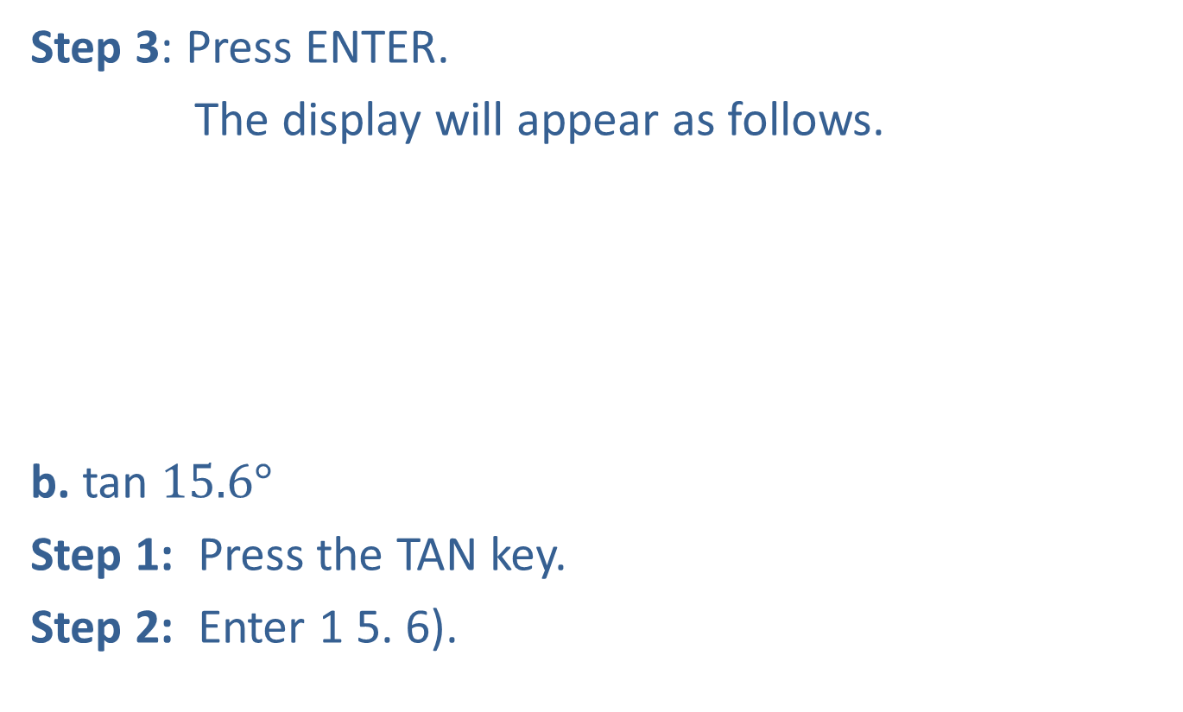
Example 2: Using a Calculator to Find Values of Trig Functions (cont.)
Step 3: Press ENTER.
The display will appear as follows.
b. tan $15.6°$
Step 1: Press the TAN key.
Step 2: Enter 1 5. 6).

Slide 8
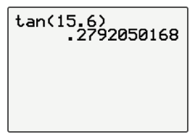
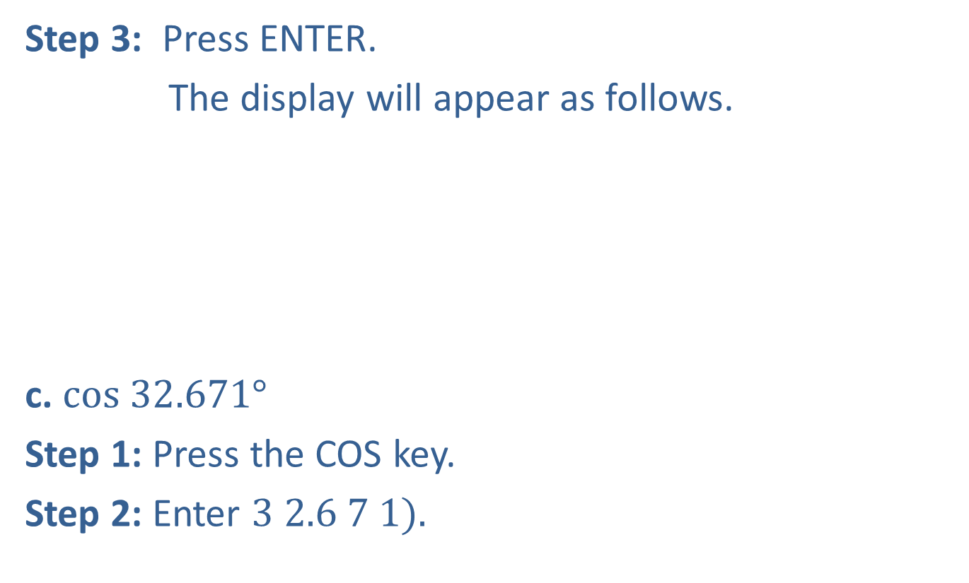
Example 2: Using a Calculator to Find Values of Trig Functions (cont.)
Step 3: Press ENTER.
The display will appear as follows.
c. $cos 32.671°$
Step 1: Press the COS key.
Step 2: Enter $3 2.6 7 1).$

Slide 9
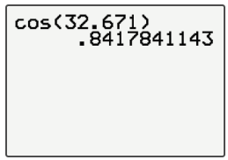
Example 2: Using a Calculator to Find Values of Trig Functions (cont.)
Step 3: Press ENTER.
The display will appear as follows.

Slide 10
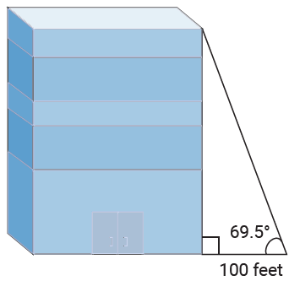
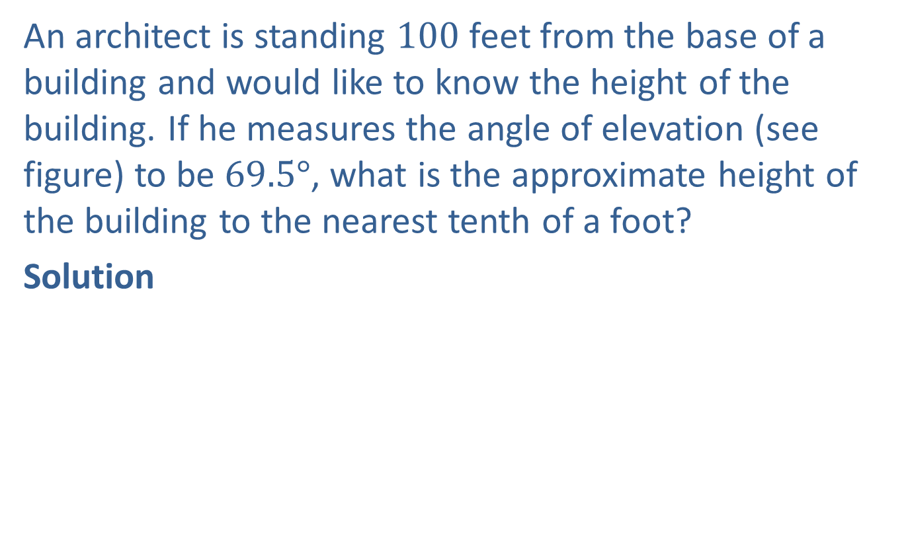
Example 3: Solving a Right Triangle
An architect is standing $100$ feet from the base of a building and would like to know the height of the building. If he measures the angle of elevation (see figure) to be $69.5°$, what is the approximate height of the building to the nearest tenth of a foot?
Solution

Slide 11
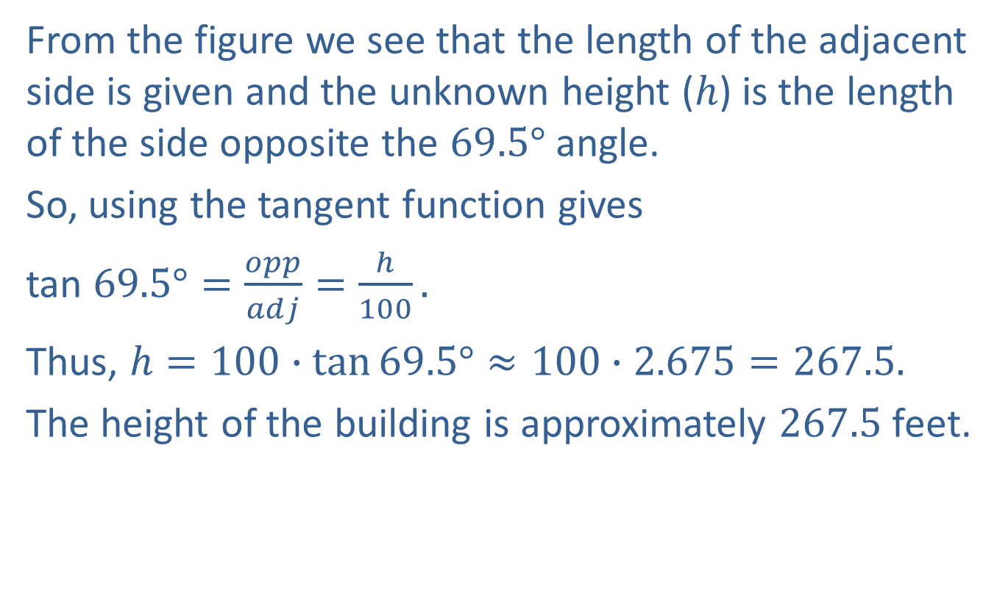
Example 3: Solving a Right Triangle (cont.)
From the figure we see that the length of the adjacent side is given and the unknown height ($h$) is the length of the side opposite the $69.5°$ angle.
So, using the tangent function gives
tan $69.5°=\frac{opp}{adj}=\frac{h}{100}.$
Thus, $h=100∙\tan{69.5°}≈100∙2.675=267.5.$
The height of the building is approximately $267.5$ feet.

Slide 12
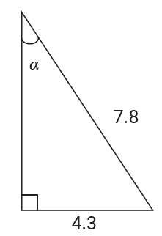
Example 4: Solving a Right Triangle
Determine the measure of the acute angle α (the Greek letter alpha), to the nearest tenth, in the following right triangle.

Slide 13
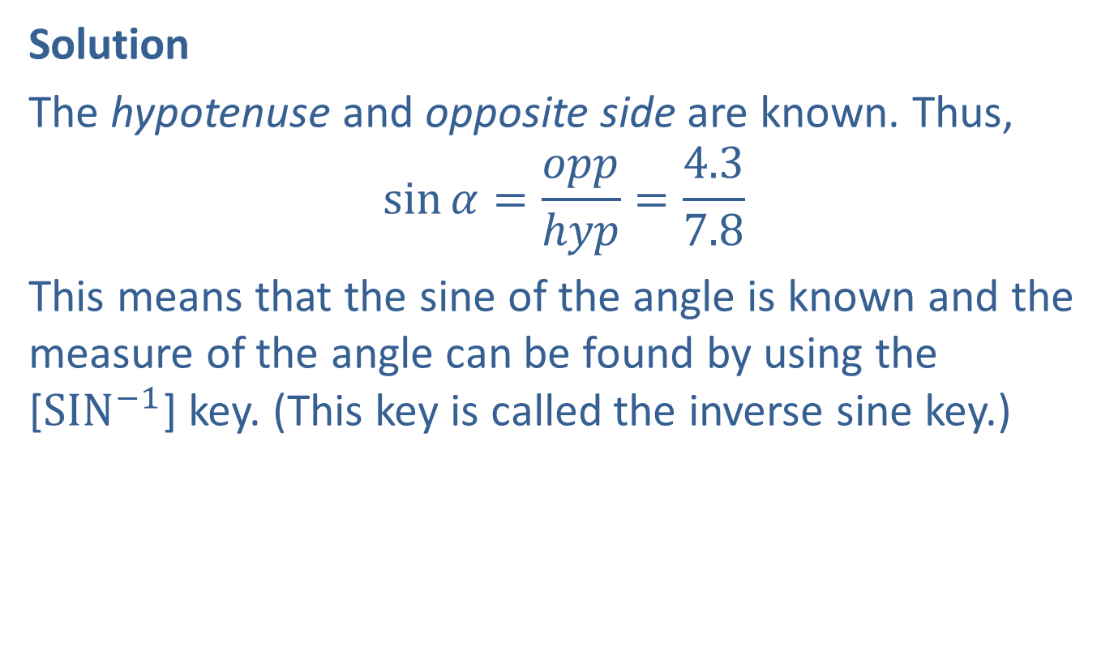
Example 4: Solving a Right Triangle (cont.)
Solution
The hypotenuse and opposite side are known. Thus,
$$\sin{α=\frac{opp}{hyp}=\frac{4.3}{7.8}}$$
This means that the sine of the angle is known and the measure of the angle can be found by using the [${SIN}^{−1}$] key. (This key is called the inverse sine key.)

Slide 14
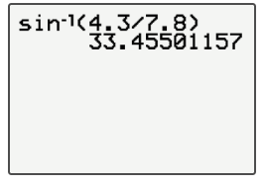
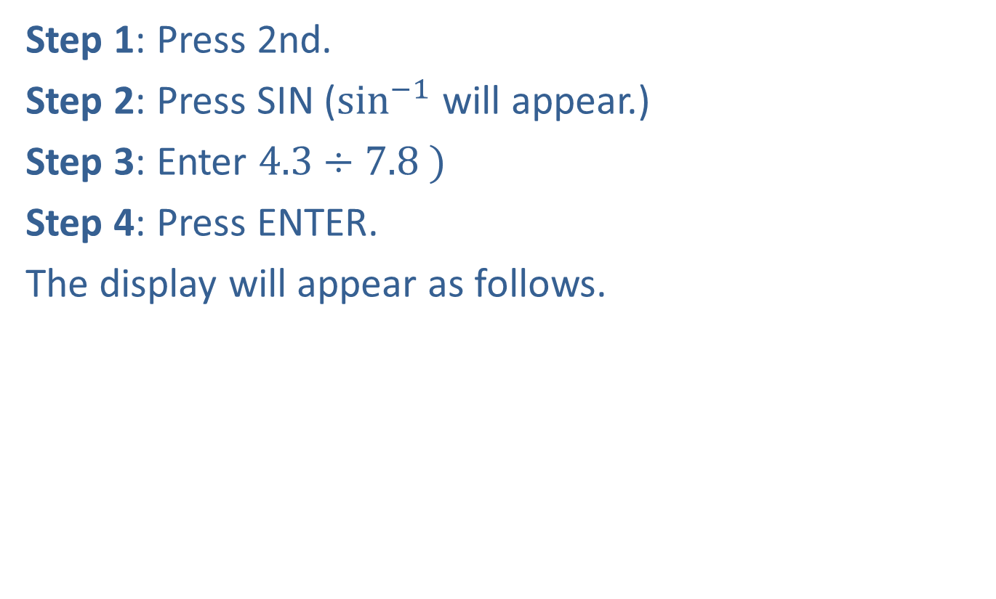
Example 4: Solving a Right Triangle (cont.)
Step 1: Press 2nd.
Step 2: Press SIN ($\sin^{−1}$ will appear.)
Step 3: Enter $4.3÷7.8 )$
Step 4: Press ENTER.
The display will appear as follows.

Slide 15

Example 4: Solving a Right Triangle (cont.)
Thus, $α≈33.5°.$
(Note about rounding. Dividing first gives $\frac{4.3}{7.8}≈0.55.$ If we then calculate $\sin^{−1}(0.55){ }$the answer will be $33.4°$ because of rounding in an intermediate step.)

