Slide 1
Section 7.1
Percents

Slide 2



Example 1: Changing between Percents and Decimal Numbers
​Change $0.254$ to a percent.
​Change $76\%$ to a decimal number.
Solution
a. $0.25.4=25.4\%$
b. $76.\% = 0.76$
$\%$ symbol added.
Decimal point moved two places to the right
$\%$ symbol dropped.
Understood decimal point
Decimal point moved two places to the left

Slide 3
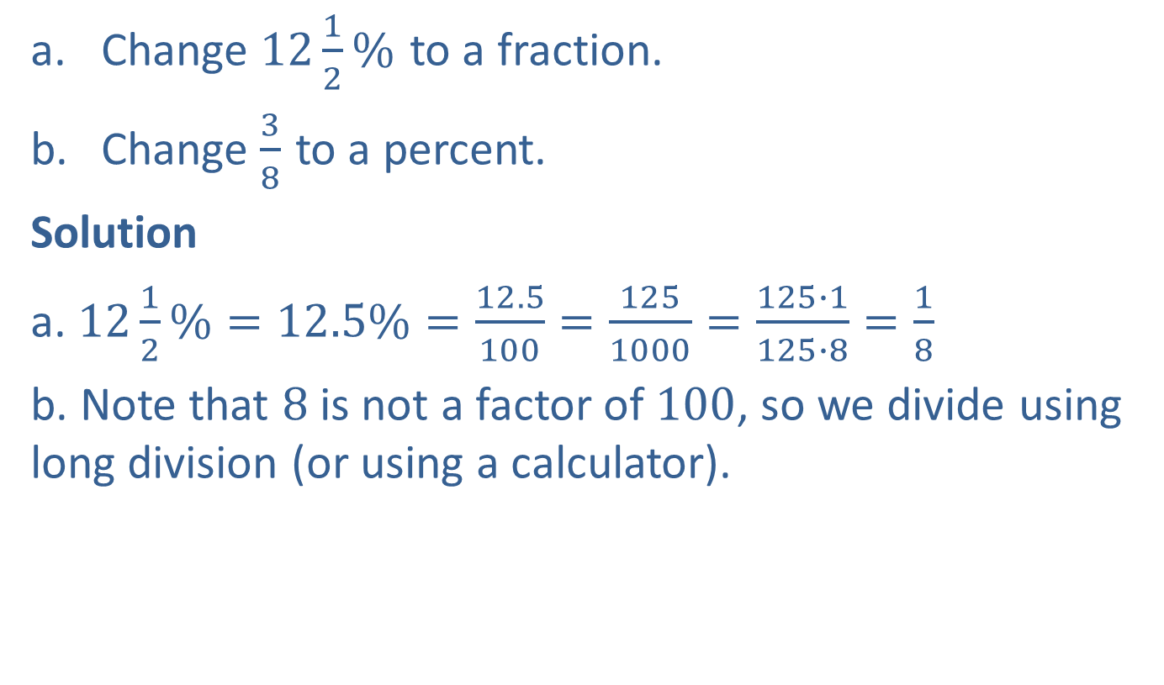
Example 2: Changing between Percents and Fractions
​Change $12\frac{1}{2}\%$ to a fraction.
​Change $\frac{3}{8}$ to a percent.
Solution
a. $12\frac{1}{2}\%=12.5\%=\frac{12.5}{100}=\frac{125}{1000}=\frac{125∙1}{125∙8}=\frac{1}{8}$
b. Note that $8$is not a factor of $100$, so we divide using long division (or using a calculator).

Slide 4
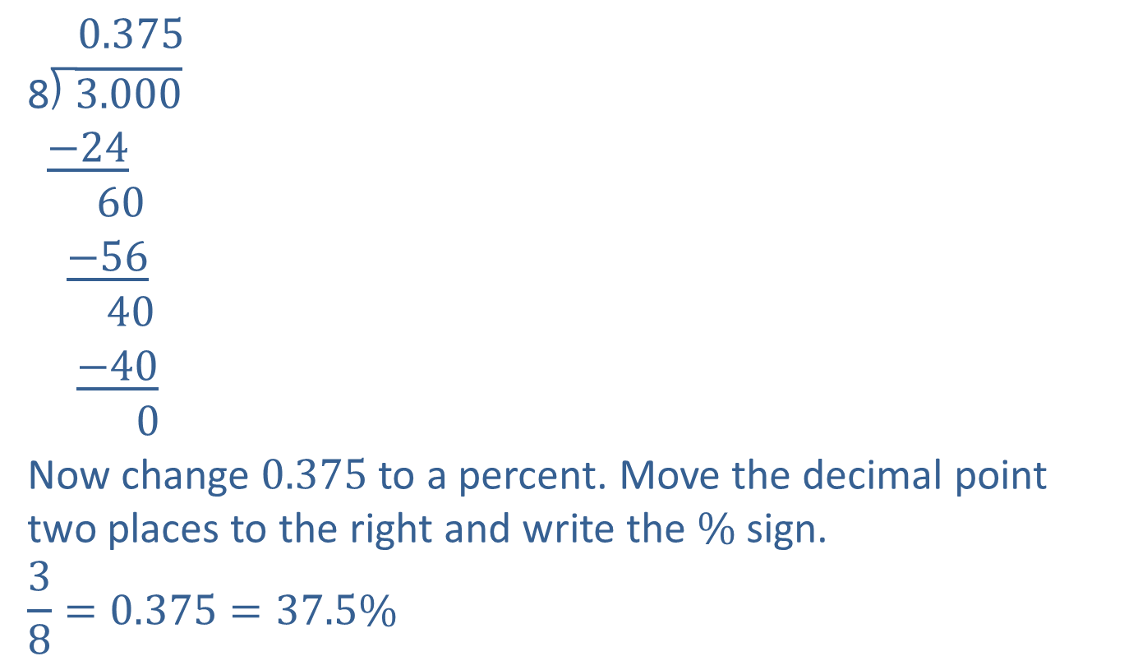
Example 2: Changing between Percents and Fractions (cont.)
$0.375$
$$\text{8}\text{⟌}\overline{3.000}$$
$$\underline{−24}$$
$$60$$
$$\underline{−56}$$
$$40$$
$$\underline{−40}$$
$$0$$
Now change $0.375$ to a percent. Move the decimal point two places to the right and write the $\%$sign.
$$\frac{3}{8}=0.375=37.5\%$$

Slide 5
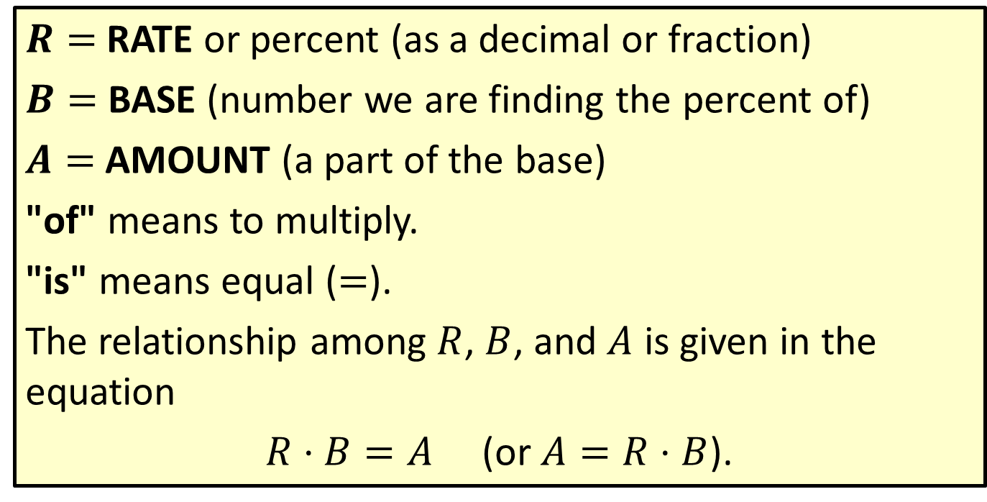

Formula: The Basic Formula $R$ ⋅ $B$ = $A$
$R=$ RATE or percent (as a decimal or fraction)
$B=$ BASE (number we are finding the percent of)
$A=$ AMOUNT (a part of the base)
"of" means to multiply.
"is" means equal ($=$).
The relationship among $R$, $B$, and $A$ is given in the equation
$R⋅B=A$ (or $A=R⋅B$).

Slide 6

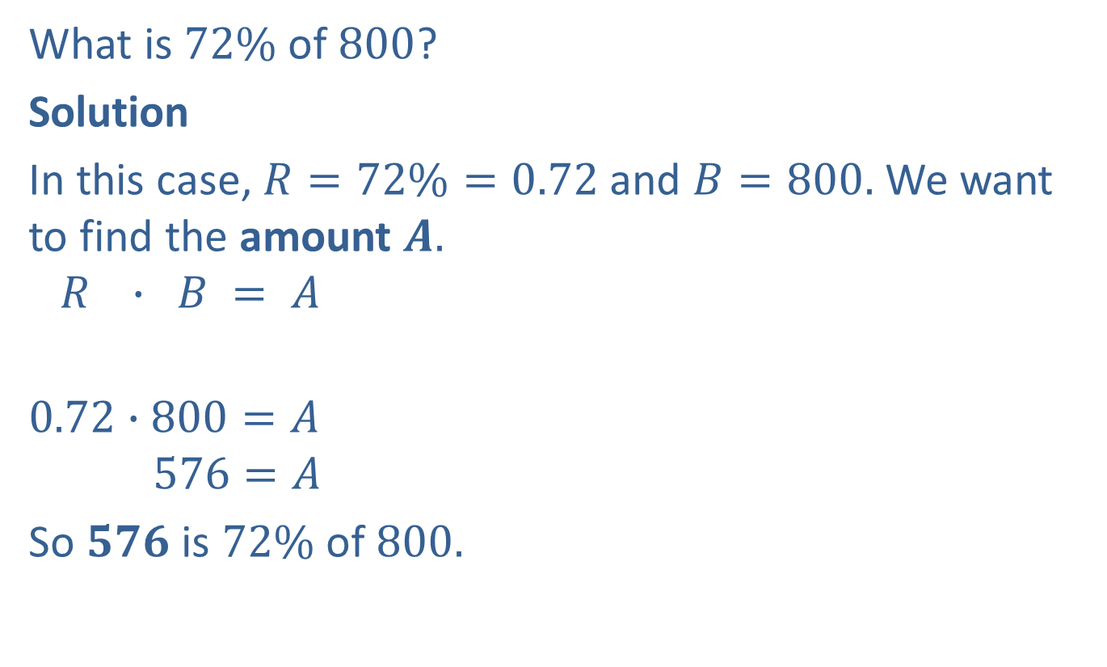
Example 3: Finding the Amount
What is $72\%$ of $800$?
Solution
In this case, $R=72\%=0.72$ and $B=800.$ We want to find the amount $A.$
$$R ∙ B = A$$
$$0.72∙800=A$$
$$576=A$$
So $576$ is $72\%$ of $800.$
Here, simply multiply to find $A$.

Slide 7

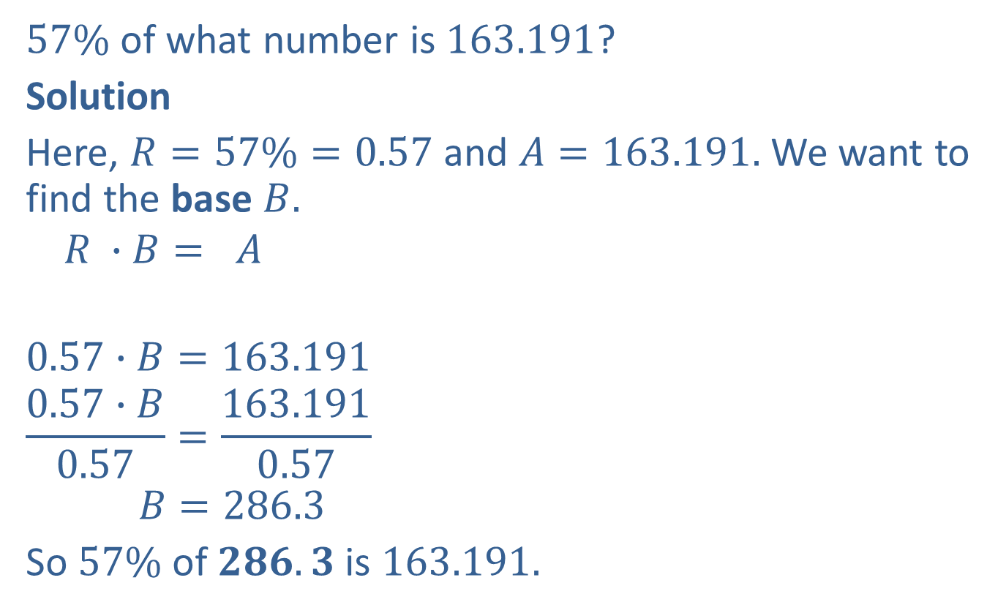
Example 4: Finding the Base
$57\%$ of what number is $163.191$?
Solution
Here, $R=57\%=0.57$ and $A=163.191.$ We want to find the base $B.$
$$R ∙B= A$$
$$0.57∙B=163.191$$
$$\frac{0.57∙B}{0.57}=\frac{163.191}{0.57}$$
$$B=286.3$$
So $57\%$ of $286.3$ is $163.191.$
Now divide both sides by $0.57$ to find $B$.

Slide 8

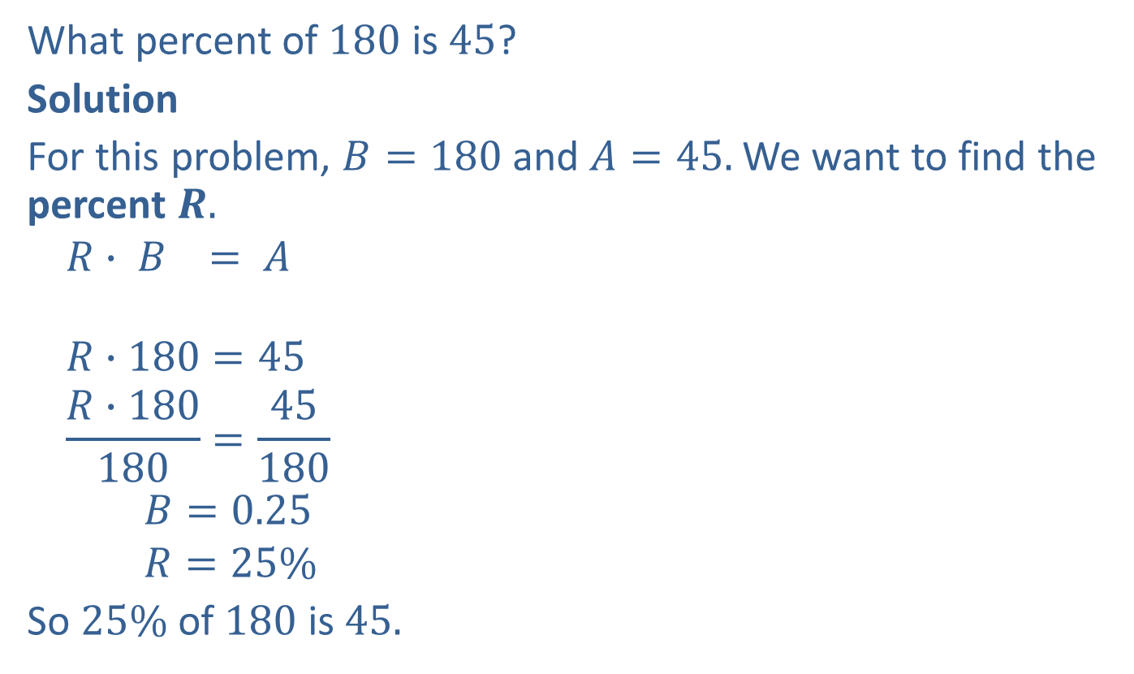
Example 5: Finding the Percent
What percent of $180$ is $45$?
Solution
For this problem, $B=180$ and $A=45.$ We want to find the percent $R.$
$$R∙ B = A$$
$$R∙180=45$$
$$\frac{R∙180}{180}=\frac{45}{180}$$
$$B=0.25$$
$$R=25\%$$
So $25\%$ of $180$ is $45.$
Now divide both sides by $180$ to find $R$.
Write the decimal in percent form.

Slide 9
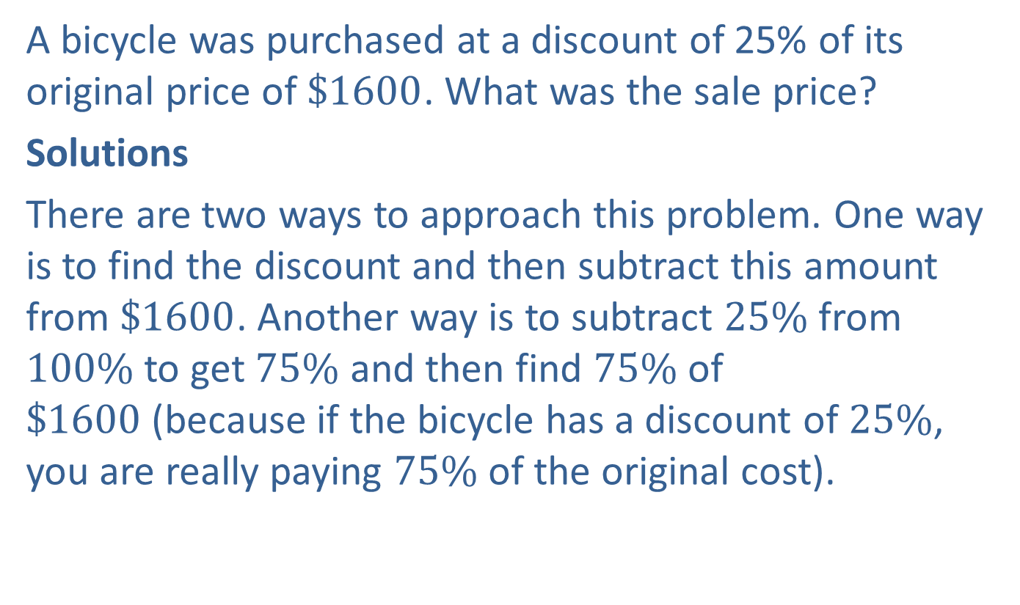
Example 6: Application: Finding a Discount
A bicycle was purchased at a discount of 25% of its original price of $\$1600$. What was the sale price?
Solutions
There are two ways to approach this problem. One way is to find the discount and then subtract this amount from $\$1600$. Another way is to subtract $25\%$ from $100\%$to get $75\%$ and then find $75\%$ of $\$1600$(because if the bicycle has a discount of $25\%$, you are really paying $75\%$ of the original cost).

Slide 10
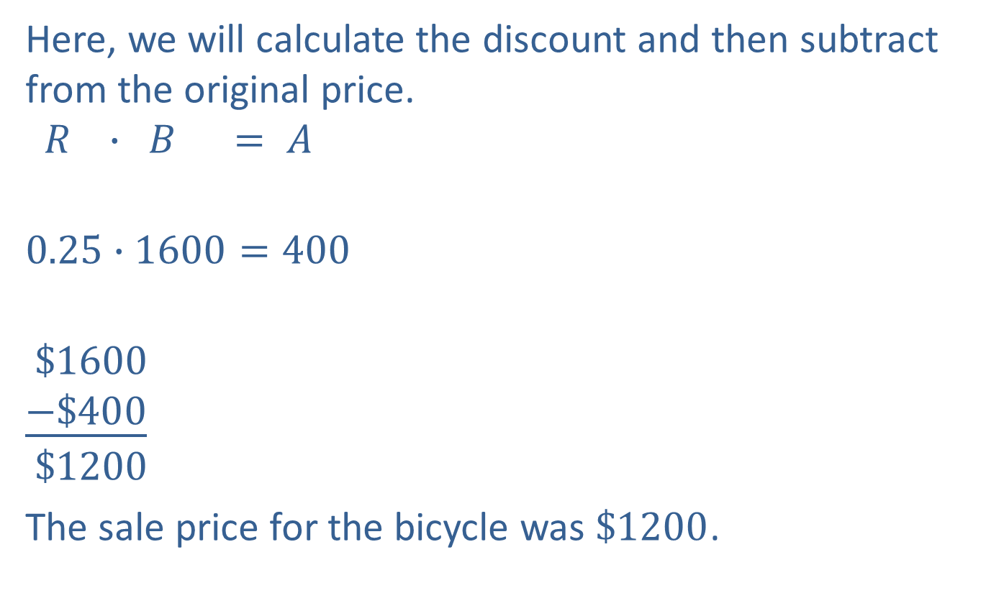
Example 6: Application: Finding a Discount (cont.)
Here, we will calculate the discount and then subtract from the original price.
$$R ∙ B = A$$
$$0.25∙1600=400$$
$$\$1600$$
$$\underline{−\$400}$$
$$\$1200$$
The sale price for the bicycle was $\$1200$.
Discount
Original price
Discount
Sale Price

Slide 11
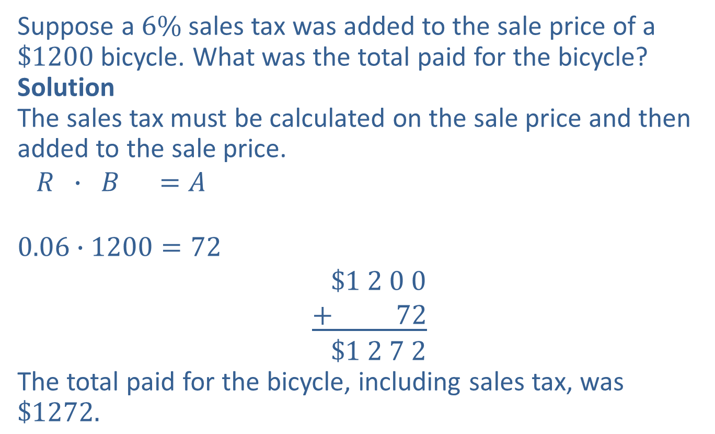
Example 7: Application: Calculating Sales Tax
Suppose a $6\%$ sales tax was added to the sale price of a $\$1200$bicycle. What was the total paid for the bicycle?
Solution
The sales tax must be calculated on the sale price and then added to the sale price.
$$R ∙ B =A$$
$$0.06∙1200=72$$
$$\$1 2 0 0$$
$$\underline{+ 72}$$
$$\$1 2 7 2$$
The total paid for the bicycle, including sales tax, was $\$1272.$
Sales tax
Sales price
Sales tax
Total paid

Slide 12
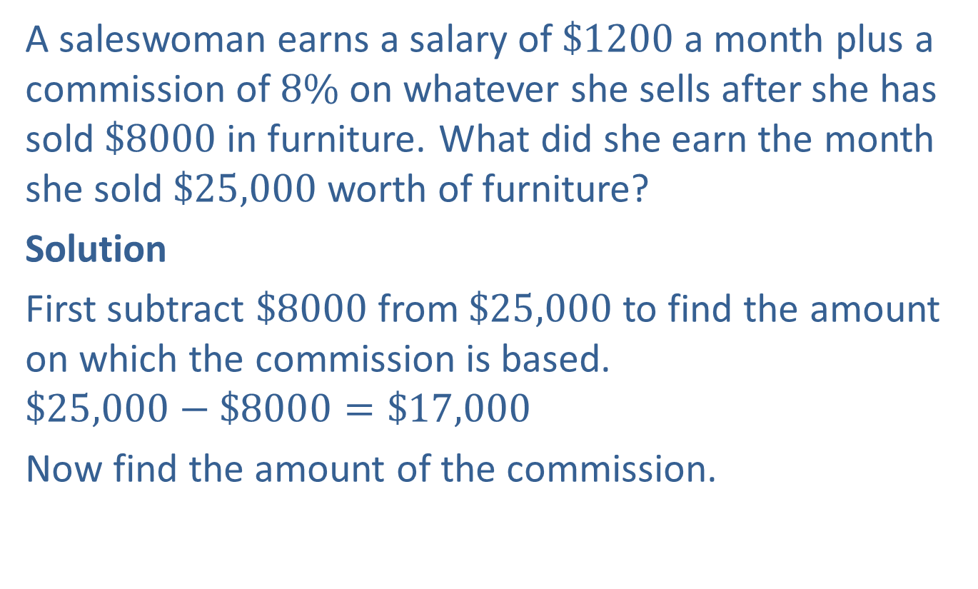
Example 8: Application: Determining Commission
A saleswoman earns a salary of $\$1200$a month plus a commission of $8\%$on whatever she sells after she has sold $\$8000$in furniture. What did she earn the month she sold $\$25,000$worth of furniture?
Solution
First subtract $\$8000$from $\$25,000$to find the amount on which the commission is based.
$$\$25,000−\$8000=\$17,000$$
Now find the amount of the commission.

Slide 13
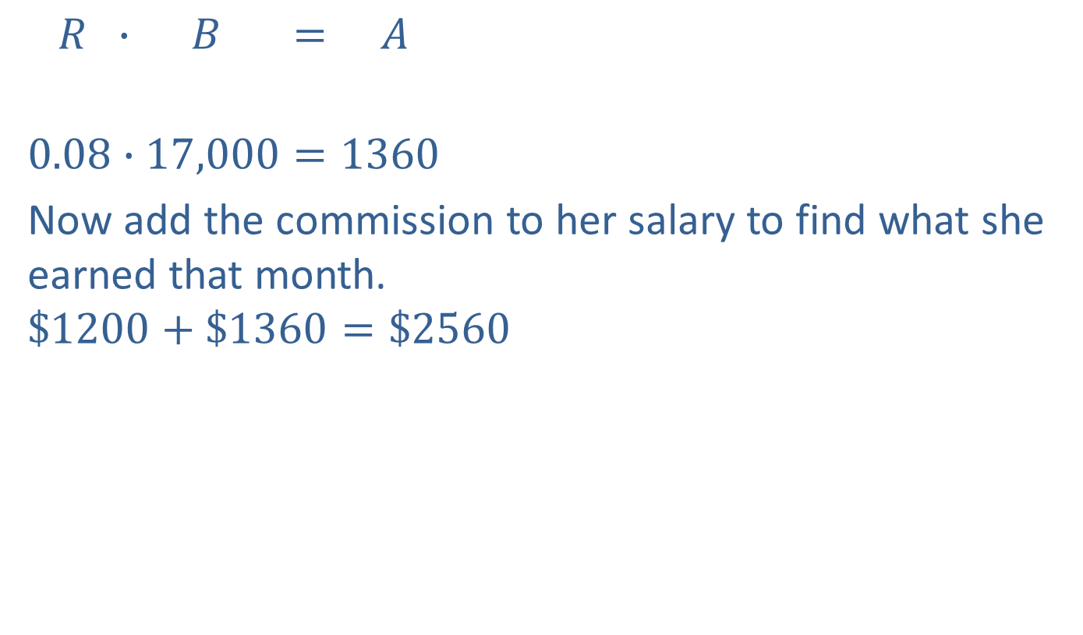
Example 8: Application: Determining Commission (cont.)
$$R ∙ B = A$$
$$0.08∙17,000=1360$$
Now add the commission to her salary to find what she earned that month.
$$\$1200+\$1360=\$2560$$
Commission
Earned for the month

Slide 14
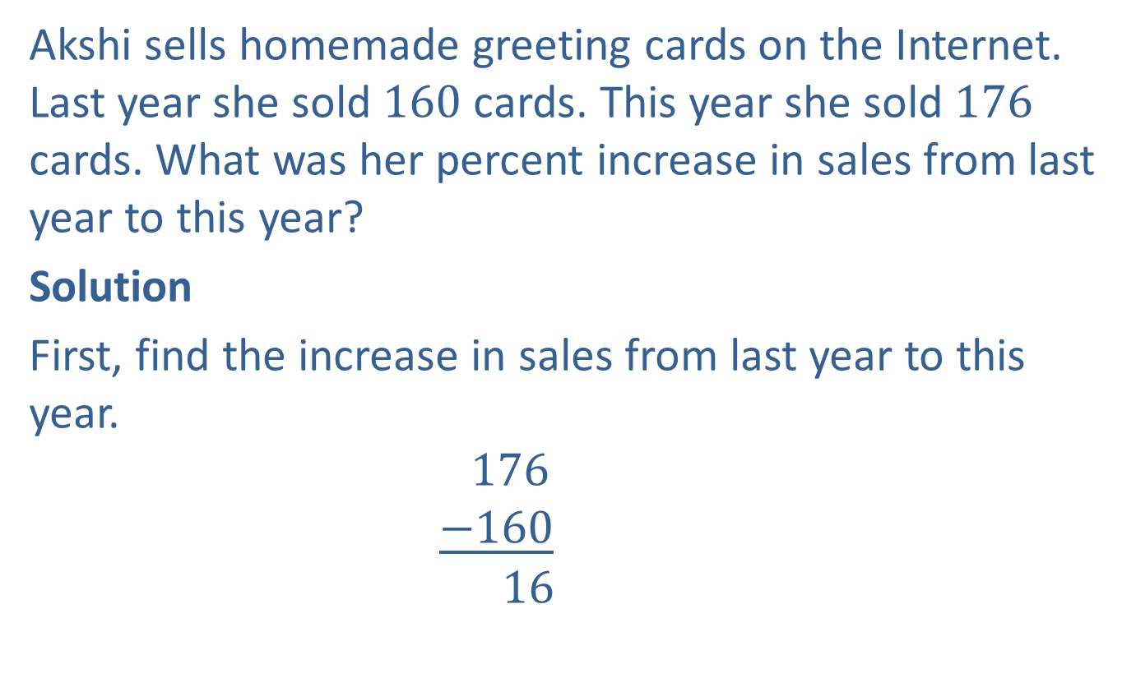
Example 9: Application: Calculating Percent Increase
Akshi sells homemade greeting cards on the Internet. Last year she sold $160$ cards. This year she sold $176$ cards. What was her percent increase in sales from last year to this year?
Solution
First, find the increase in sales from last year to this year.
$$176$$
$$\underline{−160}$$
$$16$$
This year’s sales
Last year’s sales
Amount of change

Slide 15
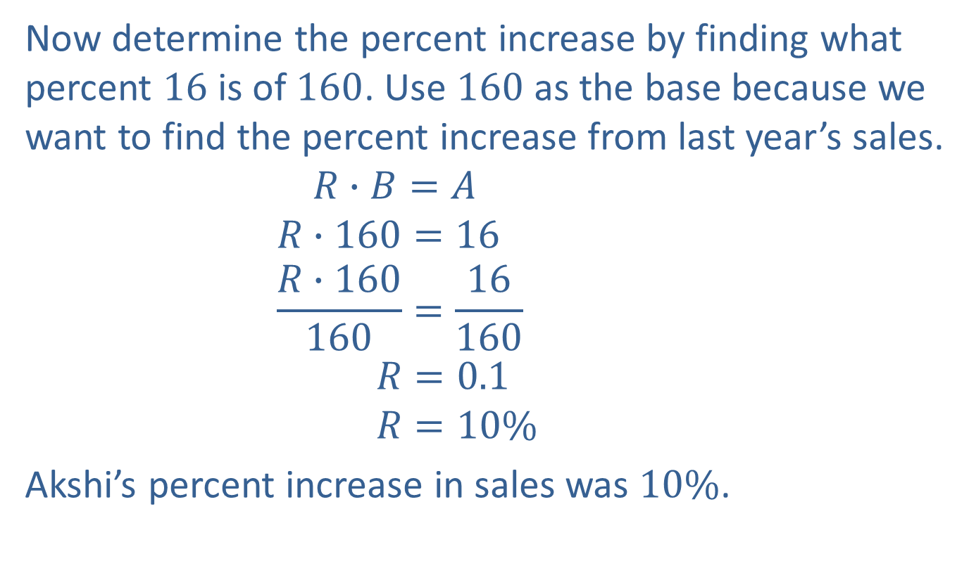
Example 9: Application: Calculating Percent Increase (cont.)
Now determine the percent increase by finding what percent $16$ is of $160$. Use $160$ as the base because we want to find the percent increase from last year’s sales.
$$R∙B=A$$
$$R∙160=16$$
$$\frac{R∙160}{160}=\frac{16}{160}$$
$$R=0.1$$
$$R=10\%$$
Akshi’s percent increase in sales was $10\%$.

Slide 16
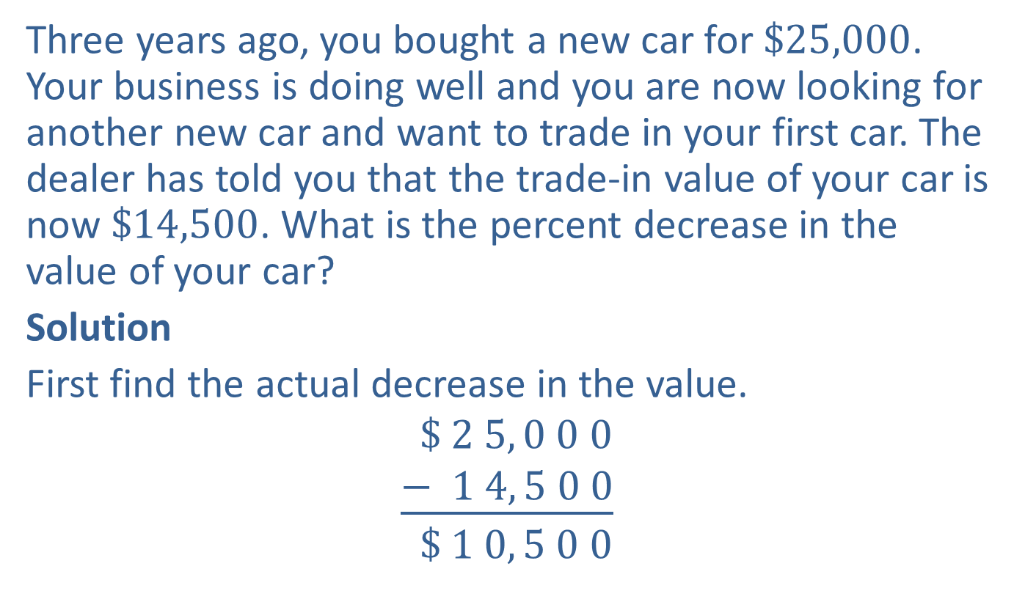
Example 10: Application: Calculating Percent Decrease
Three years ago, you bought a new car for $\$25,000$. Your business is doing well and you are now looking for another new car and want to trade in your first car. The dealer has told you that the trade-in value of your car is now $\$14,500$. What is the percent decrease in the value of your car?
Solution
First find the actual decrease in the value.
$$\$ 2 5, 0 0 0$$
$$\underline{− 1 4, 5 0 0}$$
$$\$ 1 0, 5 0 0$$
Original price
Current price
Decrease in value

Slide 17
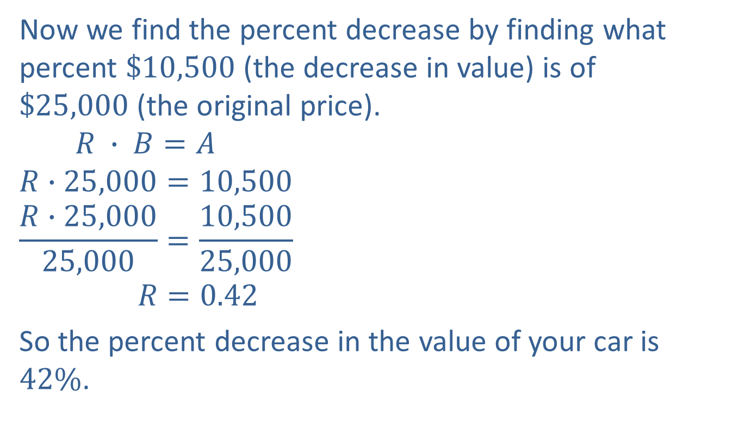
Example 10: Application: Calculating Percent Decrease (cont.)
Now we find the percent decrease by finding what percent $\$10,500$(the decrease in value) is of $\$25,000$(the original price).
$$R ∙ B=A$$
$$R∙25,000=10,500$$
$$\frac{R∙25,000}{25,000}=\frac{10,500}{25,000}$$
$$R=0.42$$
So the percent decrease in the value of your car is $42\%$.

Slide 18
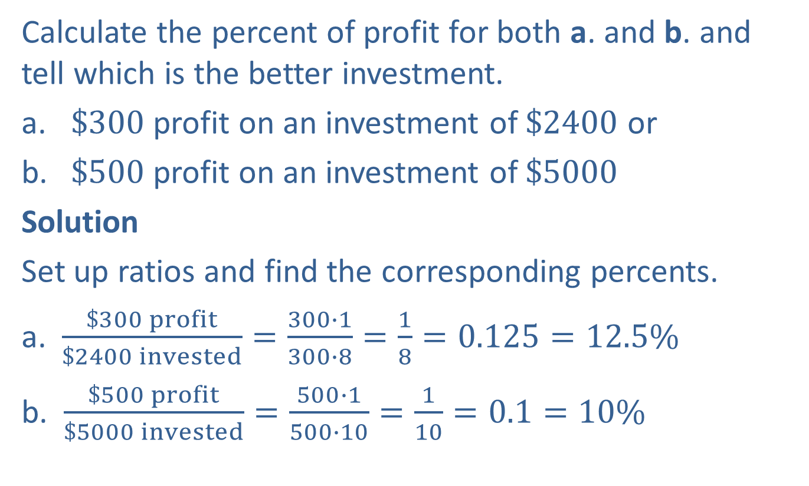
Example 11: Application: Calculating the Percent of Profit
Calculate the percent of profit for both a. and b. and tell which is the better investment.
​$\$300$ profit on an investment of $\$2400$ or
​$\$500$ profit on an investment of $\$5000$
Solution
Set up ratios and find the corresponding percents.
a. $\frac{\$300 profit}{\$2400 invested}=\frac{300∙1}{300∙8}=\frac{1}{8}=0.125=12.5\%$
b. $\frac{\$500 profit}{\$5000 invested}=\frac{500∙1}{500∙10}=\frac{1}{10}=0.1=10\%$
Percent of profit
Percent of profit

Slide 19

Example 11: Application: Calculating the Percent of Profit (cont.)
Clearly, $\$500$is more than $\$300$, but $12.5\%$ is greater than $10\%$, and investment a. is the better investment.

