Slide 1
Section 7.2
Simple and Compound Interest

Slide 2
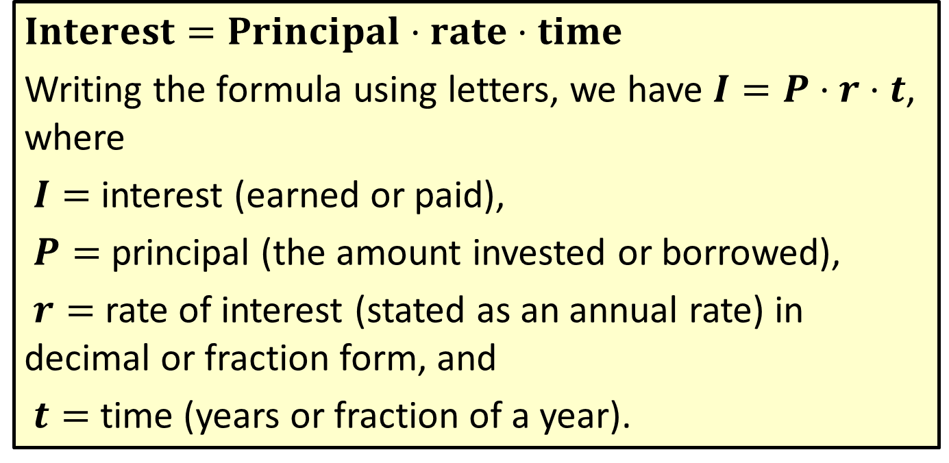
Formula: Simple Interest Formula
$$Interest=Principal⋅rate⋅time$$
Writing the formula using letters, we have $I=P⋅r⋅t$, where
$I=$ interest (earned or paid),
$P=$ principal (the amount invested or borrowed),
$r=$ rate of interest (stated as an annual rate) in decimal or fraction form, and
$t=$ time (years or fraction of a year).

Slide 3
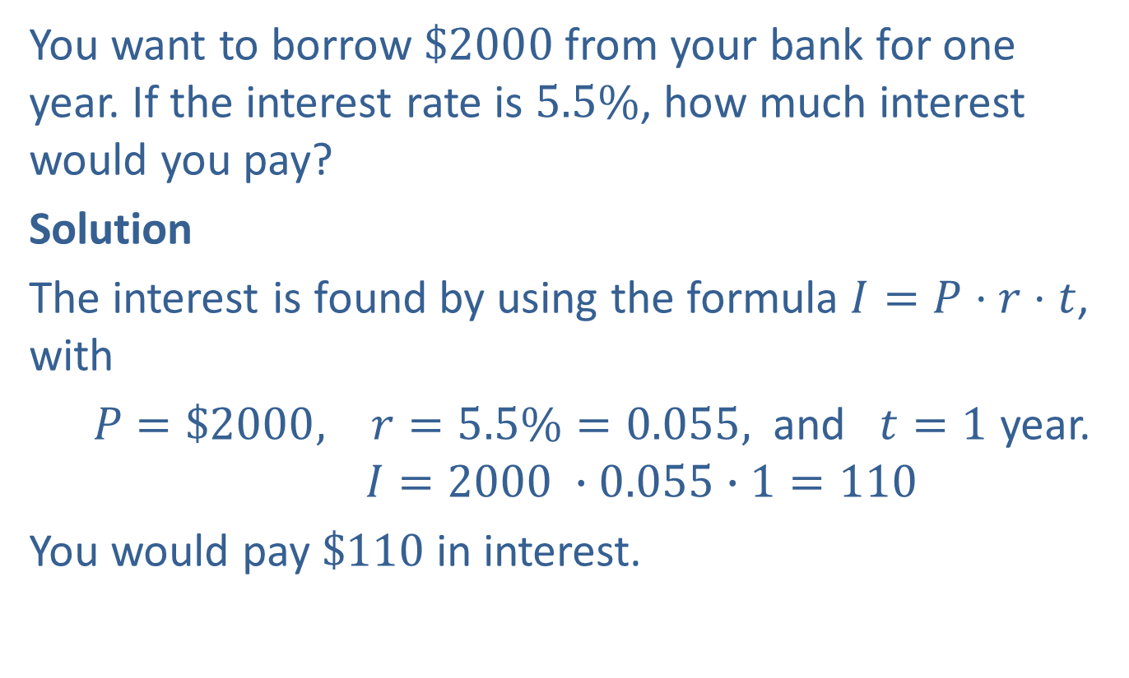
Example 1: Application: Calculating Simple Interest
You want to borrow $\$2000$from your bank for one year. If the interest rate is $5.5\%$, how much interest would you pay?
Solution
The interest is found by using the formula $I=P⋅r⋅t$, with
$P=\$2000, r=5.5\%=0.055,$ and $t=1$ year.
$$I=2000 ∙0.055∙1=110$$
You would pay $\$110$in interest.

Slide 4
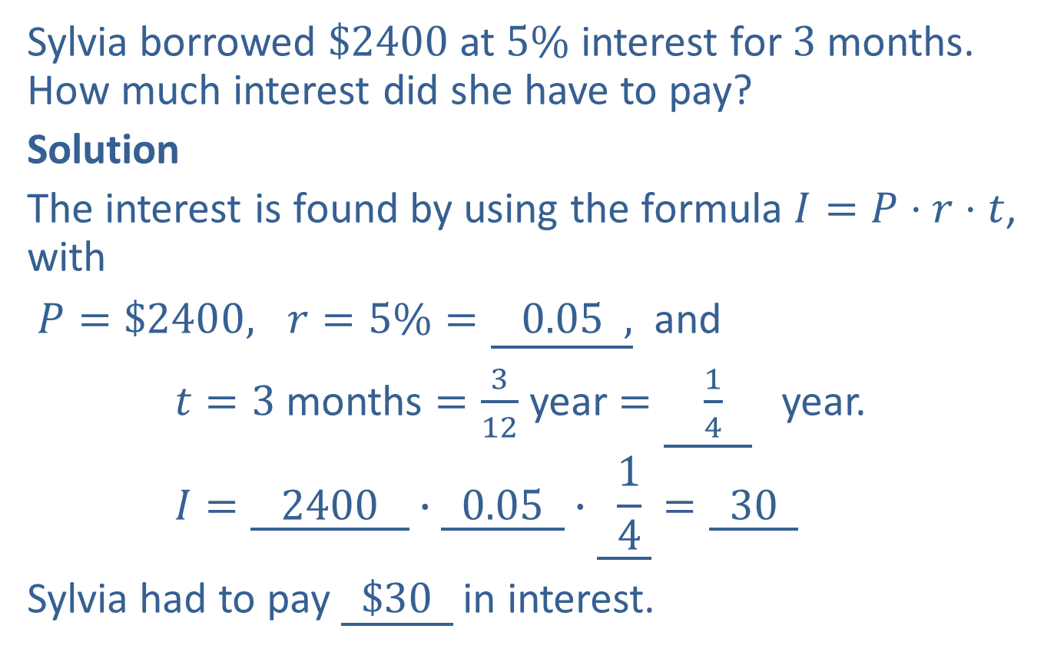
Completion Example 2: Application: Calculating Simple Interest
Sylvia borrowed $\$2400$at $5\%$ interest for $3$ months. How much interest did she have to pay?
Solution
The interest is found by using the formula $I=P⋅r⋅t$, with
$P=\$2400, r=5\%=\underline{ 0.05 ,}$ and
$t=3$ months $=\frac{3}{12}$ year $=\underline{ \frac{1}{4} }$ year.
$$I=\underline{ 2400 }∙\underline{ 0.05 }∙\underline{ \frac{1}{4} }=\underline{ 30 }$$
Sylvia had to pay $\underline{ \$30 }$ in interest.

Slide 5
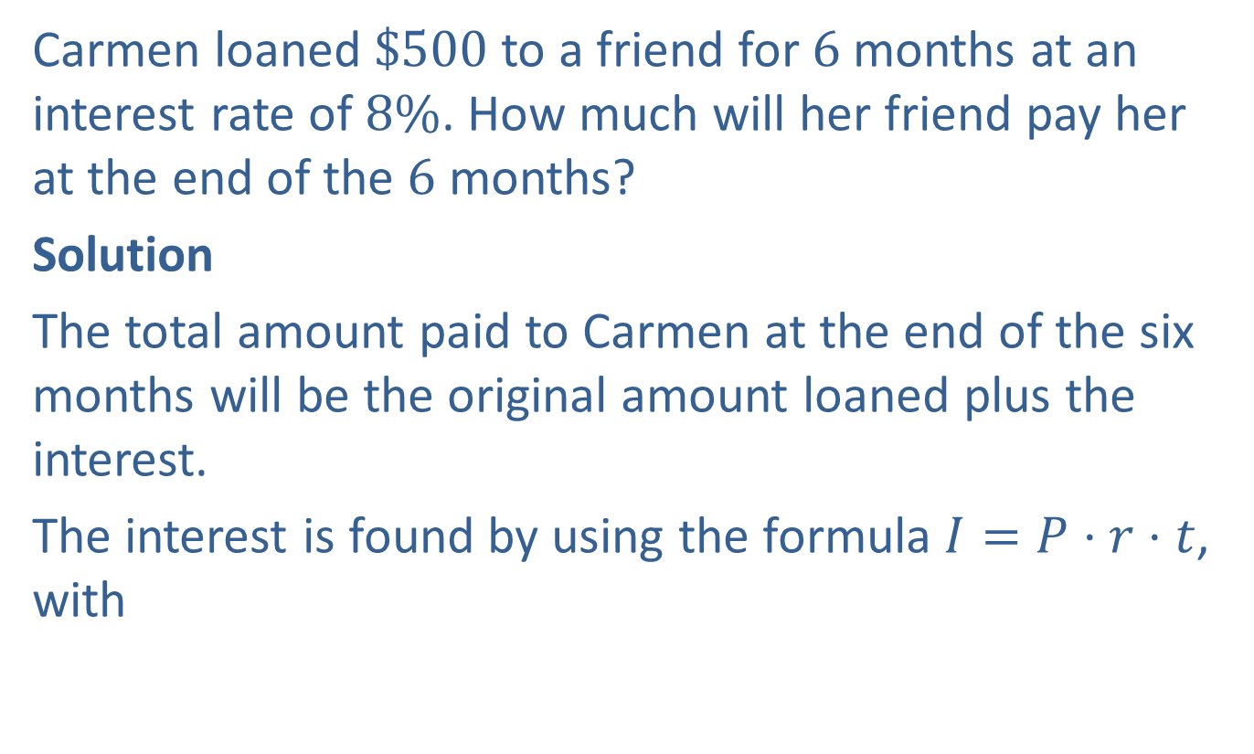
Example 3: Application: Calculating Total Amount Due
Carmen loaned $\$500$to a friend for $6$ months at an interest rate of $8\%$. How much will her friend pay her at the end of the $6$ months?
Solution
The total amount paid to Carmen at the end of the six months will be the original amount loaned plus the interest.
The interest is found by using the formula $I=P⋅r⋅t$, with

Slide 6

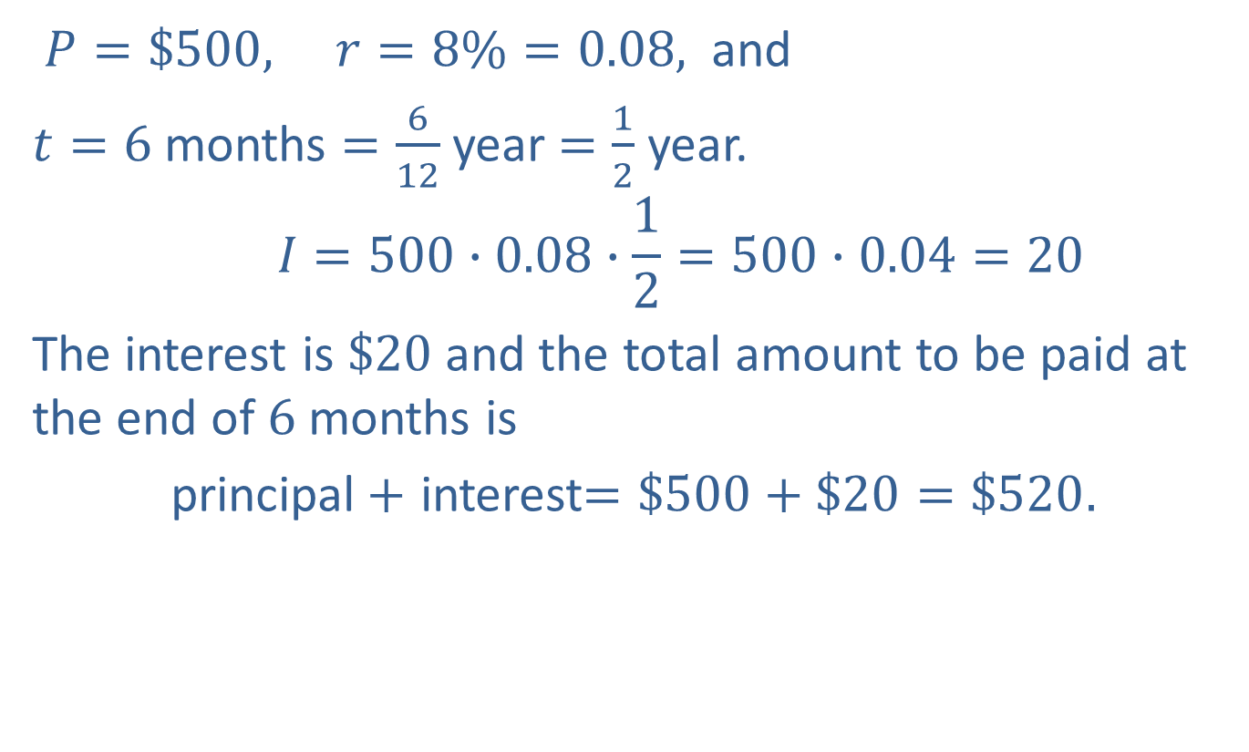
Example 3: Application: Calculating Total Amount Due (cont.)
$P=\$500, r=8\%=0.08,$ and
$t=6$months $=\frac{6}{12}$ year $=\frac{1}{2}$ year.
$$I=500∙0.08∙\frac{1}{2}=500∙0.04=20$$
The interest is $\$20$and the total amount to be paid at the end of $6$ months is
principal$+$ interest$=\$500+\$20=\$520.$
$$0.04$$

Slide 7
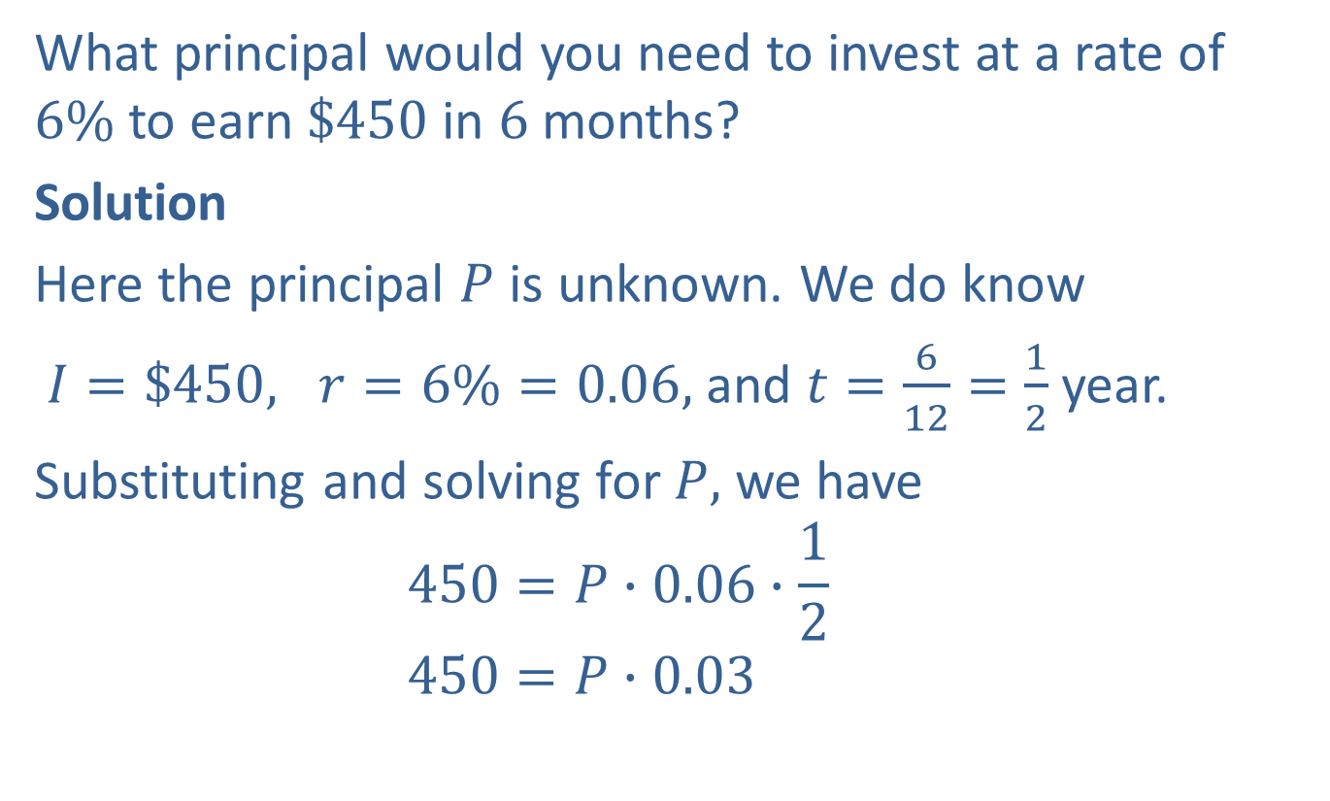
Example 4: Application: Calculating Principal using Simple Interest
What principal would you need to invest at a rate of $6\%$ to earn $\$450$in $6$ months?
Solution
Here the principal $P$ is unknown. We do know
$I=\$450, r=6\%=0.06,$ and $t=\frac{6}{12}=\frac{1}{2}$ year.
Substituting and solving for $P,$ we have
$$450=P∙0.06∙\frac{1}{2}$$
$$450=P∙0.03$$

Slide 8


Example 4: Application: Calculating Principal using Simple Interest (cont.)
$$\frac{450}{0.03}=\frac{P∙0.03}{0.03}$$
$$15,000=P$$
You would need to invest a principal amount of $\$15,000$to earn $\$450$in $6$ months at a rate of $6\%$.
Divide both sides by $0.03.$

Slide 9
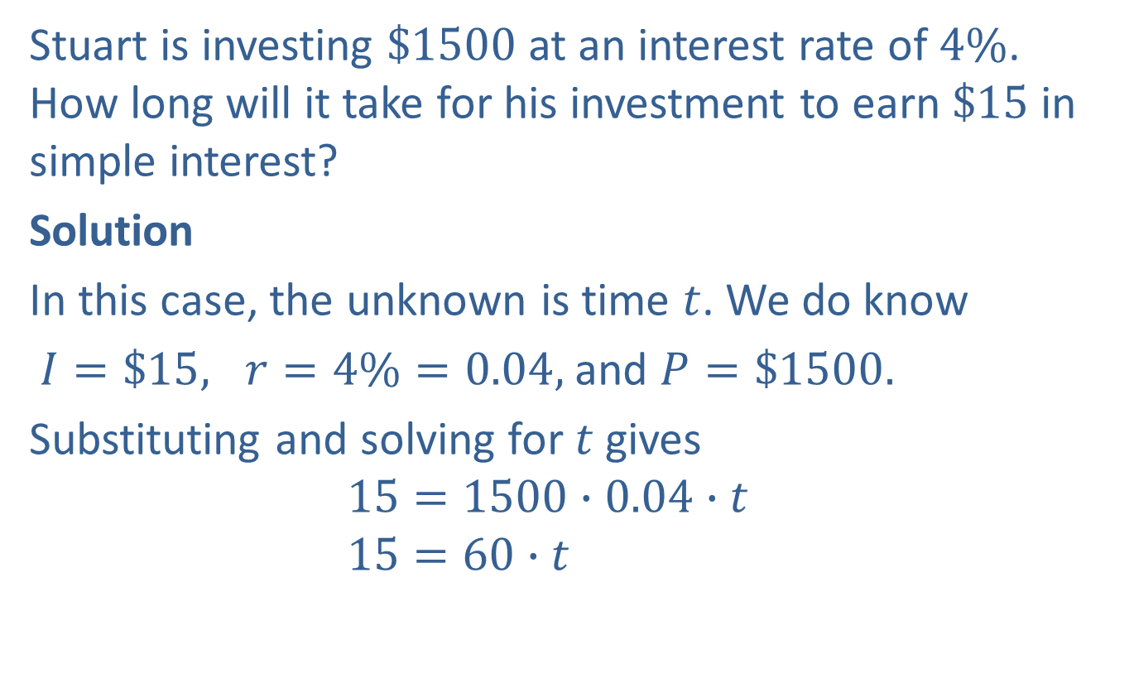
Example 5: Application: Calculating Time using Simple Interest
Stuart is investing $\$1500$at an interest rate of $4\%$. How long will it take for his investment to earn $\$15$in simple interest?
Solution
In this case, the unknown is time $t$. We do know
$I=\$15, r=4\%=0.04,$ and $P=\$1500.$
Substituting and solving for $t$ gives
$$15=1500∙0.04∙t$$
$$15=60∙t$$

Slide 10


Example 5: Application: Calculating Time using Simple Interest (cont.)
$$\frac{15}{60}=\frac{60∙t}{60}$$
$$\frac{1}{4}=t$$
Stuart will earn $\$15$in interest after $\frac{1}{4}$ year (or $3$months).
Divide both sides by $60$.

Slide 11
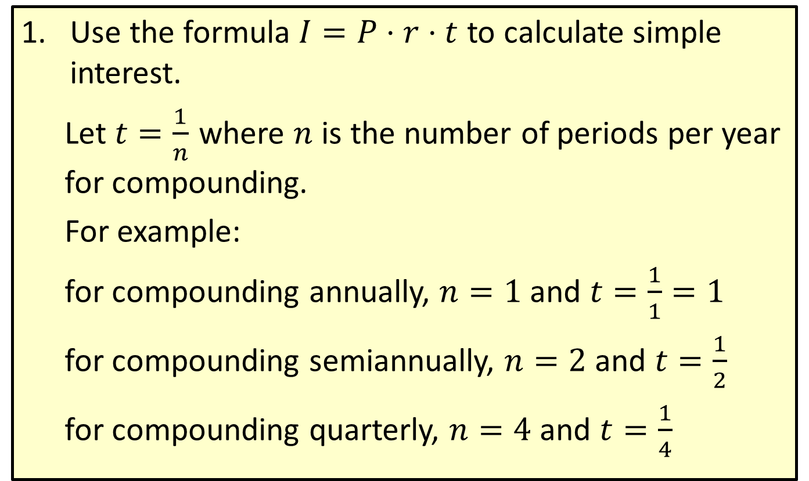
Procedure: To Calculate Compound Interest
​Use the formula $I=P⋅r⋅t$ to calculate simple interest.
  Let $t=\frac{1}{n}$ where $n$ is the number of periods per year for compounding.
  For example:
  for compounding annually, $n=1$ and $t=\frac{1}{1}=1$
  for compounding semiannually, $n=2$ and $t=\frac{1}{2}$
  for compounding quarterly, $n=4$ and $t=\frac{1}{4}$

Slide 12
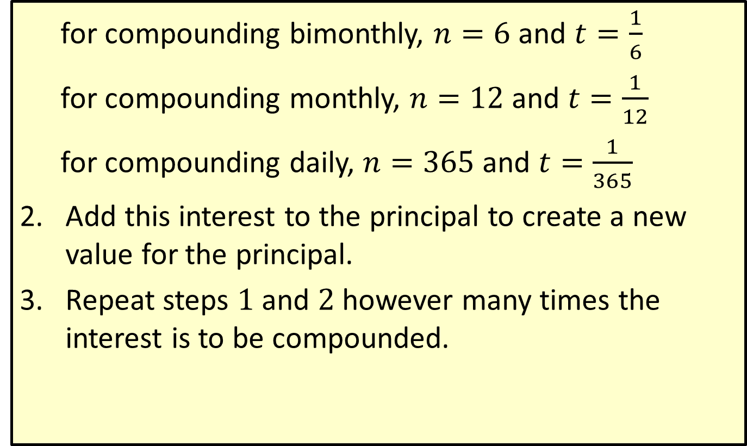
Procedure: To Calculate Compound Interest (cont.)
  for compounding bimonthly, $n=6$ and $t=\frac{1}{6}$
  for compounding monthly, $n=12$ and $t=\frac{1}{12}$
  for compounding daily, $n=365$ and $t=\frac{1}{365}$
​Add this interest to the principal to create a new value for the principal.
​Repeat steps $1$ and $2$ however many times the interest is to be compounded.

Slide 13
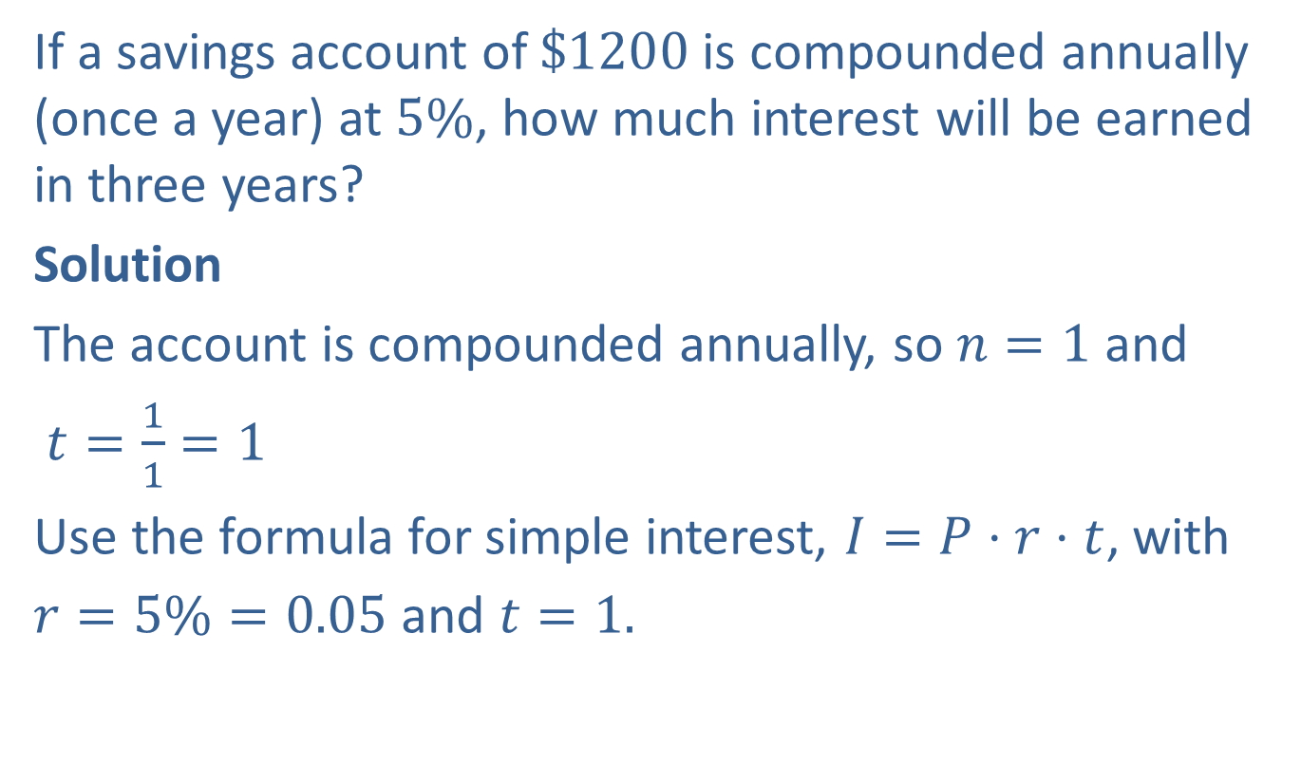
Example 6: Application: Calculating Compound Interest
If a savings account of $\$1200$is compounded annually (once a year) at $5\%$, how much interest will be earned in three years?
Solution
The account is compounded annually, so $n=1$ and
$t=\frac{1}{1}=1$
Use the formula for simple interest, $I=P⋅r⋅t$, with
$r=5\%=0.05$ and $t=1.$

Slide 14
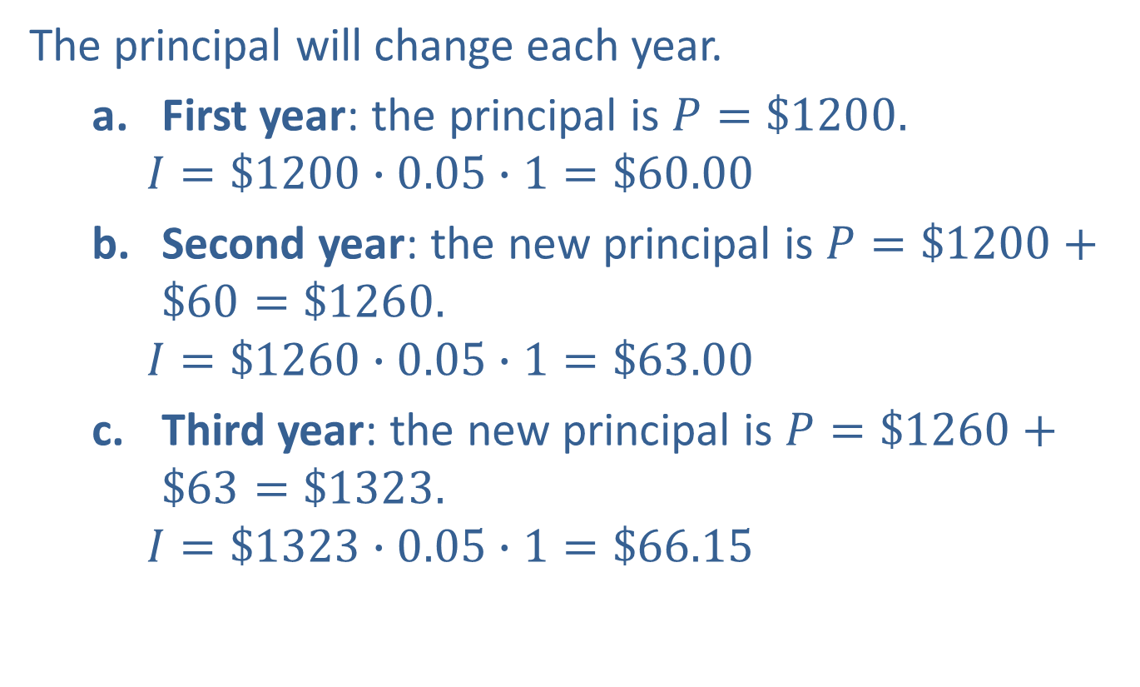
Example 6: Application: Calculating Compound Interest (cont.)
The principal will change each year.
  First year: the principal is $P=\$1200.$
    $$I=\$1200∙0.05∙1=\$60.00$$
  Second year: the new principal is $P=\$1200+\$60=\$1260.$
    $$I=\$1260∙0.05∙1=\$63.00$$
  Third year: the new principal is $P=\$1260+\$63=\$1323.$
    $$I=\$1323∙0.05∙1=\$66.15$$
Interest for the first year
Interest for the second year
Interest for the third year

Slide 15
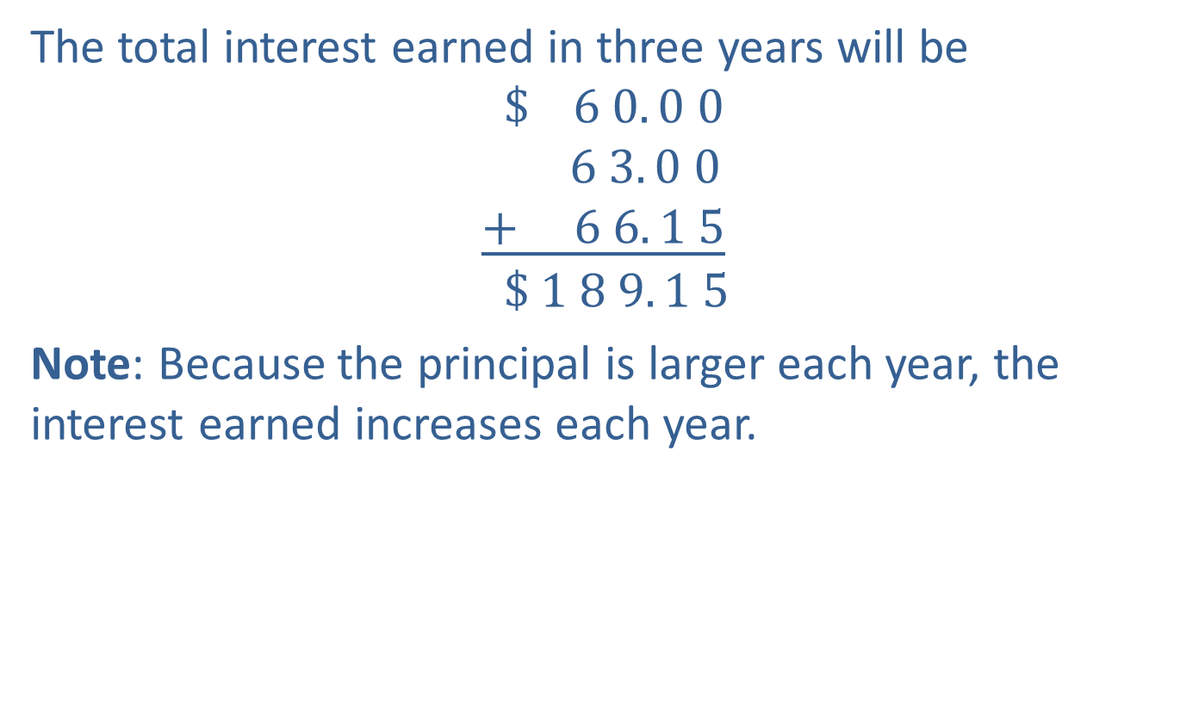
Example 6: Application: Calculating Compound Interest (cont.)
The total interest earned in three years will be
$$\$ 6 0. 0 0$$
$$6 3. 0 0$$
$$\underline{+ 6 6. 1 5}$$
$$\$ 1 8 9. 1 5$$
Note: Because the principal is larger each year, the interest earned increases each year.

Slide 16
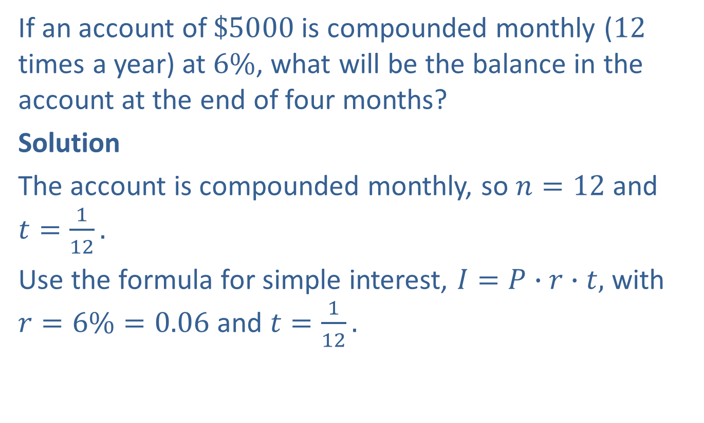
Example 7: Application: Calculating Compound Interest
If an account of $\$5000$is compounded monthly ($12$ times a year) at $6\%$, what will be the balance in the account at the end of four months?
Solution
The account is compounded monthly, so $n=12$ and $t=\frac{1}{12}.$
Use the formula for simple interest, $I=P∙r∙t,$ with $r=6\%=0.06$ and $t=\frac{1}{12}.$

Slide 17
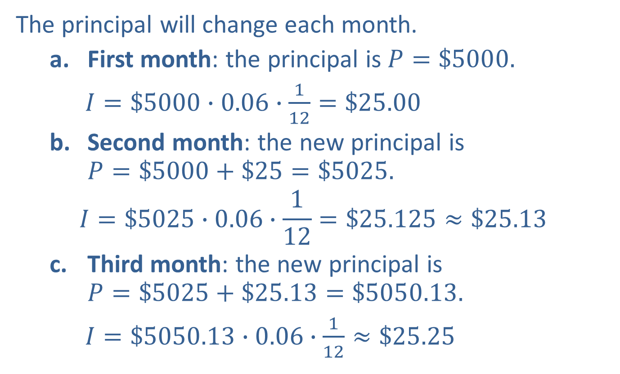
Example 7: Application: Calculating Compound Interest (cont.)
The principal will change each month.
  First month: the principal is $P=\$5000.$
    $I=\$5000∙0.06∙\frac{1}{12}=\$25.00$
  Second month: the new principal is $P=\$5000+\$25=\$5025.$
    $$I=\$5025∙0.06∙\frac{1}{12}=\$25.125≈\$25.13$$
  Third month: the new principal is $P=\$5025+\$25.13=\$5050.13.$
    $I=\$5050.13∙0.06∙\frac{1}{12}≈\$25.25$
Interest for the first month
Interest for the second month
Interest for the third month

Slide 18
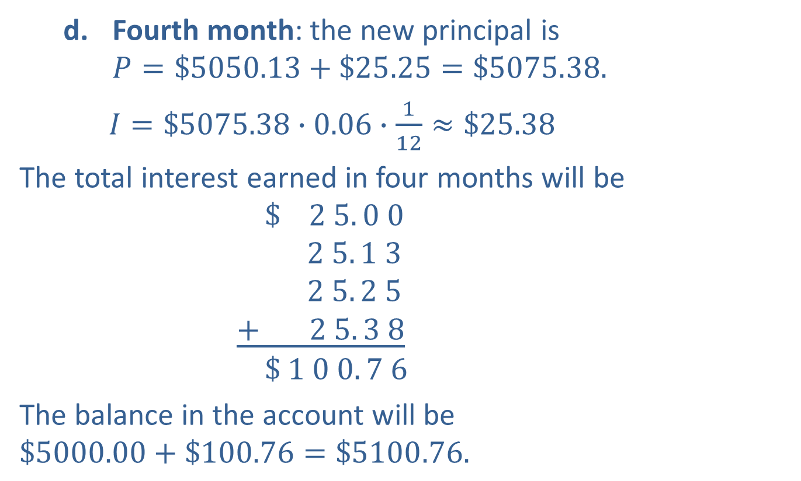
Example 7: Application: Calculating Compound Interest (cont.)
  Fourth month: the new principal is $P=\$5050.13+\$25.25=\$5075.38.$
    $I=\$5075.38∙0.06∙\frac{1}{12}≈\$25.38$
The total interest earned in four months will be
$$\$ 2 5. 0 0$$
$$2 5. 1 3$$
$$2 5. 2 5$$
$$\underline{+ 2 5. 3 8}$$
$$\$ 1 0 0. 7 6$$
The balance in the account will be $\$5000.00+\$100.76=\$5100.76.$
Interest for the fourth month

Slide 19
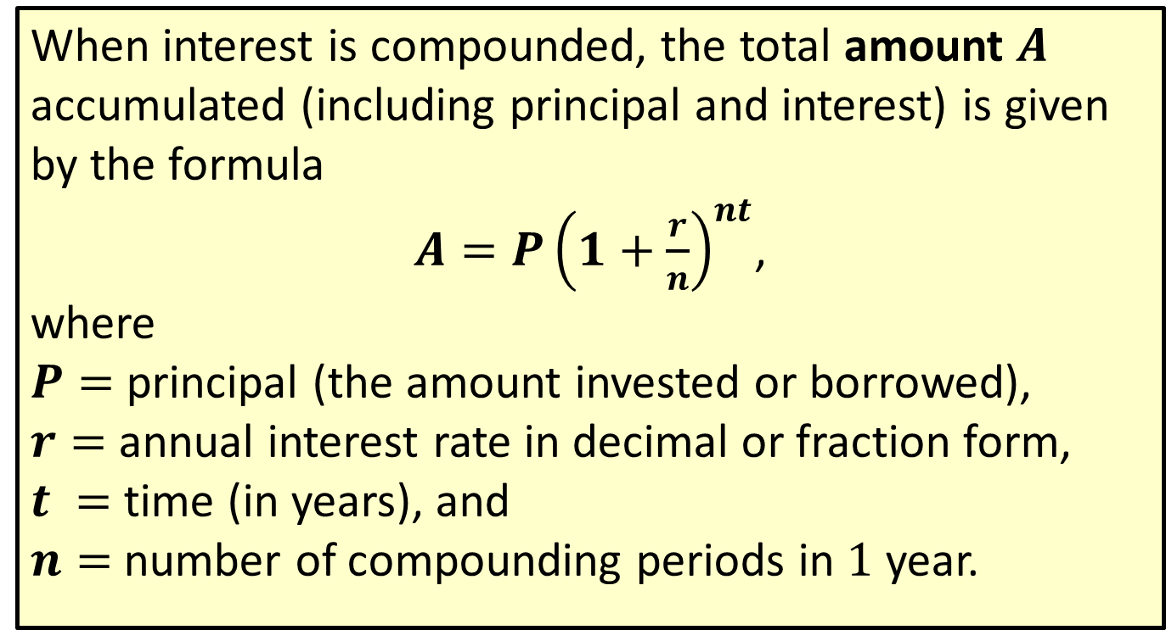
Formula: Compound Interest Formula
When interest is compounded, the total amount $A$ accumulated (including principal and interest) is given by the formula
$A=P{\left(1+\frac{r}{n}\right)}^{nt}$,
where
$P=$ principal (the amount invested or borrowed),
$r=$ annual interest rate in decimal or fraction form,
$t =$ time (in years), and
$n=$ number of compounding periods in $1$ year.

Slide 20
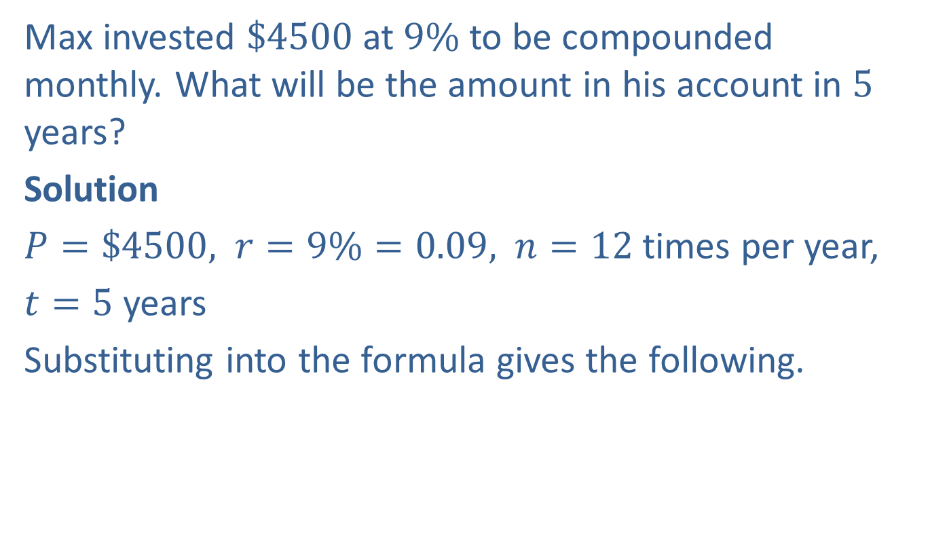
Example 8: Application: Using the Compound Interest Formula
Max invested $\$4500$at $9\%$ to be compounded monthly. What will be the amount in his account in $5$ years?
Solution
$P=\$4500,$ $r=9\%=0.09,$ $n=12$ times per year,
$t=5$ years
Substituting into the formula gives the following.

Slide 21
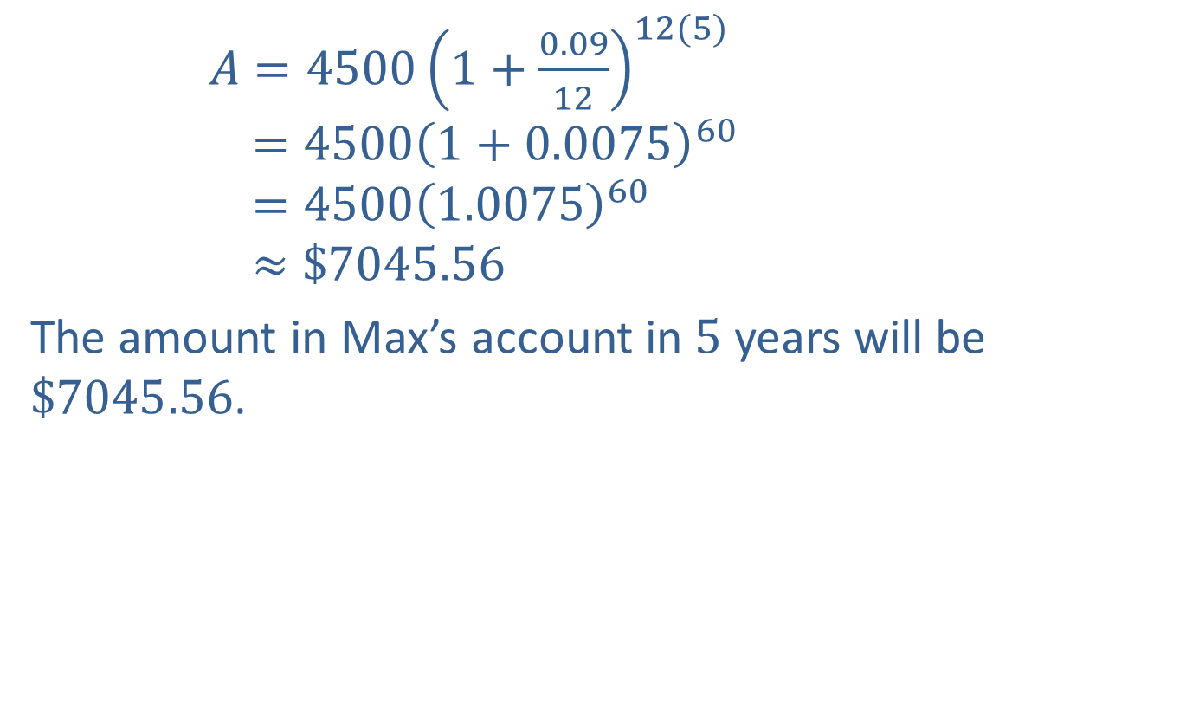
Example 8: Application: Using the Compound Interest Formula (cont.)
$A=4500{\left(1+\frac{0.09}{12}\right)}^{12(5)}$
$$=4500{\left(1+0.0075\right)}^{60}$$
$$=4500{\left(1.0075\right)}^{60}$$
$$≈\$7045.56$$
The amount in Max’s account in $5$ years will be $\$7045.56$.
Rounded to the nearest cent

Slide 22
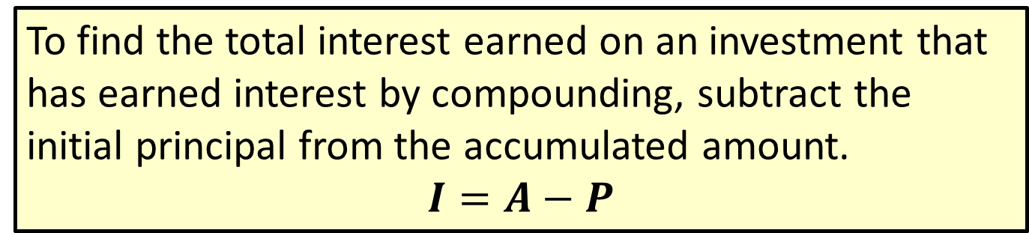
Formula: Total Interest Earned
To find the total interest earned on an investment that has earned interest by compounding, subtract the initial principal from the accumulated amount.
$$I=A−P$$

Slide 23
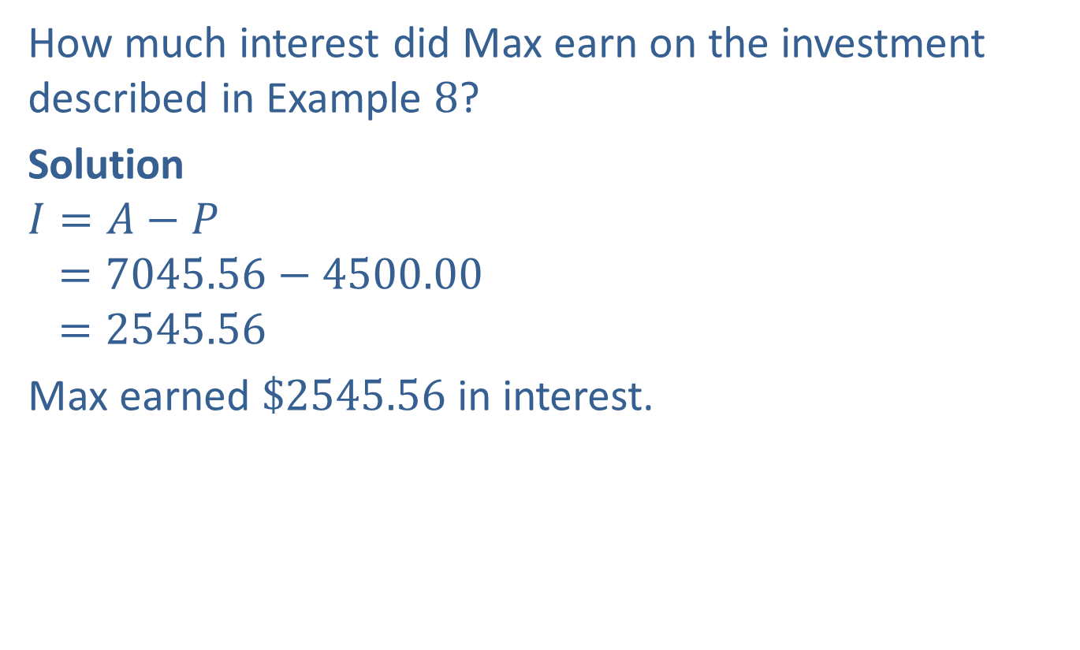
Example 9: Application: Calculating Total Interest Earned
How much interest did Max earn on the investment described in Example $8$?
Solution
$$I=A−P$$
$$=7045.56−4500.00$$
$$=2545.56$$
Max earned $\$2545.56$in interest.

Slide 24
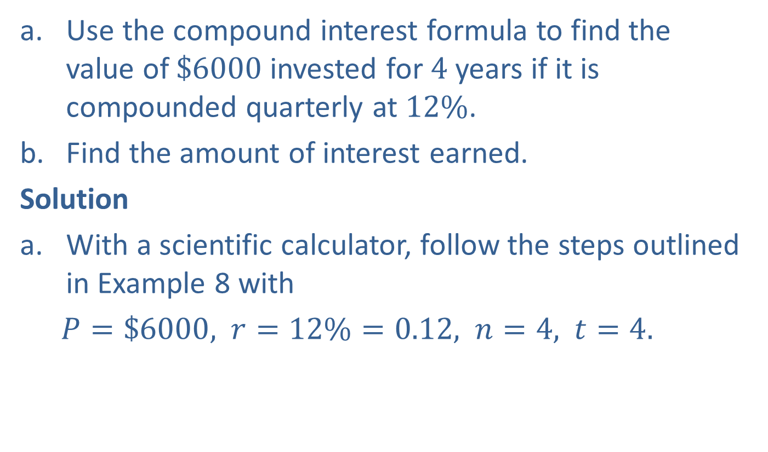
Completion Example 10: Application: Compound Interest
Use the compound interest formula to find the value of $\$6000$invested for $4$ years if it is compounded quarterly at $12\%$.
Find the amount of interest earned.
Solution
With a scientific calculator, follow the steps outlined in Example 8 with
  $P=\$6000,$ $r=12\%=0.12,$ $n=4,$ $t=4.$

Slide 25
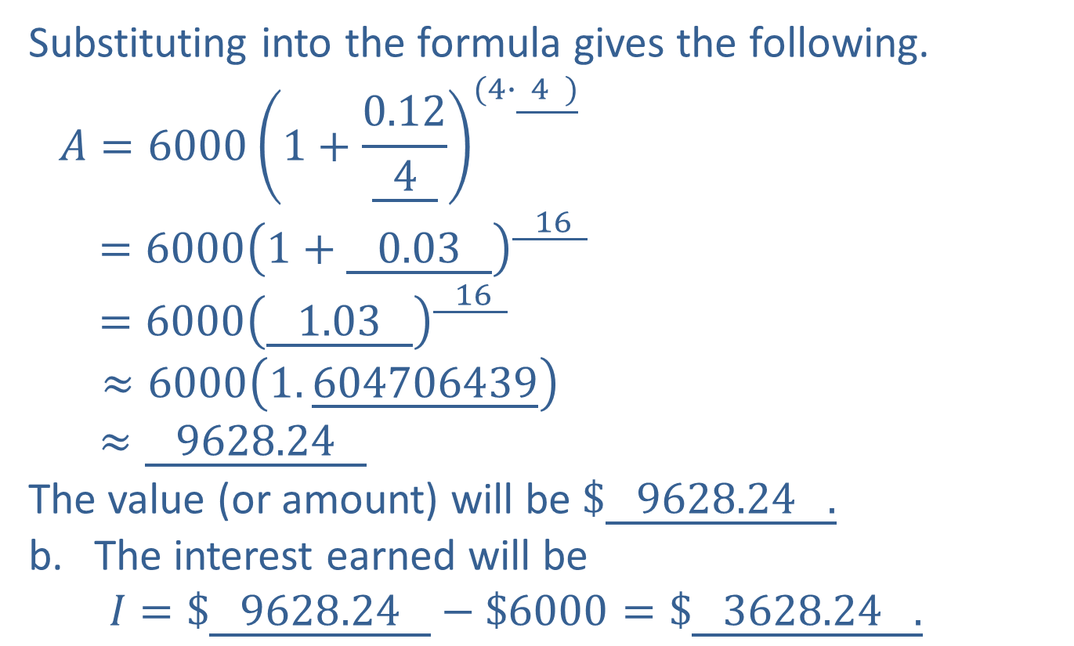
Completion Example 10: Application: Compound Interest (cont.)
Substituting into the formula gives the following.
$$A=6000{\left(1+\frac{0.12}{\underline{ 4 }}\right)}^{(4∙\underline{ 4 )}}$$
$$=6000{\left(1+\underline{ 0.03 }\right)}^{\underline{ 16 }}$$
$$=6000{\left(\underline{ 1.03 }\right)}^{\underline{ 16 }}$$
$≈6000\left(1.\underline{604706439}\right)$
$$≈\underline{ 9628.24 }$$
The value (or amount) will be $\$\underline{ 9628.24 .}$
The interest earned will be
$$I=\$\underline{ 9628.24 }−\$6000=\$\underline{ 3628.24 .}$$
Rounded to the nearest cent

Slide 26
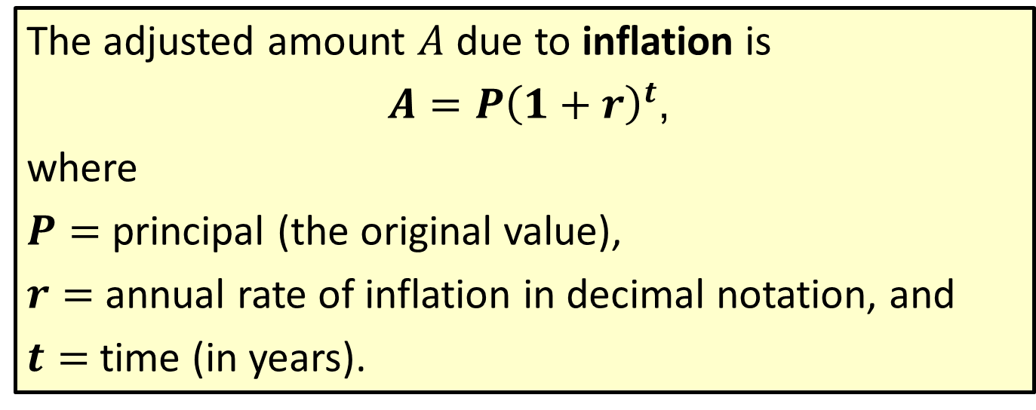
Formula: Inflation
The adjusted amount $A$ due to inflation is
$A=P{\left(1+r\right)}^{t}$,
where
$P=$ principal (the original value),
$r=$ annual rate of inflation in decimal notation, and
$t=$ time (in years).

Slide 27
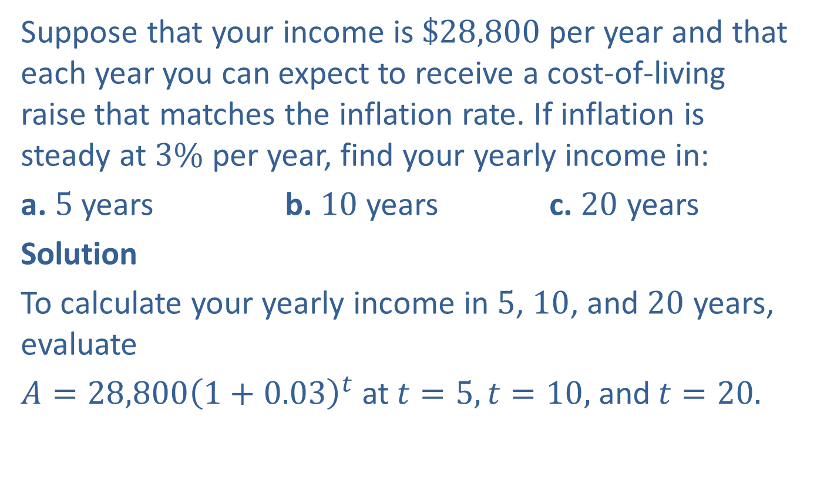
Example 11: Application: Calculating Inflation
Suppose that your income is $\$28,800$per year and that each year you can expect to receive a cost-of-living raise that matches the inflation rate. If inflation is steady at $3\%$ per year, find your yearly income in:
a. $5$years b. $10$ years c. $20$ years
Solution
To calculate your yearly income in $5$, $10$, and $20$ years, evaluate
$A=28,800{\left(1+0.03\right)}^{t}$at$t=5, t=10,$and$t=20.$

Slide 28
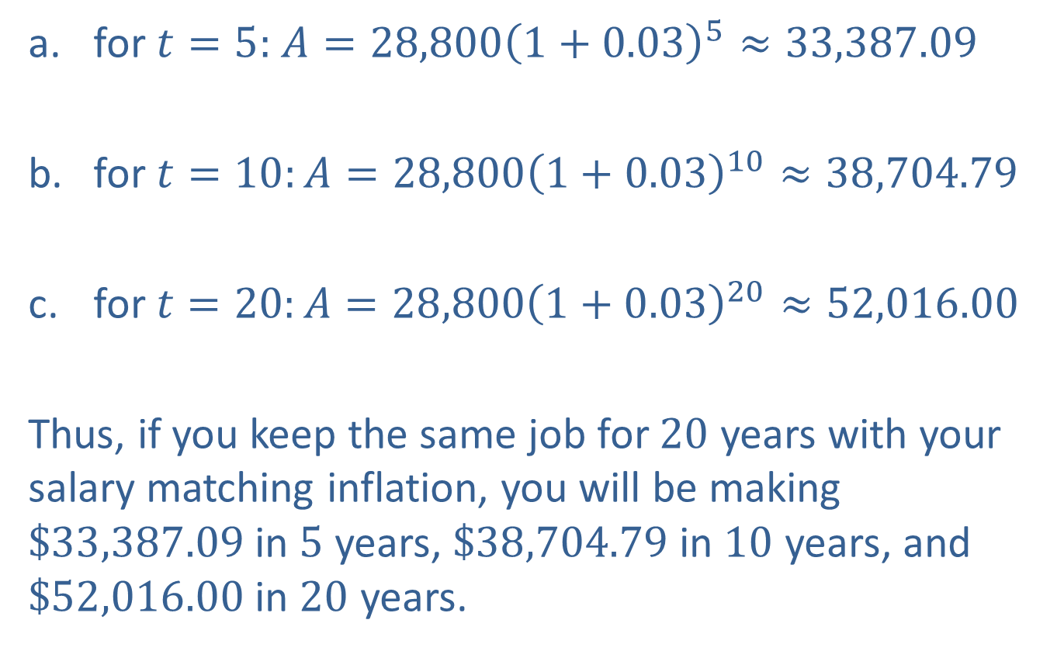
Example 11: Application: Calculating Inflation (cont.)
for $t=5:$ $A=28,800{\left(1+0.03\right)}^{5}≈33,387.09$
for $t=10:A=28,800{\left(1+0.03\right)}^{10}≈38,704.79$
for$t=20:A=28,800{\left(1+0.03\right)}^{20}≈52,016.00$
Thus, if you keep the same job for $20$ years with your salary matching inflation, you will be making $\$33,387.09$in $5$ years, $\$38,704.79$in $10$ years, and $\$52,016.00$in $20$ years.
Rounded to the nearest cent
Rounded to the nearest cent
Rounded to the nearest cent

Slide 29
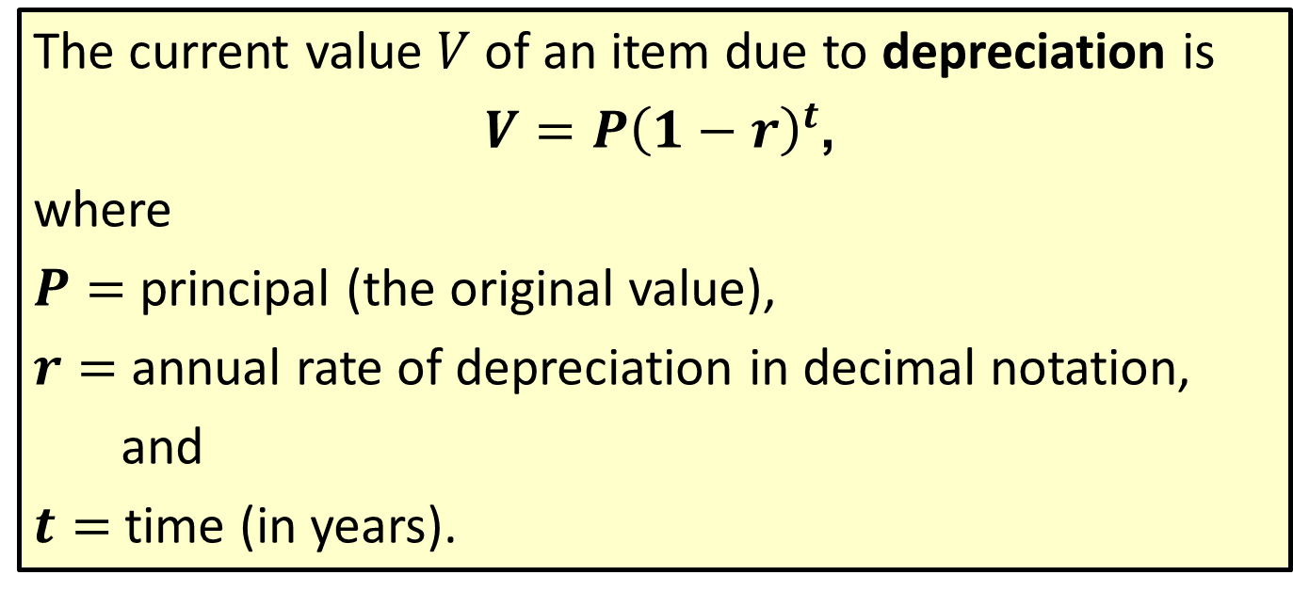
Formula: Depreciation
The current value $V$ of an item due to depreciation is
$V=P{\left(1−r\right)}^{t}$,
where
$P=$ principal (the original value),
$r=$ annual rate of depreciation in decimal notation,
and
$t=$ time (in years).

Slide 30
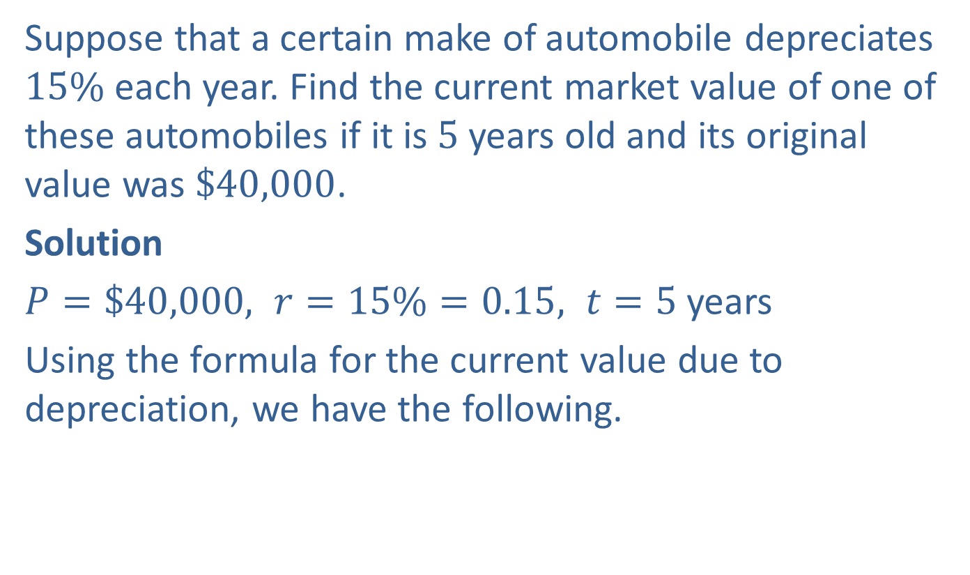
Example 12: Application: Calculating the Current Value Due to Depreciation
Suppose that a certain make of automobile depreciates $15\%$ each year. Find the current market value of one of these automobiles if it is $5$ years old and its original value was $\$40,000$.
Solution
$P=\$40,000, r=15\%=0.15, t=5$years
Using the formula for the current value due to depreciation, we have the following.

Slide 31

Example 12: Application: Calculating the Current Value Due to Depreciation (cont.)
$$V=P{\left(1−r\right)}^{t}=40,000{\left(1−0.15\right)}^{5}$$
Putting this in the calculator gives us $17,748.2125$.
The current market value of the automobile is $\$17,748.21$.

