Slide 1
Section 7.3
Buying a Car

Slide 2
Definition: Terminology Used when Purchasing a Car
Purchase Price: The amount agreed to be paid to the seller in exchange for the car, including taxes and fees.
Principal: The amount financed, or borrowed, from the lender.
Down Payment: The amount of cash you pay upfront for the car if you take out a loan.
Finance Charge: The amount of interest paid over the life of the loan. Can also include fees, such as account maintenance and late payment fees.

Slide 3
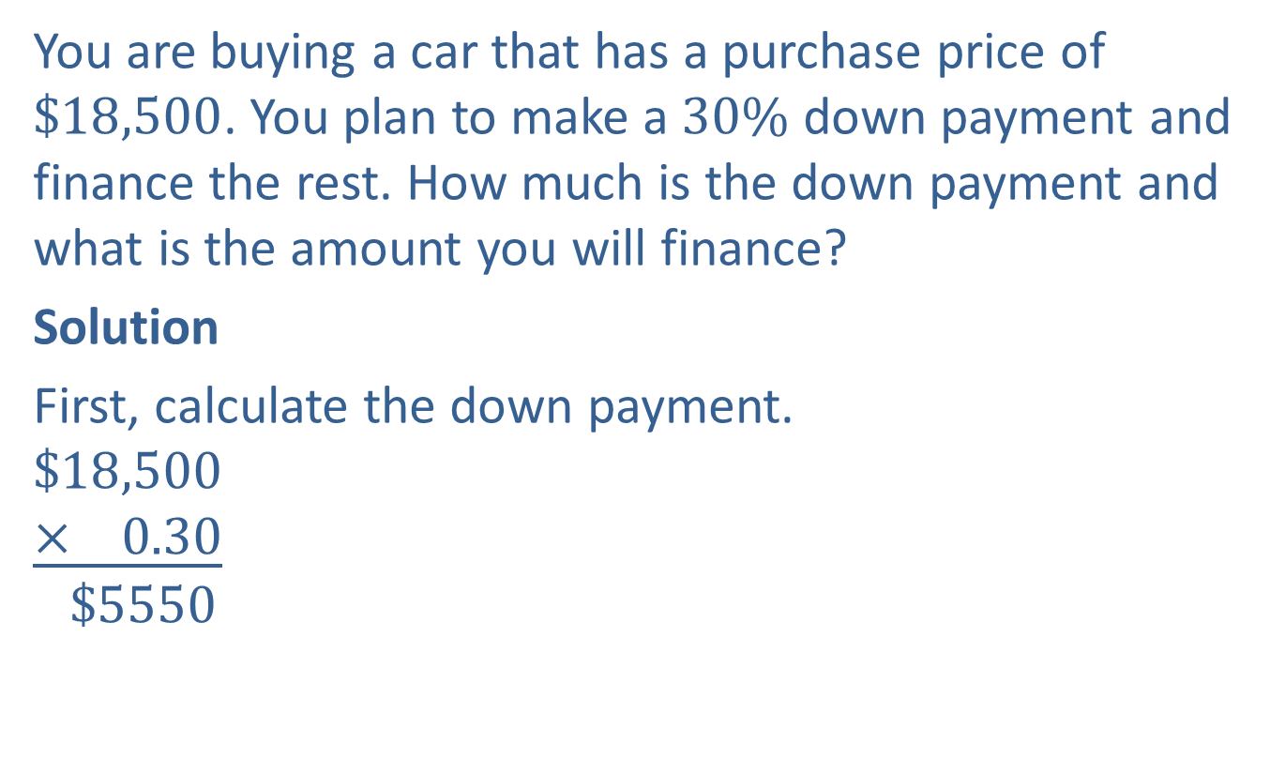
Example 1: Application: Finding the Financed Amount of a Car Purchase
You are buying a car that has a purchase price of $\$18,500$. You plan to make a $30\%$ down payment and finance the rest. How much is the down payment and what is the amount you will finance?
Solution
First, calculate the down payment.
$$\$18,500$$
$$\underline{× 0.30}$$
$$\$5550$$

Slide 4

Example 1: Application: Finding the Financed Amount of a Car Purchase (cont.)
Now, subtract the down payment from the purchase price of the car to determine the amount financed.
$$\$18,500−\$5550=\$12,950$$
Therefore, you will make a down payment of $\$5550$and finance $\$12,950$.

Slide 5
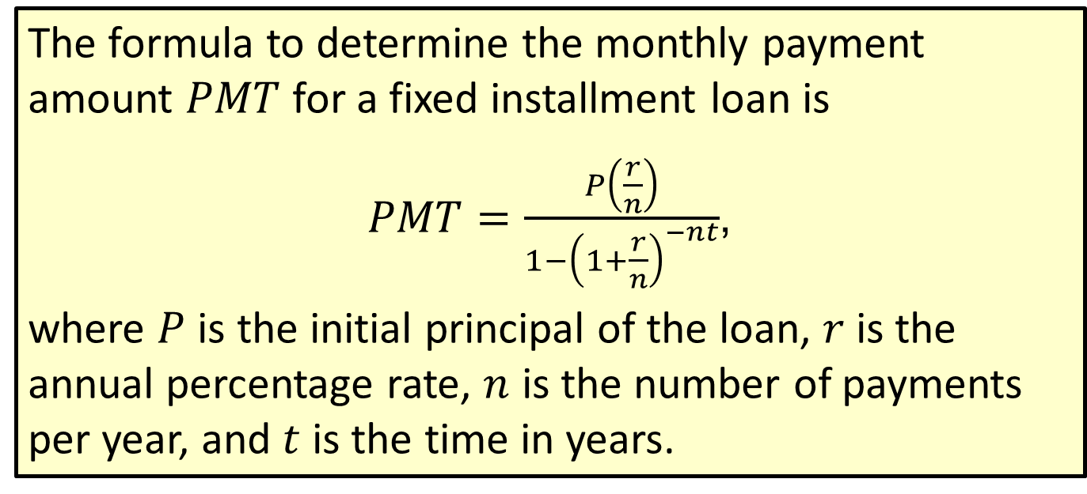
Formula: Loan Repayment Formula
The formula to determine the monthly payment amount $PMT$ for a fixed installment loan is
$PMT=\frac{P\left(\frac{r}{n}\right)}{1−{\left(1+\frac{r}{n}\right)}^{−nt}}$,
where $P$ is the initial principal of the loan, $r$ is the annual percentage rate, $n$ is the number of payments per year, and $t$ is the time in years.

Slide 6
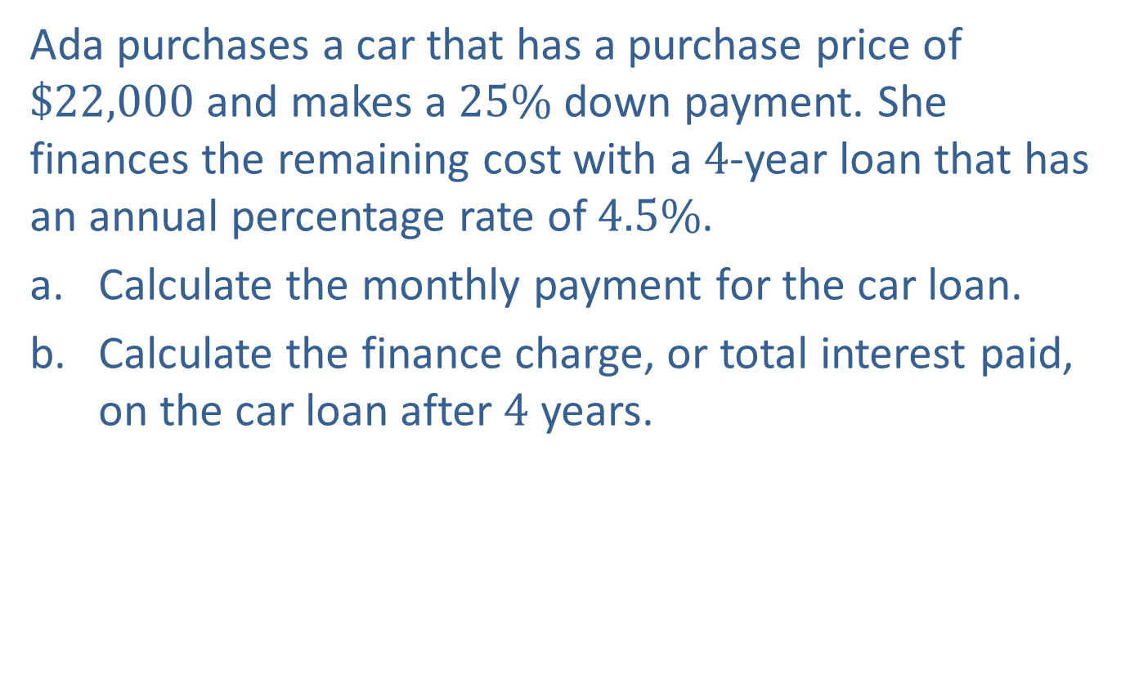
Example 2: Application: Calculating Car Payments and Finance Charges
Ada purchases a car that has a purchase price of $\$22,000$and makes a $25\%$ down payment. She finances the remaining cost with a $4$-year loan that has an annual percentage rate of $4.5\%$.
​Calculate the monthly payment for the car loan.
​Calculate the finance charge, or total interest paid, on the car loan after $4$ years.

Slide 7
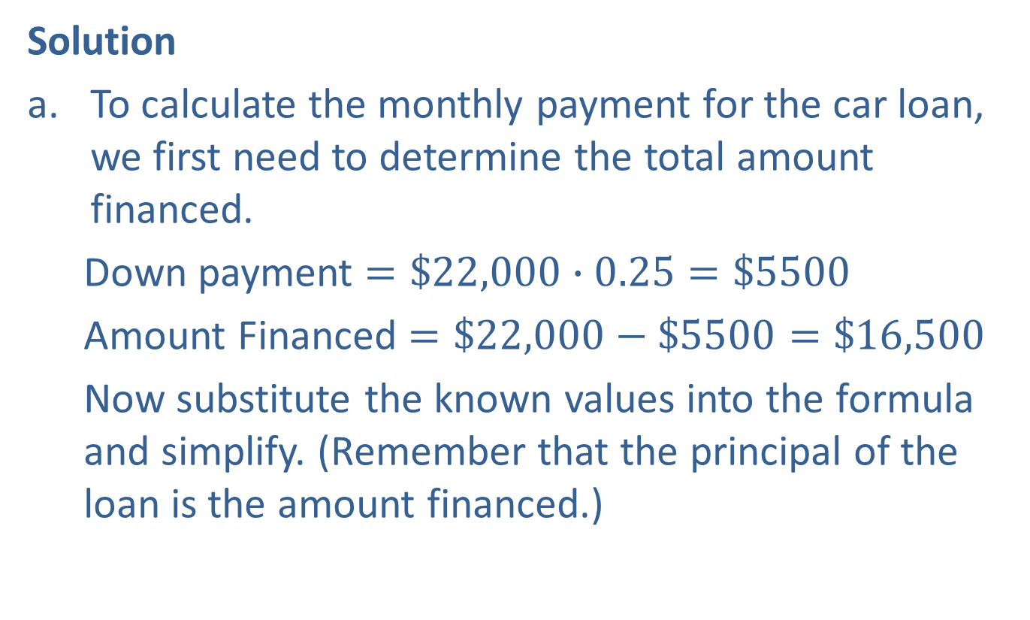
Example 2: Application: Calculating Car Payments and Finance Charges (cont.)
Solution
To calculate the monthly payment for the car loan, we first need to determine the total amount financed.
  Down payment $=\$22,000∙0.25=\$5500$
  Amount Financed $=\$22,000−\$5500=\$16,500$
  Now substitute the known values into the formula and simplify. (Remember that the principal of the loan is the amount financed.)

Slide 8
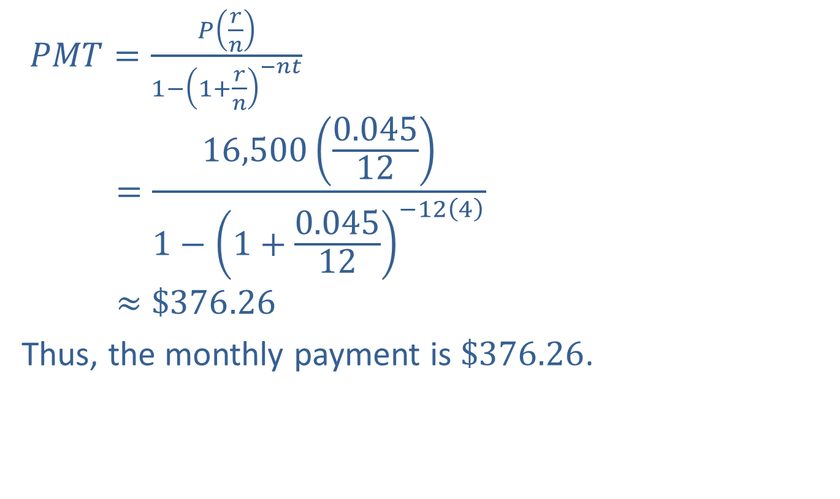
Example 2: Application: Calculating Car Payments and Finance Charges (cont.)
$PMT=\frac{P\left(\frac{r}{n}\right)}{1−{\left(1+\frac{r}{n}\right)}^{−nt}}$
$$=\frac{16,500\left(\frac{0.045}{12}\right)}{1−{\left(1+\frac{0.045}{12}\right)}^{−12\left(4\right)}}$$
$$≈\$376.26$$
Thus, the monthly payment is $\$376.26$.

Slide 9
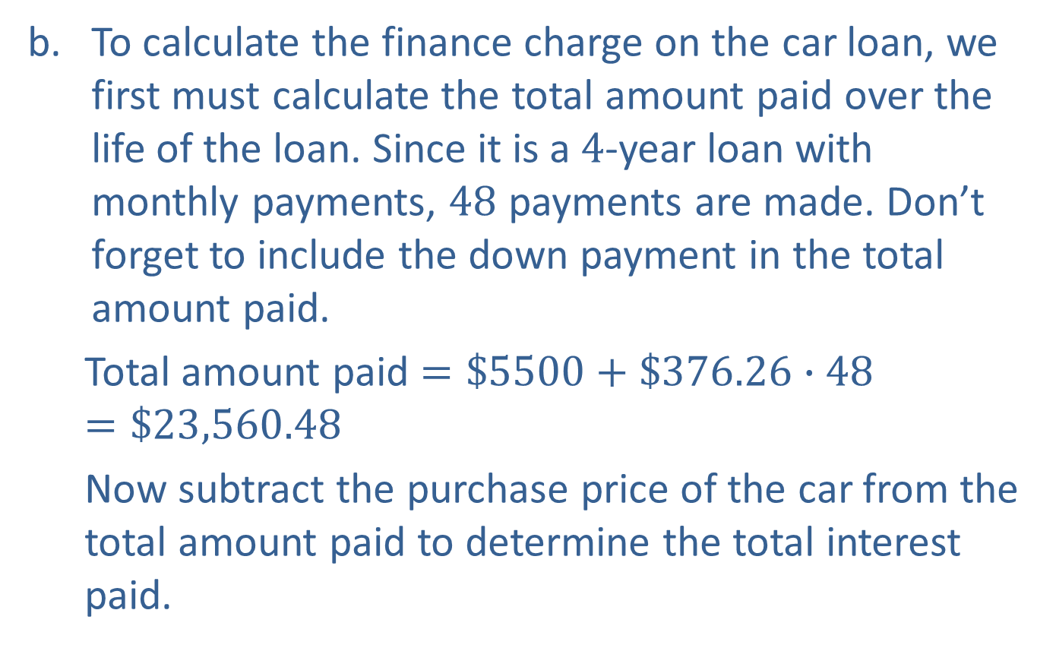
Example 2: Application: Calculating Car Payments and Finance Charges (cont.)
To calculate the finance charge on the car loan, we first must calculate the total amount paid over the life of the loan. Since it is a $4$-year loan with monthly payments, $48$ payments are made. Don’t forget to include the down payment in the total amount paid.
  Total amount paid $=\$5500+\$376.26∙48=\$23,560.48$
  Now subtract the purchase price of the car from the total amount paid to determine the total interest paid.

Slide 10

Example 2: Application: Calculating Car Payments and Finance Charges (cont.)
  Total interest paid $= \$23,560.48 − \$22,000 = \$1560.48$
  Therefore, Ada will pay $\$1560.48$in interest over $4$ years to finance the car.

Slide 11
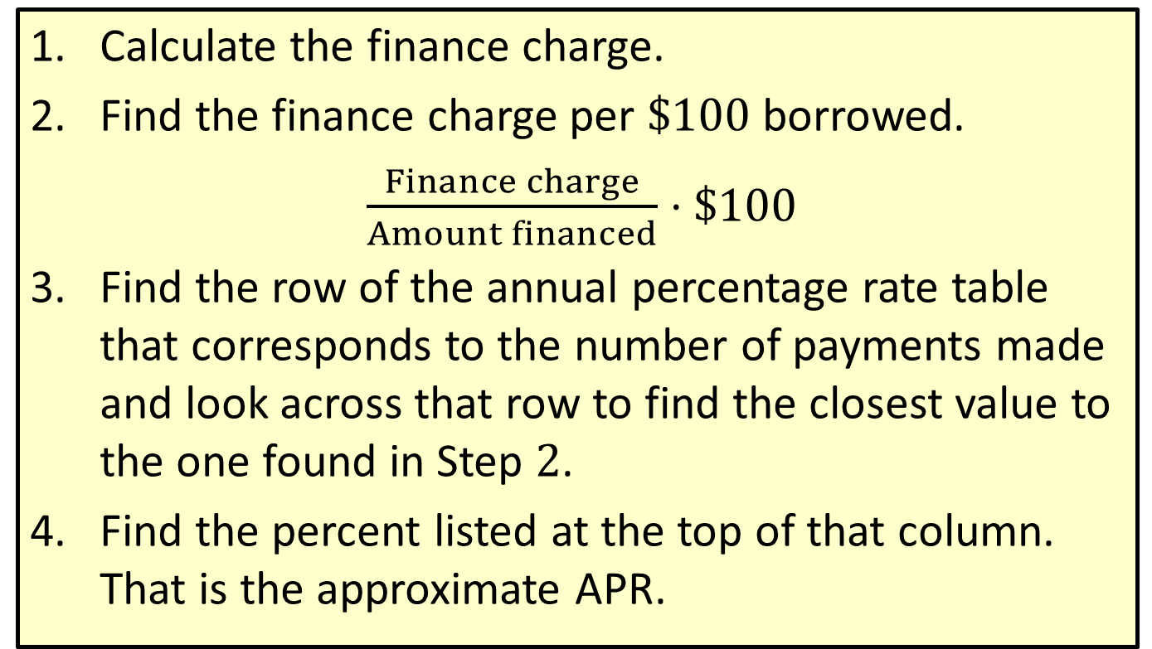
Procedure: Finding the APR of a Loan
​Calculate the finance charge.
​Find the finance charge per $\$100$ borrowed.
​ $\frac{Finance charge}{Amount financed}⋅\$100$
​Find the row of the annual percentage rate table that corresponds to the number of payments made and look across that row to find the closest value to the one found in Step $2$.
​Find the percent listed at the top of that column. That is the approximate APR.

Slide 12
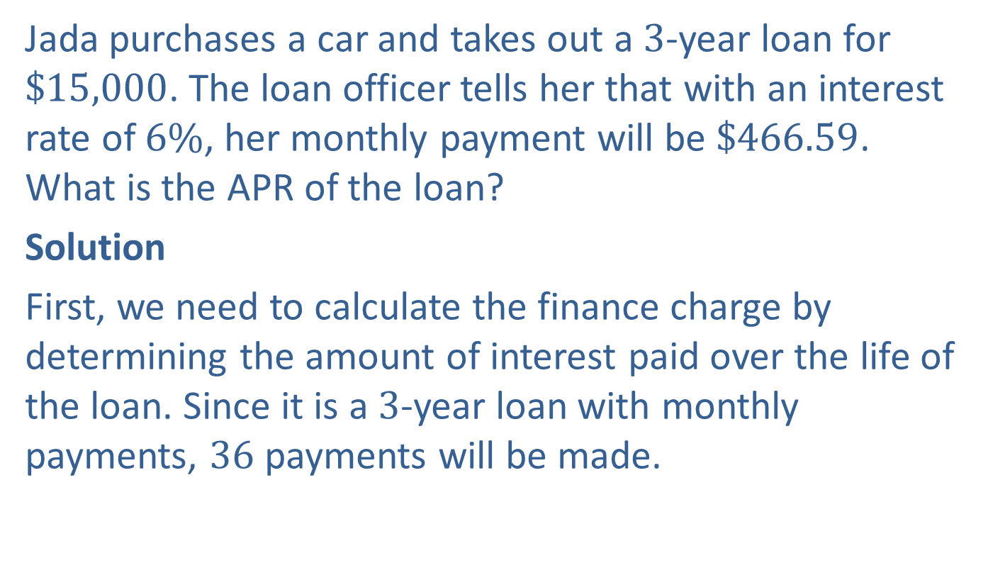
Example 3: Application: Finding the APR of a Loan
Jada purchases a car and takes out a $3$-year loan for $\$15,000$. The loan officer tells her that with an interest rate of $6\%$, her monthly payment will be $\$466.59$. What is the APR of the loan?
Solution
First, we need to calculate the finance charge by determining the amount of interest paid over the life of the loan. Since it is a $3$-year loan with monthly payments, $36$ payments will be made.

Slide 13
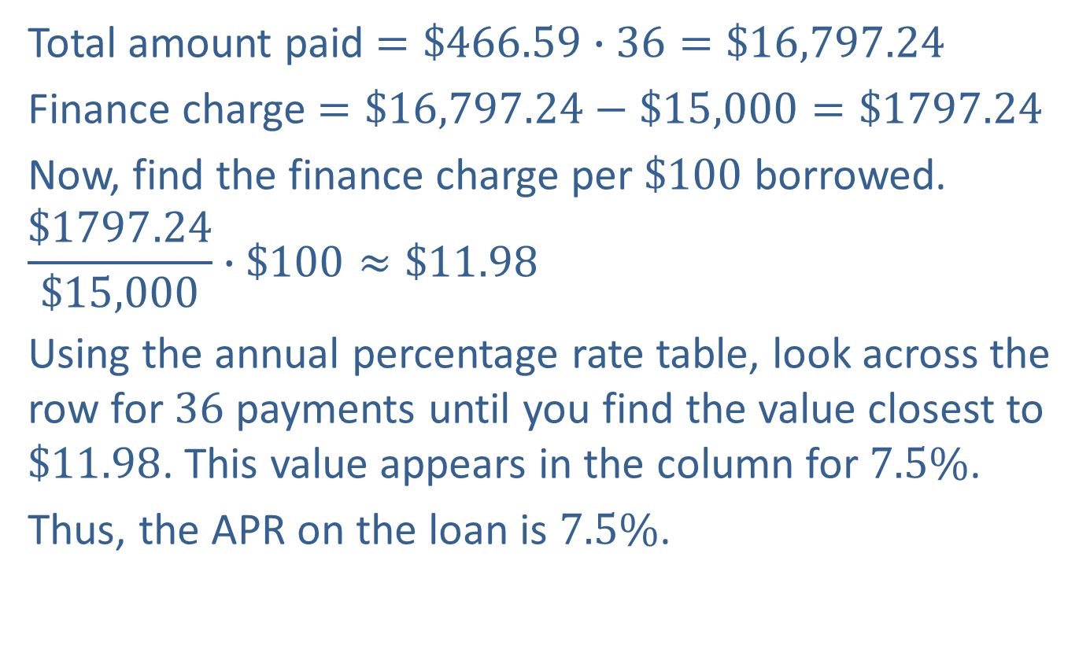
Example 3: Application: Finding the APR of a Loan (cont.)
Total amount paid $=\$466.59∙36=\$16,797.24$
Finance charge $=\$16,797.24−\$15,000=\$1797.24$
Now, find the finance charge per $\$100$ borrowed.
$$\frac{\$1797.24}{\$15,000}∙\$100≈\$11.98$$
Using the annual percentage rate table, look across the row for $36$ payments until you find the value closest to $\$11.98$. This value appears in the column for $7.5\%$.
Thus, the APR on the loan is $7.5\%$.

Slide 14
Definition: Additional Expenses in Owning a Car
Auto Insurance: Protects you against financial loss due to a variety of situations with your car, such as collisions, liability, theft,
and so on.
Operating Costs: Includes basic costs such as gasoline, oil, tires, and tune-ups.
Repairs: Includes replacing worn-out or damaged parts, such as water pumps or thermostats.

Slide 15
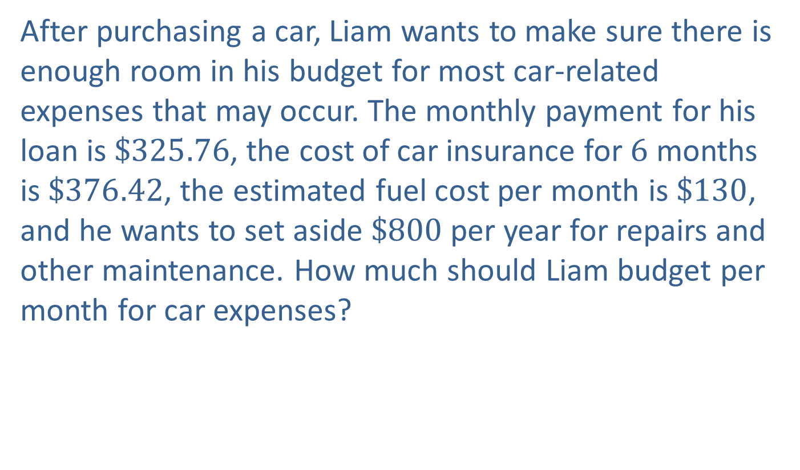
Example 4: Application: Budgeting for Car Expenses
After purchasing a car, Liam wants to make sure there is enough room in his budget for most car-related expenses that may occur. The monthly payment for his loan is $\$325.76$, the cost of car insurance for $6$ months is $\$376.42$, the estimated fuel cost per month is $\$130$, and he wants to set aside $\$800$per year for repairs and other maintenance. How much should Liam budget per month for car expenses?

Slide 16
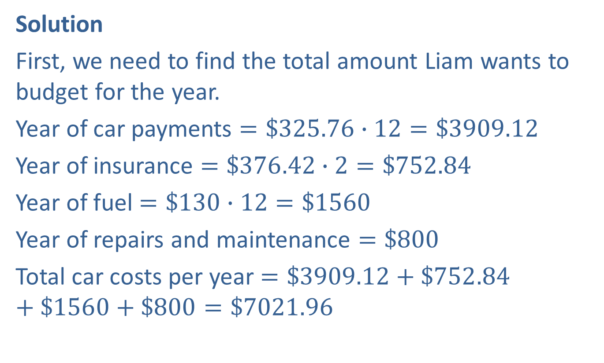
Example 4: Application: Budgeting for Car Expenses (cont.)
Solution
First, we need to find the total amount Liam wants to budget for the year.
Year of car payments $=\$325.76∙12=\$3909.12$
Year of insurance $=\$376.42∙2=\$752.84$
Year of fuel $=\$130∙12=\$1560$
Year of repairs and maintenance $=\$800$
Total car costs per year $=\$3909.12+\$752.84+\$1560+\$800=\$7021.96$

Slide 17
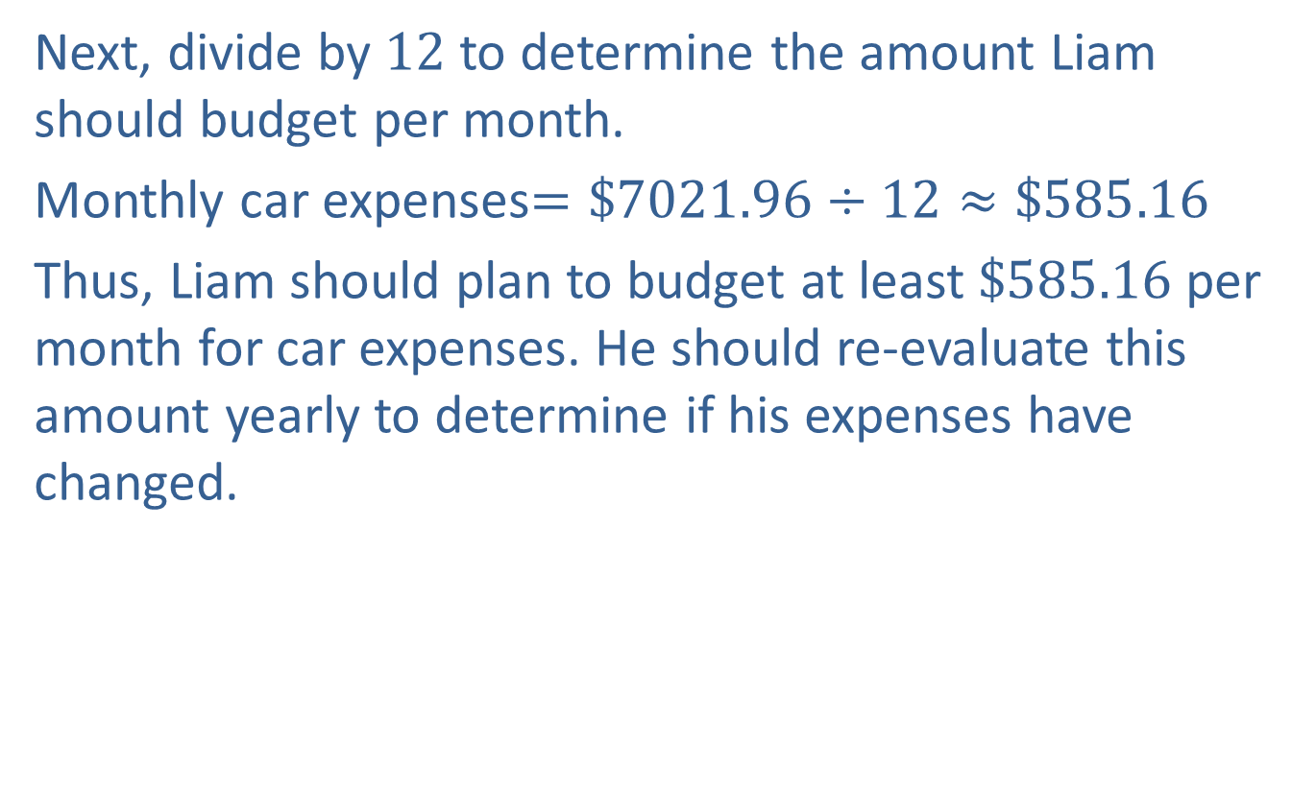
Example 4: Application: Budgeting for Car Expenses (cont.)
Next, divide by $12$ to determine the amount Liam should budget per month.
Monthly car expenses$=\$7021.96÷12≈\$585.16$
Thus, Liam should plan to budget at least $\$585.16$ per month for car expenses. He should re-evaluate this amount yearly to determine if his expenses have changed.

