Slide 1
Section 7.4
Buying a House

Slide 2
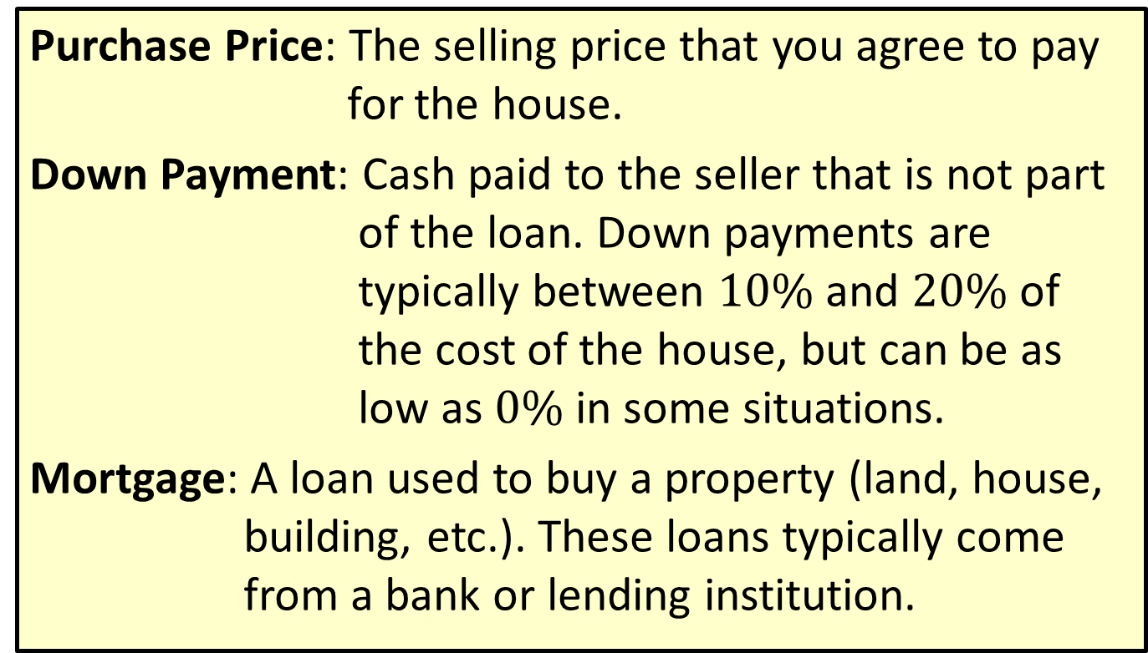
Definition: Terminology Used when Buying a House
Purchase Price: The selling price that you agree to pay for the house.
Down Payment: Cash paid to the seller that is not part of the loan. Down payments are typically between $10\%$ and $20\%$ of the cost of the house, but can be as low as $0\%$ in some situations.
Mortgage: A loan used to buy a property (land, house, building, etc.). These loans typically come from a bank or lending institution.

Slide 3
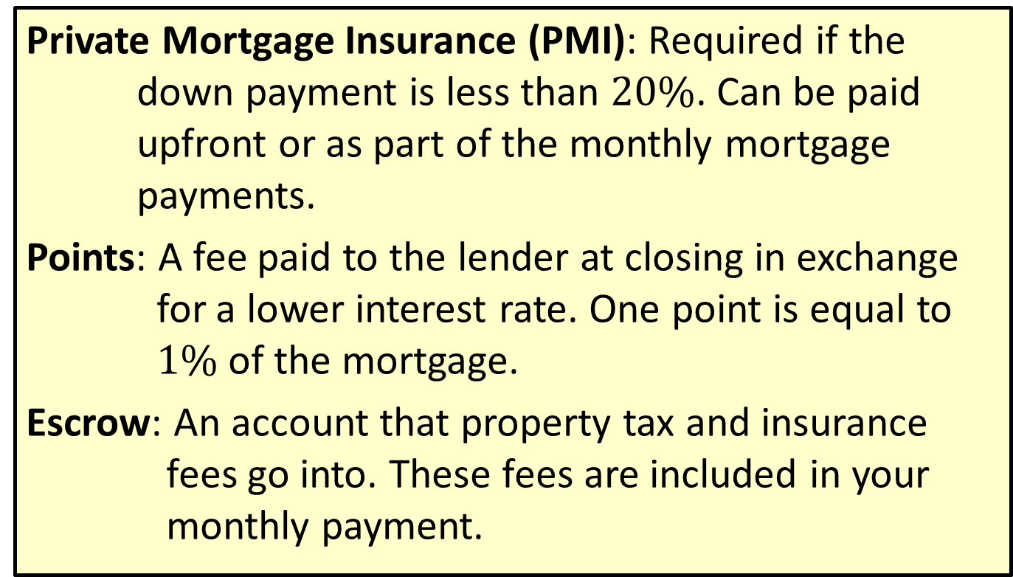
Definition: Terminology Used when Buying a House (cont.)
Private Mortgage Insurance (PMI): Required if the down payment is less than $20\%$. Can be paid upfront or as part of the monthly mortgage payments.
Points: A fee paid to the lender at closing in exchange for a lower interest rate. One point is equal to $1\%$ of the mortgage.
Escrow: An account that property tax and insurance fees go into. These fees are included in your monthly payment.

Slide 4
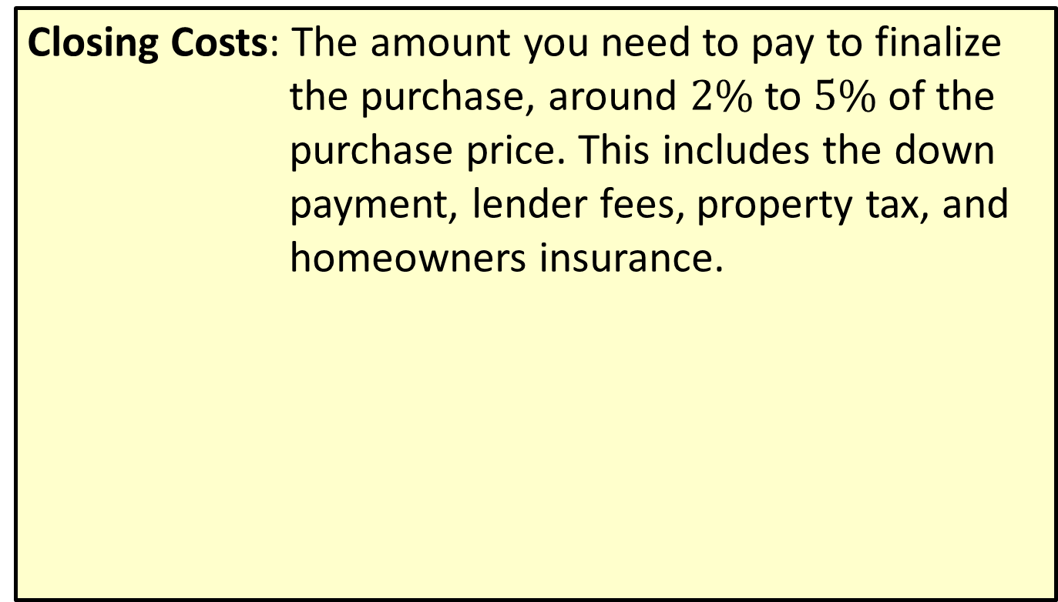
Definition: Terminology Used when Buying a House (cont.)
Closing Costs: The amount you need to pay to finalize the purchase, around $2\%$ to $5\%$ of the purchase price. This includes the down payment, lender fees, property tax, and homeowners insurance.

Slide 5
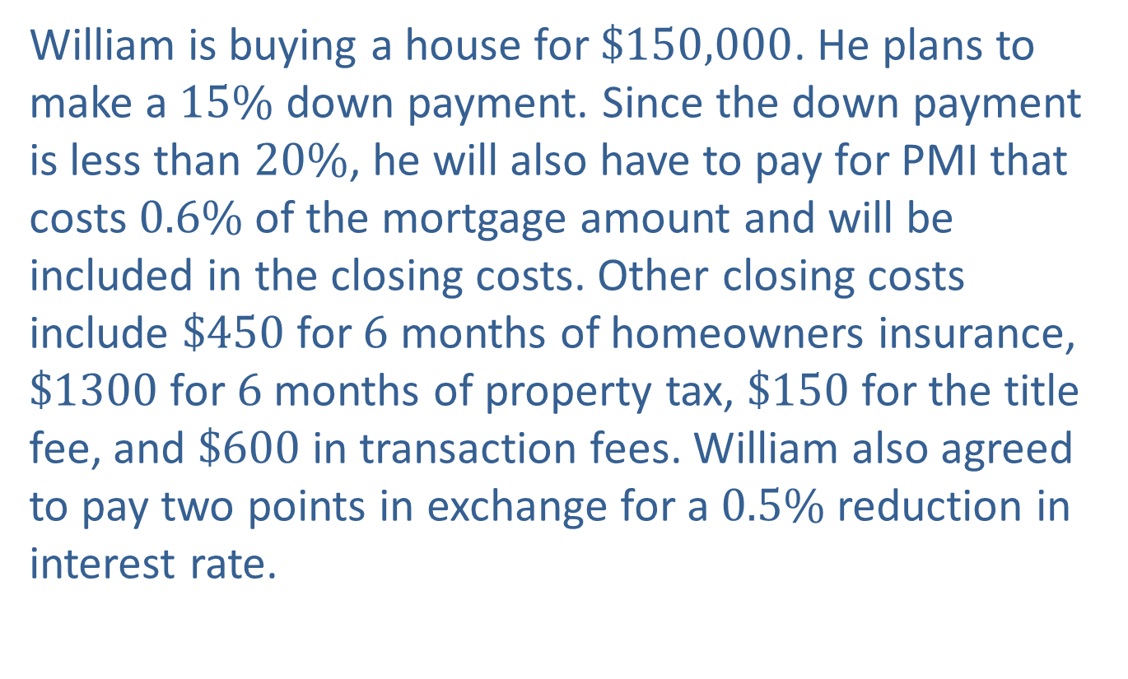
Example 1: Application: Determining the Mortgage Amount and Closing Costs
William is buying a house for $\$150,000$. He plans to make a $15\%$ down payment. Since the down payment is less than $20\%$, he will also have to pay for PMI that costs $0.6\%$ of the mortgage amount and will be included in the closing costs. Other closing costs include $\$450$for $6$ months of homeowners insurance, $\$1300$for $6$ months of property tax, $\$150$for the title fee, and $\$600$in transaction fees. William also agreed to pay two points in exchange for a $0.5\%$ reduction in interest rate.

Slide 6
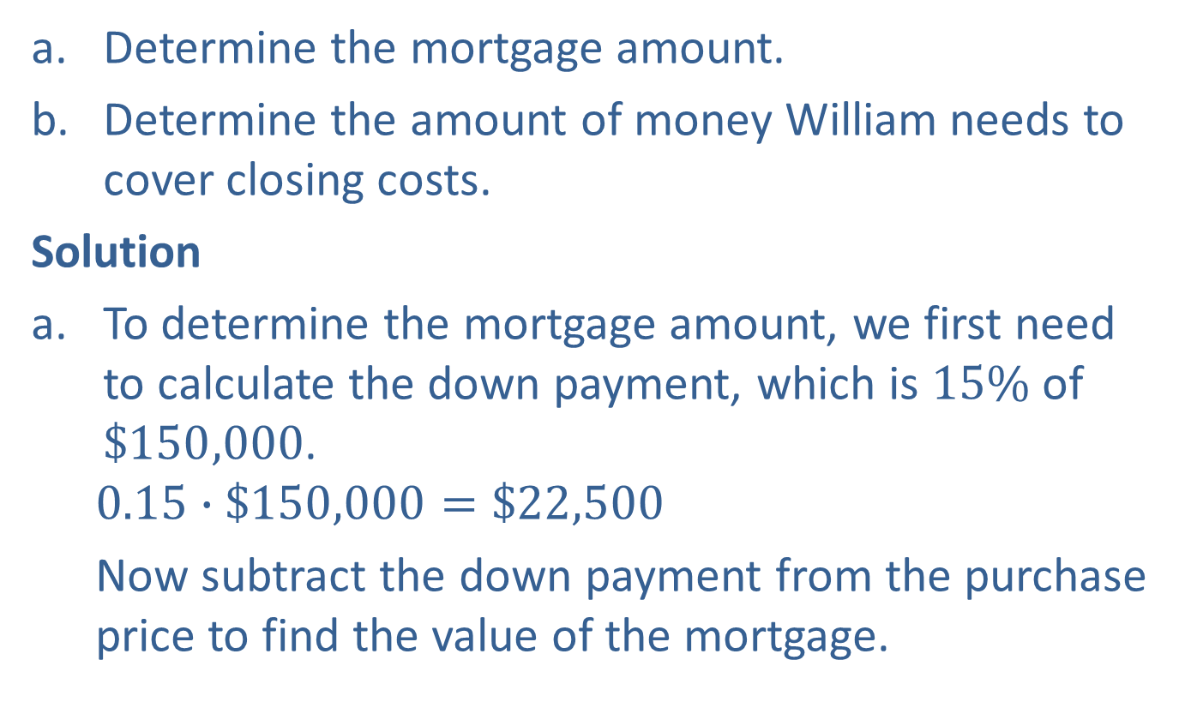
Example 1: Application: Determining the Mortgage Amount and Closing Costs (cont.)
​Determine the mortgage amount.
​Determine the amount of money William needs to cover closing costs.
Solution
To determine the mortgage amount, we first need to calculate the down payment, which is $15\%$ of $\$150,000$.
$$0.15∙\$150,000=\$22,500$$
Now subtract the down payment from the purchase price to find the value of the mortgage.

Slide 7
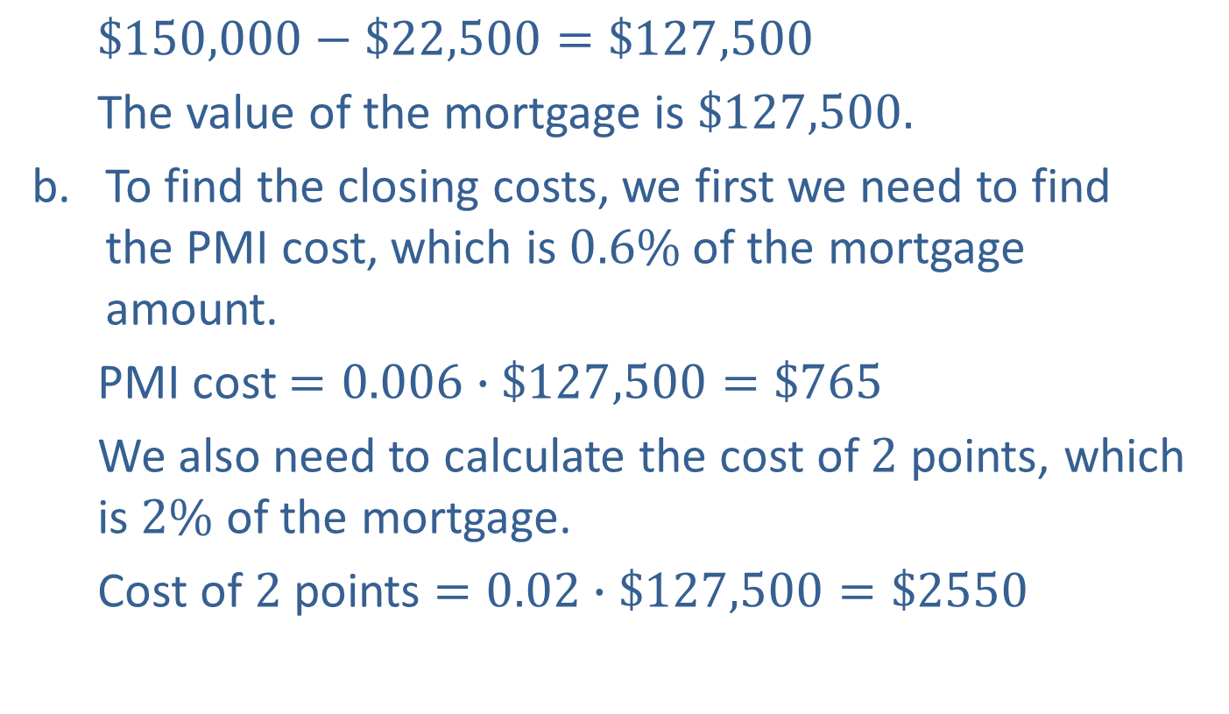
Example 1: Application: Determining the Mortgage Amount and Closing Costs (cont.)
$$\$150,000−\$22,500=\$127,500$$
The value of the mortgage is $\$127,500.$
To find the closing costs, we first we need to find the PMI cost, which is $0.6\%$ of the mortgage amount.
PMI cost $=0.006∙\$127,500=\$765$
We also need to calculate the cost of $2$ points, which is $2\%$ of the mortgage.
Cost of $2$ points $=0.02∙\$127,500=\$2550$

Slide 8

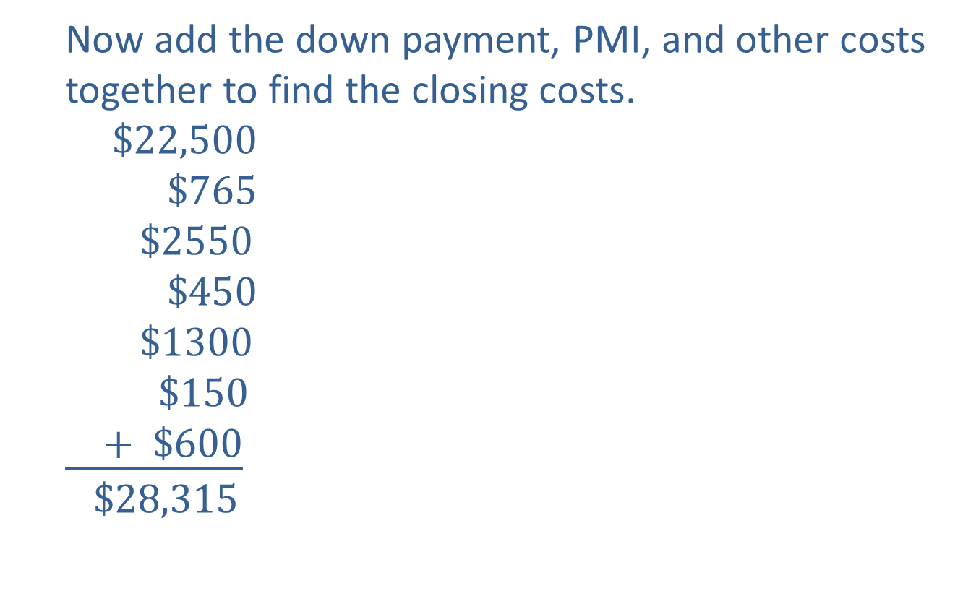
Example 1: Application: Determining the Mortgage Amount and Closing Costs (cont.)
Now add the down payment, PMI, and other costs together to find the closing costs.
$$\$22,500$$
$$\$765$$
$$\$2550$$
$$\$450$$
$$\$1300$$
$$\$150$$
$$\underline{ + \$600}$$
$$\$28,315$$
Down payment
PMI cost
Cost of $2$ points
Homeowners insurance
Property tax
Title fee
Transaction fees

Slide 9

Example 1: Application: Determining the Mortgage Amount and Closing Costs (cont.)
So you will need to have $\$28,315$for closing costs. Notice that this is about $\$5000$more than the down payment!

Slide 10
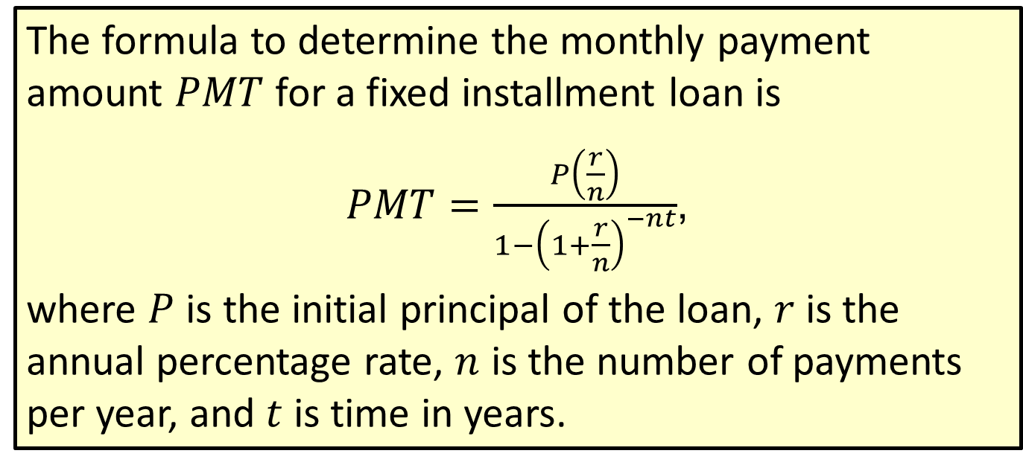
Formula: Loan Repayment Formula
The formula to determine the monthly payment amount $PMT$ for a fixed installment loan is
$PMT=\frac{P\left(\frac{r}{n}\right)}{1−{\left(1+\frac{r}{n}\right)}^{−nt}}$,
where $P$ is the initial principal of the loan, $r$ is the annual percentage rate, $n$ is the number of payments per year, and $t$ is time in years.

Slide 11
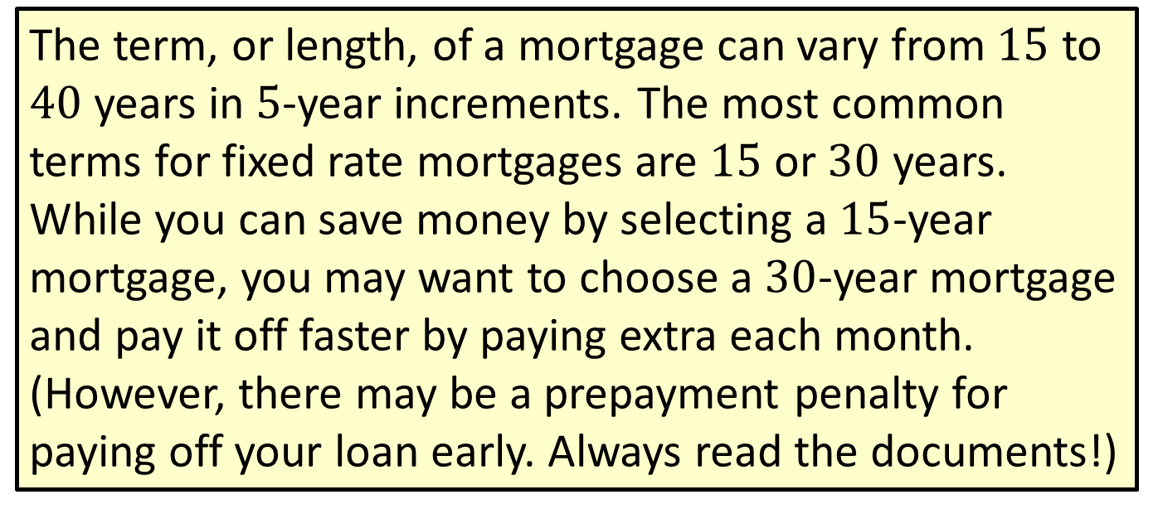
Note
The term, or length, of a mortgage can vary from $15$ to $40$ years in $5$-year increments. The most common terms for fixed rate mortgages are $15$ or $30$ years. While you can save money by selecting a $15$-year mortgage, you may want to choose a $30$-year mortgage and pay it off faster by paying extra each month. (However, there may be a prepayment penalty for paying off your loan early. Always read the documents!)

Slide 12
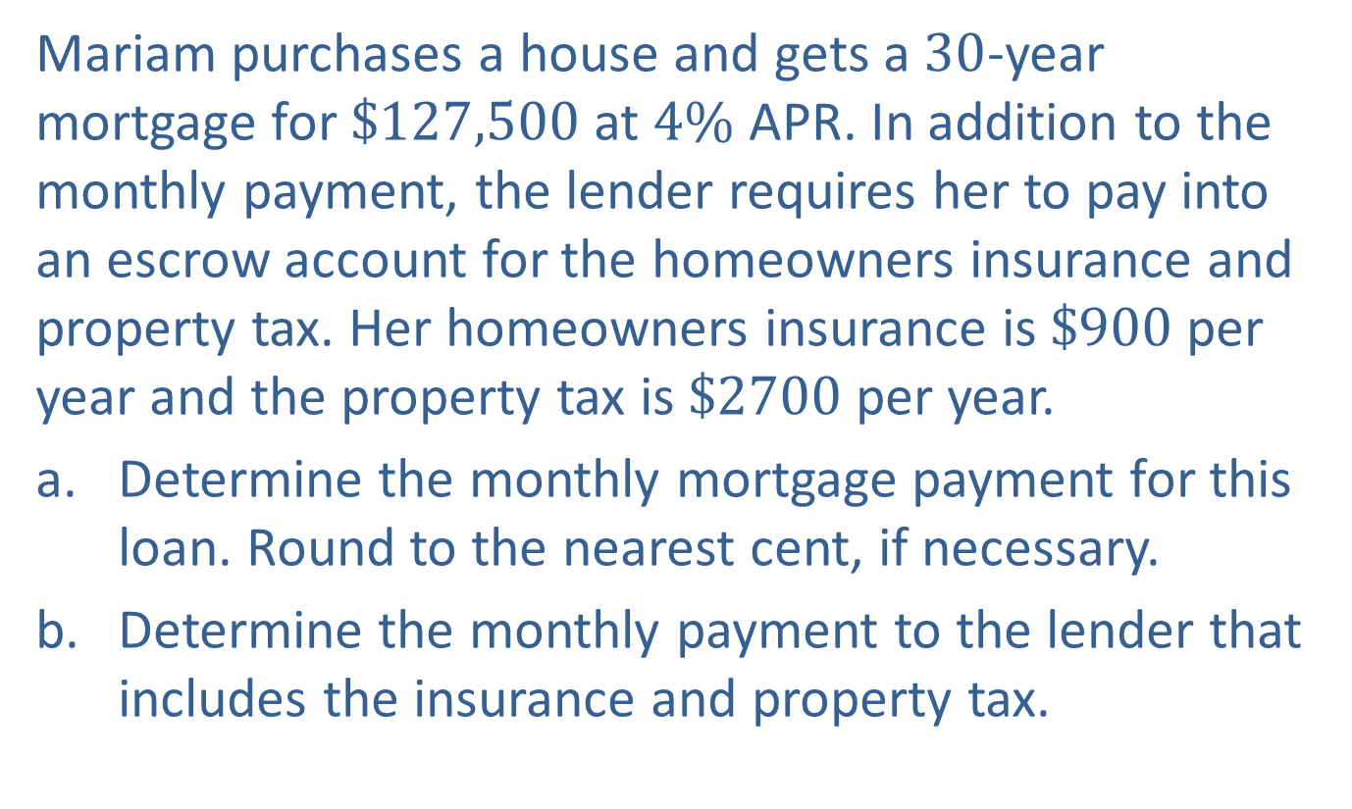
Example 2: Application: Determining a Monthly Mortgage Payment
Mariam purchases a house and gets a $30$-year mortgage for $\$127,500$at $4\%$ APR. In addition to the monthly payment, the lender requires her to pay into an escrow account for the homeowners insurance and property tax. Her homeowners insurance is $\$900$per year and the property tax is $\$2700$per year.
​Determine the monthly mortgage payment for this loan. Round to the nearest cent, if necessary.
​Determine the monthly payment to the lender that includes the insurance and property tax.

Slide 13
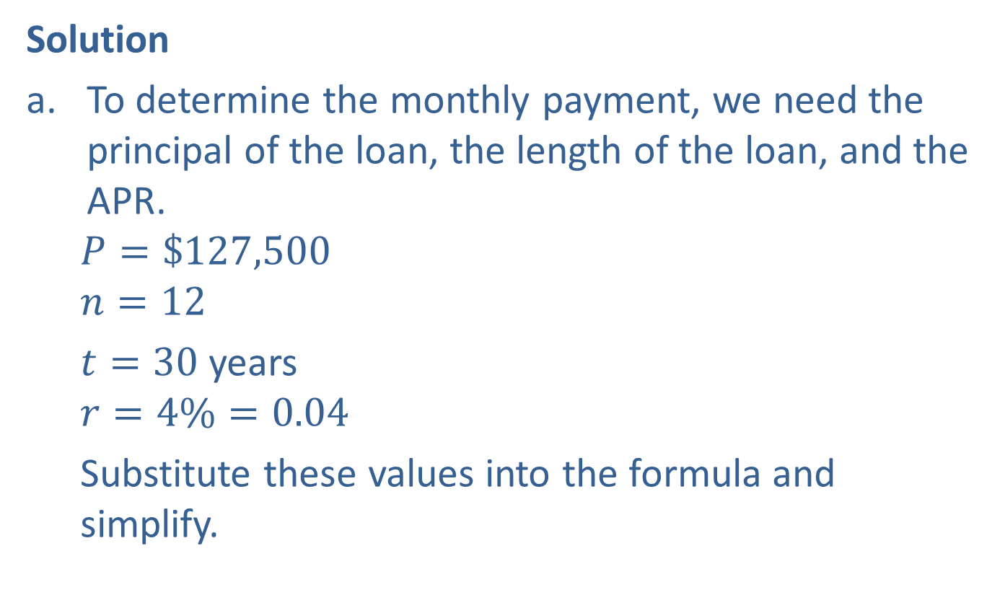
Example 2: Application: Determining a Monthly Mortgage Payment (cont.)
Solution
To determine the monthly payment, we need the principal of the loan, the length of the loan, and the APR.
$$P=\$127,500$$
$$n=12$$
$t=30$ years
$$r=4\%=0.04$$
Substitute these values into the formula and simplify.

Slide 14
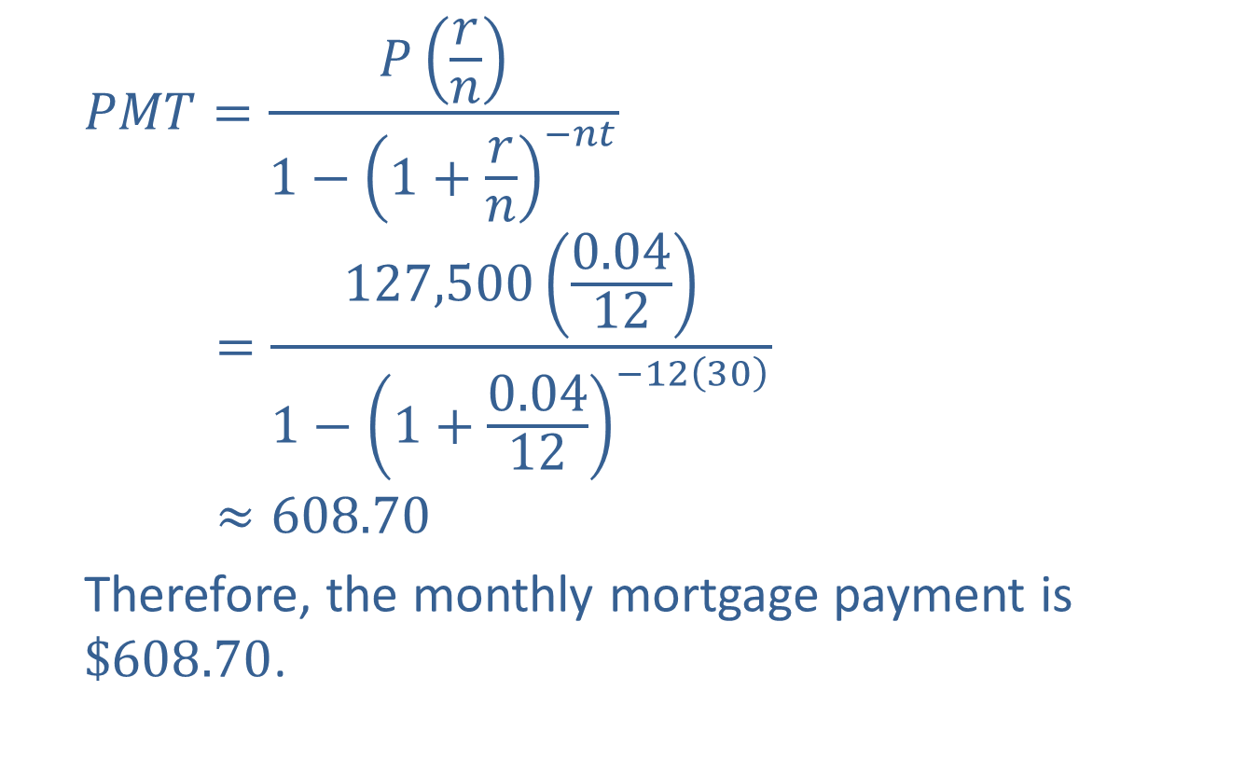
Example 2: Application: Determining a Monthly Mortgage Payment (cont.)
$$PMT=\frac{P\left(\frac{r}{n}\right)}{1−{\left(1+\frac{r}{n}\right)}^{−nt}}$$
$$=\frac{127,500\left(\frac{0.04}{12}\right)}{1−{\left(1+\frac{0.04}{12}\right)}^{−12\left(30\right)}}$$
$$≈608.70$$
Therefore, the monthly mortgage payment is $\$608.70$.

Slide 15
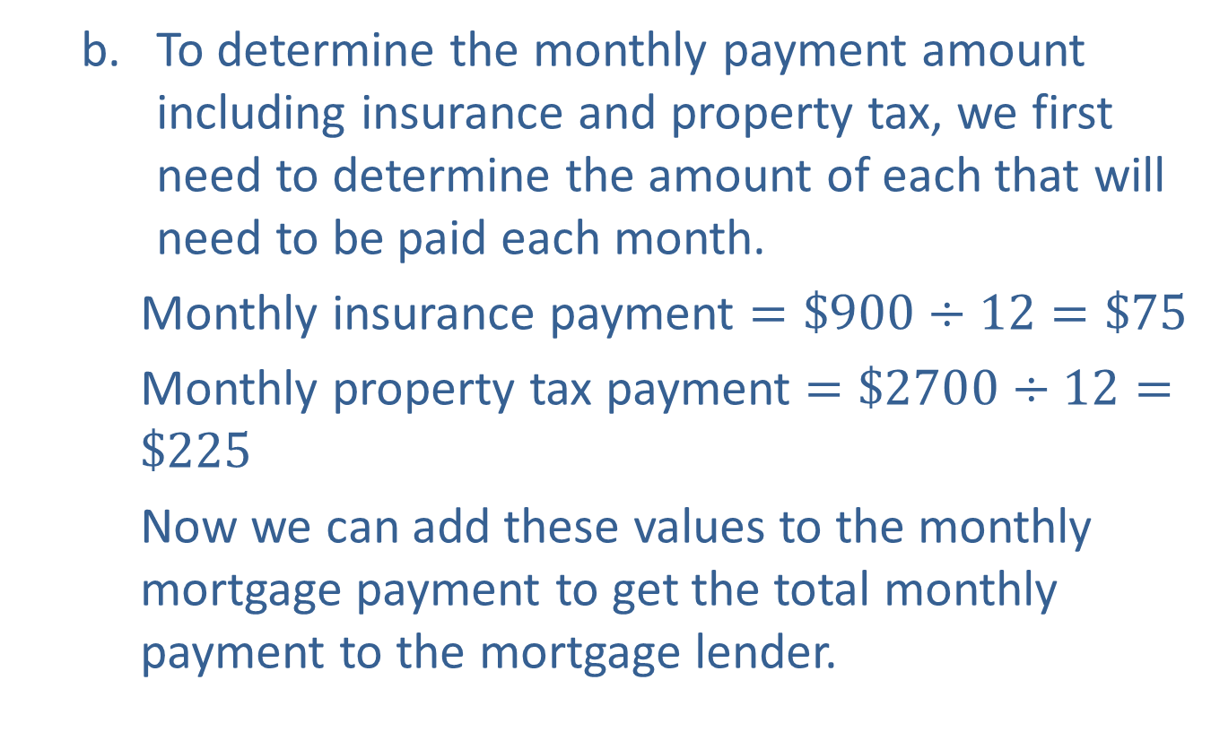
Example 2: Application: Determining a Monthly Mortgage Payment (cont.)
To determine the monthly payment amount including insurance and property tax, we first need to determine the amount of each that will need to be paid each month.
Monthly insurance payment $=\$900÷12=\$75$
Monthly property tax payment $=\$2700÷12=\$225$
Now we can add these values to the monthly mortgage payment to get the total monthly payment to the mortgage lender.

Slide 16

Example 2: Application: Determining a Monthly Mortgage Payment (cont.)
$$\$608.70$$
$$\$75.00$$
$$\underline{ +\$225.00}$$
$$\$908.70$$
Therefore, the monthly payment made to the lender is $\$908.70$.
Monthly mortgage payment
Monthly insurance payment
Monthly property tax payment

Slide 17
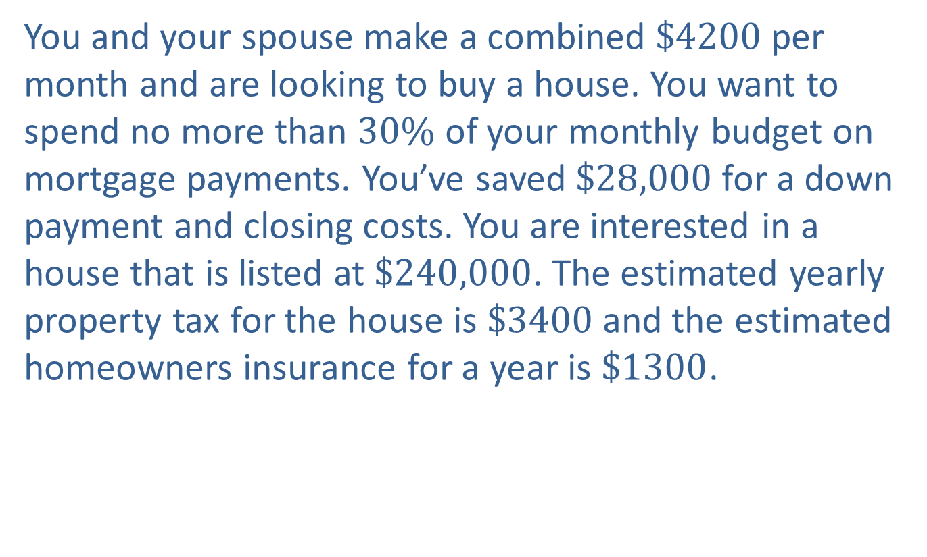
Example 3: Application: Determining Whether You Can Afford a House
You and your spouse make a combined $\$4200$per month and are looking to buy a house. You want to spend no more than $30\%$ of your monthly budget on mortgage payments. You’ve saved $\$28,000$for a down payment and closing costs. You are interested in a house that is listed at $\$240,000$. The estimated yearly property tax for the house is $\$3400$and the estimated homeowners insurance for a year is $\$1300$.

Slide 18
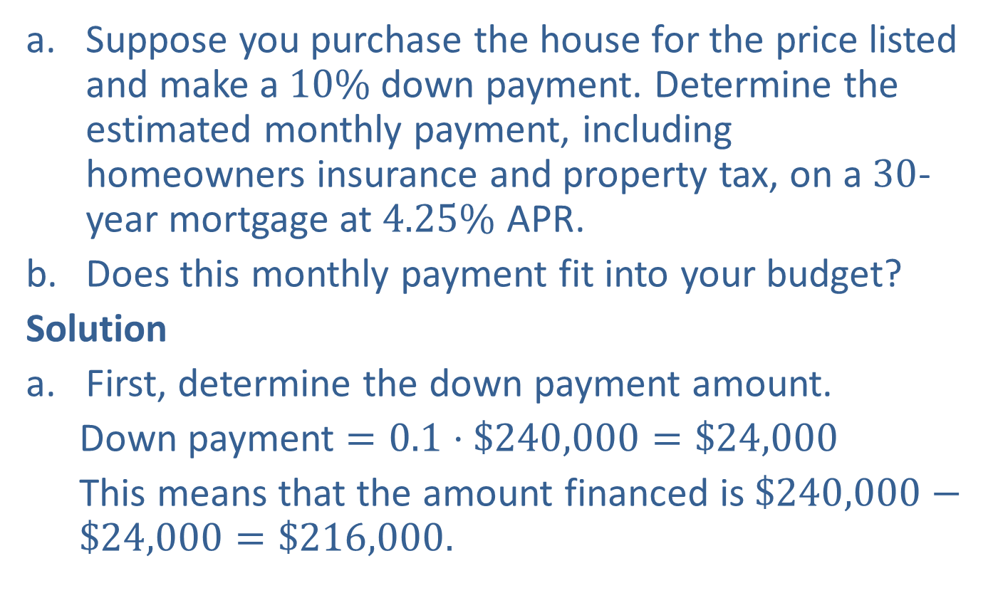
Example 3: Application: Determining Whether You Can Afford a House (cont.)
Suppose you purchase the house for the price listed and make a $10\%$ down payment. Determine the estimated monthly payment, including homeowners insurance and property tax, on a $30$-year mortgage at $4.25\%$ APR.
Does this monthly payment fit into your budget?
Solution
First, determine the down payment amount.
Down payment $=0.1⋅\$240,000=\$24,000$
This means that the amount financed is $\$240,000−\$24,000=\$216,000.$

Slide 19
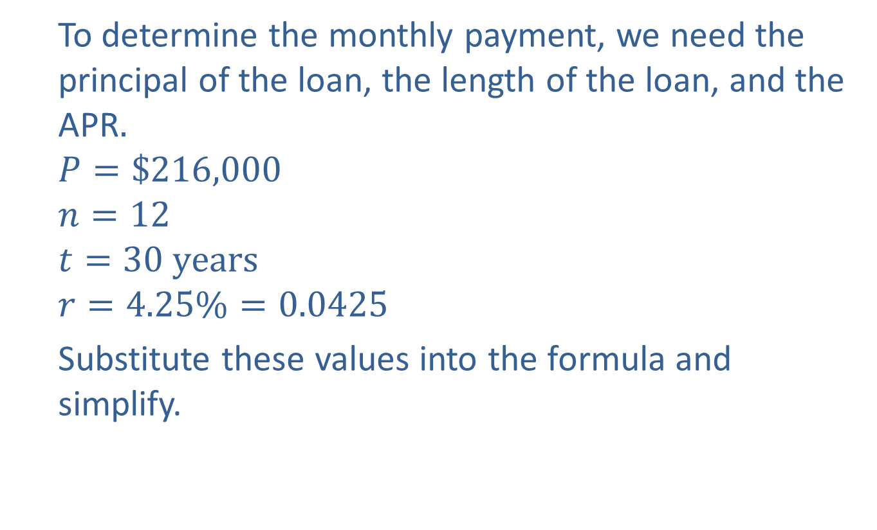
Example 3: Application: Determining Whether You Can Afford a House (cont.)
To determine the monthly payment, we need the principal of the loan, the length of the loan, and the APR$.$
$$P=\$216,000$$
$$n=12$$
$$t=30 years$$
$$r=4.25\%=0.0425$$
Substitute these values into the formula and simplify.

Slide 20
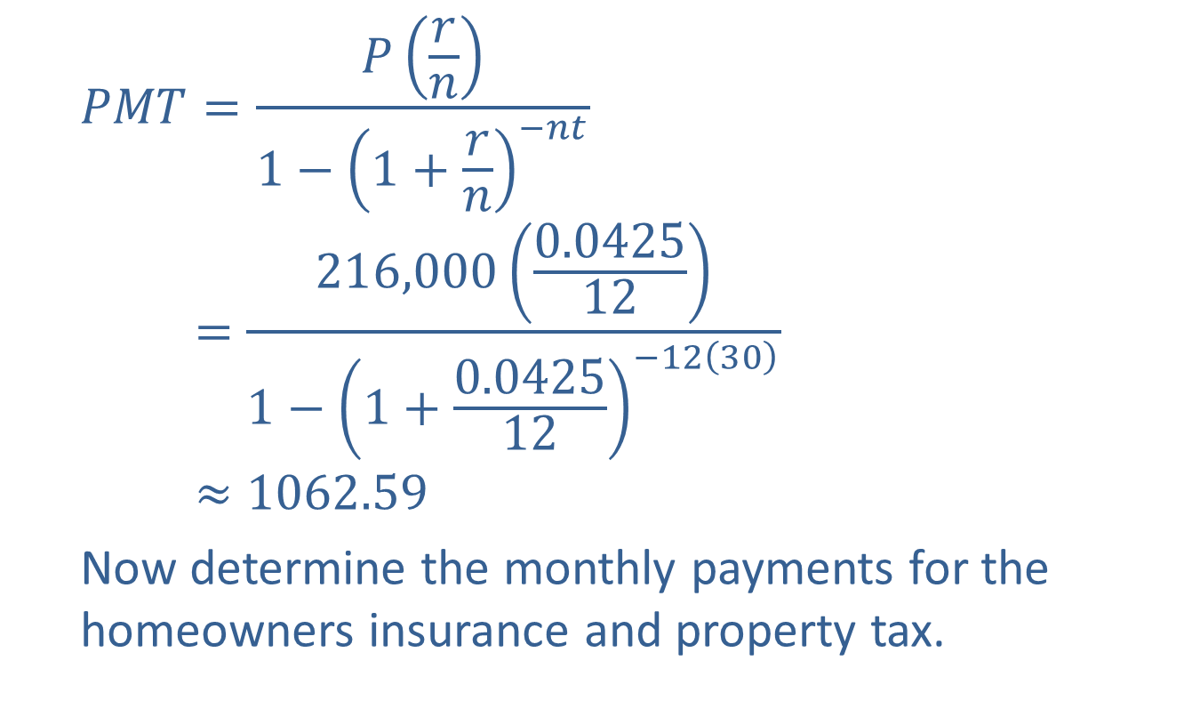
Example 3: Application: Determining Whether You Can Afford a House (cont.)
$$PMT=\frac{P\left(\frac{r}{n}\right)}{1−{\left(1+\frac{r}{n}\right)}^{−nt}}$$
$$=\frac{216,000\left(\frac{0.0425}{12}\right)}{1−{\left(1+\frac{0.0425}{12}\right)}^{−12\left(30\right)}}$$
$$≈1062.59$$
Now determine the monthly payments for the homeowners insurance and property tax.

Slide 21
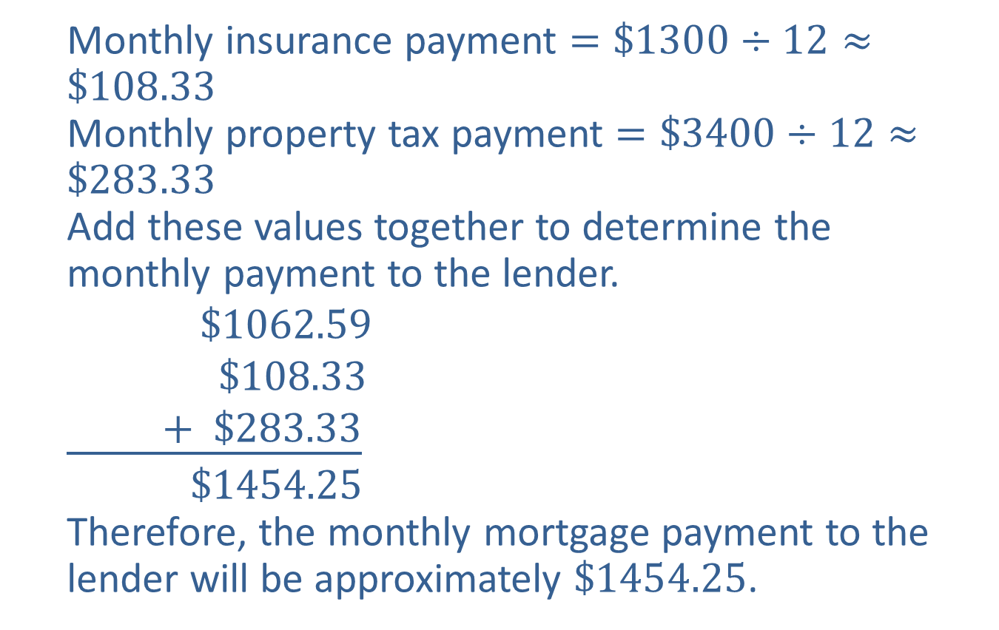
Example 3: Application: Determining Whether You Can Afford a House (cont.)
Monthly insurance payment $=\$1300÷12≈\$108.33$
Monthly property tax payment $=\$3400÷12≈\$283.33$
Add these values together to determine the monthly payment to the lender.
$$\$1062.59$$
$$\$108.33$$
$$\underline{ + \$283.33}$$
$$\$1454.25$$
Therefore, the monthly mortgage payment to the lender will be approximately $\$1454.25$.
Monthly mortgage payment
Monthly insurance payment
Monthly property tax payment

Slide 22
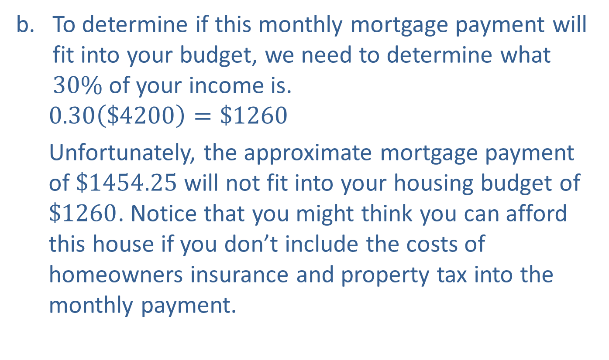
Example 3: Application: Determining Whether You Can Afford a House (cont.)
To determine if this monthly mortgage payment will fit into your budget, we need to determine what $30\%$ of your income is.
$$0.30\left(\$4200\right)=\$1260$$
Unfortunately, the approximate mortgage payment of $\$1454.25$will not fit into your housing budget of $\$1260$. Notice that you might think you can afford this house if you don’t include the costs of homeowners insurance and property tax into the monthly payment.

Slide 23
Example 3: Application: Determining Whether You Can Afford a House (cont.)
You can try making a low offer on this house, but you’ll likely need to find a less expensive house to purchase or set aside more money to make a larger down payment.

Slide 24

Example 4: Building an Amortization Table
Fill in the amortization table for the first three months of a $30$-year $\$180,000$mortgage that has an APR of $4.5\%$. The monthly payment for this mortgage (not including insurance or property tax) is $\$912.03$.
Payment Number | Interest Payment | Principal Payment | Mortgage Balance
1
2
3

Slide 25
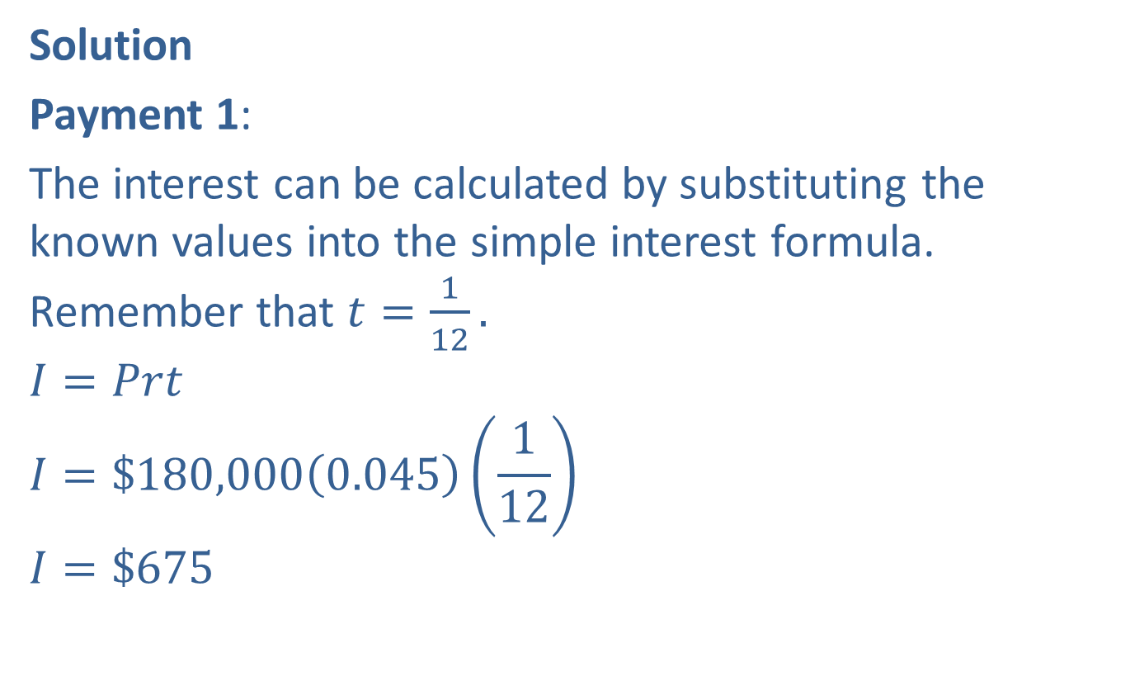
Example 4: Building an Amortization Table (cont.)
Solution
Payment 1:
The interest can be calculated by substituting the known values into the simple interest formula. Remember that $t=\frac{1}{12}.$
$$I=Prt$$
$$I=\$180,000\left(0.045\right)\left(\frac{1}{12}\right)$$
$$I=\$675$$

Slide 26
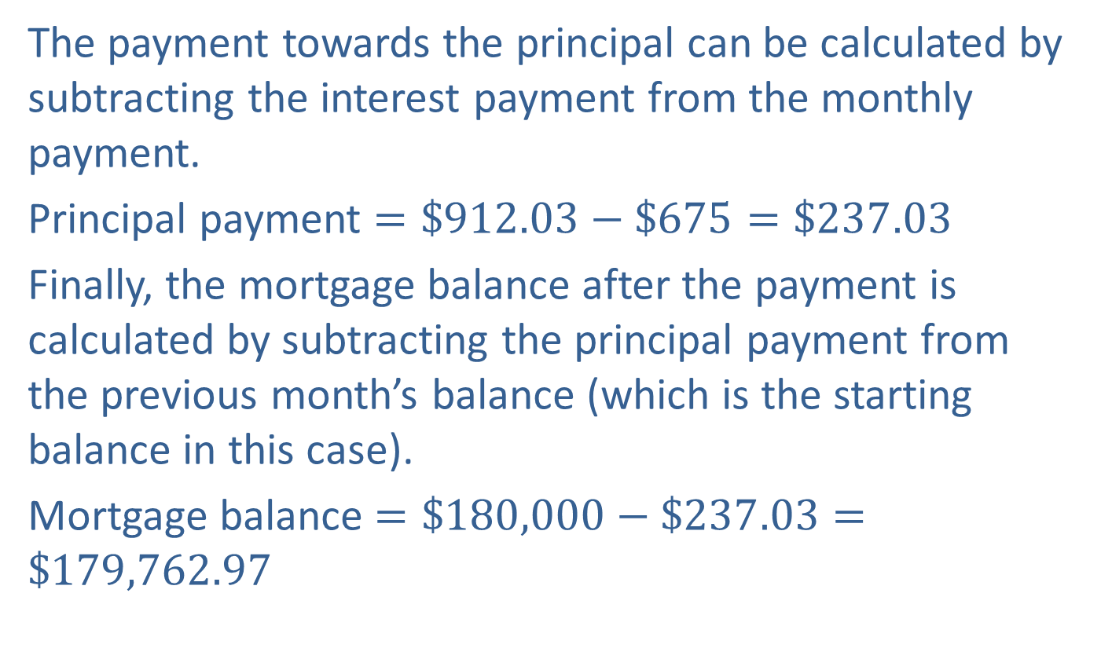
Example 4: Building an Amortization Table (cont.)
The payment towards the principal can be calculated by subtracting the interest payment from the monthly payment.
Principal payment $=\$912.03−\$675=\$237.03$
Finally, the mortgage balance after the payment is calculated by subtracting the principal payment from the previous month’s balance (which is the starting balance in this case).
Mortgage balance $=\$180,000−\$237.03=\$179,762.97$

Slide 27
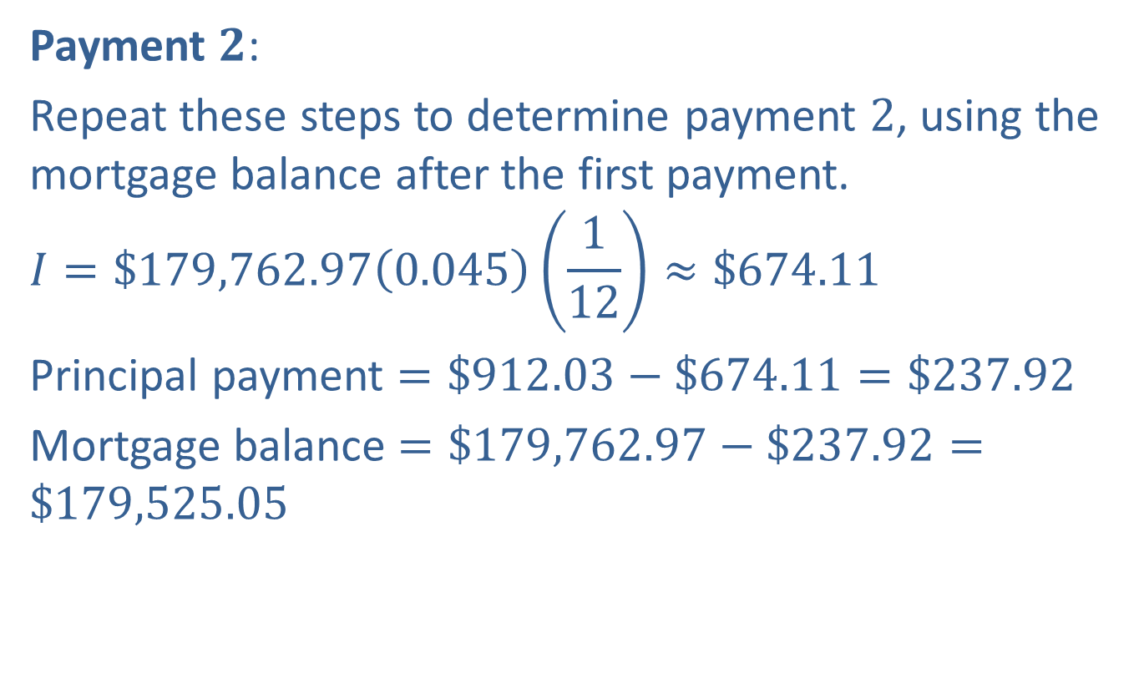
Example 4: Building an Amortization Table (cont.)
Payment $2$:
Repeat these steps to determine payment $2$, using the mortgage balance after the first payment.
$$I=\$179,762.97\left(0.045\right)\left(\frac{1}{12}\right)≈\$674.11$$
Principal payment $=\$912.03−\$674.11=\$237.92$
Mortgage balance $=\$179,762.97−\$237.92=\$179,525.05$

Slide 28
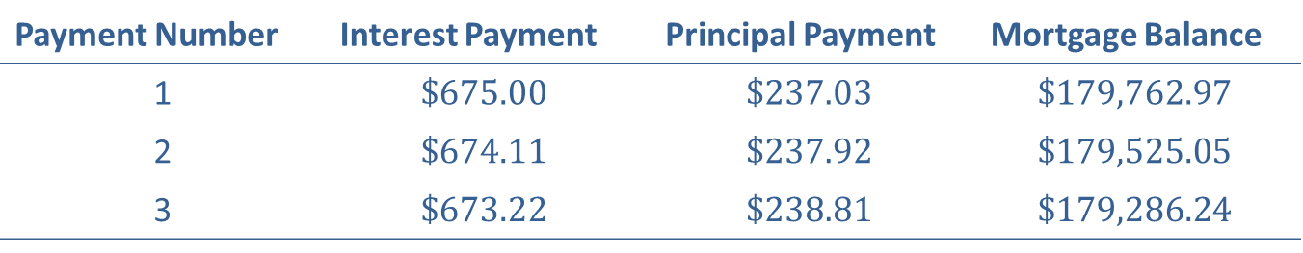
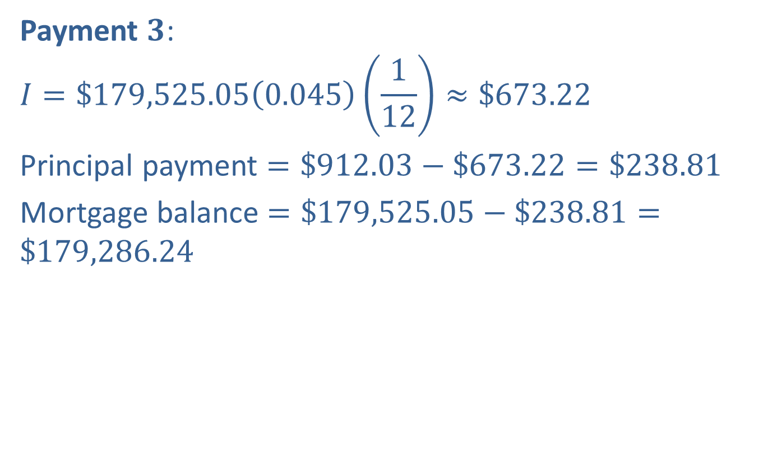
Example 4: Building an Amortization Table (cont.)
Payment $3$:
$$I=\$179,525.05\left(0.045\right)\left(\frac{1}{12}\right)≈\$673.22$$
Principal payment $=\$912.03−\$673.22=\$238.81$
Mortgage balance $=\$179,525.05−\$238.81=\$179,286.24$
Payment Number | Interest Payment | Principal Payment | Mortgage Balance
1 | $$\$675.00$$ | $$\$237.03$$ | $$\$179,762.97$$
2 | $$\$674.11$$ | $$\$237.92$$ | $$\$179,525.05$$
3 | $$\$673.22$$ | $$\$238.81$$ | $$\$179,286.24$$

Slide 29
Example 4: Building an Amortization Table (cont.)
Notice that each month the interest payment decreases and the principal payment increases.

