Slide 1
Section 8.1
Introduction to Sets

Slide 2
Definition: Sets
A set is a collection of items. The items are called elements or members of the set.

Slide 3
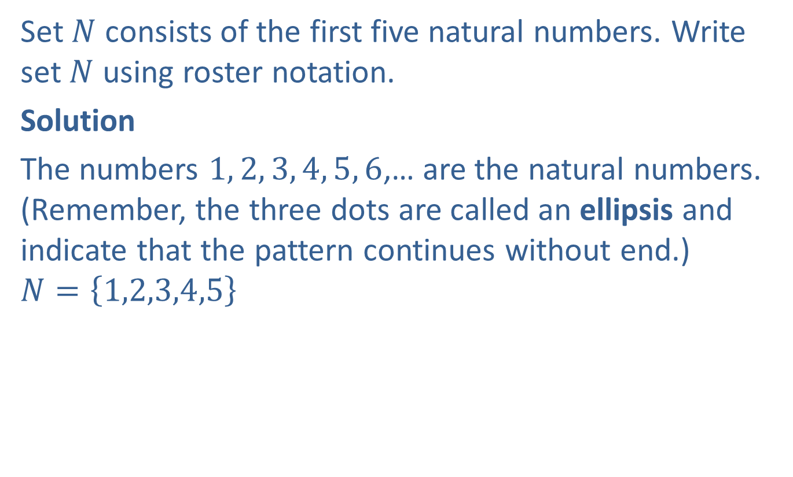
Example 1: Writing Sets Using Roster Notation
Set $N$ consists of the first five natural numbers. Write set $N$ using roster notation.
Solution
The numbers $1, 2, 3, 4, 5, 6$,… are the natural numbers. (Remember, the three dots are called an ellipsis and indicate that the pattern continues without end.)
$$N=\left\{\left.1,2,3,4,5\right\}\right.$$

Slide 4
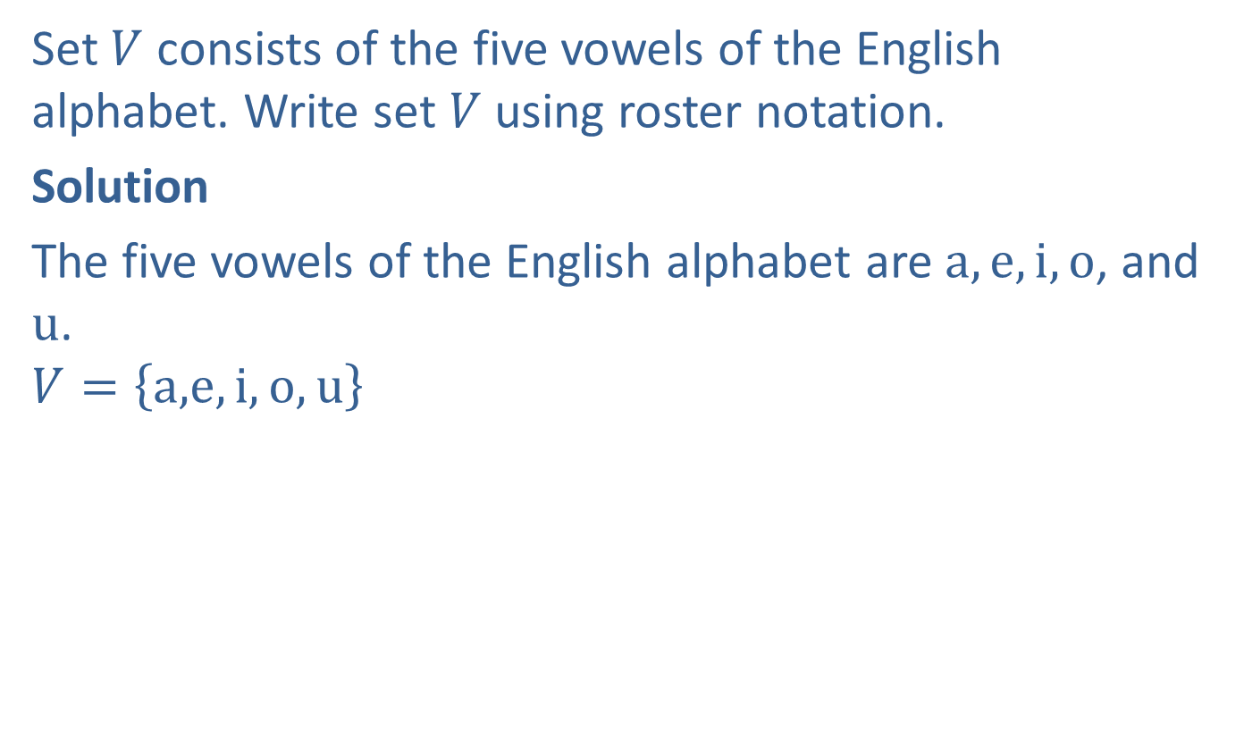
Example 2: Writing Sets Using Roster Notation
Set $V$ consists of the five vowels of the English alphabet. Write set $V$ using roster notation.
Solution
The five vowels of the English alphabet are $a, e, i, o$, and $u$.
$$V=\left\{a,\right.\left.e,i,o,u\right\}$$

Slide 5

Example 3: Writing Sets Using Set-Builder Notation
Set $B$ consists of the books authored by J.K. Rowling. Write set $B$ using set-builder notation.
Solution
$B=\left\{x \right| x$ is a book authored by J.K. Rowling$\}$

Slide 6
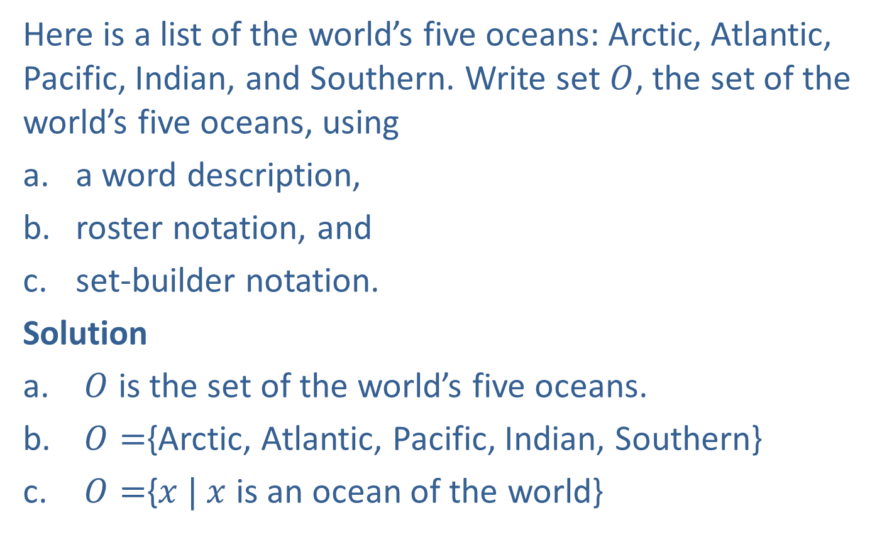
Example 4: Writing Sets
Here is a list of the world’s five oceans: Arctic, Atlantic, Pacific, Indian, and Southern. Write set $O$, the set of the world’s five oceans, using
​a word description,
​roster notation, and
​set-builder notation.
Solution
$O$ is the set of the world’s five oceans.
$O=${Arctic, Atlantic, Pacific, Indian, Southern}
$O=${$x | x$ is an ocean of the world}

Slide 7
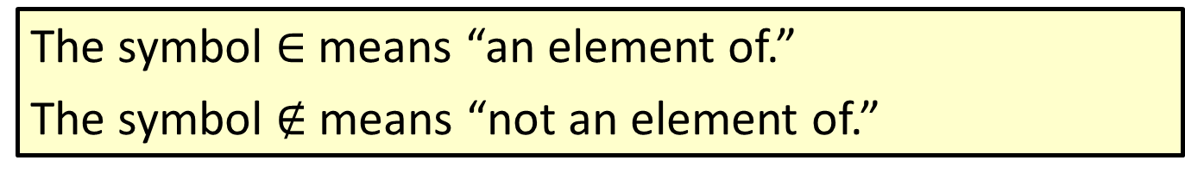

Definition: The Symbols $∈$ and $∉$
The symbol $∈$ means “an element of.”
The symbol $∉$ means “not an element of.”

Slide 8
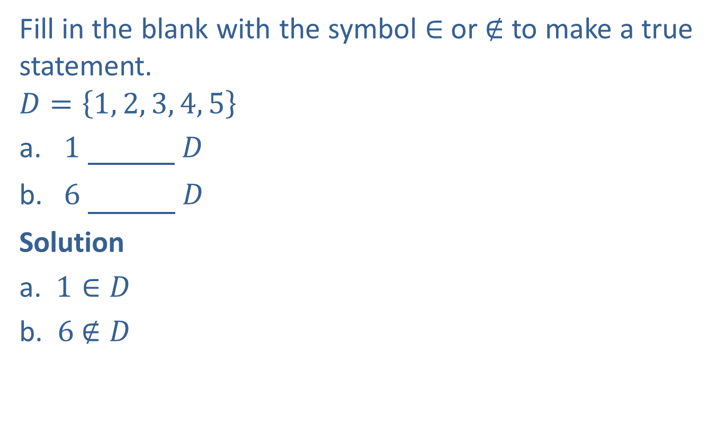

Example 5: Using the Symbols $∈$ and $∉$
Fill in the blank with the symbol $∈$ or $∉$ to make a true statement.
$$D=\left\{1, 2, 3, 4, 5\right\}$$
​1 ∈ 𝐷
​6 ∉ 𝐷
Solution
a. $1∈D$
b. $6$ $∉D$

Slide 9
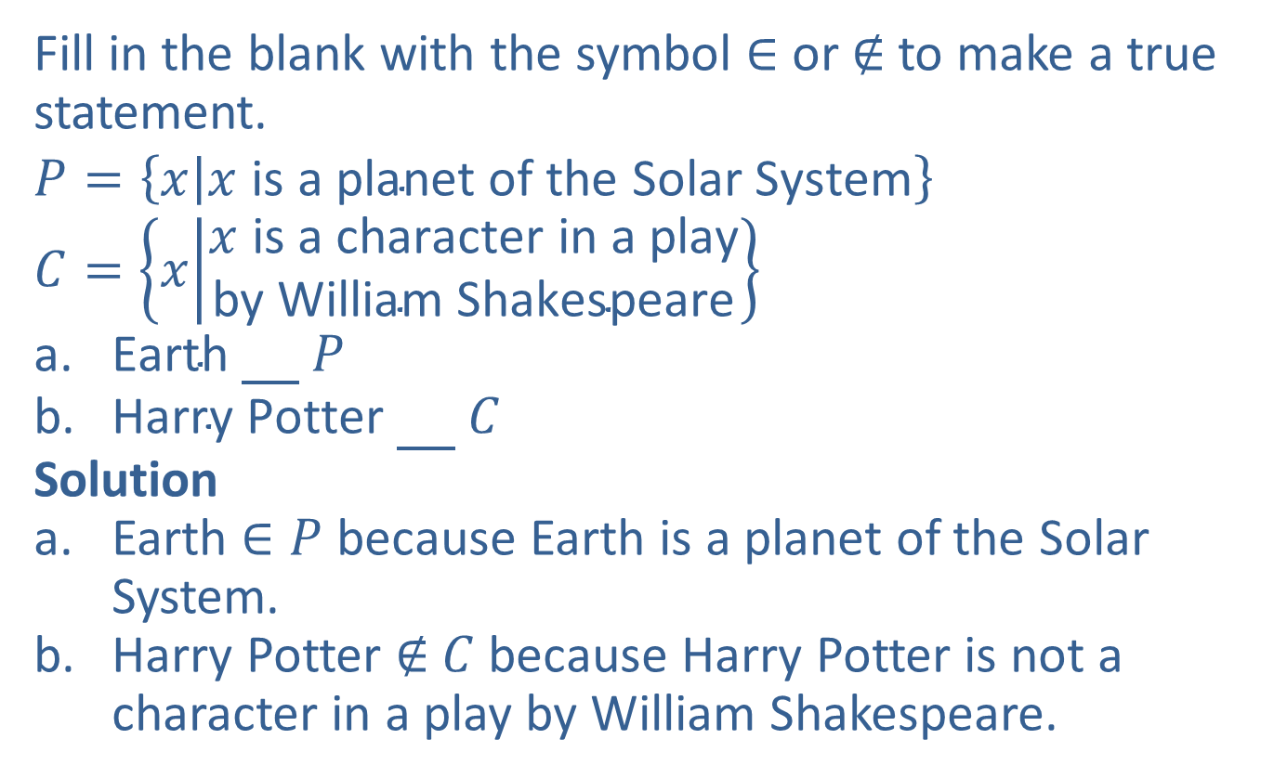
Example 6: Using the Symbols ∈ and ∉
Fill in the blank with the symbol ∈ or ∉ to make a true statement.
$$P=\left\{x | x \text{is} \text{a} \text{planet} \text{of} \text{the} \text{Solar} \text{System}\right\}$$
$$C=\left\{x | \begin{matrix}x \text{is} \text{a} \text{character} \text{in} \text{a} \text{play} \\ \text{by} \text{William} \text{Shakespeare}\end{matrix}\right\}$$
​Earth ∈ 𝑃
​Harry Potter ∉ 𝐶
Solution
Earth $∈P$ because Earth is a planet of the Solar System.
Harry Potter ∉ $C$because Harry Potter is not a character in a play by William Shakespeare.

Slide 10
Definition: The Empty Set
The empty set (or null set) is a set with no elements. It is represented by the symbol ∅ or by writing nothing between a set of braces, { }.

Slide 11
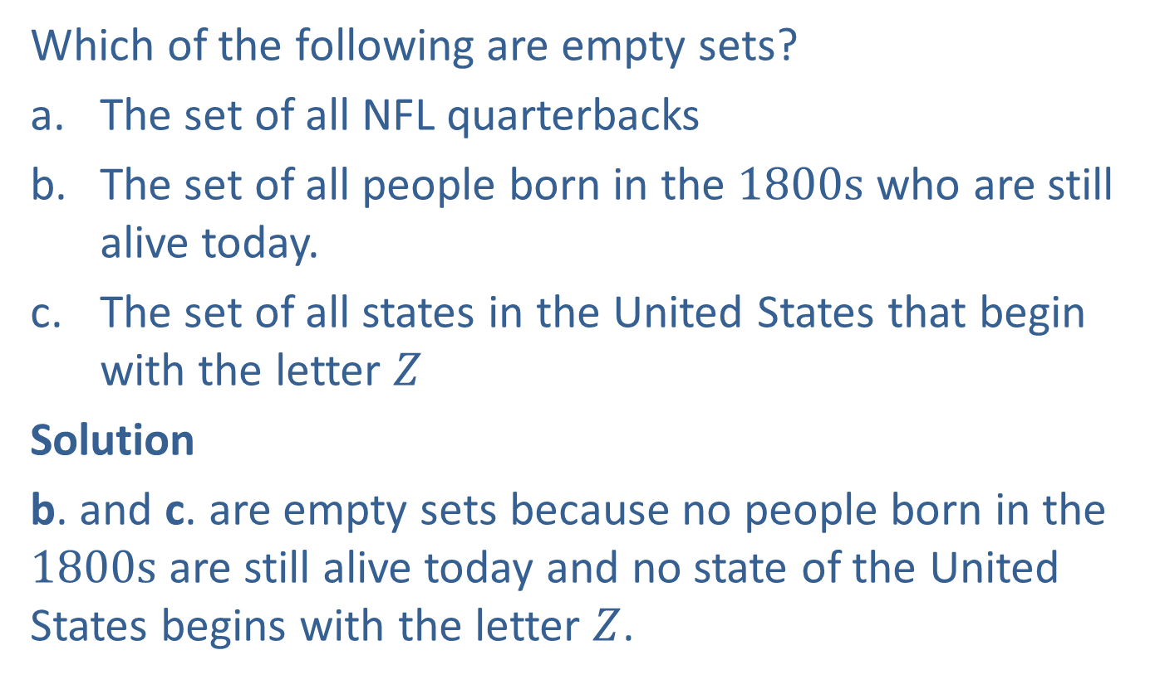
Example 7: Recognizing the Empty Set
Which of the following are empty sets?
​The set of all NFL quarterbacks
​The set of all people born in the $1800s$ who are still alive today.
​The set of all states in the United States that begin with the letter $Z$
Solution
b. and c. are empty sets because no people born in the $1800s$ are still alive today and no state of the United States begins with the letter $Z$.

Slide 12
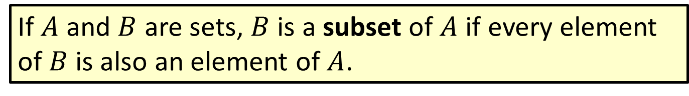
Definition: Subsets
If $A$ and $B$ are sets, $B$ is a subset of $A$ if every element of $B$ is also an element of $A$.

Slide 13
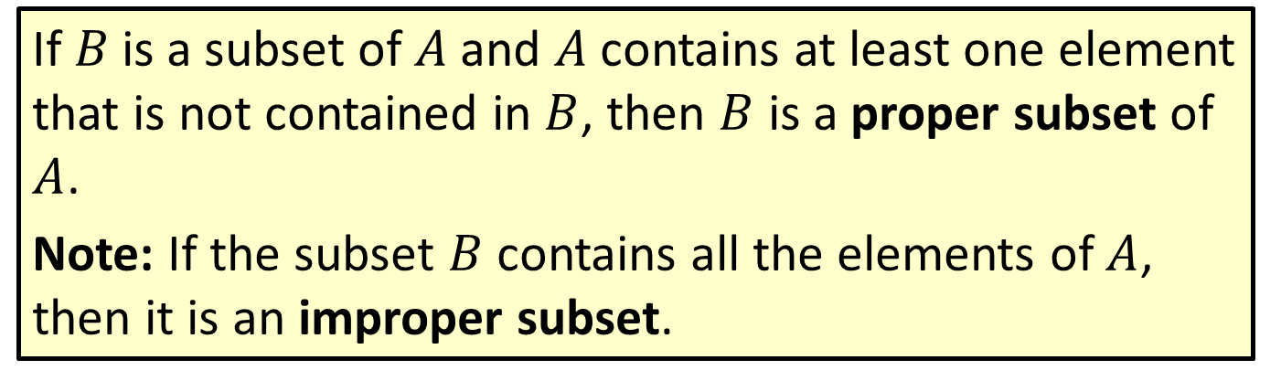
Definition: Proper Subsets
If$B$is a subset of $A$and $A$contains at least one element that is not contained in $B$, then $B$ is a proper subset of $A$.
Note: If the subset $B$ contains all the elements of $A$, then it is an improper subset.

Slide 14
Note
It’s a good idea when writing subsets to always begin with the empty set since this is the easiest subset to forget.

Slide 15
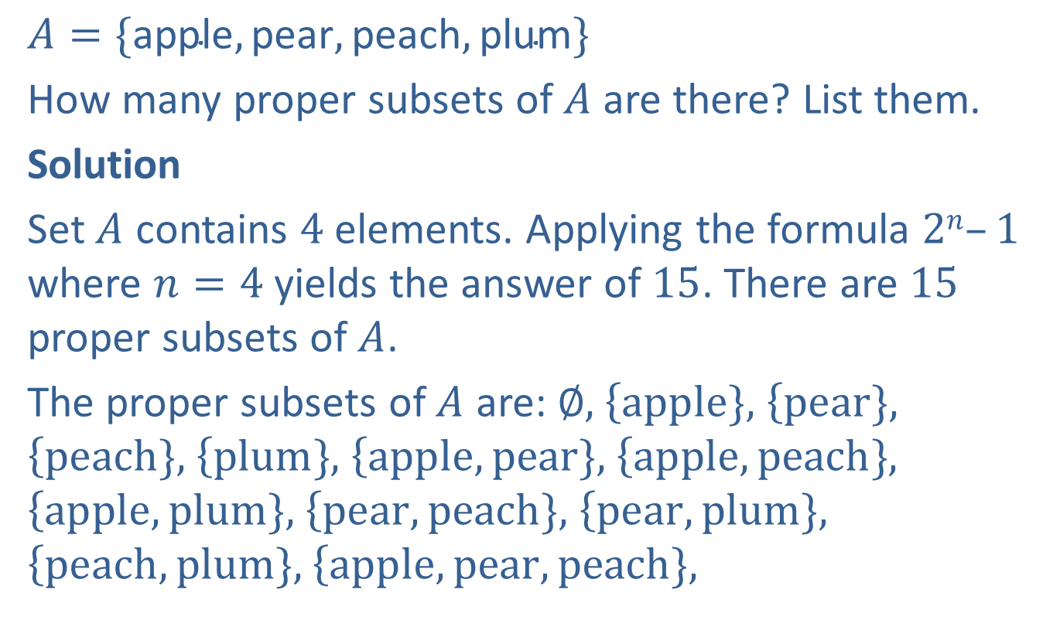
Example 8: Finding All Proper Subsets of a Given Set
$$A=\{\text{apple},\text{pear},\text{peach},\text{plum}\}$$
How many proper subsets of $A$ are there? List them.
Solution
Set $A$ contains $4$ elements. Applying the formula $2n–1$ where $n=4$ yields the answer of $15$. There are $15$ proper subsets of $A$.
The proper subsets of $A$ are: ∅, $\left\{apple\},\right.$ $\left\{pear\},\right.$ $\left\{peach\},\right.$ $\left\{plum\},\right.$ $\left\{apple, pear\},\right.$ $\left\{apple, peach\},\right.$ $\left\{apple, plum\},\right.$ $\left\{pear, peach\},\right.$ $\left\{pear, plum\},\right.$ $\left\{peach, plum\},\right.$ $\left\{apple, pear, peach\},\right.$

Slide 16

Example 8: Finding All Proper Subsets of a Given Set (cont.)
$\left\{apple, pear, plum\},\right.$ $\left\{apple, peach, plum\},\right.$ and $\left\{pear, peach, plum\}.\right.$ The proper subsets of $A$ are the sets that contain none or some of the elements of $A$.

Slide 17
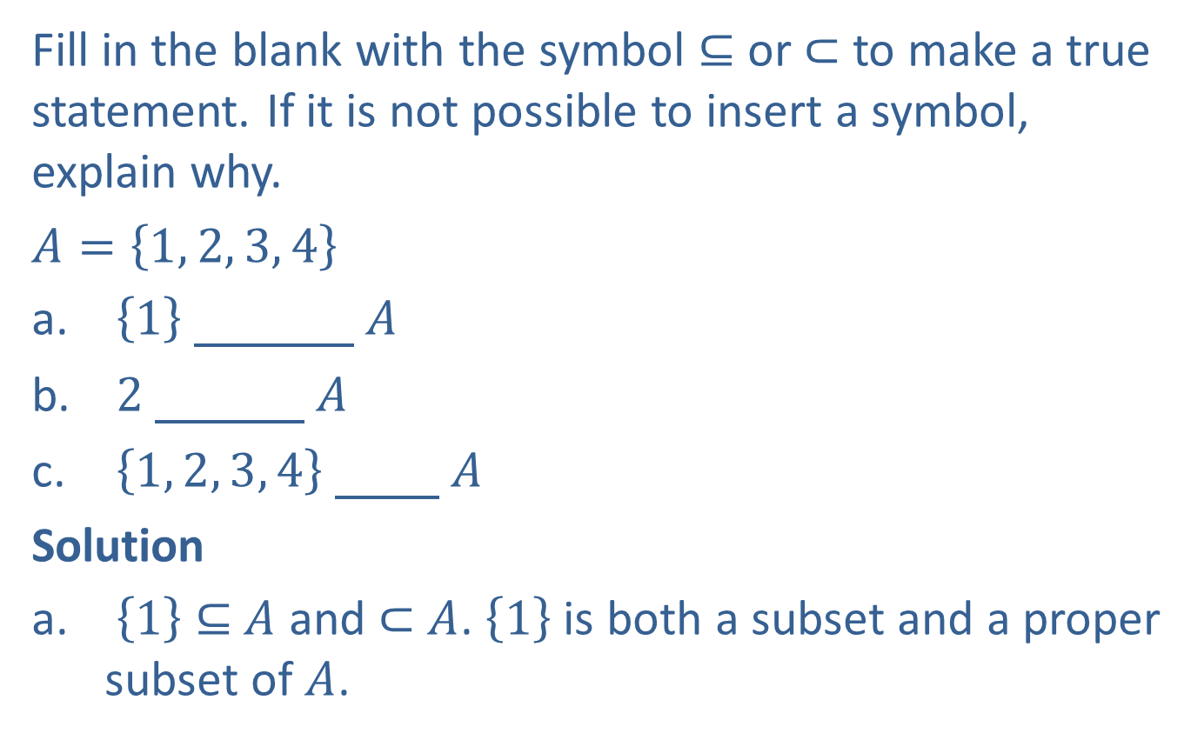
Example 9: Using the Symbols ⊆ and ⊂
Fill in the blank with the symbol ⊆ or ⊂ to make a true statement. If it is not possible to insert a symbol, explain why.
$A=\left\{1, 2, 3, 4\right\}$​
1 ⊂ 𝐴
​ 2 ⊂ 𝐴
​ $\left\{1, 2, 3, 4\right\}$​ ⊂ 𝐴
Solution
$\left\{\left.1\right\}\right.$ ⊆ $A$ and ⊂ $A$. $\left\{\left.1\right\}\right.$ is both a subset and a proper subset of $A$.

Slide 18
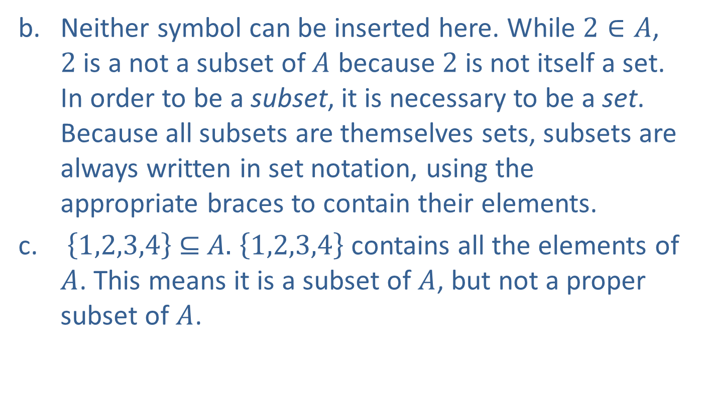
Example 9: Using the Symbols ⊆ and ⊂ (cont.)
Neither symbol can be inserted here. While $2∈A$, $2$ is a not a subset of $A$ because $2$ is not itself a set. In order to be a subset, it is necessary to be a set. Because all subsets are themselves sets, subsets are always written in set notation, using the appropriate braces to contain their elements.
$\left\{\left.1,2,3,4\right\}\right. \text{⊆} A.$ $\left\{\left.1,2,3,4\right\}\right.$ contains all the elements of $A$. This means it is a subset of $A$, but not a proper subset of $A$.

