Slide 1
Section 8.2
Venn Diagrams and Operations with Sets

Slide 2
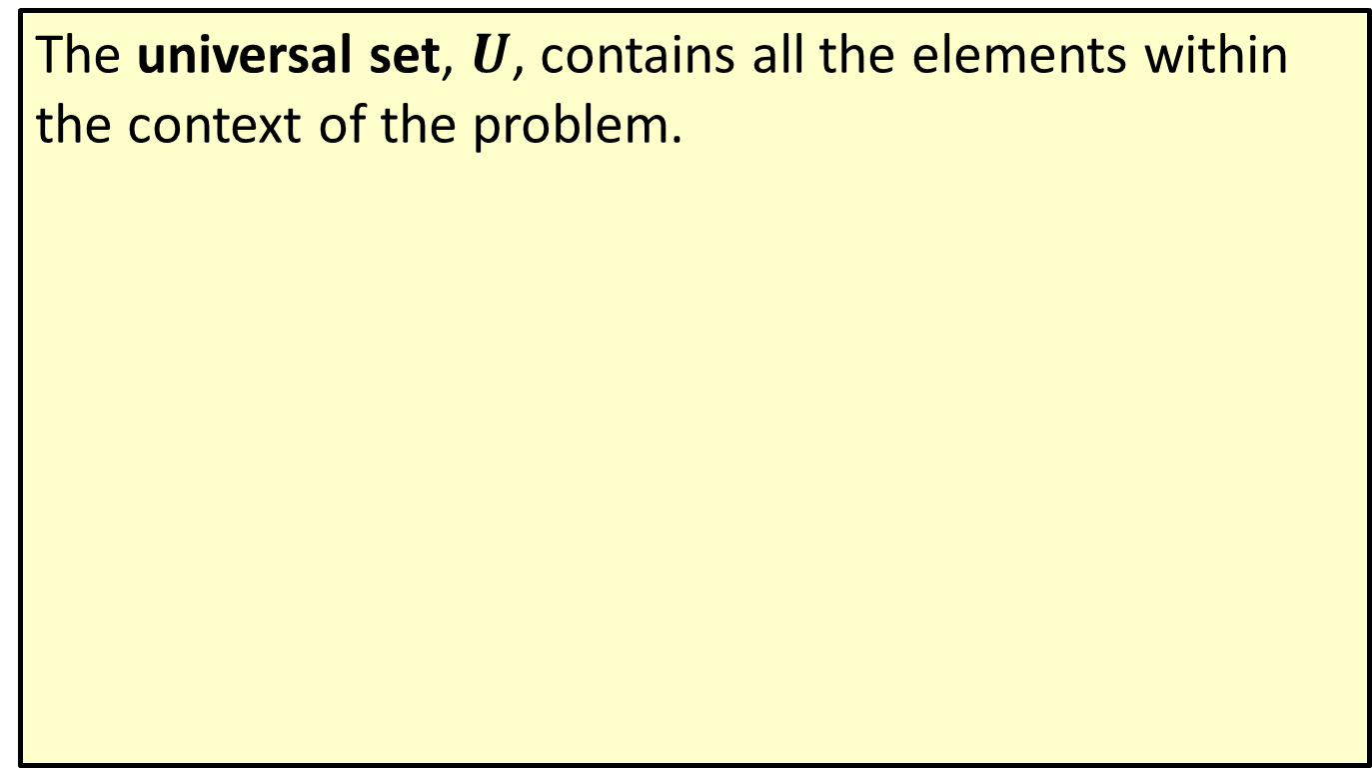
Definition: Universal Set
The universal set, $U$, contains all the elements within the context of the problem.

Slide 3
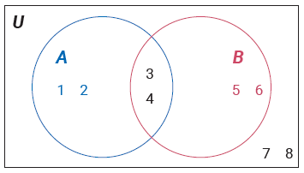

Example 1: Interpreting Venn Diagrams
Given a Venn diagram, use roster notation to list the elements of sets $A$, $B,$ and $U$.

Slide 4

Example 1: Interpreting Venn Diagrams (cont.)
Solution
$A=\left\{1, 2, 3, 4\right\},$ the elements contained in set $A.$
$B=\left\{3, 4, 5, 6\right\},$ the elements contained in set $B.$
$U=\left\{1, 2, 3, 4, 5, 6, 7, 8\right\},$ all the elements contained within the Venn diagram.

Slide 5
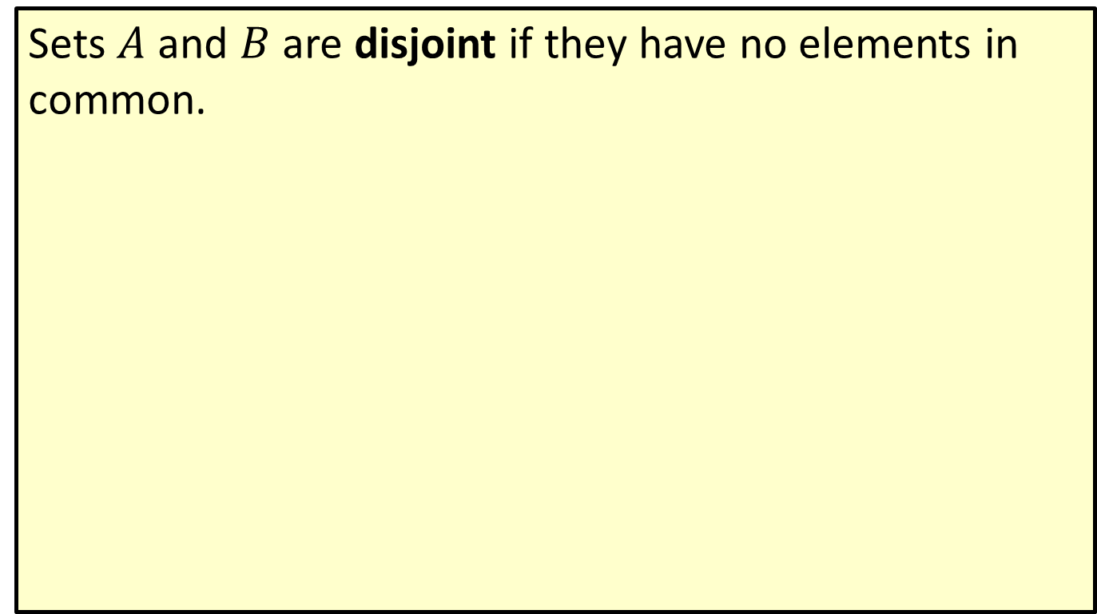
Definition: Disjoint
Sets $A$ and $B$ are disjoint if they have no elements in common.

Slide 6
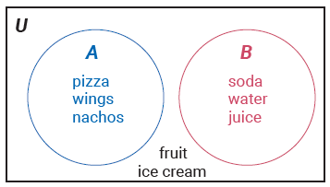

Example 2: Interpreting a Venn Diagram with Disjoint Sets
Given the Venn diagram below, use roster notation to list the elements of sets $A$, $B,$ and $U$.

Slide 7
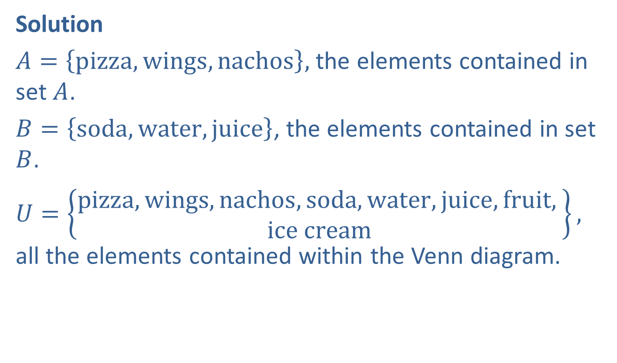
Example 2: Interpreting a Venn Diagram with Disjoint Sets (cont.)
Solution
$A=\left\{pizza, wings, nachos\right\},$ the elements contained in set $A$.
$B=\left\{soda, water, juice\right\}$, the elements contained in set $B$.
$U=\left\{\begin{aligned}pizza, wings, nachos, soda, water, juice, fruit, \\ ice cream\end{aligned}\right\},$ all the elements contained within the Venn diagram.

Slide 8
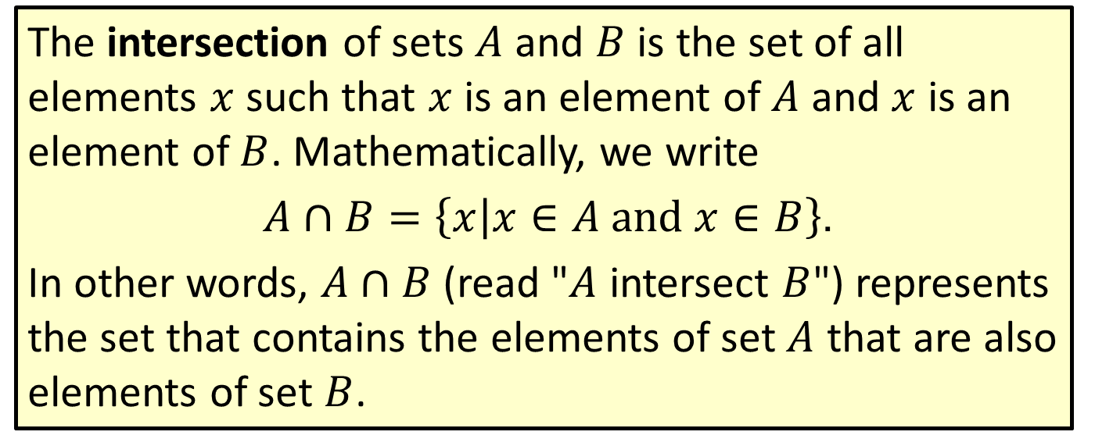
Definition: Intersection
The intersection of sets $A$ and $B$ is the set of all elements $x$ such that $x$ is an element of $A$ and $x$ is an element of $B$. Mathematically, we write
$A∩B=\left\{x | x∈A and x∈B\right\}$.
In other words, $A∩B$ (read "$A$ intersect $B$") represents the set that contains the elements of set $A$ that are also elements of set $B$.

Slide 9
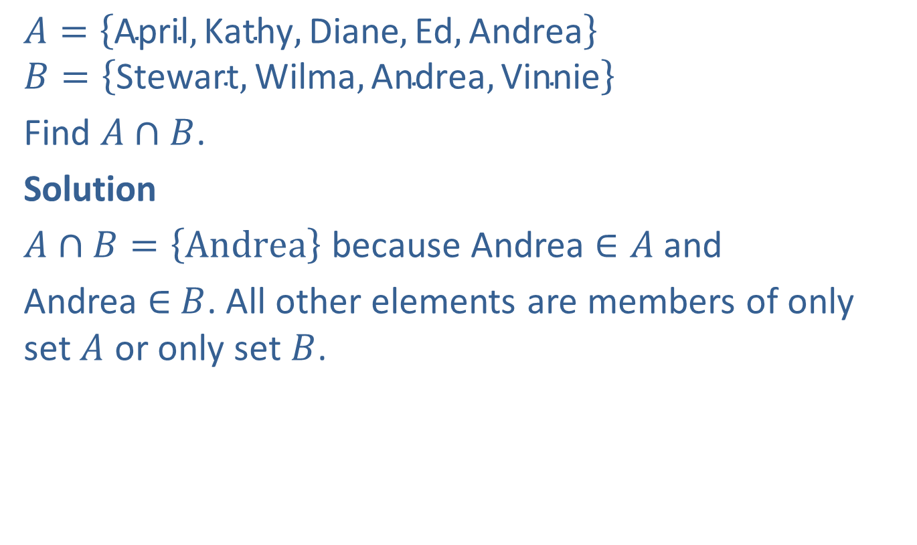
Example 3: Finding the Intersection of Two Sets
$$A=\left\{\text{April},\text{Kathy},\text{Diane},\text{Ed},\text{Andrea}\right\}$$
$$B=\left\{\text{Stewart},\text{Wilma},\text{Andrea},\text{Vinnie}\right\}$$
Find $A∩B$.
Solution
$A∩B=\left\{Andrea\right\}$ because Andrea $∈A$ and
Andrea $∈$ $B$. All other elements are members of only set $A$ or only set $B$.

Slide 10
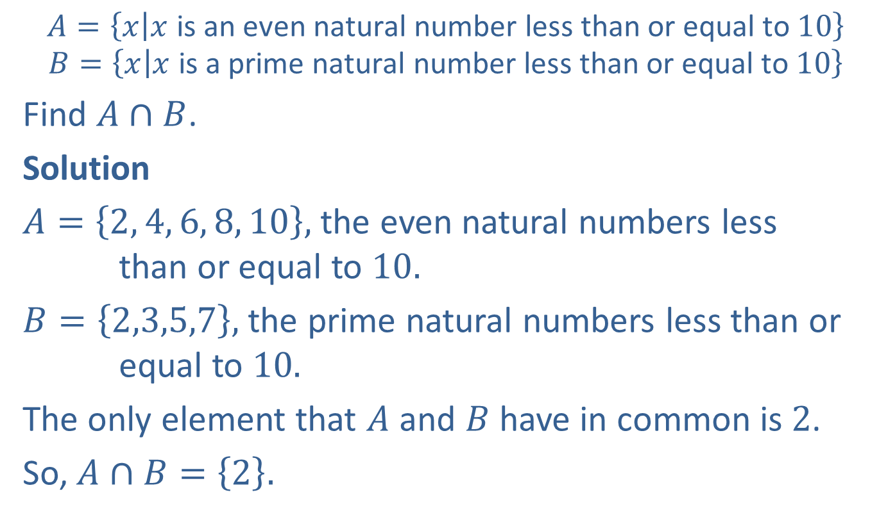
Example 4: Finding the Intersection of Two Sets
$$A=\left\{x | x \text{is} \text{an} \text{even} \text{natural} \text{number} \text{less} \text{than} \text{or} \text{equal} \text{to} 10\right\}$$
$$B=\left\{x | x \text{is} \text{a} \text{prime} \text{natural} \text{number} \text{less} \text{than} \text{or} \text{equal} \text{to} 10\right\}$$
Find $A∩B$.
Solution
$A=\left\{2, 4, 6, 8, 10\right\},$ the even natural numbers less than or equal to $10.$
$B=\left\{2,3,5,7\right\},$ the prime natural numbers less than or equal to $10.$
The only element that $A$ and $B$ have in common is $2$.
So, $A∩B=\left\{2\right\}.$

Slide 11
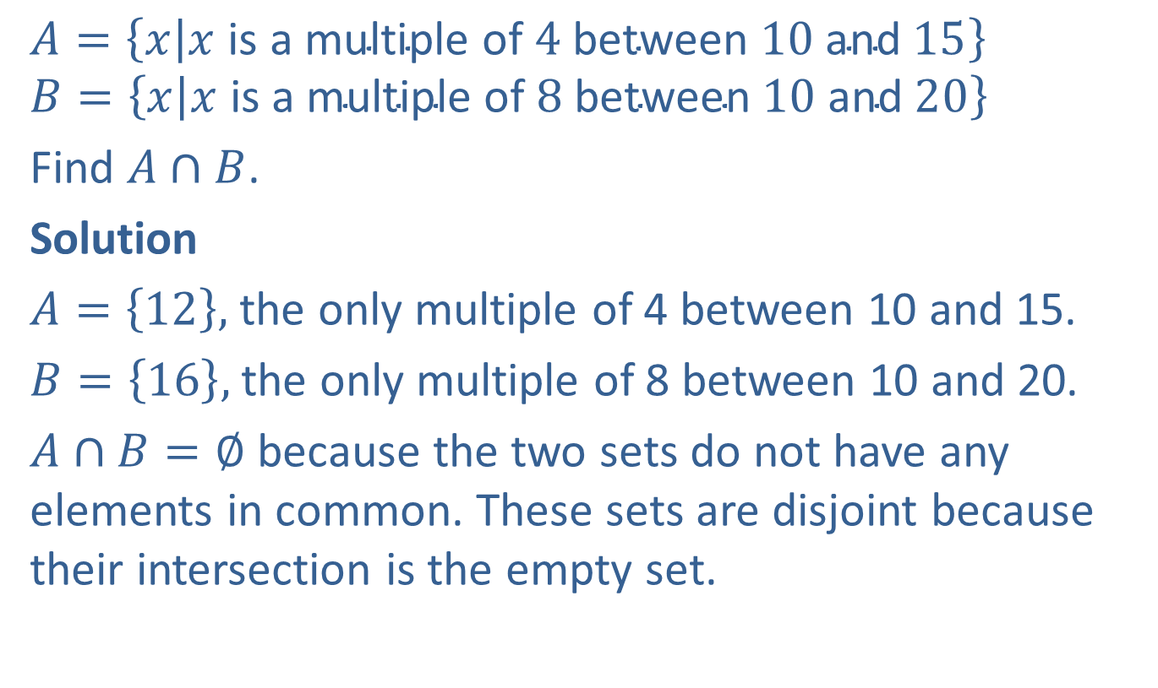
Example 5: Finding the Intersection of Two Sets
$$A=\left\{x | x \text{is} \text{a} \text{multiple} \text{of} 4 \text{between} 10 \text{and} 15\right\}$$
$$B=\left\{x | x \text{is} \text{a} \text{multiple} \text{of} 8 \text{between} 10 \text{and} 20\right\}$$
Find $A∩B$.
Solution
$A=\left\{12\right\},$ the only multiple of 4 between 10 and 15.
$B=\left\{16\right\},$ the only multiple of 8 between 10 and 20.
$A∩B=∅$ because the two sets do not have any elements in common. These sets are disjoint because their intersection is the empty set.

Slide 12
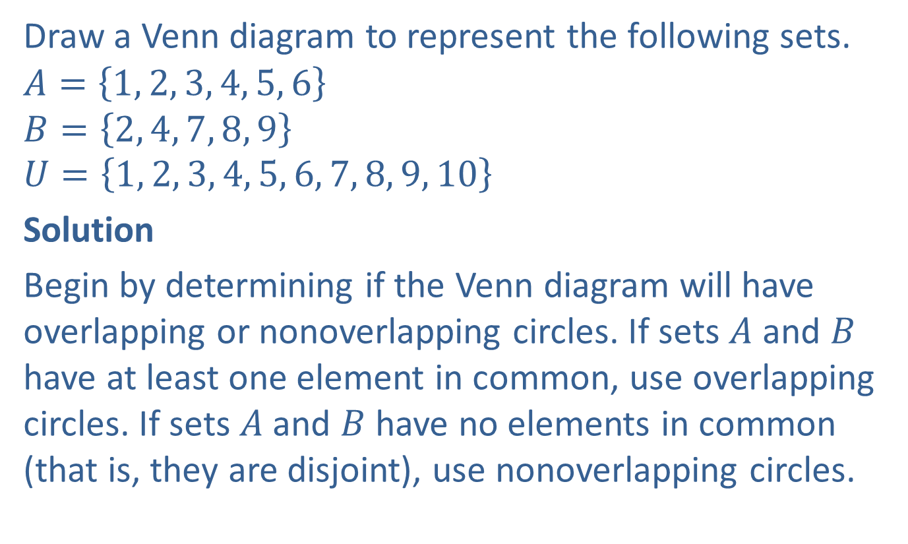
Example 6: Drawing Venn Diagrams with Intersecting Sets
Draw a Venn diagram to represent the following sets.
$$A=\left\{1, 2, 3, 4, 5, 6\right\}$$
$$B=\left\{2, 4, 7, 8, 9\right\}$$
$$U=\left\{1, 2, 3, 4, 5, 6, 7, 8, 9, 10\right\}$$
Solution
Begin by determining if the Venn diagram will have overlapping or nonoverlapping circles. If sets $A$ and $B$ have at least one element in common, use overlapping circles. If sets $A$and $B$ have no elements in common (that is, they are disjoint), use nonoverlapping circles.

Slide 13
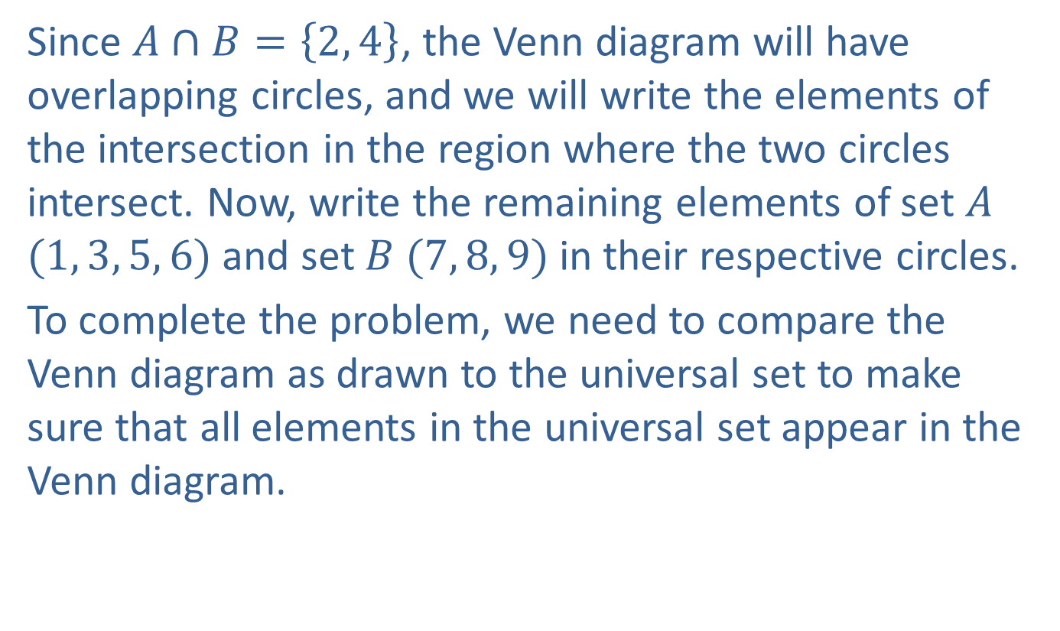
Example 6: Drawing Venn Diagrams with Intersecting Sets (cont.)
Since $A∩B=\left\{2, 4\right\}$, the Venn diagram will have overlapping circles, and we will write the elements of the intersection in the region where the two circles intersect. Now, write the remaining elements of set $A$ $(1, 3, 5, 6)$and set $B (7, 8, 9)$in their respective circles.
To complete the problem, we need to compare the Venn diagram as drawn to the universal set to make sure that all elements in the universal set appear in the Venn diagram.

Slide 14
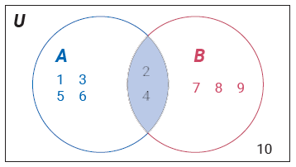
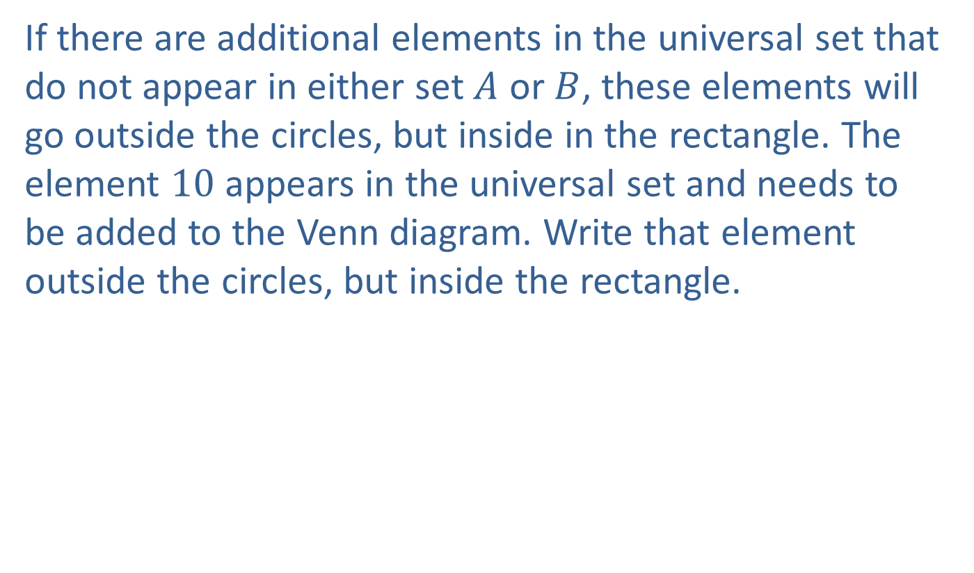
Example 6: Drawing Venn Diagrams with Intersecting Sets (cont.)
If there are additional elements in the universal set that do not appear in either set $A$ or $B$, these elements will go outside the circles, but inside in the rectangle. The element $10$ appears in the universal set and needs to be added to the Venn diagram. Write that element outside the circles, but inside the rectangle.

Slide 15
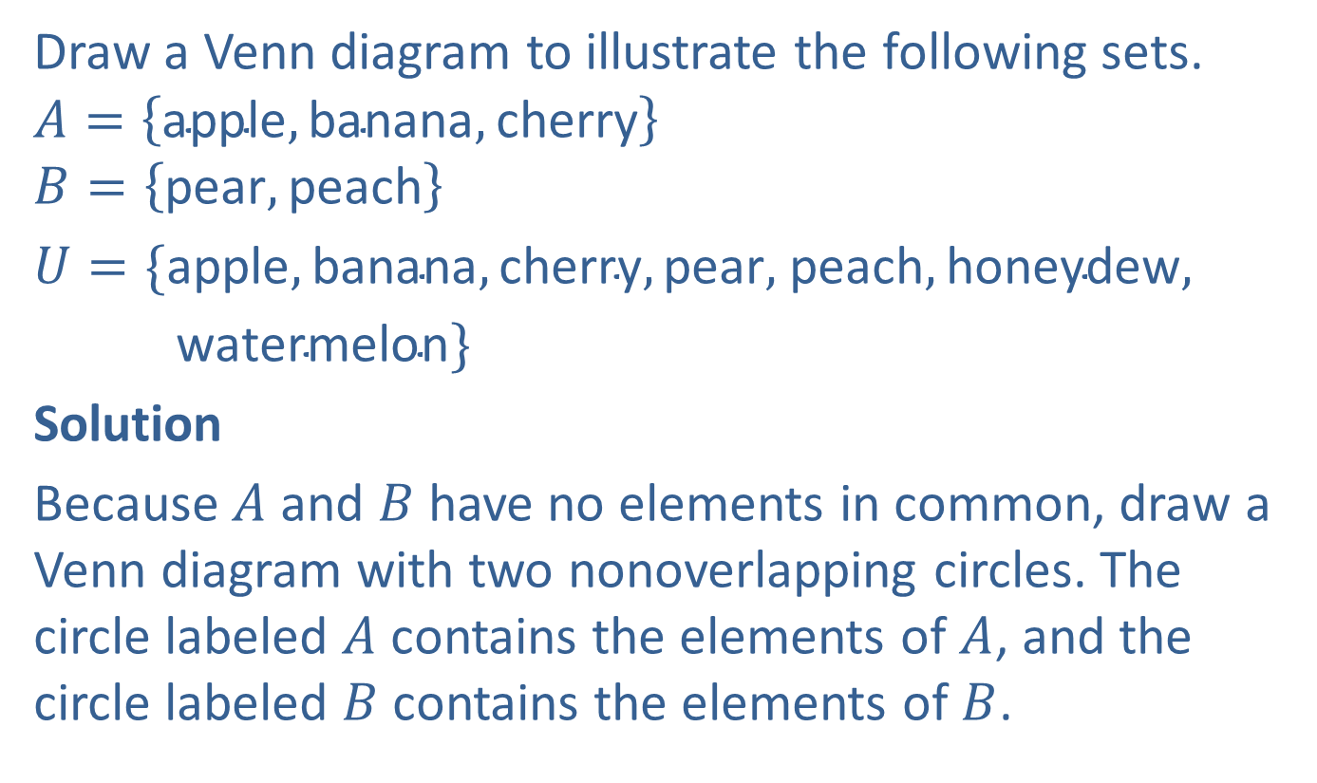
Example 7: Drawing Venn Diagrams with Disjoint Sets
Draw a Venn diagram to illustrate the following sets.
$$A=\left\{\text{apple},\text{banana},\text{cherry}\right\}$$
$$B=\left\{\text{pear},\text{peach}\right\}$$
$U=\{\text{apple},\text{banana},\text{cherry},\text{pear},$ $\text{peach},\text{honeydew},$
$\text{watermelon}\}$
Solution
Because $A$ and $B$ have no elements in common, draw a Venn diagram with two nonoverlapping circles. The circle labeled $A$ contains the elements of $A$, and the circle labeled $B$ contains the elements of $B$.

Slide 16
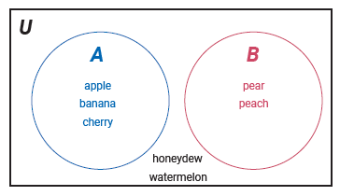
Example 7: Drawing Venn Diagrams with Disjoint Sets (cont.)
In this example, the elements honeydew and watermelon are contained within the rectangle, but not in either circle.

Slide 17
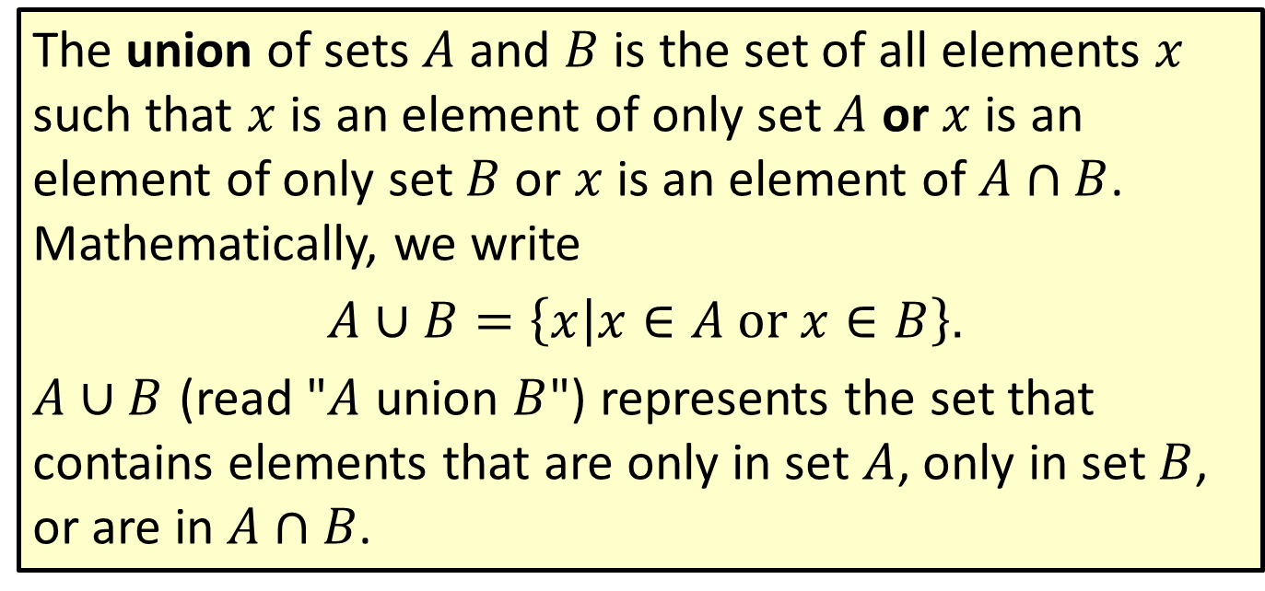
Definition: Union
The union of sets $A$ and $B$ is the set of all elements $x$ such that $x$ is an element of only set $A$ or $x$ is an element of only set $B$ or $x$ is an element of $A∩B$. Mathematically, we write
$A∪B=\left\{x | x∈A or x∈B\right\}$.
$A∪B$ (read "$A$ union $B$") represents the set that contains elements that are only in set $A$, only in set $B$, or are in $A∩B$.

Slide 18
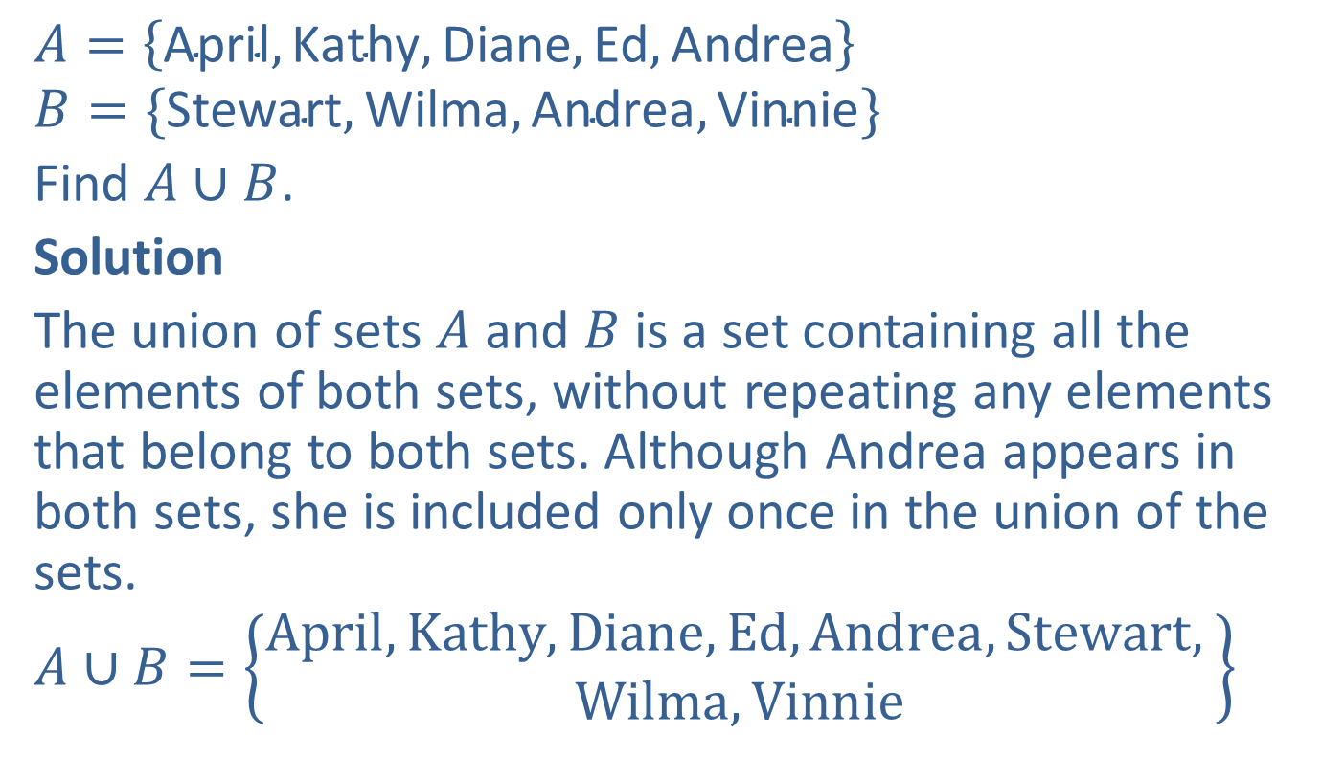
Example 8: Finding the Union of Two Sets
$$A=\left\{\text{April},\text{Kathy},\text{Diane},\text{Ed},\text{Andrea}\right\}$$
$$B=\{\text{Stewart},\text{Wilma},\text{Andrea},\text{Vinnie}\}$$
Find $A∪B$.
Solution
The union of sets $A$ and $B$ is a set containing all the elements of both sets, without repeating any elements that belong to both sets. Although Andrea appears in both sets, she is included only once in the union of the sets.
$$A∪B=\left\{\begin{aligned}April, Kathy, Diane, Ed, Andrea, Stewart, \\ Wilma, Vinnie\end{aligned}\right\}$$

Slide 19
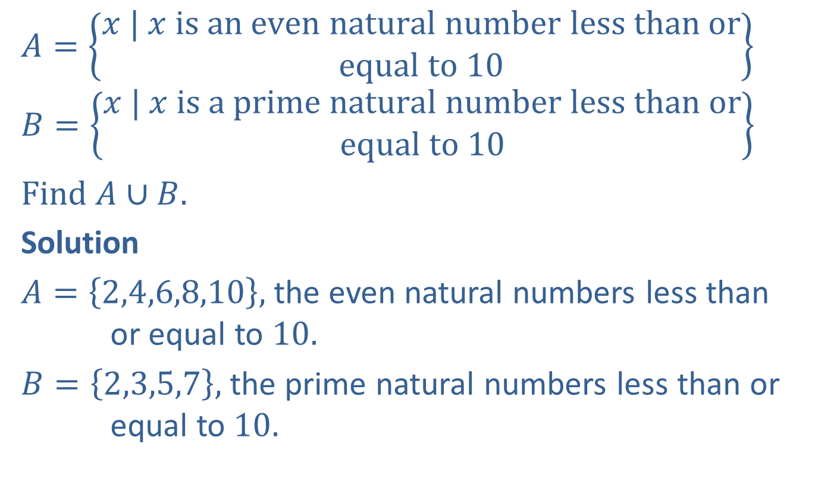
Example 9: Finding the Union of Two Sets
$$A=\left\{\begin{aligned}x | x is an even natural number less than or \\ equal to 10\end{aligned}\right\}$$
$$B=\left\{\begin{aligned}x | x is a prime natural number less than or \\ equal to 10\end{aligned}\right\}$$
Find $A∪B.$
Solution
$A=\left\{2,4,6,8,10\right\},$ the even natural numbers less than or equal to $10$.
$B=\left\{2,3,5,7\right\},$ the prime natural numbers less than or equal to $10$.

Slide 20

Example 9: Finding the Union of Two Sets (cont.)
List all the elements of $A$ or $B$ or $A∩B$, but do not repeat any elements. The only element that $A$ and $B$ have in common is $2$.
$$A∪B=\left\{2, 3, 4, 5, 6, 7, 8, 10\right\}$$

Slide 21
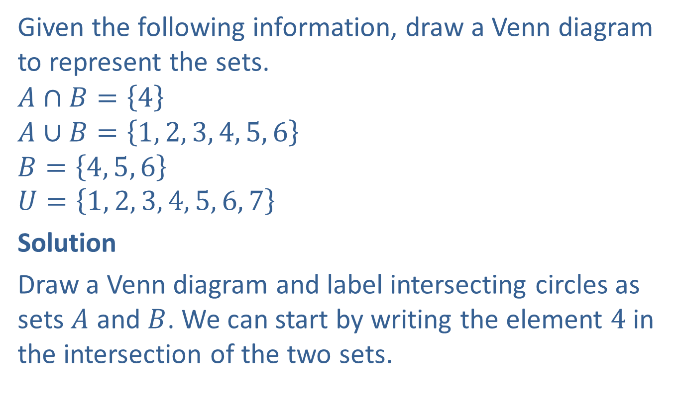
Example 10: Using Venn Diagrams to Describe the Relationship Between Two Sets
Given the following information, draw a Venn diagram to represent the sets.
$$A∩B=\left\{4\right\}$$
$$A∪B=\left\{1, 2, 3, 4, 5, 6\right\}$$
$$B=\left\{4, 5, 6\right\}$$
$$U=\left\{1, 2, 3, 4, 5, 6, 7\right\}$$
Solution
Draw a Venn diagram and label intersecting circles as sets $A$ and $B$. We can start by writing the element $4$ in the intersection of the two sets.

Slide 22
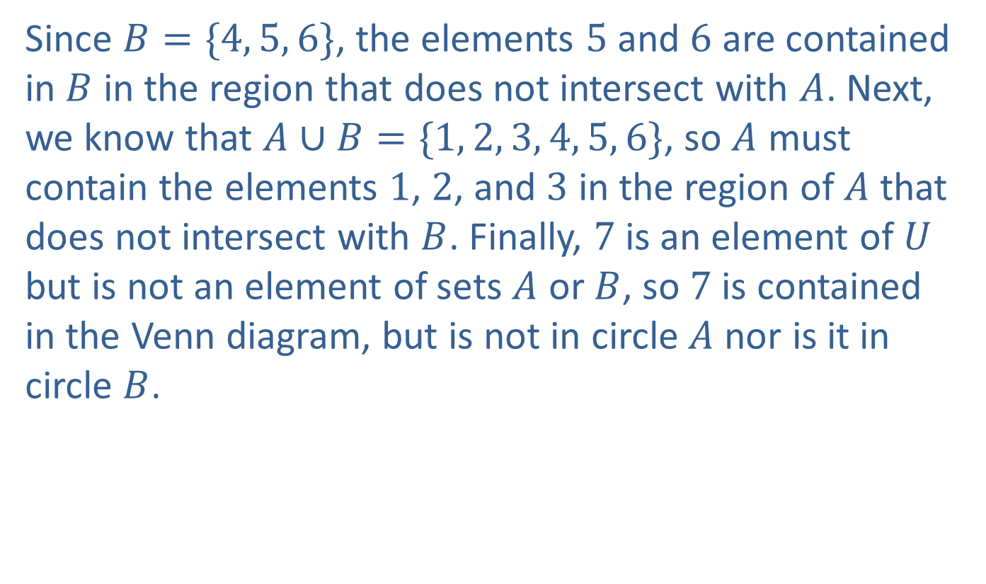
Example 10: Using Venn Diagrams to Describe the Relationship Between Two Sets (cont.)
Since $B=\{4, 5, 6\}$, the elements $5$ and $6$ are contained in $B$ in the region that does not intersect with $A$. Next, we know that $A∪B=\{1, 2, 3, 4, 5, 6\}$, so $A$ must contain the elements $1$, $2$, and $3$ in the region of $A$ that does not intersect with $B$. Finally, $7$ is an element of $U$ but is not an element of sets $A$ or $B$, so $7$ is contained in the Venn diagram, but is not in circle $A$ nor is it in circle $B$.

Slide 23
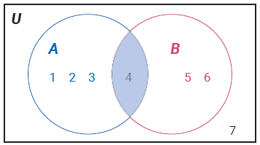
Example 10: Using Venn Diagrams to Describe the Relationship Between Two Sets (cont.)

Slide 24
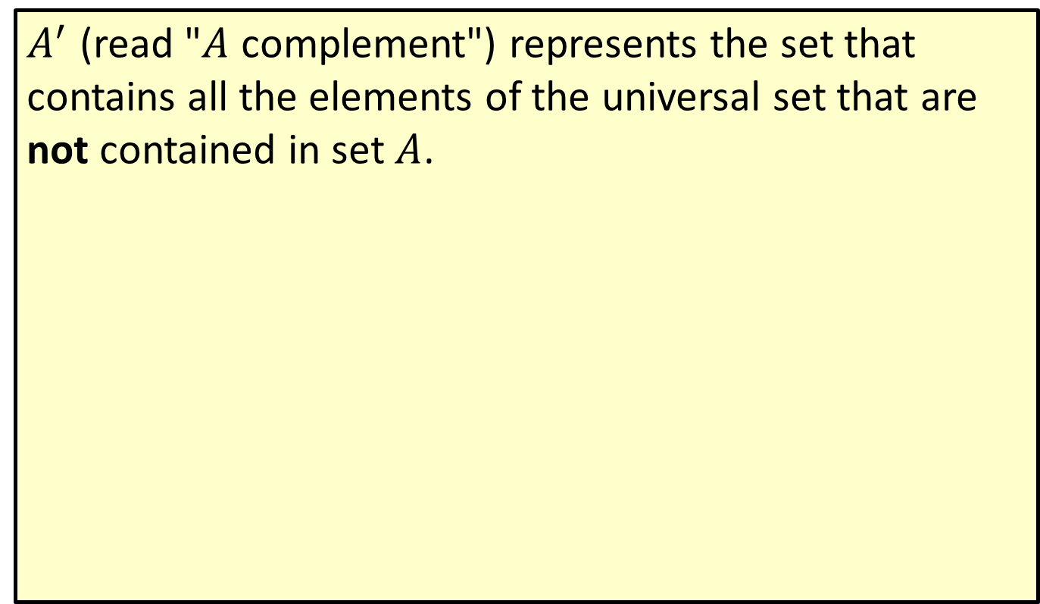
Definition: Complement
$A^{′}$ (read "$A$ complement") represents the set that contains all the elements of the universal set that are not contained in set $A$.

Slide 25
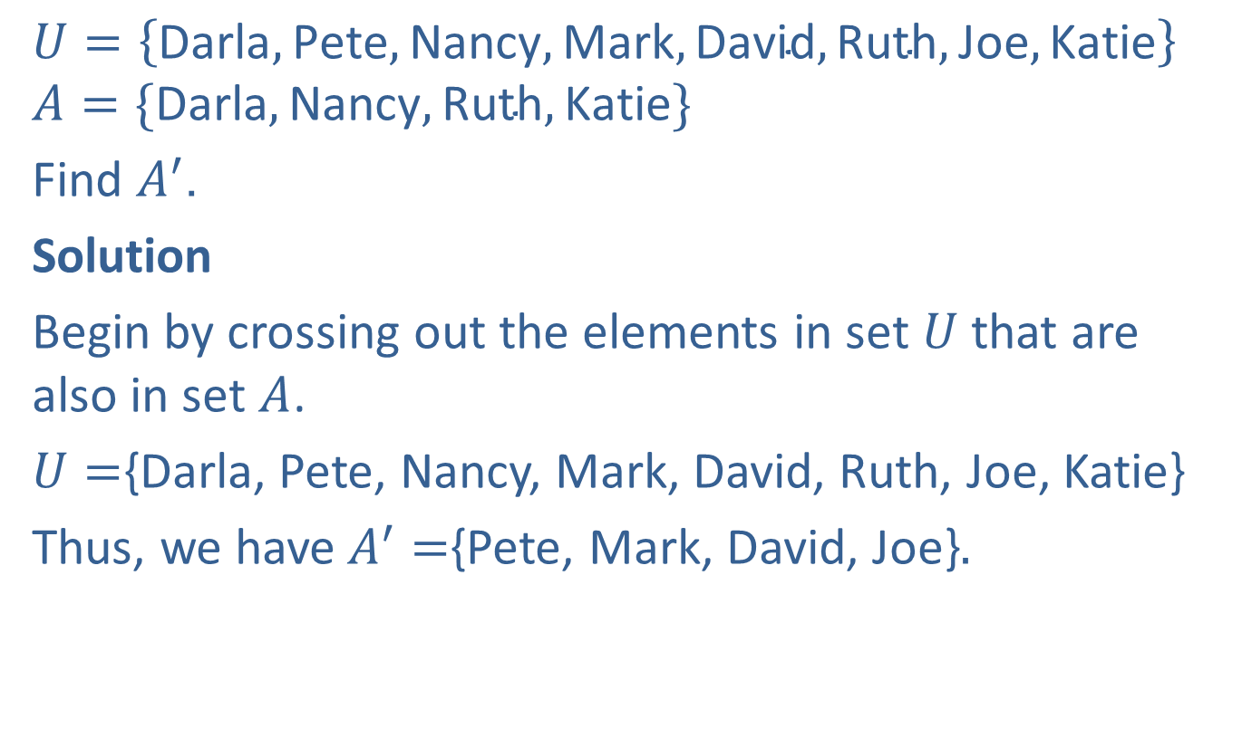
Example 11: Finding the Complement of a Set
$$U=\left\{\text{Darla},\text{Pete},\text{Nancy},\text{Mark},\text{David},\text{Ruth},\text{Joe},\text{Katie}\right\}$$
$$A=\{\text{Darla},\text{Nancy},\text{Ruth},\text{Katie}\}$$
Find $A^{′}$.
Solution
Begin by crossing out the elements in set $U$ that are also in set $A$.
$U=${Darla, Pete, Nancy, Mark, David, Ruth, Joe, Katie}
Thus, we have$A^{′}=${Pete, Mark, David, Joe}$.$

Slide 26
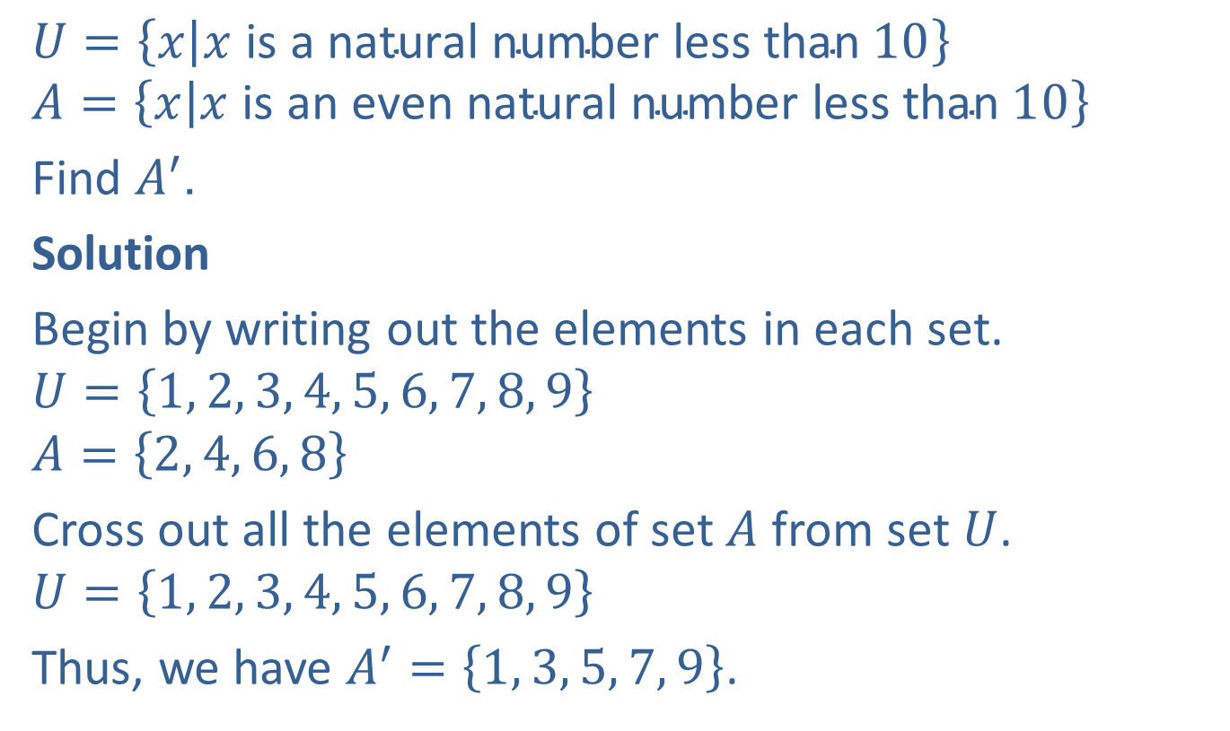
Example 12: Finding the Complement of a Set
$$U=\left\{x | x \text{is} \text{a} \text{natural} \text{number} \text{less} \text{than} 10\right\}$$
$$A=\left\{x | x \text{is} \text{an} \text{even} \text{natural} \text{number} \text{less} \text{than} 10\right\}$$
Find $A^{′}$.
Solution
Begin by writing out the elements in each set.
$$U=\left\{1, 2, 3, 4, 5, 6, 7, 8, 9\right\}$$
$$A=\left\{2, 4, 6, 8\right\}$$
Cross out all the elements of set $A$ from set $U$.
$$U=\left\{1, 2, 3, 4, 5, 6, 7, 8, 9\right\}$$
Thus, we have $A^{′}=\left\{1, 3, 5, 7, 9\right\}$.

