Slide 1
Section 8.3
Inductive and Deductive Reasoning

Slide 2
Definition: Inductive reasoning
Inductive reasoning is a process of reaching a generalization or conclusion from specific incidents or observations.

Slide 3
Definition: Counterexample
A counterexample is an instance or time when the conjecture does not hold true.

Slide 4
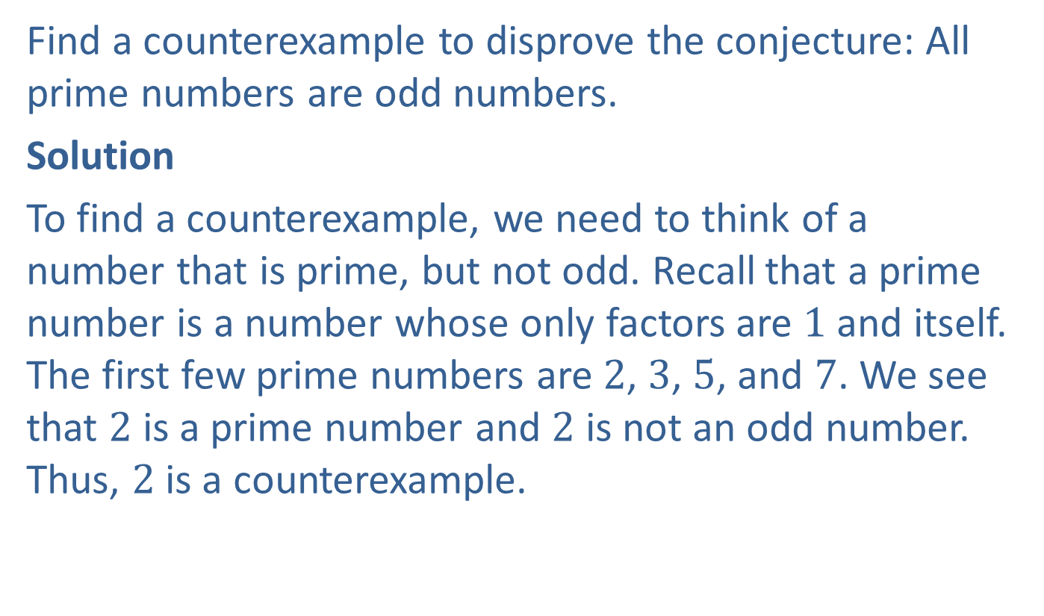
Example 1: Finding a Counterexample
Find a counterexample to disprove the conjecture: All prime numbers are odd numbers.
Solution
To find a counterexample, we need to think of a number that is prime, but not odd. Recall that a prime number is a number whose only factors are $1$ and itself. The first few prime numbers are $2$, $3$, $5$, and $7$. We see that $2$ is a prime number and $2$ is not an odd number. Thus, $2$ is a counterexample.

Slide 5
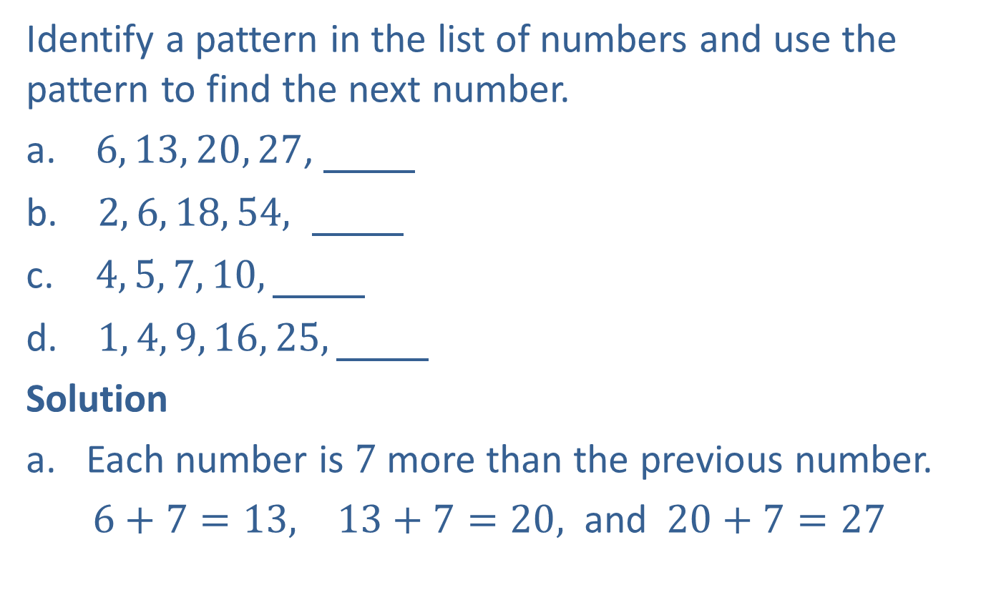
Example 2: Using Inductive Reasoning
Identify a pattern in the list of numbers and use the pattern to find the next number.
​ $6, 13, 20, 27$,
​ $2, 6, 18, 54, \underline{ }$
$4, 5, 7, 10,\underline{ }$
​ $1, 4, 9, 16, 25,\underline{ }$
Solution
Each number is $7$ more than the previous number.
$6+7=13, 13+7=20,$ and $20+7=27$

Slide 6
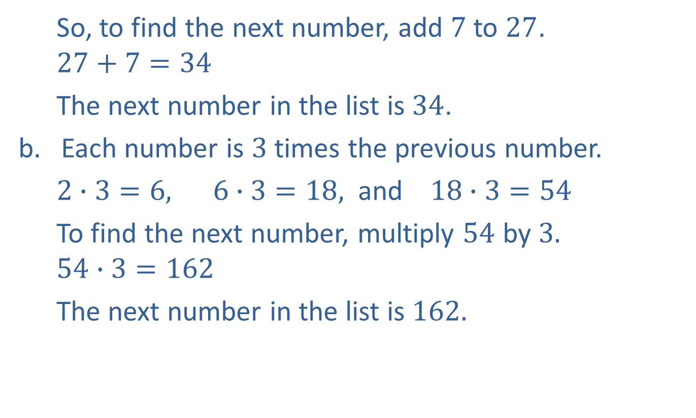
Example 2: Using Inductive Reasoning (cont.)
So, to find the next number, add $7$to $27$.
$$27+7=34$$
The next number in the list is $34$.
Each number is $3$ times the previous number.
$2∙3=6, 6∙3=18,$ and $18∙3=54$
To find the next number, multiply $54$ by $3.$
$$54∙3=162$$
The next number in the list is $162.$

Slide 7
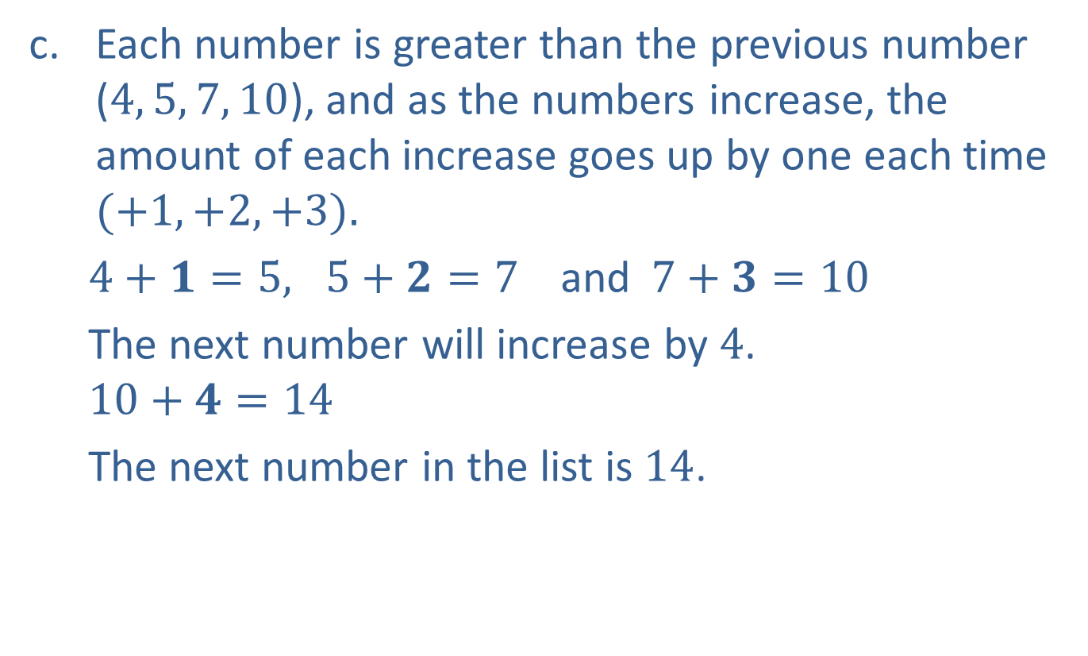
Example 2: Using Inductive Reasoning (cont.)
Each number is greater than the previous number ($4, 5, 7, 10$), and as the numbers increase, the amount of each increase goes up by one each time $(+1, +2, +3).$
$4+1=5, 5+2=7$and$7+3=10$
The next number will increase by $4$.
$$10+4=14$$
The next number in the list is $14$.

Slide 8

Example 2: Using Inductive Reasoning (cont.)
This is a list of the squares of the natural numbers.
$$1^{2}=1, 2^{2}=4, 3^{2}=9, 4^{2}=16,$$
and $5^{2}=25$
The next natural number is $6,$and $6^{2}=36.$
The next number in the list is $36.$

Slide 9
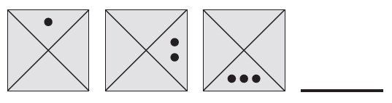
Example 3: Using Inductive Reasoning
Describe the pattern and use the pattern to draw the next figure in the sequence.

Slide 10
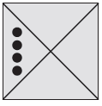
Example 3: Using Inductive Reasoning (cont.)
Solution
In each figure, the dots rotate one region in a clockwise direction and increase by one dot with each clockwise movement. To continue with the pattern, increase the number of dots by one, and rotate the dots one region in a clockwise direction.

Slide 11
Definition: Deductive Reasoning
Deductive Reasoning is the process of reaching a specific conclusion from general statements that are accepted as facts.

Slide 12
Definition: Inductive Reasoning versus Deductive Reasoning
Inductive reasoning uses specific incidents and observations to reach a general conclusion, while deductive reasoning uses general statements to reach a specific conclusion.

Slide 13
Example 4: Using Deductive Reasoning
What conclusion can be drawn from these statements: All US coins are stamped with the date it was minted. This penny is a US coin.
Solution
This penny is stamped with the date it was minted.

Slide 14
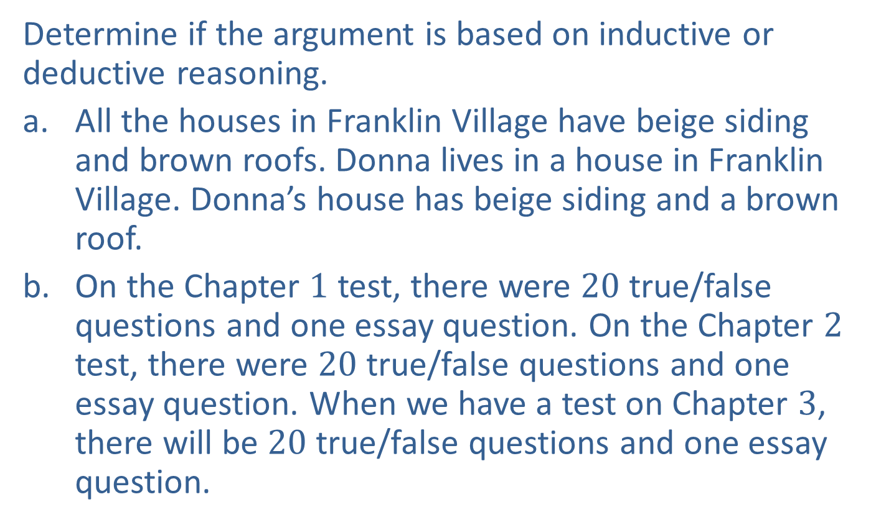
Example 5: Distinguishing between Inductive and Deductive Reasoning
Determine if the argument is based on inductive or deductive reasoning.
​All the houses in Franklin Village have beige siding and brown roofs. Donna lives in a house in Franklin Village. Donna’s house has beige siding and a brown roof.
​On the Chapter $1$ test, there were $20$ true/false questions and one essay question. On the Chapter $2$ test, there were $20$ true/false questions and one essay question. When we have a test on Chapter $3$, there will be $20$ true/false questions and one essay question.

Slide 15
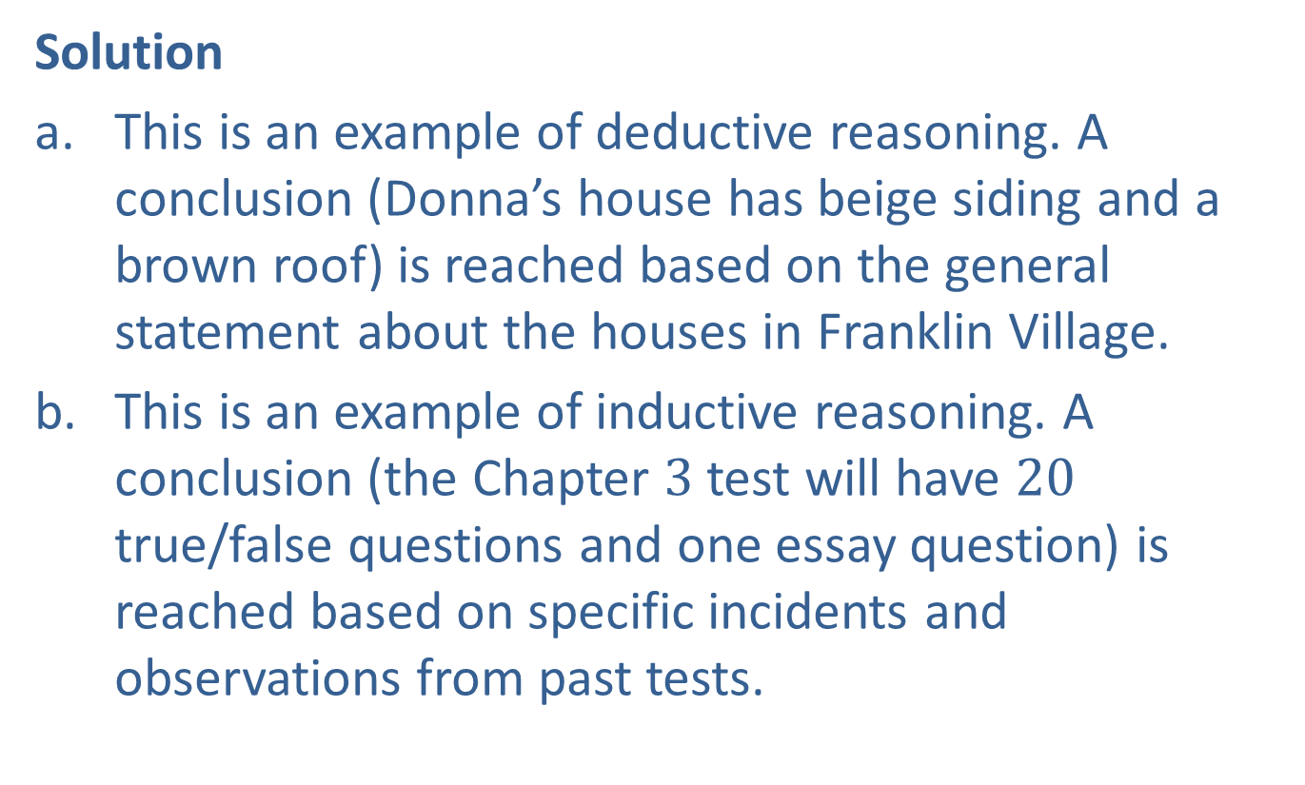
Example 5: Distinguishing between Inductive and Deductive Reasoning (cont.)
Solution
​This is an example of deductive reasoning. A conclusion (Donna’s house has beige siding and a brown roof) is reached based on the general statement about the houses in Franklin Village.
This is an example of inductive reasoning. A conclusion (the Chapter $3$ test will have $20$ true/false questions and one essay question) is reached based on specific incidents and observations from past tests.

