Slide 1
Section 8.4
Logic Statements, Negations, and Quantified Statements

Slide 2
Definition: Logic
Logic is the process we use to validate a statement as being either true or false.

Slide 3
Definition: Statements
A statement is a declaration that can be determined to be either true or false, but not both.
The truth value of a statement is the attribute of either true or false that can be assigned to the statement.

Slide 4
Example 1: Identifying Statements
Determine whether the given sentences are statements.
​It is January.
​I like Friday!
​Vanilla tastes better than chocolate.
Solution
“ It is January” is a statement because you can confirm if the current month is January (true) or not (false).

Slide 5
Example 1: Identifying Statements (cont.)
“ I like Friday” is an opinion. It could be true for some people and false for others. Therefore, it is not a statement.
“ Vanilla tastes better than chocolate” is also an opinion. Therefore, it is not a statement.

Slide 6
Definition: Negation
A negation is the logical opposite of a statement.

Slide 7
Example 2: Negating Statements
Determine the negation of the following statements.
​Yesterday was Tuesday.
​The currency in the United States is the US dollar.
​The car is not fast.
Solution
The negation of the statement “Yesterday was Tuesday” is “Yesterday was not Tuesday.”
The negation of the statement “The currency in the United States is the US dollar” is “The currency in the United States is not the US dollar.”

Slide 8
Example 2: Negating Statements (cont.)
The logical opposite of the statement “The car is not fast” is “The car is fast.” In this case we removed the “not”. Notice that if we were to simply insert the word “not” into the statement to negate it, we would end up with “The car is not not fast,” which does not make grammatical sense.

Slide 9
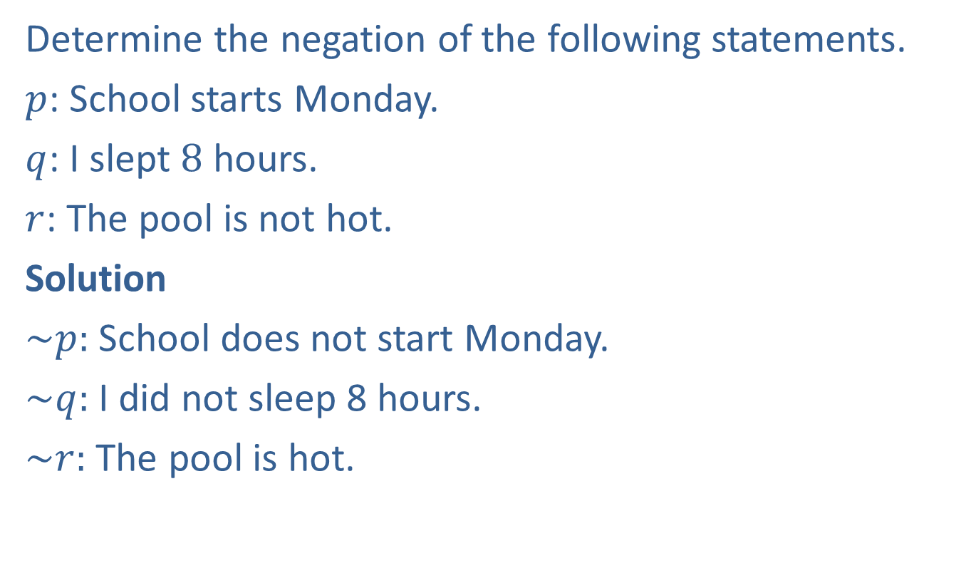
Example 3: Expressing Statements Symbolically
Determine the negation of the following statements.
$p$: School starts Monday.
$q$: I slept 8 hours.
$r$: The pool is not hot.
Solution
$\sim p:$ School does not start Monday.
$\sim q:$ I did not sleep 8 hours.
$\sim r:$ The pool is hot.

Slide 10
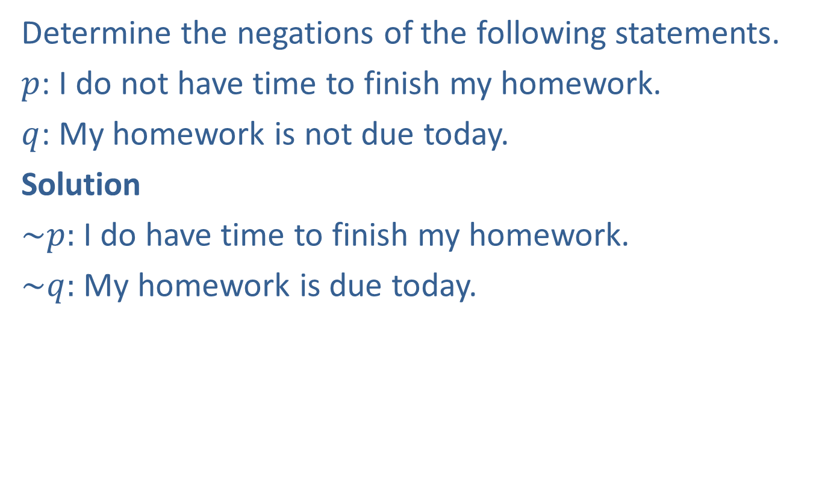
Example 4: Negating Statements
Determine the negations of the following statements.
$p$: I do not have time to finish my homework.
$q$: My homework is not due today.
Solution
$\sim p:$ I do have time to finish my homework.
$\sim q:$ My homework is due today.

Slide 11
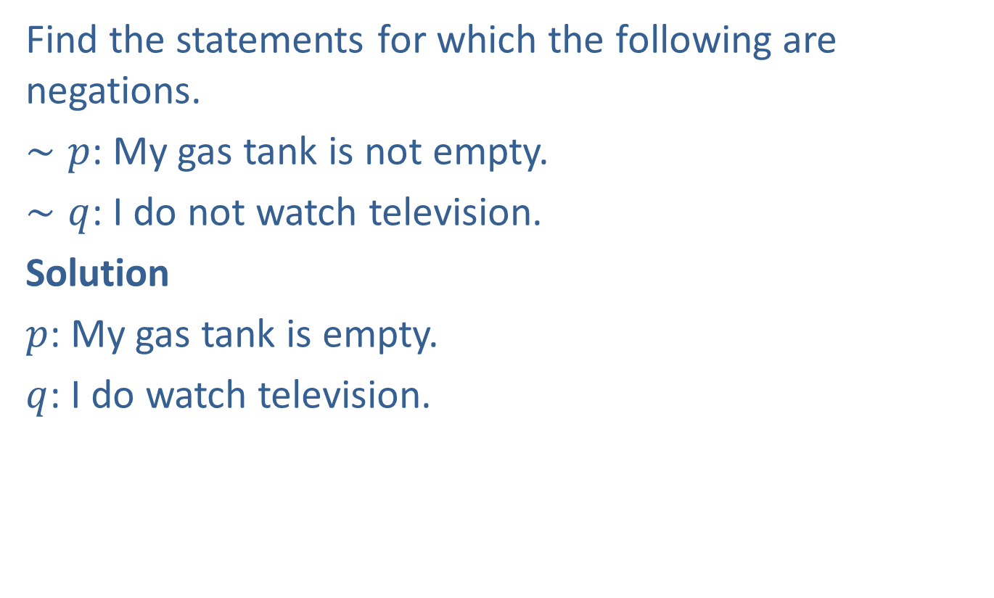
Example 5: Finding Statements Given Negations
Find the statements for which the following are negations.
$∼p$: My gas tank is not empty.
$∼q$: I do not watch television.
Solution
$p$: My gas tank is empty.
$q$: I do watch television.

Slide 12
Definition: Quantifiers and Quantified Statements
A quantifier indicates the extent or scope of the term it refers to.
A quantified statement is a statement whose subject is modified by a quantifier.

Slide 13
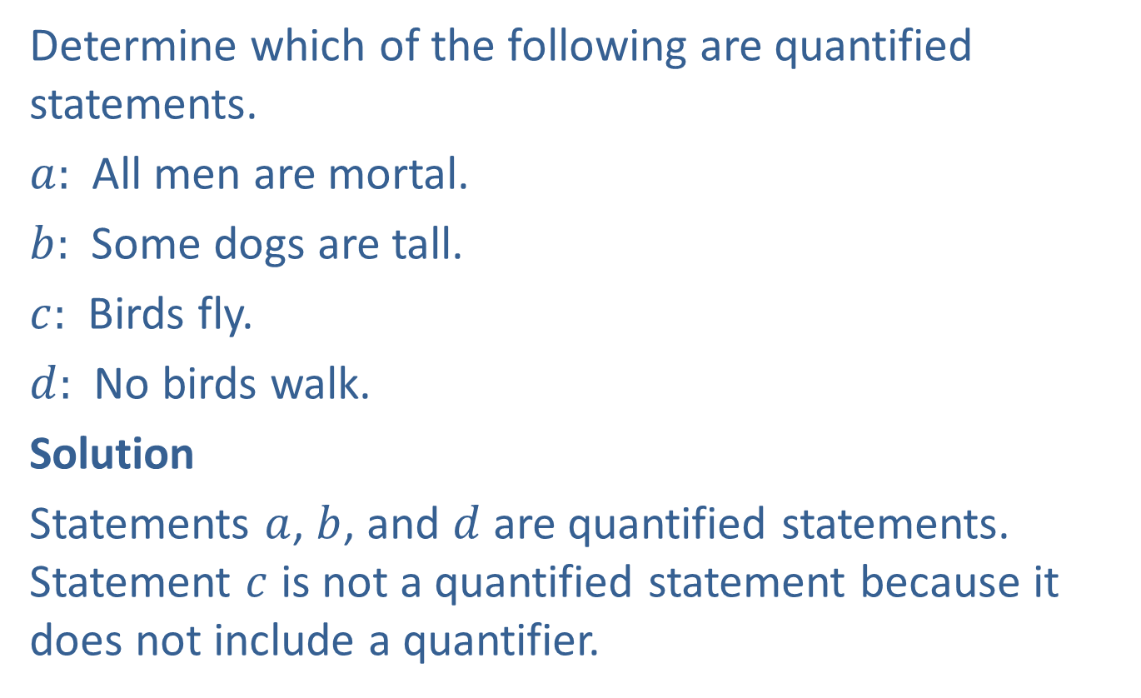
Example 6: Identifying Quantified Statements
Determine which of the following are quantified statements.
$a:$​ All men are mortal.
$b:$​ Some dogs are tall.
$c:$​ Birds fly.
$d:$​ No birds walk.
Solution
Statements $a$, $b$, and $d$ are quantified statements. Statement $c$ is not a quantified statement because it does not include a quantifier.

Slide 14
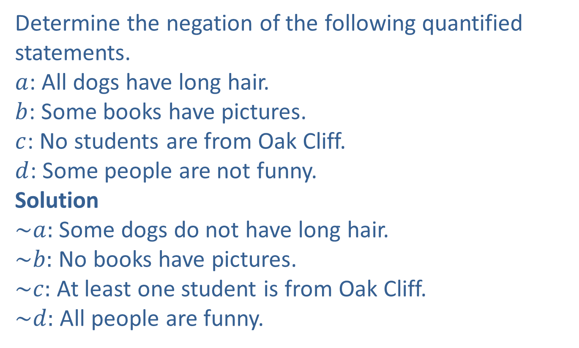
Example 7: Negating Quantified Statements
Determine the negation of the following quantified statements.
$a$: All dogs have long hair.
$b$: Some books have pictures.
$c$: No students are from Oak Cliff.
$d$: Some people are not funny.
Solution
$\sim a:$ Some dogs do not have long hair.
$\sim b:$ No books have pictures.
$\sim c:$ At least one student is from Oak Cliff.
$\sim d:$ All people are funny.

