Slide 1
Section 8.5
Compound Statements and Connectives

Slide 2
Definition: Types of Statements
A simple statement can be determined to be true or false, but not both.
A compound statement is created by connecting two or more simple statements with logical connectives.
A logical connective is a word or phrase (such as and, or, and if/then) that connects two or more simple statements.

Slide 3
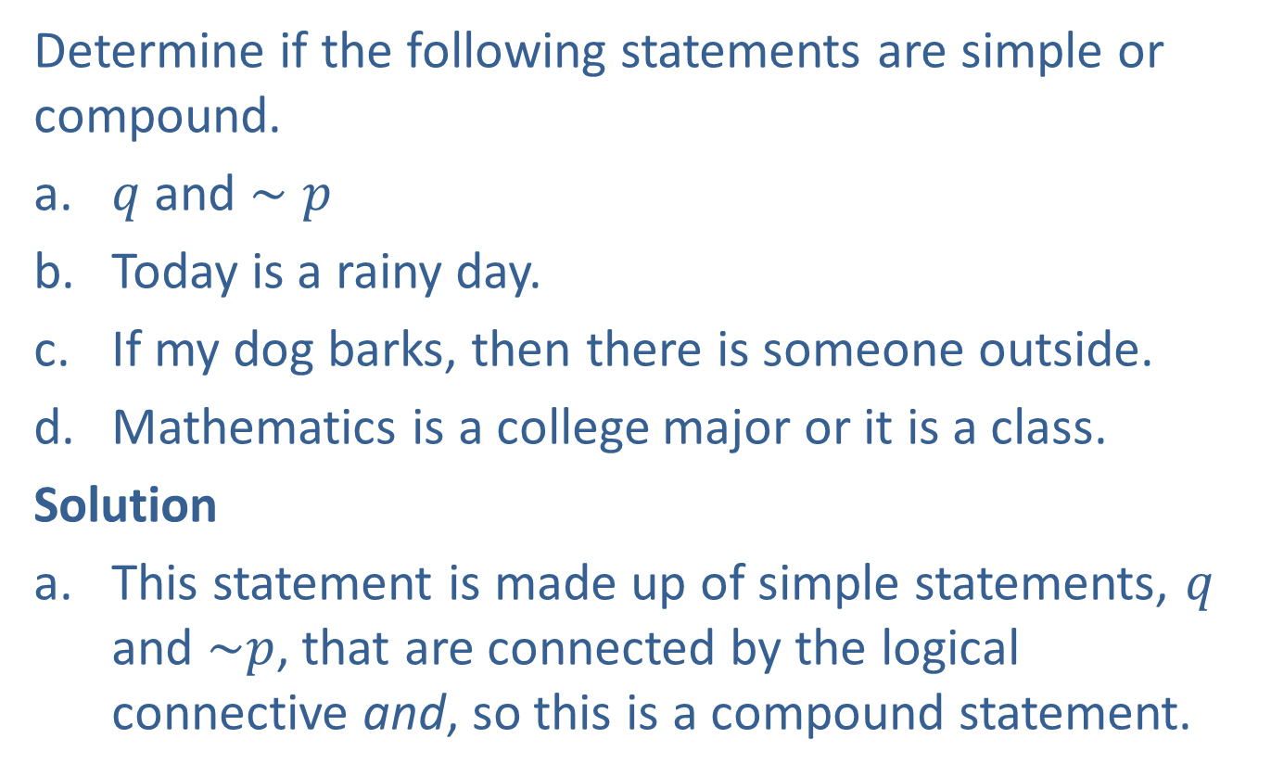
Example 1: Identifying Compound Statements
Determine if the following statements are simple or compound.
​$q$ and $∼p$​
Today is a rainy day.
​If my dog barks, then there is someone outside.
​Mathematics is a college major or it is a class.
Solution
This statement is made up of simple statements, $q$ and $\sim p$, that are connected by the logical connective and, so this is a compound statement.

Slide 4
Example 1: Identifying Compound Statements (cont.)
This is a simple statement because it does not contain any logical connectives.
This is a compound statement made up of the simple statements “My dog barks” and “There is someone outside,” which are connected with the logical connectives if/then.
This is a compound statement where the statements “Mathematics is a college major” and “Mathematics is a class” are joined by the connective or.

Slide 5
Definition: Conjunctions
A conjunction is a compound statement made up of two or more simple statements combined with the logical connector and.

Slide 6
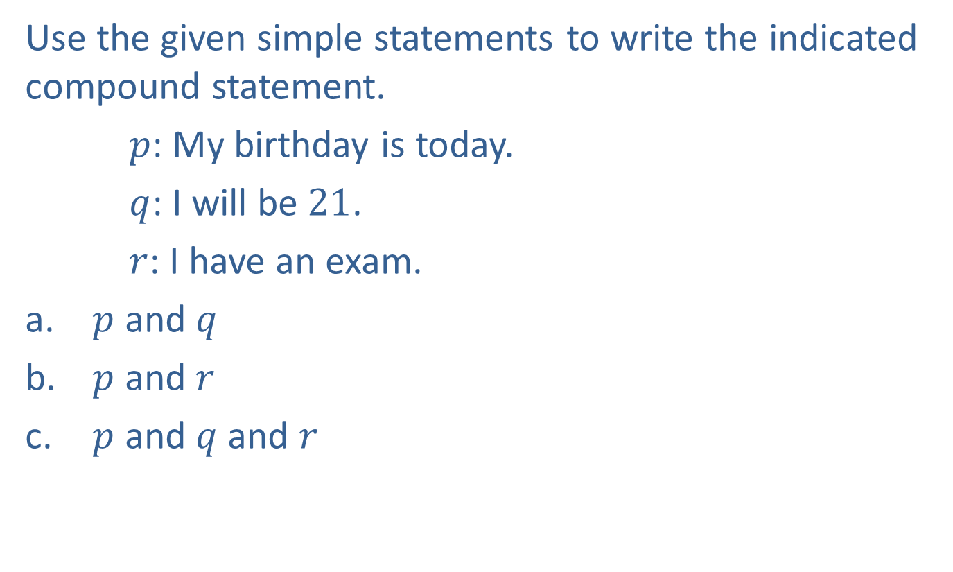
Example 2: Writing Compound Statements with Conjunctions
Use the given simple statements to write the indicated compound statement.
$p$: My birthday is today.
$q$: I will be $21$.
$r$: I have an exam.
​ $p$ and $q$
​ $p$ and $r$
​ $p$ and $q$ and $r$

Slide 7
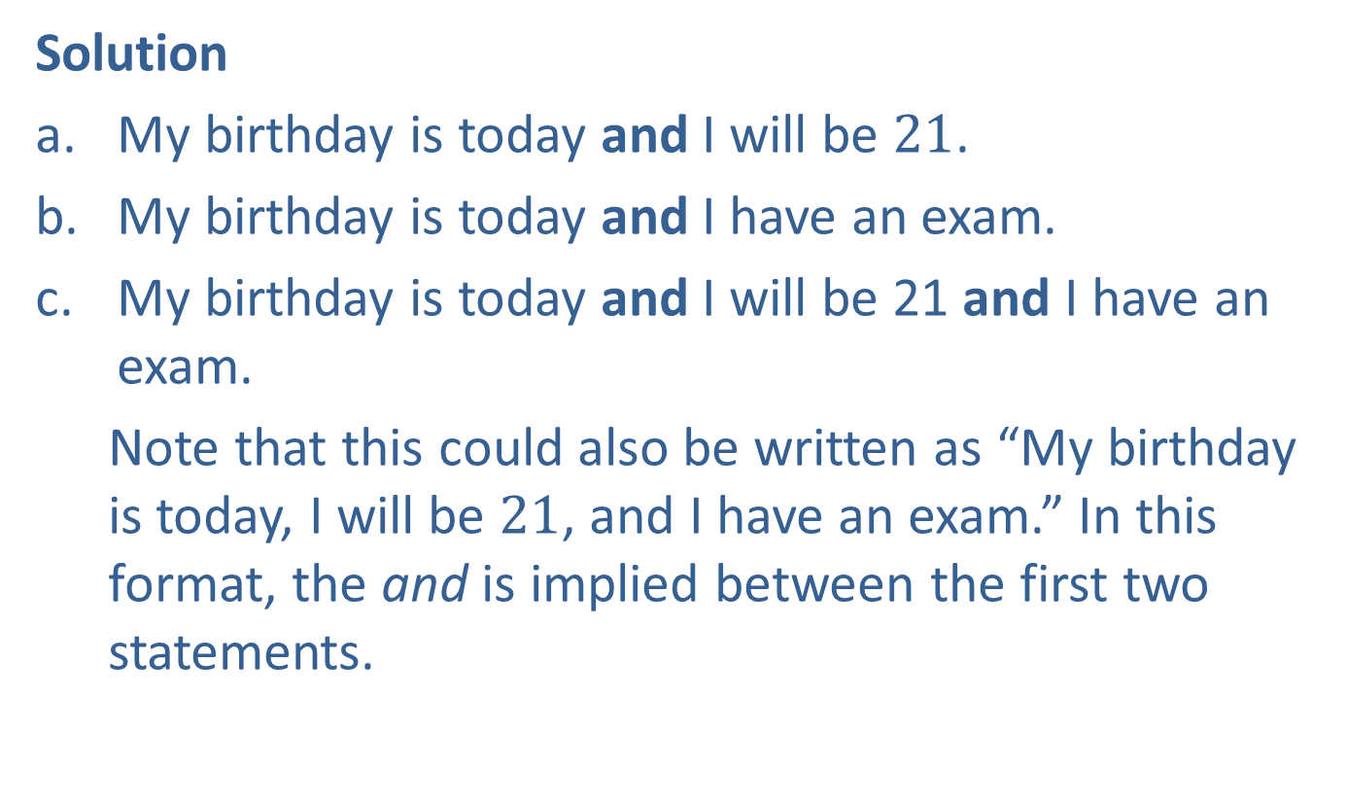
Example 2: Writing Compound Statements with Conjunctions (cont.)
Solution
My birthday is today and I will be $21$.
My birthday is today and I have an exam.
My birthday is today and I will be 21 and I have an exam.
Note that this could also be written as “My birthday is today, I will be $21$, and I have an exam.” In this format, the and is implied between the first two statements.

Slide 8
Definition: Disjunctions
A disjunction is a compound statement made up of two or more simple statements combined with the logical connector or.

Slide 9
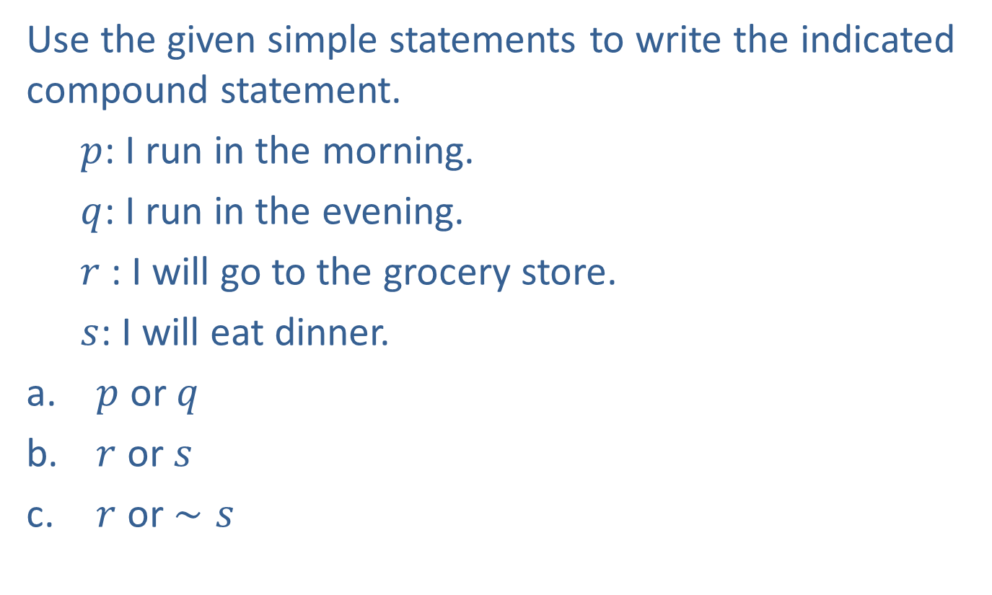
Example 3: Writing Compound Statements with Disjunctions
Use the given simple statements to write the indicated compound statement.
$p$: I run in the morning.
$q$: I run in the evening.
$r$: I will go to the grocery store.
$s$: I will eat dinner.
​ $p$ or $q$
​ $r$ or $s$
​ $r$ or $∼s$

Slide 10
Example 3: Writing Compound Statements with Disjunctions (cont.)
Solution
I run in the morning or I run in the evening.
I will go to the grocery store or I will eat dinner.
I will go to the grocery store or I will not eat dinner.

Slide 11
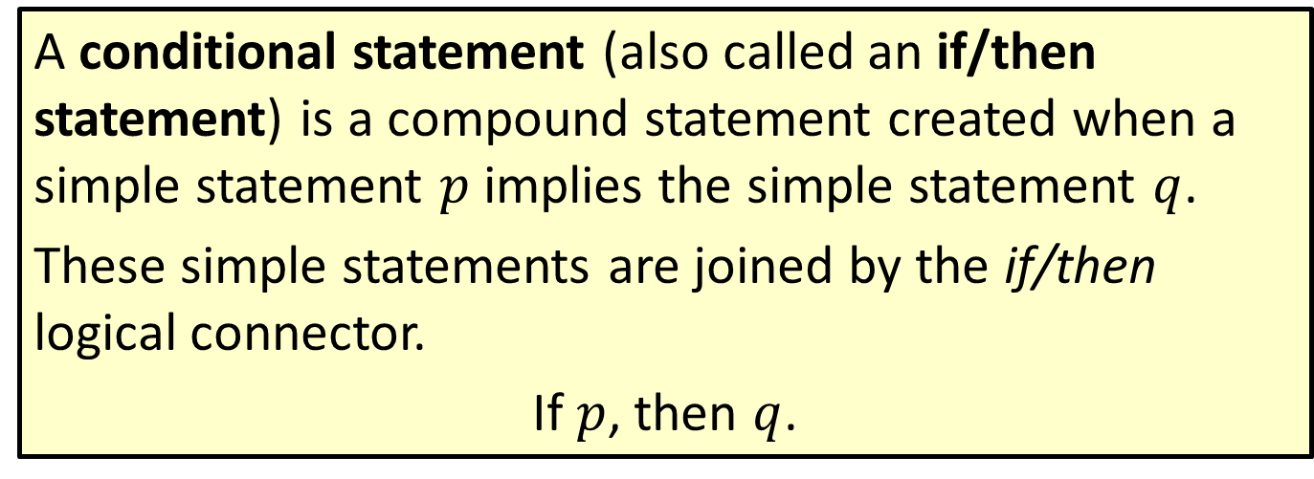
Definition: Conditional Statements
A conditional statement (also called an if/then statement) is a compound statement created when a simple statement $p$ implies the simple statement $q$.
These simple statements are joined by the if/then logical connector.
If $p$, then $q$.

Slide 12
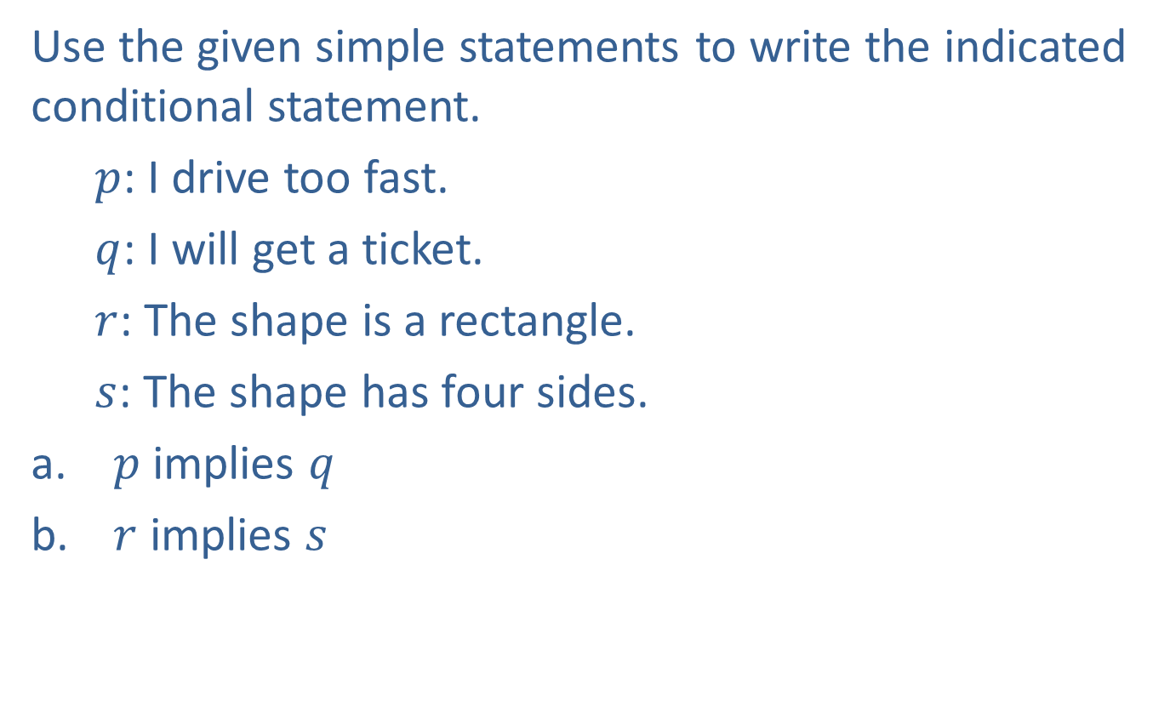
Example 4: Writing Conditional Statements
Use the given simple statements to write the indicated conditional statement.
$p$: I drive too fast.
$q$: I will get a ticket.
$r$: The shape is a rectangle.
$s$: The shape has four sides.
​ $p$implies $q$
​ $r$ implies $s$

Slide 13
Example 4: Writing Conditional Statements (cont.)
Solution
If I drive too fast, then I will get a ticket.
If the shape is a rectangle, then it has four sides.

Slide 14
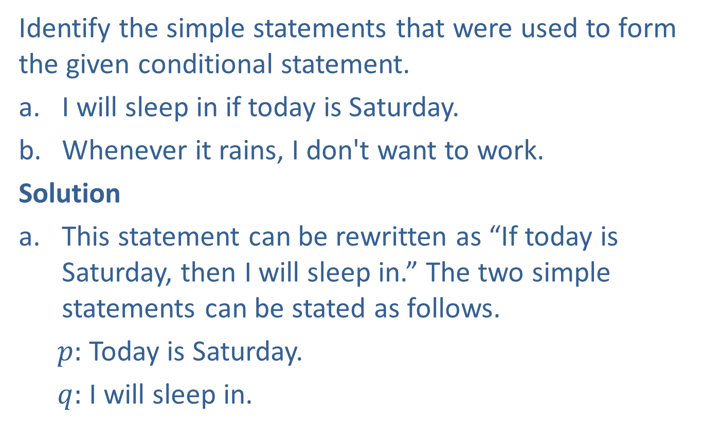
Example 5: Analyzing Conditional Statements
Identify the simple statements that were used to form the given conditional statement.
​I will sleep in if today is Saturday.
​Whenever it rains, I don't want to work.
Solution
This statement can be rewritten as “If today is Saturday, then I will sleep in.” The two simple statements can be stated as follows.
$p:$ Today is Saturday.
$q:$ I will sleep in.

Slide 15
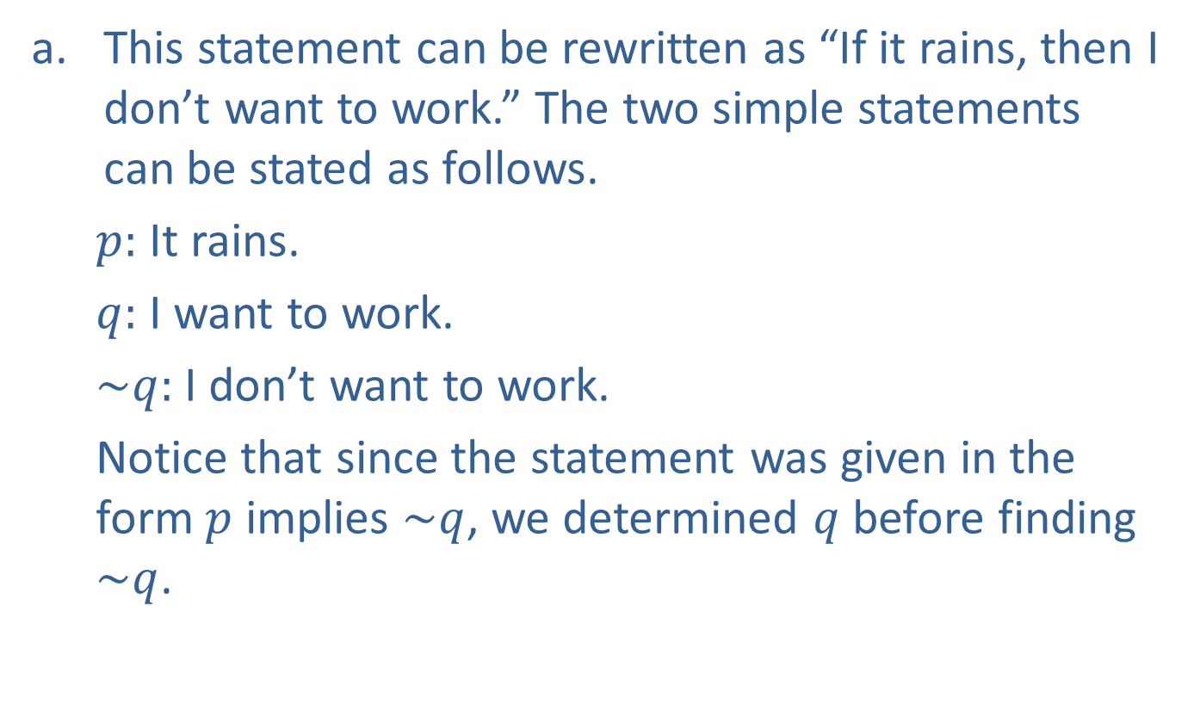
Example 5: Analyzing Conditional Statements (cont.)
This statement can be rewritten as “If it rains, then I don’t want to work.” The two simple statements can be stated as follows.
$p:$ It rains.
$q:$ I want to work.
$\sim q:$ I don’t want to work.
Notice that since the statement was given in the form $p$ implies $\sim q$, we determined $q$ before finding $\sim q$.

Slide 16
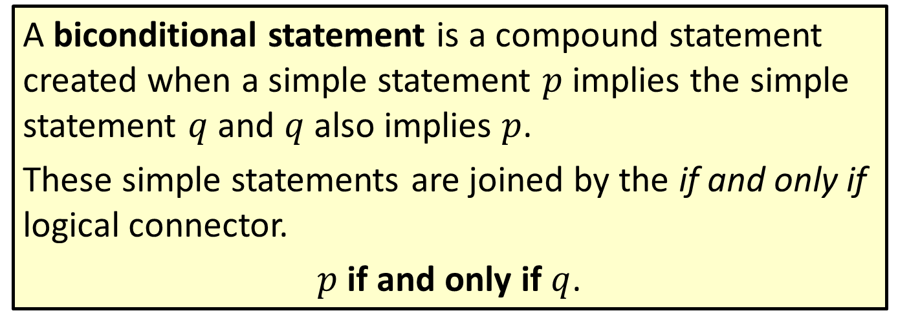
Definition: Biconditional Statements
A biconditional statement is a compound statement created when a simple statement $p$ implies the simple statement $q$ and $q$ also implies $p$.
These simple statements are joined by the if and only if logical connector.
$p$ if and only if $q$.

Slide 17
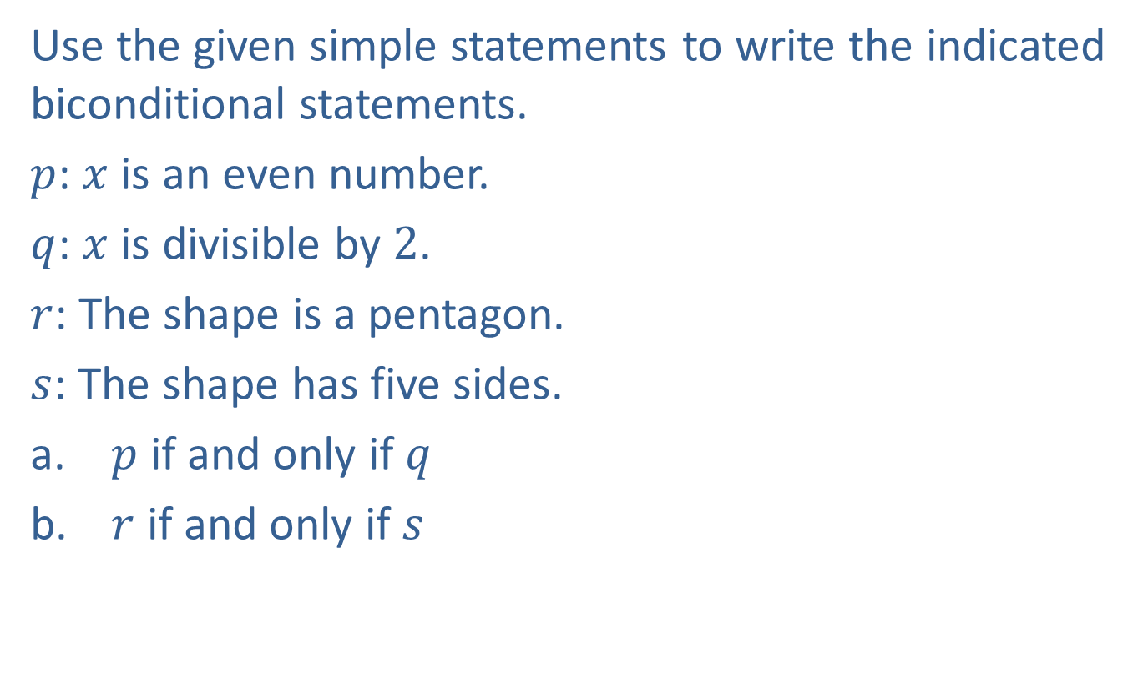
Example 6: Writing Biconditional Statements
Use the given simple statements to write the indicated biconditional statements.
$p$: $x$ is an even number.
$q$: $x$ is divisible by $2$.
$r$: The shape is a pentagon.
$s$: The shape has five sides.
​ $p$ if and only if $q$
​ $r$ if and only if $s$

Slide 18

Example 6: Writing Biconditional Statements (cont.)
Solution
$x$ is an even number if and only if $x$ is divisible by $2$.
The shape is a pentagon if and only if the shape has five sides.

Slide 19
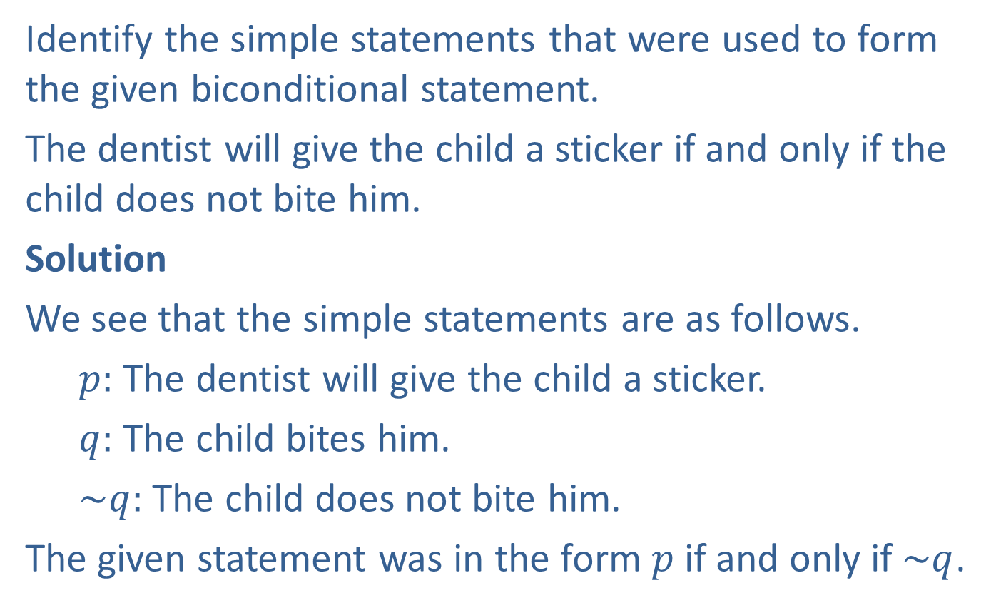
Example 7: Working with Biconditional Statements
Identify the simple statements that were used to form the given biconditional statement.
The dentist will give the child a sticker if and only if the child does not bite him.
Solution
We see that the simple statements are as follows.
$p:$ The dentist will give the child a sticker.
$q:$ The child bites him.
$\sim q:$ The child does not bite him.
The given statement was in the form $p$ if and only if $\sim q$.

Slide 20
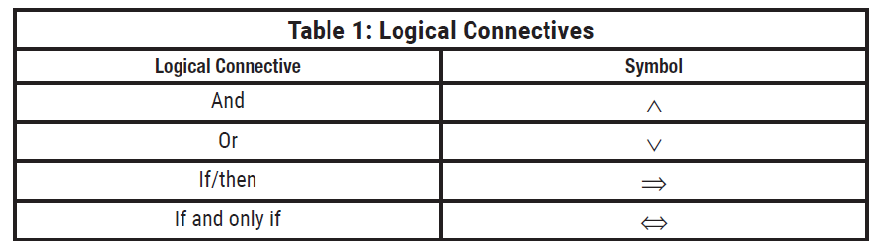
Expressing Logical Connectives Symbolically
Each of the connective phrases we have been studying so far can be written in symbols.

Slide 21
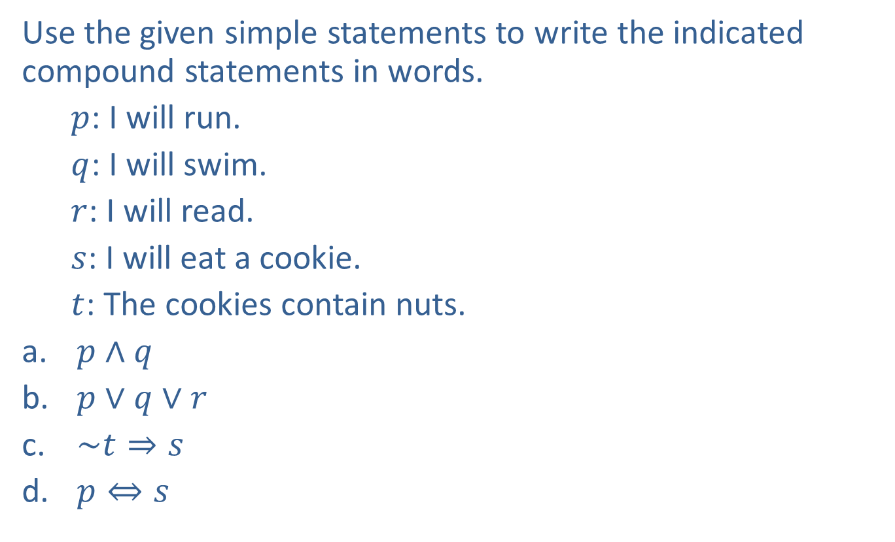
Example 8: Working with Symbolic Logical Connectives
Use the given simple statements to write the indicated compound statements in words.
$p$: I will run.
$q$: I will swim.
$r$: I will read.
$s$: I will eat a cookie.
$t$: The cookies contain nuts.
​$p∧q$
​$p∨q∨r$
​$\sim t⇒s$
​$p⇔s$

Slide 22
Example 8: Working with Symbolic Logical Connectives (cont.)
Solution
I will run and I will swim.
I will run or I will swim or I will read.
If the cookies do not contain nuts, then I will eat a cookie.
I will run if and only if I eat a cookie.

Slide 23
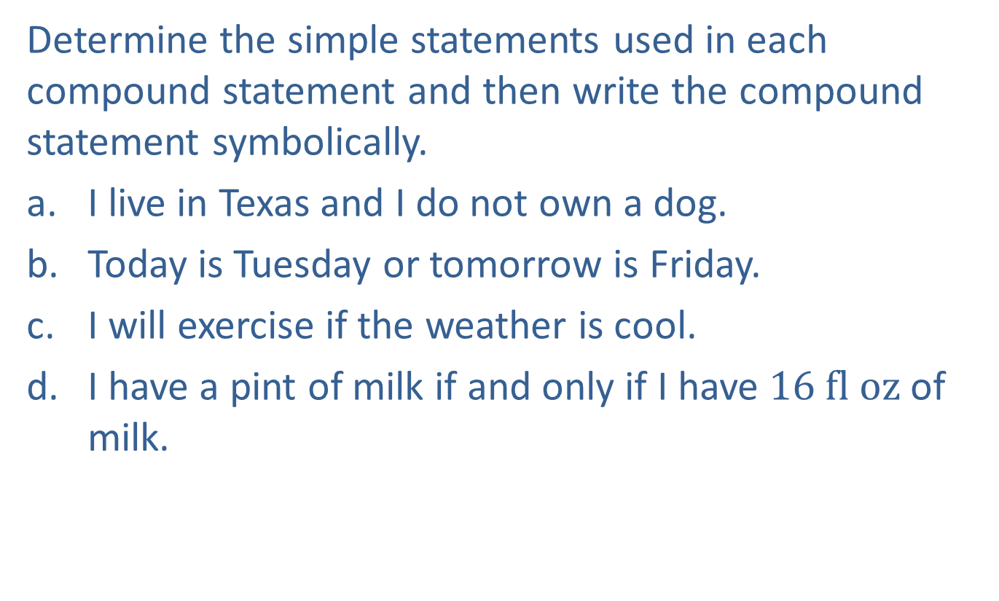
Example 9: Expressing Logical Connectives Symbolically
Determine the simple statements used in each compound statement and then write the compound statement symbolically.
​I live in Texas and I do not own a dog.
​Today is Tuesday or tomorrow is Friday.
​I will exercise if the weather is cool.
​I have a pint of milk if and only if I have $16 fl oz$of milk.

Slide 24

Example 9: Expressing Logical Connectives Symbolically (cont.)
Solution
a. $p:$ I live in Texas.
$q:$ I own a dog.
$p ∧\sim q$
$p:$ Today is Tuesday.
$q:$ Tomorrow is Friday.
$p∨q$

Slide 25
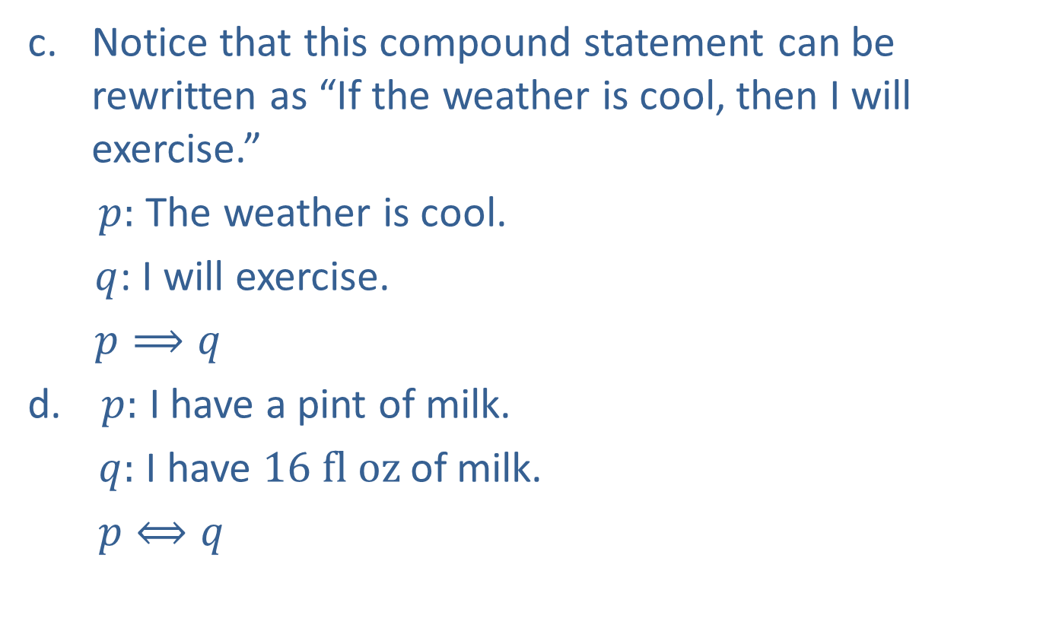
Example 9: Expressing Logical Connectives Symbolically (cont.)
Notice that this compound statement can be rewritten as “If the weather is cool, then I will exercise.”
$p:$ The weather is cool.
$q$: I will exercise.
$p⟹q$
$p:$ I have a pint of milk.
$q:$ I have $16 fl oz$of milk.
$p⟺q$

