Slide 1
Section 8.6
Truth Tables

Slide 2
Definition: Truth Table
A truth table describes the possible truth values of a compound statement. This is accomplished by organizing all the possible combinations of truth values of the individual simple statements.

Slide 3
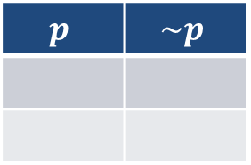
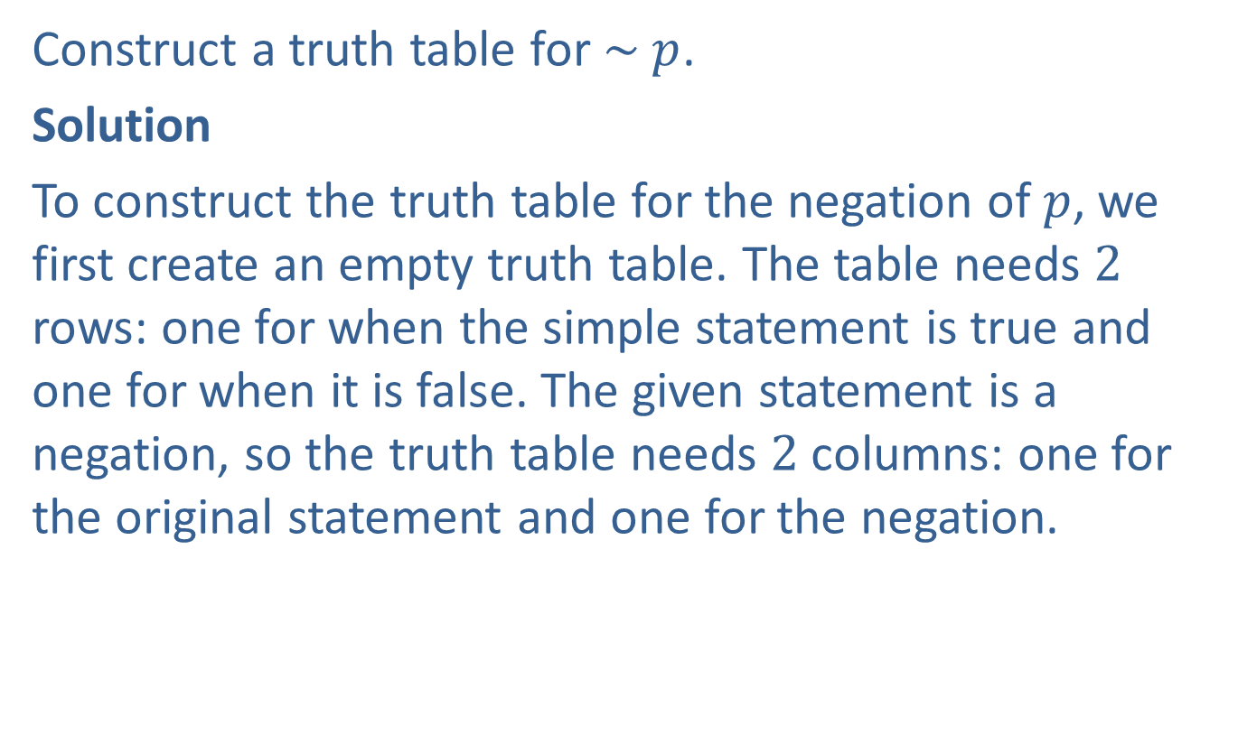
Example 1: Constructing a Truth Table for a Negation
Construct a truth table for $\sim p$.
Solution
To construct the truth table for the negation of $p$, we first create an empty truth table. The table needs $2$ rows: one for when the simple statement is true and one for when it is false. The given statement is a negation, so the truth table needs $2$ columns: one for the original statement and one for the negation.
$$p$$ | $$\sim p$$

Slide 4
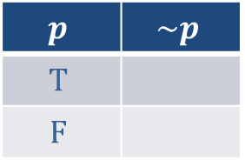
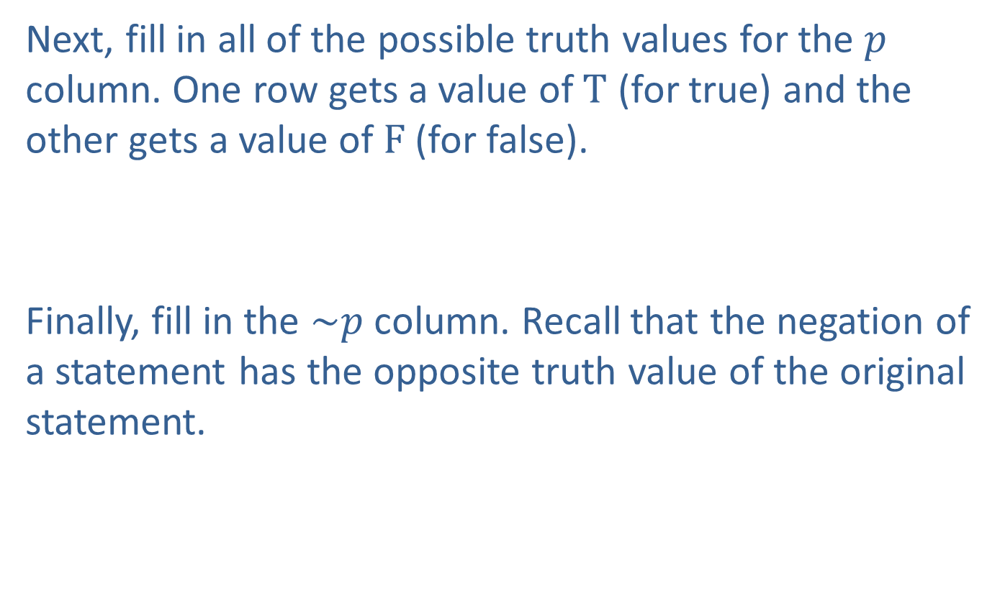
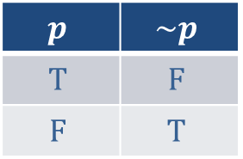
Example 1: Constructing a Truth Table for a Negation (cont.)
Next, fill in all of the possible truth values for the $p$ column. One row gets a value of $T$ (for true) and the other gets a value of $F$ (for false).
Finally, fill in the $\sim p$ column. Recall that the negation of a statement has the opposite truth value of the original statement.
$$p$$ | $$\sim p$$
$$T$$
$$F$$
$$p$$ | $$\sim p$$
$$T$$ | $$F$$
$$F$$ | $$T$$

Slide 5

Example 1: Constructing a Truth Table for a Negation (cont.)
Notice that the final column of the truth table contains both $T$ and $F$. This means that the statement $\sim p$ is true only under certain conditions; in this case, when $p$ is false.

Slide 6
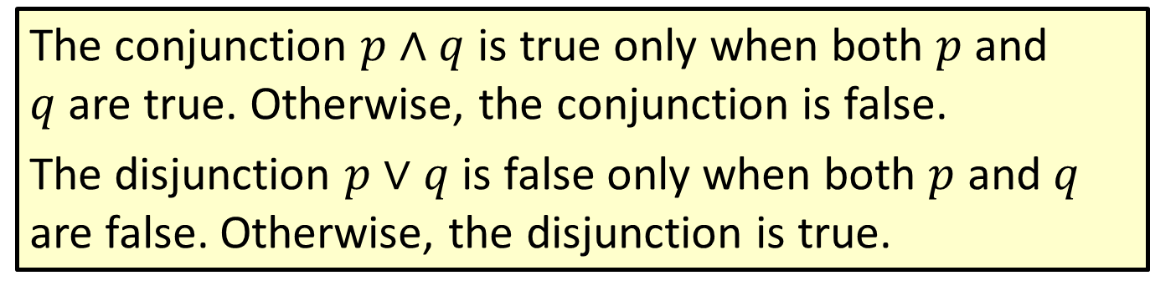
Properties: Truth Values of Conjunctions and Disjunctions
The conjunction $p∧q$ is true only when both $p$ and $q$are true. Otherwise, the conjunction is false.
The disjunction $p∨q$ is false only when both $p$ and $q$ are false. Otherwise, the disjunction is true.

Slide 7
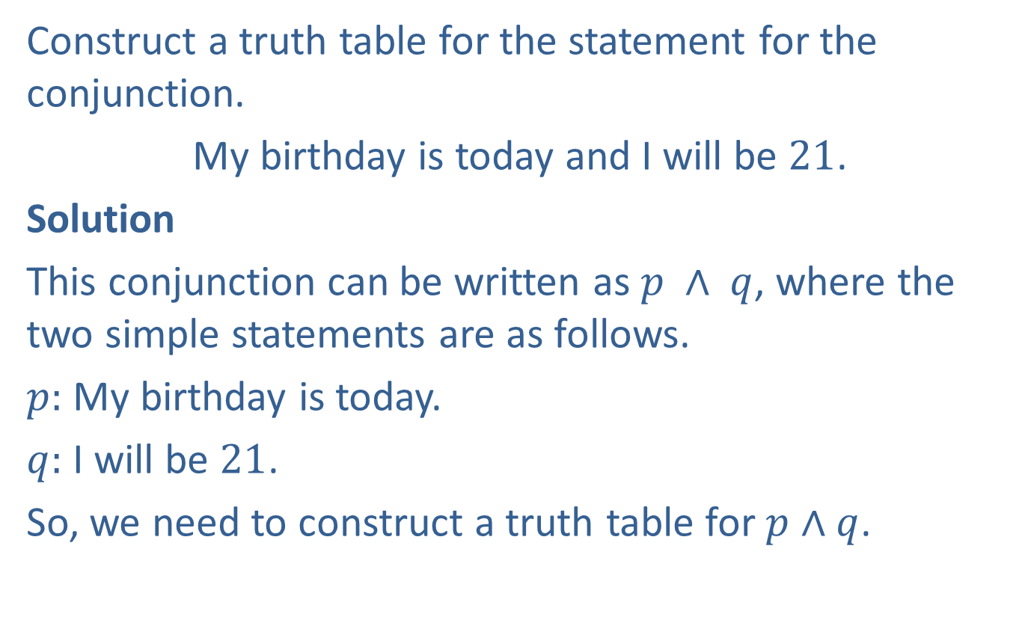
Example 2: Constructing a Truth Table for a Conjunction
Construct a truth table for the statement for the conjunction.
My birthday is today and I will be $21$.
Solution
This conjunction can be written as $p ∧ q$, where the two simple statements are as follows.
$p:$ My birthday is today.
$q:$ I will be $21$.
So, we need to construct a truth table for $p∧q$.

Slide 8
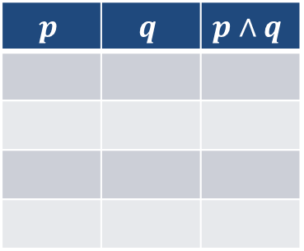

Example 2: Constructing a Truth Table for a Conjunction (cont.)
Since the conjunction is made up of two simple statements, create an empty truth table with $4$ rows. There is one connective and no negations, so we need three columns: $p$, $q$, and $p∧q$.
$$p$$ | $$q$$ | $$p∧q$$

Slide 9
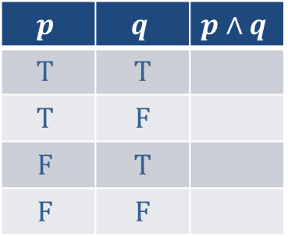

Example 2: Constructing a Truth Table for a Conjunction (cont.)
Next, fill in all the possible combinations of truth values for the simple statements. Recall that each simple statement can be either true or false. It is either true or false that today is my birthday, and it is either true or false that I will be $21$.
$$p$$ | $$q$$ | $$p∧q$$
$$T$$ | $$T$$
$$T$$ | $$F$$
$$F$$ | $$T$$
$$F$$ | $$F$$

Slide 10
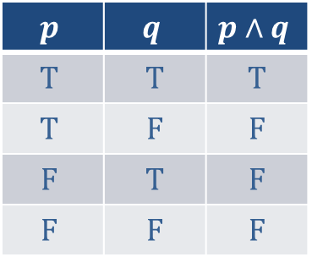
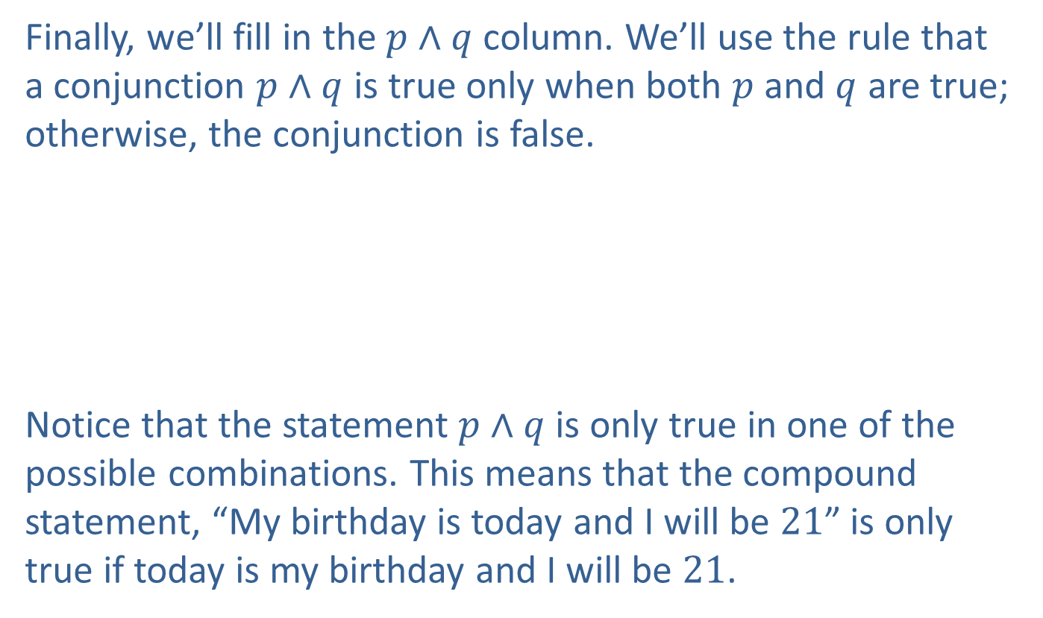
Example 2: Constructing a Truth Table for a Conjunction (cont.)
Finally, we’ll fill in the $p∧q$ column. We’ll use the rule that a conjunction $p∧q$ is true only when both $p$ and $q$ are true; otherwise, the conjunction is false.
Notice that the statement $p∧q$ is only true in one of the possible combinations. This means that the compound statement, “My birthday is today and I will be $21$” is only true if today is my birthday and I will be $21$.
$$p$$ | $$q$$ | $$p∧q$$
$$T$$ | $$T$$ | $$T$$
$$T$$ | $$F$$ | $$F$$
$$F$$ | $$T$$ | $$F$$
$$F$$ | $$F$$ | $$F$$

Slide 11

Example 2: Constructing a Truth Table for a Conjunction (cont.)
If either of the simple statements are false, then the entire compound statement is false. That is, if today is not my birthday, then the conjunction is false. Similarly, if I will be any age other than $21$, then the conjunction is false.

Slide 12
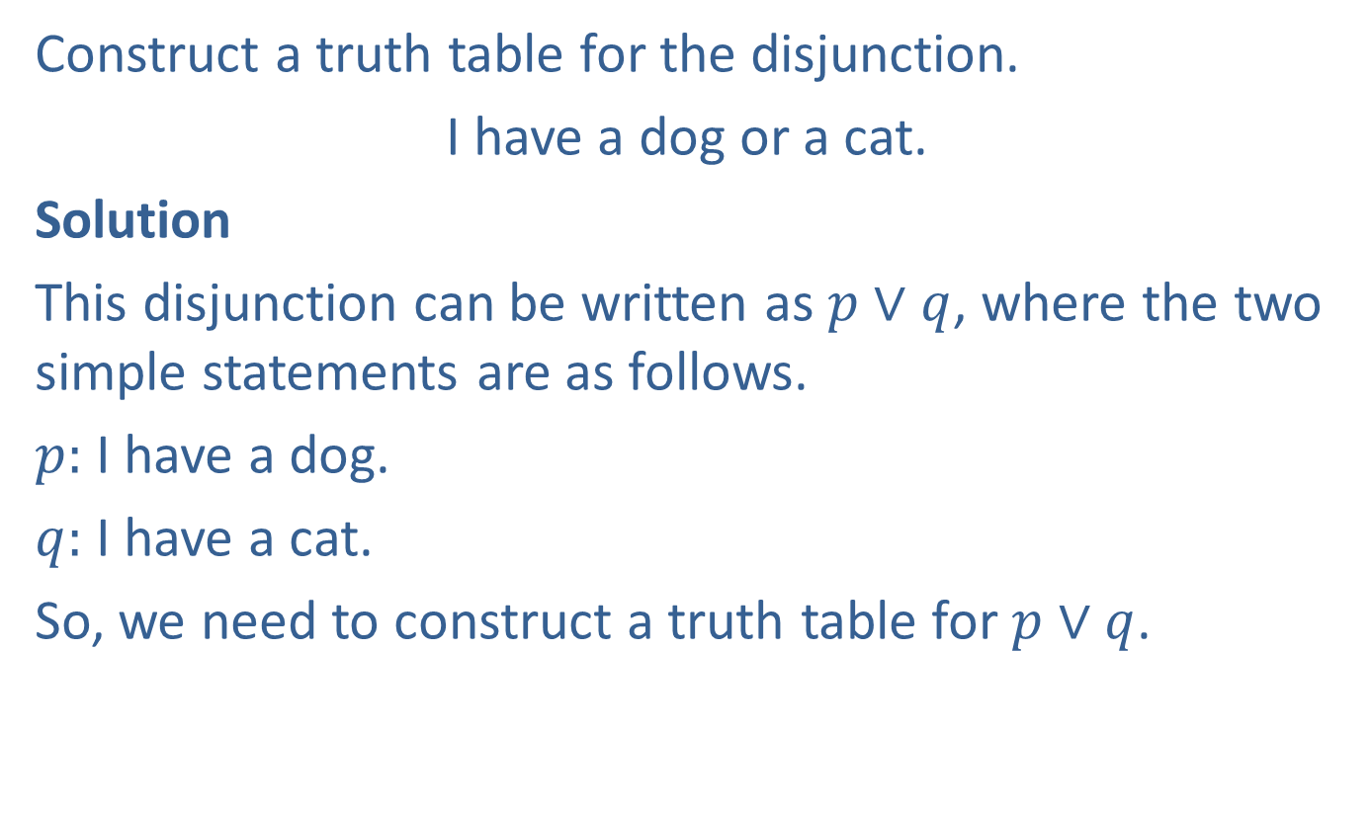
Example 3: Constructing a Truth Table for a Disjunction
Construct a truth table for the disjunction.
I have a dog or a cat.
Solution
This disjunction can be written as $p∨q$, where the two simple statements are as follows.
$p:$ I have a dog.
$q:$ I have a cat.
So, we need to construct a truth table for $p∨q$.

Slide 13


Example 3: Constructing a Truth Table for a Disjunction (cont.)
Create an empty truth table with $4$ rows (since we have two simple statements) and $3$ columns: $p$, $q$, and $p∨q$. Fill in all possible combinations of truth values for the simple statements. It is either true or false that I have a dog and it is either true or false that I have a cat.
$$p$$ | $$q$$ | $$p∨q$$
$$T$$ | $$T$$
$$T$$ | $$F$$
$$F$$ | $$T$$
$$F$$ | $$F$$

Slide 14
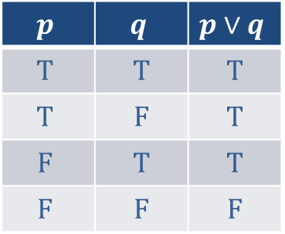
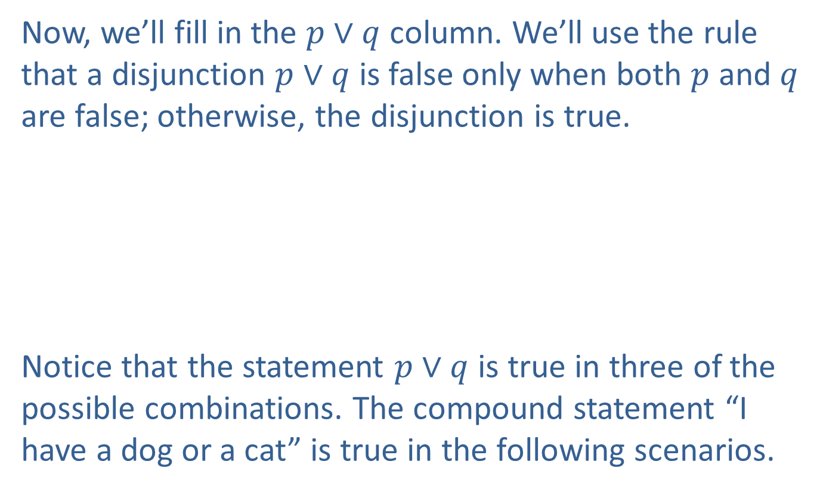
Example 3: Constructing a Truth Table for a Disjunction (cont.)
Now, we’ll fill in the $p∨q$ column. We’ll use the rule that a disjunction $p∨q$ is false only when both $p$ and $q$ are false; otherwise, the disjunction is true.
Notice that the statement $p∨q$ is true in three of the possible combinations. The compound statement “I have a dog or a cat” is true in the following scenarios.
$$p$$ | $$q$$ | $$p∨q$$
$$T$$ | $$T$$ | $$T$$
$$T$$ | $$F$$ | $$T$$
$$F$$ | $$T$$ | $$T$$
$$F$$ | $$F$$ | $$F$$

Slide 15
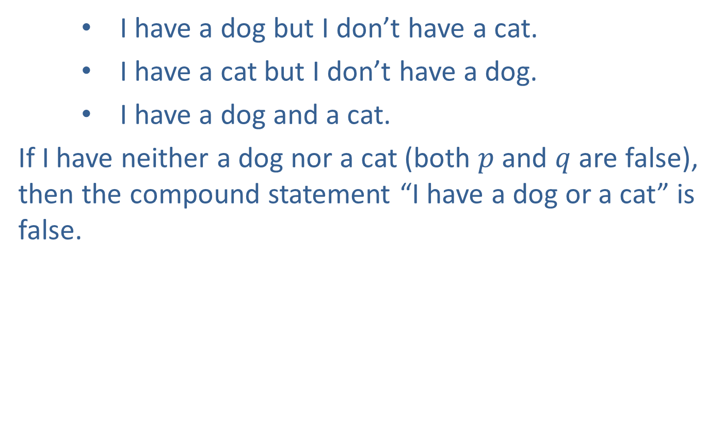
Example 3: Constructing a Truth Table for a Disjunction (cont.)
I have a dog but I don’t have a cat.
I have a cat but I don’t have a dog.
I have a dog and a cat.
If I have neither a dog nor a cat (both $p$ and $q$ are false), then the compound statement “I have a dog or a cat” is false.

Slide 16
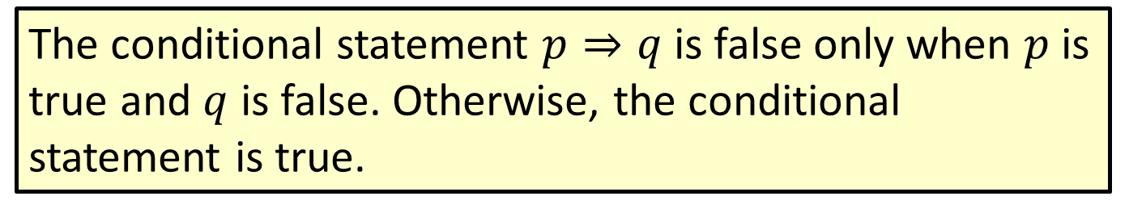
Properties: Truth Value of Conditional Statements
The conditional statement $p⇒q$ is false only when $p$ is true and $q$ is false. Otherwise, the conditional statement is true.

Slide 17
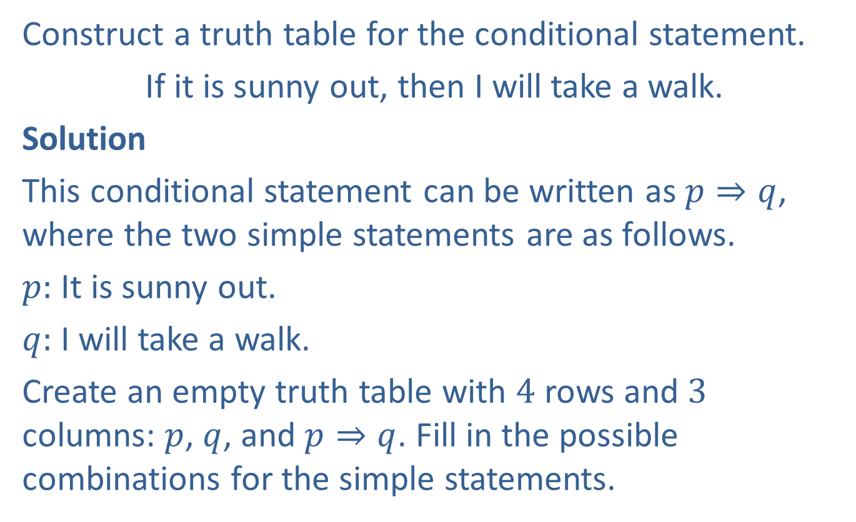
Example 4: Constructing a Truth Table for a Conditional Statement
Construct a truth table for the conditional statement.
If it is sunny out, then I will take a walk.
Solution
This conditional statement can be written as $p⇒q$, where the two simple statements are as follows.
$p:$ It is sunny out.
$q:$ I will take a walk.
Create an empty truth table with $4$ rows and $3$ columns: $p$, $q$, and $p⇒q$. Fill in the possible combinations for the simple statements.

Slide 18
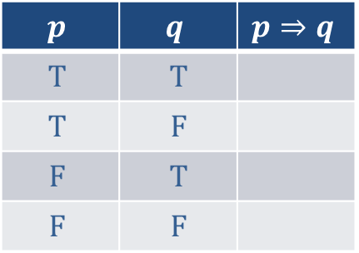
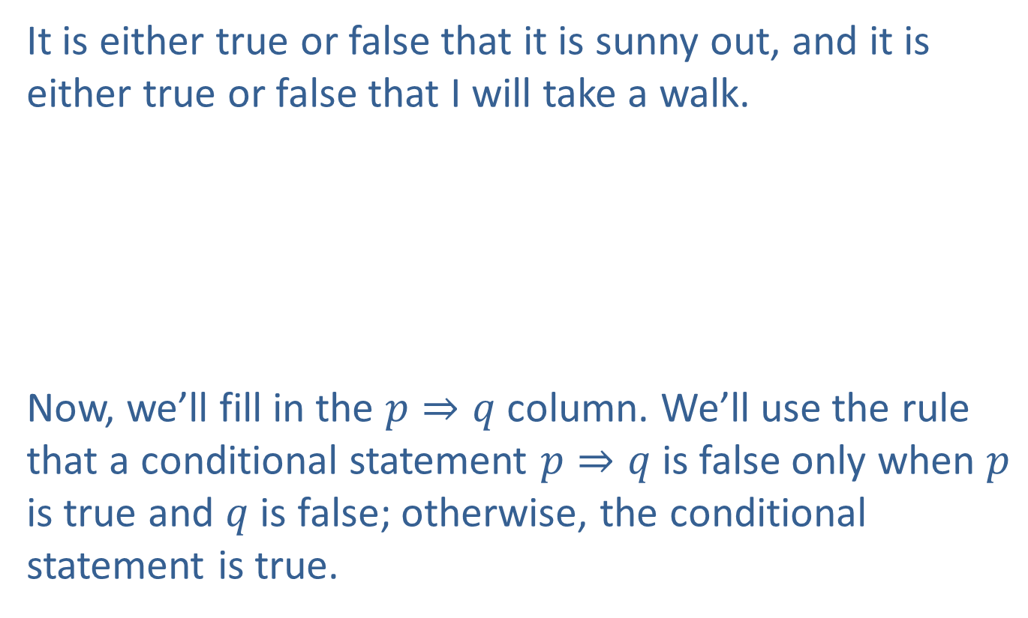
Example 4: Constructing a Truth Table for a Conditional Statement (cont.)
It is either true or false that it is sunny out, and it is either true or false that I will take a walk.
Now, we’ll fill in the $p⇒q$ column. We’ll use the rule that a conditional statement $p⇒q$ is false only when $p$ is true and $q$ is false; otherwise, the conditional statement is true.
$$p$$ | $$q$$ | $$p⇒q$$
$$T$$ | $$T$$
$$T$$ | $$F$$
$$F$$ | $$T$$
$$F$$ | $$F$$

Slide 19
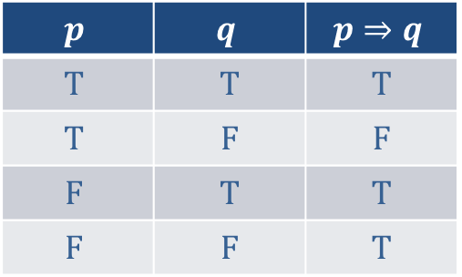
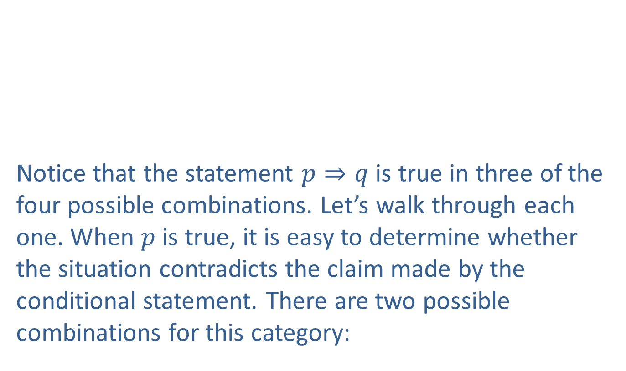
Example 4: Constructing a Truth Table for a Conditional Statement (cont.)
Notice that the statement $p⇒q$ is true in three of the four possible combinations. Let’s walk through each one. When $p$ is true, it is easy to determine whether the situation contradicts the claim made by the conditional statement. There are two possible combinations for this category:
$$p$$ | $$q$$ | $$p⇒q$$
$$T$$ | $$T$$ | $$T$$
$$T$$ | $$F$$ | $$F$$
$$F$$ | $$T$$ | $$T$$
$$F$$ | $$F$$ | $$T$$

Slide 20
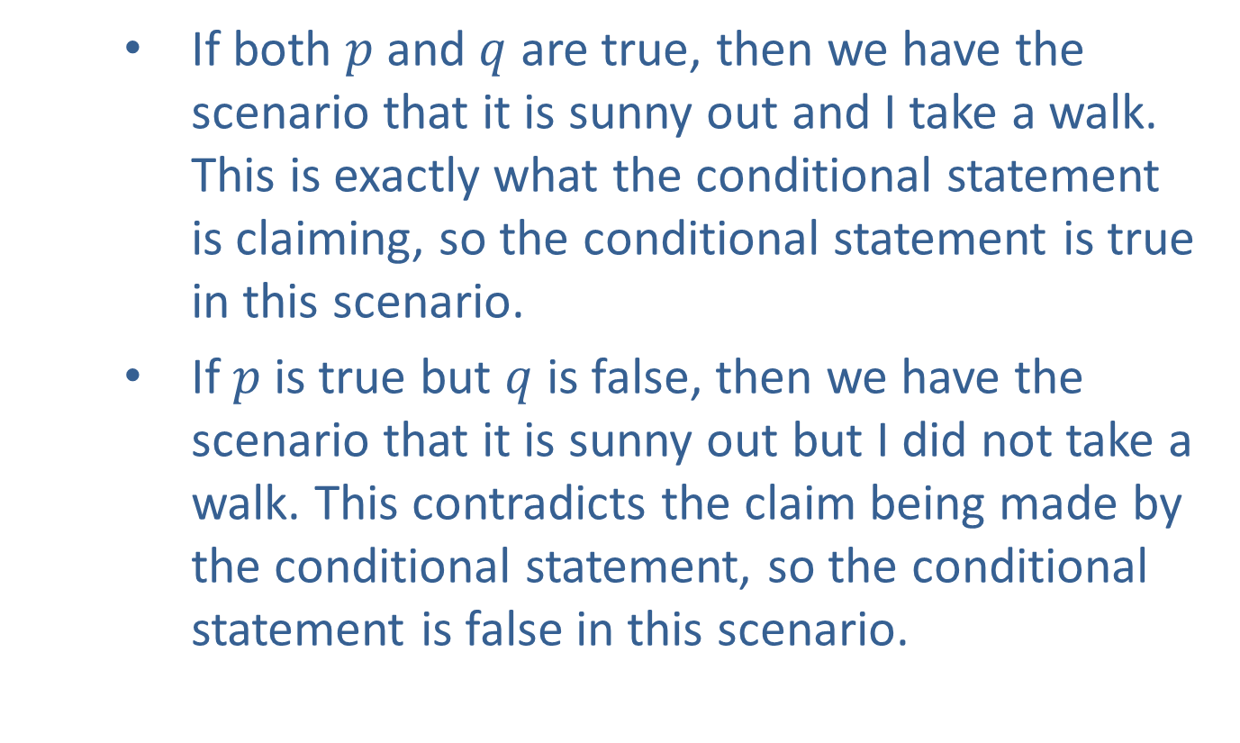
Example 4: Constructing a Truth Table for a Conditional Statement (cont.)
If both $p$ and $q$ are true, then we have the scenario that it is sunny out and I take a walk. This is exactly what the conditional statement is claiming, so the conditional statement is true in this scenario.
If $p$ is true but $q$ is false, then we have the scenario that it is sunny out but I did not take a walk. This contradicts the claim being made by the conditional statement, so the conditional statement is false in this scenario.

Slide 21
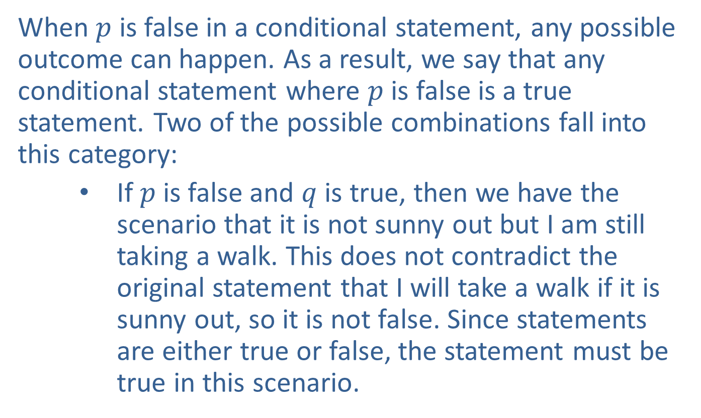
Example 4: Constructing a Truth Table for a Conditional Statement (cont.)
When $p$ is false in a conditional statement, any possible outcome can happen. As a result, we say that any conditional statement where $p$ is false is a true statement. Two of the possible combinations fall into this category:
If $p$ is false and $q$ is true, then we have the scenario that it is not sunny out but I am still taking a walk. This does not contradict the original statement that I will take a walk if it is sunny out, so it is not false. Since statements are either true or false, the statement must be true in this scenario.

Slide 22

Example 4: Constructing a Truth Table for a Conditional Statement (cont.)
If both $p$ and $q$ are false, then we have the scenario that it is not sunny out and I am not taking a walk. Again, this does not contradict the original statement, so it is not false. The conditional statement is true in this scenario.

Slide 23
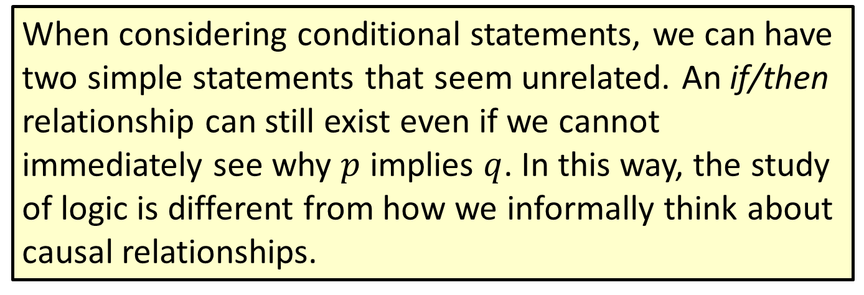
Note
When considering conditional statements, we can have two simple statements that seem unrelated. An if/then relationship can still exist even if we cannot immediately see why $p$ implies $q$. In this way, the study of logic is different from how we informally think about causal relationships.

Slide 24
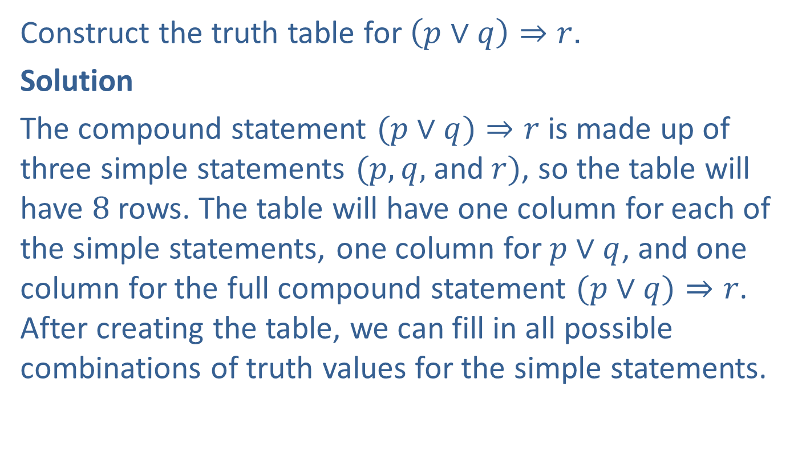
Example 5: Constructing a Truth Table for a Compound Statement
Construct the truth table for $\left(p∨q\right)⇒r$.
Solution
The compound statement $(p∨q)⇒r$ is made up of three simple statements $(p,q,$and$r)$, so the table will have $8$ rows. The table will have one column for each of the simple statements, one column for $p∨q$, and one column for the full compound statement $(p∨q)⇒r$. After creating the table, we can fill in all possible combinations of truth values for the simple statements.

Slide 25
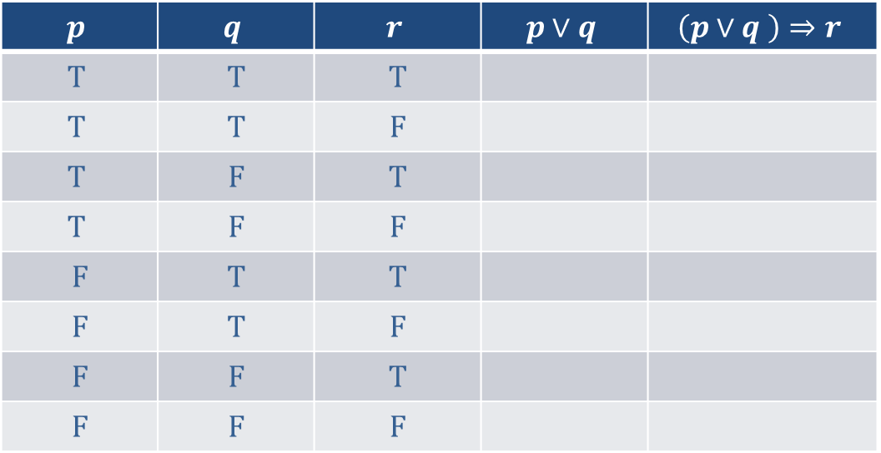

Example 5: Constructing a Truth Table for a Compound Statement (cont.)
The next step is to fill in the $p∨q$ column. We’ll use the rule that a disjunction $p∨q$ is false only when both $p$ and $q$ are false; otherwise, the disjunction is true.
$$p$$ | $$q$$ | $$r$$ | $$p∨q$$ | $$\left(p∨q \right)⇒r$$
$$T$$ | $$T$$ | $$T$$
$$T$$ | $$T$$ | $$F$$
$$T$$ | $$F$$ | $$T$$
$$T$$ | $$F$$ | $$F$$
$$F$$ | $$T$$ | $$T$$
$$F$$ | $$T$$ | $$F$$
$$F$$ | $$F$$ | $$T$$
$$F$$ | $$F$$ | $$F$$

Slide 26
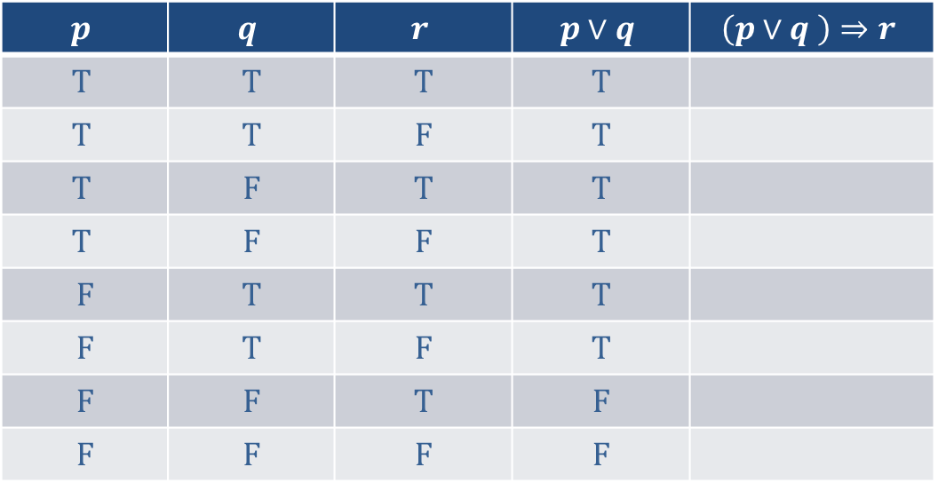
Example 5: Constructing a Truth Table for a Compound Statement (cont.)
$$p$$ | $$q$$ | $$r$$ | $$p∨q$$ | $$\left(p∨q \right)⇒r$$
$$T$$ | $$T$$ | $$T$$ | $$T$$
$$T$$ | $$T$$ | $$F$$ | $$T$$
$$T$$ | $$F$$ | $$T$$ | $$T$$
$$T$$ | $$F$$ | $$F$$ | $$T$$
$$F$$ | $$T$$ | $$T$$ | $$T$$
$$F$$ | $$T$$ | $$F$$ | $$T$$
$$F$$ | $$F$$ | $$T$$ | $$F$$
$$F$$ | $$F$$ | $$F$$ | $$F$$

Slide 27

Example 5: Constructing a Truth Table for a Compound Statement (cont.)
Finally, we’ll fill in the column for $(p∨q)⇒r$ by using the truth values in the $p∨q$ column and the $r$ column. Recall that the conditional statement $(p∨q)⇒r$ is false only when $p∨q$ is true and $r$ is false; otherwise, the conditional statement is true.

Slide 28
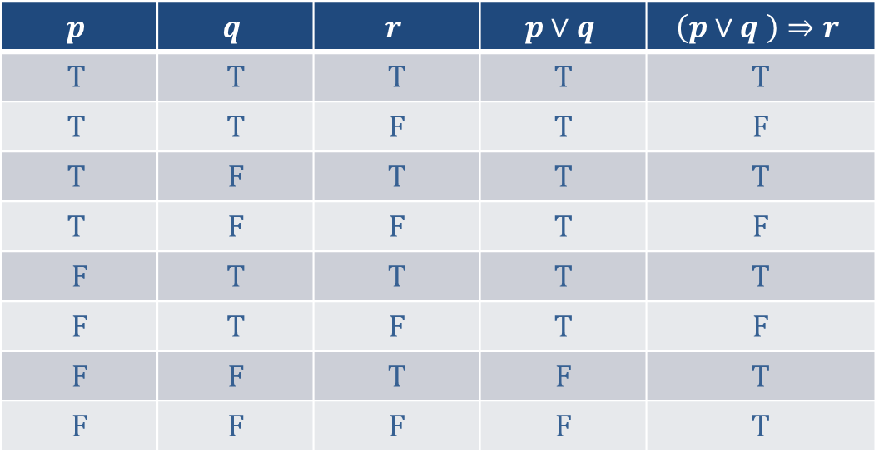

Example 5: Constructing a Truth Table for a Compound Statement (cont.)
Notice that that the statement $(p∨q)⇒r$ is false for $3$ of the $8$ possible truth value combinations of $p$, $q$, and $r$.
$$p$$ | $$q$$ | $$r$$ | $$p∨q$$ | $$\left(p∨q \right)⇒r$$
$$T$$ | $$T$$ | $$T$$ | $$T$$ | $$T$$
$$T$$ | $$T$$ | $$F$$ | $$T$$ | $$F$$
$$T$$ | $$F$$ | $$T$$ | $$T$$ | $$T$$
$$T$$ | $$F$$ | $$F$$ | $$T$$ | $$F$$
$$F$$ | $$T$$ | $$T$$ | $$T$$ | $$T$$
$$F$$ | $$T$$ | $$F$$ | $$T$$ | $$F$$
$$F$$ | $$F$$ | $$T$$ | $$F$$ | $$T$$
$$F$$ | $$F$$ | $$F$$ | $$F$$ | $$T$$

