Slide 1
Section 9.1
Introduction to Probability

Slide 2
Definition: Terms Related to Probability
A trial is a repetition of the same procedure.
An outcome of a trial is the observed value of the variable we are measuring in the experiment.
The sample space is the set of every potential outcome that could occur in one trial of an experiment.
An event is a set of outcomes.

Slide 3
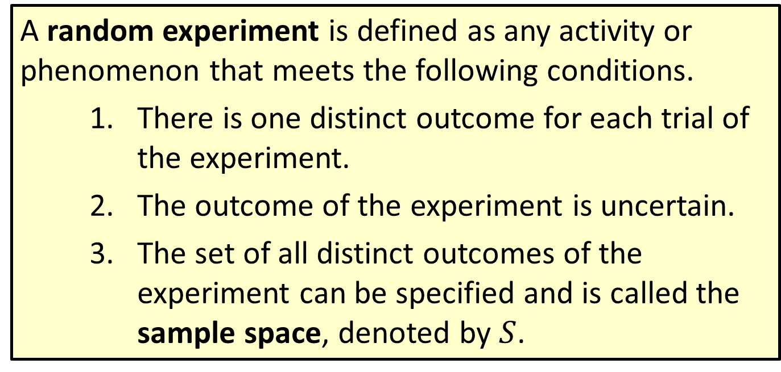
Definition: Random Experiment
A random experiment is defined as any activity or phenomenon that meets the following conditions.
  ​There is one distinct outcome for each trial of the experiment.
  ​The outcome of the experiment is uncertain.
  ​The set of all distinct outcomes of the experiment can be specified and is called the sample space, denoted by $S$.

Slide 4
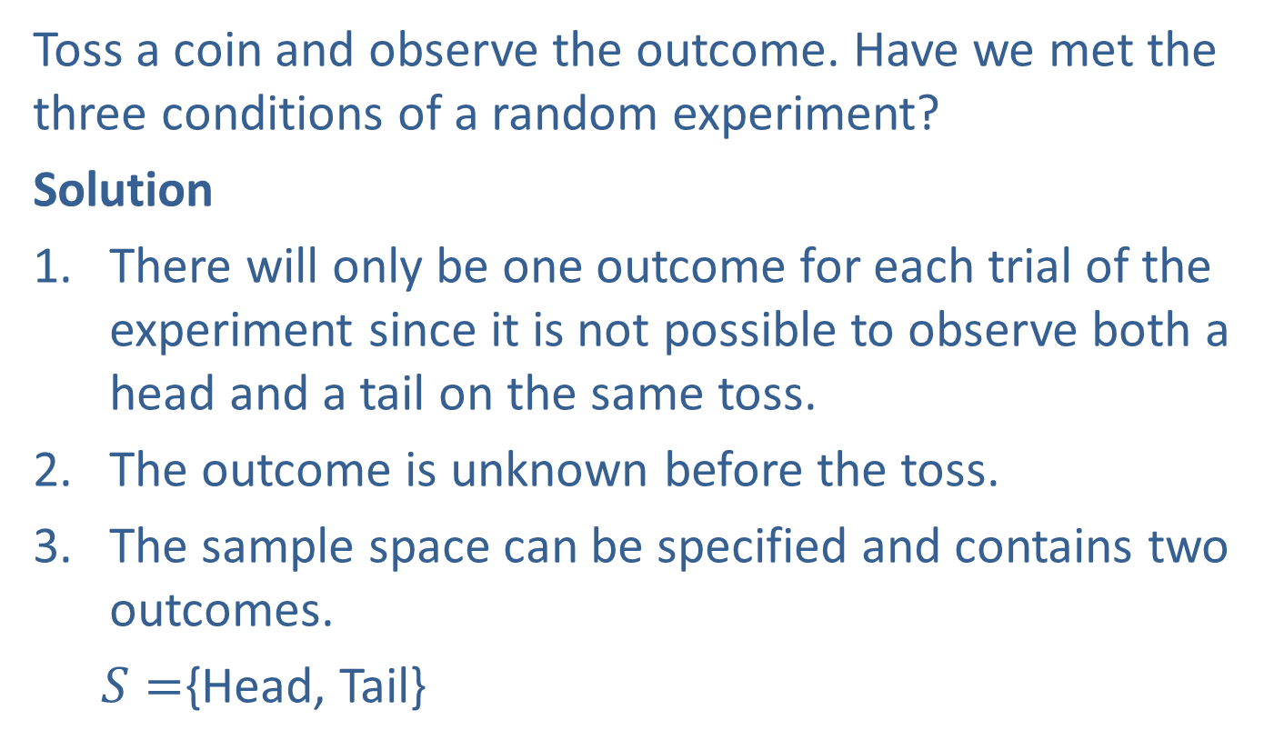
Example 1: Tossing a Coin
Toss a coin and observe the outcome. Have we met the three conditions of a random experiment?
Solution
There will only be one outcome for each trial of the experiment since it is not possible to observe both a head and a tail on the same toss.
The outcome is unknown before the toss.
The sample space can be specified and contains two outcomes.
  $S=${Head, Tail}

Slide 5
Example 1: Tossing a Coin (cont.)
Because each of the three conditions is satisfied, this experiment meets the conditions of a random experiment.
Note: It is possible for a coin to land on its edge and thus neither be heads nor tails. Any theory, however, involves a certain degree of idealization, which means, in this case, that landing on an edge will not be considered a possible outcome.

Slide 6
Example 2: Tossing a Coin Three Times
Toss a coin three times and observe the number of heads. Have we met the three conditions of a random experiment? Note, one trial of the experiment is tossing a coin three times.
Solution
There will only be one outcome since, for example, it is not possible to have exactly one and exactly two heads on the same trial.
The outcome is unknown before tossing the coin three times.

Slide 7
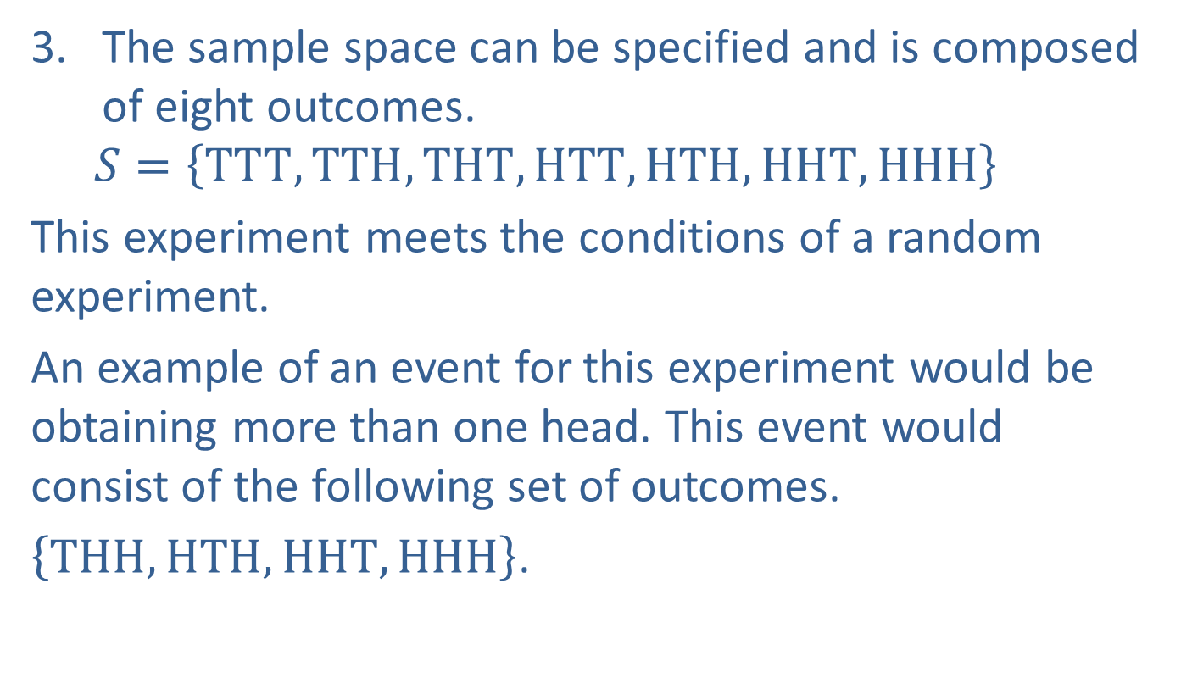
Example 2: Tossing a Coin Three Times (cont.)
The sample space can be specified and is composed of eight outcomes.
  $$S=\left\{TTT, TTH, THT, HTT, HTH, HHT, HHH\right\}$$
This experiment meets the conditions of a random experiment.
An example of an event for this experiment would be obtaining more than one head. This event would consist of the following set of outcomes.
$\left\{THH, HTH, HHT, HHH\right\}$.

Slide 8

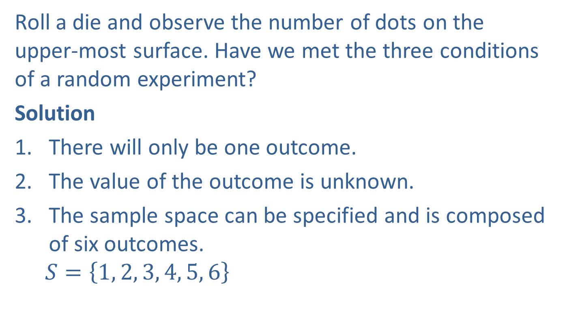
Example 3: Rolling a Die
Roll a die and observe the number of dots on the upper-most surface. Have we met the three conditions of a random experiment?
Solution
There will only be one outcome.
The value of the outcome is unknown.
The sample space can be specified and is composed of six outcomes.
  $$S=\left\{1, 2, 3, 4, 5, 6\right\}$$

Slide 9

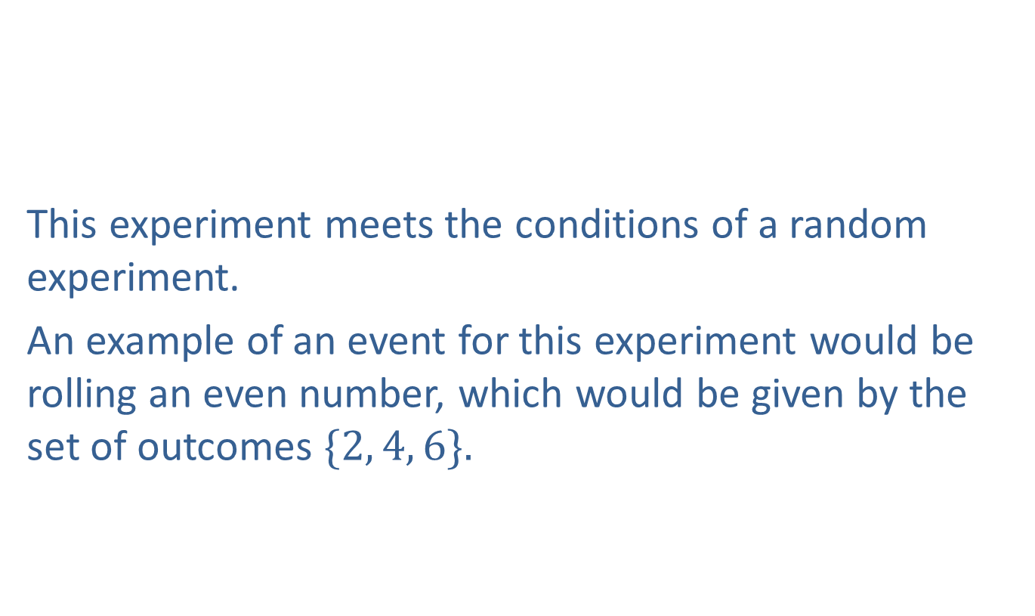
Example 3: Rolling a Die (cont.)
This experiment meets the conditions of a random experiment.
An example of an event for this experiment would be rolling an even number, which would be given by the set of outcomes $\{2, 4, 6\}.$

Slide 10
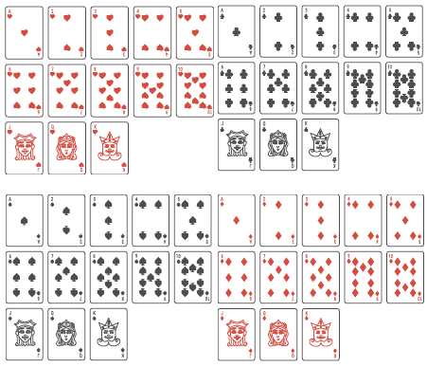

Example 4: Choosing One Card from a Deck of Cards
Assume we have a standard deck of playing cards consisting of $13$ hearts, $13$ clubs, $13$ spades, and $13$ diamonds.

Slide 11
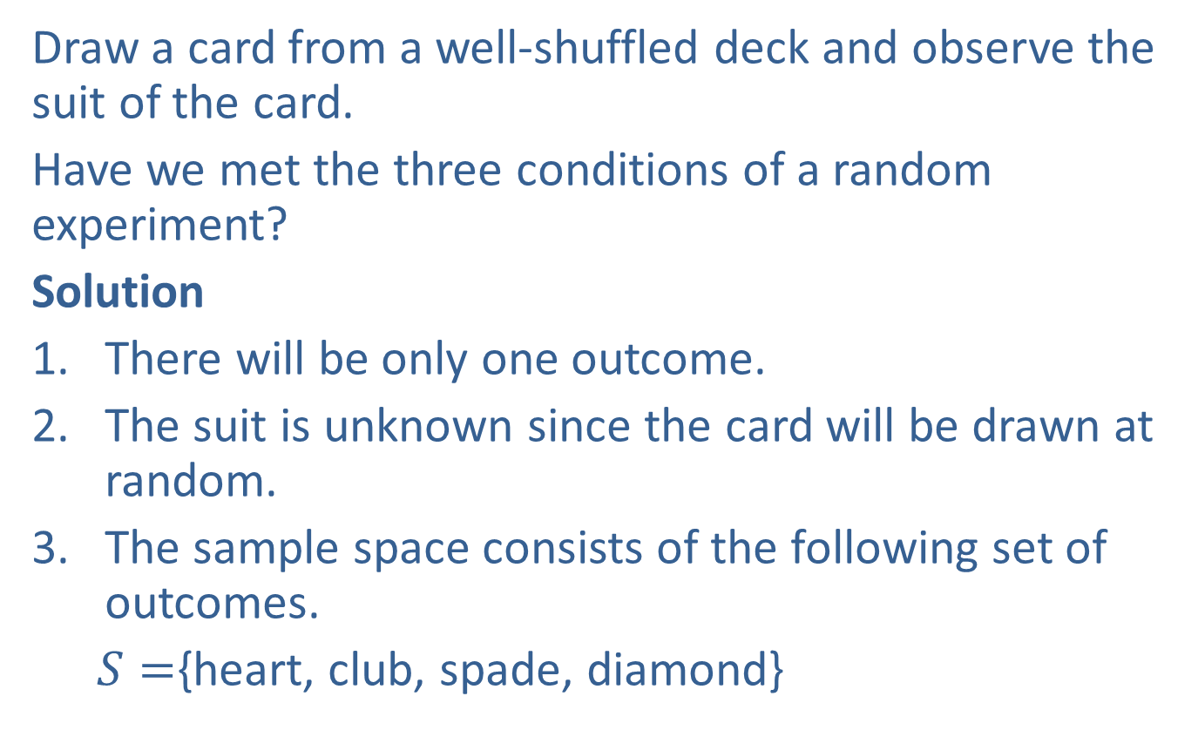
Example 4: Choosing One Card from a Deck of Cards (cont.)
Draw a card from a well-shuffled deck and observe the suit of the card.
Have we met the three conditions of a random experiment?
Solution
There will be only one outcome.
The suit is unknown since the card will be drawn at random.
The sample space consists of the following set of outcomes.
  $S=${heart, club, spade, diamond}

Slide 12

Example 4: Choosing One Card from a Deck of Cards (cont.)
This experiment meets the conditions of a random experiment.
If the random experiment involves drawing a card and observing a spade or a club, then the event would be given by the set of outcomes $\{$club, spade$\}.$

Slide 13
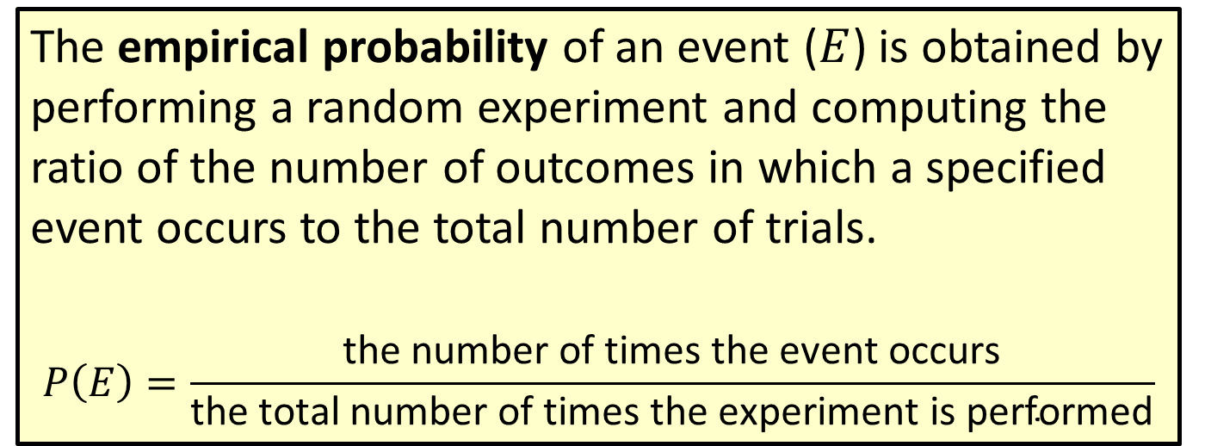
Formula: Empirical Probability
The empirical probability of an event ($E$) is obtained by performing a random experiment and computing the ratio of the number of outcomes in which a specified event occurs to the total number of trials.
$$P\left(E\right)=\frac{\text{the} \text{number} \text{of} \text{times} \text{the} \text{event} \text{occurs}}{\text{the} \text{total} \text{number} \text{of} \text{times} \text{the} \text{experiment} \text{is} \text{performed}}$$

Slide 14
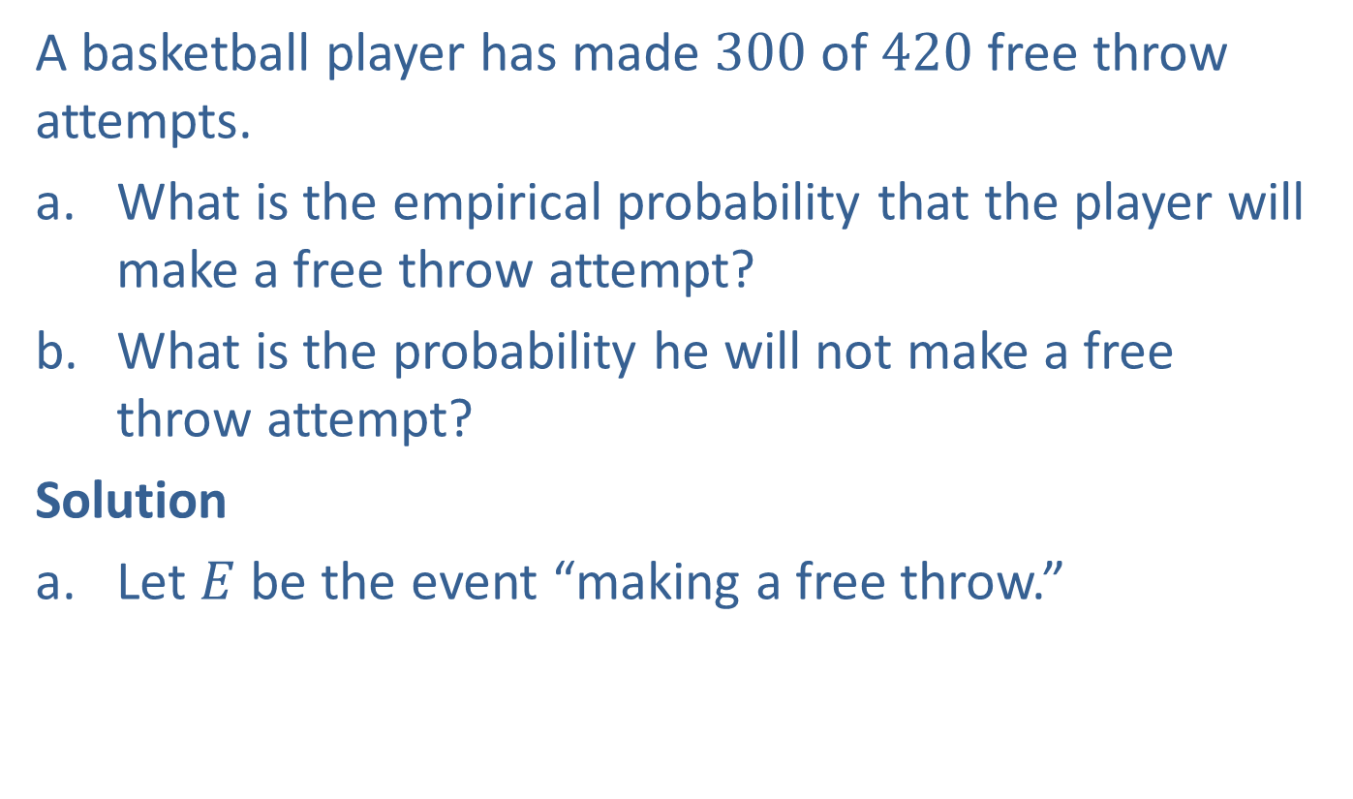
Example 5: Calculating Empirical Probability
A basketball player has made $300$ of $420$ free throw attempts.
​What is the empirical probability that the player will make a free throw attempt?
​What is the probability he will not make a free throw attempt?
Solution
Let $E$ be the event “making a free throw.”

Slide 15
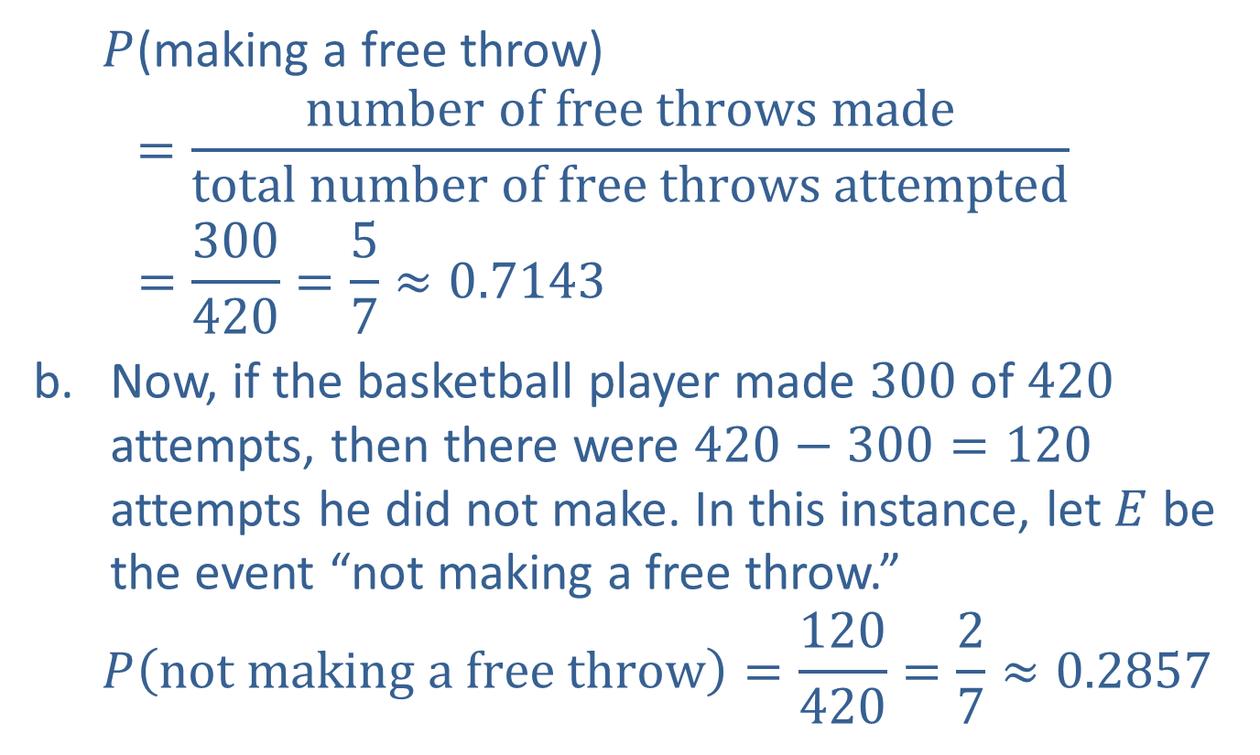
Example 5: Calculating Empirical Probability (cont.)
  $P$(making a free throw)
  $$=\frac{number of free throws made}{total number of free throws attempted}$$
  $$=\frac{300}{420}=\frac{5}{7}≈0.7143$$
Now, if the basketball player made $300$ of $420$ attempts, then there were $420−300=120$ attempts he did not make. In this instance, let $E$ be the event “not making a free throw.”
  $$P\left(not making a free throw\right)=\frac{120}{420}=\frac{2}{7}≈0.2857$$

Slide 16
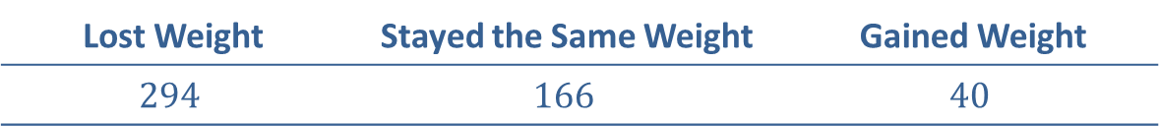
Example 6: Calculating Empirical Probability
A drug company is testing a new diet pill. Five hundred people participated in the research experiment. The results were as follows.
If the drug is given to a patient,
​What is the empirical probability that the patient will lose weight?
​What is the empirical probability the patient does not gain weight?
Lost Weight | Stayed the Same Weight | Gained Weight
$$294$$ | $$166$$ | $$40$$

Slide 17
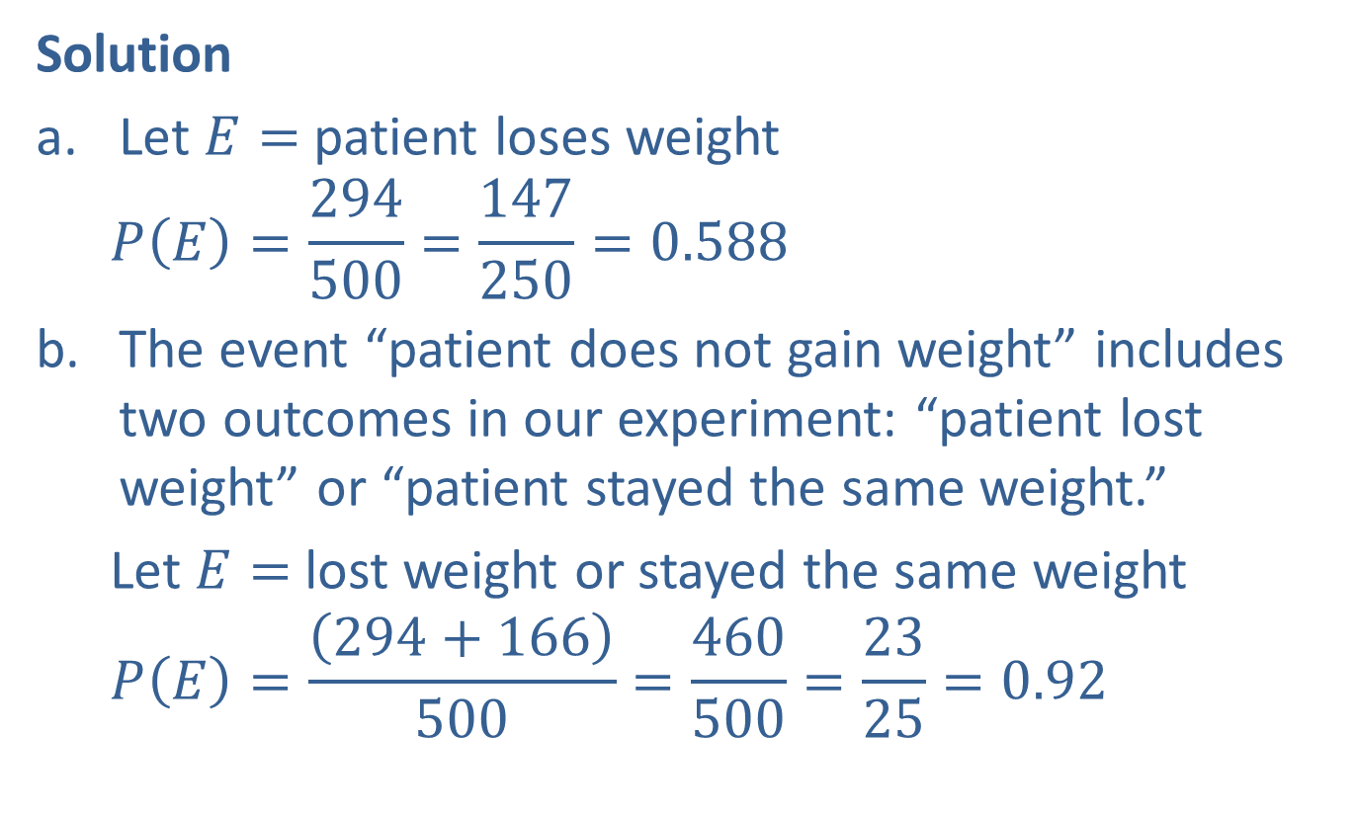
Example 6: Calculating Empirical Probability (cont.)
Solution
Let $E=$ patient loses weight
  $$P\left(E\right)=\frac{294}{500}=\frac{147}{250}=0.588$$
The event “patient does not gain weight” includes two outcomes in our experiment: “patient lost weight” or “patient stayed the same weight.”
  Let $E=$ lost weight or stayed the same weight
  $$P\left(E\right)=\frac{\left(294+166\right)}{500}=\frac{460}{500}=\frac{23}{25}=0.92$$

Slide 18
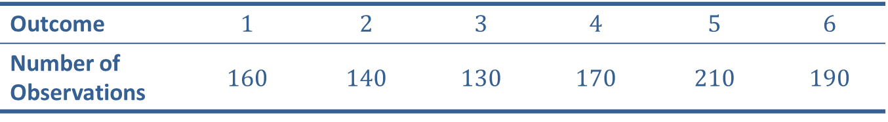
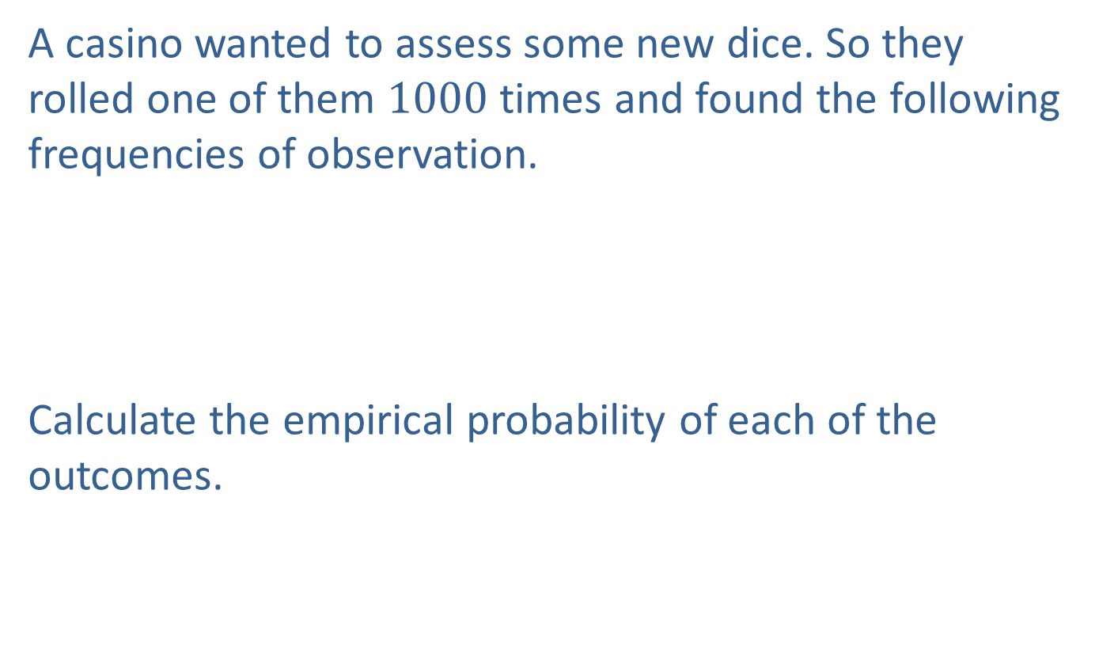
Example 7: Calculating Empirical Probability
A casino wanted to assess some new dice. So they rolled one of them $1000$ times and found the following frequencies of observation.
Calculate the empirical probability of each of the outcomes.
Outcome | $$1$$ | $$2$$ | $$3$$ | $$4$$ | $$5$$ | $$6$$
Number of Observations | $$160$$ | $$140$$ | $$130$$ | $$170$$ | $$210$$ | $$190$$

Slide 19
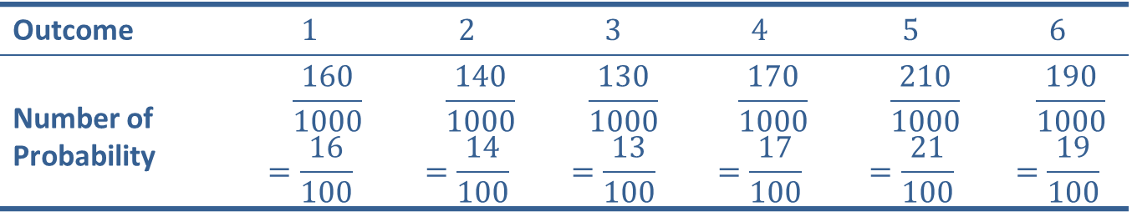
Example 7: Calculating Empirical Probability (cont.)
Solution
A list of all outcomes and their associated probabilities is called a probability distribution. Thus, the table above displays the empirical probability distribution associated with the casino die throwing experiment.
Outcome | $$1$$ | $$2$$ | $$3$$ | $$4$$ | $$5$$ | $$6$$
Number of Probability | $$\frac{160}{1000}$$ $$=\frac{16}{100}$$ | $$\frac{140}{1000}$$ $$=\frac{14}{100}$$ | $$\frac{130}{1000}$$ $$=\frac{13}{100}$$ | $$\frac{170}{1000}$$ $$=\frac{17}{100}$$ | $$\frac{210}{1000}$$ $$=\frac{21}{100}$$ | $$\frac{190}{1000}$$ $$=\frac{19}{100}$$

Slide 20
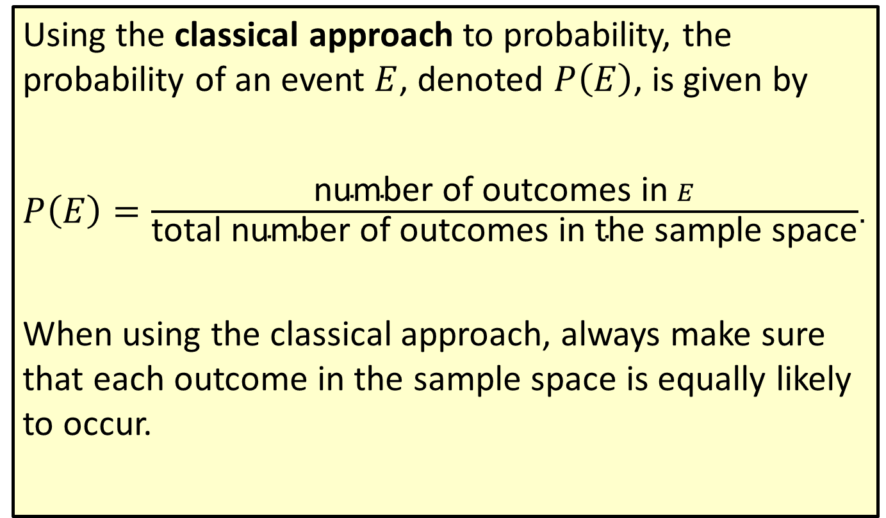
Formula: Classical Probability
Using the classical approach to probability, the probability of an event $E$, denoted $P⁡\left(E\right)$, is given by
$P\left(E\right)=\frac{\text{number} \text{of} \text{outcomes} \text{in} E}{\text{total} \text{number} \text{of} \text{outcomes} \text{in} \text{the} \text{sample} \text{space}}$.
When using the classical approach, always make sure that each outcome in the sample space is equally likely to occur.

Slide 21
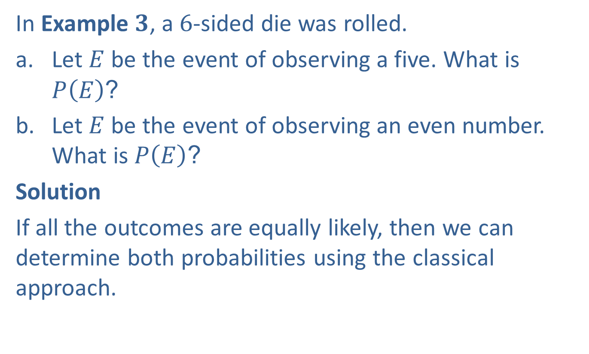
Example 8: Calculating Classical Probability
In Example $3$, a $6$-sided die was rolled.
​Let $E$ be the event of observing a five. What is $P⁡\left(E\right)$?
​Let $E$ be the event of observing an even number. What is $P⁡\left(E\right)$?
Solution
If all the outcomes are equally likely, then we can determine both probabilities using the classical approach.

Slide 22
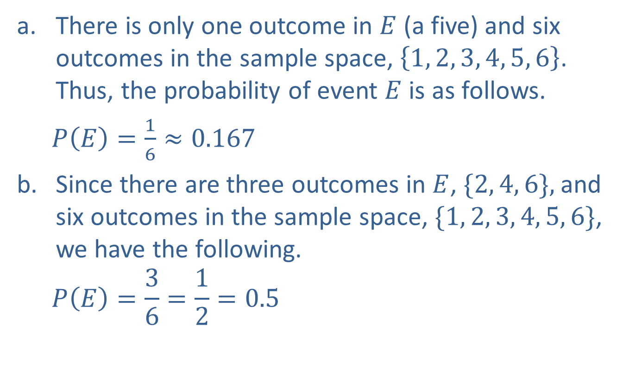
Example 8: Calculating Classical Probability (cont.)
​There is only one outcome in $E$ (a five) and six outcomes in the sample space, $\left\{1, 2, 3, 4, 5, 6\right\}$. Thus, the probability of event $E$ is as follows.
  $P\left(E\right)=\frac{1}{6}≈0.167$
​Since there are three outcomes in $E$, $\{2, 4, 6\},$and six outcomes in the sample space, $\{1, 2, 3, 4, 5, 6\}$, we have the following.
  $$P\left(E\right)=\frac{3}{6}=\frac{1}{2}=0.5$$

Slide 23

Example 9: Calculating Classical Probability
In Example $4$, a card was drawn from a standard deck of cards consisting of $13$ hearts, $13$ clubs, $13$ spades, and $13$ diamonds. Let $E$ be the event of drawing a heart. What is $P(E)$?

Slide 24
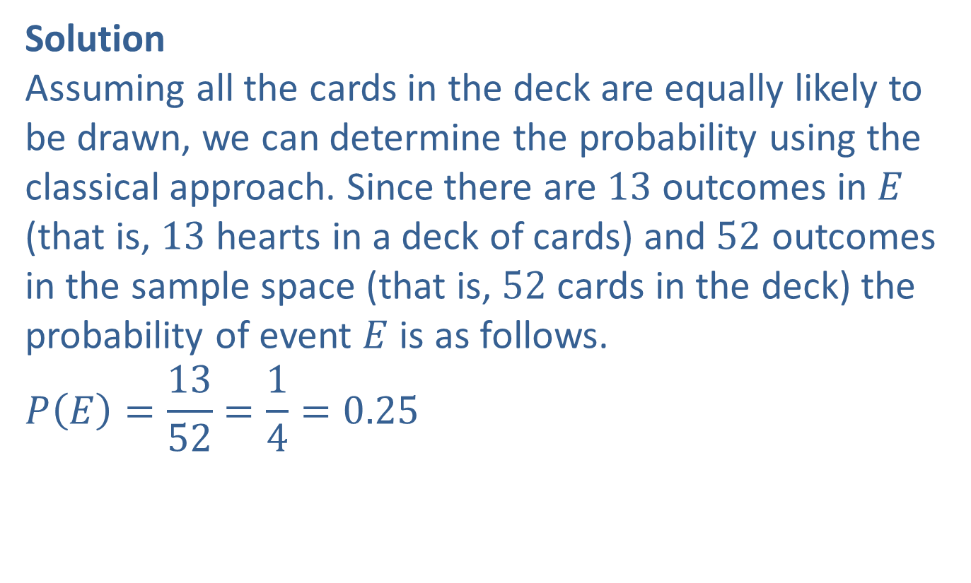
Example 9: Calculating Classical Probability (cont.)
Solution
Assuming all the cards in the deck are equally likely to be drawn, we can determine the probability using the classical approach. Since there are $13$ outcomes in $E$ (that is, $13$ hearts in a deck of cards) and $52$ outcomes in the sample space (that is, $52$ cards in the deck) the probability of event $E$ is as follows.
$$P\left(E\right)=\frac{13}{52}=\frac{1}{4}=0.25$$

Slide 25

Example 10: Calculating Classical Probability
In Example $2$, a coin was tossed three times and the number of heads was observed. The sample space consists of $8$ outcomes $\{HHH, HHT, HTH, HTT, THH, THT, TTH, TTT\}$. Let $E$ be the event of getting at least one head. What is $P(E)$?

Slide 26
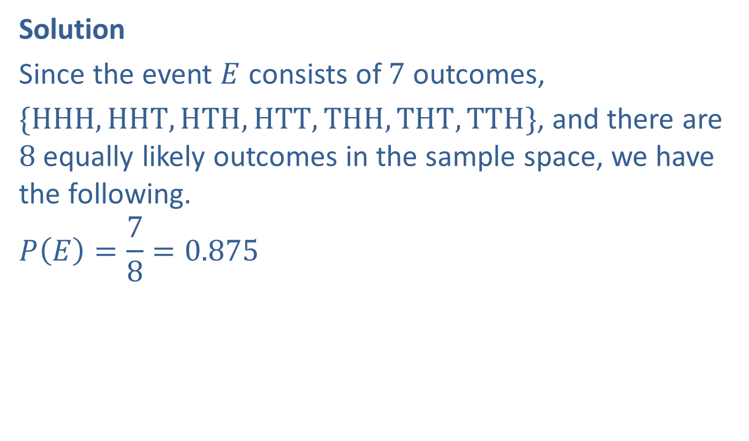
Example 10: Calculating Classical Probability (cont.)
Solution
Since the event $E$ consists of $7$ outcomes,
$\{HHH, HHT, HTH, HTT, THH, THT, TTH\}$, and there are $8$ equally likely outcomes in the sample space, we have the following.
$$P\left(E\right)=\frac{7}{8}=0.875$$

Slide 27
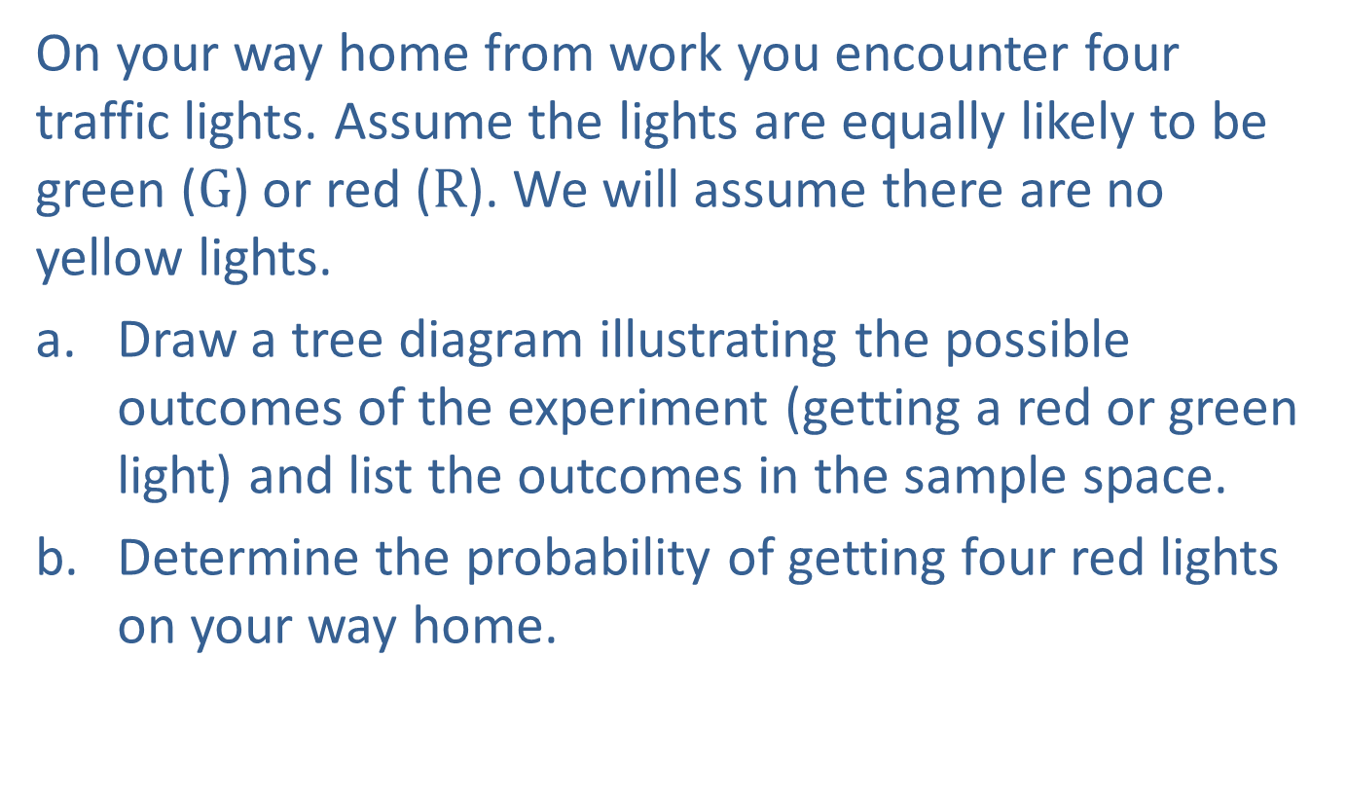
Example 11: Using a Tree Diagram to Calculate Classical Probability
On your way home from work you encounter four traffic lights. Assume the lights are equally likely to be green ($G$) or red ($R$). We will assume there are no yellow lights.
​Draw a tree diagram illustrating the possible outcomes of the experiment (getting a red or green light) and list the outcomes in the sample space.
​Determine the probability of getting four red lights on your way home.

Slide 28

Example 11: Using a Tree Diagram to Calculate Classical Probability (cont.)
Solution
There are $16$ outcomes in the sample space.
  $$S=\left\{\begin{aligned}\text{GGGG}\text{,} \text{RGGG}\text{,} \text{GRGG}\text{,} \text{GGRG}\text{,} \text{GGGR}\text{,} \\ \text{RRGG}\text{,} \text{RGRG}\text{,} \text{RGGR}\text{,} \text{GRRG}\text{,} \text{GRGR}\text{,} \\ \text{GGRR}\text{, }\text{GRRR}\text{, }\text{RGRR}\text{, }\text{RRGR}\text{, }\text{RRRG}\text{, }\text{RRRR}\end{aligned}\right\}$$

Slide 29
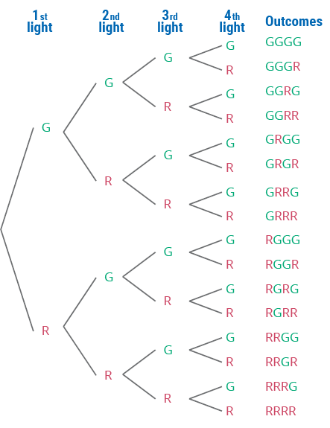
Example 11: Using a Tree Diagram to Calculate Classical Probability (cont.)

Slide 30

Example 11: Using a Tree Diagram to Calculate Classical Probability (cont.)
There are $16$ possible outcomes on the way home. However, there is only one way to get four red lights {RRRR}. Thus, $P\left(E\right)=\frac{1}{16}=0.0625.$

Slide 31
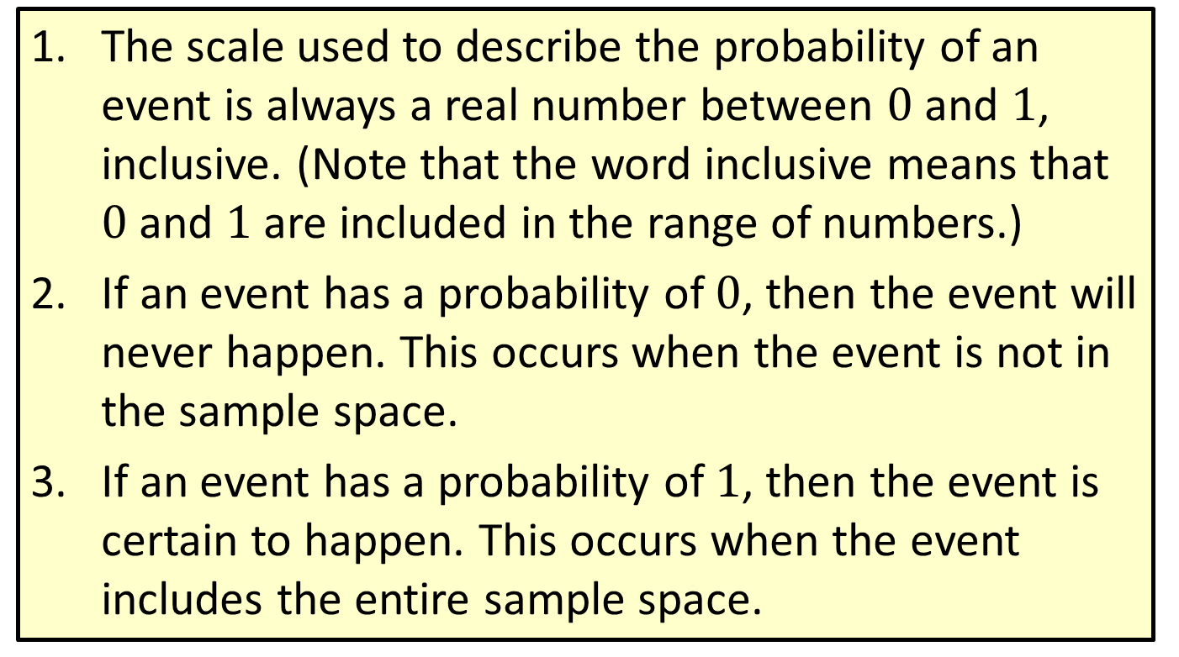
Properties: Rules of Probability
​The scale used to describe the probability of an event is always a real number between $0$ and $1$, inclusive. (Note that the word inclusive means that $0$ and $1$ are included in the range of numbers.)
​If an event has a probability of $0$, then the event will never happen. This occurs when the event is not in the sample space.
If an event has a probability of $1$, then the event is certain to happen. This occurs when the event includes the entire sample space.

Slide 32
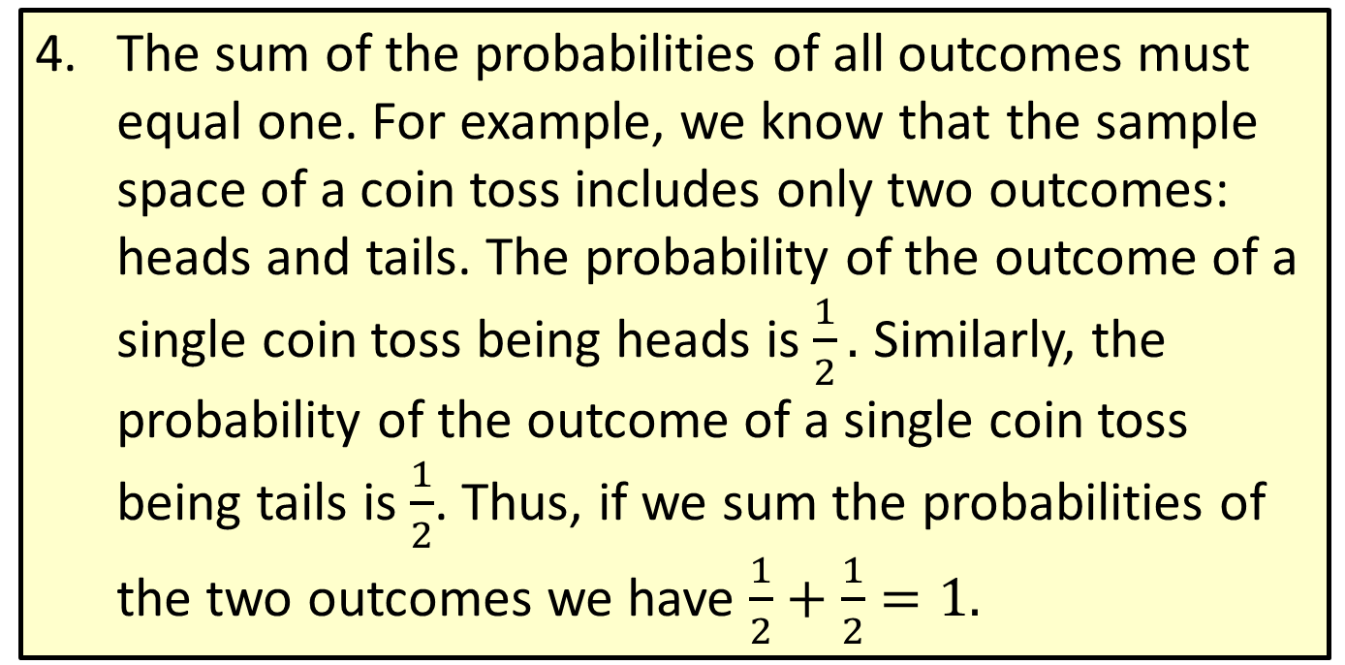
Properties: Rules of Probability (cont.)
​The sum of the probabilities of all outcomes must equal one. For example, we know that the sample space of a coin toss includes only two outcomes: heads and tails. The probability of the outcome of a single coin toss being heads is $\frac{1}{2}.$ Similarly, the probability of the outcome of a single coin toss being tails is $\frac{1}{2}$. Thus, if we sum the probabilities of the two outcomes we have $\frac{1}{2}+\frac{1}{2}=1.$

