Slide 1
Section 9.2
The Addition Rules of Probability and Odds

Slide 2
Note
As a reminder, the word inclusive means that the given range of numbers should include the endpoints.

Slide 3
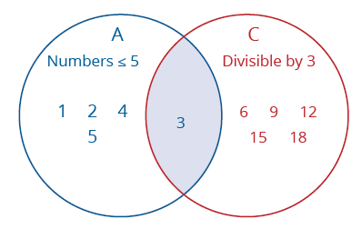
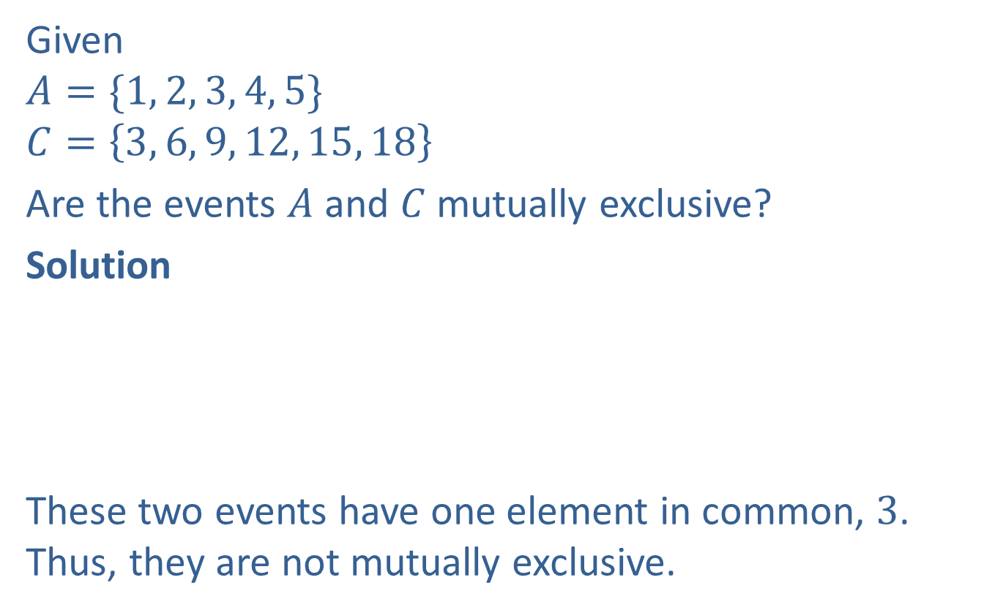
Example 1: Determining Whether Events Are Mutually Exclusive
Given
$$A=\{1, 2, 3, 4, 5\}$$
$$C=\left\{3, 6, 9, 12, 15, 18\right\}$$
Are the events $A$ and $C$ mutually exclusive?
Solution
These two events have one element in common, $3$. Thus, they are not mutually exclusive.

Slide 4
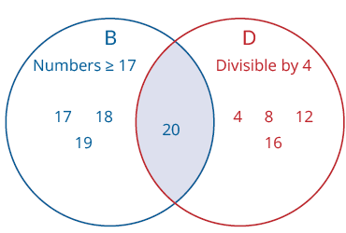
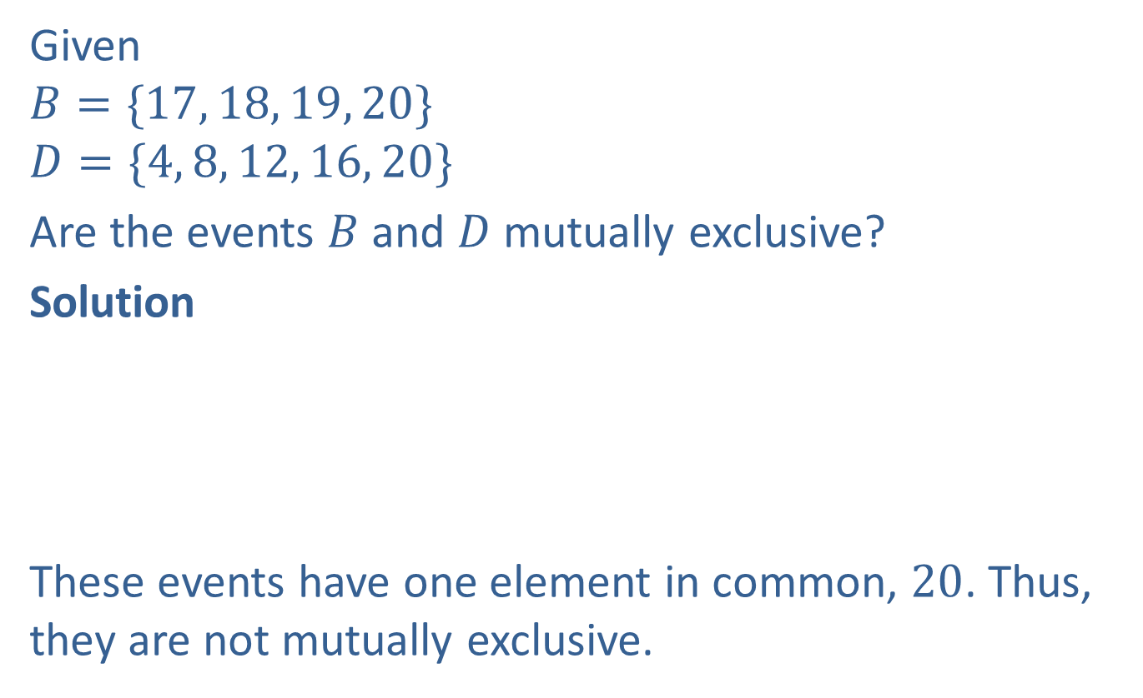
Example 2: Determining Whether Events Are Mutually Exclusive
Given
$$B=\{17, 18, 19, 20\}$$
$$D=\{4, 8, 12, 16, 20\}$$
Are the events $B$ and $D$ mutually exclusive?
Solution
These events have one element in common, $20$. Thus, they are not mutually exclusive.

Slide 5
Example 3: Determining Whether Events Are Mutually Exclusive
In one trial of a coin toss experiment, are the events “getting a head” and “getting a tail” mutually exclusive?
Solution
You cannot get both a head and a tail on a single flip of a coin. Thus, the events are mutually exclusive.

Slide 6
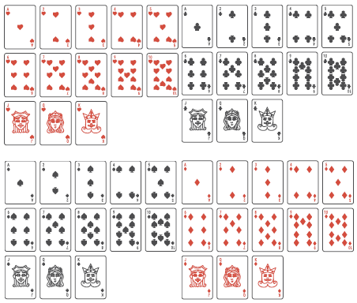

Example 4: Determining Whether Events Are Mutually Exclusive
In one trial of drawing a card from a deck of $52$ cards, are the events “drawing a $9$” and “drawing an $8$” mutually exclusive? A standard deck of cards contains the following.

Slide 7
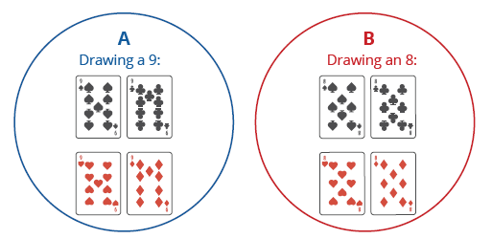

Example 4: Determining Whether Events Are Mutually Exclusive (cont.)
Solution
You cannot get both a $9$ and an $8$ by selecting one card from a deck. Thus, the events are mutually exclusive.

Slide 8
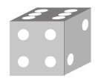
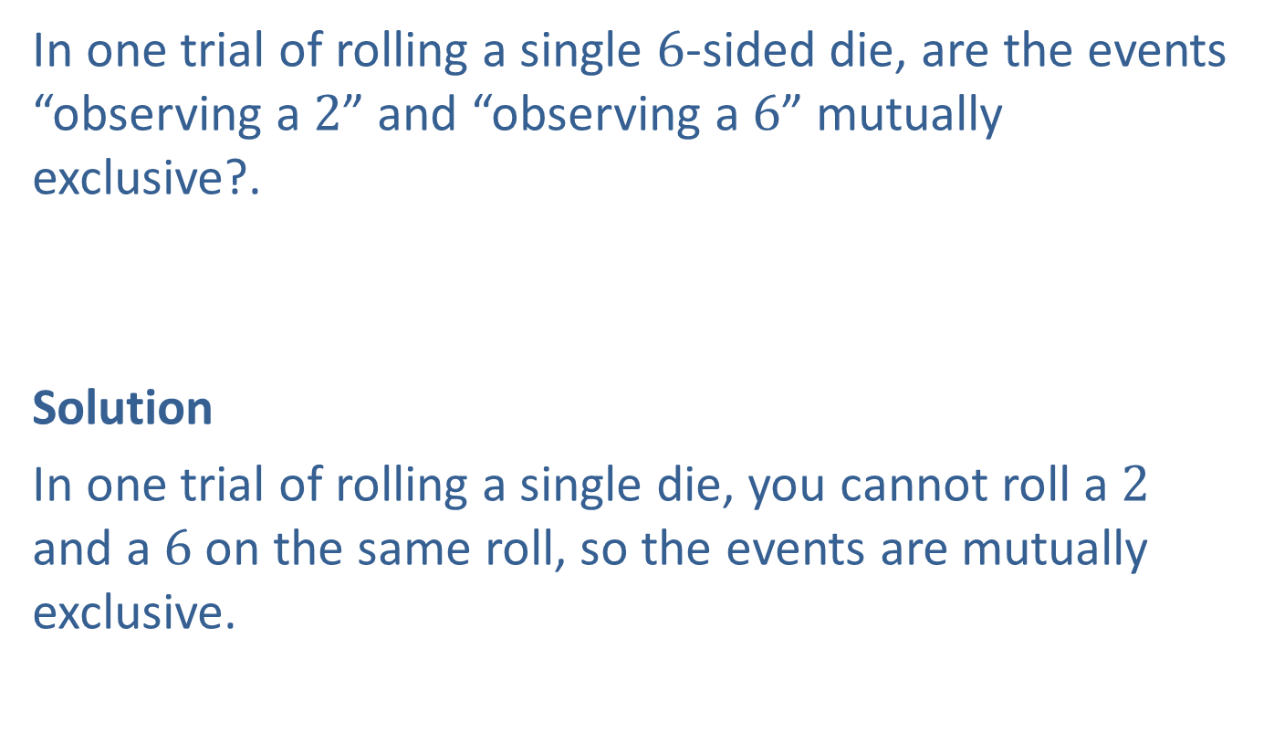
Example 5: Determining Whether Events Are Mutually Exclusive
In one trial of rolling a single $6$-sided die, are the events “observing a $2$” and “observing a $6$” mutually exclusive?.
Solution
In one trial of rolling a single die, you cannot roll a $2$ and a $6$ on the same roll, so the events are mutually exclusive.

Slide 9
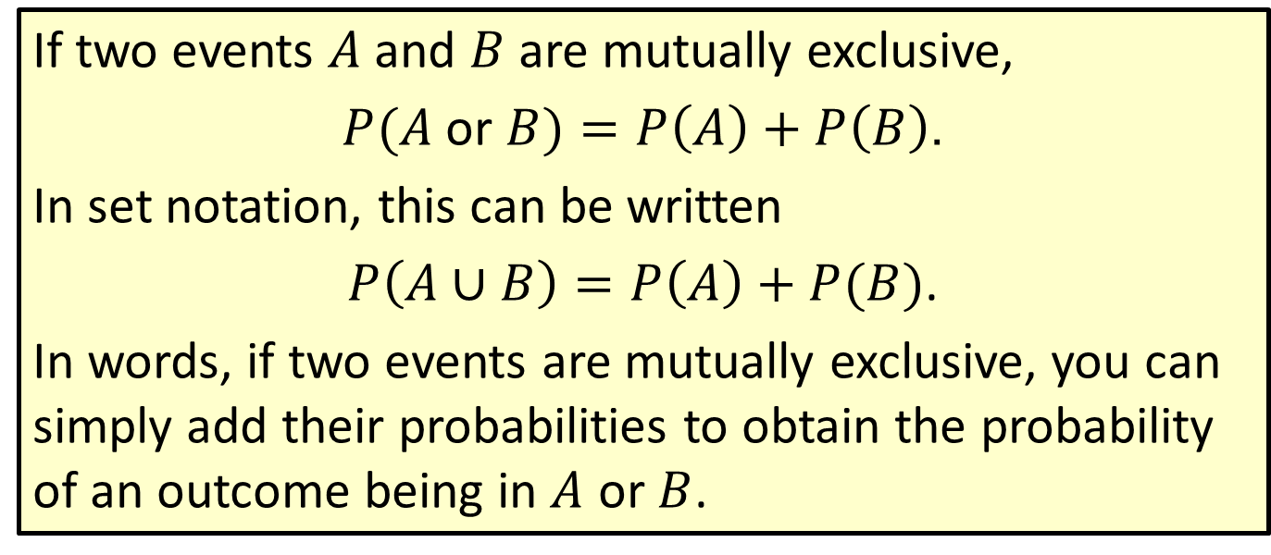
Formula: Addition Rule for Probability of
Mutually Exclusive Events
If two events $A$and $B$ are mutually exclusive,
$P(A$ or $B)=P\left(A\right)+P\left(B\right)$.
In set notation, this can be written
$P\left(A∪B\right)=P\left(A\right)+P(B)$.
In words, if two events are mutually exclusive, you can simply add their probabilities to obtain the probability of an outcome being in $A$ or $B$.

Slide 10

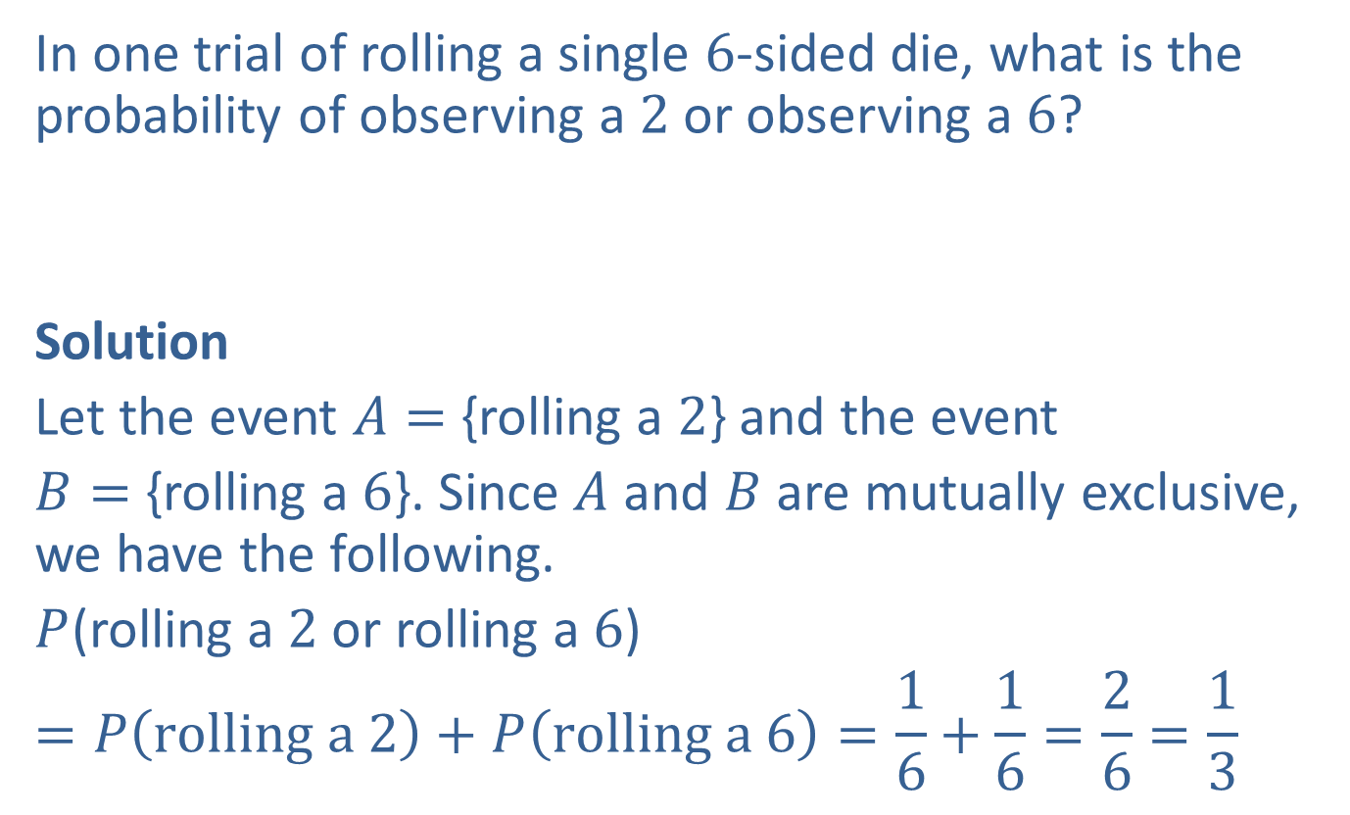
Example 6: Finding the Probability of Mutually Exclusive Events
In one trial of rolling a single $6$-sided die, what is the probability of observing a $2$ or observing a $6$?
Solution
Let the event $A=$ {rolling a $2$} and the event
$B=$ {rolling a $6$}. Since $A$ and $B$ are mutually exclusive, we have the following.
$P$(rolling a $2$ or rolling a $6$)
$$=P\left(rolling a 2\right)+P\left(rolling a 6\right)=\frac{1}{6}+\frac{1}{6}=\frac{2}{6}=\frac{1}{3}$$

Slide 11
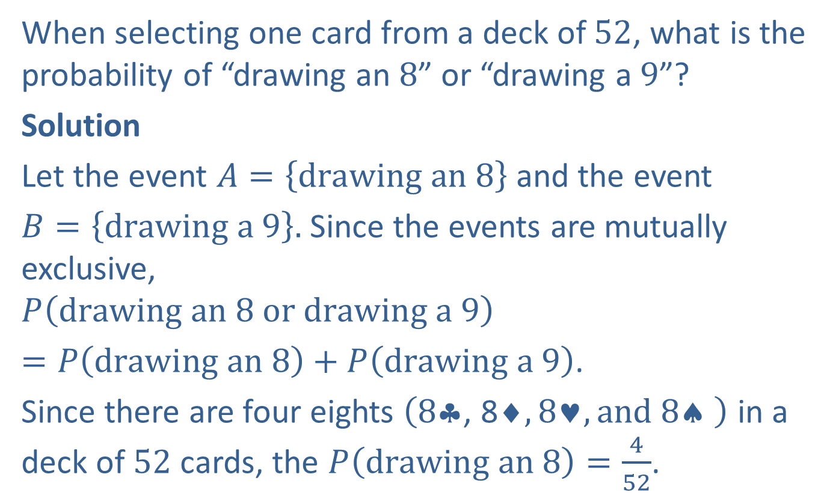
Example 7: Finding the Probability of Mutually Exclusive Events
When selecting one card from a deck of $52$, what is the probability of “drawing an $8$” or “drawing a $9$”?
Solution
Let the event $A=\left\{drawing an 8\right\}$ and the event
$B=\left\{drawing a 9\right\}.$ Since the events are mutually exclusive,
$$P\left(drawing an 8 or drawing a 9\right)$$
$=P\left(drawing an 8\right)+P\left(drawing a 9\right)$.
Since there are four eights $\left(8\text{▪}\text{, }\text{8}◻,8♥, and 8♠ \right)$ in a deck of $52$ cards, the $P\left(drawing an 8\right)=\frac{4}{52}$.

Slide 12

Example 7: Finding the Probability of Mutually Exclusive Events (cont.)
Since there are four nines $\left(9\text{▪}\text{, }\text{9}◻,9♥, and 9♠ \right)$ in a deck of $52$ cards, the $P\left(drawing a 9\right)=\frac{4}{52}.$
Thus $P\left(drawing an 8 or drawing a 9\right)$
$$=\frac{4}{52}+\frac{4}{52}=\frac{8}{52}=\frac{2}{13}.$$

Slide 13
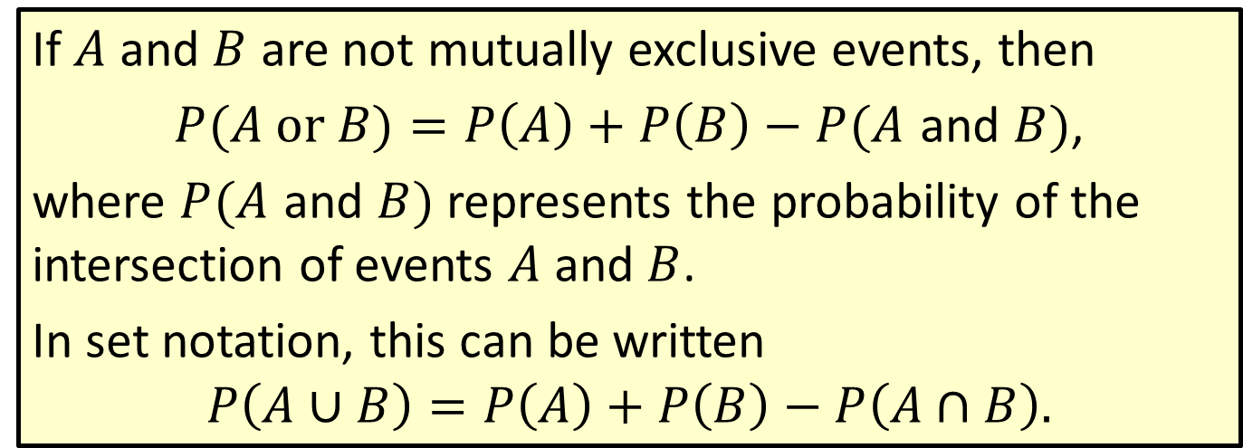
Formula: Addition Rule for Probability of
Non-mutually Exclusive Events
If $A$ and $B$ are not mutually exclusive events, then
$P(A or$ $B)=P\left(A\right)+P\left(B\right)−P(A$ and $B)$,
where $P(A$ and $B)$ represents the probability of the intersection of events $A$ and $B$.
In set notation, this can be written
$$P\left(A∪B\right)=P\left(A\right)+P\left(B\right)−P\left(A∩B\right).$$

Slide 14
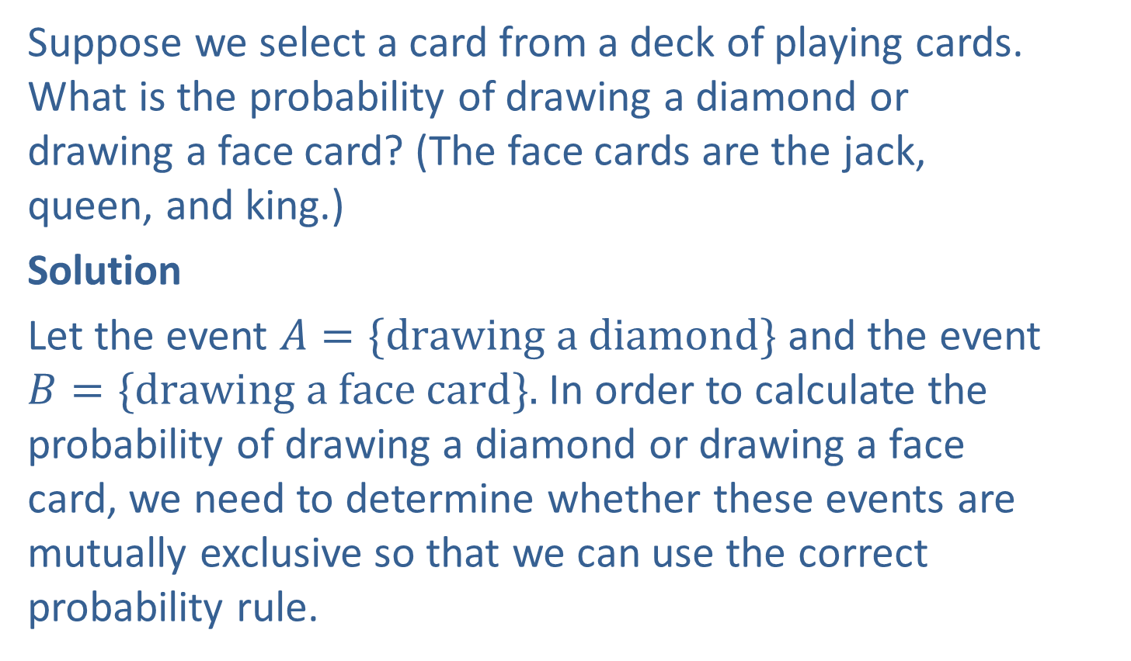
Example 8: Finding the Probability of Non-mutually Exclusive Events
Suppose we select a card from a deck of playing cards. What is the probability of drawing a diamond or drawing a face card? (The face cards are the jack, queen, and king.)
Solution
Let the event $A=\{drawing a diamond\}$and the event $B=\{drawing a face card\}.$In order to calculate the probability of drawing a diamond or drawing a face card, we need to determine whether these events are mutually exclusive so that we can use the correct probability rule.

Slide 15
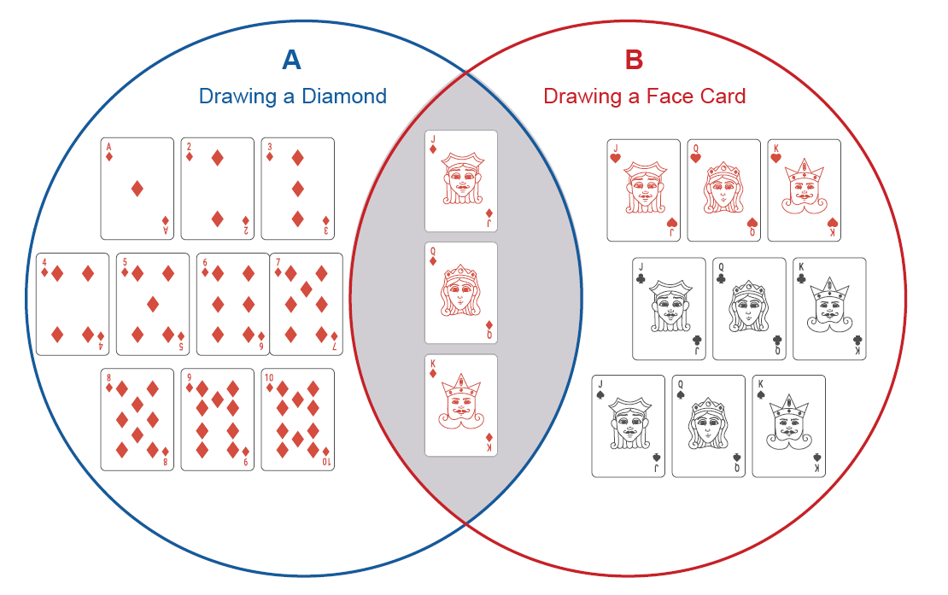

Example 8: Finding the Probability of Non-mutually Exclusive Events (cont.)
Can we draw a card that is both a diamond and a face card? Since the $J♦$, $Q♦$, and $K♦$ belong to both events, the events are not mutually exclusive.

Slide 16
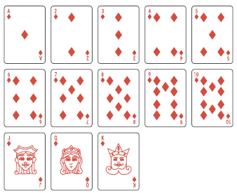

Example 8: Finding the Probability of Non-mutually Exclusive Events (cont.)
Because the events are not mutually exclusive, we need to use the addition rule for non-mutually exclusive events, $P\left(A or B\right)=P\left(A\right)+P\left(B\right)−P\left(A and B\right).$
$P\left(A\right)=P\left(drawing a diamond\right)=\frac{13}{52},$ since there are $13$ diamonds in a deck of $52$ cards.

Slide 17
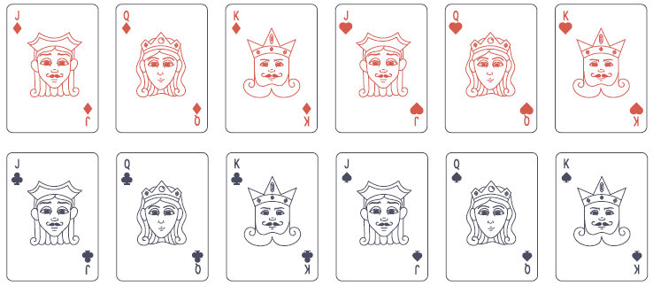

Example 8: Finding the Probability of Non-mutually Exclusive Events (cont.)
$P\left(A\right)=P\left(drawing a face card\right)=\frac{12}{52}$, since there are $4$ jacks, $4$ queens, and $4$ kings in a deck of $52$ cards.

Slide 18
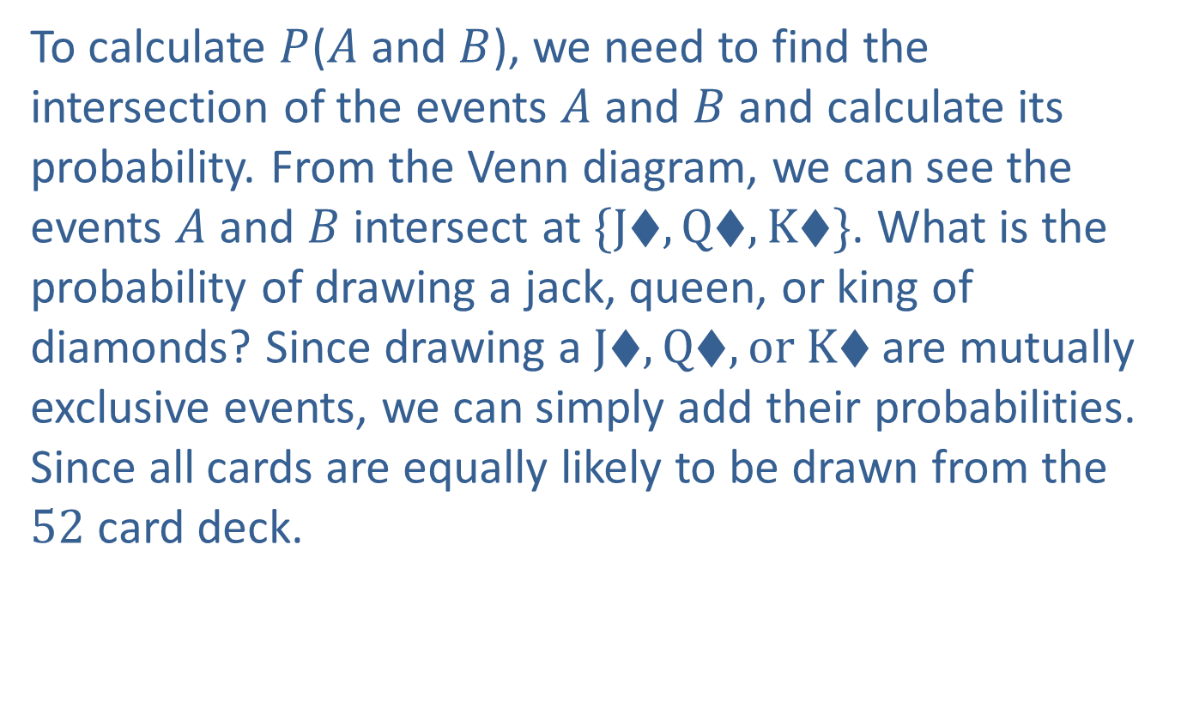
Example 8: Finding the Probability of Non-mutually Exclusive Events (cont.)
To calculate $P$($A$ and $B$), we need to find the intersection of the events $A$ and $B$ and calculate its probability. From the Venn diagram, we can see the events $A$ and $B$ intersect at $\{J♦, Q♦, K♦\}$. What is the probability of drawing a jack, queen, or king of diamonds? Since drawing a $J♦, Q♦, or K♦$are mutually exclusive events, we can simply add their probabilities. Since all cards are equally likely to be drawn from the $52$ card deck.

Slide 19
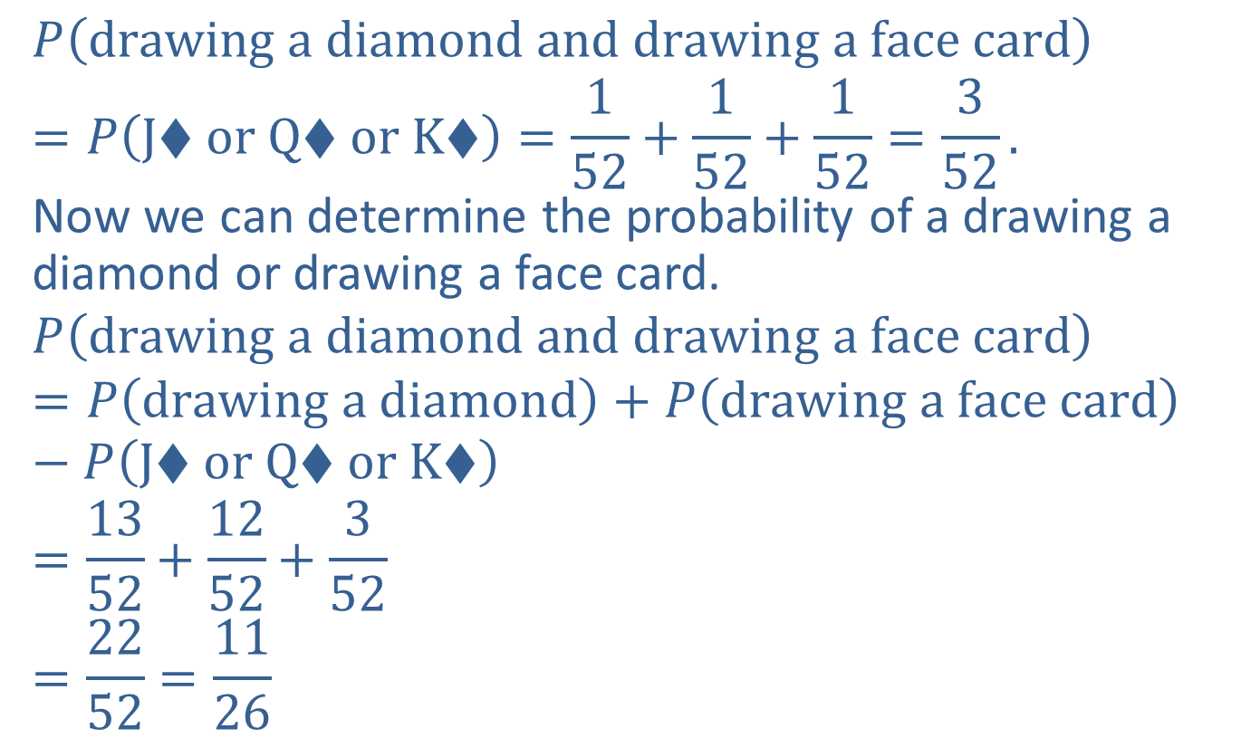
Example 8: Finding the Probability of Non-mutually Exclusive Events (cont.)
$$P\left(drawing a diamond and drawing a face card\right)$$
$$=P\left(J♦ or Q♦ or K♦\right)=\frac{1}{52}+\frac{1}{52}+\frac{1}{52}=\frac{3}{52}.$$
Now we can determine the probability of a drawing a diamond or drawing a face card.
$$P\left(drawing a diamond and drawing a face card\right)$$
$$=P\left(drawing a diamond\right)+P\left(drawing a face card\right)−P\left(J♦ or Q♦ or K♦\right)$$
$$=\frac{13}{52}+\frac{12}{52}+\frac{3}{52}$$
$$=\frac{22}{52}=\frac{11}{26}$$

Slide 20
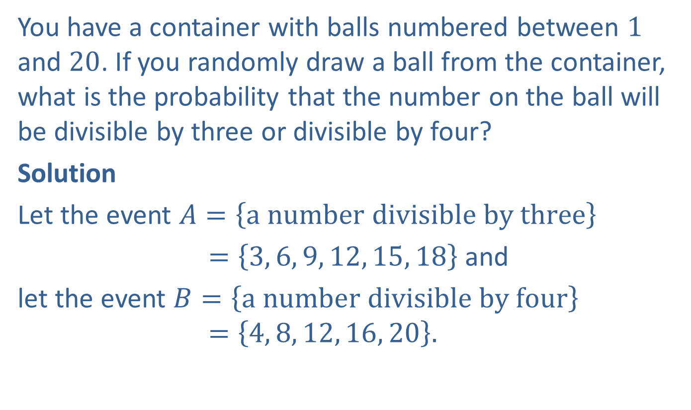
Example 9: Finding the Probability of Non-mutually Exclusive Events
You have a container with balls numbered between $1$ and $20$. If you randomly draw a ball from the container, what is the probability that the number on the ball will be divisible by three or divisible by four?
Solution
Let the event $A=\left\{a number divisible by three\right\}$
$=\left\{3, 6, 9, 12, 15, 18\right\}$ and
let the event $B=\left\{a number divisible by four\right\}$
$$=\left\{4, 8, 12, 16, 20\right\}.$$

Slide 21
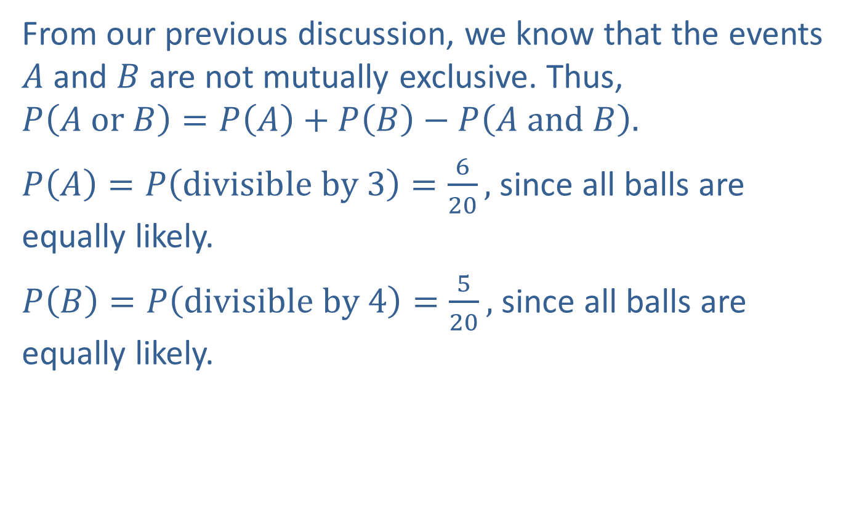
Example 9: Finding the Probability of Non-mutually Exclusive Events (cont.)
From our previous discussion, we know that the events $A$ and $B$ are not mutually exclusive. Thus,
$$P\left(A or B\right)=P\left(A\right)+P\left(B\right)−P\left(A and B\right).$$
$P\left(A\right)=P\left(divisible by 3\right)=\frac{6}{20},$ since all balls are equally likely.
$P\left(B\right)=P\left(divisible by 4\right)=\frac{5}{20},$ since all balls are equally likely.

Slide 22
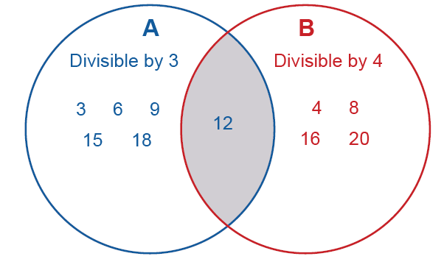

Example 9: Finding the Probability of Non-mutually Exclusive Events (cont.)
To calculate $P(A and B)$, we need to determine the intersection of the two events.
The only point of intersection of the two events is $\{12\}$. Since all balls are equally likely,

Slide 23
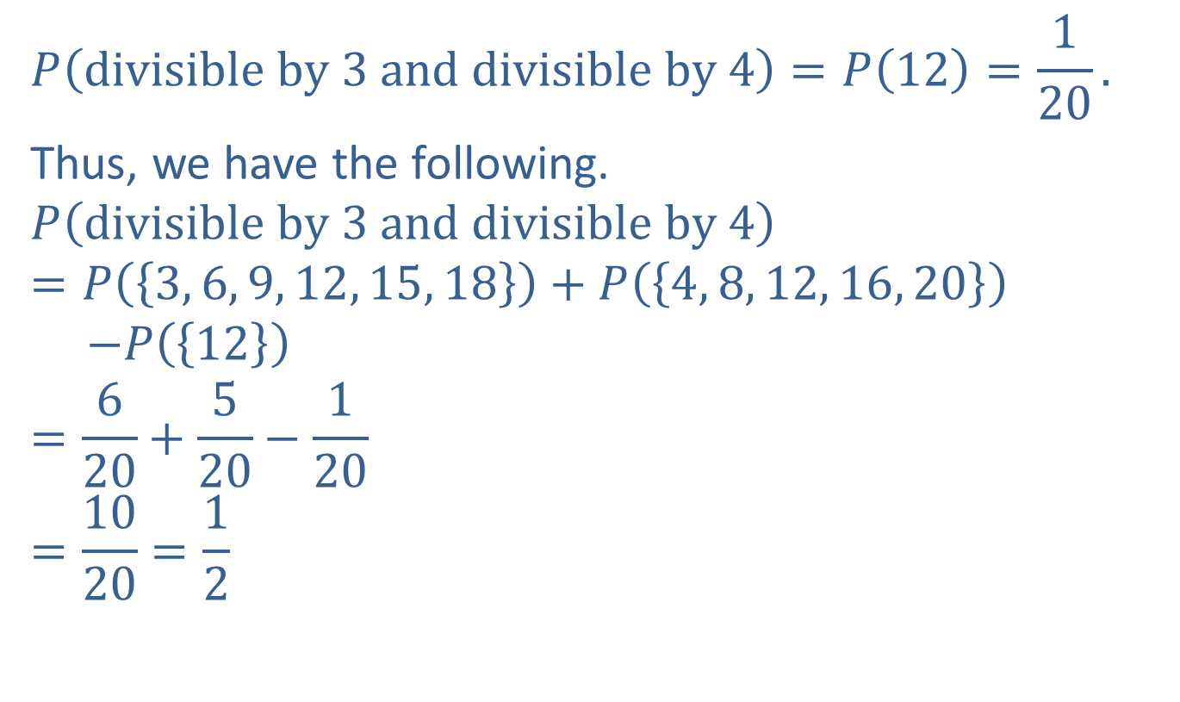
Example 9: Finding the Probability of Non-mutually Exclusive Events (cont.)
$$P\left(divisible by 3 and divisible by 4\right)=P\left(12\right)=\frac{1}{20}.$$
Thus, we have the following.
$$P\left(divisible by 3 and divisible by 4\right)$$
$$=P\left(\left\{3, 6, 9, 12, 15, 18\right\}\right)+P\left(\left\{4, 8, 12, 16, 20\right\}\right)$$
$$−P\left(\left\{12\right\}\right)$$
$$=\frac{6}{20}+\frac{5}{20}−\frac{1}{20}$$
$$=\frac{10}{20}=\frac{1}{2}$$

Slide 24
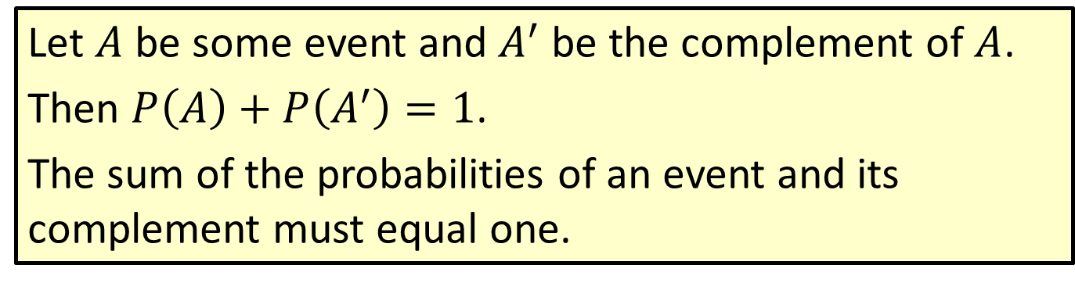
Formula: Probability Law for Complementary Events
Let $A$ be some event and $A^{′}$ be the complement of $A$.
Then $P\left(A\right)+P\left(A^{′}\right)=1$.
The sum of the probabilities of an event and its complement must equal one.

Slide 25
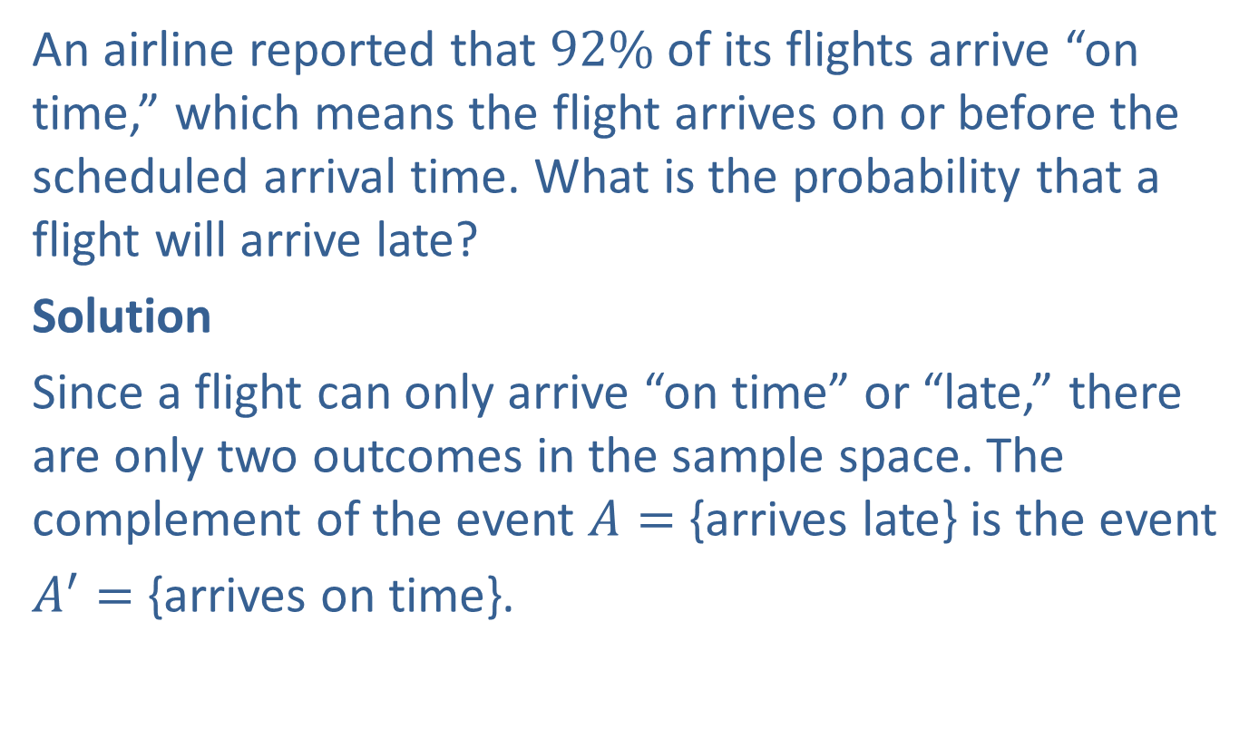
Example 10: Finding Probability Using Complementary Events
An airline reported that $92\%$of its flights arrive “on time,” which means the flight arrives on or before the scheduled arrival time. What is the probability that a flight will arrive late?
Solution
Since a flight can only arrive “on time” or “late,” there are only two outcomes in the sample space. The complement of the event $A=$ {arrives late} is the event
$A^{′}=$ {arrives on time}.

Slide 26

Example 10: Finding Probability Using Complementary Events (cont.)
Using the probability law for complementary events, we have the following.
$$P\left(A\right)=1−P\left(A′\right)=1−0.92=0.08$$

Slide 27
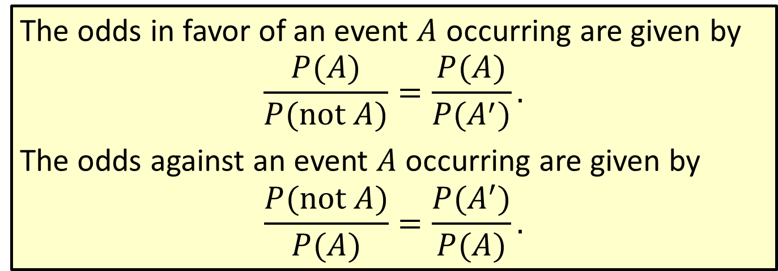
Formula: Odds
The odds in favor of an event $A$ occurring are given by
$$\frac{P(A)}{P(not A)}=\frac{P(A)}{P(A^{′})}.$$
The odds against an event $A$ occurring are given by
$$\frac{P(not A)}{P(A)}=\frac{P(A^{′})}{P(A)}.$$

Slide 28
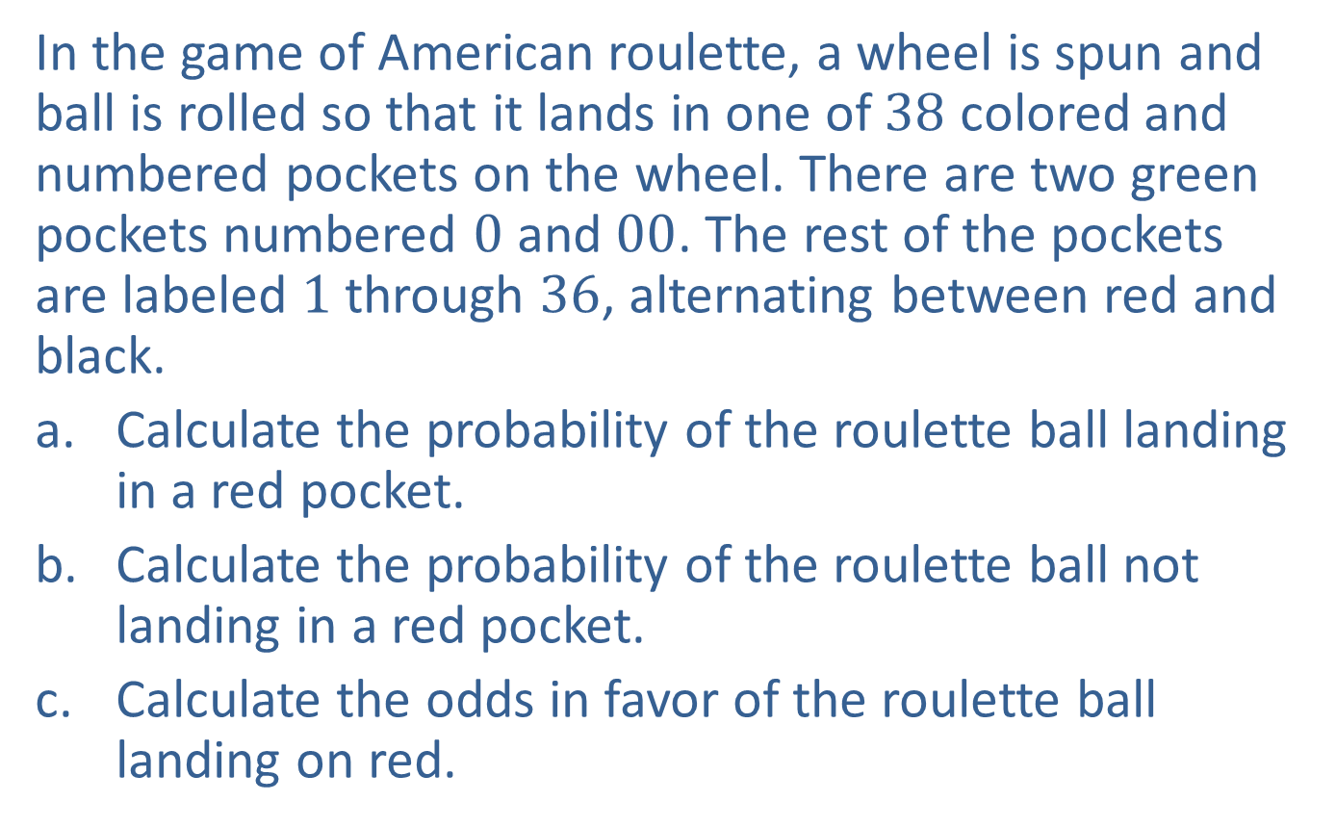
Example 11: Calculating Odds
In the game of American roulette, a wheel is spun and ball is rolled so that it lands in one of $38$ colored and numbered pockets on the wheel. There are two green pockets numbered $0$ and $00$. The rest of the pockets are labeled $1$ through $36$, alternating between red and black.
​Calculate the probability of the roulette ball landing in a red pocket.
​Calculate the probability of the roulette ball not landing in a red pocket.
​Calculate the odds in favor of the roulette ball landing on red.

Slide 29
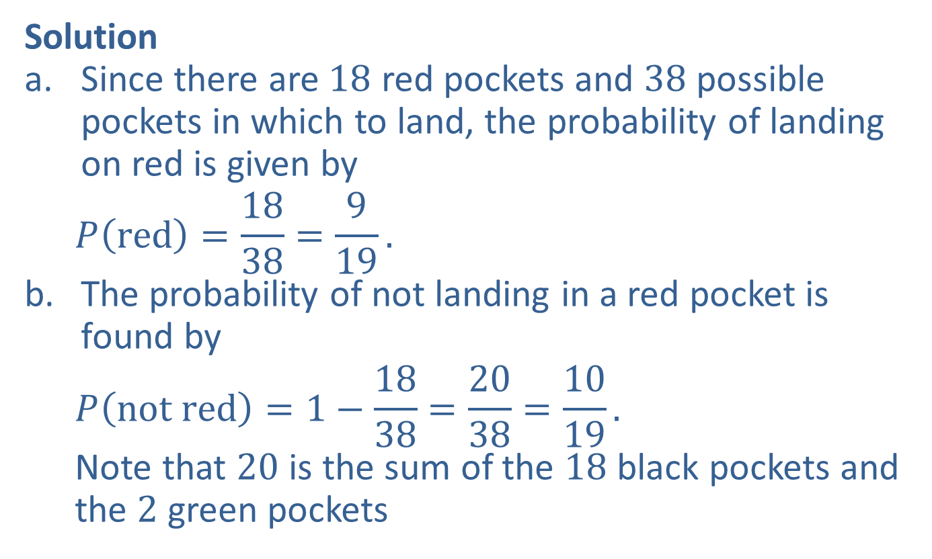
Example 11: Calculating Odds (cont.)
Solution
​Since there are $18$ red pockets and $38$ possible pockets in which to land, the probability of landing on red is given by
  $$P\left(red\right)=\frac{18}{38}=\frac{9}{19}.$$
The probability of not landing in a red pocket is found by
  $$P\left(not red\right)=1−\frac{18}{38}=\frac{20}{38}=\frac{10}{19}.$$
  Note that $20$ is the sum of the $18$ black pockets and the $2$ green pockets

Slide 30

Example 11: Calculating Odds (cont.)
The odds in favor of the roulette ball landing on red can therefore be found as follows.
  $$\frac{P(red)}{P(not red)}=\frac{9}{19}÷\frac{10}{19}=\frac{9}{19}∙\frac{19}{10} or 9:10$$

Slide 31
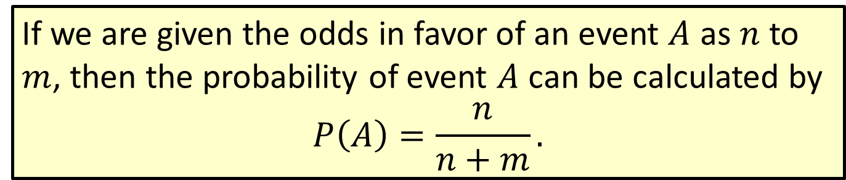
Formula: Finding Probability Given the Odds
If we are given the odds in favor of an event $A$ as $n$ to $m$, then the probability of event $A$ can be calculated by
$$P\left(A\right)=\frac{n}{n+m}.$$

Slide 32
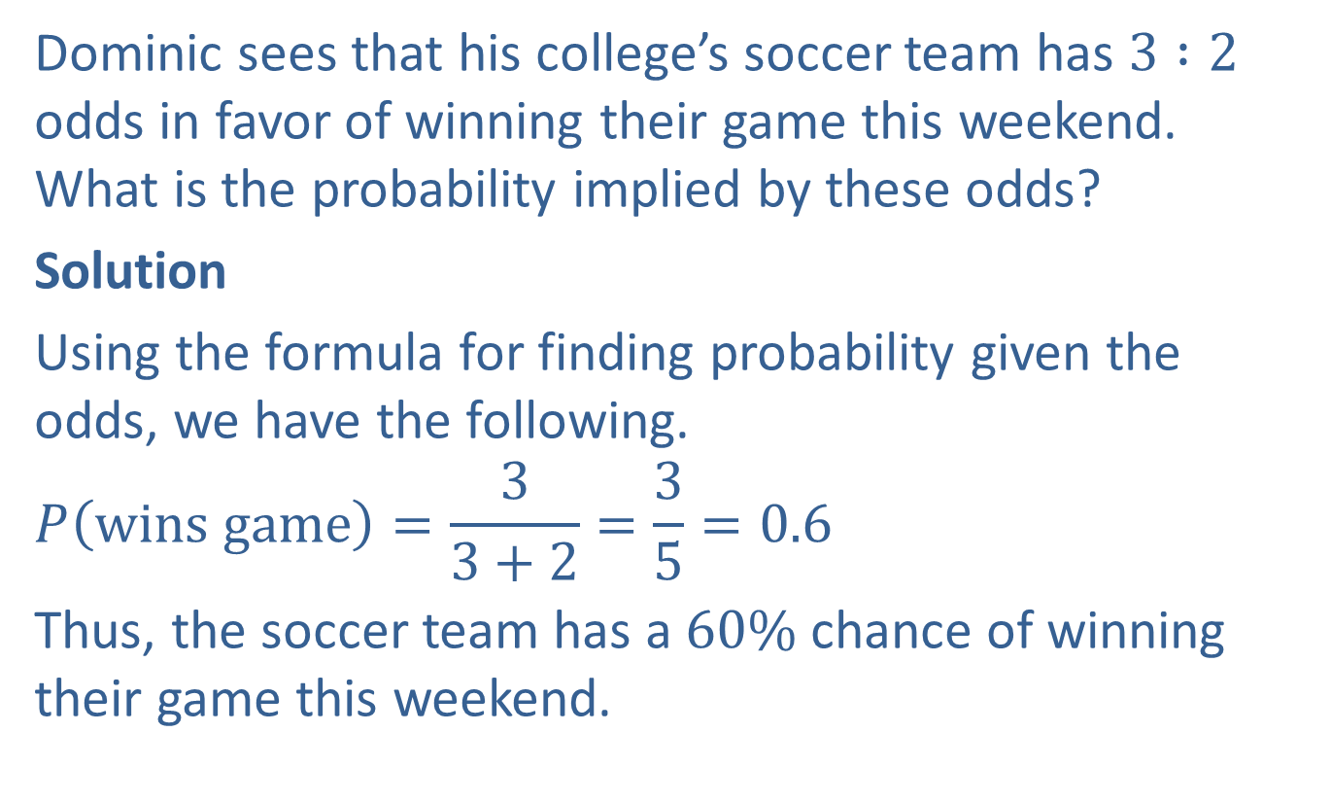
Example 12: Calculating Probability Given the Odds
Dominic sees that his college’s soccer team has $3 :2$ odds in favor of winning their game this weekend. What is the probability implied by these odds?
Solution
Using the formula for finding probability given the odds, we have the following.
$$P\left(wins game\right)=\frac{3}{3+2}=\frac{3}{5}=0.6$$
Thus, the soccer team has a $60\%$ chance of winning their game this weekend.

