Slide 1
Section 9.3
The Multiplication Rules of Probability and Conditional Probability

Slide 2
Definition: Conditional Probability
The probability that an event will occur given that some other event has already occurred or is certain to occur, is a conditional probability.

Slide 3
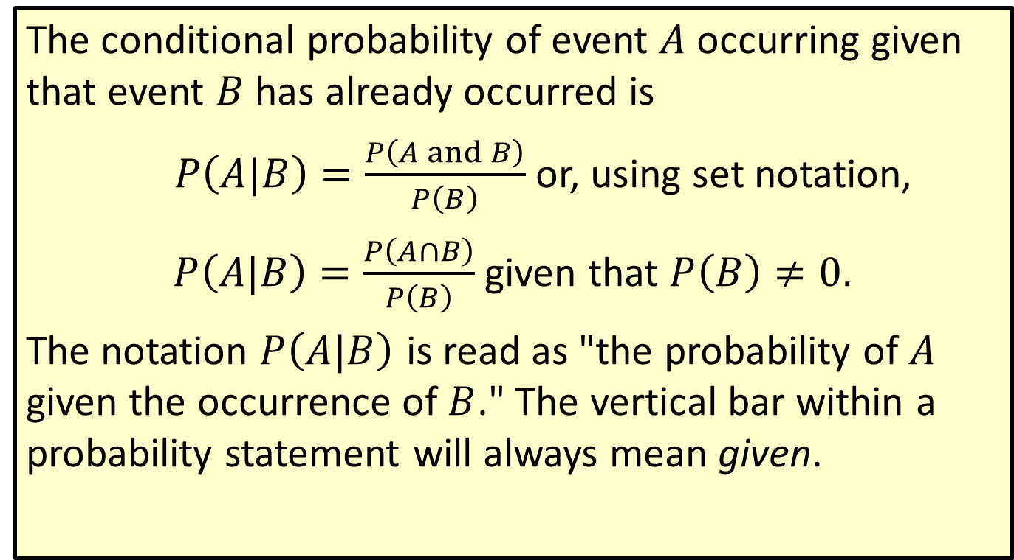
Formula: Rule for Conditional Probability
The conditional probability of event $A$ occurring given that event $B$ has already occurred is
$P\left(A|B\right)=\frac{P\left(A and B\right)}{P\left(B\right)}$ or, using set notation,
$P\left(A|B\right)=\frac{P\left(A∩B\right)}{P\left(B\right)}$ given that $P\left(B\right)≠0$.
The notation $P⁡\left(A|B\right)$ is read as "the probability of $A$ given the occurrence of $B$." The vertical bar within a probability statement will always mean given.

Slide 4
Example 1: Calculating Conditional Probability
Suppose a marketing research firm has surveyed a panel of consumers to test a new product and produced the following table indicating the number of panelists that liked the product, the number that did not like the product, and the number that were undecided.
Market Research Survey
Age | Like | Not Like | Undecided | Total
18-34 | 213 | 197 | 103 | 513
35-50 | 193 | 184 | 67 | 444
Over 50 | 144 | 219 | 83 | 446
Total | 550 | 600 | 253 | 1403

Slide 5
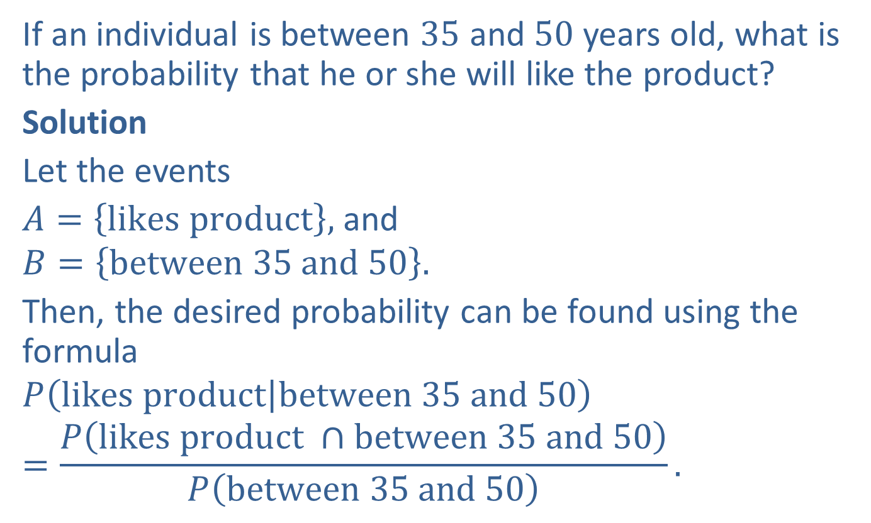
Example 1: Calculating Conditional Probability (cont.)
If an individual is between $35$ and $50$ years old, what is the probability that he or she will like the product?
Solution
Let the events
$A=\left\{likes product\right\},$ and
$$B=\left\{between 35 and 50\right\}.$$
Then, the desired probability can be found using the formula
$$P\left(likes product | between 35 and 50\right)$$
$$=\frac{P\left(likes product ∩between 35 and 50\right)}{P\left(between 35 and 50\right)}.$$

Slide 6
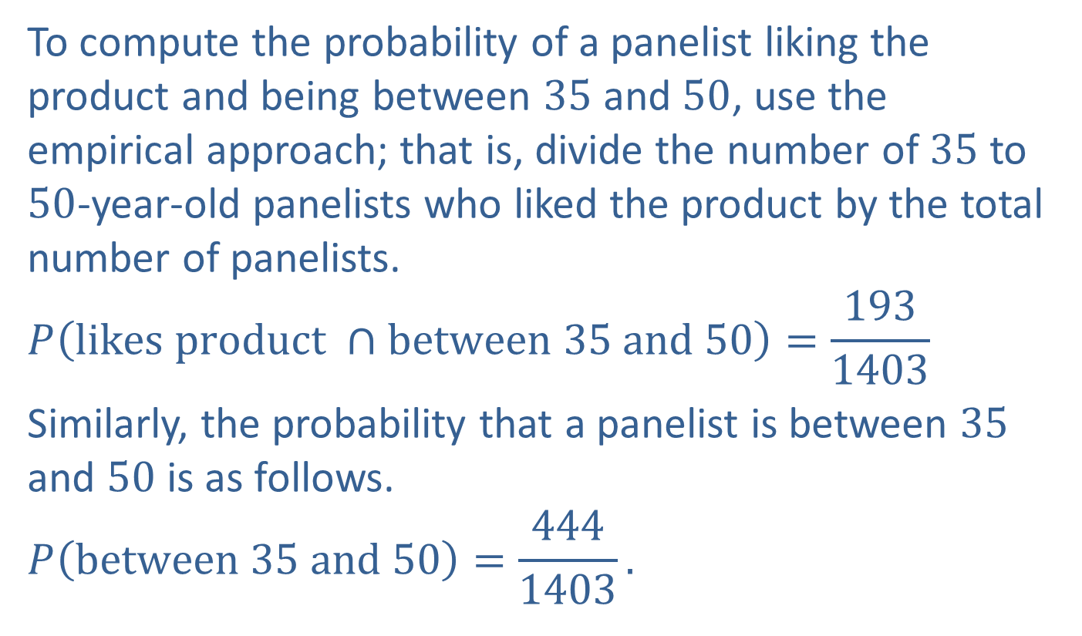
Example 1: Calculating Conditional Probability (cont.)
To compute the probability of a panelist liking the product and being between $35$ and $50$, use the empirical approach; that is, divide the number of $35$ to $50$-year-old panelists who liked the product by the total number of panelists.
$$P\left(likes product ∩between 35 and 50\right)=\frac{193}{1403}$$
Similarly, the probability that a panelist is between $35$ and $50$ is as follows.
$$P\left(between 35 and 50\right)=\frac{444}{1403}.$$

Slide 7
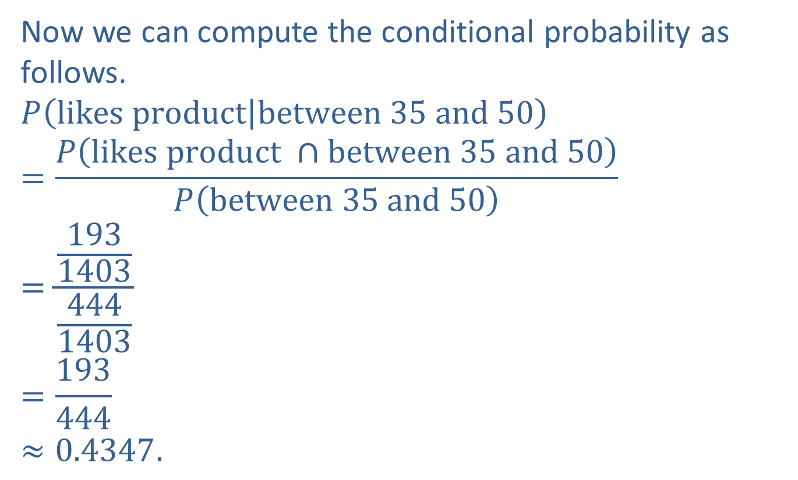
Example 1: Calculating Conditional Probability (cont.)
Now we can compute the conditional probability as follows.
$$P\left(likes product | between 35 and 50\right)$$
$$=\frac{P\left(likes product ∩between 35 and 50\right)}{P\left(between 35 and 50\right)}$$
$$=\frac{\frac{193}{1403}}{\frac{444}{1403}}$$
$$=\frac{193}{444}$$
$$≈0.4347.$$

Slide 8
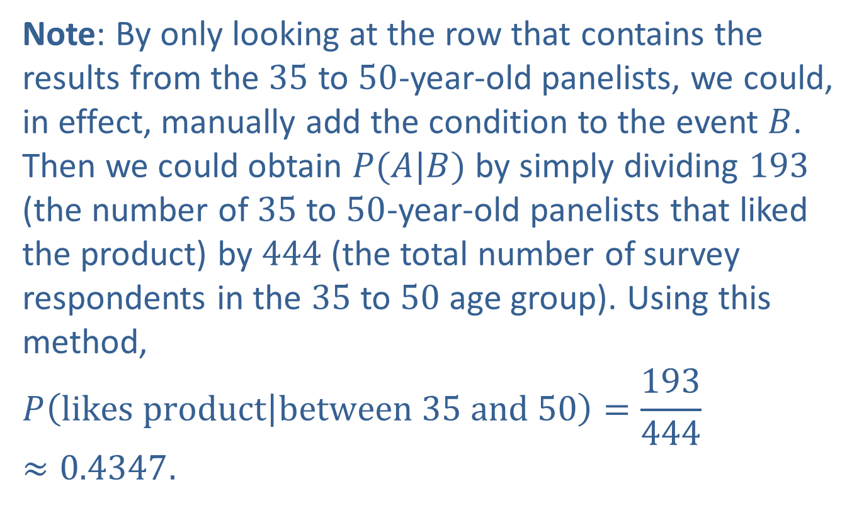
Example 1: Calculating Conditional Probability (cont.)
Note: By only looking at the row that contains the results from the $35$ to $50$-year-old panelists, we could, in effect, manually add the condition to the event $B$. Then we could obtain $P(A|B)$ by simply dividing $193$ (the number of $35$ to $50$-year-old panelists that liked the product) by $444$ (the total number of survey respondents in the $35$ to $50$ age group). Using this method,
$$P\left(likes product | between 35 and 50\right)=\frac{193}{444}≈0.4347.$$

Slide 9
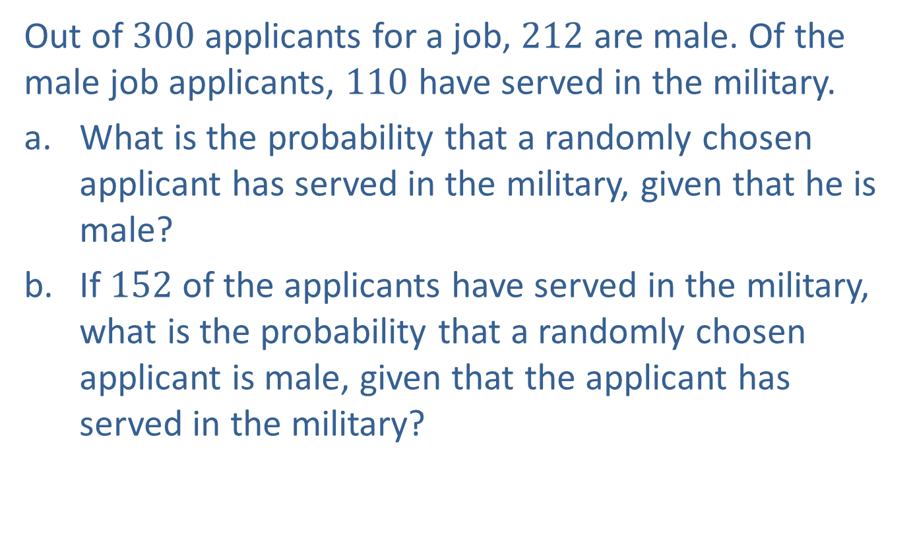
Example 2: Calculating Conditional Probability
Out of $300$ applicants for a job, $212$ are male. Of the male job applicants, $110$ have served in the military.
​What is the probability that a randomly chosen applicant has served in the military, given that he is male?
​If $152$ of the applicants have served in the military, what is the probability that a randomly chosen applicant is male, given that the applicant has served in the military?

Slide 10
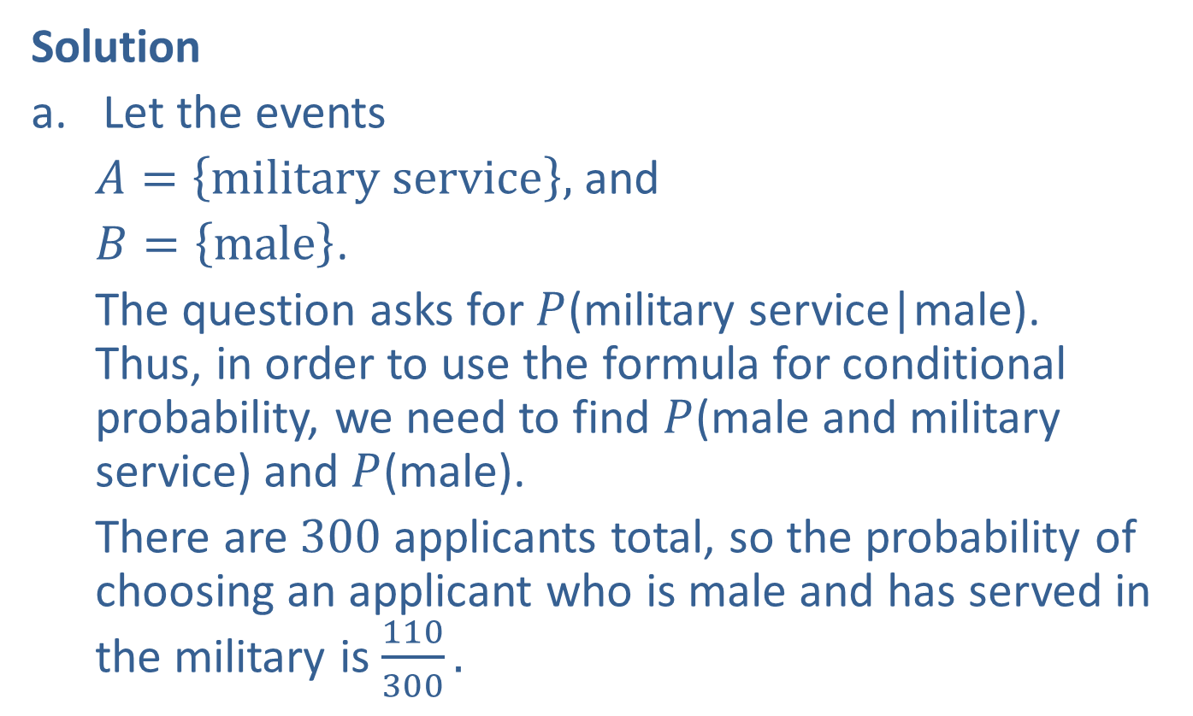
Example 2: Calculating Conditional Probability (cont.)
Solution
Let the events
$A=\left\{military service\right\},$ and
$B=\left\{male\right\}$.
The question asks for $P$(military service|male). Thus, in order to use the formula for conditional probability, we need to find $P$(male and military service) and $P$(male).
There are $300$applicants total, so the probability of choosing an applicant who is male and has served in the military is $\frac{110}{300}.$

Slide 11
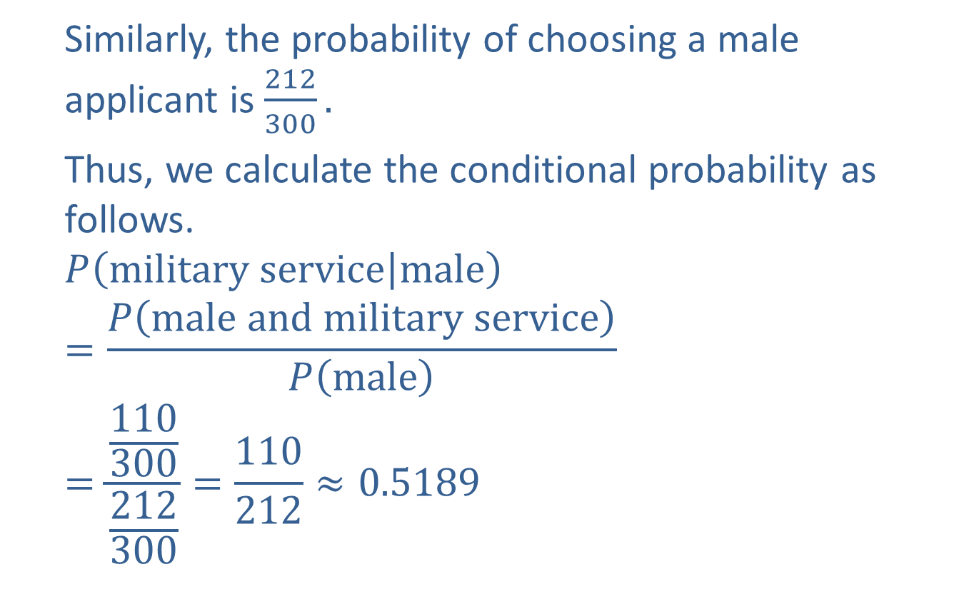
Example 2: Calculating Conditional Probability (cont.)
Similarly, the probability of choosing a male applicant is $\frac{212}{300}.$
Thus, we calculate the conditional probability as follows.
$$P\left(military service | male\right)$$
$$=\frac{P\left(male and military service\right)}{P\left(male\right)}$$
$$=\frac{\frac{110}{300}}{\frac{212}{300}}=\frac{110}{212}≈0.5189$$

Slide 12
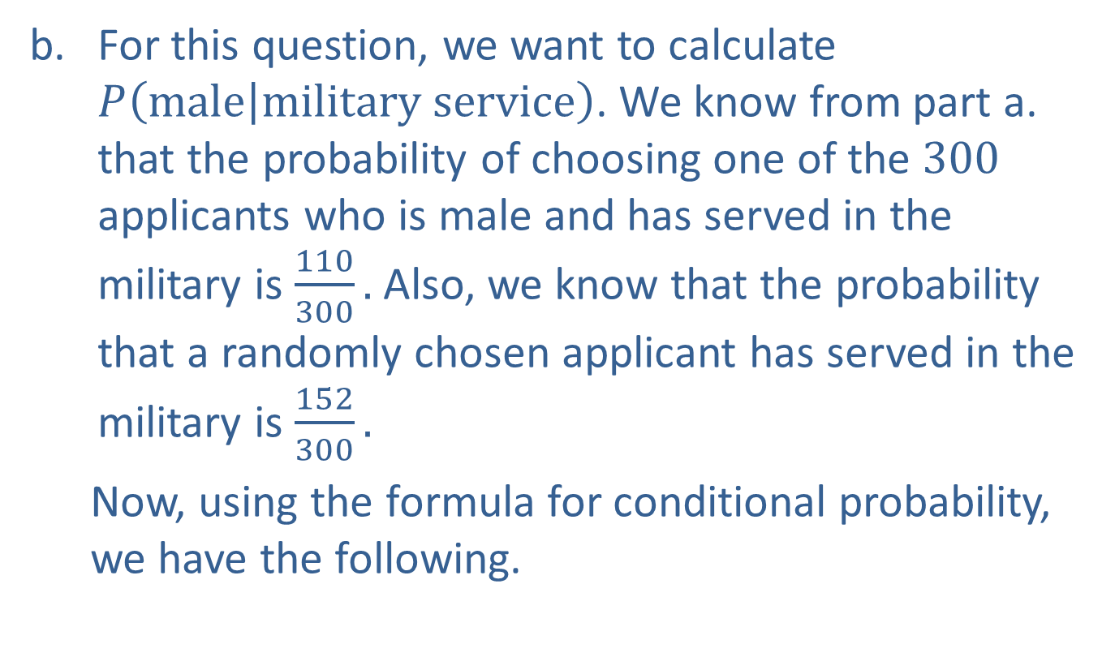
Example 2: Calculating Conditional Probability (cont.)
For this question, we want to calculate $P\left(male | military service\right)$. We know from part a. that the probability of choosing one of the $300$ applicants who is male and has served in the military is $\frac{110}{300}.$ Also, we know that the probability that a randomly chosen applicant has served in the military is $\frac{152}{300}.$
Now, using the formula for conditional probability, we have the following.

Slide 13
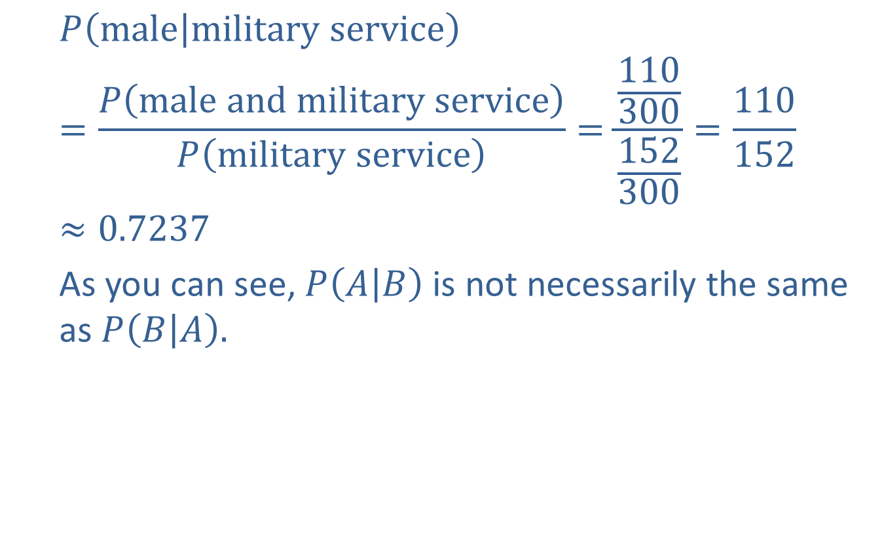
Example 2: Calculating Conditional Probability (cont.)
$$P\left(male | military service\right)$$
$$=\frac{P\left(male and military service\right)}{P\left(military service\right)}=\frac{\frac{110}{300}}{\frac{152}{300}}=\frac{110}{152}≈0.7237$$
As you can see, $P\left(A | B\right)$ is not necessarily the same as $P\left(B | A\right).$

Slide 14
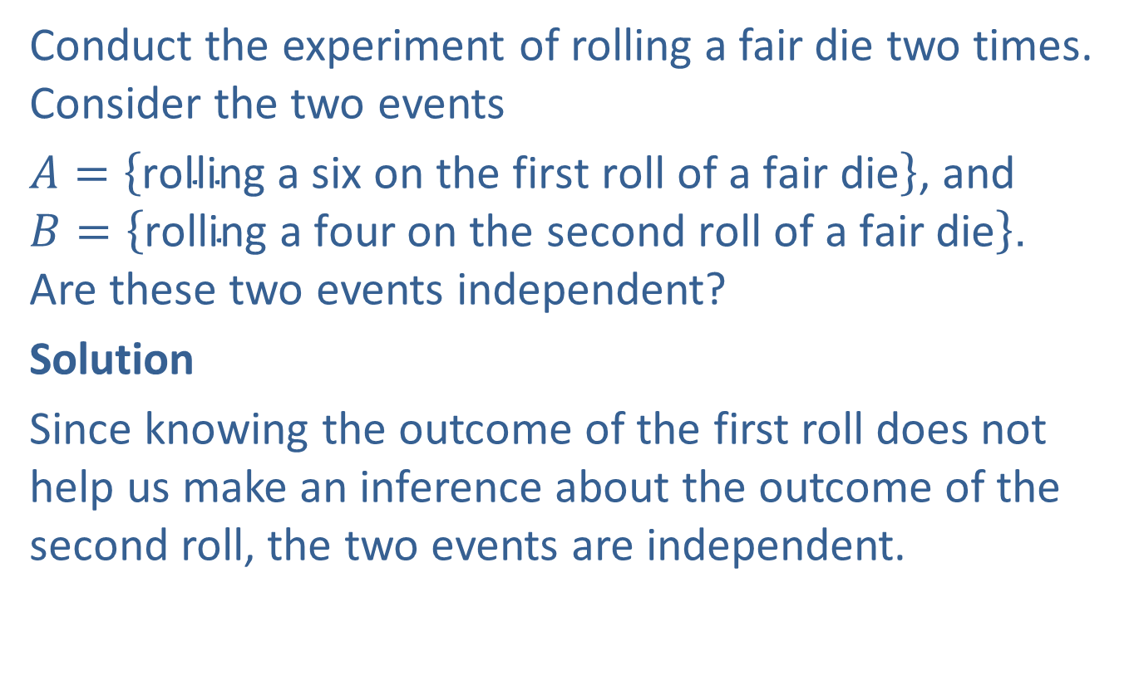
Example 3: Determining the Independence of Events
Conduct the experiment of rolling a fair die two times. Consider the two events
$A=\left\{\text{rolling} \text{a} \text{six} \text{on} \text{the} \text{first} \text{roll} \text{of} \text{a} \text{fair} \text{die}\right\}$, and $B=\left\{\text{rolling} \text{a} \text{four} \text{on} \text{the} \text{second} \text{roll} \text{of} \text{a} \text{fair} \text{die}\right\}$. Are these two events independent?
Solution
Since knowing the outcome of the first roll does not help us make an inference about the outcome of the second roll, the two events are independent.

Slide 15
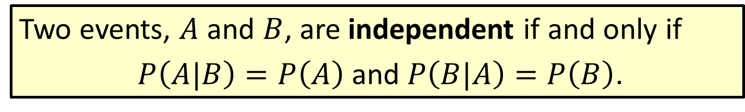
Definition: Independent Events
Two events, $A$ and $B$, are independent if and only if
$P\left(A|B\right)=P\left(A\right)$ and $P\left(B|A\right)=P\left(B\right)$.

Slide 16
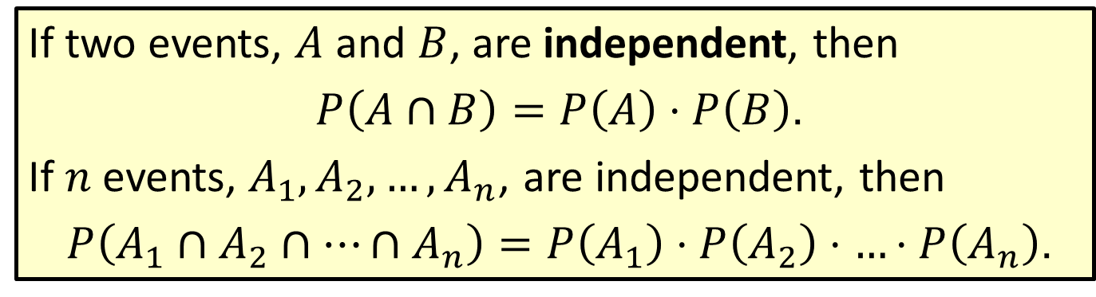
Definition: Multiplication Rule for Independent Events
If two events, $A$ and $B$, are independent, then
$P\left(A∩B\right)=P\left(A\right)⋅P\left(B\right)$.
If $n$events, $A_{1},A_{2},…,A_{n}$, are independent, then
$P\left(A_{1}∩A_{2}∩…∩A_{n}\right)=P\left(A_{1}\right)⋅P\left(A_{2}\right)⋅…⋅P\left(A_{n}\right)$.

Slide 17
Example 4: Using the Multiplication Rule for Independent Events
A coin is flipped and a fair die is rolled. Find the probability of getting a head on the coin and an even number on the die.
​Use a tree diagram to find the probability.
​Use the multiplication rule for independent events to find the probability.
Solution
The tree diagram for flipping a coin and rolling a fair die is shown.

Slide 18
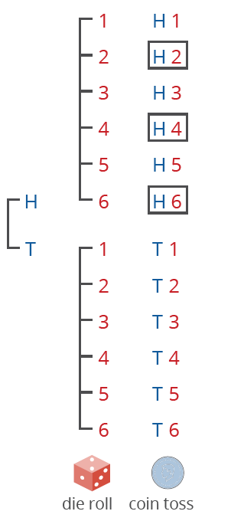
Example 4: Using the Multiplication Rule for Independent Events (cont.)

Slide 19
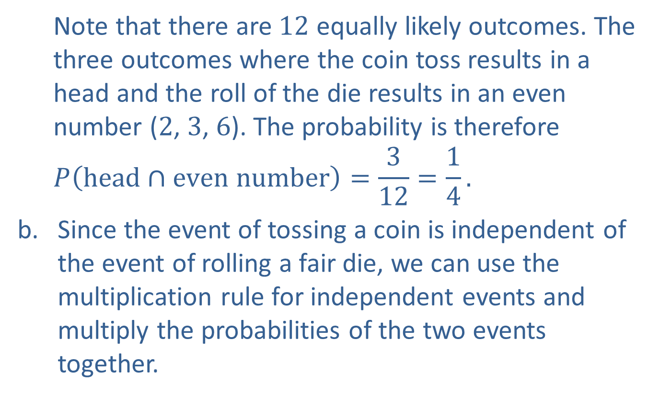
Example 4: Using the Multiplication Rule for Independent Events (cont.)
Note that there are $12$ equally likely outcomes. The three outcomes where the coin toss results in a head and the roll of the die results in an even number ($2$, $3$, $6$). The probability is therefore
$$P\left(head∩even number\right)=\frac{3}{12}=\frac{1}{4}.$$
Since the event of tossing a coin is independent of the event of rolling a fair die, we can use the multiplication rule for independent events and multiply the probabilities of the two events together.

Slide 20

Example 4: Using the Multiplication Rule for Independent Events (cont.)
$$P\left(head∩even number\right)$$
$$=P\left(head\right)∙P\left(even number\right)$$
$$=\frac{1}{2}∙\frac{3}{6}=\frac{3}{12}=\frac{1}{4}.$$

Slide 21
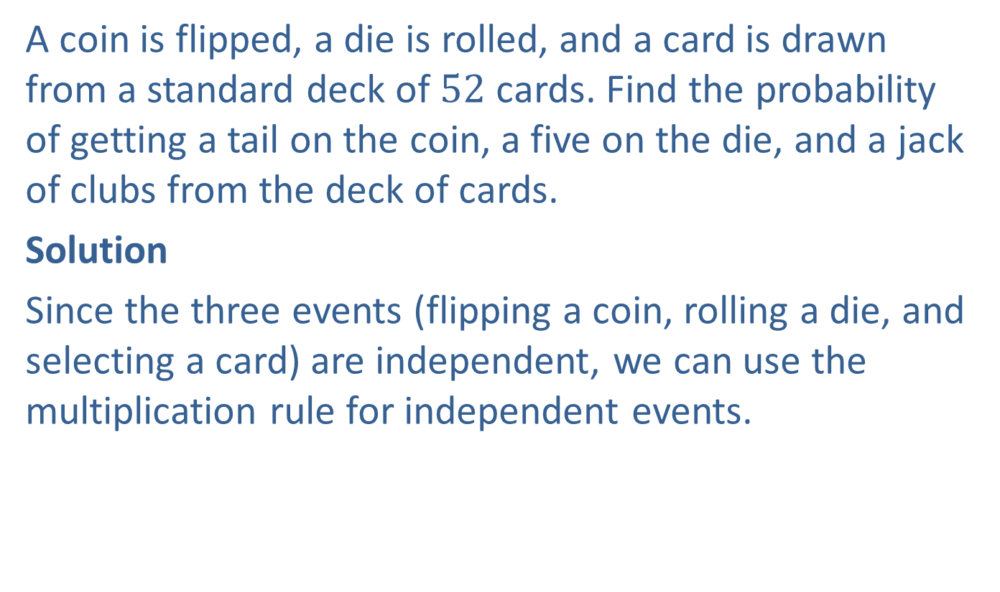
Example 5: Using the Multiplication Rule for Independent Events
A coin is flipped, a die is rolled, and a card is drawn from a standard deck of $52$ cards. Find the probability of getting a tail on the coin, a five on the die, and a jack of clubs from the deck of cards.
Solution
Since the three events (flipping a coin, rolling a die, and selecting a card) are independent, we can use the multiplication rule for independent events.

Slide 22
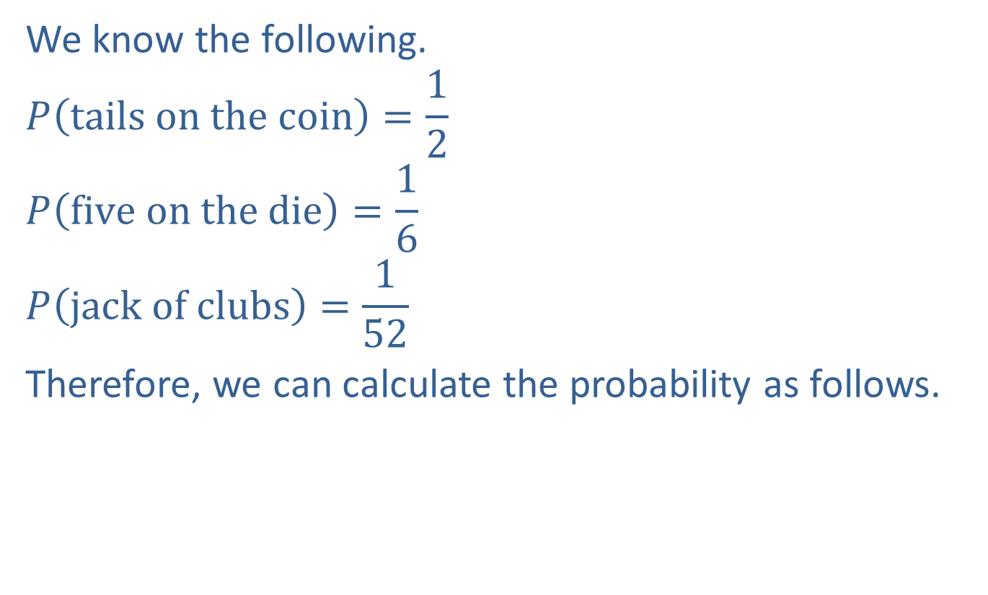
Example 5: Using the Multiplication Rule for Independent Events (cont.)
We know the following.
$$P\left(tails on the coin\right)=\frac{1}{2}$$
$$P\left(five on the die\right)=\frac{1}{6}$$
$$P\left(jack of clubs\right)=\frac{1}{52}$$
Therefore, we can calculate the probability as follows.

Slide 23
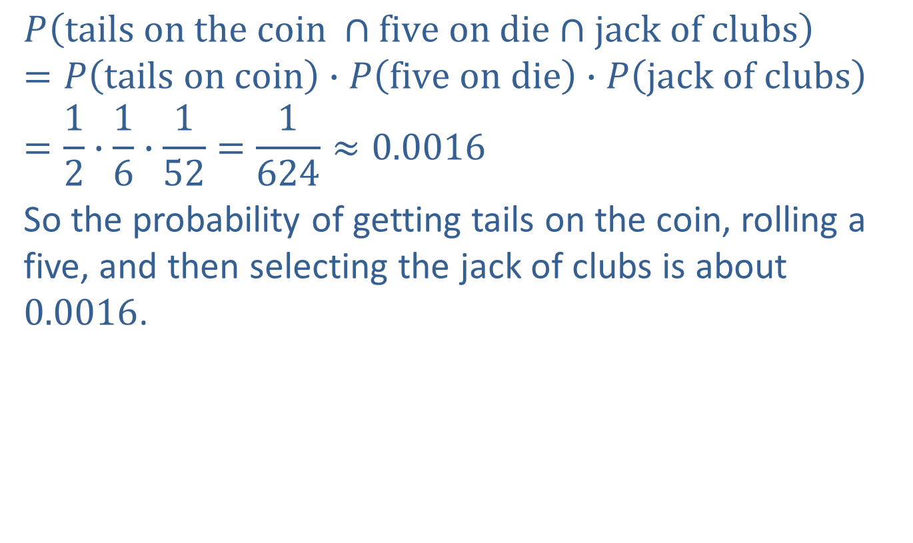
Example 5: Using the Multiplication Rule for Independent Events (cont.)
$$P\left(tails on the coin ∩five on die∩jack of clubs\right)$$
$$=P\left(tails on coin\right)∙P\left(five on die\right)∙P\left(jack of clubs\right)$$
$$=\frac{1}{2}∙\frac{1}{6}∙\frac{1}{52}=\frac{1}{624}≈0.0016$$
So the probability of getting tails on the coin, rolling a five, and then selecting the jack of clubs is about $0.0016$.

Slide 24
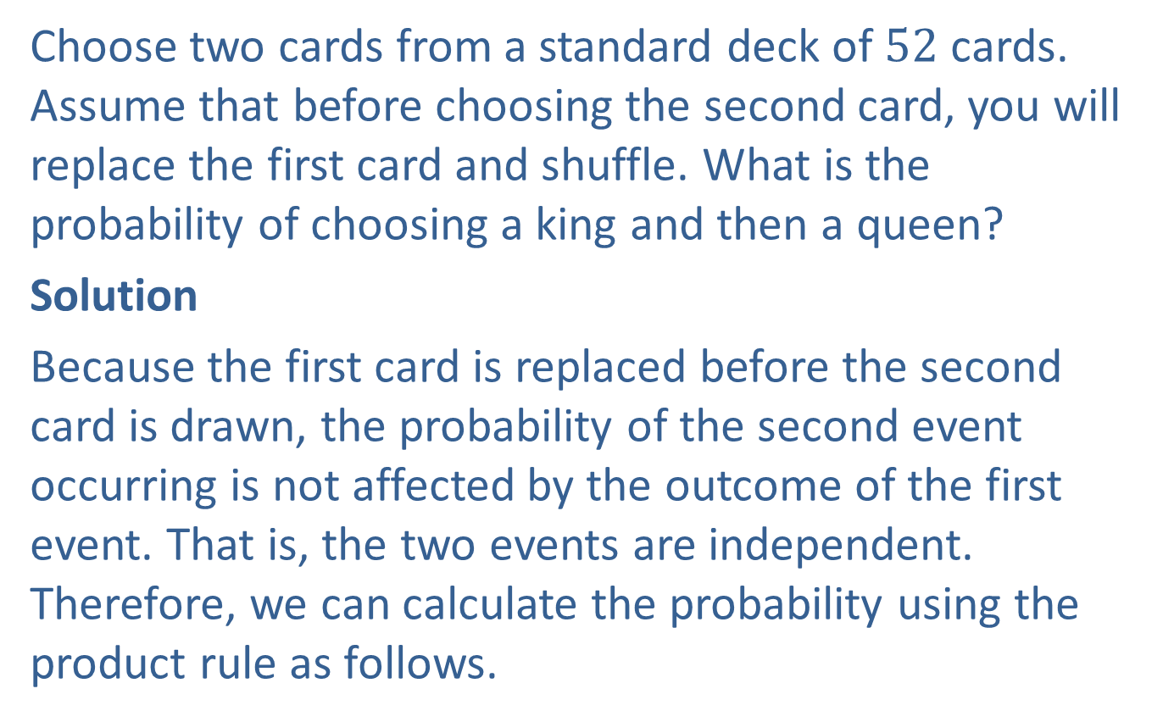
Example 6: Using the Multiplication Rule for Independent Events
Choose two cards from a standard deck of $52$ cards. Assume that before choosing the second card, you will replace the first card and shuffle. What is the probability of choosing a king and then a queen?
Solution
Because the first card is replaced before the second card is drawn, the probability of the second event occurring is not affected by the outcome of the first event. That is, the two events are independent. Therefore, we can calculate the probability using the product rule as follows.

Slide 25

Example 6: Using the Multiplication Rule for Independent Events (cont.)
$$P\left(king∩queen\right)=P\left(king\right)∙P\left(queen\right)$$
$$=\frac{4}{52}∙\frac{4}{52}=\frac{16}{2704}≈0.0059$$

Slide 26
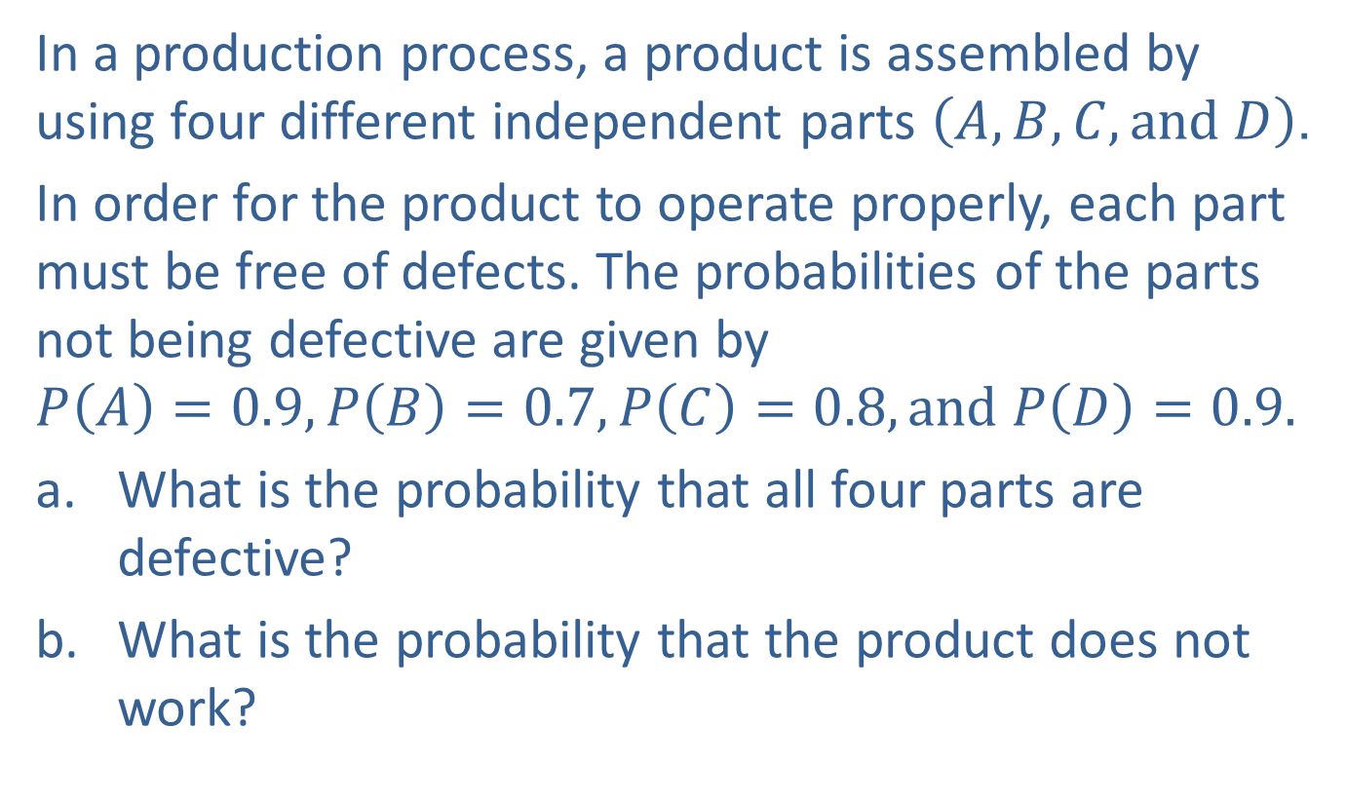
Example 7: Using the Multiplication Rule for Independent Events
In a production process, a product is assembled by using four different independent parts $\left(A, B, C, and D\right)$.
In order for the product to operate properly, each part must be free of defects. The probabilities of the parts not being defective are given by
$$P\left(A\right)=0.9, P\left(B\right)=0.7, P\left(C\right)=0.8, and P\left(D\right)=0.9.$$
​What is the probability that all four parts are defective?
​What is the probability that the product does not work?

Slide 27
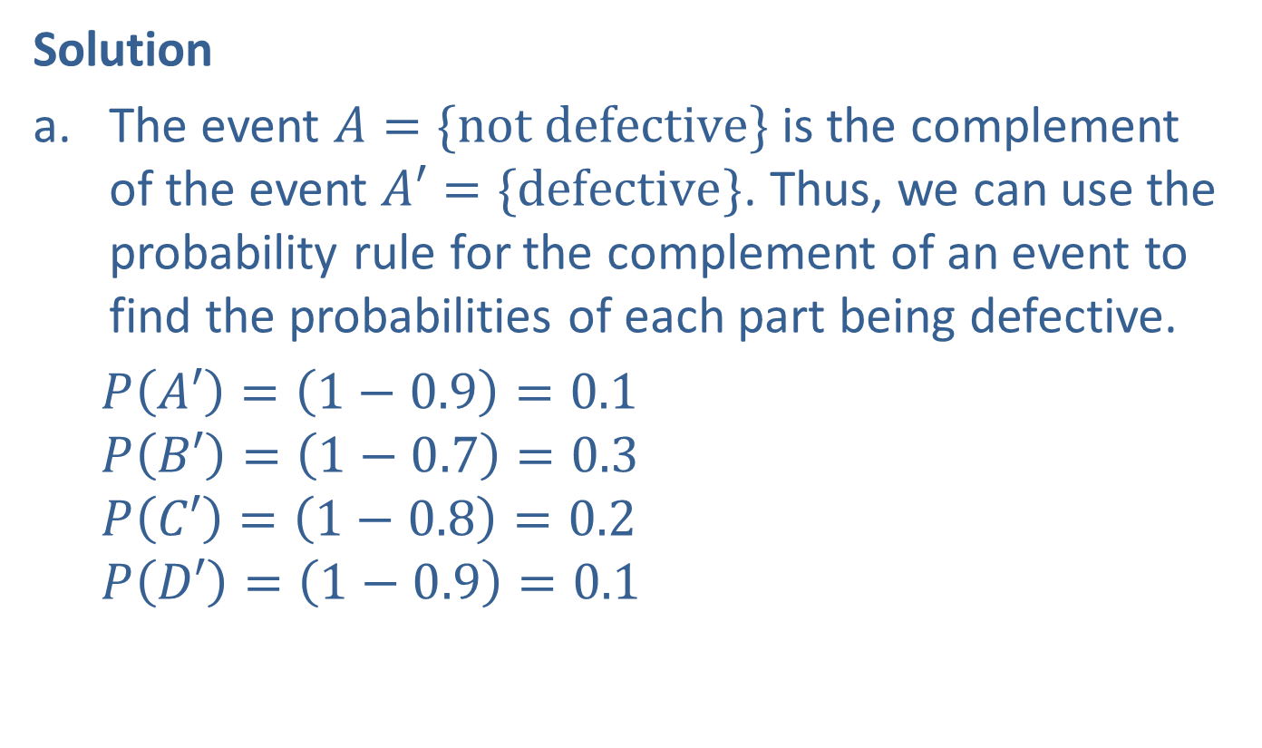
Example 7: Using the Multiplication Rule for Independent Events (cont.)
Solution
The event $A=\{not defective\}$ is the complement of the event $A′=\{defective\}$. Thus, we can use the probability rule for the complement of an event to find the probabilities of each part being defective.
$P\left(A′\right)=\left(1−0.9\right)=0.1$
$$P\left(B′\right)=\left(1−0.7\right)=0.3$$
$$P\left(C′\right)=\left(1−0.8\right)=0.2$$
$$P\left(D′\right)=\left(1−0.9\right)=0.1$$

Slide 28
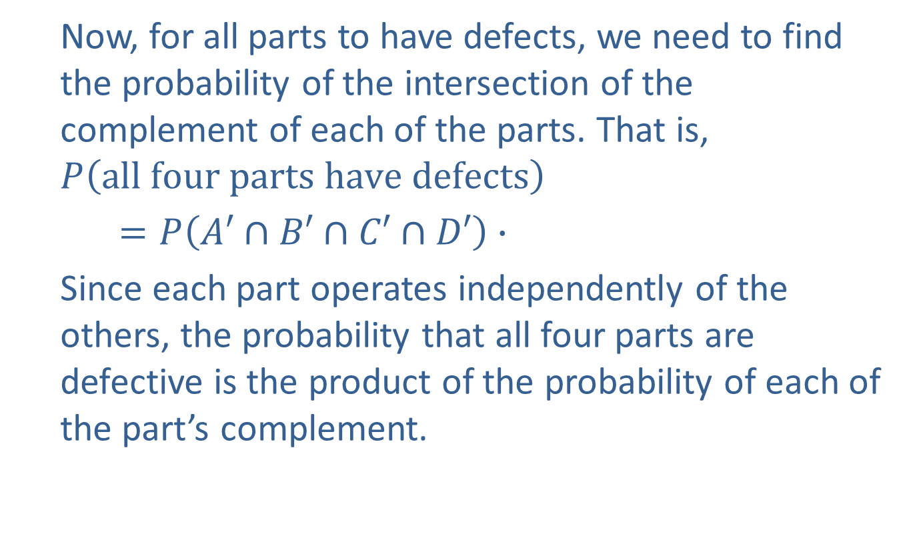
Example 7: Using the Multiplication Rule for Independent Events (cont.)
Now, for all parts to have defects, we need to find the probability of the intersection of the complement of each of the parts. That is,
$$P\left(all four parts have defects\right)$$
$=P\left(A′∩B′∩C′∩D′\right)∙$
Since each part operates independently of the others, the probability that all four parts are defective is the product of the probability of each of the part’s complement.

Slide 29
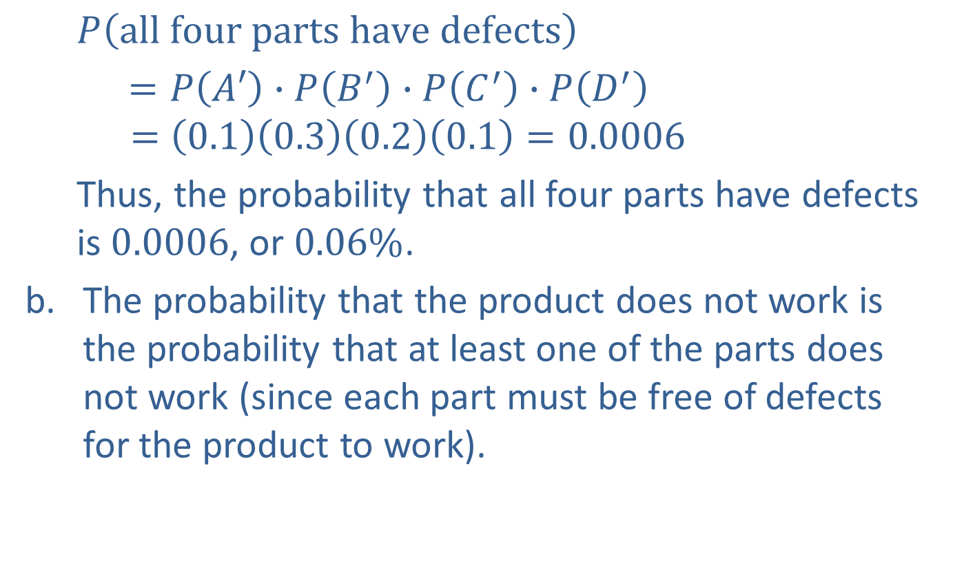
Example 7: Using the Multiplication Rule for Independent Events (cont.)
$$P\left(all four parts have defects\right)$$
$=P\left(A′\right)∙P\left(B^{′}\right)∙P\left(C^{′}\right)∙P\left(D^{′}\right)$
$$=\left(0.1\right)\left(0.3\right)\left(0.2\right)\left(0.1\right)=0.0006$$
Thus, the probability that all four parts have defects is $0.0006$, or $0.06\%$.
The probability that the product does not work is the probability that at least one of the parts does not work (since each part must be free of defects for the product to work).

Slide 30
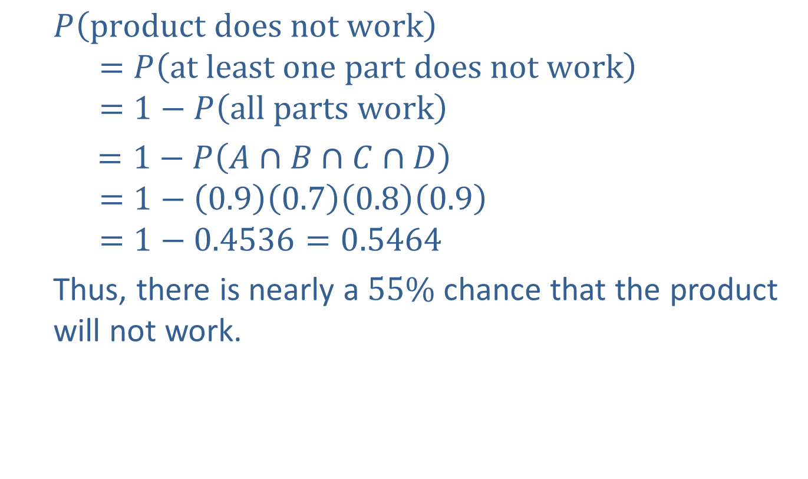
Example 7: Using the Multiplication Rule for Independent Events (cont.)
$$P\left(product does not work\right)$$
$$=P\left(at least one part does not work\right)$$
$$=1−P\left(all parts work\right)$$
$=1−P\left(A∩B∩C∩D\right)$
$$=1−\left(0.9\right)\left(0.7\right)\left(0.8\right)\left(0.9\right)$$
$$=1−0.4536=0.5464$$
Thus, there is nearly a $55\%$ chance that the product will not work.

Slide 31
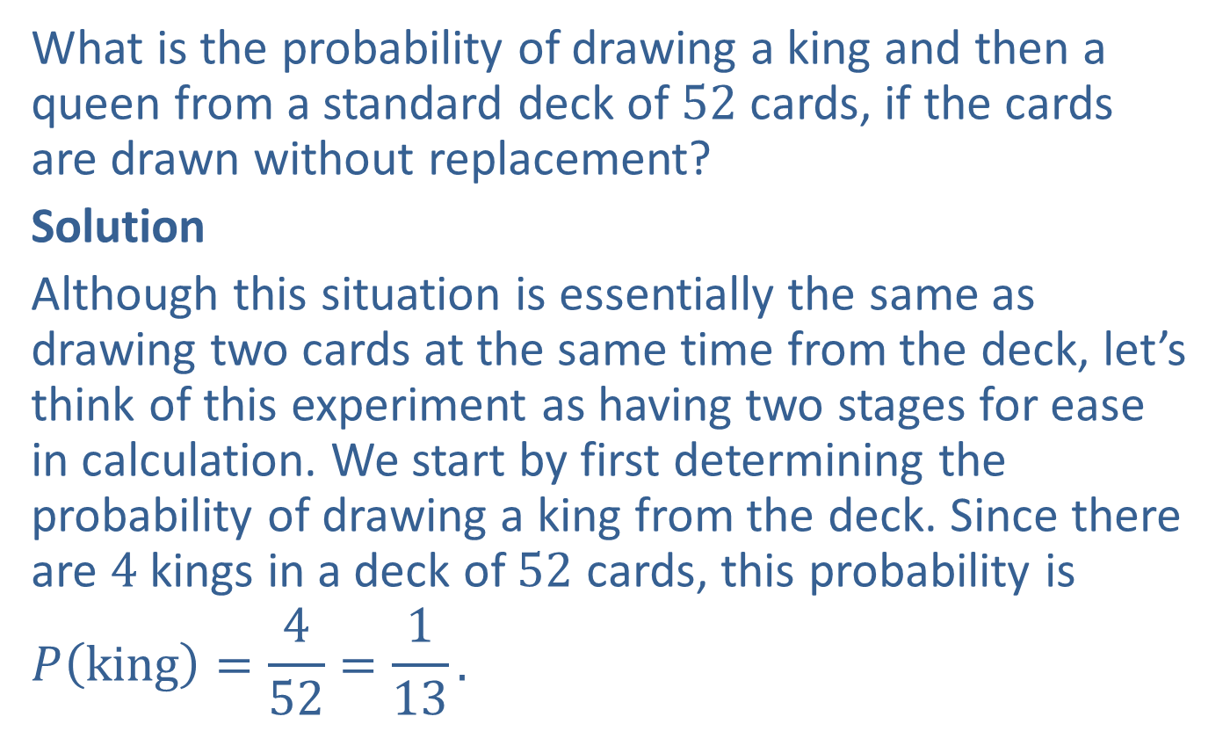
Example 8: Using the Multiplication Rule for Dependent Events
What is the probability of drawing a king and then a queen from a standard deck of $52$ cards, if the cards are drawn without replacement?
Solution
Although this situation is essentially the same as drawing two cards at the same time from the deck, let’s think of this experiment as having two stages for ease in calculation. We start by first determining the probability of drawing a king from the deck. Since there are $4$ kings in a deck of $52$ cards, this probability is
$$P\left(king\right)=\frac{4}{52}=\frac{1}{13}.$$

Slide 32
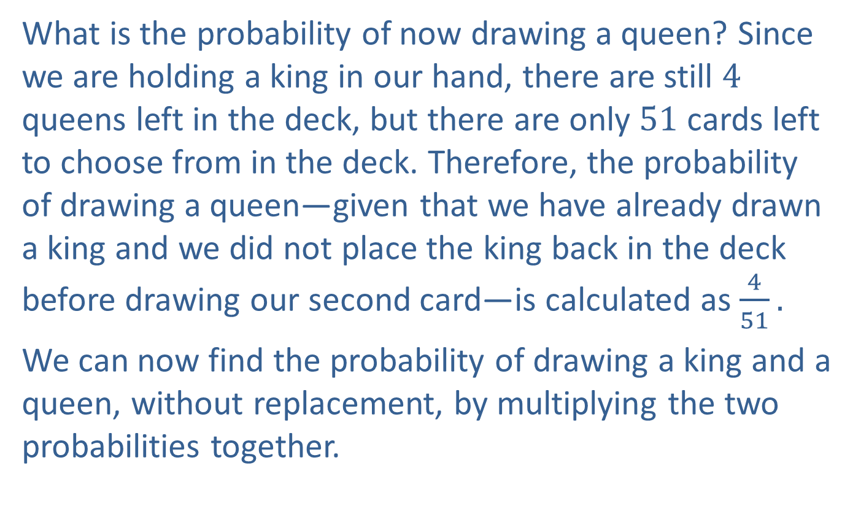
Example 8: Using the Multiplication Rule for Dependent Events (cont.)
What is the probability of now drawing a queen? Since we are holding a king in our hand, there are still $4$ queens left in the deck, but there are only $51$ cards left to choose from in the deck. Therefore, the probability of drawing a queen—given that we have already drawn a king and we did not place the king back in the deck before drawing our second card—is calculated as $\frac{4}{51}.$
We can now find the probability of drawing a king and a queen, without replacement, by multiplying the two probabilities together.

Slide 33

Example 8: Using the Multiplication Rule for Dependent Events (cont.)
$$P\left(king∩queen, without replacement\right)$$
$$=P\left(king\right)∙P\left(queen | king\right)$$
$$=\frac{1}{13}∙\frac{4}{51}=\frac{4}{663}≈0.0060$$

Slide 34
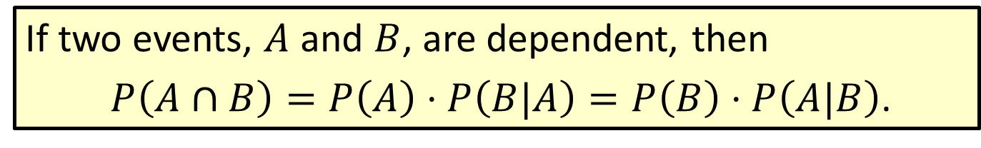
Formula: Multiplication Rule for Dependent Events
If two events, $A$ and $B$, are dependent, then
$P\left(A∩B\right)=P\left(A\right)⋅P\left(B|A\right)=P\left(B\right)⋅P\left(A|B\right)$.

Slide 35
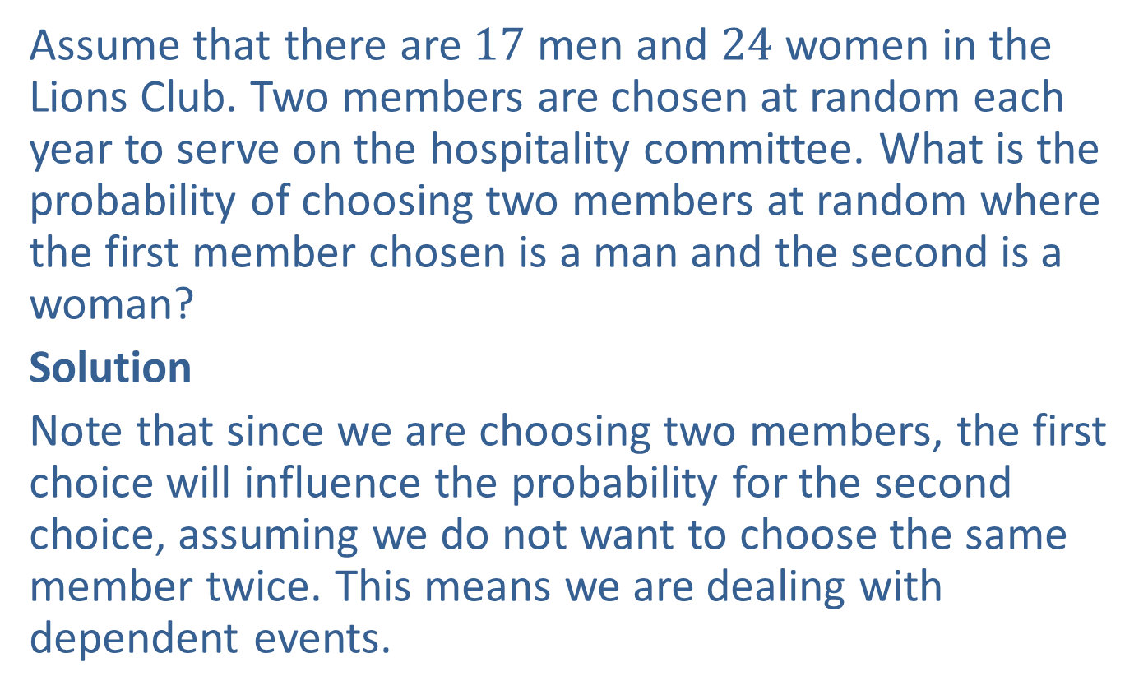
Example 9: Using the Multiplication Rule for Dependent Events
Assume that there are $17$ men and $24$ women in the Lions Club. Two members are chosen at random each year to serve on the hospitality committee. What is the probability of choosing two members at random where the first member chosen is a man and the second is a woman?
Solution
Note that since we are choosing two members, the first choice will influence the probability for the second choice, assuming we do not want to choose the same member twice. This means we are dealing with dependent events.

Slide 36
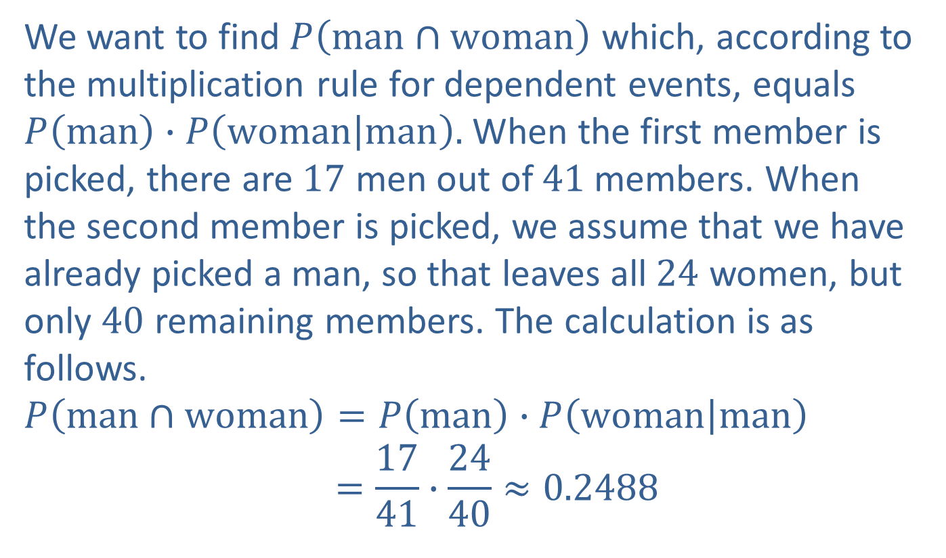
Example 9: Using the Multiplication Rule for Dependent Events (cont.)
We want to find $P\left(man∩woman\right)$ which, according to the multiplication rule for dependent events, equals $P\left(man\right)∙P\left(woman | man\right).$ When the first member is picked, there are $17$ men out of $41$members. When the second member is picked, we assume that we have already picked a man, so that leaves all $24$ women, but only $40$ remaining members. The calculation is as follows.
$$P\left(man∩woman\right)=P\left(man\right)∙P\left(woman | man\right)$$
$$=\frac{17}{41}∙\frac{24}{40}≈0.2488$$

