Slide 1
Section 9.4
The Fundamental Counting Principle and Permutations

Slide 2
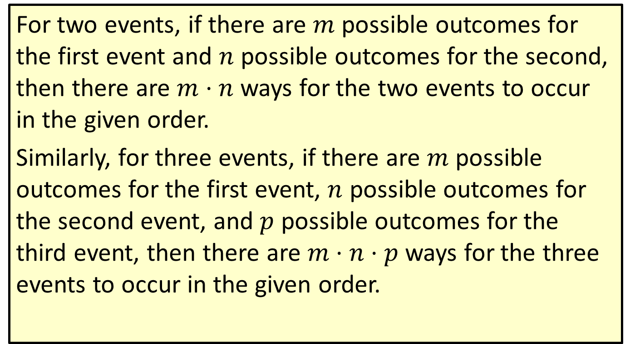
Definition: The Fundamental Counting Principle
For two events, if there are $m$ possible outcomes for the first event and $n$ possible outcomes for the second, then there are $m⋅n$ ways for the two events to occur in the given order.
Similarly, for three events, if there are $m$ possible outcomes for the first event, $n$ possible outcomes for the second event, and $p$ possible outcomes for the third event, then there are $m⋅n⋅p$ ways for the three events to occur in the given order.

Slide 3
Definition: The Fundamental Counting Principle (cont.)
In general, the total number of ways several events can occur in a given order is found by multiplying the number of outcomes of each event together.

Slide 4
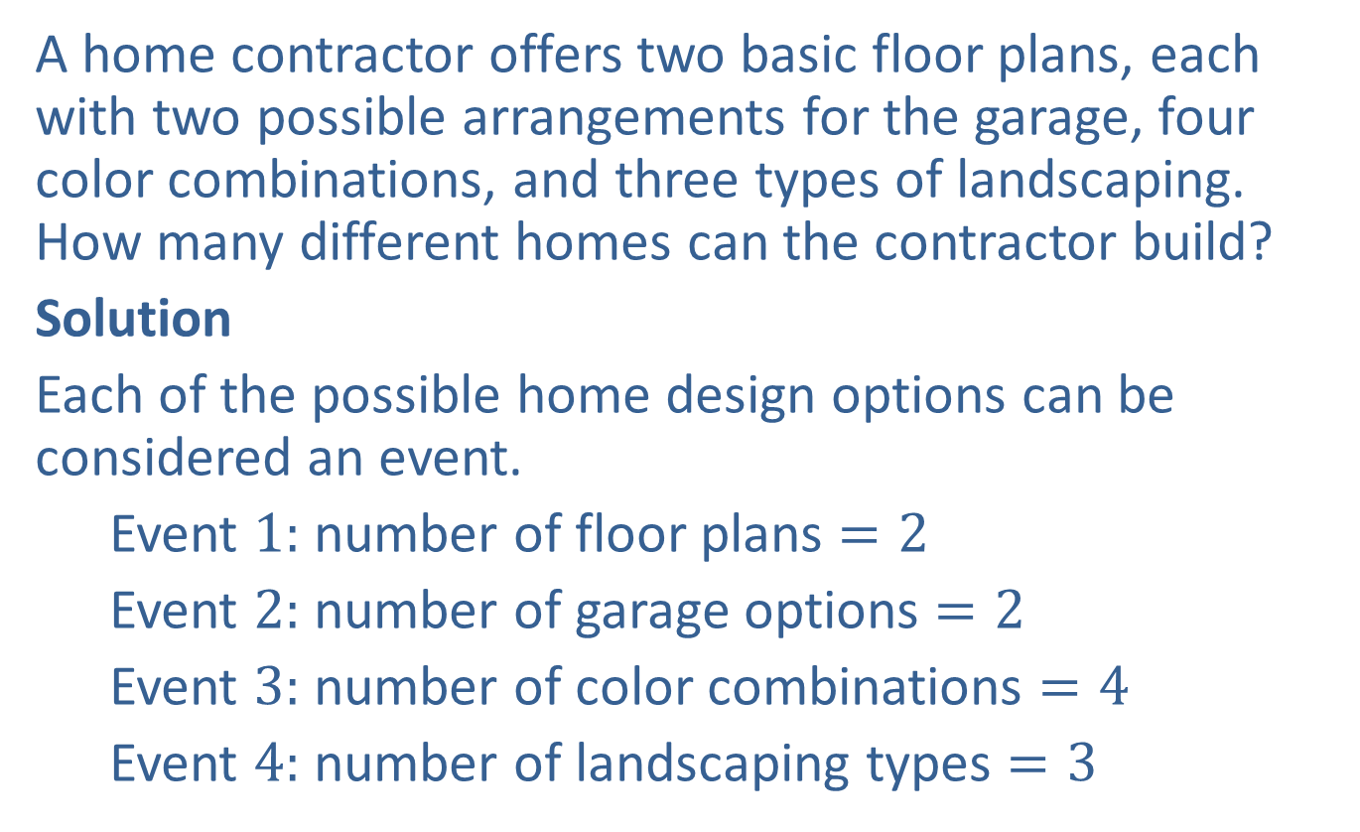
Example 1: Using the Fundamental Counting Principle
A home contractor offers two basic floor plans, each with two possible arrangements for the garage, four color combinations, and three types of landscaping. How many different homes can the contractor build?
Solution
Each of the possible home design options can be considered an event.
Event $1:$ number of floor plans $=2$
Event $2:$ number of garage options $=2$
Event $3:$ number of color combinations $=4$
Event $4:$ number of landscaping types $=3$

Slide 5
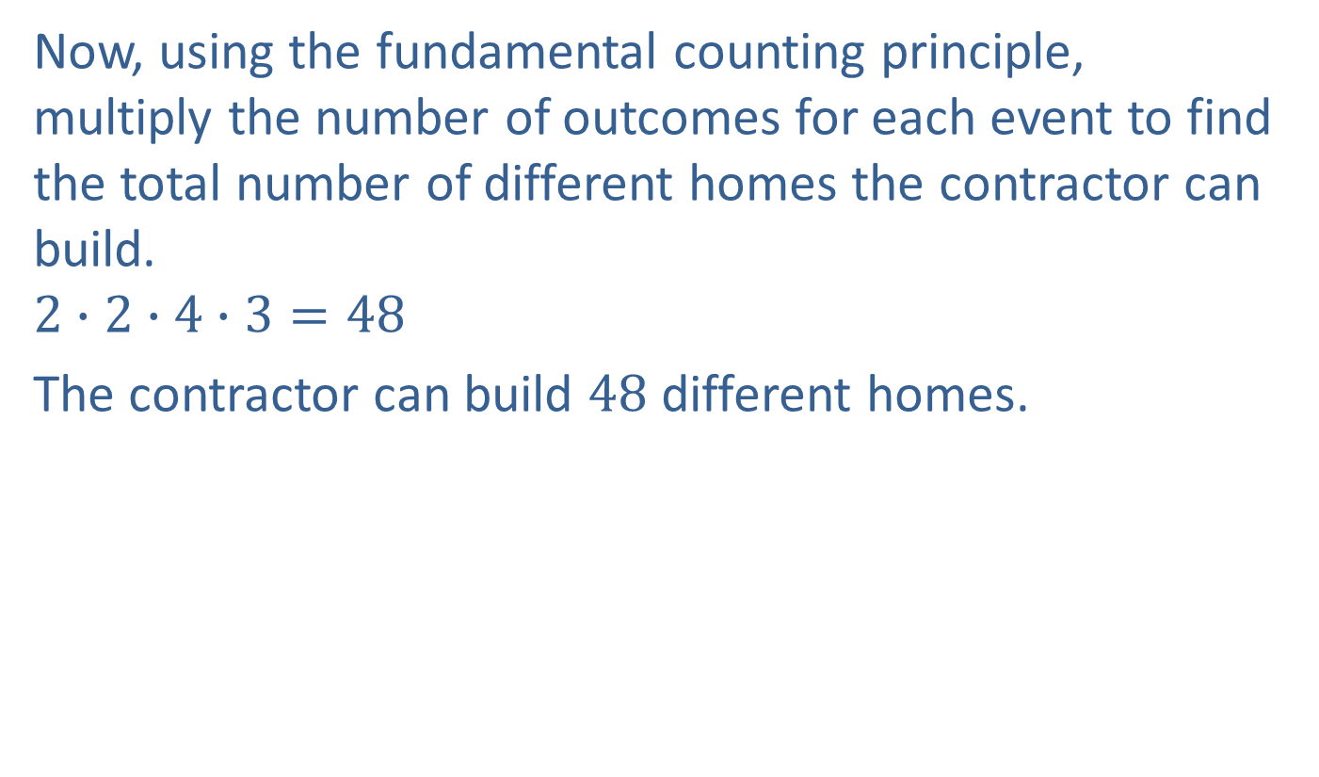
Example 1: Using the Fundamental Counting Principle (cont.)
Now, using the fundamental counting principle, multiply the number of outcomes for each event to find the total number of different homes the contractor can build.
$$2∙2∙4∙3=48$$
The contractor can build $48$ different homes.

Slide 6
Definition: Permutation
A permutation is an arrangement (or ordering) of the elements of a set where the order matters.

Slide 7
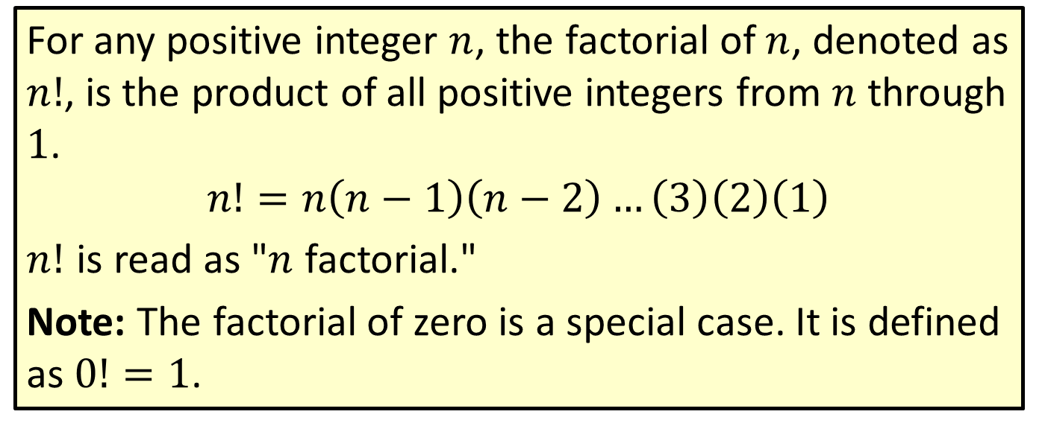

Definition: $n$ Factorial ($n!$)
For any positive integer $n$, the factorial of $n$, denoted as $n!$, is the product of all positive integers from $n$ through $1$.
$$n!=n\left(n−1\right)\left(n−2\right)…\left(3\right)\left(2\right)\left(1\right)$$
$n!$ is read as "$n$ factorial."
Note: The factorial of zero is a special case. It is defined as $0!=1$.

Slide 8
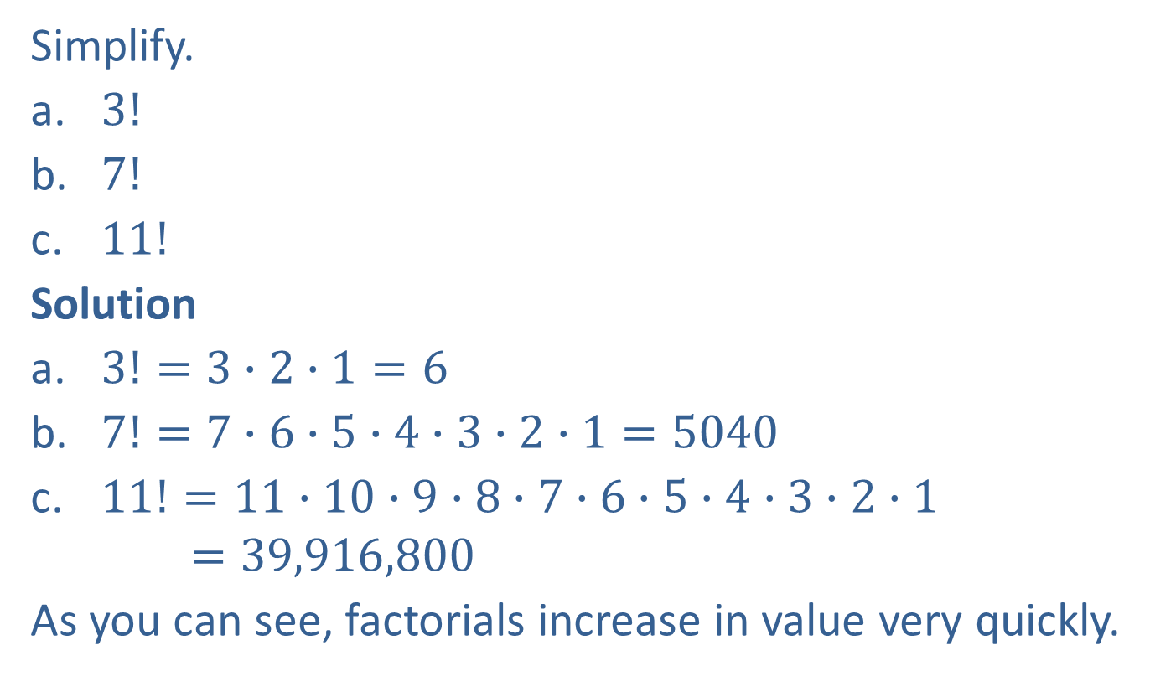
Example 2: Simplifying Factorials
Simplify.
​$3!$
​$7!$
​$11!$
Solution
​$3!=3∙2∙1=6$
​$7!=7∙6∙5∙4∙3∙2∙1=5040$
​$11!=11∙10∙9∙8∙7∙6∙5∙4∙3∙2∙1$
$$=39,916,800$$
As you can see, factorials increase in value very quickly.

Slide 9
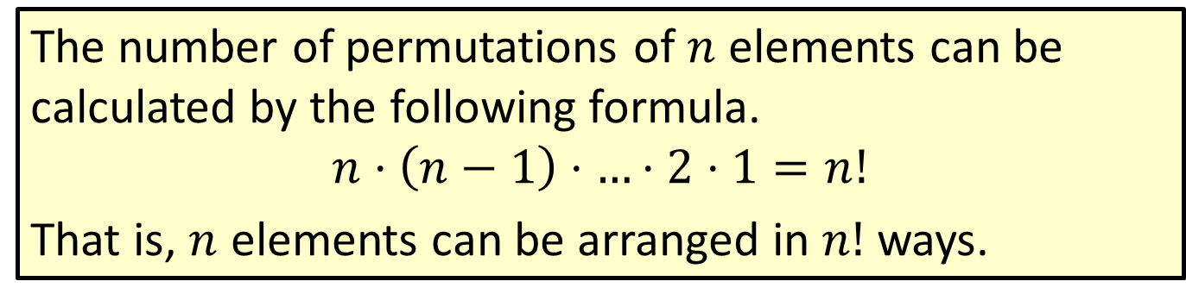

Formula: Number of Permutations of $n$ Elements
The number of permutations of $n$ elements can be calculated by the following formula.
$$n⋅\left(n−1\right)⋅…⋅2⋅1=n!$$
That is, $n$ elements can be arranged in $n!$ ways.

Slide 10
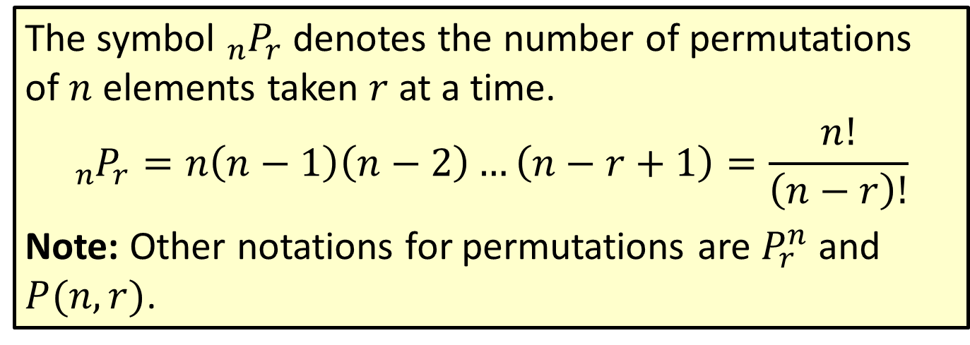

Formula: Number of Permutations of $n$ Elements Taken $r$ at a Time
The symbol ${}_{n}^{ }{P_{r}}$ denotes the number of permutations of $n$ elements taken $r$ at a time.
$${}_{n}^{ }{P_{r}}=n\left(n−1\right)\left(n−2\right)…\left(n−r+1\right)=\frac{n!}{\left(n−r\right)!}$$
Note: Other notations for permutations are $P_{r}^{n}$ and $P(n,r)$.

Slide 11
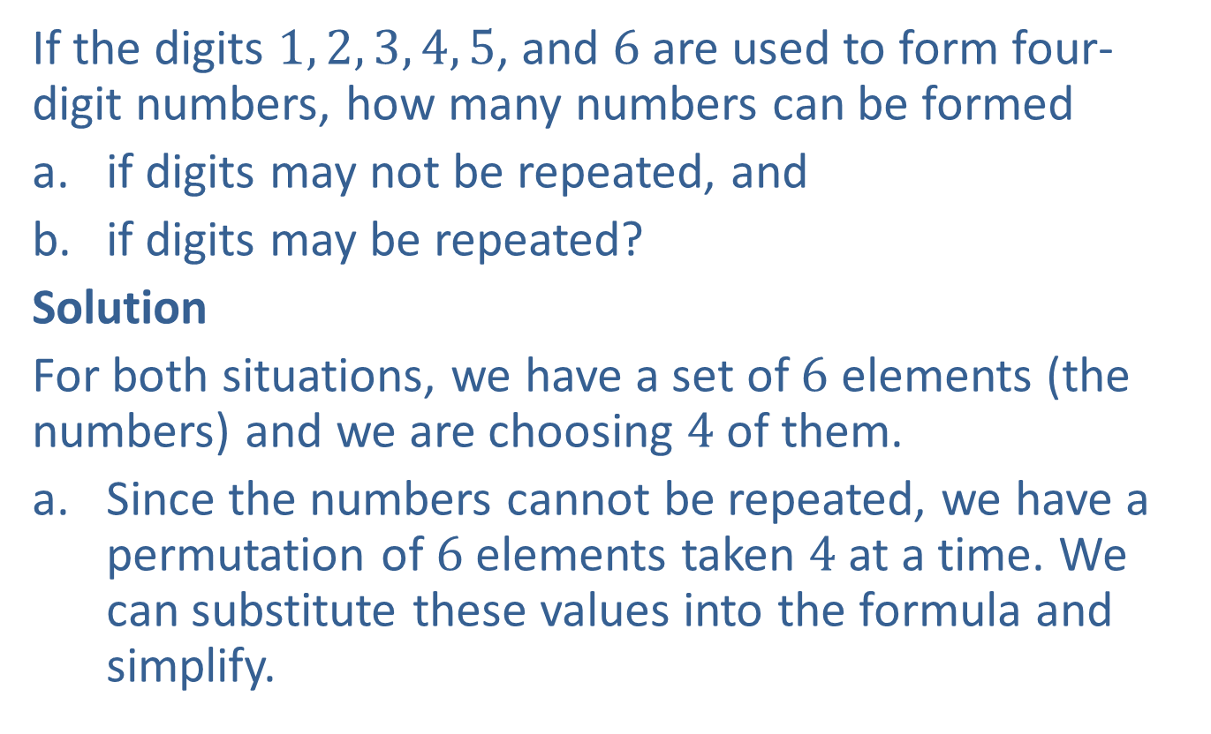

Example 3: Calculating the Number of Permutations of $n$ Elements Taken $r$ at a Time
If the digits $1, 2, 3, 4, 5$, and $6$ are used to form four-digit numbers, how many numbers can be formed
​if digits may not be repeated, and
​if digits may be repeated?
Solution
For both situations, we have a set of $6$ elements (the numbers) and we are choosing $4$ of them.
Since the numbers cannot be repeated, we have a permutation of $6$ elements taken $4$ at a time. We can substitute these values into the formula and simplify.

Slide 12
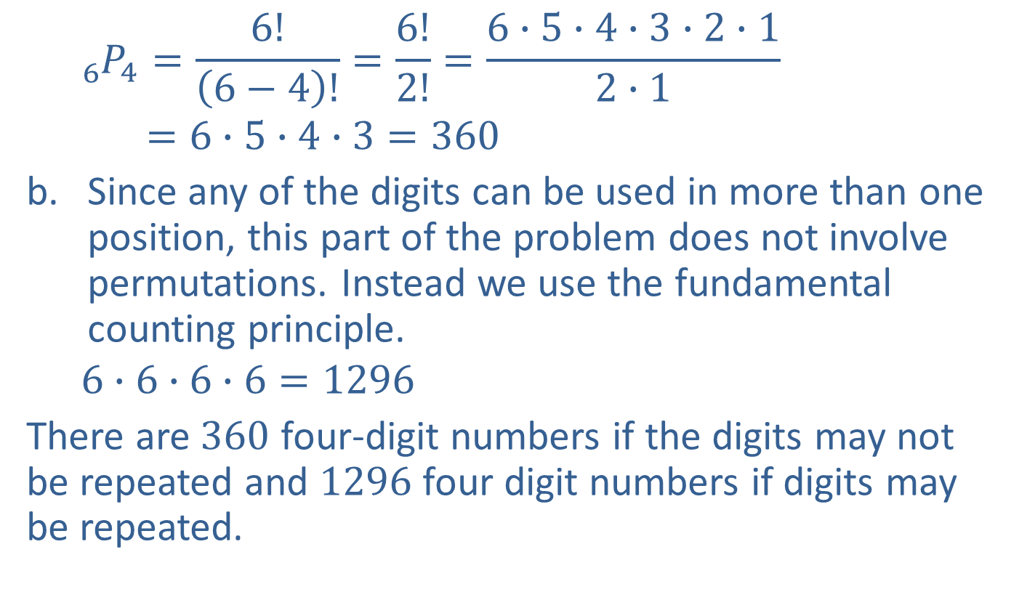

Example 3: Calculating the Number of Permutations of $n$ Elements Taken $r$ at a Time (cont.)
$${}_{6}^{ }{P_{4}=}\frac{6!}{\left(6−4\right)!}=\frac{6!}{2!}=\frac{6∙5∙4∙3∙2∙1}{2∙1}$$
$$=6∙5∙4∙3=360$$
Since any of the digits can be used in more than one position, this part of the problem does not involve permutations. Instead we use the fundamental counting principle.
$$6∙6∙6∙6=1296$$
There are $360$ four-digit numbers if the digits may not be repeated and $1296$ four digit numbers if digits may be repeated.

Slide 13
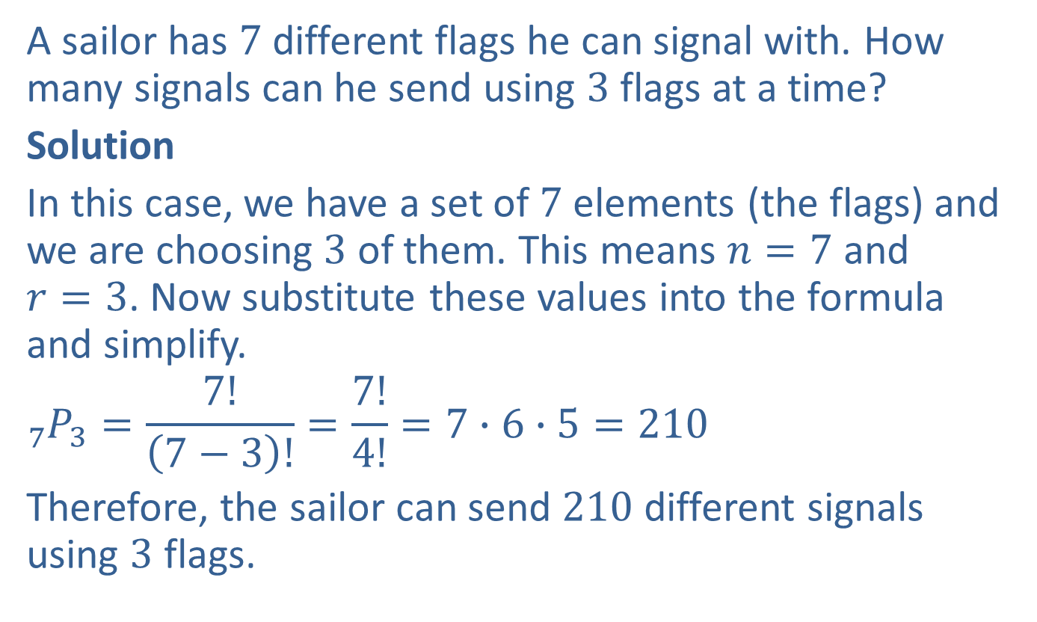

Example 4: Calculating the Number of Permutations of $n$ Elements Taken $r$ at a Time
A sailor has $7$different flags he can signal with. How many signals can he send using $3$ flags at a time?
Solution
In this case, we have a set of $7$ elements (the flags) and we are choosing $3$ of them. This means $n=7$ and $r=3$. Now substitute these values into the formula and simplify.
$${}_{7}^{ }{P_{3}=}\frac{7!}{\left(7−3\right)!}=\frac{7!}{4!}=7∙6∙5=210$$
Therefore, the sailor can send $210$different signals using $3$ flags.

