Slide 1
Section 9.5
Combinations

Slide 2
Definition: Combination
A combination is a collection of some (or all) of the elements of a set without regard to the order of the elements.

Slide 3
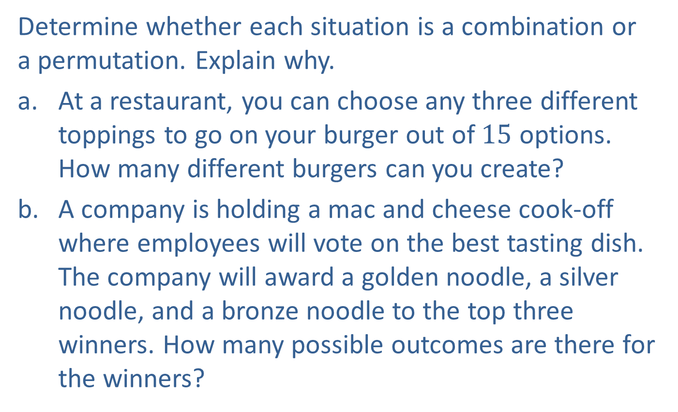
Example 1: Differentiating between Combinations and Permutations
Determine whether each situation is a combination or a permutation. Explain why.
​At a restaurant, you can choose any three different toppings to go on your burger out of $15$ options. How many different burgers can you create?
​A company is holding a mac and cheese cook-off where employees will vote on the best tasting dish. The company will award a golden noodle, a silver noodle, and a bronze noodle to the top three winners. How many possible outcomes are there for the winners?

Slide 4
Example 1: Differentiating between Combinations and Permutations (cont.)
​A student government needs to select a five person committee. Twelve members of the student government are interested in being on this committee. How many different committees can be created?
Solution
On a burger, the order of toppings doesn’t change the type of burger you have. Whether the cheese goes on top of or beneath the tomato is a personal preference. Therefore, this is a combination problem.

Slide 5
Example 1: Differentiating between Combinations and Permutations (cont.)
Since there are three different prizes, the order in which the top winners are selected matters. Therefore, this is a permutation problem.
For committees, the order in which people are selected does not matter since everyone has an equal position in the committee. Therefore, this is a combination problem.

Slide 6
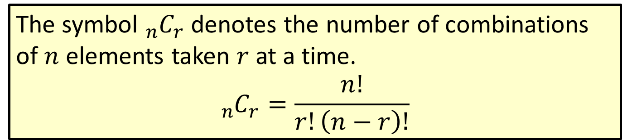

Formula: Number of Combinations of $n$ Elements Taken $r$ at a Time
The symbol ${}_{n}^{ }{C_{r}}$ denotes the number of combinations of $n$ elements taken $r$ at a time.
$${}_{n}^{ }{C_{r}}=\frac{n!}{r!\left(n−r\right)!}$$

Slide 7
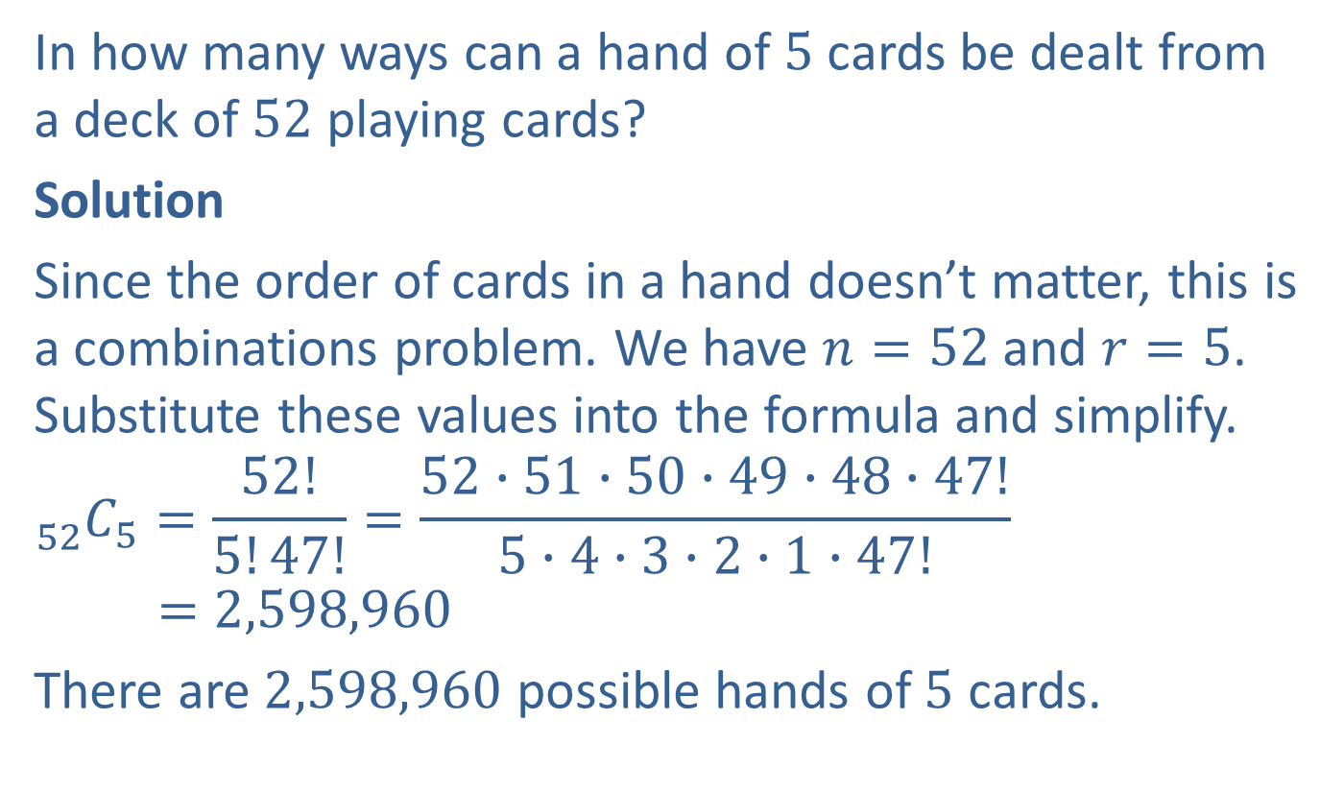
Example 2: Calculating Combinations
In how many ways can a hand of $5$ cards be dealt from a deck of $52$ playing cards?
Solution
Since the order of cards in a hand doesn’t matter, this is a combinations problem. We have $n=52$and $r=5$. Substitute these values into the formula and simplify.
$${}_{52}^{ }{C_{5}}=\frac{52!}{5!47!}=\frac{52∙51∙50∙49∙48∙47!}{5∙4∙3∙2∙1∙47!}$$
$$=2,598,960$$
There are $2,598,960$ possible hands of $5$ cards.

Slide 8
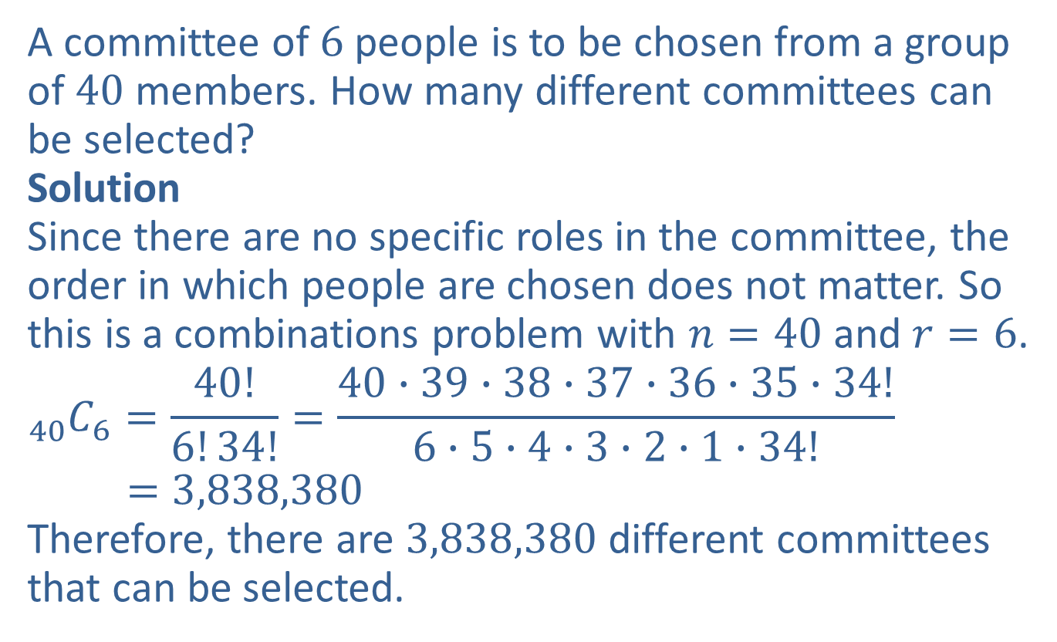
Example 3: Application: Calculating Combinations
A committee of $6$people is to be chosen from a group of $40$ members. How many different committees can be selected?
Solution
Since there are no specific roles in the committee, the order in which people are chosen does not matter. So this is a combinations problem with $n=40$and $r=6$.
$${}_{40}^{ }{C_{6}}=\frac{40!}{6!34!}=\frac{40∙39∙38∙37∙36∙35∙34!}{6∙5∙4∙3∙2∙1∙34!}$$
$$=3,838,380$$
Therefore, there are $3,838,380$ different committees that can be selected.

Slide 9
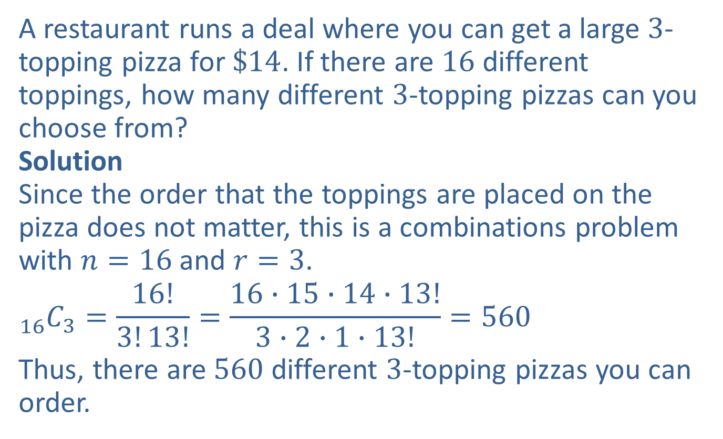
Example 4: Application: Calculating Combinations
A restaurant runs a deal where you can get a large $3$-topping pizza for $\$14$. If there are $16$ different toppings, how many different $3$-topping pizzas can you choose from?
Solution
Since the order that the toppings are placed on the pizza does not matter, this is a combinations problem with $n=16$and $r=3$.
$${}_{16}^{ }{C_{3}}=\frac{16!}{3!13!}=\frac{16∙15∙14∙13!}{3∙2∙1∙13!}=560$$
Thus, there are $560$ different $3$-topping pizzas you can order.

Slide 10
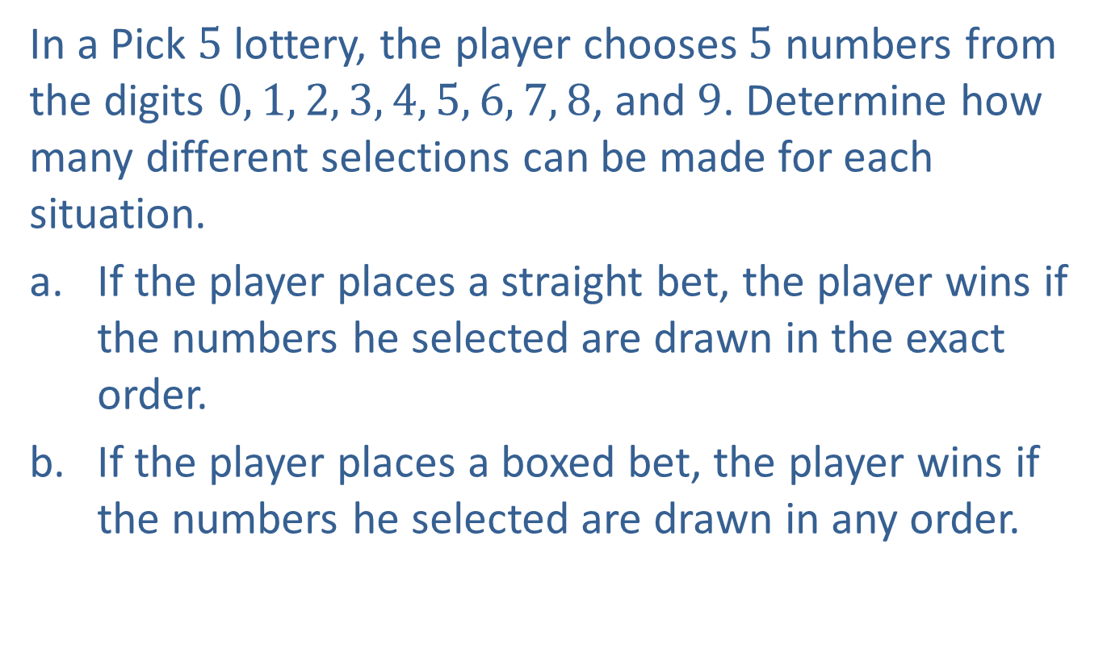
Example 5: Calculating Permutations and Combinations
In a Pick $5$ lottery, the player chooses $5$ numbers from the digits $0, 1, 2, 3, 4, 5, 6, 7, 8$, and $9$. Determine how many different selections can be made for each situation.
​If the player places a straight bet, the player wins if the numbers he selected are drawn in the exact order.
​If the player places a boxed bet, the player wins if the numbers he selected are drawn in any order.

Slide 11
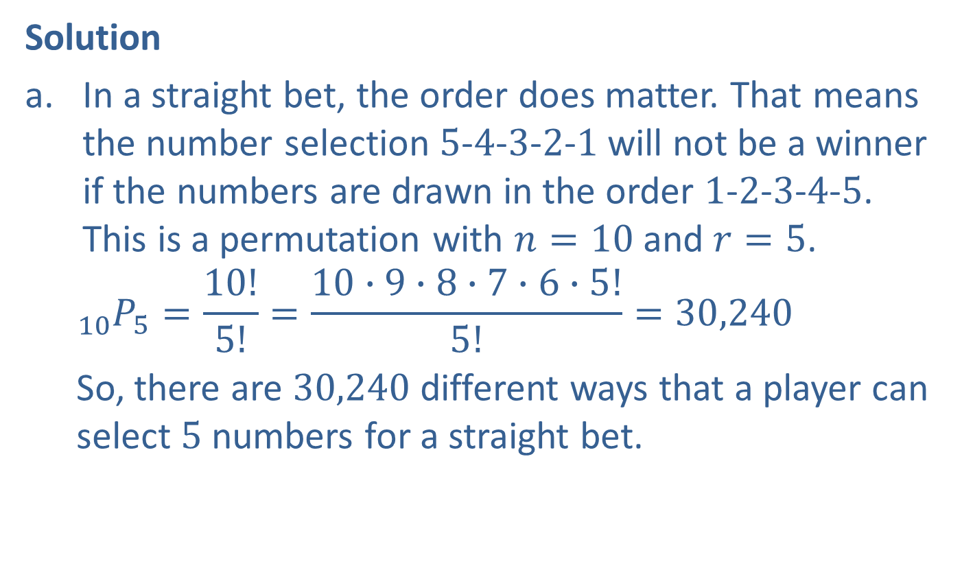
Example 5: Calculating Permutations and Combinations (cont.)
Solution
In a straight bet, the order does matter. That means the number selection $5$-$4$-$3$-$2$-$1$ will not be a winner if the numbers are drawn in the order $1$-$2$-$3$-$4$-$5$. This is a permutation with $n=10$and $r=5$.
$${}_{10}^{ }{P_{5}=}\frac{10!}{5!}=\frac{10∙9∙8∙7∙6∙5!}{5!}=30,240$$
So, there are $30,240$ different ways that a player can select $5$ numbers for a straight bet.

Slide 12
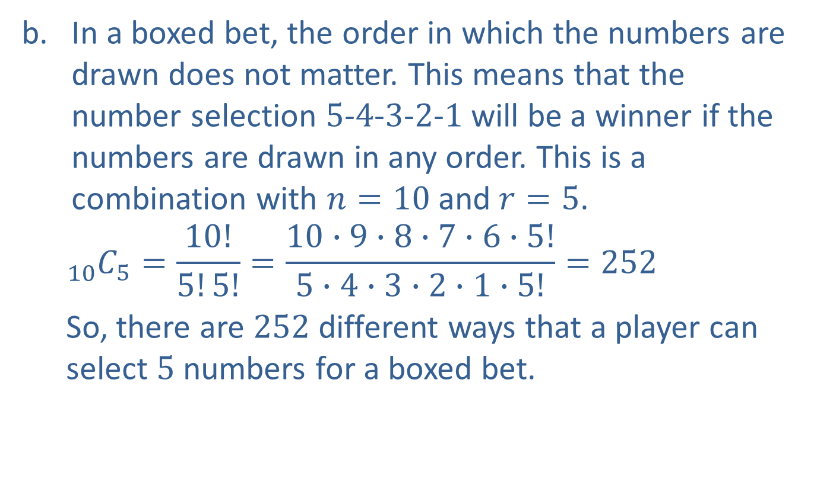
Example 5: Calculating Permutations and Combinations (cont.)
In a boxed bet, the order in which the numbers are drawn does not matter. This means that the number selection $5$-$4$-$3$-$2$-$1$ will be a winner if the numbers are drawn in any order. This is a combination with $n=10$and $r=5$.
$${}_{10}^{ }{C_{5}=}\frac{10!}{5!5!}=\frac{10∙9∙8∙7∙6∙5!}{5∙4∙3∙2∙1∙5!}=252$$
So, there are $252$ different ways that a player can select $5$ numbers for a boxed bet.

Slide 13
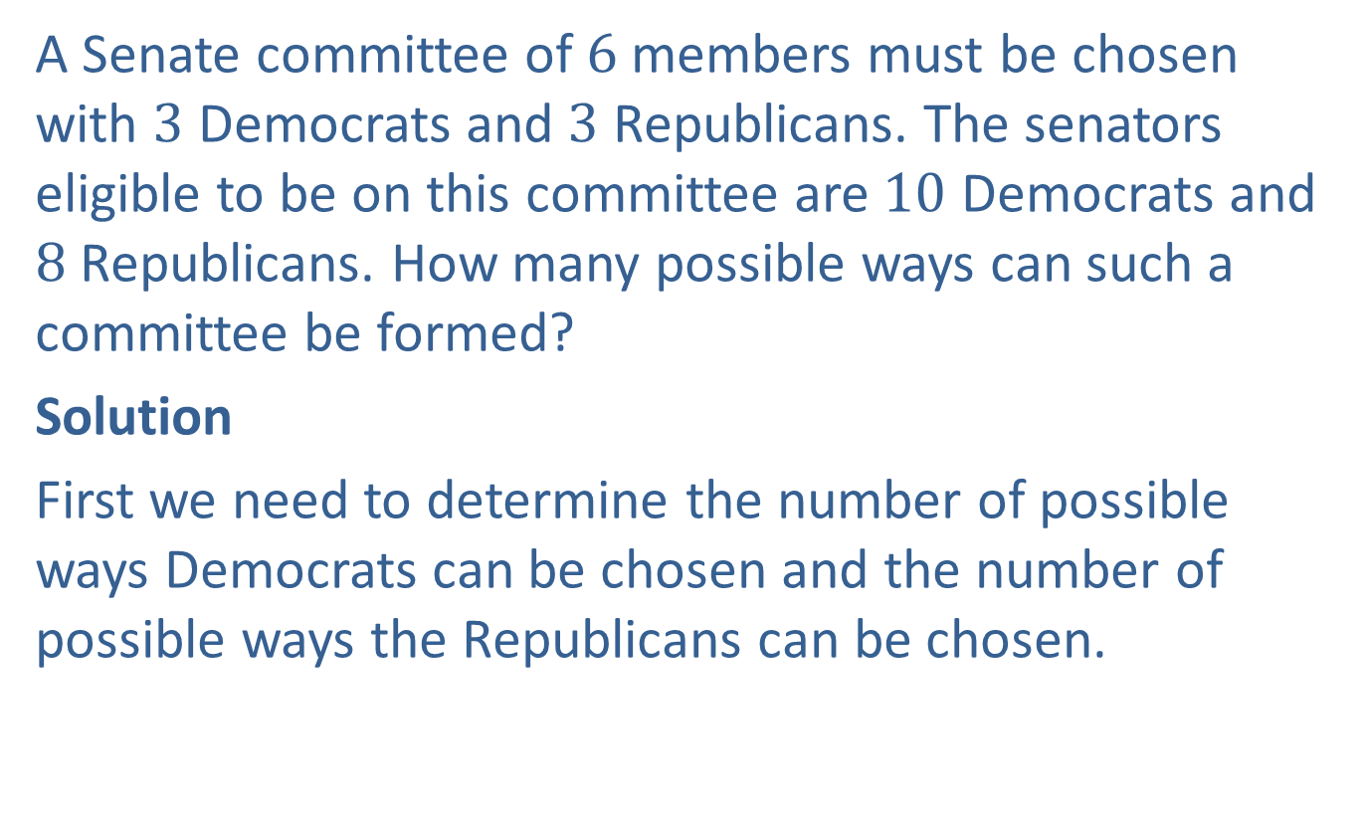
Example 6: Calculating Combinations
A Senate committee of $6$ members must be chosen with $3$ Democrats and $3$ Republicans. The senators eligible to be on this committee are $10$ Democrats and $8$ Republicans. How many possible ways can such a committee be formed?
Solution
First we need to determine the number of possible ways Democrats can be chosen and the number of possible ways the Republicans can be chosen.

Slide 14
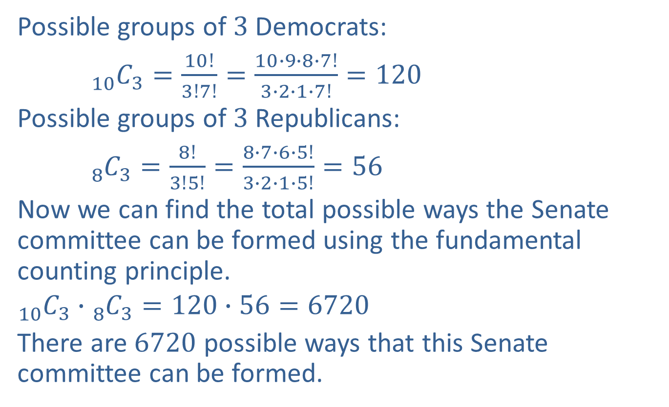
Example 6: Calculating Combinations (cont.)
Possible groups of $3$ Democrats:
${}_{10}^{ }{C_{3}=}\frac{10!}{3!7!}=\frac{10∙9∙8∙7!}{3∙2∙1∙7!}=120$
Possible groups of $3$ Republicans:
${}_{8}^{ }{C_{3}=}\frac{8!}{3!5!}=\frac{8∙7∙6∙5!}{3∙2∙1∙5!}=56$
Now we can find the total possible ways the Senate committee can be formed using the fundamental counting principle.
$${}_{10}^{ }{C_{3}∙}{}_{8}^{ }{C_{3}=120}∙56=6720$$
There are $6720$ possible ways that this Senate committee can be formed.

