Slide 1
Section 9.6
Using Counting Methods to Find Probability

Slide 2
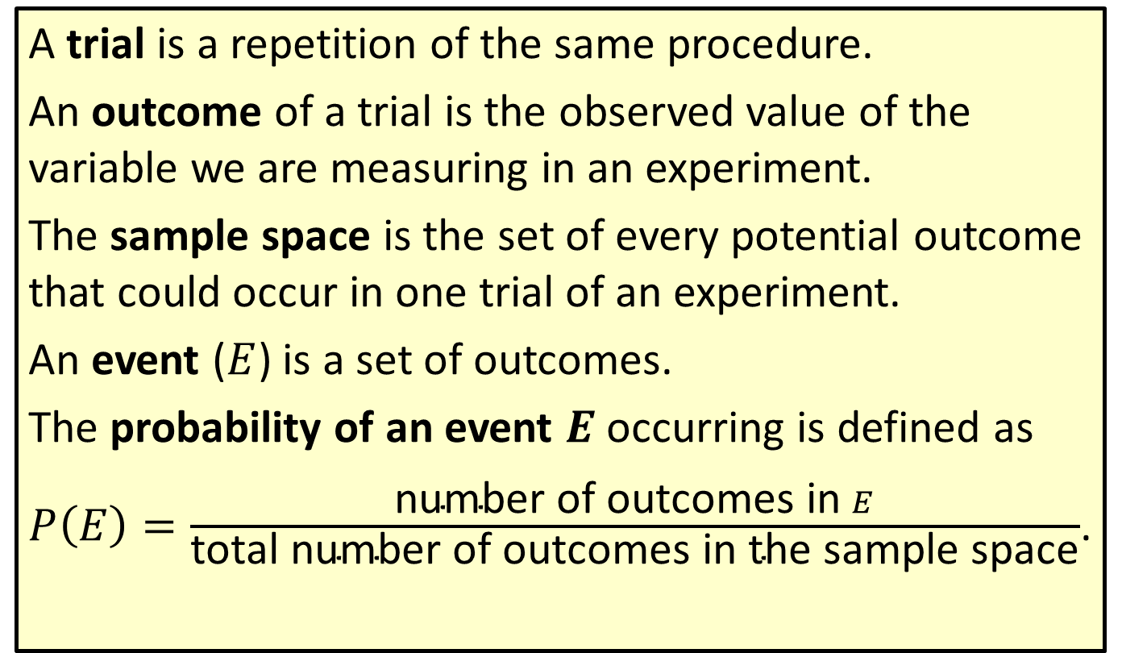
Definition: Review of Probability Terms
A trial is a repetition of the same procedure.
An outcome of a trial is the observed value of the variable we are measuring in an experiment.
The sample space is the set of every potential outcome that could occur in one trial of an experiment.
An event ($E$) is a set of outcomes.
The probability of an event $E$ occurring is defined as
$P\left(E\right)=\frac{\text{number} \text{of} \text{outcomes} \text{in} E}{\text{total} \text{number} \text{of} \text{outcomes} \text{in} \text{the} \text{sample} \text{space}}$.

Slide 3
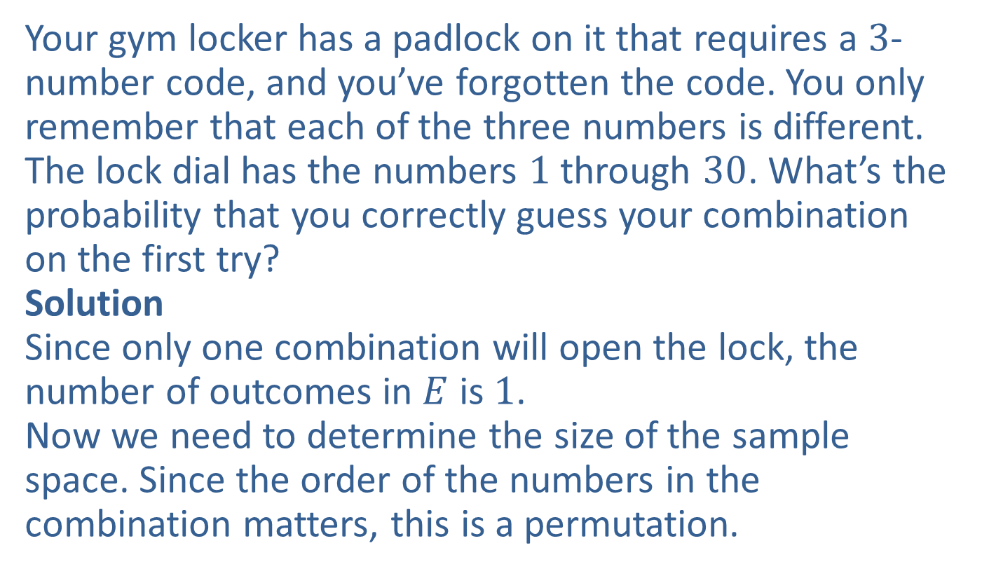
Example 1: Application: Calculating Probabilities Using Permutations
Your gym locker has a padlock on it that requires a $3$-number code, and you’ve forgotten the code. You only remember that each of the three numbers is different.
The lock dial has the numbers $1$ through $30$. What’s the probability that you correctly guess your combination on the first try?
Solution
Since only one combination will open the lock, the number of outcomes in $E$ is $1$.
Now we need to determine the size of the sample space. Since the order of the numbers in the combination matters, this is a permutation.

Slide 4
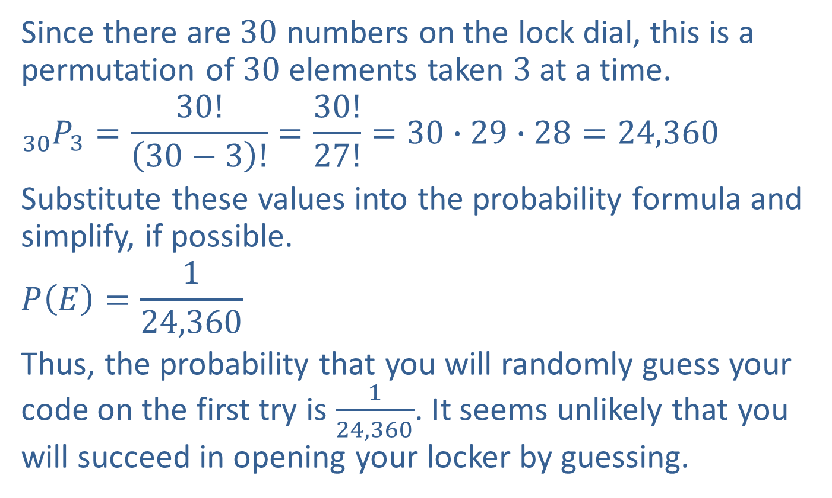
Example 1: Application: Calculating Probabilities Using Permutations (cont.)
Since there are $30$ numbers on the lock dial, this is a permutation of $30$ elements taken $3$ at a time.
$${}_{30}^{ }{P_{3}}=\frac{30!}{\left(30−3\right)!}=\frac{30!}{27!}=30∙29∙28=24,360$$
Substitute these values into the probability formula and simplify, if possible.
$$P\left(E\right)=\frac{1}{24,360}$$
Thus, the probability that you will randomly guess your code on the first try is $\frac{1}{24,360}$. It seems unlikely that you will succeed in opening your locker by guessing.

Slide 5
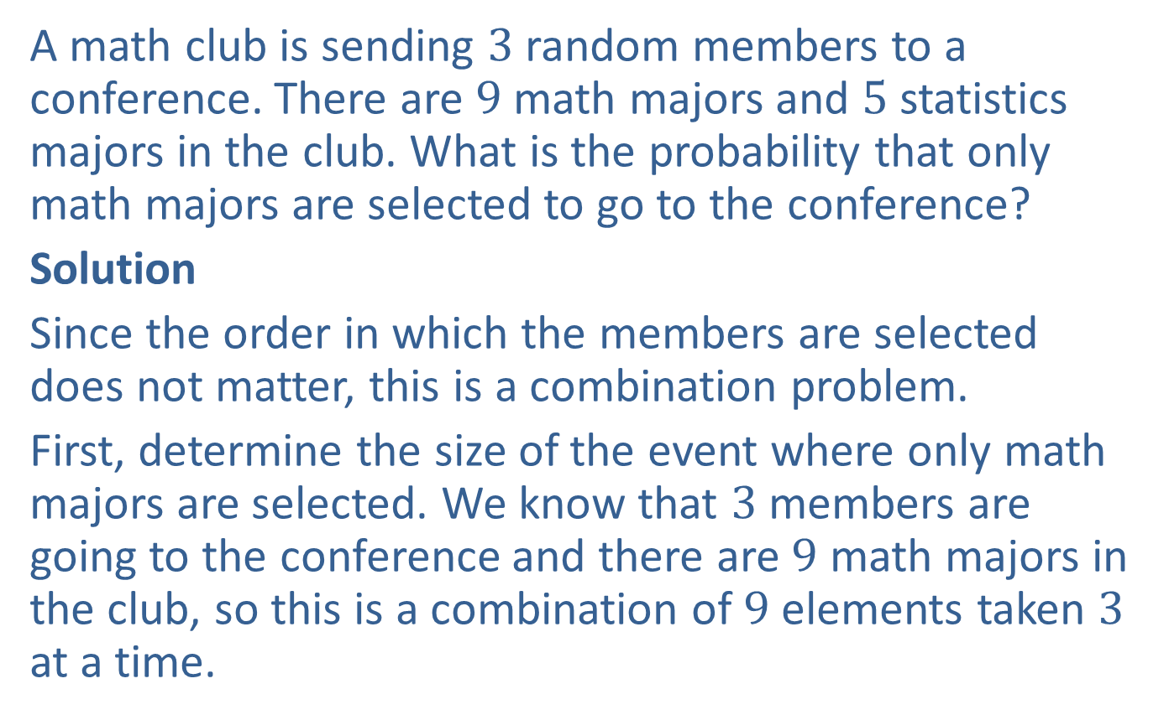
Example 2: Application: Calculating Probabilities Using Combinations
A math club is sending $3$ random members to a conference. There are $9$ math majors and $5$ statistics majors in the club. What is the probability that only math majors are selected to go to the conference?
Solution
Since the order in which the members are selected does not matter, this is a combination problem.
First, determine the size of the event where only math majors are selected. We know that $3$ members are going to the conference and there are $9$ math majors in the club, so this is a combination of $9$ elements taken $3$ at a time.

Slide 6
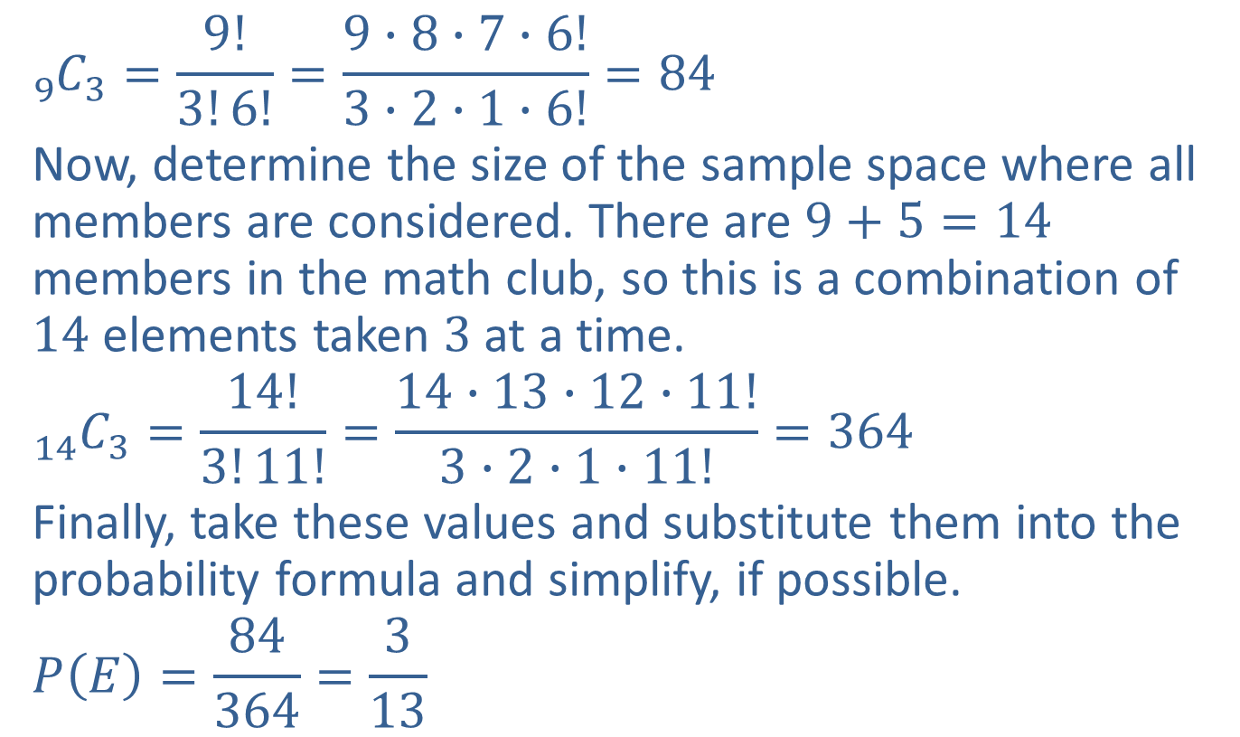
Example 2: Application: Calculating Probabilities Using Combinations (cont.)
$${}_{9}^{ }{C_{3}=\frac{9!}{3!6!}=\frac{9∙8∙7∙6!}{3∙2∙1∙6!}=84}$$
Now, determine the size of the sample space where all members are considered. There are $9+5=14$ members in the math club, so this is a combination of $14$ elements taken $3$ at a time.
$${}_{14}^{ }{C_{3}=\frac{14!}{3!11!}=\frac{14∙13∙12∙11!}{3∙2∙1∙11!}=364}$$
Finally, take these values and substitute them into the probability formula and simplify, if possible.
$$P\left(E\right)=\frac{84}{364}=\frac{3}{13}$$

Slide 7
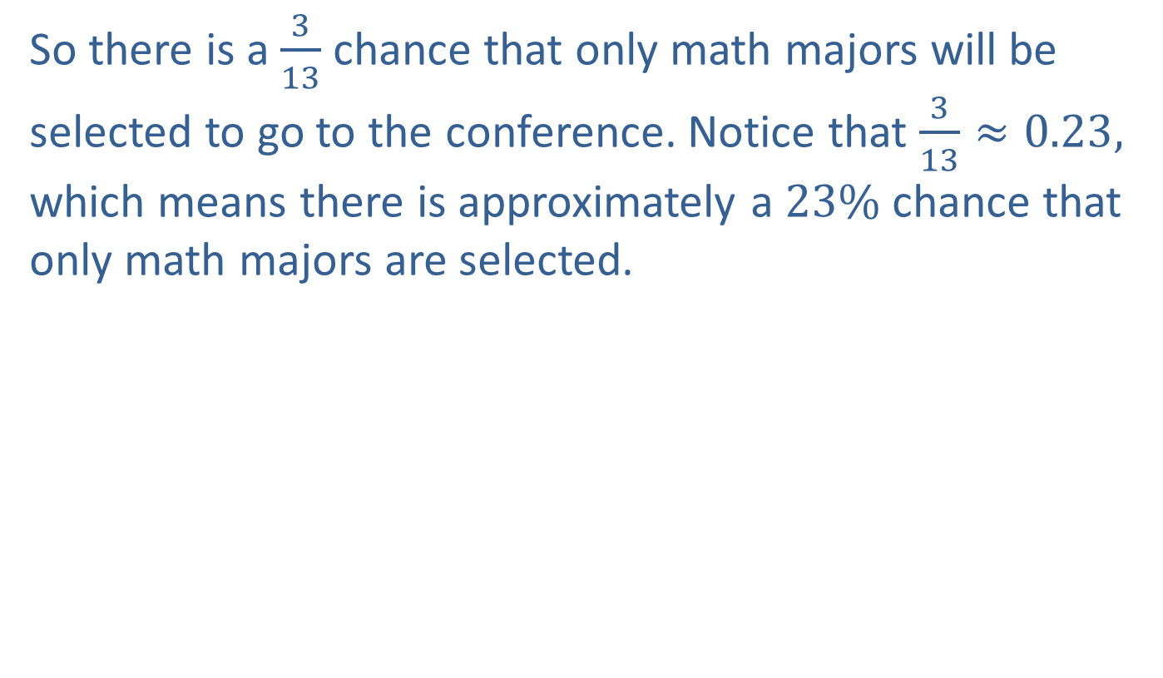
Example 2: Application: Calculating Probabilities Using Combinations (cont.)
So there is a $\frac{3}{13}$ chance that only math majors will be selected to go to the conference. Notice that $\frac{3}{13}≈0.23,$ which means there is approximately a $23\%$chance that only math majors are selected.

Slide 8
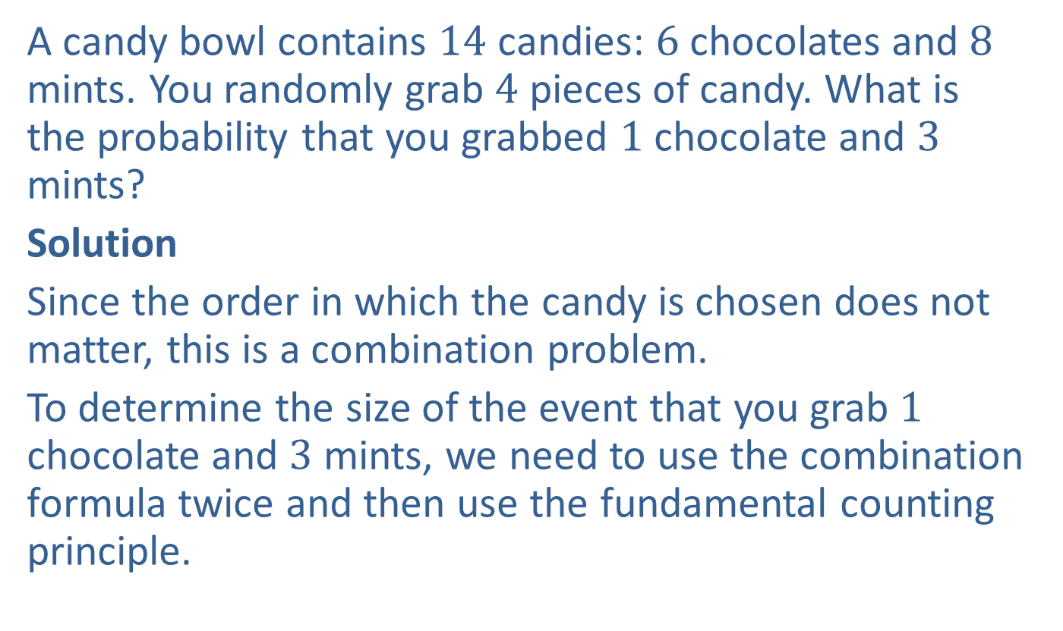
Example 3: Application: Calculating Probabilities Using Combinations
A candy bowl contains $14$ candies: $6$ chocolates and $8$ mints. You randomly grab $4$ pieces of candy. What is the probability that you grabbed $1$ chocolate and $3$ mints?
Solution
Since the order in which the candy is chosen does not matter, this is a combination problem.
To determine the size of the event that you grab $1$ chocolate and $3$ mints, we need to use the combination formula twice and then use the fundamental counting principle.

Slide 9
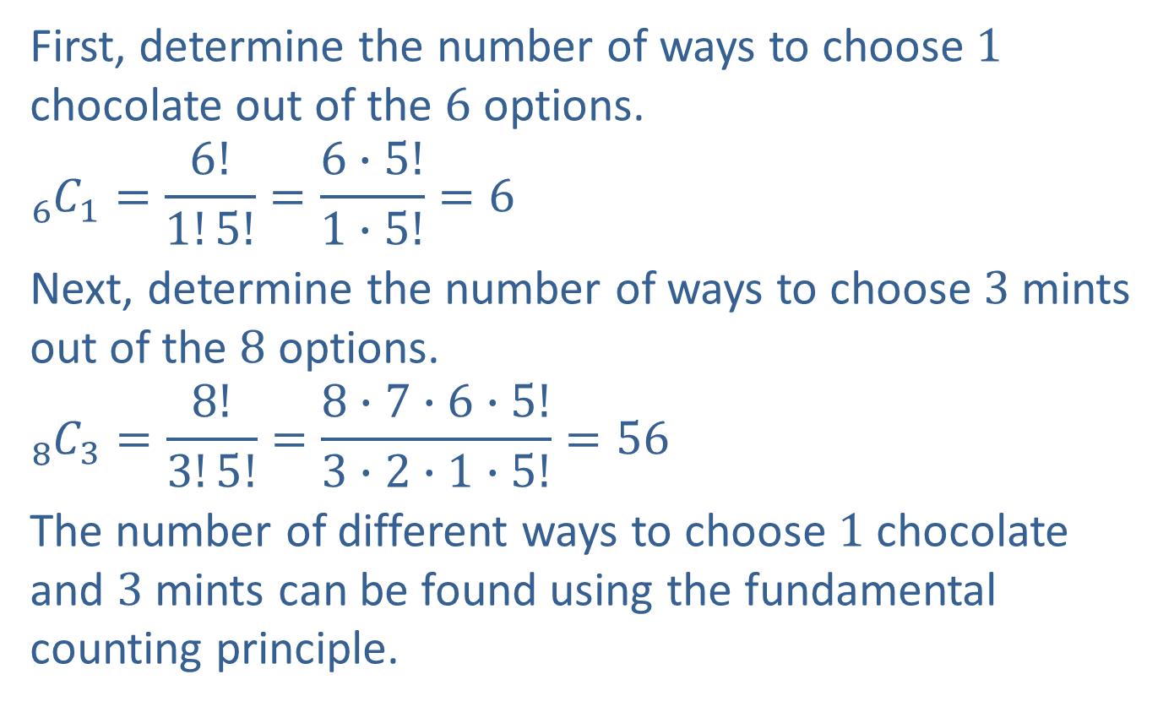
Example 3: Application: Calculating Probabilities Using Combinations (cont.)
First, determine the number of ways to choose $1$ chocolate out of the $6$ options.
$${}_{6}^{ }{C_{1}=\frac{6!}{1!5!}=\frac{6∙5!}{1∙5!}=6}$$
Next, determine the number of ways to choose $3$ mints out of the $8$ options.
$${}_{8}^{ }{C_{3}=\frac{8!}{3!5!}=\frac{8∙7∙6∙5!}{3∙2∙1∙5!}=56}$$
The number of different ways to choose $1$ chocolate and $3$ mints can be found using the fundamental counting principle.

Slide 10
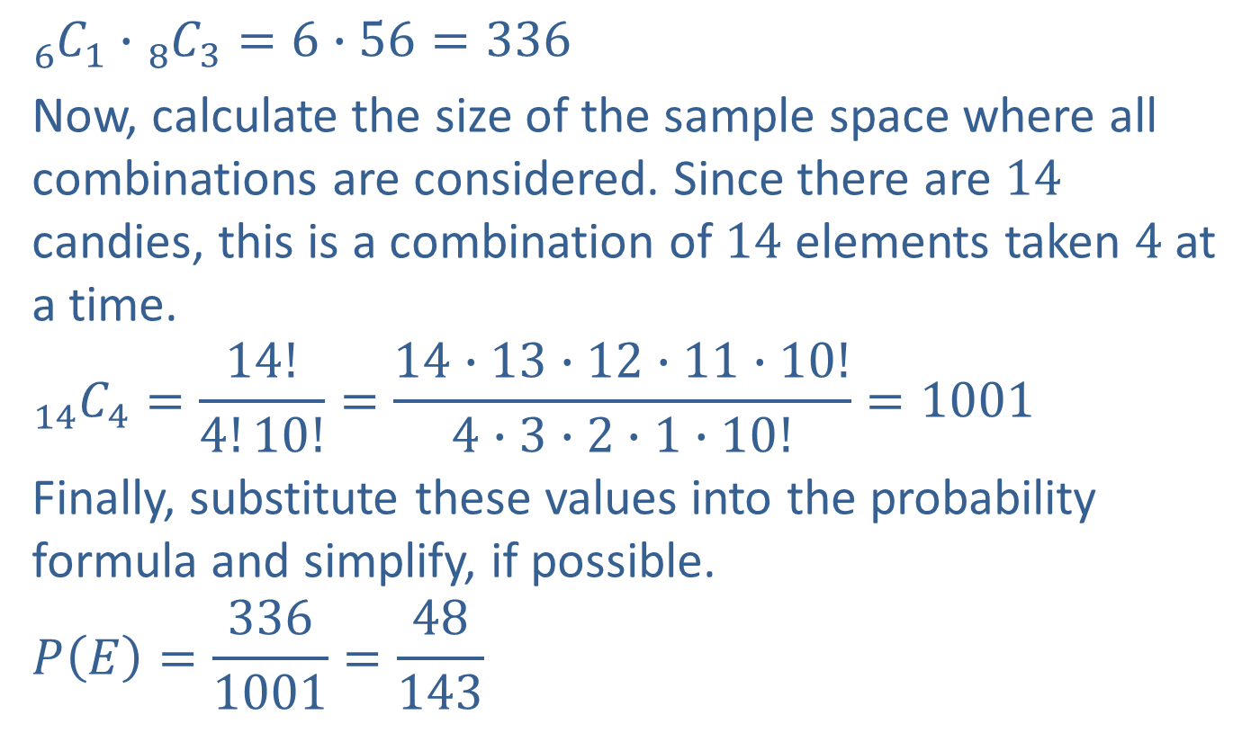
Example 3: Application: Calculating Probabilities Using Combinations (cont.)
$${}_{6}^{ }{C_{1}∙{}_{8}^{ }{C_{3}}=6∙56=336}$$
Now, calculate the size of the sample space where all combinations are considered. Since there are $14$ candies, this is a combination of $14$ elements taken $4$ at a time.
$${}_{14}^{ }{C_{4}=\frac{14!}{4!10!}=\frac{14∙13∙12∙11∙10!}{4∙3∙2∙1∙10!}=1001}$$
Finally, substitute these values into the probability formula and simplify, if possible.
$$P\left(E\right)=\frac{336}{1001}=\frac{48}{143}$$

Slide 11

Example 3: Application: Calculating Probabilities Using Combinations (cont.)
Thus, the probability of grabbing $1$ chocolate and $3$ mints is $=\frac{48}{143}.$

Slide 12
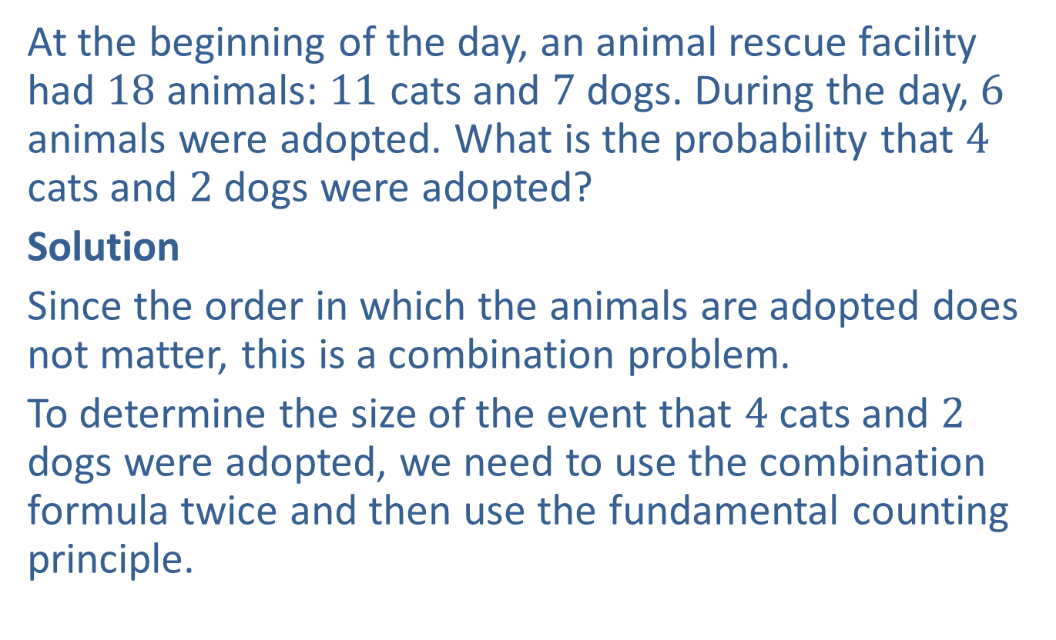
Example 4: Application: Calculating Probabilities Using Combinations
At the beginning of the day, an animal rescue facility had $18$ animals: $11$ cats and $7$ dogs. During the day, $6$ animals were adopted. What is the probability that $4$ cats and $2$ dogs were adopted?
Solution
Since the order in which the animals are adopted does not matter, this is a combination problem.
To determine the size of the event that $4$ cats and $2$ dogs were adopted, we need to use the combination formula twice and then use the fundamental counting principle.

Slide 13
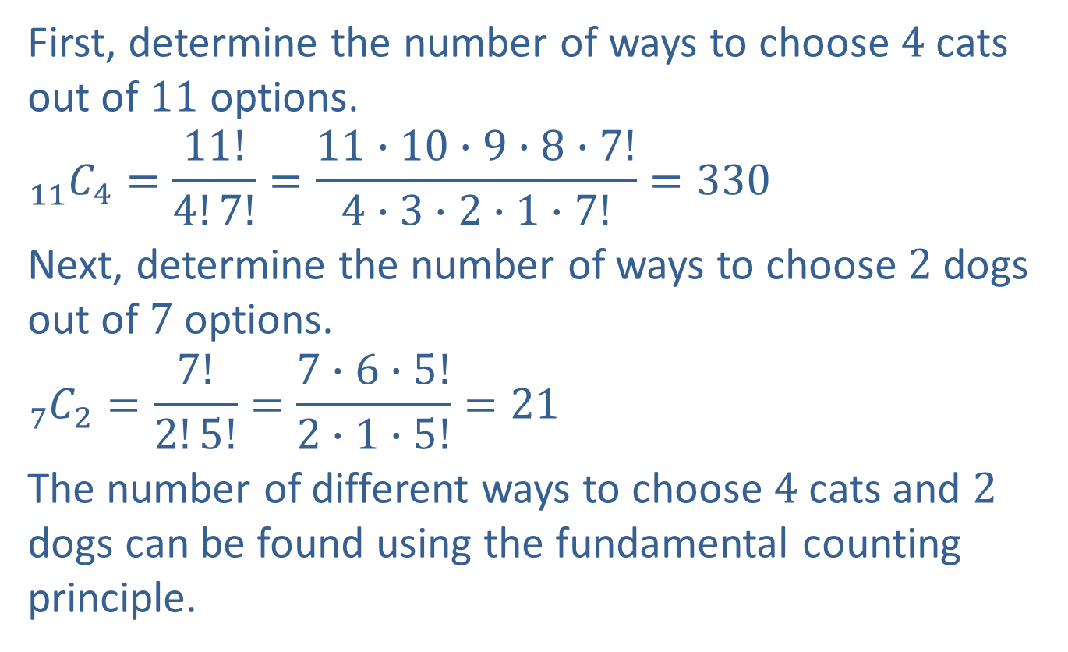
Example 4: Application: Calculating Probabilities Using Combinations (cont.)
First, determine the number of ways to choose $4$ cats out of $11$ options.
$${}_{11}^{ }{C_{4}=\frac{11!}{4!7!}=\frac{11∙10∙9∙8∙7!}{4∙3∙2∙1∙7!}=330}$$
Next, determine the number of ways to choose $2$ dogs out of $7$ options.
$${}_{7}^{ }{C_{2}=\frac{7!}{2!5!}=\frac{7∙6∙5!}{2∙1∙5!}=21}$$
The number of different ways to choose $4$ cats and $2$ dogs can be found using the fundamental counting principle.

Slide 14
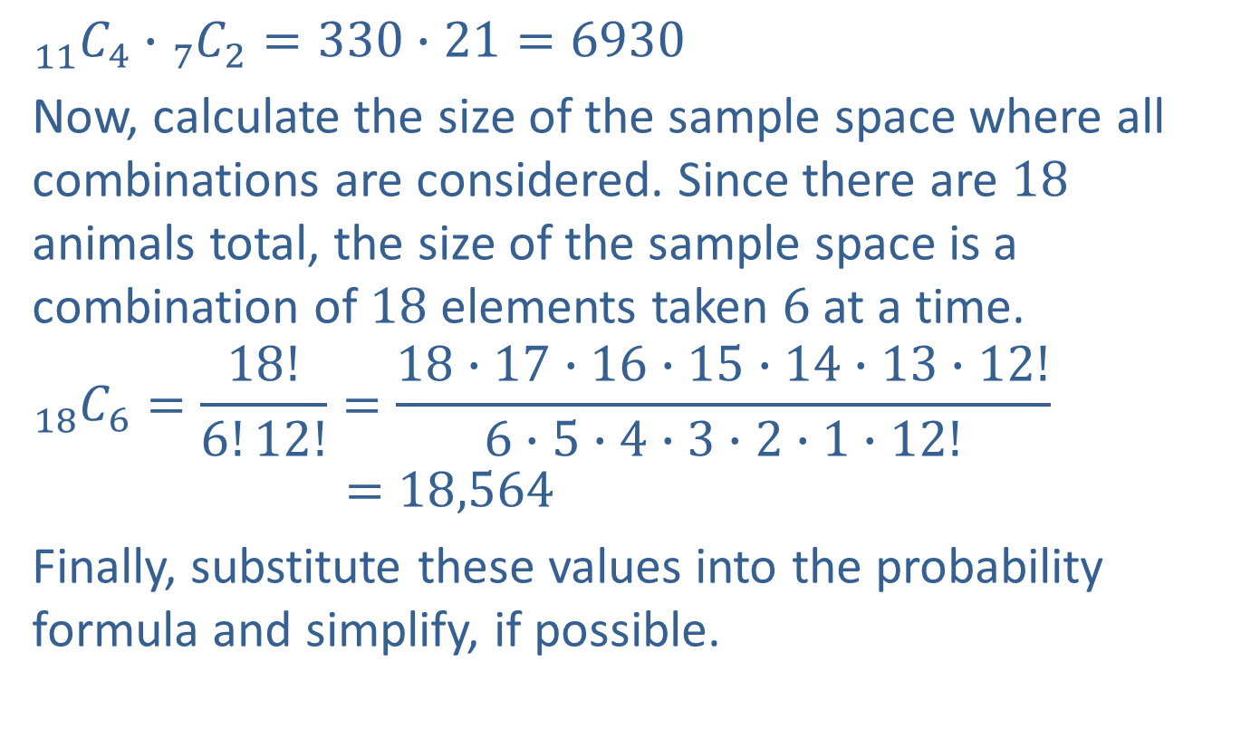
Example 4: Application: Calculating Probabilities Using Combinations (cont.)
$${}_{11}^{ }{C_{4}∙{}_{7}^{ }{C_{2}=330}∙21=6930}$$
Now, calculate the size of the sample space where all combinations are considered. Since there are $18$ animals total, the size of the sample space is a combination of $18$ elements taken $6$ at a time.
$${}_{18}^{ }{C_{6}=}\frac{18!}{6!12!}=\frac{18∙17∙16∙15∙14∙13∙12!}{6∙5∙4∙3∙2∙1∙12!}$$
$$=18,564$$
Finally, substitute these values into the probability formula and simplify, if possible.

Slide 15

Example 4: Application: Calculating Probabilities Using Combinations (cont.)
$$P\left(E\right)=\frac{6930}{18,564}=\frac{165}{442}$$
Thus, the probability of $4$ cats and $2$ dogs being adopted is $\frac{165}{442}.$

