Slide 1
Section A.1
Matrices and Basic Matrix Operations

Slide 2

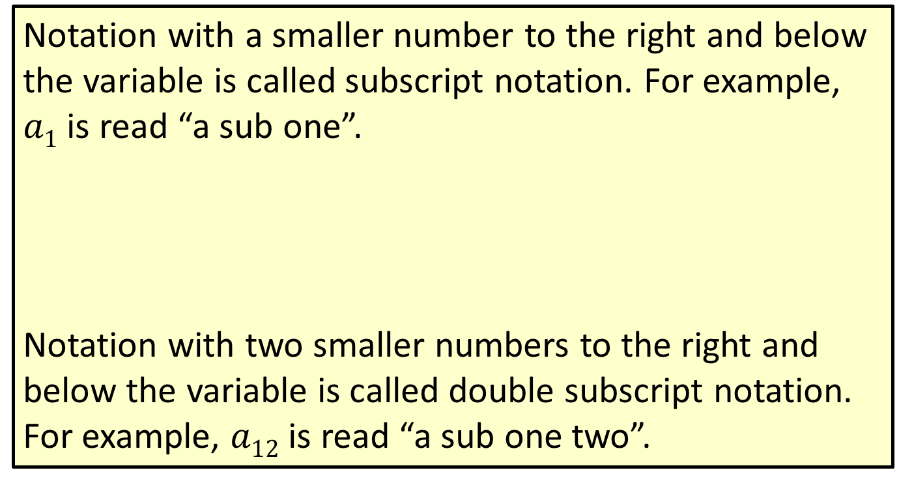
Note
Notation with a smaller number to the right and below the variable is called subscript notation. For example, $a1$ is read “a sub one”.
Notation with two smaller numbers to the right and below the variable is called double subscript notation. For example, $a12$ is read “a sub one two”.
$$a1$$
Subscript
Variable

Slide 3
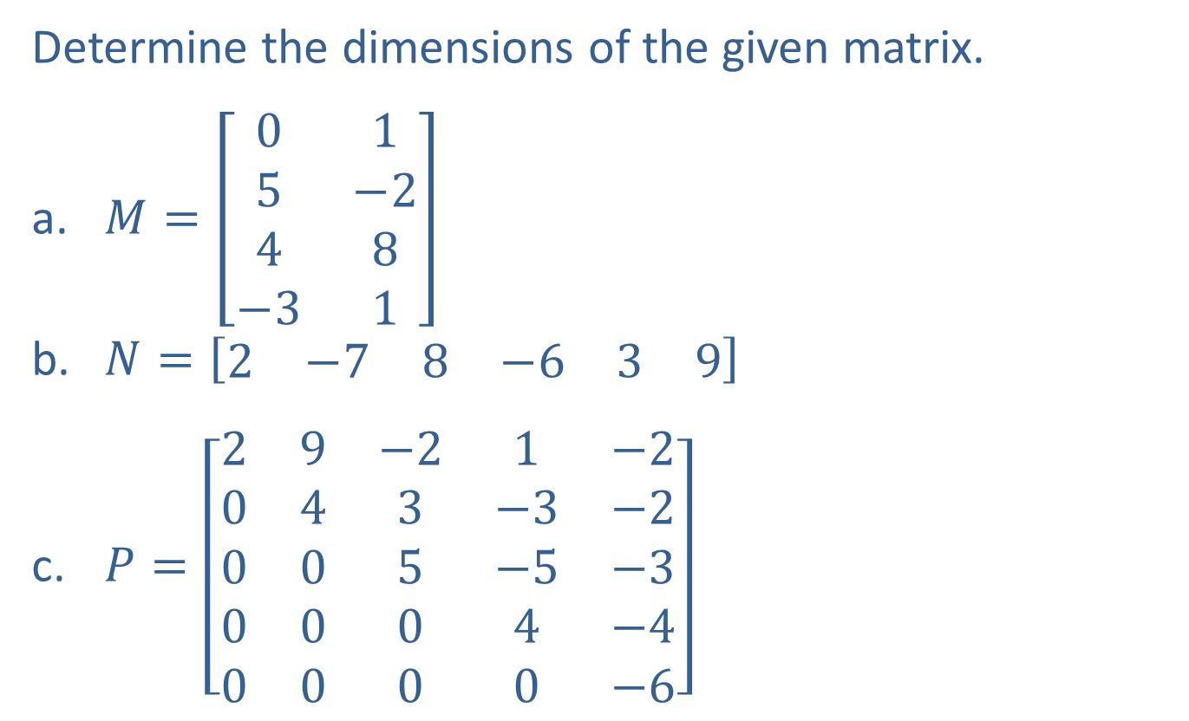
Example 1: Determining the Dimensions of a Matrix
Determine the dimensions of the given matrix.
​$M=\left[\begin{matrix}0 & 1 \\ 5 & −2 \\ 4 & 8 \\ −3 & 1\end{matrix}\right]$
​$N=\left[\begin{matrix}2 & −7 & 8 & −6 & 3 & 9\end{matrix}\right]$
​$P=\left[\begin{matrix}2 & 9 & −2 & 1 & −2 \\ 0 & 4 & 3 & −3 & −2 \\ 0 & 0 & 5 & −5 & −3 \\ 0 & 0 & 0 & 4 & −4 \\ 0 & 0 & 0 & 0 & −6\end{matrix}\right]$

Slide 4
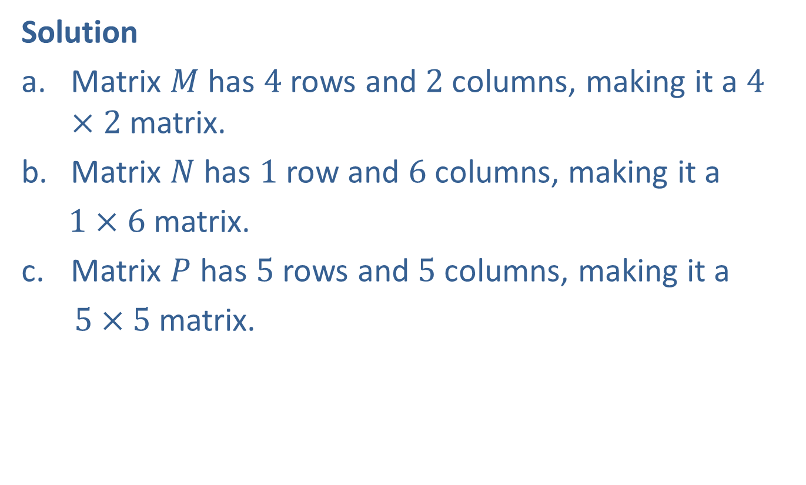
Example 1: Determining the Dimensions of a Matrix (cont.)
Solution
Matrix $M$ has $4$ rows and $2$ columns, making it a $4×2$ matrix.
Matrix $N$ has $1$ row and $6$ columns, making it a
$1×6$ matrix.
Matrix $P$ has $5$ rows and $5$ columns, making it a
$5×5$ matrix.

Slide 5
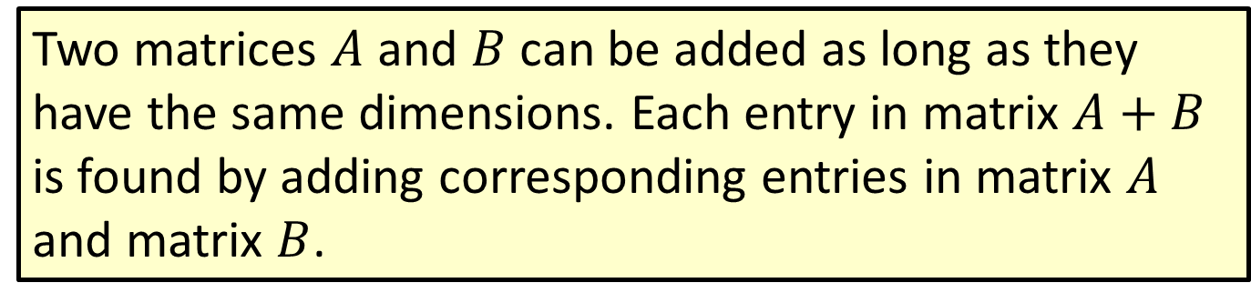
Procedure: Addition with Matrices
Two matrices $A$ and $B$ can be added as long as they have the same dimensions. Each entry in matrix $A+B$ is found by adding corresponding entries in matrix $A$ and matrix $B$.

Slide 6
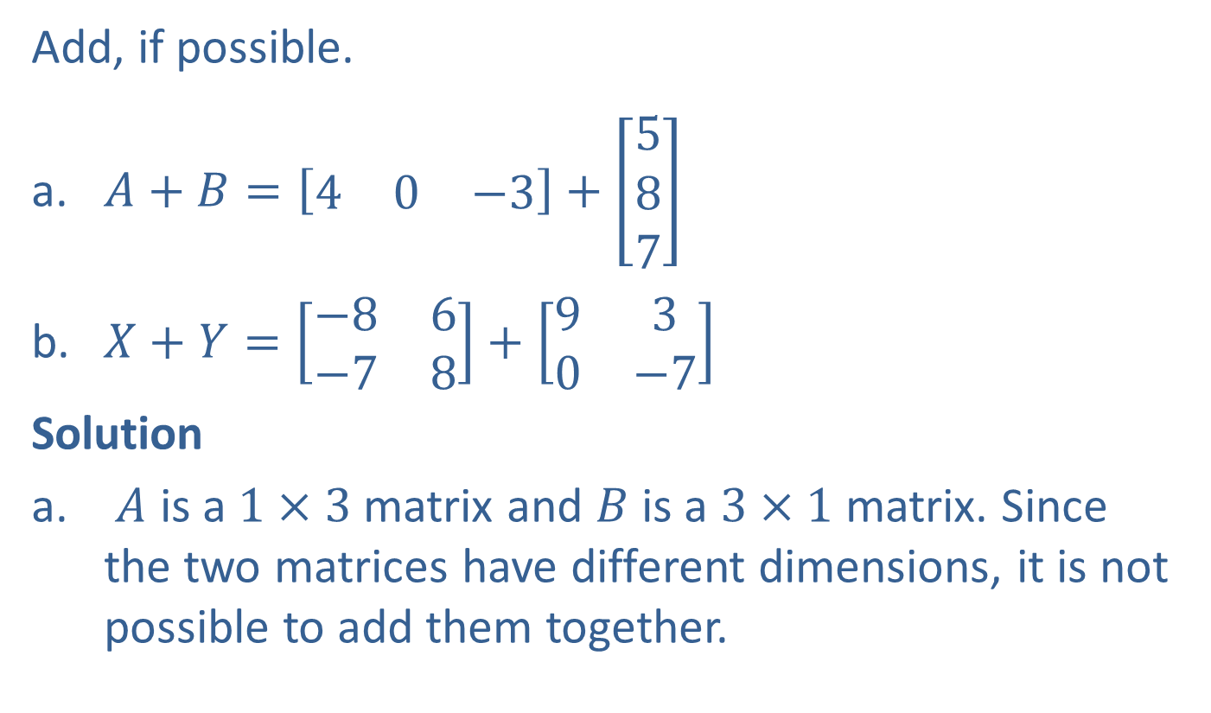
Example 2: Adding Matrices
Add, if possible.
​$A+B=\left[\begin{matrix}4 & 0 & −3\end{matrix}\right]+\left[\begin{aligned}5 \\ 8 \\ 7\end{aligned}\right]$
​$X+Y=\left[\begin{matrix}−8 & 6 \\ −7 & 8\end{matrix}\right]+\left[\begin{matrix}9 & 3 \\ 0 & −7\end{matrix}\right]$
Solution
$A$ is a $1×3$ matrix and $B$ is a $3×1$ matrix. Since the two matrices have different dimensions, it is not possible to add them together.

Slide 7
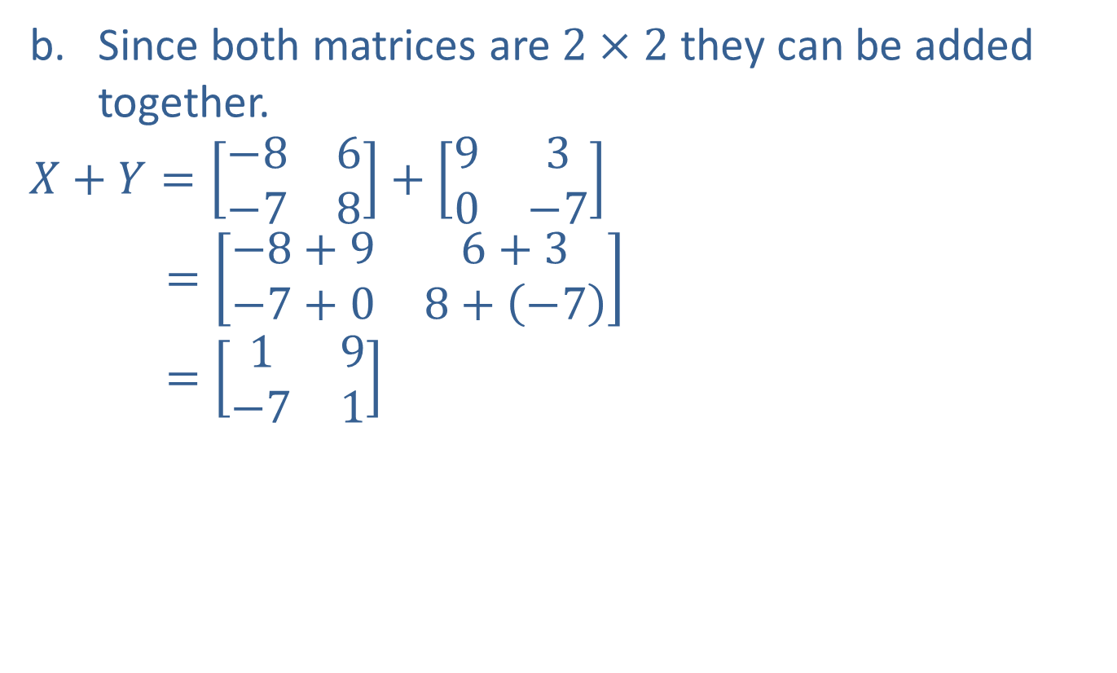
Example 2: Adding Matrices (cont.)
Since both matrices are $2×2$ they can be added together.
$$X+Y=\left[\begin{matrix}−8 & 6 \\ −7 & 8\end{matrix}\right]+\left[\begin{matrix}9 & 3 \\ 0 & −7\end{matrix}\right]$$
$$=\left[\begin{matrix}−8+9 & 6+3 \\ −7+0 & 8+\left(−7\right)\end{matrix}\right]$$
$$=\left[\begin{matrix}1 & 9 \\ −7 & 1\end{matrix}\right]$$

Slide 8
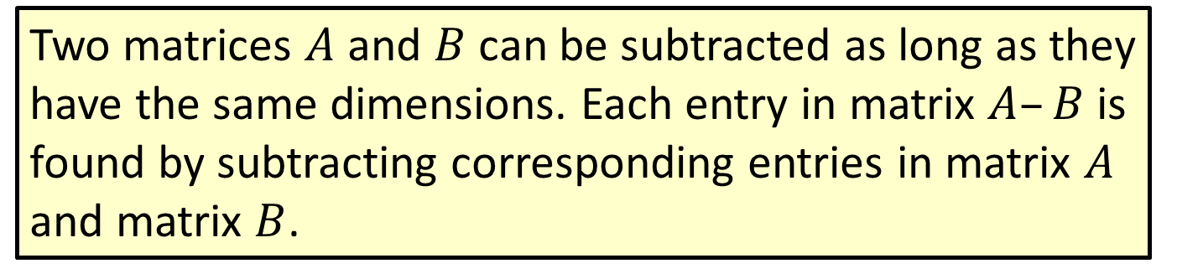
Procedure: Subtraction with Matrices
Two matrices $A$ and $B$ can be subtracted as long as they have the same dimensions. Each entry in matrix $A–B$ is found by subtracting corresponding entries in matrix $A$ and matrix $B$.

Slide 9

Example 3: Subtracting Matrices
Subtract, if possible.
​$C−D=\left[\begin{matrix}−6 & 5 \\ 9 & 8\end{matrix}\right]−\left[\begin{matrix}2 & 9 \\ 1 & −3\end{matrix}\right]$
​$W−V=\left[\begin{matrix}0 & 5 \\ −7 & 7 \\ −8 & 6\end{matrix}\right]−\left[\begin{matrix}8 & −6 \\ −2 & −3 \\ 2 & 4\end{matrix}\right]$

Slide 10
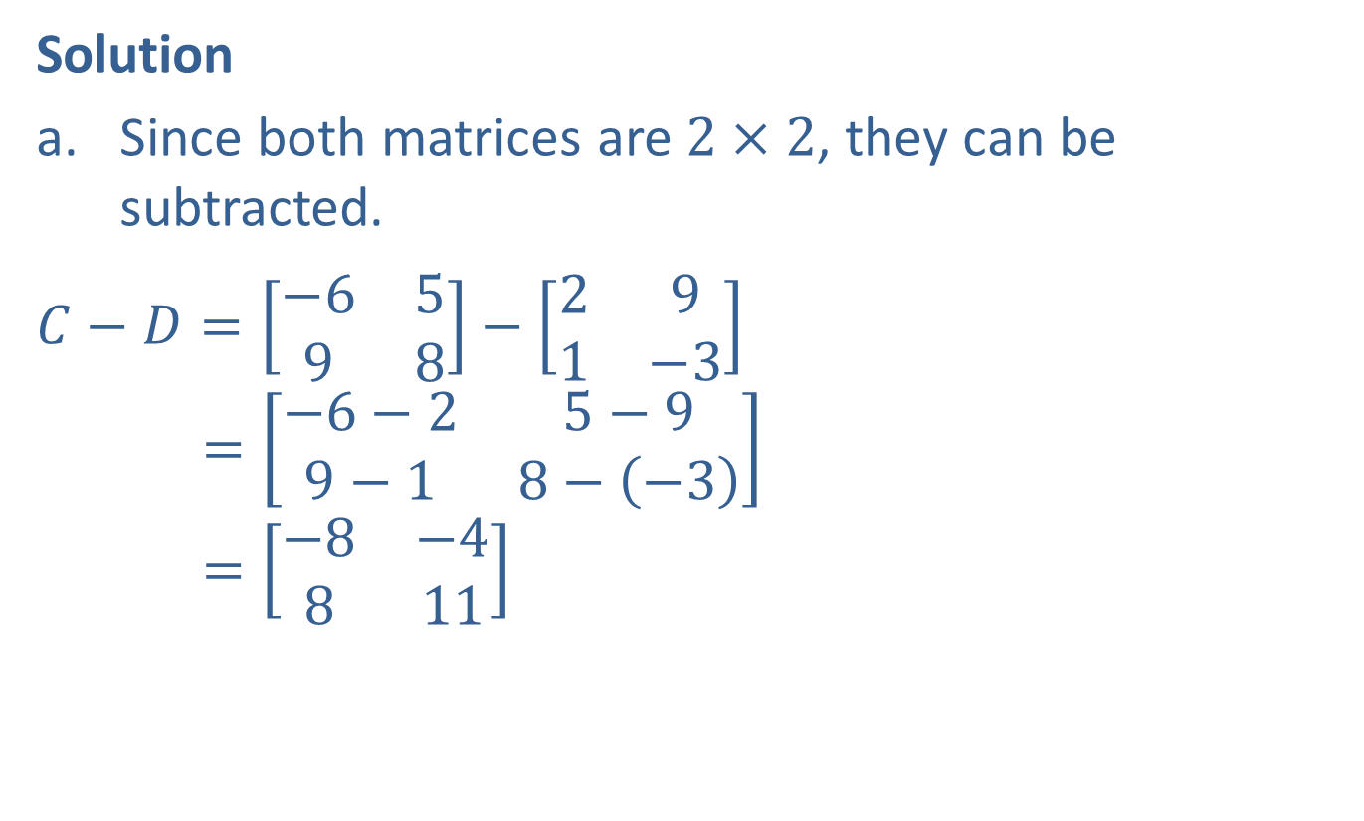
Example 3: Subtracting Matrices (cont.)
Solution
Since both matrices are $2×2$, they can be subtracted.
​$C−D=\left[\begin{matrix}−6 & 5 \\ 9 & 8\end{matrix}\right]−\left[\begin{matrix}2 & 9 \\ 1 & −3\end{matrix}\right]$
$$=\left[\begin{matrix}−6−2 & 5−9 \\ 9−1 & 8−\left(−3\right)\end{matrix}\right]$$
$$=\left[\begin{matrix}−8 & −4 \\ 8 & 11\end{matrix}\right]$$

Slide 11
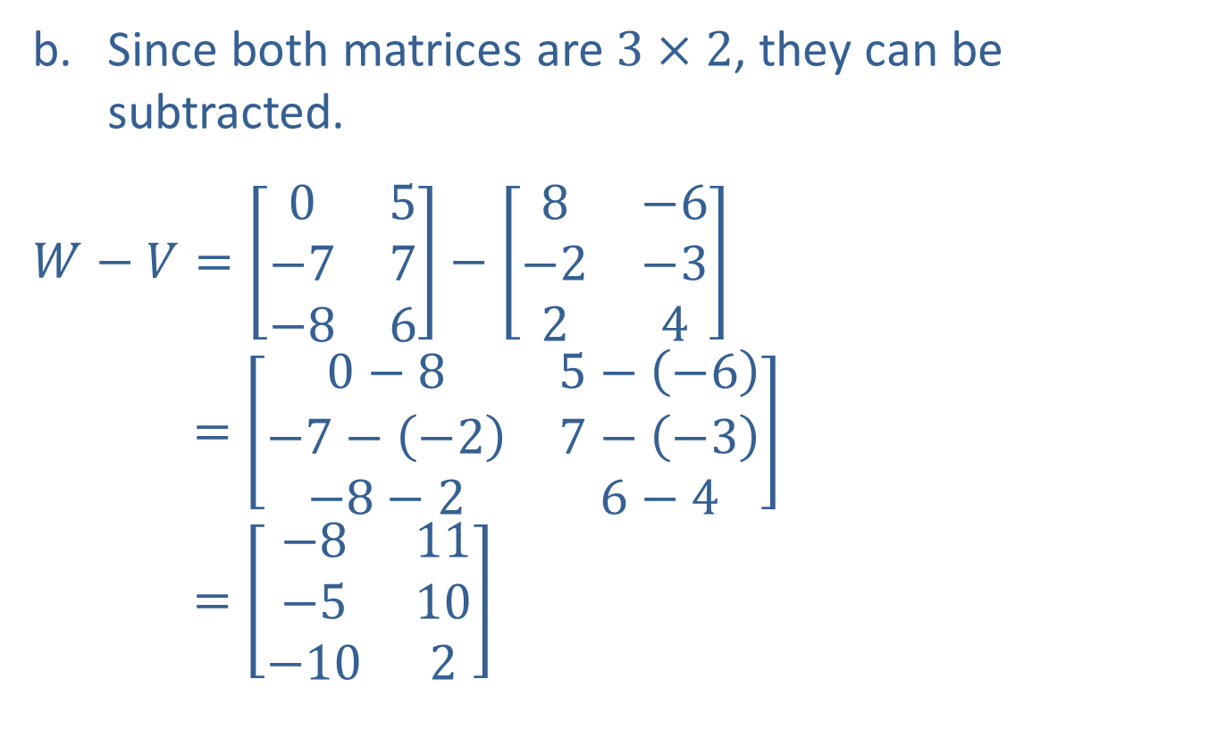
Example 3: Subtracting Matrices (cont.)
Since both matrices are $3×2$, they can be subtracted.
​$W−V=\left[\begin{matrix}0 & 5 \\ −7 & 7 \\ −8 & 6\end{matrix}\right]−\left[\begin{matrix}8 & −6 \\ −2 & −3 \\ 2 & 4\end{matrix}\right]$
$$=\left[\begin{matrix}0−8 & 5−\left(−6\right) \\ −7−\left(−2\right) & 7−\left(−3\right) \\ −8−2 & 6−4\end{matrix}\right]$$
$$=\left[\begin{matrix}−8 & 11 \\ −5 & 10 \\ −10 & 2\end{matrix}\right]$$

Slide 12
Procedure: Product of a Scalar and a Matrix
To find the product of a scalar and a matrix, multiply each entry of the matrix by the scalar.

Slide 13

Example 4: Multiplying a Matrix by a Scalar
Find the product.
​$−7A=−7\left[\begin{aligned}4 \\ 0 \\ −5\end{aligned}\right]$
​$5B=5\left[\begin{matrix}6 & 1 & 7 & −4 \\ 2 & 9 & 1 & 9\end{matrix}\right]$

Slide 14
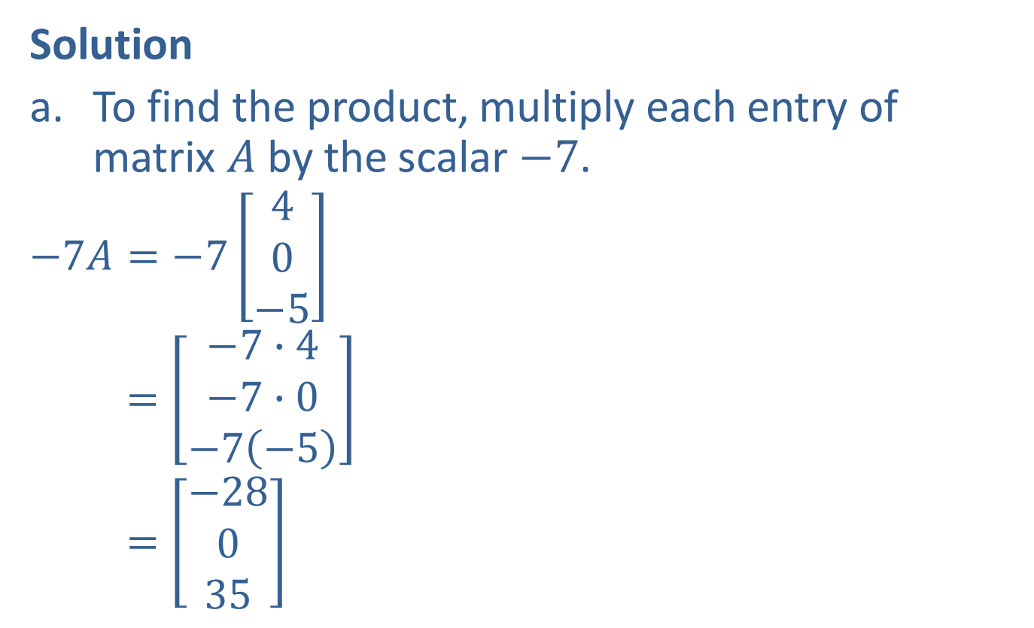
Example 4: Multiplying a Matrix by a Scalar (cont.)
Solution
To find the product, multiply each entry of matrix $A$ by the scalar $−7$.
$$−7A=−7\left[\begin{aligned}4 \\ 0 \\ −5\end{aligned}\right]$$
$$=\left[\begin{aligned}−7∙4 \\ −7∙0 \\ −7\left(−5\right)\end{aligned}\right]$$
$$=\left[\begin{aligned}−28 \\ 0 \\ 35\end{aligned}\right]$$

Slide 15
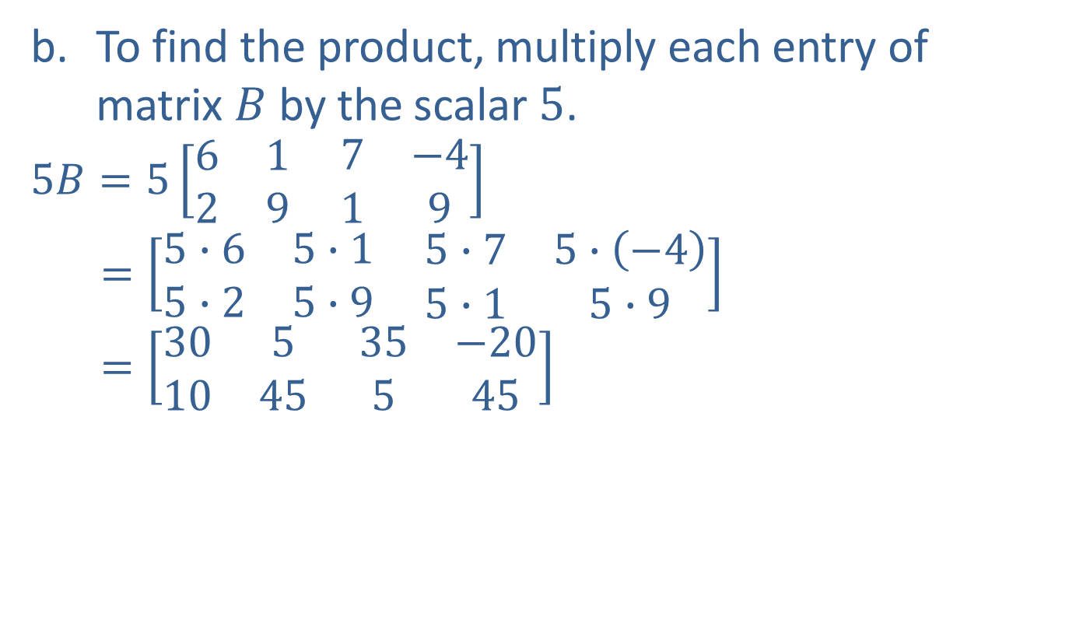
Example 4: Multiplying a Matrix by a Scalar (cont.)
To find the product, multiply each entry of matrix $B$ by the scalar $5$.
$$5B=5\left[\begin{matrix}6 & 1 \\ 2 & 9\end{matrix} \begin{matrix}7 & −4 \\ 1 & 9\end{matrix}\right]$$
$$=\left[\begin{matrix}5∙6 & 5∙1 \\ 5∙2 & 5∙9\end{matrix} \begin{matrix}5∙7 & 5∙\left(−4\right) \\ 5∙1 & 5∙9\end{matrix}\right]$$
$$=\left[\begin{matrix}30 & 5 \\ 10 & 45\end{matrix} \begin{matrix}35 & −20 \\ 5 & 45\end{matrix}\right]$$

Slide 16
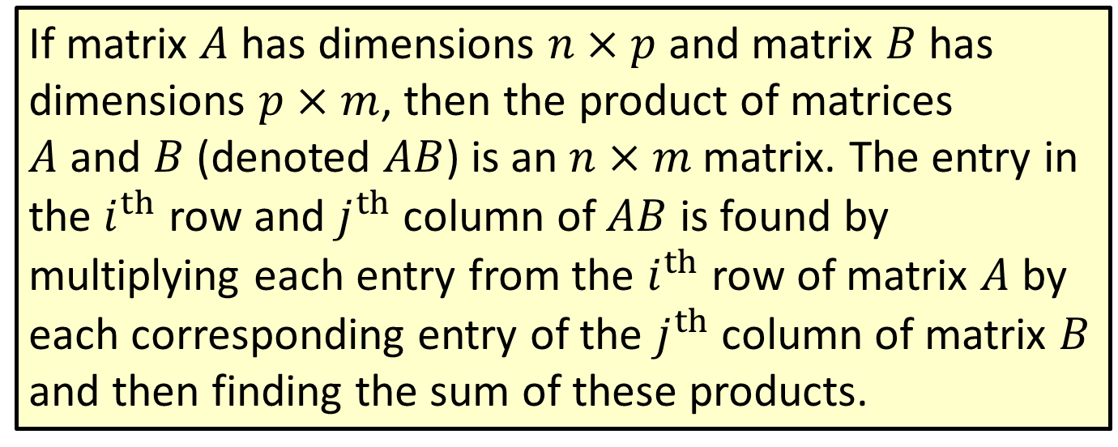
Procedure: Multiplication with Matrices
If matrix $A$ has dimensions $n×p$ and matrix $B$ has dimensions $p×m$, then the product of matrices $A$ and $B$ (denoted $AB$) is an $n×m$ matrix. The entry in the $i^{th}$ row and $j^{th}$column of $AB$ is found by multiplying each entry from the $i^{th}$row of matrix $A$ by each corresponding entry of the $j^{th}$column of matrix $B$ and then finding the sum of these products.

Slide 17
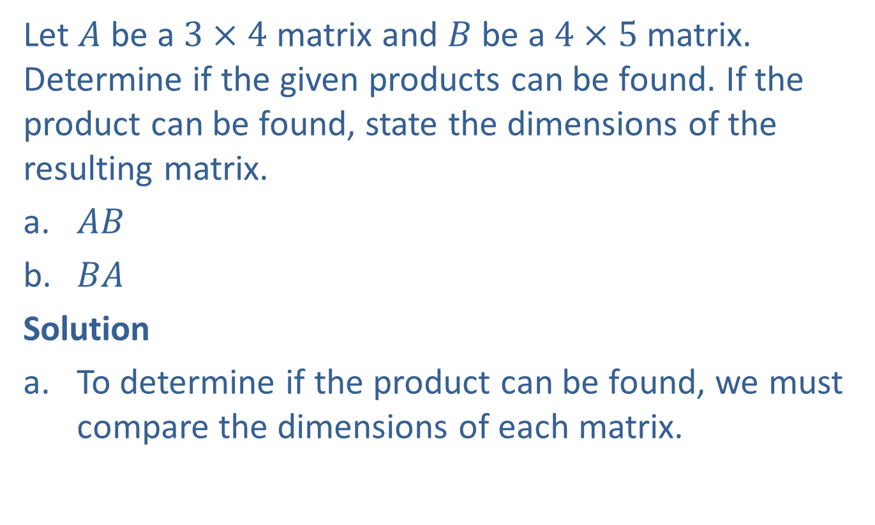
Example 5: Multiplying Two Matrices
Let $A$ be a $3×4$ matrix and $B$ be a $4×5$ matrix. Determine if the given products can be found. If the product can be found, state the dimensions of the resulting matrix.
​$AB$
​$BA$
Solution
To determine if the product can be found, we must compare the dimensions of each matrix.

Slide 18
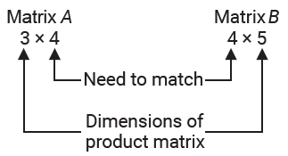
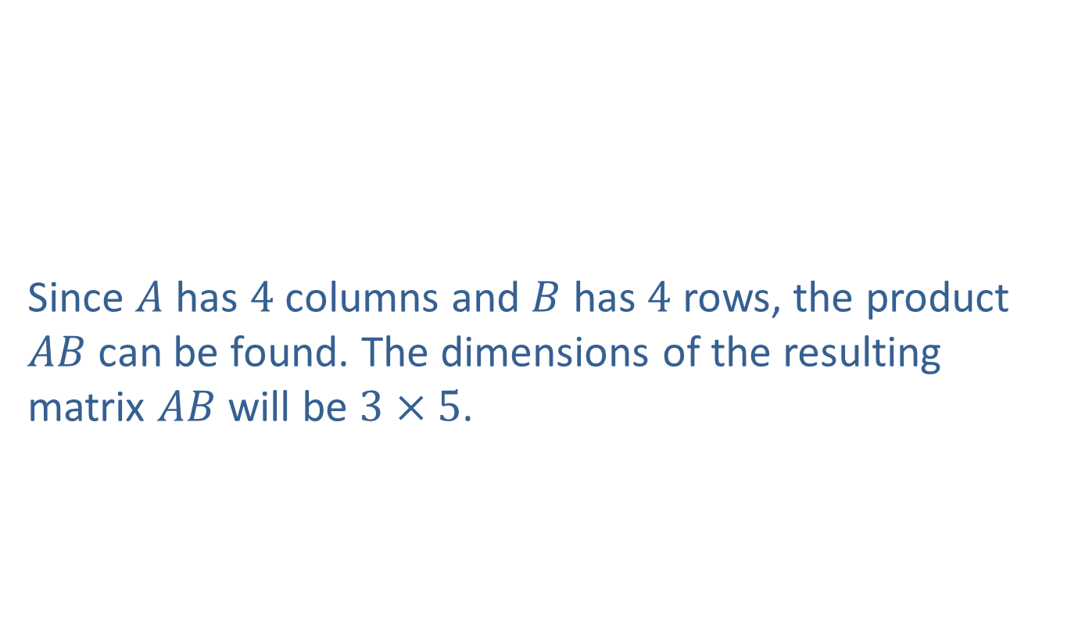
Example 5: Multiplying Two Matrices (cont.)
Since $A$ has $4$ columns and $B$ has $4$ rows, the product $AB$ can be found. The dimensions of the resulting matrix $AB$ will be $3×5$.

Slide 19
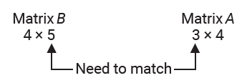

Example 5: Multiplying Two Matrices (cont.)
Using a similar comparison, we see that matrix $B$ has $5$ columns and matrix $A$ has $3$ rows. This means the product $BA$ cannot be found.

Slide 20
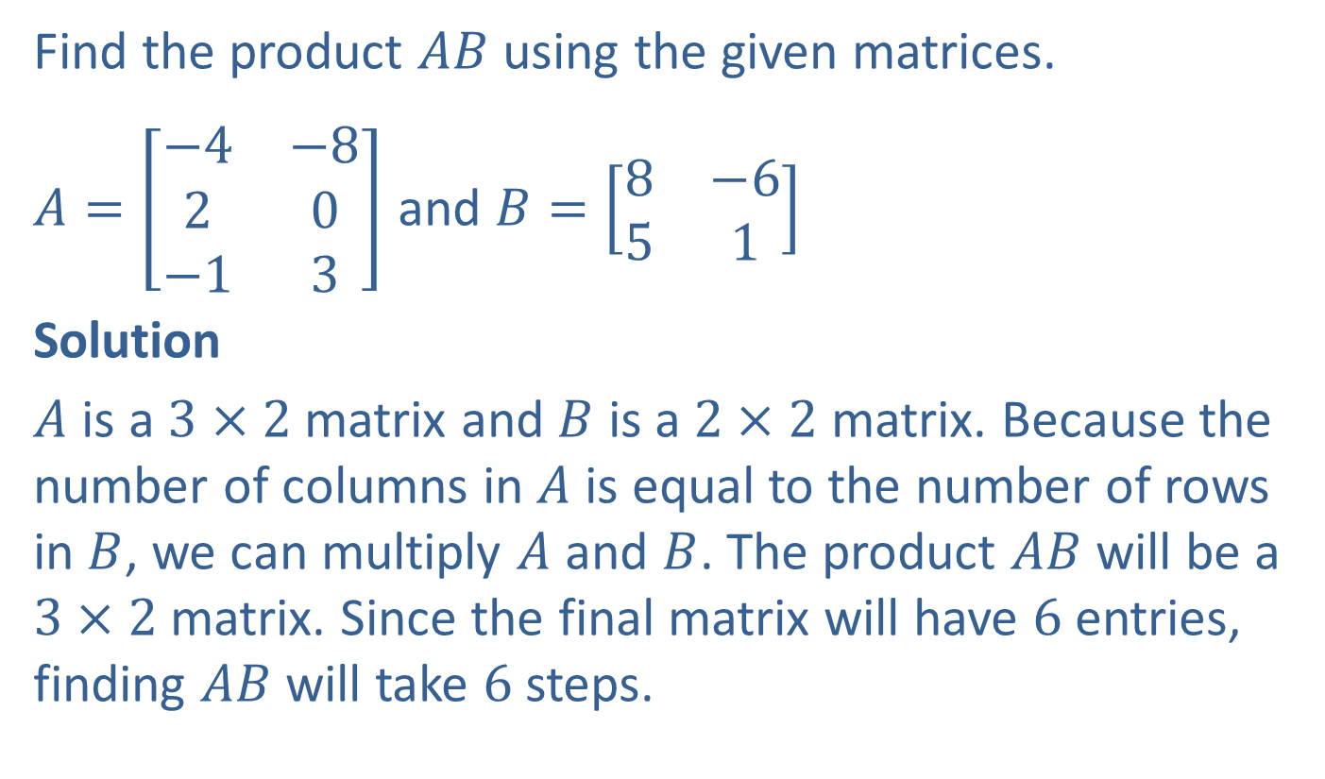
Example 6: Multiplying Two Matrices
Find the product $AB$ using the given matrices.
$A=\left[\begin{matrix}−4 & −8 \\ 2 & 0 \\ −1 & 3\end{matrix}\right]$ and $B=\left[\begin{matrix}8 & −6 \\ 5 & 1\end{matrix}\right]$
Solution
$A$ is a $3×2$ matrix and $B$ is a $2×2$ matrix. Because the number of columns in $A$ is equal to the number of rows in $B$, we can multiply $A$ and $B$. The product $AB$will be a $3×2$matrix. Since the final matrix will have $6$ entries, finding $AB$ will take $6$ steps.

Slide 21
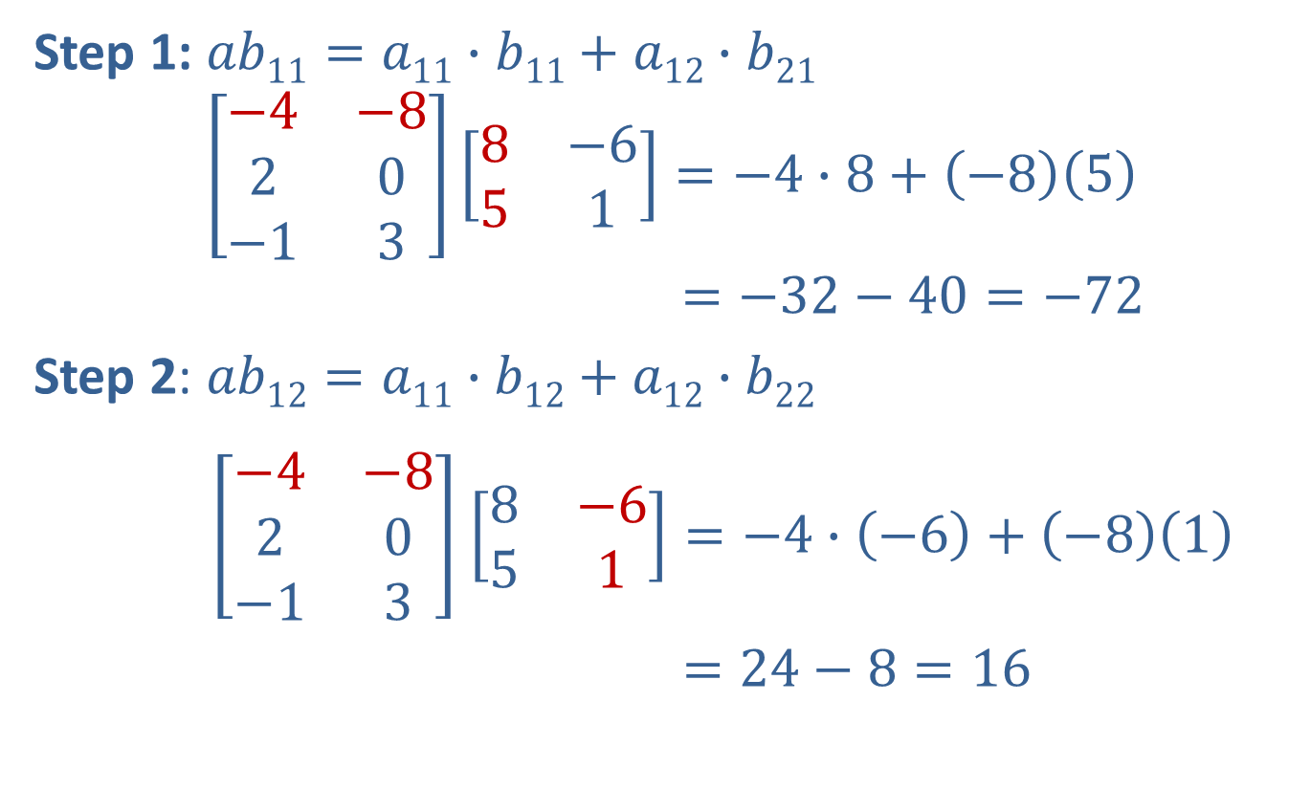
Example 6: Multiplying Two Matrices (cont.)
Step 1: $ab11=a11∙b11+a12∙b21$
$$\left[\begin{matrix}−4 & −8 \\ 2 & 0 \\ −1 & 3\end{matrix}\right]\left[\begin{matrix}8 & −6 \\ 5 & 1\end{matrix}\right]=−4∙8+\left(−8\right)\left(5\right)$$
$$=−32−40=−72$$
Step 2: $ab12=a11∙b12+a12∙b22$
$\left[\begin{matrix}−4 & −8 \\ 2 & 0 \\ −1 & 3\end{matrix}\right]$ $\left[\begin{matrix}8 & −6 \\ 5 & 1\end{matrix}\right]=−4∙\left(−6\right)+\left(−8\right)\left(1\right)$
$=24−8=16$

Slide 22
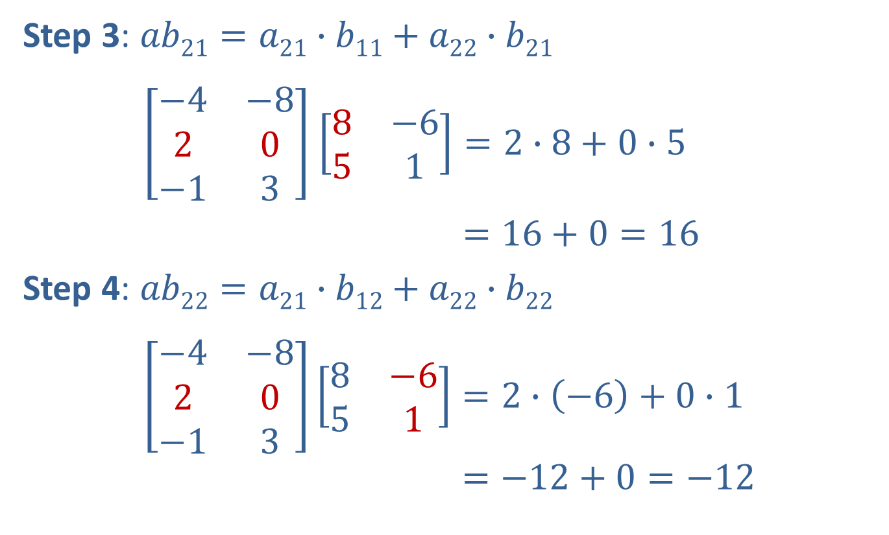
Example 6: Multiplying Two Matrices (cont.)
Step 3: $ab21=a21∙b11+a22∙b21$
$\left[\begin{matrix}−4 & −8 \\ 2 & 0 \\ −1 & 3\end{matrix}\right]$ $\left[\begin{matrix}8 & −6 \\ 5 & 1\end{matrix}\right]=2∙8+0∙5$
$=16+0=16$
Step 4: $ab22=a21∙b12+a22∙b22$
$\left[\begin{matrix}−4 & −8 \\ 2 & 0 \\ −1 & 3\end{matrix}\right]\left[\begin{matrix}8 & −6 \\ 5 & 1\end{matrix}\right]=2∙\left(−6\right)+0∙1$
$$=−12+0=−12$$

Slide 23
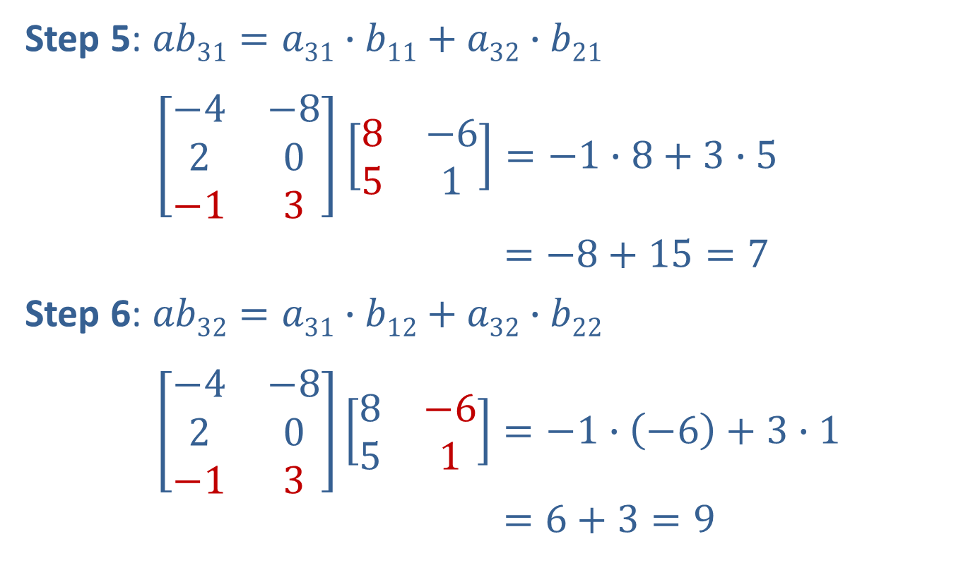
Example 6: Multiplying Two Matrices (cont.)
Step 5: $ab31=a31∙b11+a32∙b21$
$\left[\begin{matrix}−4 & −8 \\ 2 & 0 \\ −1 & 3\end{matrix}\right]$ $\left[\begin{matrix}8 & −6 \\ 5 & 1\end{matrix}\right]=−1∙8+3∙5$
$=−8+15=7$
Step 6: $ab32=a31∙b12+a32∙b22$
$\left[\begin{matrix}−4 & −8 \\ 2 & 0 \\ −1 & 3\end{matrix}\right]\left[\begin{matrix}8 & −6 \\ 5 & 1\end{matrix}\right]=−1∙\left(−6\right)+3∙1$
$$=6+3=9$$

Slide 24

Example 6: Multiplying Two Matrices (cont.)
We can now take all of those values and place them into their corresponding locations in the product matrix $AB$.
$$AB=\left[\begin{matrix}−4 & −8 \\ 2 & 0 \\ −1 & 3\end{matrix}\right]\left[\begin{matrix}8 & −6 \\ 5 & 1\end{matrix}\right]=\left[\begin{matrix}−72 & 16 \\ 16 & −12 \\ 7 & 9\end{matrix}\right]$$

Slide 25

Example 7: Multiplying Two Matrices
Using the given matrices, find the indicated product, if possible.
​ $CD$
​ $DC$
$C=\left[\begin{matrix}−1 & −9 & −1 & 2\end{matrix}\right]$ and $D=\left[\begin{aligned}5 \\ 7 \\ −1 \\ 3\end{aligned}\right]$

Slide 26
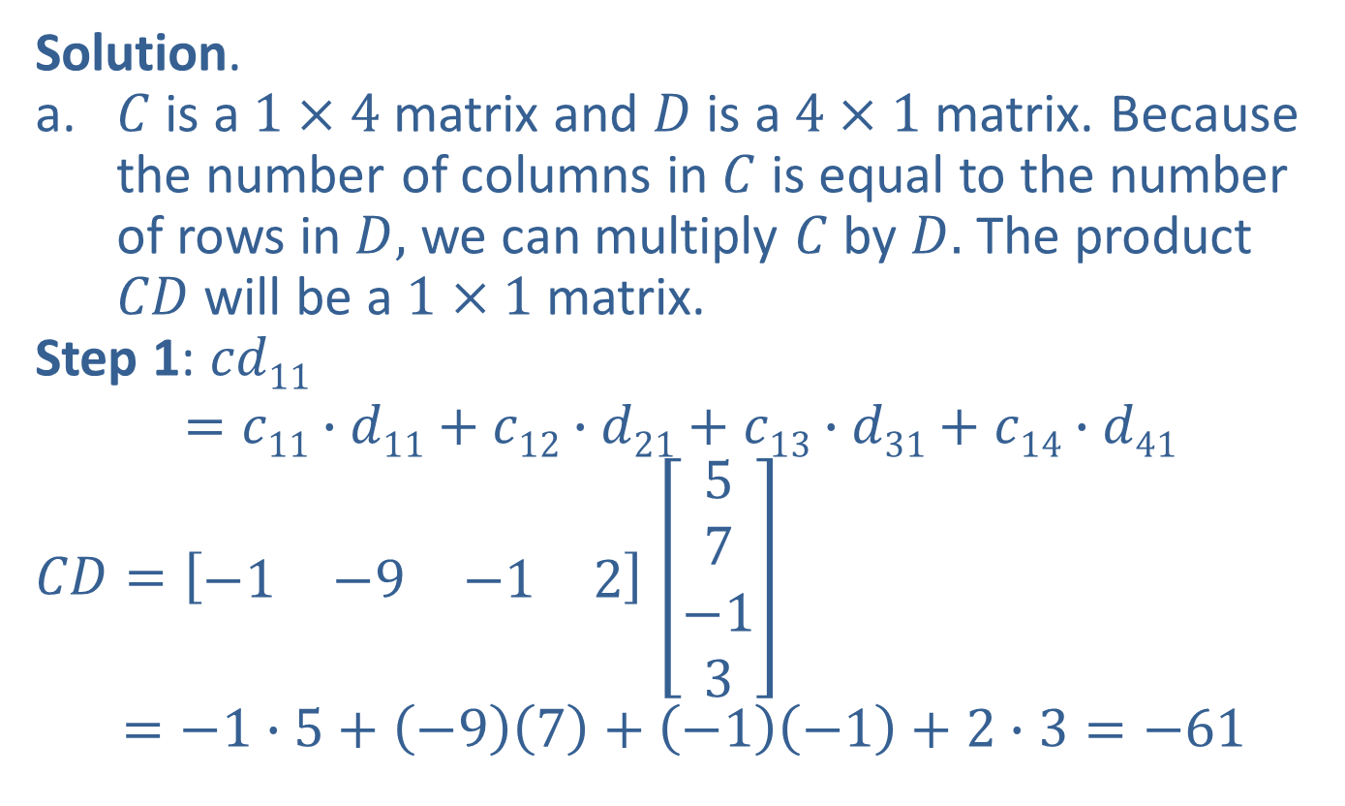
Example 7: Multiplying Two Matrices (cont.)
Solution.
​$C$ is a $1×4$ matrix and $D$ is a $4×1$ matrix. Because the number of columns in $C$ is equal to the number of rows in $D,$ we can multiply $C$ by $D.$ The product $CD$ will be a $1×1$ matrix.
Step 1: $cd11$
$$=c11∙d11+c12∙d21+c13∙d31+c14∙d41$$
$CD=\left[\begin{matrix}−1 & −9 & −1 & 2\end{matrix}\right]$ $\left[\begin{aligned}5 \\ 7 \\ −1 \\ 3\end{aligned}\right]$
$$=−1∙5+\left(−9\right)\left(7\right)+\left(−1\right)\left(−1\right)+2∙3=−61$$

Slide 27
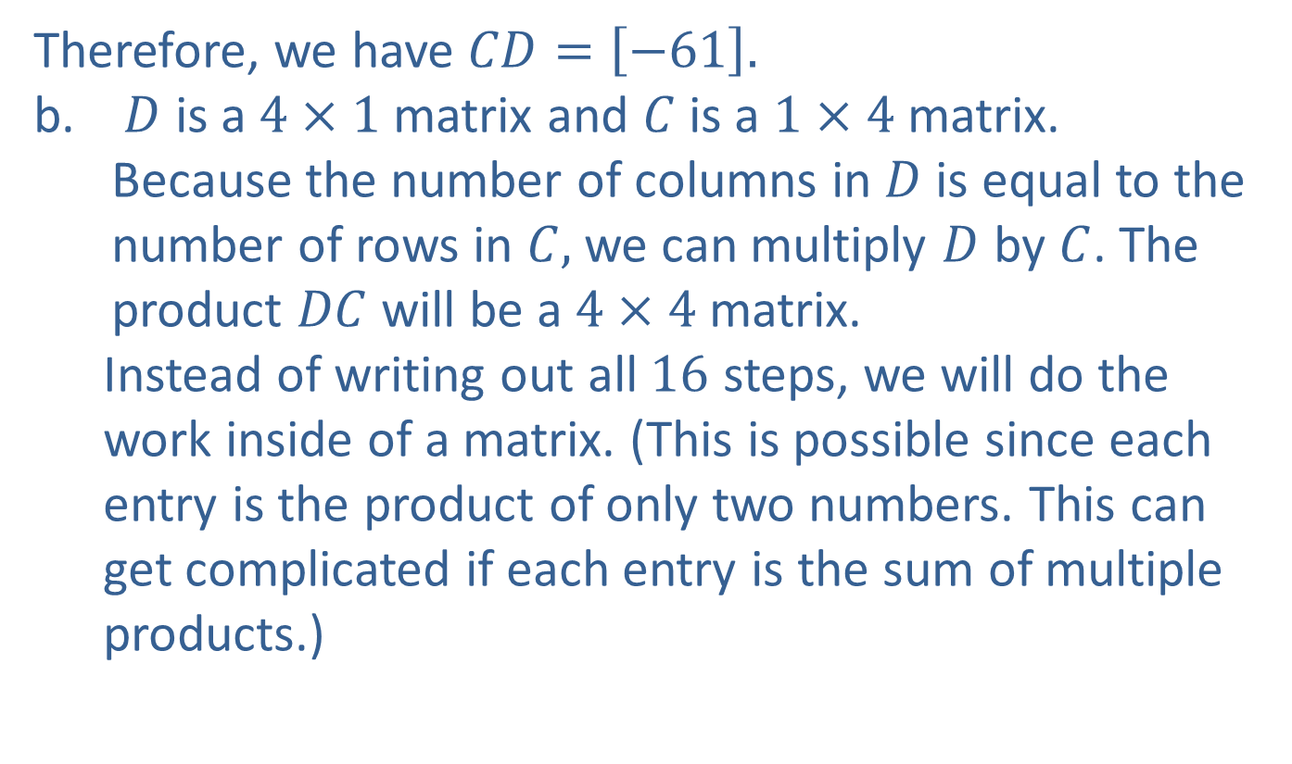
Example 7: Multiplying Two Matrices (cont.)
Therefore, we have $CD=\left[−61\right].$
$D$ is a $4×1$ matrix and $C$ is a $1×4$ matrix. Because the number of columns in $D$ is equal to the number of rows in $C,$ we can multiply $D$ by $C$. The product $DC$ will be a $4×4$ matrix.
Instead of writing out all $16$ steps, we will do the work inside of a matrix. (This is possible since each entry is the product of only two numbers. This can get complicated if each entry is the sum of multiple products.)

Slide 28
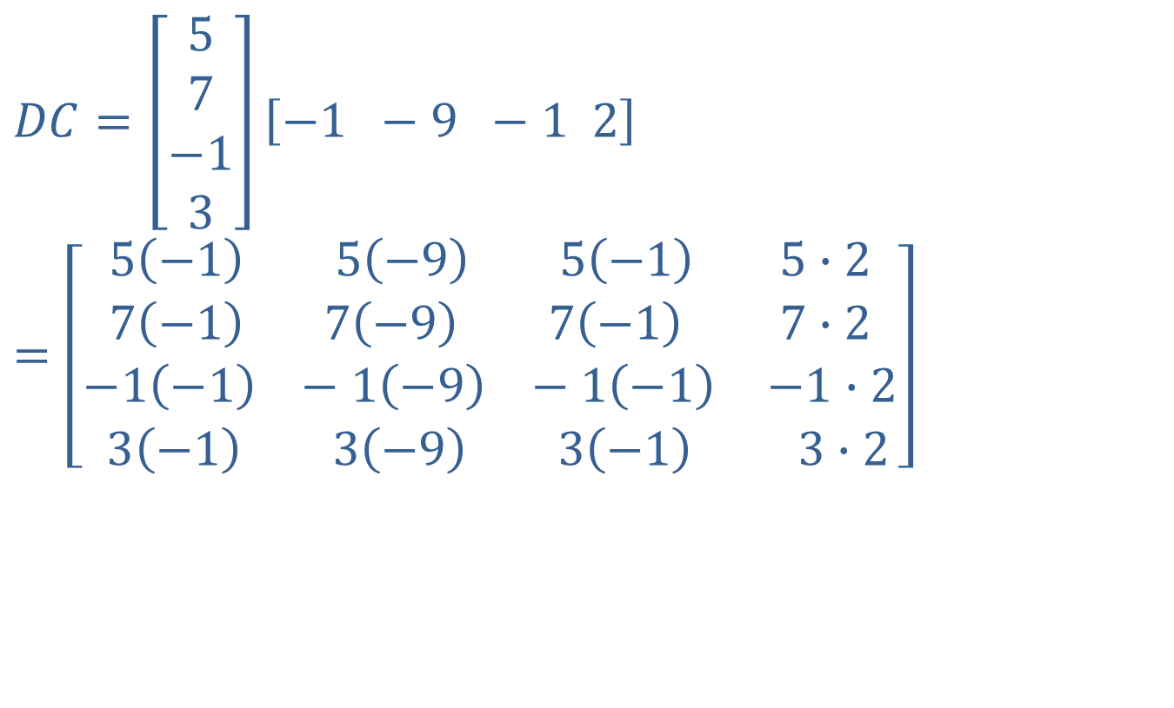
Example 7: Multiplying Two Matrices (cont.)
$$DC=\left[\begin{aligned}5 \\ 7 \\ −1 \\ 3\end{aligned}\right]\left[−1 −9 −1 2\right]$$
$$=\left[\begin{aligned}\begin{matrix}5\left(−1\right) 5\left(−9\right) 5\left(−1\right) & 5∙2 \\ 7\left(−1\right) 7\left(−9\right) 7\left(−1\right) & 7∙2\end{matrix} \\ \begin{matrix}−1\left(−1\right) −1\left(−9\right) −1\left(−1\right) & −1∙2 \\ 3\left(−1\right) 3\left(−9\right) 3\left(−1\right) & 3∙2\end{matrix}\end{aligned}\right]$$

Slide 29
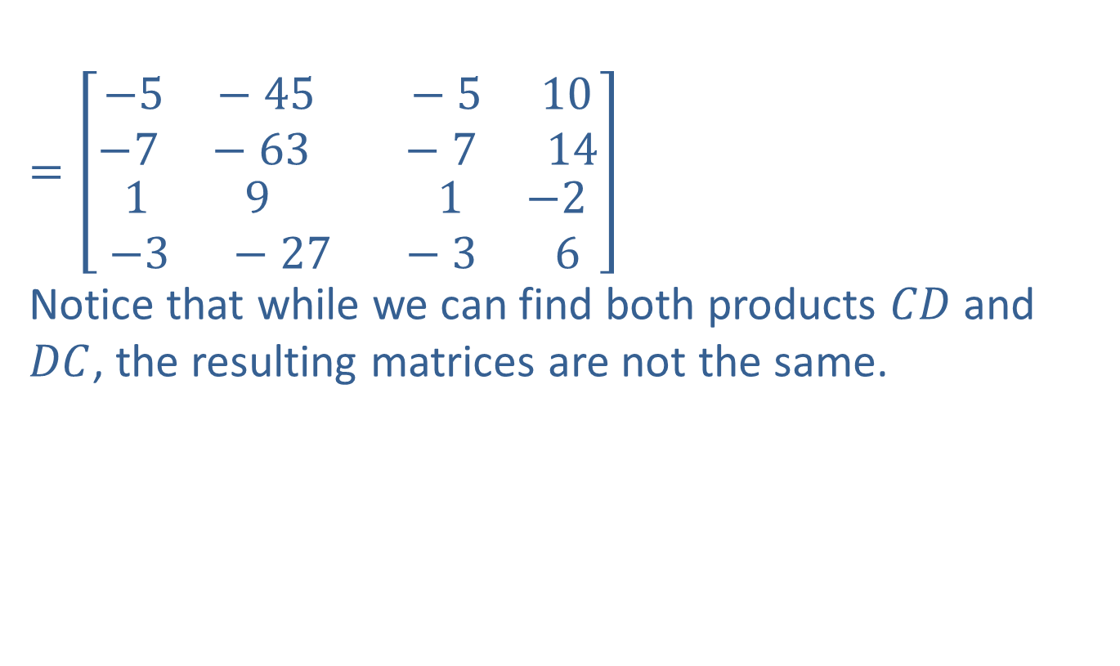
Example 7: Multiplying Two Matrices (cont.)
$$=\left[\begin{aligned}\begin{matrix}−5 −45 −5 & 10 \\ −7 −63 −7 & 14\end{matrix} \\ \begin{matrix}1 9 1 & −2 \\ −3 −27 −3 & 6\end{matrix}\end{aligned}\right]$$
Notice that while we can find both products $CD$ and $DC$, the resulting matrices are not the same.

