Slide 1
Section A.2
Logarithmic Functions

Slide 2
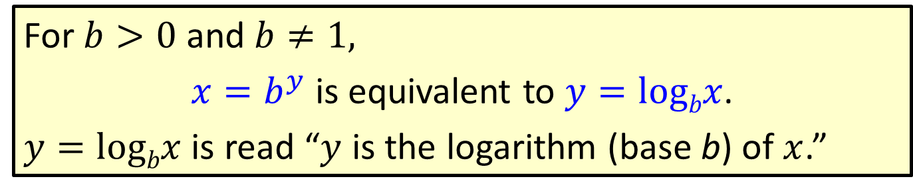
Definition: Definition of Logarithm (base b)
For $b>0$ and $b≠1,$
$x=b^{y}$is equivalent to $y=logbx$.
$y=logbx$ is read “$y$ is the logarithm (base b) of $x$.”

Slide 3
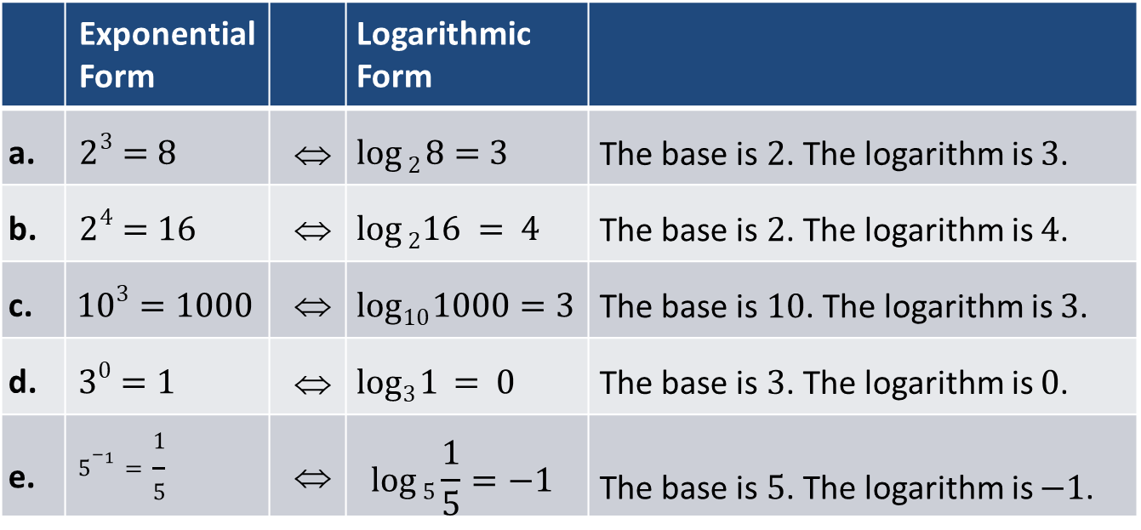
Example 1: Translating Between Exponential and Logarithmic Form
 | Exponential Form |  | Logarithmic Form
a. | $$23=8$$ | ⇔ | $$log⁡2 8=3$$ | The base is $2$. The logarithm is $3$.
b. | $$24=16$$ | ⇔ | $$log⁡216 = 4$$ | The base is $2$. The logarithm is $4$.
c. | $$103=1000$$ | ⇔ | $$log10 1000=3$$ | The base is $10$. The logarithm is $3$.
d. | $$30=1$$ | ⇔ | $$log3 1 = 0$$ | The base is $3$. The logarithm is $0$.
e. | $$5^{−1}=\frac{1}{5}$$ | ⇔ | $$\log{5\frac{1}{5}}=−1$$ | The base is $5$. The logarithm is $−1$.
Note that in each case the base of the exponent is the base of the logarithm.

Slide 4
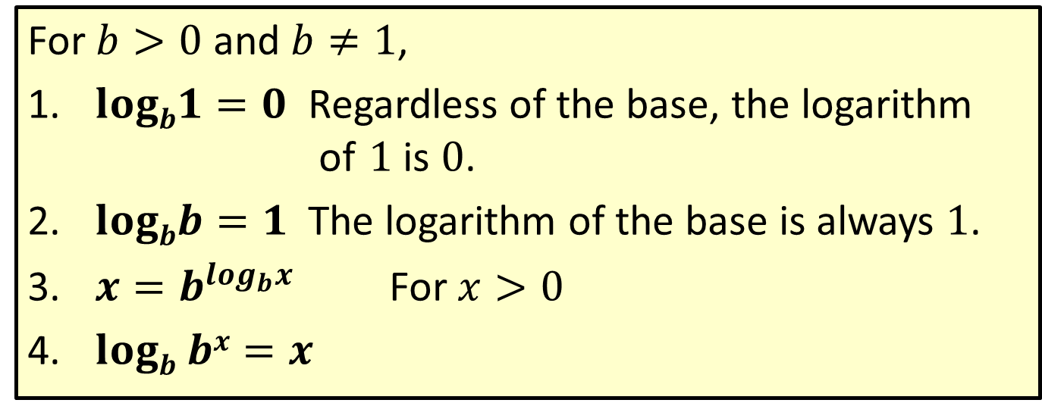
Properties: Basic Properties of Logarithms
For $b>0$ and $b≠1$,
$logb1=0$ Regardless of the base, the logarithm of $1$ is $0$.
$logbb=1$ The logarithm of the base is always $1$.
$x=b^{\log_{b}x}$ For $x>0$
$logb bx=x$

Slide 5


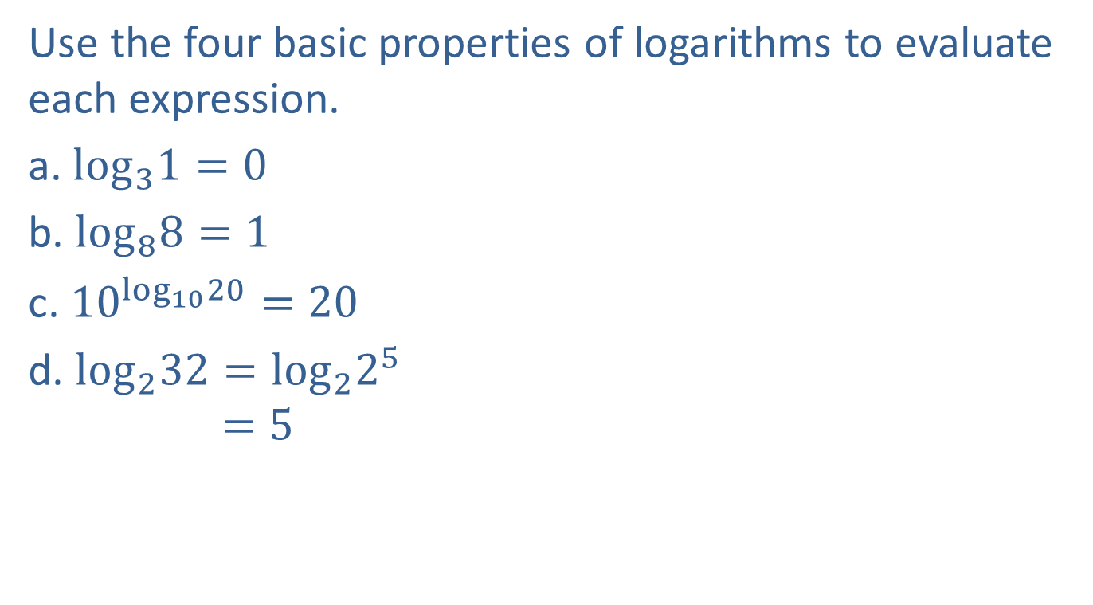



Example 2: Evaluating Logarithms
Use the four basic properties of logarithms to evaluate each expression.
a. $\log_{3}1=0$
b. $\log_{8}8=1$
c. ${10}^{\log_{10}20}=20$
d. $\log_{2}32=\log_{2}2^{5}$
$$=5$$
By property $1$
By property $2$
By property $3$
Write $32$ as $2^{5},$ so the base is $2.$
By property $4$

Slide 6



Example 2: Evaluating Logarithms (cont.)
e. $\log_{10}0.01=\log_{10}\frac{1}{100}$
$$=\log_{10}\frac{1}{{10}^{2}}$$
$$=\log_{10}{10}^{−2}$$
$$=−2$$
Write $\frac{1}{{10}^{2}}$ as ${10}^{−2},$ so the base is $10.$
By property $4$

Slide 7
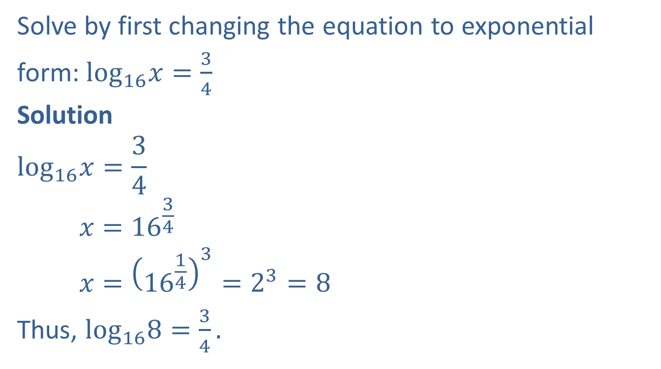
Example 3: Solving Logarithmic Equations
Solve by first changing the equation to exponential
form: $\log_{16}x=\frac{3}{4}$
Solution
$$\log_{16}x=\frac{3}{4}$$
$$x={16}^{\frac{3}{4}}$$
$$x={\left({16}^{\frac{1}{4}}\right)}^{3}=2^{3}=8$$
Thus, $\log_{16}8=\frac{3}{4}.$
Write the equation in exponential form and solve for $x.$

Slide 8
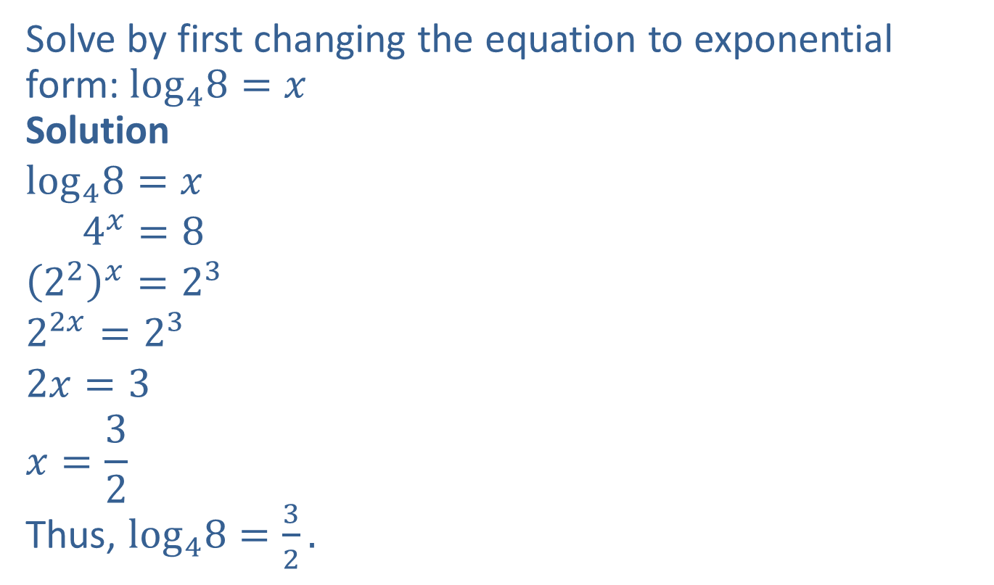
Example 4: Solving Logarithmic Equations
Solve by first changing the equation to exponential form: $\log_{4}8=x$
Solution
$$\log_{4}8=x$$
$$4^{x}=8$$
$${\left(2^{2}\right)}^{x}=2^{3}$$
$$2^{2x}=2^{3}$$
$$2x=3$$
$$x=\frac{3}{2}$$
Thus, $\log_{4}8=\frac{3}{2}.$
Write the equation in exponential form and solve for $x.$
Use the common base, $2.$
The exponents are equal because the bases are the same.

