Slide 1

Section A.3
Applications: Exponential and Logarithmic Functions

Slide 2

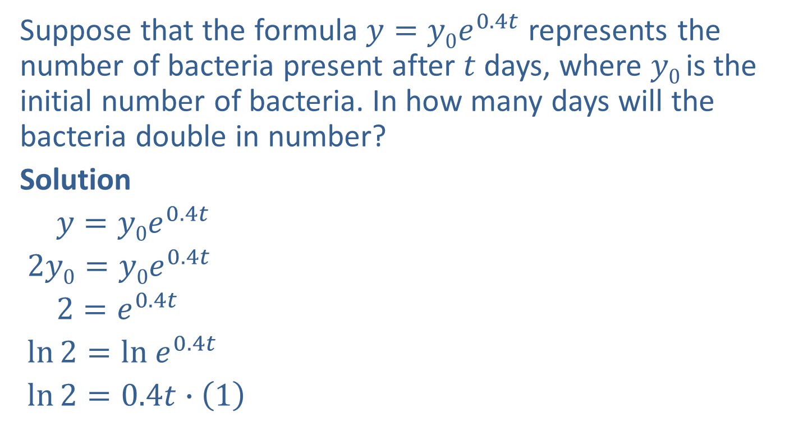

Example 1: Application: Exponential Growth
Suppose that the formula $y=y0e^{0.4t}$ represents the number of bacteria present after $t$ days, where $y0$ is the initial number of bacteria. In how many days will the bacteria double in number?
Solution
$y=y0e^{0.4t}$
$2y0=y0e^{0.4t}$
$2=e^{0.4t}$
$ln⁡2=ln e^{0.4t}$
$ln⁡2=0.4t∙\left(1\right)$
$2y0$ is double the initial number present.
Take the natural log of both sides.
Power rule of logarithms; $ln⁡e=1$

Slide 3
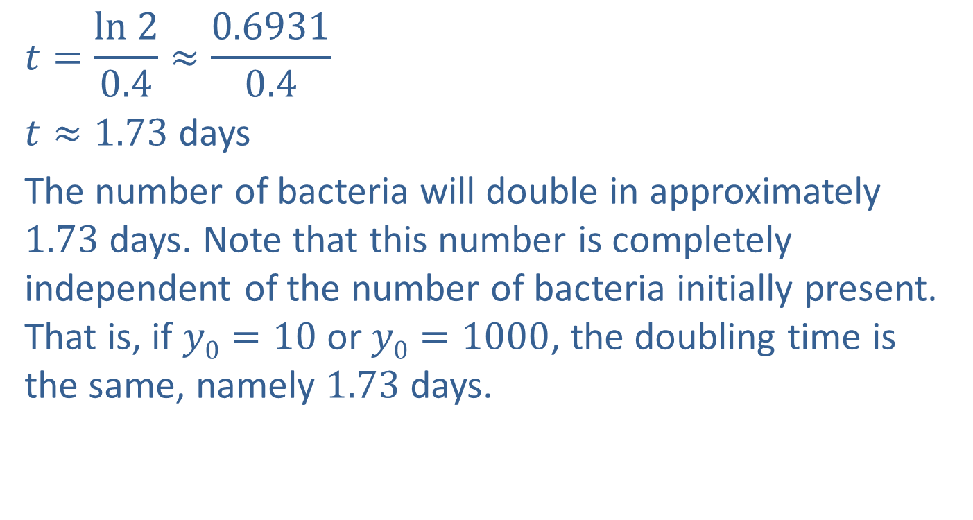
Example 1: Application: Exponential Growth (cont.)
$$t=\frac{ln 2}{0.4}≈\frac{0.6931}{0.4}$$
$t≈1.73$ days
The number of bacteria will double in approximately $1.73$ days. Note that this number is completely independent of the number of bacteria initially present. That is, if $y0=10$ or $y0=1000$, the doubling time is the same, namely $1.73$ days.

Slide 4
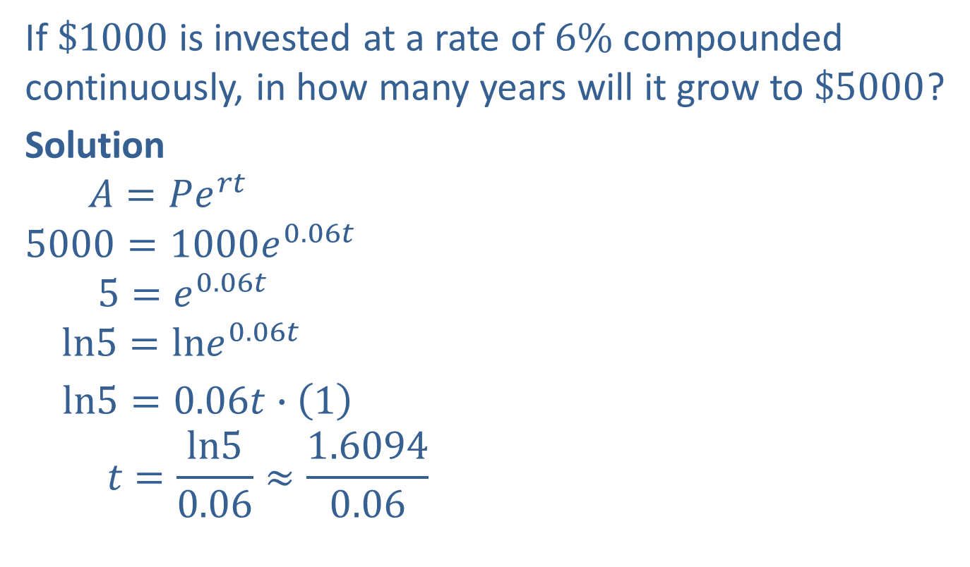
Example 2: Application: Continuously Compounded Interest
If $\$1000$ is invested at a rate of $6\%$ compounded continuously, in how many years will it grow to $\$5000$?
Solution
$$A=Pe^{rt}$$
$$5000=1000e^{0.06t}$$
$$5=e^{0.06t}$$
$$ln5=lne^{0.06t}$$
$ln5=0.06t∙\left(1\right)$
$$t=\frac{ln5}{0.06}≈\frac{1.6094}{0.06}$$
Formula for continuously compounded interest
Substitute $A=5000, P=1000,$ and $r=0.06.$
Take the natural log of both sides.
Power rule of logarithms; $lne=1$

Slide 5

Example 2: Application: Continuously Compounded Interest (cont.)
$t≈26.82$ years
$\$1000$will grow to $\$5000$in approximately $26.82$ years.

Slide 6
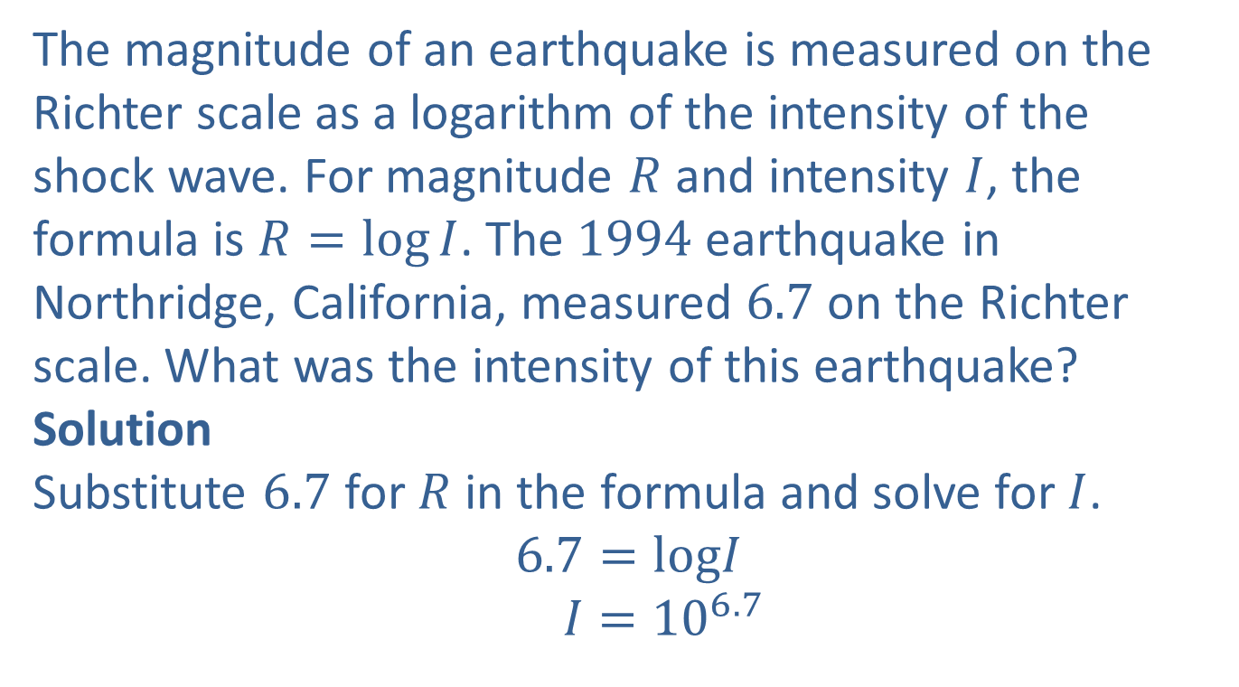
Example 3: Application: The Richter Scale
The magnitude of an earthquake is measured on the Richter scale as a logarithm of the intensity of the shock wave. For magnitude $R$ and intensity $I$, the formula is $R=log⁡I$. The $1994$ earthquake in Northridge, California, measured $6.7$ on the Richter scale. What was the intensity of this earthquake?
Solution
Substitute $6.7$ for $R$ in the formula and solve for $I$.
$$6.7=logI$$
$$I={10}^{6.7}$$

Slide 7
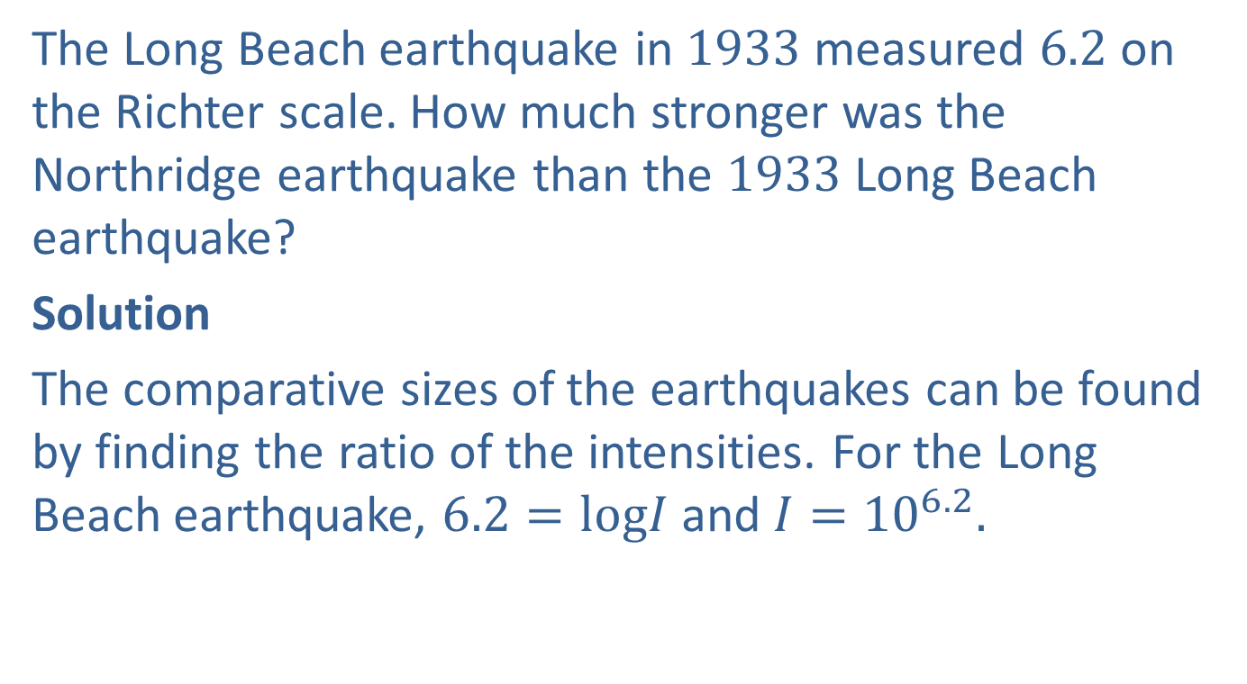
Example 4: Application: The Richter Scale
The Long Beach earthquake in $1933$ measured $6.2$ on the Richter scale. How much stronger was the Northridge earthquake than the $1933$ Long Beach earthquake?
Solution
The comparative sizes of the earthquakes can be found by finding the ratio of the intensities. For the Long Beach earthquake, $6.2=logI$ and $I={10}^{6.2}.$

Slide 8
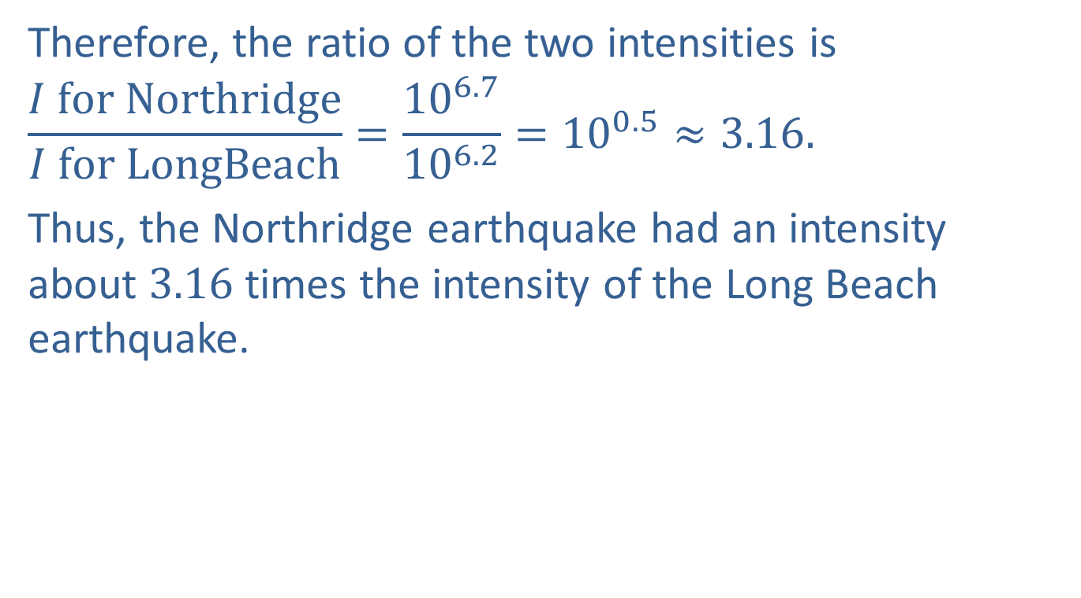
Example 4: Application: The Richter Scale (cont.)
Therefore, the ratio of the two intensities is
$$\frac{I for Northridge}{I for LongBeach}=\frac{{10}^{6.7}}{{10}^{6.2}}={10}^{0.5}≈3.16.$$
Thus, the Northridge earthquake had an intensity about $3.16$ times the intensity of the Long Beach earthquake.

Slide 9
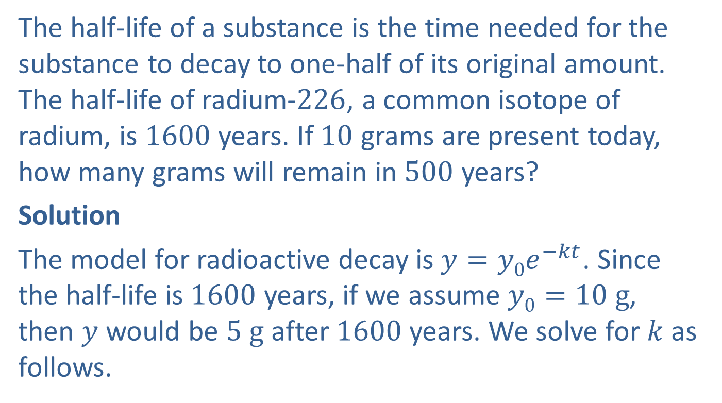
Example 5: Application: Half-life of Radium
The half-life of a substance is the time needed for the substance to decay to one-half of its original amount. The half-life of radium-$226$, a common isotope of radium, is $1600$ years. If $10$ grams are present today, how many grams will remain in $500$ years?
Solution
The model for radioactive decay is $y=y0e^{−kt}$. Since the half-life is $1600$ years, if we assume $y0=10 g$, then $y$ would be $5 g$ after $1600$ years. We solve for $k$ as follows.

Slide 10
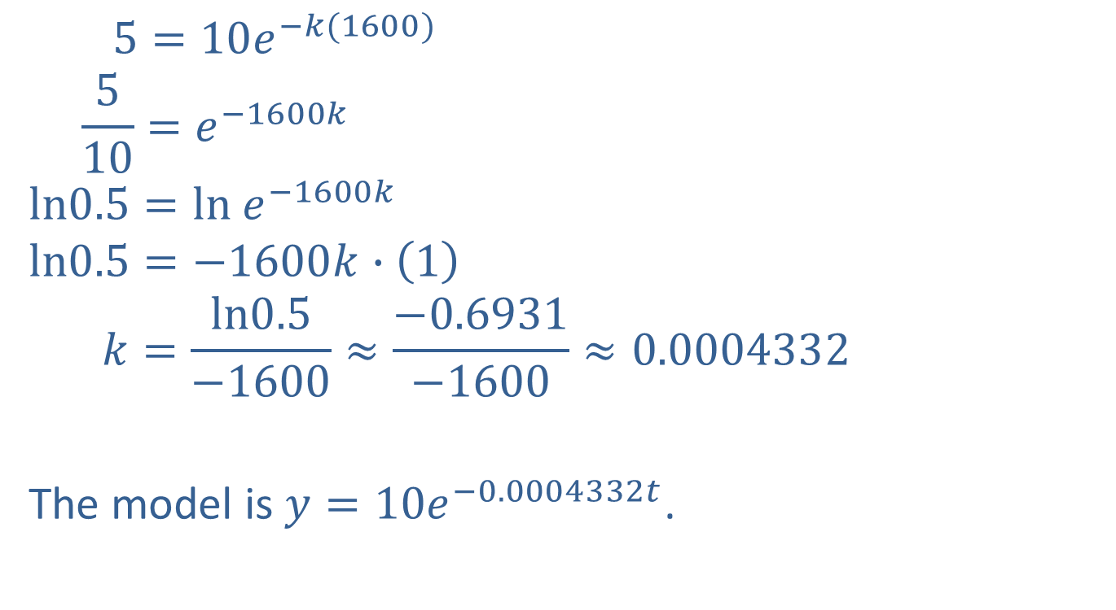

Example 5: Application: Half-life of Radium (cont.)
$5=10e^{−k(1600)}$
$$\frac{5}{10}=e^{−1600k}$$
$$ln0.5=ln e^{−1600k}$$
$$ln0.5=−1600k∙\left(1\right)$$
$$k=\frac{ln0.5}{−1600}≈\frac{−0.6931}{−1600}≈0.0004332$$
The model is $y=10e^{−0.0004332t}$.
Substitute $y=5, y0=10,$ and $t=1600.$
Take the natural log of both sides.
Power rule for logarithms; $lne=1$

Slide 11
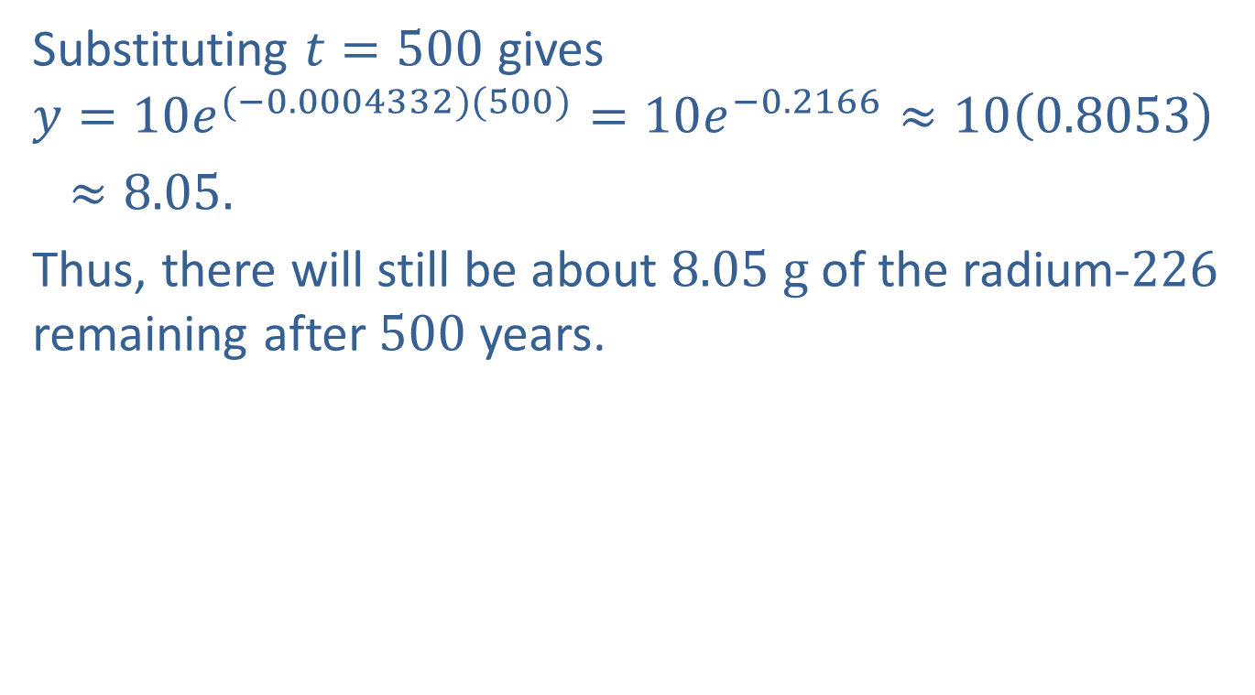
Example 5: Application: Half-life of Radium (cont.)
Substituting $t=500$ gives
$$y=10e^{(−0.0004332)(500)}=10e^{−0.2166}≈10\left(0.8053\right)$$
$≈8.05.$
Thus, there will still be about $8.05 g$ of the radium-$226$ remaining after $500$ years.

Slide 12
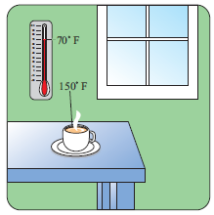
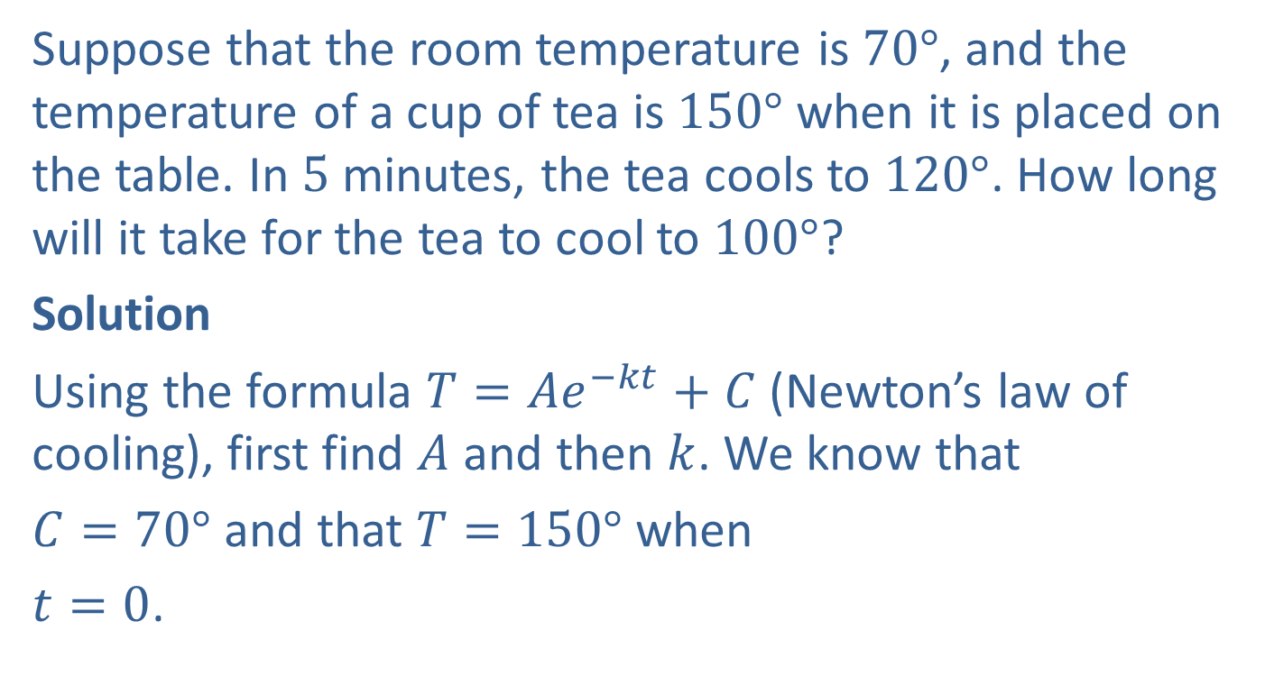
Example 6: Application: Newton’s Law of Cooling
Suppose that the room temperature is $70°$, and the temperature of a cup of tea is $150°$ when it is placed on the table. In $5$ minutes, the tea cools to $120°$. How long will it take for the tea to cool to $100°$?
Solution
Using the formula $T=Ae^{−kt}+C$(Newton’s law of cooling), first find $A$ and then $k$. We know that
$C=70°$and that $T=150°$when
$t=0$.

Slide 13

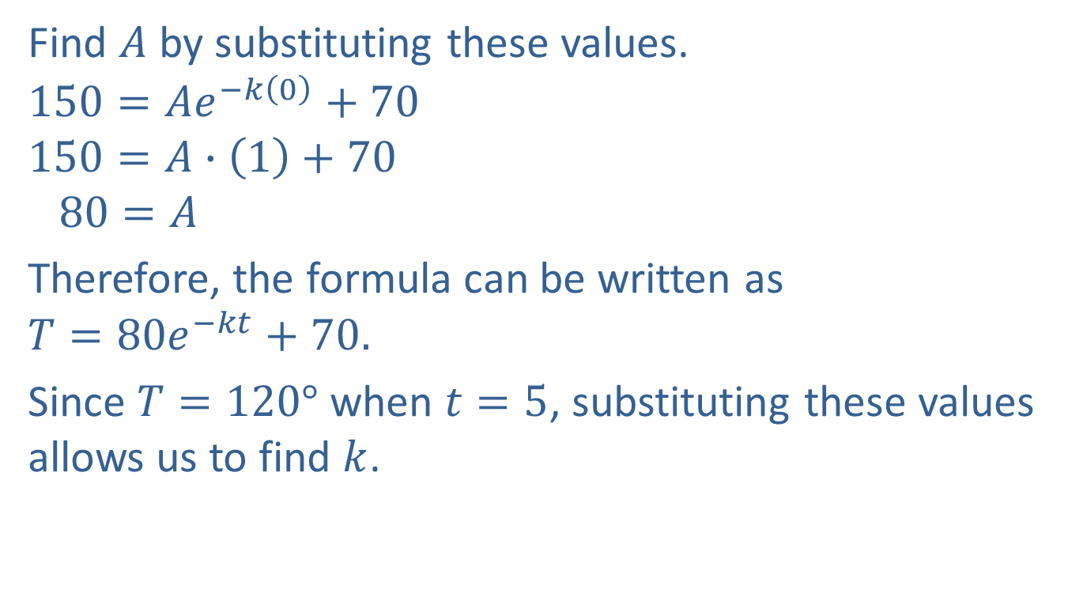
Example 6: Application: Newton’s Law of Cooling (cont.)
Find $A$ by substituting these values.
$$150=Ae^{−k\left(0\right)}+70$$
$$150=A∙\left(1\right)+70$$
$$80=A$$
Therefore, the formula can be written as
$$T=80e^{−kt}+70.$$
Since $T=120°$ when $t=5$, substituting these values allows us to find $k$.
$$e^{−k(0)}=e^{0}=1$$

Slide 14
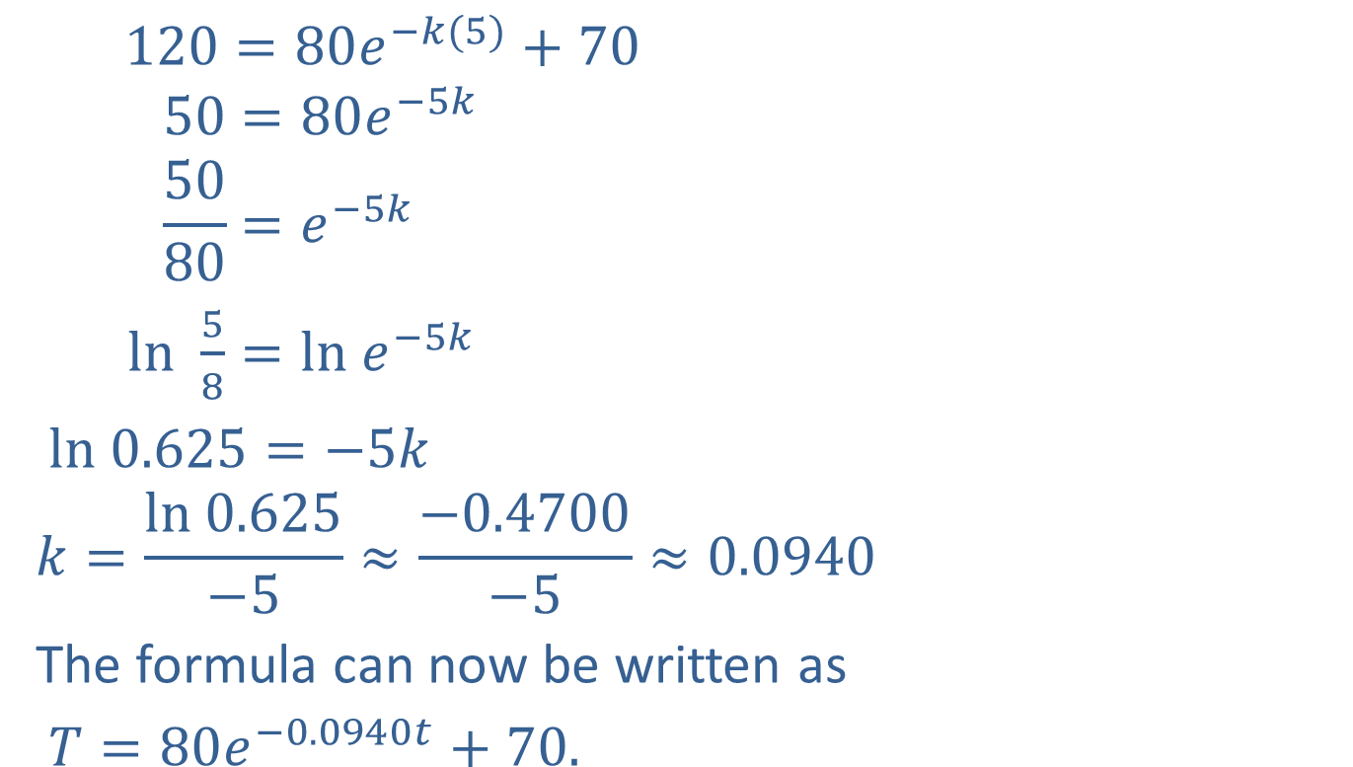
Example 6: Application: Newton’s Law of Cooling (cont.)
$$120=80e^{−k(5)}+70$$
$$50=80e^{−5k}$$
$$\frac{50}{80}=e^{−5k}$$
$ln⁡$ $\frac{5}{8}=ln e^{−5k}$
$ln 0.625=−5k$
$$k=\frac{ln 0.625}{−5}≈\frac{−0.4700}{−5}≈0.0940$$
The formula can now be written as
$T=80e^{−0.0940t}+70.$
Take the natural log of both sides.

Slide 15
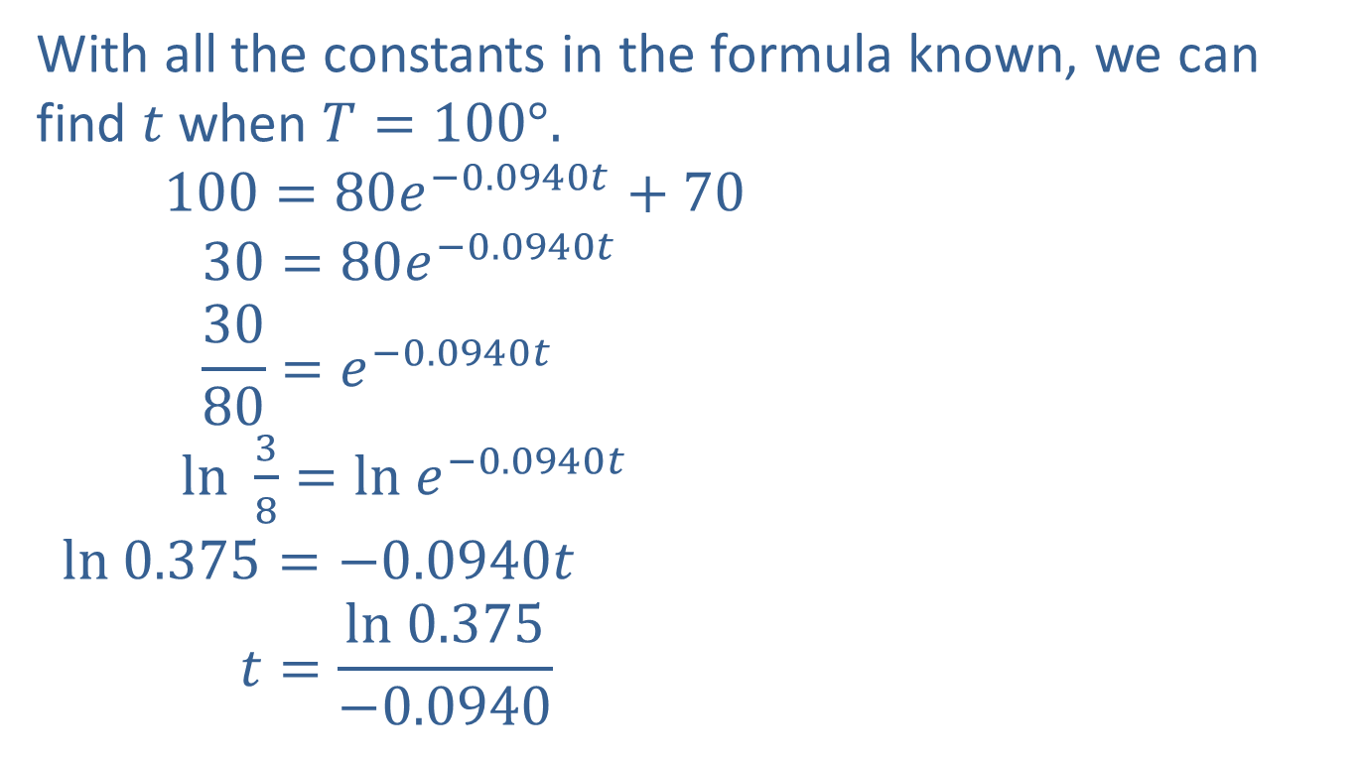
Example 6: Application: Newton’s Law of Cooling (cont.)
With all the constants in the formula known, we can find $t$ when $T=100°.$
$$100=80e^{−0.0940t}+70$$
$$30=80e^{−0.0940t}$$
$$\frac{30}{80}=e^{−0.0940t}$$
$ln⁡$ $\frac{3}{8}=ln e^{−0.0940t}$
$$ln 0.375=−0.0940t$$
$$t=\frac{ln 0.375}{−0.0940}$$
Take the natural log of both sides.

Slide 16

Example 6: Application: Newton’s Law of Cooling (cont.)
$≈\frac{−0.9808}{−0.0940}≈10.43$ minutes
The tea will cool to $100°$ in about $10.43$ minutes.

