Slide 1
Section R.1
Exponents, Prime Numbers, and LCM

Slide 2
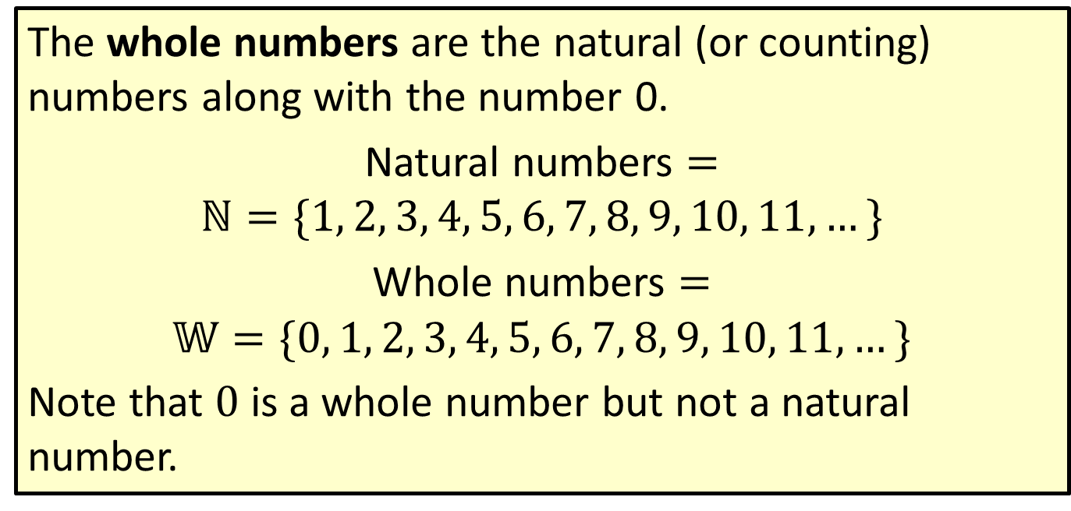
Definition: Whole Numbers
The whole numbers are the natural (or counting) numbers along with the number 0.
Natural numbers $=$
$$ℕ=\{1, 2, 3, 4, 5, 6, 7, 8, 9, 10, 11,…\}$$
Whole numbers $=$
$$𝕎=\{0, 1, 2, 3, 4, 5, 6, 7, 8, 9, 10, 11,…\}$$
Note that 0 is a whole number but not a natural number.

Slide 3
Note
Variables are introduced here so that rules and definitions can be stated in a general form. Variables
will be used in the examples and exercises beginning with Chapter 1.

Slide 4
Definition: Variable
A variable is a symbol (generally a letter of the alphabet) that is used to represent an unknown number or any one of several numbers.

Slide 5
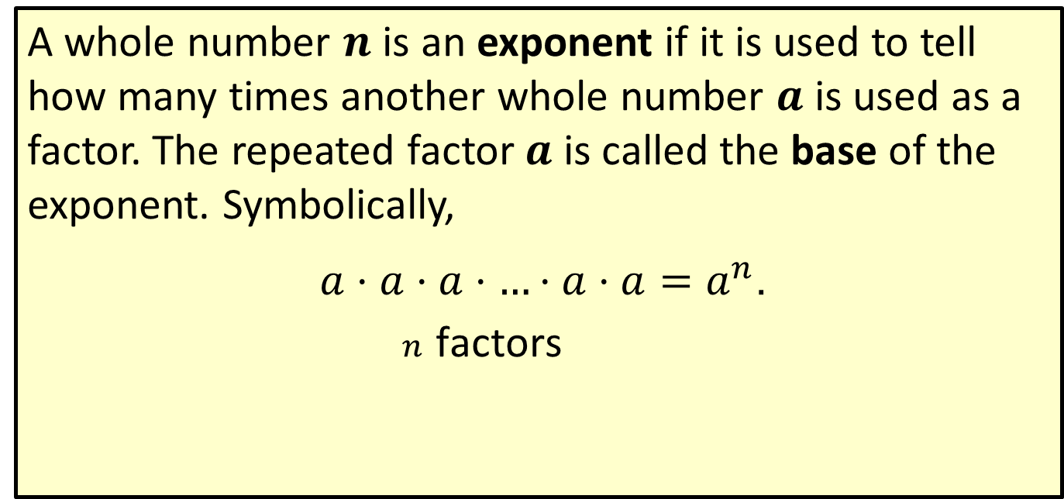
Definition: Exponent and Base
A whole number $n$ is an exponent if it is used to tell how many times another whole number $a$ is used as a factor. The repeated factor $a$ is called the base of the exponent. Symbolically,
$\underset{n \text{factors}}{\underset{ }{a⋅a⋅a⋅…⋅a⋅a}}=a^{n}$.
exponent
base

Slide 6
Note
There is usually some confusion about the use of the word “power.” Since 2⁵ is read “two to the fifth power,” it is natural to think of 5 as the power. This is not true. A power is not an exponent. A power is the product indicated by a base raised to an exponent. Thus, for the equation 2⁵ = 32, think of the phrase “two to the fifth power” in its entirety. The corresponding power is the product, 32.

Slide 7
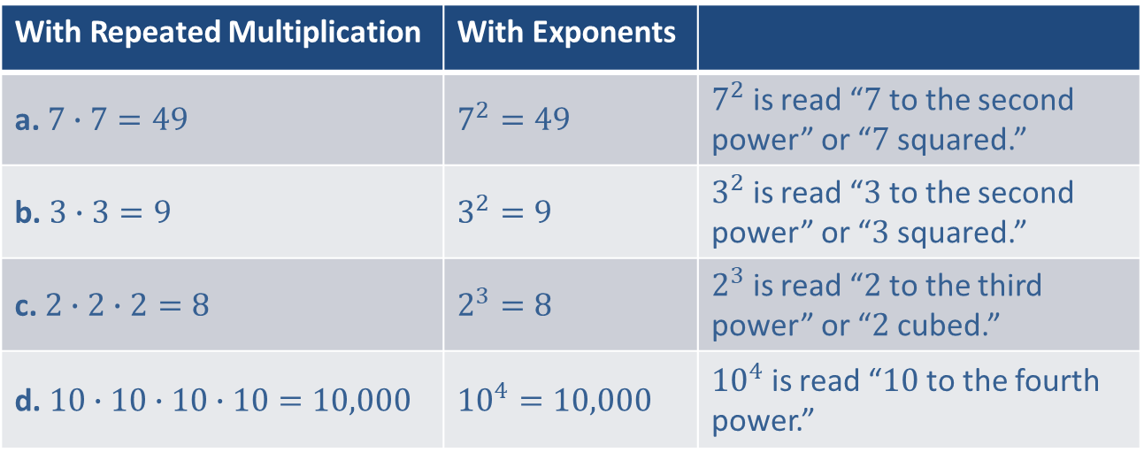
Example 1: Writing Expressions using Exponents
In order to illustrate exponential notation, we show several products written with repeated multiplication and the equivalent exponential expressions.
With Repeated Multiplication | With Exponents
a. $7∙7=49$ | $$7^{2}=49$$ | $7^{2}$ is read “$7$ to the second power” or “$7$ squared.”
b. $3∙3=9$ | $$3^{2}=9$$ | $3^{2}$ is read “$3$ to the second power” or “$3$ squared.”
c. $2∙2∙2=8$ | $$2^{3}=8$$ | $2^{3}$ is read “$2$ to the third power” or “$2$ cubed.”
d. $10∙10∙10∙10=10,000$ | $${10}^{4}=10,000$$ | ${10}^{4}$ is read “$10$ to the fourth power.”

Slide 8

Example 2: Evaluating Exponential Expressions
Evaluate each exponential expression.
​$6^{3}$ b. ​$5^{2}$ C. ​$2^{6}$
Solution
$6^{3}$ $=$ $6$ $∙$ $6$ $∙$ $6$ $=$ $216$
$5^{2}$ $=$ $5$ $∙$ $5$ $= 25$
$2^{6}=2∙$ $2∙$ $2∙$ $2∙$ $2∙$ $2=64$

Slide 9
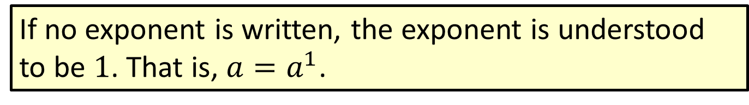
Note
If no exponent is written, the exponent is understood to be $1$. That is, $a=a^{1}$.

Slide 10
Definition: Prime Numbers
A prime number is a counting number greater than 1 that has exactly two different factors (or divisors), namely itself and 1.

Slide 11
Definition: Composite Numbers
A composite number is a counting number with more than two different factors (or divisors).

Slide 12
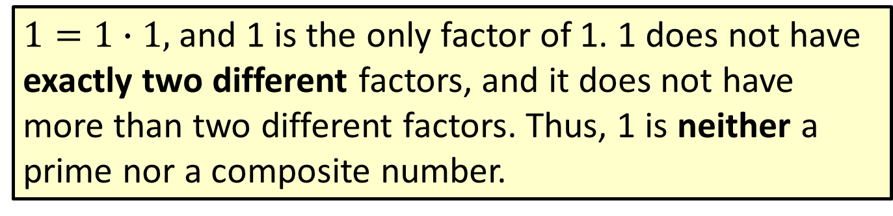
Attention!
$1=1∙1,$ and 1 is the only factor of 1. 1 does not have exactly two different factors, and it does not have more than two different factors. Thus, 1 is neither a prime nor a composite number.

Slide 13
Example 3: Determining Prime Numbers
The following numbers are prime because each has exactly two different factors, 1 and itself.
2: 2 has exactly two different factors, 1 and 2.
3: 3 has exactly two different factors, 1 and 3.
11: 11 has exactly two different factors, 1 and 11.
29: 29 has exactly two different factors, 1 and 29.

Slide 14
Example 4: Determining Composite Numbers
The following numbers are composite.
15: 1, 3, 5, and 15 are all factors of 15
39: 1, 3, 13, and 39 are all factors of 39
49: 1, 7, and 49 are all factors of 49
51: 1, 3, 17, and 51 are all factors of 51

Slide 15
Definition: Even and Odd Whole Numbers
If a whole number is divisible by 2, it is even.
If a whole number is not divisible by 2, it is odd.

Slide 16
Procedure: To Find the Prime Factorization of a Composite Number
​Factor the composite number into any two factors.
​Factor each factor that is not prime into two more factors.
​Continue this process until all factors are prime.
The prime factorization is the product of all the prime factors.

Slide 17

Example 5: Finding the Prime Factorization of a Number
Find the prime factorization of 90.
Solution
$$90= 9 ∙ 10$$
$$=3∙3∙2∙5$$
Since the units digit is 0, we know that 10 is a factor.
9 and 10 can both be factored so that each factor is a prime number. This is the prime factorization.

Slide 18
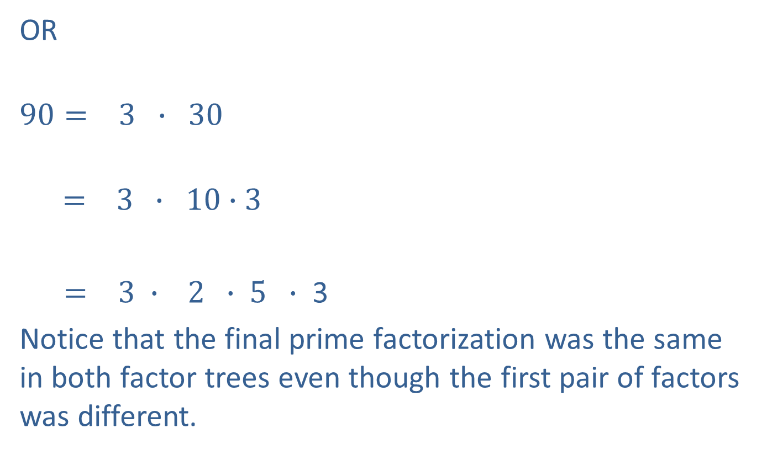
Example 5: Finding the Prime Factorization of a Number (cont.)
OR
$$90= 3 ∙ 30$$
$$= 3 ∙ 10∙3$$
$= 3 ∙ 2 ∙ 5 ∙$ 3
Notice that the final prime factorization was the same in both factor trees even though the first pair of factors was different.
3 is prime, but 30 is not.
10 is not prime.
All factors are prime.

Slide 19

Example 5: Finding the Prime Factorization of a Number (cont.)
Since multiplication is commutative, the order of the factors is not important. What is important is that all the factors are prime. Writing the factors in ascending order, we can write $90=2⋅3⋅3⋅5$ or, with exponents, $90=2⋅3^{2}⋅5$.

Slide 20
Note
You may have studied quick tests for divisibility by 2, 3, 5, 6, 8, and 10 in a previous course in mathematics. For example, a number is divisible by 2, and therefore even, if the units digit is 0, 2, 4, 6, or 8. We will make
reference to some of these tests for divisibility in the examples. See the end of the section for a brief review of this helpful topic.

Slide 21

Example 6: Finding the Prime Factorization of a Number
Find the prime factorization of each number.
​65
​72
​294
Solution
a. $65=5∙13$
5 is a factor because the units digit is 5. Since both 5 and 13 are prime, 5 ⋅ 13 is the prime factorization.

Slide 22

Example 6: Finding the Prime Factorization of a Number (cont.)
b. $72 =8∙9$
$=2∙4∙3$ $∙3$
$=2∙2∙2$ $∙3$ $∙3$
$=2^{3}∙32$
9 is a factor because the sum of the digits is 9.
Prime factorization
Using exponents

Slide 23

Example 6: Finding the Prime Factorization of a Number (cont.)
c. $294=2∙147$
$=2 ∙ 3 ∙49$
$=2 ∙ 3 ∙7$ $∙7$
$=2$ $∙ 3$ $∙7^{2}$
2 is a factor because the units digit is even.
3 is a factor of 147 because the sum of the digits is divisible by 3.
Prime factorization
Using exponents

Slide 24

Example 6: Finding the Prime Factorization of a Number (cont.)
If we begin with the product $294=6⋅49$, we see that the prime factorization is the same.
$294=6 ∙ 49$
$= 2 ∙ 3 ∙ 7 ∙ 7$
$= 2$ $∙ 3$ $∙ 72$

Slide 25
Definition: Least Common Multiple (LCM)
The least common multiple (LCM) of two (or more) counting numbers is the smallest number that is a multiple of each of these numbers.

Slide 26
Procedure: To Find the LCM of a Set of Counting Numbers
​Find the prime factorization of each number.
​List the prime factors that appear in any one of the prime factorizations.
​Find the product of these primes using each prime the most number of times it appears in any one of the prime factorizations.

Slide 27
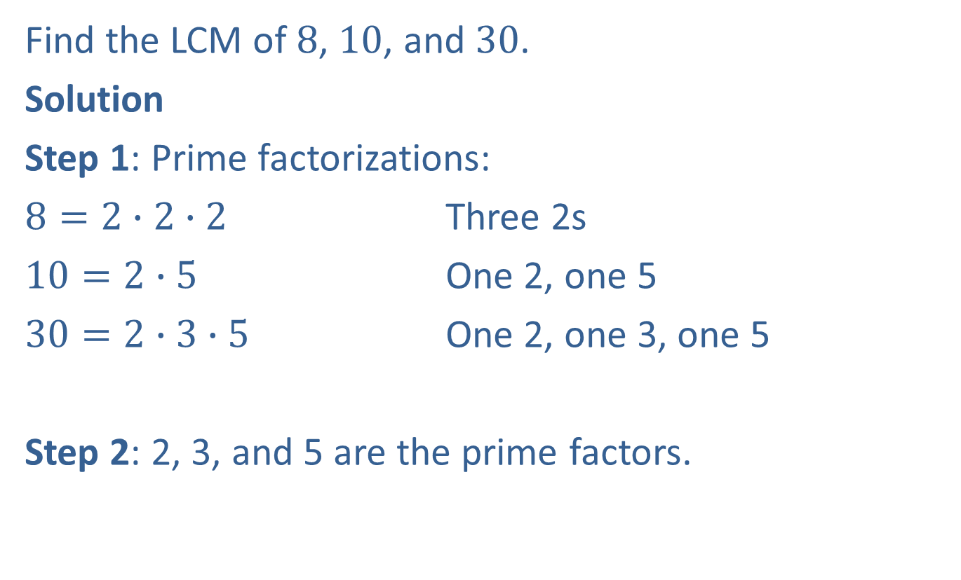
Example 7: Finding the Least Common Multiple (LCM)
Find the LCM of 8, 10, and 30.
Solution
Step 1: Prime factorizations:
$8=2∙2∙2$ Three 2s
$10=2∙5$ One 2, one 5
$30=2∙3$ $∙5$ One 2, one 3, one 5
Step 2: 2, 3, and 5 are the prime factors.

Slide 28
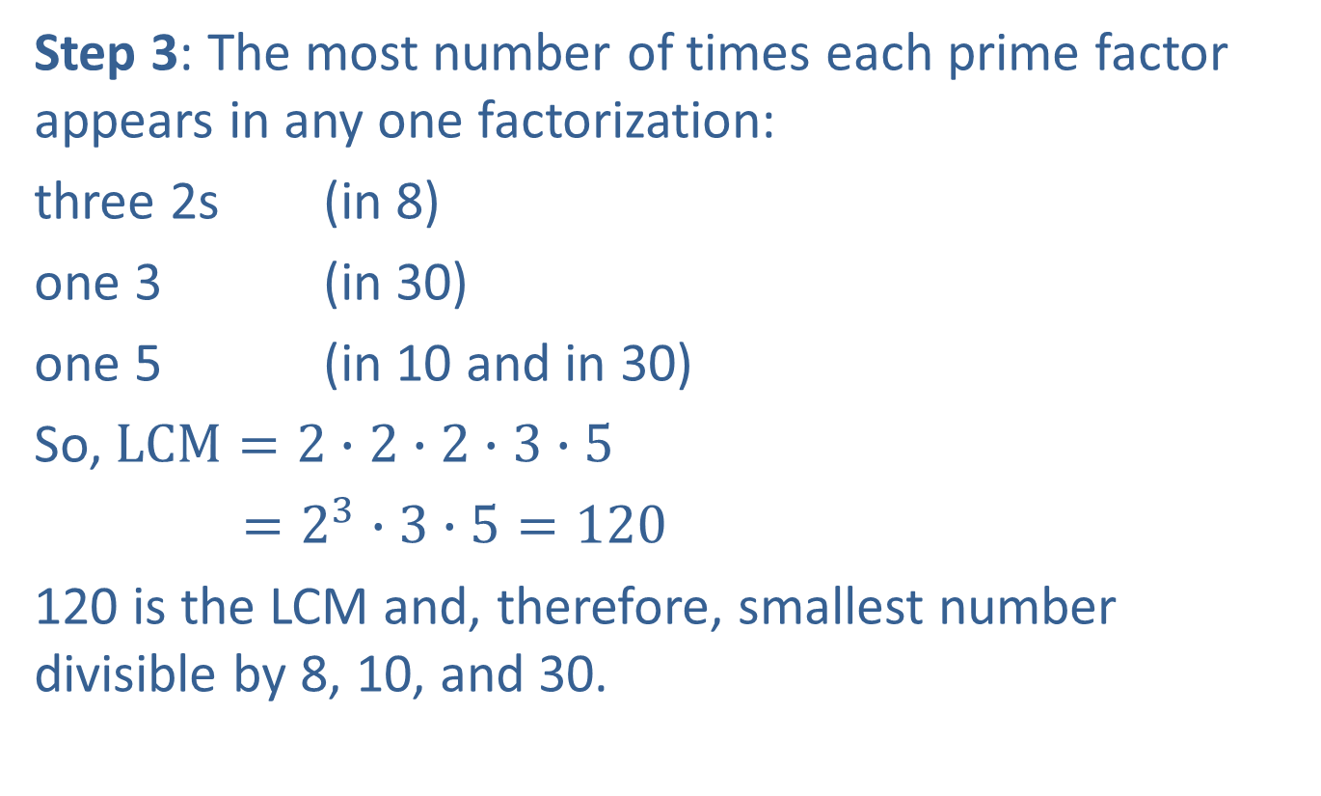
Example 7: Finding the Least Common Multiple (LCM) (cont.)
Step 3: The most number of times each prime factor appears in any one factorization:
three 2s (in 8)
one 3 (in 30)
one 5 (in 10 and in 30)
So, $LCM=2∙2∙2∙3∙5$
$=2^{3}∙3∙5=120$
120 is the LCM and, therefore, smallest number divisible by 8, 10, and 30.

Slide 29
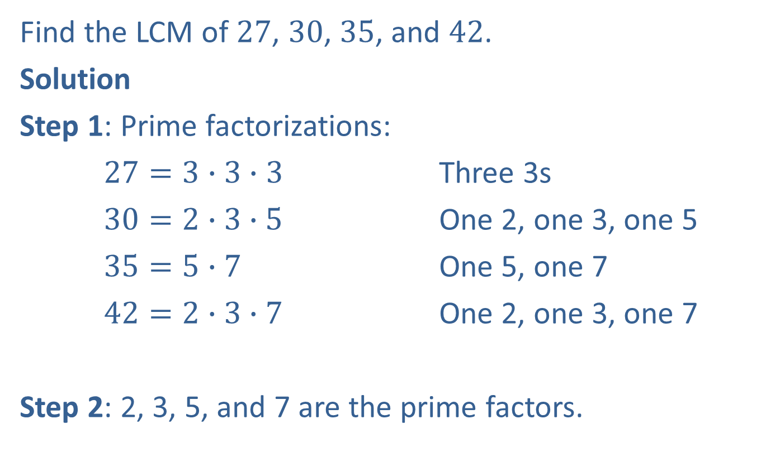
Example 8: Finding the Least Common Multiple (LCM)
Find the LCM of 27, 30, 35, and 42.
Solution
Step 1: Prime factorizations:
$27=3∙3∙3$ Three 3s
$30=2∙3$ $∙5$ One 2, one 3, one 5
$35=5∙7$ One 5, one 7
$42=2∙3$ $∙7$ One 2, one 3, one 7
Step 2: 2, 3, 5, and 7 are the prime factors.

Slide 30
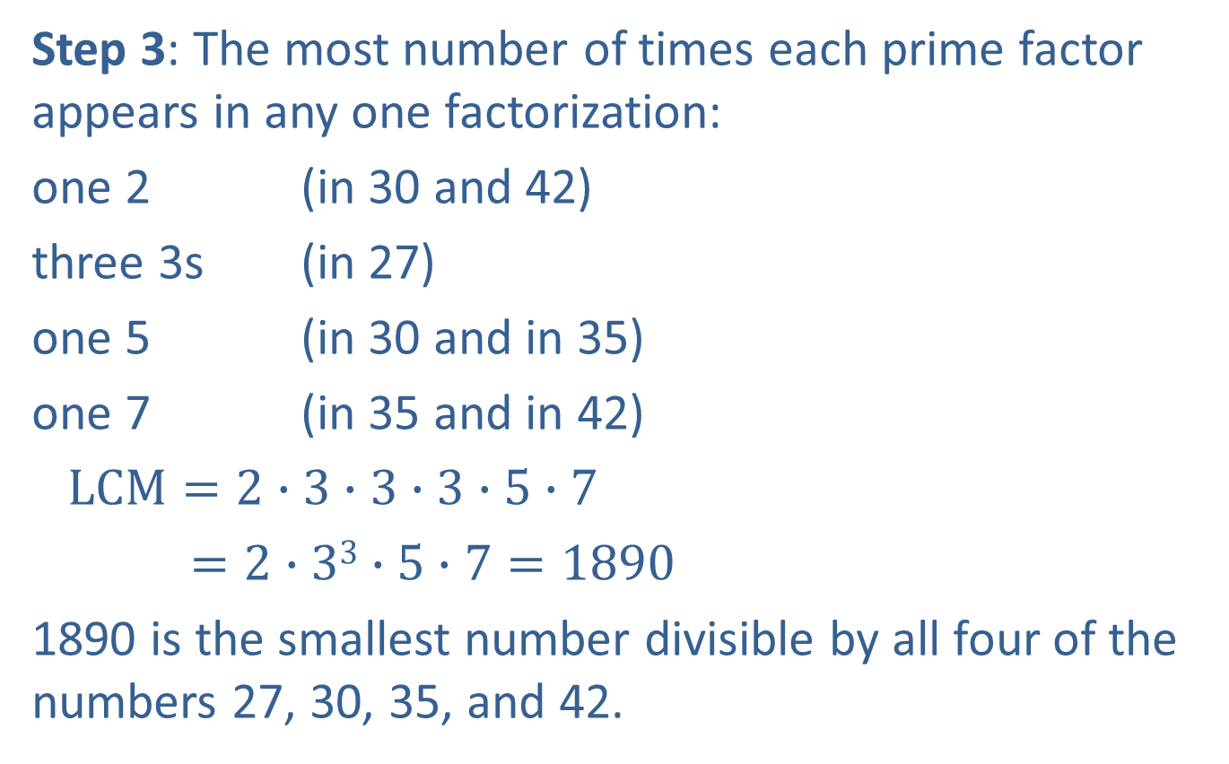
Example 8: Finding the Least Common Multiple (LCM) (cont.)
Step 3: The most number of times each prime factor appears in any one factorization:
one 2 (in 30 and 42)
three 3s (in 27)
one 5 (in 30 and in 35)
one 7 (in 35 and in 42)
$LCM=2∙3∙3∙3∙5$ $∙7$
$=2∙33∙5∙7=1890$
1890 is the smallest number divisible by all four of the numbers 27, 30, 35, and 42.

Slide 31
Procedure: Tests for Divisibility
As mentioned in the note earlier in the section, here are the quick tests for divisibility.
A number is divisible
By 2: if the units digit is 0, 2, 4, 6, or 8.
By 3: if the sum of the digits is divisible by 3.
By 4: if the number formed by the last two digits is divisible by 4.
By 5: if the units digit is 0 or 5.
By 6: if the number is divisible by both 2 and 3.
By 9: if the sum of the digits is divisible by 9.
By 10: if the units digit is 0.

