Slide 1
Section R.5
Bar Graphs, Pictographs, Circle Graphs, and Line Graphs

Slide 2
Definition: Four Types of Graphs and Their Purposes
​Bar Graphs: To emphasize comparative amounts
​Pictographs: To emphasize the topic being related as well as the quantities
​Circle Graphs: To help in understanding percents or parts of a whole (Circle graphs are also called pie charts.)
​Line Graphs: To indicate tendencies or trends over a period of time

Slide 3
Properties: Properties of Graphs
​They should be clearly labeled.
​They should be easy to read.
​They should have an appropriate title.

Slide 4
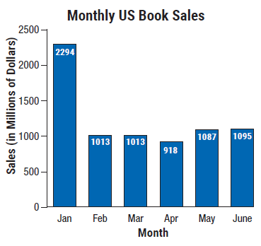
Example 1: Reading a Bar Graph
Examine the bar graph and answer the questions given. Note that the scale on the left (sales) and the categories at the bottom (months) are clearly labeled and the graph itself has a title.

Slide 5
Example 1: Reading a Bar Graph (cont.)
​What were the sales in February?
​During what month were sales lowest?
During what month were sales highest?
What were sales during the highest-sales month?
What were the sales in June?
What was the amount of increase in sales between April and May?

Slide 6
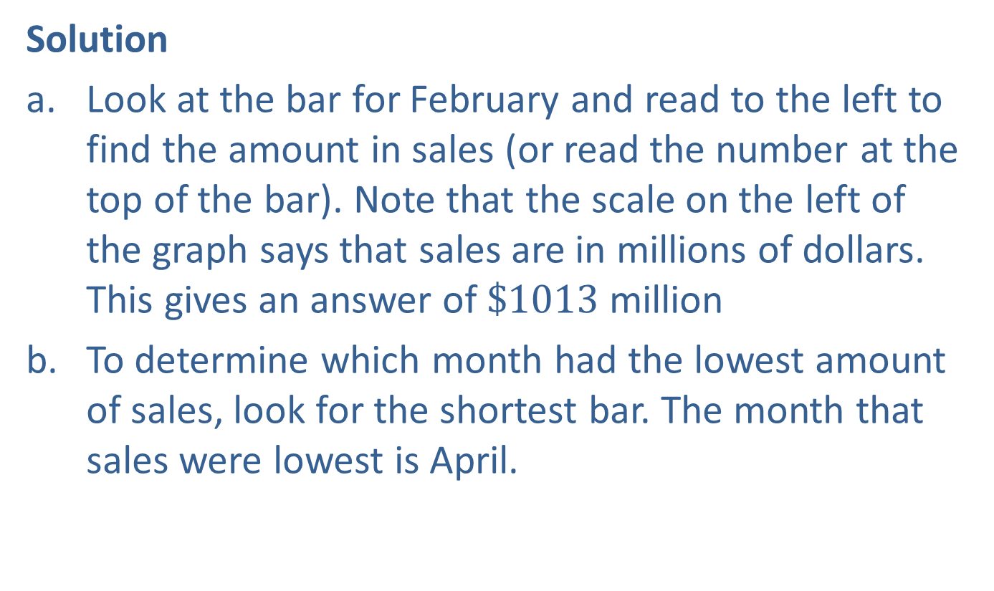
Example 1: Reading a Bar Graph (cont.)
Solution
​Look at the bar for February and read to the left to find the amount in sales (or read the number at the top of the bar). Note that the scale on the left of the graph says that sales are in millions of dollars. This gives an answer of $\$1013$million
To determine which month had the lowest amount of sales, look for the shortest bar. The month that sales were lowest is April.

Slide 7
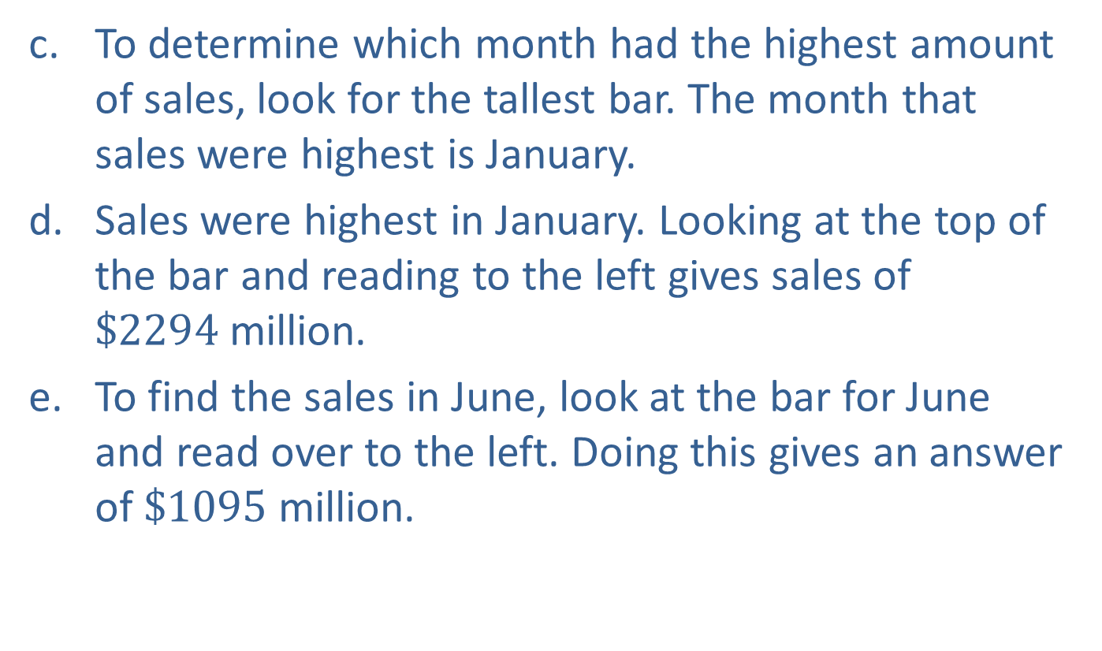
Example 1: Reading a Bar Graph (cont.)
To determine which month had the highest amount of sales, look for the tallest bar. The month that sales were highest is January.
Sales were highest in January. Looking at the top of the bar and reading to the left gives sales of $\$2294$million.
To find the sales in June, look at the bar for June and read over to the left. Doing this gives an answer of $\$1095$million.

Slide 8
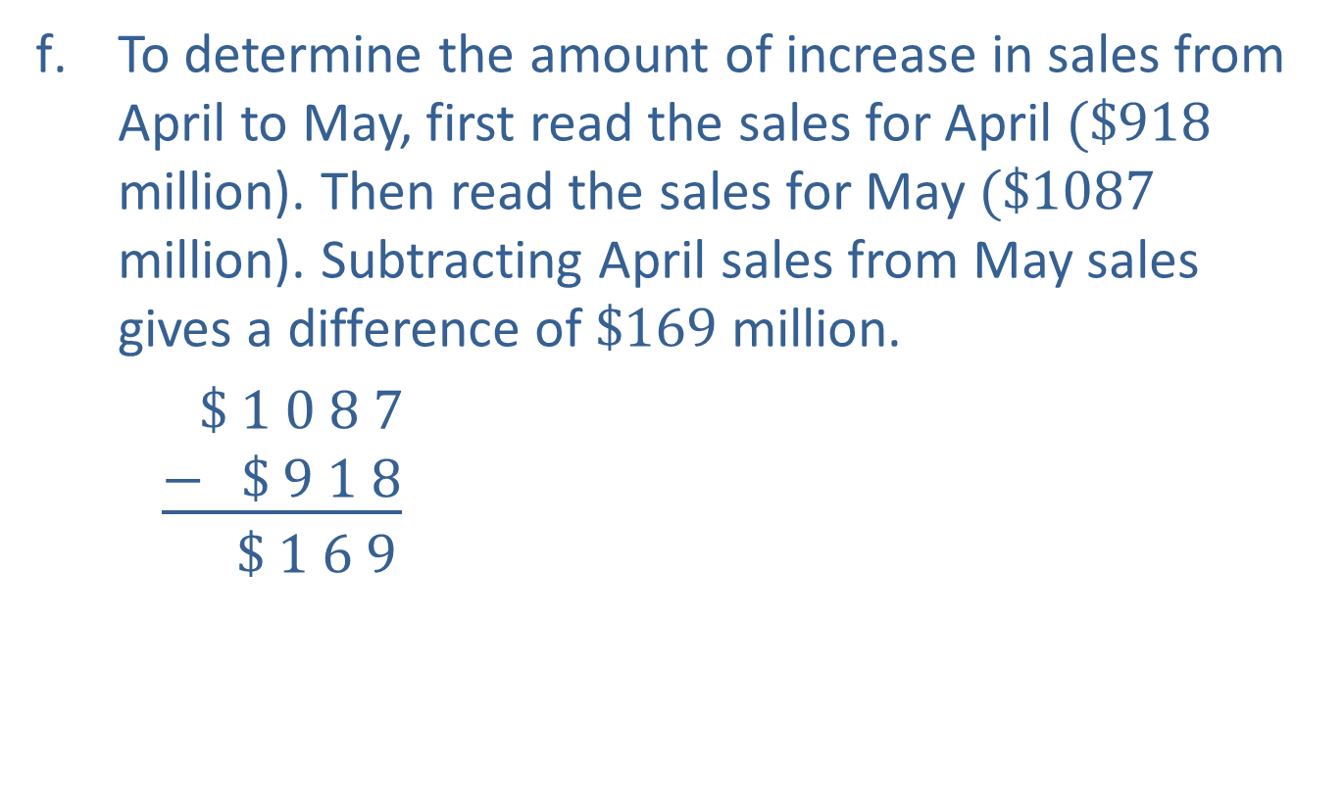
Example 1: Reading a Bar Graph (cont.)
To determine the amount of increase in sales from April to May, first read the sales for April $(\$918$ million). Then read the sales for May $(\$1087$ million). Subtracting April sales from May sales gives a difference of $\$169$million.
$\$ 1 0 8 7$
$$\underline{− \$ 9 1 8}$$
$$\$ 1 6 9$$
May sales
April sales
Increase in sales

Slide 9
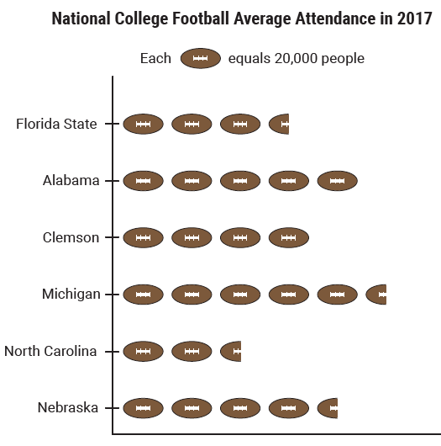
Example 2: Reading a Pictograph
Answer the following questions based on the pictograph.

Slide 10
Example 2: Reading a Pictograph (cont.)
Of the colleges shown here,
Which college had the lowest average attendance?
Which college had the highest average attendance?
What was the average attendance for Nebraska?
Handson Foods is supplying hot dogs to Clemson, Alabama, and Florida State football games on Saturday. If they are supplying one hot dog for each attendee based on the 2017 average attendance, how many hot dogs will they be supplying?

Slide 11
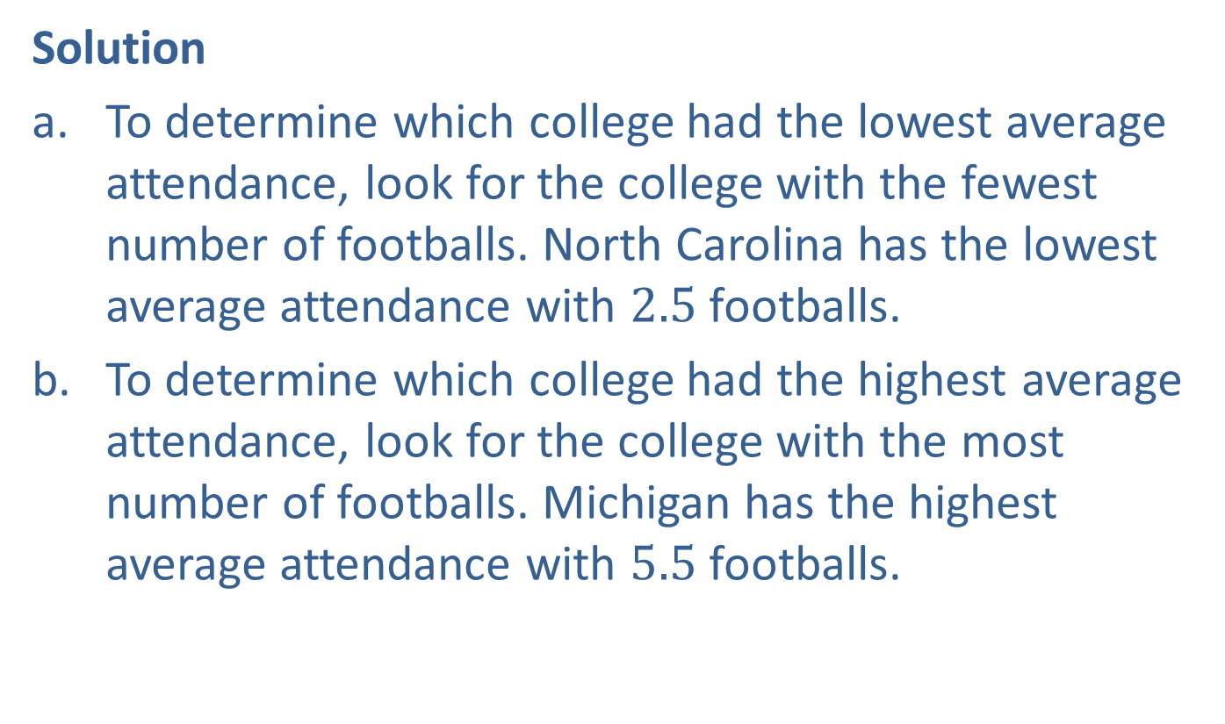
Example 2: Reading a Pictograph (cont.)
Solution
To determine which college had the lowest average attendance, look for the college with the fewest number of footballs. North Carolina has the lowest average attendance with $2.5$ footballs.
To determine which college had the highest average attendance, look for the college with the most number of footballs. Michigan has the highest average attendance with $5.5$ footballs.

Slide 12
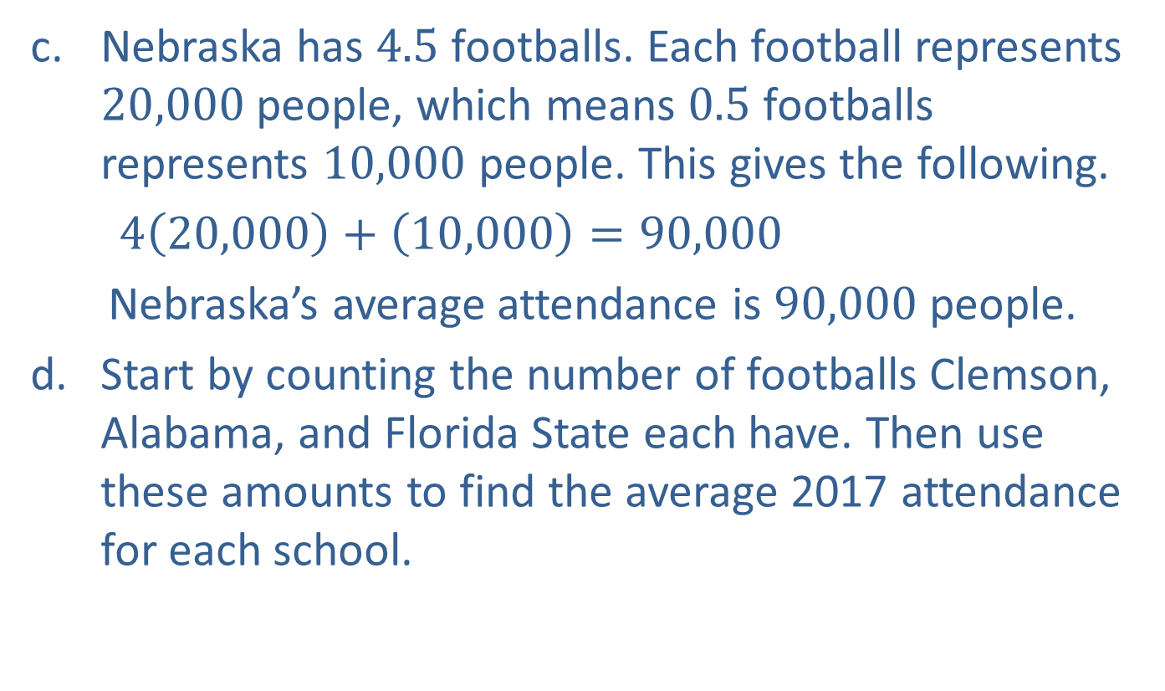
Example 2: Reading a Pictograph (cont.)
Nebraska has $4.5$ footballs. Each football represents $20,000$ people, which means $0.5$ footballs represents $10,000$ people. This gives the following.
$4\left(20,000\right)+\left(10,000\right)=90,000$
Nebraska’s average attendance is $90,000$ people.
Start by counting the number of footballs Clemson, Alabama, and Florida State each have. Then use these amounts to find the average 2017 attendance for each school.

Slide 13
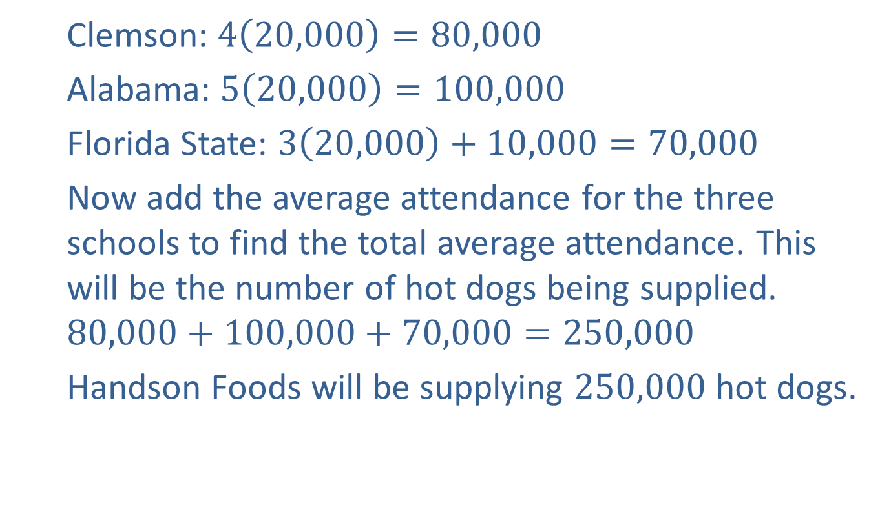
Example 2: Reading a Pictograph (cont.)
Clemson: $4\left(20,000\right)=80,000$
Alabama: $5\left(20,000\right)=100,000$
Florida State: $3\left(20,000\right)+10,000=70,000$
Now add the average attendance for the three schools to find the total average attendance. This will be the number of hot dogs being supplied.
$$80,000+100,000+70,000=250,000$$
Handson Foods will be supplying $250,000$ hot dogs.

Slide 14
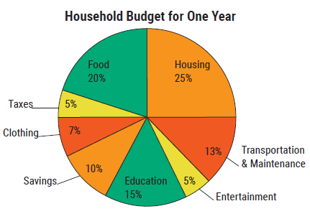
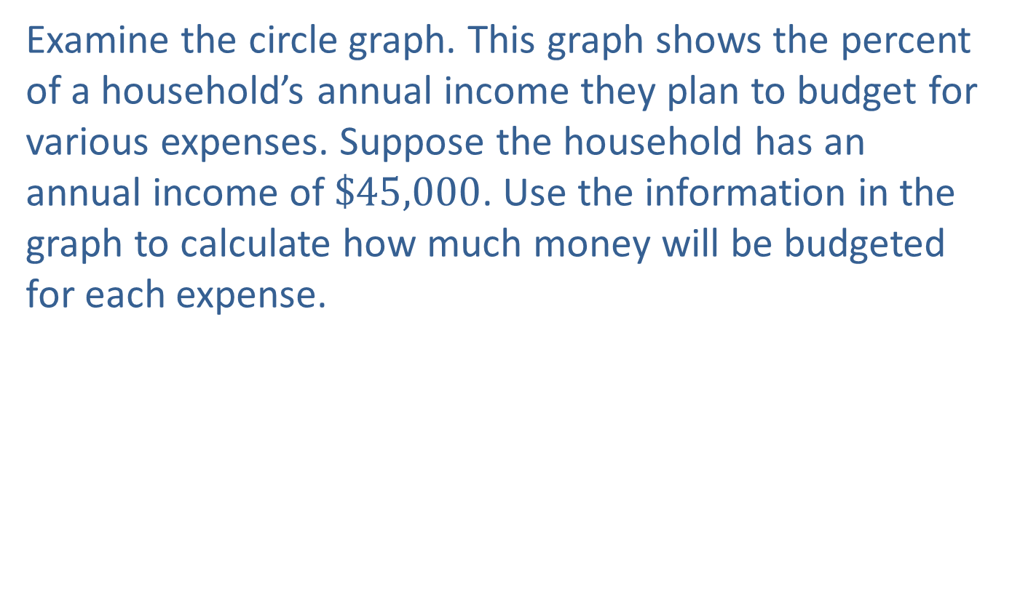
Example 3: Reading a Circle Graph
Examine the circle graph. This graph shows the percent of a household’s annual income they plan to budget for various expenses. Suppose the household has an annual income of $\$45,000$. Use the information in the graph to calculate how much money will be budgeted for each expense.

Slide 15
Example 3: Reading a Circle Graph (cont.)
Solution
To calculate the budget expense for each item, multiply the corresponding percent by the total household income.

Slide 16
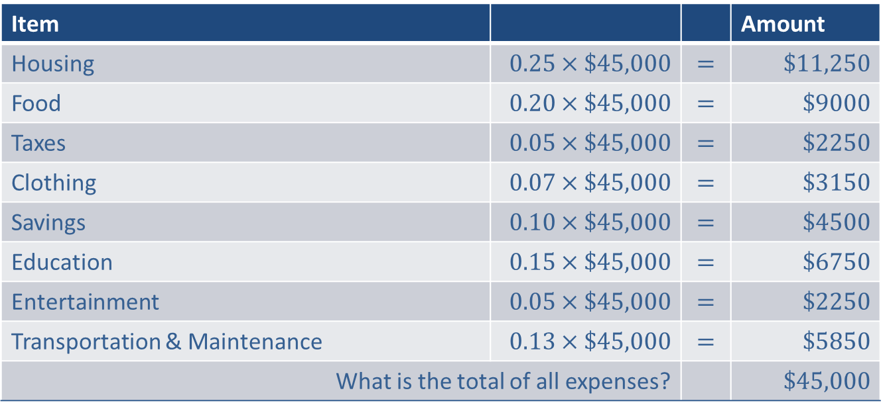
Example 3: Reading a Circle Graph (cont.)
Item |  |  | Amount
Housing | $$0.25×\$45,000$$ | $$=$$ | $\$11,250$
Food | $$0.20×\$45,000$$ | $$=$$ | $\$9000$
Taxes | $$0.05×\$45,000$$ | $$=$$ | $\$2250$
Clothing | $$0.07×\$45,000$$ | $$=$$ | $\$3150$
Savings | $$0.10×\$45,000$$ | $$=$$ | $\$4500$
Education | $$0.15×\$45,000$$ | $$=$$ | $\$6750$
Entertainment | $$0.05×\$45,000$$ | $$=$$ | $\$2250$
Transportation & Maintenance | $$0.13×\$45,000$$ | $$=$$ | $\$5850$
What is the total of all expenses? |  |  | $\$45,000$

Slide 17
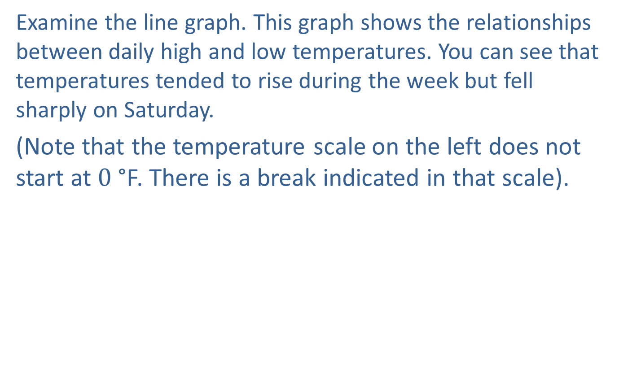
Example 4: Reading a Line Graph
Examine the line graph. This graph shows the relationships between daily high and low temperatures. You can see that temperatures tended to rise during the week but fell sharply on Saturday.
(Note that the temperature scale on the left does not start at $0$ °F. There is a break indicated in that scale).

Slide 18
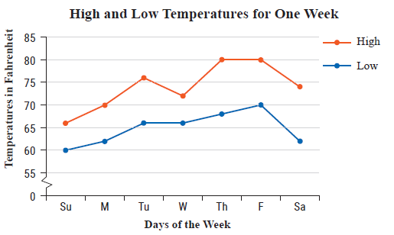
Example 4: Reading a Line Graph (cont.)

Slide 19
Example 4: Reading a Line Graph (cont.)
What was the lowest high temperature?
On what day did the lowest high temperature occur?
What was the highest low temperature?
On what day did the highest low temperature occur?
Find the mean difference between the daily high and low temperatures on Tuesday for the week shown.

Slide 20
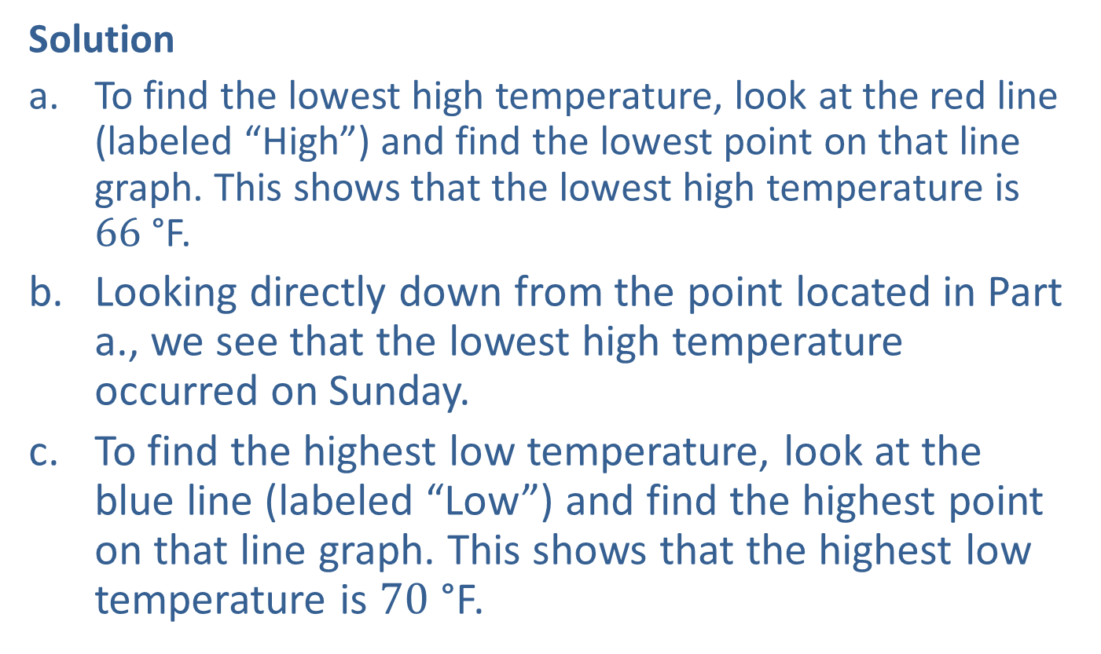
Example 4: Reading a Line Graph (cont.)
Solution
To find the lowest high temperature, look at the red line (labeled “High”) and find the lowest point on that line graph. This shows that the lowest high temperature is $66$ °F.
Looking directly down from the point located in Part a., we see that the lowest high temperature occurred on Sunday.
To find the highest low temperature, look at the blue line (labeled “Low”) and find the highest point on that line graph. This shows that the highest low temperature is $70$ °F.

Slide 21
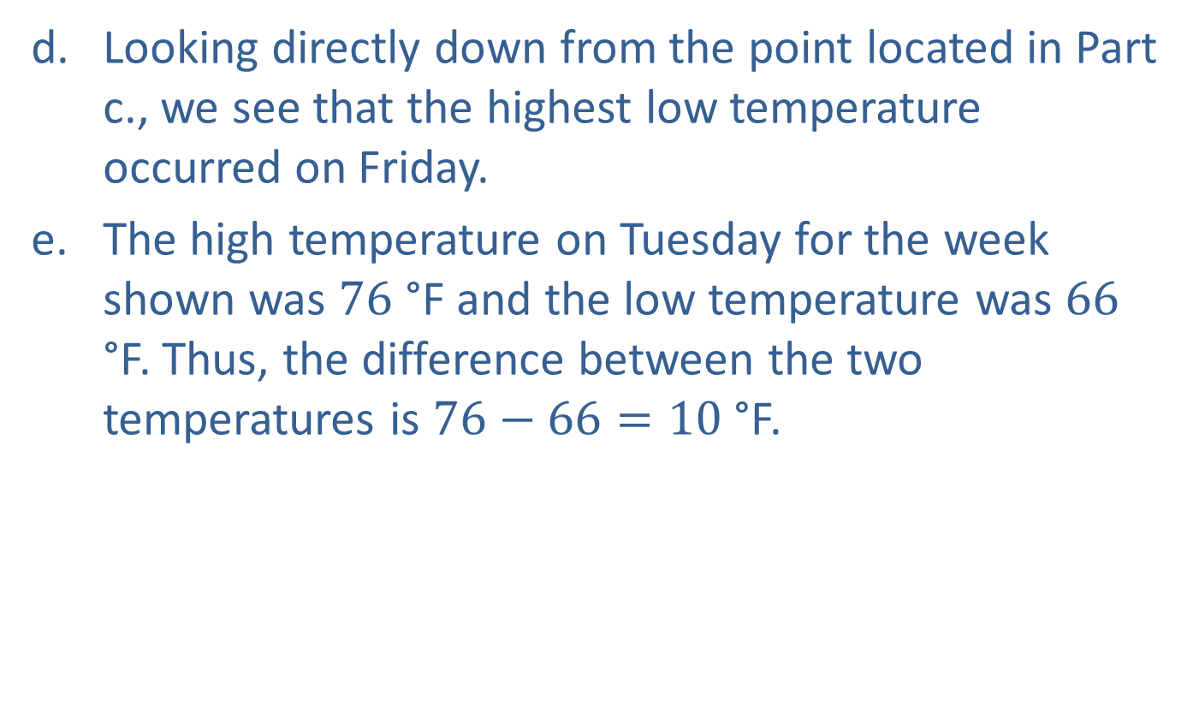
Example 4: Reading a Line Graph (cont.)
Looking directly down from the point located in Part c., we see that the highest low temperature occurred on Friday.
The high temperature on Tuesday for the week shown was $76$ °F and the low temperature was $66$ °F. Thus, the difference between the two temperatures is $76−66=10$ °F.

