Slide 1
Section 1.1
Introduction to Whole Numbers

Slide 2
Objectives
Understand the decimal system.
Read and write whole numbers in words.
Read tables.

Slide 3
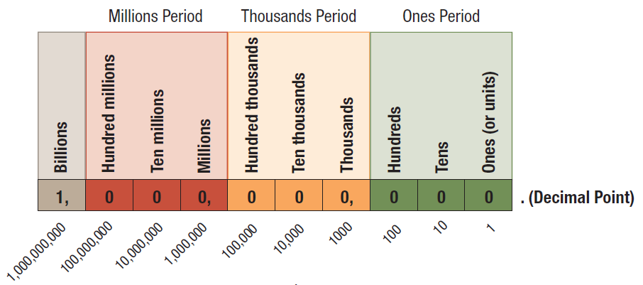
The Decimal System

Slide 4
Whole Numbers
Definition
The whole numbers are the natural numbers (or counting numbers) and the number 0.
Natural numbers
ℕ = { 1, 2, 3, 4, 5, 6, 7, 8, 9, 10, 11, . . . }
Whole numbers
𝕎= { 0, 1, 2, 3, 4, 5, 6, 7, 8, 9, 10, 11, . . . }
Note that 0 is a whole number but not a natural number.

Slide 5
The Decimal System
Definition
The decimal system (or base ten system) is a place value system that depends on three things:
the ten digits: 0, 1, 2, 3, 4, 5, 6, 7, 8, 9
the placement of each digit; and
the value of each place.

Slide 6
Example 1: Understanding Place Value
Given the number 350,472, which digit indicates the number of
thousands?
tens?
hundreds?
Solution
0
7
4

Slide 7
Example 2: Understanding Place Value
For the number 37,895, state the place value of each digit.
Solution
3 is in the ten thousands place.
7 is in the thousands place.
8 is in the hundreds place.
9 is in the tens place.
5 is in the ones place.

Slide 8
Reading and Writing Whole Numbers
Procedure
You should note the following four things when reading or writing whole numbers.
Digits are read in periods (groups of three).
Commas are used to separate periods if a number has more than four digits. (A comma is optional if a number has exactly four digits.)
The word and does not appear in whole numbers written in words. And is said only when reading a decimal point.

Slide 9
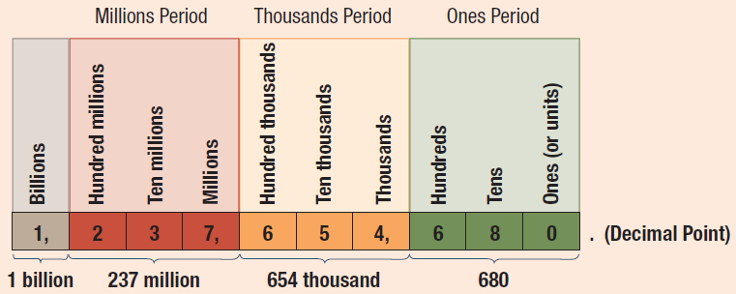
Reading and Writing Whole Numbers
Procedure (cont.)
4. Hyphens (-) are used to write words for the two-digit numbers from 21 to 99 except for those that end in 0. For example: twenty-one and thirty-five.

Slide 10
Example 3: Reading and Writing
Whole Numbers
Each number is written in standard notation. Write it in words.
25,380
3,000,562
Solution
twenty-five thousand, three hundred eighty
three million, five hundred sixty-two

Slide 11
Completion Example 4: Reading and Writing Whole Numbers
Each number is written in standard notation. Write it in words.
8407
15,352
Solution
eight thousand _________________
fifteen thousand, ___________________
four hundred seven
three hundred fifty‑two

Slide 12
Example 5: Reading and Writing
Whole Numbers
Each number is written in words. Write it in standard notation.
twenty-seven thousand, three hundred thirty-six
three hundred forty million, sixty-two thousand,
forty-eight
Solution
27,336
340,062,048
Note: 0’s must be used to fill out a three-digit period.

Slide 13
Completion Example 6: Reading and Writing Whole Numbers
Each number is written in words. Write it in standard notation.
two million, eight hundred thousand, thirty-five
five million, three hundred fifty thousand
Solution
2,800, ____
5, _____, ______
035
350
000

Slide 14
Example 7: Application: Reading Tables
Use the following table and your understanding of whole numbers to answer each question.
Depths of Lakes
Depths of Lakes
Name | Location | Depth (in feet)
Baikal | Siberia, Russia | 2487
Tanganyika | Tanzania, Africa | 1870
Crater | Oregon, United States | 1148
Vostok | Antarctica | 1129
Tahoe | California, United States | 989
Issyk Kul | Kyrgyzstan | 886
Hornindalsvatnet | Sogn og Fjordane, Norway | 778

Slide 15
Example 7: Application: Reading Tables (cont.)
Name | Location | Depth (in feet)
Toba | Sumatra, Indonesia | 707
Caspian Sea | Iran, Russia, Turkmenistan, Kazakhstan, Azerbaijan | 604
Quesnel | British Columbia, Canada | 515
Ohrid | Macedonia, Albania | 508
Geneva | Switzerland, France | 502
Loch Ness | Scotland, United Kingdom | 436
Dead Sea | Jordan, Israel | 387
Titicaca | Peru, Bolivia | 351
Source: http://en.wikipedia.org/wiki/List_of_lakes_by_depth

Slide 16
Example 9: Application: Reading Tables (cont.)
What is the depth of Lake Tahoe in California?
Which lake is the deepest and what is its location?
Write the depth of Crater Lake in words.
Solution
989 feet
The deepest lake is Baikal Lake in Siberia, Russia.
One thousand one hundred forty-eight feet

