Slide 1
Section 12.8
Applications: Variation

Slide 2
Objectives
Solve problems involving direct variation.
Solve problems involving inverse variation.
Solve problems involving combined variation.

Slide 3
Direct Variation
Definition
A variable quantity y varies directly as (or is directly proportional to) a variable x if there is a constant k such that
The constant k is called the constant of variation.

Slide 4
Example 1: Direct Variation
If y varies directly as x, and y = 6 when x = 2, find y if
x = 6.
Solution
y = kx The general formula for direct variation
6 = 2k Substitute the known values and solve for k.
3 = k Use this value for k in the general formula.
So y = 3x. Thus, if x = 6 then, y = 3 ∙ 6 = 18.

Slide 5
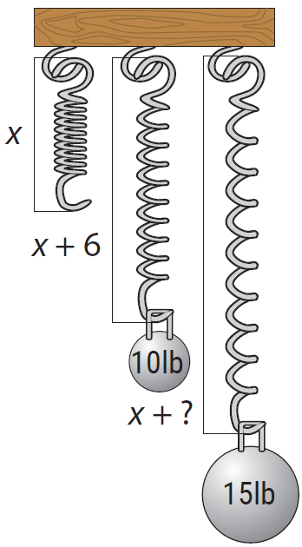
Example 2: Direct Variation
A spring will stretch a greater distance as more weight is placed on the end of it. The distance (d) the spring stretches varies directly as the weight (w) placed at the end of the spring. This is a property of springs studied in physics and is known as Hooke’s Law. If a weight of
10 lb stretches a certain spring 6 in., how far will the spring stretch with a weight of 15 lb?

Slide 6
Example 2: Direct Variation (cont.)
(Note: We assume that the weight is not so great as to break the spring.)
Solution
Because the two variables are directly proportional, the relationship can be indicated with the formula
d = k ∙ w
Where d = distance spring stretches in inches,
w = weight in lb, and
k = constant of variation.

Slide 7
Example 2: Direct Variation (cont.)
First, substitute the given information to find the value for k. (The value of k will depend on the particular spring. Springs made of different material or which are wound more tightly will have different values for k.)
d = k ∙ w
6 = k ∙ 10 Substitute the known values into the formula.
Use this value for k in the general formula.

Slide 8
Example 2: Direct Variation (cont.)
The spring will stretch 9 in. if a weight of 15 lb is placed at its end.

Slide 9
Inverse Variation
Inverse Variation
A variable quantity y varies inversely as (or is inversely proportional to) a variable x if there is a constant k such that
The constant k is called the constant of variation.

Slide 10
Example 3: Inverse Variation
If y varies inversely as the cube of x, and y = −1 when x = 3, find y if x = −3.
Solution

Slide 11
Example 3: Inverse Variation (cont.)

Slide 12
Example 4: Inverse Variation
The gravitational force (F) between an object and the Earth is inversely proportional to the square of the distance (d) from the object to the center of the Earth. Hence we have the formula

Slide 13
Example 4: Inverse Variation (cont.)
(As the distance of an object from the Earth becomes larger, the gravitational force exerted by the Earth on the object becomes smaller.)
If an astronaut weighs 200 pounds on the surface of the Earth, what will he weigh 100 miles above the Earth? Assume that the radius of the Earth is 4000 miles.

Slide 14
Example 4: Inverse Variation (cont.)
Use scientific notation to make values simpler to work with in the calculations.

Slide 15
Example 4: Inverse Variation (cont.)
When the astronaut is 100 miles above the Earth,
d = 4100 = 4.1 × 10³ miles.
Then,
That is, 100 miles above the Earth, the astronaut will weigh about 190 pounds.

Slide 16
Example 5: Joint Variation
If z varies jointly as x² and y, and z = 18 when x = 2 and y = 4, what is z when x = 4 and y = 3?
Solution

Slide 17
Example 5: Joint Variation (cont.)
If x = 4 and y = 3 then,

Slide 18
Example 6: More Variation
The distance an object falls varies directly as the square of the time it falls (until it hits the ground and assuming little or no air resistance). If an object fell 64 feet in
2 seconds, how far would it have fallen by the end of
3 seconds?
Solution

Slide 19
Example 6: More Variation (cont.)
The object would have fallen 144 feet in 3 seconds.

Slide 20
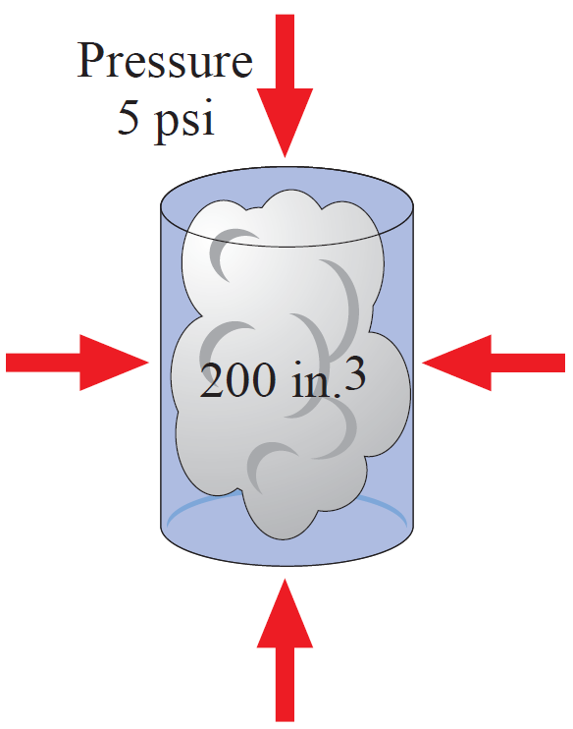
Example 7: More Variation
The volume of a gas in a container varies inversely as the pressure on the gas. If a gas has a volume of 200 cubic inches under pressure of 5 pounds per square inch, what will be its volume if the pressure is increased to 8 pounds per square inch?

Slide 21
Example 7: More Variation (cont.)

Slide 22
Example 8: More Variation
The safe load (L) of a wooden beam supported at both ends varies jointly as the width (w) and the square of the depth (d) and inversely as the length (l). A 3 in.-wide by 10 in.-deep beam that is 8 ft long supports a load of 9600 lb safely. What is the safe load of a beam of the same material that is 4 in. wide, 9 in. deep, and 12 ft long?

Slide 23
Example 8: More Variation (cont.)

Slide 24
Example 8: More Variation (cont.)

