Slide 1
Section 3.1
Introduction to Fractions and Mixed Numbers

Slide 2
Objectives
Understand the basic concepts of fractions.
Graph fractions on a number line.
Understand the basic concepts of mixed numbers.
Graph mixed numbers on a number line.
Change mixed numbers to improper fractions.
Change improper fractions to mixed numbers.

Slide 3
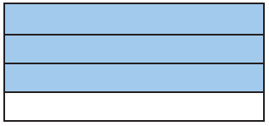
Example 1: Understanding Fractions
Write a fraction indicating
the shaded part of the rectangle and
the unshaded part of the rectangle.
Solution
In the rectangle, 3 of the 4 equal parts are shaded.
Thus, of the rectangle is shaded.
b. is not shaded.

Slide 4
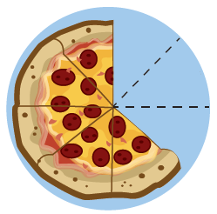
Example 2: Understanding Fractions
Write a fraction indicating
the remaining portion of the pizza and
the missing portion of the pizza.
Solution
The pizza was cut into 8 equal pieces. The 5 pieces
remaining represent of the pizza.
The missing portion of the pizza represents of the
pizza.

Slide 5
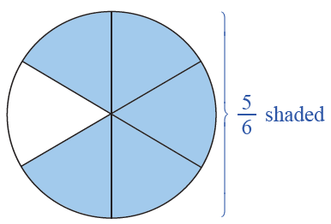
Example 3: Understanding Proper Fractions
Draw a figure to represent the fraction
Solution
indicates 5 of 6 equal parts. Drawing a figure to
represent this fraction, we divide a circle into 6 equal sections and shade 5 of them. (Note: Figures other than circles can be used.)

Slide 6
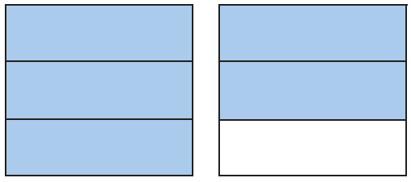
Example 4: Understanding Improper Fractions
Write a fraction that indicates the shaded parts of the figure.
Solution
There are two squares, each
separated into 3 equal parts.
This means that the denominator is 3. The shading here indicates 5 of these equal parts, which means the numerator is 5. Thus, the shaded part of the figure can
be represented by the improper fraction

Slide 7
Example 5: Evaluating Fractions Involving 0
Find the value of each expression.
Solution

Slide 8
Rule for the Placement of Negative Signs
Procedure
If a and b are integers and b ≠ 0, then
Note: The preferred form is to leave the negative sign in front of the fraction. In some cases a negative numerator is acceptable, but a negative sign is seldom used in a denominator.

Slide 9
Example 6: Placing Negative Signs in Fractions

Slide 10
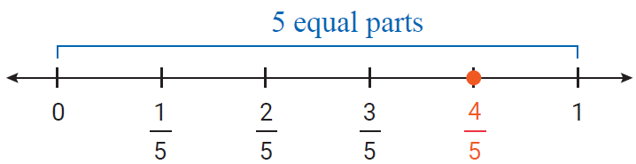
Example 7: Graphing Proper Fractions
Graph each proper fraction on a number line.
Solution

Slide 11
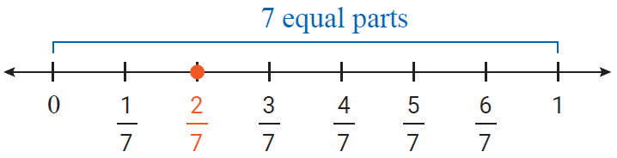
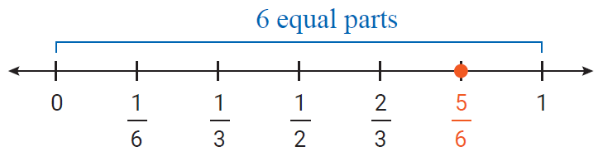
Example 7: Graphing Proper Fractions (cont.)

Slide 12
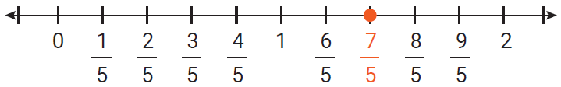
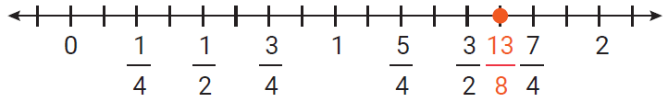
Example 8: Graphing improper Fractions
Graph each of the following improper fractions on a number line.
Solution
a.
b.

Slide 13
Example 9: Identifying Types of Fractions and Mixed Numbers
Identify each number as a proper fraction, an improper fraction, or a mixed number.
Solution
a. improper fraction
b. mixed number
c. proper fraction

Slide 14
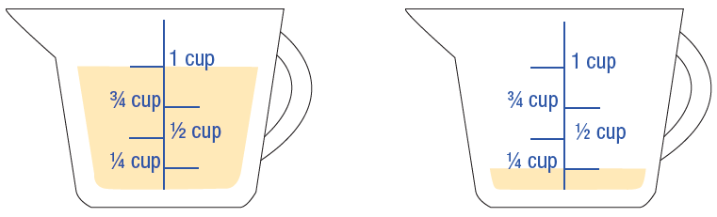
Example 10: Application: Understanding Mixed Numbers
A recipe calls for the amount of oil indicated in the figure.
Write a mixed number indicating the amount of oil in the measuring cups.
Write this amount as an improper fraction.

Slide 15
Example 10: Application: Understanding Mixed Numbers (cont.)
Solution
Each cup is marked in fourths and we see that there
is a total of cups.
As an improper fraction, cups = cups.

Slide 16
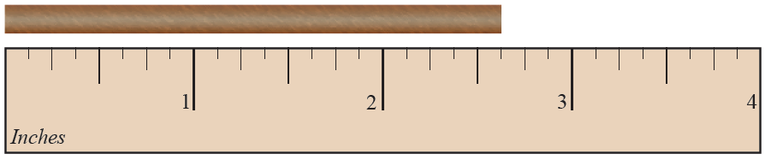
Example 11: Application: Understanding Mixed Numbers
A wooden rod is cut to the length indicated in the figure. Write the length of the rod as a mixed number.
Solution
The ruler is marked in eighths of an inch. The rod
measures in.

Slide 17
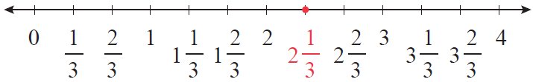
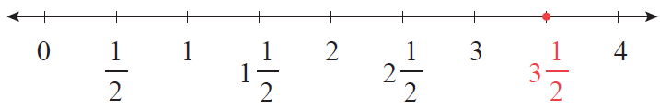
Example 12: Graphing Mixed Numbers
Graph each of the following mixed numbers on a number line.
Solution
a.
b.

Slide 18
To Change a Mixed Number to an Improper Fraction
Procedure
Multiply the whole number by the denominator of the proper fraction.
Add the numerator of the proper fraction to this product.
Write this sum over the denominator of the fraction.

Slide 19
Example 13: Changing Mixed Number to Improper Fractions
Change to an improper fraction.
Solution
Step 1: Multiply the whole number by the denominator: 8 ∙ 10 = 80.
Step 2: Add the numerator: 80 + 9 = 89.
Step 3: Write this sum over the denominator:

Slide 20
Example 14: Mixed Numbers to Improper Fractions
Change to an improper fraction.
Solution
We first change to a mixed number and then write
the result as a negative number.
Step 1: Multiply the whole number by the denominator: 11 ∙ 3 = 33
Step 2: Add the numerator: 33 + 2 = 35

Slide 21
Example 14: Mixed Numbers to an Improper Fractions (cont.)
Step 3: Write this sum over the denominator:
Thus,

Slide 22
To Change an Improper Fraction to a Mixed Number
Procedure
Divide the numerator by the denominator. The quotient is the whole number part of the mixed number.
Write the remainder over the denominator as the fraction part of the mixed number.

Slide 23
Example 15: Changing Improper Fractions to Mixed Numbers
Change to a mixed number.
Solution
Step 1:
Divide the numerator by the
denominator. The quotient
is the whole number part
of the mixed number.
Whole number part
Remainder

Slide 24
Example 15: Changing Improper Fractions to Mixed Numbers (cont.)
Step 2:
Write the remainder over the denominator as the fraction part of the mixed number:

Slide 25
Example 16: Changing Improper Fractions to Mixed Numbers
Change to a mixed number.
Solution
First we change to a mixed number then write the
result as a negative number.
Step 1: Divide the numerator by
the denominator. The quotient
is the whole number part of the
mixed number.
Whole number part
Remainder

Slide 26
Example 16: Changing Improper Fractions to Mixed Numbers (cont.)
Step 2:
Write the remainder over the denominator as the fraction part of the mixed number:
Thus,

